Slide 1

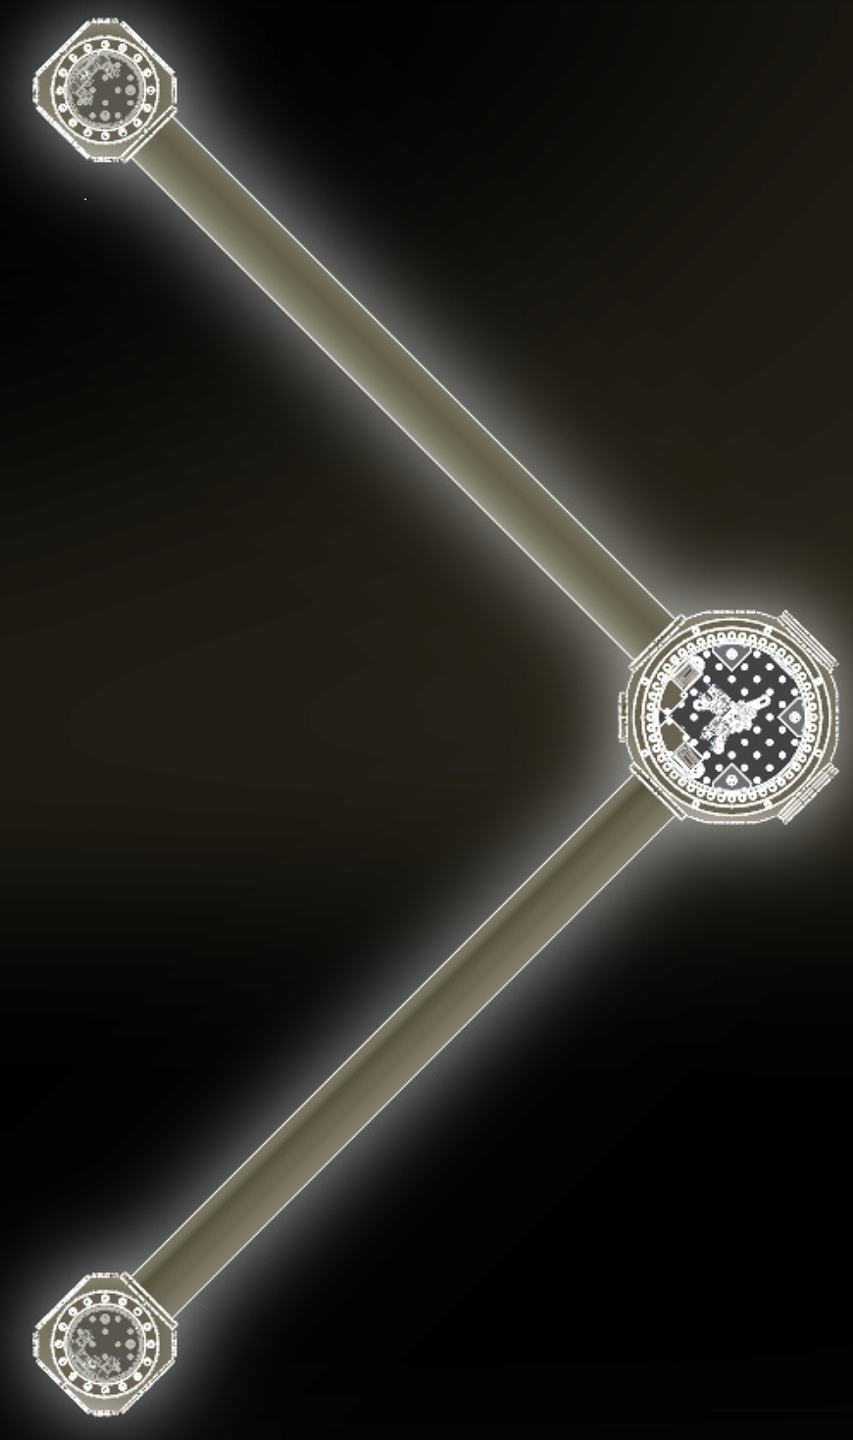
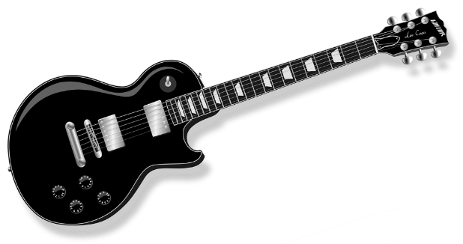
Probing light and ultralight bosons through a variety of precision measurements
Nancy Aggarwal, University of California, DAVIS
BICOQ 2026
Jun 17, 2026

Slide 2

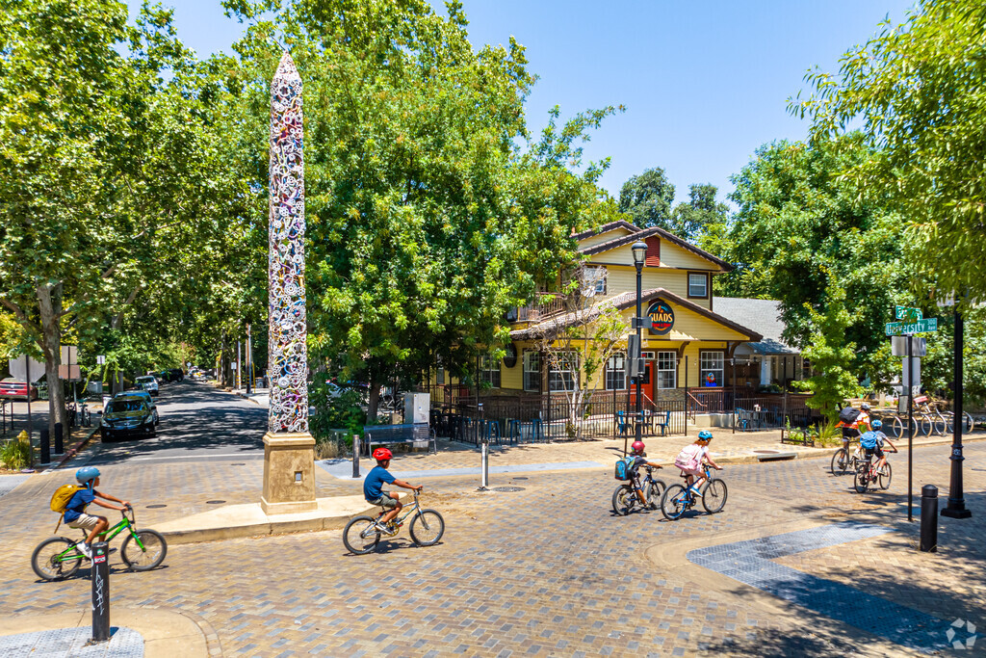



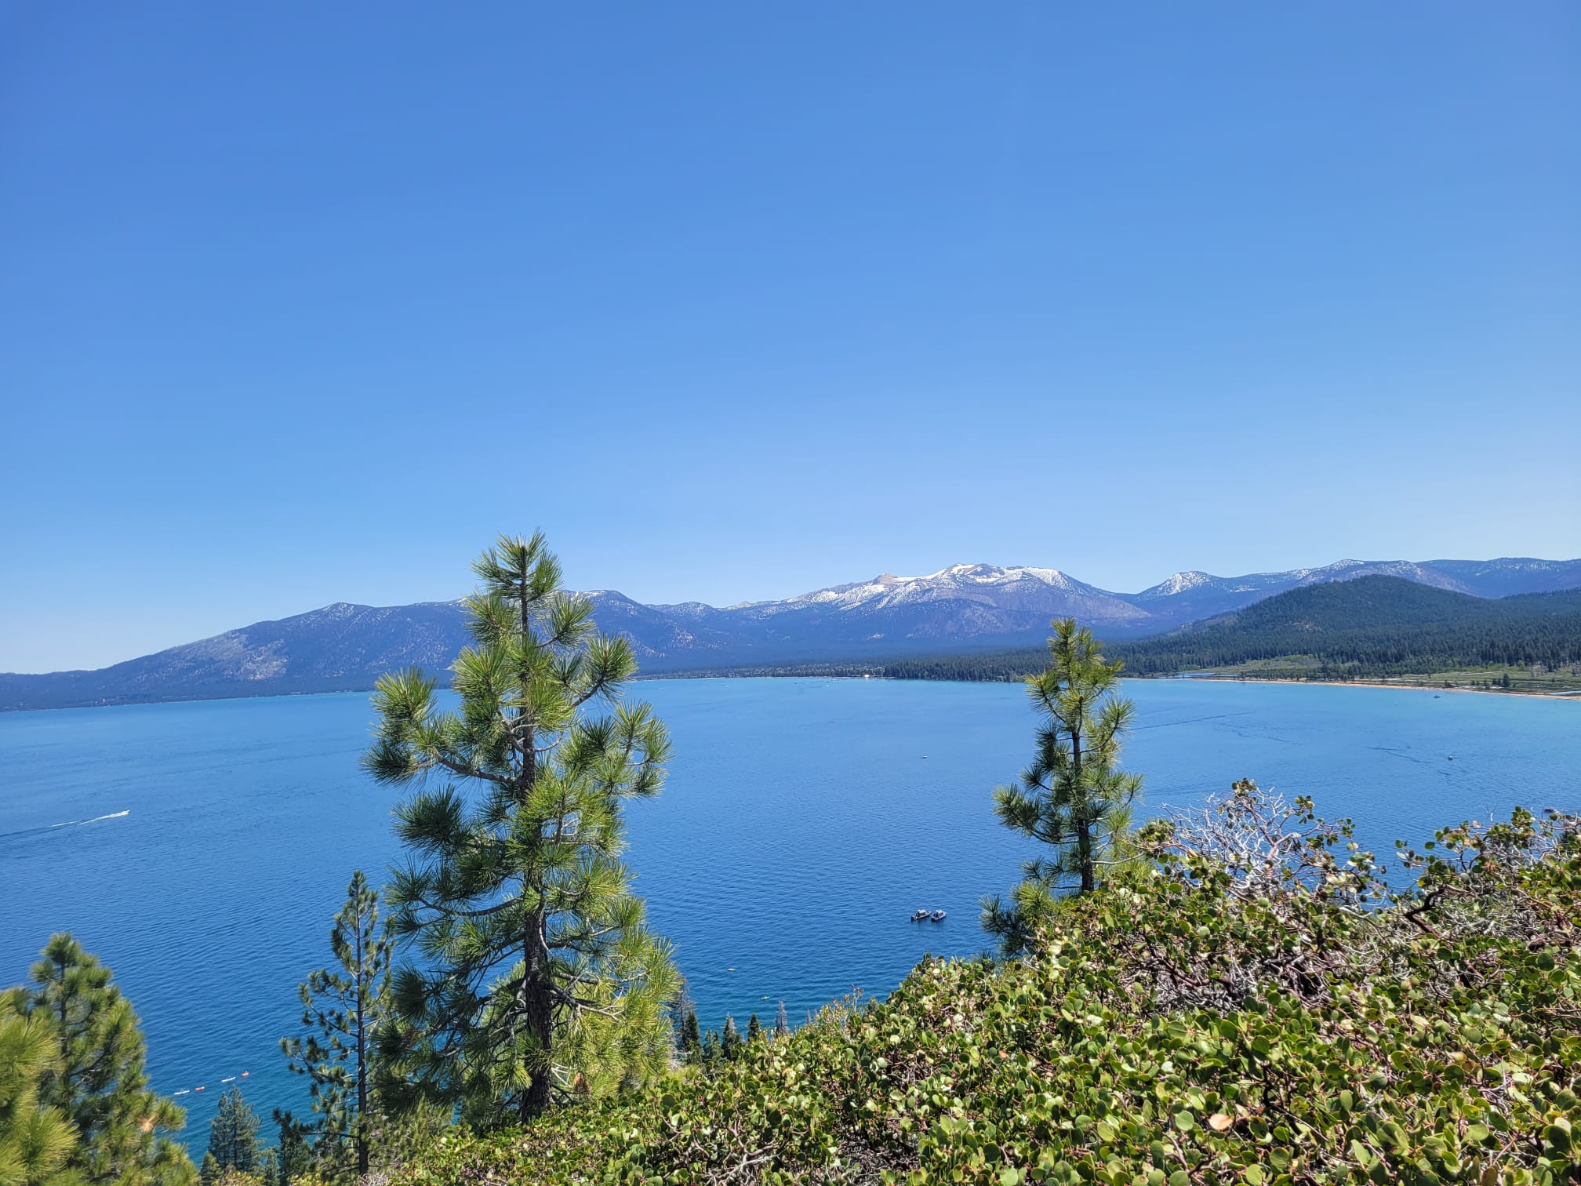
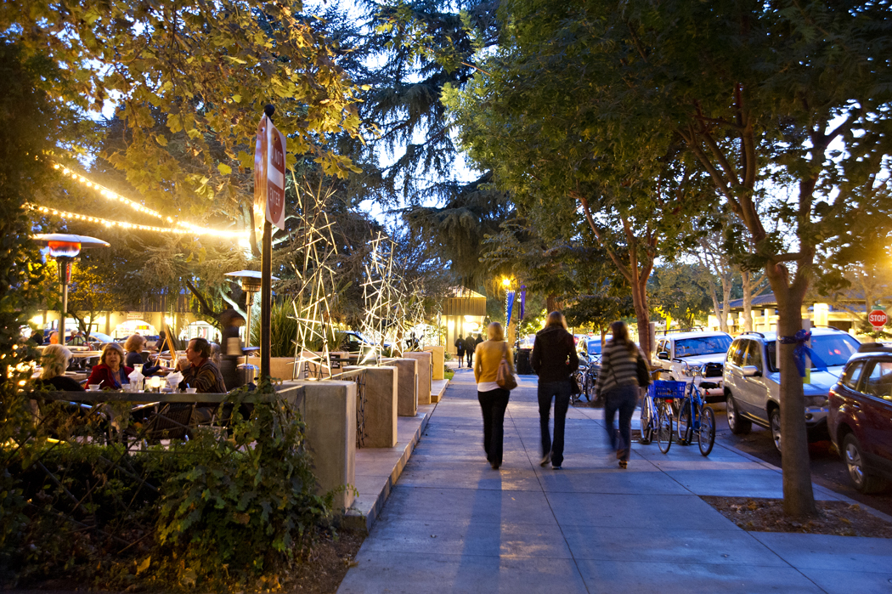

Slide 3
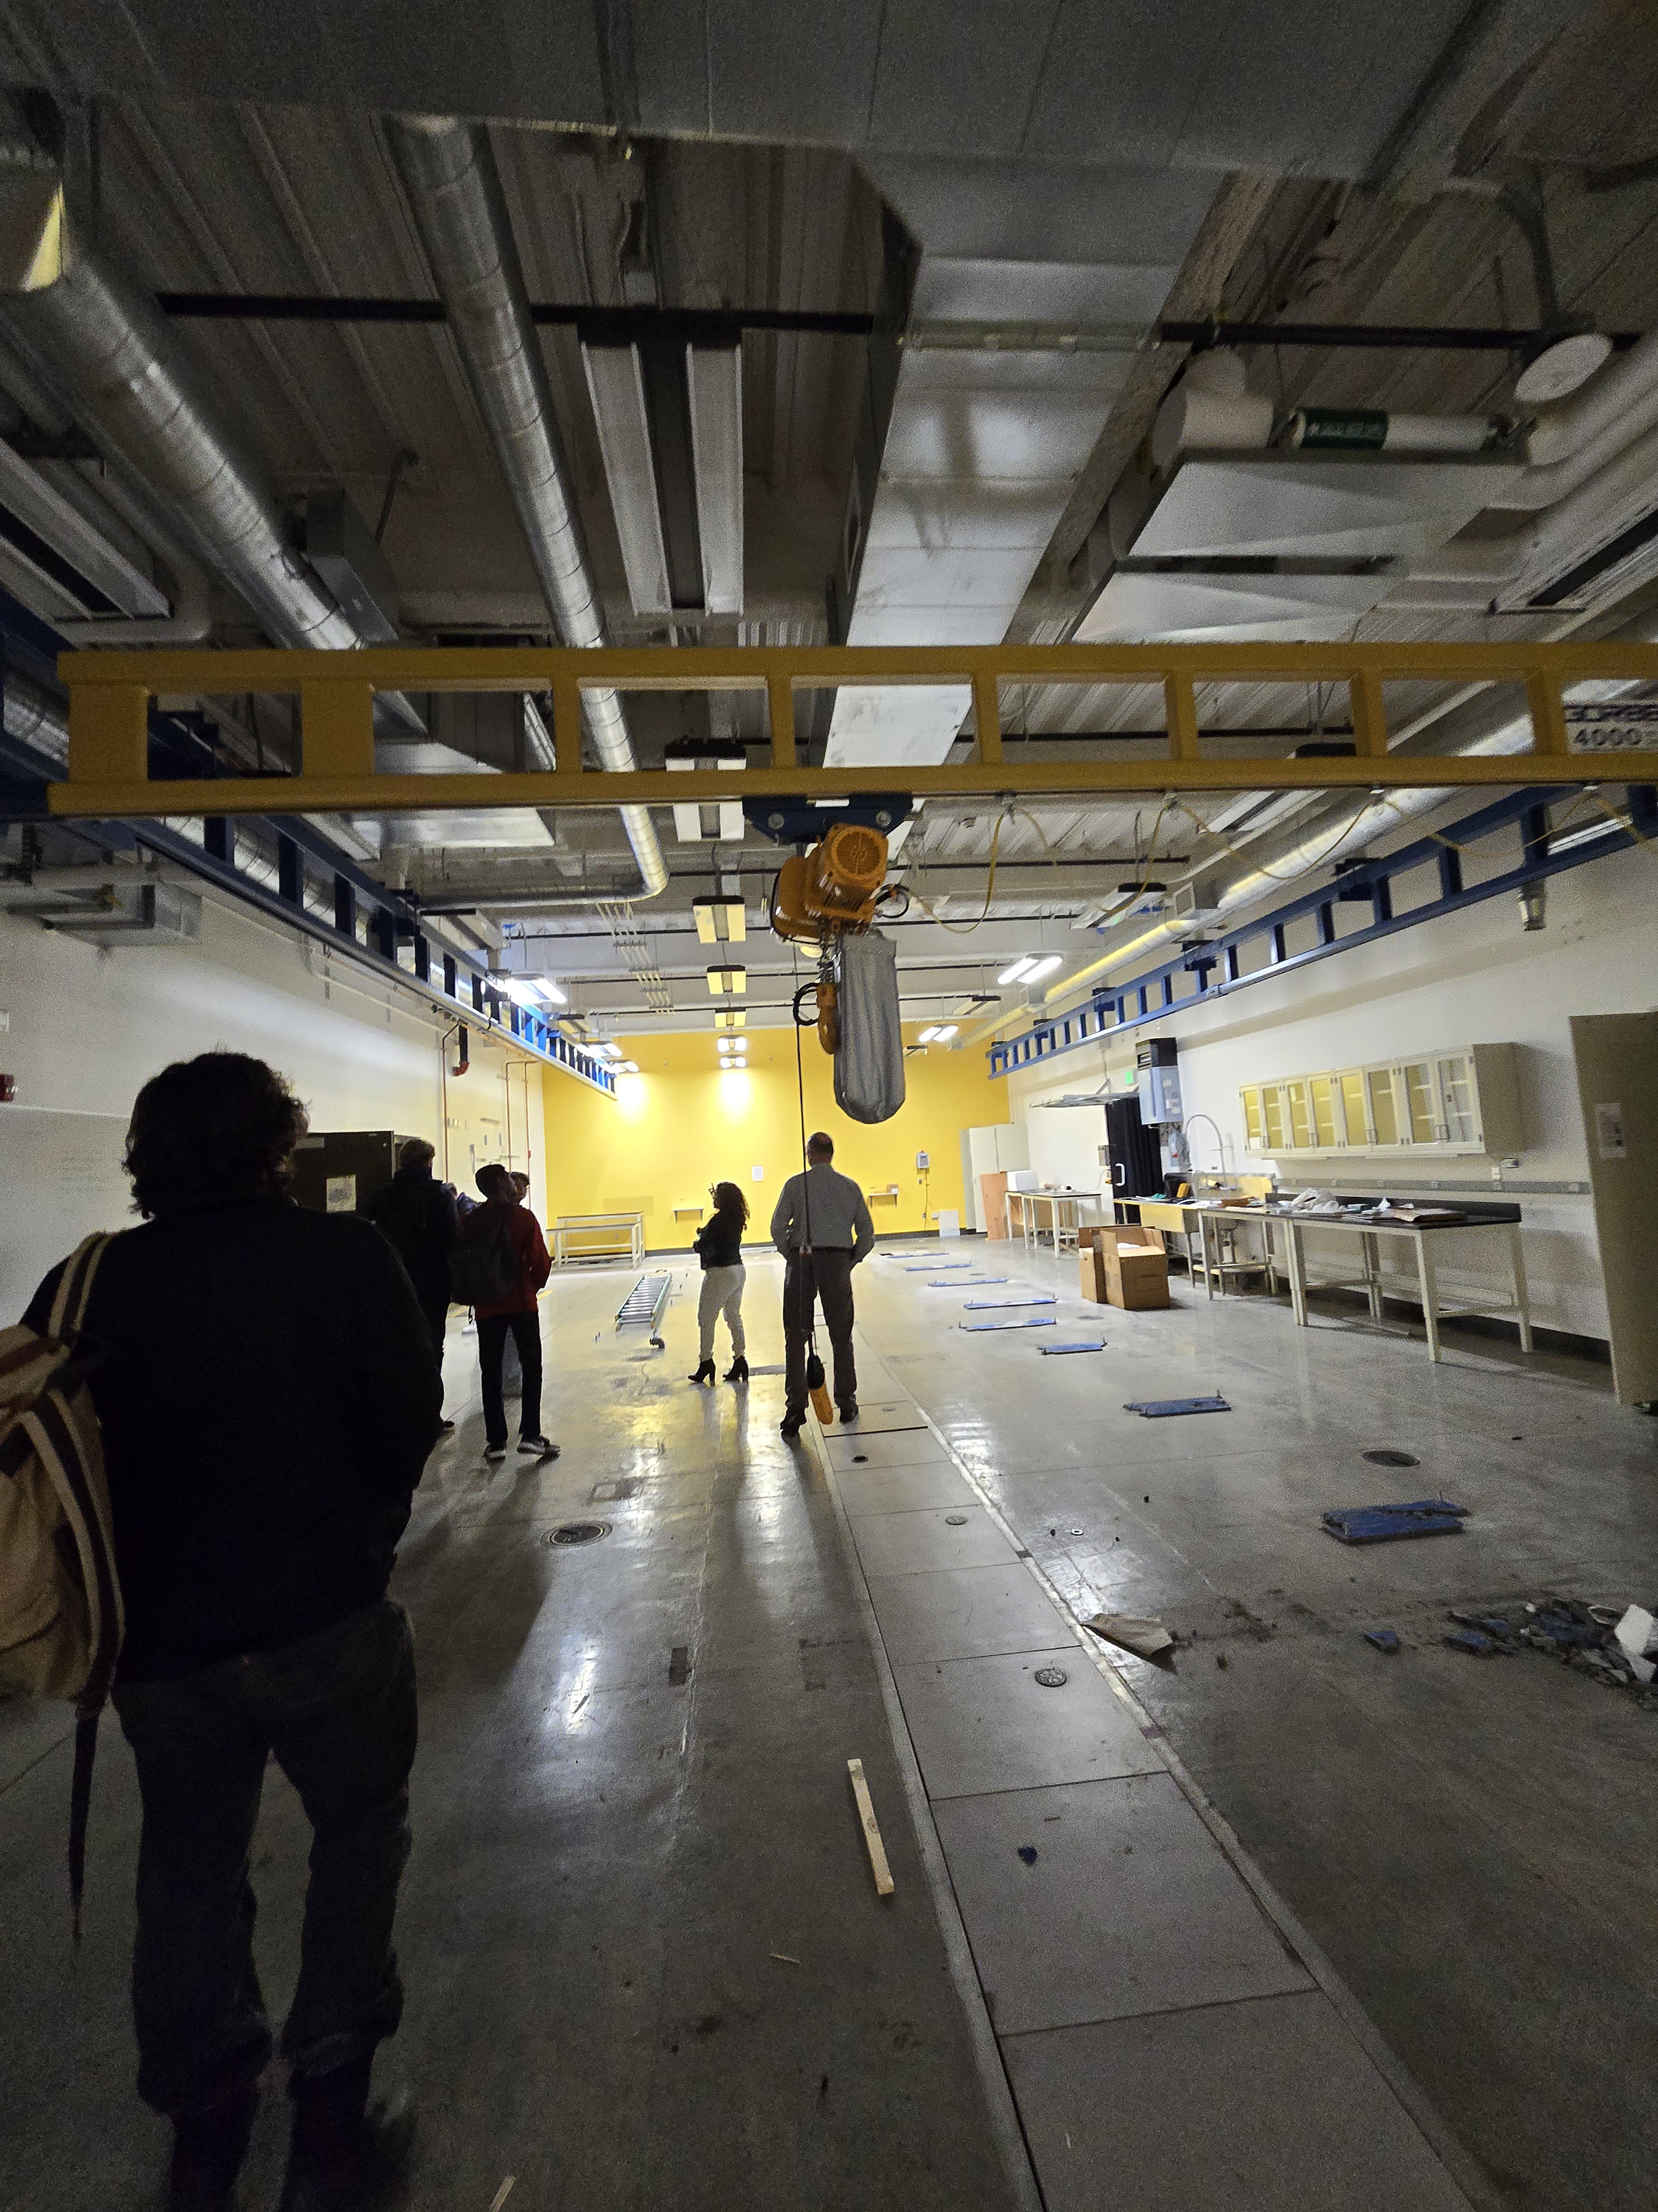
UC Davis: Jackson Larsen, Dillon Goulart, Elmar Herzig, Jonathan Varghese, Anjani Gadkari, Akilan Babu, Isa Khalak, Rohan Patel
Northwestern University: Andrew Geraci, Vicky Kalogera, George Winstone, Aaron Wang, Shelby Klomp, Jacob Sprague, Shefaq Elahi
Caltech: Andrew Laeuger
MIT: Evan Hall, Swadha Pandey
PTB Berlin: Wolfgang Killian
Clarkson University: Shane Larson
U of Washington: Masha Baryakhtar
Stanford: Mae Teo, Aharon Kahputalnik
Open PhD and Postdoc positions at UC Davis!
Funding – Noyce Foundation, Department of Energy, Hertz Foundation, Keck Foundation, NSF

Slide 4
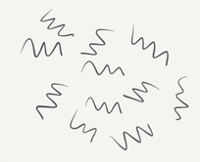
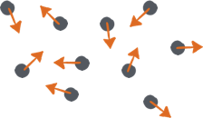
Light and ultralight bosons
Beyond the Standard Model Physics | Strong CP violation (axion) | Dark matter candidates
Possible Dark Matter Mass Range
WIMPS
~10-1000 GeV
Axion DM
~10⁻¹¹eV to 10⁻²eV
10⁻³³
10⁻²²
10⁻³
10⁵
10¹¹
10²⁸
Neutrinos
Dark Energy
Standard Model
LHC
Hubble
Planck
Field-like
Particle-like
10⁰ eV
Exploring ultralight bosons connects fundamental theory, cosmology, and lab-based precision measurements

Slide 5
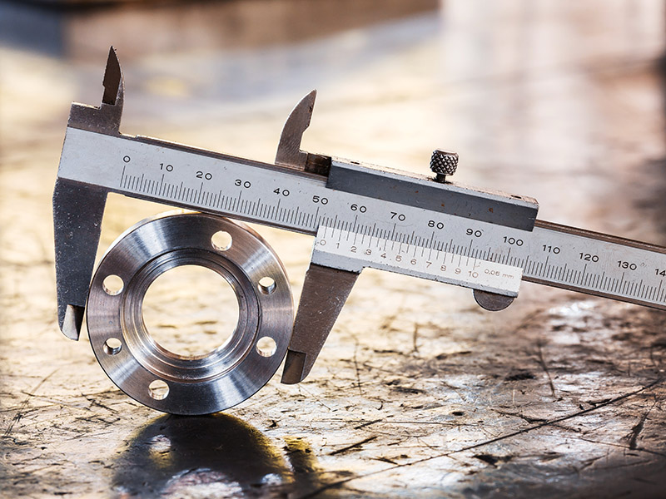

Precision measurements key to:
probe deeper into the universe via really faint GWs
look for dark matter candidates like WIMPs and axions
new physics at low-energy lab scales
Also: GWs emitted by dark matter?
$$D±ΔD$$
Notes:
Comment: GWs will also help look for dark matter
key to probe deeper into the universe via really faint GWs
Key to look for dark matter candidates like WIMPs and axions
Key to probe new physics at low-energy lab scales
Also: GWs emitted by dark matter?

Slide 6


















Precision measurements

Slide 7

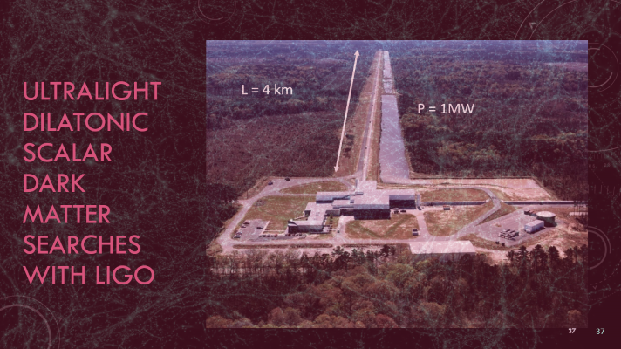
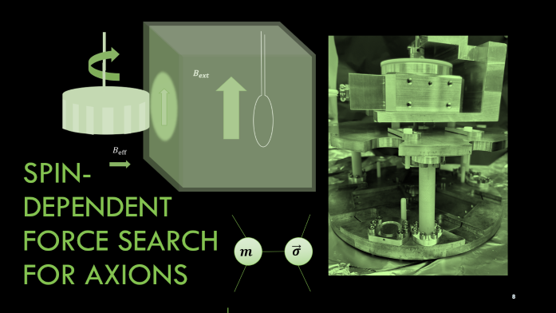
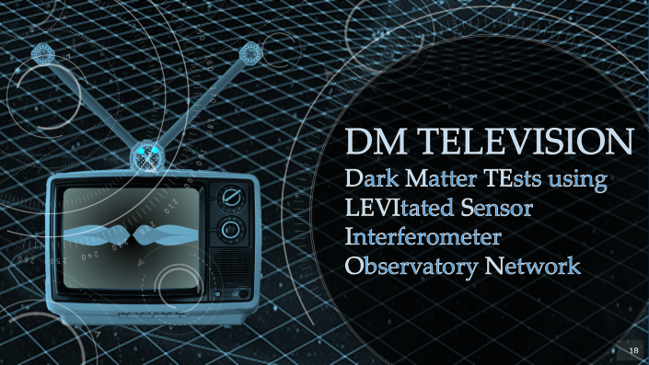
Today’s talk
m [eV]
10⁻¹⁴
10⁻¹¹
10⁻⁹
10⁻⁶
10⁻³
f [Hz]
10⁻¹⁴
10⁻¹¹
10⁻¹⁰
10⁸
10¹¹
$λ$ [m]
10⁷
10⁴
10³
10⁰
10⁻³

Slide 8
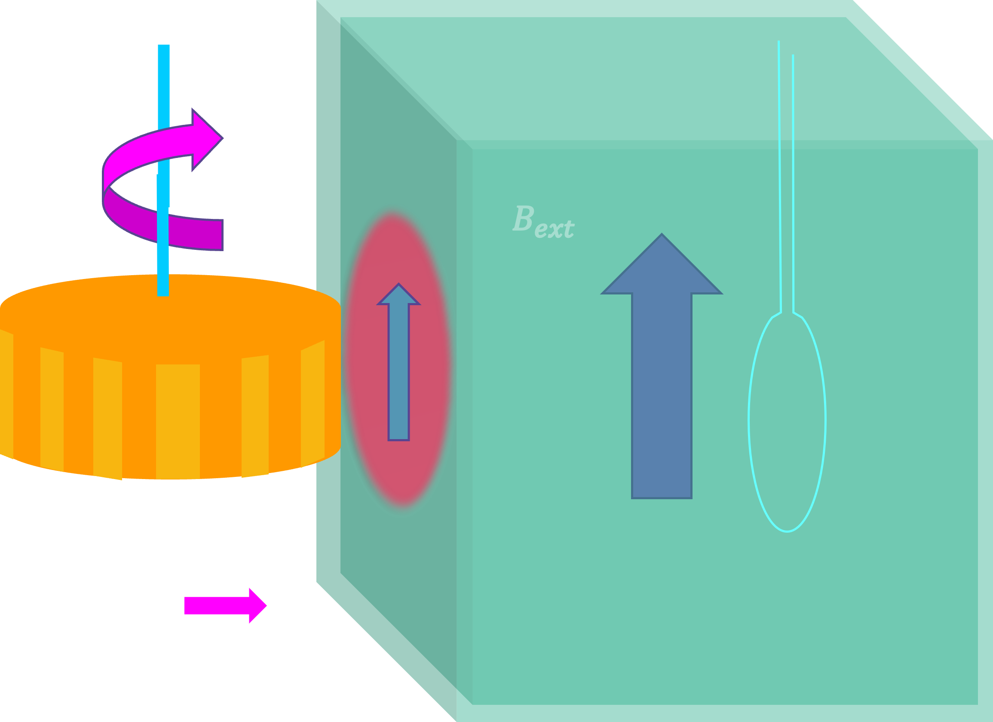
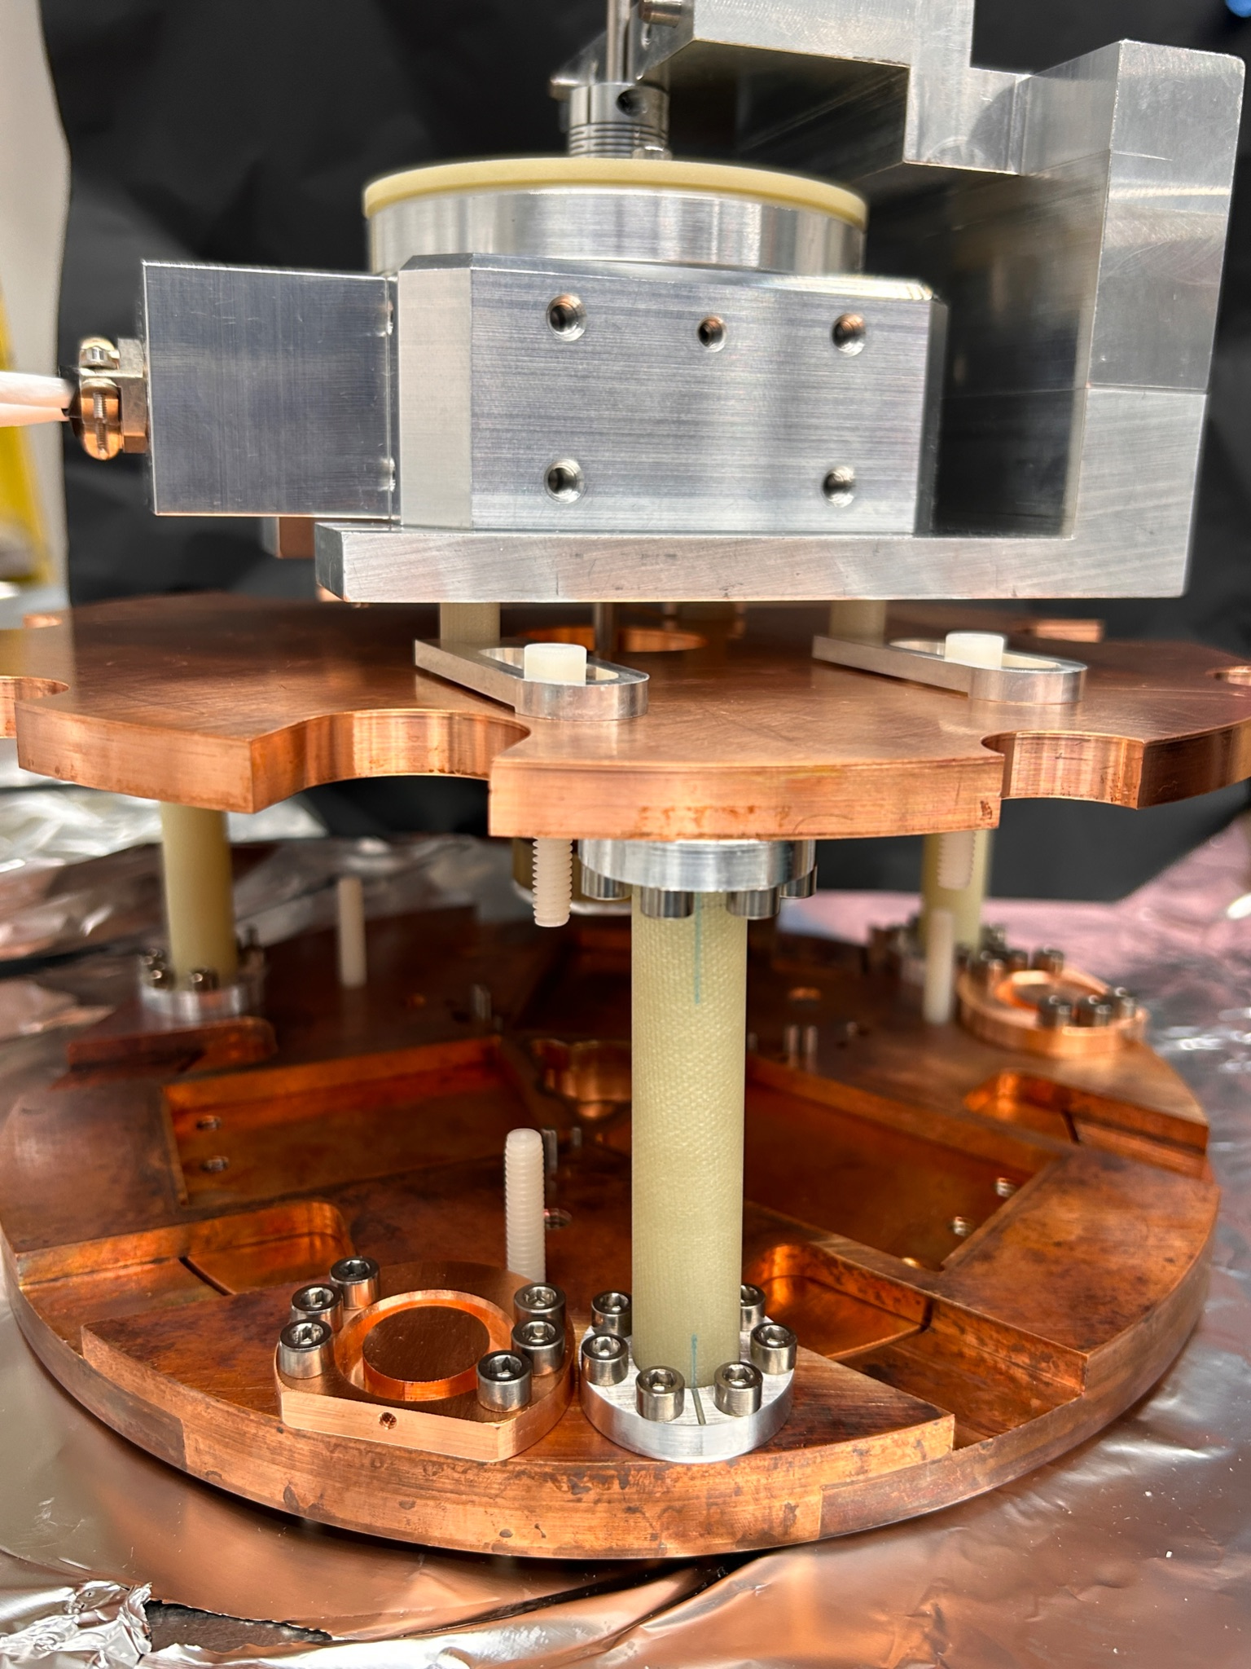


spin-dependent force search for axionS
$$m$$
$$\vec{σ}$$

Slide 9
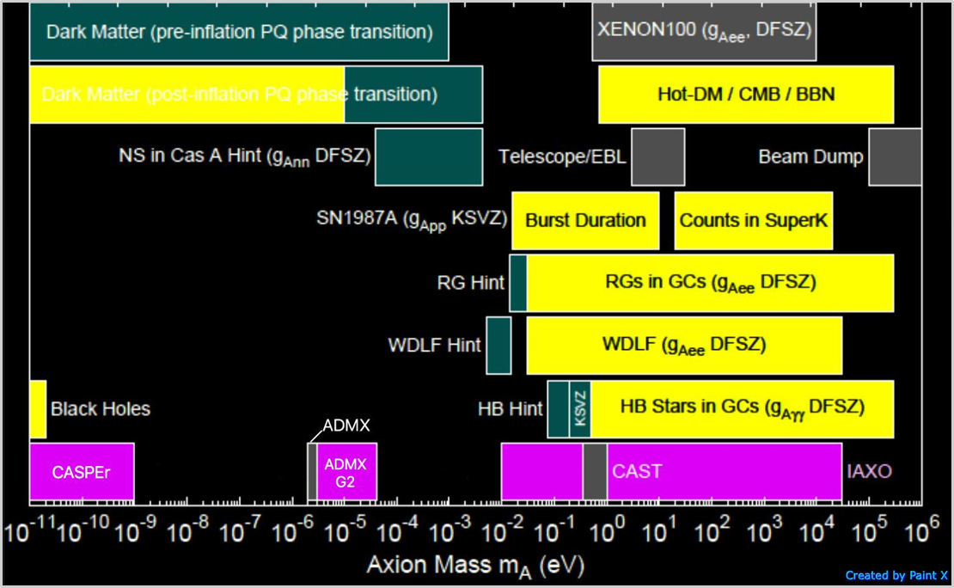
Axion parameter space - mass
Astrophysical Bounds
Dark Matter (post-inflation PQ phase
Hints
Experimental Bounds
Current Experiments
ARIADNE
ALPHA
DM radio, LC circuit, ABRACADABRA
Adapted from http://pdg.lbl.gov/2015/reviews/rpp2015-rev-axions.pdf

Slide 10
Axion parameter space – source and coupling
Source
Coupling
 | Photons | Nucleons | Electrons
Dark Matter (Cosmic) axions | ADMX, HAYSTAC, DM Radio, LC Circuit, ABRACADABRA MADMAX,Orpheus | CASPEr | QUAX
Solar axions | CAST IAXO
Lab-produced | Light-shining-thru- walls (ALPS, ALPS-II) | ARIADNE
Only experiment to directly test for nuclear couplings mediated by QCD axion in the lab

Slide 11









Axion-mediated interactions between nucleons
:
$$\vec{σ_{2}}$$
$$m$$
$$\vec{σ}$$
N
N
$$m_{1}$$
$$m_{2}$$
$$\vec{σ_{1}}$$
$$U_{ss}∝g_{s_{1}}g_{s_{2}}$$
$$U_{pp}∝g_{p_{1}}g_{p_{2}}$$
$$U_{sp}∝g_{s}g_{p}$$
Refs: https://journals.aps.org/prd/abstract/10.1103/PhysRevD.30.130

Slide 12
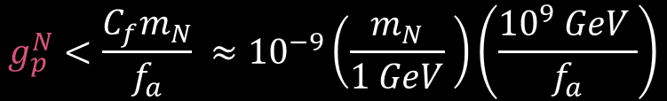
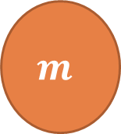


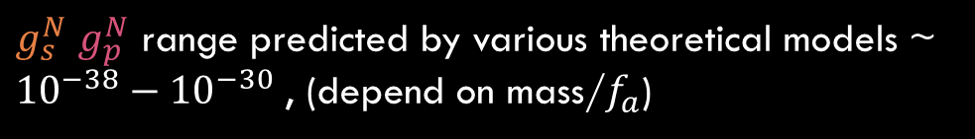

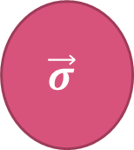
Monopole-dipole forces due to axion
$$\vec{r}$$
$$m$$
$$\vec{σ}$$
$$U_{sp}\left(r\right)=\frac{ℏ^{2}g_{s}^{N}g_{p}^{N}}{8 π m_{N}}\left(\frac{1}{r λ_{a}}+\frac{1}{r^{2}}\right)e^{−\frac{r}{λ_{a}}}\left(\hat{σ}⋅\hat{r}\right)$$
$${10}^{−29}\left(\frac{{10}^{9}GeV}{f_{a}}\right)<g_{s}^{N}<{10}^{−21}\left(\frac{{10}^{9} GeV}{f_{a}}\right)$$
$$g_{p}^{N}<\frac{C_{f}m_{N}}{f_{a}} ≈{10}^{−9}\left(\frac{m_{N}}{1 GeV} \right)\left(\frac{{10}^{9} GeV }{f_{a}}\right)$$
$g_{s}^{N}$ $g_{p}^{N}$ range predicted by various theoretical models ~ ${10}^{−38}−{10}^{−30}$ , (depend on mass/$f_{a}$)
Refs: 2010.03889, https://journals.aps.org/prd/abstract/10.1103/PhysRevD.30.130, https://www.science.org/doi/10.1126/sciadv.abm9928, 2006:12508, 1801.08127

Slide 13





ARIADNE Experiment concept
Quartz block with superconducting shield
$$U_{sp}\left(r\right)=\frac{ℏ^{2}g_{s}^{N}g_{p}^{N}}{8 π m_{N}}\left(\frac{1}{r λ_{a}}+\frac{1}{r^{2}}\right)e^{−\frac{r}{λ_{a}}}\left(\hat{σ}⋅\hat{r}\right)$$
$$B_{ext}$$
Source
Squid pickup loop
Spins in hyperpolarized Helium-3 gas
Transverse modulation by rotating a wheel with gear shaped pattern
NMR-like transition if modulation matches He Larmor frequency
Axion field doesn’t obey Maxwell’s equations, SM fields shielded using a superconductor
³He spin
Z
Y
$$B_{axion}$$
Ellipsoid ³He cell
X
$$ω_{L}=11 ω_{rot}$$

Slide 14
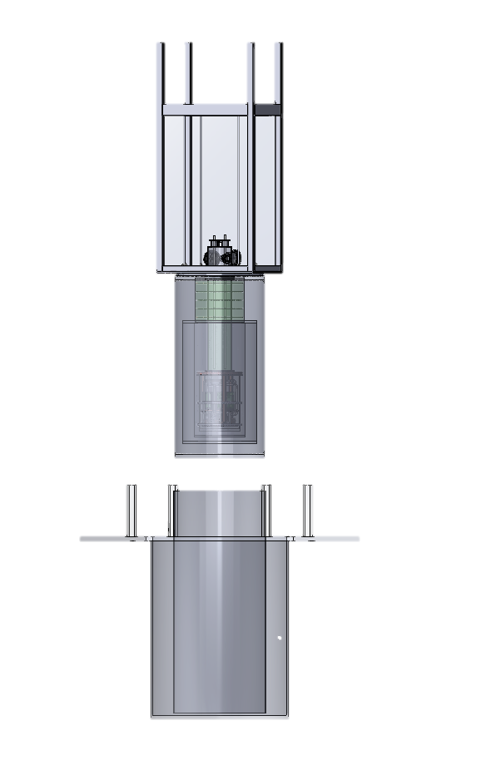
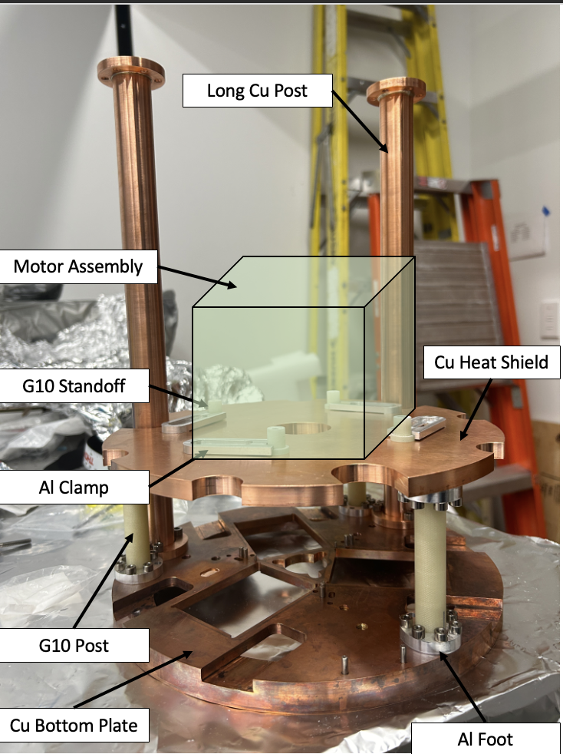
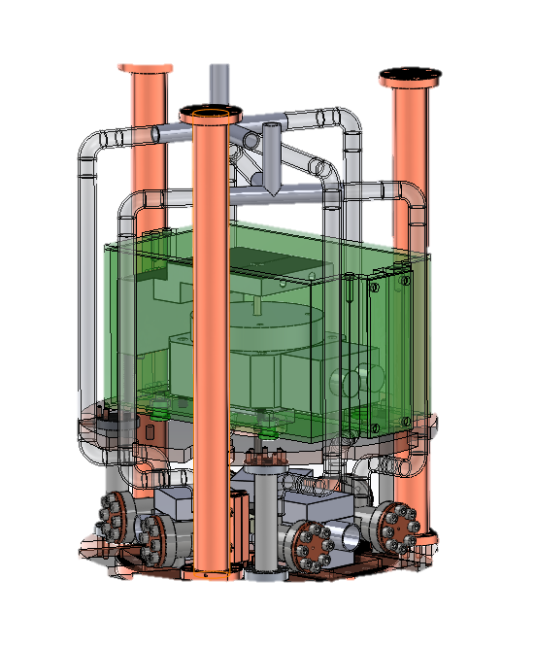
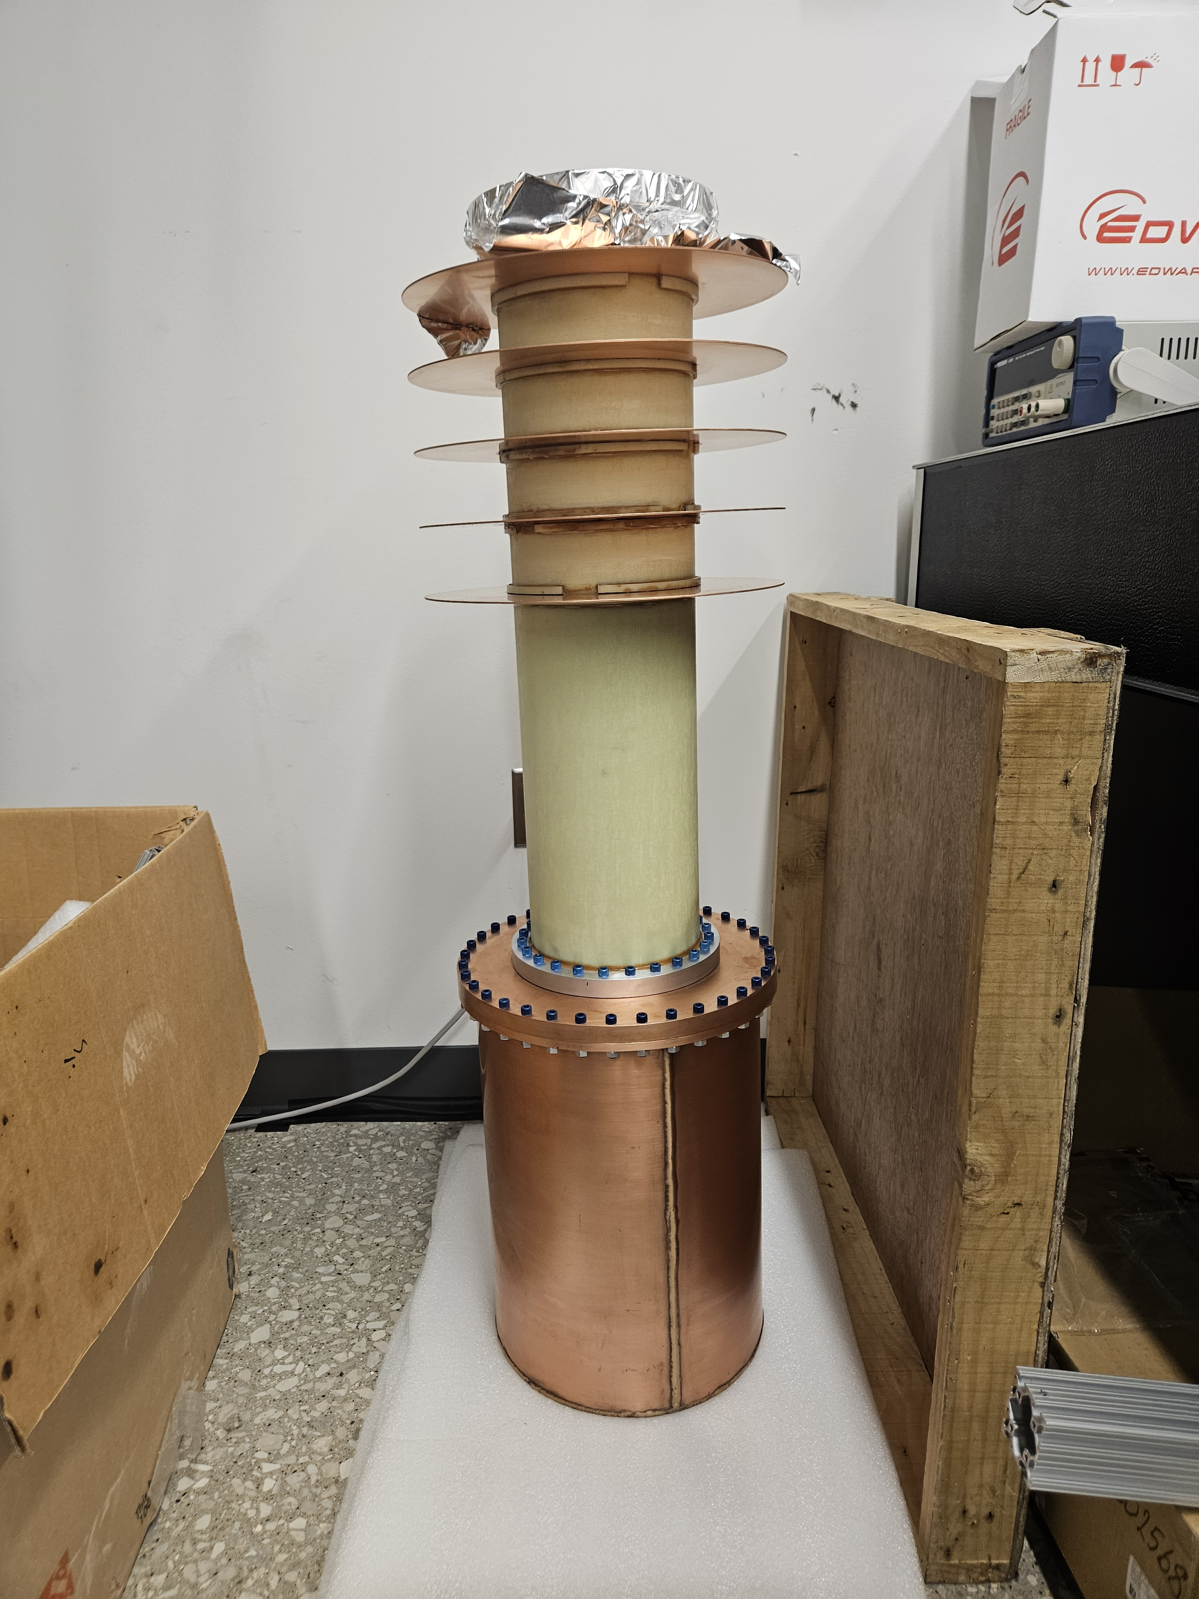
PARTS FINALLY DELIVERED AFTER many years delay!

Slide 15
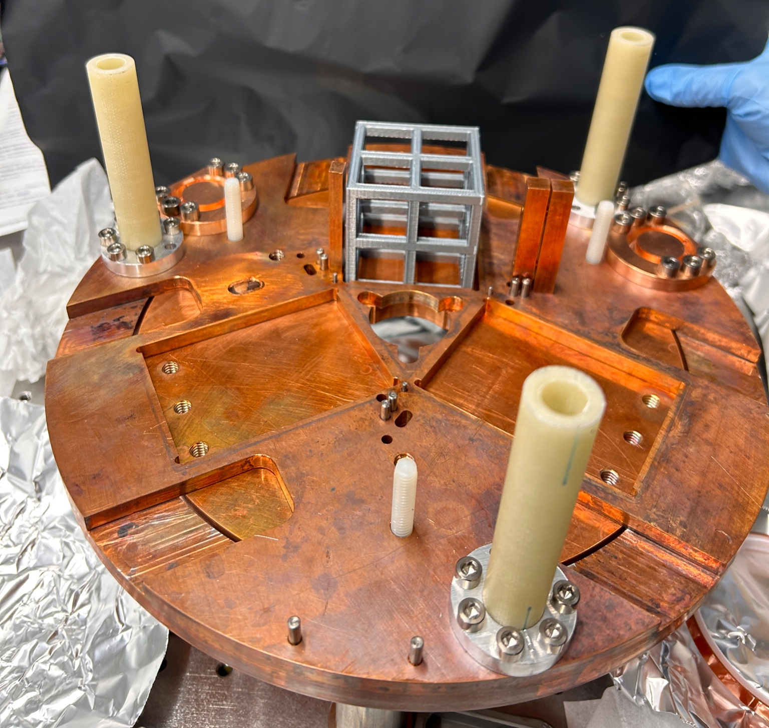
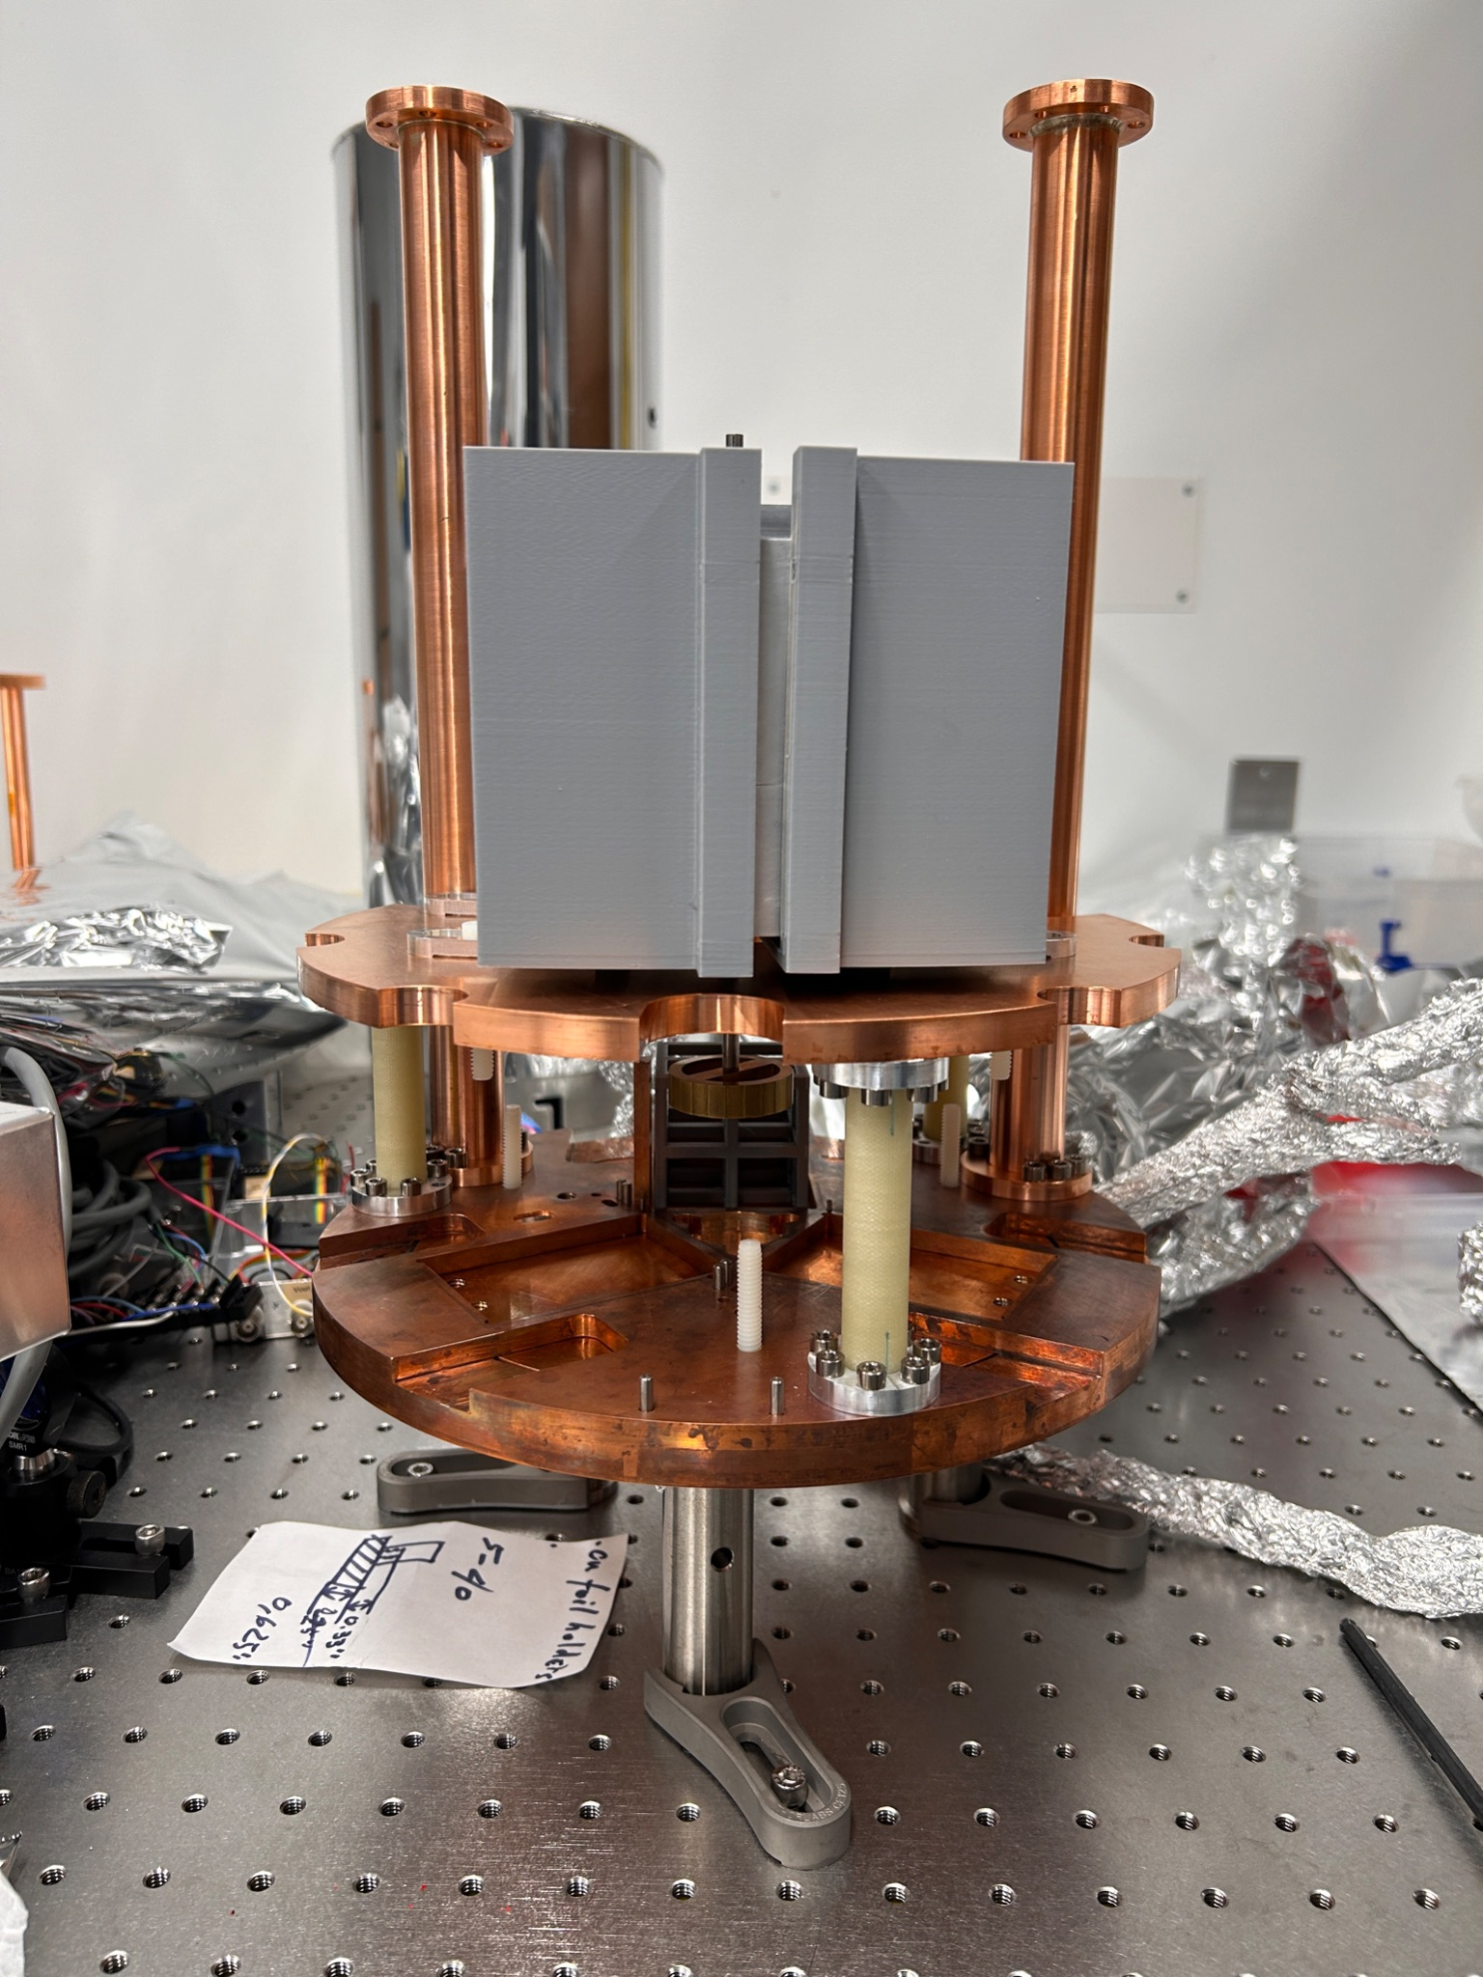
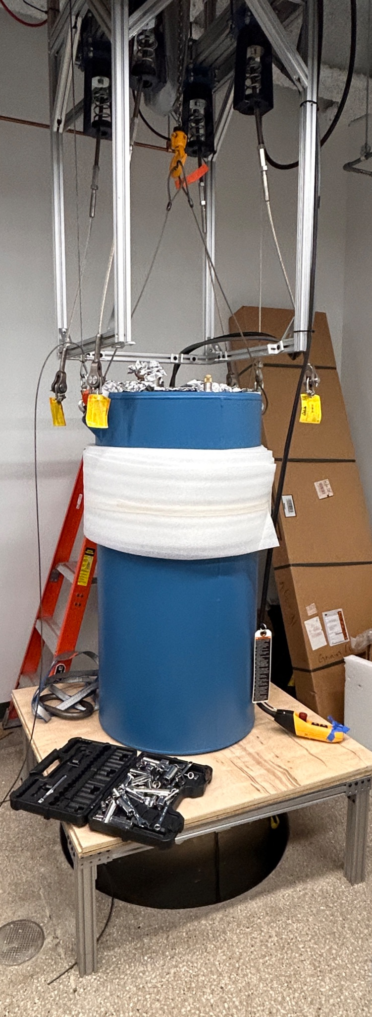
Cryostat assembly

Slide 16
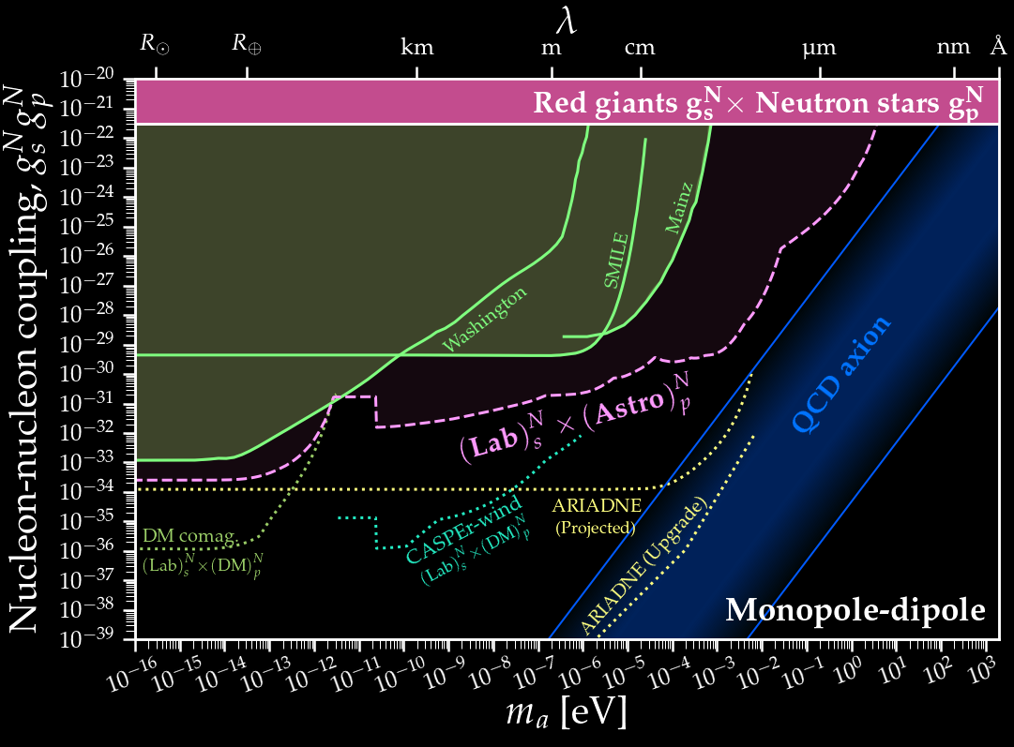
State of the art in $g_{s}g_{p}$
Search for PQ axions 10⁻⁶ eV < m_{a} < 10⁻³ eV
probe into the PQ axion parameter space with ~ 10⁸ improvement over previous techniques
O’Hare & Vitagliano, PRD 102 115026 2021

Slide 17
ARIADNE Summary
New spin-dependent forces mediated by QCD axion
Only experiment looking for axion interaction with nucleons
ueV to meV mass range
Searches for axion independent of DM paradigm by looking for axion-mediated interactions between two SM particles instead of axion interacting with one SM particle

Slide 18
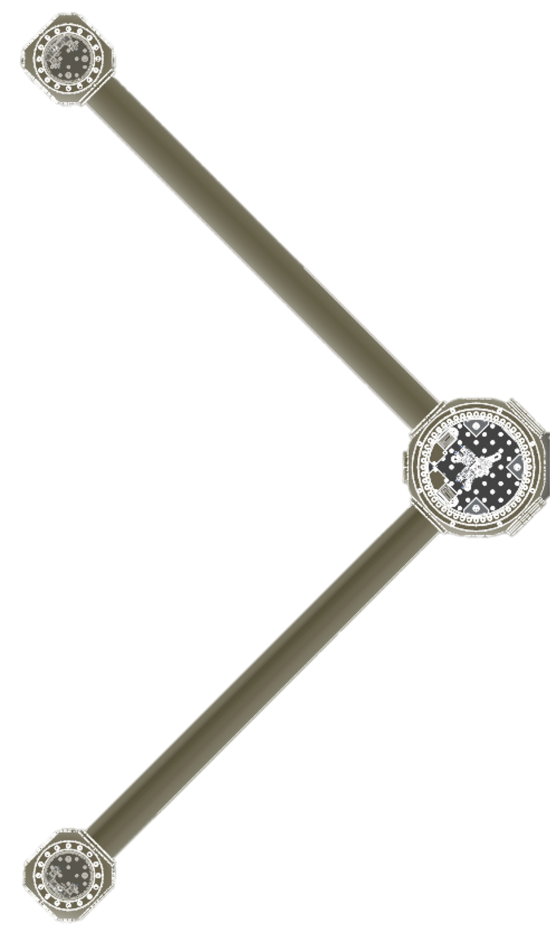
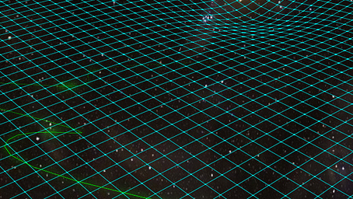

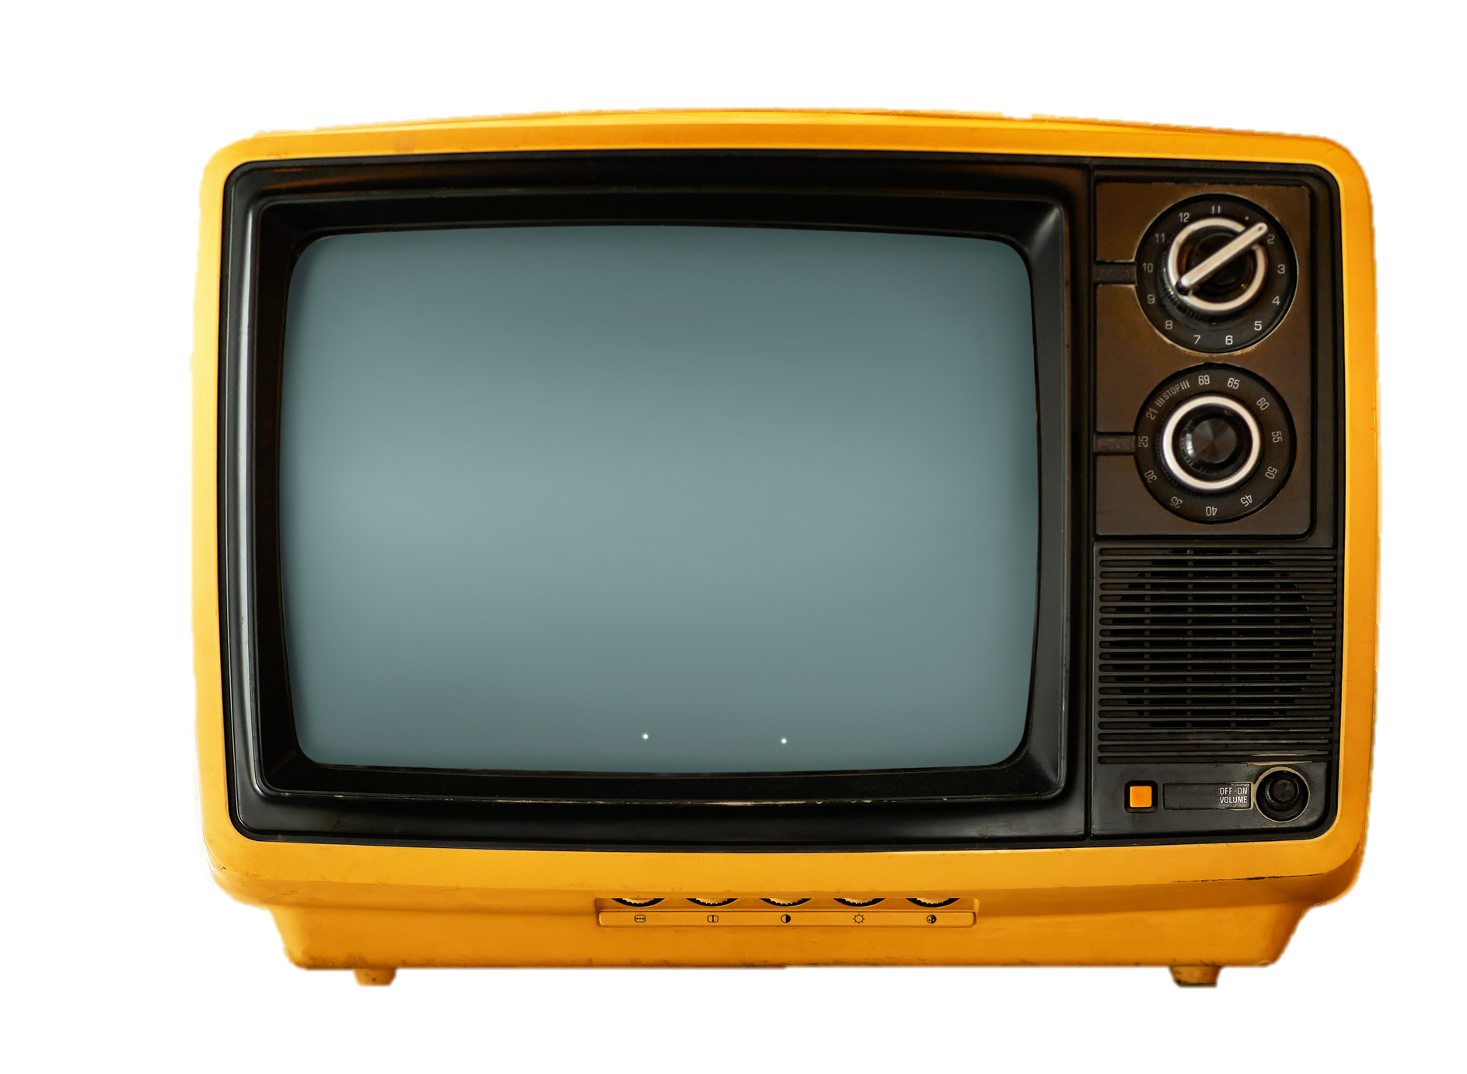
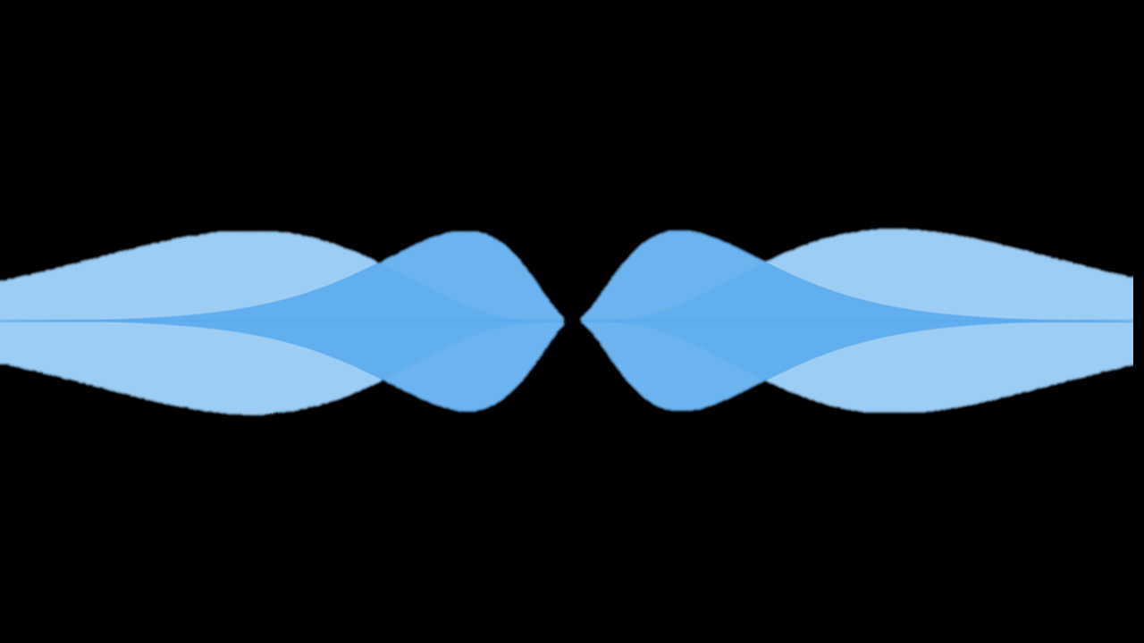
DM TELEVISION
Dark Matter TEsts using LEVItated Sensor Interferometer Observatory Network

Slide 19
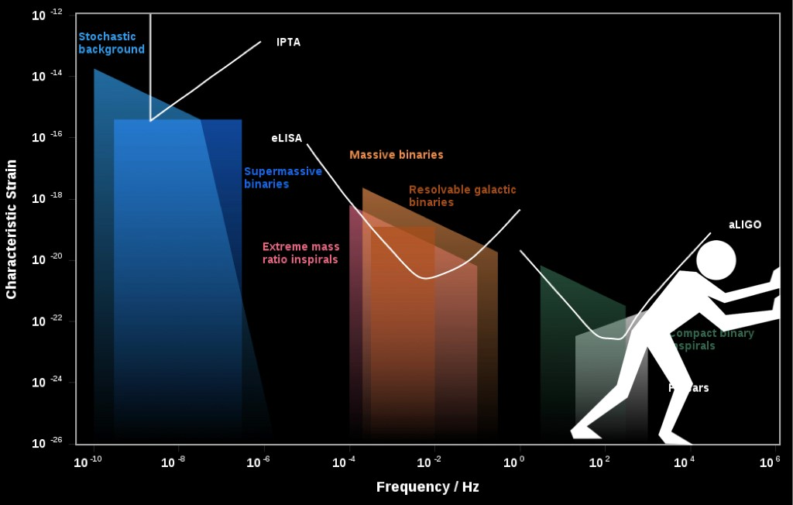
GWs above the audio band?
http://www.ctc.cam.ac.uk/activities/UHF-GW.php
Members: Nancy Aggarwal, Mike Cruise, Valerie Domcke, Francesco Muia, Fernando Quevedo, Andreas Ringwald, Jessica Stenlechner, Sebastien Steinlechner

Slide 20
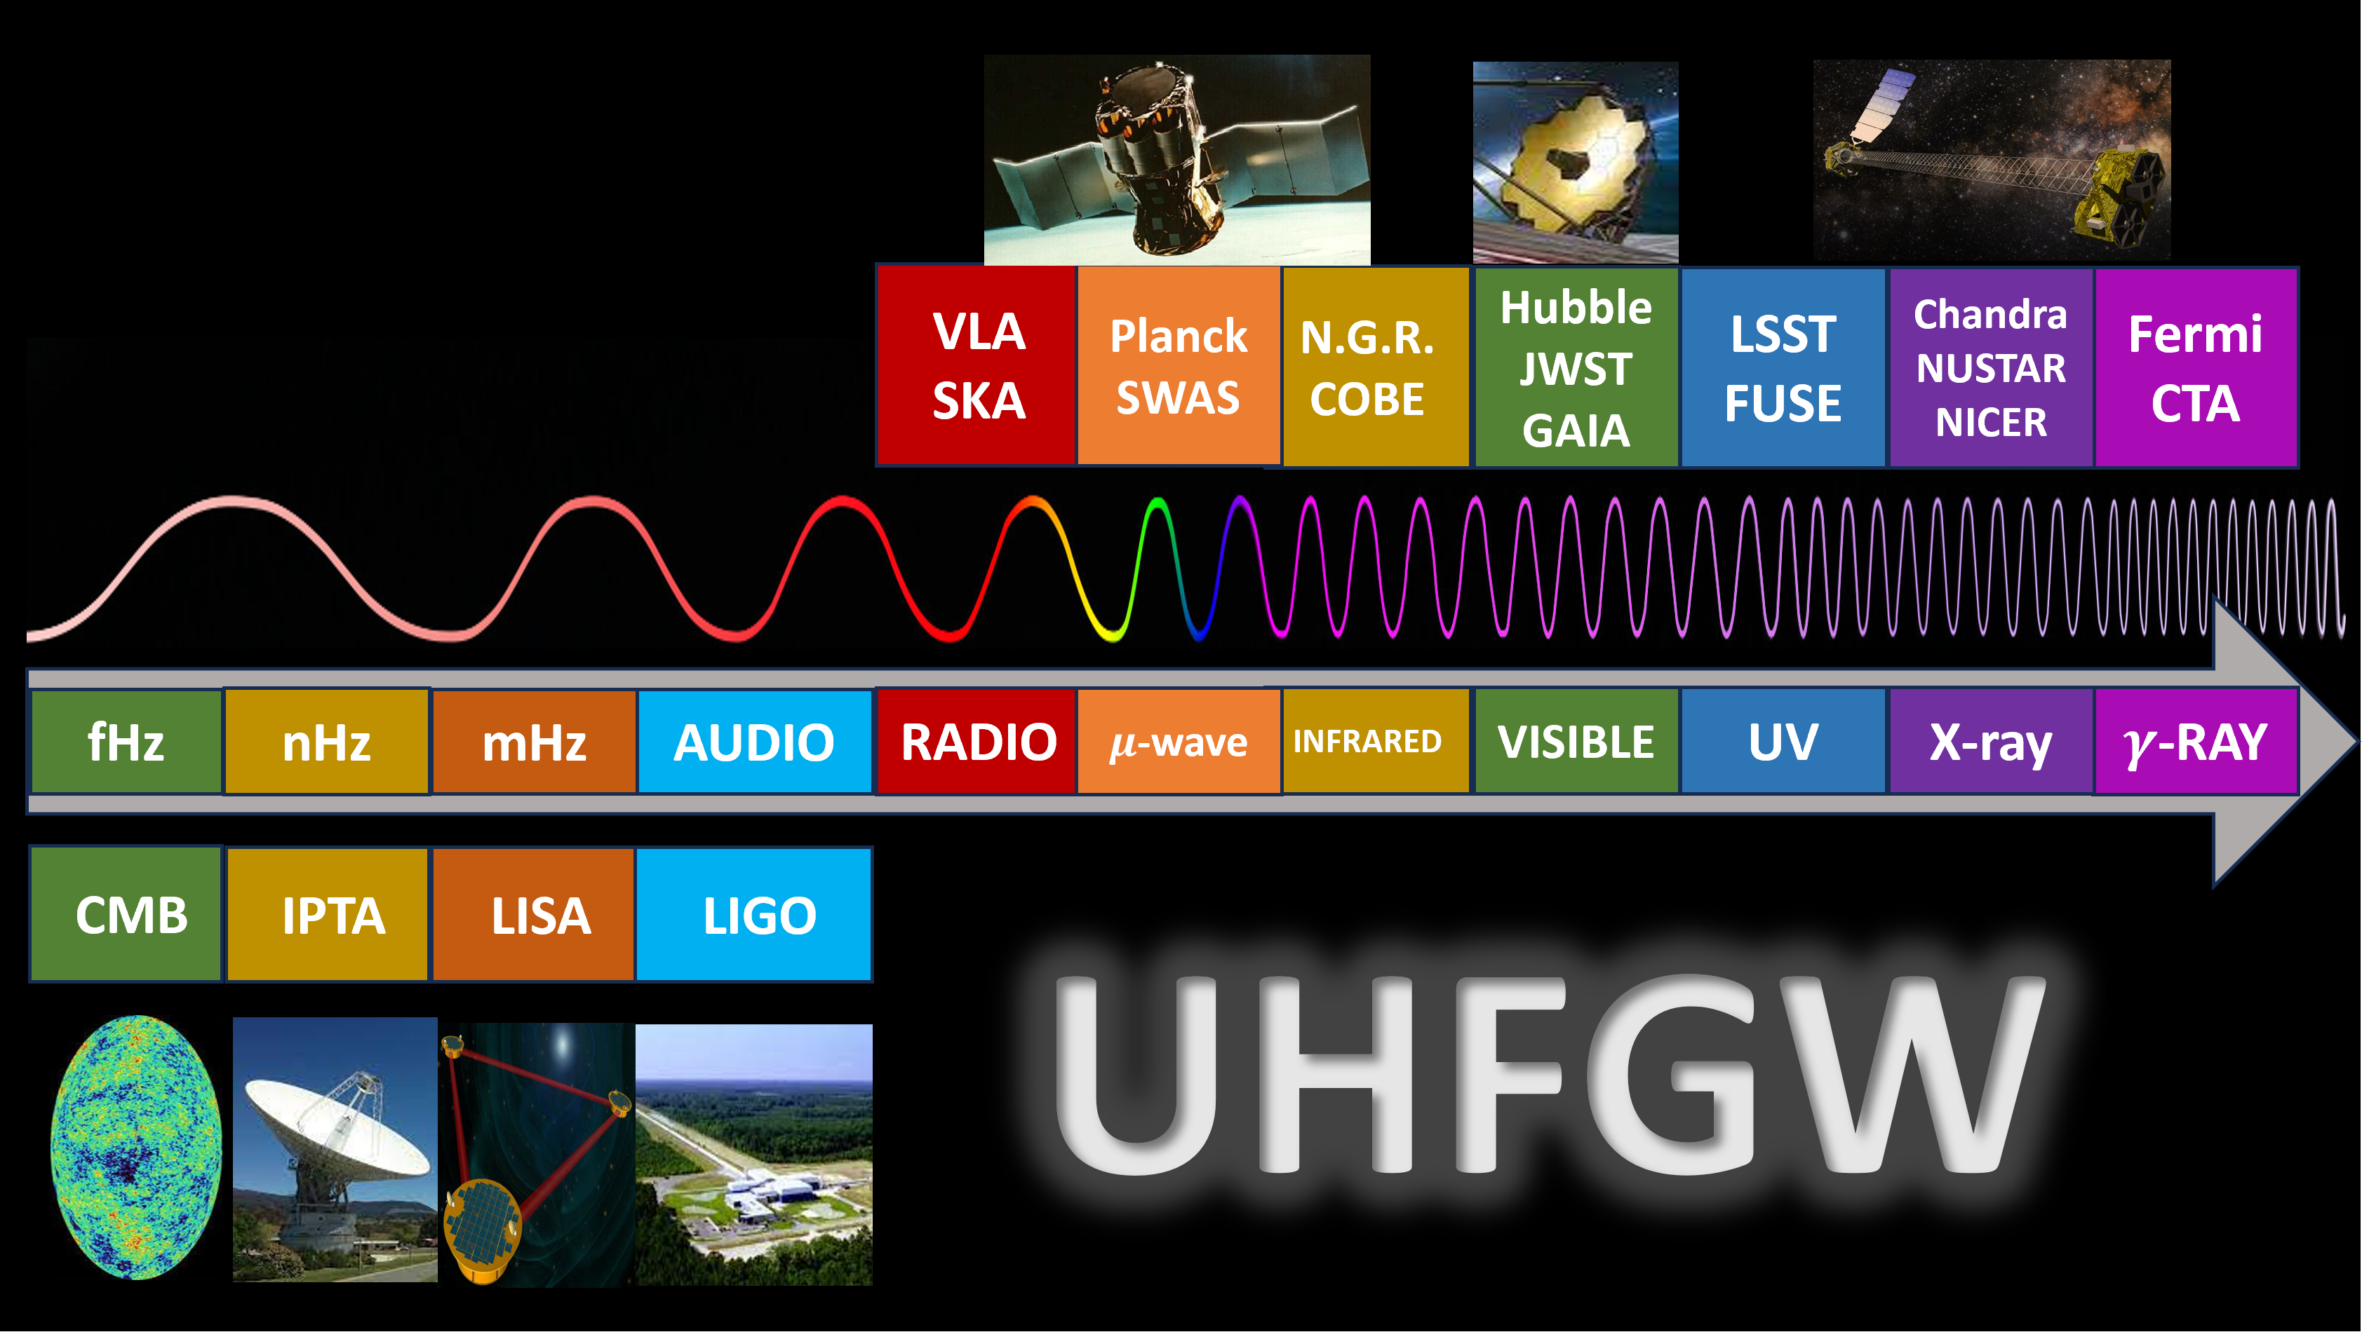
MISSED opportunity for multi-messenger Probes

Slide 21
+
UHFGWs provide direct window to inflation (ie pre CMB)
No vanilla astrophysical sources above 10 kHz (BBHs, BNSs, NSBHs)
No astrophysical foreground
Directly probe cosmology below foreground OR be blocked by exotic sources

Slide 22
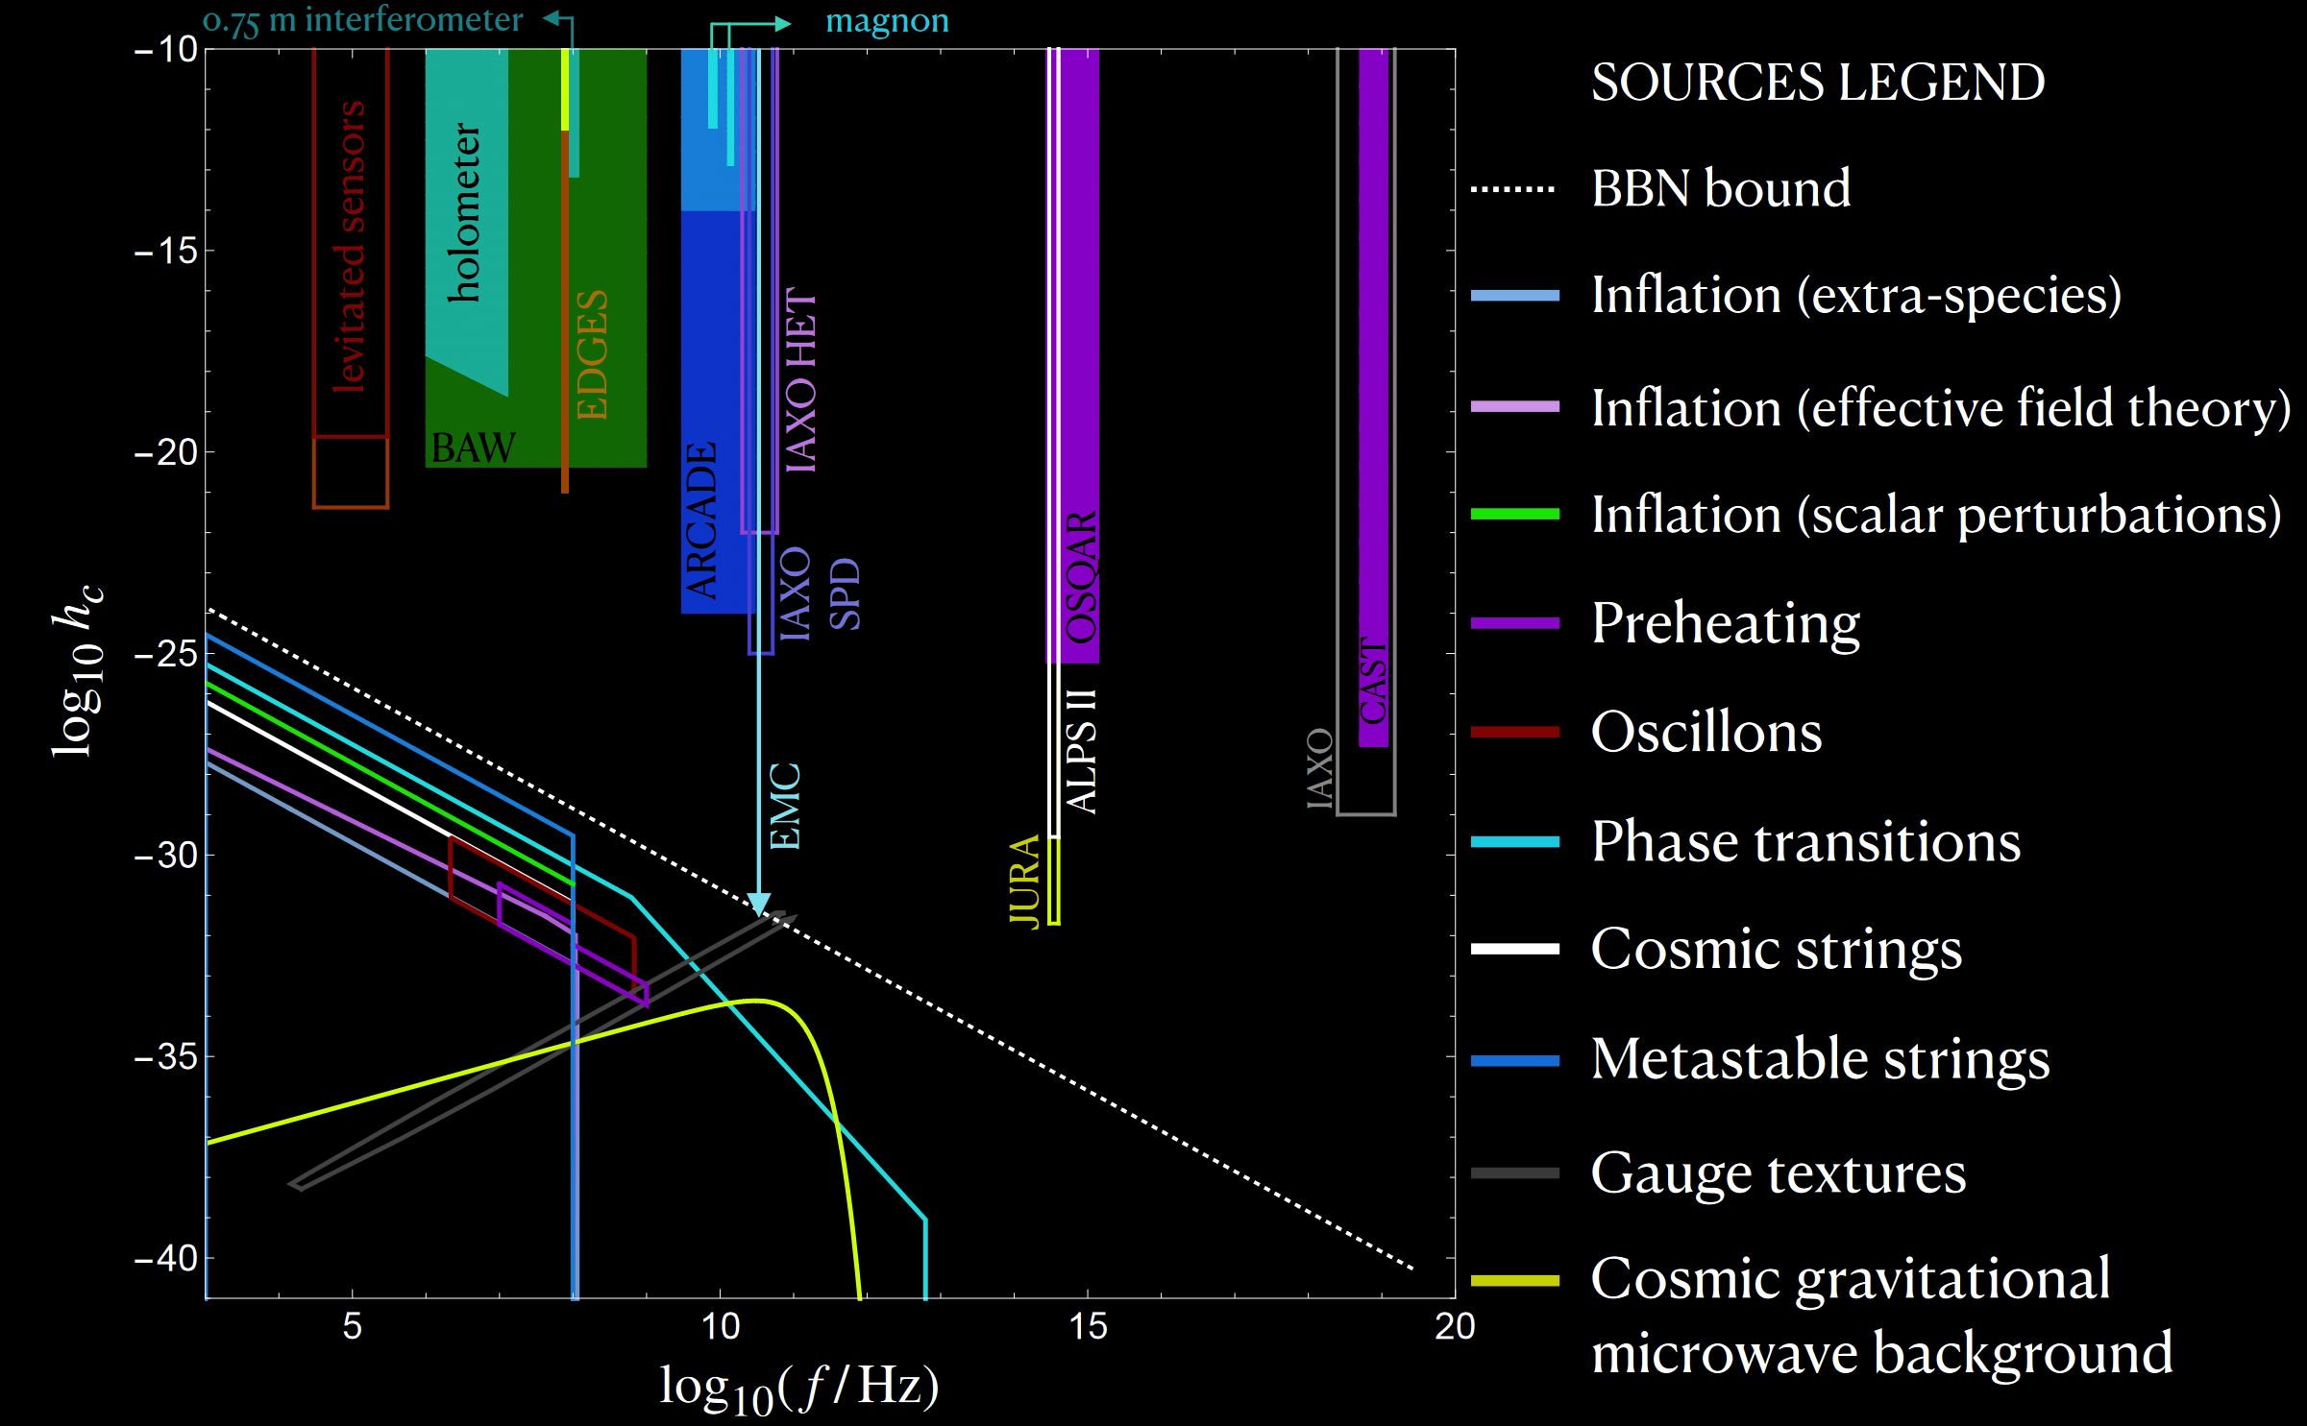
Future GW detectors beyond the audio band for particle astrophysics and cosmology
Aggarwal, N., Aguiar, O.D., Bauswein, A. et al. Challenges and opportunities of gravitational-wave searches at MHz to GHz frequencies. Living Rev Relativ 24, 4 (2021).
Also see https://arxiv.org/pdf/2501.11723

Slide 23
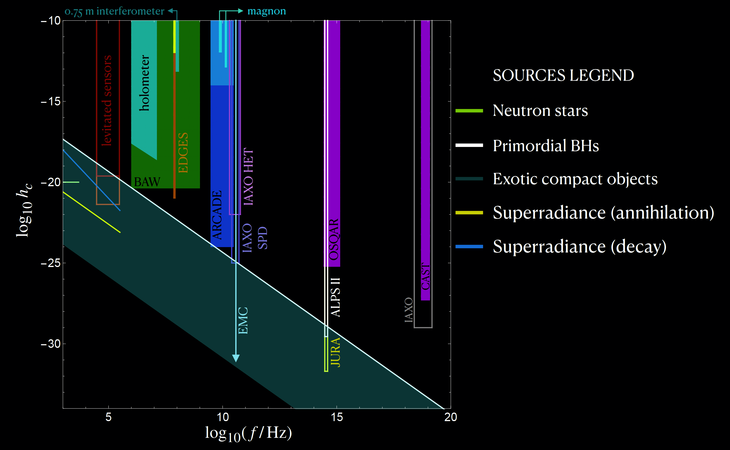
Numerous interesting sources & promising Techs!!!
Aggarwal, N., Aguiar, O.D., Bauswein, A. et al. Challenges and opportunities of gravitational-wave searches at MHz to GHz frequencies. Living Rev Relativ 24, 4 (2021).
Also see https://arxiv.org/pdf/2501.11723

Slide 24
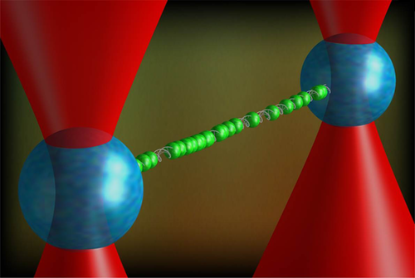
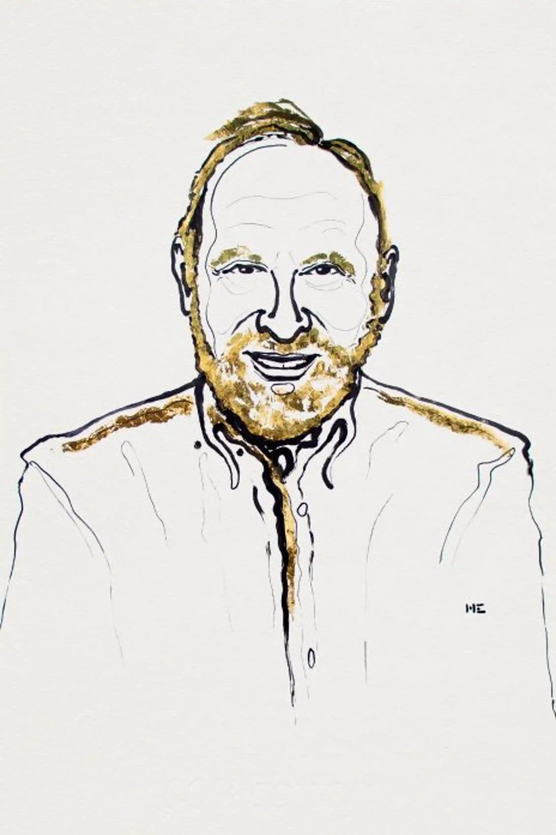

Optical trapping
$$U\left(\vec{r}\right)=−\frac{1}{2}α (\vec{r} ) E^{2}(\vec{r})$$
Niklas Elmehed, Nobel Media
K. Schakenraad et al

Slide 25
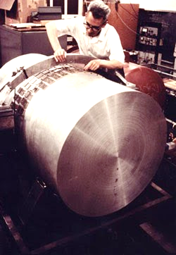
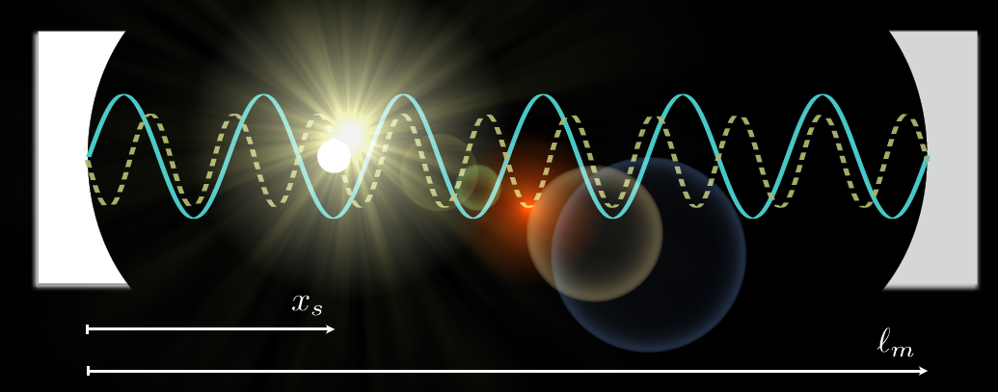
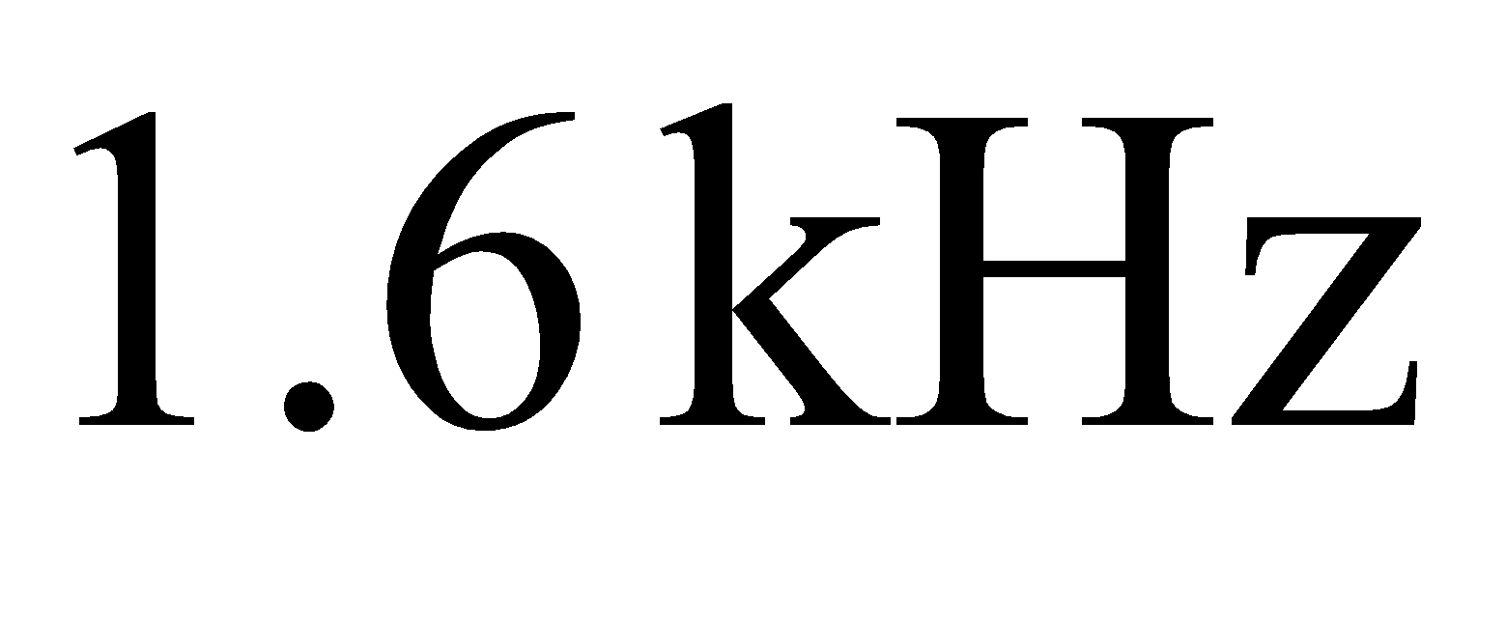
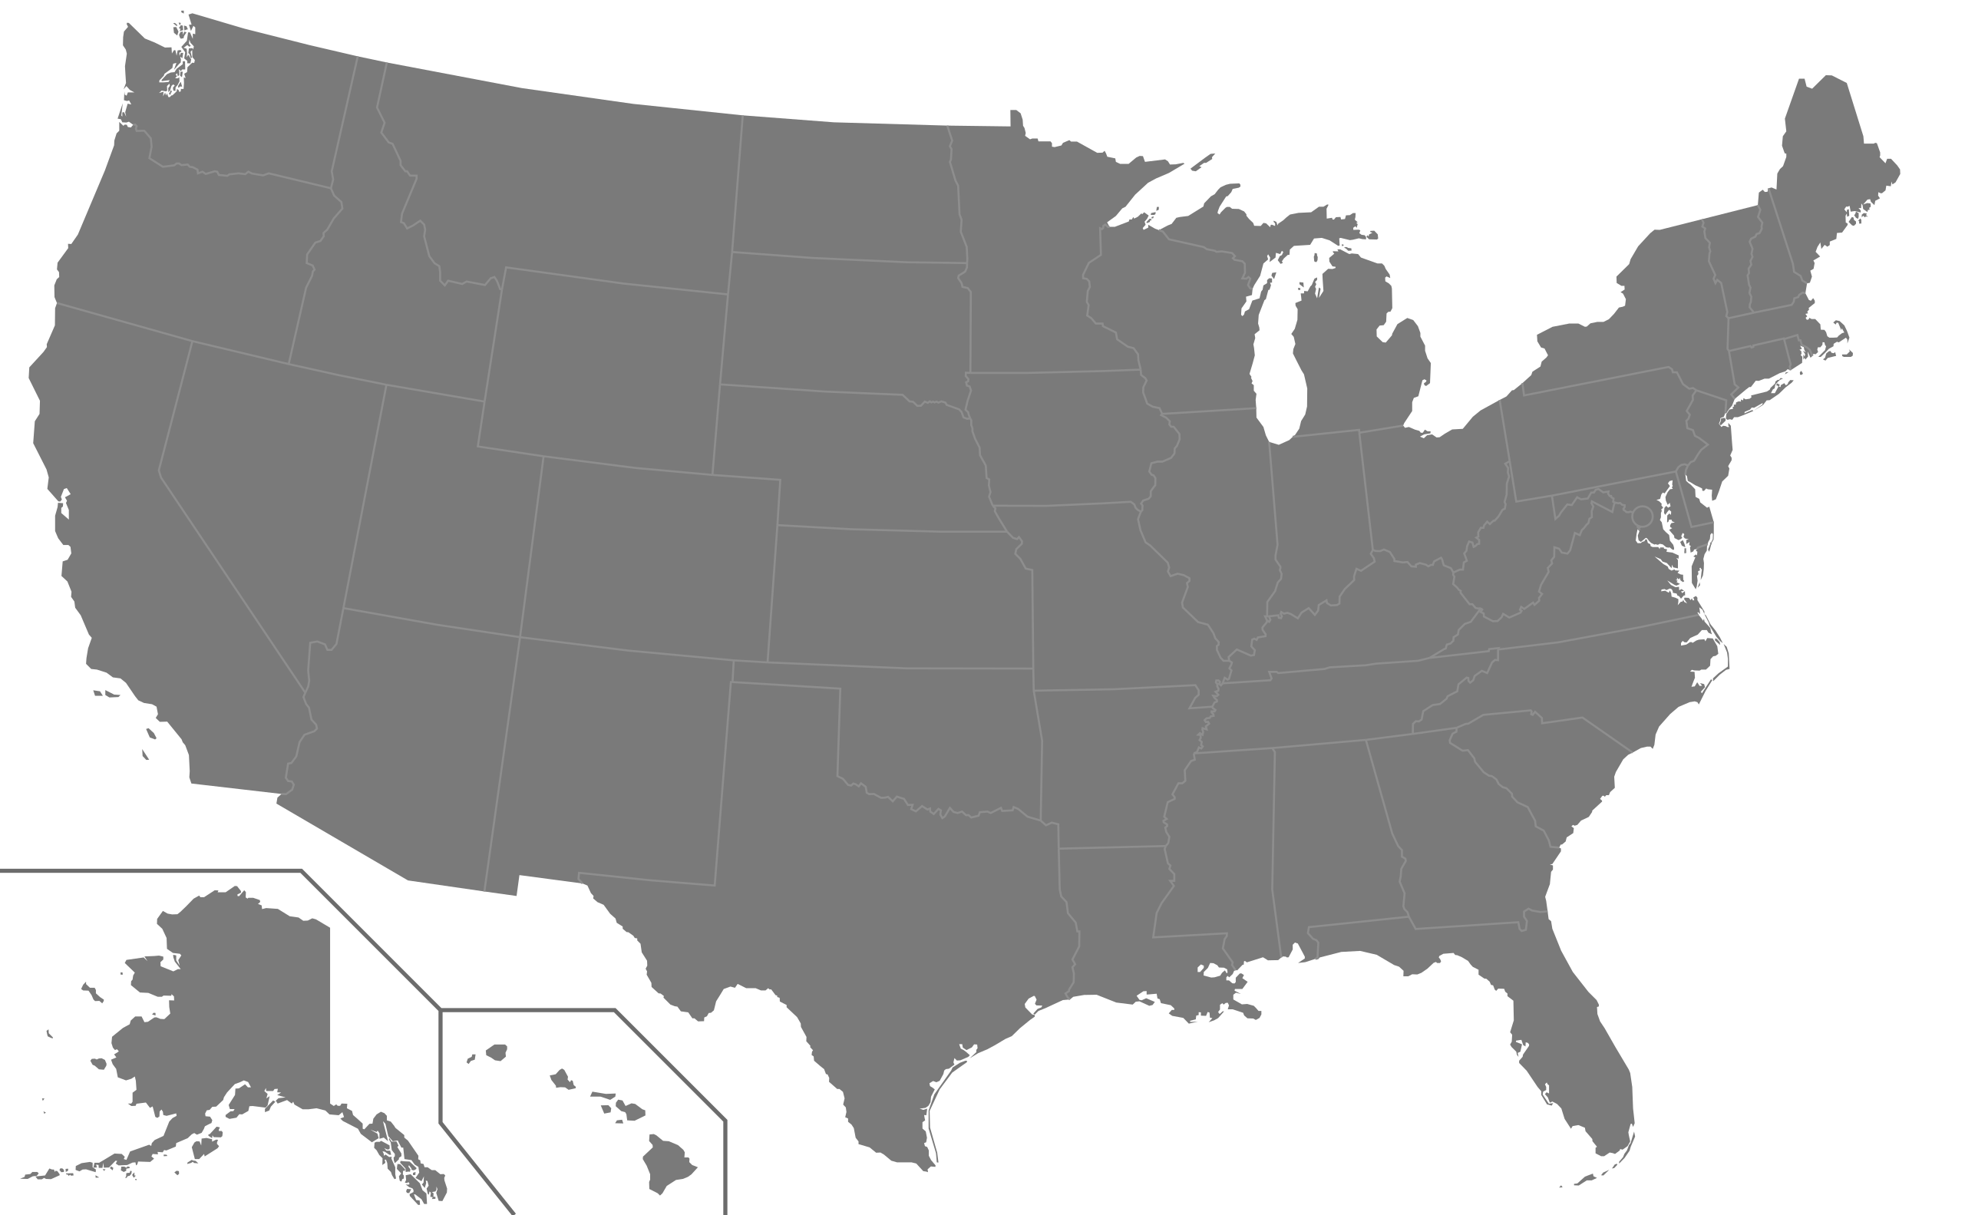




Gw detector using optical traps
$$L$$
Arvanitaki and Geraci,
PRL 110, 071105 (2013)
$$ΔL=\frac{h}{2}L, Δx_{a}=ΔL, Δx_{s}=\frac{h}{2}x_{s}$$
$Δx_{GW}=Δx_{s}−{Δx}_{a}=\frac{h}{2}(x_{s}−L)$, maximized at $x_{s}→0$
$$F_{GW}=MΩ_{T}^{2} Δx_{GW} =M Ω_{T}^{2}\frac{L}{2} h_{0}\cos{Ω_{GW}t}$$

Slide 26
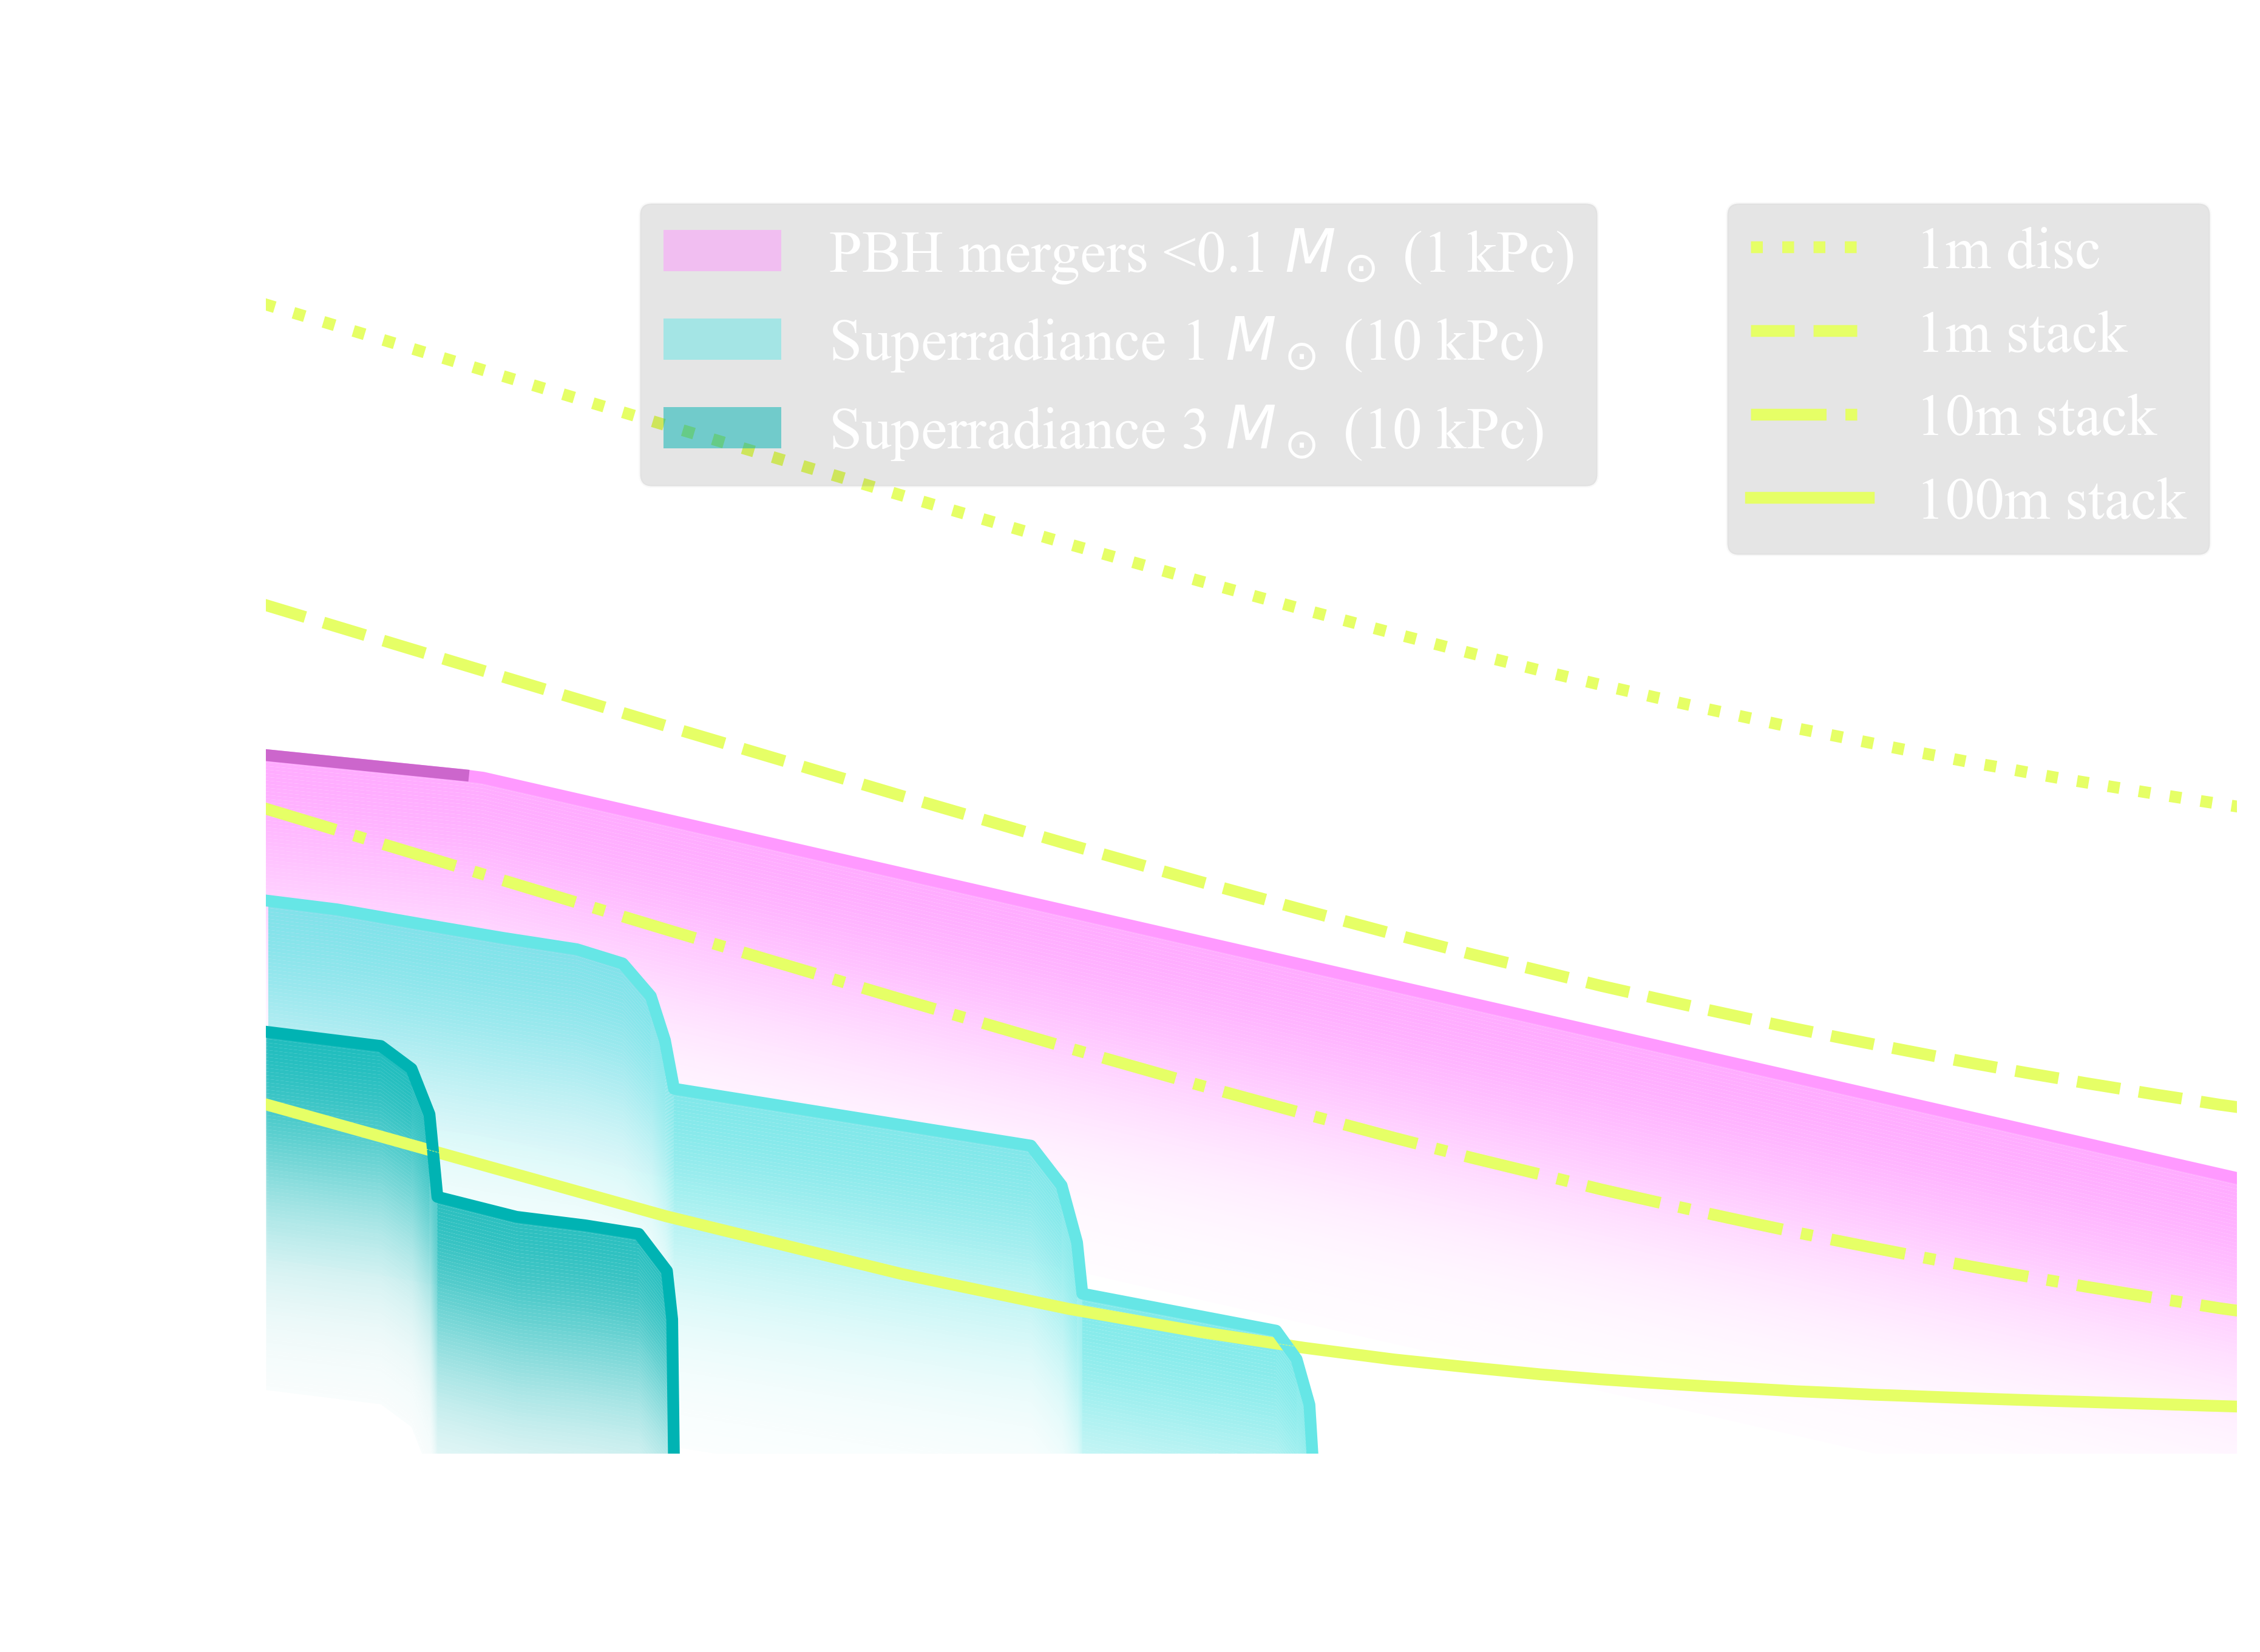
Optical Trapping for GW detection
Network of miniature GW detectors
Uses optically levitated objects
Tunable detection frequencies
L = 1m, disc
L = 1m, stack
L= 10 m, stack
L = 100 m, stack
L
Searching for new physics with a levitated-sensor-based GW detector
Aggarwal et al PRL 128, 111101

Slide 27
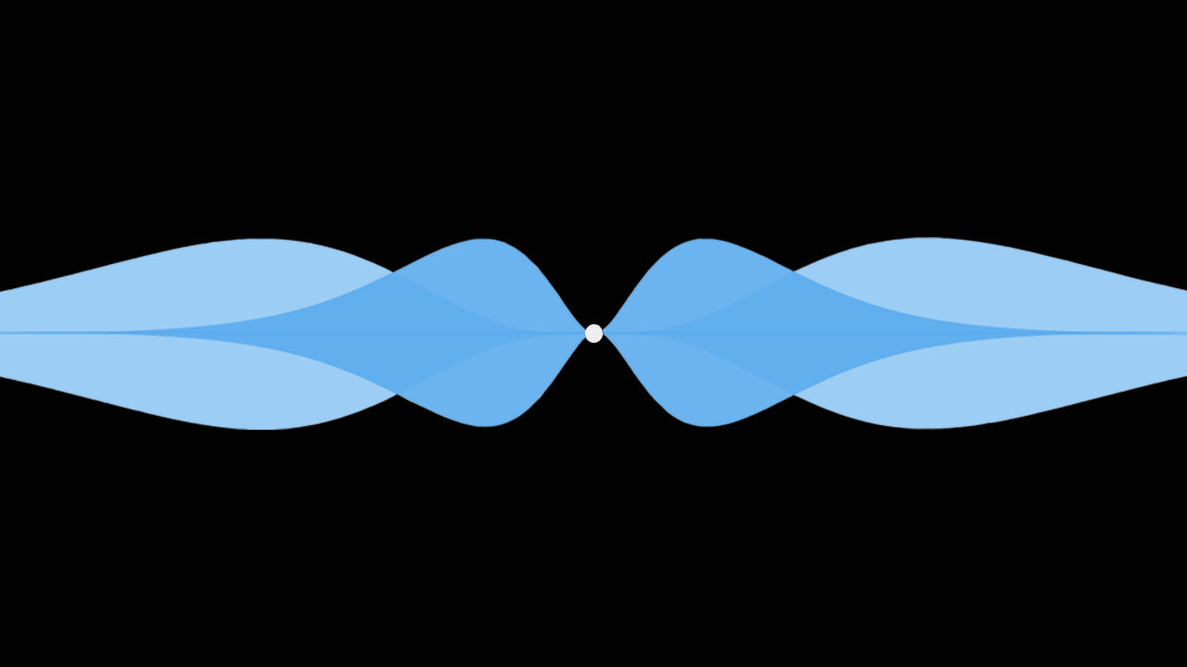
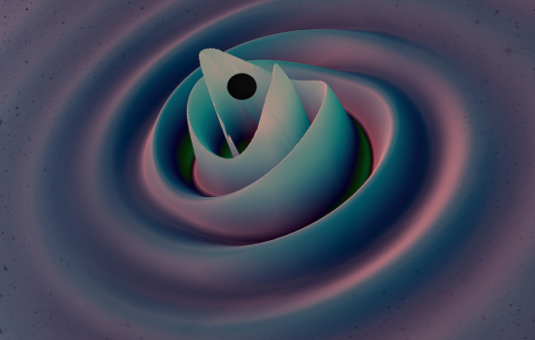

Science case
BH Superradiance
Masha Baryakhtar
Primordial black holes
Deborah Ferguson, Karan Jani, Deirdre Shoemaker, Pablo Laguna | Georgia Tech, MAYA Collaboration
The unknown unknowns???

Slide 28
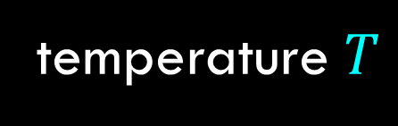

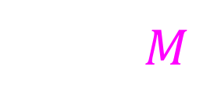
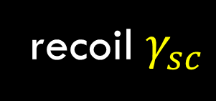
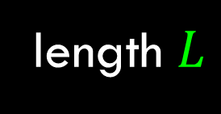
Limiting noise: gas damping and photon recoil heating
$S_{FF}=4 M( k_{B}T γ_{g}+ ℏ ω γ_{sc})$
Limit on resonance $(Ω→Ω_{T})$,
$S_{hh}∼16 \frac{1}{Ω_{T}^{4}}\frac{1}{M}\frac{1}{L^{2}}(ℏ ω$ $γ_{sc}+k_{B}T γ_{g})$
Arvanitaki and Geraci,
PRL 110, 071105 (2013)
temperature $T$
length $L$
recoil $γ_{sc}$
mass $M$

Slide 29




GEOMETRY AFFECTS SCATTER
    $\text{plane} \text{wave} \text{incident}$: $\vec{E}=1 Vm^{−1} \hat{x}\cos{kz}$
Sphere scatters light in all directions
Disk scatters light in the beam direction (low $γ_{sc}$)
Numerical simulations of scattering from disks show low scattering loss, hence low recoil heating
    SiO2 Sphere (d=300 nm)
    NaYF Hexagon (d=4 um, $τ=$200 nm), 300 times more mass
Aggarwal et al arxiv:2010.13157 Phys. Rev. Lett. 128, 111101,
Winstone et al arxiv:2204.10843 Phys. Rev. Lett. 129, 053604

Slide 30






INCREASE MASS WHILE KEEPING SCATTER LOW?
Stacked disks to increase mass (high $M$)
Is such a stack trappable?
  What is the transmission through the stack?
  What is the field inside the stack?
  What is the trapping frequency/stiffness?
  Can these things be fabricated in the lab?
Modified wavelength$λ_{i}=\frac{λ_{0}}{n_{i}}$
$$t_{1}=\frac{λ_{1}}{4}$$
$$t_{2}=\frac{λ_{2}}{2}$$
$$t_{1}$$
Aggarwal et al arxiv:2010.13157
Phys. Rev. Lett. 128, 111101

Slide 31



Trapping of flat objects In the lab…

Slide 32





trapping of NAYF hexagon plates
Winstone et al arxiv:2204.10843 Phys. Rev. Lett. 129, 053604

Slide 33




State of the art in optical trapping
$η_{thermal}={\left(\frac{Ω_{z}}{2π}\right)}^{2}\sqrt{Mρτ}$ $\left(γ_{g}∝1/ρτ \right)$
$$η_{recoil}={\left(\frac{Ω_{z}}{2π}\right)}^{3/2}\sqrt{\frac{M}{γ_{sc}} }$$
Winstone et al arxiv:2204.10843 Phys. Rev. Lett. 129, 053604

Slide 34



Davis ifo layout
Jonathan Varghese, Andrew Laeuger
Manage interplay between tight mode matching constraints alongside real-estate constraints inside vacuum chamber
Stear multiple beams
Mode-match multiple beams
Large footprint & proximal launchers

Slide 35
Fully relativistic detector response and noise
Andrew Laeuger
arxiv2604.07302
Laeuger et al, Gravitational wave signal and noise response of an optically levitated sensor in a Fabry Perot Cavity

Slide 36

DM TELEVISION SummarY
New initiative for building high-frequency GW detectors
Network of miniature radio-frequency GW detectors
Based on optical levitation
Tunable resonance in the 10-300 kHz range
Will set independent limits on axions from blackhole superradiance and primordial black holes
Surprises!!!

Slide 37


Ultralight dilatonic scalar dark matter searches with ligo
L = 4 km
P = 1MW
37

Slide 38




Tiny measurements with big things
$h= \frac{ΔL}{L}= {10}^{−21}$
L = 4 km
P = 1MW
$$ΔL= {10}^{−18} m$$
$$= \frac{R_{p}}{1000}$$
M = 40kg

Slide 39

Most sensitive displacement measurement
A. Buikema et al. Phys. Rev. D 102, 062003 (2020)

Slide 40



GWs inform astrophysics and cosmology
Biggish bang: artist's impression of a neutron-star merger (Courtesy: NASA)
300 different theories ruled out by a SINGLE measurement!!!

Slide 41





The CANDIDATE signal
Scalar coupling to SM Lagrangian:
Modulates fine structure constant and mass of electron:

Slide 42

Impact on solid objects
(due to change in Bohr radius and bond lengths)

Slide 43

Impact on GW detectors
due to change in Bohr radius and bond lengths
(ignore change in refractive index due to small contribution)
Modulation of thickness of beamsplitter
  Can be measured at dark port of Michelson (shown in GEO600)
  $h_{DM\left(t\right)}=𝒢_{arm}\frac{L_{arm}}{l_{BS}} h_{GW\left(t\right)}$
Modulation of length of solid reference cavity
  Can be measured by comparing frequency fluctuations of reference cavities w.r.t. suspended cavities – typically one of the auxiliary channels of a GW detector

Slide 44


Where is the reference cavity?
Relative frequency shifts will show up in this auxiliary channel

Slide 45

Projected upper limits (coupling)
Hall, E and Aggarwal, N
Advanced LIGO, LISA, and Cosmic Explorer as dark matter transducers, 2022, arxiv 2210.17487

Slide 46


Cross-correlate between TWO LIGOs
Swadha Pandey Evan Hall
Cross spectral density S_{HL}(Ω) = S_{DM}(Ω)
S_{DM}(Ω) ∝ coupling constant |d_{e} + d_{me}|²
Optimal estimator for correlated search between detectors: $ρ=\frac{S_{HL}\left(Ω\right)}{\sqrt{S_{HH}\left(Ω\right)S_{LL}\left(Ω\right)}}$
Outliers?

Slide 47
Summary LIGO ULDM
Repurposing GW detectors as DM detectors
Many other DM searches use LIGO
Reference cavity is the only method that is
  sensitive below 10 Hz.
  Extracting science out of auxiliary channels
Compares frequency fluctuations in a solid cavity with those in a free-space cavity to obtain differential noise suppression

Slide 48
summary
Dark matter spans a huge mass range
Scalar bosons span an even larger mass range (may or maynot be DM)
Experimental strategies at different masses look different.
Our group is working on three of them combining tabletop and kilometer-scale experiments across quantum optics for precision displacement/frequency measurements and cryogenics for precision magnetic field measurements.
Thank you!

Slide 49
Ultralight dilatonic scalar dark matter searches with ligo

Slide 50

IFO Optical Layout

Slide 51
Opening / Big Picture (3 slides)
Title / hook slide – “Probing the Invisible: Ultralight Bosons in the Lab and Beyond”
Figure: Conceptual schematic of “particle → weak signal → experiment”
Motivation: why ultralight bosons matter
Takeaway: Physics beyond the Standard Model; dark matter candidate
Figure: mass vs coupling cartoon
Problem statement / challenge
Takeaway: Signals extremely weak; need tailored detectors
Figure: simple cartoon: “signal invisible without precision tools”

Slide 52
2. Conceptual Map / Regimes (3 slides)
Observable-based classification – static force vs oscillating field vs radiated signal
Figure: table or schematic
Parameter space illustration – axion mass (log scale), highlight ARIADNE, LIGO, LSD coverage
Figure: single mass-axis diagram
Field types & couplings – pseudoscalar vs scalar, connection to detectors
Figure: simple legend or cartoon

Slide 53
3. ARIADNE: static-force example (3–4 slides)
Physics motivation / mass range (μeV–meV)
Figure: cartoon showing short-range force
Observable & experimental principle – spin-dependent force detection
Figure: simplified schematic
Key technical challenge / noise limitation
Figure: magnetic noise plot or illustration
Optional recent result slide – magnetic noise characterization
Figure: data / example result
Tip: Keep ARIADNE short; purpose = framing and credibility.

Slide 54
7. Unified view / summary (3–4 slides)
Parameter space recap – all three regimes together
Figure: final “mass → observable → detector” diagram
Take-home message – “Precision experiments can access previously unreachable physics”
Optional team photo / group overview – humanizes talk
Optional future directions / open questions – small bullets

Slide 55
4. Transition to low-mass / direct detection (2 slides)
Why lighter mass requires different observables – signals become coherent oscillating fields
Figure: cartoon: static → oscillating field
Introduce LIGO / ULDM / dilaton
Takeaway: Low-mass scalar DM detectable via strain / frequency shifts
Figure: schematic LIGO arms with oscillating signal overlay

Slide 56
5. LIGO / ULDM / scalar DM (4–5 slides)
Phenomenology of scalar DM – frequency, coherence time
Figure: frequency spectrum cartoon
Signal in detector – strain / effective measurement
Figure: simplified strain vs time diagram
Noise & sensitivity argument – what limits detection
Figure: plot of sensitivity curve
Optional recent result 1 – LIGO projection or analysis
Optional recent result 2 – alternative mode / ancillary calculation
Tip: One core takeaway: “Field is directly detectable, not astrophysical.”

Slide 57
6. LSD / BH superradiance (6–7 slides)
Motivation / mass range (~10⁻¹¹ eV)
Figure: mass-axis zoom-in
Black hole superradiance signal – simplified explanation
Figure: cartoon BH + boson cloud
Detection principle: levitated sensor – observable in lab
Figure: schematic levitated system
Main noise source & mitigation strategy
Figure: noise budget schematic
Projection / sensitivity figure – LSD reach for axion/BH mass
Figure: sensitivity vs mass plot
Optional recent result 1 – latest measurement / calculation
Optional recent result 2 – ancillary optomechanics or system characterization
Tip: This is the deep technical core; keep the audience oriented via repeated “observable → detector” reminders.

Slide 58
Multi-frequency gW detection

Slide 59
GWs above the audio band?
UHFGWs provide direct window to inflation (ie pre CMB)
No vanilla astrophysical sources above 10 kHz (BBHs, BNSs, NSBHs)
  No astrophysical foreground
  Directly probe cosmology below foreground OR be blocked by exotic sources
Aggarwal, N., Aguiar, O.D., Bauswein, A. et al. Challenges and opportunities of gravitational-wave searches at MHz to GHz frequencies. Living Rev Relativ 24, 4 (2021).
Also see https://arxiv.org/pdf/2501.11723

Slide 60
Two Levitated sensor GW detectors
Network of miniature GW detectors
Uses optically levitated objects
Tunable detection frequencies
L
Searching for new physics with a levitated-sensor-based GW detector
Aggarwal et al PRL 128, 111101

Slide 61
Science TARGETS
Blackhole Superradiance
Masha Baryakhtar
Primordial black holes
Deborah Ferguson, Karan Jani, Deirdre Shoemaker, Pablo Laguna | Georgia Tech, MAYA Collaboration
The unknown unknowns???

Slide 62


Effect of gravitational waves on levitated sensors
Antinode-Particle Displacement (Relativistic Treatment)
Transverse-Traceless Gauge
Free masses stay at fixed coordinates, distance between coordinates changes through the metric $g_{xx}\left(t\right)=1+h_{+}\left(t\right)$ and light coordinate velocity is $v=c(1−h\left(t\right)/2)$
Coordinate velocity dictates internal field phase accumulation
$δφ\left(a,b\right)\left(t\right)=\frac{ω_{0}}{c}\left(b−a\right)+\frac{1}{2}\int_{a}^{b}{h(t−(b−x′)/c})dx′$
Locally-Lorentz Gauge
Free mass at $L_{t}$ displaced by $L_{t} h(t)/2$, distance between coordinates unaffected
Internal field phase accumulation affected by mirror displacement, modified light coordinate velocity, and localized gravitational redshift [Rakhmanov 2005]
Andrew Laeuger
Poster #9
Breaking the Cavity: Non-perturbative Levitated Sensor Systems for Gravitational Wave Detection
Solve steady-state system of equations to find $E(x,t)$, then find maxima in ${\left|E\left(x,t\right)\right|}^{2}$ to calculate displacement of cavity antinodes, and with $h_{+}\left(t\right)=h cosωt$ :
a
$δx_{particle−antinode}=\frac{h\left(L−L_{t}\right)}{2}(\cos{ωt}+\frac{1}{2}\frac{ωL}{c}\sin{ωt})$
Laeuger, Aggarwal et al, in prep
Notes:
In TT gauge cavity mirrors behave as free masses (f_GW > f_resonance). Levitated particle behaves like a free mass (not accounting for the optical field).

Slide 63
Optical counterpart of a weber bar
$$L$$
Arvanitaki and Geraci,
PRL 110, 071105 (2013)
$$ΔL=\frac{h}{2}L, Δx_{a}=ΔL, Δx_{s}=\frac{h}{2}x_{s}$$
$Δx_{GW}=Δx_{s}−{Δx}_{a}=\frac{h}{2}(x_{s}−L)$, maximized at $x_{s}→0$
$$F_{GW}=MΩ_{T}^{2} Δx_{GW} =M Ω_{T}^{2}\frac{L}{2} h_{0}\cos{Ω_{GW}t}$$

Slide 64
Limiting noise: gas damping and photon recoil heating
$S_{FF}=4 M( k_{B}T γ_{g}+ ℏ ω γ_{sc})$
Limit on resonance $(Ω→Ω_{T})$,
$S_{hh}∼16 \frac{1}{Ω_{T}^{4}}\frac{1}{M}\frac{1}{L^{2}}(ℏ ω$ $γ_{sc}+k_{B}T γ_{g})$
Arvanitaki and Geraci,
PRL 110, 071105 (2013)
temperature $T$
length $L$
recoil $γ_{sc}$
mass $M$

Slide 65
GEOMETRY AFFECTS SCATTER
    $\text{plane} \text{wave} \text{incident}$: $\vec{E}=1 Vm^{−1} \hat{x}\cos{kz}$
Sphere scatters light in all directions
Disk scatters light in the beam direction (low $γ_{sc}$)
Numerical simulations of scattering from disks show low scattering loss, hence low recoil heating
    SiO2 Sphere (d=300 nm)
    NaYF Hexagon (d=4 um, $τ=$200 nm), 300 times more mass
Aggarwal et al arxiv:2010.13157 Phys. Rev. Lett. 128, 111101,
Winstone et al arxiv:2204.10843 Phys. Rev. Lett. 129, 053604

Slide 66



INCREASE MASS WHILE KEEPING SCATTER LOW?
Altering shape: examine trappability
Is a stack trappable?
  What is the transmission through the stack?
  What is the field inside the stack?
  What is the trapping frequency/stiffness?
  Can these things be fabricated in the lab?
Modified wavelength$λ_{i}=\frac{λ_{0}}{n_{i}}$
Stacked disks to increase mass (high $M$)
$$t_{1}=\frac{λ_{1}}{4}$$
$$t_{2}=\frac{λ_{2}}{2}$$
Aggarwal et al arxiv:2010.13157
Phys. Rev. Lett. 128, 111101
$$t_{1}$$
Notes:
Sure they have low recoil, but are they even trappable?

Slide 67
Improved sensitivity
L = 1m, disc
L = 1m, stack
L= 10 m, stack
L = 100 m, stack
Aggarwal et al arxiv:2010.13157 Phys. Rev. Lett. 128, 111101

Slide 68
Trapping of flat objects In the lab…

Slide 69
trapping of NAYF hexagon plates
Winstone et al arxiv:2204.10843 Phys. Rev. Lett. 129, 053604

Slide 70


State of the art in optical trapping
$η_{thermal}={\left(\frac{Ω_{z}}{2π}\right)}^{2}\sqrt{Mρτ}$ $\left(γ_{g}∝1/ρτ \right)$
$$η_{recoil}={\left(\frac{Ω_{z}}{2π}\right)}^{3/2}\sqrt{\frac{M}{γ_{sc}} }$$
Winstone et al arxiv:2204.10843 Phys. Rev. Lett. 129, 053604

Slide 71


Hexagons trapped in cavity

Slide 72

Optomechanics simulations

Slide 73





NEED a NEW CUSTOM Simulation package
Levitated Optomechanics | Membrane in the middle | LIGO-like systems/Finesse | DM TELEVISION
$$d≪λ$$ |  |  | $$d>∼λ$$
Phase accumulation only important when $d\sim λ$ |  |  | Phase accumulation important for $d≪λ$ due to cavity and due to $R≫w$ from gradient force
 | High-reflectivity |  | ~1 transmission -> strong subcavity coupling
Perturbative Cavity Mode |  |  | Split cavity, non-perturbative
 |  | Finesse only has one laser | Trapping laser noises need to be added ad-hoc in finesse
 |  | Only scattering force is important | Both gradient and scattering force are important
Andrew Laeuger
Poster #9
Breaking the Cavity: Non-perturbative Levitated Sensor Systems for Gravitational Wave Detection
Laeuger, Aggarwal et al, in prep

Slide 74



treat membrane as a pair of moving mirrors?
Free
Space
|x(t)|
L-|x(t)|
X(t)
Moving Miror
Corbitt et al, PRA 2005
Laeuger, Aggarwal et al, in prep
Notes:
The space between the fixed evaluation points on either end is split into $\left|x\left(t\right)\right|$ vacuum and $L_{slab }−|x(t)|$ dielectric, which does not lend well to a linear sideband analysis in the frequency domain due to the presence of $|x(t)|$.

Slide 75


Sensor location affects cavity resonance
(Left subcavity)
(Right subcavity)
(Left subcavity)
(Sensor)
the sensor produces a non-negligible effect on the cavity fields!
(Right subcavity)
Laeuger, Aggarwal et al, in prep

Slide 76


What is the OM coupling?
Detector response to sensor motion often characterized by the coupling $g_{0}≡∂ω_{c}/∂φ_{f}$.
Perturbation theory:
inserting dielectric $→$
resonant frequency $→$
$$\frac{δ⁢ω_{c}}{ω_{c}}≈−\frac{1}{2}⁢\frac{\int{d^{3}⁢\vec{r}⁢ ^{′}⁢δ⁢ε\left(\vec{r}⁢ ^{′}\right)⁢{\vec{𝔼}}_{0}⁢{\left(\vec{r}⁢ ^{′}\right)}^{2}}}{\int{d^{3}⁢\vec{r}⁢ ^{′}⁢{\vec{𝔼}}_{0}⁢{\left(\vec{r}⁢ ^{′}\right)}^{2}}}.$$
Deviations occur at just ~100 nm – further evidence of nonperturbative physics.
Laeuger, Aggarwal et al, in prep

Slide 77




Light-matter interaction: forces
Also see:
A. Ashkin, J. M. Dziedzic, J. E. Bjorkholm, and Steven Chu, 1986
P. C. Chaumet and M. Nieto-Vesperinas, 2003
Giuseppe Pesce1,Philip H. Jones, Onofrio M. Maragò, Giovanni Volpe, 2020
Winstone, Grinin, Bhattacharya, Geraci, Li, Pauzauskie, Vamivakas, 2024
Also see:
Jackson, E&M
A. Xuereb, 2009

Slide 78


Putting it all together: levitation frequency

Slide 79


Putting it all together: system response
Full system response includes
Trap laser
Sensor
Cooling/sensing laser
cooling
heating
Next: detector noise budgets and optimal operational parameters

Slide 80

Axion population simulations
PBS

Slide 81




Galactic Axion cloud population
Fix the axion mass; assume ${10}^{8}$ BHs in the Milky Way
Of these, how many will have an axion cloud?
$$α ≡GM_{BH}μ/ℏc^{3}$$
Superradiance when:
$$α≤\frac{m}{2}\frac{χ}{1+ \sqrt{1−χ^{2}}}$$
Jacob Sprague
Sprague et al. Phys. Rev. D 110, 123025 (2024)
Notes:
the number of black holes assumed in these simulations, 10^{8}, is just an order of magnitude estimate. The true number could be larger by a factor of a few, or maybe even another order of magnitude, so the true numbers of resolvable signals could also be larger than the above values by factors of a few.
In each simulation, we fix the axion mass and set the number of BH's to 10^{8}. The number of axion clouds at each mass is:
3: 830,000
3.5: 236,400
4: 95,300
4.5: 35,000
5: 5300
5.5: 1912
6: 623
6.5: 64

Slide 82


GW strain depends on many params
Calculate strain for each cloud.
Example for $μ=3×{10}^{−11}$eV
Sprague et al. Phys. Rev. D 110, 123025 (2024)

Slide 83

Resolvable sources
Sprague et al. Phys. Rev. D 110, 123025 (2024)
Notes:
10^{7} seconds was used as the integration time in the "resolvable" and "quadrature sum" plots
In "resolvable.png", the 100-m sensitivity curve is assumed, and the number of resolvable signals at each boson mass ( x10^{-11} eV ) is:
3: 570
3.5: 733
4: 87
4.5: 100
5: 12
5.5: 9

Slide 84

Unresolveable sources
Sprague et al. Phys. Rev. D 110, 123025 (2024)

