Slide 1
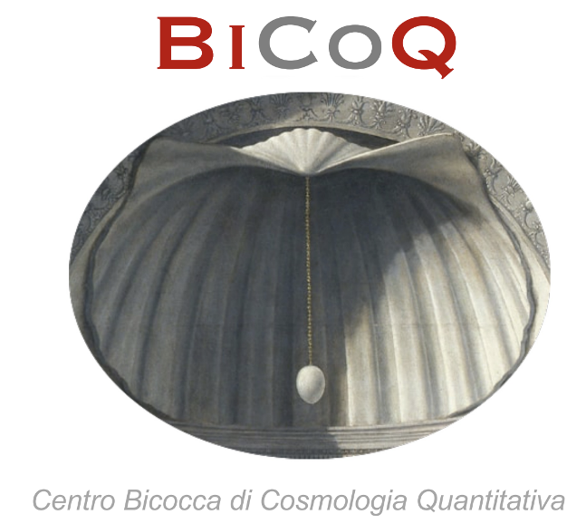
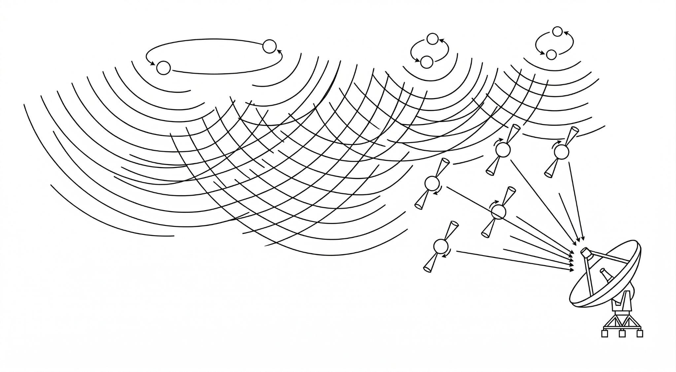

PINPOINTING
PULSAR TIMING ARRAY
SINGLE SOURCES
Mikel Falxa
Alberto Sesana
University Milano-Bicocca ☆ Ludovica Carbone

Slide 2
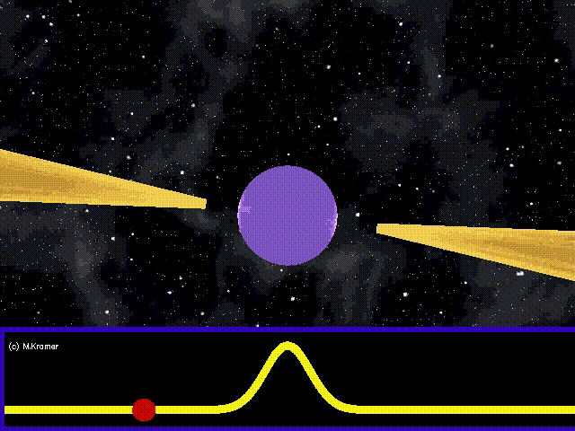
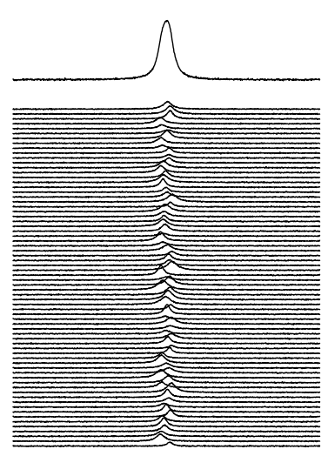

PULSAR TIMING ARRAY
Average pulse profile
Time
Credits: A. Chalumeau
Credits: M. Kramer
Rotational phase
effect
University Milano-Bicocca ☆ Ludovica Carbone

Slide 3
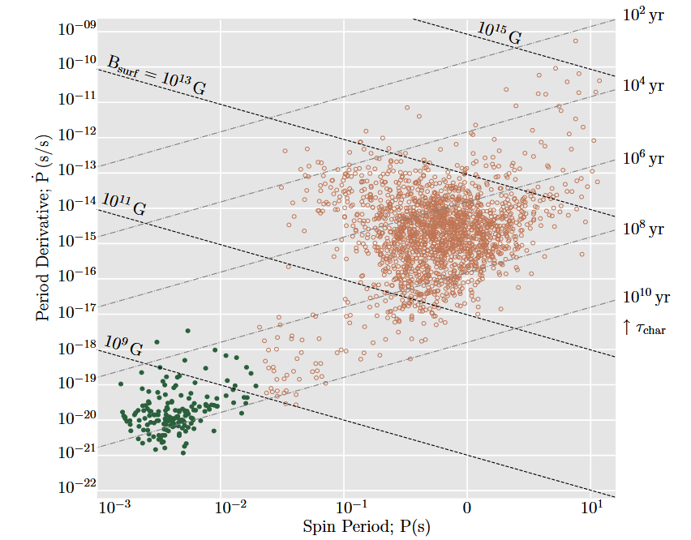
PULSAR TIMING ARRAY
Verbiest and Shaifullah 2018
Jocelyn Bell Burnell 1967
Period < 30 ms
Very stable
University Milano-Bicocca ☆ Ludovica Carbone

Slide 4
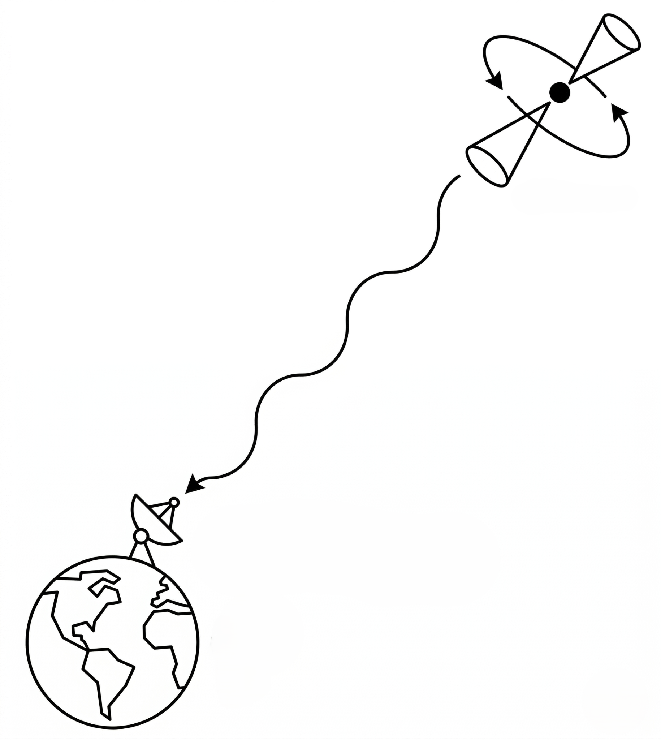
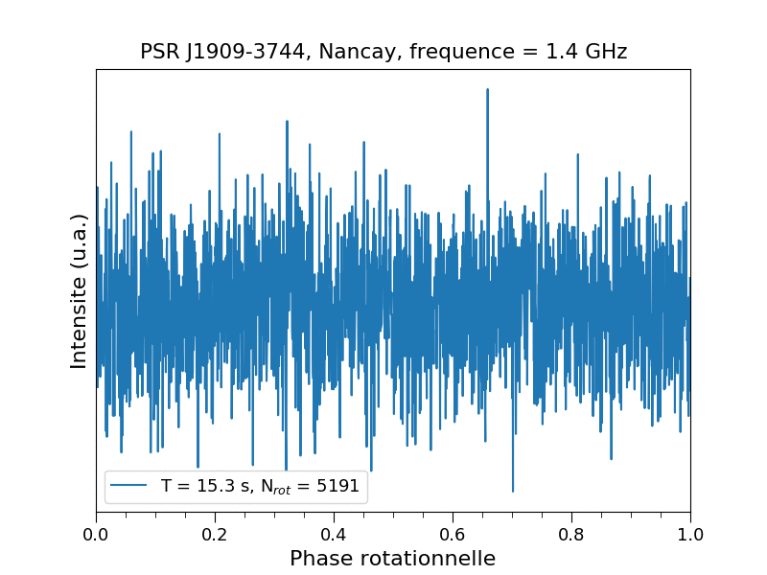
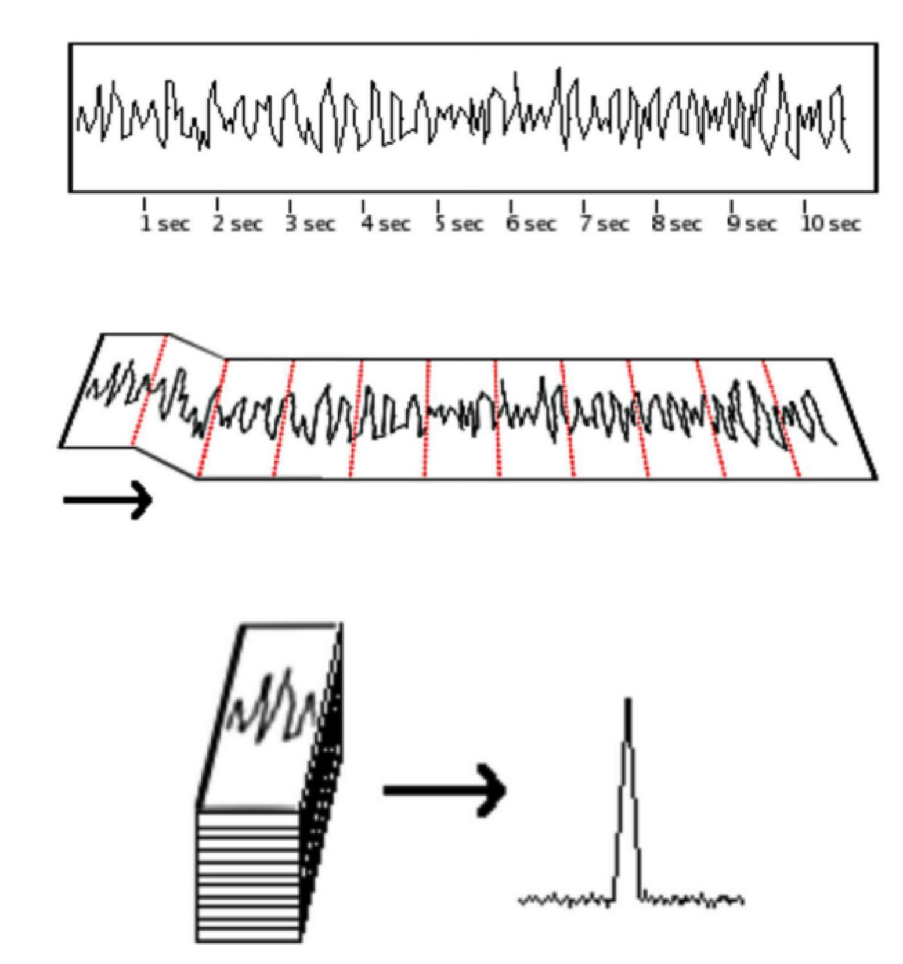
PULSAR TIMING ARRAY
Pulse Folding
average pulses from ~ 1 hour observation to get
average pulse profile
Credits : L. Guillemot
Credits : L. Guillemot
credits: McKee talk @ IPTA Student Week 2019
University Milano-Bicocca ☆ Ludovica Carbone

Slide 5
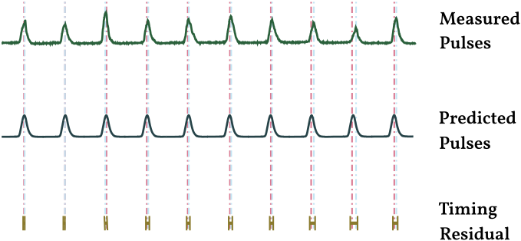
PULSAR TIMING ARRAY
Observed pulse
t_{TOA}
-
t_{det}
=
dt
Deterministic timing model
Timing Residuals
University Milano-Bicocca ☆ Ludovica Carbone

Slide 6
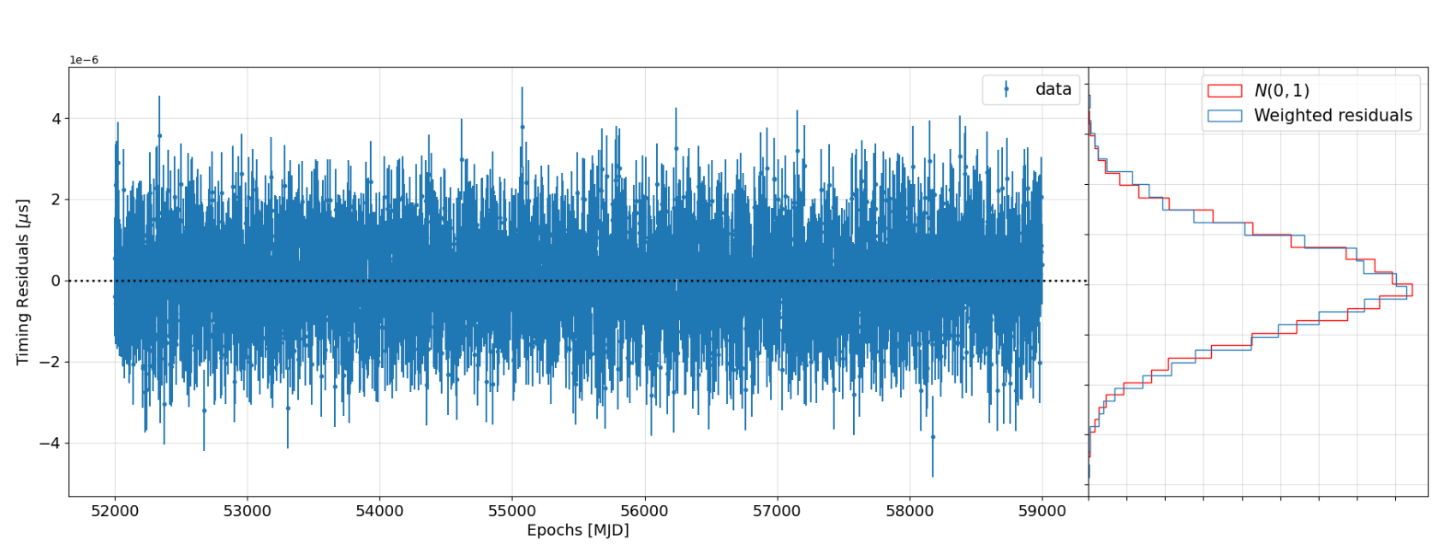
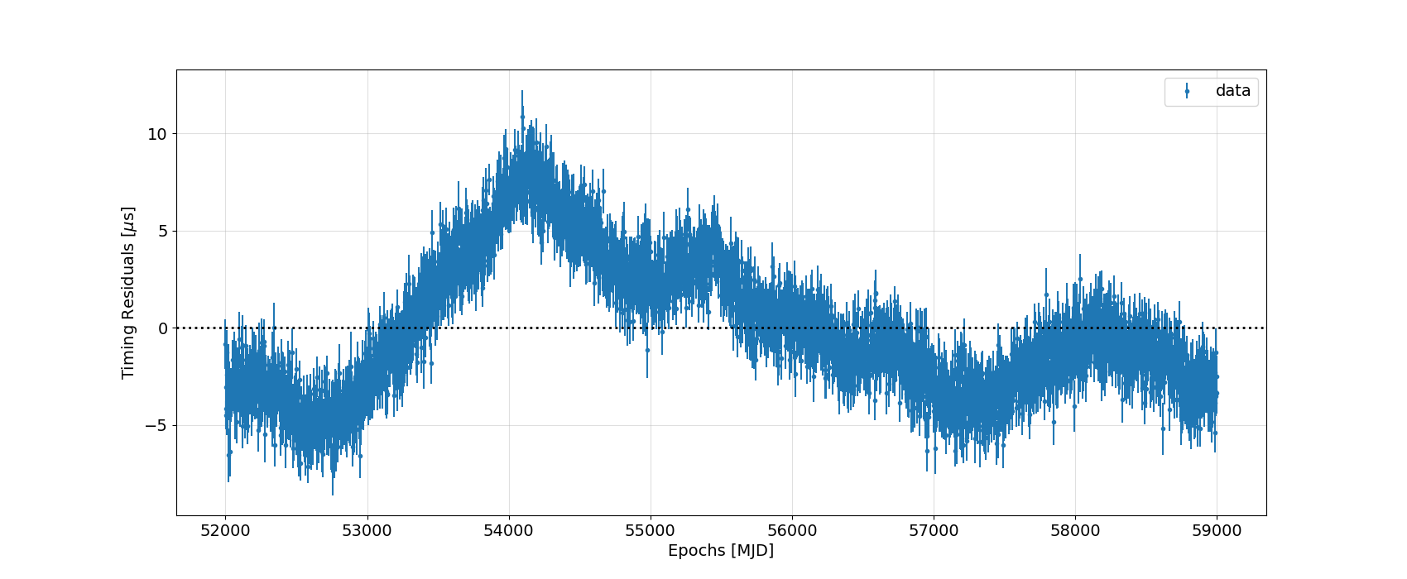
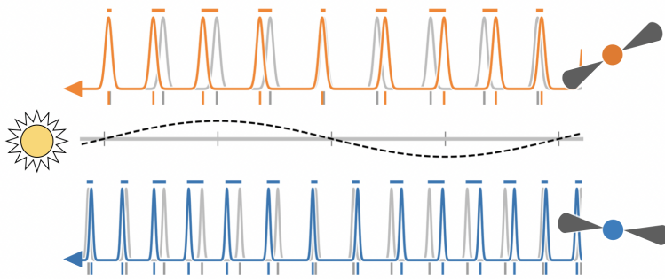
RESIDUALS
if we would know perfectly what’s going on
in reality
University Milano-Bicocca ☆ Ludovica Carbone

Slide 7
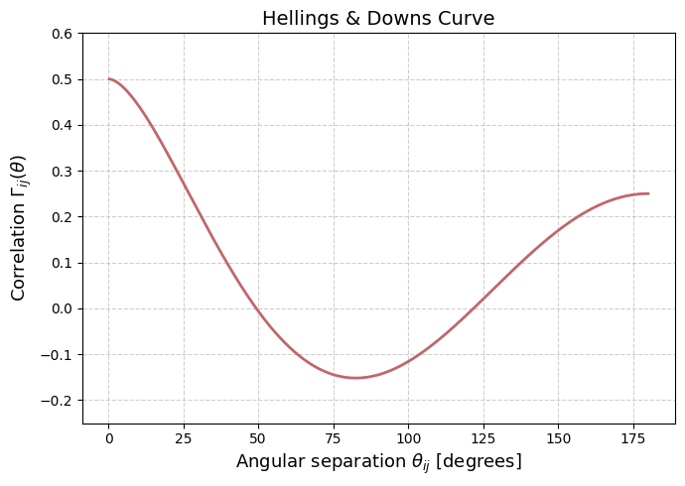
PULSAR TIMING ARRAY
h << n
-> correlate the residuals of an array of pulsars to be sensitive to this weak signal!
University Milano-Bicocca ☆ Ludovica Carbone

Slide 8
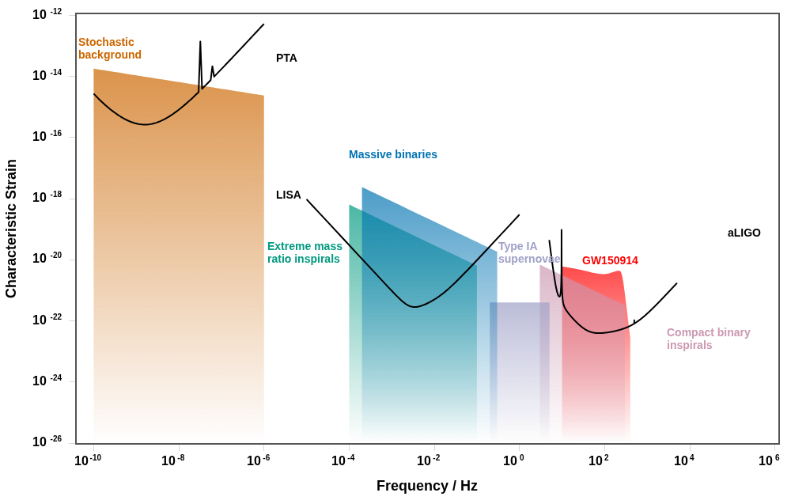
PULSAR TIMING ARRAY
https://jeremy-baier.github.io/GWplotter/
University Milano-Bicocca ☆ Ludovica Carbone

Slide 9
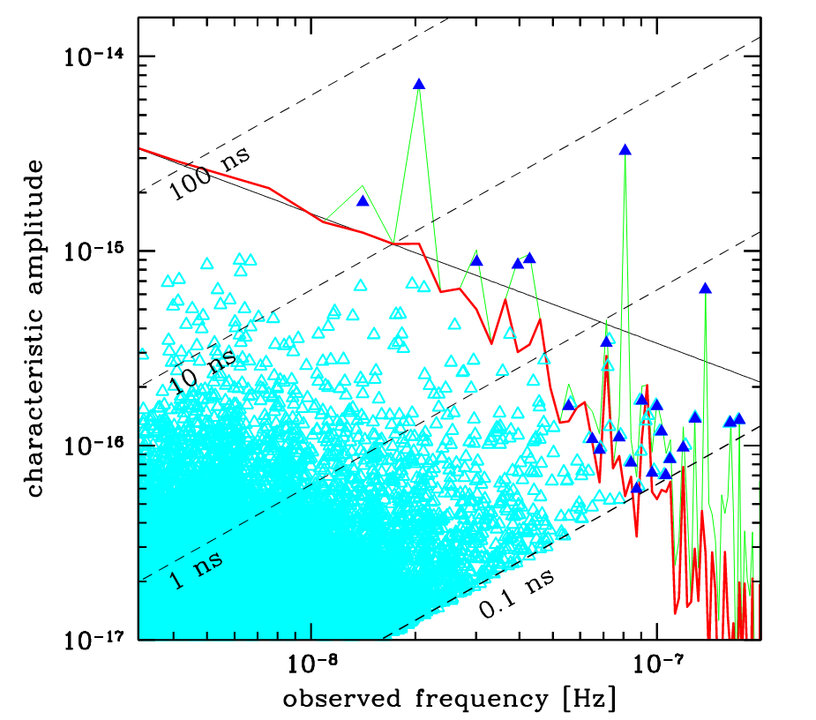
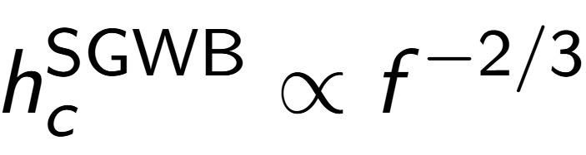
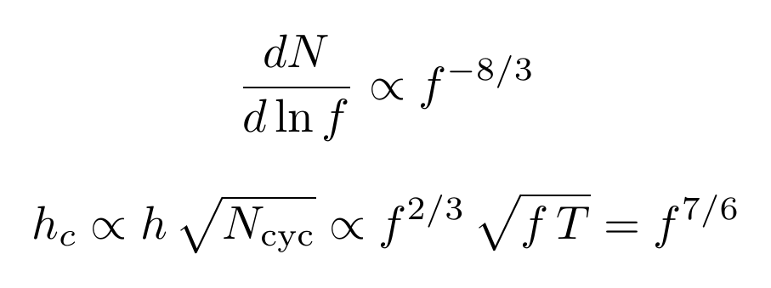
THE SIGNALS
Credits: Alberto Sesana
Stochastic GW background
from the superposition of SMBHB
Phinney 2001
Continuous GW
seen as an excess of power, they’re bright individual SMBHB
University Milano-Bicocca ☆ Ludovica Carbone

Slide 10
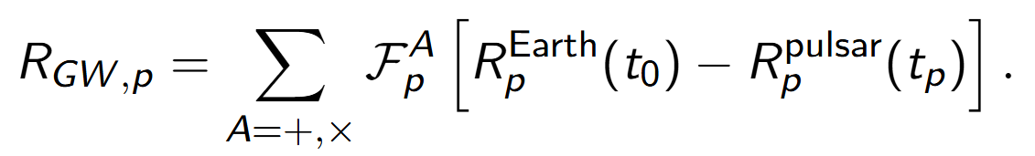
MY PROJECTS - CGWs SEARCH
The model of the CGW signal is analytic and included in the timing residual model. At a given frequency, for a pulsar p, the delayed arrival rate of the TOAs can be expressed as a convolution with the antenna response function F of the pulsar:
University Milano-Bicocca ☆ Ludovica Carbone

Slide 11
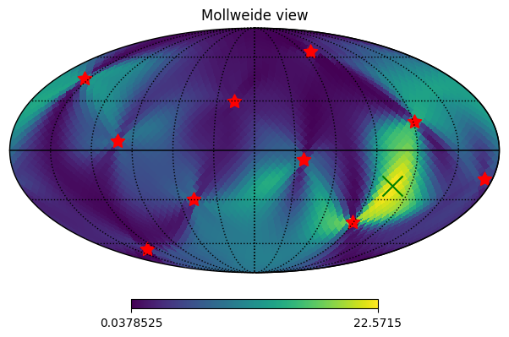
MY PROJECTS - CGWs SEARCH
The Fe statistic is a detection method for CGWs in PTA. Babak and Sesana 2011
It's the analytical maximization of the likelihood, over the intrinsic signal parameters at fixed frequency.
Then it is evaluated for a fixed sky location (θ, ɸ)
By scanning the sky, one obtains a sky map of Fe, highlighting the most likely source positions
University Milano-Bicocca ☆ Ludovica Carbone

Slide 12
MY PROJECTS - CGWs SEARCH
PRO
CONS
Fast to obtain -> now even faster with GPU based code we have 100k maps in less than 3 min
A way to embed the data in a 1D array with N entries
It “loose” info on the other parameters
It has spurious power due to the antenna pattern functions of the PTA
University Milano-Bicocca ☆ Ludovica Carbone

Slide 13
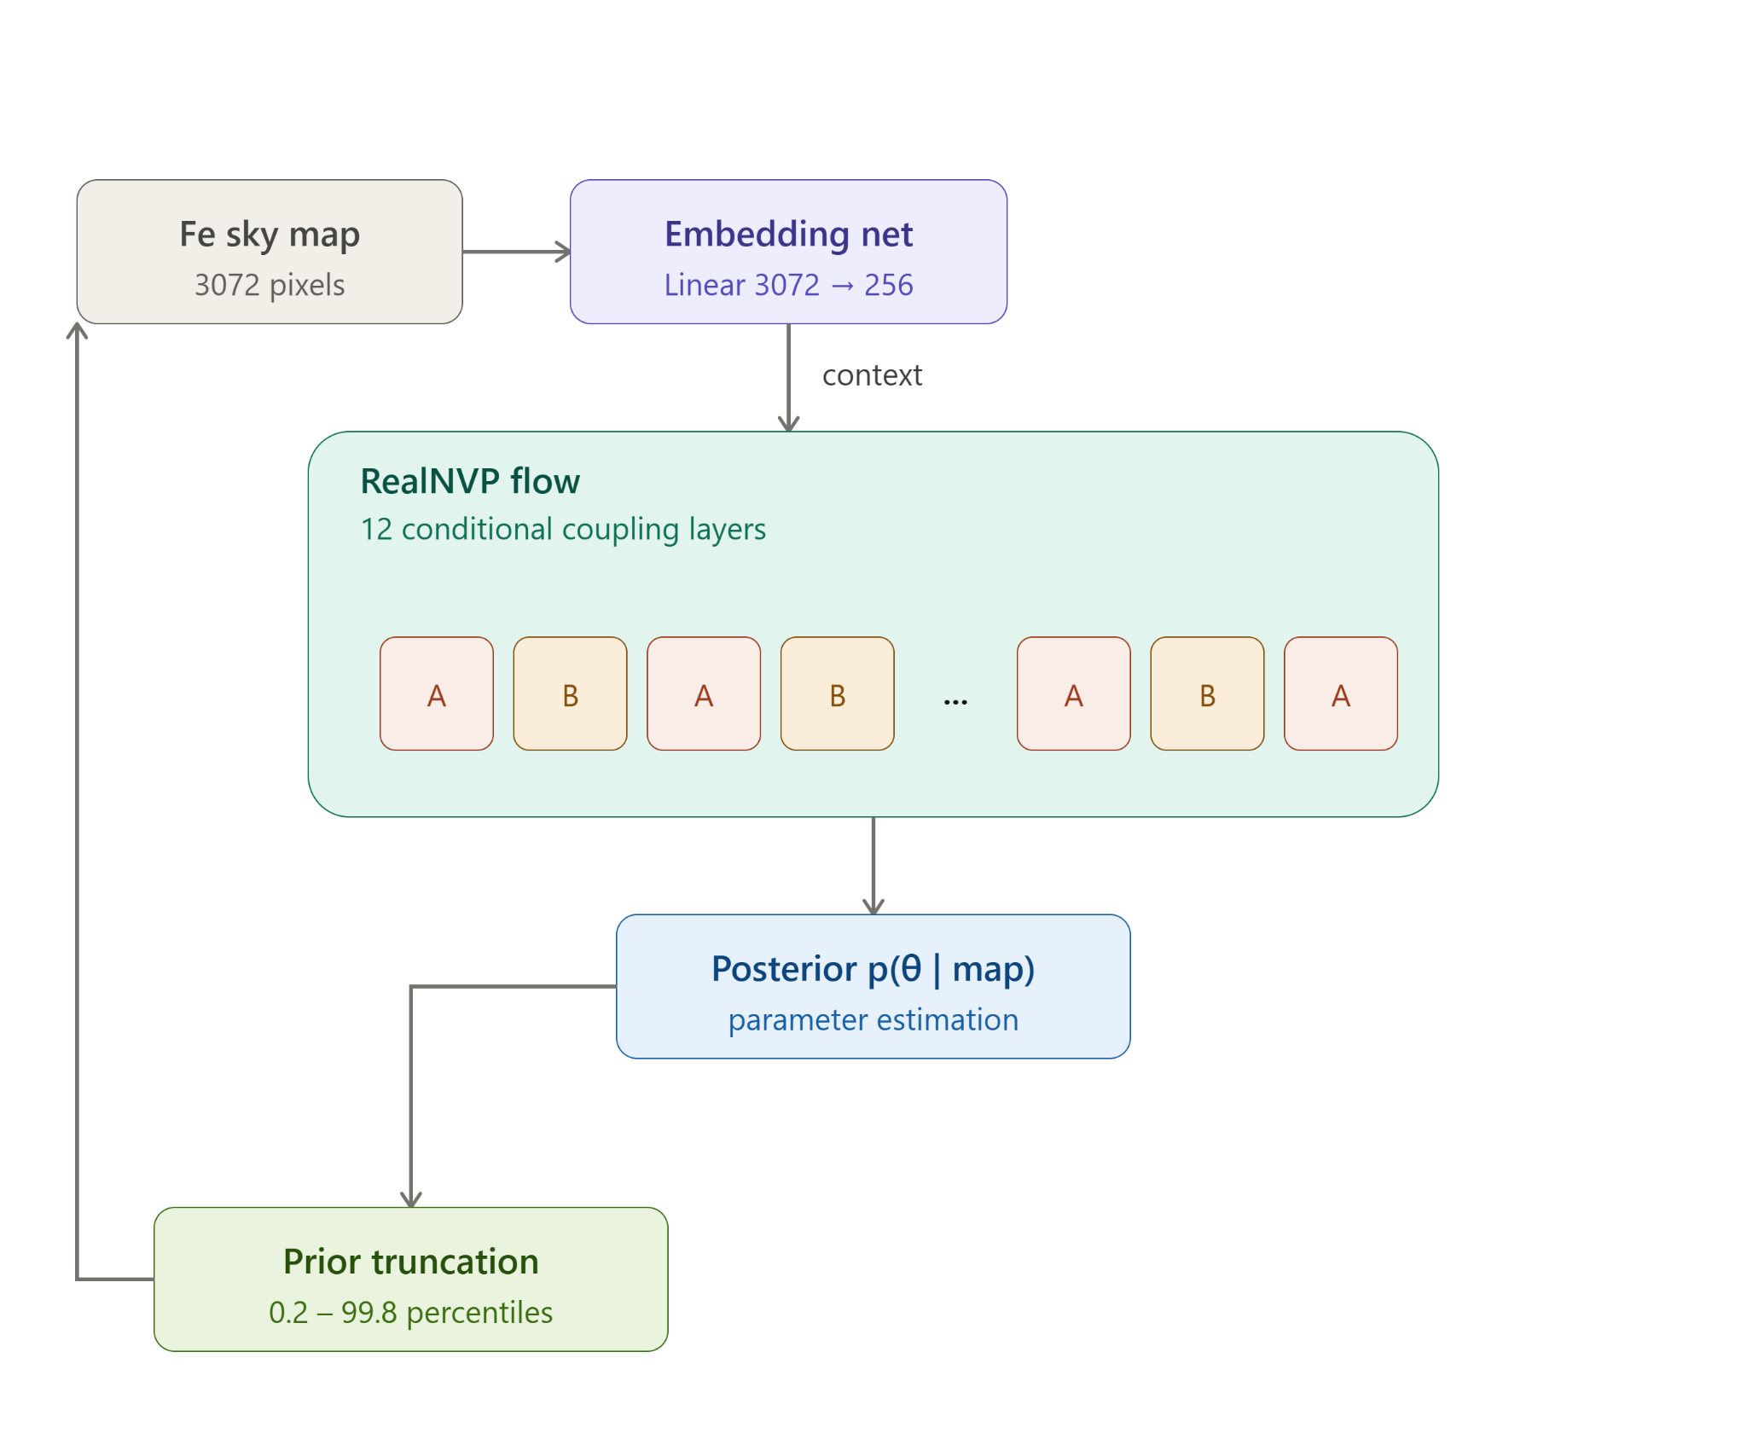
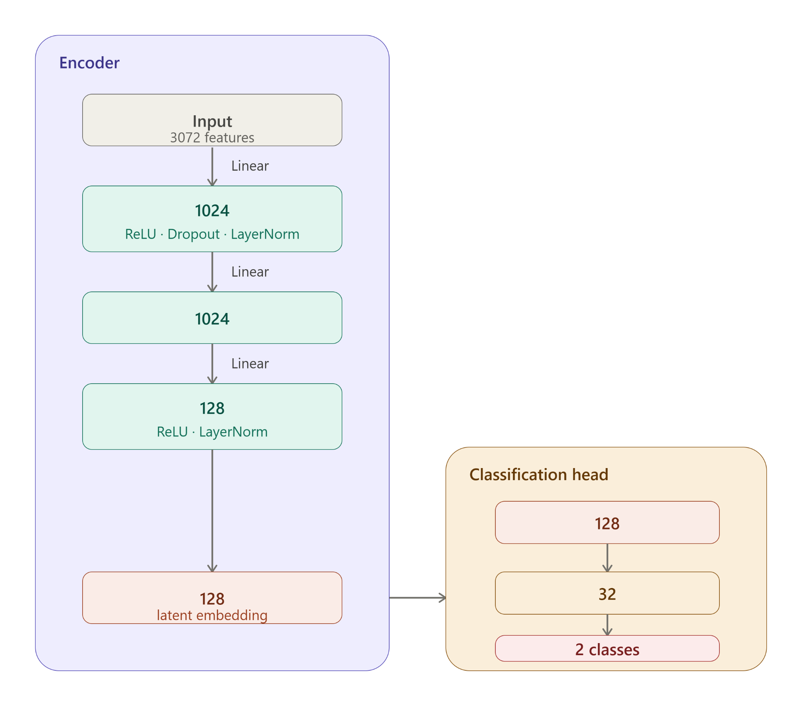
MY PROJECTS - CGWs SEARCH
SIMULATOR ✔
sky localisation
detection
Classifier to show if there is a source and in which frequency bin
Sequential SBI for parameter estimation
University Milano-Bicocca ☆ Ludovica Carbone

Slide 14
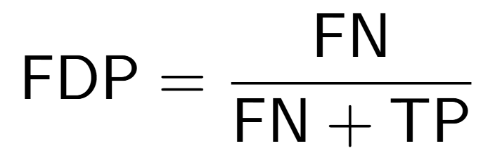
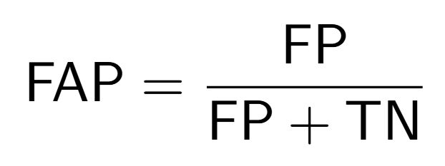
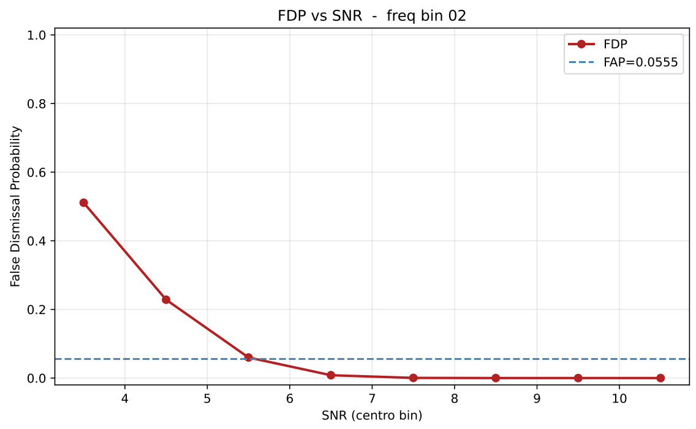
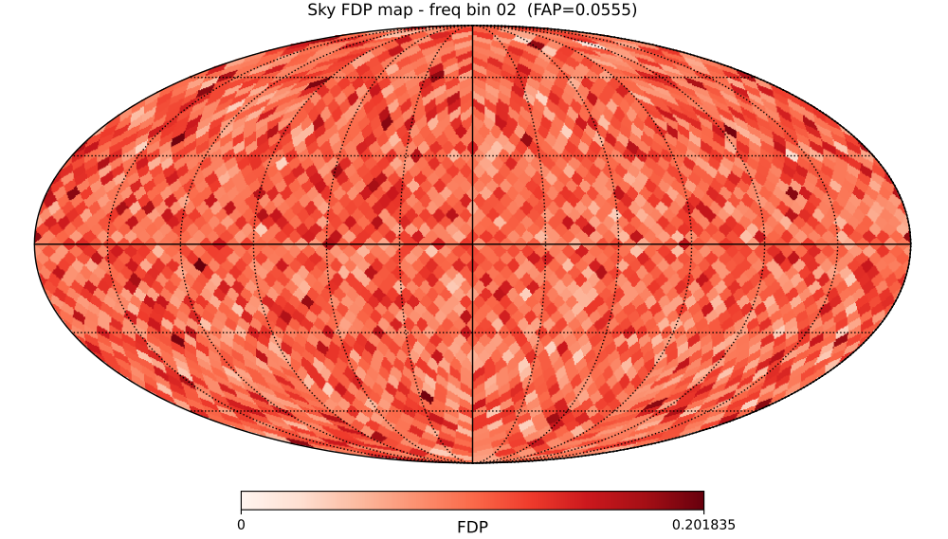
MY PROJECTS - DETECTOR RESULTS
False Dismissal Probability
False Alarm Probability
Simulated PTA 25 pulsars
Isotropically distributed
sensitivity 100ns
University Milano-Bicocca ☆ Ludovica Carbone

Slide 15
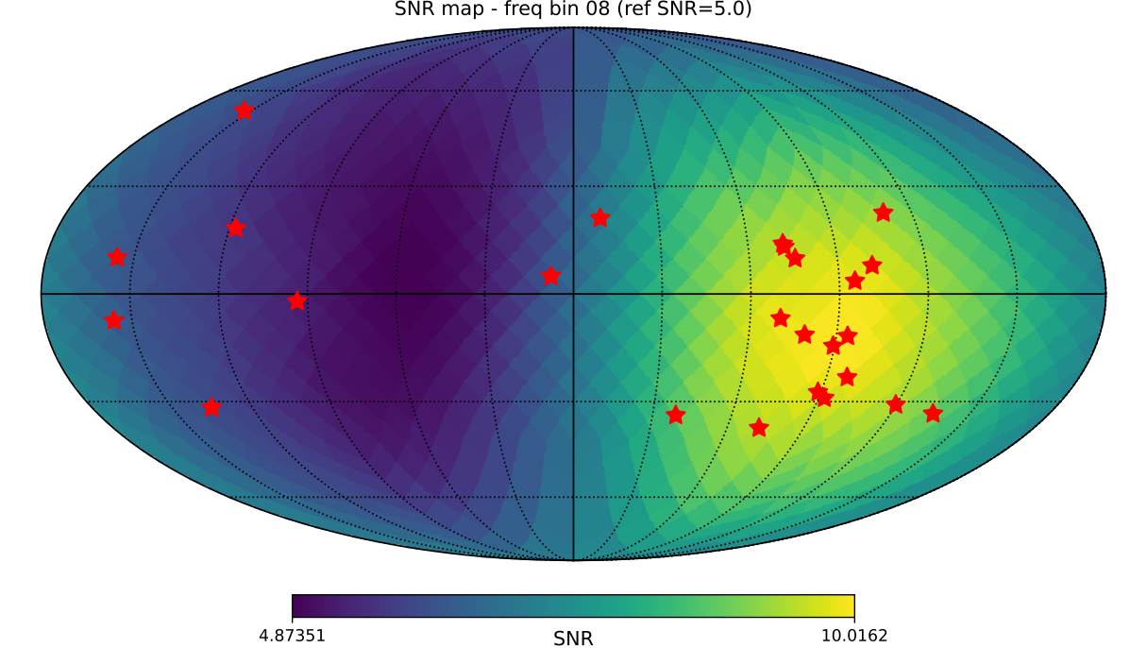
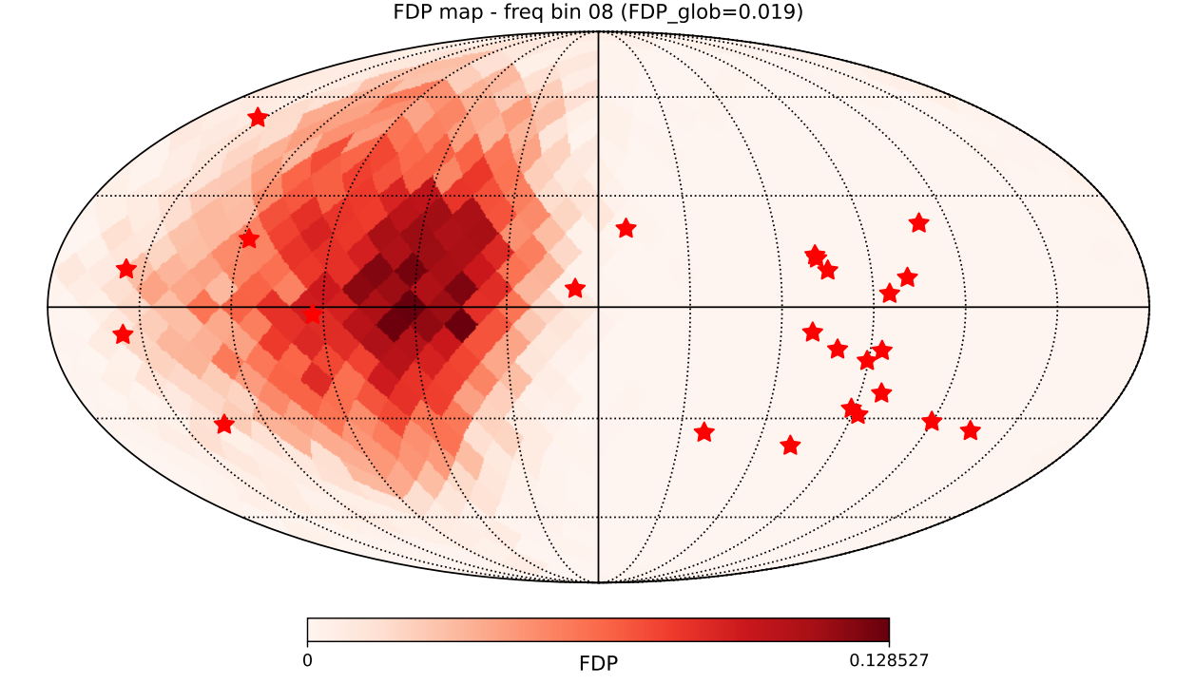
MY PROJECTS - DETECTOR RESULTS
False Dismissal Probability
False Alarm Probability
University Milano-Bicocca ☆ Ludovica Carbone

Slide 16
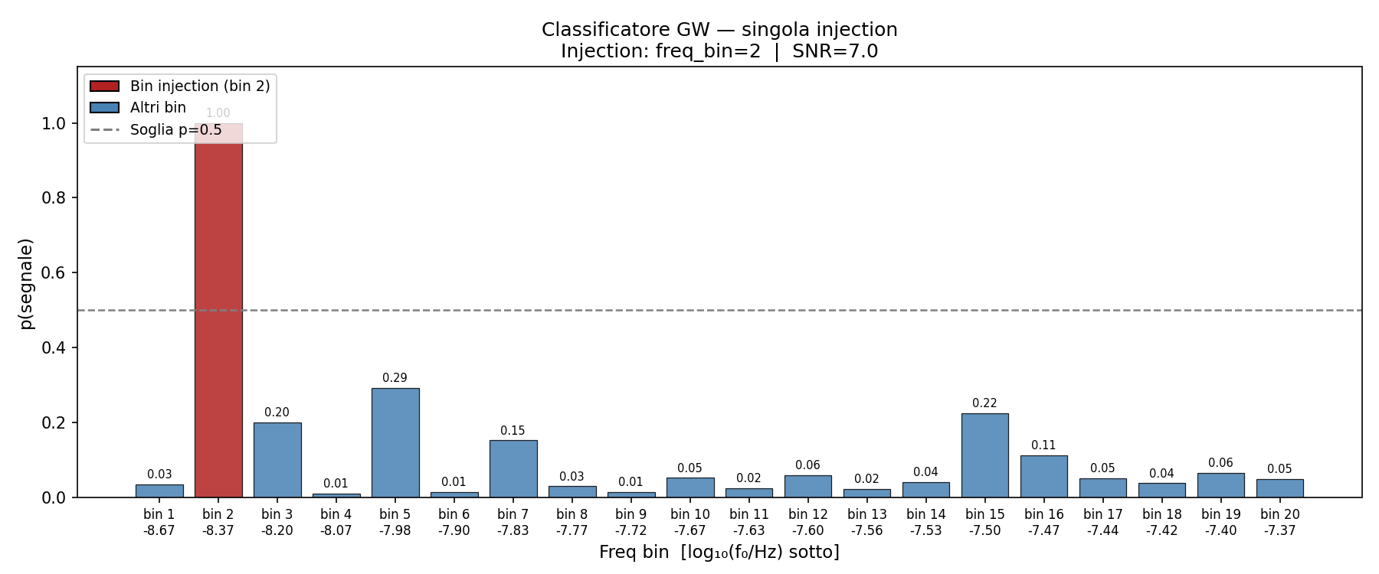
MY PROJECTS - DETECTOR RESULTS
1. You have your PTA data
2. You create one map per frequency bin
3. You infer the probability of having a single source in each freq. bin with the trained NN (1 min inference)
University Milano-Bicocca ☆ Ludovica Carbone

Slide 17
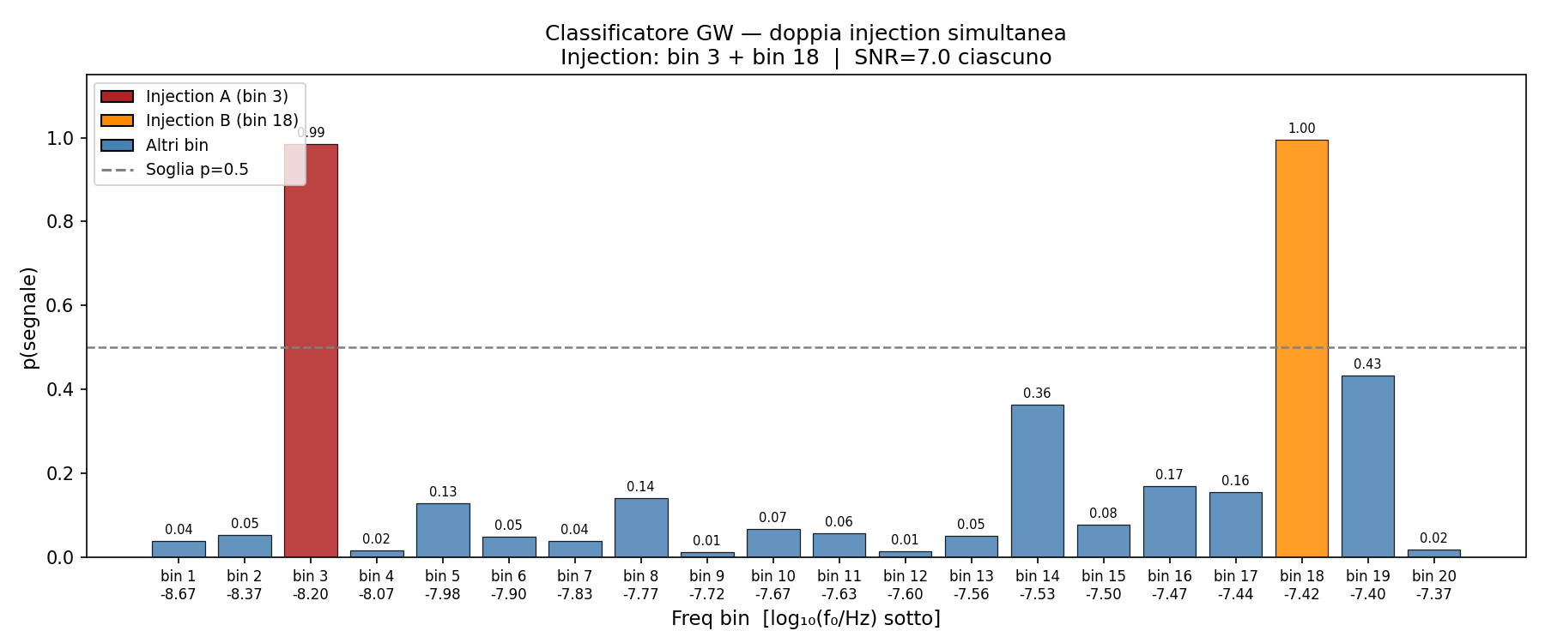
MY PROJECTS - DETECTOR RESULTS
1. You have your PTA data
2. You create one map per frequency bin
3. You infer the probability of having a single source in each freq. bin with the trained NN (1 min inference)
University Milano-Bicocca ☆ Ludovica Carbone

Slide 18
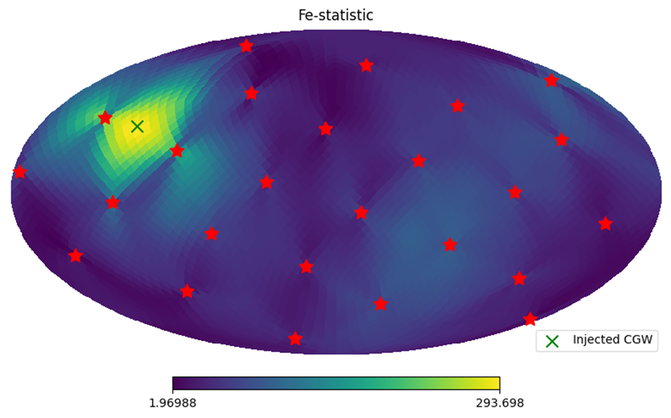
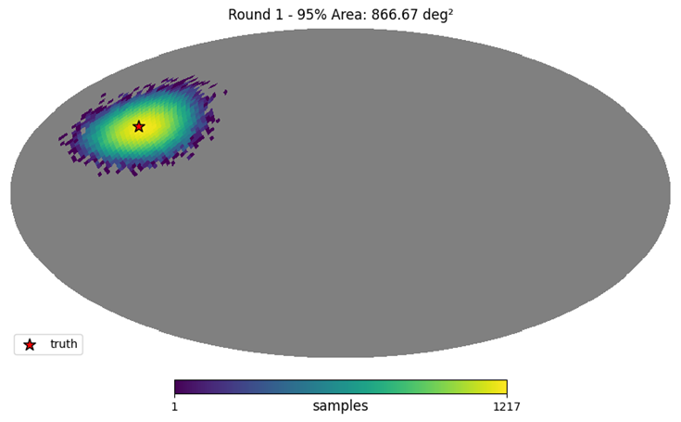
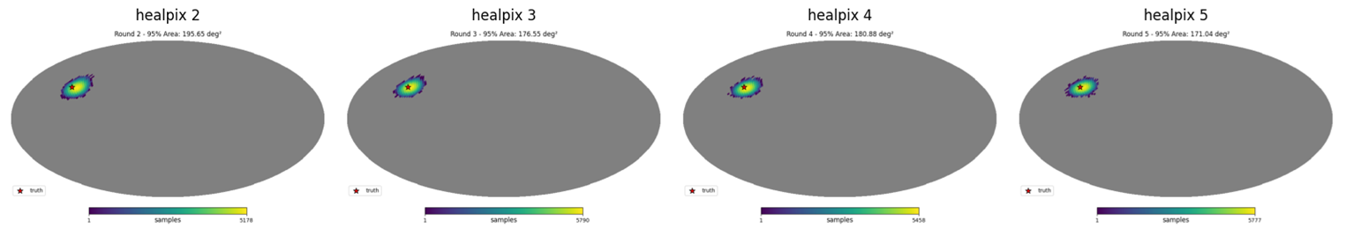
MY PROJECTS - SBI RESULTS
preliminary
University Milano-Bicocca ☆ Ludovica Carbone

Slide 19
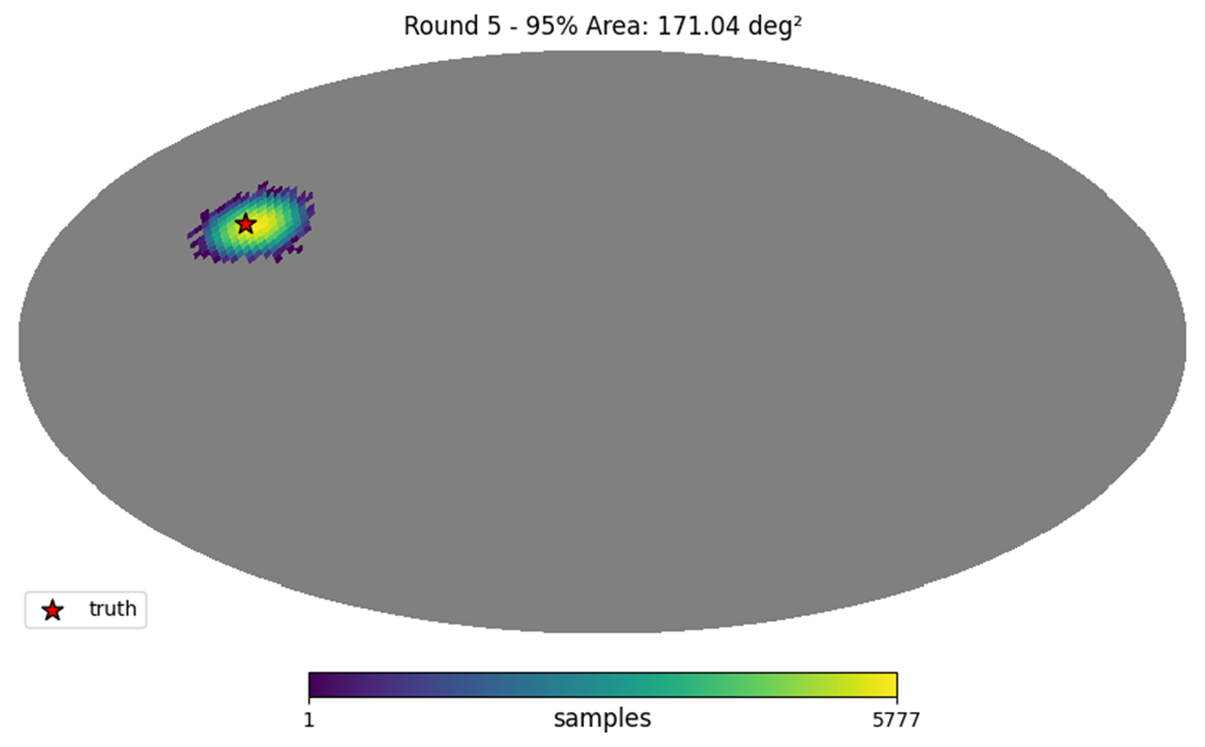
MY PROJECTS - SBI RESULTS
preliminary
University Milano-Bicocca ☆ Ludovica Carbone

Slide 20
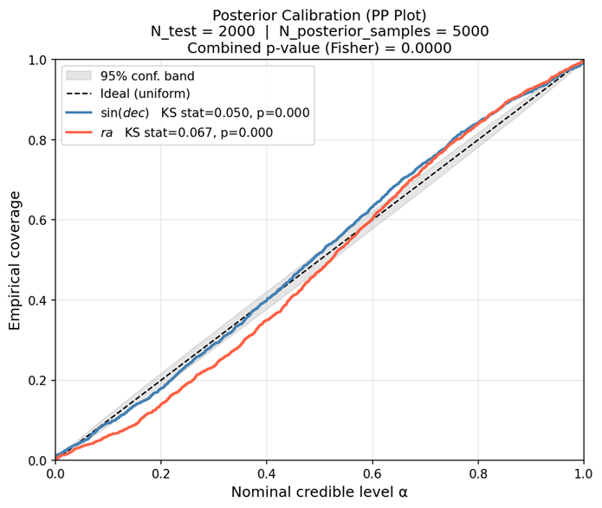
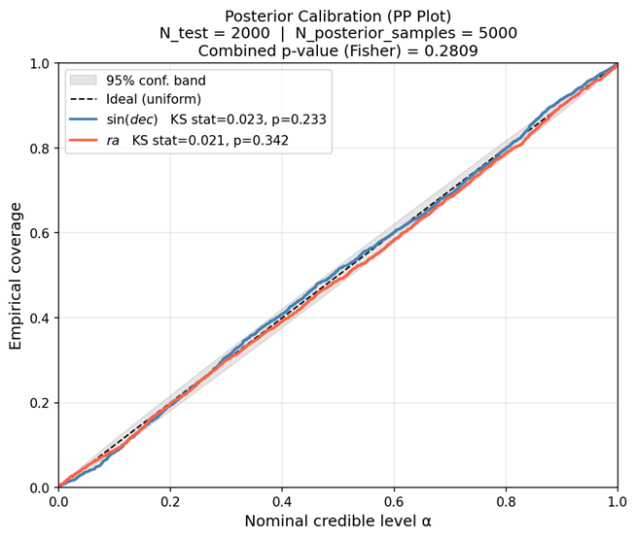
MY PROJECTS - SBI RESULTS
preliminary
1st round
5th round
University Milano-Bicocca ☆ Ludovica Carbone

Slide 21
THANK YOUUU!!
University Milano-Bicocca ☆ Ludovica Carbone

Slide 22
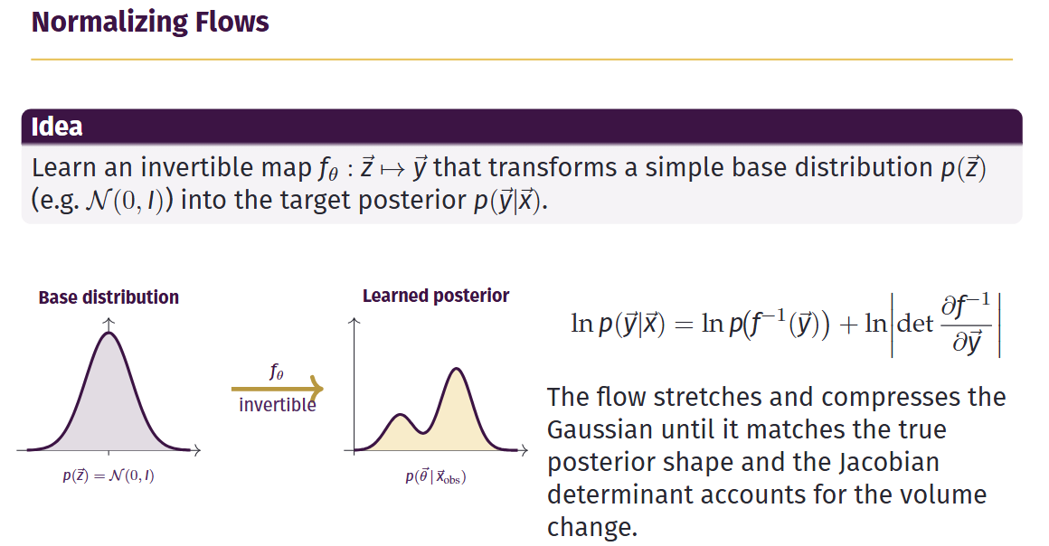
University Milano-Bicocca ☆ Ludovica Carbone

Slide 23
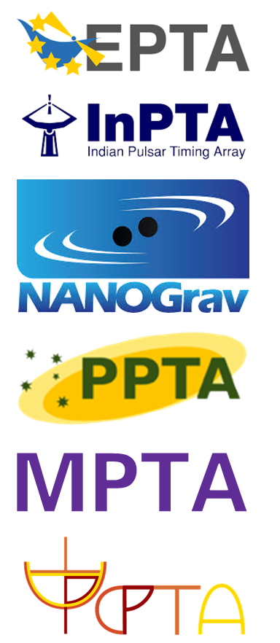
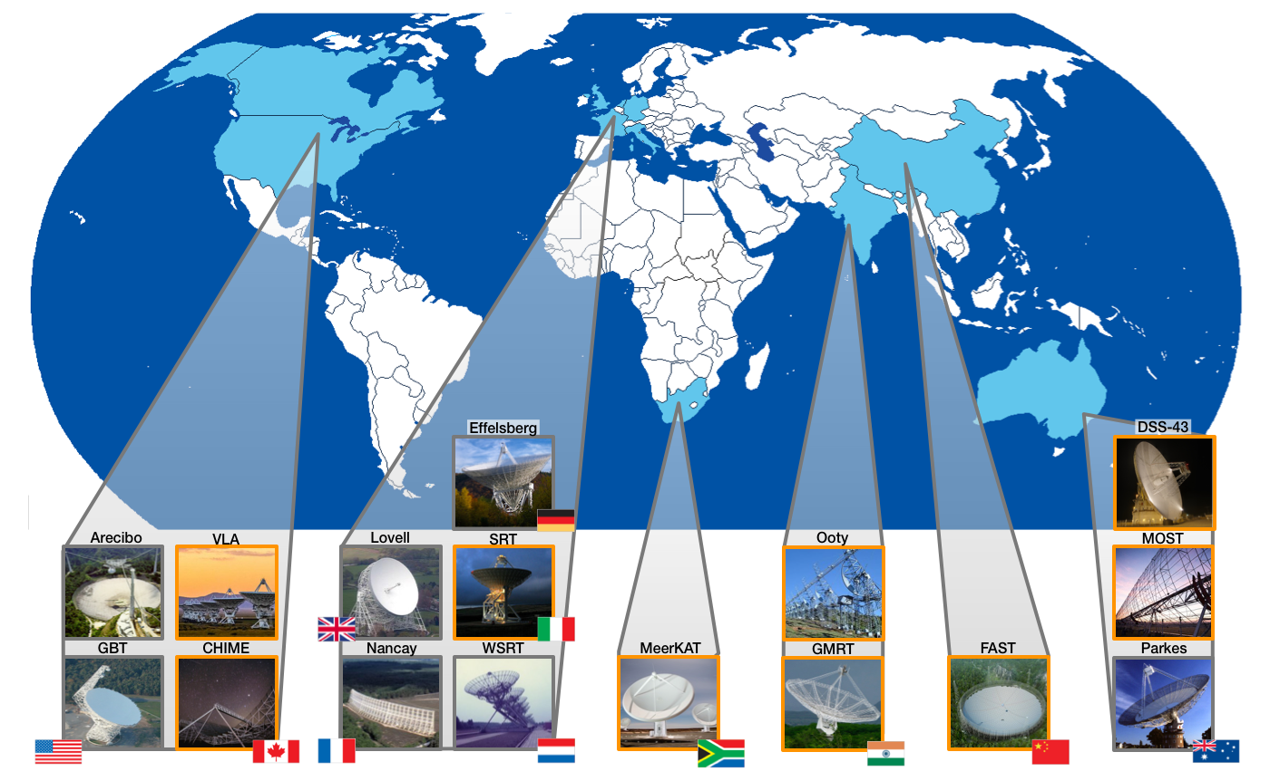
PULSAR TIMING ARRAYS
University Milano-Bicocca ☆ Ludovica Carbone

