Slide 1
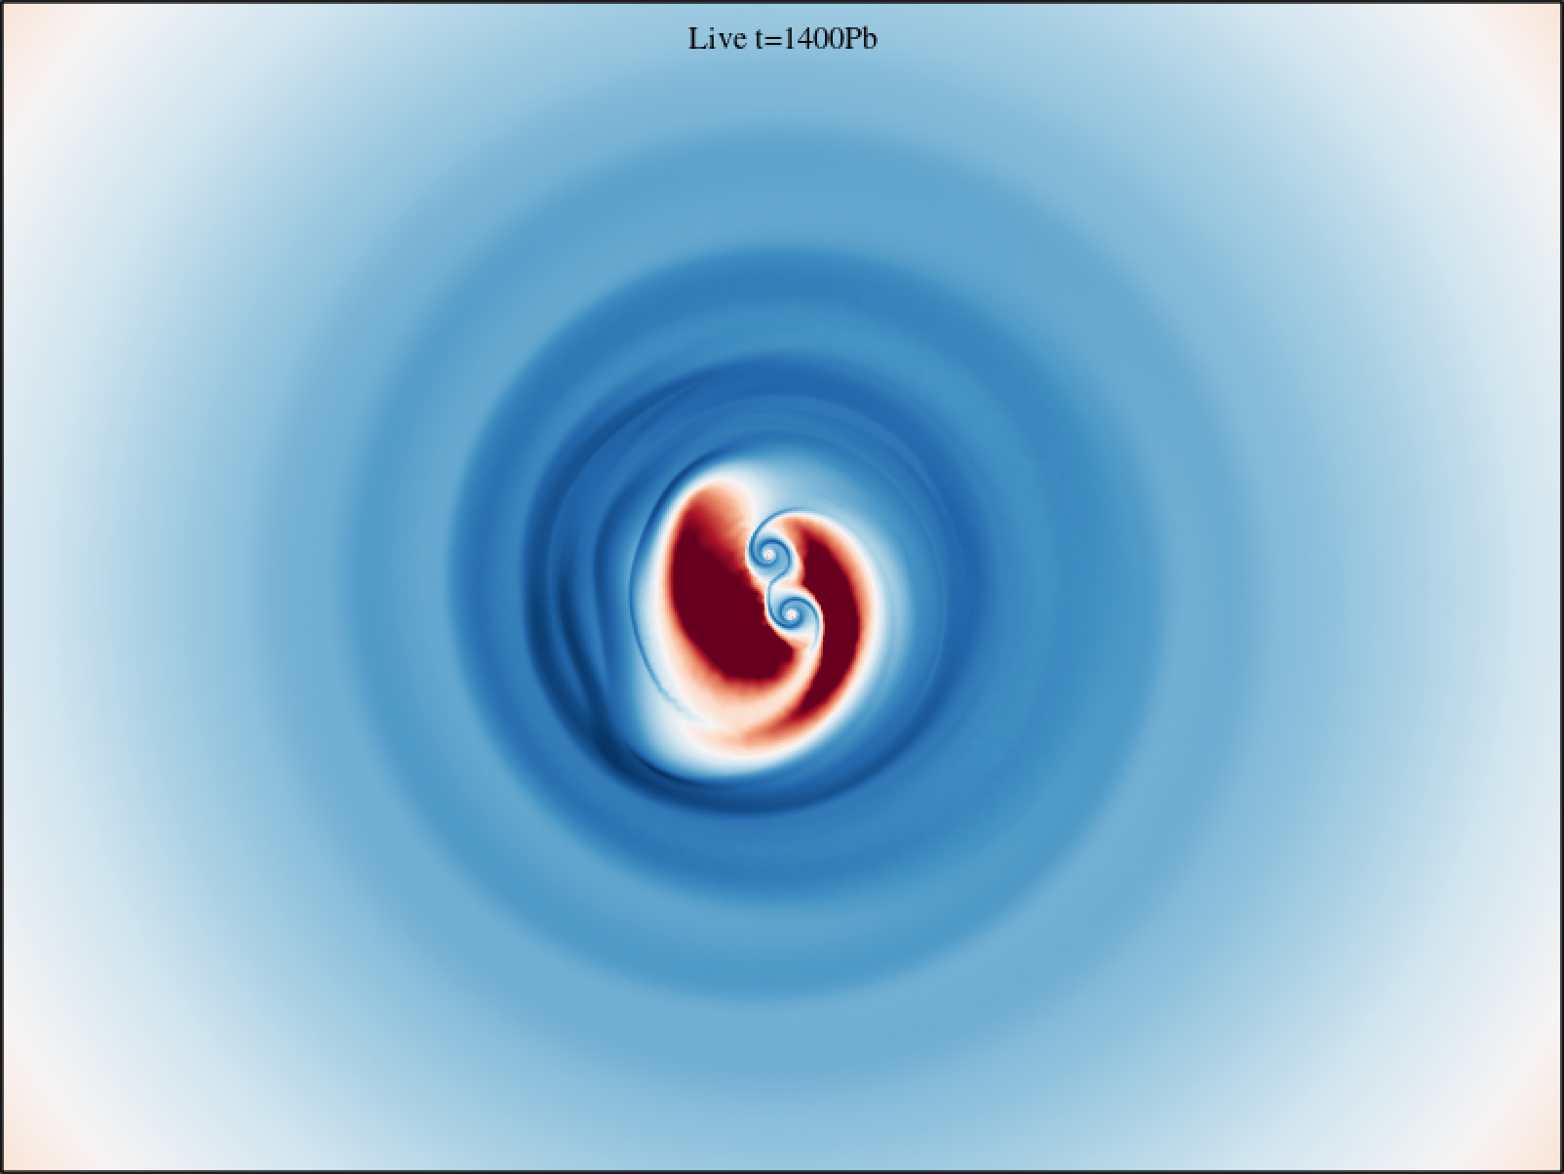


Towards a comprehensive description of black hole binary inspiral from Newtonian to relativistic scales
ALEssandro Lupi
1st BiCoQ conference
June 18th 2026
Como Lake Center for Astrophysics, University of Insubria
In collaboration with:
F. Bollati, M. Bonetti, M. Dotti, G. Fedrigo, A. Franchini, F. Haardt, M. Volonteri

Slide 2
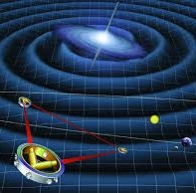
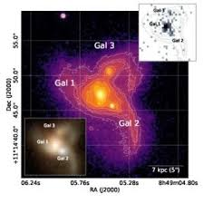
Introduction
(Almost) all galaxies host a MBH
Galaxies grow via accretion and mergers
MBH should pair and finally coalesce!
WHERE ARE ALL THESE BINARIES?
GW detection
AGN EM detection
… and in between?

Slide 3
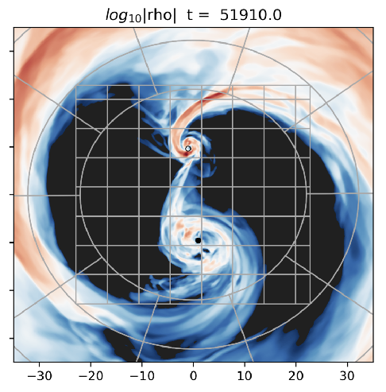
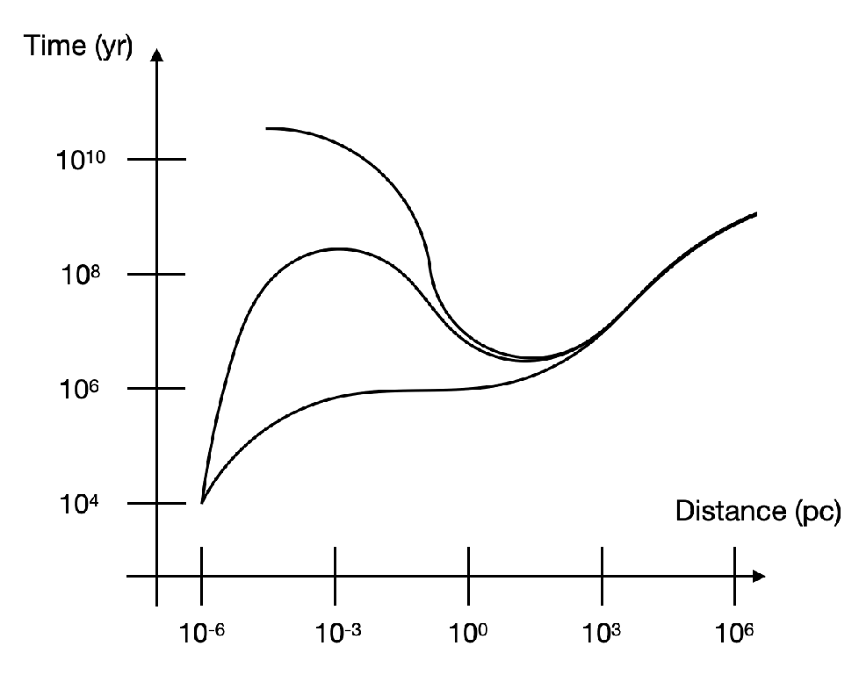
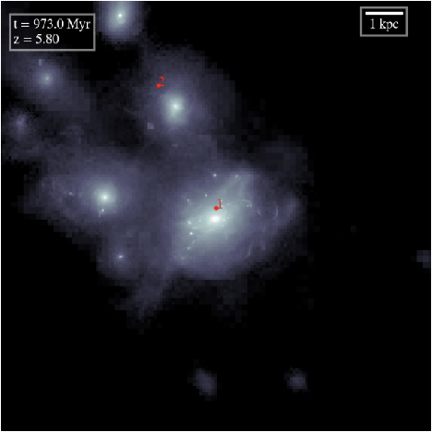
How can we study the MBH path to coalescence?
pre/post merger
(GRMHD-NR)
Large scales (dual AGN)
cosmological simulations
Avara+24
(Begelman, Blandford & Rees 1980)
e.g. Tremmel+17, Pfister+19
Last pc problem
Phase III:
GW-driven
inspiral
Phase I:
DF
(gas/stars/DM)
Phase II:
hardening
=> decoupling <=
=> pairing <=

Slide 4
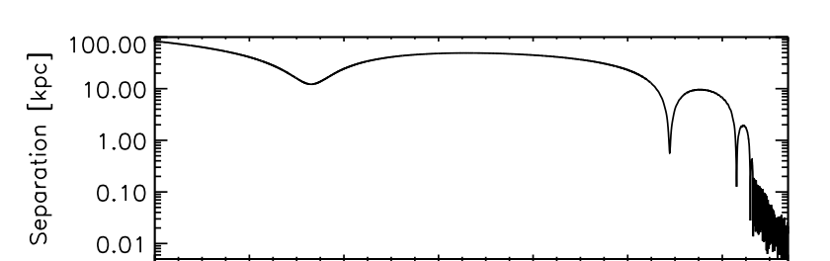

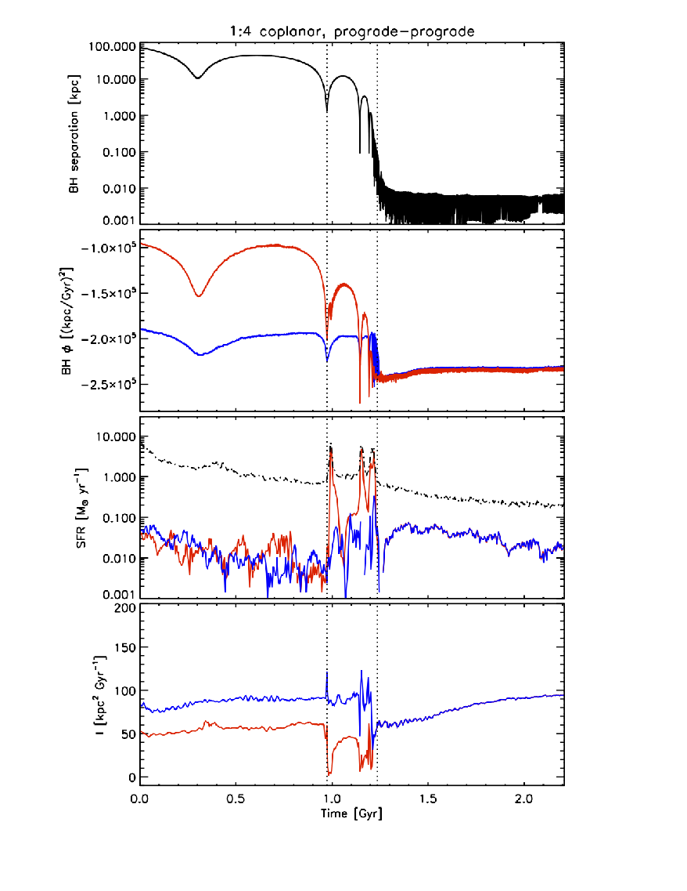
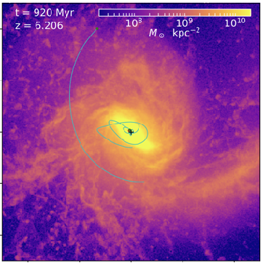
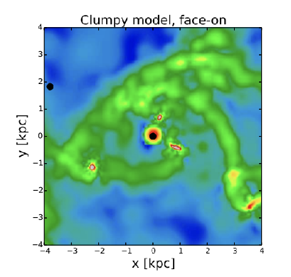
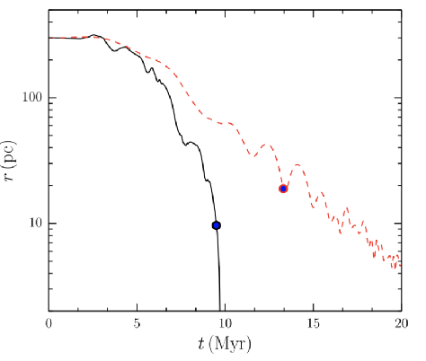
Stage I: how efficiently binaries form?
Phase I - dynamical friction
The process seems reasonably simple, but
(van Wassenhove+14)
Tidal stripping of the galaxy nucleus (nuclear coup)…
Bortolas+20,+22
(Tamburello+16)
Lupi+15(a,b)
Interaction with clumps/bars

Slide 5
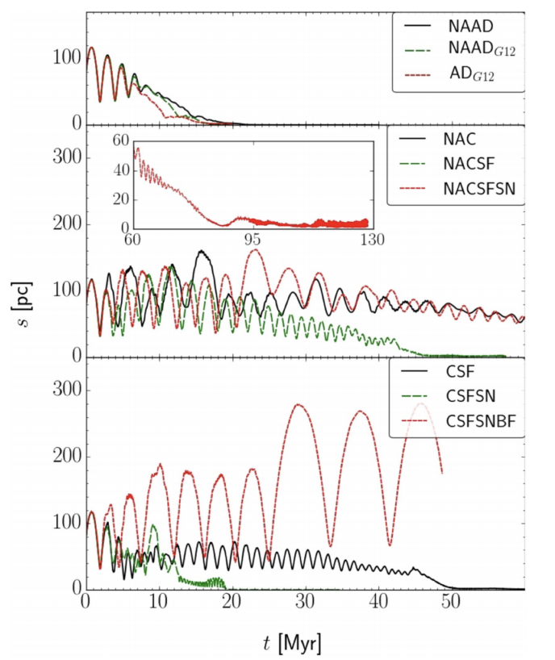
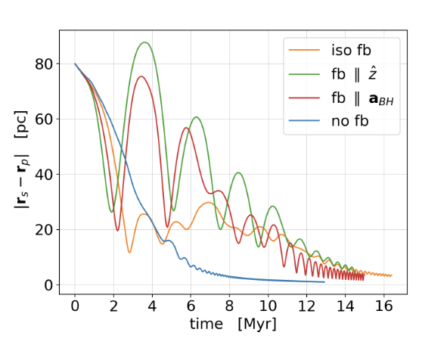
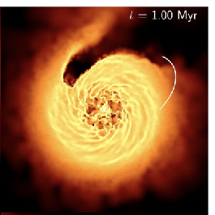
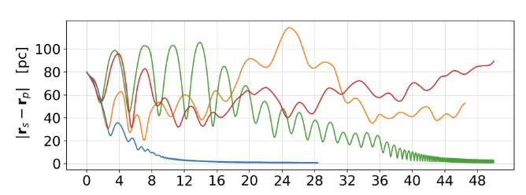
Stage I: how efficiently binaries form?
The impact of black hole accretion and feedback
Apart from the effects due to the galactic structure and stellar feedback, the orbital decay can be strongly affected by MBH accretion and feedback in gas-rich galactic nuclei
The nature of BH feedback is complex:
- jets (highly collimated, commonly aligned
with BH spin)
- radiatively-driven winds, with different
anisotropies depending on the spin
s(t)
Spin-dependent feedback
(Bollati, AL+23)
(Souza-Lima+17)
q=1
q=1/4

Slide 6
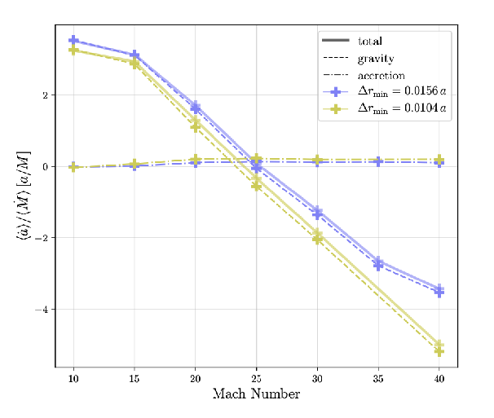
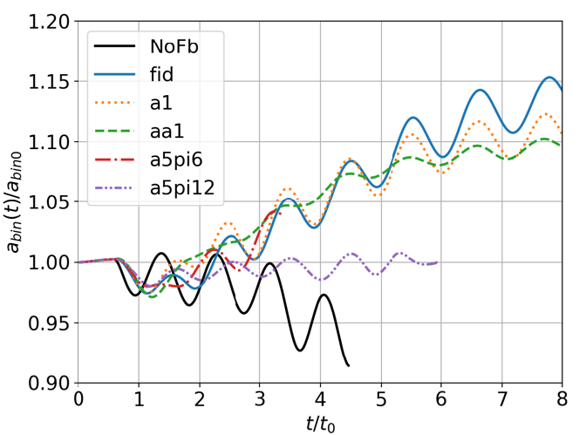
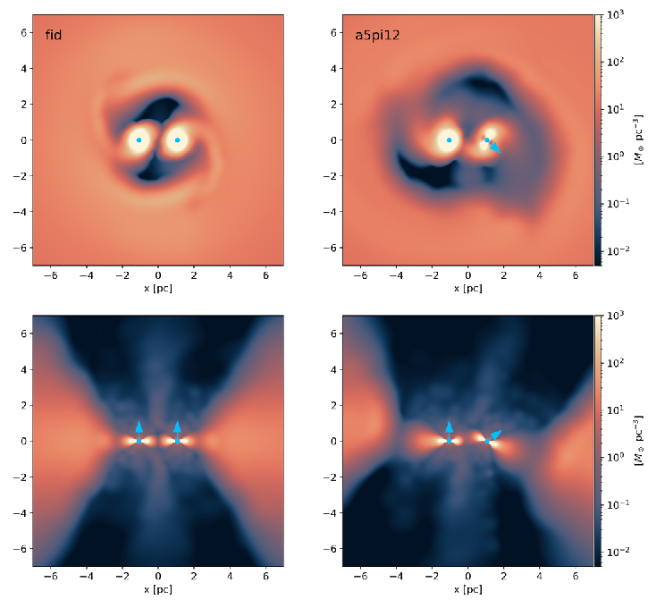
Stage II : shrinking or widening
After a bound binary has formed, dynamical friction becomes inefficient, and other processes intervene to shrink the binary: i) 3-body interactions with stars; ii) triplets (Kozai-Lidov resonances); iii) gas torques in CBDs
Net torque depends on H/R (Tiede+20)
NOTE: Several works have recently pointed out that thick discs result in binary expansion, thus significantly affecting the number of sources potentially detectable by LISA, unless stars dominate the evolution
…and again BH feedback (Bollati+ in prep)

Slide 7
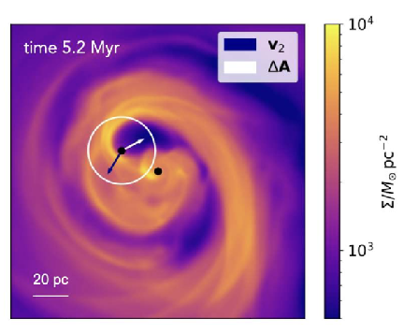
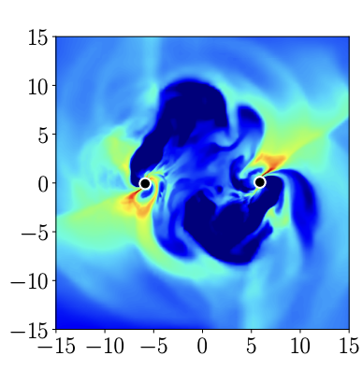
How to achieve a consistent modelling of the different stages
10⁻³–10⁴ pc
(Newtonian)
pre/post merger
(GRMHD-NR)
Pfister+19
Avara+24
?
Bollati, AL+22
Fedrigo+24
Franchini, AL+22

Slide 8
How to achieve a consistent modelling of the different stages
10⁻³–10⁴ pc
(Newtonian)
pre/post merger
(GRMHD-NR)
Pfister+19
Avara+24
Sub-grid modelling
(e.g. Mannerkoski+23)
Bollati, AL+22
~100-1000 R_{g}
Fedrigo+24
Intermediate-scale modelling
(Post-Newtonian)
Franchini, AL+22

Slide 9
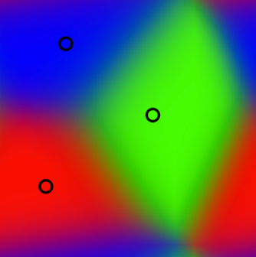
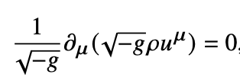



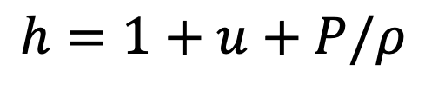
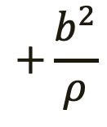

GIZMO-GR(M)HD: meshless relativistic (magneto-)hydrodynamics
(Lupi 2023; Fedrigo & Lupi 2025)
At about 100 Rg separations, relativistic corrections can start affecting the gas entering the CBD cavity.
Extension of the meshless conservative scheme of the Newtonian hydrodynamic code GIZMO (Hopkins 2015) to incorporate GR hydrodynamics with stationary metrics.
Why GIZMO?
Unstructured “mesh” => better conservation of mass, angular momentum, and energy
Naturally moving/adapting mesh => Intrinsic adaptive resolution and lower diffusion
Finite volume formulation => Better treatment of shock (no artificial viscosity/conduction needed)
What do we need?
Metric
Conservation laws
Particle number (continuity)
Energy-momentum conservation
EOS
$$P≡P(ρ,u, ∙)$$
*
$$+\frac{b^{2}}{ρ}$$
$$−b^{μ}b^{ν}$$
$$h=1+u+P/ρ$$

Slide 10
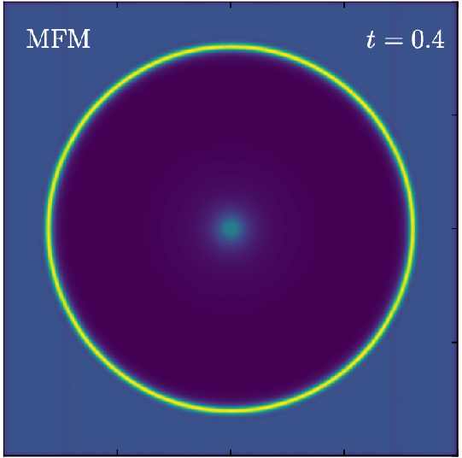
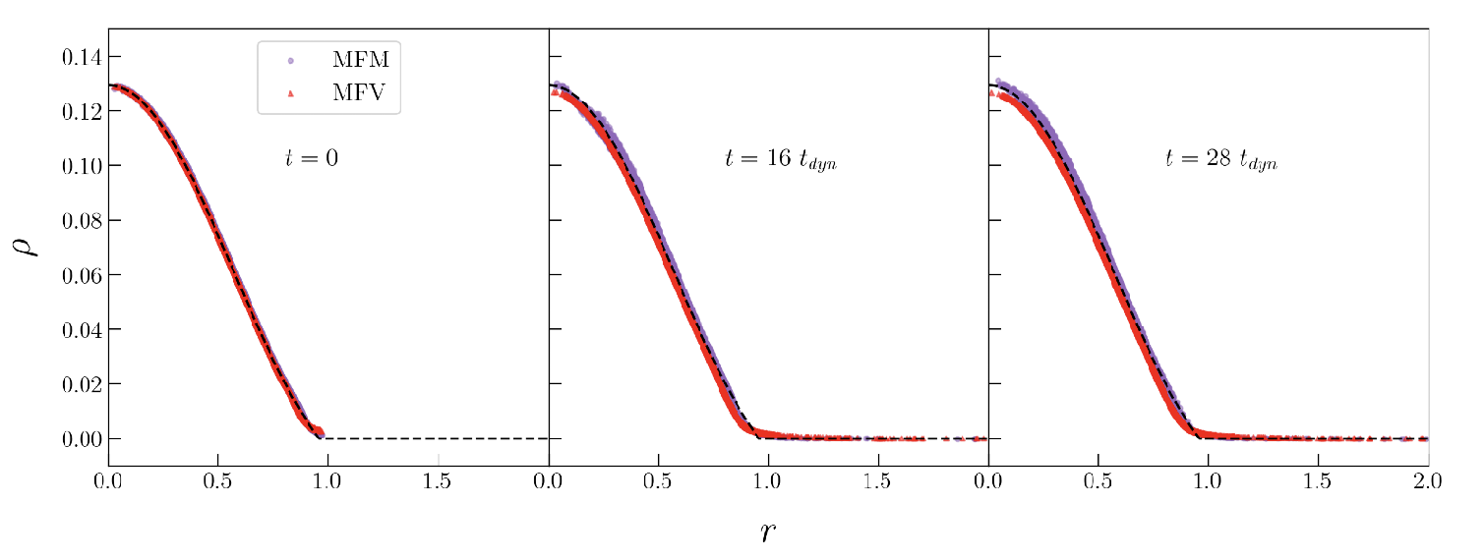

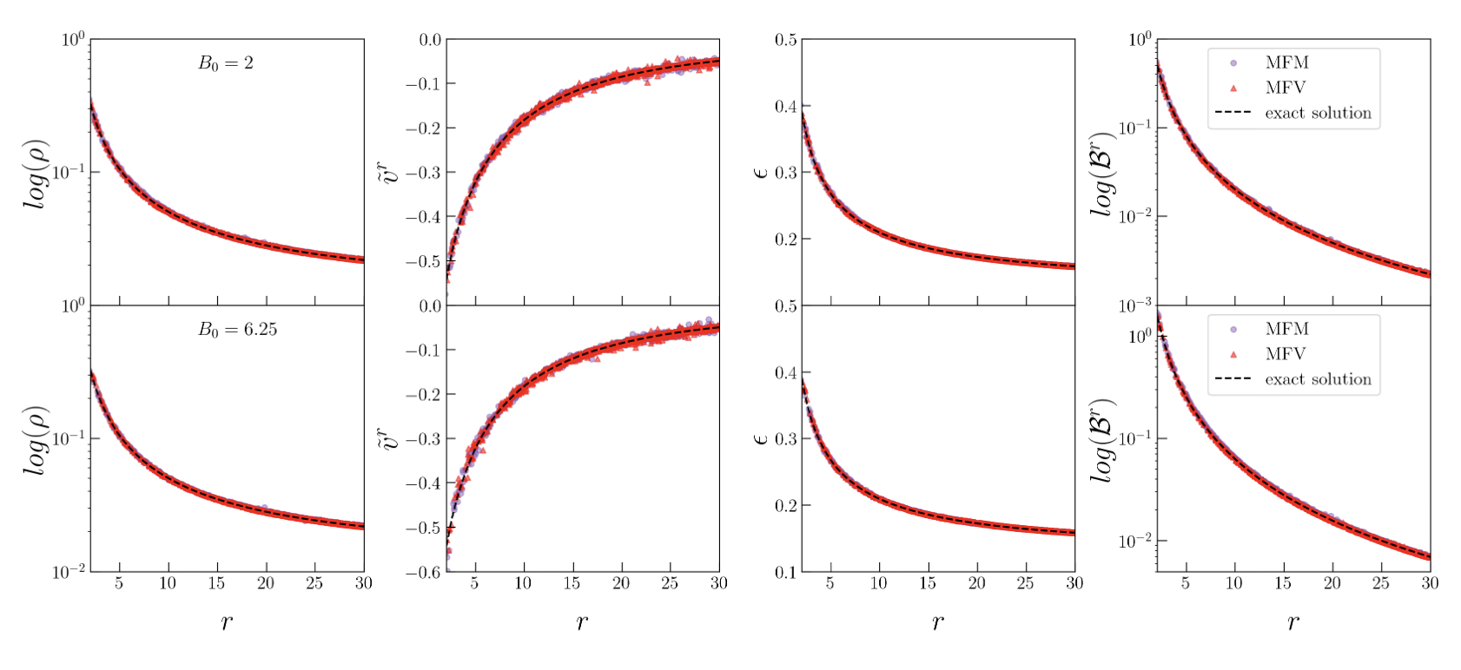
GIZMO-GR(M)HD: meshless relativistic (magneto-)hydrodynamics
(Lupi 2023; Fedrigo & Lupi 2025)
$∇_{i}ℬ^{i}=0$ => Powell-like (8-waves) + Dedner divergence cleaning to consistently evolve the magnetic field
Magnetized TOV
The code showed very good accuracy even at relatively low resolution compared to fixed-grid and SPH codes
Relativistic BW (HD)
Magnetized Bondi

Slide 11
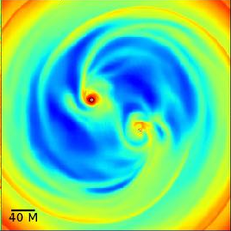
A consistent view of MBHB path to coalescence
By exploiting the double nature of GIZMO (Newtonian and relativistic), in the near future we will be able to follow MBH binary pairing and shrinking down to the merger, covering about 14 orders of magnitude in spatial scale.
CBD formation
CBD evolution
down to ~100 Rg
GIZMO
GRMHD
a> ~10Rg
Post-merger
kicks

Slide 12
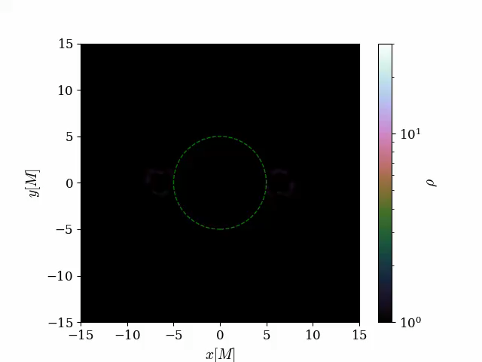
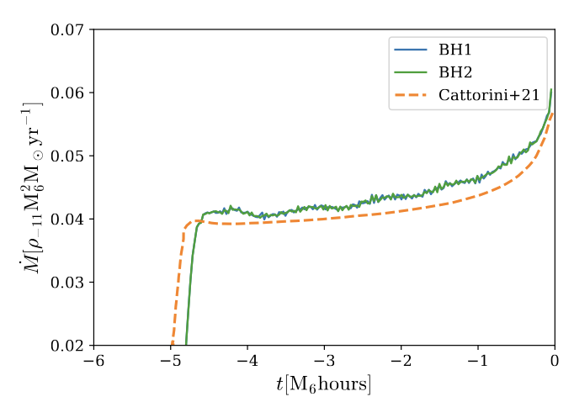
A consistent view of MBHB path to coalescence
(Fedrigo, Lupi, Franchini & Bonetti 2026)
We have further extended GIZMO-GRMHD to include:
Tabulated (CBwaves) or live binary evolution (including PN corrections up to 2.5, see Franchini, Bonetti, AL and Sesana 2024)
Analytic binary metric in Kerr-Schild coordinates (Combi & Ressler 2024)
Adaptive refinement around the two BHs (user-defined)
Gas removal inside the horizon => accretion (work in progress) or excision
Benchmark: Bondi-like accretion - $a_{0}=12M$, $Γ=4/3$, $h\sim 0.6M$ at horizon

Slide 13
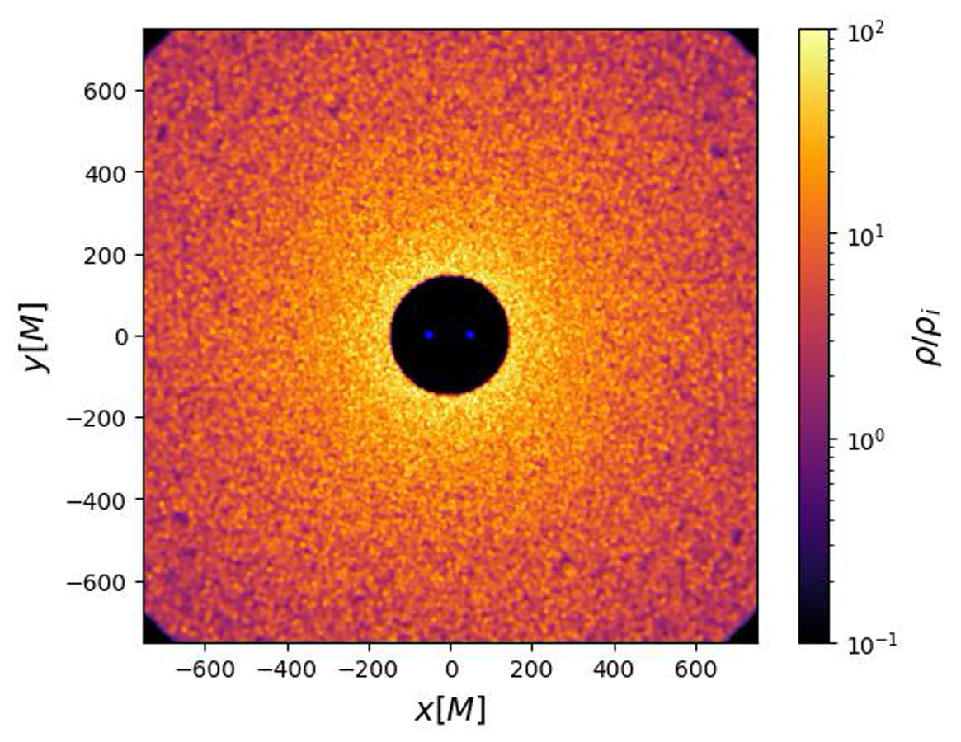
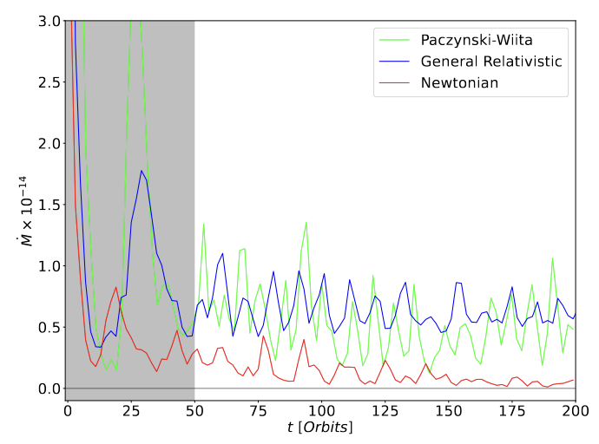

Black hole binaries from Newtonian to relativistic scales
(Fedrigo, Lupi, Franchini & Bonetti 2026)
Inviscid CBD around an equal mass non-spinning BH binary ($Γ=5/3$, no gas self gravity)
Max resolution ~0.5M at horizon
No gas torques (for now)
Newtonian+PN
Even at hundreds of Rg, GR precession alters gas dynamics, causing orbit crossing and shocks that transport angular momentum outwards
GR+PN

Slide 14
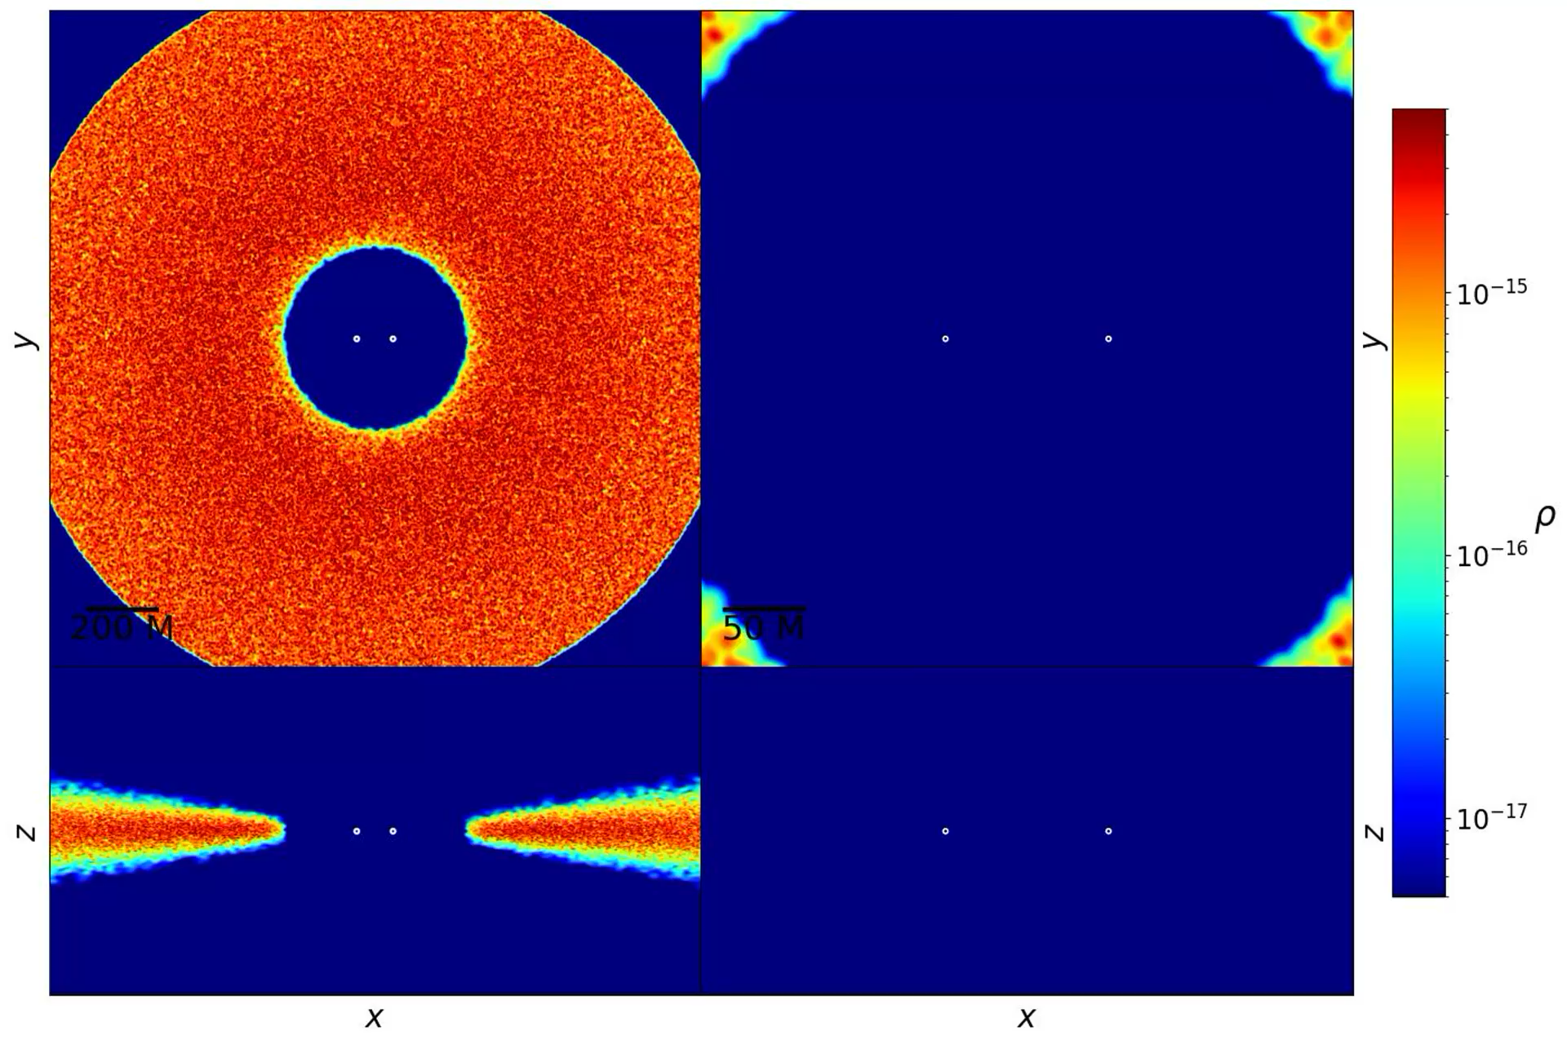
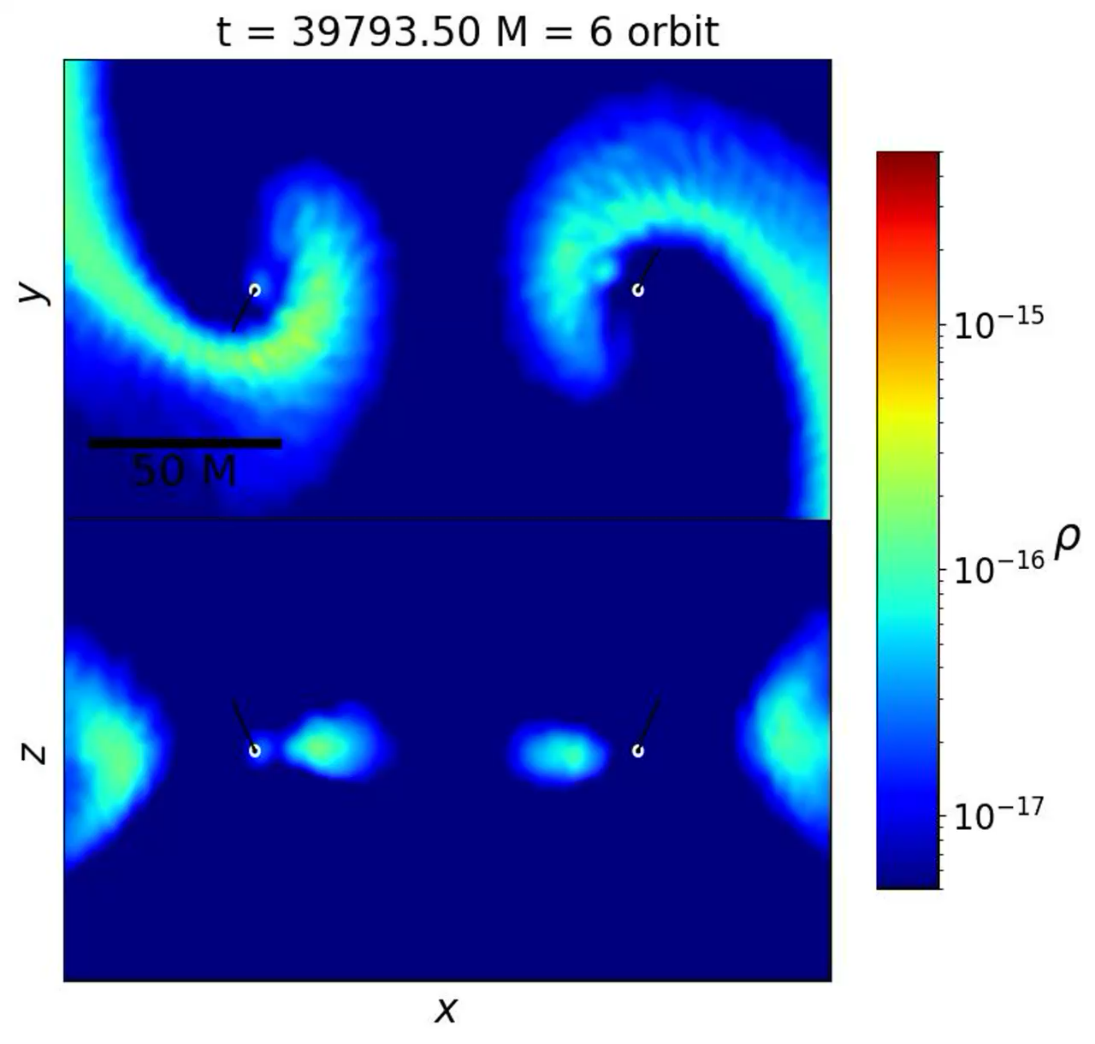
Black hole binaries from Newtonian to relativistic scales
A consistent approach (Fedrigo, Lupi et al. in prep.)
GRMHD simulations of spinning and non-spinning BHs surrounded by H/R=0.1 CBDs (β cooling) with resolved MRI
spinning BHs
non-spinning BHs
GIZMO: ~72k CPU hours up to t=290000M
vs AMR sims: 75000M (Noble+12)
150000M (Ennoggi+24)

Slide 15
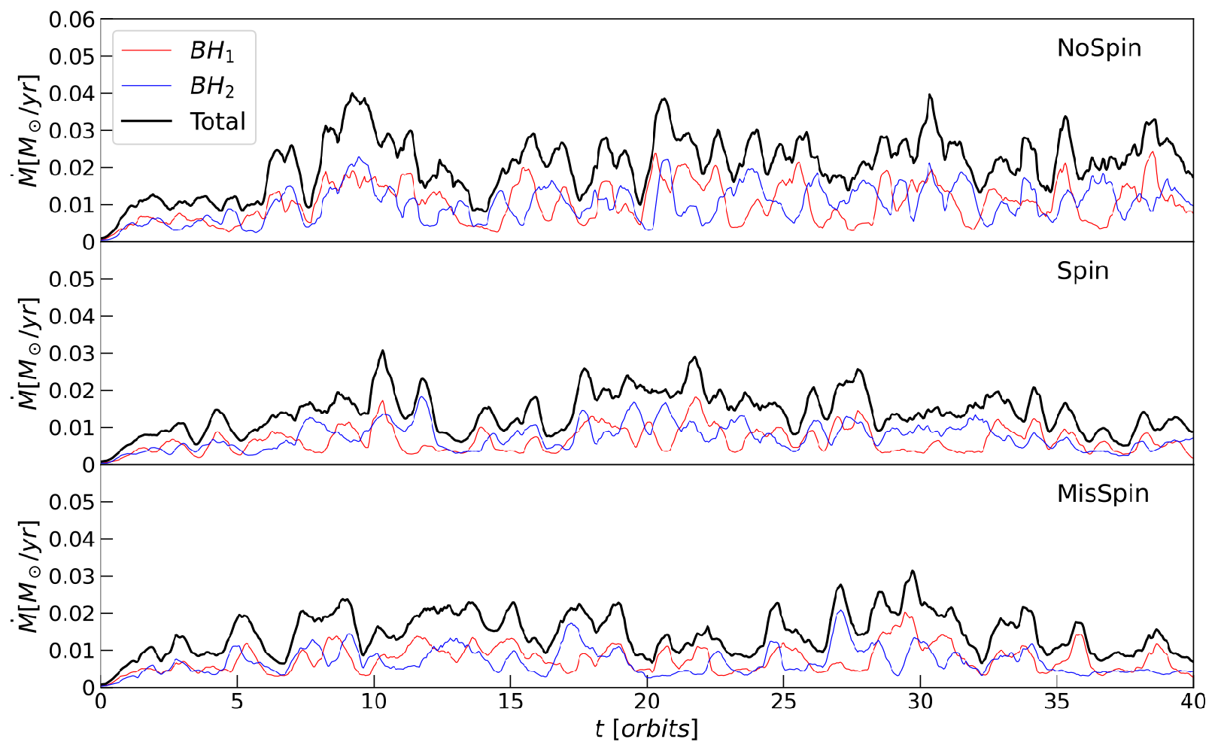
Black hole binaries from Newtonian to relativistic scales
A consistent approach (Fedrigo, Lupi et al. in prep.)
GRMHD simulations of spinning and non-spinning BHs surrounded by H/R=0.1 CBDs (β cooling)

Slide 16
Conclusions
An accurate description of the MBHB path to coalesce is crucial to make reliable predictions for LISA and MBHB electromagnetic counterparts. However, current modelling is still lacking many important physical processes.
MBHB pairing is strongly affected by the environment, and can lead to completely different MBHB occupation fractions in galaxies => we need to better understand the impact of non-axisymmetries in galaxies on the inspiral. We are still to far from a proper understanding of the last kpc problem
When MBH feedback is included, a cavity opens around the MBHB, inhibiting fast migration even when the disc conditions favoured it.
Despite recent efforts to include PN evolution for pre-merger MBHBs in CBDs, GR effects on the gas dynamics might be important both for the binary evolution and the EM emission even at 100 Rg=> consistent and efficient GR calculations are necessary
  GR-HD simulations show that relativistic precession changes angular momentum transport in inviscid discs
  The inclusion of GR-MHD now allows us for the first time to cover the entire dynamic range with a unique tool, without the need for ad-hoc assumptions.

Slide 17
Backup slides

Slide 18
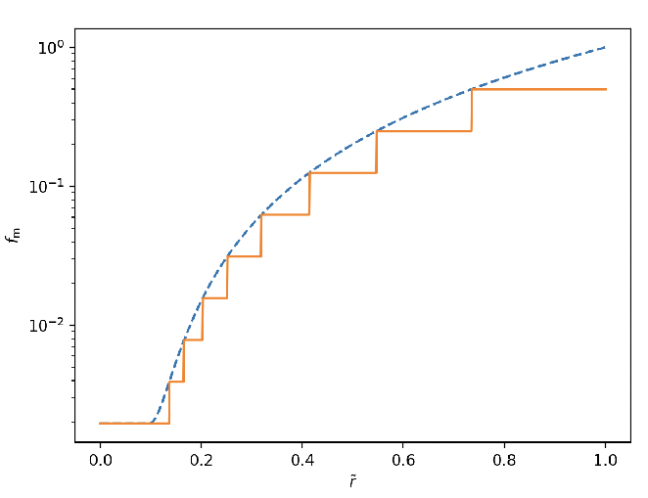
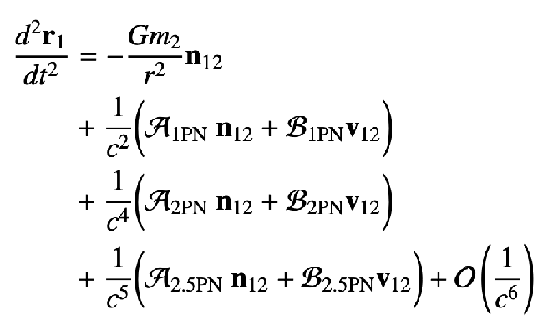

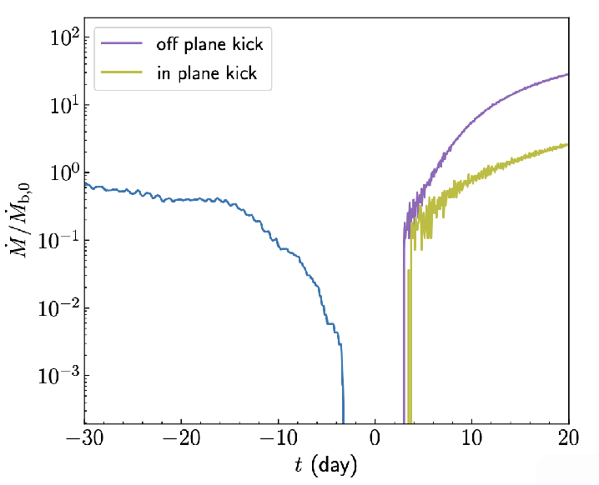
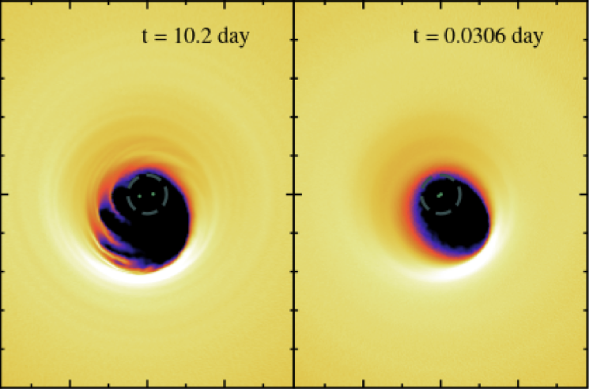
Towards a consistent modelling of the different stages
Franchini, Bonetti, Lupi and Sesana (2023)
One of the key stages in the binary evolution that most simulations have neglected so far is the transition from the Newtonian, gas-driven regime to the GW-dominated evolution, i.e. the ‘decoupling’.
Modelling this phase is crucial to assess the EM counterparts.

