Slide 1
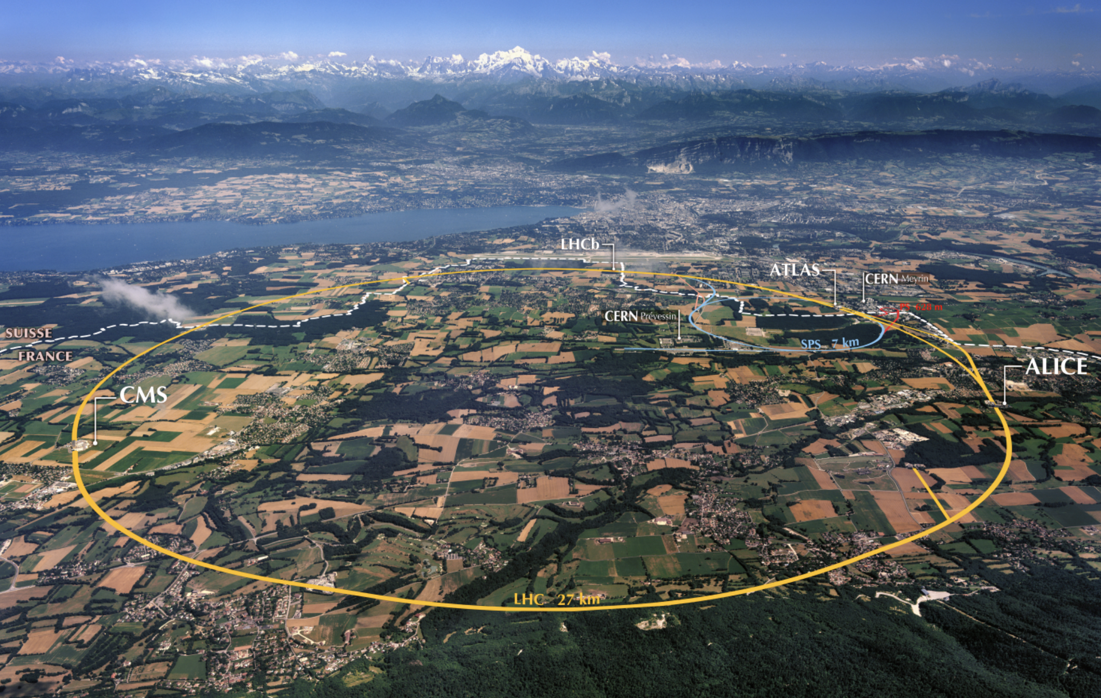
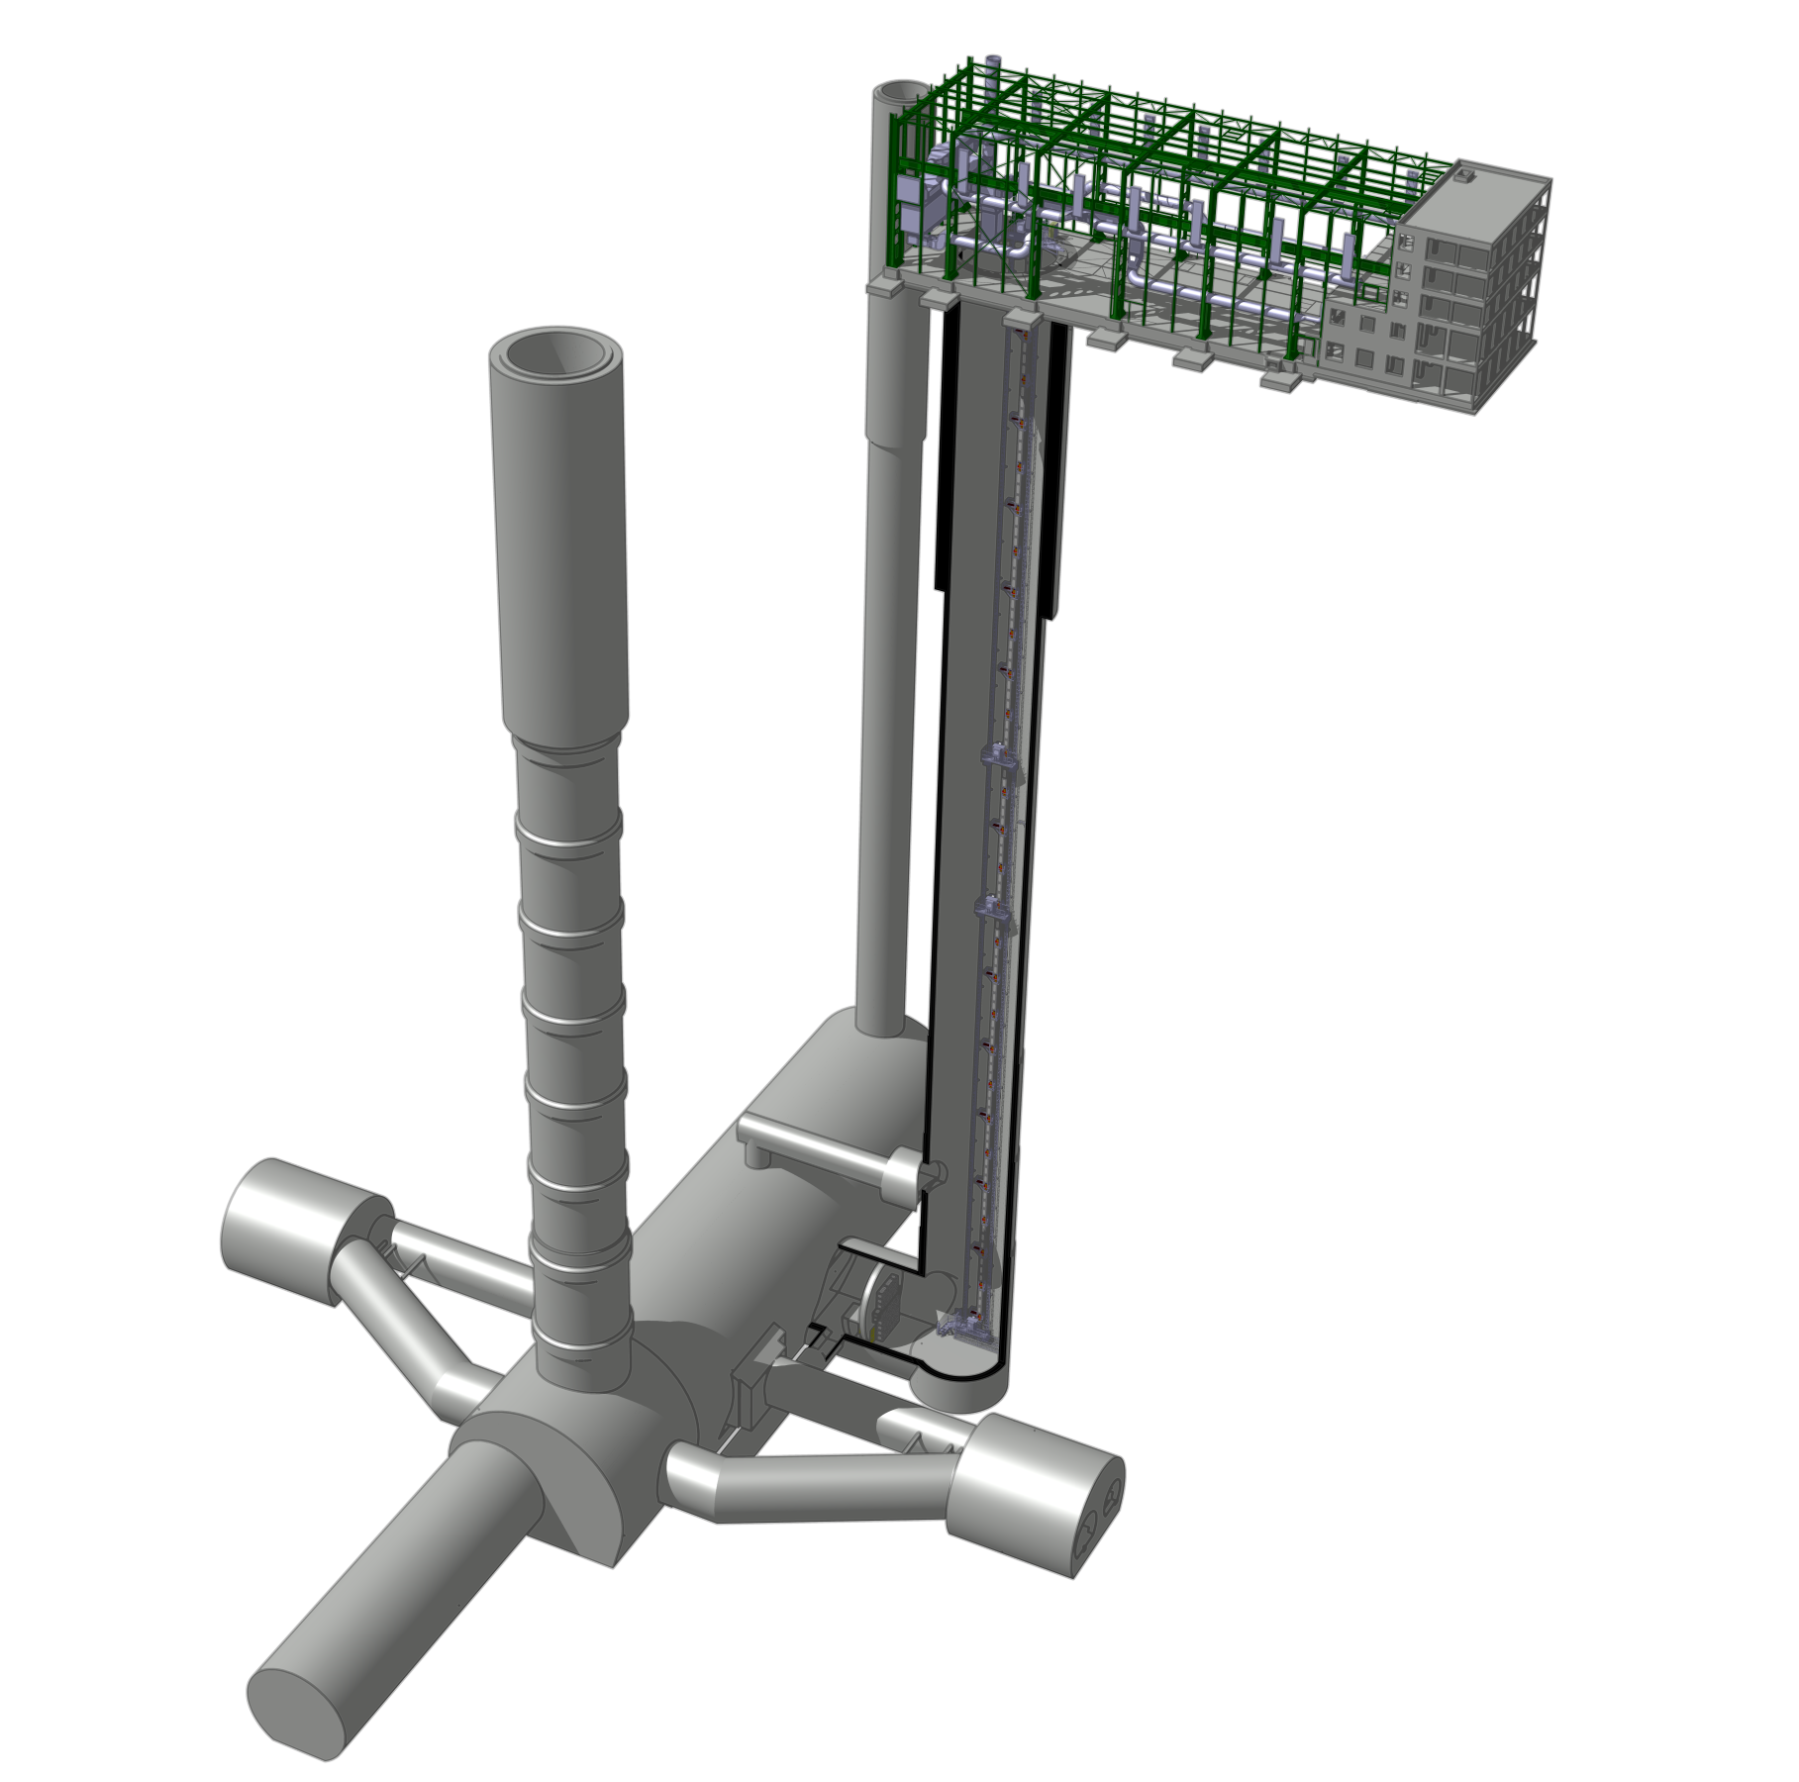
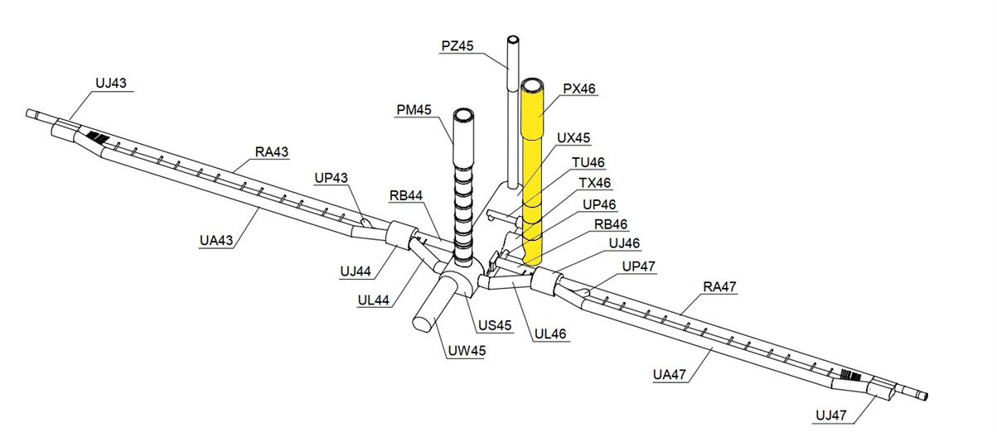
AICE: A long-baseline atom interferometry facility at CERN
AICE @ PX46

Slide 2
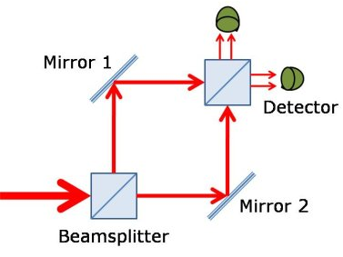
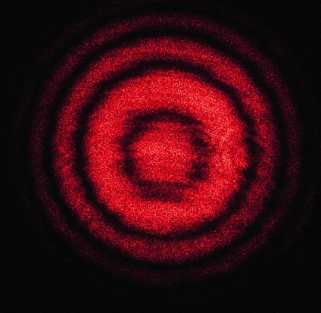
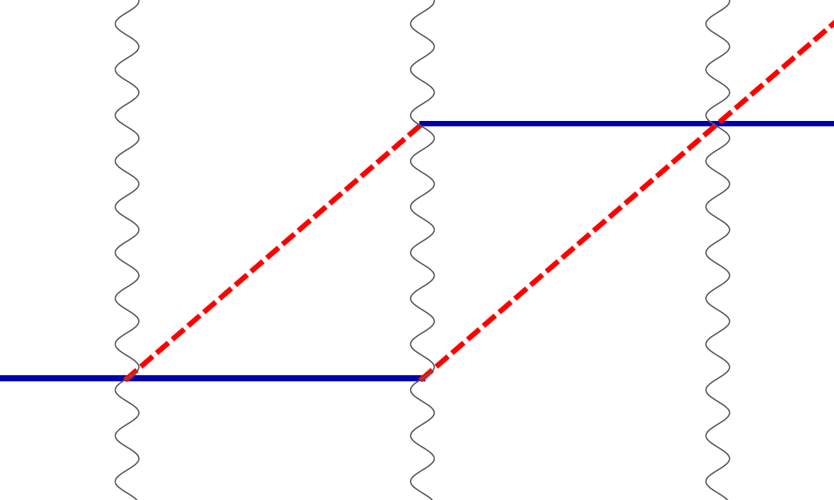
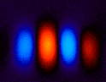
Light vs. Cold Atoms: Atom Interferometry
Light interferometer
Light
Light fringes
http://scienceblogs.com/principles/2013/10/22/quantum-erasure/
https://hubner-photonics.com/applications/lasers-for-interferometry/
Atom interferometer
Beamsplitter
Atom fringes
Atom
Beamsplitter
Mirror
https://arxiv.org/abs/2105.00992

Slide 3
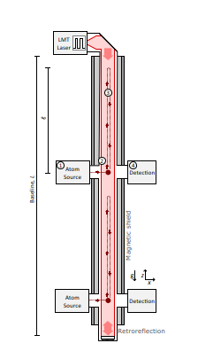
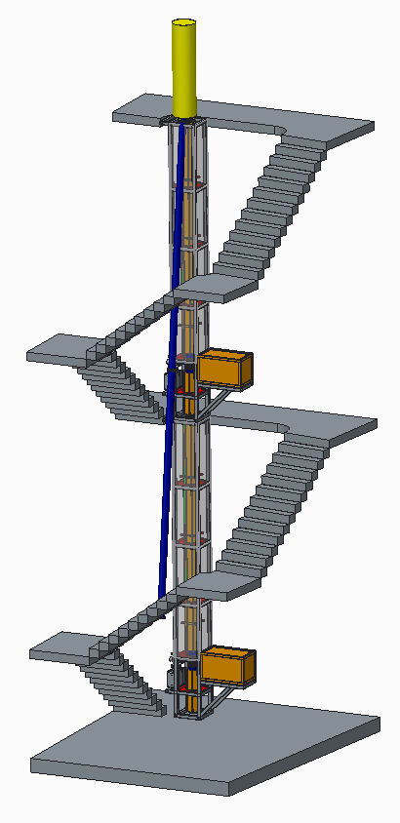
Long baseline atom interferometer
Coupled atom sources have a larger potential for measurement of Gravitational Waves and Dark Matter. AION-10 in Oxford

Slide 4
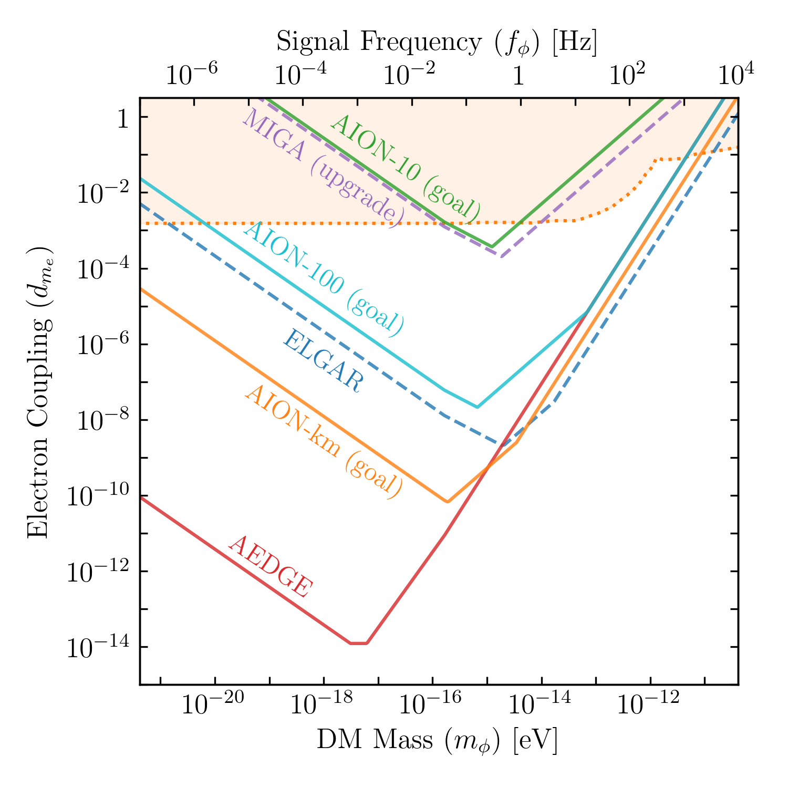
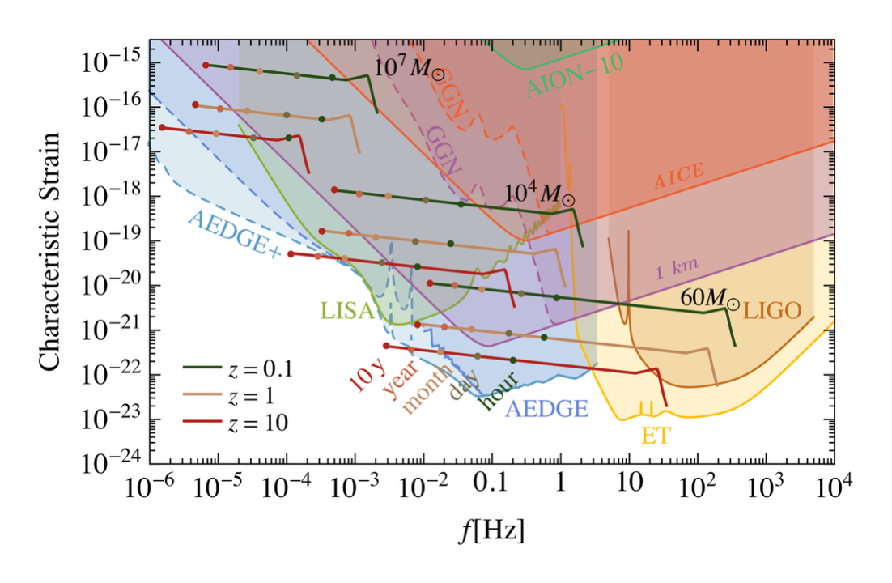
Motivation for atom interferometer
Unlocking the potential for observation of Ultra-Light Dark Matter and Gravitational Waves from cosmological and astrophysical sources in the unexplored mid-frequency band

Slide 5
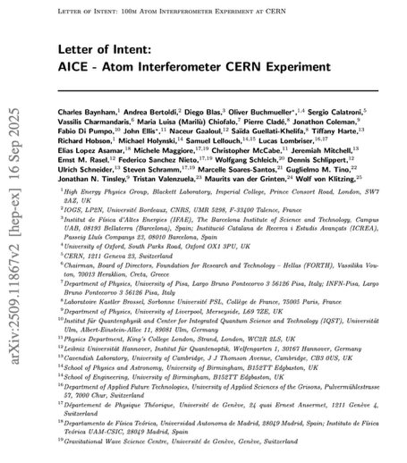
AICE Facility at PX46
What is AICE?
140 m vertical atom interferometer infrastructure in PX46
Based on clock-transition interferometry (Sr baseline, but also others)
Designed as an upgradable long-baseline facility
Core Physics Programme
Dark Matter & Fundamental Physics
Ultralight dark matter (coherent field searches)
New interactions / B–L couplings
Precision tests (e.g. alpha, equivalence pri. in multi-species mode)
Exploratory Extension
Mid-frequency gravitational waves (0.01–10 Hz)
Pathfinder towards km-scale detectors
Facility Philosophy
Staged commissioning → baseline → upgrades
Multi-source configuration along the baseline
Species flexibility (Sr → Yb → dual-species)
Infrastructure intended for evolving cold-atom programmes

Slide 6
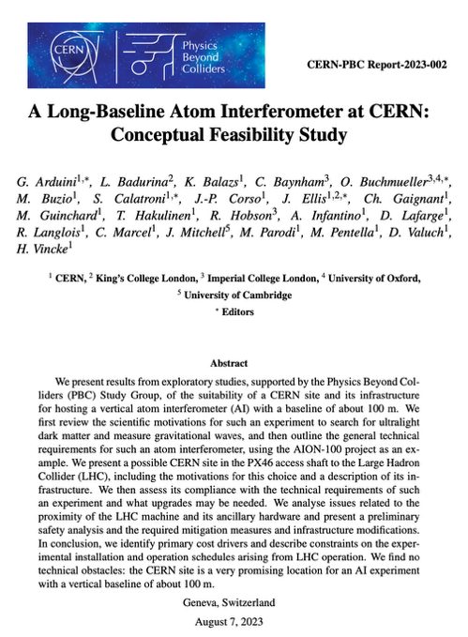
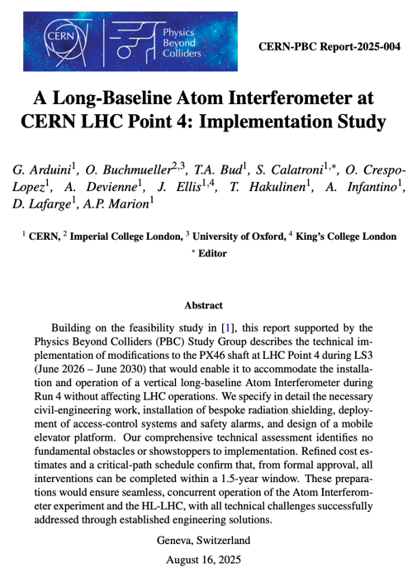
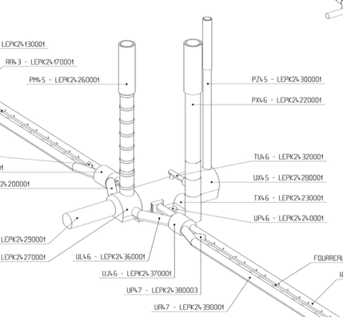
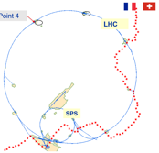
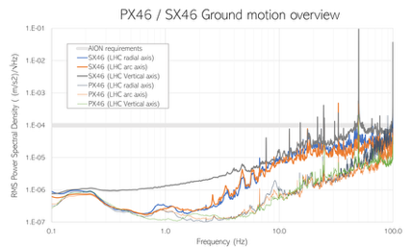
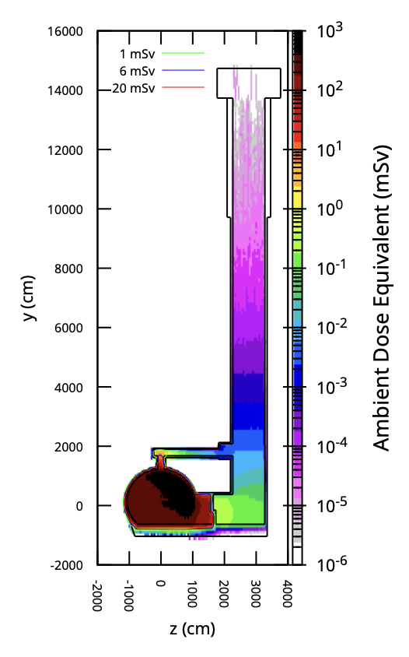
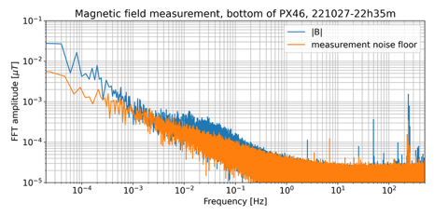

Possible site for a vertical VLBAI at CERN
PX46 – P4 Support shaft
Depth 143m, diameter 10.10m
Dose equivalent – case of beam loss
Shielding wall at the bottom of TX46
2025: https://www.arxiv.org/abs/2508.09694
2023: https://arxiv.org/abs/2304.00614
LHC beam on
Safety, access, evacuation, etc.: demonstrated feasibility for 365d/y 24h24 access and AION operation, also when the LHC beam is on

Slide 7
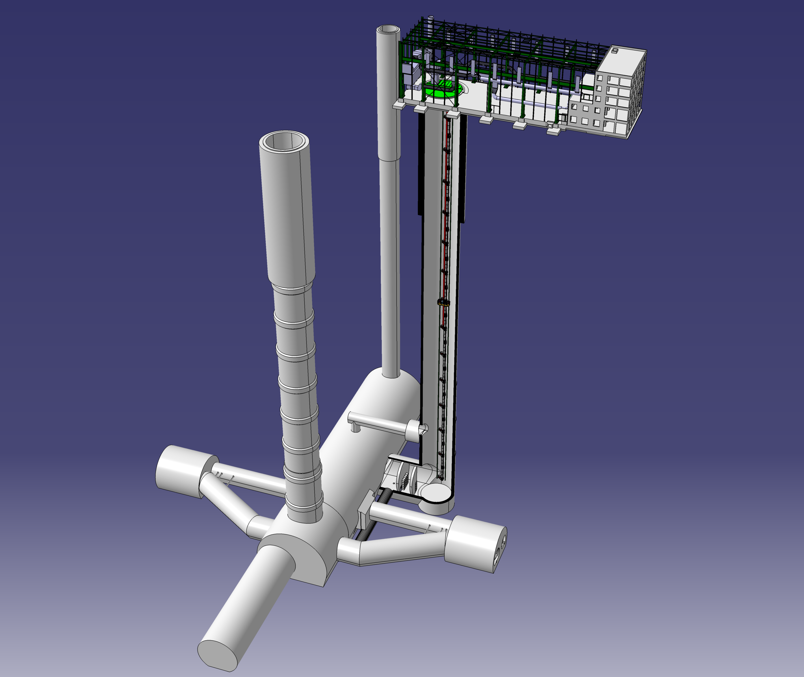
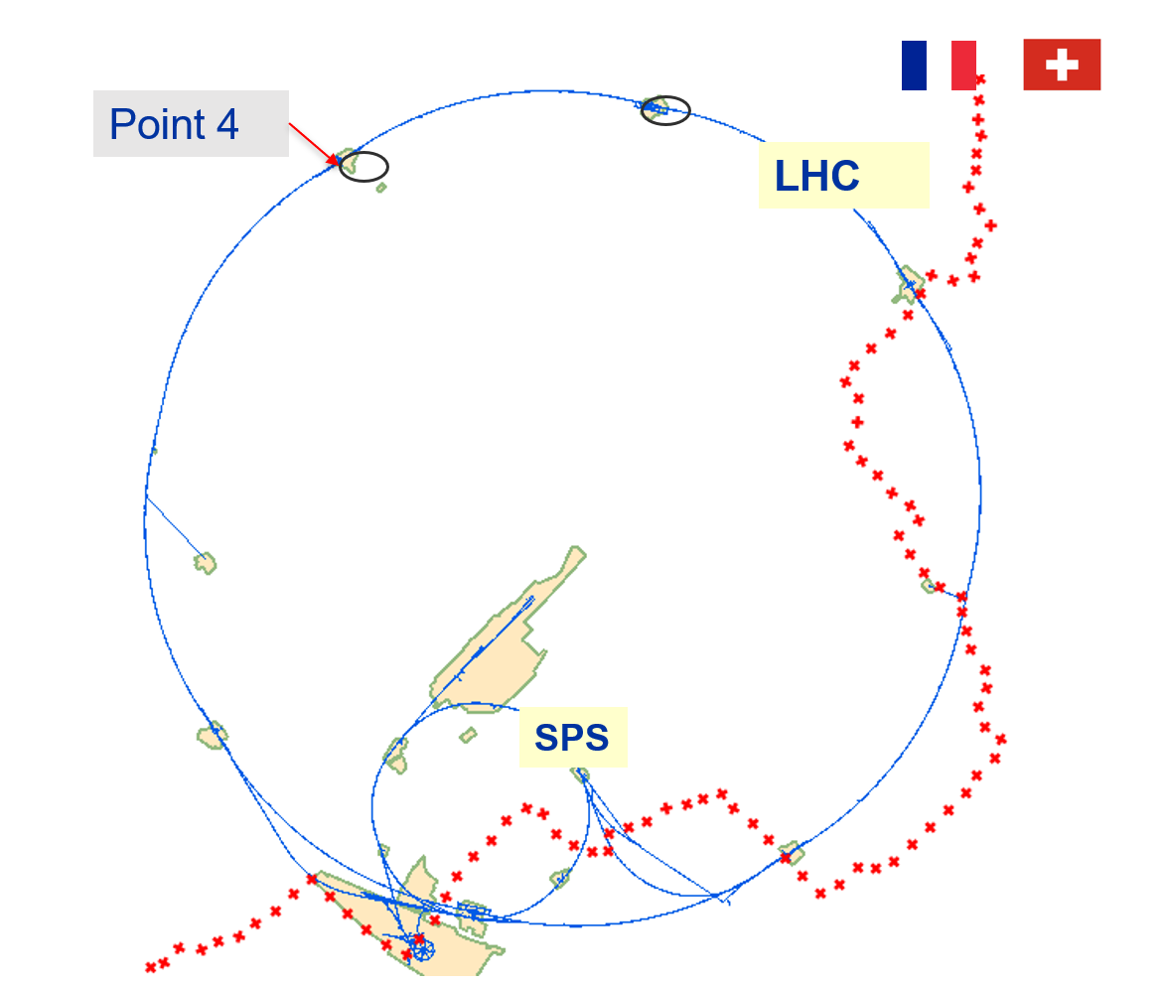
General layout and location of the site
143 m

Slide 8
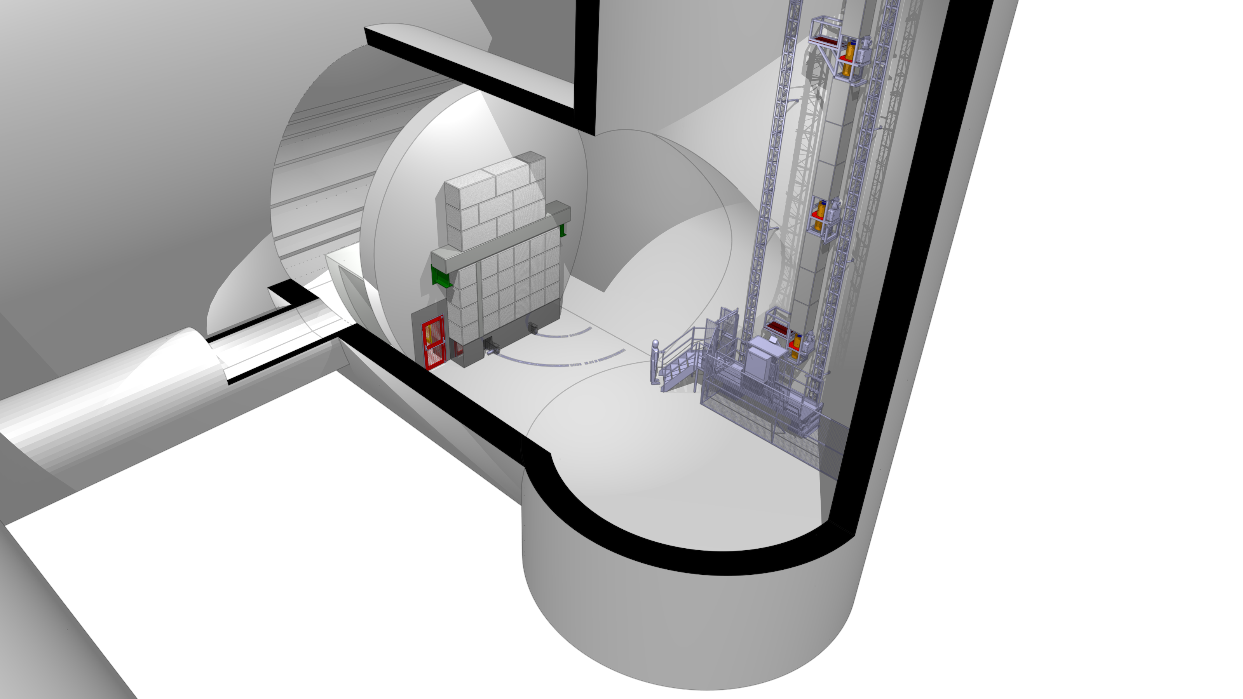
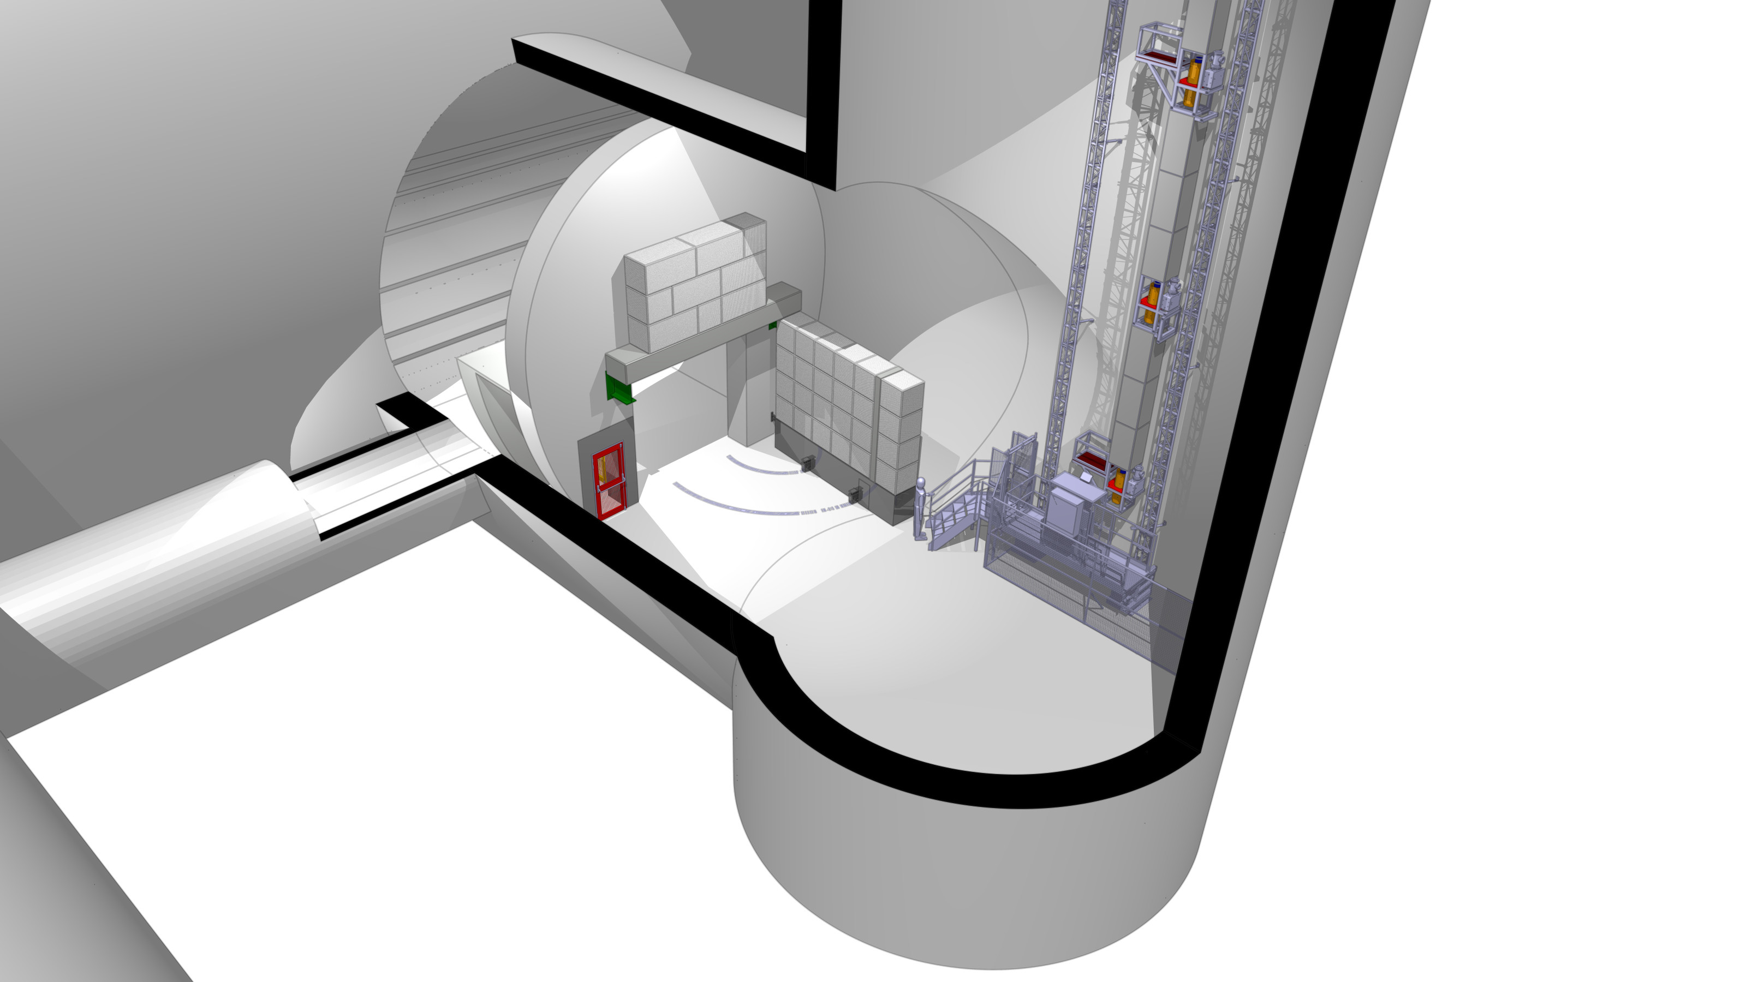
Shielding wall
Free passageway for transport of LHC components

Slide 9
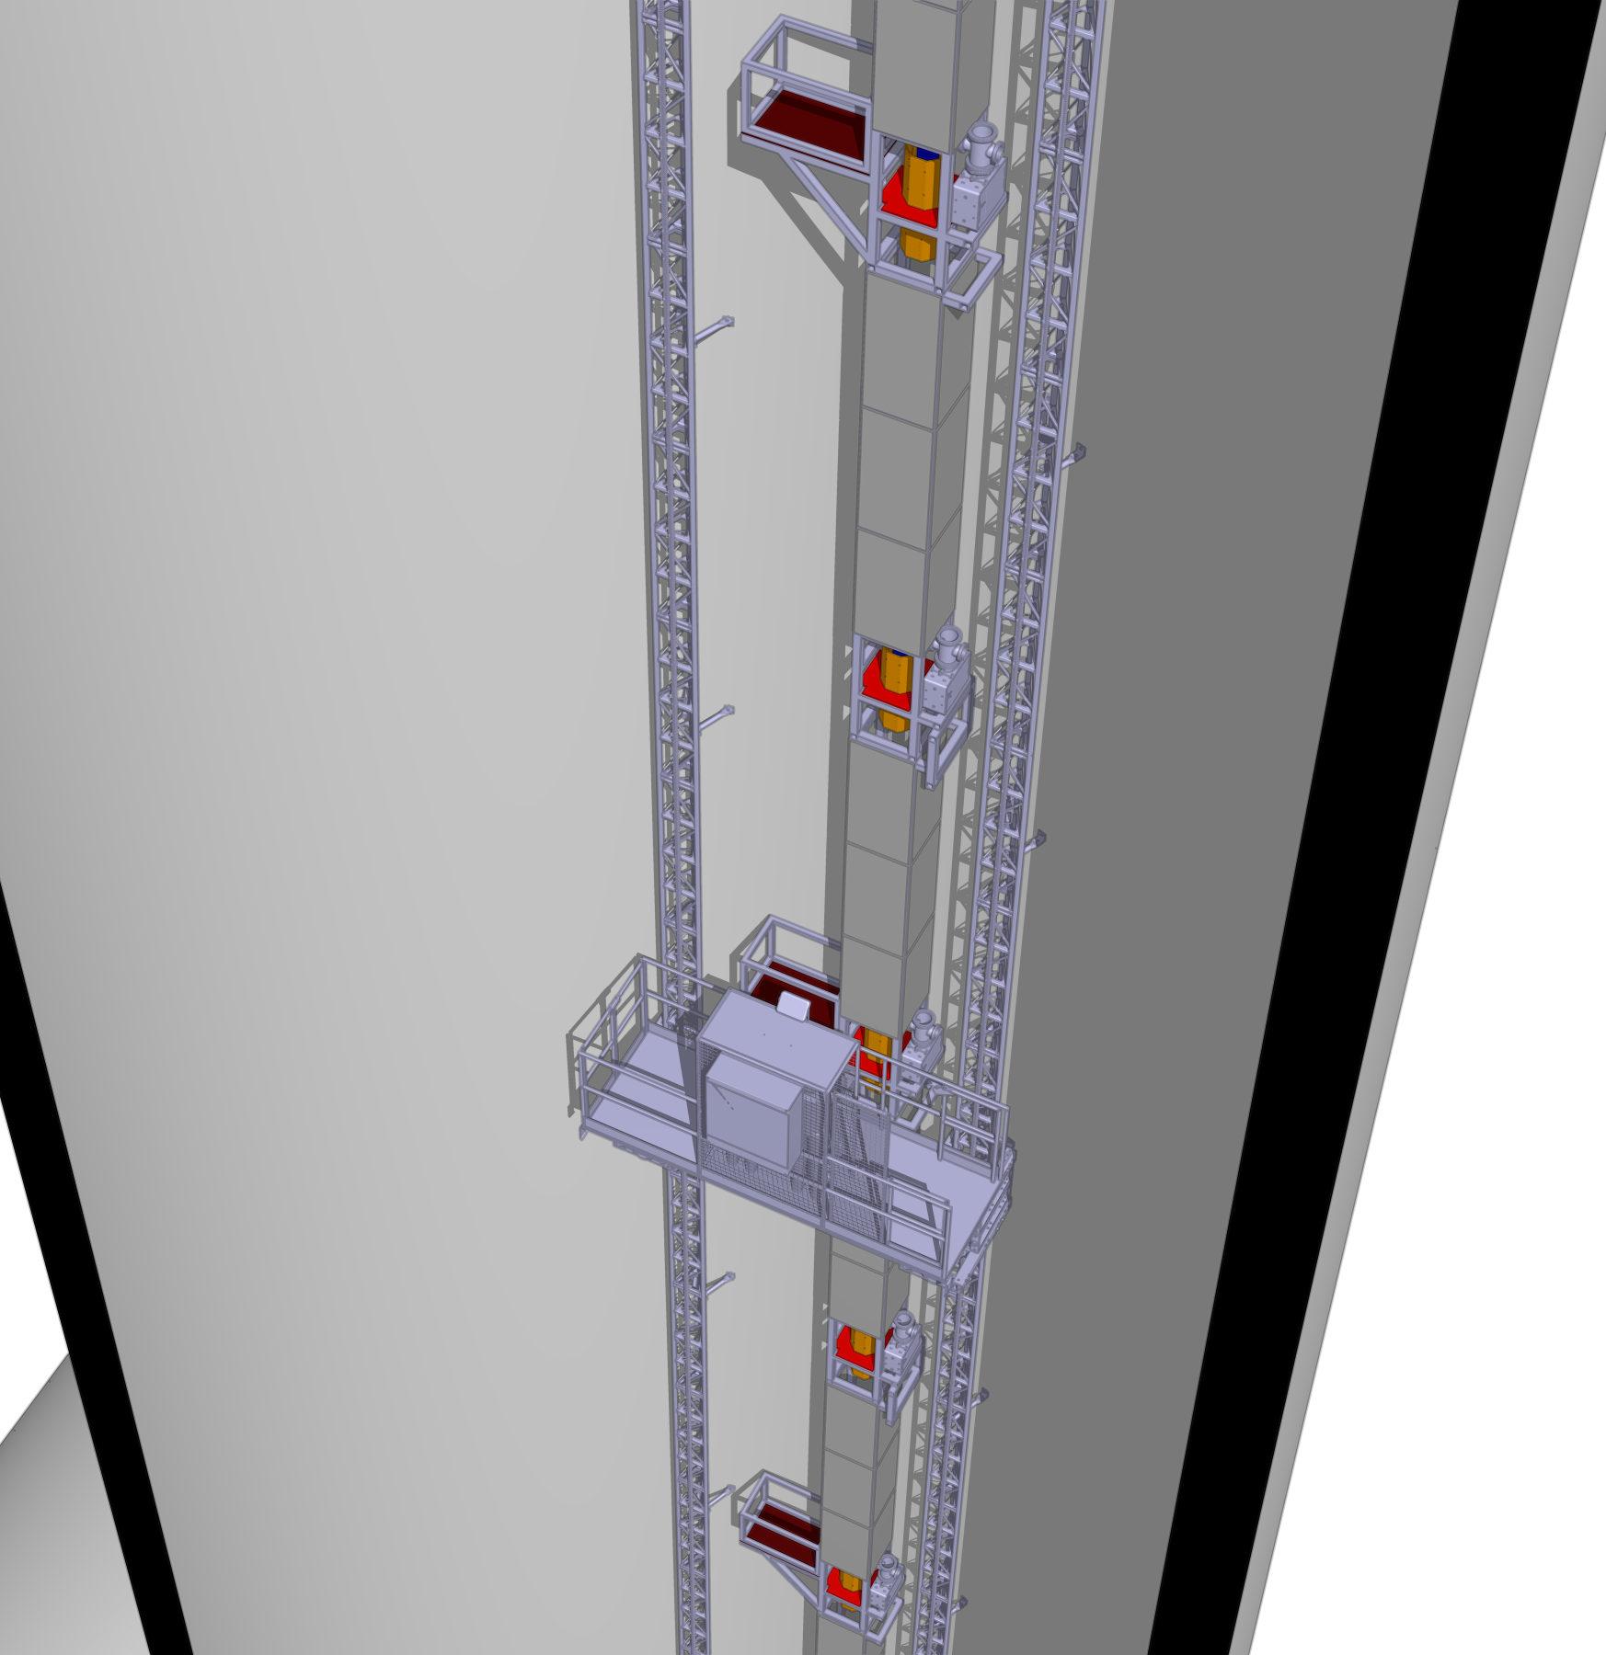
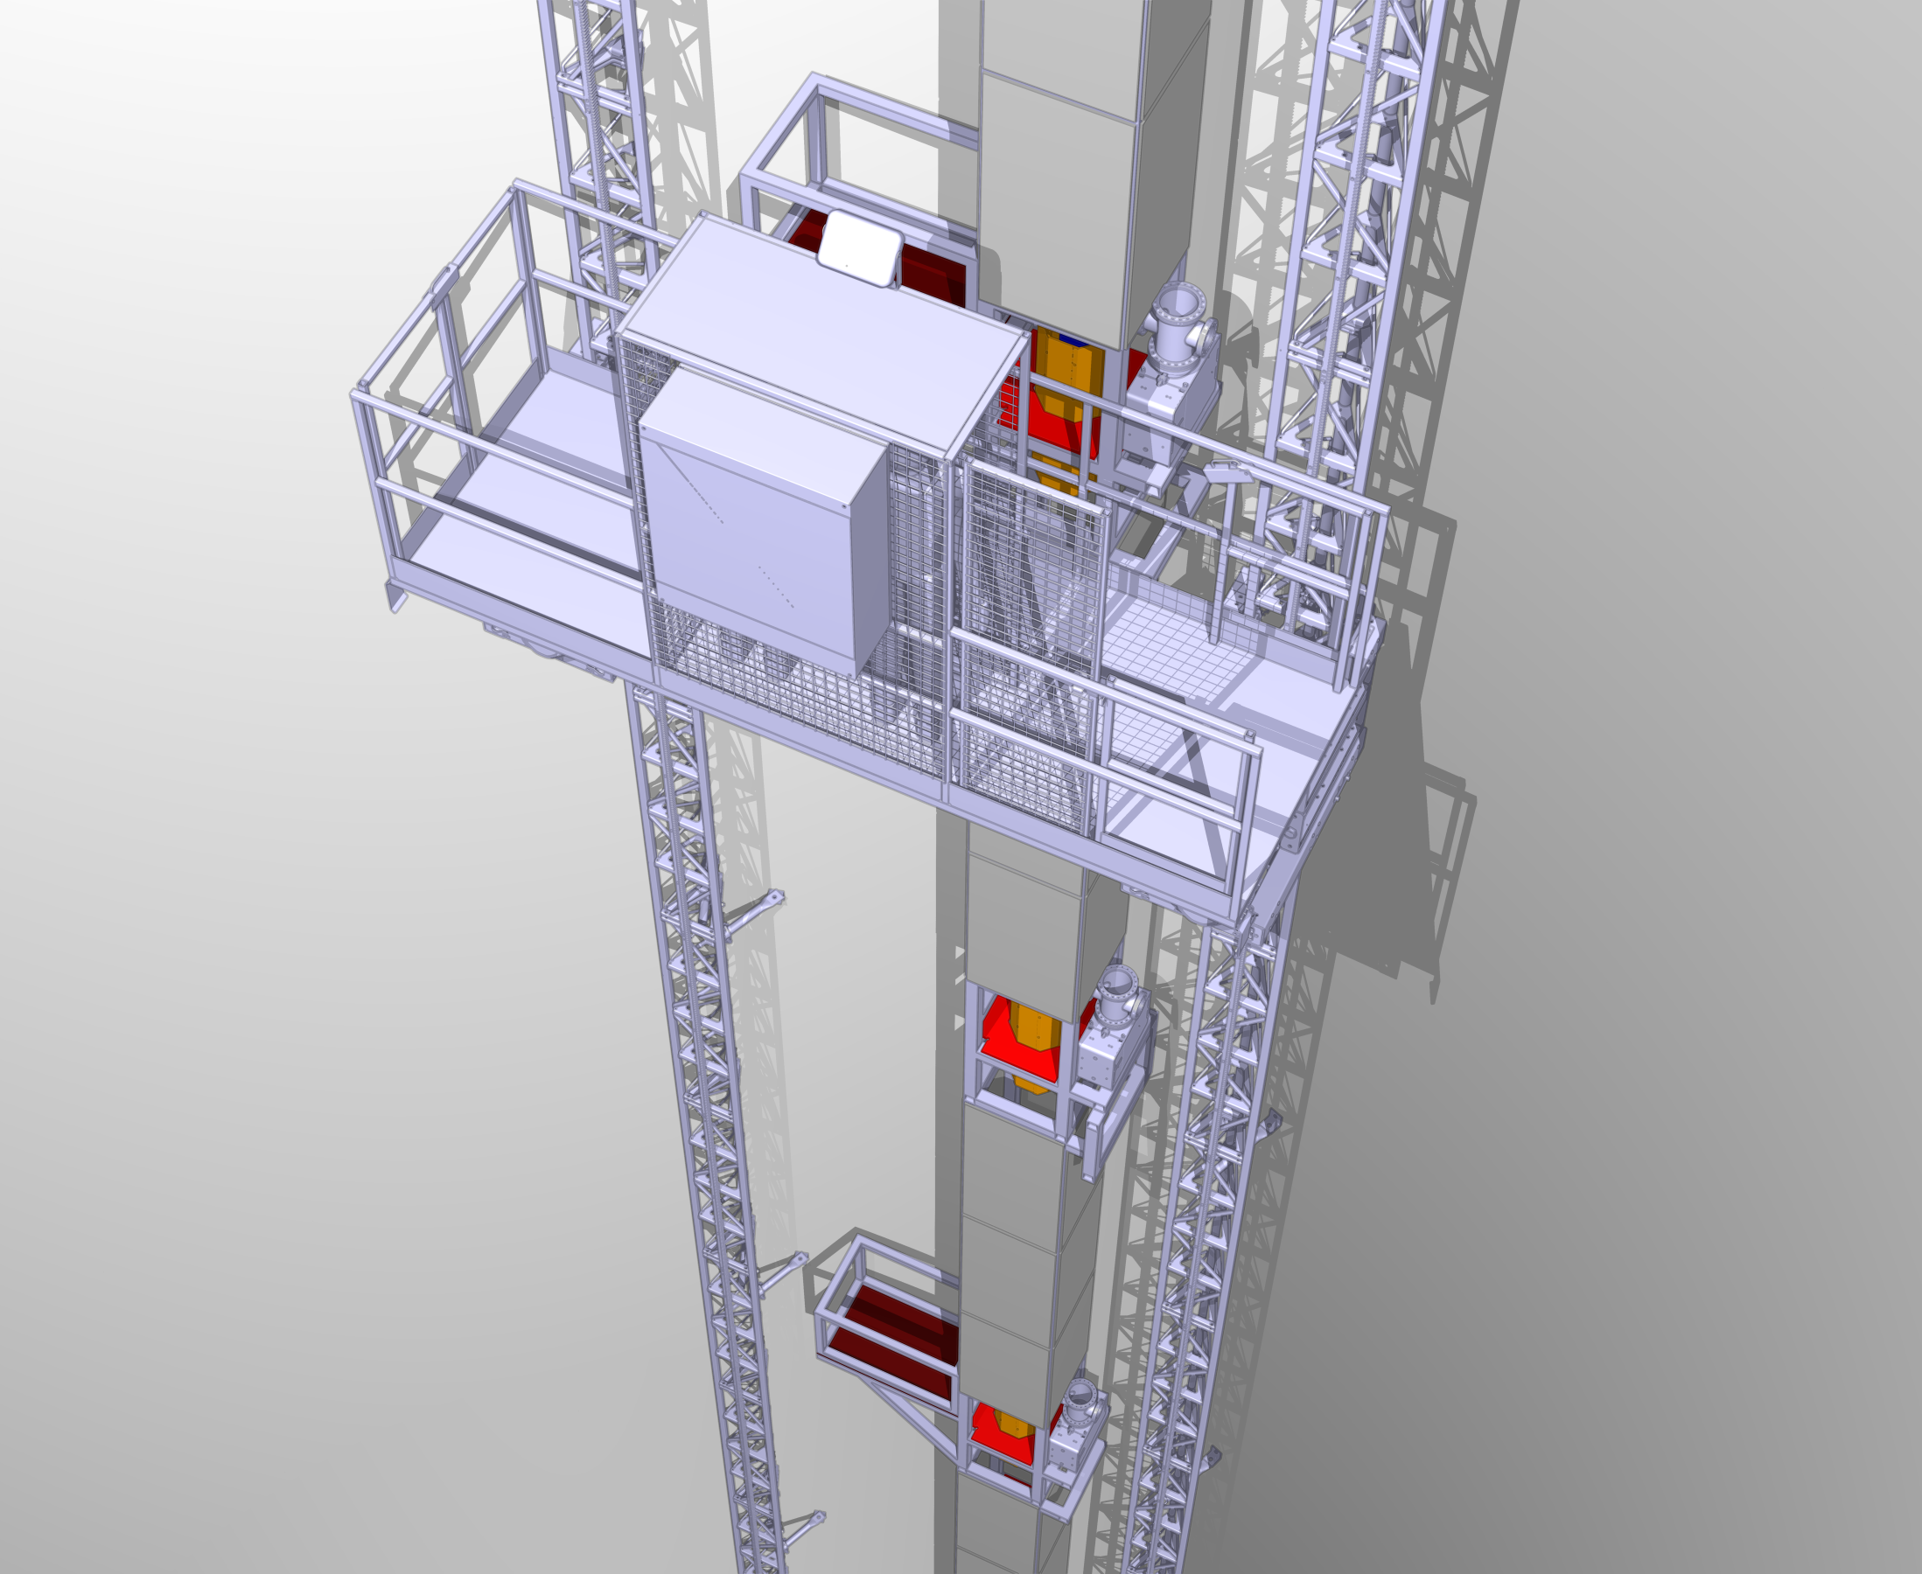
Along the shaft

Slide 10
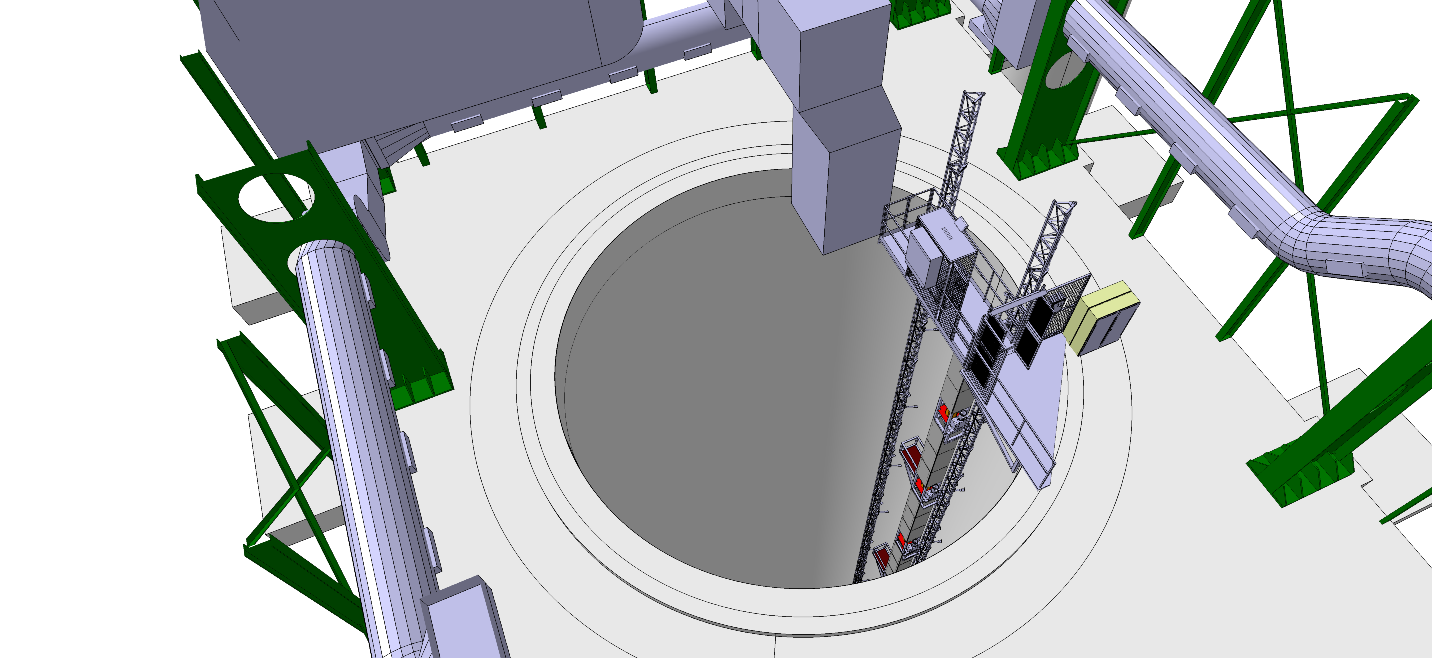
Elevator platform

Slide 11
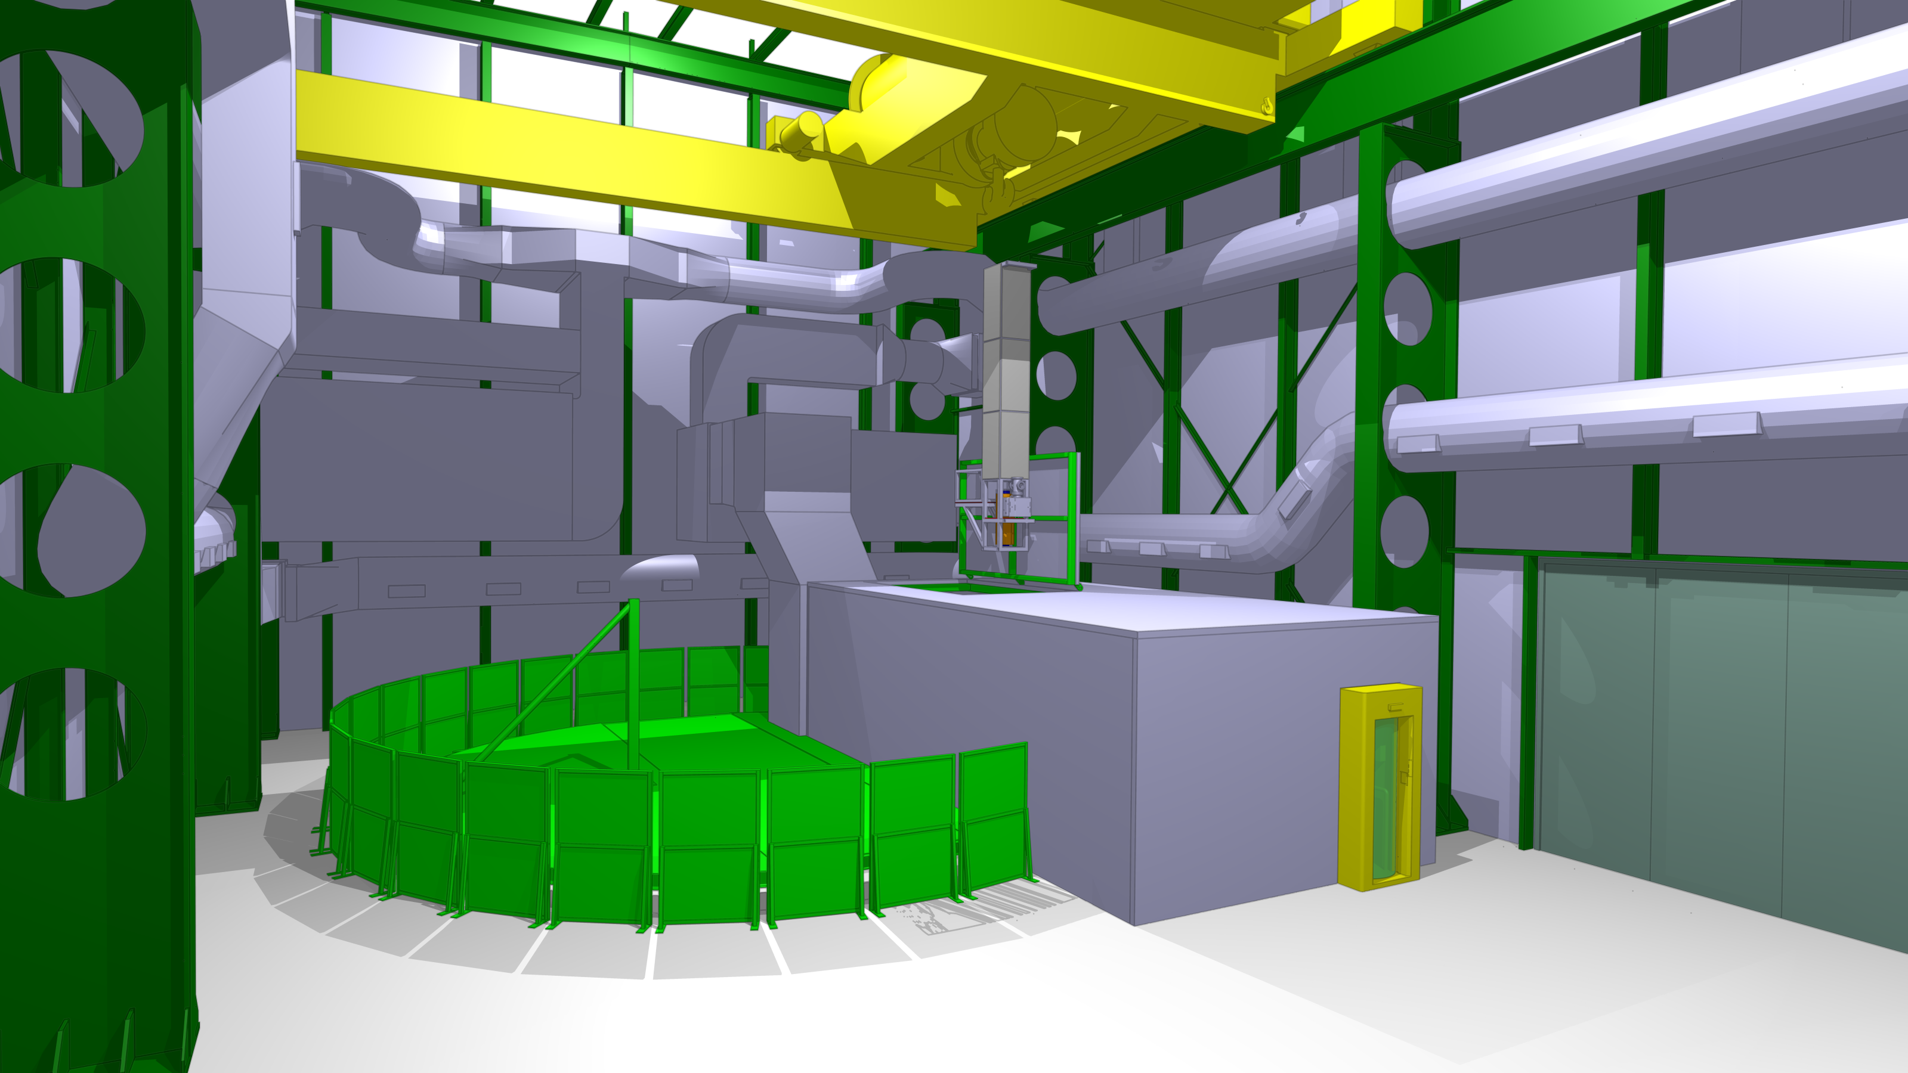
Ventilation room / laser lab – and components handling

Slide 12
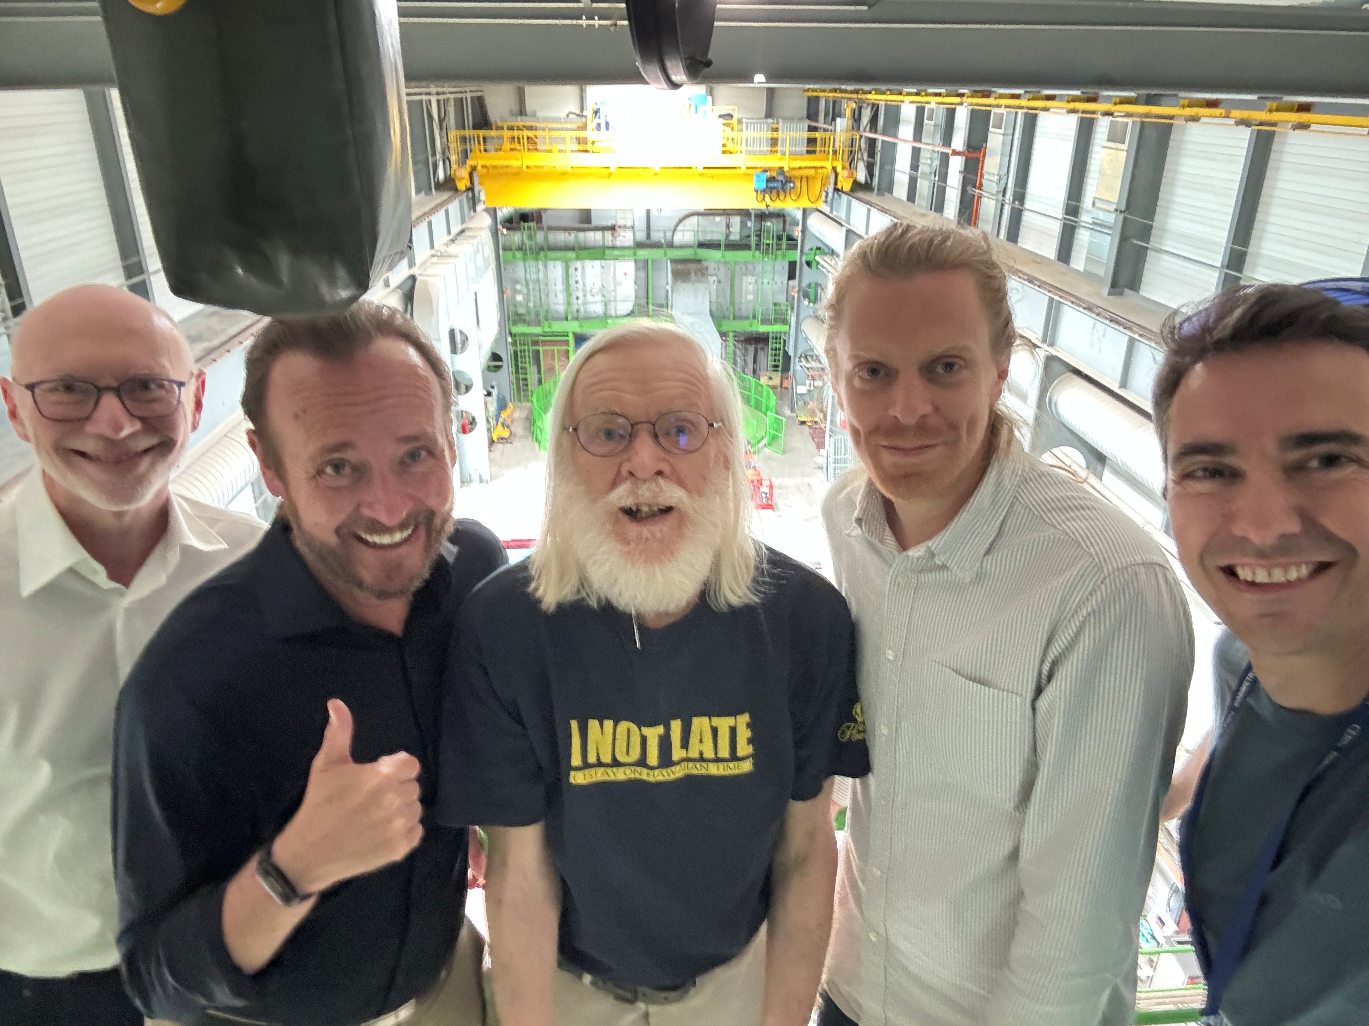
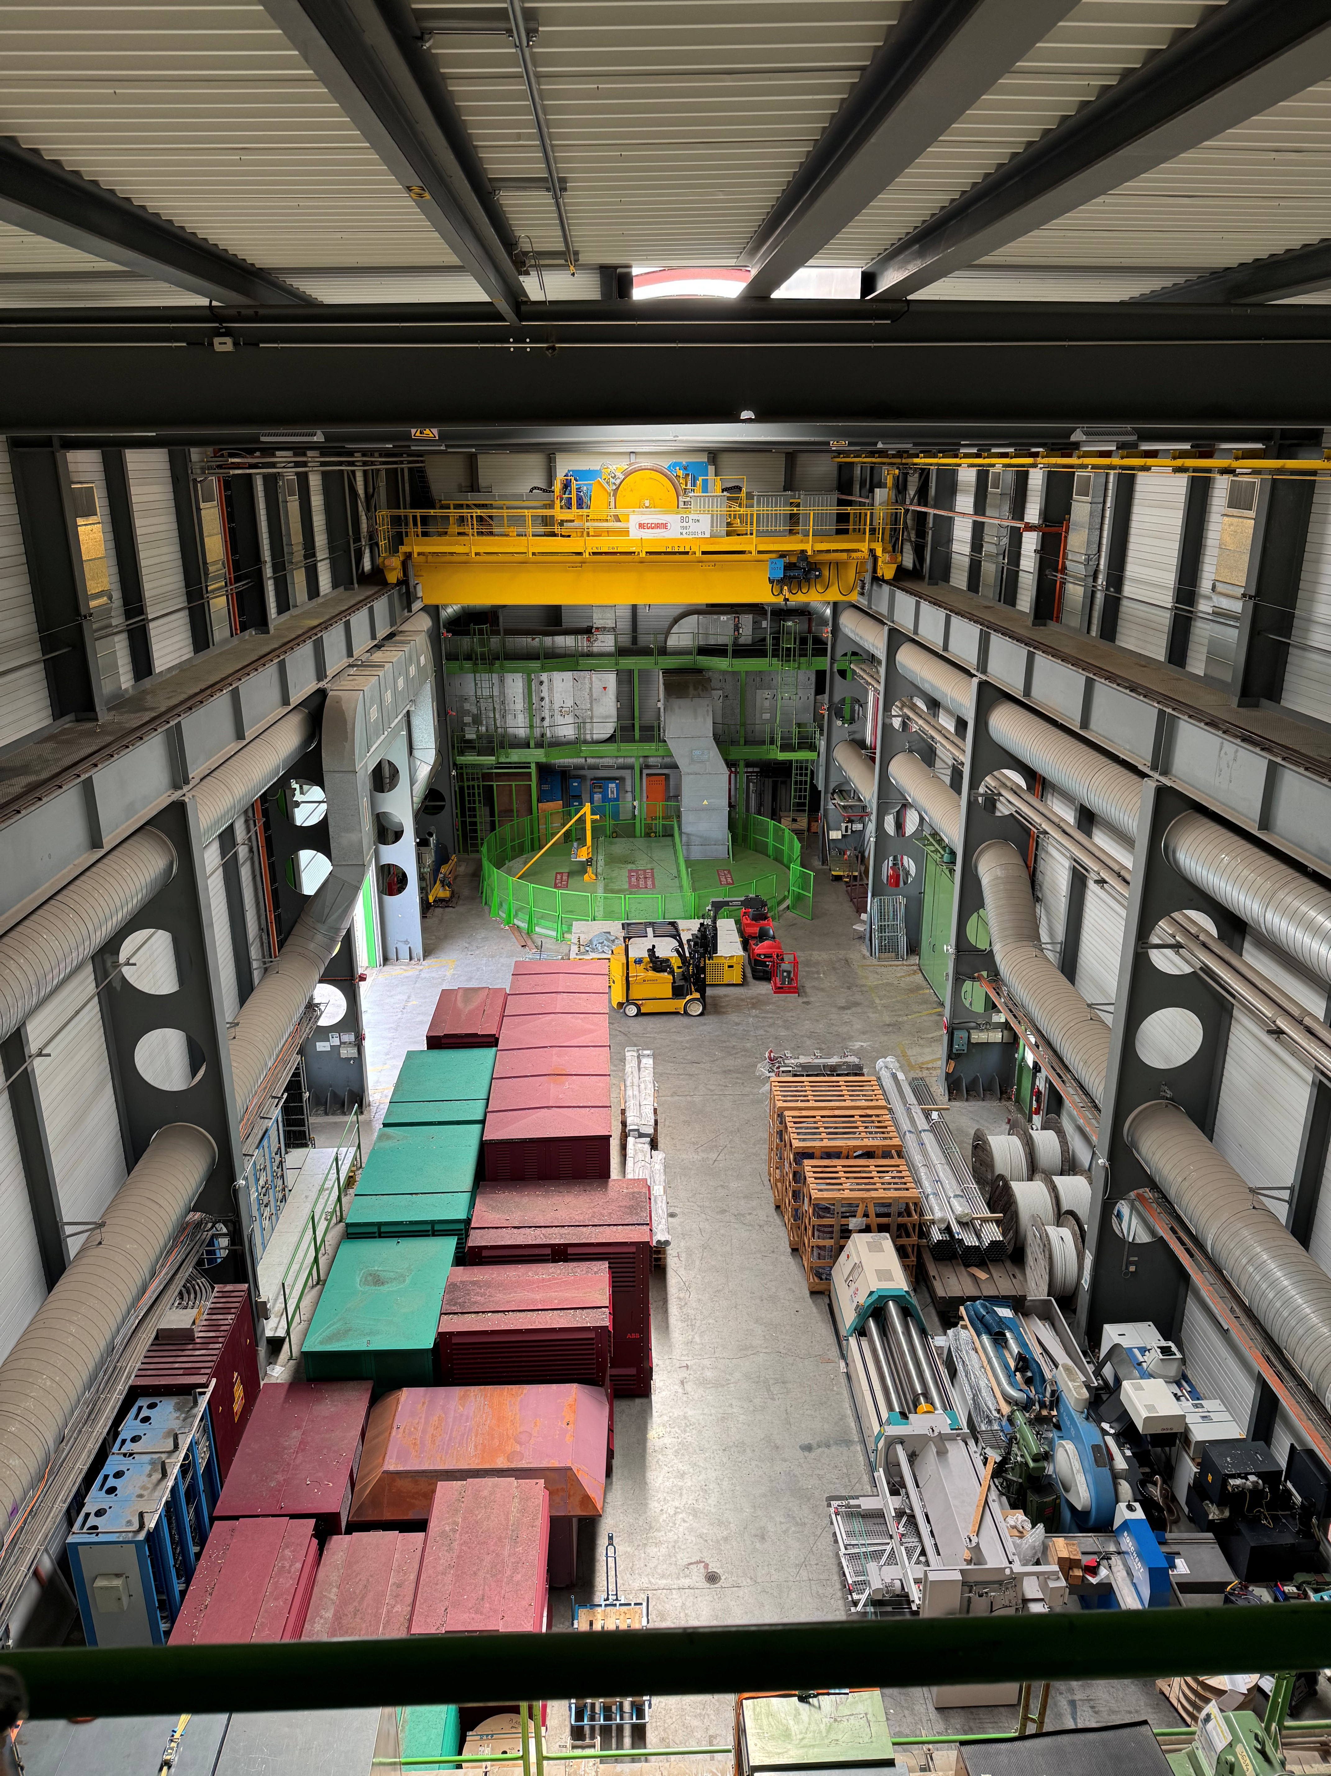
Present status
SC John Ellis Eduardo Granados
Oliver Buchmüller Richard Hobson

Slide 13
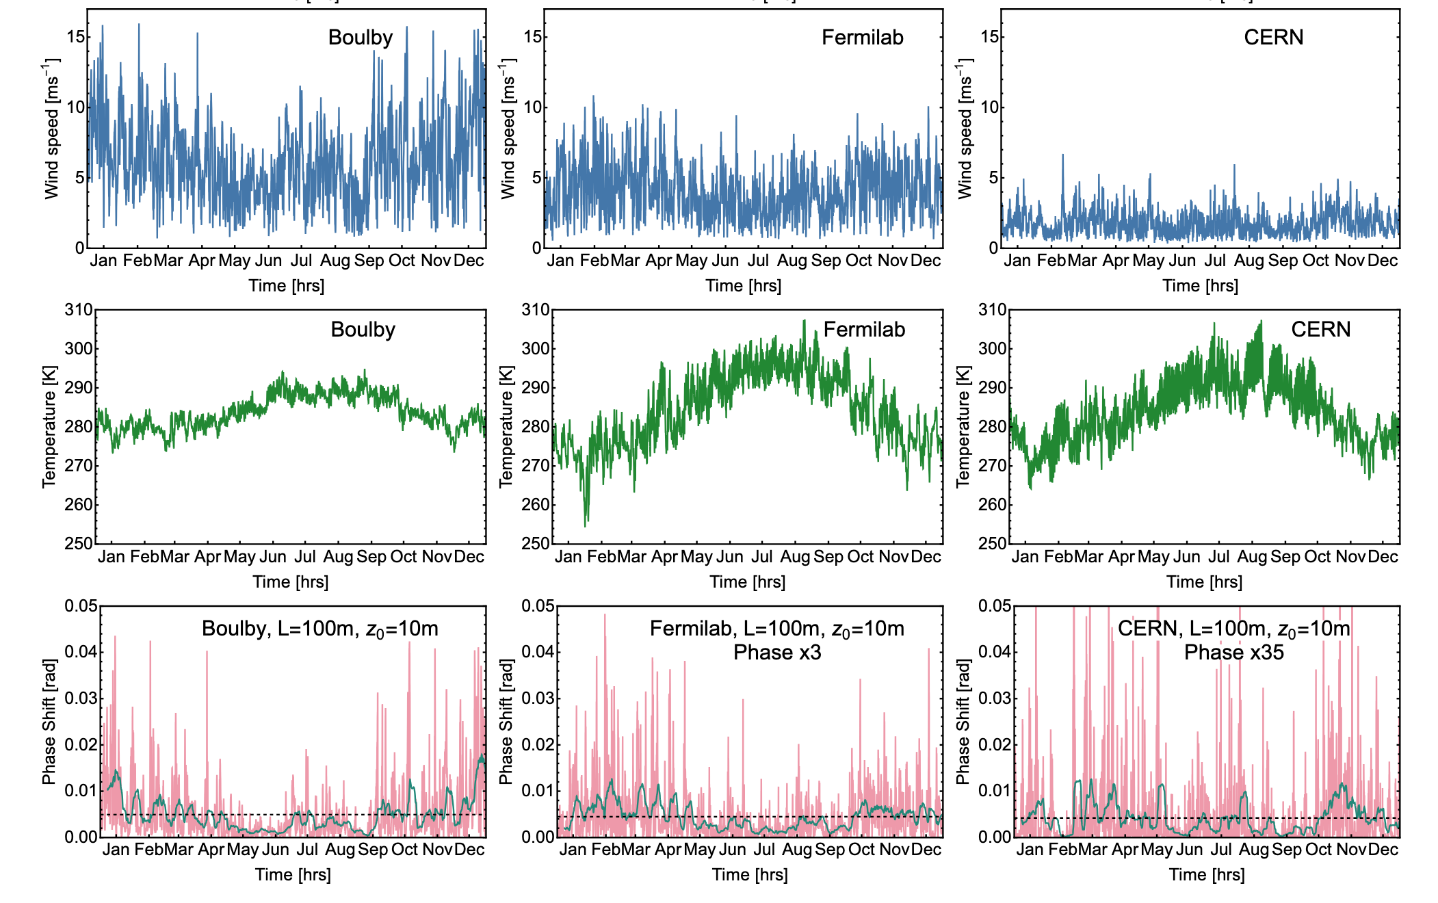
Site selection – many studies done already
Temperature GGN is much more variable and harder to characterise
However integrated weather data shows that CERN is by far the quietest for this noise source compared to similar sites like Boulby and Fermilab
This is mainly due to the lower average windspeeds

Slide 14
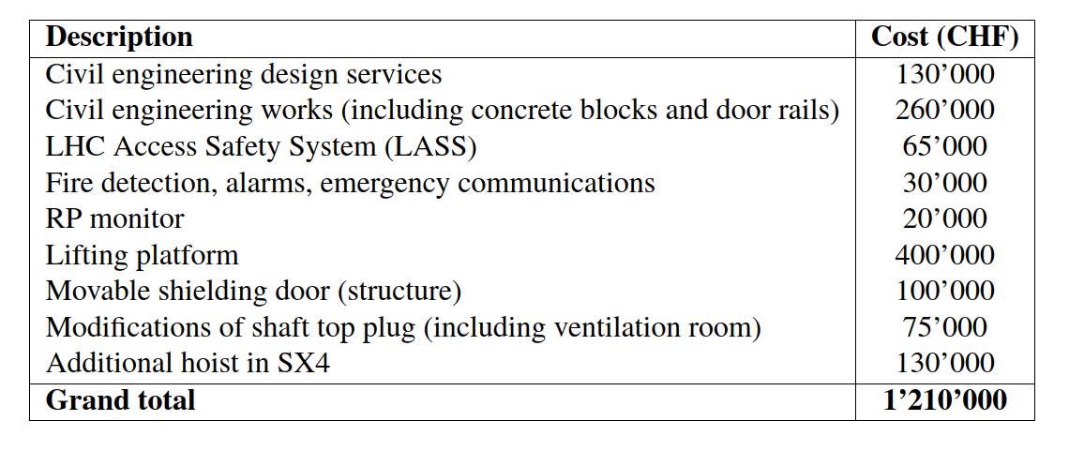
Revised “Class 4” cost estimates
Class 4: low margin from -15% to -30%; high margin from +20% to +50% (from DOE G 413.3-21A, Cost Estimating Guide)
Lower than Class 5 estimate of 2023 (1.5 MCHF), however non-essential ancillaries (chilling water production and distribution system and electrical and service cabling for the experiment) no longer included

Slide 15
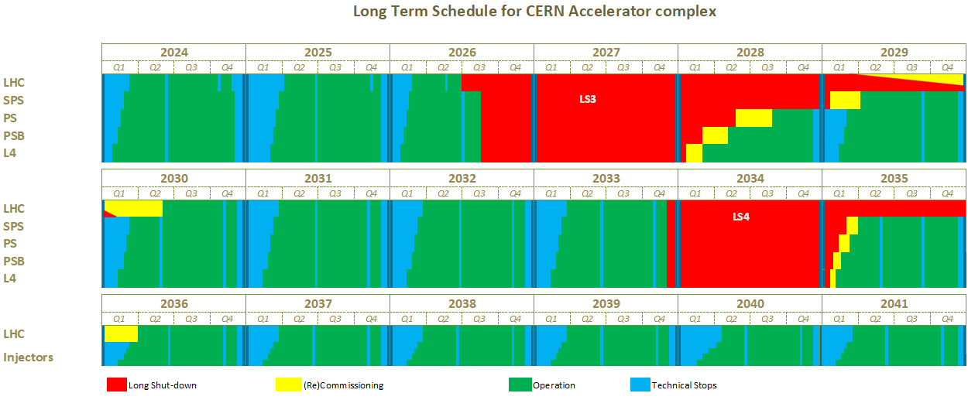
Tentative planning
Long-term CERN accelerator schedule

Slide 16
From Oliver Buchmüller

Slide 17
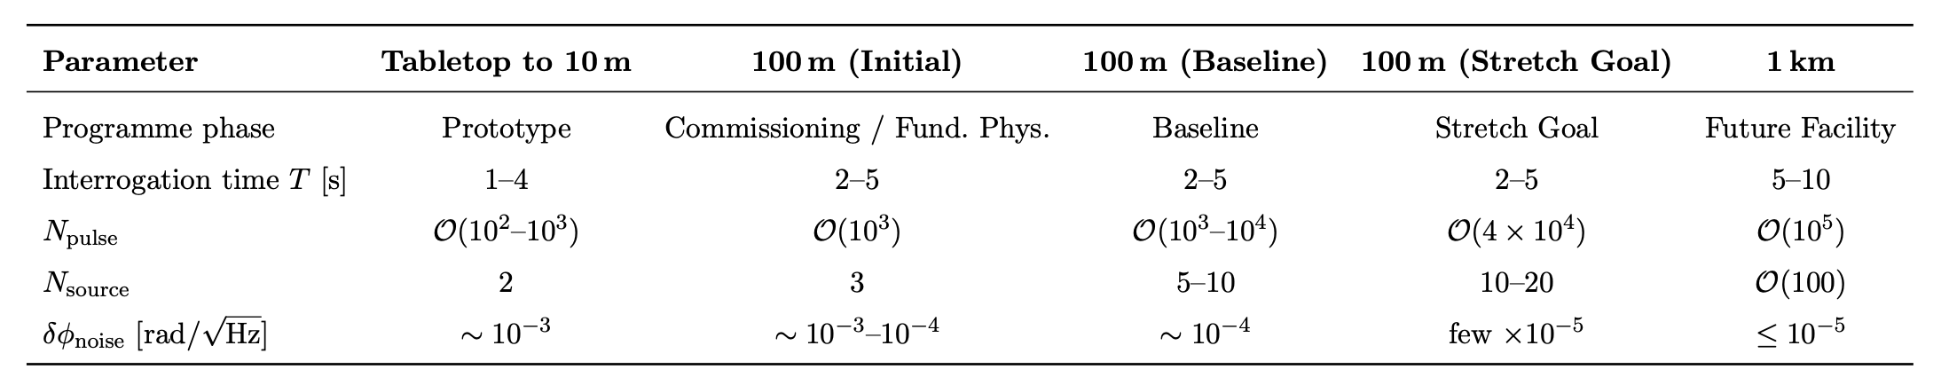
Facility Roadmap Parameters
From Oliver Buchmüller

Slide 18
Facility Roadmap Parameters
Prototype
Demonstration
AICE@CERN
Future Facility
Programme currently ongoing
at AION prototype (UK), MAGIS-10 Stanford, US and VLBAI Hannover, Germany
AICE facility programme of different stages. Baseline is used for most DM results
Several sites under active consideration, e.g. Porta Alpina, Boulby, SURF, etc
From Oliver Buchmüller

Slide 19
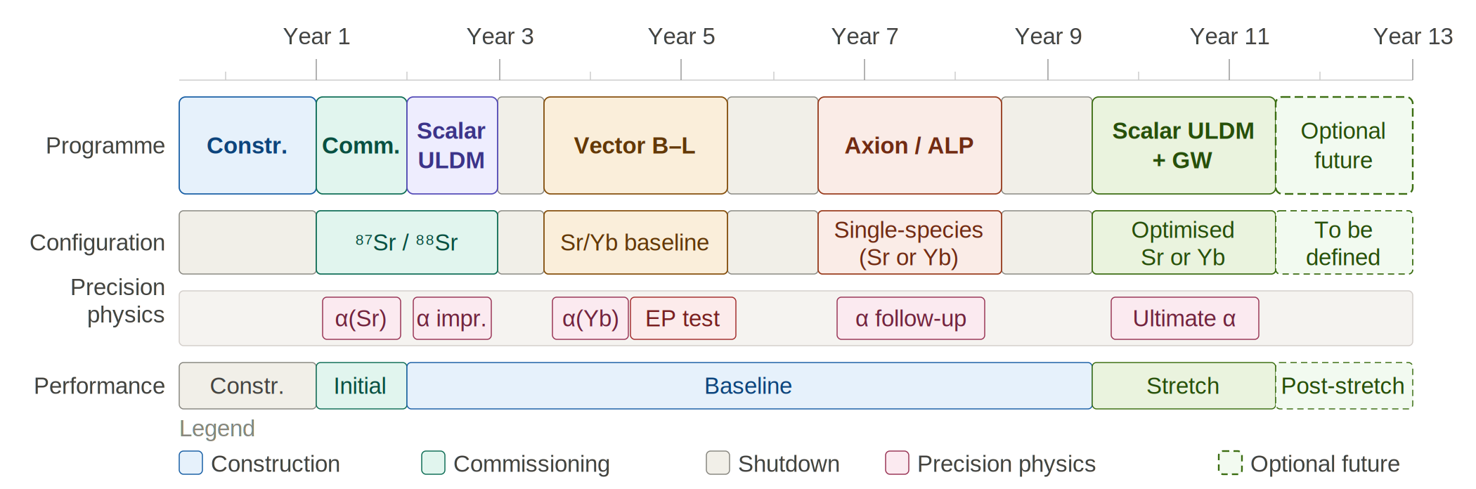
Possible timeline of AICE facility
Needless to say, uncertainties grow as we project further out.

Slide 20
AICE: A Staged Facility for Three Sciences
Dark Matter
Precision Physics
Gravitational Waves
Scalar and vector B–L: up to two orders of magnitude beyond current bounds.
Axion couplings: nucleon-spin (g_{aN}) and QCD gluon (1/f_{a}) channels.
Beyond ULDM: dilatonic and non-standard models.
Fine-structure constant α: sub-ppb, resolving the >5σ Cs–Rb tension
Equivalence Principle: η reach few × 10⁻¹⁶, one decade beyond Microscope.
Pioneers terrestrial access to the mid-frequency band (~0.03–3 Hz), bridging LIGO/Virgo and LISA and extending toward 10 Hz in future concepts.
FACILITY CONCEPT
Vertical baseline. 140 m shaft, ultra-high vacuum, flexible atom source installation .
Dual-species design. Cold ⁸⁷Sr and ¹⁷¹Yb fountains share the same vertical baseline.
Three running modes. Phase 1 gradiometer, Phase 2 dual-species comparison, Phase 3 full-shaft single cloud.
STRATEGIC POSITIONING
Terrestrial bridge. AICE is the natural step between current 10 m prototypes and future km-scale TVLBAI facilities, and a terrestrial complement to space missions.
Cost-effective scale. A single facility delivers science that would otherwise require several separate experiments.

Slide 21
AICE: Path to Technical Proposal (Q3 2026)
WE ARE HERE
• Mid-June 2026
Mar – April
May – June
Summer
Sep
Q3 2026
Define structure
& assign sections
Draft TP
(physics + technical)
Write TP &
prepare workshop
Submit TP
Workshop @ CERN
LHCC Review
Critical Path
Key Milestones Ahead
• Coordination across institutes
• Technical design maturity
• Funding narrative
• Jun '26 — Draft TP outline circulated
• Jul '26 — Internal review of TP draft
• Sep '26 — Community workshop at CERN
• Q3 '26 — Submission to LHCC

Slide 22
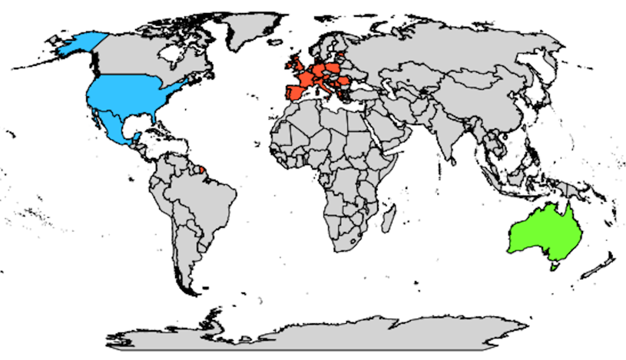
AICE is fully embedded in the TVLBAI Proto-Collaboration
Austria
Institute of Science and Technology Austria
Bosnia and Herzegovina
University of Sarajevo - Faculty of Science
Denmark
Aarhus University - Department of Physics and Astronomy
Estonia
National Institute of Chemical Physics and Biophysics (KBFI)
France
University of Toulouse III – Paul Sabatier
École Normale Supérieure
Germany
Technische Universität Darmstadt
Leibniz University Hannover
Ulm University
Greece
Laboratory of Theoretical and Computational Physics, National Technical University of Athens (LThCP)
Foundation for Research and Technology – Hellas (FORTH)
Laboratory of Astronomy, Aristotle University of Thessaloniki (AUTH)
Ireland
Tyndall National Institute
Italy
University of Florence – DFA
LENS Laboratory
University of Pisa
Malta
University of Malta
Netherlands
University of Amsterdam
Poland
Space Technology Centre, AGH University of Science and Technology, Krakow
Center for Theoretical Physics, Polish Academy of Sciences (CTP PAS)
University of Warsaw
Portugal
Instituto de Telecomunicações
Romania
Institute of Space Science
Serbia
Institute of Physics Belgrade (IPB)
South East European Network for Mathematical and Theoretical Physics (SEENET-MTP) Centre
Spain
Institute of Theoretical Physics (IFT UAM-CSIC)
Institute of Corpuscular Physics (IFIC), Valencia
Autonomous University of Madrid (UAM)
Institut de Fisica d'Altes Energies (IFAE)
United States
University of Arizona
Johns Hopkins University
Stanford University
Northwestern University
University of Delaware
University of Kentucky
Bates College, Maine
Switzerland
University of Geneva
CERN
University of Neuchâtel
University of Zurich
United Kingdom
Imperial College London
King's College London
University College London (UCL)
University of Birmingham
University of Cambridge
University of Liverpool
University of Manchester
University of Oxford
University of Southampton
University of Sussex
University of Warwick
UKRI-STFC RAL
Mexico
Autonomous University of Aguascalientes (UAA)
Observers (Under Evaluation)
Germany
German Aerospace Center (DLR)
Iran
Isfahan University of Technology
United States
Fermi National Accelerator Laboratory (Fermilab)
Jet Propulsion Laboratory (JPL)
55 institutions from 21 countries
TVLBAI Chair: Prof. O. Buchmueller
Australia
University of
Western Australia

Slide 23
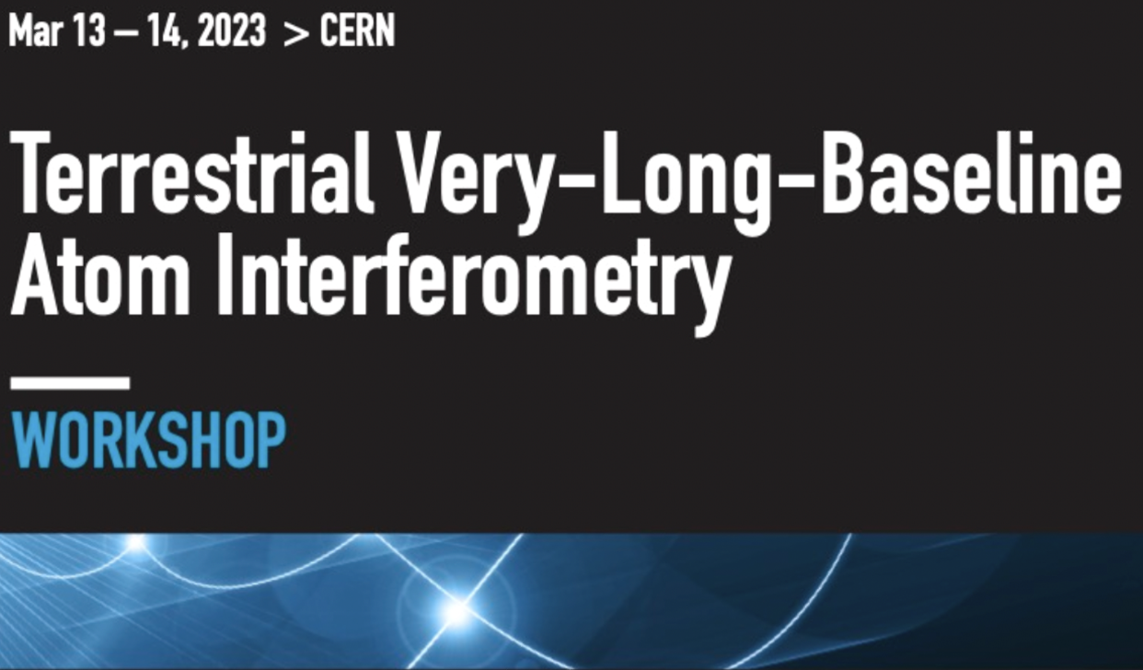
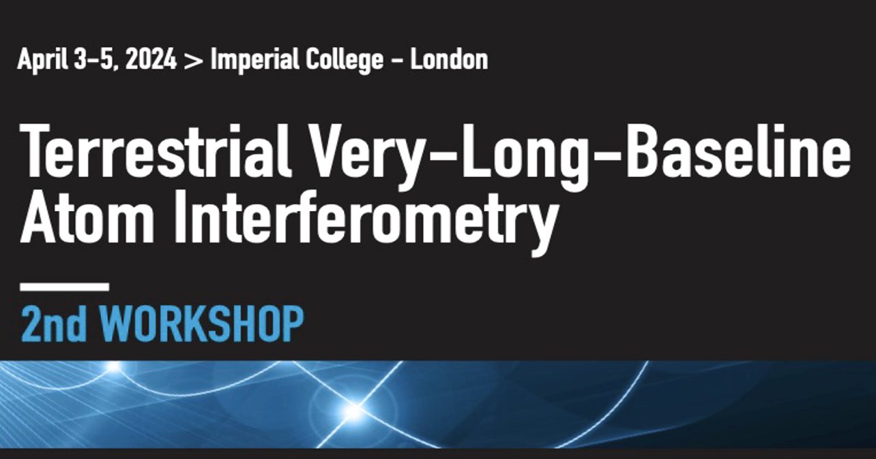
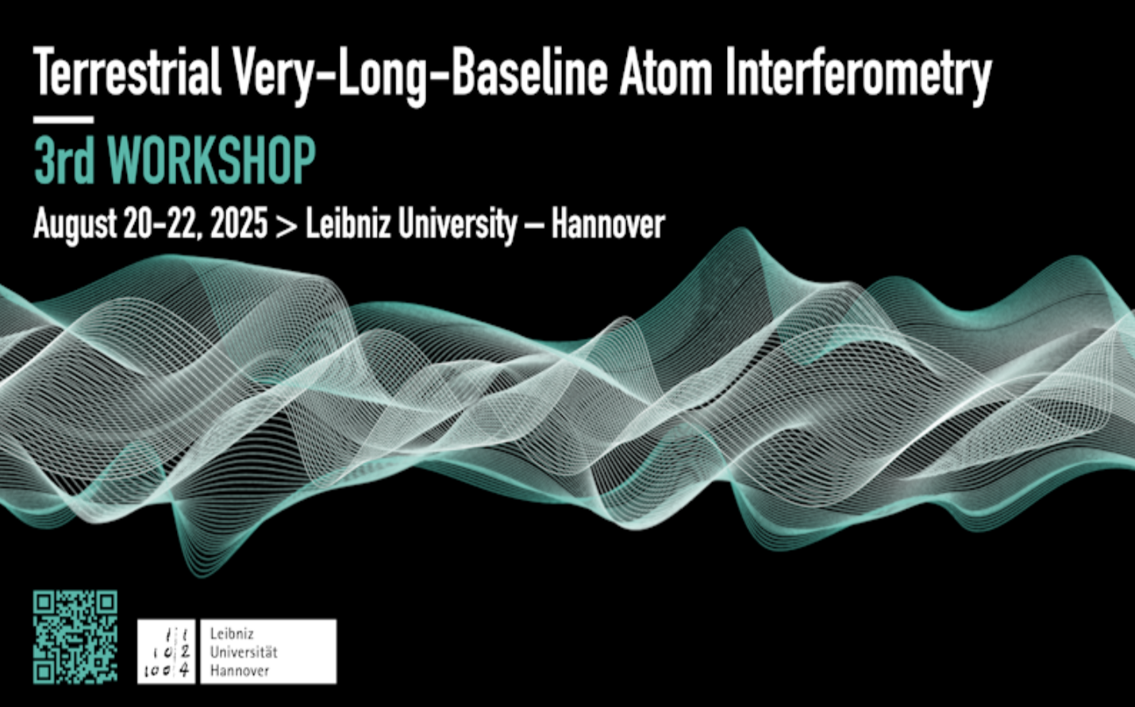
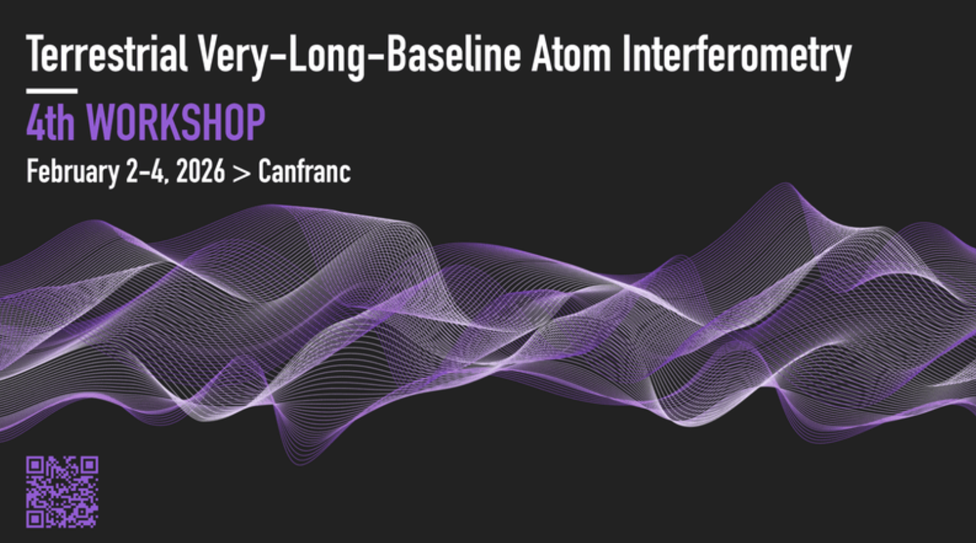

Slide 24

Coinciding with the submission of the AICE Technical Proposal to CERN
REGISTRATION NOW OPEN
indico.cern.ch/event/1687915/registrations/
Workshop page: indico.cern.ch/event/1687915/
Hybrid event, but in-person participation strongly encouraged.
Organisers: Oliver Buchmueller · John Ellis · Sergio Calatroni: Contact: sergio.calatroni@cern.ch · oliver.buchmuller@cern.ch

Slide 25
Summary
AICE: long-term atom-interferometer facility planned at CERN in PX46.
Technical Proposal: in advanced preparation, following the invitation from the LHCC and the CERN Research Board.
Ultralight dark matter: broad programme with sensitivity across a wide mass range and many dark-matter scenarios.
Precision tests of fundamental physics: equivalence principle and variations of fundamental constants such as α, all in the same apparatus.
Gravitational-wave pathfinder: opening the mid-frequency band between LISA and ground-based interferometers.
Aligned with CERN’s physics mission: flagship quantum-technology experiment with diverse science output, attracting new communities & new funding.

Slide 26
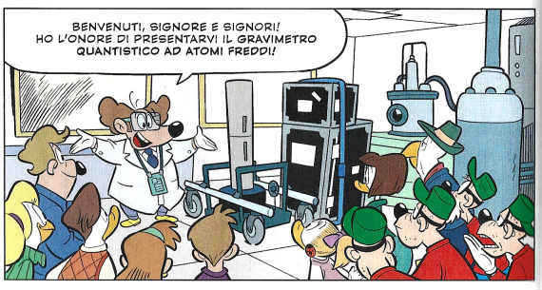

Slide 28




Simple Example: Two Atomic Clocks
Atom clock
Atom clock
Phase evolved by atom after time T
Time
Courtesy of Jason Hogan!

Slide 29
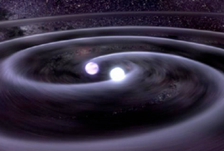


Simple Example: Two Atomic Clocks
GW changes light travel time
Time
Atom clock
Atom clock
Courtesy of Jason Hogan!

Slide 30


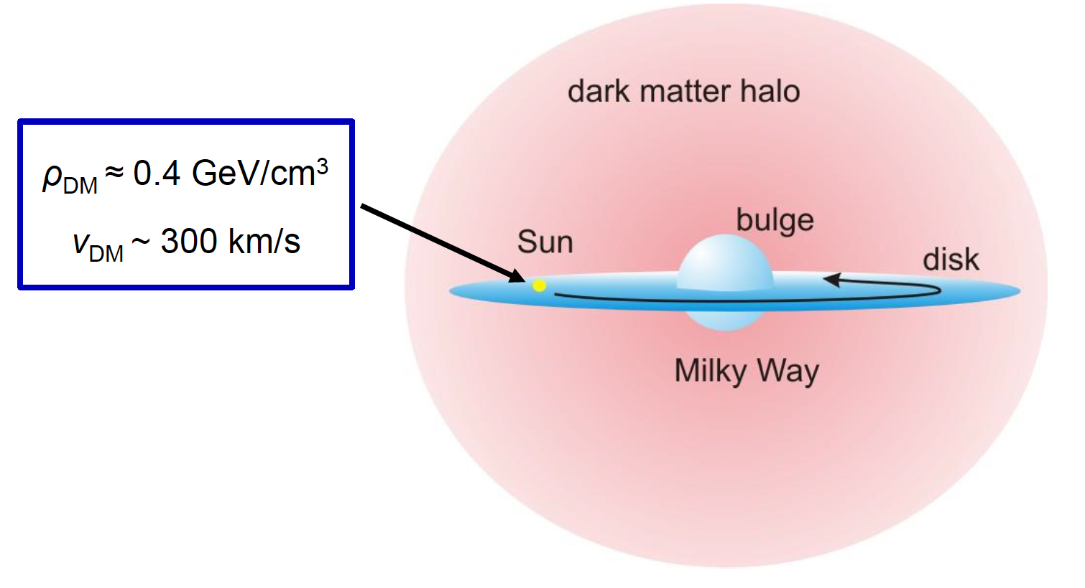
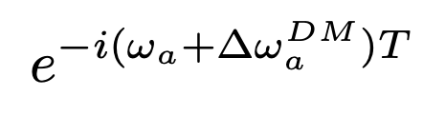
Simple Example: Two Atomic Clocks
DM induced oscillation
Dark matter coupling
Time
DM cloud changes atom frequency
DM coupling
causes time-varying
atomic energy levels:
Time
Atom clock
Atom clock
Courtesy of Jason Hogan!

