Slide 1
Novel BSM approach could leave unique signatures on the SGWB
University of Milan
2026
Usha Raut

Slide 2
Rise Of Graviational Wave Astronomy
Spectacular advances by LIGO, and other detectors in recent years.
…making gravitational wave astronomy a very promising window to explore the universe.
Gravitational waves interact very weakly with matter.
Due to such a minimal interaction, they can carry vital information, especially about the very early universe
Also allows them to permeate the entire universe, creating a background, referred to as the SGWB.
Identifying the possible sources as coming from a cosmological origin versus an astrophysical origin is considered one of the main challenges today.
We mostly rely on Beyond Standard Model (BSM) theories in order to study possible cosmological sources..

Slide 3
Promising Field of SGWB
SGWB refers broadly to a superposition of several weak independent unresolved gravitational-wave sources.
.. could include various cosmological sources from early universe scenarios.
…for example, stochastic processes in the early Universe.
relic gravitational waves from an inflationary epoch.
cosmological phase transitions in the early universe, including QCD first order phase transition.
BSM theories provide candidates for possible cosmological sources.
detection of any of the primordial source for SGWB would be an exciting discovery.

Slide 4
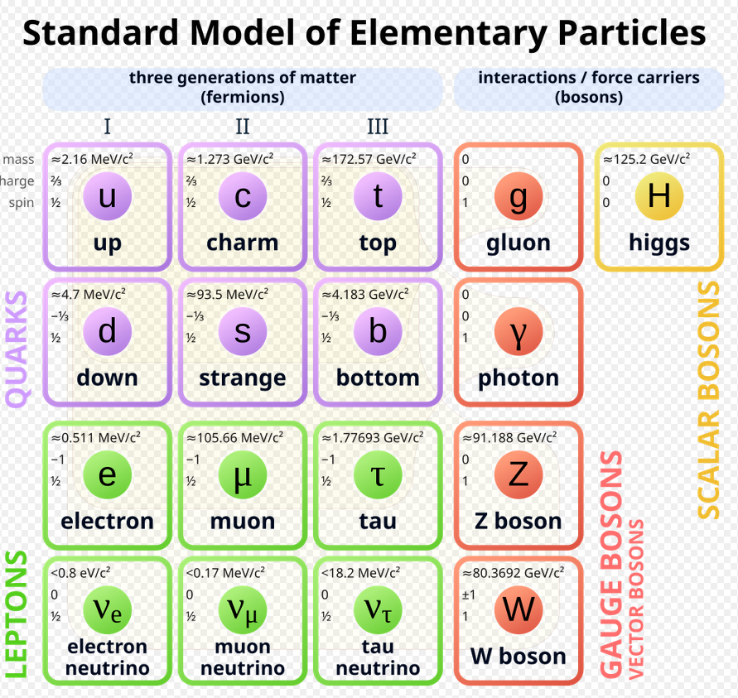
Credit: Wikimedia

Slide 5
BUT… where is Gravity? Why is it Missing?
Enormous successes of SM with describing elementary particles, and their interactions.
But.. Gravity is missing altogether!
Hundreds of attempts have been made over several decades …
But still no success in including gravity in any meaningful way in Standard Model.
Generally seen as an acceptable situation..
..but is consistently being swept under the rug.

Slide 6
Attempts to Add Gravity Continue..
Current Approach to integrating Gravity into the standard model:
Via the AdS/CFT gauge-gravity duality.
Initially very promising but increasingly been seen as unsustainable and unable to describe QCD.
Relies on an anti-de-Sitter spacetime as its underlying structural manifold…
…that clashes with reality.
Recent astrophysical experiments, involving supernova, point to a deSitter spacetime.

Slide 7
Gravity still not a part of SM
Bottom Line: The AdS/CFT gravity-gauge duality is not a path to unify gravity with the other fundamental interactions:
..In fact, the AdS/CFT cannot even be applied to QCD physics.
Gravity still not included in Standard Model

Slide 8
Time for A Paradigm Shift?
We present a novel attempt to include gravity in the Standard Model.
The new proposed BSM “the strong or Nuclear Gravity approach”, is basically a geometric approach based on GR, rather than QFT.
General idea first proposed by A. Salam, who pioneered the use of GR methods to study the strong interactions.
Ref: A. Salam and D. Strathdee: Phys. Rev. D16 (1977) 2668; D18 (1978) 4596;
Several other authors worked along similar lines:P.Caldirola, M.Pavsic and E.Recami: Nuovo Cimento B48 (1978) 205; Phys. Lett. A66 (1978) 9;
This GR Approach eventually got sidelined with string theory rise.

Slide 9
Introducing a new gauge/gravity duality
In the Geometric Dual Approach, referred to as GDA, a new gauge/gravity duality is introduced.
Conceptually very different from the so-called AdS/CFT duality.
based on general relativistic arguments, rather than field-theoretic methods
leads to the interesting conclusion:
that a strong-field version of gravity (also called nuclear gravity, or particle-level gravity) naturally emerges in the IR sector of QCD
Same conclusions also been drawn by several other researchers.
..has been pretty much established as a traditionally alternate route to the infra-red sector of Quantum Chromodynamics.

Slide 10
Highlights from New BSM Approach
A strong ‘color’ nuclear level gravity force can lead to color confinement in accordance with GR.
Color confinement in QCD essentially forbids the existence of isolated quarks and gluons.
Can be compared to the well-known gravitational confinement provided by black holes.
Color confinement could lead to a dual description of the strong interactions in terms of the usual gravitational confinement of matter inside black holes. (Hence the GDA) name
Two equal descriptions for the confinement of quarks inside hadrons that are dual to each other:
U. Raut, A General Relativistic Approach to Non-Perturbative QCD, Jour. High Energy Phys. Grav, 2023
Also see ‘Extreme States of Matter”(Helmut Satz), published by Springer, 2006

Slide 11
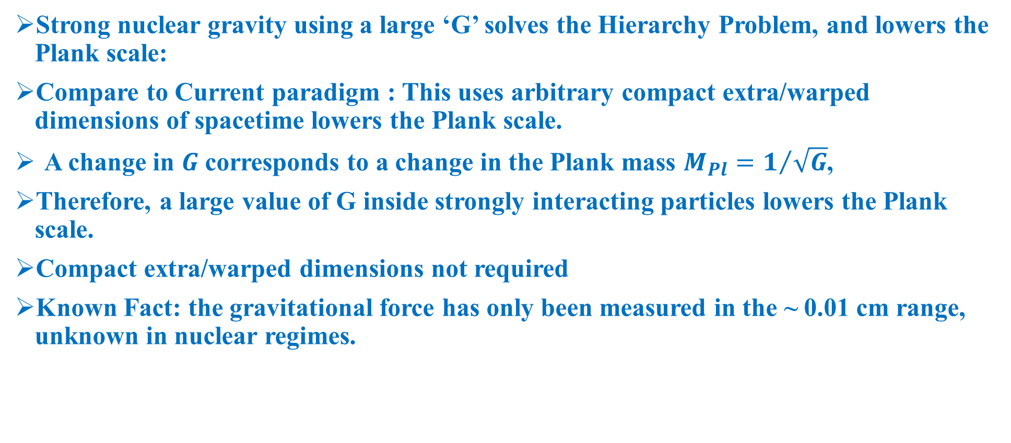
New Paradigms for Hierarchy problem and TeV scale Gravity
Strong nuclear gravity using a large ‘G’ solves the Hierarchy Problem, and lowers the Plank scale:
Compare to Current paradigm : This uses arbitrary compact extra/warped dimensions of spacetime lowers the Plank scale.
A change in $G$corresponds to a change in the Plank mass $M_{P⁢l}=1/{\sqrt{G}}$,
Therefore, a large value of G inside strongly interacting particles lowers the Plank scale.
Compact extra/warped dimensions not required
Known Fact: the gravitational force has only been measured in the ~ 0.01 cm range, unknown in nuclear regimes.

Slide 12
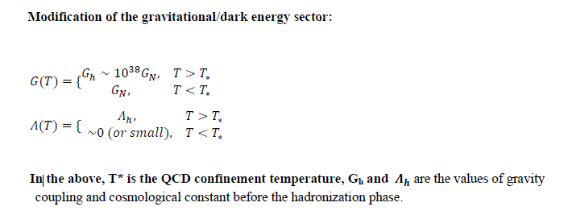
G as a step function versus a time varying function

Slide 13
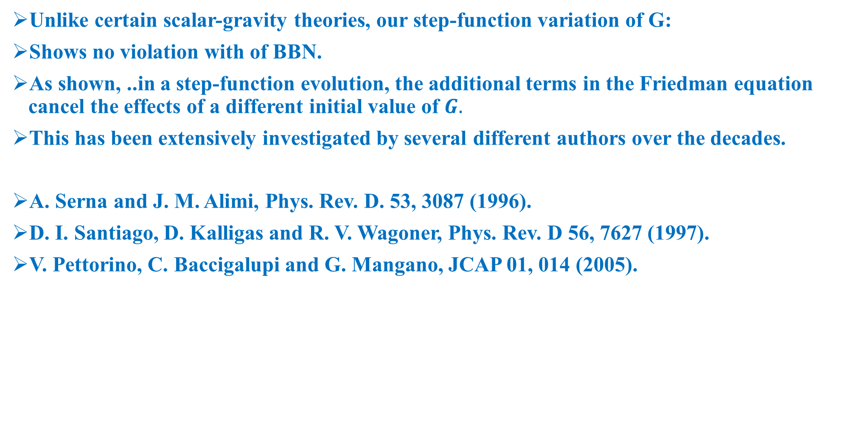
Theoretical Feasibility of a High G, High $Λ$ scenario
Unlike certain scalar-gravity theories, our step-function variation of G:
Shows no violation with of BBN.
As shown, ..in a step-function evolution, the additional terms in the Friedman equation cancel the effects of a different initial value of $G.$
This has been extensively investigated by several different authors over the decades.
A. Serna and J. M. Alimi, Phys. Rev. D. 53, 3087 (1996).
D. I. Santiago, D. Kalligas and R. V. Wagoner, Phys. Rev. D 56, 7627 (1997).
V. Pettorino, C. Baccigalupi and G. Mangano, JCAP 01, 014 (2005).

Slide 14
Summary of Approach
New geometrical version of the gauge/gravity correspondence introduced.
promises to be a new and effective tool for exploring the non-perturbative IR segment of QCD.
.. strong nuclear gravity force acting in nuclei might leave ‘signatures’ of HFGWs on phenomenology at LHC and RHIC, including high and ultra-high frequency Gravitational Waves
Focus today will be on possible signatures in the SGWB from QCD phase transitions in the early universe.

Slide 15
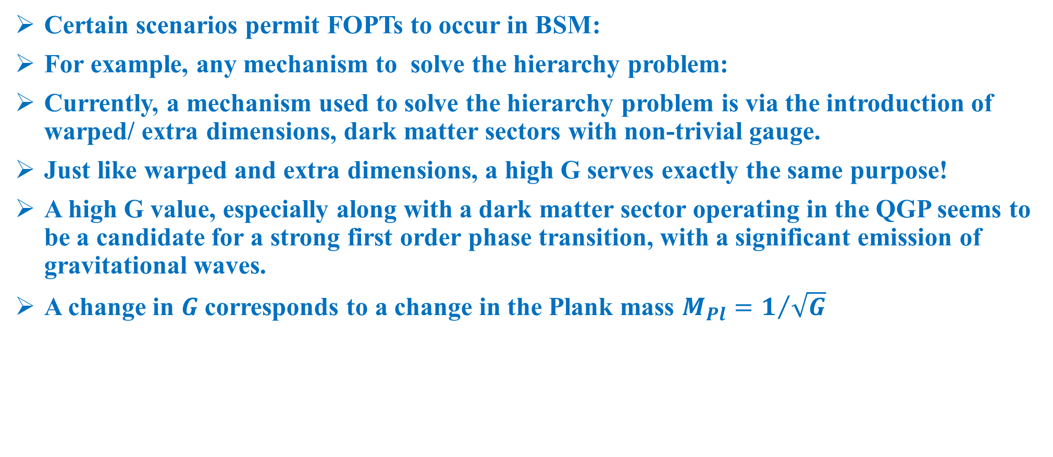
BSM and First Order Phase Transitions
Certain scenarios permit FOPTs to occur in BSM:
For example, any mechanism to solve the hierarchy problem:
Currently, a mechanism used to solve the hierarchy problem is via the introduction of warped/ extra dimensions, dark matter sectors with non-trivial gauge.
Just like warped and extra dimensions, a high G serves exactly the same purpose!
A high G value, especially along with a dark matter sector operating in the QGP seems to be a candidate for a strong first order phase transition, with a significant emission of gravitational waves.
A change in $G$corresponds to a change in the Plank mass $M_{P⁢l}=1/{\sqrt{G}}$

Slide 16
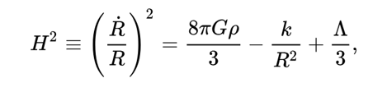
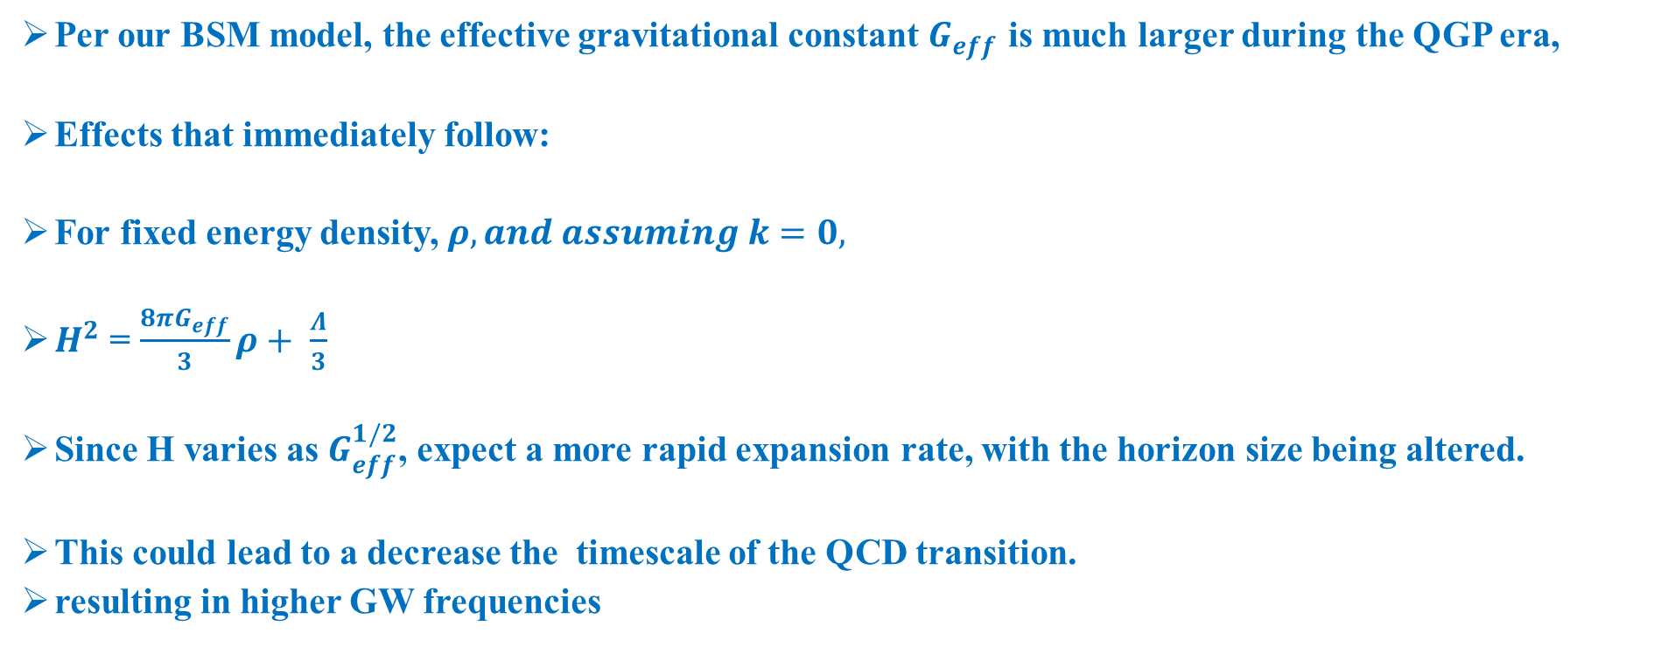
Other Expected Effects of a much larger G.
We use the following independent Friedmann equation to model a homogeneous isotropic universe.
Per our BSM model, the effective gravitational constant $G_{eff}$ is much larger during the QGP era,
Effects that immediately follow:
For fixed energy density, $ρ, and assuming k=0,$
$H^{2}$ = $\frac{8πG_{eff}}{3}ρ+ \frac{Λ}{3}$
Since H varies as $G_{eff}^{1/2}$, expect a more rapid expansion rate, with the horizon size being altered.
This could lead to a decrease the timescale of the QCD transition.
resulting in higher GW frequencies

Slide 17
Potential Gravitational Wave Sources
Pre-Hadronization and Transition Phase:
Strong Gravitational Waves can originate from a potential FOPT during QGP-Hadronic matter transition
QGP known to behave as a near-perfect fluid.
Bubbles expand within the background fluid. Kinetic energy stored in the bubble walls are released during bubble collisions.
Transformed into gravitational waves that carry away information about the phase transition.
GWs also coming from Sound waves from the Expanding bubbles.
Turbulent motion of charged particles in the QGP background fluid can form magnetohydrodynamic (MHD) turbulence
..another significant source of gravitational waves

Slide 18


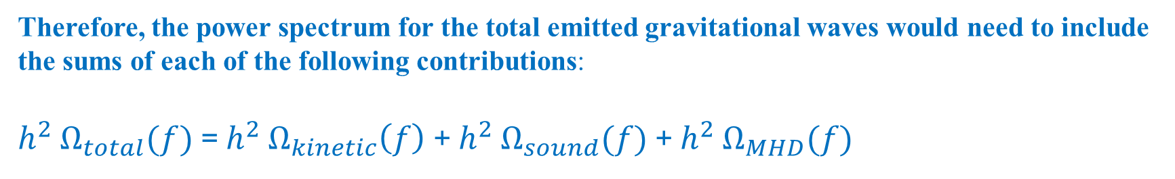
Total Power Spectrum
Therefore, the power spectrum for the total emitted gravitational waves would need to include the sums of each of the following contributions:
$h^{2}$ $Ω_{total}(f)$ = $h^{2}$ $Ω_{kinetic}\left(f\right)$ + $h^{2}$ $Ω_{sound}(f)$ + $h^{2}$ $Ω_{MHD}(f)$
The energy density spectral function that can be used to describe the stochastic gravitational wave background:
The critical energy density today that will be needed to close the universe can be expressed as:
$H_{0}$ is the current Hubble rate

Slide 19
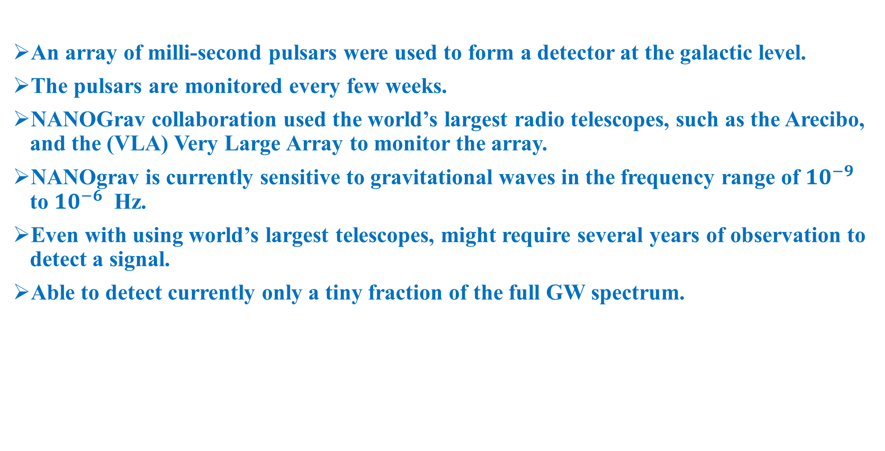
The NANOGrav 15 yr Data Set: Evidence for a Gravitational-wave Background In July 2023
An array of milli-second pulsars were used to form a detector at the galactic level.
The pulsars are monitored every few weeks.
NANOGrav collaboration used the world’s largest radio telescopes, such as the Arecibo, and the (VLA) Very Large Array to monitor the array.
NANOgrav is currently sensitive to gravitational waves in the frequency range of ${10}^{−9}$ to ${10}^{−6}$ Hz.
Even with using world’s largest telescopes, might require several years of observation to detect a signal.
Able to detect currently only a tiny fraction of the full GW spectrum.

Slide 20
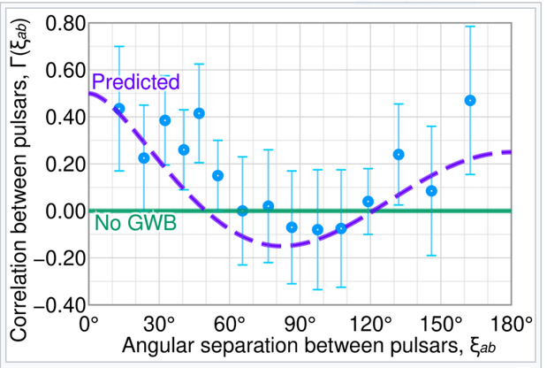
The blue dots show the correlation observed between pulsars in the NANOgrav (2023) study versus the angular separation between those pulsars.
The theoretically predicted correlation curve is the Hellings-Downs model curve (indicated in purple)
The solid green line refers to the case when there is no gravitational wave background at all.

Slide 21
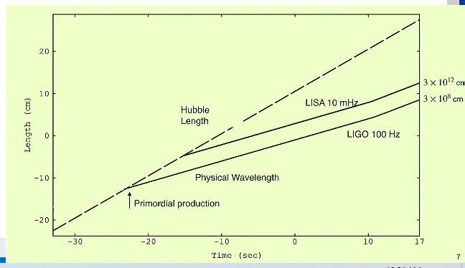
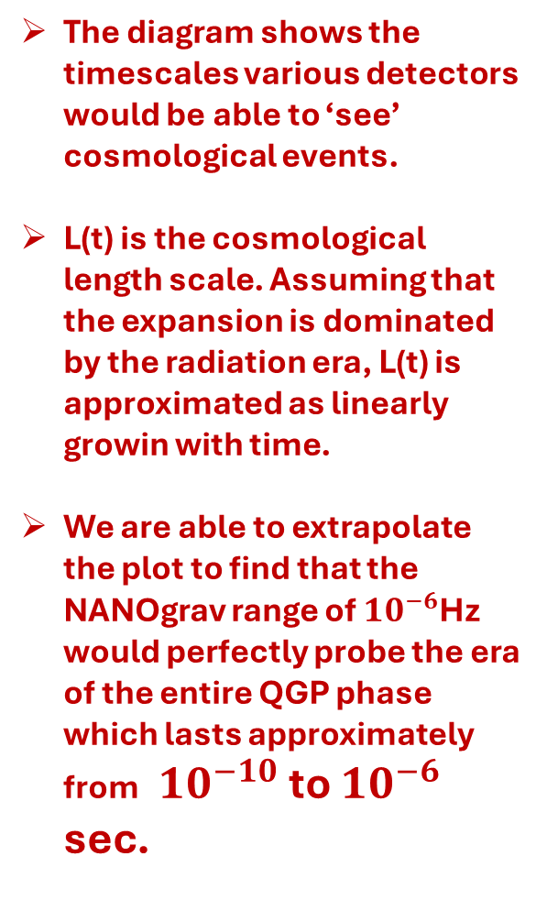
The timescales various detectors would be able to ‘see’ cosmological events.
The diagram shows the timescales various detectors would be able to ‘see’ cosmological events.
L(t) is the cosmological length scale. Assuming that the expansion is dominated by the radiation era, L(t) is approximated as linearly growin with time.
We are able to extrapolate the plot to find that the NANOgrav range of ${10}^{−6}$Hz would perfectly probe the era of the entire QGP phase which lasts approximately from ${10}^{−10}$ to ${10}^{−6}$ sec.
(Diagram by Bruce Allen, Courtesy of Institute of Physics, IOP) Better diagram (next slide)

Slide 22
SGWB signals vs LIGO signals! Very Different!
The Hellings and Downs correlation curves are what the PTA and or LISA detectors would be looking for.
Not the ‘binary chirp’ observed by the LIGO collaboration
The GW150914 signal, picked up by LIGO was very distinctive (the final inspiral and merger of two stellar-mass black holes),
But… any possible SGWB signal would be much harder to pick up.
.. signal likely to be a result of superposition of millions of unresolvable signals associated with various sources.
General Prediction: waves from FOPT in our BSM model would be detected by either LISA or PTA SGWB collaborations.

Slide 23
Conclusion
The proposed theory is theoretically feasible and unlike scalar-tensor theories does not violate any known physics, in spite of a changing G.
Is phenomenologically falsifiable, which makes it very much a scientifically sound hypothesis.
Predictions are very strong and can directly involve current NANOgrav detectors.
Obtaining actual cosmological signatures is a highly desirable outcome, as it can shed light on inflation, and other early universe scenarios.
Thank you!!

