Slide 1


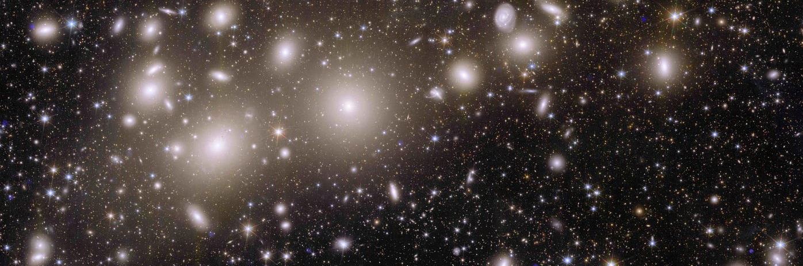
A new era for Galaxy Clusters
Testing gravity and the dark sector using mass profile reconstructions
Lorenzo Pizzuti
Dipartimento di Fisica G. Occhialini – Università degli Studi Milano Bicocca
16/06/2026 1° BiCoQ Conference: from gravity to particles

Slide 2

Anatomy of a galaxy cluster
Typically a few Mpc across, $M∼{10}^{14} ÷{10}^{15} M_{⊙}$
${10}^{2} ÷{10}^{3}$ galaxies ($∼5\%$ of the total mass)
Abell 2390 Credits: ESA/XMM-Newton/Euclid/Euclid Consortium/NASA

Slide 3
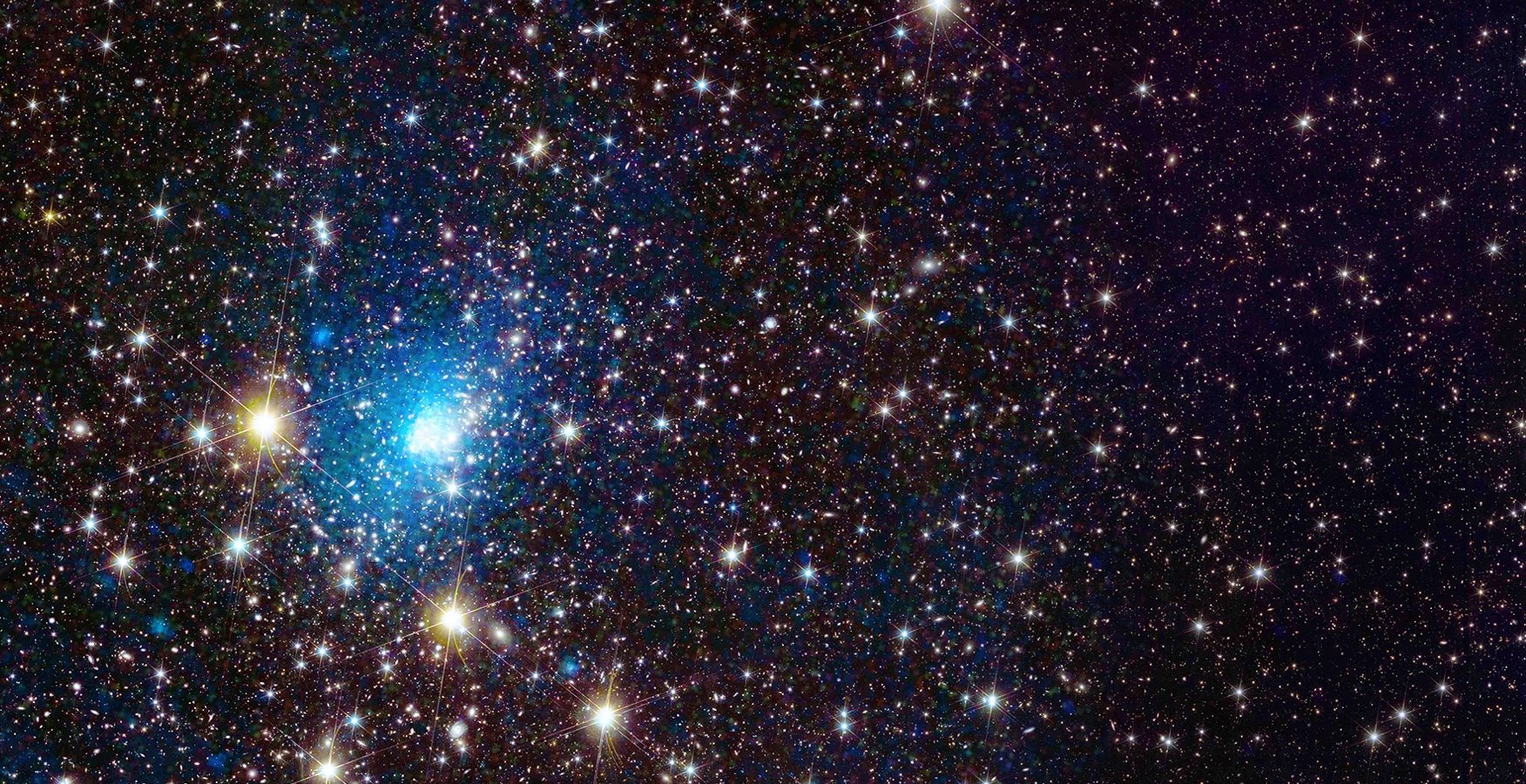

Anatomy of a galaxy cluster
Typically a few Mpc across, $M∼{10}^{14} ÷{10}^{15} M_{⊙}$
${10}^{2} ÷{10}^{3}$ galaxies ($∼5\%$ of the total mass)
Hot gas at $T∼{10}^{7} −{10}^{8} K$: Intra Cluster Medium (ICM), X-ray emission via bremmstrahlung ($∼10−15\%$ of the total mass)
Cold Dark matter component ($∼80−85\%$ of the total mass)
Abell 2390 Credits: ESA/XMM-Newton/Euclid/Euclid Consortium/NASA
Excellent natural laboratories between cosmology and astrophysics

Slide 4
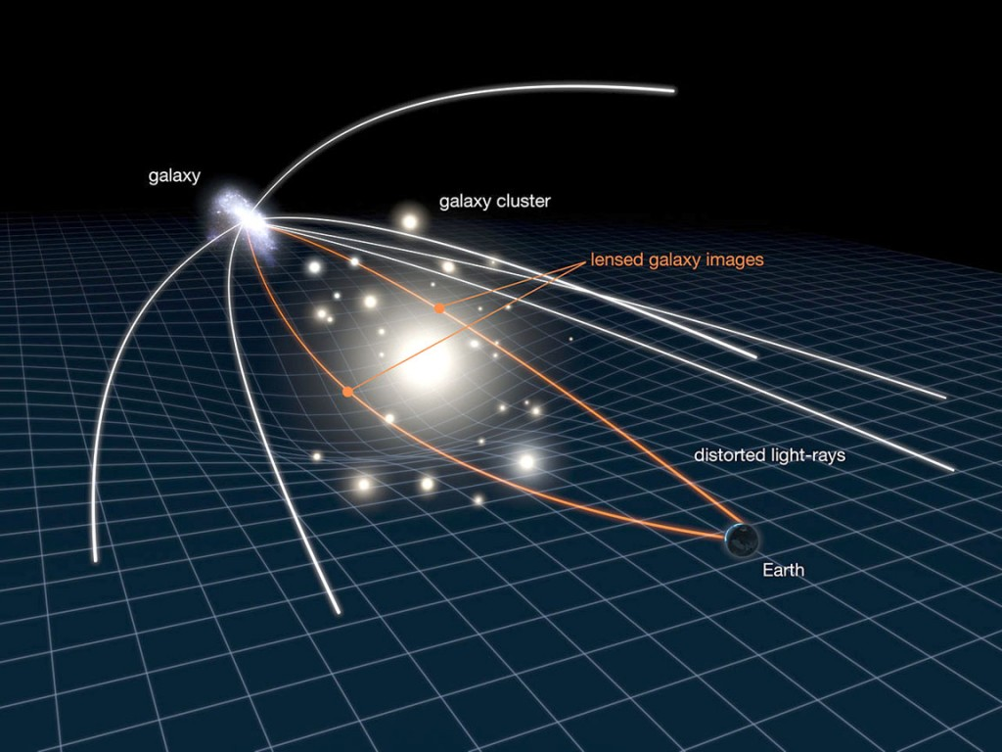
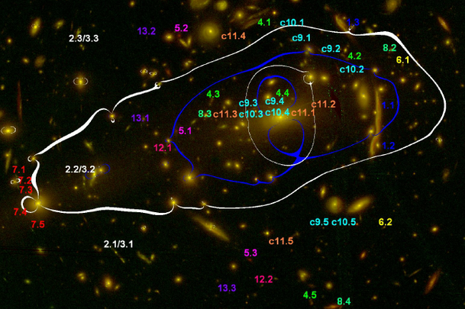

Galaxy cluster mass profiles: lensing
Light deflected by gravitational potential $→$
estimation of mass by distortion of background sources
Strong lensing analysis: projected mass profile in the inner cluster region
Weak lensing analysis: projected mass profile in the outer cluster region
High-quality imaging and photometric data required
Assumptions in de-projection to recover the 3D mass

Slide 5
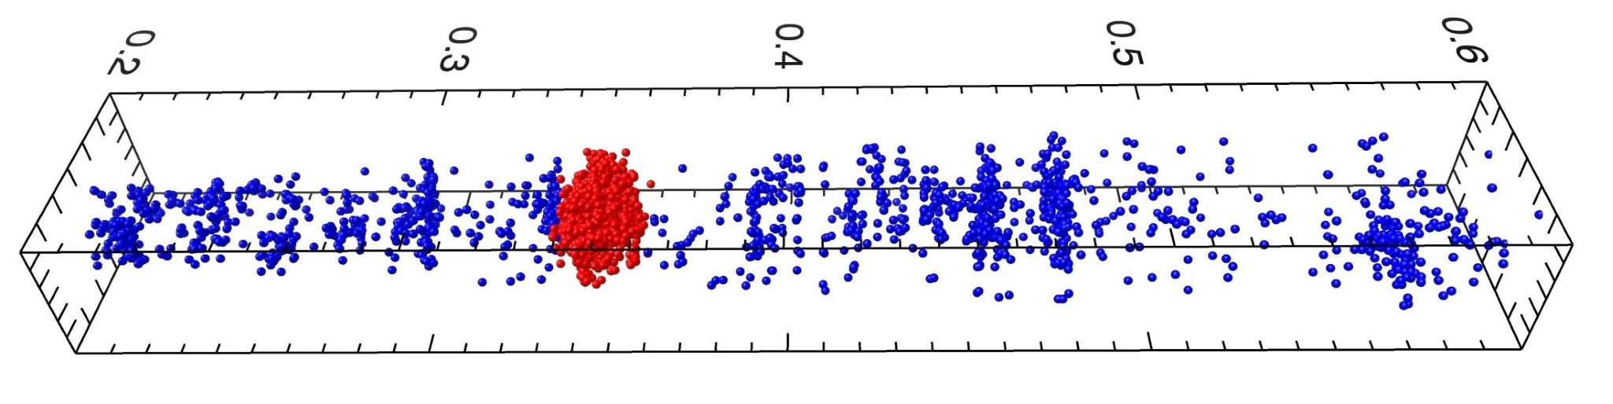
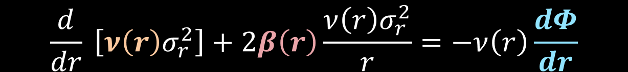
Galaxy cluster mass profiles: kinematics
Spherical Jeans’ equation:
$$\frac{d}{dr} \left[ν\left(r\right)σ_{r}^{2}\right]+2β\left(r\right)\frac{ν\left(r\right)σ_{r}^{2}}{r}=−ν\left(r\right)\frac{dΦ}{dr}$$
Member galaxies of the cluster RXJ 2248 (red points)

Slide 6
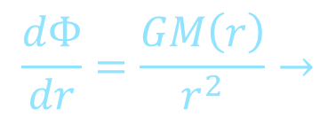
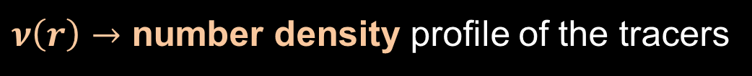
Galaxy cluster mass profiles: kinematics
Spherical Jeans’ equation:
$$\frac{d}{dr} \left[ν\left(r\right)σ_{r}^{2}\right]+2β\left(r\right)\frac{ν\left(r\right)σ_{r}^{2}}{r}=−ν\left(r\right)\frac{dΦ}{dr}$$
$ν\left(r\right)→$ number density profile of the tracers
$σ_{r}^{2}\left(r\right)→$velocity dispersion along the radial direction
$β\left(r\right)=1−(σ_{φ}^{2}+σ_{θ}^{2})/2σ_{r}^{2}→$ velocity anisotropy profile
$$\frac{dΦ}{dr}=\frac{GM\left(r\right)}{r^{2}}→$$
gravitational potential
Member galaxies of the cluster RXJ 2248 (red points)
Needed velocities: spectroscopic redshift data required
Assumption of dynamical relaxation and spherical symmetry

Slide 7
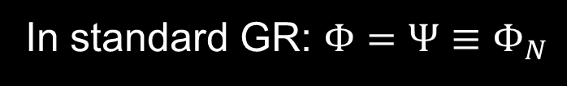


Galaxy cluster mass profiles: dynamics vs lensing analysis
Spacetime of a galaxy cluster: linear perturbation of FRW metric
$$ds^{2}=a^{2}\left(τ\right)\left[{−\left(1+\frac{2Φ}{c^{2}}\right)c}^{2}dτ^{2}+\left(1−\frac{2Ψ}{c^{2}}\right)dl^{2}\right],$$
$Φ,Ψ∼{10}^{−4}c^{2}$ $\text{gravitational} \text{potentials}$
In standard GR: $Φ=Ψ≡Φ_{N}$
$$Φ≠Ψ→\text{Signatures} \text{of} \text{modified} \text{gravity}$$

Slide 8
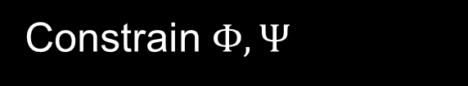
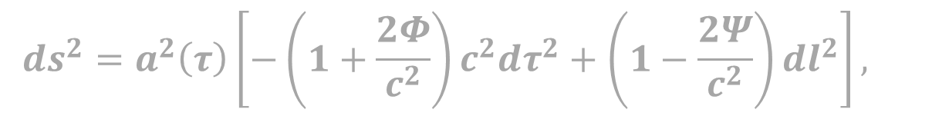


Galaxy cluster mass profiles: dynamics vs lensing analysis
Spacetime of a galaxy cluster: linear perturbation of FRW metric
$$ds^{2}=a^{2}\left(τ\right)\left[{−\left(1+\frac{2Φ}{c^{2}}\right)c}^{2}dτ^{2}+\left(1−\frac{2Ψ}{c^{2}}\right)dl^{2}\right],$$
$Φ,Ψ∼{10}^{−4}c^{2}$ $\text{gravitational} \text{potentials}$
In standard GR: $Φ=Ψ≡Φ_{N}$
$$Φ≠Ψ→\text{Signatures} \text{of} \text{modified} \text{gravity}$$
Constrain $Φ,Ψ$
Constrain deviation from General Relativity

Slide 9

Galaxy cluster mass profiles: dynamics vs lensing analysis
Spacetime of a galaxy cluster: linear perturbation of FRW metric
$$ds^{2}=a^{2}\left(τ\right)\left[{−\left(1+\frac{2Φ}{c^{2}}\right)c}^{2}dτ^{2}+\left(1−\frac{2Ψ}{c^{2}}\right)dl^{2}\right],$$
$Φ,Ψ∼{10}^{−4}c^{2}$ $\text{gravitational} \text{potentials}$
In standard GR: $Φ=Ψ≡Φ_{N}$
$$Φ≠Ψ→\text{Signatures} \text{of} \text{modified} \text{gravity}$$
Constrain $Φ,Ψ$
Constrain deviation from General Relativity
Motion of galaxies (kinematic analysis): TIME-TIME $Φ$
Photons (lensing analysis): TIME-TIME + SPACE-SPACE $Φ_{lens}=\frac{1}{2}(Φ+Ψ)$

Slide 10
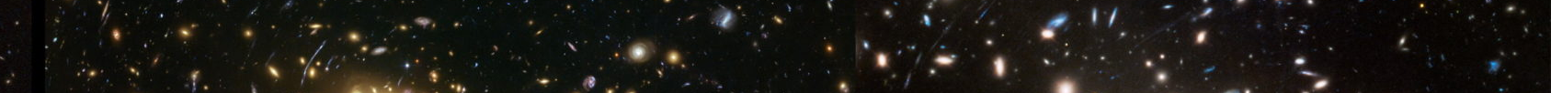
MG-MAMPOSSt
MAMPOSSt = Modelling Anisotropy and Mass Profile of Observed Spherical System
Developed by Mamon, Biviano, Boué (MNRAS 429 (Mar. 2013)3079–3098)
Jeans’ equation solved in the projected phase-pace $\left(R,v_{z}\right)$

Slide 11
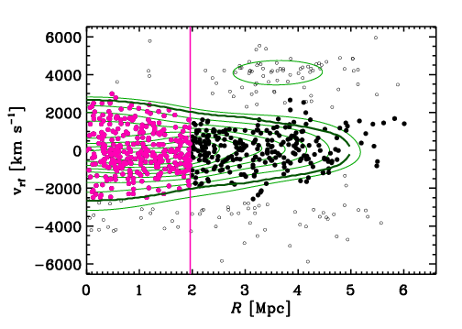
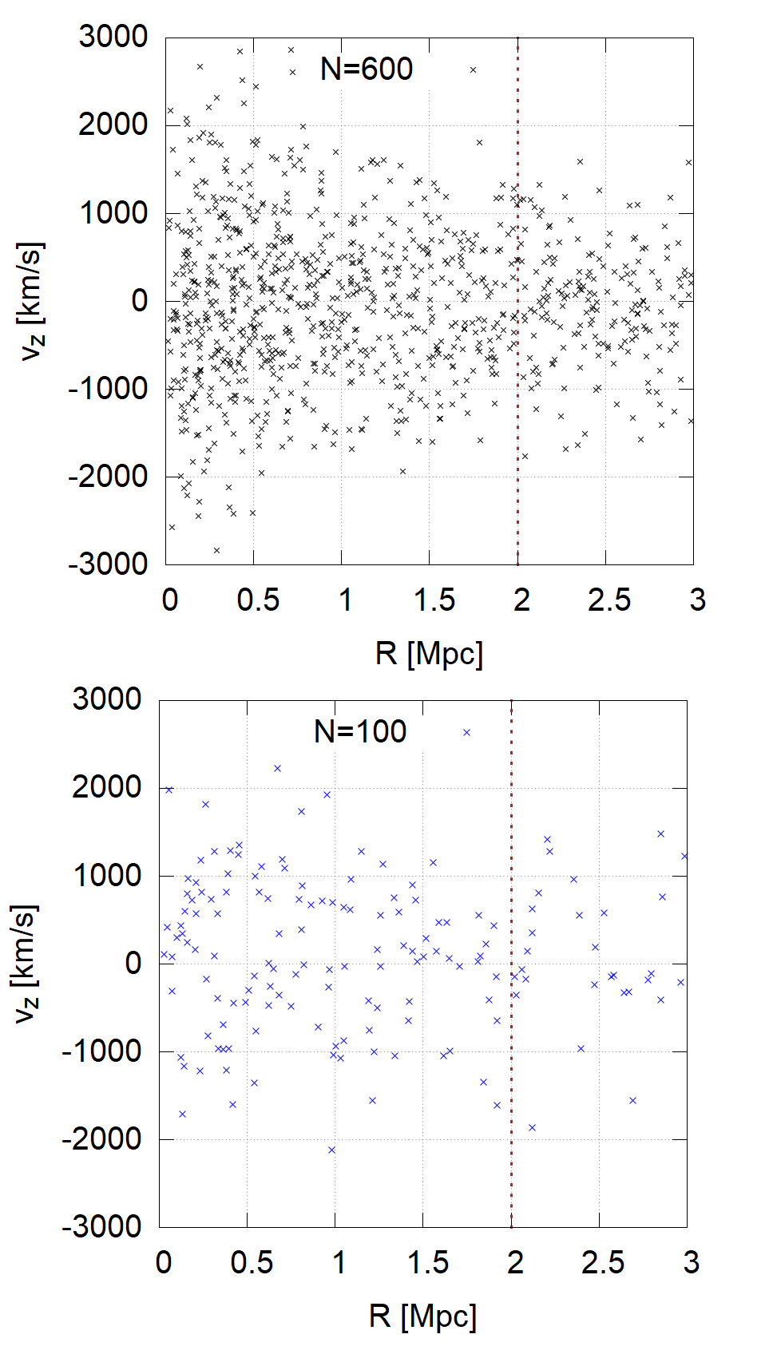


MG-MAMPOSSt
MAMPOSSt = Modelling Anisotropy and Mass Profile of Observed Spherical System
Developed by Mamon, Biviano, Boué (MNRAS 429 (Mar. 2013)3079–3098)
Jeans’ equation solved in the projected phase-pace $\left(R,v_{z}\right)$
Real cluster MACS 1206 (Biviano et al., 2013)
Synthetic cluster N=600 (Pizzuti et al., 2021)
$$v_{z}[Km s^{−1}]$$
$$R[Mpc]$$
Maximum Likelihood fit to obtain the parameters of kinematics quantities

Slide 12


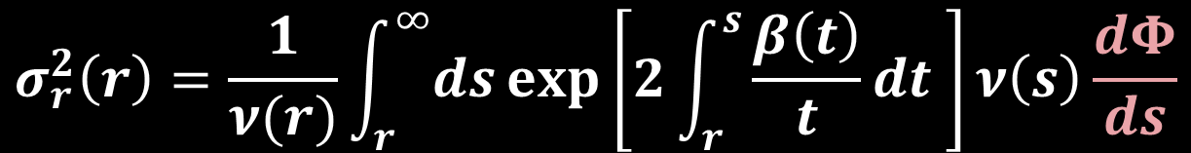
MG-MAMPOSSt (Pizzuti L., Saltas I.D., Amendola L., 2021)
$$σ_{r}^{2}\left(r\right)=\frac{1}{ν(r)}\int_{r}^{∞}{ds}\exp\left[2\int_{r}^{s}{\frac{β\left(t\right)}{t}dt }\right]ν\left(s\right)\frac{dΦ}{ds}$$
$β(r)→$ anisotropy profile
$ν(r)→$ number density profile
$\text{P}\text{arameter} \text{space}\text{:}$ GR
MG-MAMPOSSt:
Modified Newtonian potential
Chameleon screening, Vainshtein screening (DHOST)
Grid /MCMC (Metropolis-Hastings) parameter space exploration.
Simulated (weak) lensing information
Generalised anisotropy and BCG dynamics

Slide 13

MG-MAMPOSSt (Pizzuti L., Saltas I.D., Amendola L., 2021)
$$σ_{r}^{2}\left(r\right)=\frac{1}{ν(r)}\int_{r}^{∞}{ds}\exp\left[2\int_{r}^{s}{\frac{β\left(t\right)}{t}dt }\right]ν\left(s\right)\frac{dΦ}{ds}$$
$β(r)→$ anisotropy profile
$ν(r)→$ number density profile
$$𝓜_{i}=\left\{\begin{aligned}Y_{1},Y_{2} VS \\ Q, φ_{∞} CS \\ ε_{0}, ρ_{c}, Q RG \\ f_{DE} c_{s}^{2} CDE\end{aligned}\right.$$
$\text{P}\text{arameter} \text{space}\text{:}$ GR + non-standard params: $𝓜_{1},𝓜_{2},𝓜_{3}$
MG-MAMPOSSt:
Modified Newtonian potential
Chameleon screening, Vainshtein screening (DHOST), Refracted Gravity, Clustering DE
Grid /MCMC (Metropolis-Hastings) parameter space exploration.
Simulated (weak) lensing information
Generalised anisotropy and BCG dynamics

Slide 14
An overview of what we can do…
MG - MAMPOSSt
Notes:
Elencare tutti i passaggi usati per completare l'esperimento.
Ricordare di numerare i passaggi.

Slide 15
An overview of what we can do…
Lensing + kinematics (+X-ray?)
Test idealised scenarios (simulations) to explore new models
Constrain MG and DE models
MG - MAMPOSSt
Notes:
Elencare tutti i passaggi usati per completare l'esperimento.
Ricordare di numerare i passaggi.

Slide 16
An overview of what we can do…
Lensing + kinematics (+X-ray?)
Test idealised scenarios (simulations) to explore new models
Constrain MG and DE models
MG - MAMPOSSt
Shape of the matter profile in the innermost cluster regions
Constrain matter distributions in clusters
Notes:
Elencare tutti i passaggi usati per completare l'esperimento.
Ricordare di numerare i passaggi.

Slide 17
An overview of what we can do…
Lensing + kinematics (+X-ray?)
Test idealised scenarios (simulations) to explore new models
Constrain MG and DE models
MG - MAMPOSSt
Shape of the matter profile in the innermost cluster regions
Constrain matter distributions in clusters
Analysis of orbits
Mass estimations
Mass and orbits of the CHEX-MATE clusters
Mass and orbits of the VIRGO cluster
Notes:
Elencare tutti i passaggi usati per completare l'esperimento.
Ricordare di numerare i passaggi.

Slide 18
An overview of what we can do…
Lensing + kinematics (+X-ray?)
Test idealised scenarios (simulations) to explore new models
Constrain MG and DE models
MG - MAMPOSSt
Shape of the matter profile in the innermost cluster regions
Constrain alterantives to dark matter
Constrain matter distributions in clusters
Analysis of orbits
Mass estimations
Refracted Gravity
Boson stars and solitonic objects
MOND-like models
Mass and orbits of the CHEX-MATE clusters
Mass and orbits of the VIRGO cluster
Notes:
Elencare tutti i passaggi usati per completare l'esperimento.
Ricordare di numerare i passaggi.

Slide 19
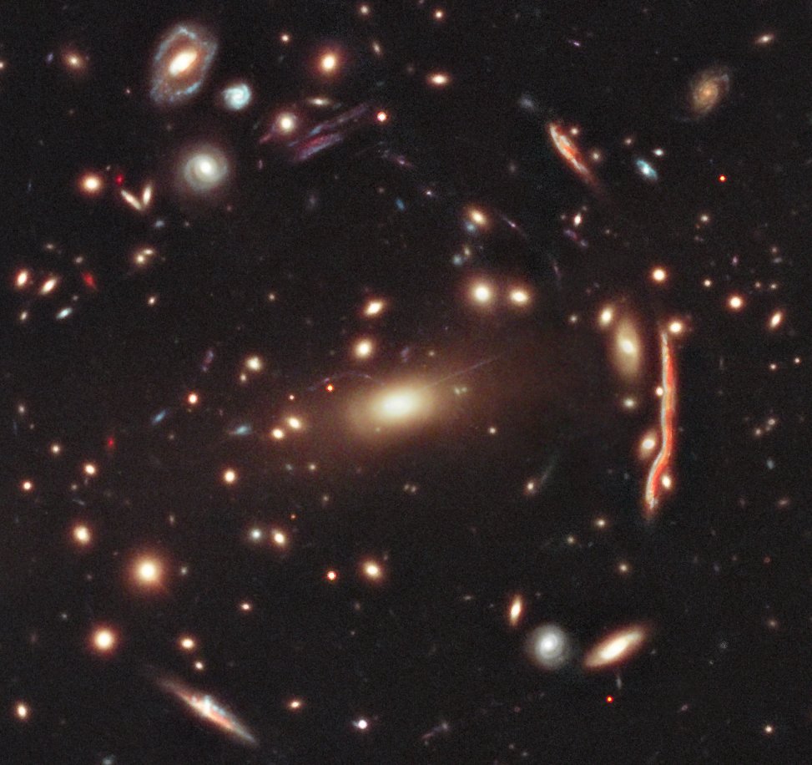
Data from CLASH and CLASH-VLT collaborations
MACSJ-1206

Slide 20
Data from CLASH and CLASH-VLT collaborations
MACSJ-1206
Subaru+HST. + VLT/VIMOS +MUSE
Credits: Biviano et al., 2013

Slide 21
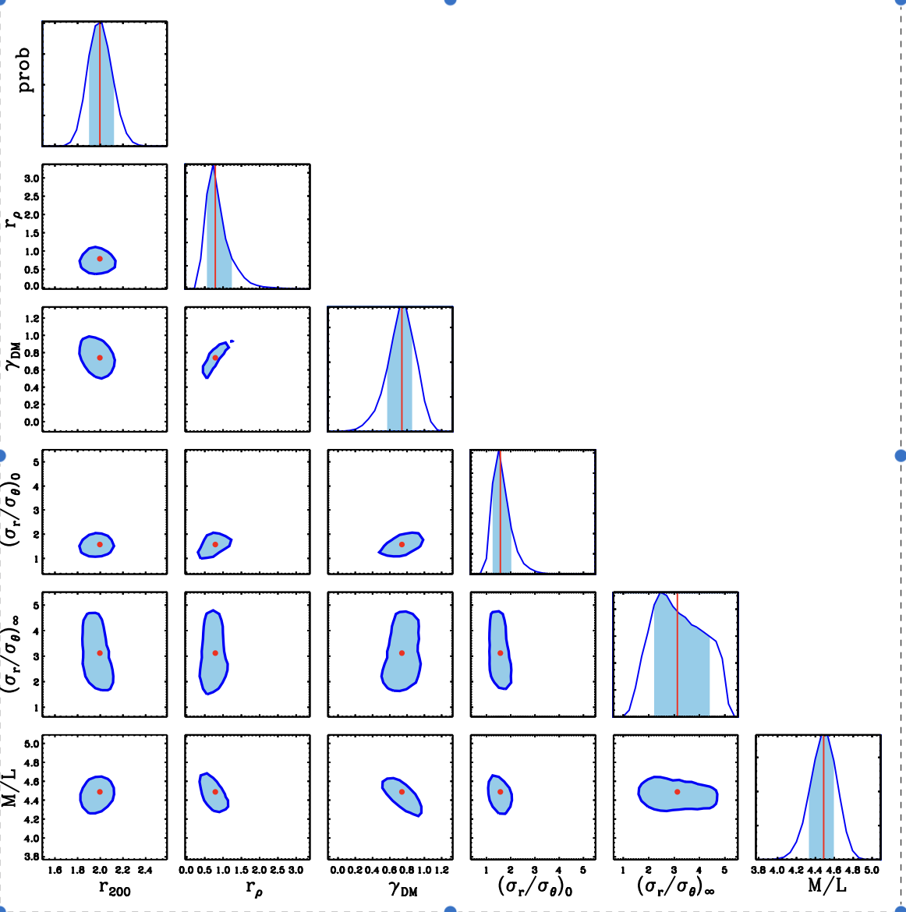
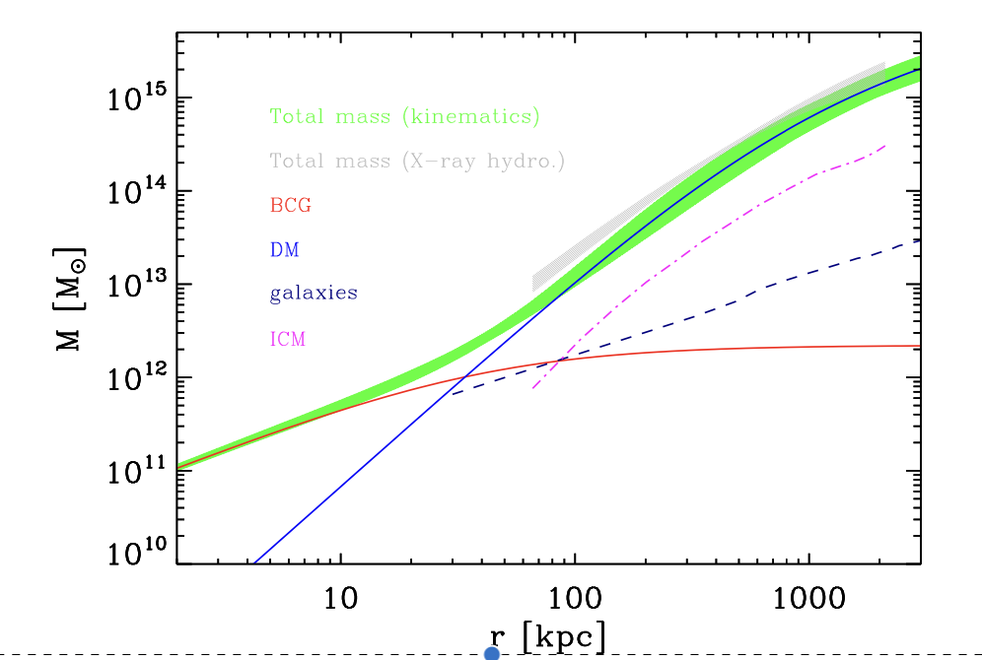
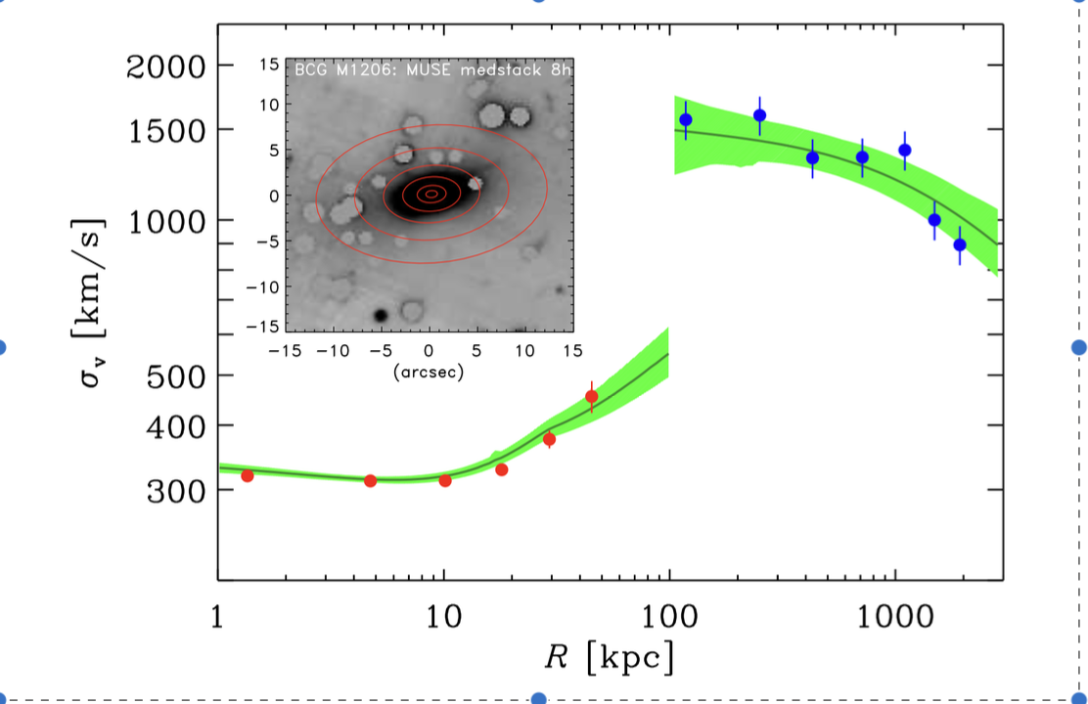
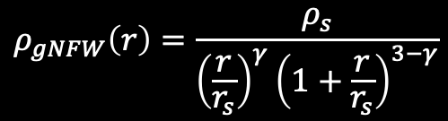
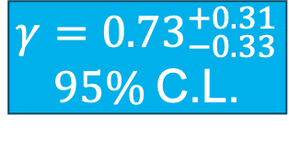
What if we further have the velocity dispersion of the BCG?
A. Biviano, LP, et al., 2023 10.3847/1538-4357/acf832
$$γ={0.73}_{−0.33}^{+0.31}$$
$95\%$C.L.
$$ρ_{gNFW}\left(r\right)=\frac{ρ_{s}}{{\left(\frac{r}{r_{s}}\right)}^{γ}{\left(1+\frac{r}{r_{s}}\right)}^{3−γ}}$$

Slide 22
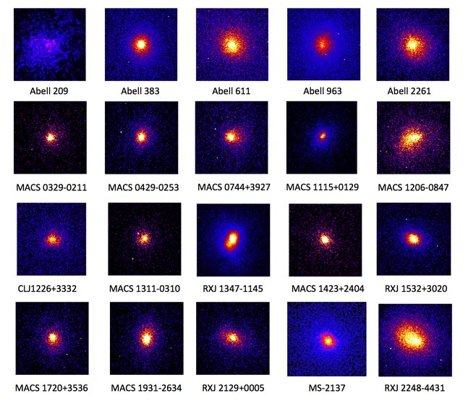
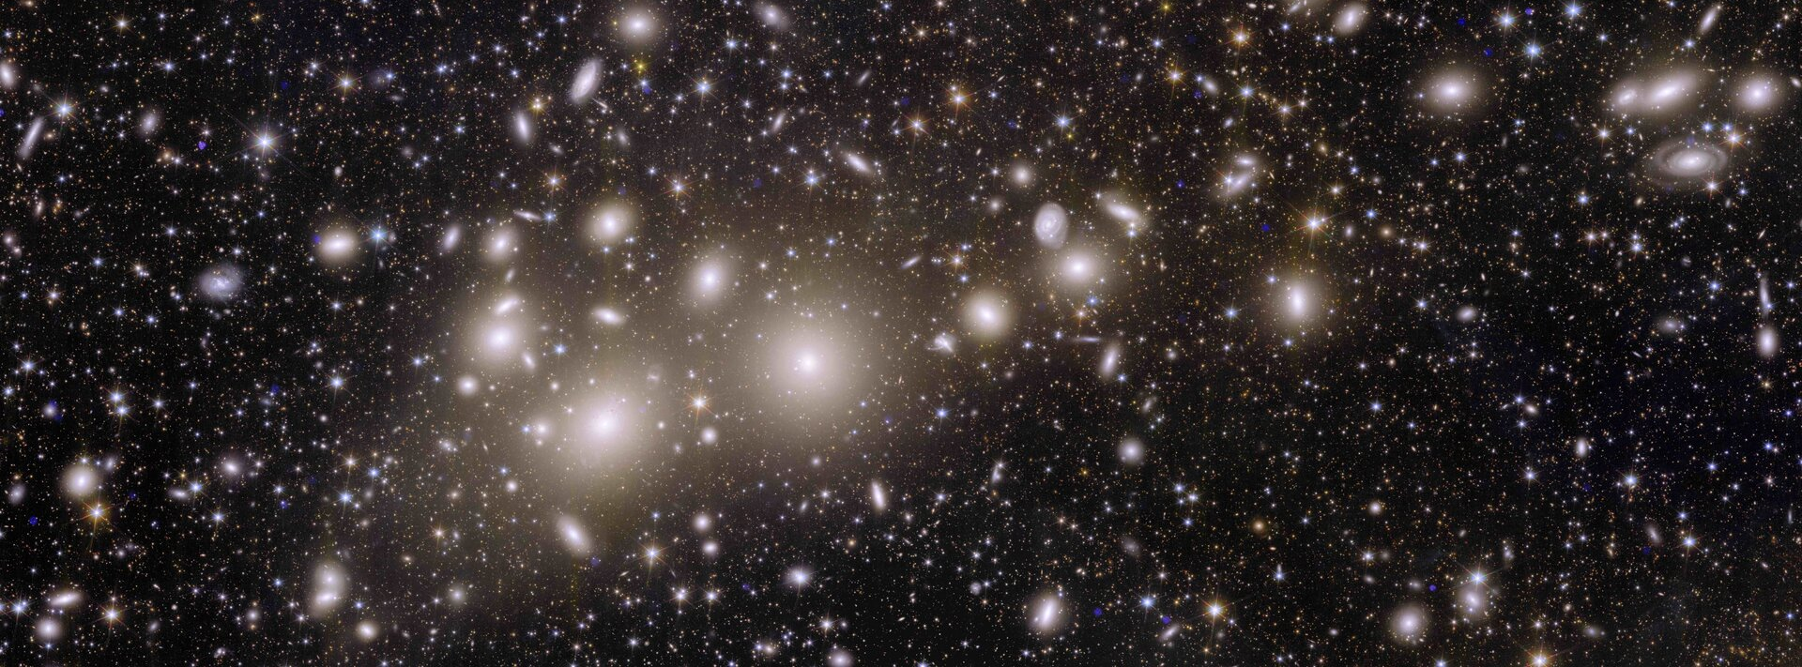
More statistics! The CLASH sample

Slide 23
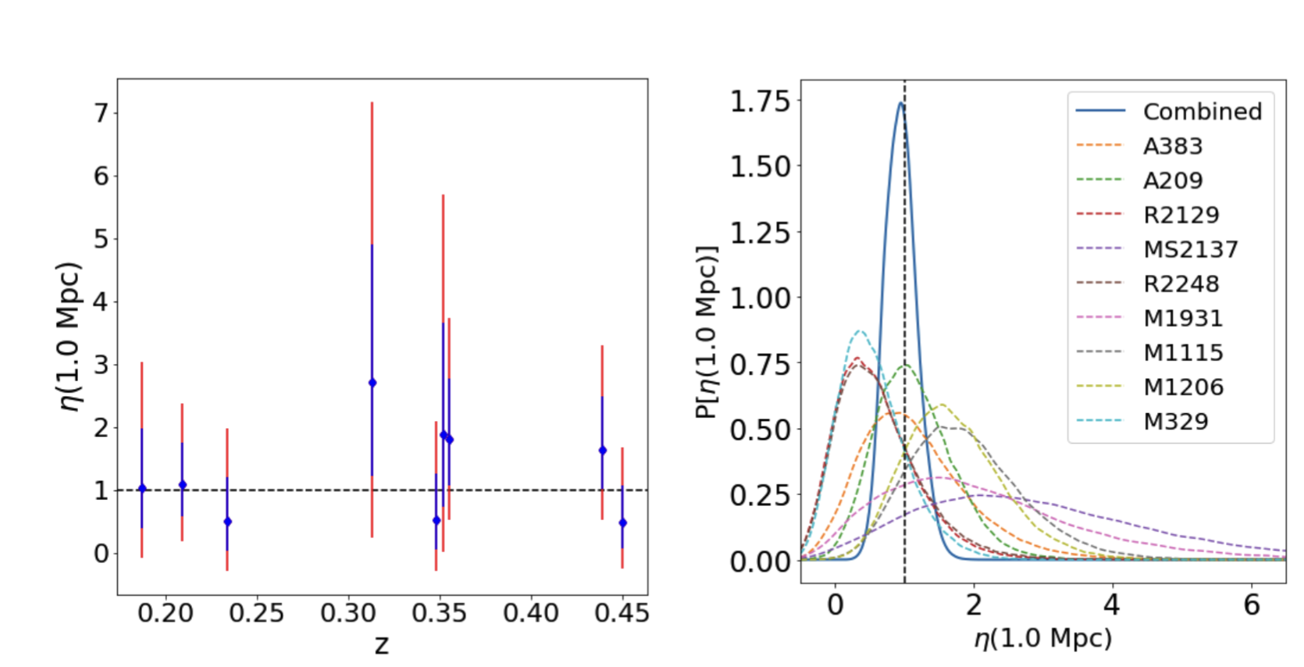
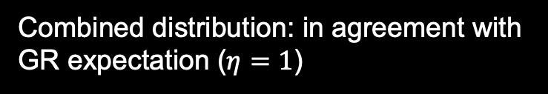

Testing genuine departures from GR using nine CLASH clusters
$$η=\frac{Ψ}{Φ}$$
Ratio between the scalar potentials of the perturbed metric of a cluster:
Pizzuti et al., 2026a, JCAP 03 (2026) 022
Combined distribution: in agreement with GR expectation ($η=1$)
NFW mass profile: on average best fit for the total mass of each cluster.
Lensing data from Umetsu et al., 2016
Kinematics data from the CLASH-VLT team
$$η(r=1 Mpc)={0.93}_{− 0.40}^{+0.48} \left(stat, 2σ\right)±0.47 (syst)$$

Slide 24
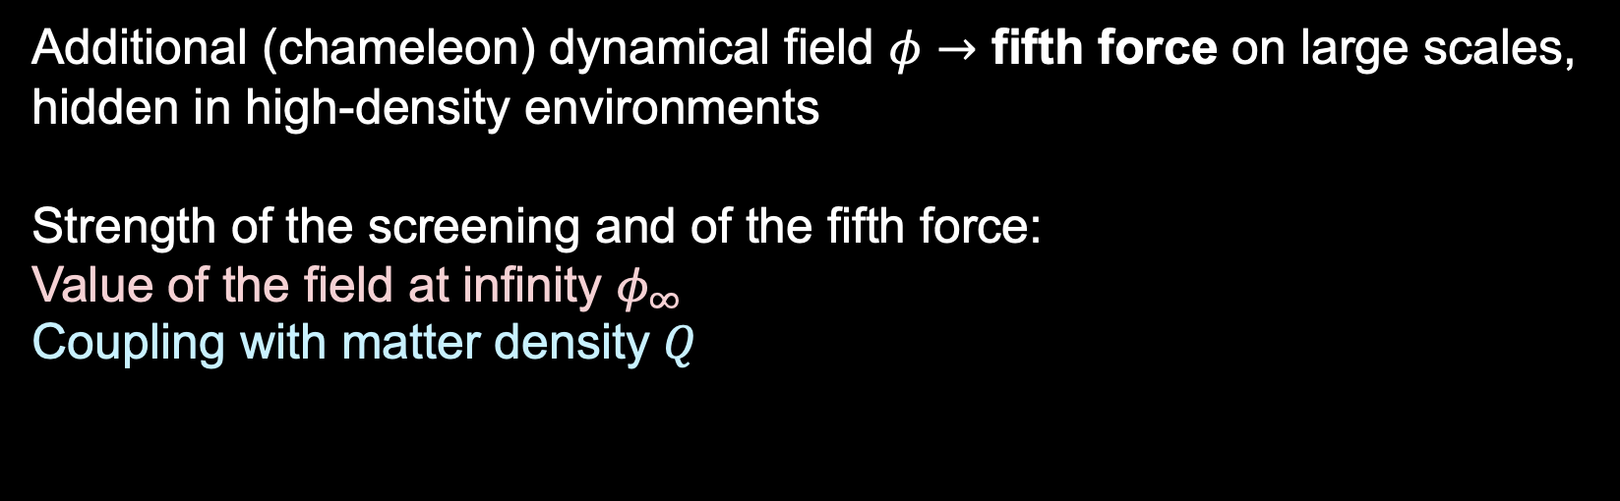

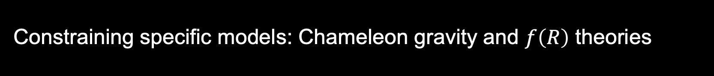
Constraining specific models: Chameleon gravity and $f\left(R\right)$ theories
Additional (chameleon) dynamical field $φ→$ fifth force on large scales, hidden in high-density environments
Strength of the screening and of the fifth force:
Value of the field at infinity $φ_{∞}$
Coupling with matter density $Q$
$$\frac{dΦ}{dr}=\frac{GM\left(r\right)}{r^{2}}+\frac{Q}{M_{P}}\frac{dφ}{dr}$$

Slide 25
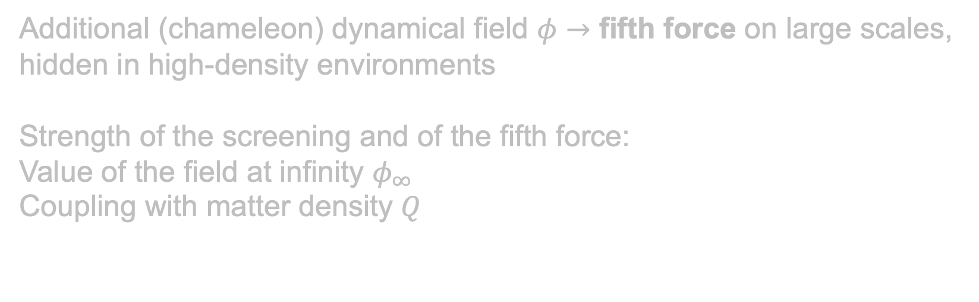
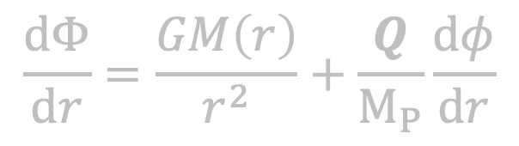
Constraining specific models: Chameleon gravity and $f\left(R\right)$ theories
Additional (chameleon) dynamical field $φ→$ fifth force on large scales, hidden in high-density environments
Strength of the screening and of the fifth force:
Value of the field at infinity $φ_{∞}$
Coupling with matter density $Q$
$$\frac{dΦ}{dr}=\frac{GM\left(r\right)}{r^{2}}+\frac{Q}{M_{P}}\frac{dφ}{dr}$$
$f\left(R\right)$ gravity: subclass of Chameleon field where the coupling is fixed to 1/3
${f_{R}∝φ}_{∞}$is the new degree of freedom

Slide 26
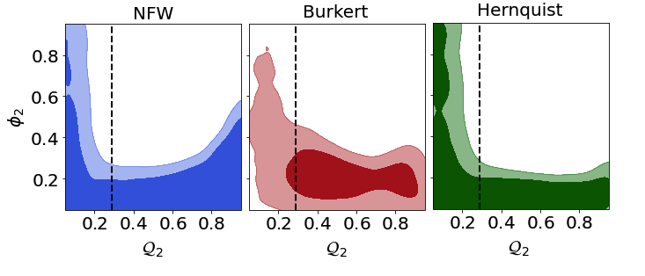

Constraining specific models: Chameleon gravity and $f\left(R\right)$ theories
Constraints in terms of $Q_{2}=Q/\left(1+Q\right)$, ${ φ}_{2}=exp\left[−φ_{∞}/(M_{p}c^{2}{10}^{−4})\right]$ (in $\left[0,1\right]$)
Pizzuti et al., 2026b, Universe 12(5), 124
When restricting to $f\left(R\right)$ gravity: $\log_{10}\left|f_{R}\right|≤2−5 ×{10}^{−5}, 95\% C.L.$ (Hernquist and NFW)
$\log_{10}\left|f_{R}\right|=−4.7±1.2, 95\% C.L.$ (Burkert)

Slide 27
THE CHEX-MATE SAMPLE

Slide 28
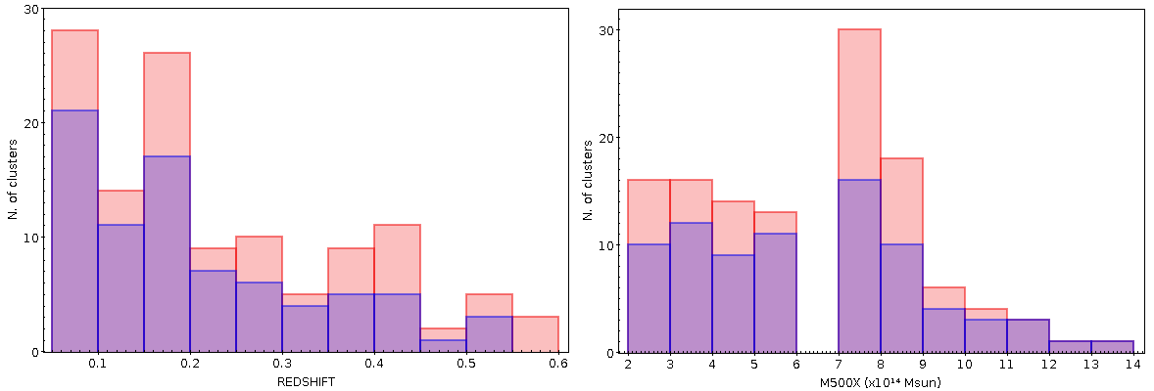
THE CHEX-MATE SAMPLE
Cluster HEritage project with XMM-Newton – Mass Assembly and Thermodynamics at the Endpoint of structure formation (CHEX – MATE)
118 cluster SZ-selected (SNR > 6.5). Two subsamples: Tier 1 (z <0.2), Tier 2 (z > 0.2)
We consider a total of 75 clusters with at least 50 confirmed members within $R=r_{200c,ap}$(Members selected with CLEAN, see Sereno+25)

Slide 29
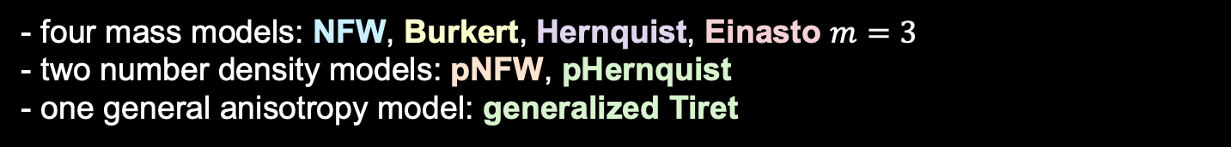
MG-MAMPOSSt fit: mass estimates
For all clusters, we run a MCMC with 110000 points (10000 burn-in). Flat uninformative priors (except for $r_{ν}$ )
- four mass models: NFW, Burkert, Hernquist, Einasto $m=3$
- two number density models: pNFW, pHernquist
- one general anisotropy model: generalized Tiret
Eight different combinations for each cluster in the sample

Slide 30
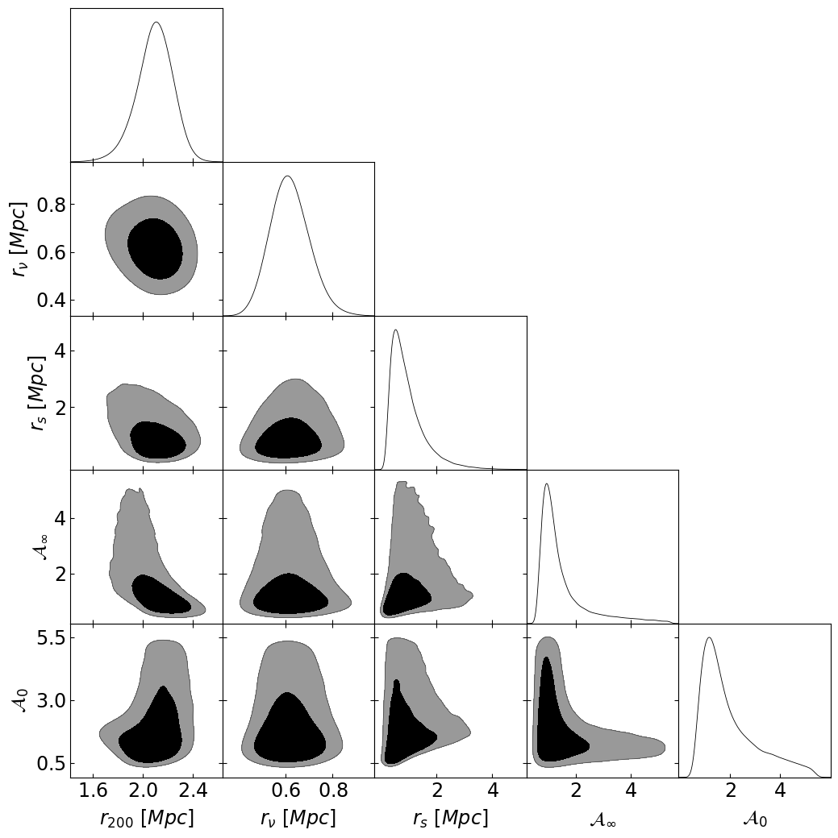
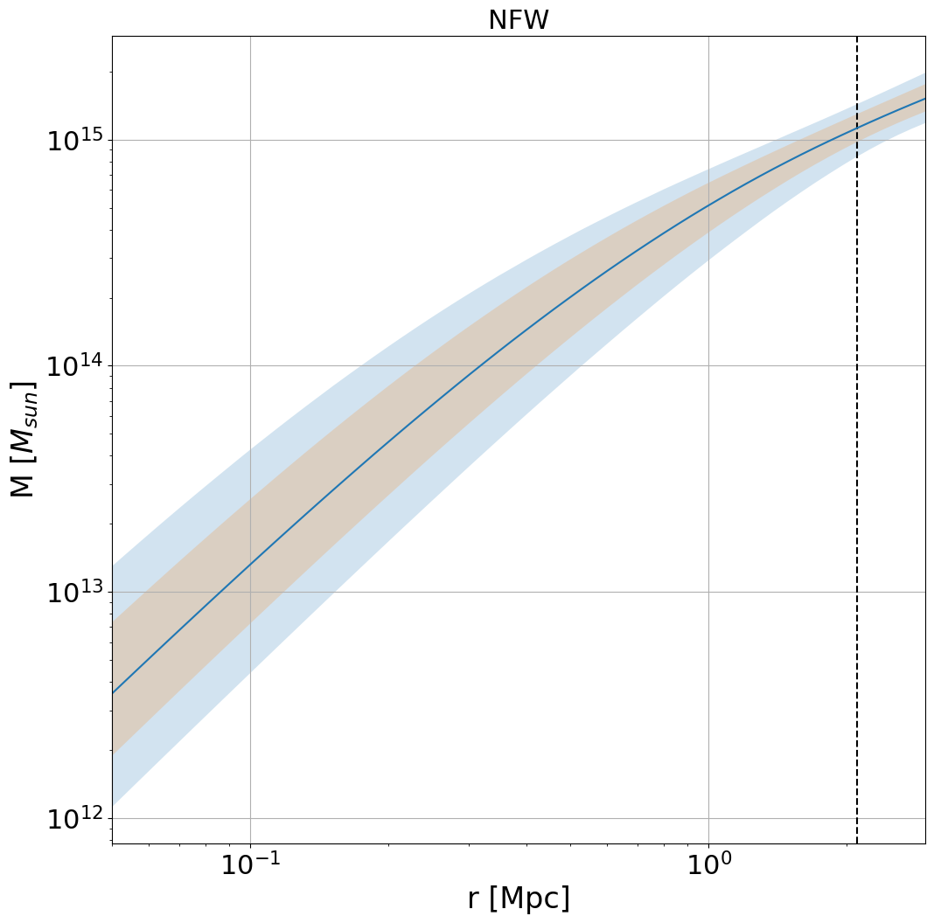
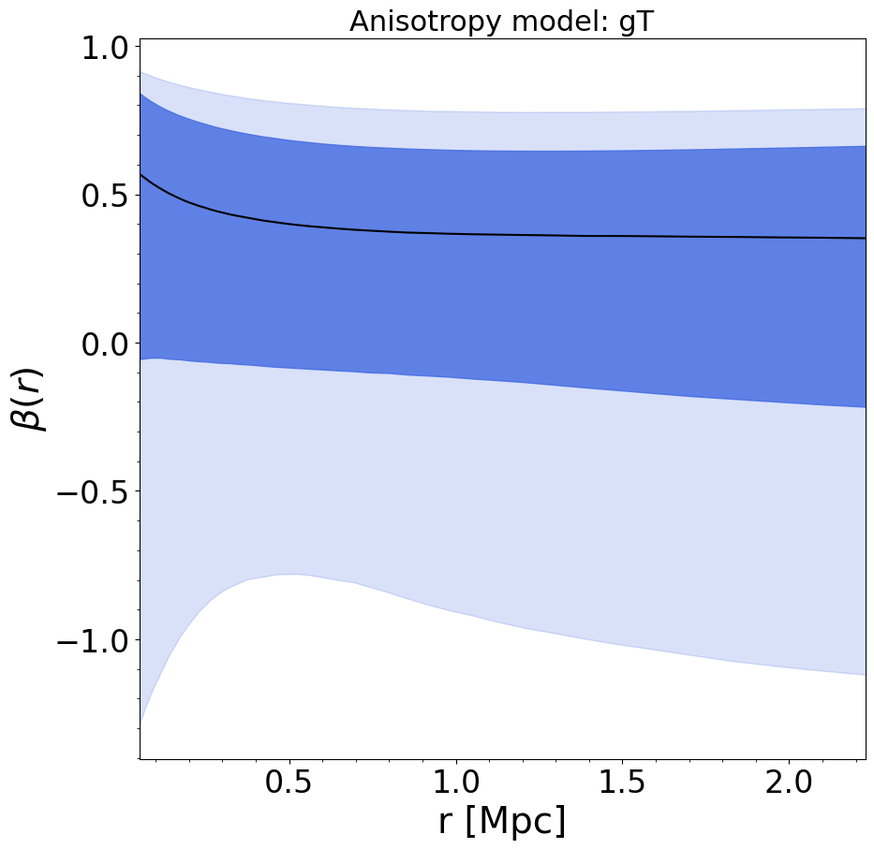
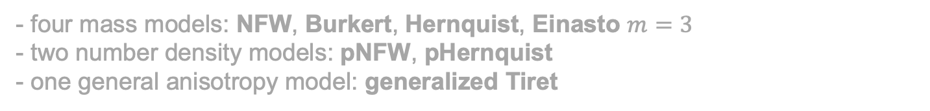
MG-MAMPOSSt fit: mass estimates
For all clusters, we run a MCMC with 110000 points (10000 burn-in). Flat uninformative priors (except for $r_{ν}$ )
- four mass models: NFW, Burkert, Hernquist, Einasto $m=3$
- two number density models: pNFW, pHernquist
- one general anisotropy model: generalized Tiret
Eight different combinations for each cluster in the sample
Example: cluster PSZ2 G049.22+30.87

Slide 31
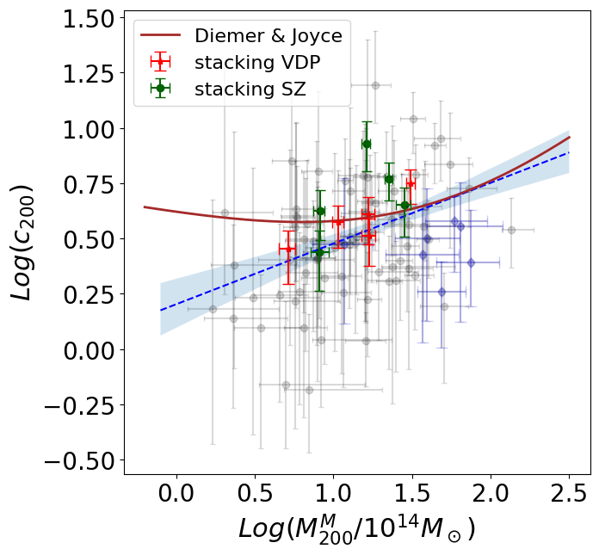
MG-MAMPOSSt fit: c-M relation
Slightly rising trend found by a ODR linear fit
In agreement with theoretical prediction of Diemer&Joyce, 2019
Red points from vdp stacking analysis

Slide 32
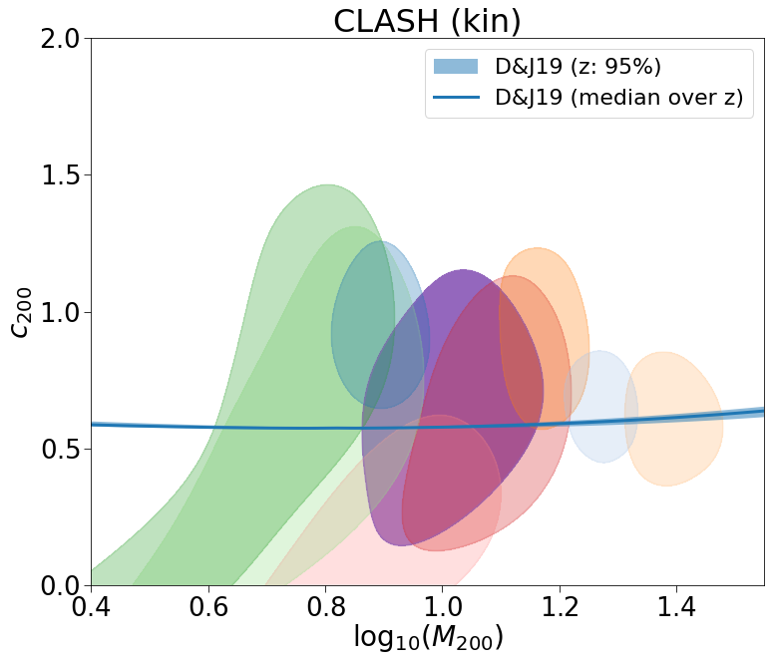
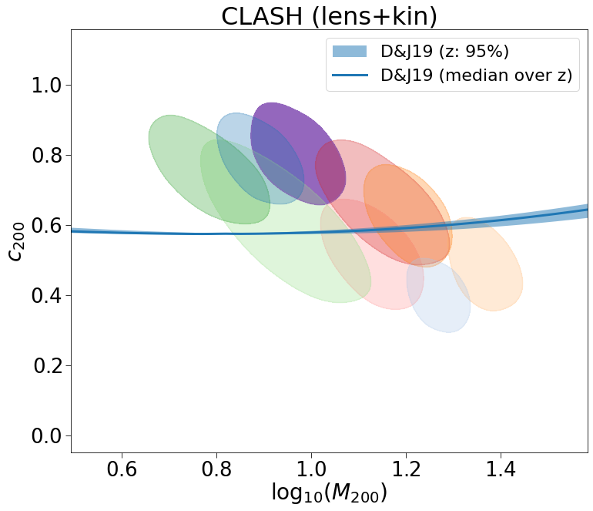
Preliminary: the CLASH c-M relation
.While kinematics seems to be consistent with Diemer&Joyce, combined lensing+kinematic analysis shows a decreasing trend
Is this an effect of kinematic mass measurements?

Slide 33
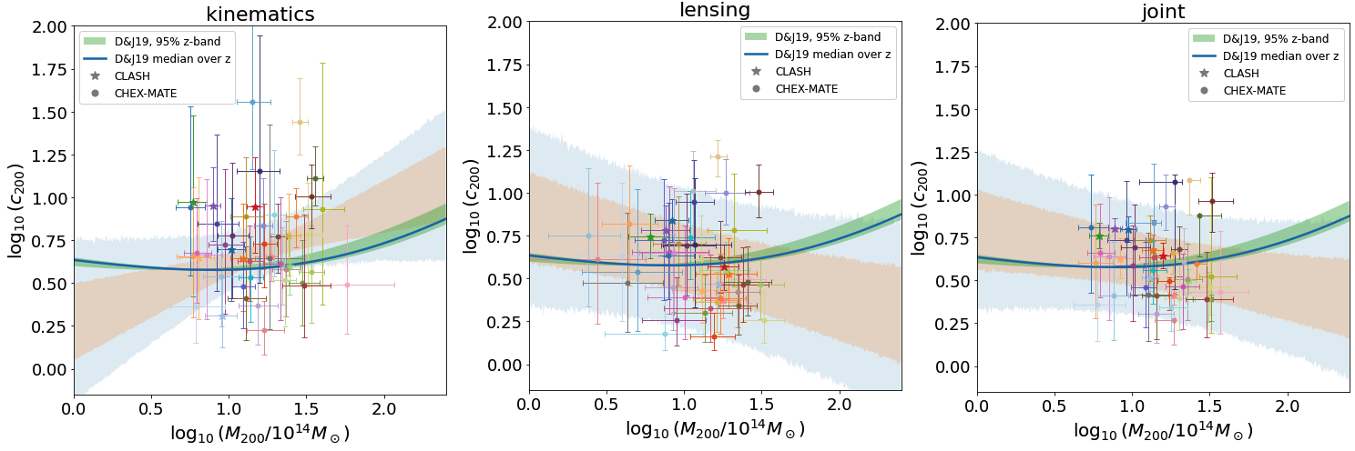
When statistics grows…
.Full kinematics+lensing combined analysis of 45 clusters between CHEX-MATE and CLASH-VLT
Again, the kinematic-only measurements show a mild increasing trend which disappears in the joint analysis…

Slide 34
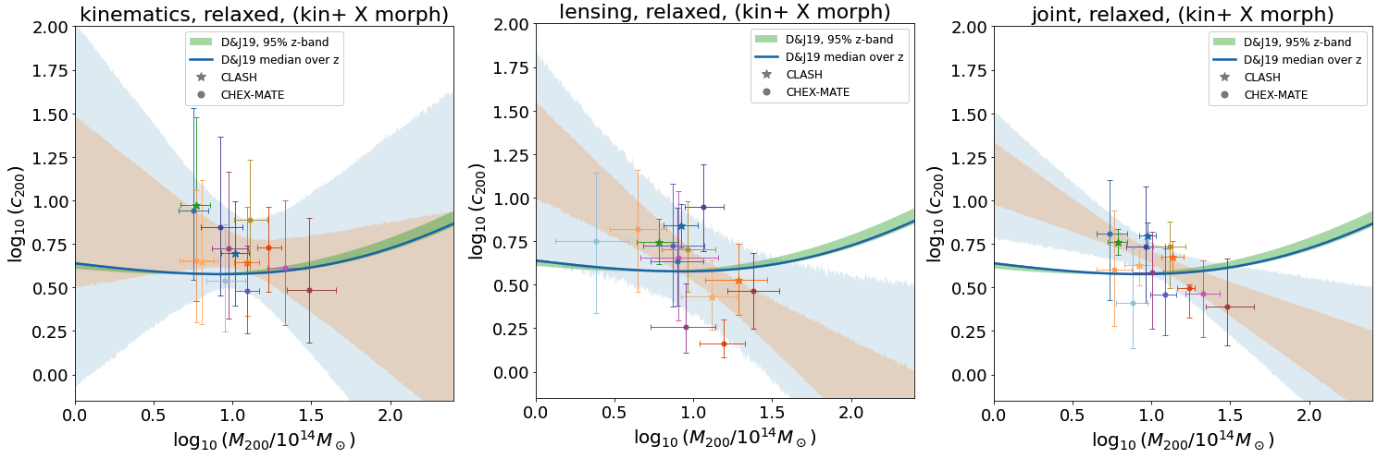
A joint lensing+kinematics c-M relation
.Full kinematics+lensing combined analysis of 45 clusters between CHEX-MATE and CLASH-VLT
EFFECT OF DISTURBED CLUSTERS: when selecting only relaxed systems the trend completely disappears

Slide 35
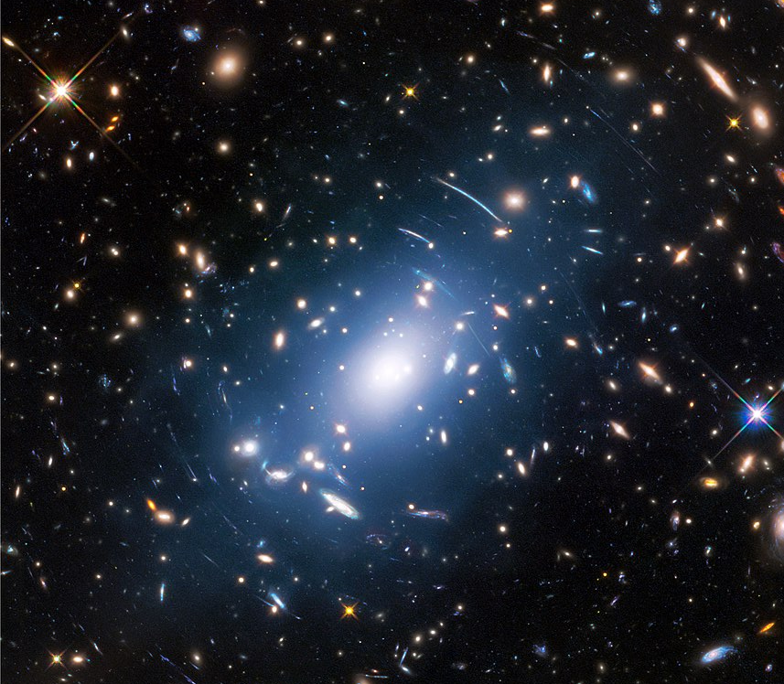

Conclusions: what next?
MG-MAMPOSSt: powerful tool to explore interesting physics at cluster scales
Available on (Pizzuti et al, 2023a) https://github.com/Pizzuti92/MG-MAMPOSSt/
Combine other information from different probes (lensing, X-rays) to get tight constraints on gravity, the dark sector but also galaxy evolution in dense environments.
Extend to many clusters: accurate selection/calibration of systematics needed
Next step: many models to test! Results are coming soon…

Slide 36

THAT’S ALL FOLKS!
Thank you!

