Slide 1
Neutrino Oscillation
By Tjelle Hartwig

Slide 2
What to expect?
What are Neutrinos?
Solar Neutrino Problem
Neutrino Oscillation
Super-Kamiokande
Outlook

Slide 3
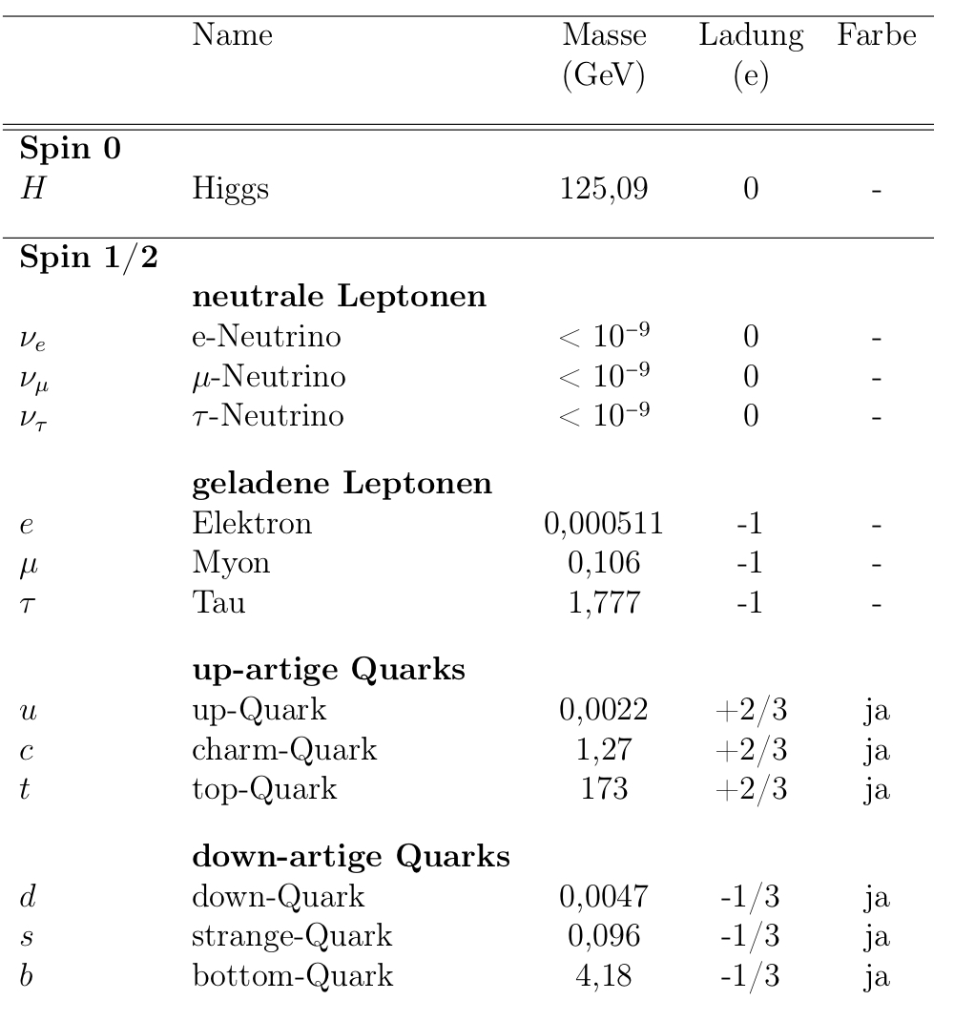
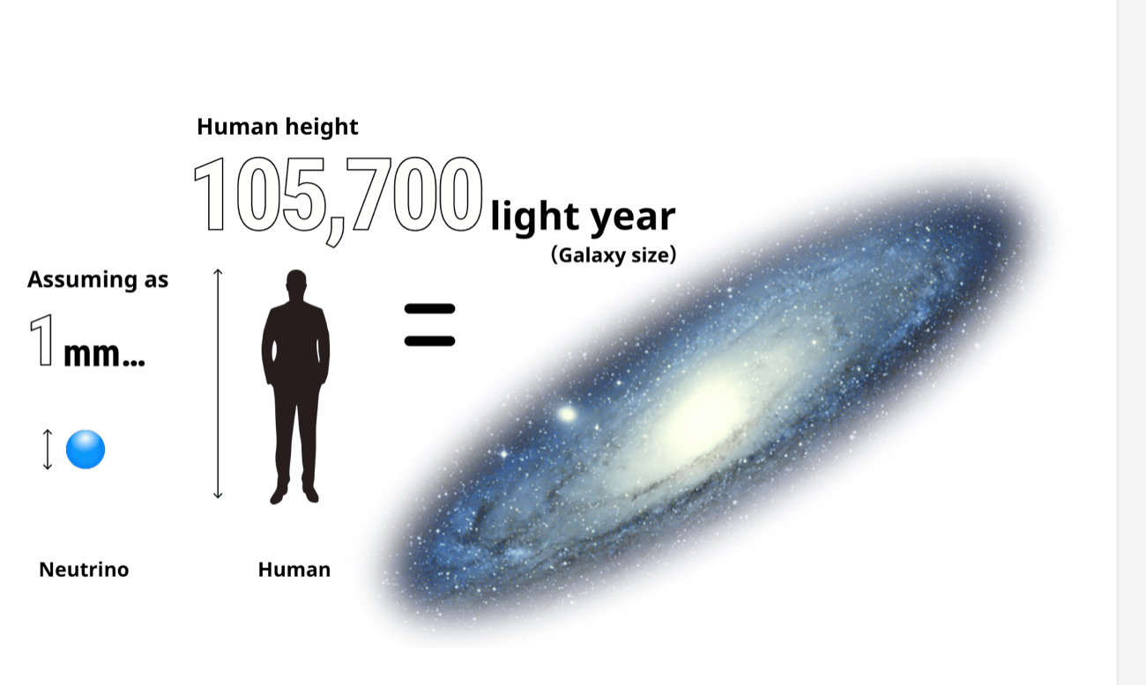
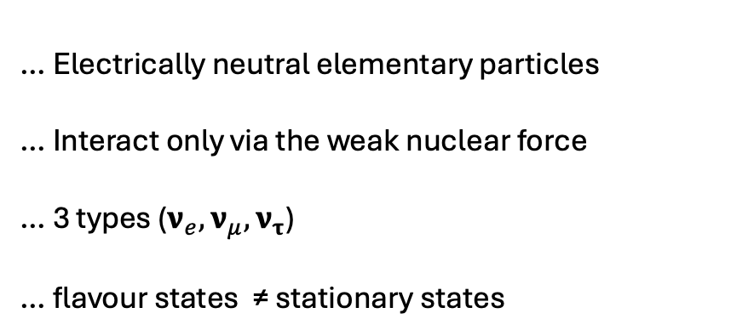
What are neutrinos?
Neutrinos are …
… Electrically neutral elementary particles
… Interact only via the weak nuclear force
… 3 types ($ν_{e},ν_{μ},ν_{τ}$)
… flavour states ≠ stationary states
https://www-sk.icrr.u-tokyo.ac.jp/en/sk/about/research/

Slide 4
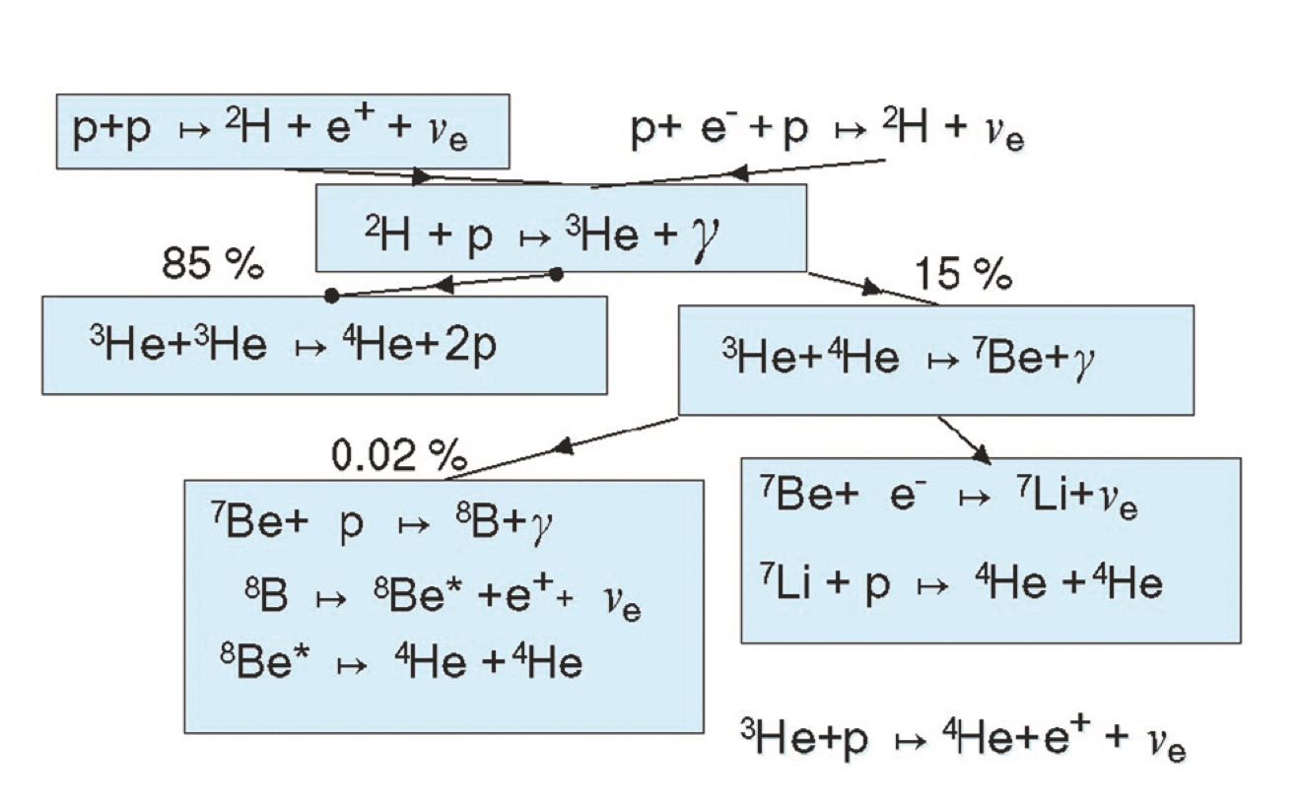

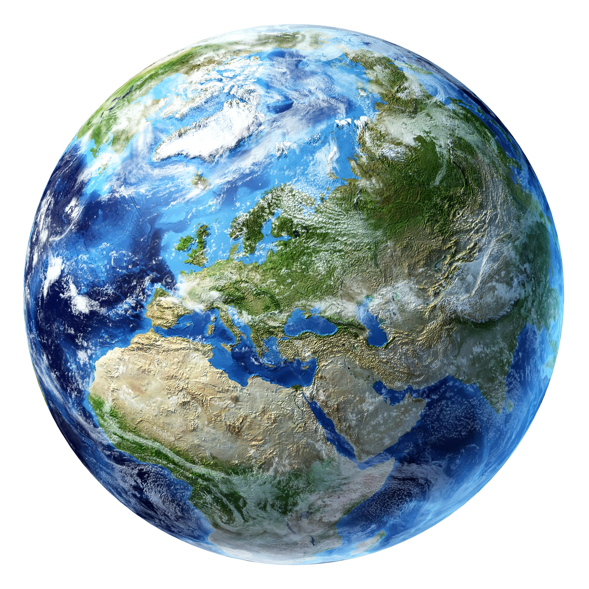


Solar Neutrino Problem
pp-chain: model for the energy production of the Sun
Experiments in the 60s: just 30% of neutrinos reach the Earth
$${\text{ν}}_{μ,τ}$$
❓
→ two possibilities:
- solar model was wrong
- neutrinos change flavour mid-flight
$${\text{ν}}_{e}$$
Pic.1: https://www.nobelprize.org/prizes/physics/2015/mcdonald/lecture/
Pic.2: https://de.freepik.com/fotos-vektoren-kostenlos/sonne
Pic.3: https://sonnen-sturm.info/lexikon/erde

Slide 5
Neutrino Oscillation
$ν_{1} =\cos\left(Θ\right)ν_{μ}− \sin\left(Θ\right)ν_{e}$ , $ν_{2} =\cos\left(Θ\right)ν_{e}+ \sin\left(Θ\right)ν_{μ}$

Slide 6
Neutrino Oscillation
$ν_{1} =\cos\left(Θ\right)ν_{μ}− \sin\left(Θ\right)ν_{e}$ , $ν_{2} =\cos\left(Θ\right)ν_{e}+ \sin\left(Θ\right)ν_{μ}$
$ν_{1}\left(t\right)=ν_{1}\left(0\right){ e}^{−i\frac{E_{1}}{h}t}$ , $ν_{2}\left(t\right)=ν_{2}\left(0\right){ e}^{−i\frac{E_{2}}{h}t}$

Slide 7
Neutrino Oscillation
$ν_{1} =\cos\left(Θ\right)ν_{μ}− \sin\left(Θ\right)ν_{e}$ , $ν_{2} =\cos\left(Θ\right)ν_{e}+ \sin\left(Θ\right)ν_{μ}$
$ν_{1}\left(t\right)=ν_{1}\left(0\right){ e}^{−i\frac{E_{1}}{h}t}$ , $ν_{2}\left(t\right)=ν_{2}\left(0\right){ e}^{−i\frac{E_{2}}{h}t}$
$ν_{e}\left(0\right)=1,ν_{μ}\left(0\right)=0$ $ν_{1}\left(0\right)=− \sin\left(Θ\right) , ν_{2}(0) =\cos\left(Θ\right)$

Slide 8
Neutrino Oscillation
$ν_{1} =\cos\left(Θ\right)ν_{μ}− \sin\left(Θ\right)ν_{e}$ , $ν_{2} =\cos\left(Θ\right)ν_{e}+ \sin\left(Θ\right)ν_{μ}$
$ν_{1}\left(t\right)=ν_{1}\left(0\right){ e}^{−i\frac{E_{1}}{h}t}$ , $ν_{2}\left(t\right)=ν_{2}\left(0\right){ e}^{−i\frac{E_{2}}{h}t}$
$ν_{e}\left(0\right)=1,ν_{μ}\left(0\right)=0$ $ν_{1}\left(0\right)=− \sin\left(Θ\right) , ν_{2}(0) =\cos\left(Θ\right)$
$ν_{1}\left(t\right)=− \sin\left(Θ\right){ e}^{−i\frac{E_{1}}{h}t}$ , $ν_{2}\left(t\right)=\cos\left(Θ\right){ e}^{−i\frac{E_{2}}{h}t}$

Slide 9
Neutrino Oscillation
$$ν_{μ} \left(t\right)=\cos\left(Θ\right)ν_{1}\left(t\right)+ \sin\left(Θ\right)ν_{2}\left(t\right)=\sin\left(Θ\right)\cos\left(Θ\right)\left[e^{−i\frac{E_{1}}{h}t}{ − e}^{−i\frac{E_{2}}{h}t}\right]$$

Slide 10

Neutrino Oscillation
$$ν_{μ} \left(t\right)=\cos\left(Θ\right)ν_{1}\left(t\right)+ \sin\left(Θ\right)ν_{2}\left(t\right)=\sin\left(Θ\right)\cos\left(Θ\right)\left[e^{−i\frac{E_{1}}{h}t}{− e}^{−i\frac{E_{2}}{h}t}\right]$$
$${{|ν}_{μ}(t)|}^{2}= … = {\left[\sin\left(2Θ\right)\sin\left(\frac{E_{2} − E_{1}}{2 h}t\right)\right]}^{2}=P(ν_{e}{ ➝ ν}_{μ})$$

Slide 11

Neutrino Oscillation
$$ν_{μ} \left(t\right)=\cos\left(Θ\right)ν_{1}\left(t\right)+ \sin\left(Θ\right)ν_{2}\left(t\right)=\sin\left(Θ\right)\cos\left(Θ\right)\left[e^{−i\frac{E_{1}}{h}t}{− e}^{−i\frac{E_{2}}{h}t}\right]$$
$${{|ν}_{μ}(t)|}^{2}= … = {\left[\sin\left(2Θ\right)\sin\left(\frac{E_{2} − E_{1}}{2 h}t\right)\right]}^{2}=P(ν_{e}{ ➝ ν}_{μ})$$
$$P(ν_{μ}{ ➝ ν}_{μ}) = 1 − \sin^{2}(2Θ) \sin^{2} \left(c Δm \frac{L}{E}\right)$$

Slide 12
Neutrino Oscillation
$$ν_{μ} \left(t\right)=\cos\left(Θ\right)ν_{1}\left(t\right)+ \sin\left(Θ\right)ν_{2}\left(t\right)=\sin\left(Θ\right)\cos\left(Θ\right)\left[e^{−i\frac{E_{1}}{h}t}{− e}^{−i\frac{E_{2}}{h}t}\right]$$
$${{|ν}_{μ}(t)|}^{2}= … = {\left[\sin\left(2Θ\right)\sin\left(\frac{E_{2} − E_{1}}{2 h}t\right)\right]}^{2}=P(ν_{e}{ ➝ ν}_{μ})$$
$$P(ν_{μ}{ ➝ ν}_{μ}) = 1 − \sin^{2}(2Θ) \sin^{2} \left(c Δm \frac{L}{E}\right)$$
Conditions for oscillation:
Θ ≠ 0
m ≠ 0

Slide 13
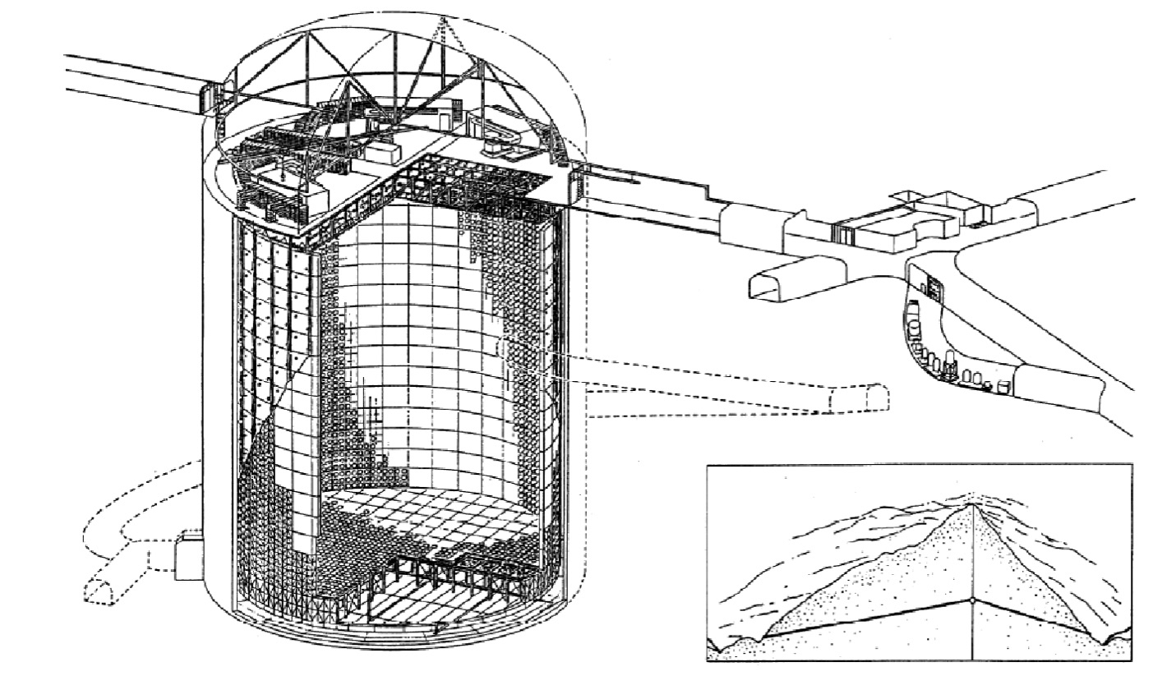
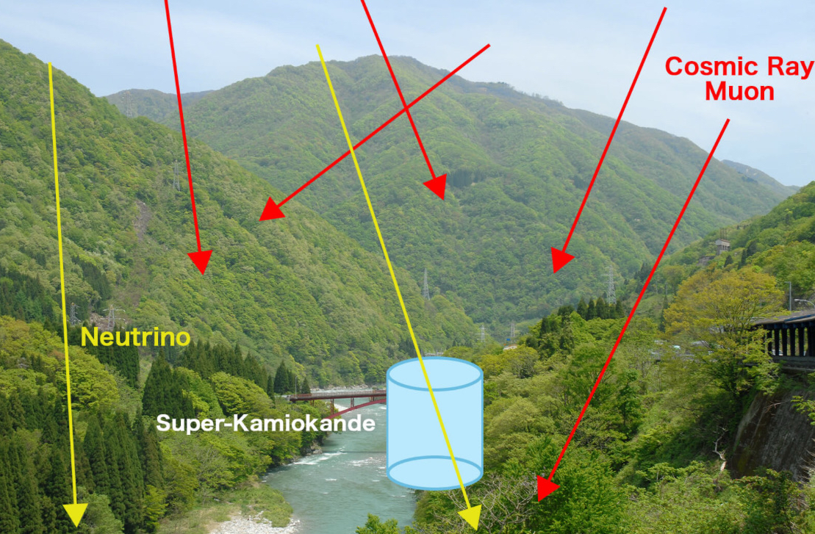
What is Super-Kamiokande?
water Cherenkov detector, 1 km underground
41m high, 39m diameter, 50,000t of ultra-pure water
11,200 PMTs to detect Cherenkov light
Inner detector: neutrino interactions
Outer detector: incoming and exiting particles
Pic.1: https://www.nobelprize.org/prizes/physics/2015/kajita/lecture/
Pic.2:
https://www-sk.icrr.u-tokyo.ac.jp/en/sk/about/research/

Slide 14
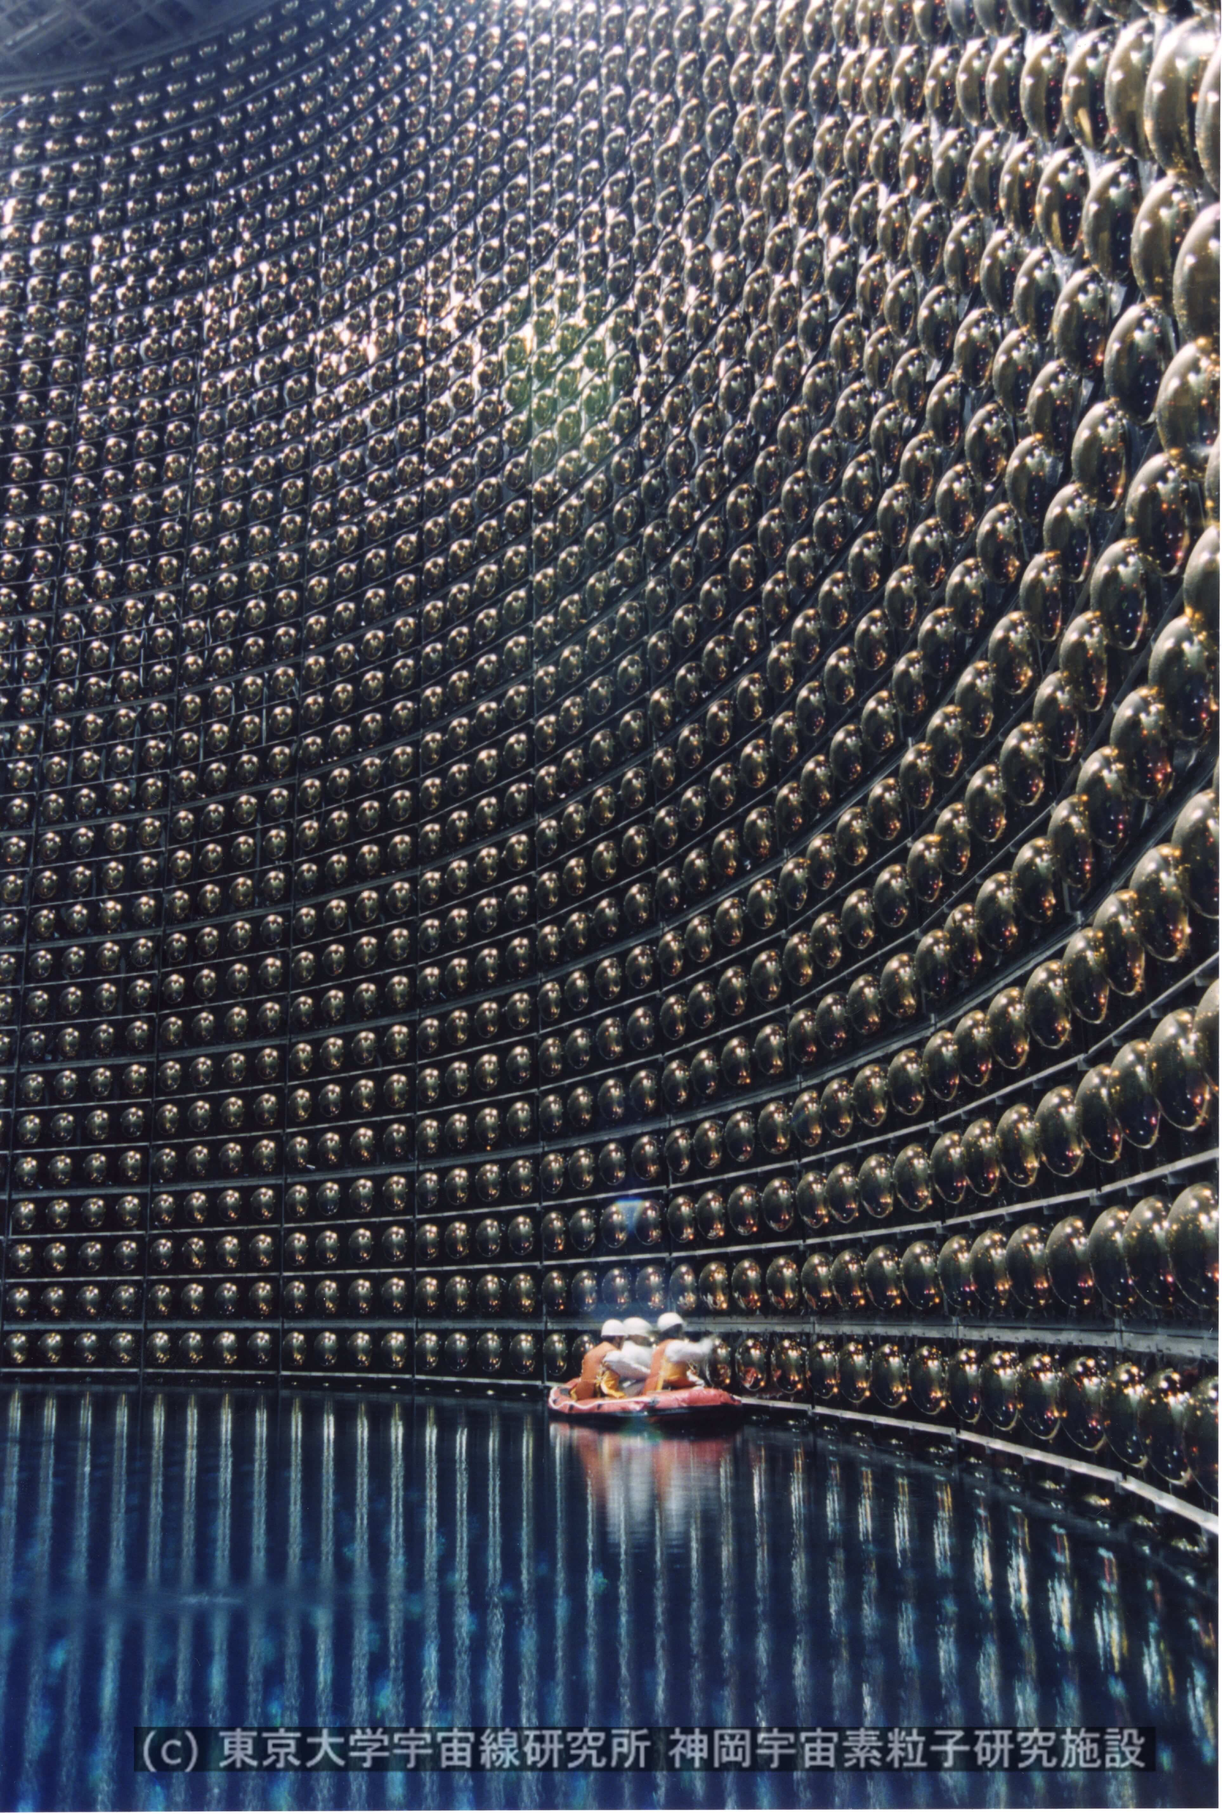
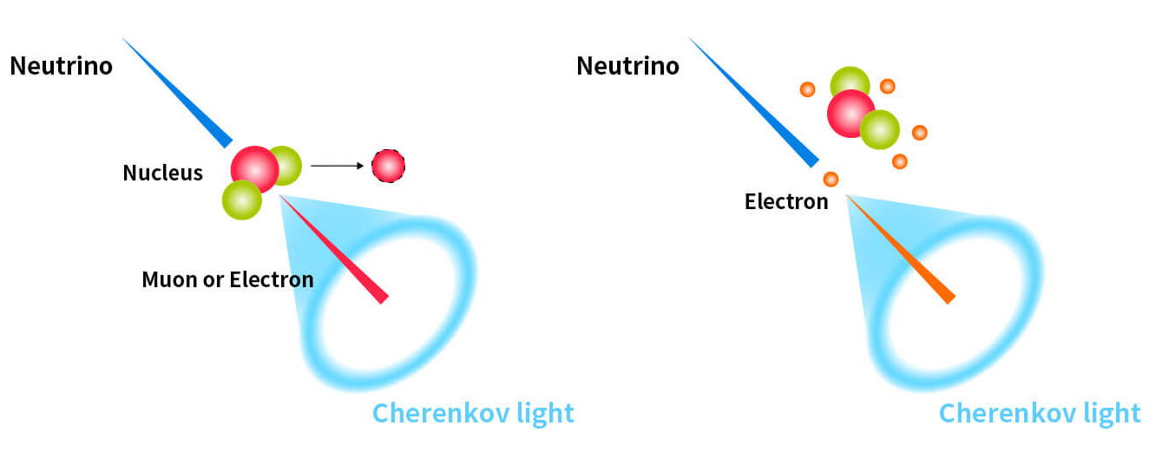
Cherenkov Light
https://www-sk.icrr.u-tokyo.ac.jp/en/sk/about/research/

Slide 15
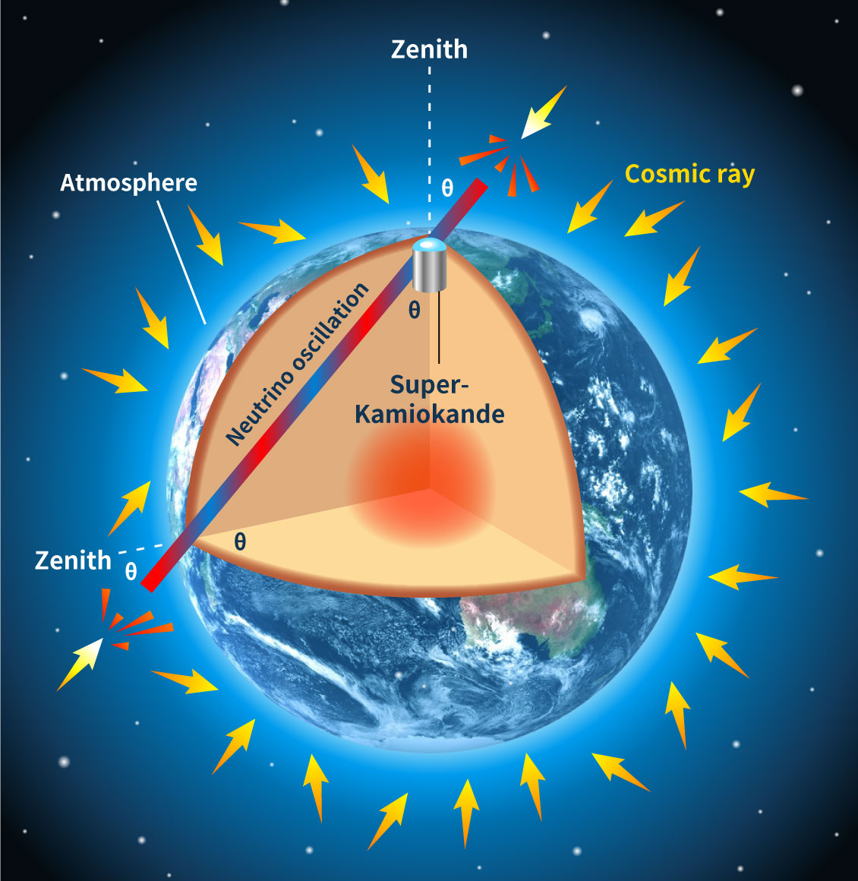
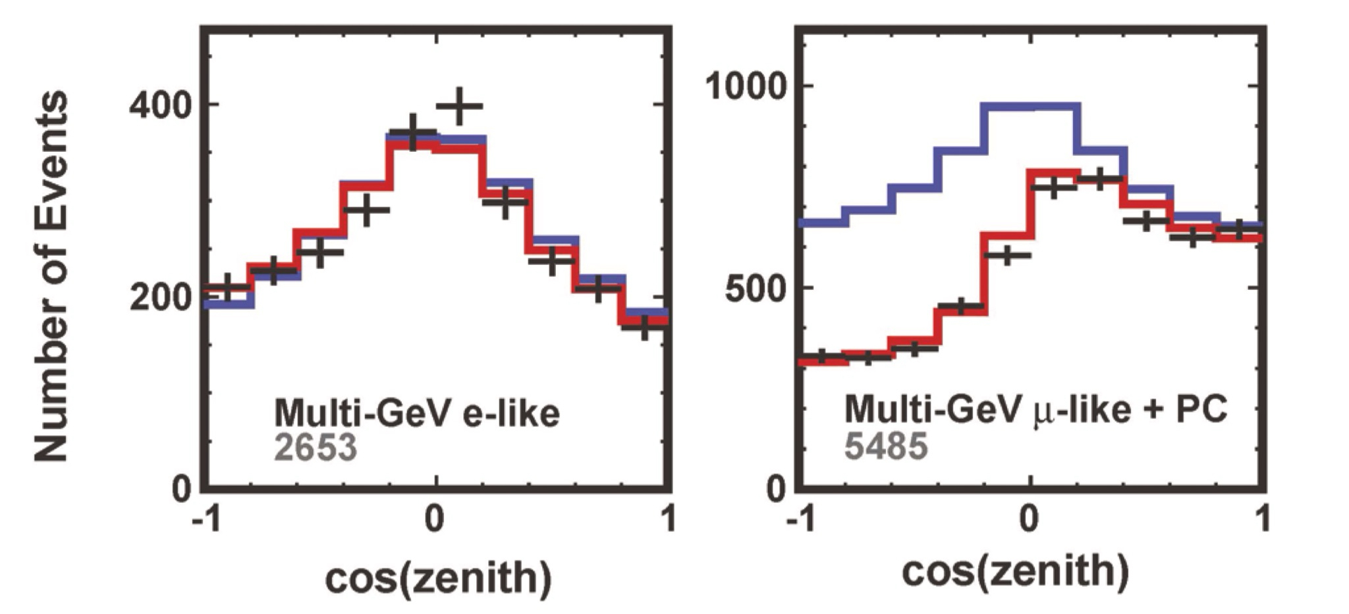
Zenith angle distribution
Pic.1: https://www.nobelprize.org/prizes/physics/2015/kajita/lecture/

Slide 16
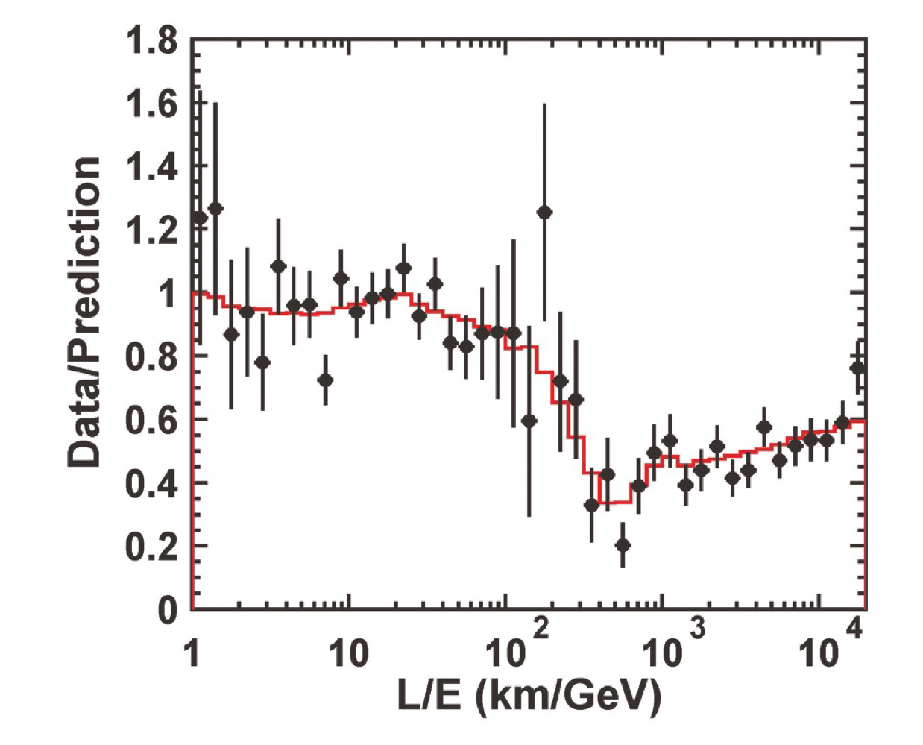
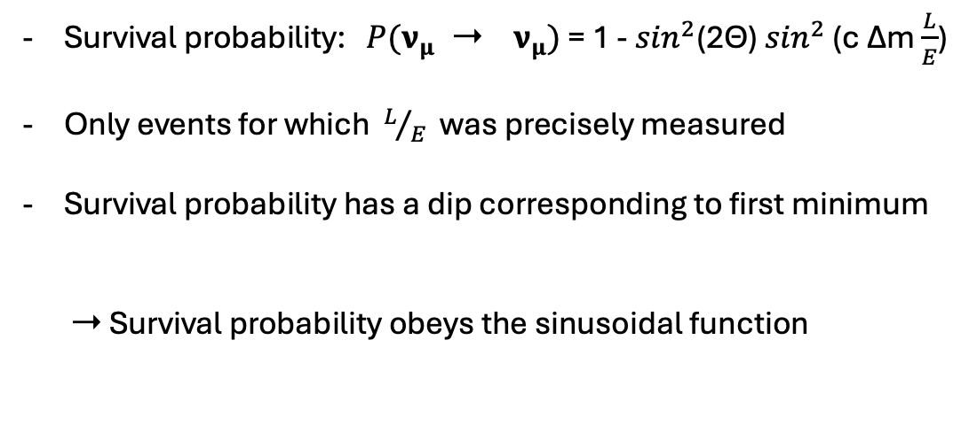
Sinusoidal behaviour
Survival probability: $P({\text{ν}}_{μ}{ \text{➝} \text{ν}}_{μ})$ = 1 - $\sin^{2}$(2Θ) $\sin^{2}$ (c Δm $\frac{L}{E}$)
Only events for which $L/{E }$was precisely measured
Survival probability has a dip corresponding to first minimum
➝ Survival probability obeys the sinusoidal function
Pic.1: https://www.nobelprize.org/prizes/physics/2015/kajita/lecture/

Slide 17
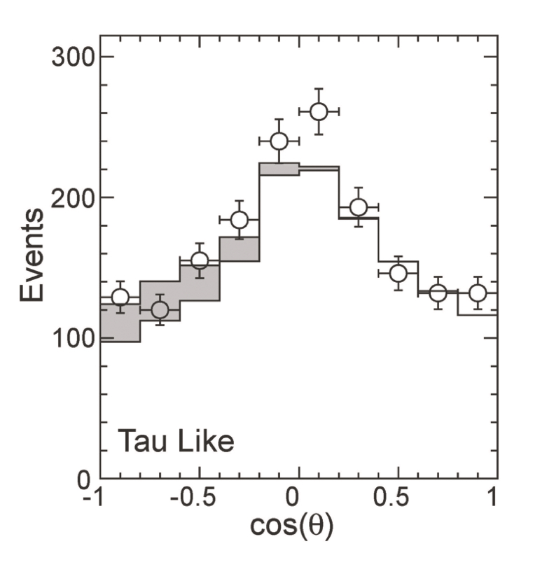
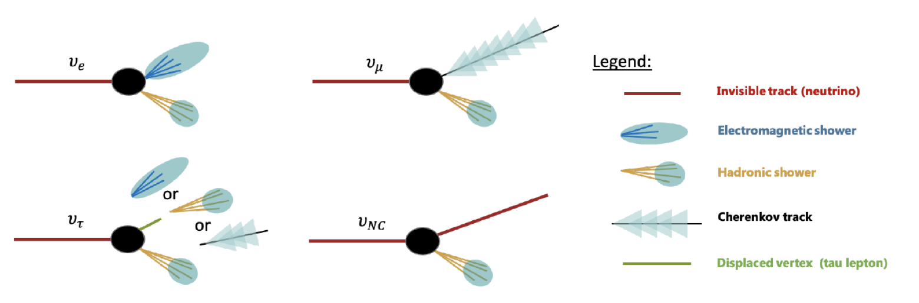

Detecting $ν_{τ}$
Pic. 1:
https://www.kth.se/polopoly_fs/1.1391959.1742249935!/Exjobb_Simon_Thor.pdf
Pic.2: https://www.nobelprize.org/prizes/physics/2015/kajita/lecture/

Slide 18

Oscillation parameters
${∆m }^{2}≈0,024{eV}^{2}$
Heaviest neutrino mass ≈ 0,05eV
Measured mixing angle is consistent with maximal mixing

Slide 19
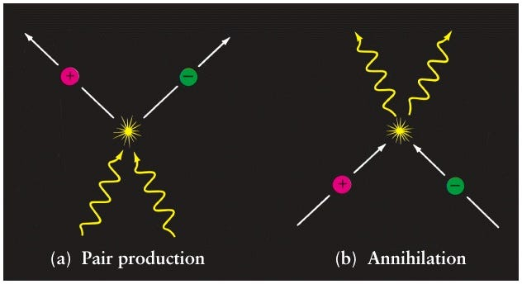
Why Neutrino Oscillations matter
- To explain why we exist
After the Big Bang: amount of matter = amount of antimatter
Matter and antimatter annihilate ➝ could have been an empty universe
How did matter survive?
Pic.1: https://medium.com/starts-with-a-bang/ask-ethan-31-why-are-we-made-of-matter-537d06075bae

Slide 20
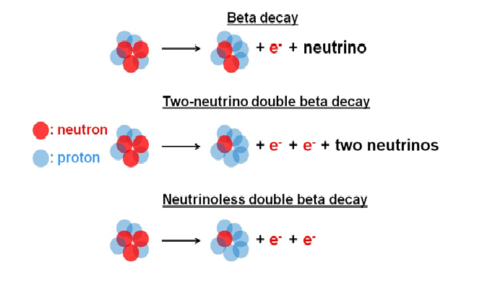

Majorana Particles
Spin ½
Majorana particles are their own antiparticles → $v_{x}$ =$\overline{v_{x}}$
No Lepton number
Lepton number conservation violated
Neutrino-less double- beta decay?
https://amore.ibs.re.kr/about/double-beta-decays/

Slide 21

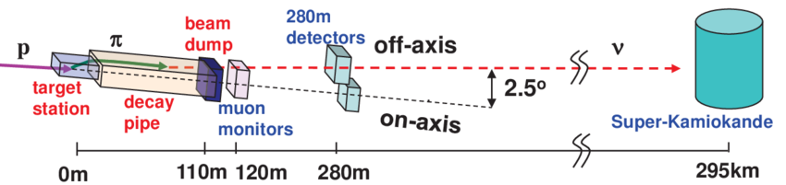
Difference in Oscillation Parameters
https://www.researchgate.net/figure/A-schematical-view-of-the-T2K-neutrino-beamline-and-detectors-Beamline-components-are_fig1_323891024
https://www-sk.icrr.u-tokyo.ac.jp/en/sk/about/research/

Slide 22
Thank you for your attention!

Slide 23
References
https://www-sk.icrr.u-tokyo.ac.jp/en/sk/about/research/
https://www.nobelprize.org/prizes/physics/2015/kajita/lecture/
https://www.nobelprize.org/prizes/physics/2015/mcdonald/lecture/
https://www.nobelprize.org/prizes/physics/2015/advanced-information/
A. Bettini, "Introduction to Elementary Particle Physics“
D. Griffiths, "Introduction to Elementary Particles“

