Slide 1
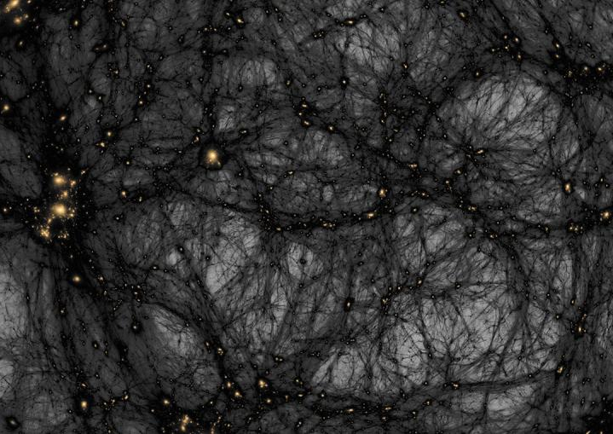
Cosmological Evidence for Dark Matter
By Micha Wischmann

Slide 2
Agenda
Early Universe
Cosmic Microwave Background (CMB)
Power Spectrum
Modern Measurements and Precision Cosmology

Slide 3
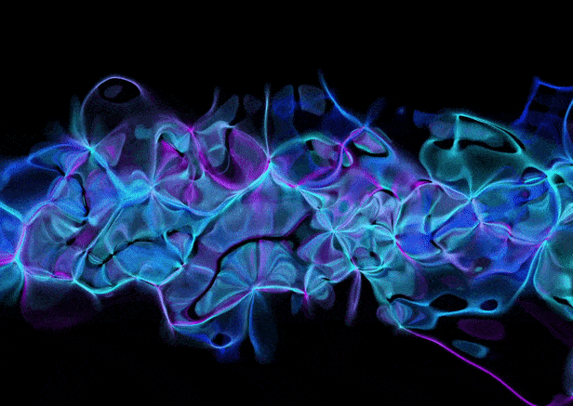

Early Universe

Slide 4
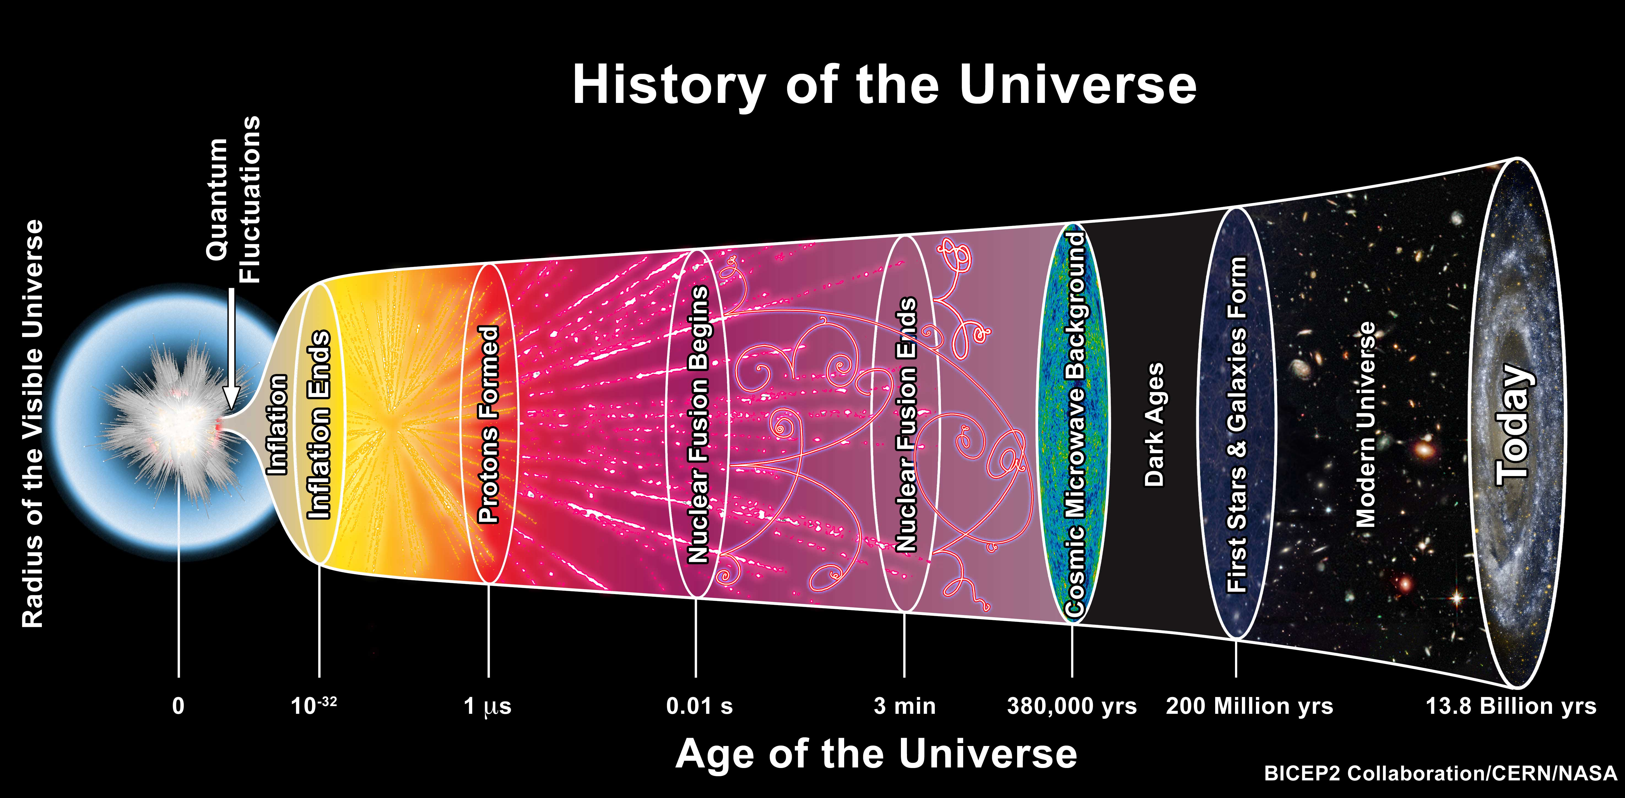
The Big Bang
Early Universe
Describes evolution from initial state
Predicts very high densities and Temperature in early state
Rapid expansion

Slide 5
Quark-Gluon-Plasma
Early Universe
Very high Temperatures prevent Hadrons from forming
  Hagedorn-Temperature T_{H} = 1.7*10¹²K
Plasma consists of Quarks and Gluons
State of the Universe from 10⁻¹² - 10⁻⁶s

Slide 6
Photon-Baryon-Plasma
Early Universe
Forms below Hagedorn-Temperature
Plasma → Free electric Charges
Consists of
  Baryons (Hydrogen ~93%, Helium ~ 7%, Lithium ~ trace amounts)
  Electrons
  Photons

Slide 7
Opaqueness of the Plasma
Early Universe
Thompson scattering
  E_{γ} ~ k_{b}T << m_{e}c² = 511keV
Free charges scatter Photons efficiently
  Atoms are neutral → no scattering

Slide 8
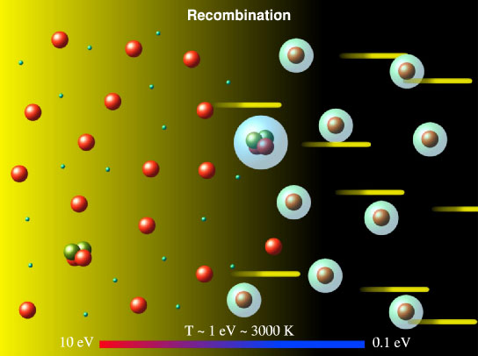
Recombination
Early Universe
T < 3000K
  Above 3000K Photons ionize Hydrogen
Age of the Universe: 378 000 years
Transparent to Photons → Photons move freely

Slide 9
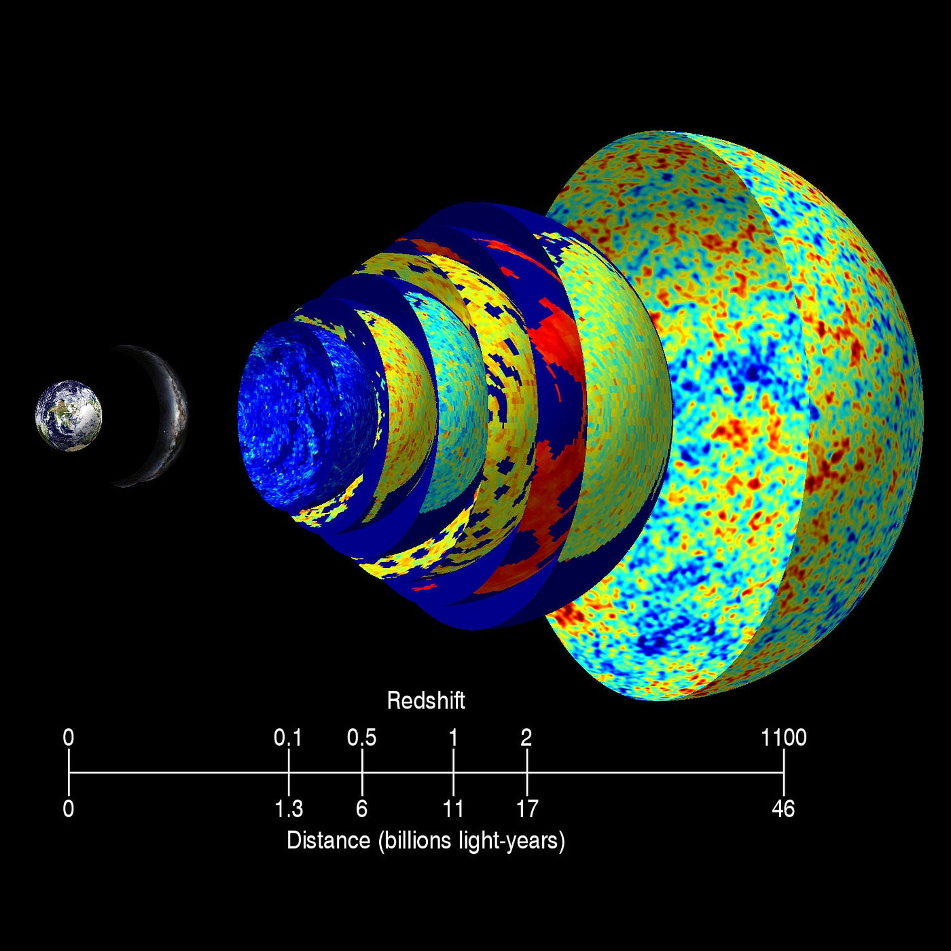
Last Scattering Surface
Early Universe
Consider a spherical shell around an observer
It takes light t = c*R seconds to arrive
For each time there is a different shell
Shell of light from Recombination is Last Scattering surface
Light gets redshifted on its way

Slide 10
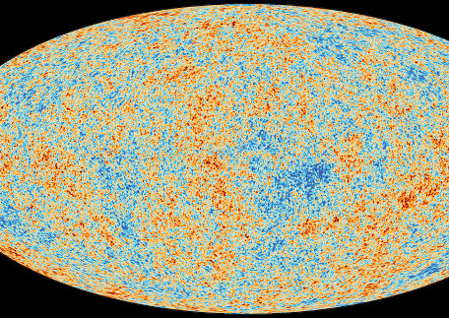

Cosmic Microwave Background

Slide 11
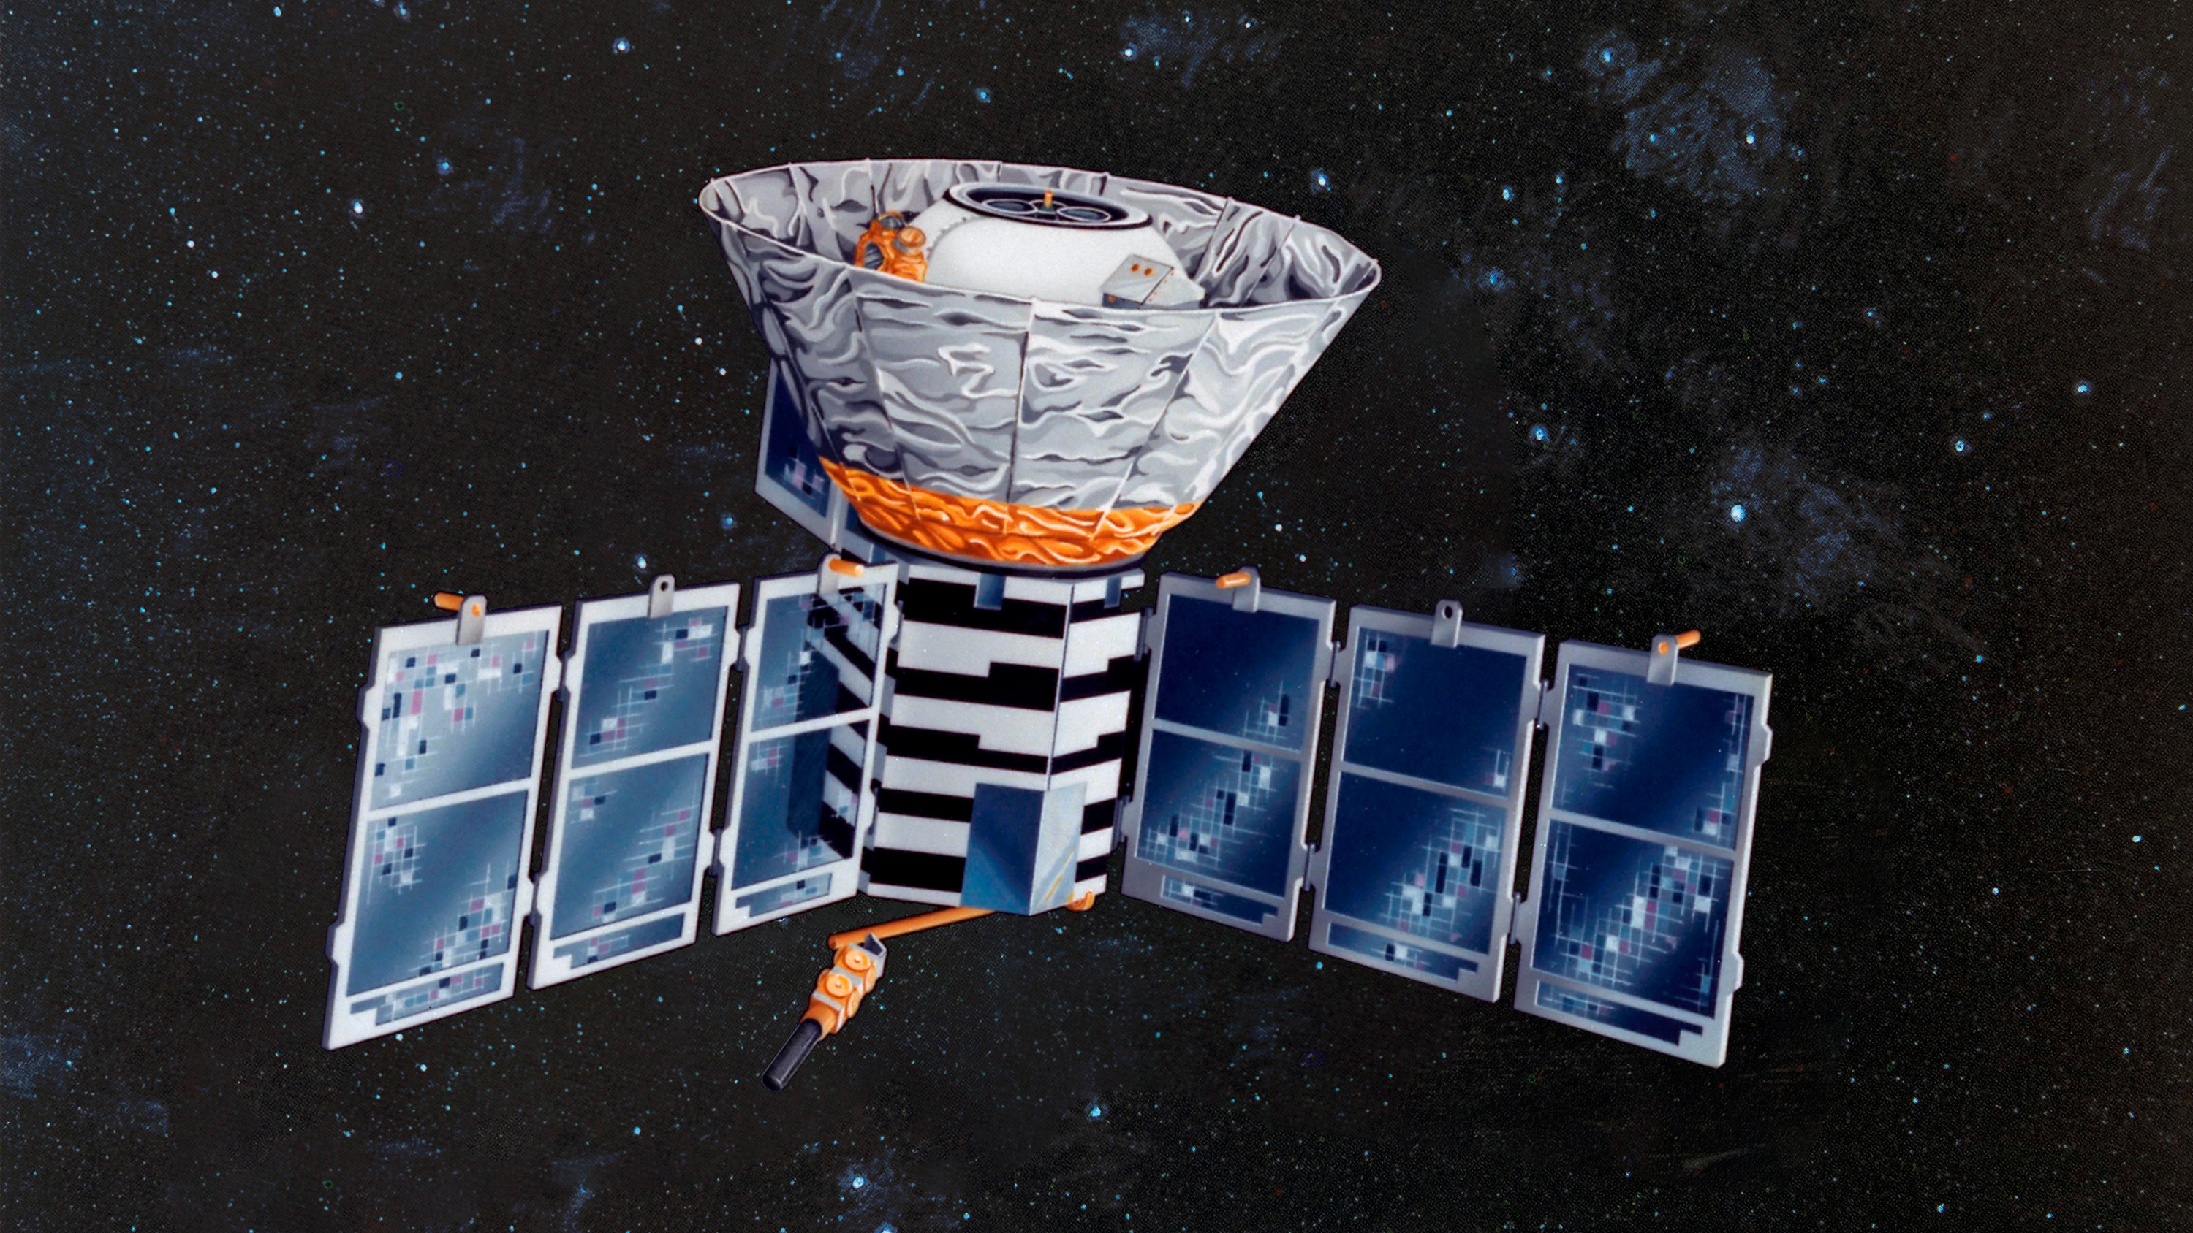
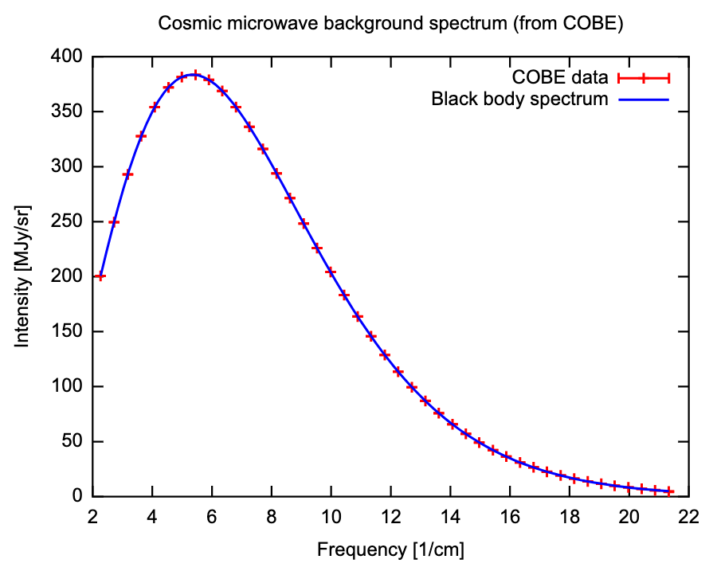
Spectrum of the CMB
Cosmic Microwave Background (CMB)
First Measurement with COBE
  COsmic Background Explorer
Follows Black body Spectrum
  Opaqueness
  Thermal equilibrium
T = 2.728K

Slide 12
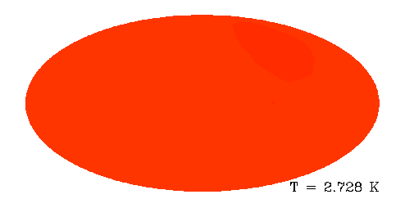
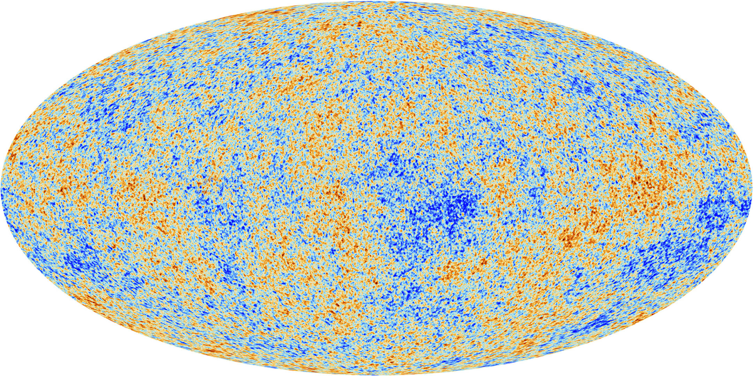
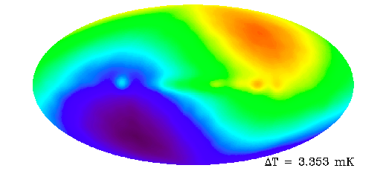
Monopole, Dipole and Multipoles
Cosmic Microwave Background (CMB)
Monopole: uniform map of T = 2.728K
Dipole: Movement of our planet and solar system
The Map we know
  Finer angular resolutions
  More sensitivity

Slide 13
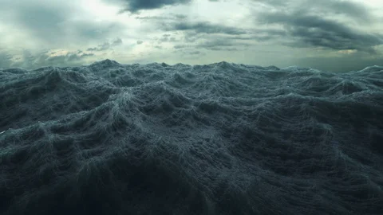
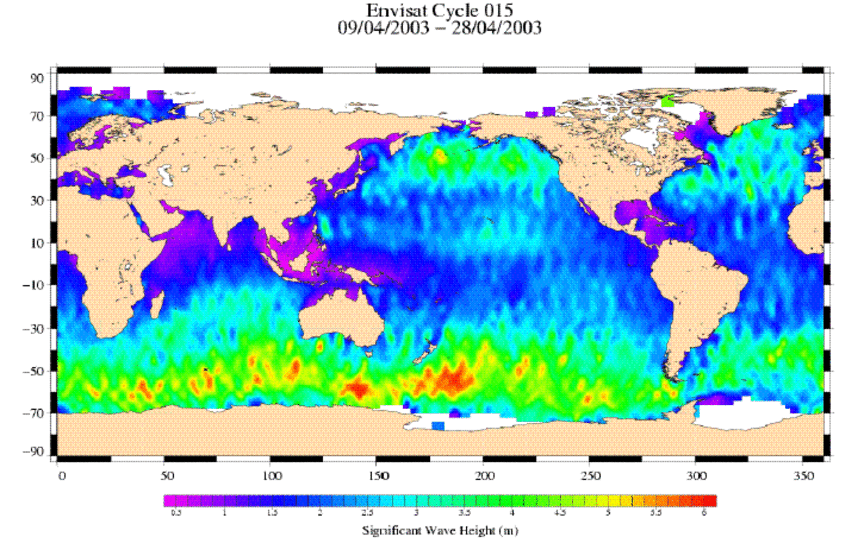
Angular Scale and Spatial Waves
Cosmic Microwave Background (CMB)
Rough ocean
  Many different Waves
  Plot heights
  Wavelengths → Angular sizes
Analogous to the CMB

Slide 14
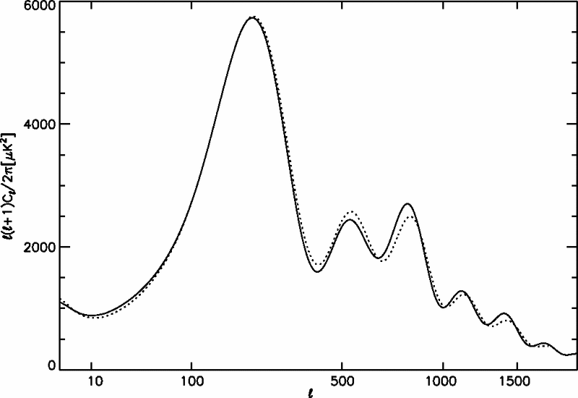
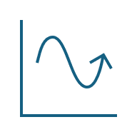
Power Spectrum

Slide 15
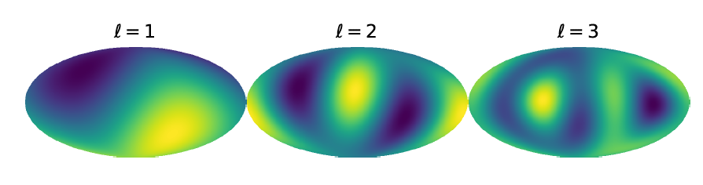
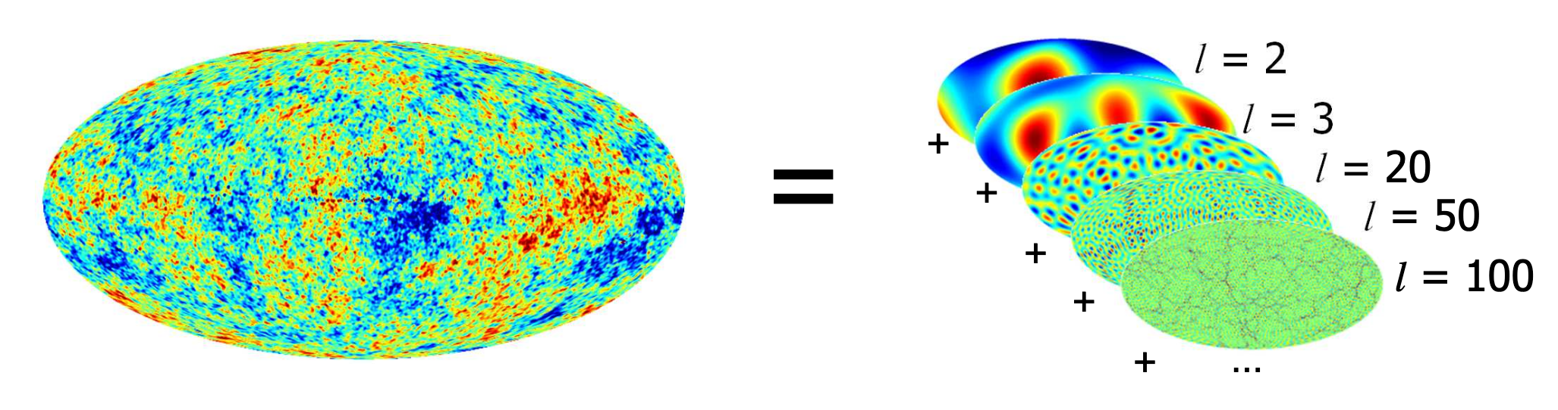

Theoretical description
Power Spectrum
Temperature as a function of angles
Spherical harmonics
$T\left(θ, φ\right)=\sum_{ℓm}{a_{ℓm}Y_{ℓm}(θ,φ)}$
  $ℓ=0$Monopole
  $ℓ=1$ Dipole
  $ℓ=2$ Quadrupole
  Higher $ℓ \overset{⇔}{ }$finer angular scale
Variance: $C_{ℓ}= \left\langle a_{ℓm} , a_{ℓm}^{∗}\right\rangle$
$D_{ℓ}=\frac{ℓ\left(ℓ+1\right)C_{ℓ}}{2π}$ Variance per logarithmic interval

Slide 16
The Power Spectrum
Power Spectrum
High first peak
Smaller second and third
  Second peak lower than third
Dampening towards the end

Slide 17
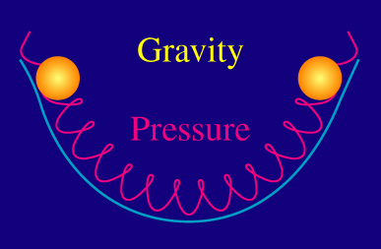
Baryon Acoustic Oscillations (BAO)
Power Spectrum
Quantum fluctuations in Photon Baryon era → dense and less dense regions
Gravity vs radiation pressure → Oscillations
Density Waves spread throughout space (sound waves)
Different independent modes form
All Oscillations start in phase when entering Photon Baryon era
  Beginning in a rarefied state
Oscillations freeze at Recombination

Slide 18
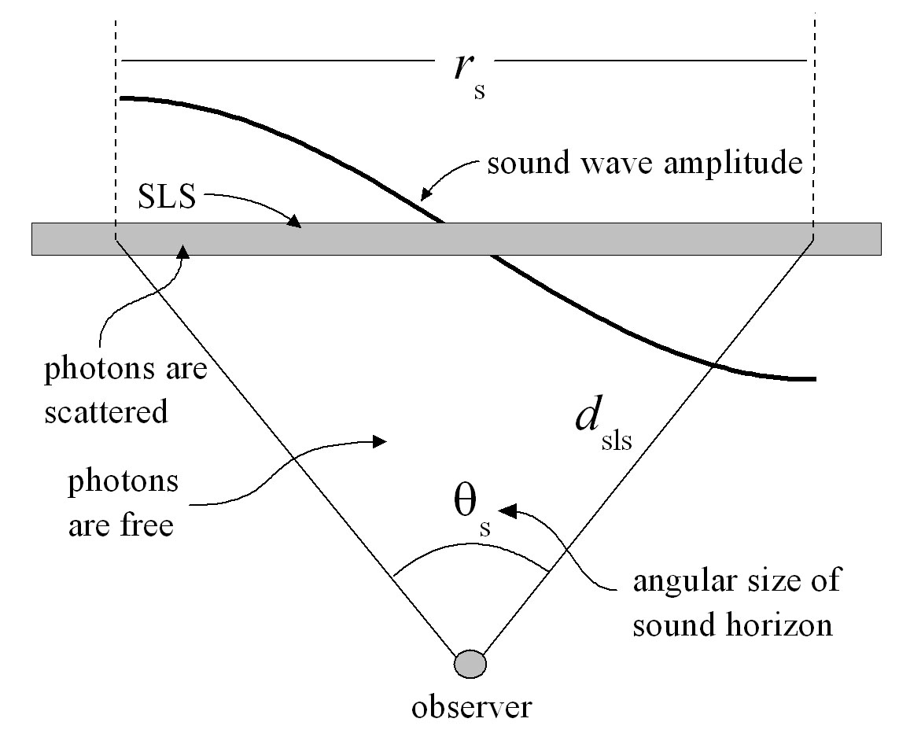

Special Wavelengths
Power Spectrum
Sound Horizon $r_{S}$
  Distance Sound can travel before recombination
  (simplified $r_{S}=v_{S}t_{rec}$)
    $v_{S}=0.59c$
Stadig Waves in a Cavity with length $r_{S}$
  $n\frac{λ}{2}=r_{S}⇒λ_{n}=\frac{2r_{S}}{n}$
  ($k_{n}=\frac{2π}{λ_{n}}=n\frac{π}{r_{S}}$)

Slide 19
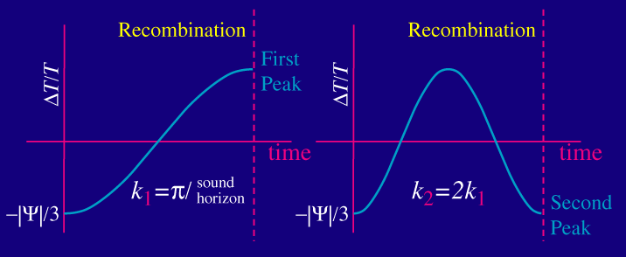

Understanding the Peaks
Power Spectrum
$n=1$ → half Oscillation→ Dense at Recombination
$n=2$ → full Oscillation → Rarefied at Recombination
$n=3$→ …
$λ_{n}$ corresponds to the $n$th peak
  Extrema → High density differences
  → high temperature differences

Slide 20
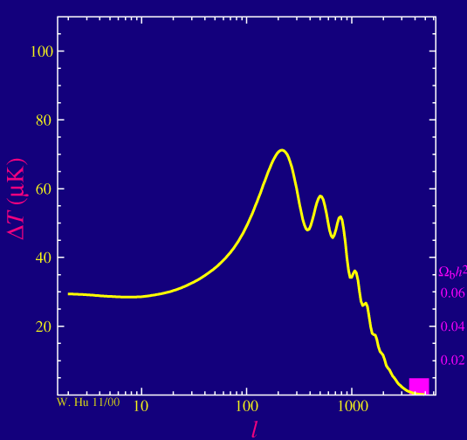
First Peak
Power Spectrum
Peak position
  Curvature of space
  Sound Horizon Measurement
Odd Peaks Describe Compression
  More Baryons → More Compression → Amplification
Peak height
  Depth of the gravitational wells
  Total matter content

Slide 21

Second Peak
Power Spectrum
Position
  Confirmation Sound Horizon measurement
Even Peaks describe Rarefication
  More Baryons → Higher Inertia → less Rarefication → less extreme $\frac{ΔT}{T}$
  → suppressed second Peak
Hight
  Sensitive to Baryonic matter content
  Interaction with light
Comparing total Matter and Baryonic matter

Slide 22
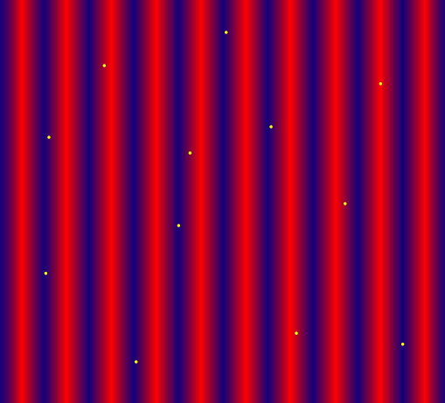

Dampening Effects On The Tail
Power Spectrum
Random Walk before Recombination
Diffusion of Photons
  Higher $ℓ⇔$ Smaller angular Scale $⇔$ Smaller Wavelengths
  Distance to different extrema get smaller with higher $ℓ$
  Photons Diffuse into regions of other extremum
  Mixing of Hot and Cold Photons

Slide 23
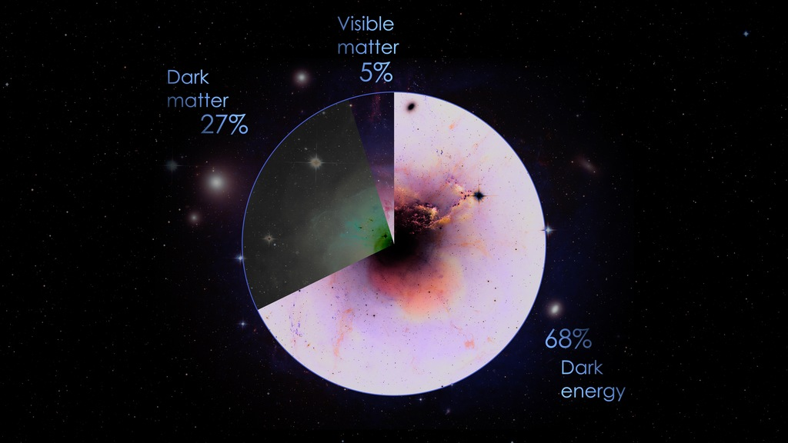

Important Results
Power Spectrum
First Peak
  Critical Density $Ω=1$ flat universe!
  Matter Density $Ω_{m}=0.32$
  Missing „Dark“ Energy! $Ω_{Λ}=Ω −Ω_{m}=0.68$
Second Peak
  $Ω_{b}=0.05$
  Missing „Dark“ Matter! $Ω_{cdm}=Ω_{m} −Ω_{b}=0.27$
    No interaction with light

Slide 24
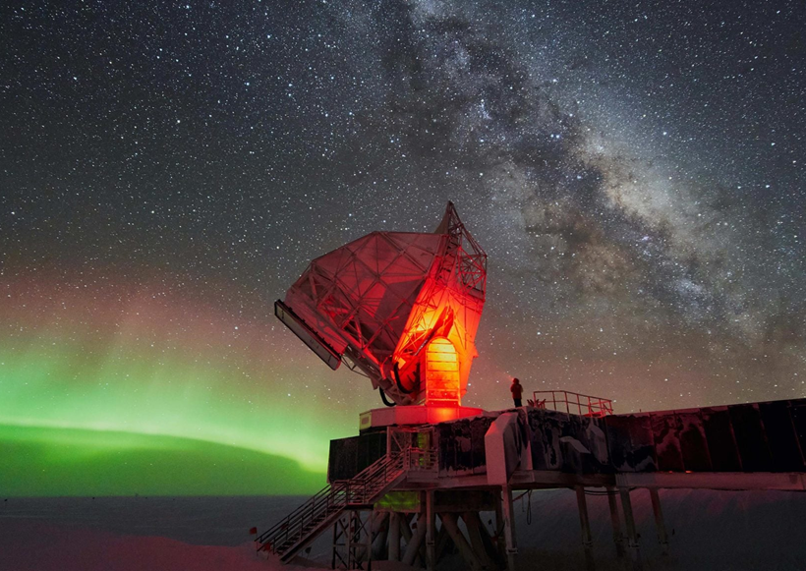

Modern Measurement and Precision Cosmology

Slide 25
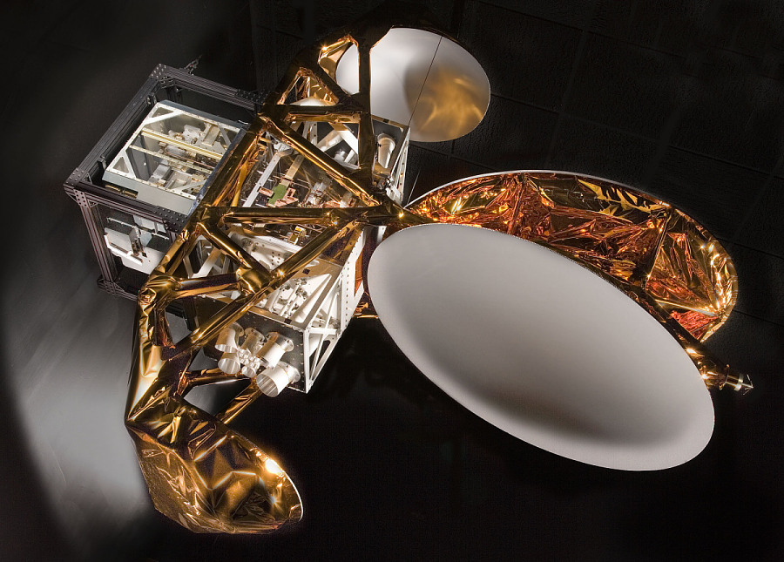
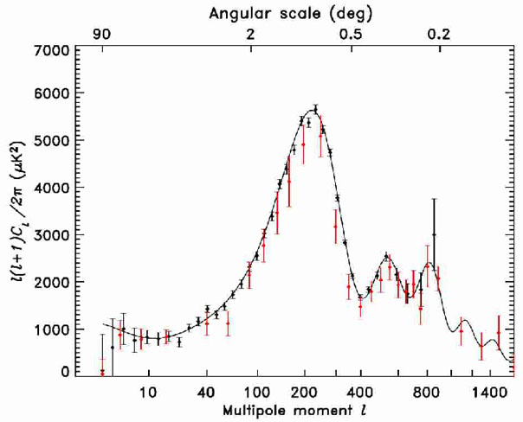

WMAP
Modern Measurements and Precision Cosmology
Wilkinson Microwave Anisotropy Probe
Active 2001 – 2010
33 times better angular Resolution than COBE
  Up to $ℓ=1200$
Full sky coverage
Results
  Age of the universe
  Third peak measurement

Slide 26
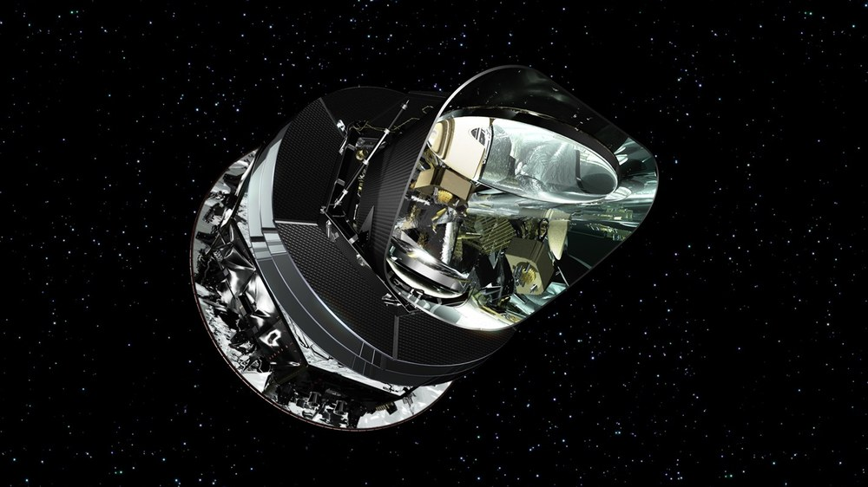
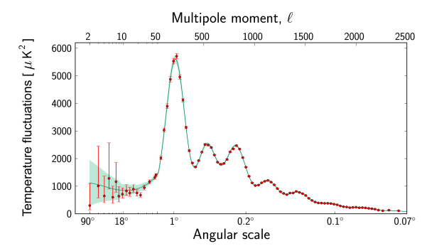

PLANCK
Modern Measurements and Precision Cosmology
Active 2009 – 2013
  Final data release 2018
~ 3 times better angular resolution
  Up to $ℓ=2500$
Full sky coverage
Results
  First seven peaks measured
  Improved precision on matter/energy contents

Slide 27
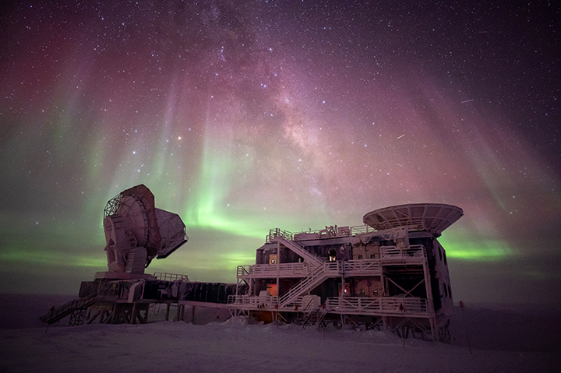
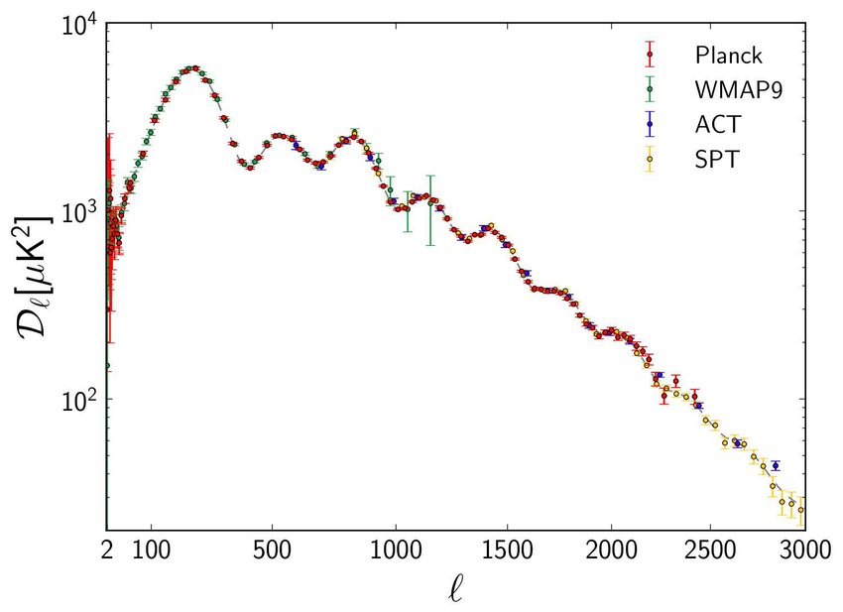

SPT
Modern Measurements and Precision Cosmology
South Pole Telescope
Not a satellite
Covers only 6%
10m diameter
  ~ 5 times better angular resolution
  Up to $ℓ=3000$
Results
  Measured first 10 peaks
  Better fixation of cosmological Parameters

Slide 28

Summary
CMB measurement → Power Spectrum
$r_{s}$ as a Cavity for BAOs
Harmonic Wavelengths $λ_{n}$ correspond to the $n$th peak
Peak Positions and Heights →
  Flat Universe
  Composition of the Universe
  Dark Energy and Dark Matter

Slide 29
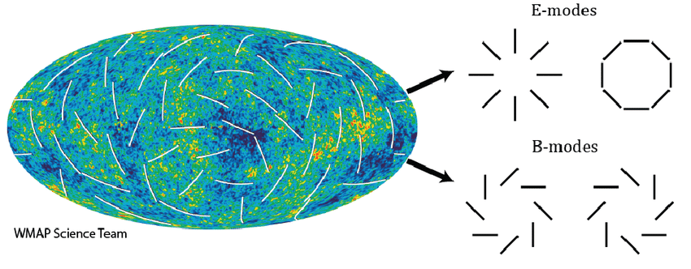
Future
Projects
  CMB-S4: ~10x more sensitivity
  Simons Observatory: High precision polarization maps, search for B-modes
  LiteBIRD: measure B-mode polarization at large angular scales
B-modes
  Predicted to be caused by gravitational waves during inflation
  Detection → evidence for inflation, Energy scale of inflation

Slide 30
Thanks For Your Attention

Slide 31
Sources
https://sci.esa.int/web/planck/-/51562-the-power-spectrum-of-temperature-fluctuations-in-the-cosmic-microwave-background-ndash-animation
https://phys.libretexts.org/Courses/University_of_California_Davis/Physics_156%3A_A_Cosmology_Workbook/01%3A_Workbook
https://background.uchicago.edu/~whu/beginners/summary.html
https://wwwmwapa.mpa-garching.mpg.de/~komatsu/lectures--reviews.html
https://physicsfeed.com/big-bang-origin-universe/
https://astro.uni-bonn.de/~kbasu/CMB/Online_Slides/CMB.03%20-%20thermal-I.pdf
https://physicsworld.com/a/b-mode-polarization-spotted-in-cosmic-microwave-background/
https://background.uchicago.edu/~whu/intermediate/Polarization/polar5.html

Slide 32
Picture Sources
https://scitechdaily.com/images/South-Pole-Telescope-at-Night-2048x1152.jpg
http://english.tachyonbeam.com/wp-content/uploads/sites/2/2018/07/ESA_Planck_CMB2018_notext.jpg
https://www.researchgate.net/publication/1902437/figure/fig6/AS:287872222547987@1445645494522/The-theoretical-CMB-temperature-angular-power-spectrum-of-our-model-solid-curve.png
https://scitechdaily.com/quark-gluon-plasma-which-filled-the-universe-shortly-after-the-big-bang-flows-like-water/
https://ids.si.edu/ids/deliveryService?id=NASM-A20060634000cp02&max=900
https://www.dlr.de/de/ar/themen-missionen/weltraumforschung/erkundung-des-weltraums/entstehung-des-universums/planck/planck_highres.jpg/@@images/image-1000-7dc8baef153d58d9b9b1098c8fc8b95e.jpeg
https://ned.ipac.caltech.edu/level5/Sept02/Kinney/Figures/figure3.jpg
https://miro.medium.com/v2/resize:fit:1400/1*2IJHJp1xAjswfGm8HyIxDA.jpeg
https://pro-physik.de/media/story_section_gallery/497/img-02-penzias02-web.jpg
https://www.shutterstock.com/shutterstock/videos/5853836/thumb/1.jpg?ip=x480
https://background.uchicago.edu/~whu/intermediate/basicoscil.gif
https://background.uchicago.edu/~whu/intermediate/extrema.gif
https://svs.gsfc.nasa.gov/vis/a010000/a012300/a012307/frame-000215_print.jpg
https://background.uchicago.edu/~whu/intermediate/dissipation.gif
https://science.nasa.gov/wp-content/uploads/2024/06/cobe-art-mashup-3000x1688-1.jpg
https://science.nasa.gov/wp-content/uploads/2023/10/darkmatter-kipacamnh-1200.jpg
https://upload.wikimedia.org/wikipedia/commons/c/cf/The_History_of_the_Universe.jpg
https://background.uchicago.edu/~whu/intermediate/clbaryon.gif
https://cmb.wintherscoming.no/images/multipoles.png
https://www.researchgate.net/profile/Edward-Wollack/publication/263811882/figure/fig1/AS:296593241722891@1447724747509/The-CMB-anisotropy-polarization-map-may-be-decomposed-into-curl-free-even-parity-E-modes.png
https://ned.ipac.caltech.edu/level5/March04/Ellis/Figures/figure1.jpg
https://cdn.sci.esa.int/documents/34222/35279/1567216755608-Planck_power_spectrum_625.jpg
https://www.researchgate.net/publication/236843975/figure/fig3/AS:613920825933876@1523381539363/CMB-power-spectrum-as-measured-by-WMAP-237-SPT-289-ACT-290-and-Planck-291-plot.png
https://www.esa.int/var/esa/storage/images/esa_multimedia/images/2003/09/global_wave_height_measured_by_envisat_s_ra-2/10037256-2-eng-GB/Global_wave_height_measured_by_Envisat_s_RA-2_pillars.gif

Slide 33
Cosmological Evidence for Dark Matter
By Micha Wischmann

