Slide 1
The Development of the Standard Model
Franka Maack
Proseminar: Particle- and Astroparticlephysics

Slide 2
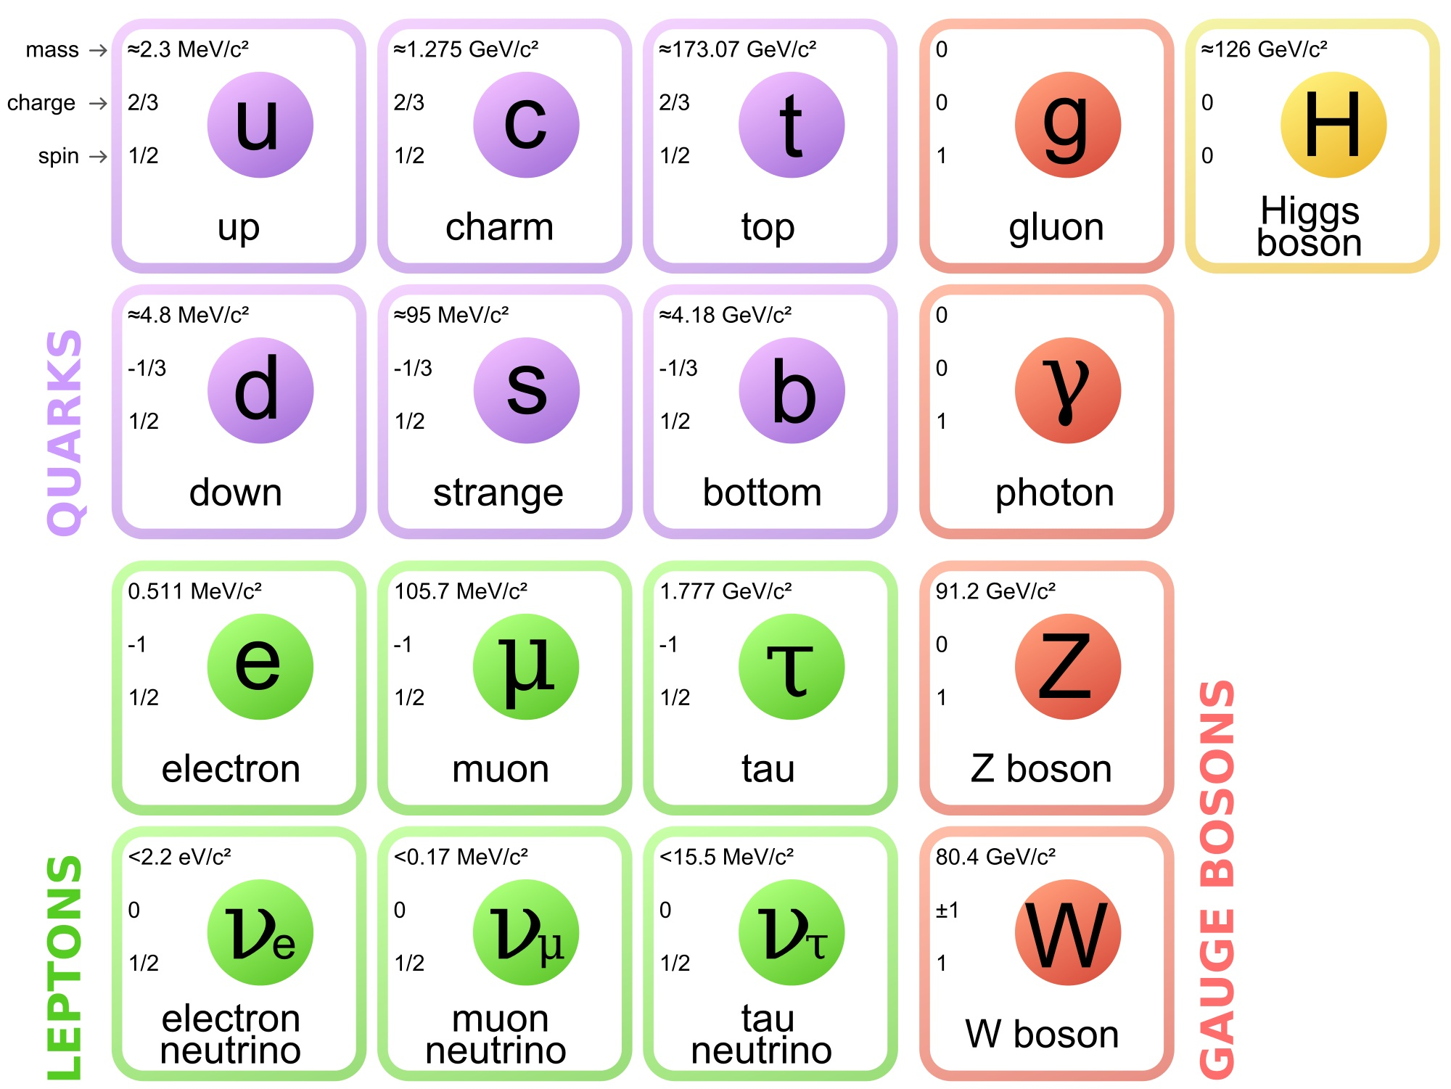
Fig.1: Particles in the standard model
Quantumdiaries: standard Model Of Elementary Particles

Slide 3
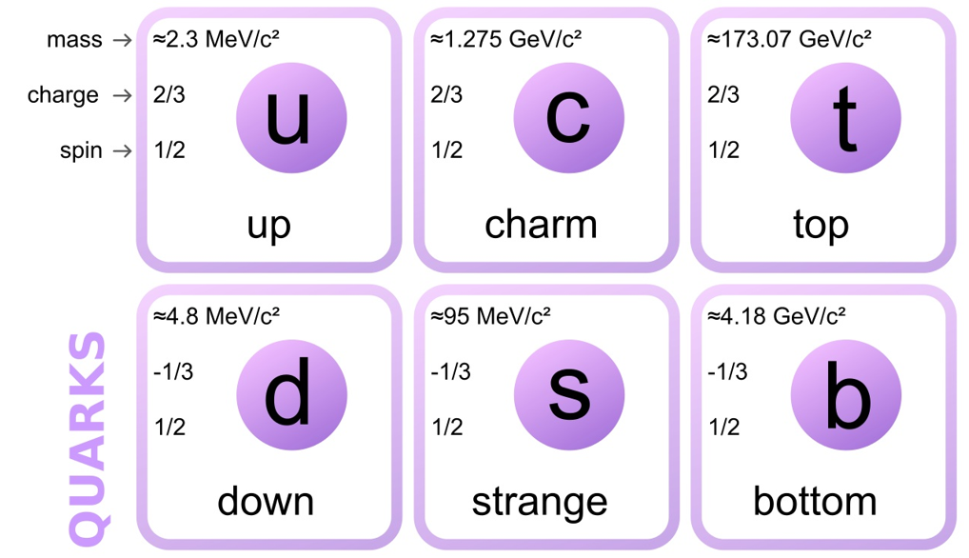
Quarks
Substructure of all hadrons (particles experiencing strong interactions)
Quarks come in six different flavours with different properties:
- spin (Fermions), charge, weight, stability
→ only u and d are stable
→ c, s, t and b decay into u and d
Fig.2: Quarks in the standard model
Quantumdiaries: standard Model Of Elementary Particles

Slide 4
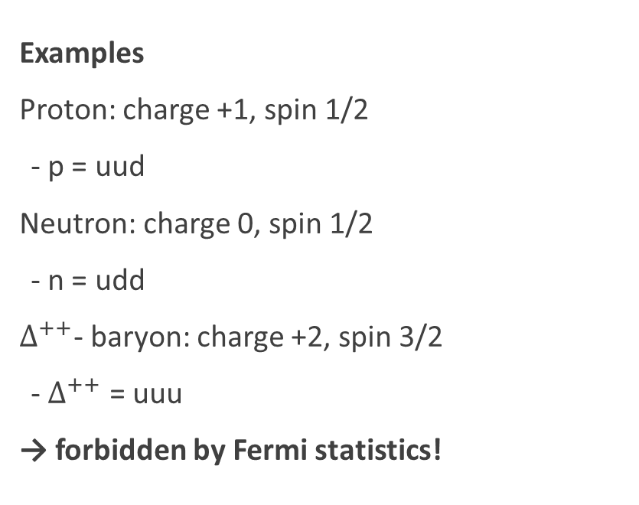
Quarks
Examples
Proton: charge +1, spin 1/2
- p = uud
Neutron: charge 0, spin 1/2
- n = udd
$∆^{++}$- baryon: charge +2, spin 3/2
- $∆^{++}$ = uuu
→ forbidden by Fermi statistics!
Fig.2: Quarks in the standard model
Quantumdiaries: standard Model Of Elementary Particles

Slide 5
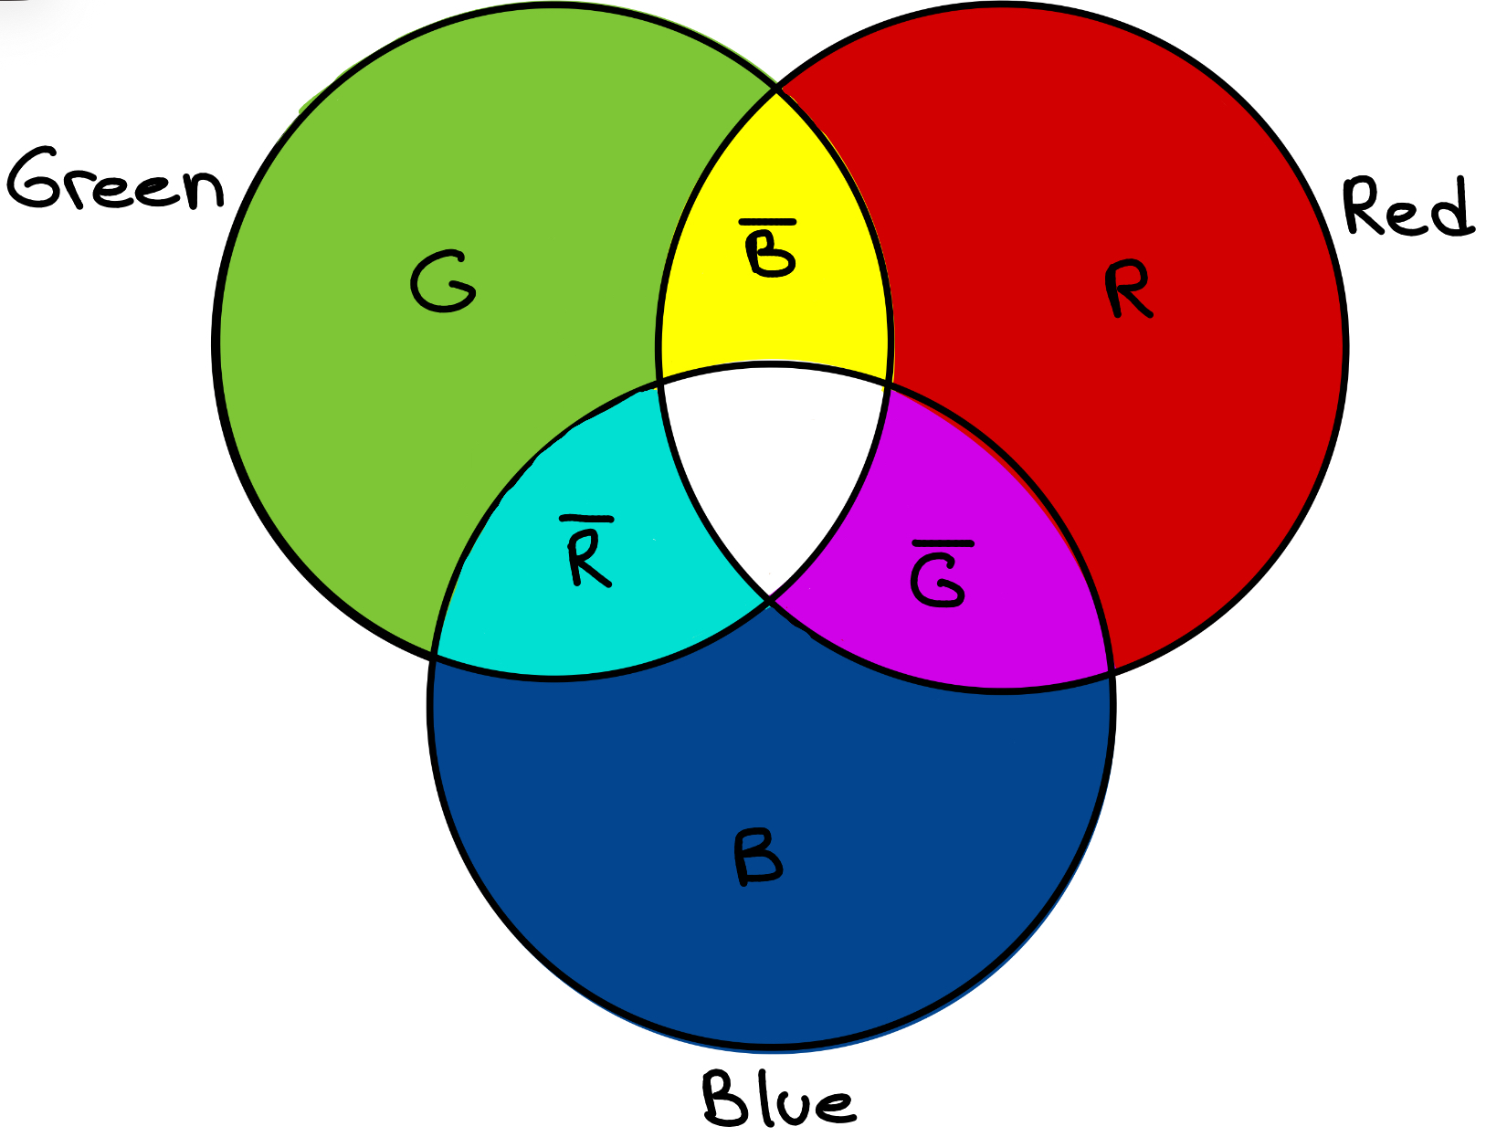
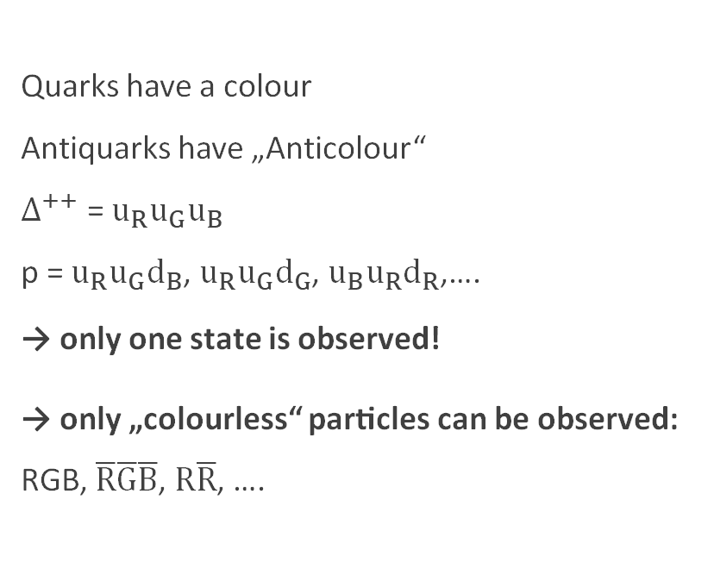
Quarks
Colour charge!
Quarks have a colour
Antiquarks have „Anticolour“
$∆^{++}$ = $u_{R}u_{G}u_{B}$
p = $u_{R}u_{G}d_{B}$, $u_{R}u_{G}d_{G}$, $u_{B}u_{R}d_{R}$,….
→ only one state is observed!
→ only „colourless“ particles can be observed: RGB, $\overline{R}\overline{G}\overline{B}$, $R\overline{R}$, ….
Fig.3: Colour composition of quarks

Slide 6
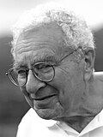
Quarks Timeline
1964 Gell-Mann and Zweig propose quark model → Nobel 1969
- including three flavours (up, down, strange)
Fig.4: Murray Gell-Mann
Wikipedia: List of Nobel laureates in Physics
u, d, s
1964
Theory
1930
1950
1970
1990
2010
Experiment

Slide 7
Quarks Timeline
1964 Gell-Mann and Zweig propose quark model → Nobel 1969
- including three flavours (up, down, strange)
1964 Glashow and Bjorken propose fourth flavour: charm
1965 Greenberg, Han and Nambu propose theory later called mmlllcolourcharge
c
Colour
1965
u, d, s
1964
Theory
1970
1990
2010
1930
1950
2010
Experiment

Slide 8
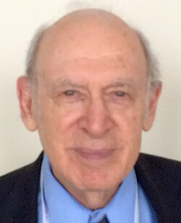

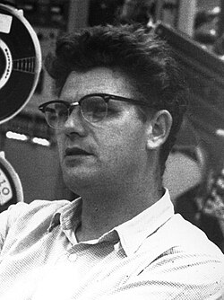
Quarks Timeline
1968 Up and down quark found at SLAC → Nobel 1990
c
Colour
1965
Fig.5: Friedman, Kendall, Taylor
Wikipedia: List of Nobel laureates in Physics
u, d, s
1964
Theory
1970
1990
2010
1930
1950
2010
1968
u, d
Experiment

Slide 9

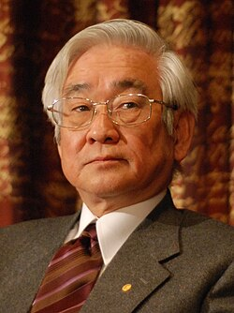
Quarks Timeline
1968 Up and down quark found at SLAC → Nobel 1990
1973 Kobayashi and Maskawa propose two additional mmlllflavours: top, bottom → Nobel 2008
Fig.6: Makoto Kobayashi, Toshihide Maskawa
Wikipedia: List of Nobel laureates in Physics
c
Colour
1965
u, d, s
1964
t, b
1973
Theory
1970
1990
2010
1930
1950
2010
1968
u, d
Experiment

Slide 10
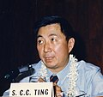
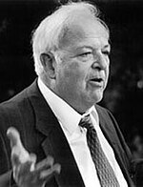
Quarks Timeline
1968 Up and down quark found at SLAC → Nobel 1990
1973 Kobayashi and Maskawa propose two additional mmlllflavours: top, bottom → Nobel 2008
1974 Charm quark found at SLAC and Brookhaven national mmlllllaboratory → Nobel 1976
Fig.7: Samuel C. C. Ting, Burton Richter
Wikipedia: List of Nobel laureates in Physics
c
Colour
1965
u, d, s
1964
t, b
1973
Theory
1970
1990
2010
1930
1950
2010
1968
u, d
1974
c
Experiment

Slide 11
Quarks Timeline
1977 Bottom quark found at Fermilab
1995 Top quark found at Fermilab
c
Colour
1965
u, d, s
1964
t, b
1973
Theory
1970
1990
2010
1930
1950
2010
1968
u, d
1974
c
1977
b
1995
t
Experiment

Slide 12
Timeline
Colour
1965
Theory
c
u, d, s
1964
t, b
1973
1930
1950
1970
1990
2010
1974
c
1995
t
1968
u, d
1977
b
Experiment

Slide 13
Fig.1: Particles in the standard model
Quantumdiaries: standard Model Of Elementary Particles

Slide 14
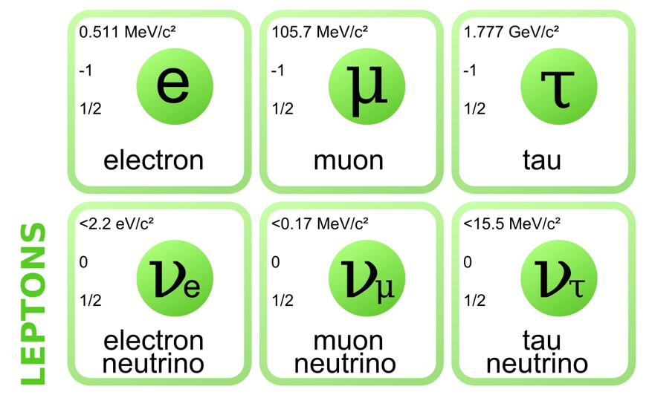
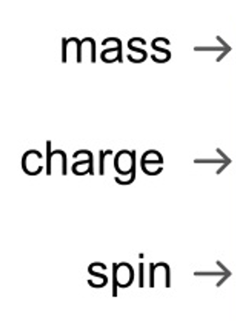
Leptons
Particles that do not experience strong interactions
In total six leptons with different properties:
- three kinds of charged leptons and their llcorresponding neutral leptons
- spin (Fermions), weight
- stability is much higher than heavy quarks
- neutrinos pass through most matter
Fig.8: Leptons in the standard model
Quantumdiaries: standard Model Of Elementary Particles

Slide 15
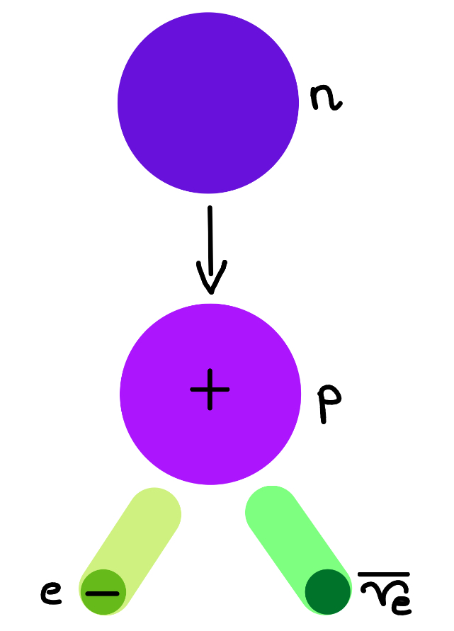

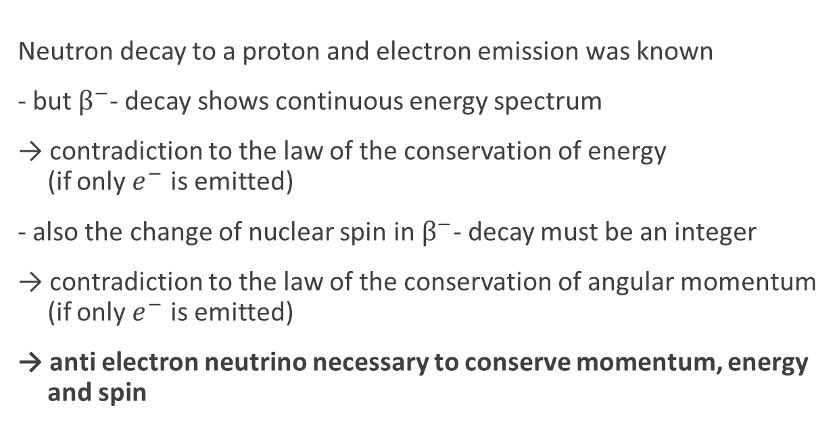

Leptons
Example: $β^{−}$- decay
n → p + $e^{−}$+ $\overline{ν_{e}}$
Neutron decay to a proton and electron emission was known
- but $β^{−}$- decay shows continuous energy spectrum
→ contradiction to the law of the conservation of energy ml(if only $e^{−}$ is emitted)
- also the change of nuclear spin in $β^{−}$- decay must be an integer
→ contradiction to the law of the conservation of angular momentum ml(if only $e^{−}$ is emitted)
→ anti electron neutrino necessary to conserve momentum, energy mland spin
Fig.9: schematic $β^{−}$- decay

Slide 16
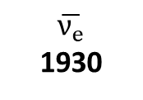
Leptons Timeline
1897 Electron found by Thomson
1927 Discovery of ß – decay
1930 Pauli proposes electron neutrino
$$\overline{ν_{e}}$$
1930
Theory
1970
1990
2010
1930
1950
2010
1897
e
Experiment

Slide 17
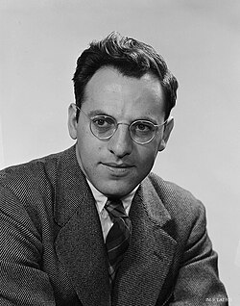

Leptons Timeline
1933/34 Fermi proposes theory for ß – decay
- matter particles can be annihilated and created (like neutrino here)
1947 Muon discovered by Powell
1956 Electron neutrino found by Reines → Nobel 1995
Fig.10: Frederick Reines
Wikipedia: List of Nobel laureates in Physics
$$\overline{ν_{e}}$$
1930
Theory
1970
1990
2010
1930
1950
2010
1897
e
1947
μ
1956
$ν_{e}$
Experiment

Slide 18
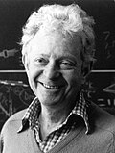
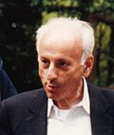
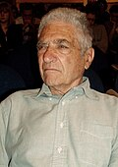
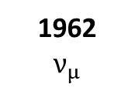
Leptons Timeline
1962 Muon neutrino found by Lederman, Schwartz, mmlllSteinberger → Nobel 1988
- Showing that there is more than one neutrino
Fig.11: Lederman, Schwartz, Steinberger
Wikipedia: List of Nobel laureates in Physics
$$\overline{ν_{e}}$$
1930
Theory
1970
1990
2010
1930
1950
2010
1897
e
1947
μ
1956
$ν_{e}$
1962
$ν_{μ}$
Experiment

Slide 19
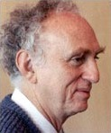

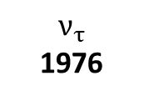
Leptons Timeline
1976 Tau found at SLAC → Nobel 1995
- Evidence for tau neutrino in missing energy and nmomentum in tau decay
2000 Tau neutrino found at Fermilab
Fig.12: Martin Lewis Pearl
Wikipedia: List of Nobel laureates in Physics
$$\overline{ν_{e}}$$
1930
$$ν_{τ}$$
1976
Theory
1970
1990
2010
1930
1950
2010
1897
e
1947
μ
1956
$ν_{e}$
1962
$ν_{μ}$
1976
τ
2000
$ν_{τ}$
Experiment

Slide 20
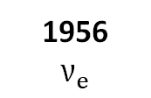
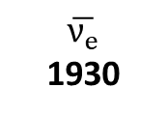
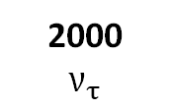
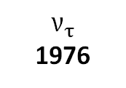
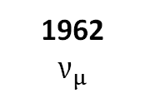
Timeline
Colour
1965
Theory
c
$$ν_{τ}$$
1976
$$\overline{ν_{e}}$$
1930
u, d, s
1964
t, b
1973
1930
1950
1970
1990
2010
1947
μ
1956
$ν_{e}$
1962
$ν_{μ}$
1974
c
1995
t
2000
$ν_{τ}$
1897
e
1968
u, d
1977
b
1976
τ
Experiment

Slide 21
Fig.1: Particles in the standard model
Quantumdiaries: standard Model Of Elementary Particles

Slide 22
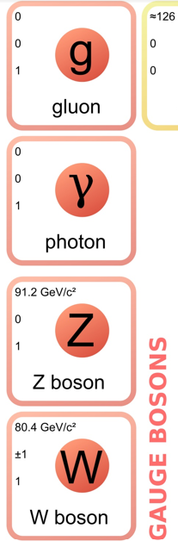
Gauge Bosons
Mediate particle interactions
In total four gauge bosons
Properties: spin (bosons), charge, mass
- Z and W are very short lived
Fig.13: Gauge Bosons in the standard model
Quantumdiaries: standard Model Of Elementary Particles

Slide 23
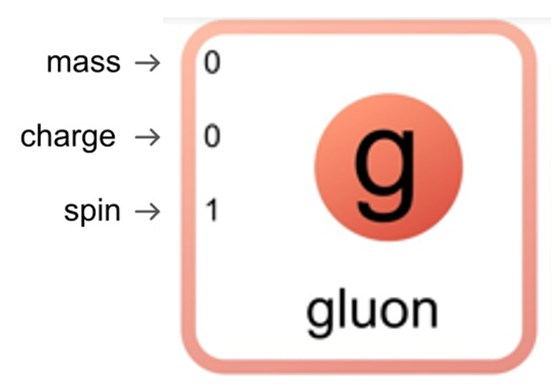
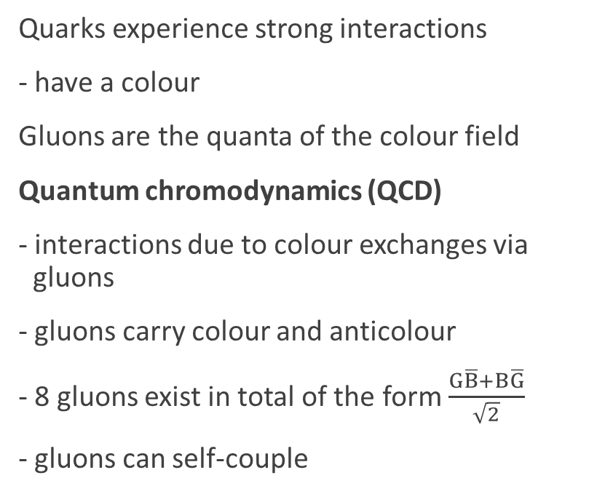
Gauge Bosons
Gluon: mediates strong interactions
Quarks experience strong interactions
- have a colour
Gluons are the quanta of the colour field
Quantum chromodynamics (QCD)
- interactions due to colour exchanges via llgluons
- gluons carry colour and anticolour
- 8 gluons exist in total of the form $\frac{G\overline{B}+B\overline{G}}{\sqrt{2}}$
- gluons can self-couple
Fig.3: Colour composition of quarks

Slide 24
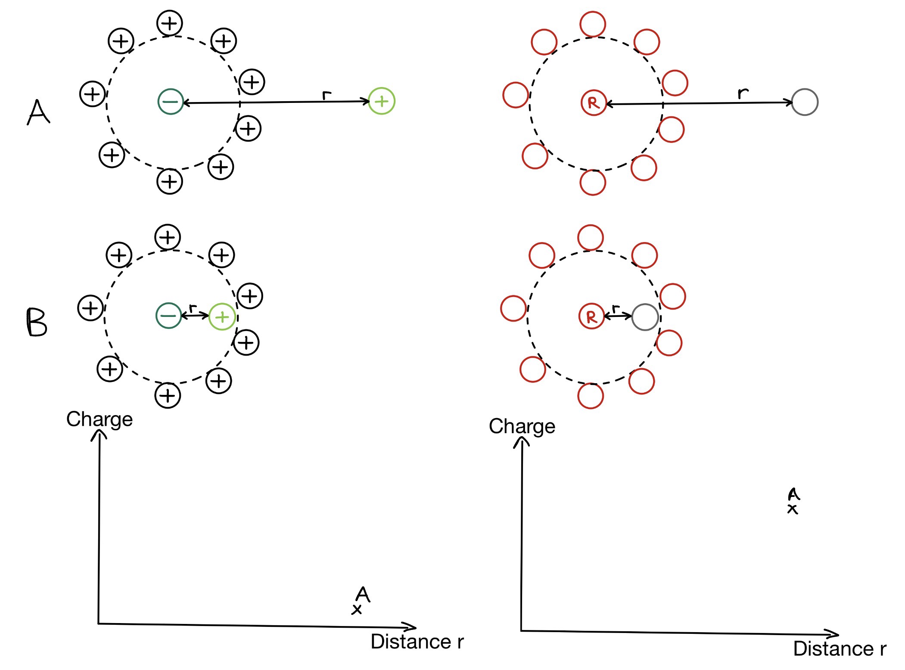
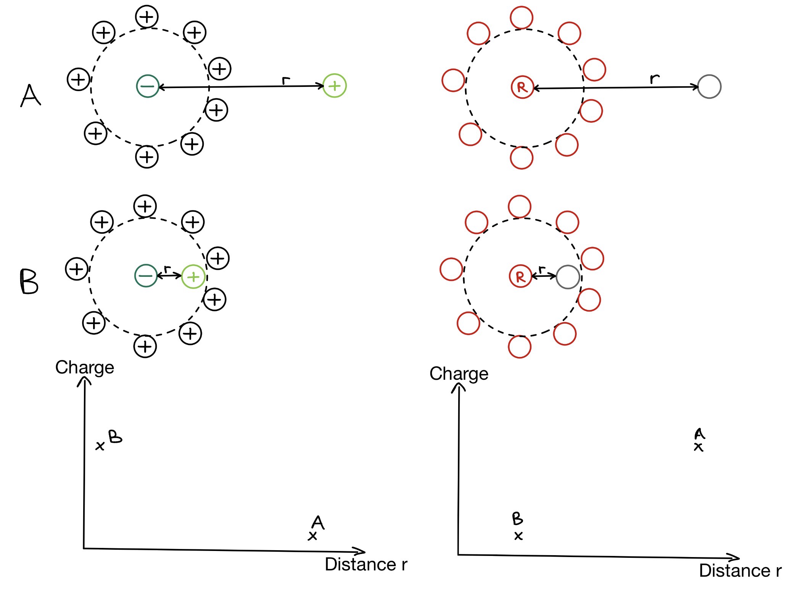
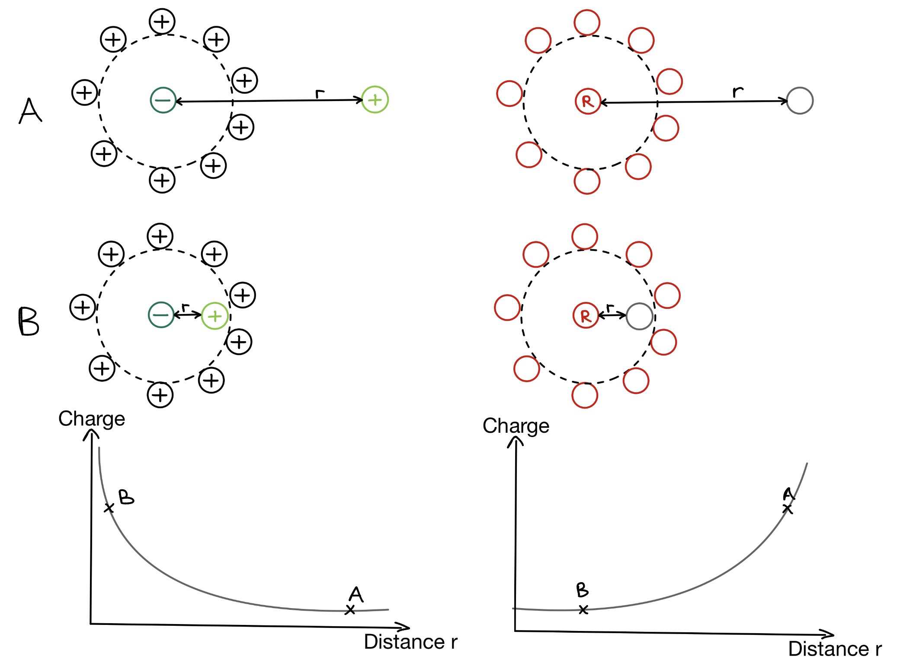
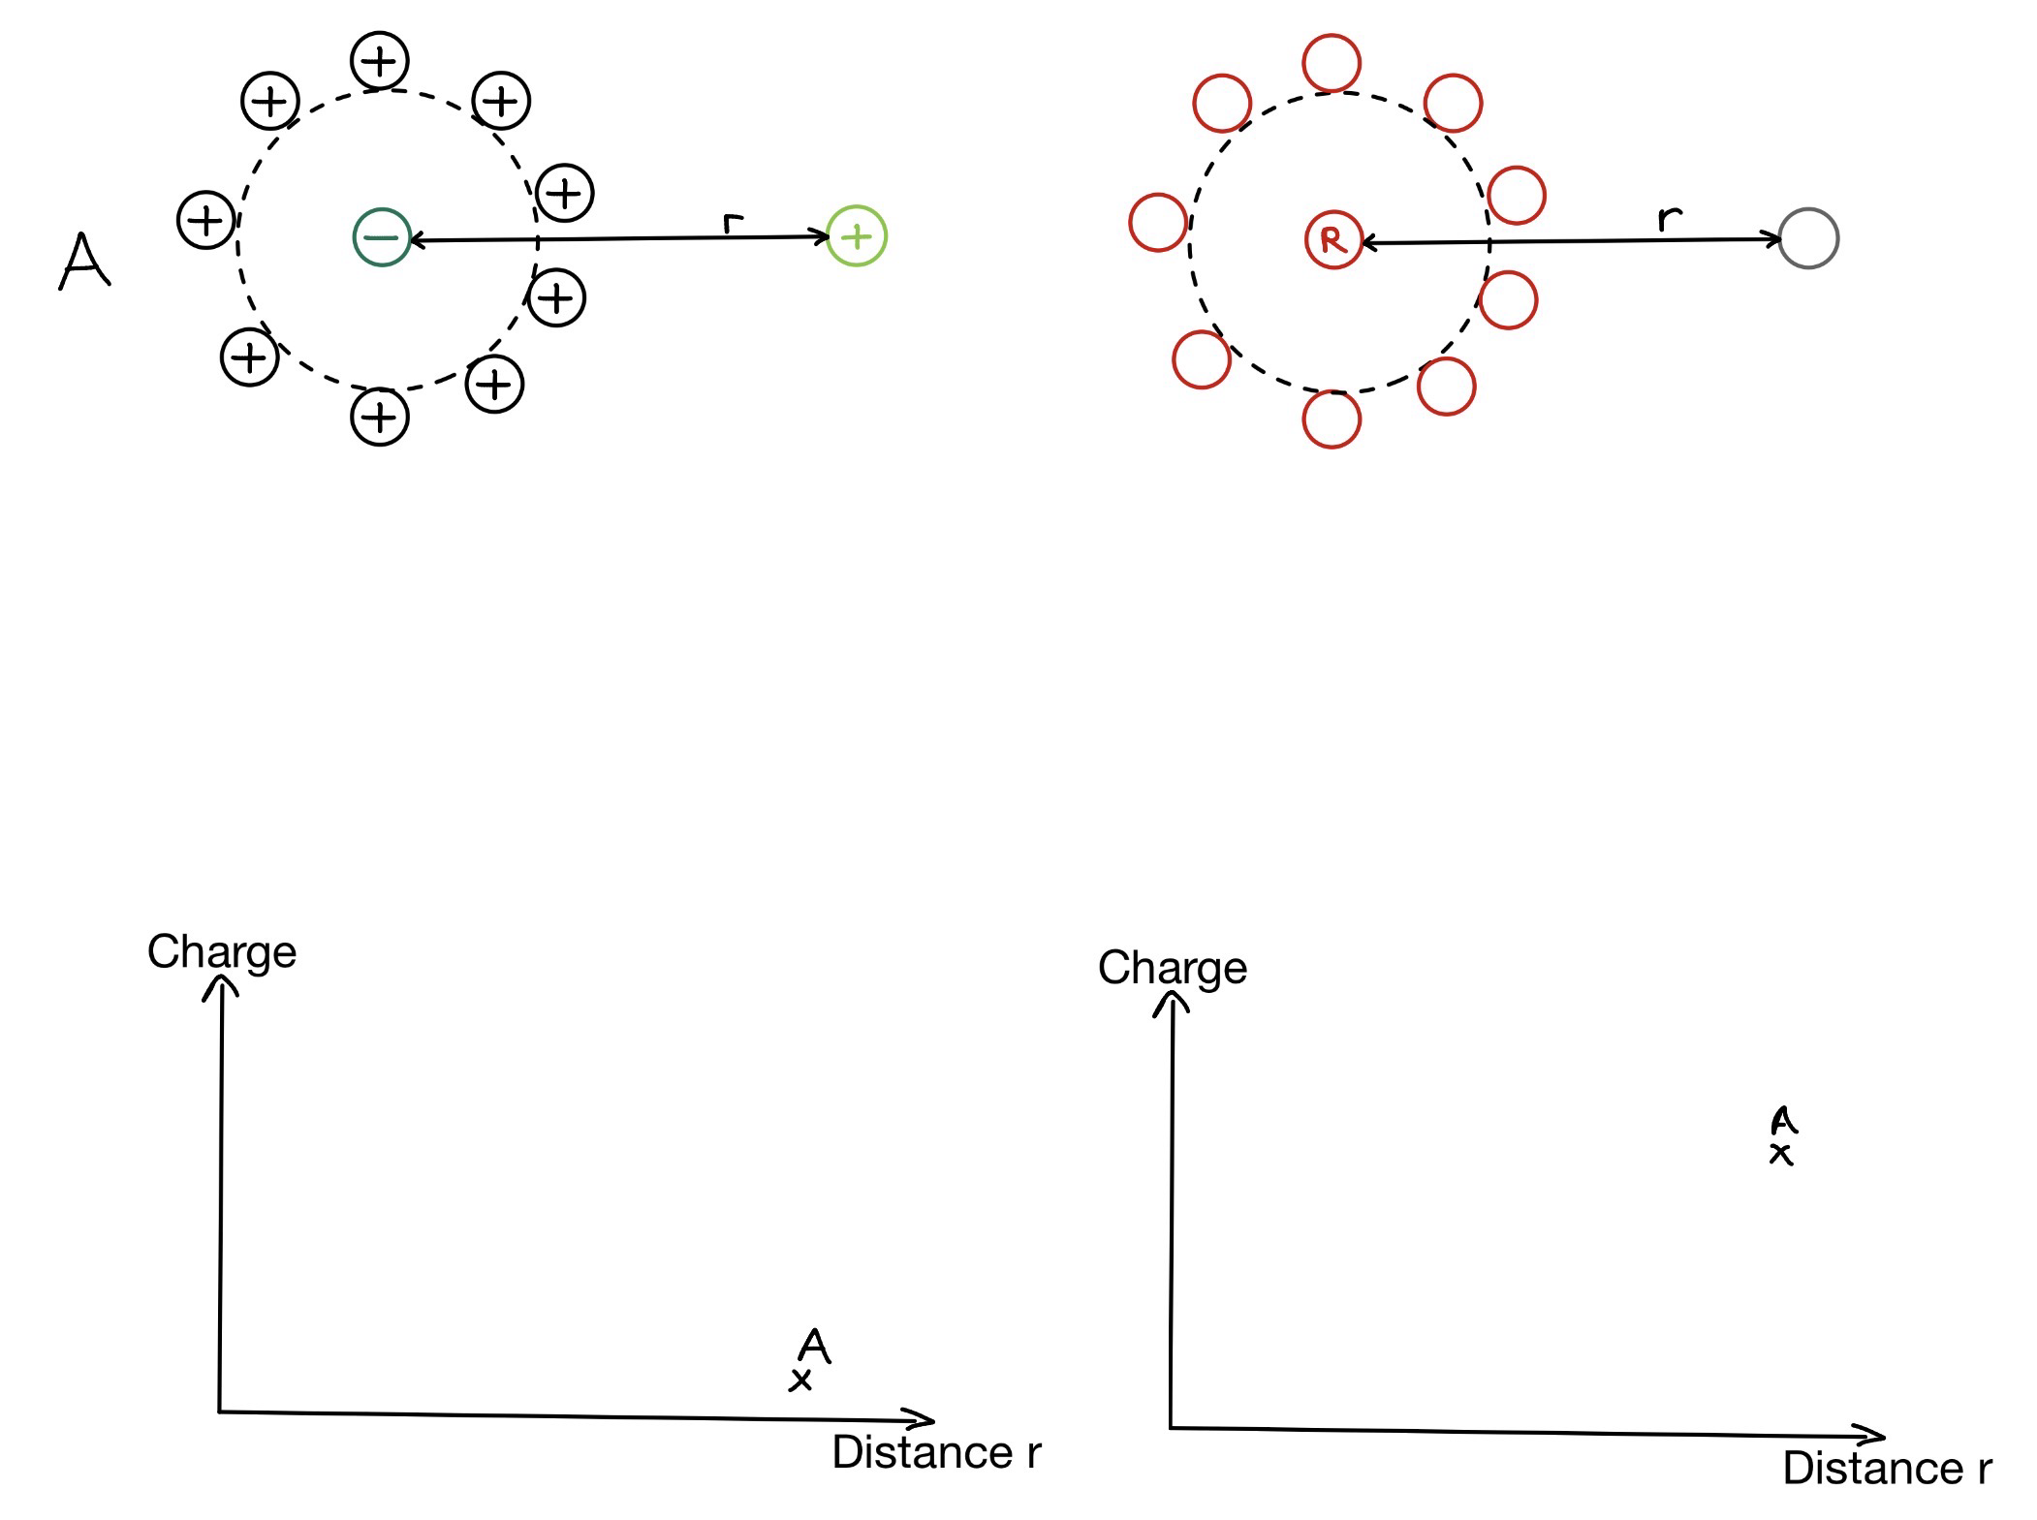
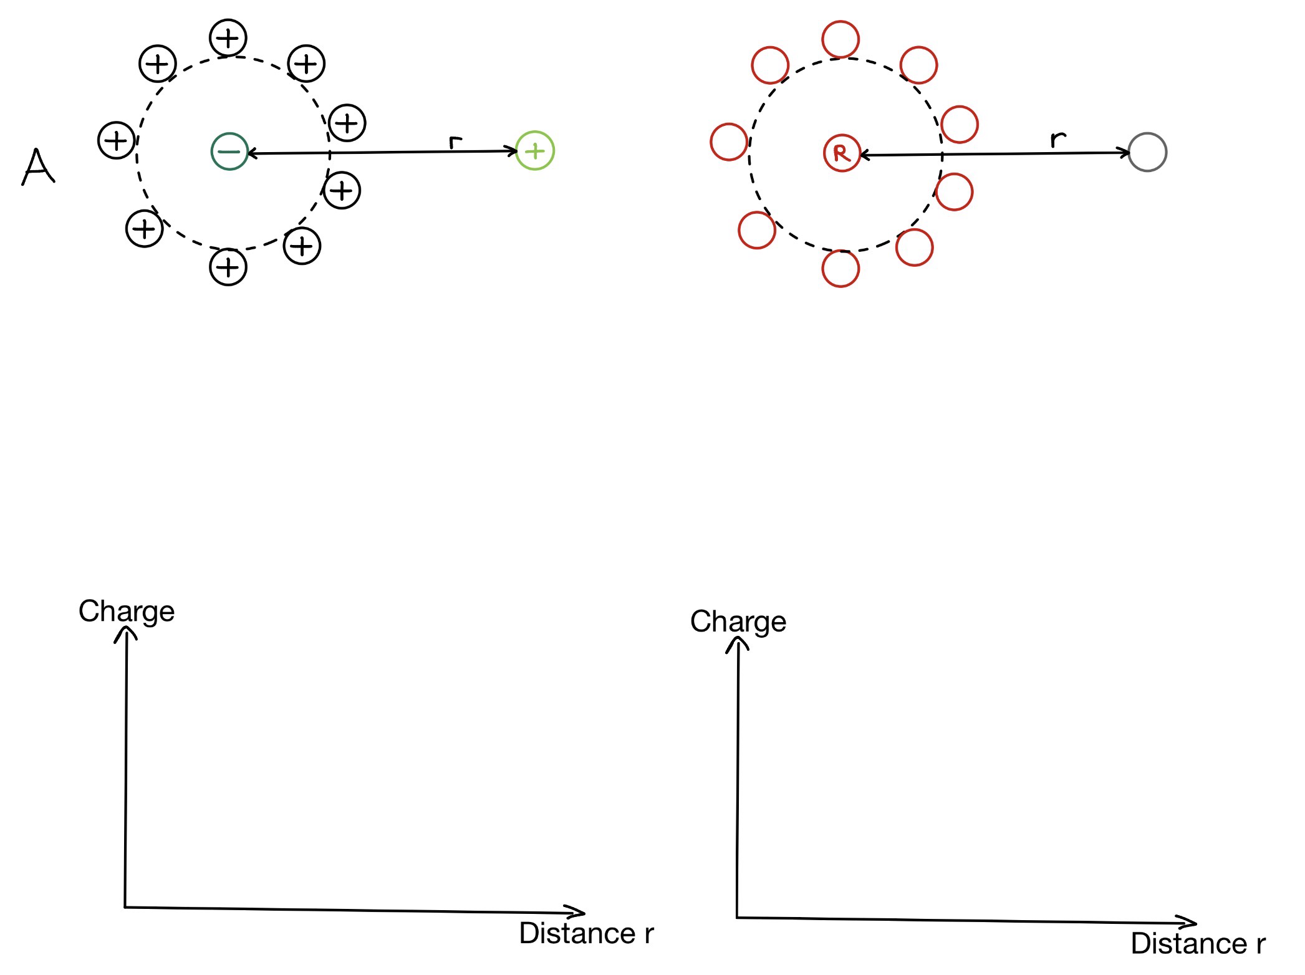
Gauge Bosons
Property: Asymptotic freedom
- Interaction strength decreases llwith decreasing distance/energy
→ Rubber band
Quarks stay inside hadrons
- Experiments show them behaving llllike free particles
Confinement: No single quark can be isolated

Slide 25
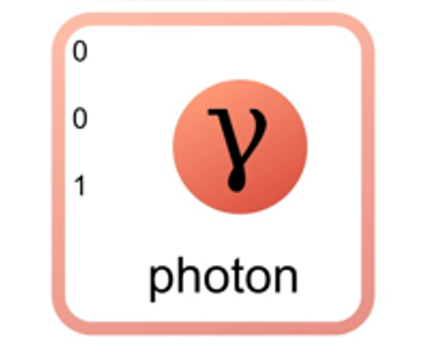
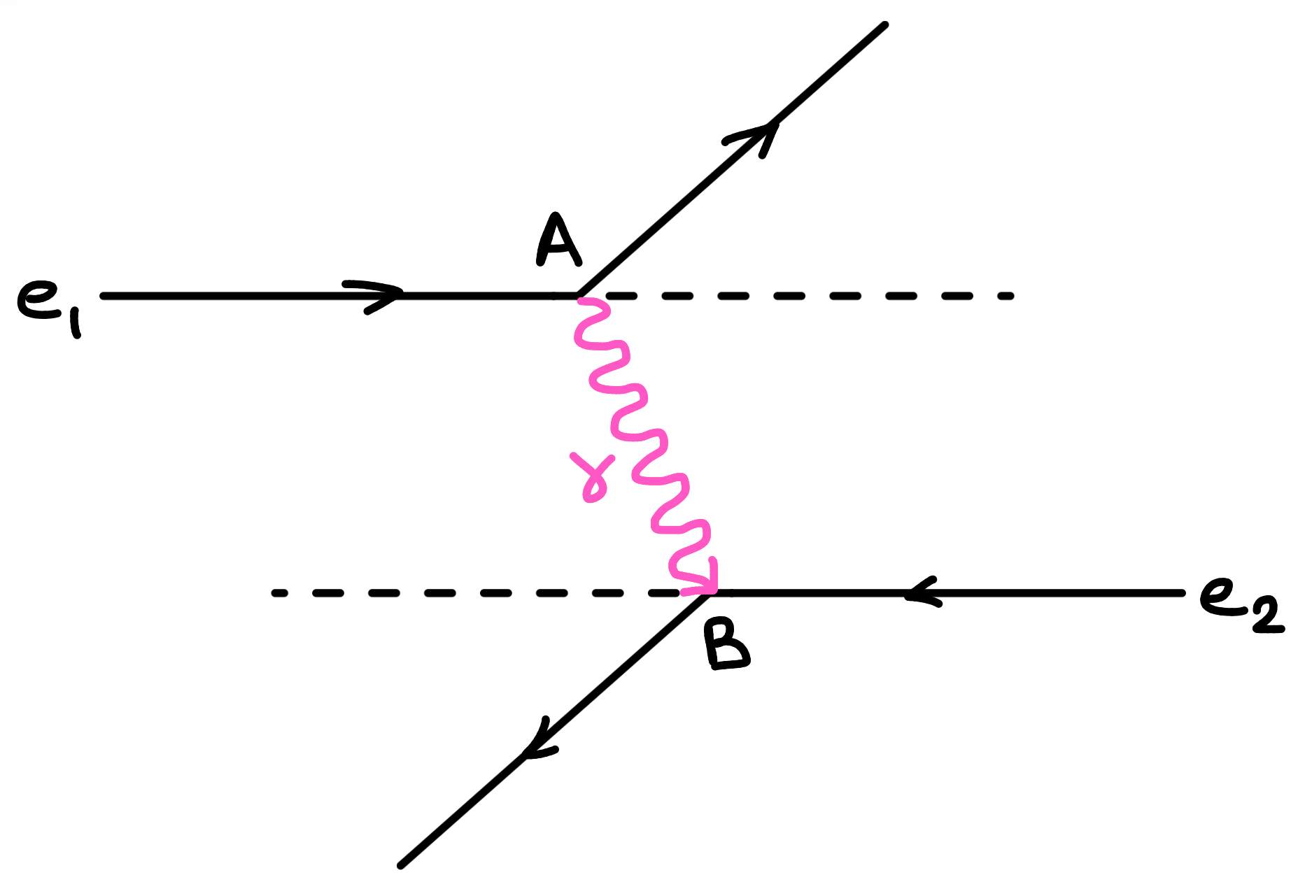
Gauge Bosons
Photon: mediates electromagnetic interactions
Quantum electrodynamics (QED)
- unified theory of quantum mechanics and special relativity
→ relativistic description of the wave function of a particle
- describes electromagnetic particle interactions via (virtual) mphoton exchange
Fig.15: Electrons repel via photon exchange

Slide 26
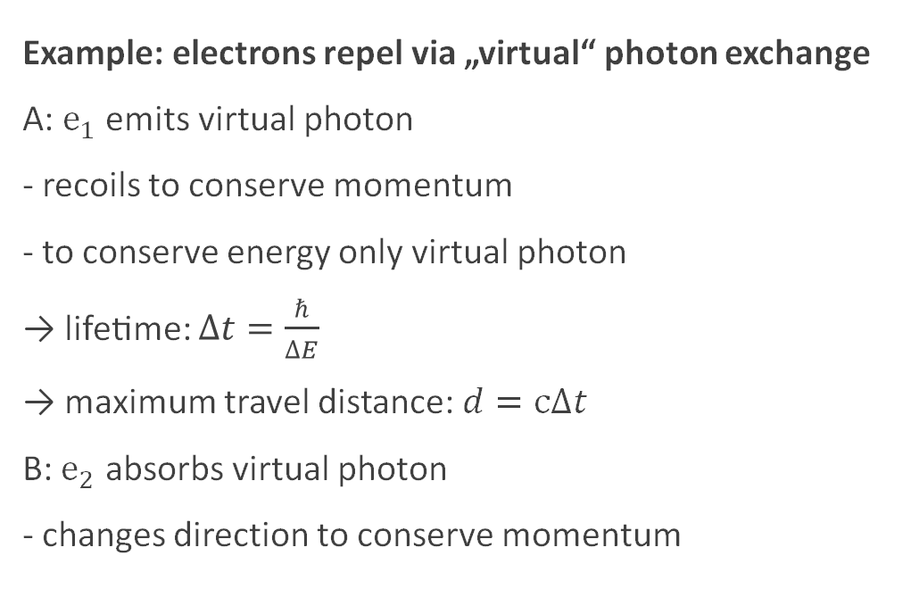
Gauge Bosons
Example: electrons repel via „virtual“ photon exchange
A: $e_{1}$ emits virtual photon
- recoils to conserve momentum
- to conserve energy only virtual photon
→ lifetime: $∆t=\frac{ℏ}{∆E}$
→ maximum travel distance: $d=c∆t$
B: $e_{2}$ absorbs virtual photon
- changes direction to conserve momentum
Fig.15: Electrons repel via photon exchange

Slide 27
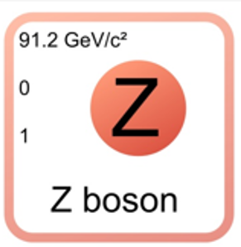
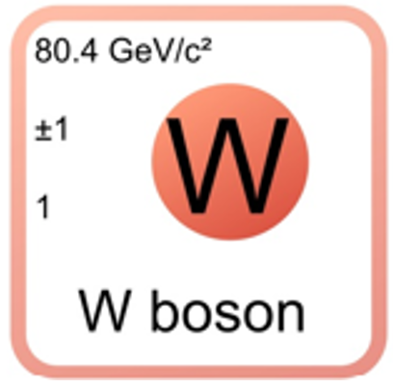
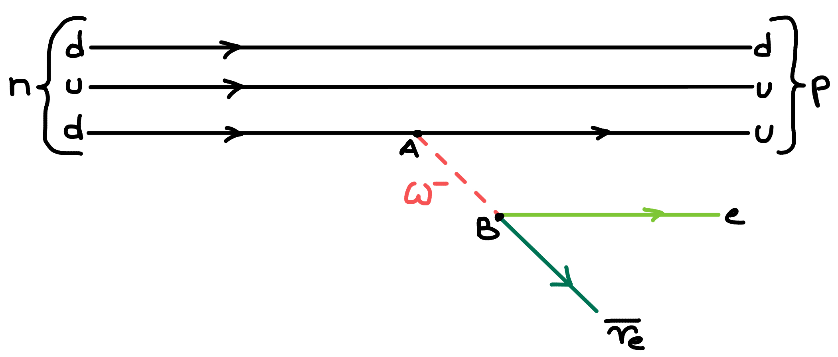

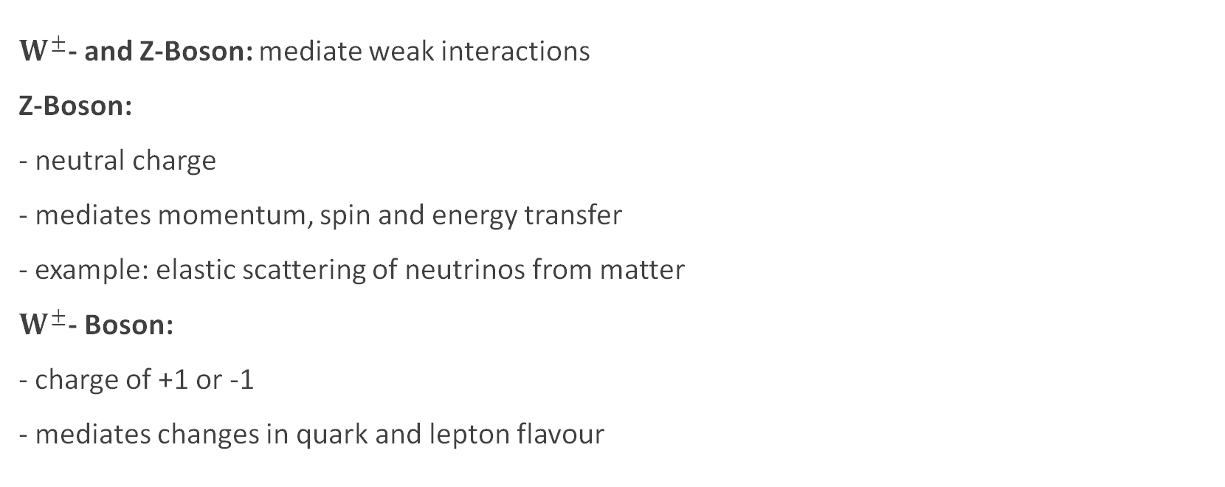
Gauge Bosons
$W^{±}$- and Z-Boson: mediate weak interactions
Z-Boson:
- neutral charge
- mediates momentum, spin and energy transfer
- example: elastic scattering of neutrinos from matter
$W^{±}$- Boson:
- charge of +1 or -1
- mediates changes in quark and lepton flavour
Fig.16: Feynman diagram of $β^{−}$- decay

Slide 28
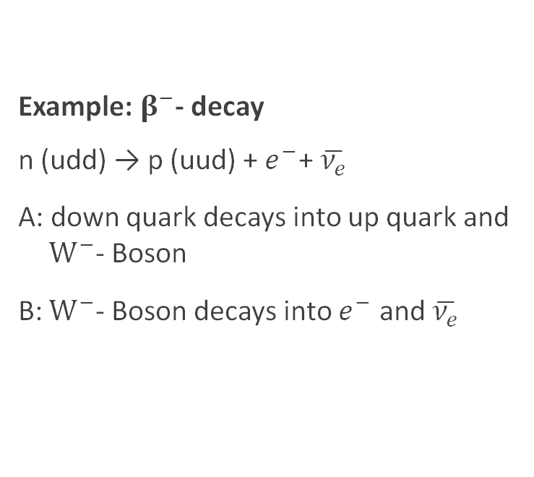
Gauge Bosons
Example: $β^{−}$- decay
n (udd) → p (uud) + $e^{−}$+ $\overline{ν_{e}}$
A: down quark decays into up quark and m $W^{−}$- Boson
B: $W^{−}$- Boson decays into $e^{−}$ and $\overline{ν_{e}}$
Fig.16: Feynman diagram of $β^{−}$- decay

Slide 29
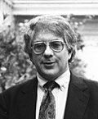
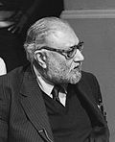
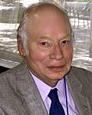


Gauge Bosons Timeline
1928 Dirac proposes QED
1968 Glashow, Salem, Weinberg propose unified mmmtheory of electromagnetic and weak mmminteractions → Nobel 1979
- theory proposes photon, $W^{±}$- and Z-Boson as llmediators
Fig.17: Glashow, Salam, Weinberg
Wikipedia: List of Nobel laureates in Physics
QED
1928
$W^{±}$, Z
1968
Theory
1970
1990
2010
1930
1950
2010
Experiment

Slide 30


Gauge Bosons Timeline
1971 ´t Hooft and Veltman legitimate the theory → Nobel 1999
- showing mathematically that the theory is llrenormalizable
Fig.18: Gerard ‘t Hooft, Martinus J. G. Veltman
Wikipedia: List of Nobel laureates in Physics
QED
1928
$W^{±}$, Z
1968
Theory
1970
1990
2010
1930
1950
2010
Experiment

Slide 31




Gauge Bosons Timeline
1973 Gross, Politzer, Wilczek propose gluons as mmmmediators of strong interactions (QCD) mmmm → Nobel 2004
Fig.19: Gross, Politzer, Wilczek
Wikipedia: List of Nobel laureates in Physics
QED
1928
$W^{±}$, Z
1968
g, QCD
1973
Theory
1970
1990
2010
1930
1950
2010
Experiment

Slide 32




Gauge Bosons Timeline
1973 Gross, Politzer, Wilczek propose gluons as mmmmediators of strong interactions (QCD) mmmm → Nobel 2004
1979 Gluons found at DESY
1983 $W^{±}$- and Z-Boson found at CERN → Nobel 1984
Fig.20: Carlo Rubbia, Simon van der Meer
Wikipedia: List of Nobel laureates in Physics
QED
1928
$W^{±}$, Z
1968
g, QCD
1973
Theory
1970
1990
2010
1930
1950
1979
g
1983
$W^{±}$, Z
2010
Experiment

Slide 33





Timeline
Colour
1965
g, QCD
Theory
$$ν_{e}$$
1930
c
t, b
1973
QED
1928
u, d, s
1964
$W^{±}$, Z
1968
$$ν_{τ}$$
1956
1930
1950
1970
1990
2010
1947
μ
1956
$ν_{e}$
1962
$ν_{μ}$
1974
c
1983
$W^{±}$, Z
1995
t
2000
$ν_{τ}$
1968
u, d
1897
e
1977
b
1979
g
1976
τ
Experiment

Slide 34
Fig.1: Particles in the standard model
Quantumdiaries: standard Model Of Elementary Particles

Slide 35


Higgs Boson
Problem:
- theoretically all gauge bosons are massless
- but experimentally the $W^{±}$- and Z-Boson have mass
Solution: Higgs field permeating all of space
- „Sombrero potential“
- scalar field with non – zero ground state
→ interactions with the Higgs-field give mass to gauge lllilbosons
Fig.21: Higgs-field
fity.club: Higgs-field Diagram

Slide 36


Higgs Boson Timeline
1964 Higgs, Englert and others mmlllindependently propose Higgs-field mmllland -boson → Nobel 2013
2012 Higgs Boson found at CERN
Fig.22: François Englert, Peter Higgs
Wikipedia: List of Nobel laureates in Physics
H
1964
Theory
1970
1990
2010
2012
H
1930
1950
2010
Experiment

Slide 37

Timeline
$$ν_{e}$$
1930
Colour
1965
g, QCD
Theory
c
t, b
1973
H
QED
1928
u, d, s
1964
$W^{±}$, Z
1968
$$ν_{τ}$$
1956
1930
1950
1970
1990
2010
1947
μ
1956
$ν_{e}$
1962
$ν_{μ}$
1974
c
1983
$W^{±}$, Z
1995
t
2000
$ν_{τ}$
1968
u, d
2012
H
1897
e
1977
b
1979
g
1976
τ
Experiment

Slide 38
Fig.1: Particles in the standard model
Quantumdiaries: standard Model Of Elementary Particles

Slide 39



Antiparticles
Antiparticles have the same mass and spin but opposite charge
- All quarks and leptons exist as particles and llantiparticles
- $W^{±}$ - Boson are also an antiparticle pair
Antiparticles form antimatter
QED: unified theory of quantum mechanics and mmlllspecial relativity
- for relativistic cases negative energies appear as llsolutions to the equation
Hydrogen
Anti-Hydrogen
Fig.23: Schematic representation of Hydrogen and Anti-Hydrogen
- leads Dirac to realize that antiparticles have to exist

Slide 40


Antiparticles Timeline
1928 Dirac proposes QED
1931 Dirac realizes Antiparticles are part of his mmmequation
1932 Anderson finds positron with cloud mmlllchamber → Nobel 1936
- cosmic ray collisions produce positrons
QED
1928
antiparticles
1931
Fig.24: Carl David Anderson
Wikipedia: List of Nobel laureates in Physics
Fig.25: Positron
Wikipedia: Positron
Theory
1970
1990
2010
1930
1932
antiparticles
1950
2010
Experiment

Slide 41
Timeline
$$ν_{e}$$
1930
Colour
1965
g, QCD
Theory
c
t, b
1973
H
QED
1928
antiparticles
1931
u, d, s
1964
$W^{±}$, Z
1968
$$ν_{τ}$$
1956
1930
1950
1970
1990
2010
1947
μ
1956
$ν_{e}$
1962
$ν_{μ}$
1968
u, d
1974
c
1983
$W^{±}$, Z
1995
t
2000
$ν_{τ}$
1897
e
1932
antiparticles
2012
H
1977
b
1979
g
1976
τ
Experiment

Slide 42

Problems
Gravity:
Description of only three out of four fundamental forces
Matter-antimatter asymmetry:
Within this model equal amounts of matter and antimatter are produced
Imbalance between matter and antimatter is observed
Fig.26: Schematic representation of gravity
Learn.podium.school: Laws of motion and gravity by Isaac Newton

Slide 43
Sources
N. Besson, The standard Model of Particle Physics, ISAPP school, 2022
V. Barger, D. Marfatia, K. Whisnant, The Physics of Neutrinos, Princeton University Press, 2012, Chapters 1-2
F. Halzen, A. D. Martin, Quarks & Leptons: An introductory Course in Modern Particle Physics, John Wiley & sons, New York, 1984, Chapter 1
Nobel Foundation, „All Nobel Prizes in Physics“, to find at www.nobelprize.org, 17.11.25
N. Walet, „1.2: A Timeline of Particle Physics“, to find at phys.libretexts.org, 17.11.25
S. Weinberg, The Making of the Standard Model, edited text of a talk given at CERN 2003, Eur.Phys.J.C34:5-13,2004

Slide 44

Problems
Neutrino oscillation:
- neutrino created with a specific lepton flavour, later measured in a different flavour
→ neutrino is in a superposition of the mlthree eigenstates
- implies that neutrinos have a non-zero llmass
→ standard model does not account for mlthat
Fig.26: Neutrino oscillation
Wikipedia: Neutrino oscillation

Slide 45
Neutrino Oscillation
Neutrinos have flavour, each flavour has a different mixture of mass-eigenstates
Every Neutrino is in a superposition of the different mass-eigenstates
For Oscillation to happen the mass-eigenstates need to develope different phases
For a massless particle all mass states would develope equally → no oscillation is observed
Neutrinos require different mass states which implies non – zero masses

Slide 46
Quarks Timeline
Before 1964 Discovery of many hadrons “particle zoo“
1964 Gell-Mann and Zweig propose quark model → Nobel 1969
- including three flavours (up, down, strange), two quantum numbers ll(spin, charge) and mass
1964 Glashow and Bjorken propose fourth flavour: charm
1965 Greenberg, Han and Nambu propose theory later called mmlllcolourcharge
1968 Up and down quark found at SLAC → Nobel 1990
- electron scattering from nucleons analogous to Rutherfords llgoldatoms
Fig.4: Murray Gell-Mann
Wikipedia: List of Nobel laureates in Physics
Fig.5: Friedman, Kendall, Taylor
Wikipedia: List of Nobel laureates in Physics

Slide 47
Leptons Timeline
1897 Electron found by Thomson
1927 Discovery of ß – decay
1930 Pauli proposes electron neutrino
1933/34 Fermi proposes theory for ß – decay
- matter particles can be annihilated and created (like neutrino here)
1936 Anderson and Neddermeyer discover “mesotron“
- observation of new cosmic rays in cloud chamber
1947 Muon discovered via new detector by Powell
- Allowing to see the mesotron decay → two kinds, pion and muon
1956 Electron neutrino found by Reines → Nobel 1995
Fig.10: Frederick Reines
Wikipedia: List of Nobel laureates in Physics

Slide 48

Gauge Bosons Timeline
1973 Gross, Politzer, Wilczek propose gluons as mediators of strong interactions (QCD) → Nobel 2004
1973 Neutral currents detected at CERN
- Gargamelle bubblechamber detects interactions llpredicted by the theory
1979 Gluons found at DESY
1983 $W^{±}$- and Z-Boson found at CERN → Nobel 1984
Fig.19: Gross, Politzer, Wilczek
Wikipedia: List of Nobel laureates in Physics
Fig.20: Carlo Rubbia, Simon van der Meer
Wikipedia: List of Nobel laureates in Physics

