Slide 1
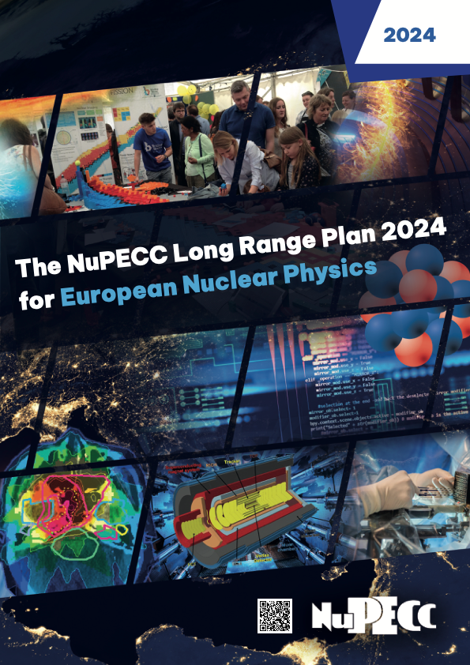
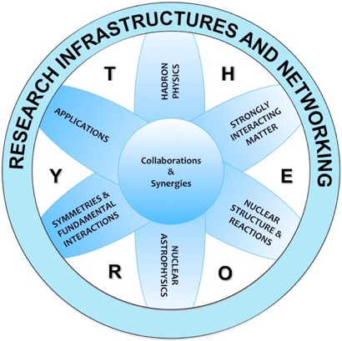
Report from NuPECC
Eberhard Widmann
NuPECC Chair
Marietta Blau Institute, Vienna
FAKT Workshop 23 Jan 2026 Bruck a.d. Mur
NuPECC Long Range Plan 2024
arXiv:2503.15575
www.nupecc.org

Slide 2
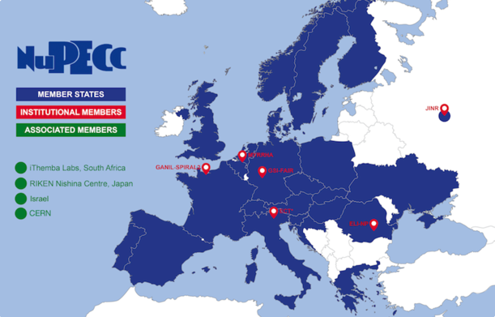
Nuclear Physics European Collaboration Committee (NuPECC)
Is the European Expert Board for Nuclear Physics
hosted by the European Science Foundation
Representing
> 5000 scientists
Composition:
35 representatives from 23 countries (new: Slovakia, Slovenia, Ukraine), 3 ESFRI NP Infrastructures & ECT*
4 associated members
CERN
Israel
iThemba Labs
Nishina Center
10 observers: ALAFNA, ANPhA, APPEC, CINP, ECFA, ESF, EPS-NPD, EPS-HEPPB, IAEA, NSAC
Croatia re-activated
Membership in 2025
Bulgaria applying for
membership
37 Years of NuPECC activities
Terminated
2025!
https://nupecc.org
3 regular Committee meetings/y
Notes:
1st meeting 1-2 Oct 1988, Oct 2026: 38 years

Slide 3
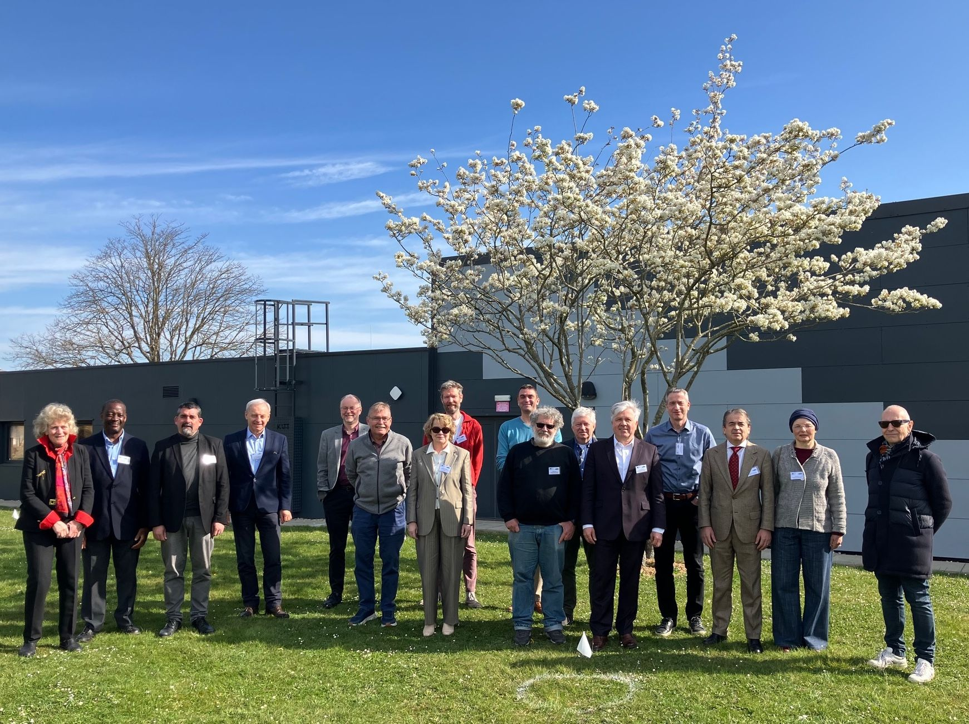
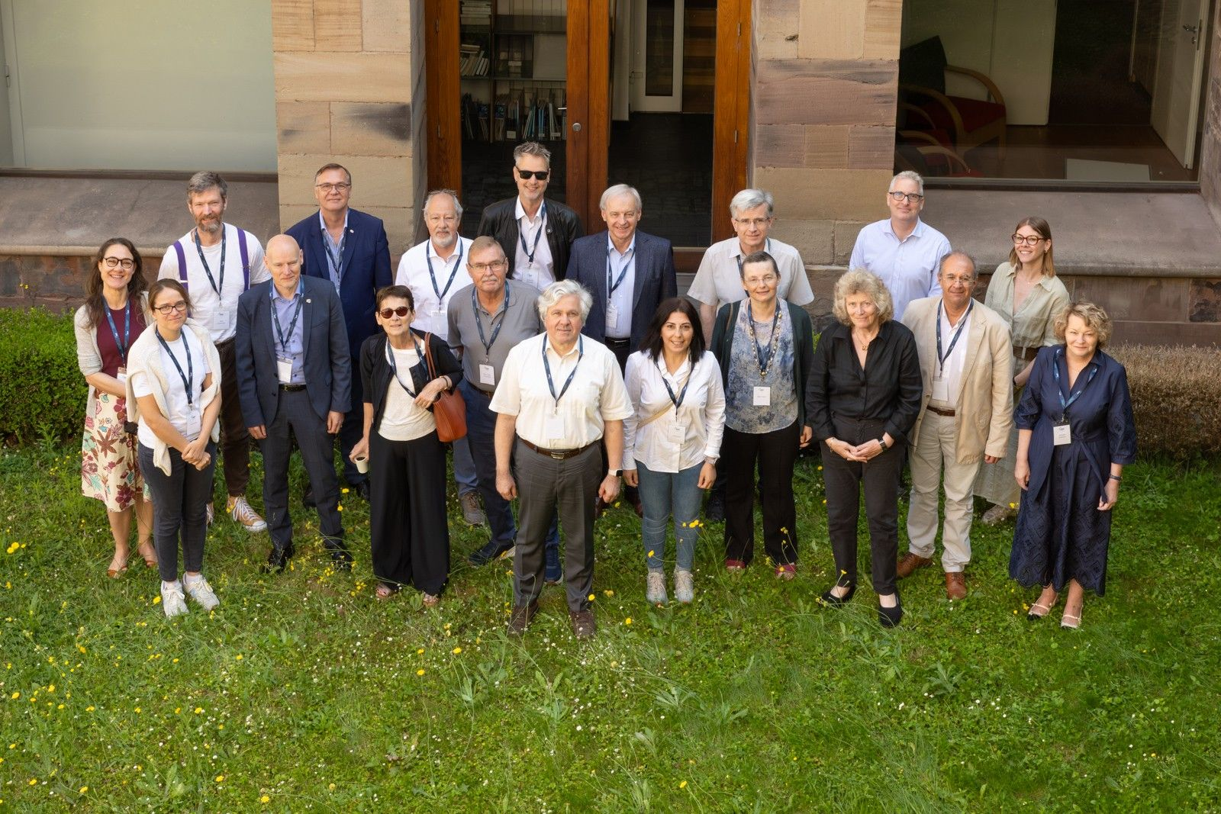
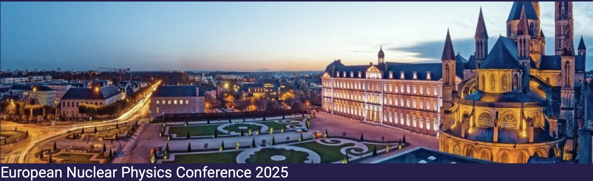
NuPECC meetings in 2025
111th Meeting, Harwell, Didcot (UK), April 7-8, 2025, in connection with JENAS
112th Meeting, Strasbourg (FR), June 12-13, 2025, at ESF and IPHC
Incl. Task Force Meeting
113th Meeting, Caen (FR), September 26-27, 2025, in connection with EuNPC
Next year: Rome (IT), Oslo (NO), Lisbon (PT)
Rome together with IUPAP commission C12 & working group WG9 of directors of international NP labs & Nuclear Science Symposium (incl. meeting with funding agencies)

Slide 4
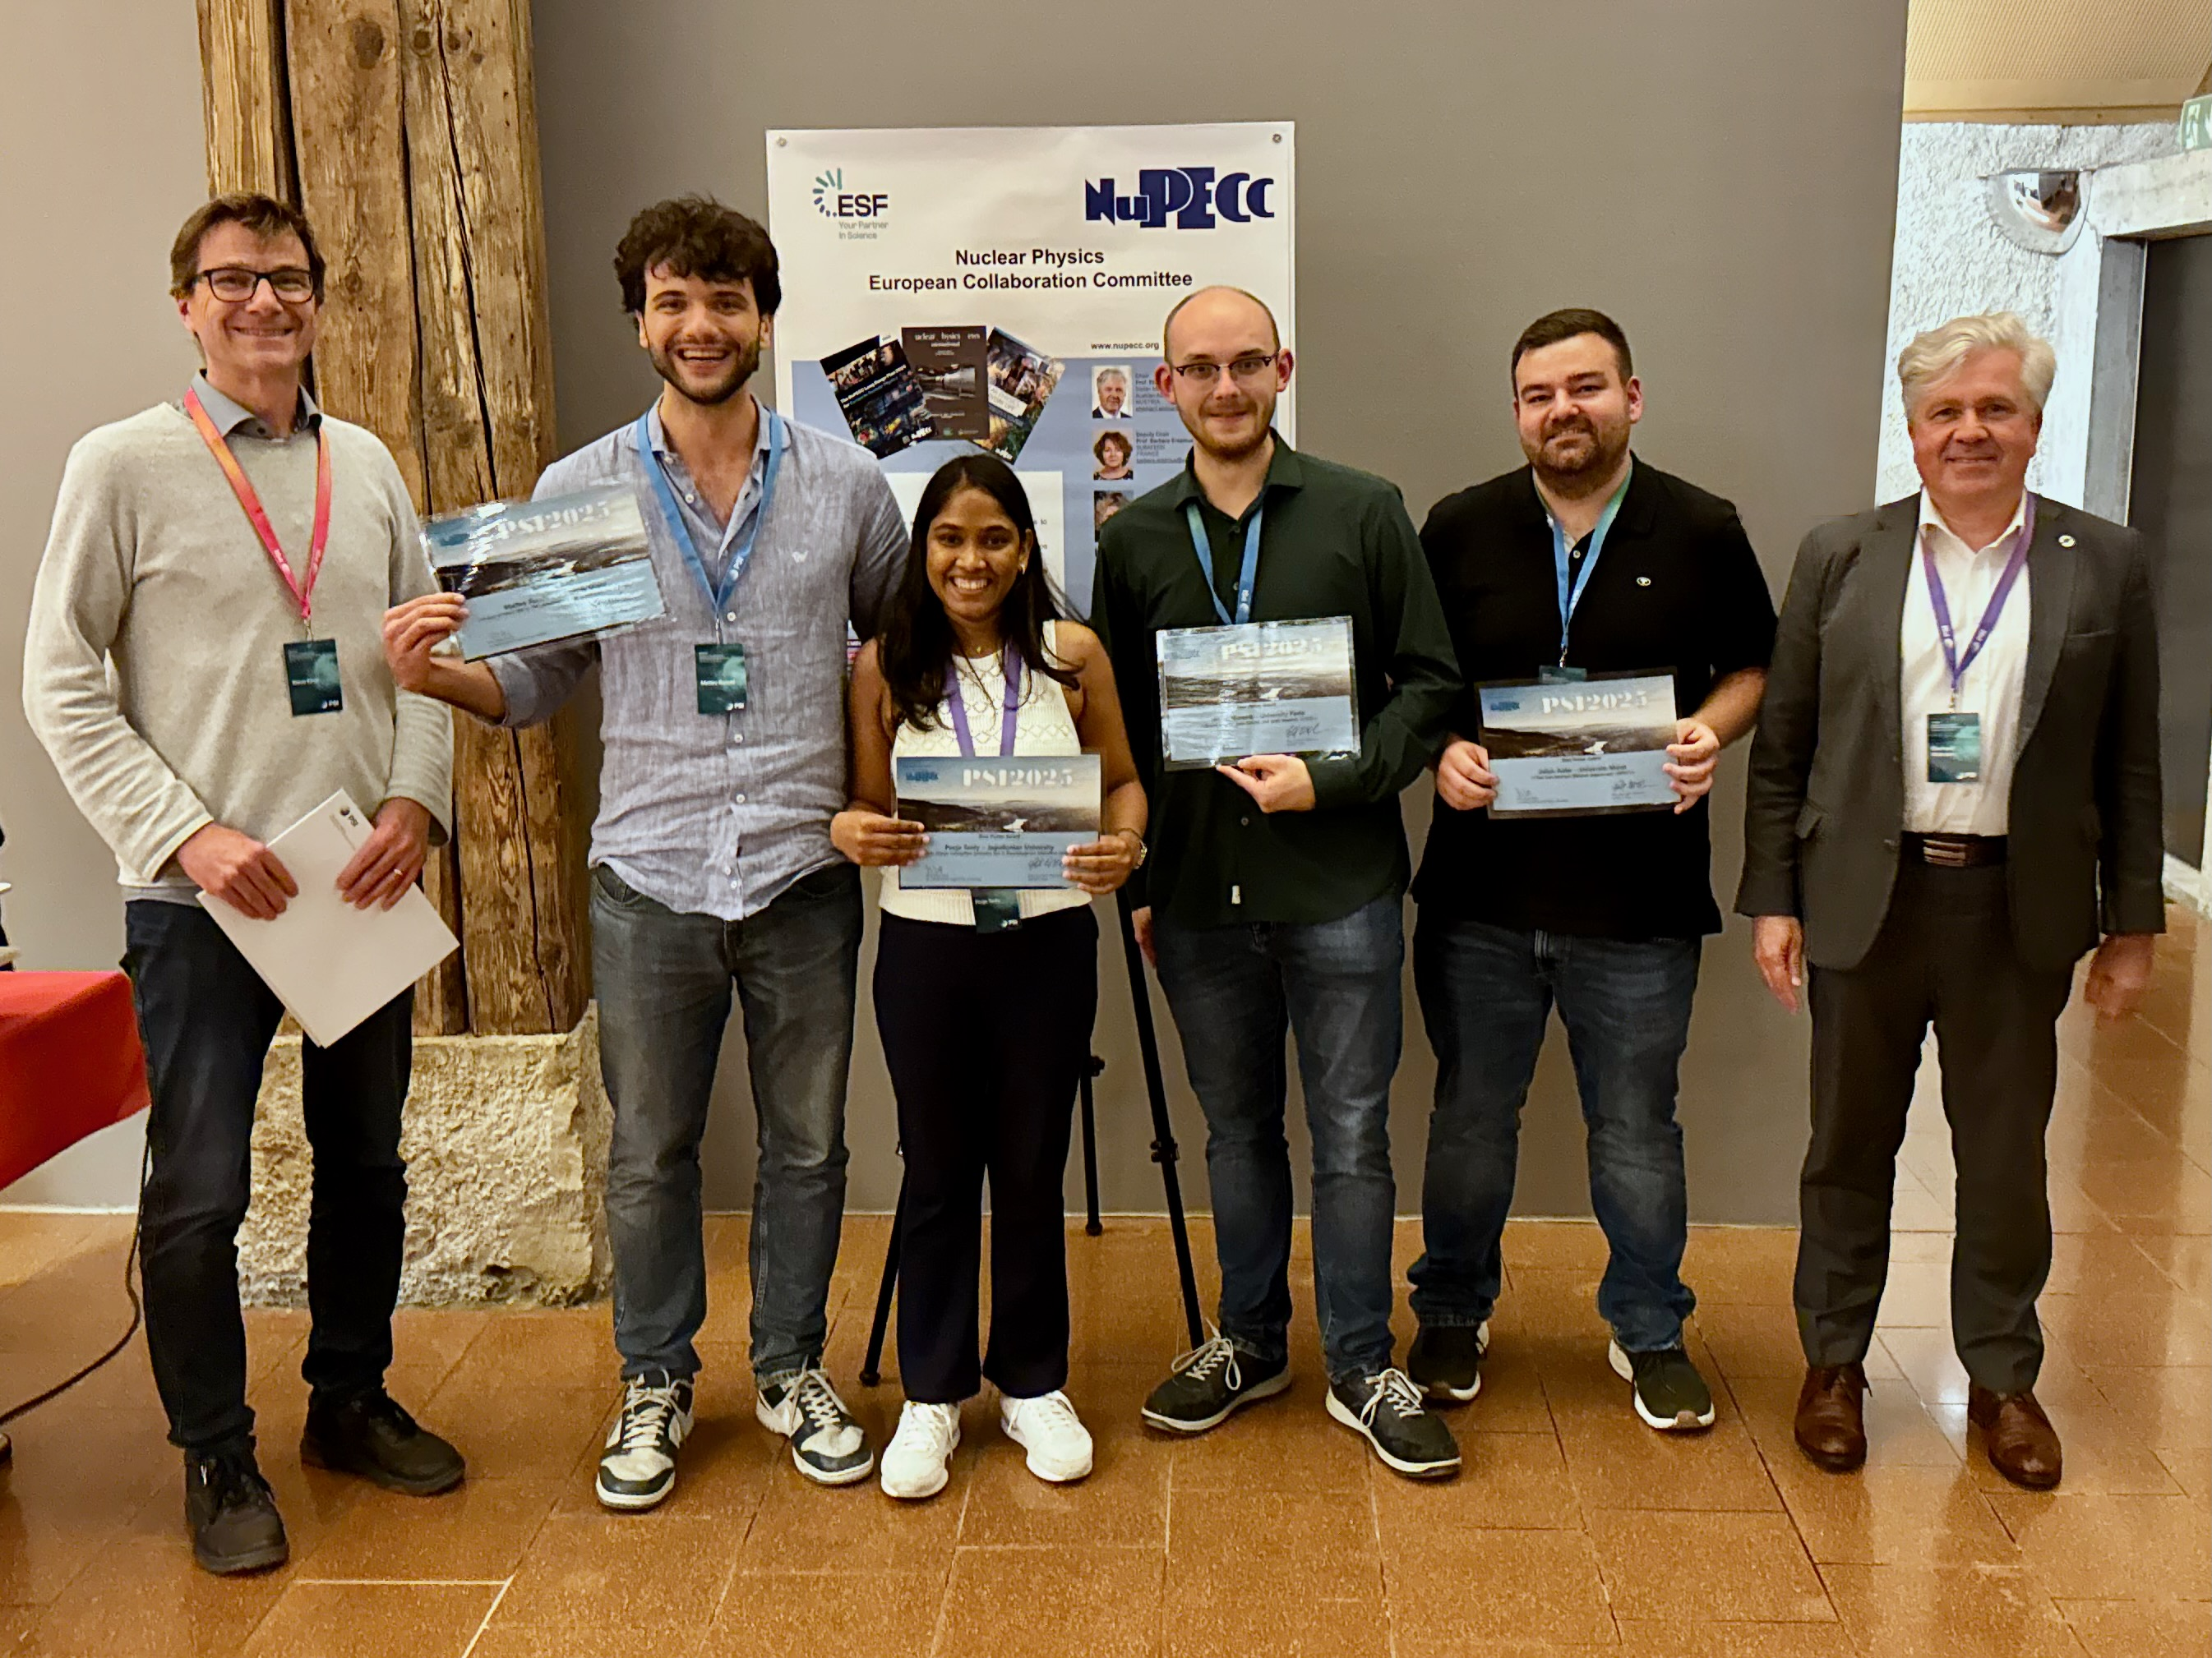
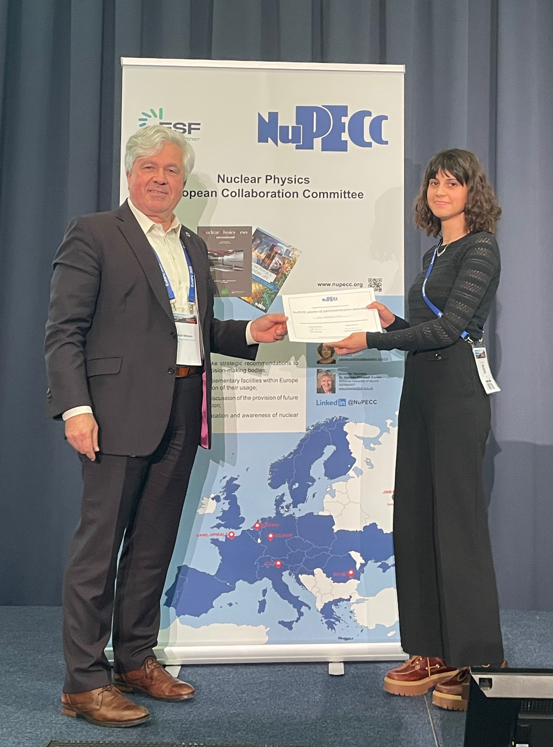
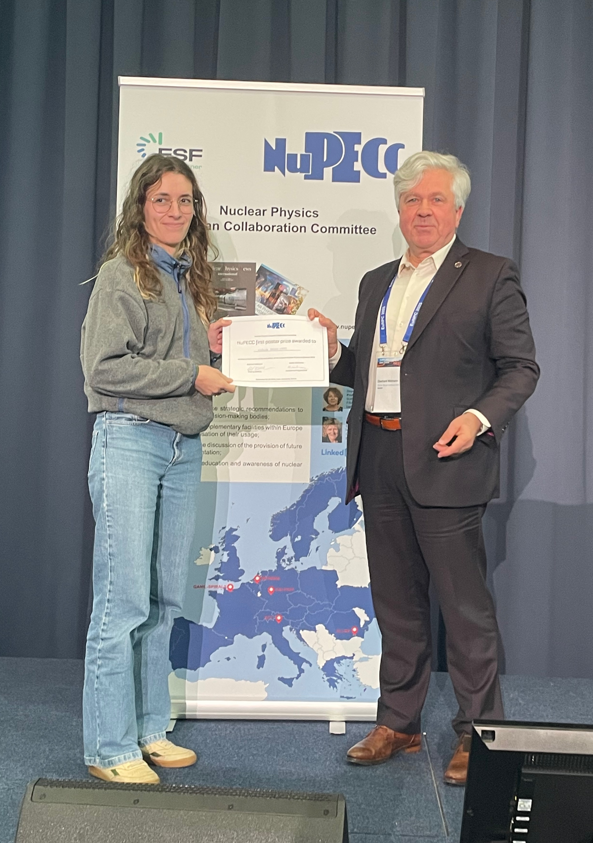
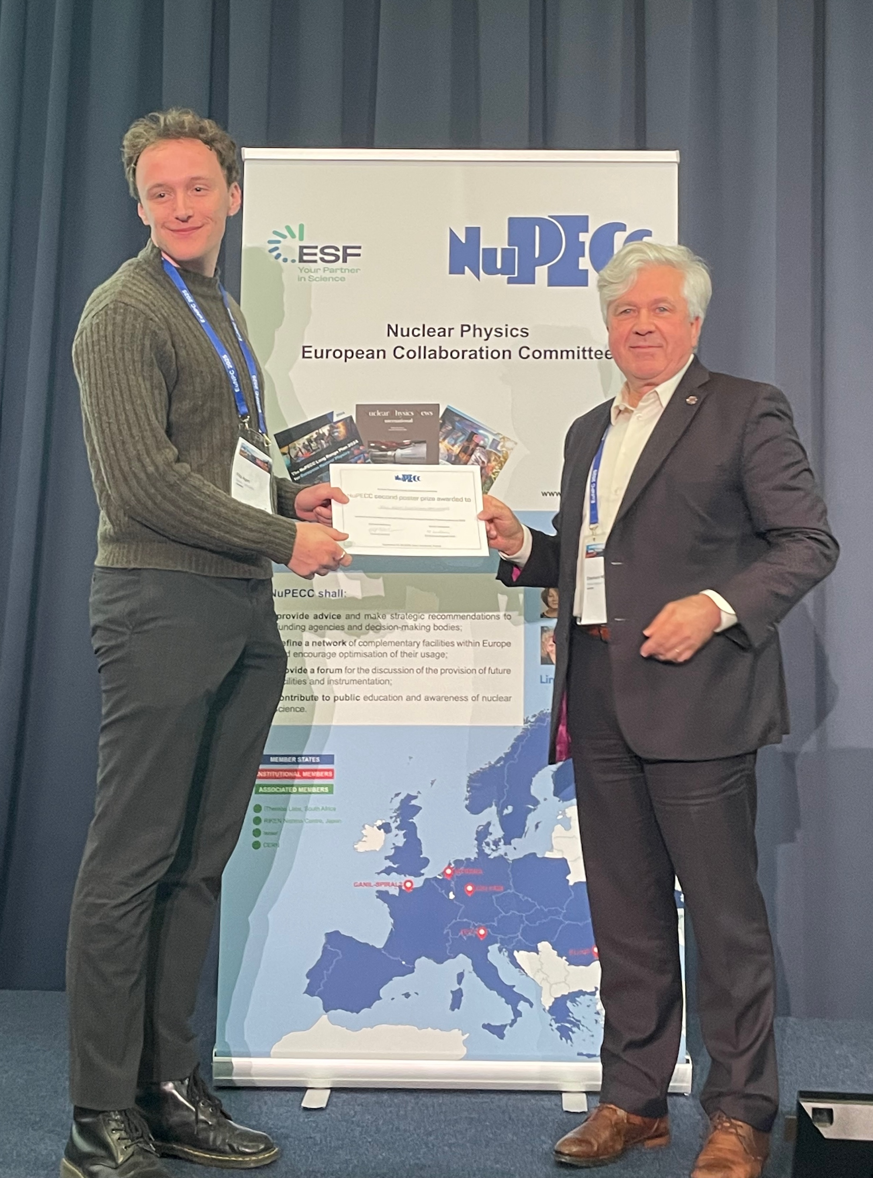
NuPECC sponsorship of conferences 2025
9 conferences (>100 atteendees, in Europe)
4 schools
4 JENA events
Poster prizes
PSI2025
EuNPC2025

Slide 5
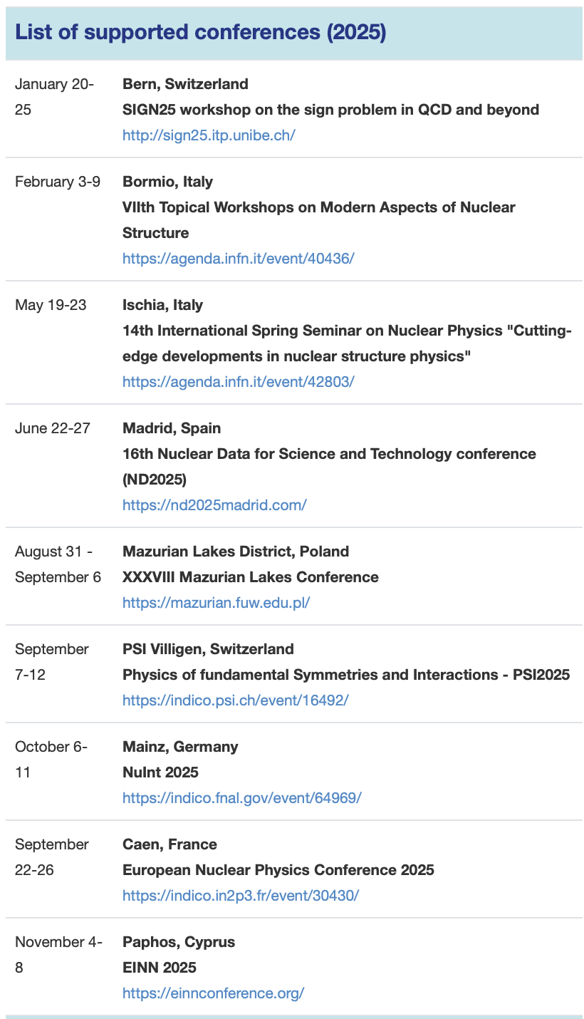
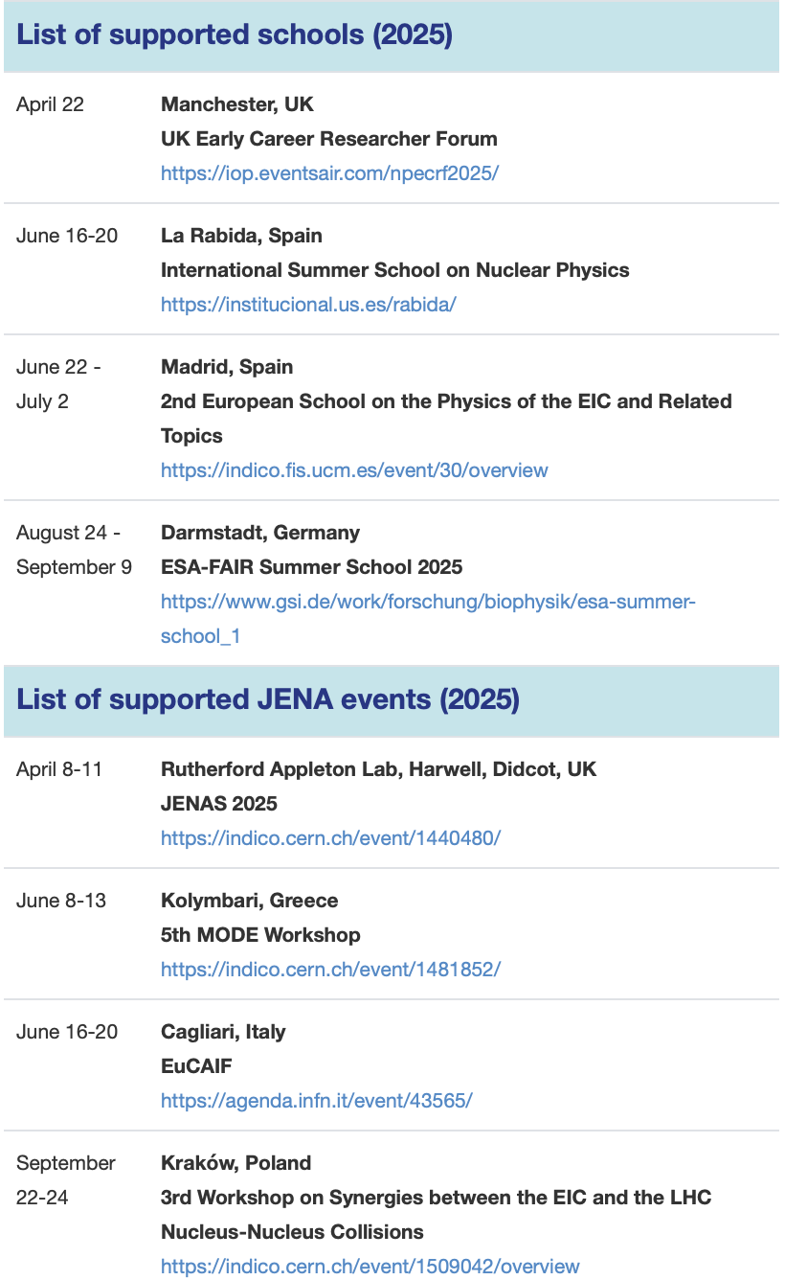
Support of conferences and schools 2025
Financial support
Conditions
Large (>100 attendees) conference in Europe
Support to be used for poster prizes or outreach (public talk)
https://www.nupecc.org/?display=support/conf

Slide 6

NuPECC Long Range Plan 2024
Prepared every ~7 years
Presentation in Brussels 19 Nov 2024
20 page brochure, 180 page full document
www.nupecc.org, arXiv:2503.15575
Printed version published summer 2025
Table of Contents
NuPECC LRP2024 Executive Summary
Hadron Physics
Properties of Strongly Interacting Matter at Extreme Conditions of Temperature and Baryon Number Density
Nuclear Structure and Reaction Dynamics
Nuclear Astrophysics
Symmetries and Fundamental Interactions
Applications and Societal Benefits
Research Infrastructures
Nuclear Physics Tools - Detectors and Experimental Techniques
Nuclear Physics Tools - Machine Learning, Artificial Intelligence, and Quantum Computing
Open Science and Data
Nuclear Science – People and Society
Physics topics

Slide 7
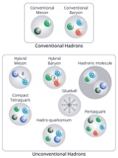
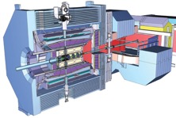
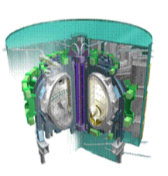
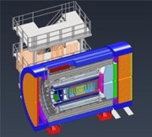
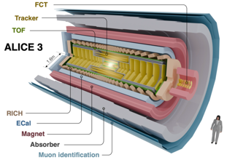
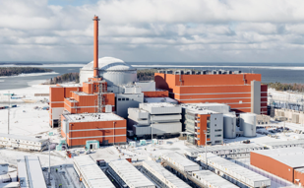
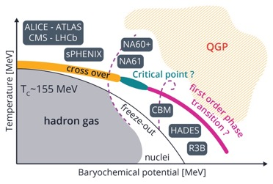
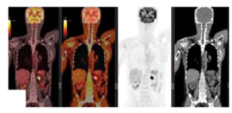
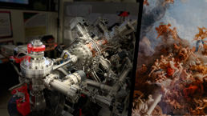
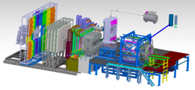
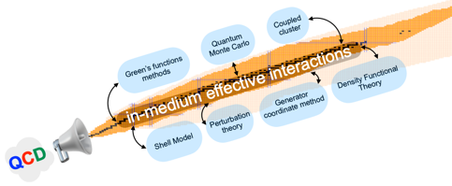
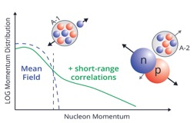
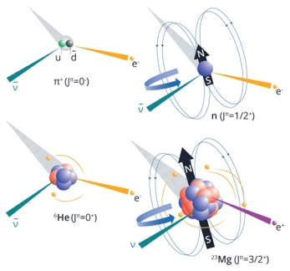
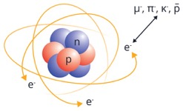
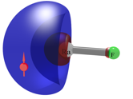
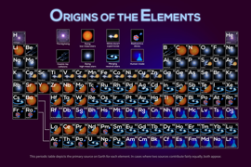
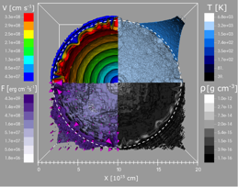
Nuclear Physics in Europe
PANDA @ FAIR
ePIC @ EIC
ALICE 3 @ LHC
CBM @ FAIR
Notes:
Wheel of Fortune of nuclear physics with 6 sub- fields

Slide 8
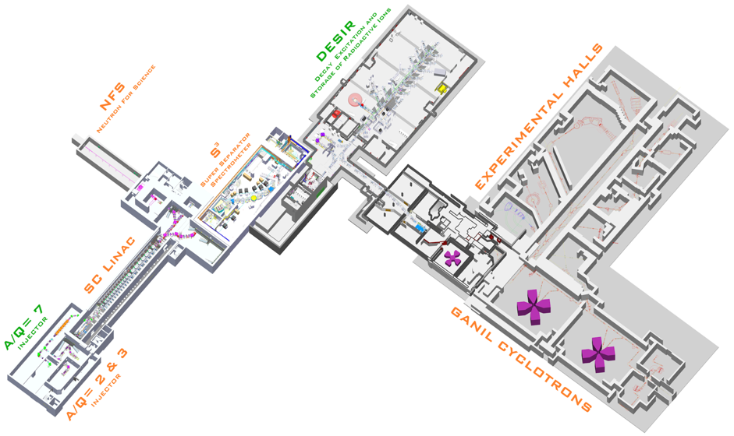
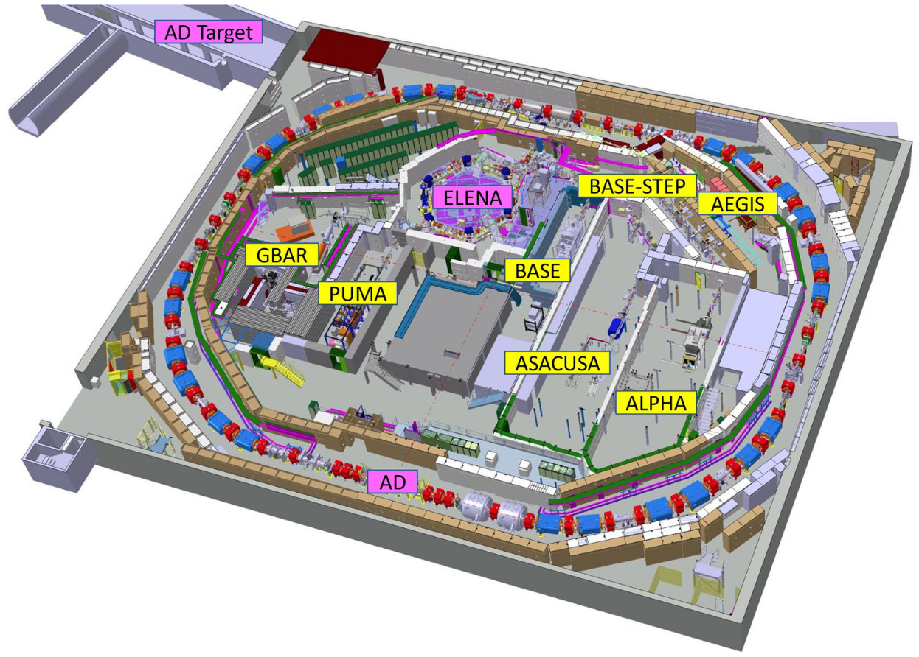

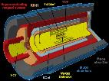

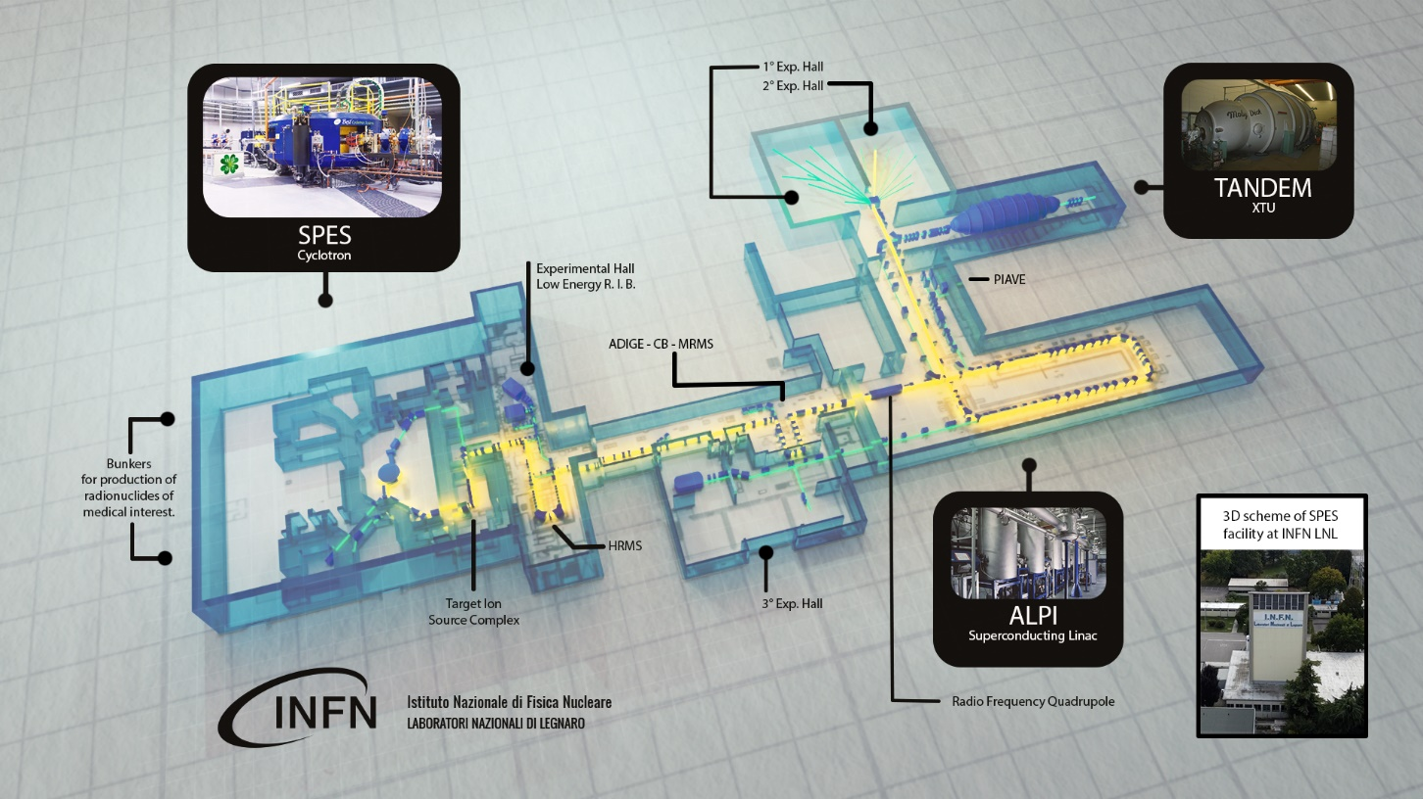
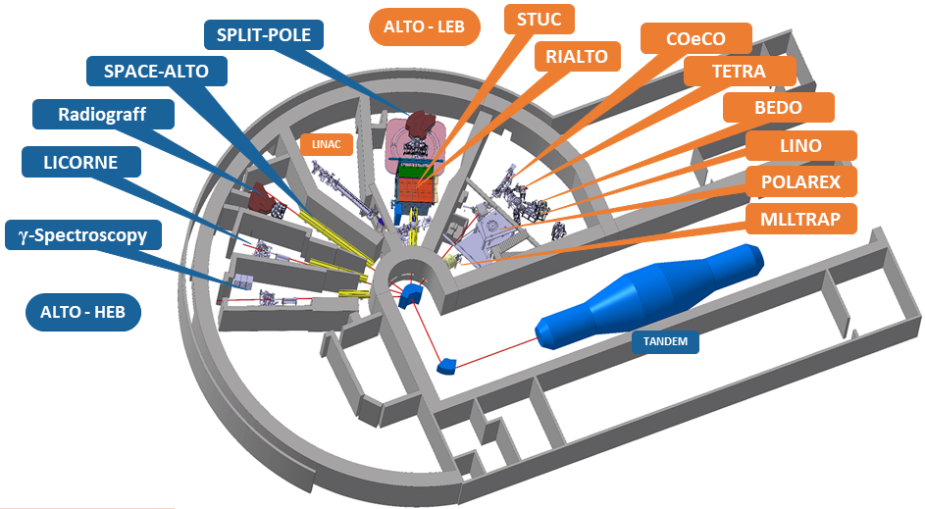
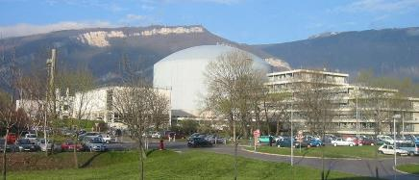
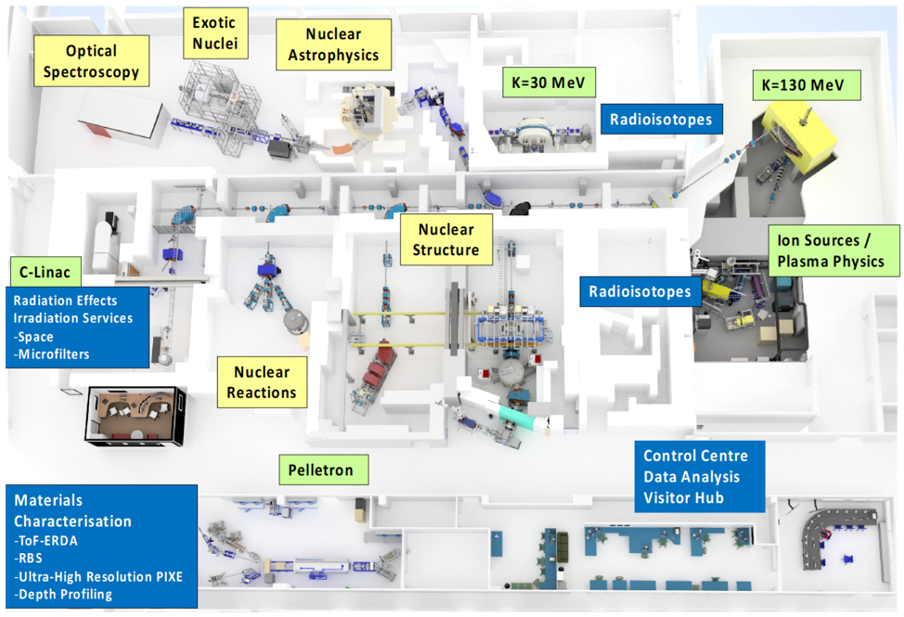
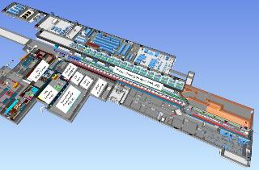
Nuclear Physics Facilities in Europe
GANIL/SPIRAL2
ALICE 3
FAIR/GSI
AD/ELENA
RIB facilities
n_TOF
SPES/LNL
ELI/NP
ILL France
n facilities
ALTO/IJCLab
+ stable beam
facilities
IGISOL/JYFL
ISOL@MYRRHA
IFMIF-DONES Spain

Slide 9
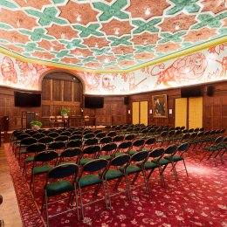
LRP2024 publication process
NuPECC Long Range Plan 2024
Presentation in Brussels 19 Nov 2024
Brochure: 20-page summary and recommendations
Targeted at public and decision makers
Available in print
Full report
Text approved in Lund meeting Jun 2024
180+ pages pdf version available Nov 2024
Executive Summary of the LRP2024 is available on the NuPECC Web site https://www.nupecc.org/lrp2024/Draft_Executive_Summary_LRP2024.pdf
The PDF web version version of the full text is available at arXiv:2503.15575
Printed version available on request
University Foundation
Bruxelles
Notes:
Wheel of Fortune of nuclear physics with 6 sub- fields

Slide 10
Implementation of the NuPECC LRP2024
NuPECC Task Force (directors of the NP ESFRI infrastructures + CERN) meetings with the funding agencies of the Member Countries to promote the LRP and encourage its implementation
9 Task Force meetings in 2017-2022
Task Force meetings in 2023-2025:
Belgium in Brussels on 31/01/2023
Slovenia in Ljubljana on 15/03/2023
Austria in Vienna on 21/04/2023
Germany in Bad Honnef on December 5th, 2024
France in Strasbourg , 11/06/2025
Meetings in Slovakia, Hungary, Romania, Finland and Sweden 2025 - 2026
Use and cite the LRP2024 in the applications for funding of new projects, collaborations, EU and national grants!
Make the LRP2024 recommendations known among the nuclear physics community
Apply for and ensure the support of EU for nuclear physics: next EC calls!

Slide 11

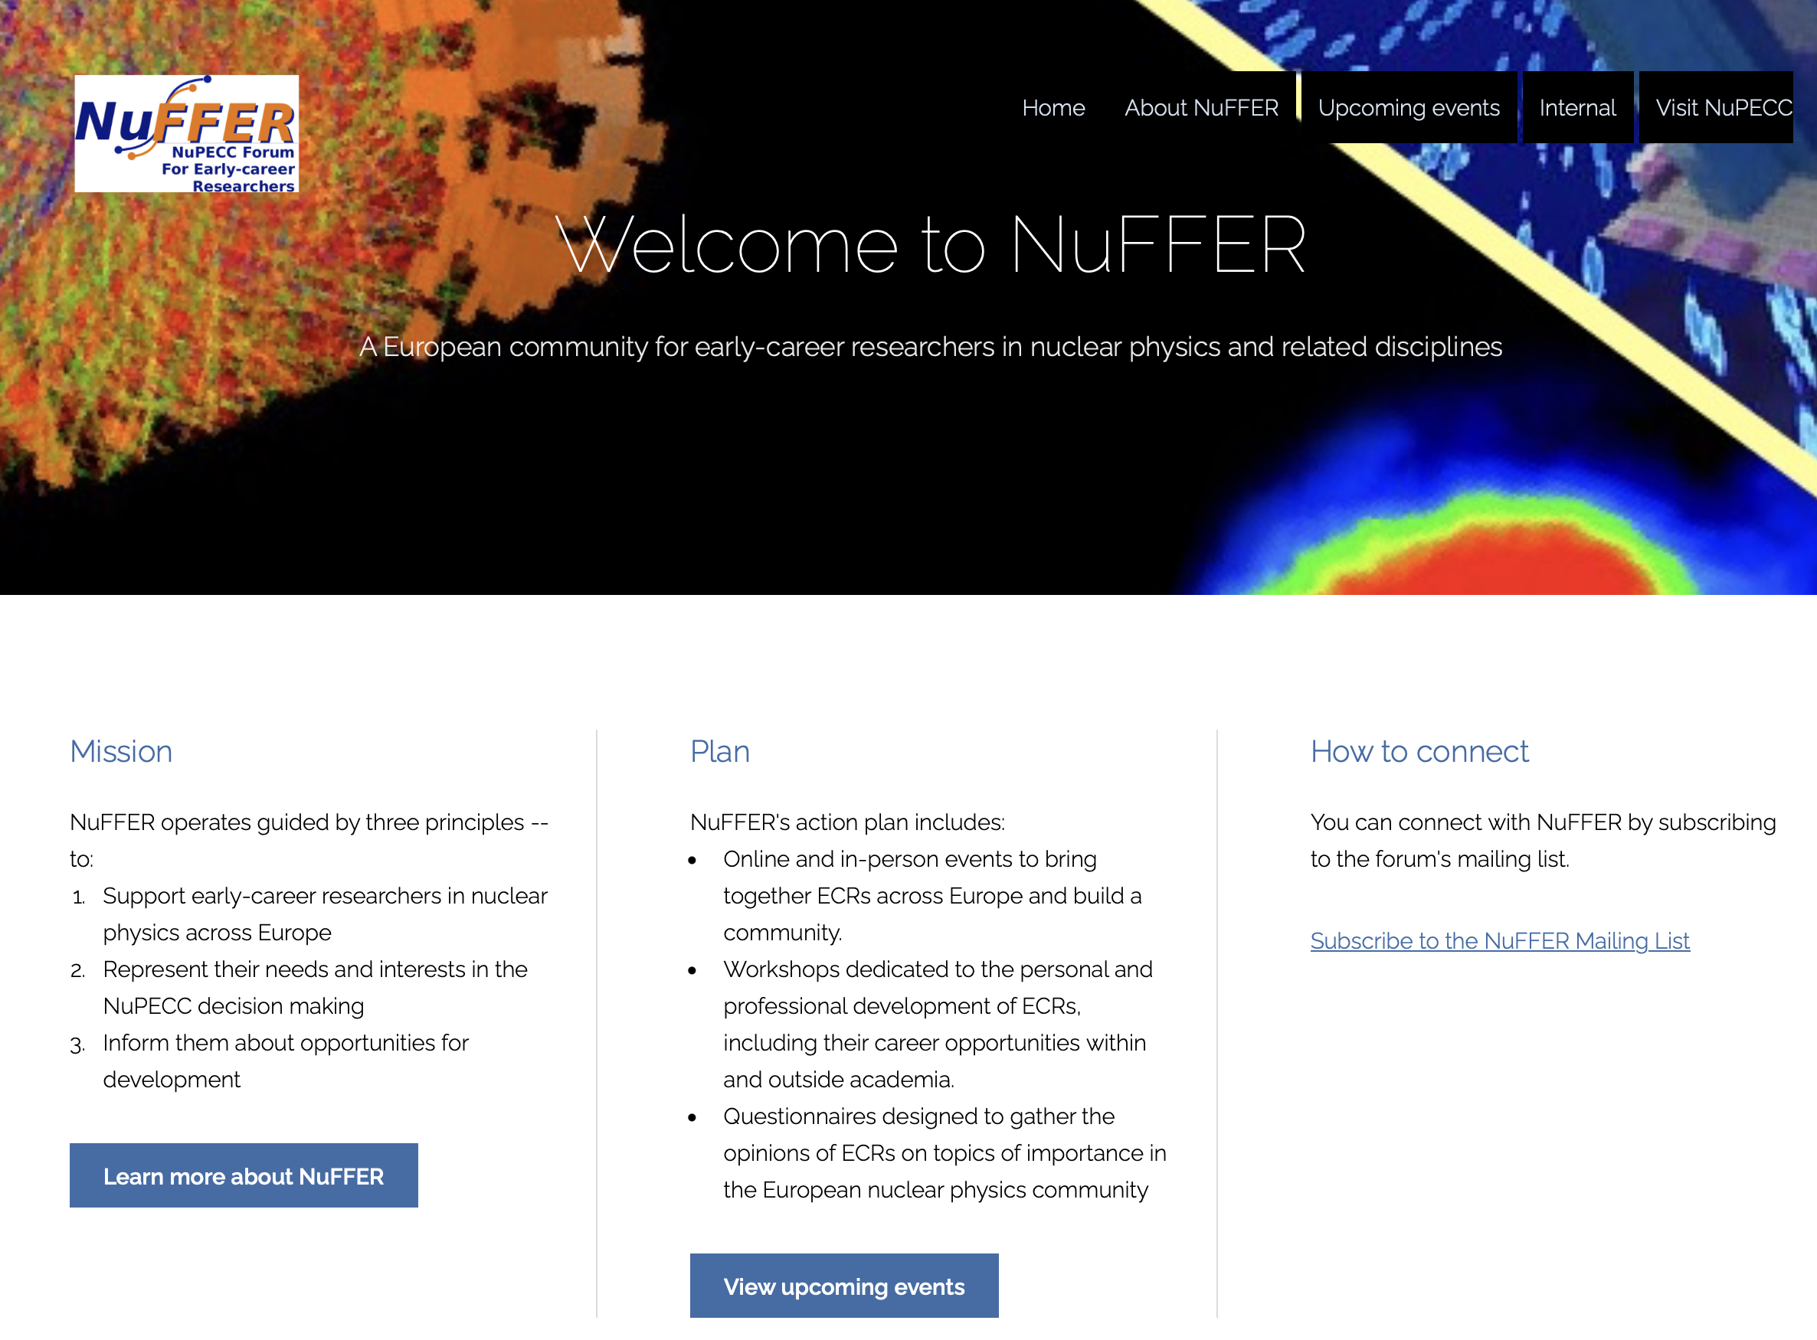
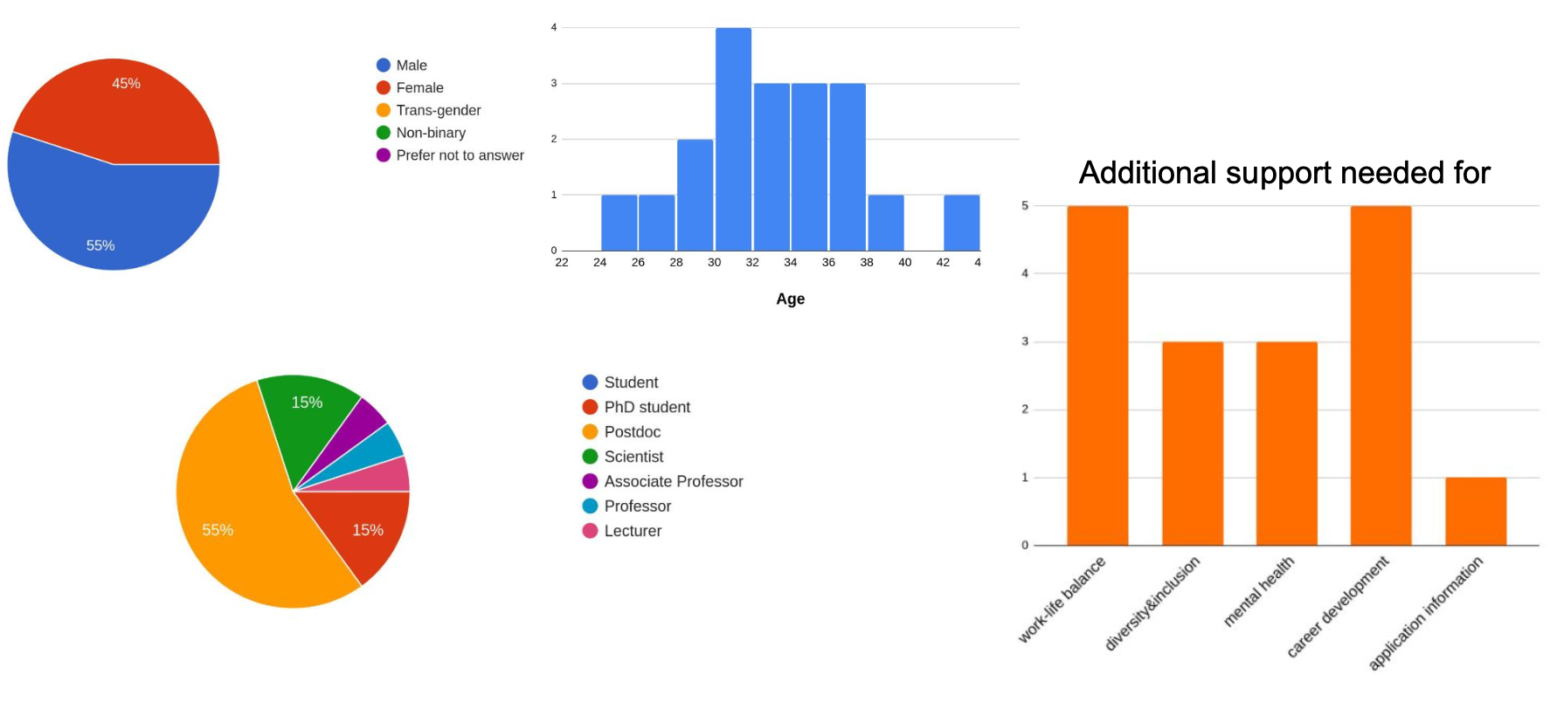
A NuPECC Forum For Early career Researchers
Established in 2024
Chair: Eliana Masha e.masha@hzdr.de
Co-Chair: Bianca Scavino
First activities
Survey on pressing problems
Kick-off meeting during EuNPC
Caen 26 Sep 2025, 42 participants
https://nuffer.eu
Austria: Michael Bacak
link

Slide 12
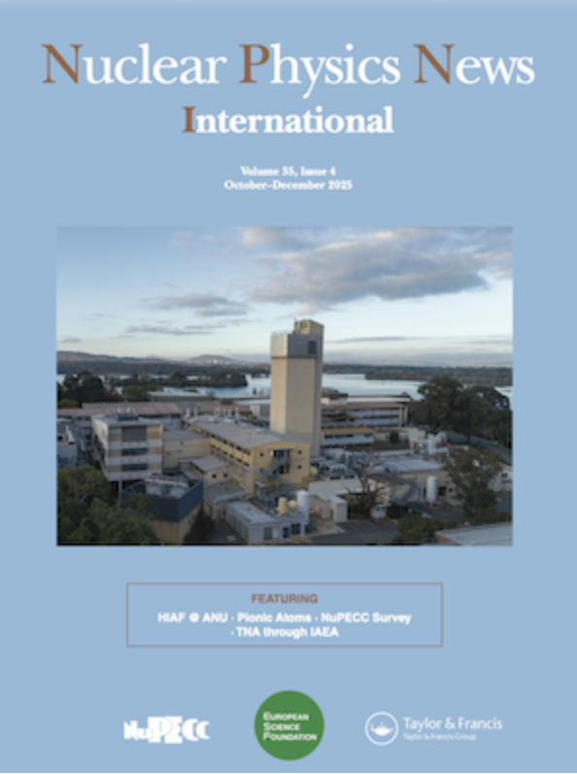
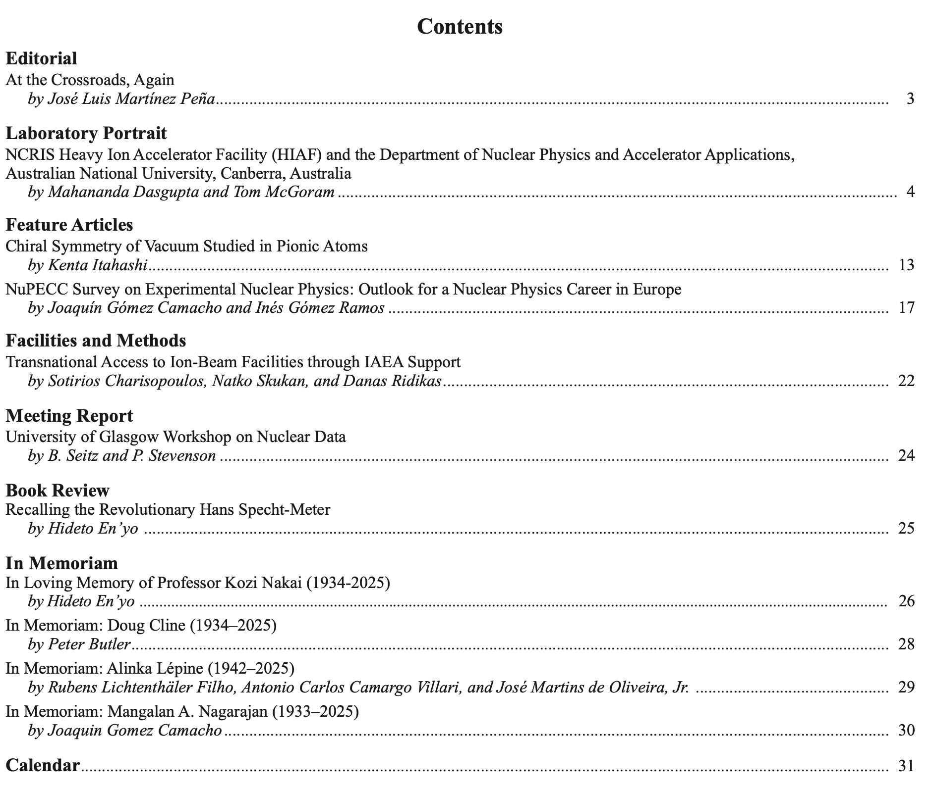
Nuclear Physics News
4 issues per year
Free distribution, send email to sissy.koerner@ph.tum.de
Oroofs online available at www.nupecc.org, final version from publisher (details on NuPECC web site)

Slide 13

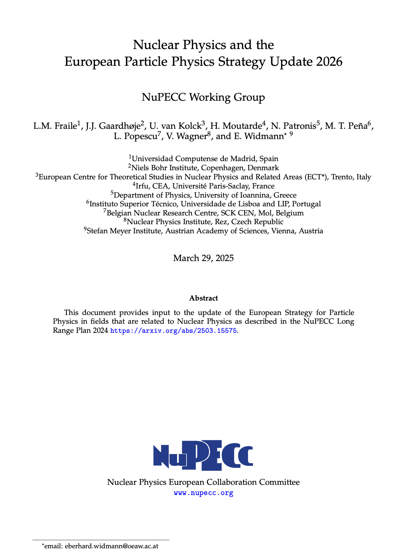
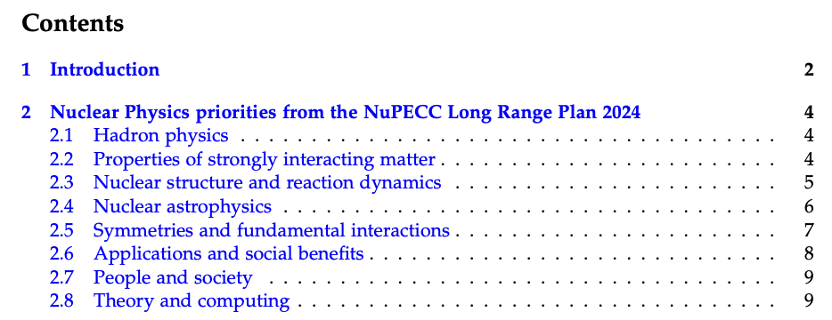
NuPECC input to ESPPU
Contribution edited by selected experts
#103 of 263
Available at arXiv:2504.04100
Participation in European Strategy Group (EW)
https://indico.cern.ch/event/1439855/contributions/

Slide 14

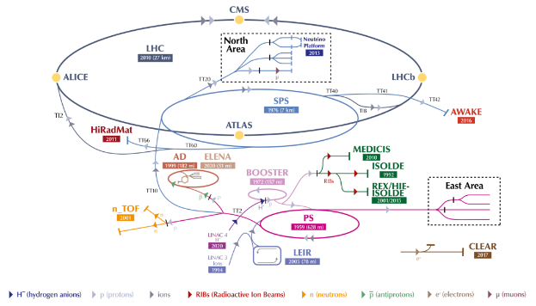
LRP 2024 Recommendations for NP Infrastructures
ALICE 3
CERN Nuclear Physics facilities and experiments
Nuclear physics opportunities at CERN constitute a world-leading research . The construction of ALICE 3 as part of the HL-LHC plans is strongly recommended. Continued support for exploitation and new developments are recommended to maximise the scientific output of ISOLDE, n_TOF, SPS fixed-target program and AD/ELENA. As the roadmap for the post-LHC future of CERN is developed, a strategy should be prepared to secure future opportunities for continuing world-leading nuclear-physics programmes that are unique to CERN.
AD/ELENA
n_TOF
-> NP contributions to the ongoing Update of the Strategy for Particle Physics

Slide 15
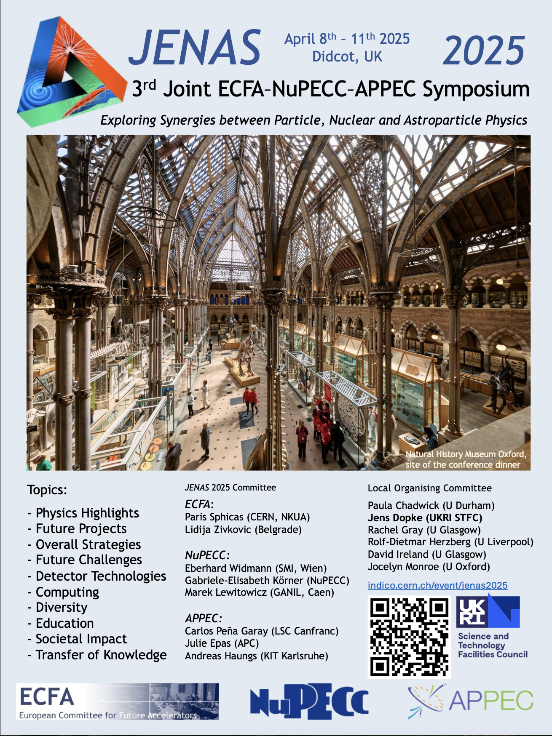
JENAS Symposia
Joint ECFA NuPECC APPEC
Orsay, FR 2019
Madrid, ES 2022
Didcot, UK 2025
Large attendance
Excellent presentation of topics of joint interest
Meeting with funding agencies
Main focus: JENA white paper on federated computing
Indication of future calls for large communities
JENAS 2028

Slide 16
Thank you

Slide 17
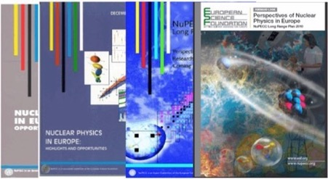
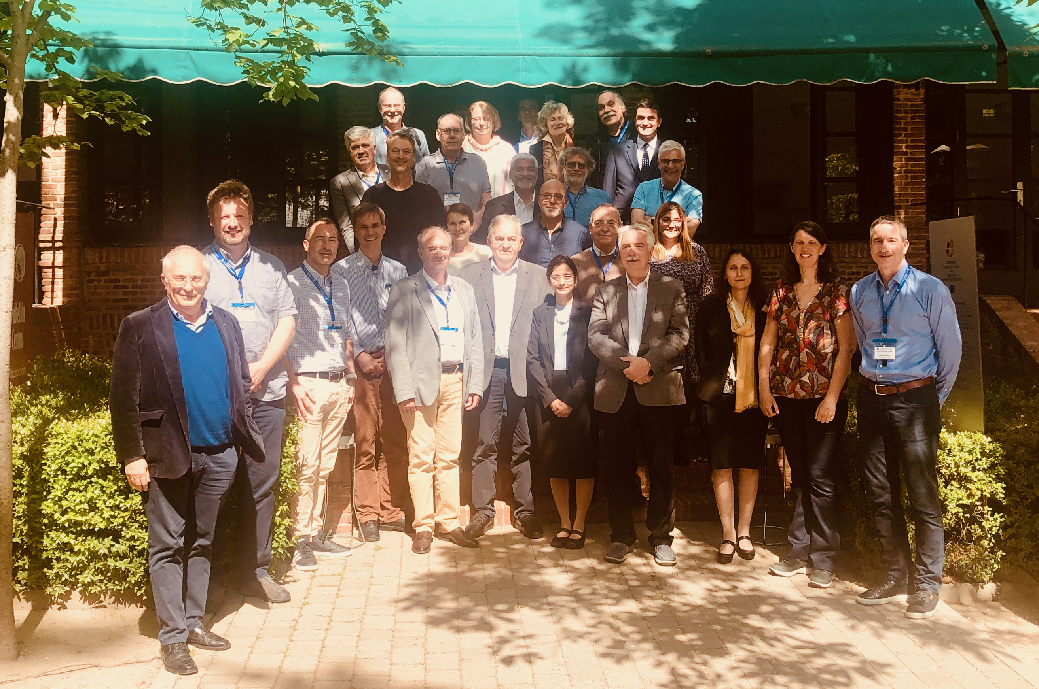
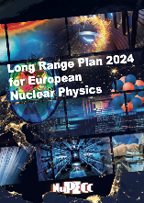
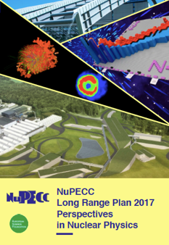
Towards NuPECC Long Range Plan 2024
1991
1997
2004
2010
The LRP identifies opportunities and priorities for nuclear science in Europe
The LRP provides national funding agencies, European Strategy Forum on Research Infrastructures and the European Commission with a framework for coordinated advances in nuclear science in Europe
Assessment of implementation of LRP 2017
https://www.nupecc.org/2017_LRP_Assessment_of_Implementation_final.pdf
Launched in May 2022 in Madrid
NuPECC
LRP 2024
arXiv:2503.15575
NuPECC LRP 2017
https://www.nupecc.org/lrp2016/Documents/lrp2017.pdf

Slide 18

NuPECC LRP2025 Time Line
Bottom-up approach

Slide 19
Nuclear Physics in Europe – two pillars
European Landscape
of Nuclear Physics Infrastructures
Nuclear Physics Workforce in Europe
5346 – total number of Nuclear Physicists (Exp. & Theory) in the European NuPECC Member States and the Associated Member CERN
2546 – permanent staff
2800 – PhD students and non-permanent staff
All infrastructures are multidisciplinary !
Taking data > 30;
Under construction or upgrade ≥ 9
From NuPECC 2021& 2023 surveys
From NuPECC LRP 2024
Notes:
Wheel of Fortune of nuclear physics with 6 sub- fields

