Slide 1
REFA Visit September 2026
Thomas Bergauer
23 February 2026

Slide 2
Agenda
RECFA Meeting and Side Events
  Infosheet Austria; preparation by „Flyer Project“
  Side events: WKO Event / Technology Talks
Agenda of previous REFA Visits in Austria and how this compares to recent other visits
Agenda Proposal and Discussion

Slide 3
Mandate of (R)ECFA
Country visits every 6-7 years
  Last ones in Austria 2018, 2011, 2004
Review panel consists of RECFA delegates (one of each CERN member state, plus CERN, plus CERN DG, DRC and RECFA chair)
Follows a strict schedule:
  Official invitation letters have been sent to: Ministry of Science, FWF, FFG, ÖAW
  1-2 Weeks before visit: Fact sheet about countries sent to committee members
  Friday, 11 September: Open Session with Presentations from Community (ÖAW Theatersaal, followed by common dinner):
    https://indico.cern.ch/event/1567710/
  Saturday, 12 September: Closed Session of RECFA committee (PSK 3rd floor meeting room)
  Weeks later: Letters with findings to the ministry and other parties sent by RECFA

Slide 4
Fact Sheet Austria
One week prior to the visit the local organizers (typically the RECFA delegate) will provide a short overview of the country’s organization related to scientific research, i.e. comprehensively overviewing the organization and funding structures, as well the census of the particle physics community in the country can be added.
In details for us, this would be
  Country GDP and fraction for research
  Education system in general; role of STEM
  Academic education: Number of students in physics, which universities teach particle physics, how many PhD students
  CERN involvement: experiments and which universities/research centers cover it
  CERN membership fee; contribution: 2.2% and source of financing, Industrial return coefficient,
  ILO, technology transfer
  CERN Personnel statisitcs: Staff, Students (Fellows), USERs statistics
Where do this data comes from → Flyer Project

Slide 5
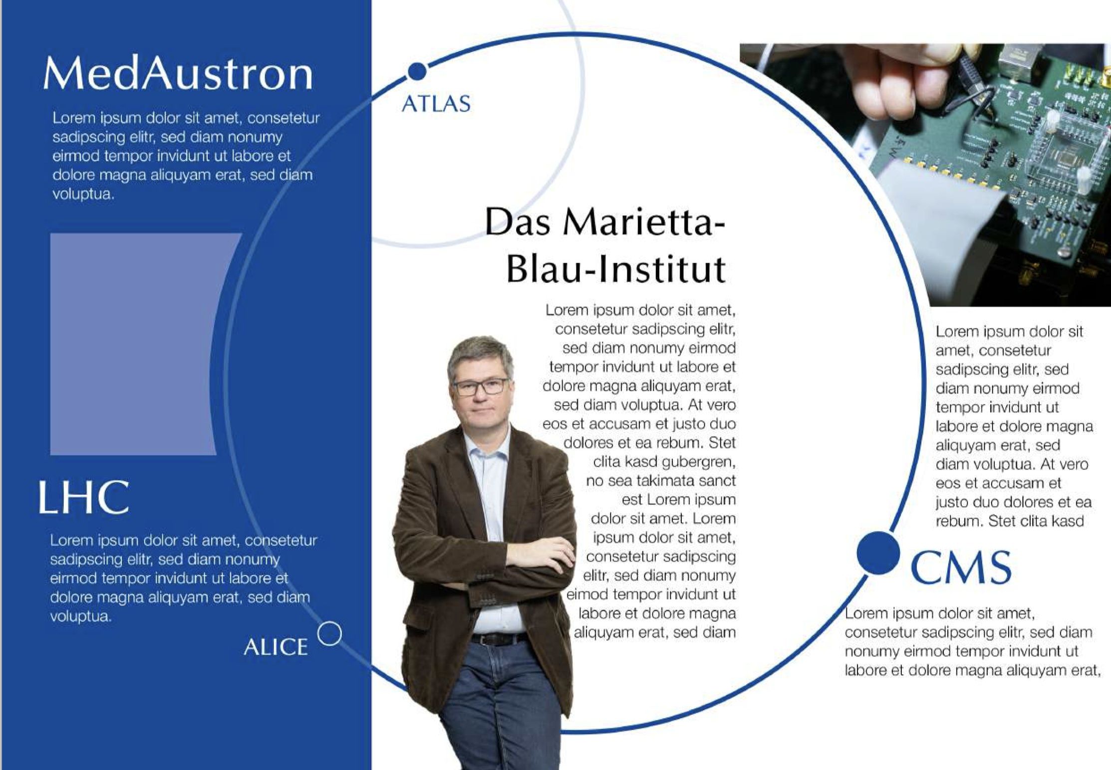
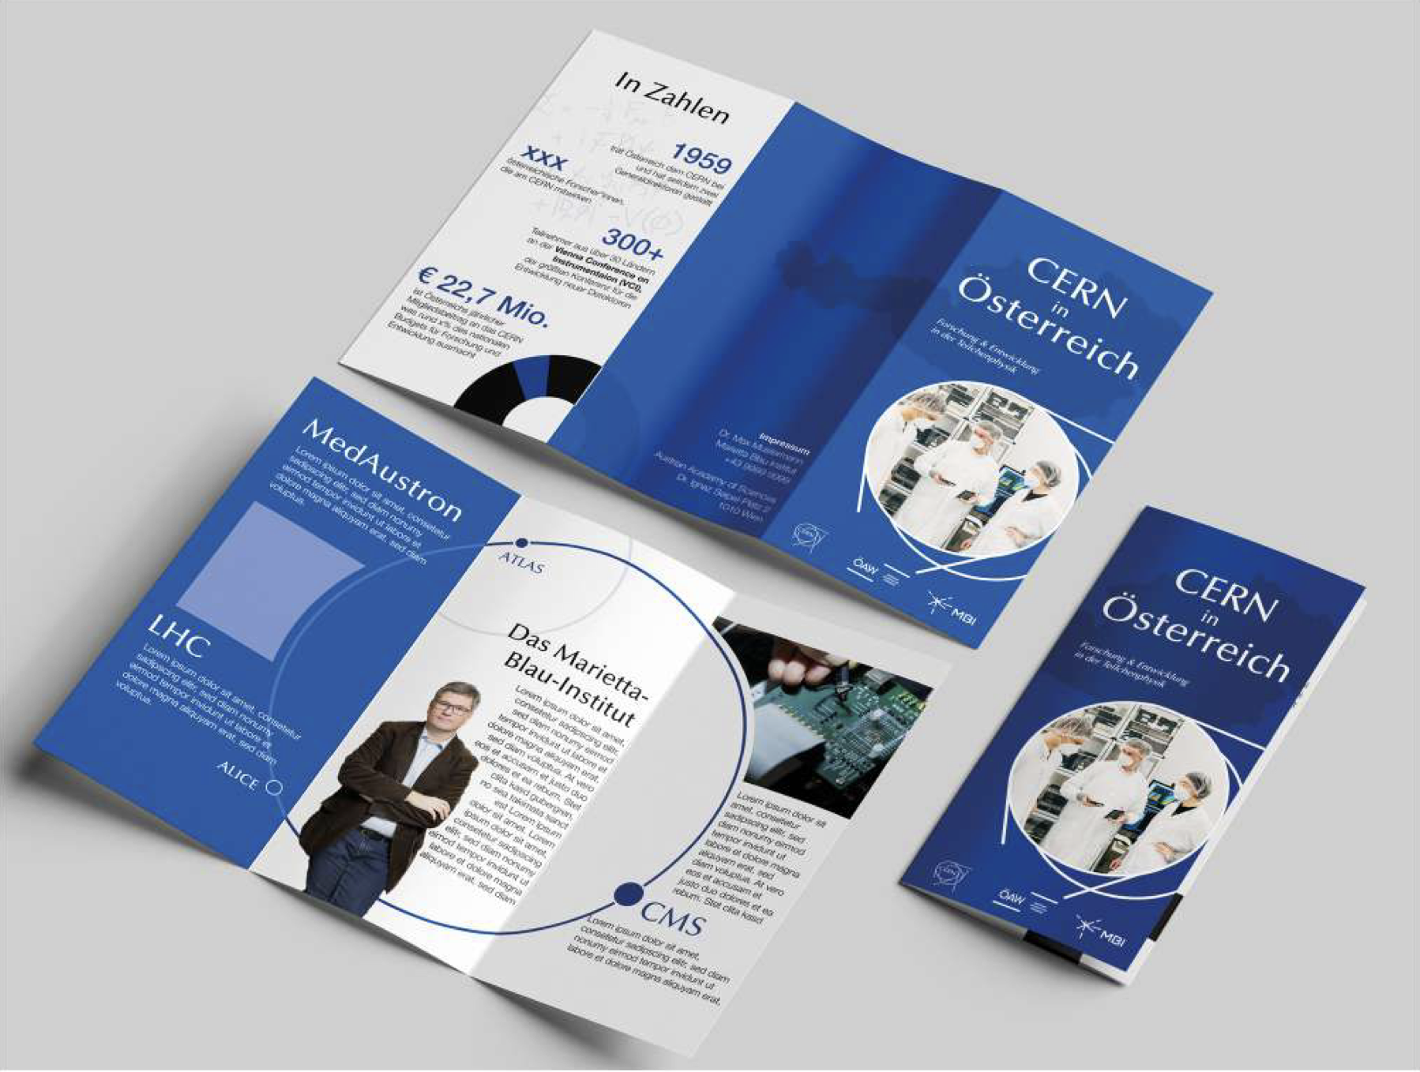
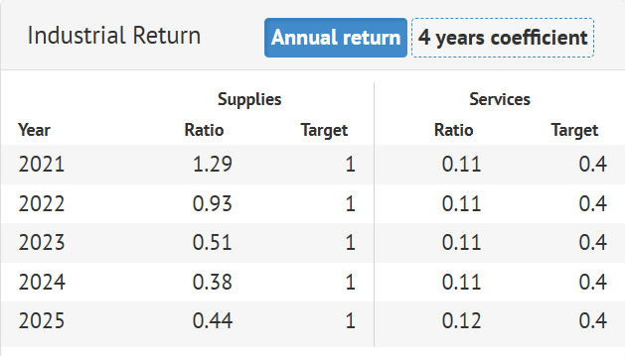
Flyer Project
As part of the project, 1–2 students will create several compact information flyers and accompanying websites that illustrate CERN's importance to Austria's industry, research, and education, as well as opportunities for working with/at CERN.
Collaboration with AT-Liasion at CERN (Markus Brugger, Cosima Rudigier)
Students: Recruited from among the recipients of Austrian Study Foundation scholarships.
  13 submissions.
  Barbara Schmidthaler (JKU Linz), who studies both physics and graphic design, was selected.

Slide 6
FAKT Sheet Example Finland

Slide 7
FAKT Sheet Example Türkiye

Slide 8
Side Events
WKO Event
Invite companies to the commerce chamber in Vienna (Wiedner Hauptstrasse)
present which opportunities exist when doing business with CERN
Accompanied by two webniars happening during the year and a visit to CERN at the end of 2026
Trying to increase industrial return and bring technology transfer to start ups
Focus on medical applications and quantum technologies
Technology Talks by AIT
https://technologytalks.ait.ac.at
Event in MQ Vienna with 850 participants and high-level speakers/attendees
  E.g. innovation ministry Hanke, FFG president, rectors of universities,..
Happend by coincidence in parallel to RECFA visit 10/11 September
Aim: propose a talk by DG Thomson and use it for networking

Slide 9
Template Agenda RECFA Session
Typical list of presentations from the country: 9:00 to 16:30 (including lunch)
  Funding Agency – organization and funding scheme
  Education
  Experimental particle physics: major experimental involvements
  Theory
  Nuclear physics (mostly CERN-related activities)
  Astroparticle (including neutrino physics)
  Detector R&D
  ILO report & technology transfer
  Accelerator science
  Computing
  Outreach
  Perspective of young scientists
Closed session: 17:00-18:00
RECFA initial report to community at 18:15-19:00
Dinner around 19:30
Maximum 15 talks

Slide 10
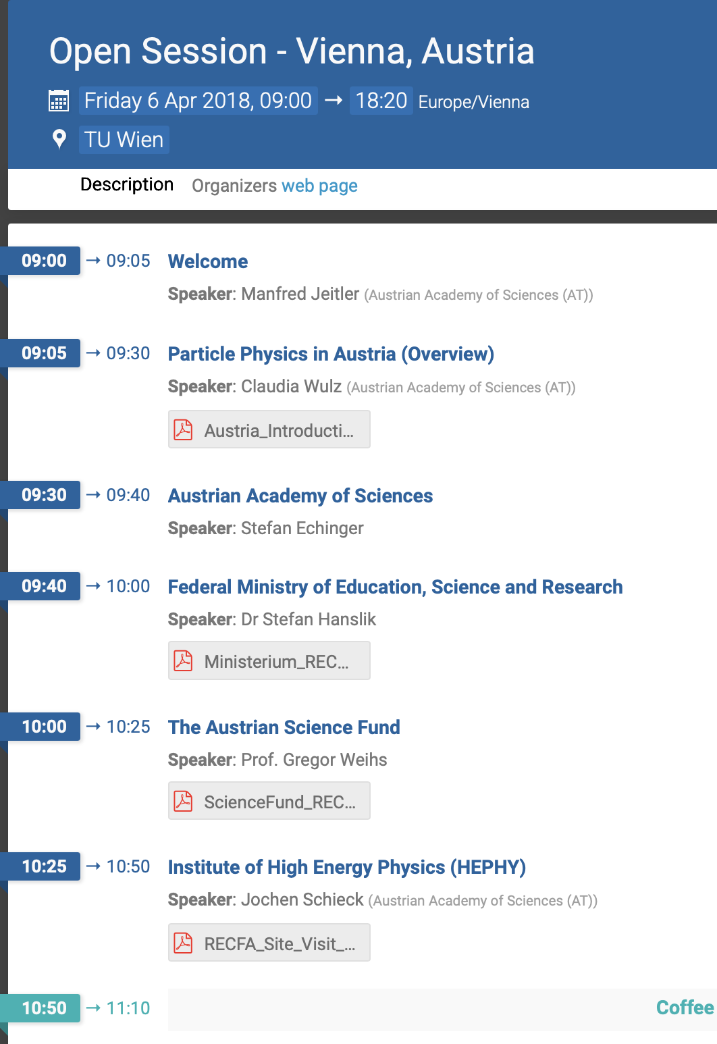
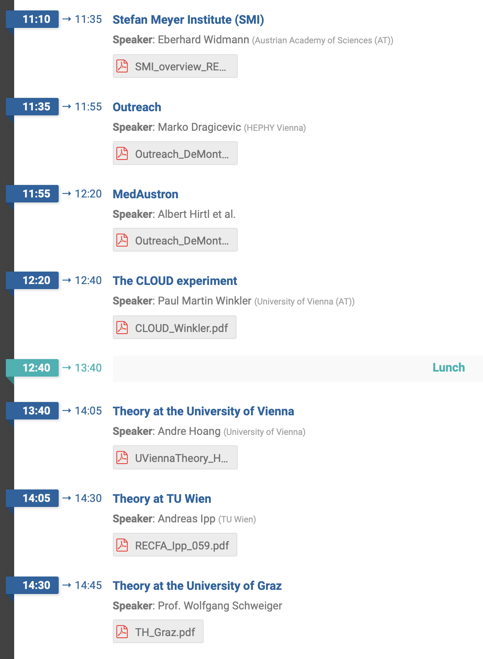
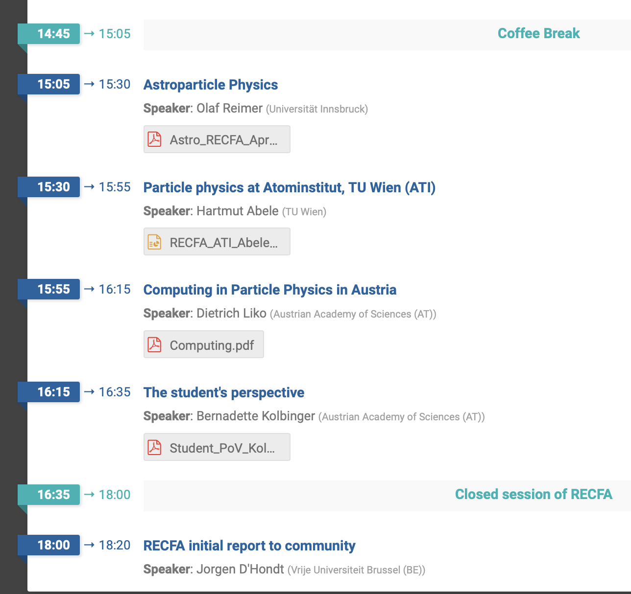
2018 visit Agenda

Slide 11
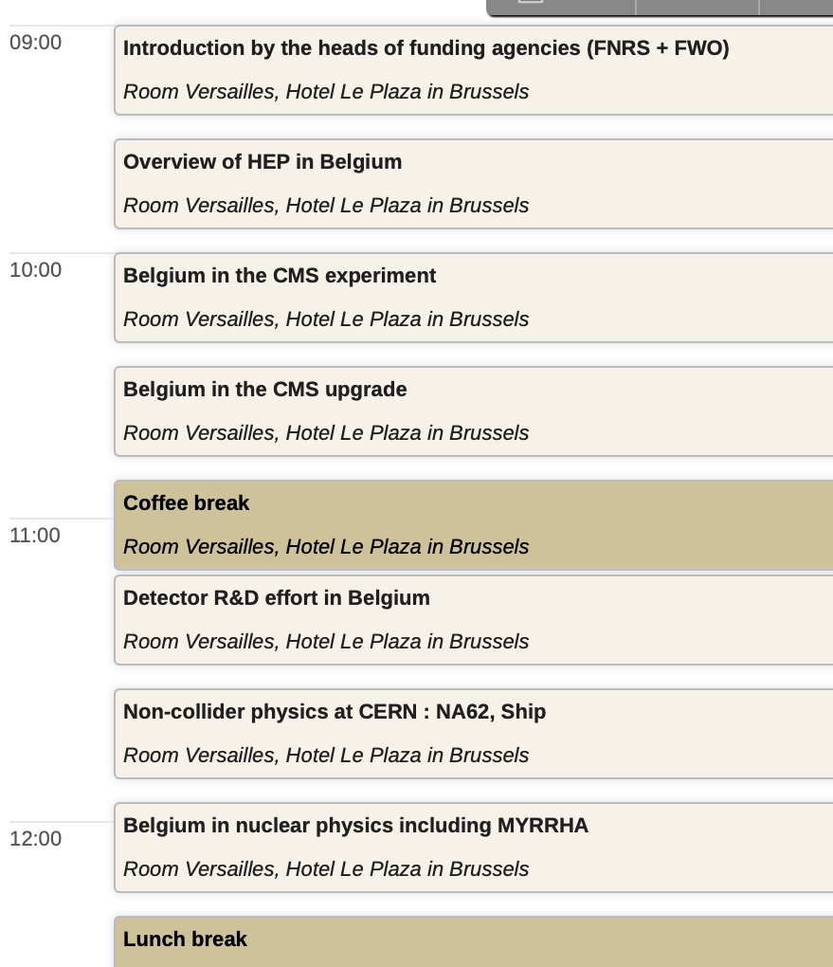
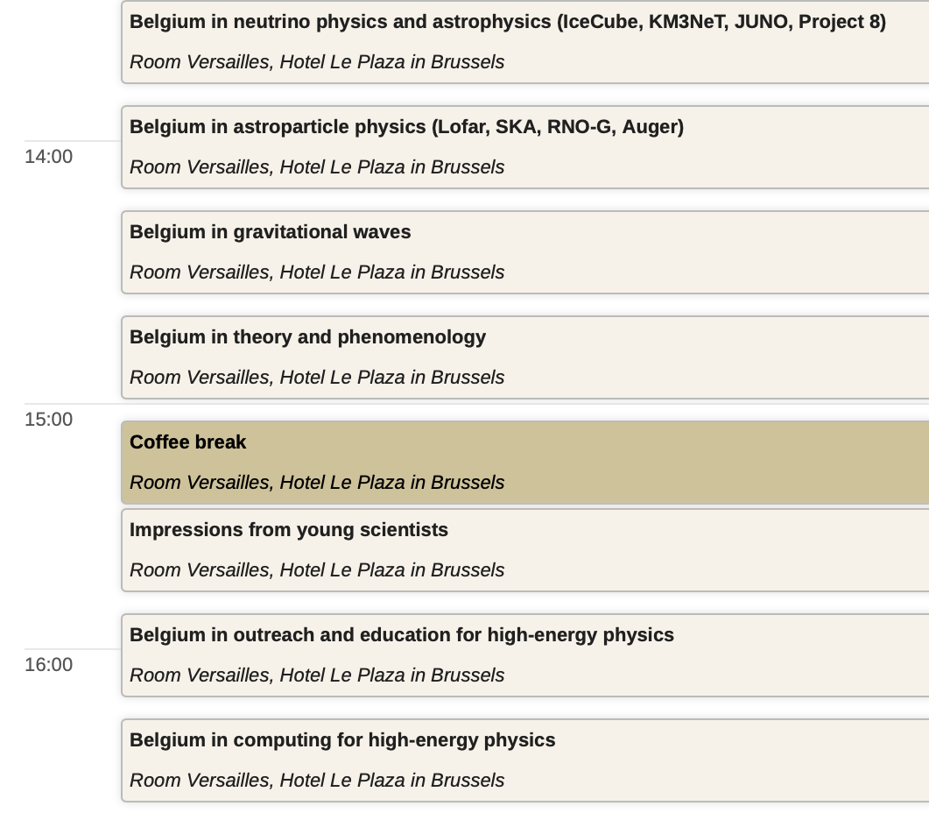
Comparison to other countries
The agenda of country visits is public in Indico, e.g. Belgium:

Slide 12
Proposal Agenda
Morning:
Welcome:
  ÖAW vice-president Diebold (confirmed)
  Ministry? Hr. Hanslik?
Funding Agencies – organization and funding scheme: FWF/FFG tentatively confirmed
HEPHY+SMI->MBI (Jochen/Eberhard)?
Education ?
Experimental particle physics: major experimental involvements
  CMS (Robert Schöfbeck), Belle (Christoph Schwanda), AD (Eberhard or his postdocs? )
Nuclear physics (mostly CERN-related activities): ALICE (David Chinellato)
N_TOF (Michael Bacak?)
Afternoon:
Theory: Simon Plätzer/Axel Maas/Andre Hoang?
Astroparticle (including neutrino physics):
  RES (Florian Reindl)
  Gravitational Waves (Gianluca)
Detector R&D (TB?)
ILO report & technology transfer ?
Accelerator science: Elisabeth Renner
Computing: ?
Outreach: Marko Dragicevic?
Perspective of young scientists: ECR Representative ?

Slide 13
Additional Topics to be presented
Innsbruck:
  ATLAS: some activities around Emmerich Kneringer
  Astroparticle (O. Reimers)
CLOUD: Uni Wien (MK contacted Eva Schmidt)
FCC Activities
  TU Wien:
    Nb3Sn coatings for RF cavities (Johannes Bernardi)
  BOKU (Christina Staudinger): https://openskylab.web.cern.ch/
  5 FTE +2 FTE starting December 2026 (EU-project)
    Institute für Pflanzenbau und der Versuchswirtschaft Groß Enzersdorf, Marketing und Innovation, Institut für Statistik
  Univ. Leoben (Prof. Robert Galler) 3-5 FTE
  Uni Innsbruck ? FTE
ISOLDE Uni Linz (Alberta Bonanni)
  Experimente (hauptsächlich Mößbauer-Spektroskopie) an ISOLDE, Aufenthalt am CERN fester Bestandteil des Master- und Doktorandenprogramms der Gruppe (5 FTE)

Slide 14
What is unclear
Can we have talks on
Education ?
ILO report & technology transfer ?
How to include AI?
  Dedicated talk by Claudius?
  Combine with computing?

Slide 15
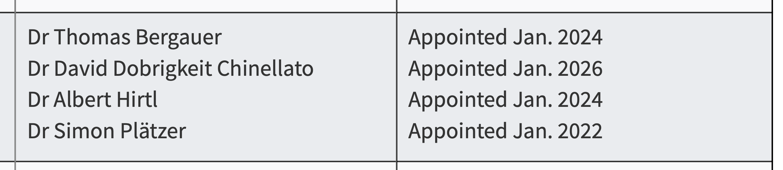
Austrian ECFA Members
Plenary ECFA Composition
Restricted ECFA: TB
ECFA Early-Career Researchers Panel:
ECFA Detector Panel: TB ex-officio through DRDC

Slide 16
The end.

Slide 17




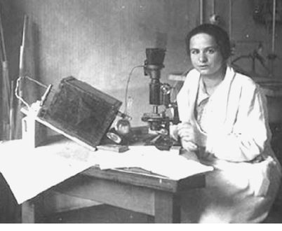
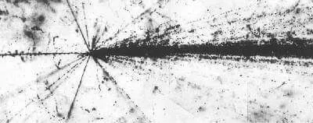
Disclaimer:
HEPHY becomes MBI
Institute for High
Energy Physics
  CMS
  Belle-II
  Dark Matter (CRESST, COSINUS)
  Gravitational Waves
  Machine Learning, Theory
Stefan Meyer Institute for
Subatomic Physics
  ALICE
  Exotic Atoms & Antimatter at ASACUSA@AD
Since 1st September 2025:
http://www.oeaw.ac.at/mbi
Marietta Blau (1894 – 1970), Jewish Austrian physicist who developed nuclear emulsion techniques
nuclear disintegration stars (Zertrümmerungsterne)

