Slide 1

Cost-effective, High impact : the AI_r system for Air Quality Monitoring
Manal Karmoude, Brenton Munhungewarwa ,Ryan Mckenzie, Donald Ngobeni, Bevan Smith, Raghav Chandra, Vongani Chabalala ,Jude Kong, Mukesh Kumar, Nicola Bragazzi,, Yahya Tayalati, Redouane Benaini, Bruce Mellado

Slide 2
Air Quality Monitoring Importance
Air quality monitoring is essential because it identifies polluted areas, tracks exposure levels, and provides reliable information about ambient air conditions.
Traditional reference-grade stations are limited, especially in low-resource regions. Their high installation and maintenance costs mean they only cover a few locations, leaving many areas unmonitored.
Conventional monitoring stations are large and require significant space, making them difficult to deploy widely, particularly in dense urban environments.

Slide 3
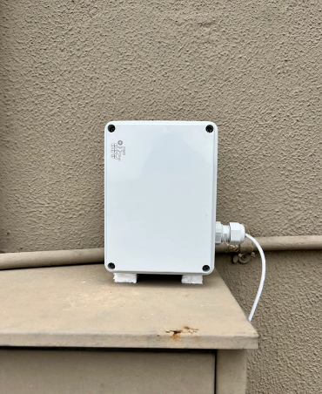
SACAQM: Developing a Cost-Effective, Scalable Air-Quality Monitoring System : AI_r
SACAQM designed a cost-effective air-quality monitoring system to overcome the limitations of traditional reference-grade stations.
The system AI_r integrates affordable sensors, IoT connectivity, and AI.
Compact and easy to deploy
The external housing protects the sensors from weather, dust, and environmental stress

Slide 4
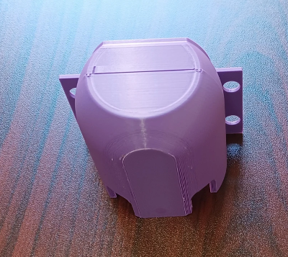
AI_r Cost-Effective Sensor Node (external Hardware)
Designed for both indoor and outdoor environments, the system features a UV-resistant and waterproof enclosure for reliable outdoor use
The AI_r system can cover multiple locations because its sensors are easy to deploy.

Slide 5
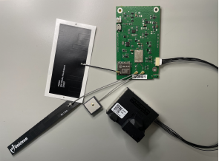
AI_r Cost-Effective Sensor Node (Internal Hardware)
The hardware includes:
  A custom PCB hosting the processing unit (Nordic nRF9160 SiP)
  LTE, GPS, and LoRa antennas for long-range communication
  A SEN55 environmental sensor module measuring PM, VOCs,NOx ,CO2, A-weighted decibels
  ,humidity, and temperature

Slide 6
Calibration Against a Reference-Grade Air Quality Station (SAAQIS)
- The system was calibrated against a reference-grade monitoring station (SAAQIS) to ensure measurement accuracy.
Results :
The calibration results demonstrate that the AI_r system provides accurate, consistent air-quality measurements when compared to a reference-grade station.

Slide 7
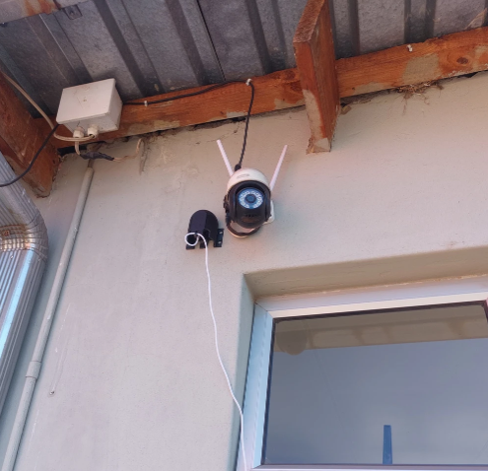
Deployment Locations and Community Engagement
Deployments take place in government buildings, including:
Clinics
Hospitals
Community centers
Schools
The network also extends to a growing citizen-science initiative, where we work directly with local communities to install and maintain sensors.

Slide 8
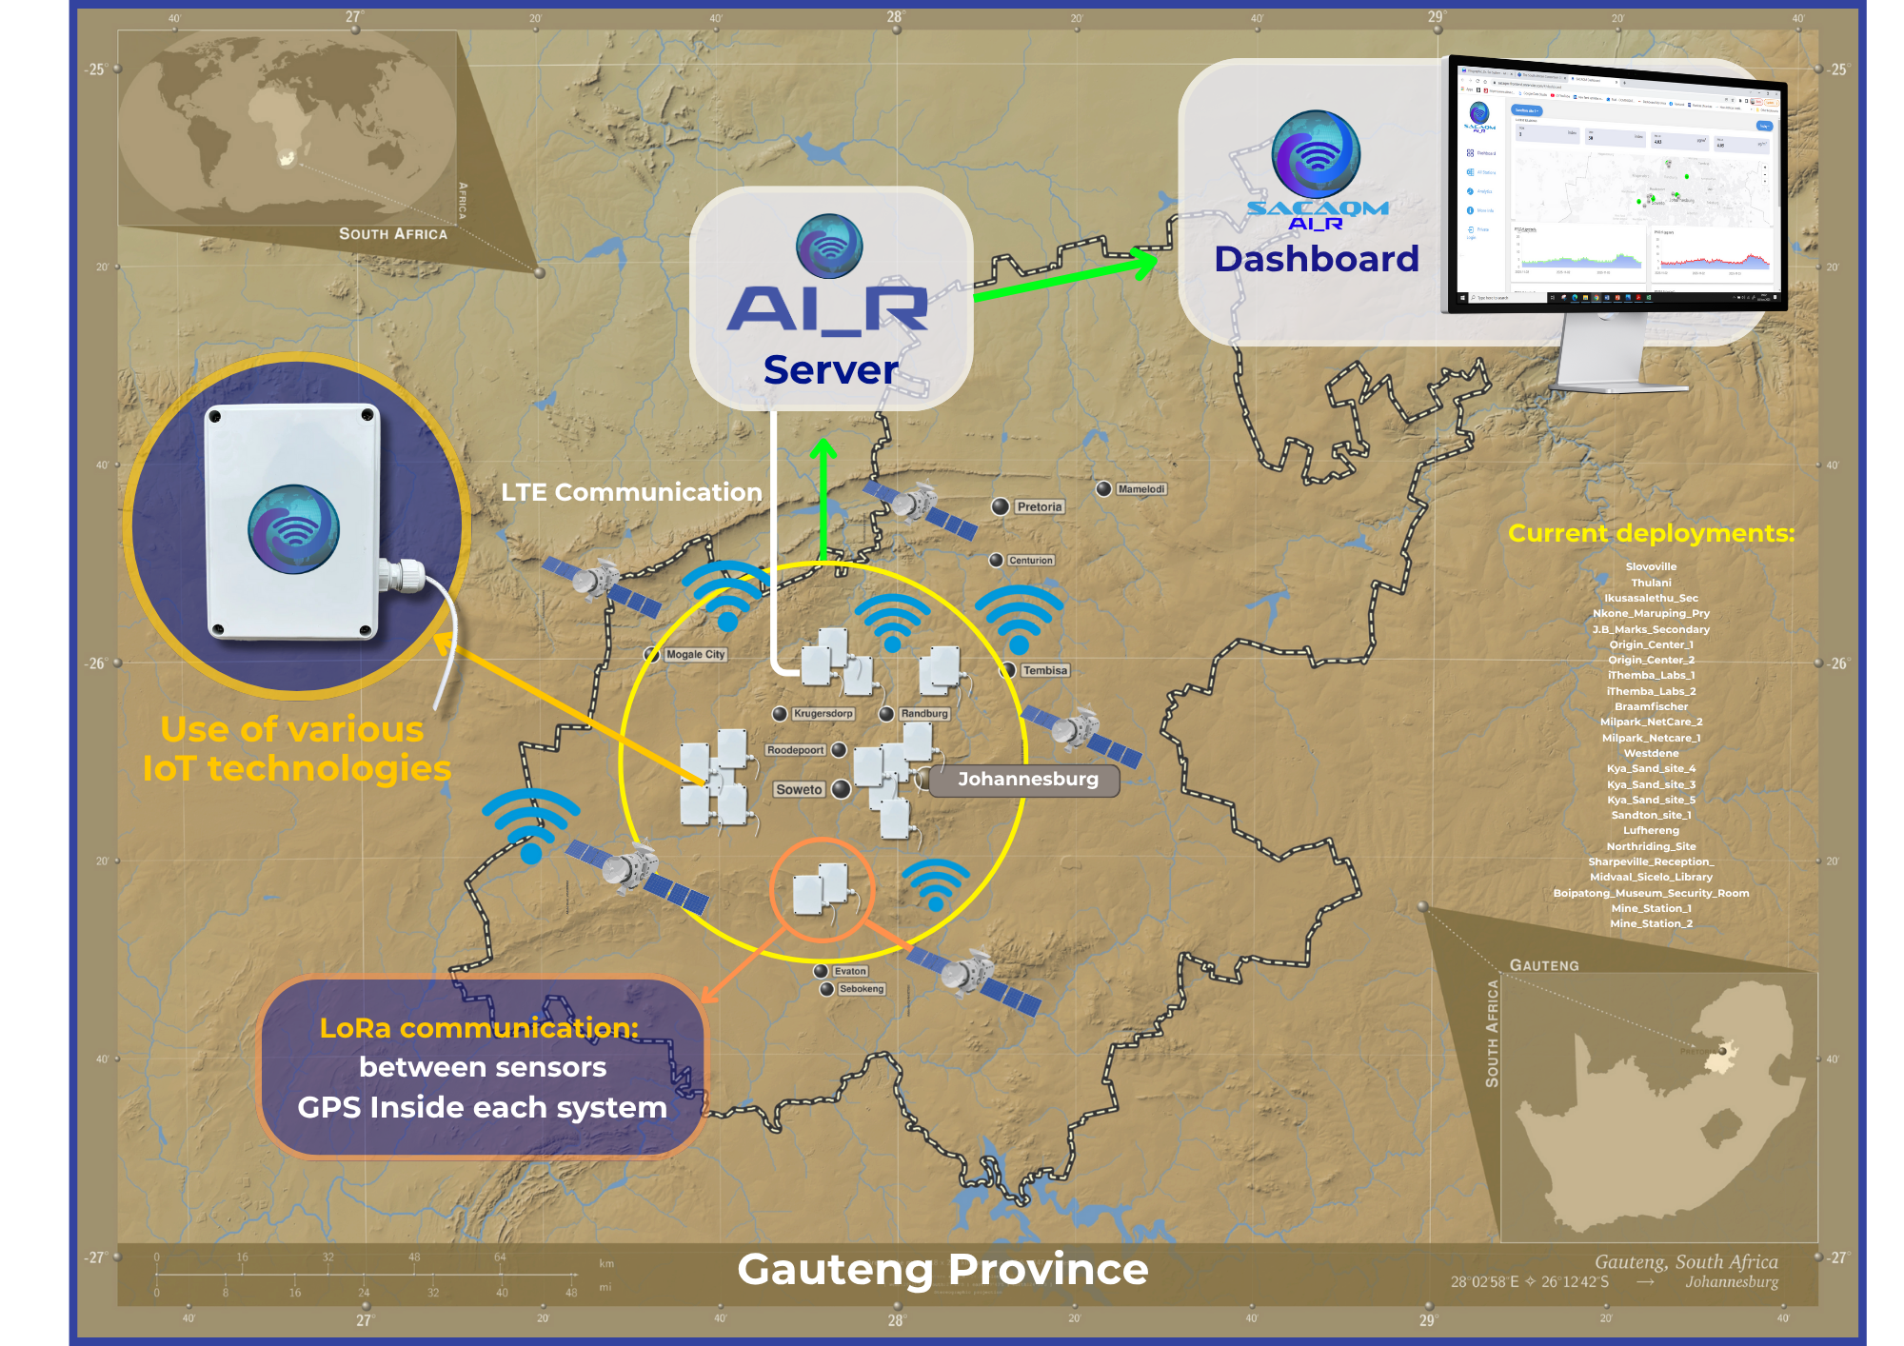
Overview of outdoor AI_r system across Gauteng Province

Slide 9
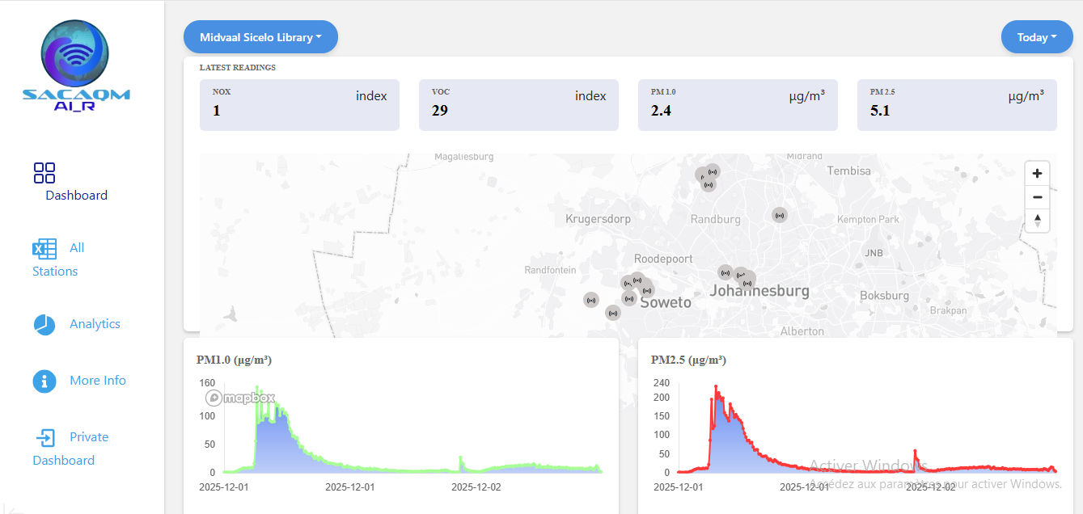
SACAQM outdoor dashboard

Slide 10
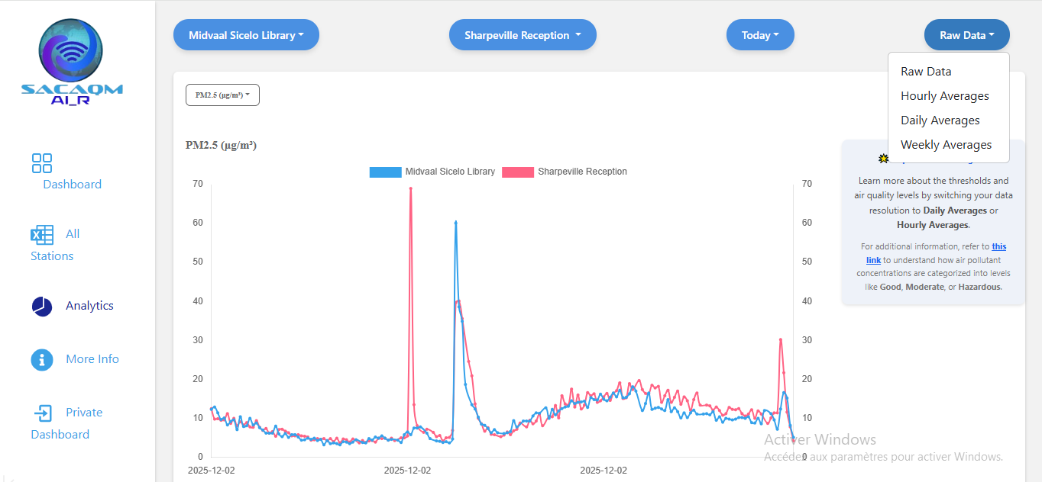

Slide 11
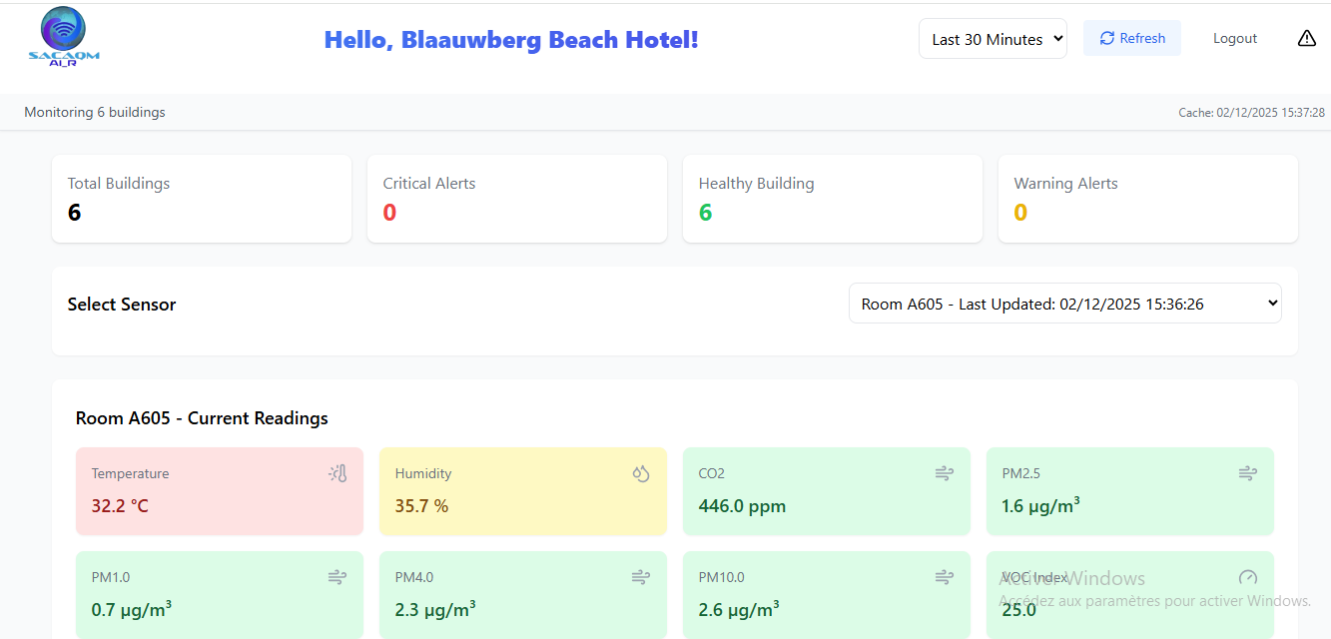
SACAQM indoor dashboard

Slide 12
Integrating AI with Cost-Effective Air Quality Sensors
- The AI_r system combines cost-effective sensor networks with advanced Artificial Intelligence to enhance predictive capability.
By leveraging AI, the system can:
- Identify pollution hotspots across communities
- Forecast air quality trends hours to days ahead
- Support public health decisions with real-time insight

Slide 13
Integrating AI with Cost-Effective Air Quality Sensors
Spatio-Temporal AI Modelling
We developed a spatio-temporal neural network that integrates data from multiple AI_r cost-effective monitoring stations for 24-hour forecasting.
The model learns:
  Spatial interactions between monitoring locations
  Temporal patterns in pollutant behavior

Slide 14
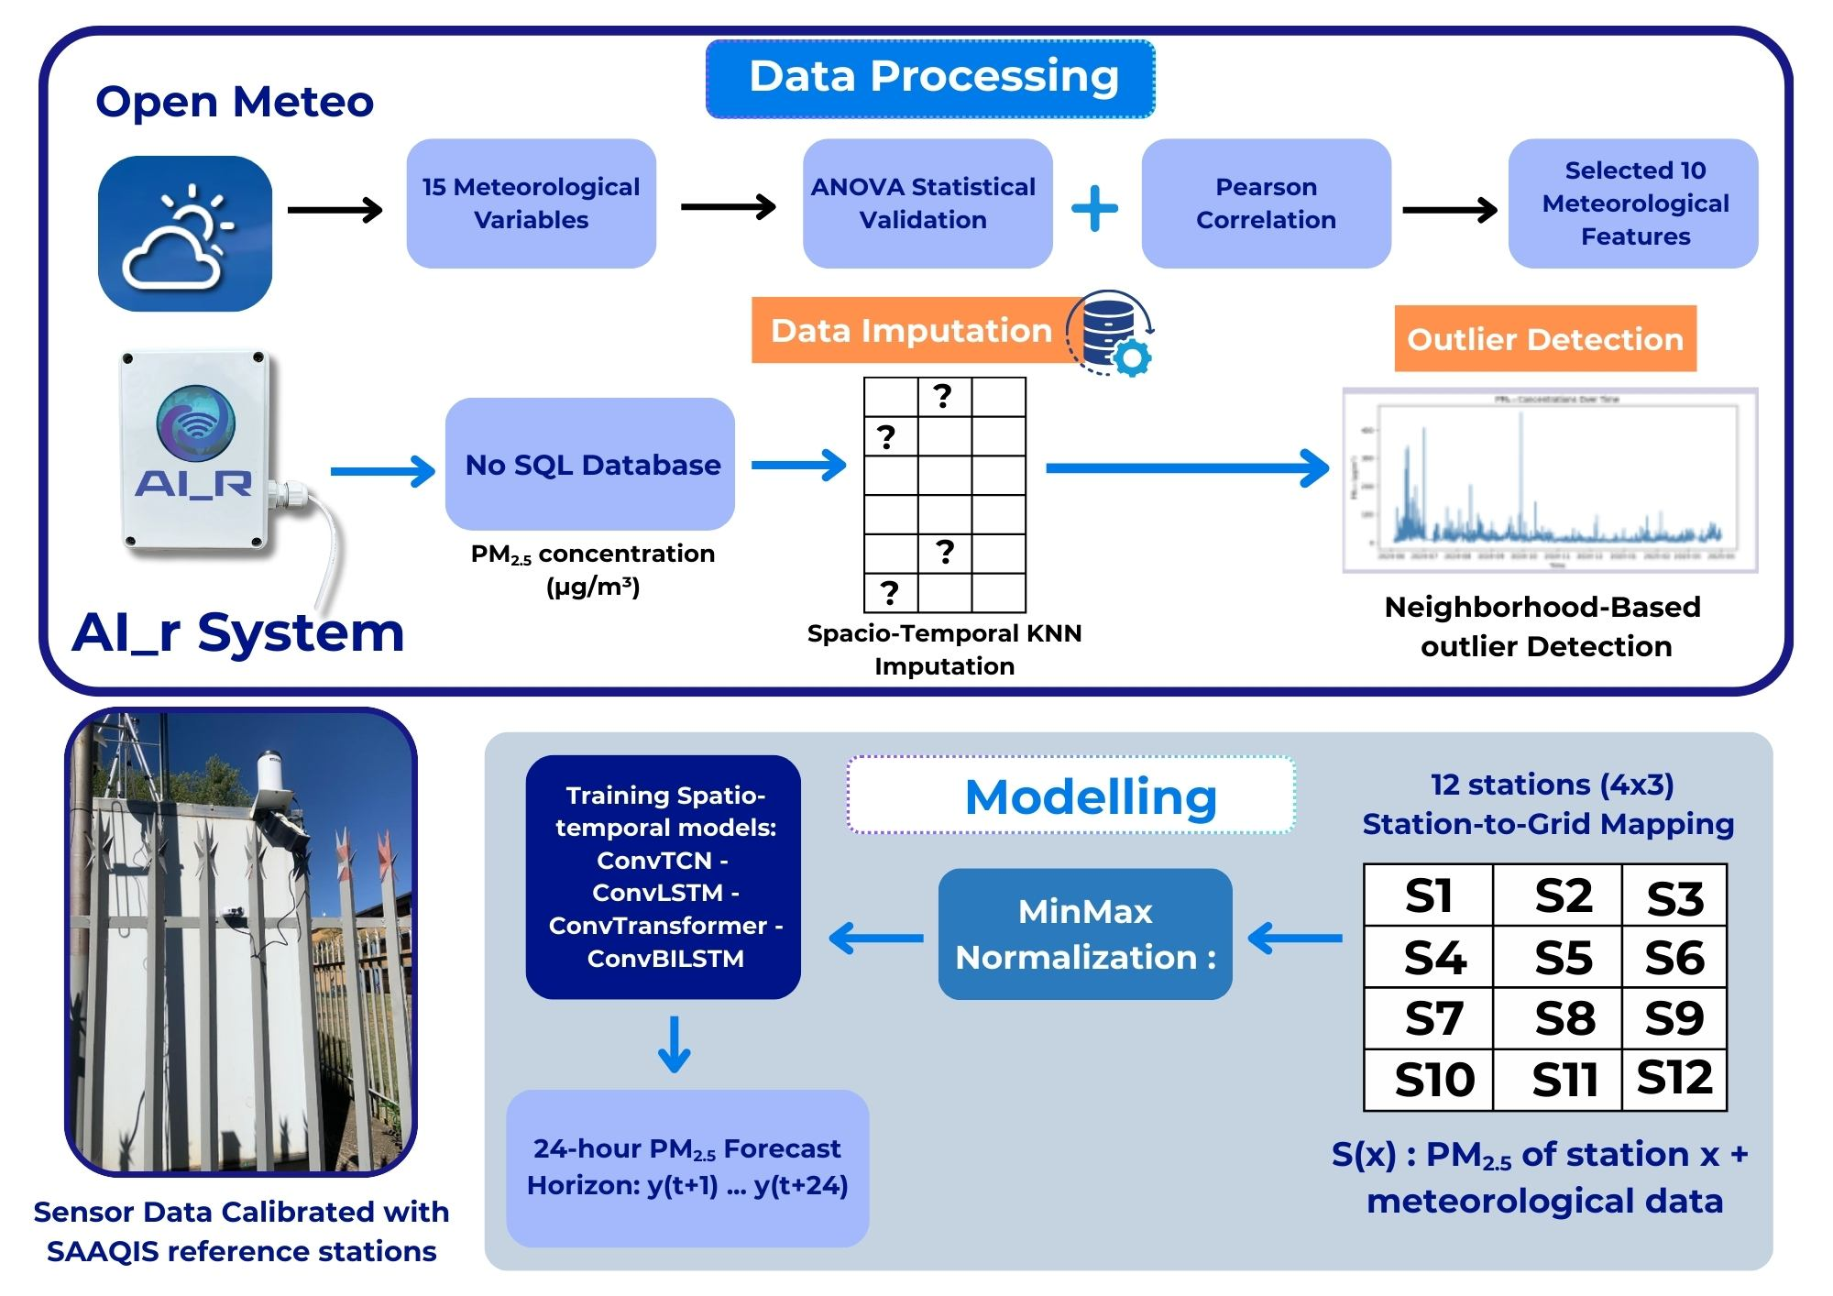

Slide 15
Framework for Stakeholder Use and Early Warning
- The developed spatio-temporal framework has shown strong performance and reliable forecasting capability across multiple monitoring stations.
- Because of its reliable predictions, this framework will be considered by stakeholders—including government institutions, health agencies, and community partners—to support early-warning systems.

Slide 16
Thank you!

