Slide 1
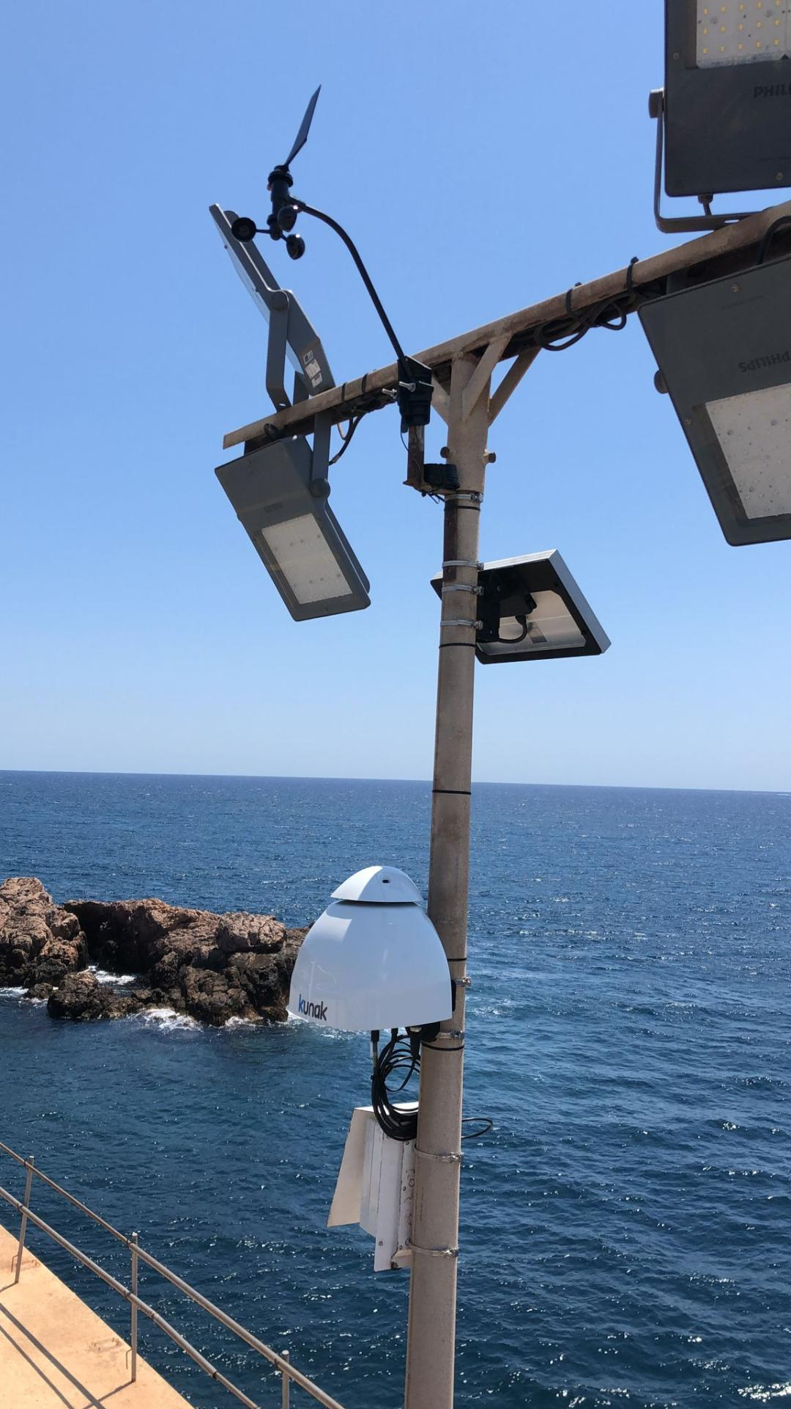
Improvement of low-cost sensor accuracy in challenging environmental conditions to obtain near-reference data
Environmental monitoring
4th December 2025
Edurne Ibarrola, PhD
Chief Scientific Officer

Slide 2

Low cost gas sensors – Issues and Challenge
Environmental conditions effects: Low-cost sensors have a non-linear response to temperature, humidity and pressure.
Cross-sensitivities in gas sensors from other common atmospheric compounds.
Baseline and Sensitivity drift: Low-cost gas sensors suffer from non-linear baseline and sensitivity drift over time. They will require regular calibration to adjust these parameters.
Lewis, A., Peltier, W. R., & von Schneidemesser, E. (2018). Low-cost sensors for the measurement of atmospheric composition: overview of topic and future applications.

Slide 3
Calibration methods
DETERMINISTIC MODELS
STOCHASTIC MODELS
Establishing a deterministic relationship between → the reference values and raw sensor responses
Rely on supervised machine learning techniques
Linear Regressions
Multilinear Regressions
Others:
Exponential, logarithmic, and quadratic models, the Kohler theory of particle growing factor used for PM LCSs
Artificial Neural Networks
Random Forest
Combined ML models
New models based on AI

Slide 4
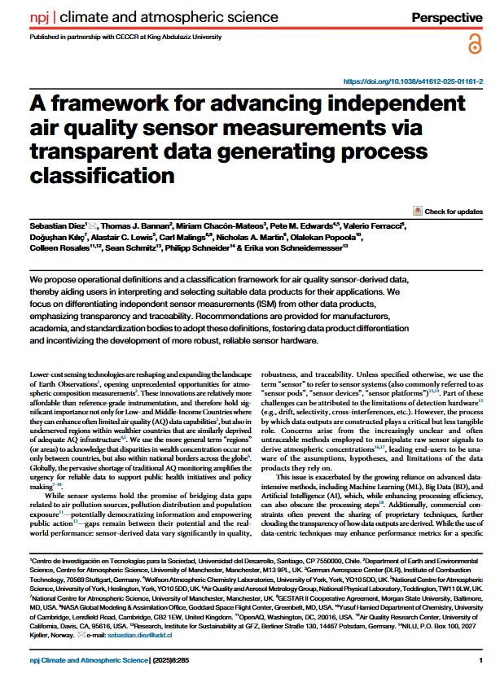
Independent Sensor Measurement
Diez, S., Bannan, T.J., Chacón-Mateos, M. et al. A framework for advancing independent air quality sensor measurements via transparent data generating process classification. npj Clim Atmos Sci 8, 285 (2025).
https://doi.org/10.1038/s41612-025-01161-2

Slide 5
Independent Sensor Measurements (ISM): the output is primarily determined by internal signals of the sensor system (especially the primary sensor) plus only justified corrections for known artefacts. External dependency (other data sources, local specific calibration, etc.) is minimized.
Non-Independent Sensor Measurement: rely on site-specific calibration, external data, or advanced corrections that reduce transparency
→ as Machine Learning/AI models
Independent Measurement
Non-independent measurement
Prediction
Processing Levels

Slide 6
Machine Learning/AI algorithms work more like predictive models than direct measurement tools.
Instead of measuring the pollutant concentration, they analyse historical patterns to anticipate what is likely to happen next (data processing).
As a result, events that deviate from those learned patterns may go unnoticed. In this sense, many ML models operate more like forecasting models than instruments of measurement.

Slide 7
Kunak Calibration approach
Environmental conditions effects: Kunak embedded its own algorithm to convert the raw data of each sensor into concentration values (ppb or µg/m3), locally and in real-time, without using or needing external reference data to calculate them.
Cross-sensitivities: Kunak algorithm corrects the main cross-sensitivities in each gas sensor.
Baseline and Sensitivity drift: Gas calibration tool to re-adjust the gas sensors remotely.
Calibration model based on ISM apprach

Slide 8
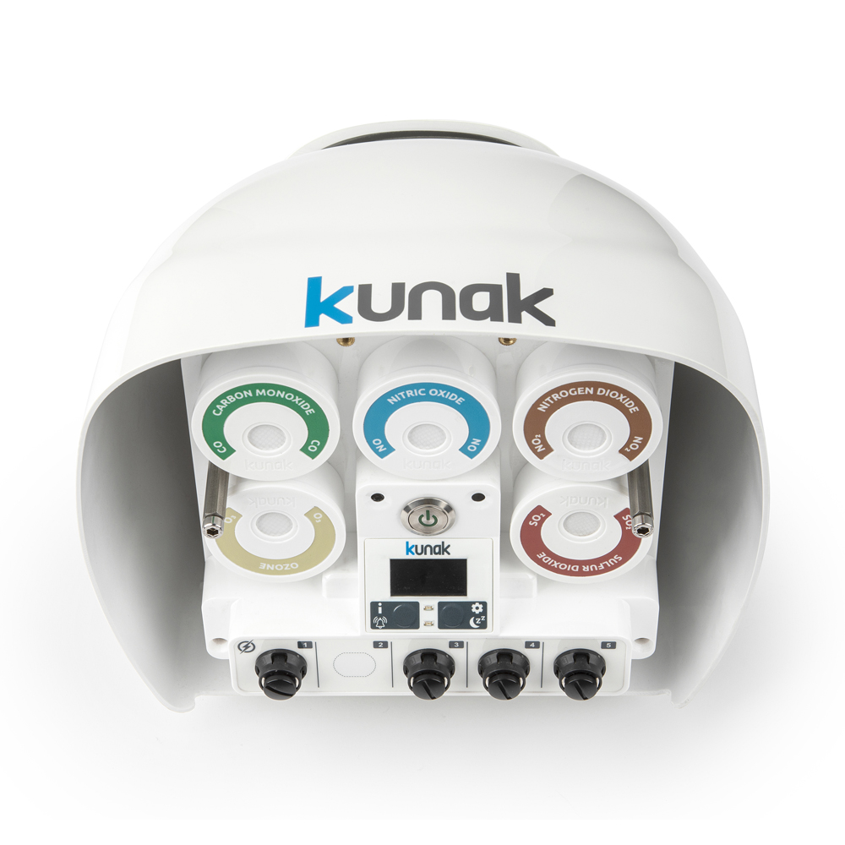
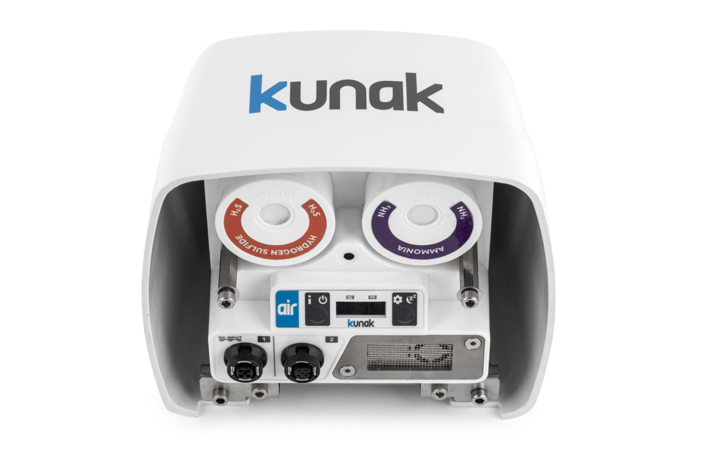
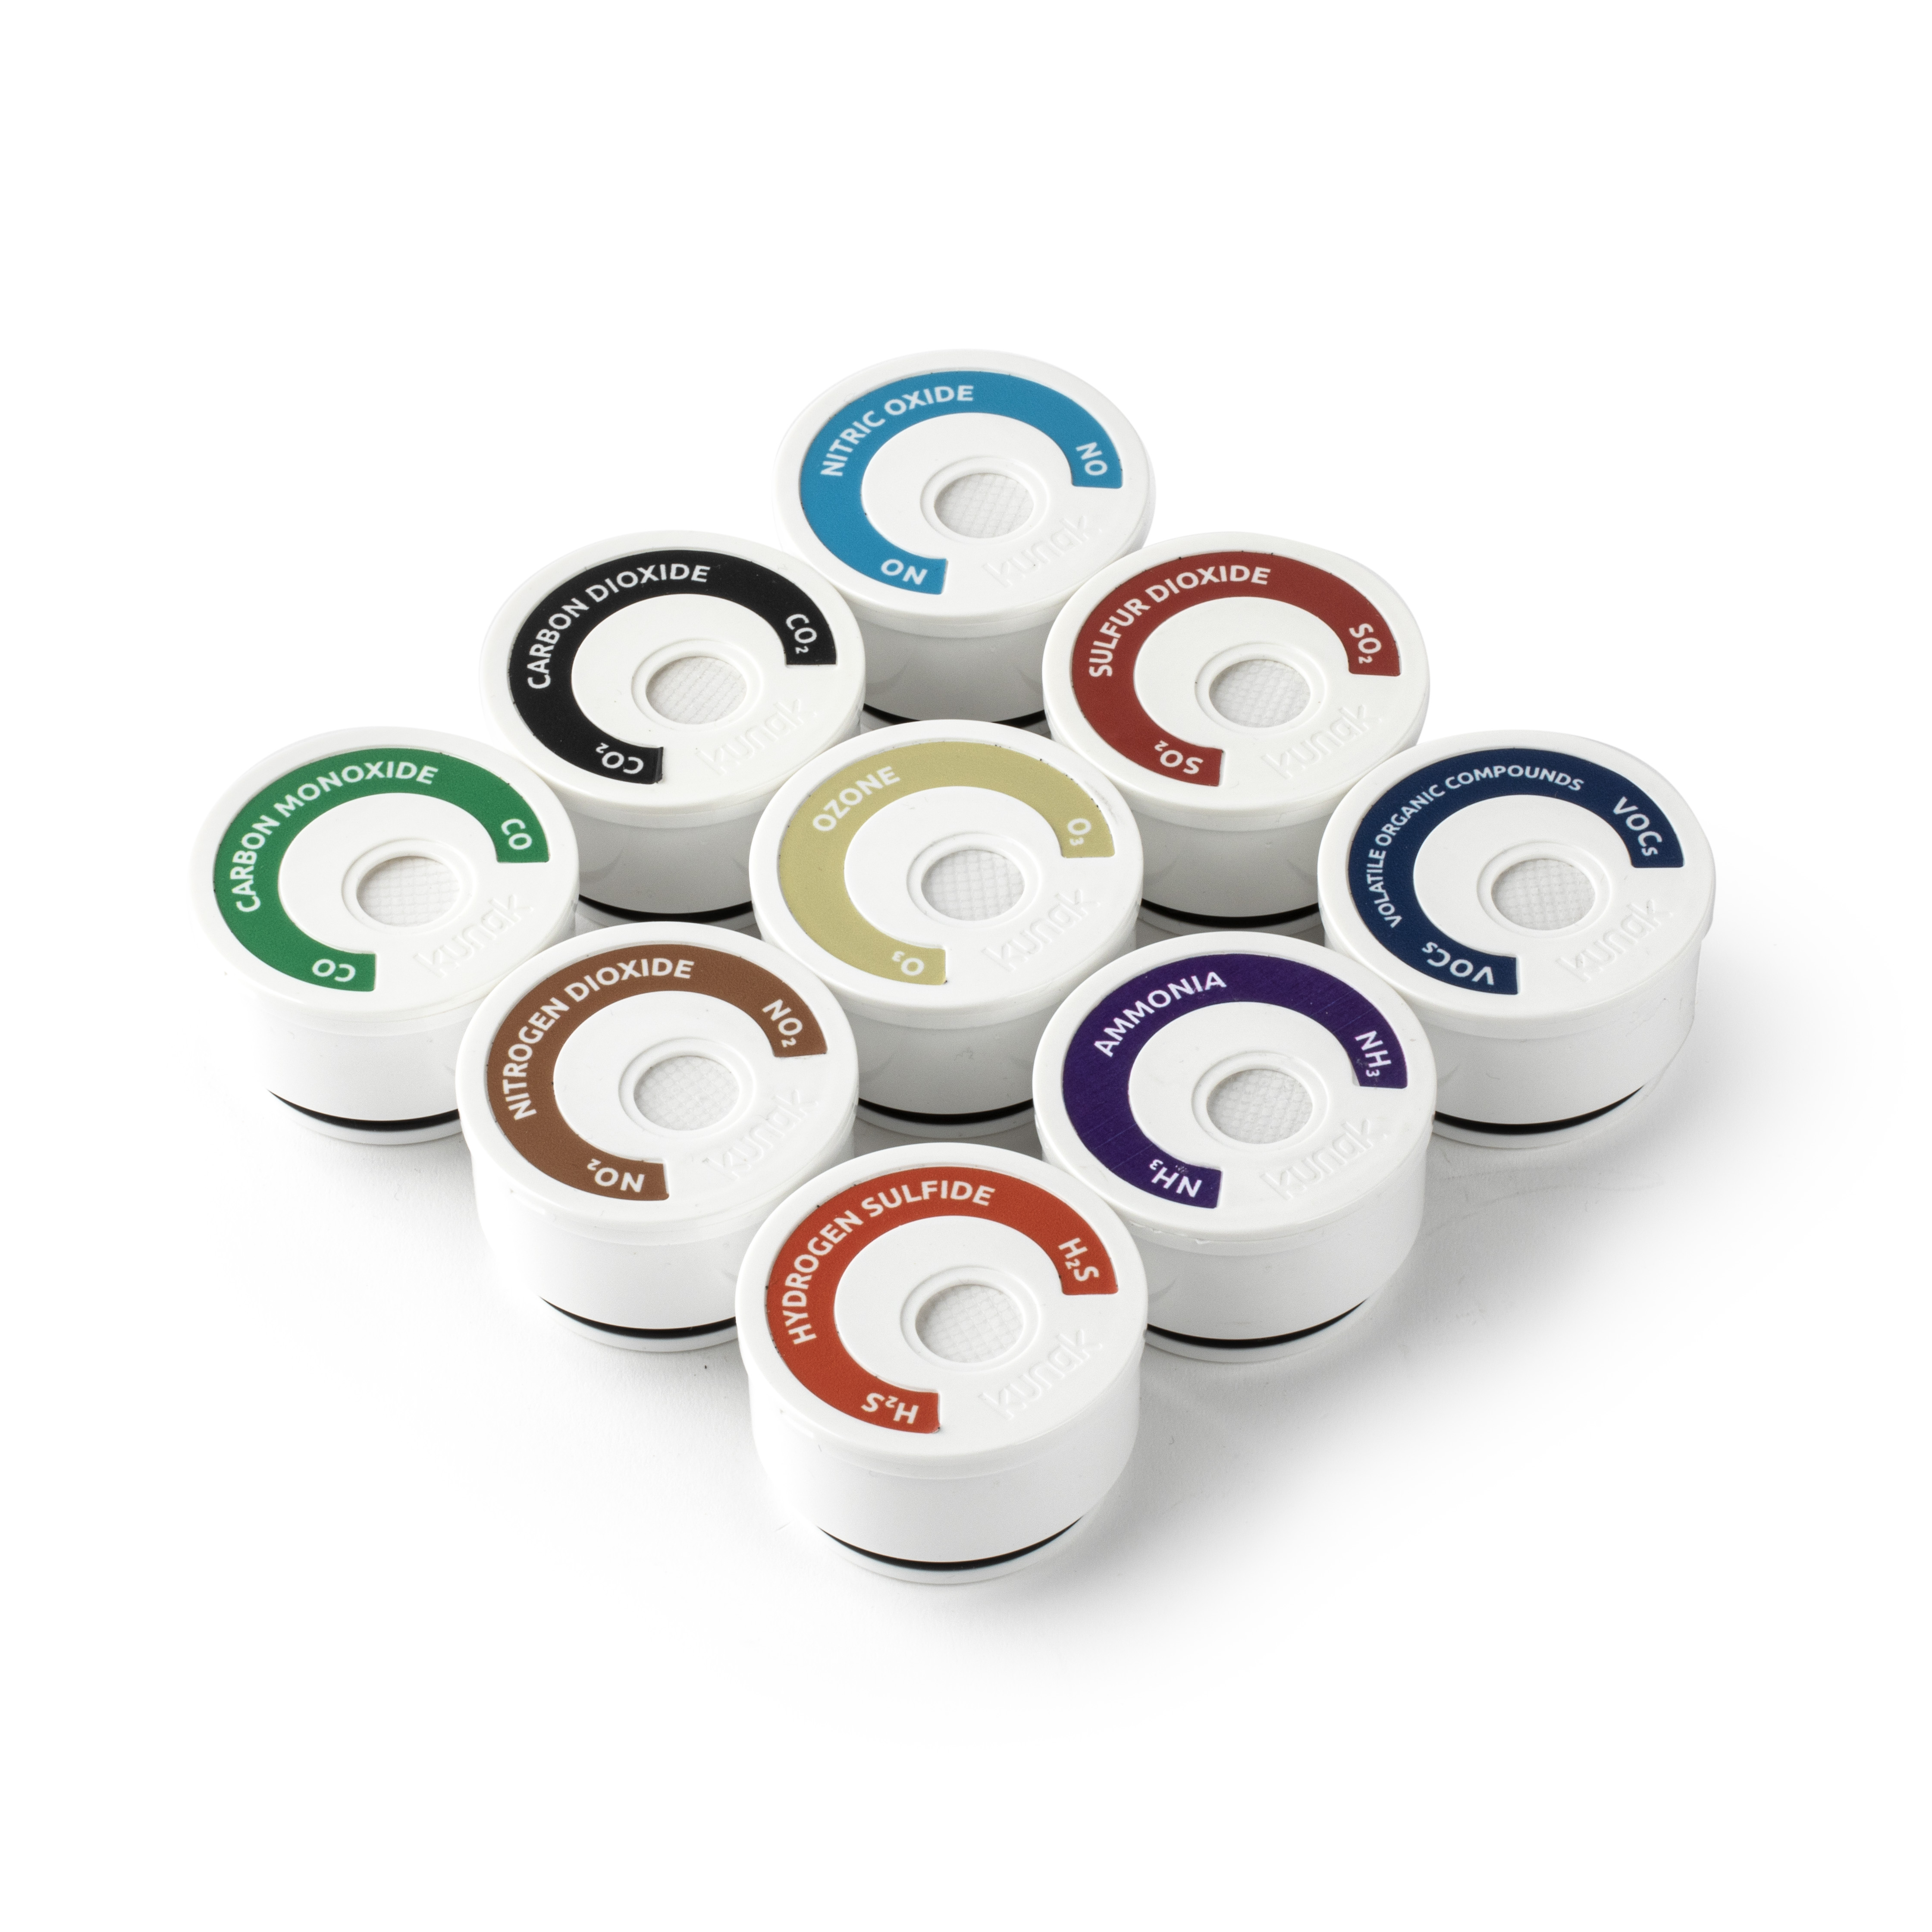
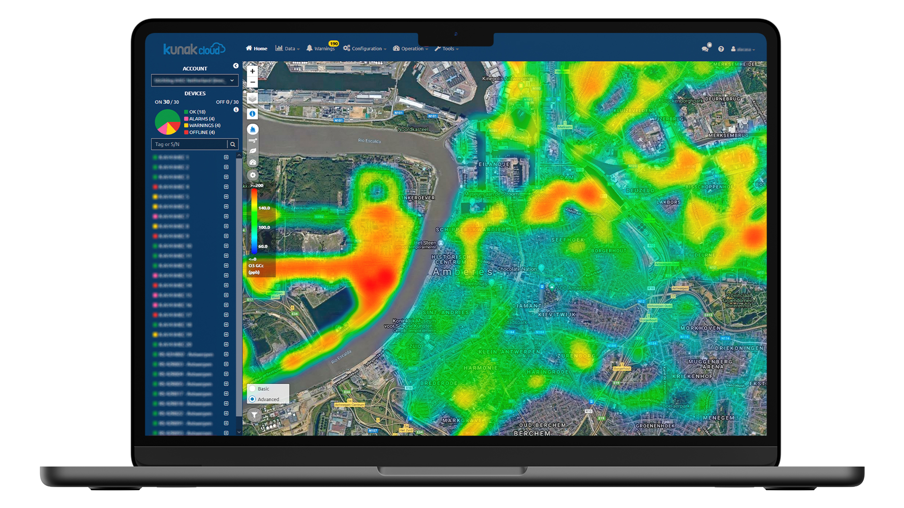
Kunak AIR sensor systems
Multipollutant monitoring
Plug&Play cartridge system
Algorithms to mitigate the influence of T and RH
Remote operation and maintenance
Data analysis and visualization tools
Kunak AIR Pro
Kunak AIR Lite
Smart Cartridges
Kunak Cloud Software

Slide 9

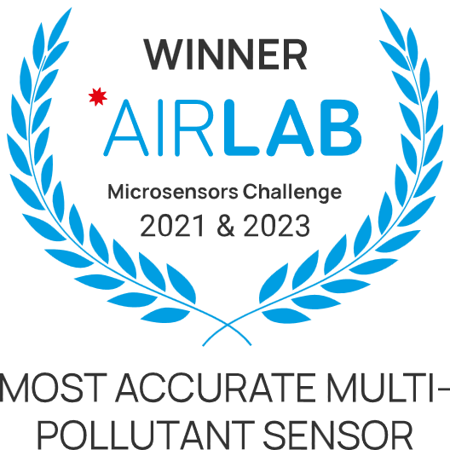
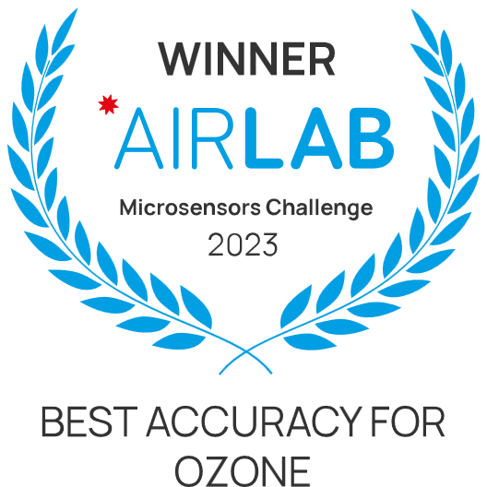
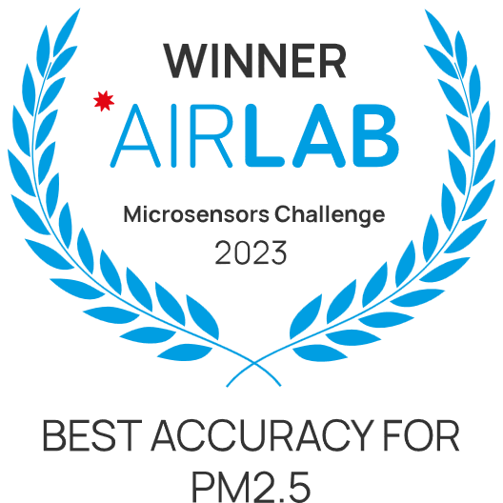
Independent Sensor Evaluations
AIRLAB Microsensors Challenge
https://airlab.solutions/en/actualites/resultats-du-challenge-airlab-microcapteurs-2023-203
2021 Challenge
Winner “Most Accurate Multipollutant Sensor” (Pro)
2023 Challenge
Winner “Most Accurate Multipollutant Sensor” (Pro & Lite)
Winner “Best accuracy O₃” (Pro & Lite)
Winner “Best accuracy PM2.5” (Lite)

Slide 10

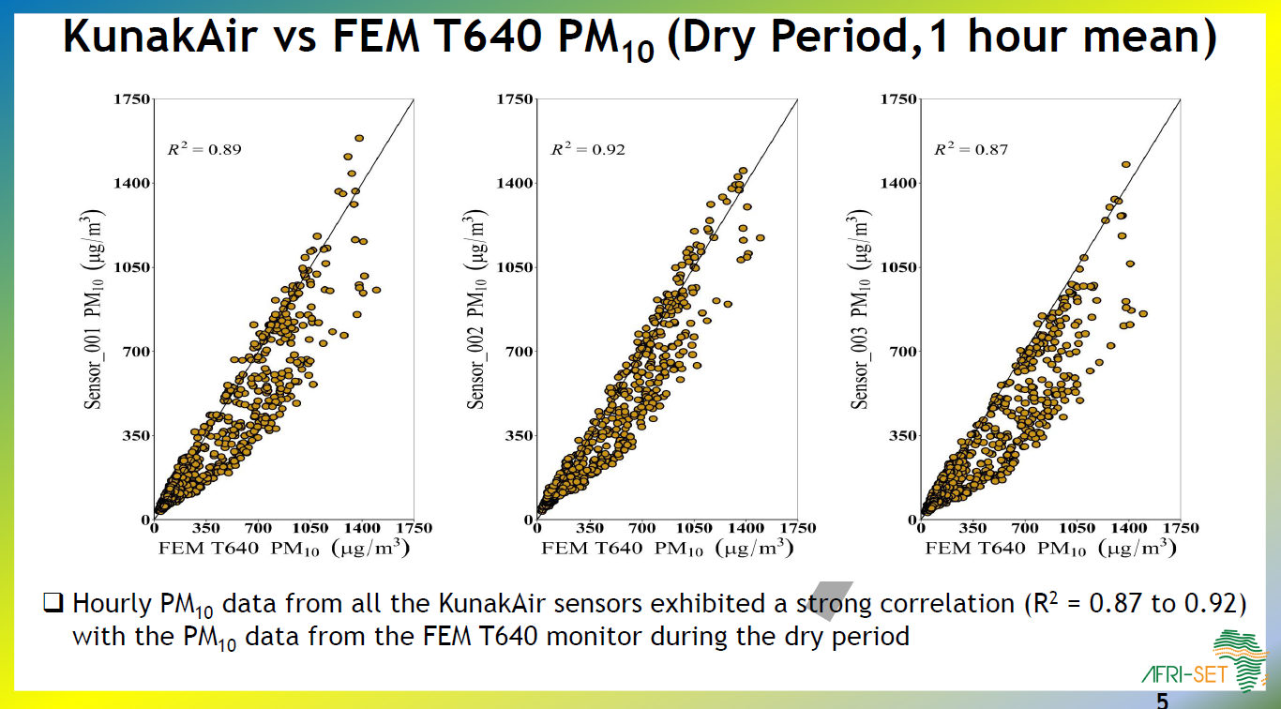
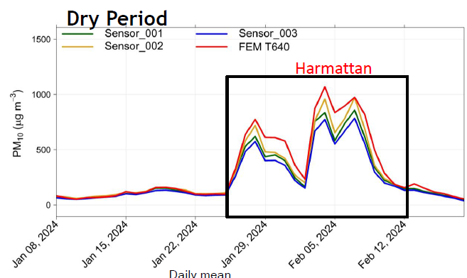
Independent Sensor Evaluations
AFRISET Evaluation
https://afriset.org/evaluations
Gas sensors – Under evaluation

Slide 11

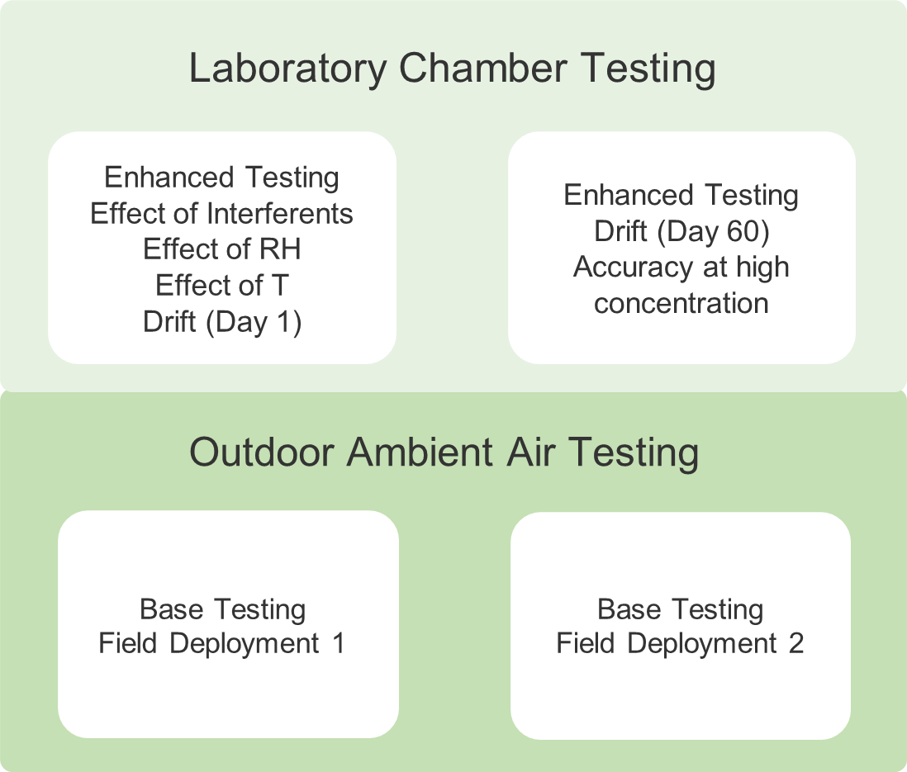
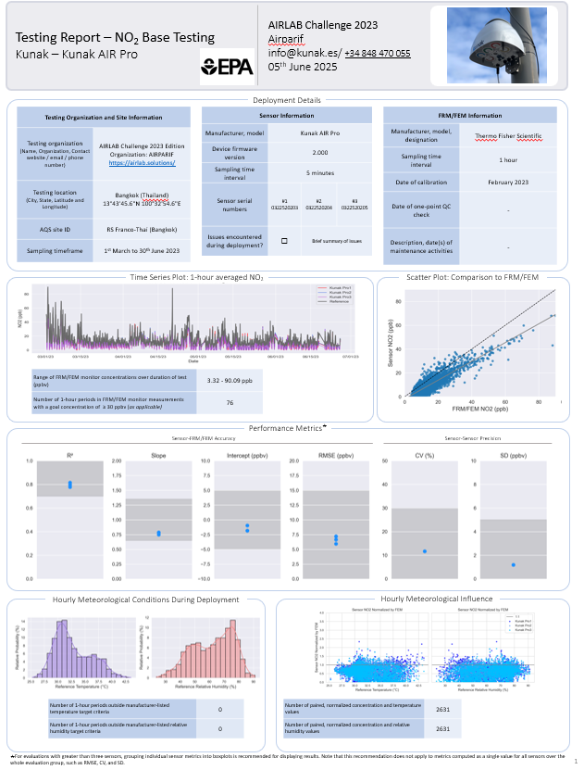
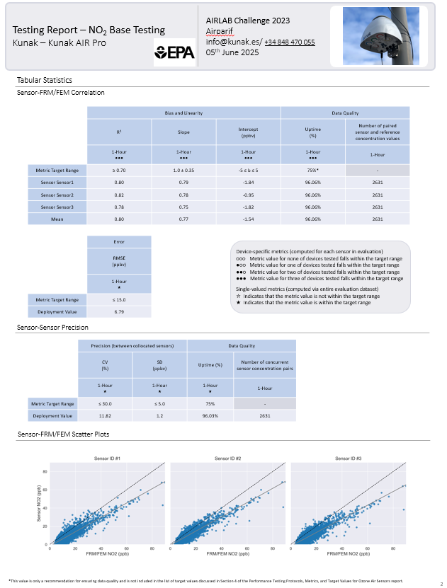
Independent Sensor Evaluations
USEPA Protocols
https://www.epa.gov/air-sensor-toolbox/air-sensor-performance-targets-and-testing-protocols

Slide 12


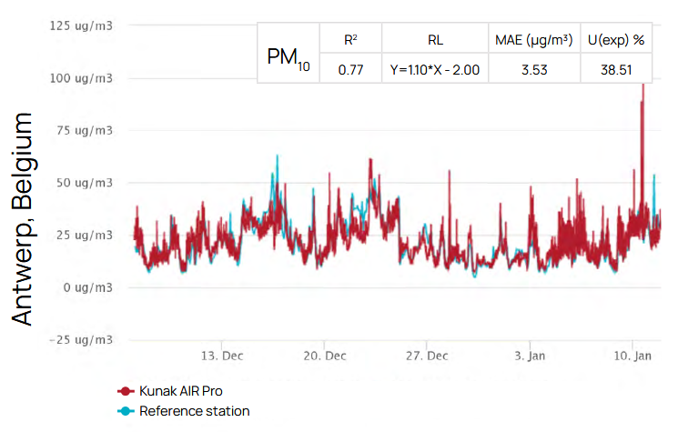
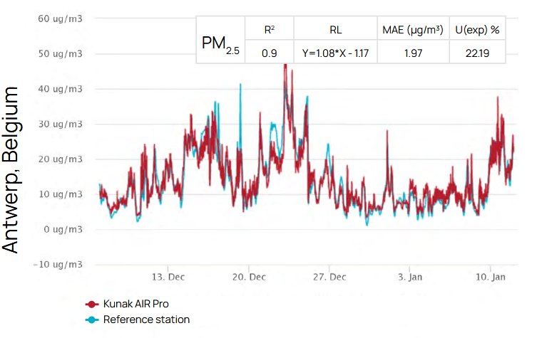
Independent Sensor Evaluations
MCERTS Certification – PM sensor Indicative Measuremtns
https://www.csagroup.org/en-gb/services/mcerts/mcerts-product-certification/mcerts-certified-products/mcerts-certified-products-indicative-ambient-particulate-monitors/?srsltid=AfmBOorh1iHqmIi_zPPBplT9OnsfeEvNRvTaGd3l6qyvLIT9DdHdTRkd
Kunak AIR Pro obtained MCERTS certification in 2023

Slide 13

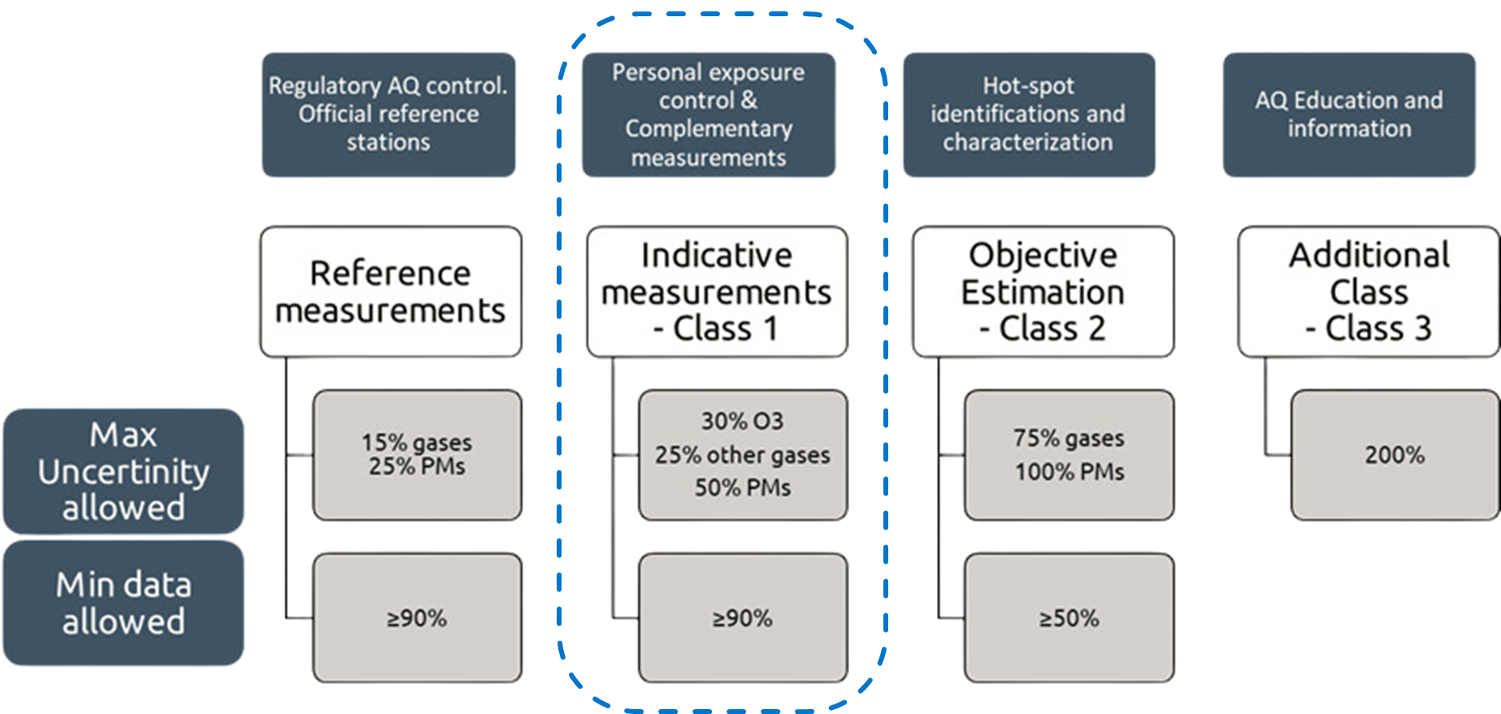
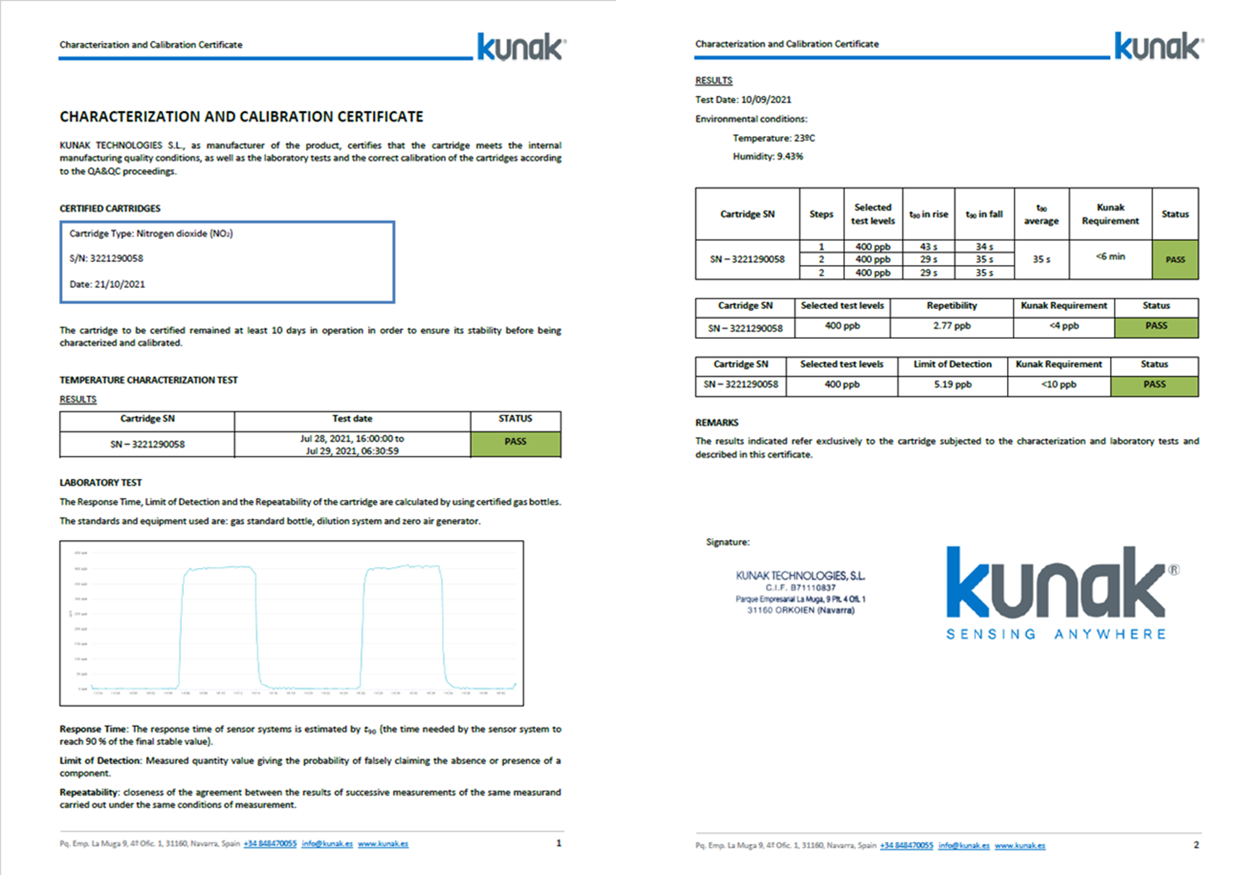
Independent Sensor Evaluations
CEN/TC264 – WG42
CEN/TS 17660-1:2021 “Air quality - Performance evaluation of air quality sensor systems - Part 1: Gaseous pollutants in ambient air”.
CEN/TS 17660-2:2024 “Air quality - Performance evaluation of air quality sensor systems - Part 2: Particulate matter in ambient air ».
Kunak Calibration Certificate

Slide 14


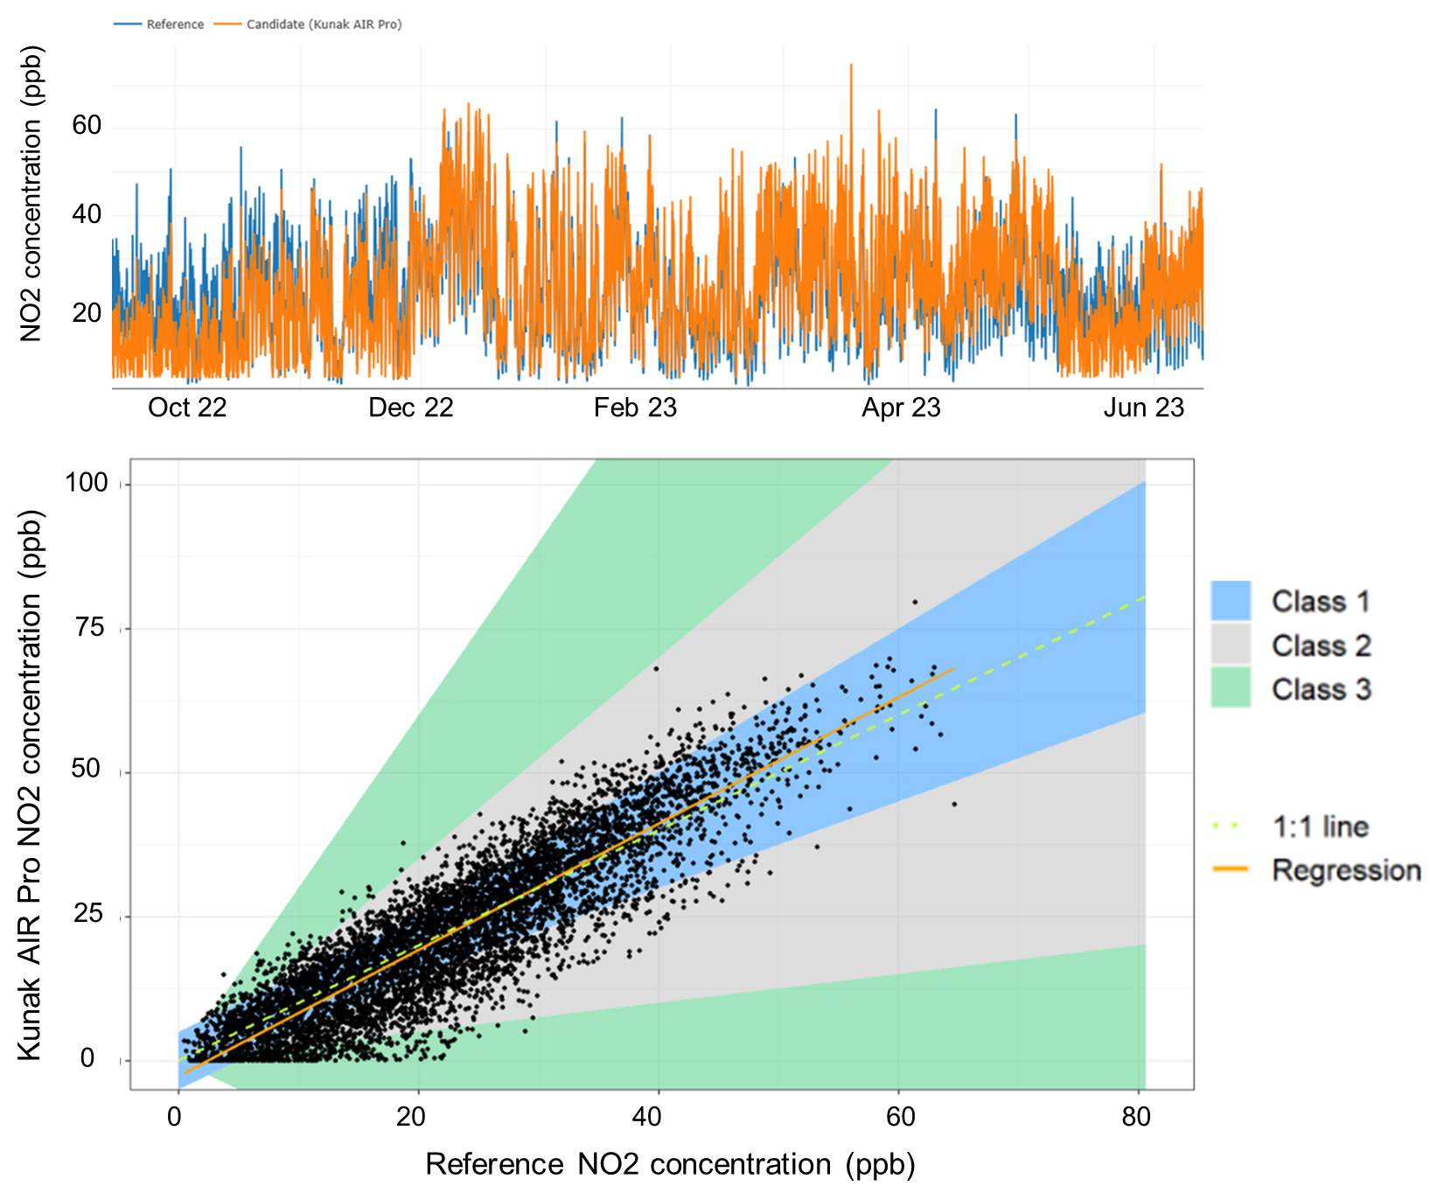

Independent Sensor Evaluations
RICARDO – Environmental Consultancy
CEN/﻿TS 17660-1:2021 Metrics
Kunak AIR Pro and Lite: NO₂, PM₁₀ and PM_{2.5} sensors would have been classified as Class 1

Slide 15
Key Takeaways
Low-cost sensors can reach near-reference performance
Deterministic, ISM-based calibration outperforms opaque ML models
Kunak’s ISM approach ensures true measurement, not prediction
Proven performance through independent evaluations
Reliable data → confident decision-making
Continuous improvement and innovation remain essential
Notes:
Low-cost sensors can reach near-reference performance: despite their inherent limitations (T/RH effects, drift, cross-sensitivities), a robust calibration strategy can significantly improve accuracy.
Deterministic, ISM-based calibration outperforms opaque ML models: transparent, physics-informed corrections produce reliable real-time measurements.
Kunak’s ISM approach ensures true measurement, not prediction: Converts raw data to concentration in real time without needing reference inputs.
Proven performance through independent evaluations
Repeated wins in AIRLAB challenges.
MCERTS-certified PM sensor.
Compliance with CEN/TS 17660 standards.
Independent verification confirms Class 1 capability for key pollutants.
Reliable data → confident decision-making: High-quality air quality data enables better regulatory support, scientific studies, and environmental management.
Continuous improvement and innovation remain essential: Advances in algorithms, materials, and evaluation frameworks will keep pushing low-cost sensing toward reference-grade performance.

Slide 16


Looking for more insights?
Feel free to reach out!
Edurne Ibarrola, PhD
Chief Scientific Officer
eibarrola@kunak.es

