Slide 1
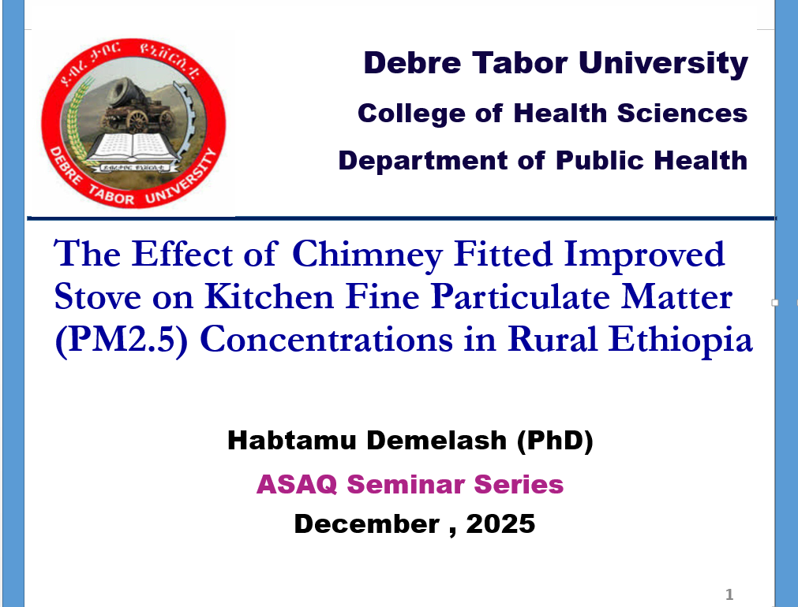

Slide 2
Presentation Outlines
Introduction
Objectives
Method and materials
Result and discussion
Conclusion
Recommendations

Slide 3
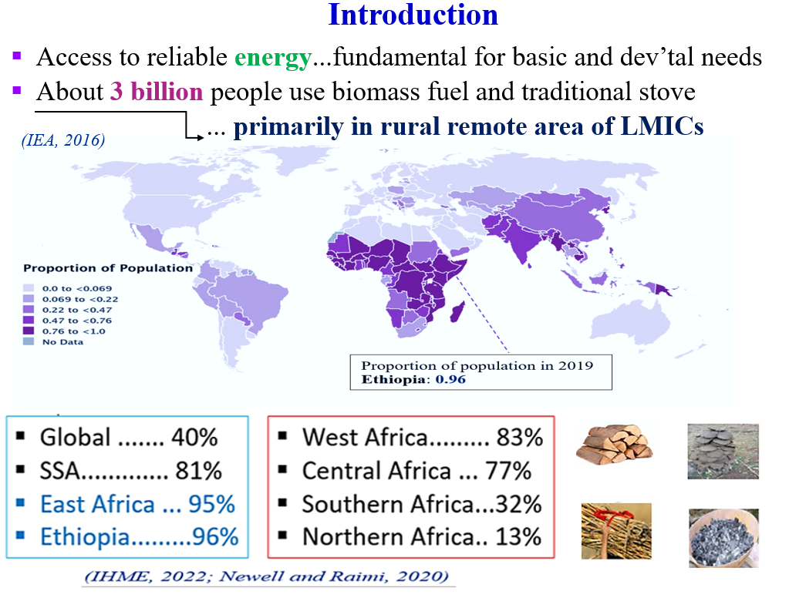

Slide 4
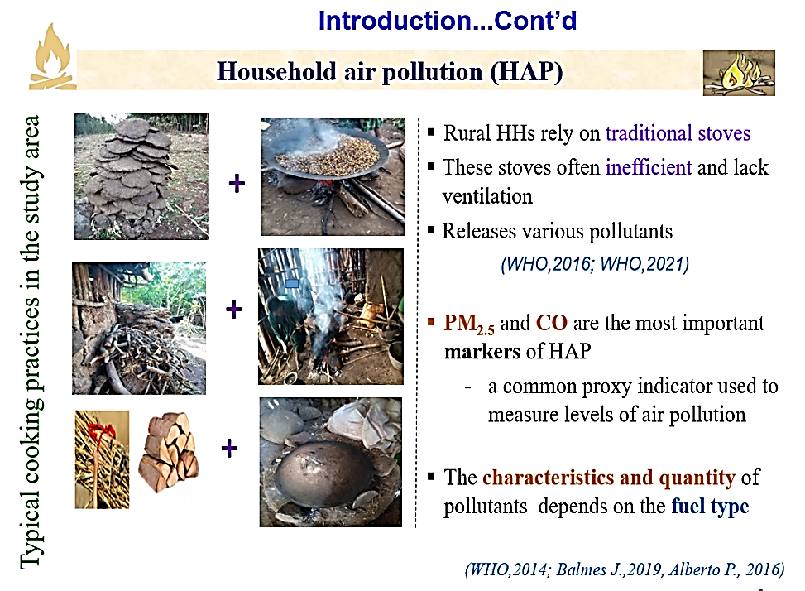
Notes:
Women and children are often most exposed to extremely high levels of health-damaging pollutants.

Slide 5
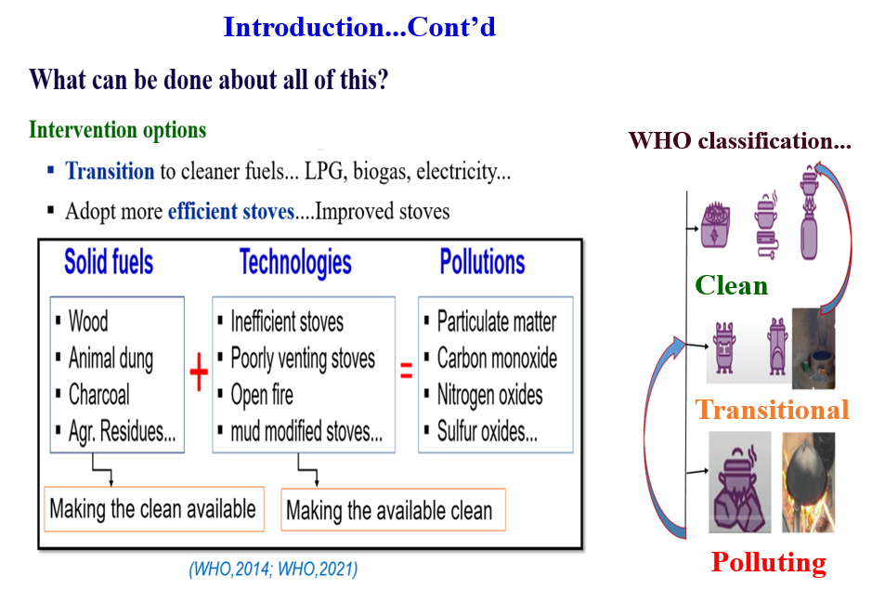
Notes:
improved stoves remain the most affordable option for rural and remote areas of developing countries in sub-Saharan Africa
In many countries, various locally manufactured and relatively cheap improved stoves dominate the market as an intervention strategy for household air pollution

Slide 6
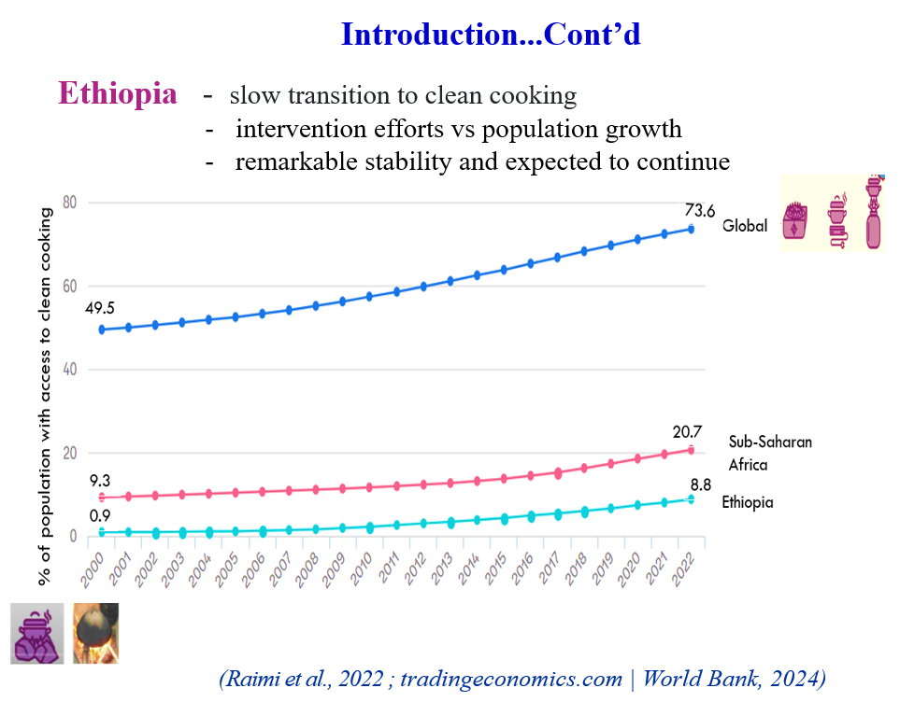
Notes:
While connecting all Ethiopians to the electricity grid remains the long-term vision, improving the performance of biomass stoves through collaborative research offers a viable short- and medium-term solution

Slide 7
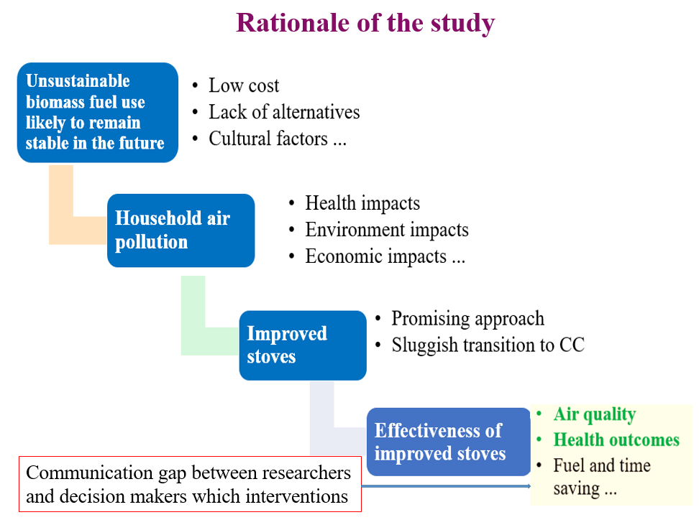
Distribute 31 million stoves earlier than 2030
Notes:
Perhaps the greatest research gap involves the lack of epidemiologic evidence to support the concept that biomass smoke exposure leads to increased risk of cardiovascular disease consistent with other combustion-sourced particle exposures, outdoor PM2.5, secondhand tobacco smoke, and active smoking
Injera will continue to be the staple food of Ethiopians
However, it remains unclear which interventions reduce exposure, improve health, and are scalable and sustainable.
There remains a communication gap between academic researchers and decision makers at all levels of government,

Slide 8
Objective
To measure the effectiveness of chimney fitted improved stove in reducing kitchen fine particulate mater (PM2.5) in Ethiopian rural household

Slide 9
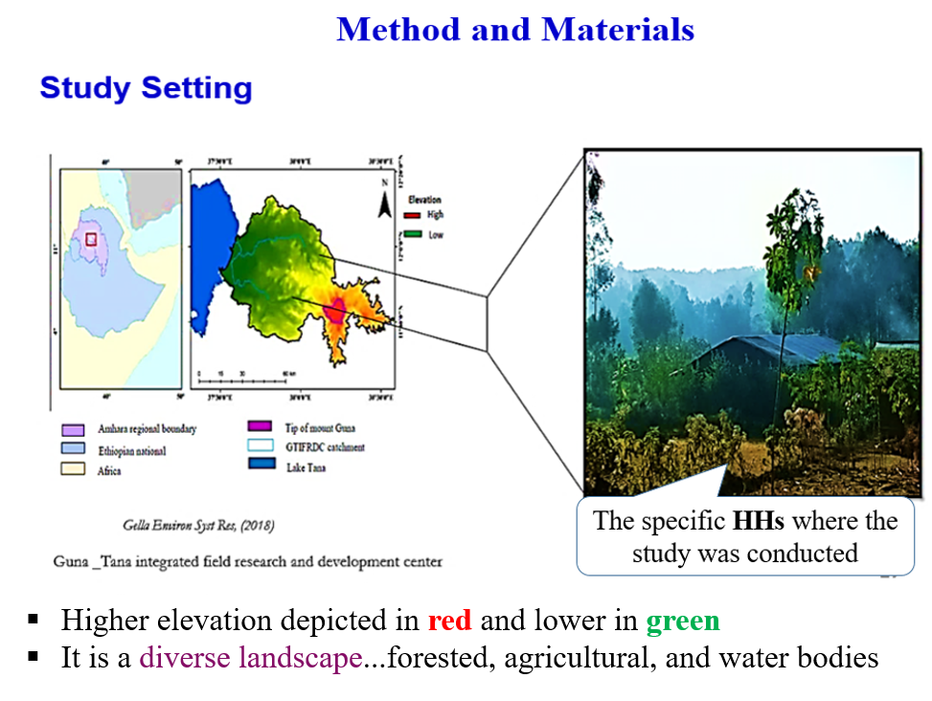
Guna-Tana field research center
Notes:
university without walls" because learning takes place outside the classroom
the study was undertaken between October, 2002, and December, 2004, in the San Marcos region of highland Guatemala.

Slide 10
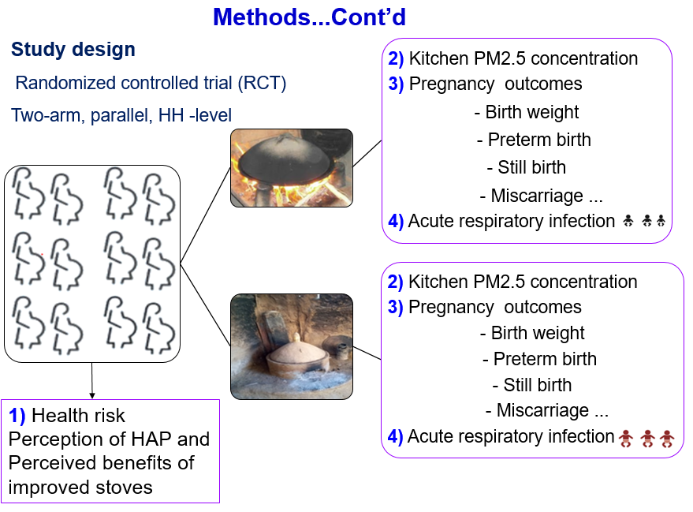

Slide 11
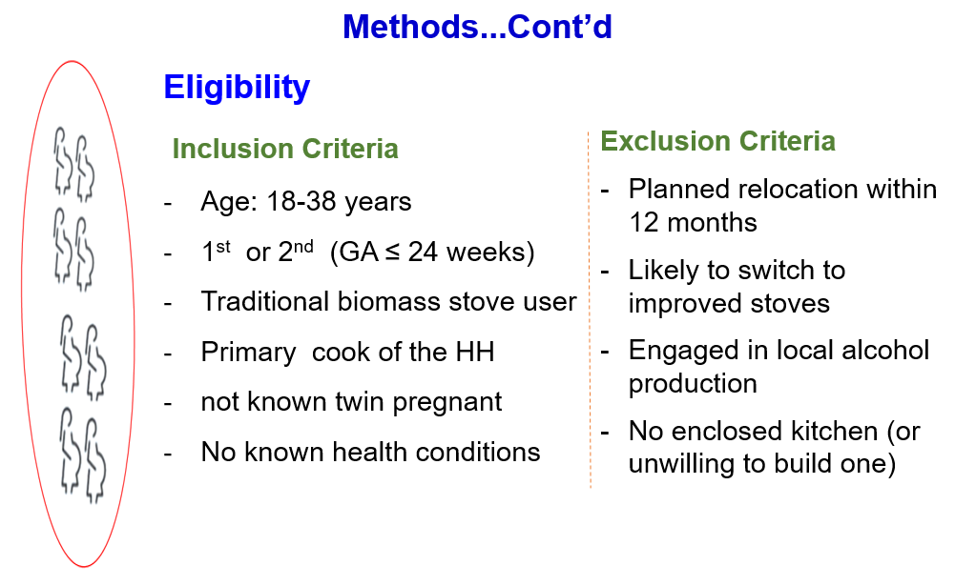

Slide 12
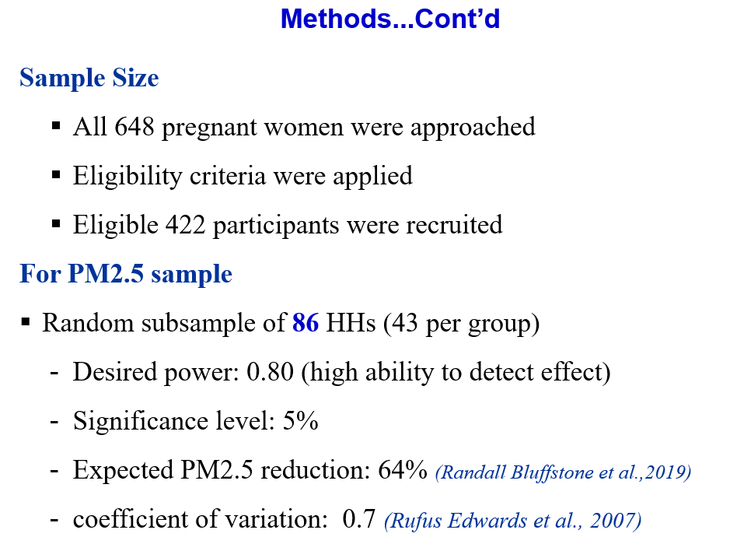
Notes:
Anticipating greater effect for chimney fitted Mirt stove

Slide 13
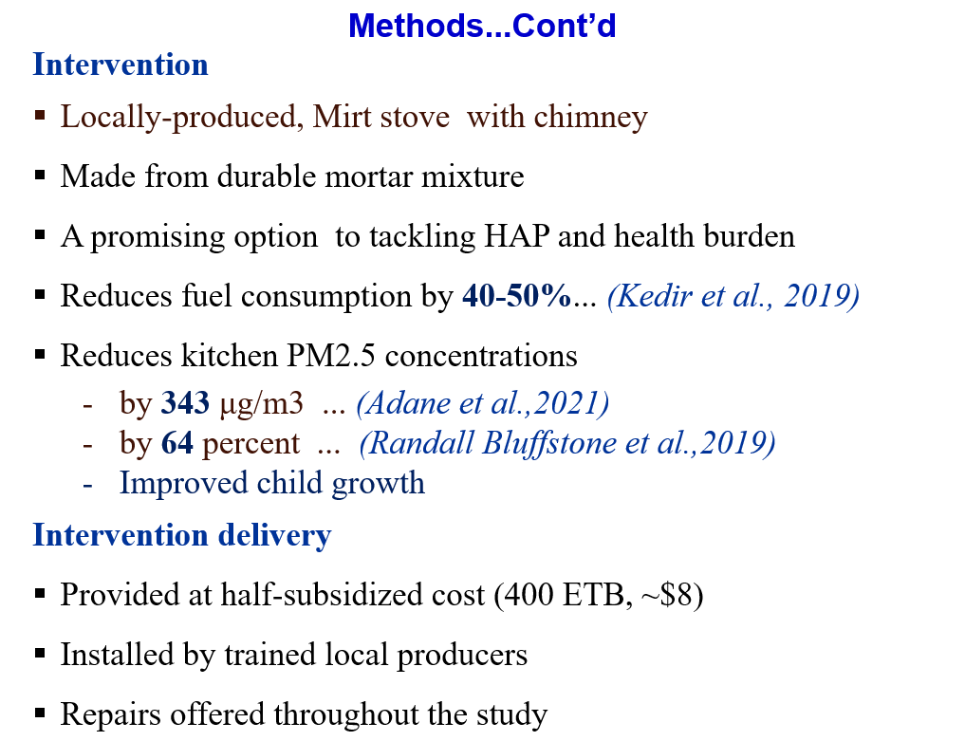
Notes:
Baking with improved stove during pregnancy and 6 month of infants life
Use of the Patsari multi-pot wood-burning cookstove in actual field conditions, has been shown to achieve
average reductions of 70% in indoor air pollution concentrations
standard conventional power calculations in the HAP intervention studies

Slide 14
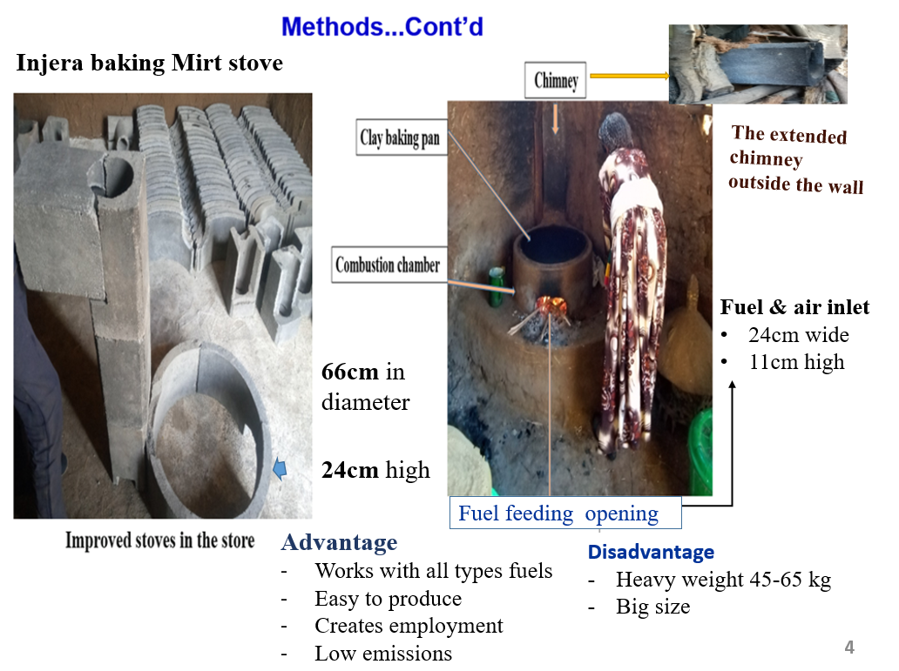
Notes:
Improvements to biomass stoves have focused on combustion efficiency and the venting of emissions outdoors
Replacing the traditional open fire with more efficient cooking technologies has long been an option to reduce indoor air pollution Because there’s only one baking pan in the household and it fits the new improved stove, it’s less likely that people will use traditional stoves alongside the new one.

Slide 15
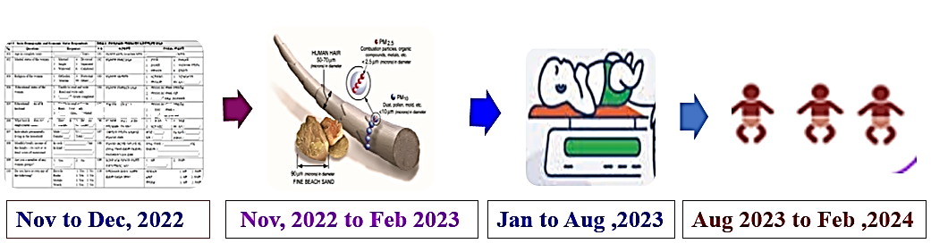
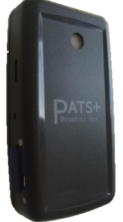
Methods...Cont’d
Data collection
Baseline data and stove installation
Kitchen PM2.5
Birth weight
ARIs
Followed for 6 months
Questionnaire
FGD guiding Qs
FAO guideline_DDS
Obs . checklists
Questionnaire
PATS+ and Dylos
PICA software
Obs . checklists
Questionnaire
Dr. care baby weighting scale
Questionnaire-IMCI
Notes:
The trial had 4 primary outcomes; the primary outcome described in the present report was
At each visit, the presence and duration of key symptoms
(cough, phlegm, nasal secretion and congestion, sore
throat, wheezing, difficult breathing, earache, fever, diarrhea, and vomit) were reported by the mother for a 15 days
recall period
Dr. Care Digital Baby Weighing Scale, Infant, & Toddler Tray weight Scale Measure up to 30kg with LCD Display Baby Weight Machine
Comprehensive Baseline: covered a wide range of important baseline variables, which is crucial for understanding potential confounders and ensuring proper randomization.

Slide 16
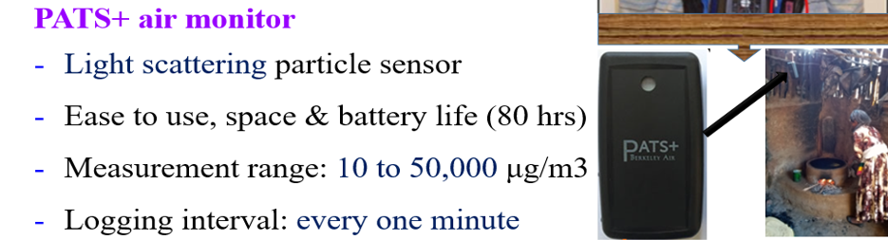

Slide 17
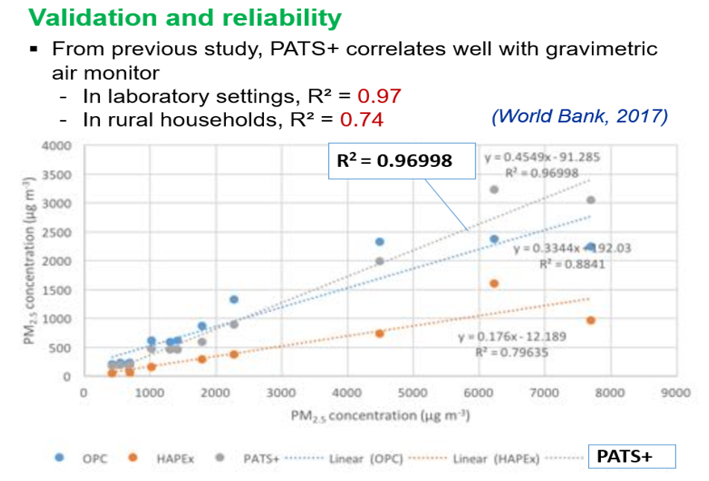
Notes:
Previous field validation tests have reported that PATS+ relates well to gravimetric

Slide 18
In Ethiopia, PATS+ were calibrated against gravimetric filters in 50 homes over 24-hour periods
Resulted an adjustment factor of 0.8065 (Bluffstone et al., 2019)
Furthermore, PATS+ and Dylos devices were directly compared in 11 kitchens
Resulted comparable readings, with a Pearson correlation coefficient of 0.78 (ranging from 0.75 to 0.86)
Therefore, PATS+ provided acceptably accurate and reliable data in the rural Ethiopian context

Slide 19
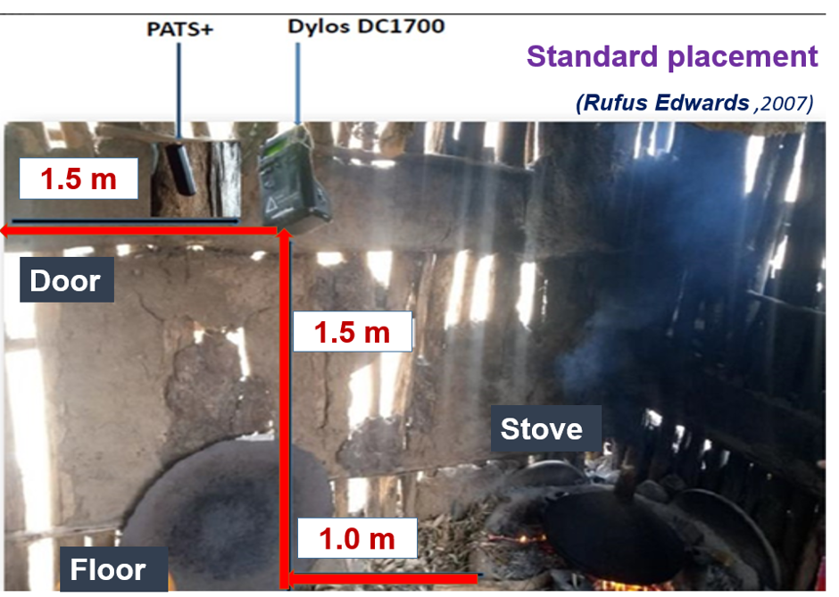
Breathing height of standing women

Slide 20
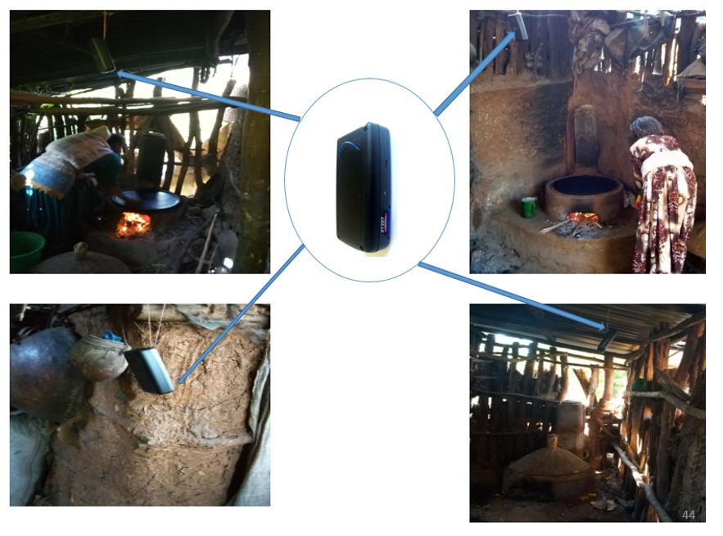
PATS+ placing in different kitchens
Four PATS+ devices were distributed daily across four different kitchens

Slide 21
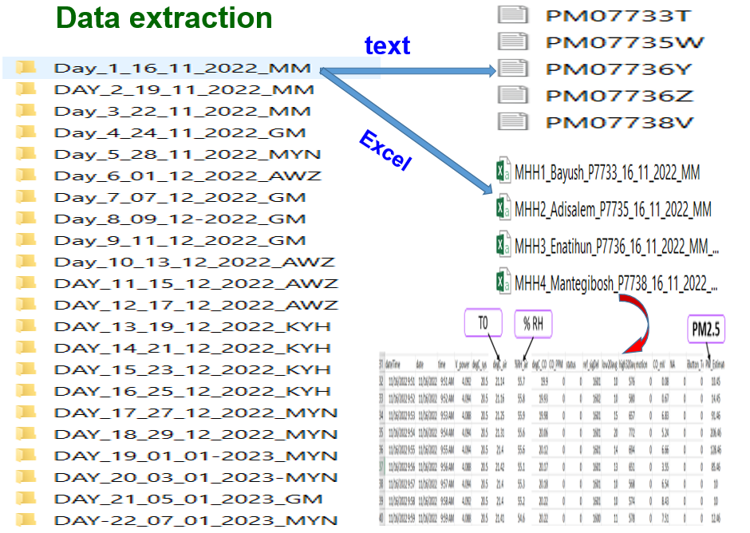

Slide 22
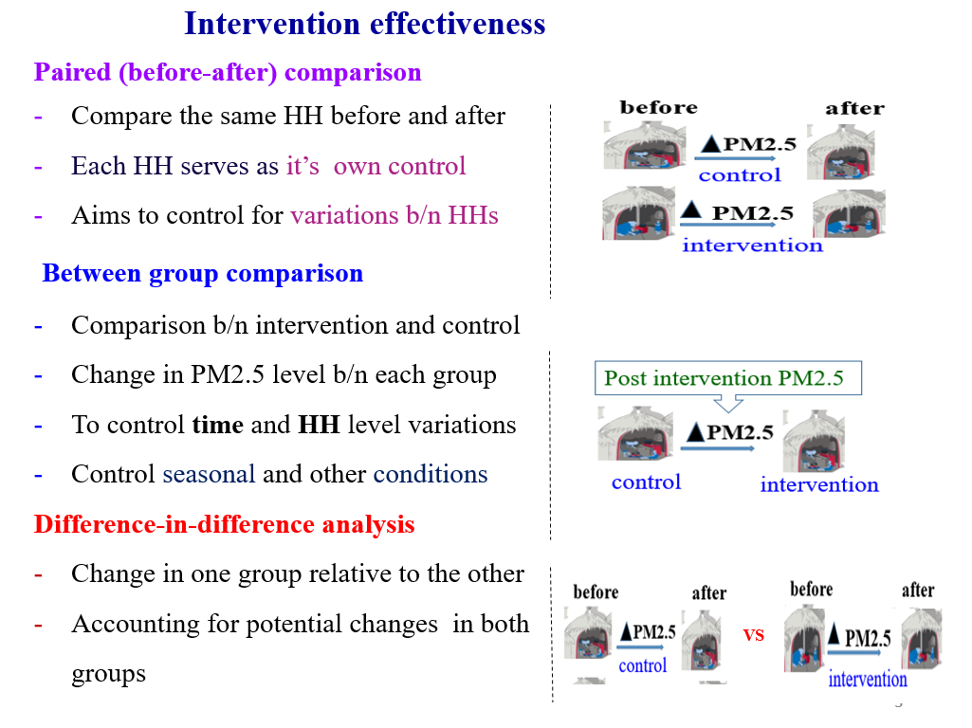

Slide 23
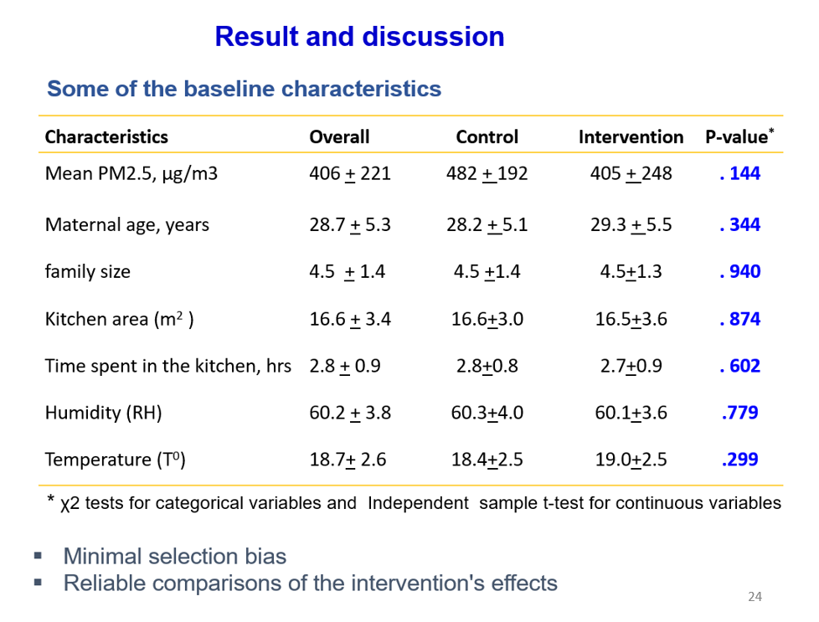

Slide 24
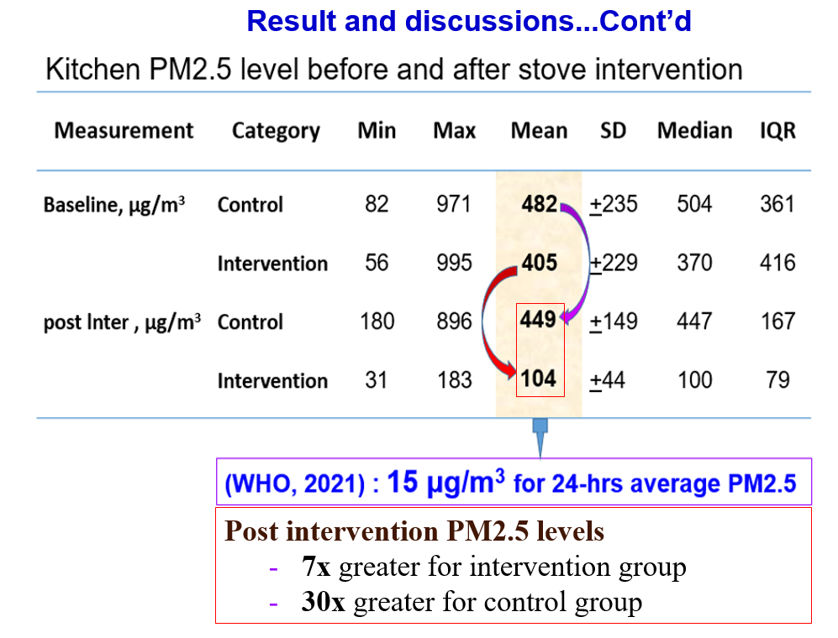
Notes:
Higher than the recommended value for health-based guidelines

Slide 25
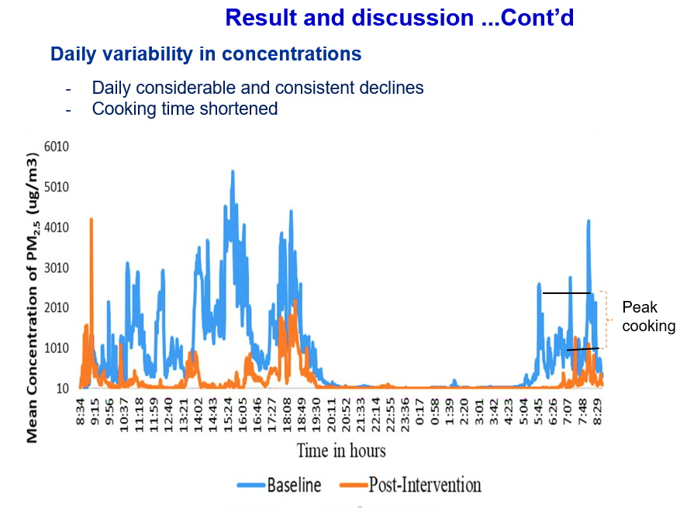
Notes:
there also seemed to be a reduction in the total count and duration of elevated kitchen area concentration events during the monitoring conducted after the improved stove intervention.

Slide 26
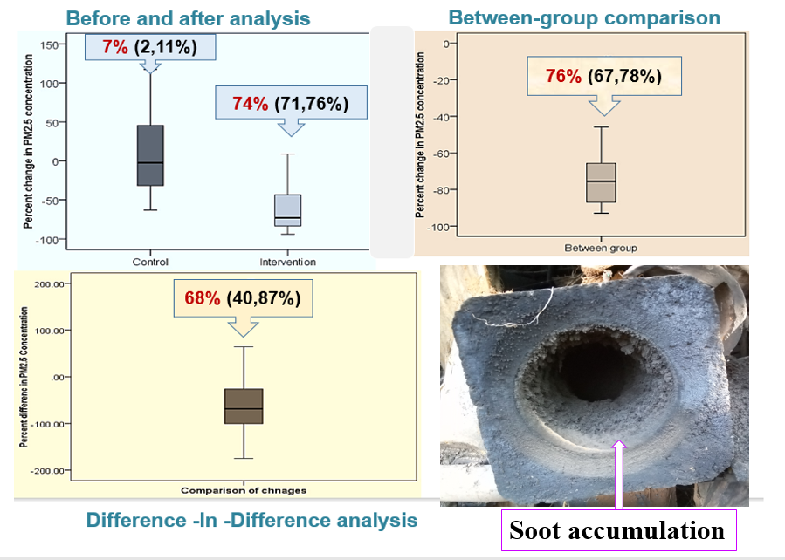
Result and discussions...Cont’d
Intervention effectiveness...relative difference
Notes:
current improved biomass cook stoves can bring large reductions in emissions in both absolute and percentage terms,

Slide 27
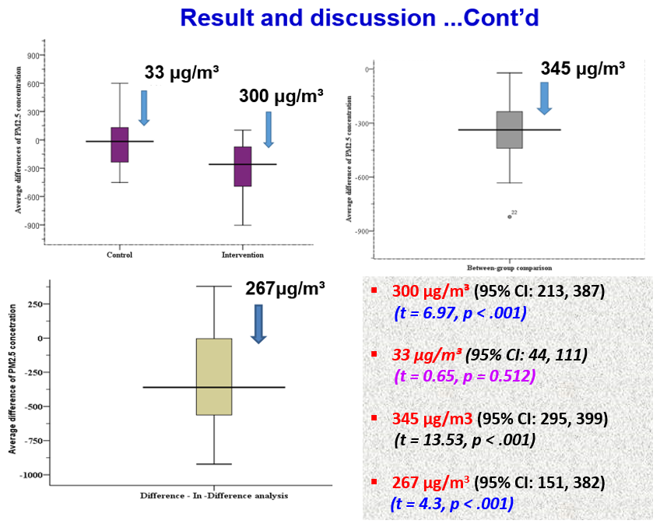
Intervention effectiveness...absolute difference

Slide 28
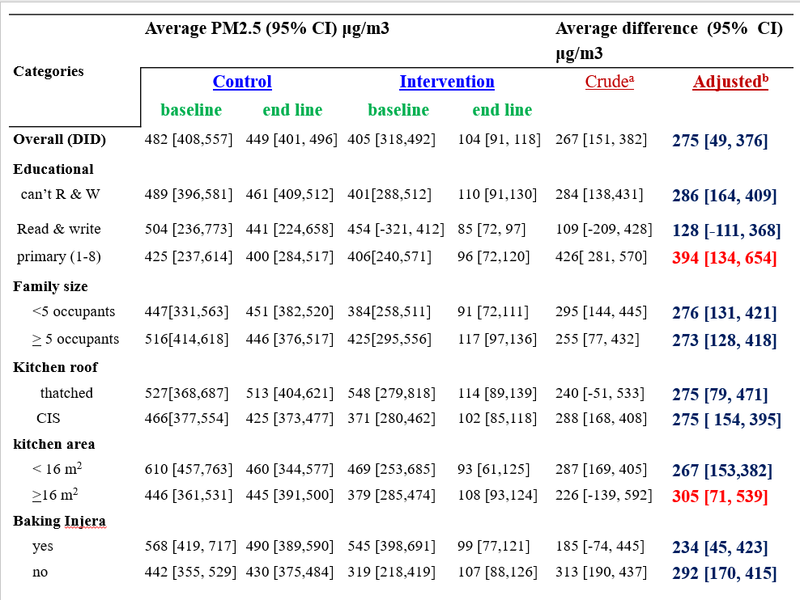
Result and discussions...Cont’d
Variations in effectiveness

Slide 29
Conclusions
The kitchen area PM2.5concentration was dangerously high
The chimney fitted improved stove significantly reduced PM2.5 level
The post-intervention PM2.5 levels remain high

Slide 30
Recommendations
Comprehensive intervention focusing on awareness, stove and kitchen
Accelerate clean cooking transition
Support small scale enterprises to design and develop more efficient stove
Promote universal improve stove use in the community

Slide 31
Thank you!

