Slide 1




https://www.i2u2.org/elab/cms/ispy-webgl/ ou tinyurl.com/4vy5rcjr
Links para acesso aos exercícios
https://bit.ly/4hAmEeH

Slide 2
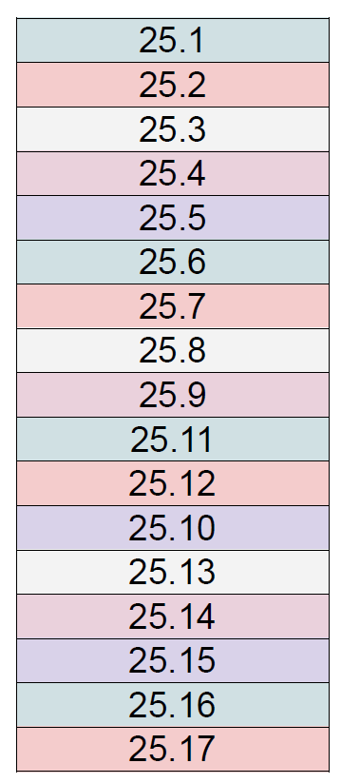
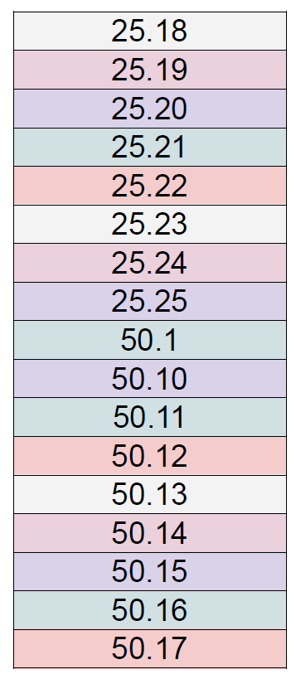
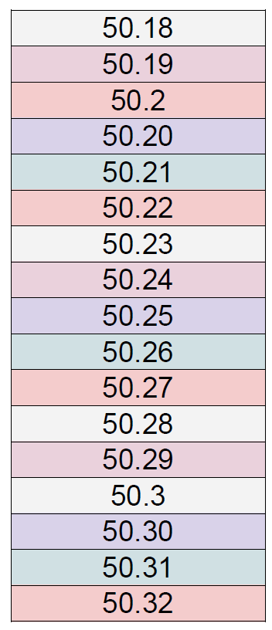

Slide 3
