Slide 1
Non-Collision Background Modelling
19 November 2025
Lindsey Gray
Scientist - CSAID

Slide 2
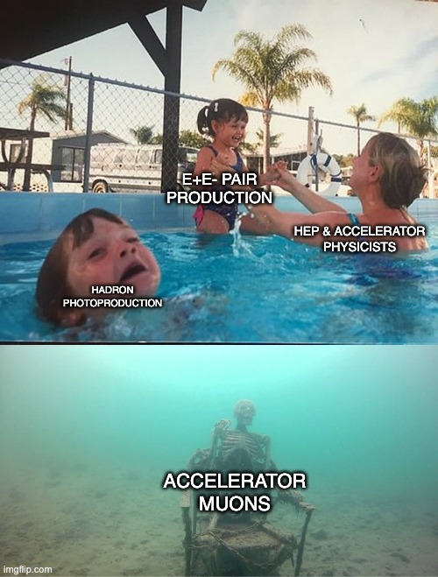
Beam Backgrounds at e+ e-

Slide 3
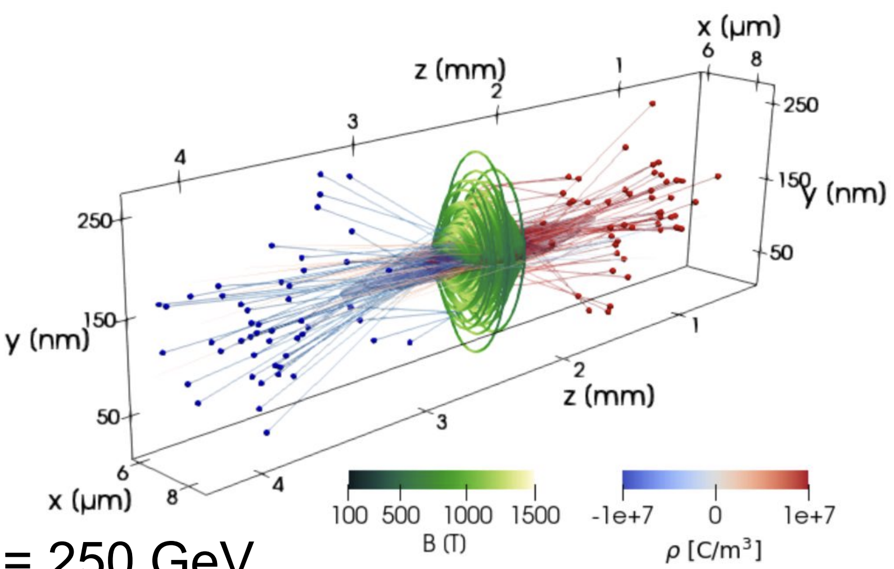
Pair Production
A. Formenti

Slide 4
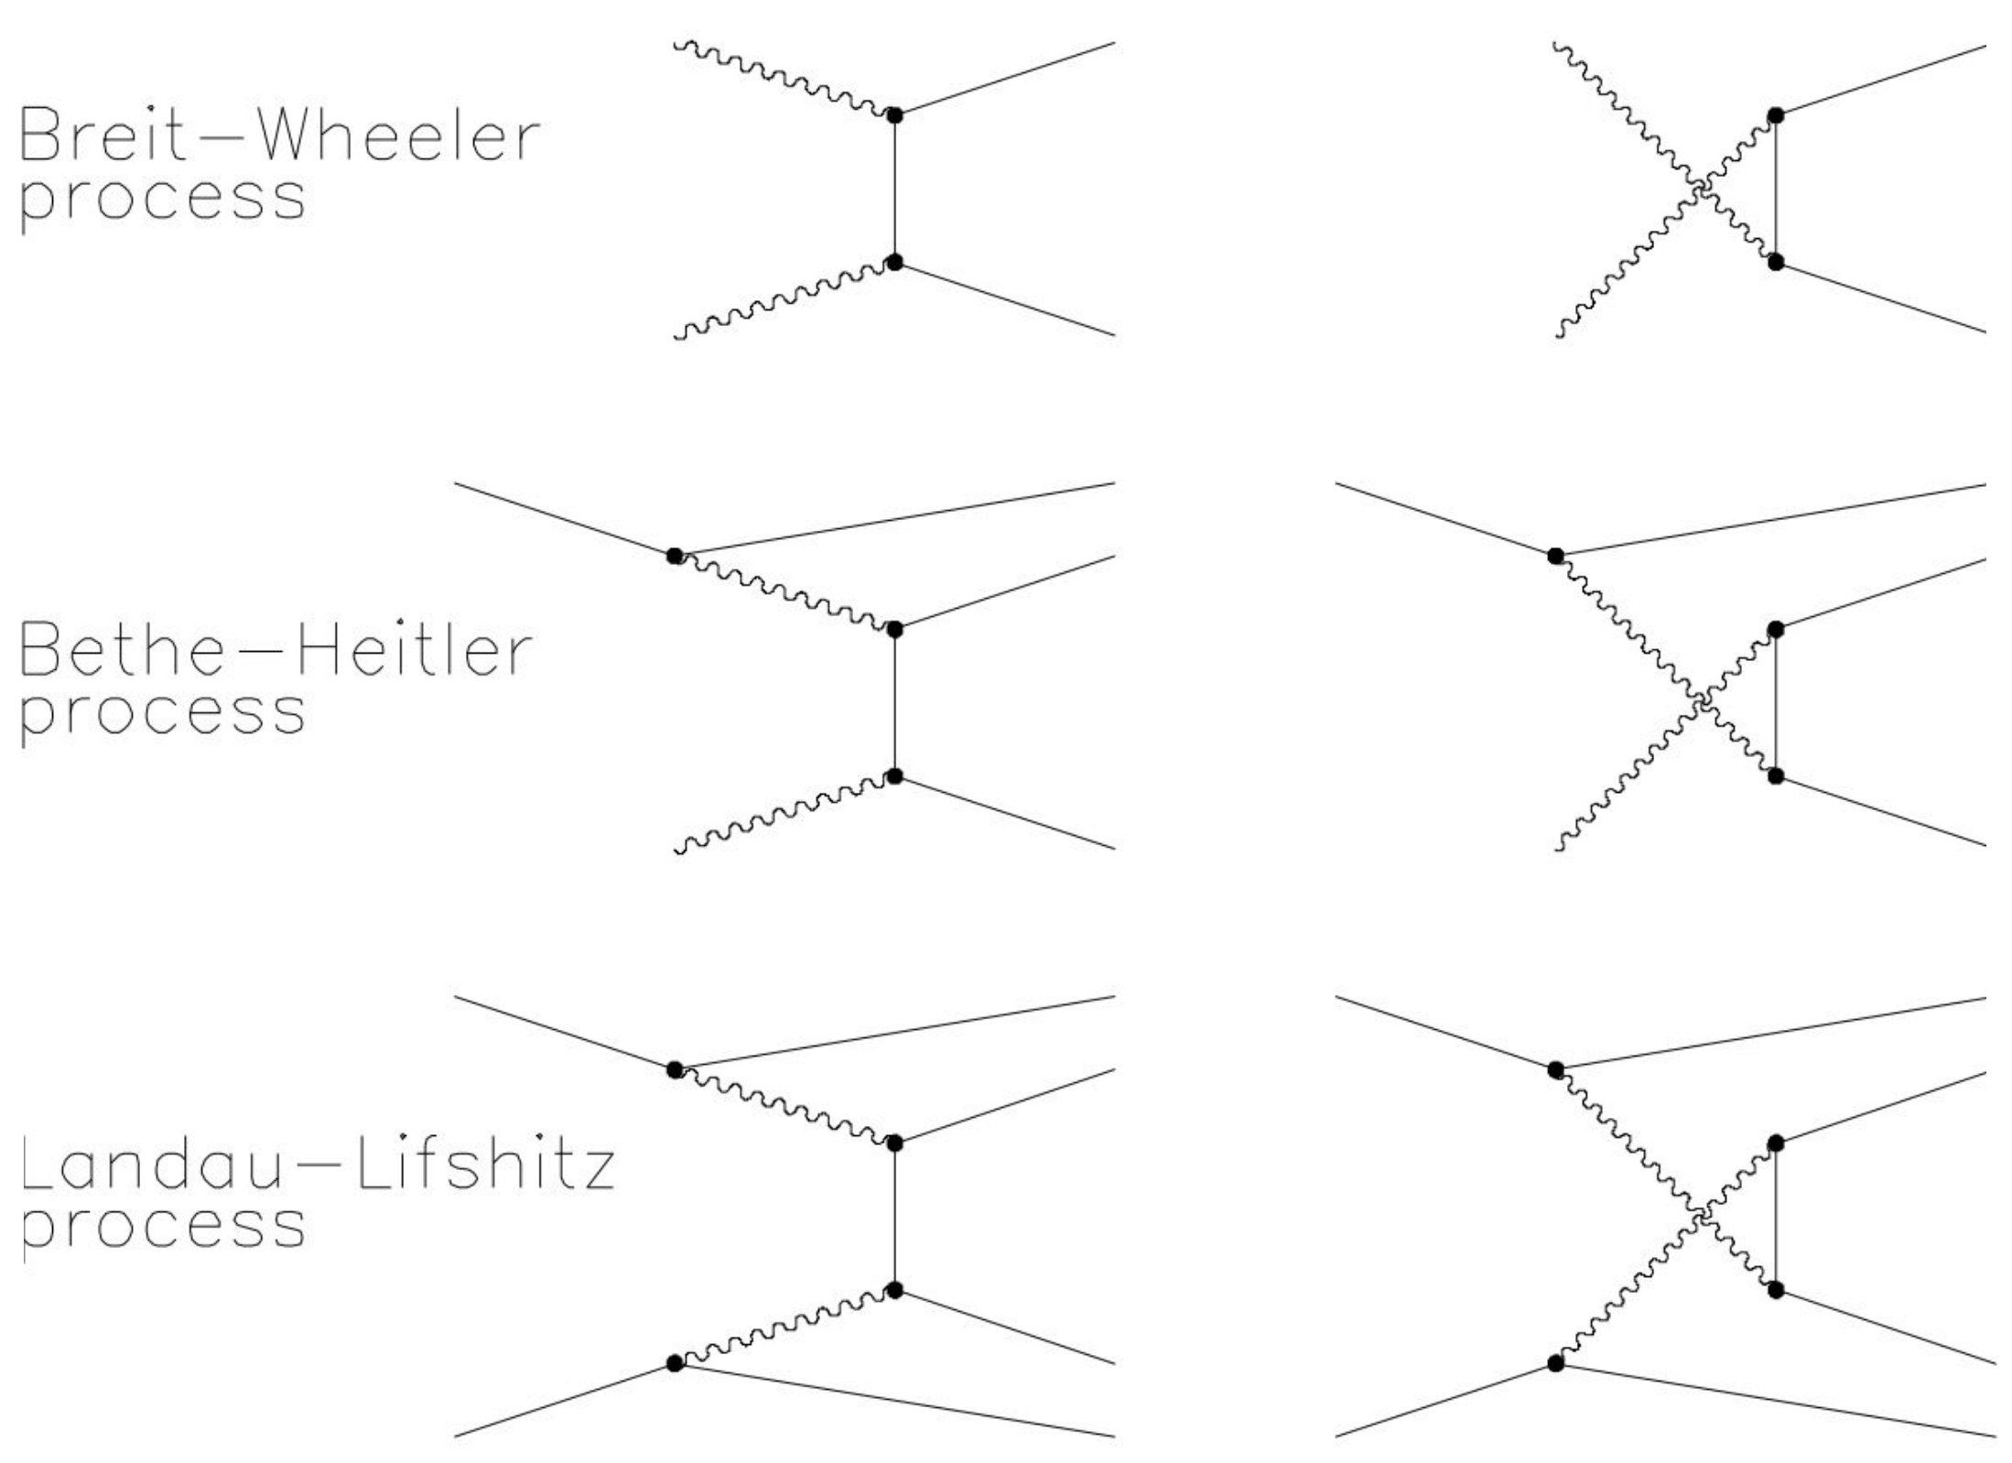
Coherent Pair Production
Two major contributing processes
One resolved electron or photon is interacting with the bunch field of the other bunch

Slide 5
Incoherent Pair Production
Three contributing processes, more important with high bremsstrahlung parameters
Both legs are resolved particles within the bunch

Slide 6
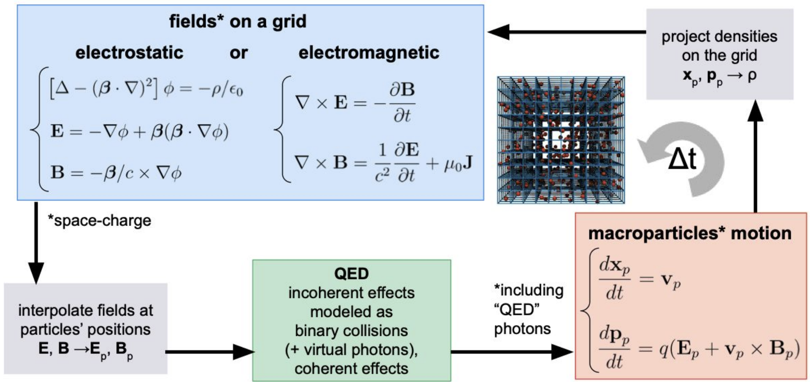
Particle-in-Cell Simulation of Bunches
A. Formenti
In order to simulate many millions of particles, consider their collective motion
Technique from plasma physics, can include creation and destruction of particles
Created particles (beam backgrounds!) can be propagated through pinching bunch field

Slide 7
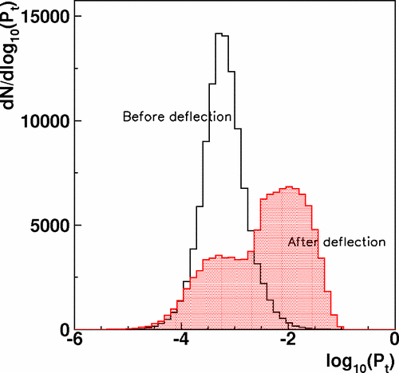
The importance of simulating transport
Transport is incredibly important to estimating background kinematics
Generated particles can be kicked by pinching fields in bunches, etc.

Slide 8
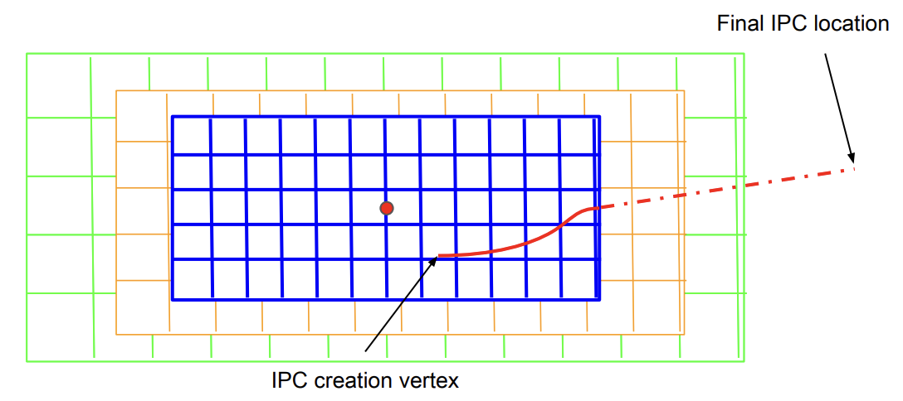
Guinea-Pig Specifics
J. Eysermans
Guinea-pig includes this particle propagation and will continue propagation until bunch crossing simulation is complete
Particles progress through more and more coarse grids of macro particles and then free propagation

Slide 9
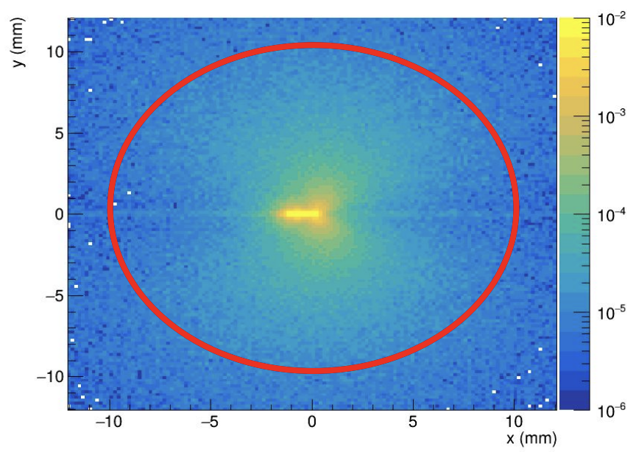
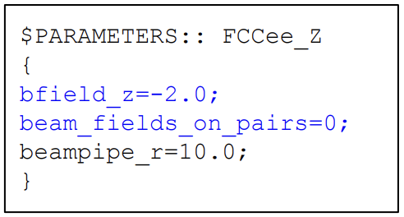
Things Missing from Guinea-Pig
J. Eysermans
However, guinea-pig does not include the experimental magnetic field
Work by Eysermans et al. to introduce propagation with field in vacuum and early stopping
Can now generate accurate spectra with physical treatment at all stages of propagation

Slide 10
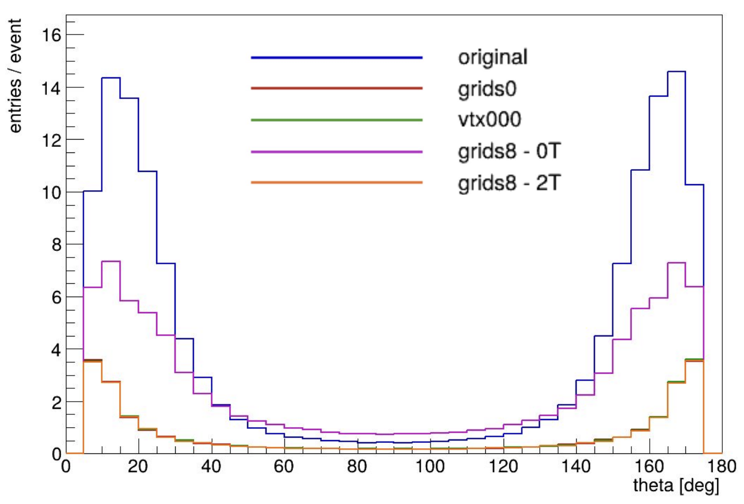
Additions to Guinea-Pig for FCCee
Early FCCee studies done by not propagating particles when created
If using standard GP propagation would overestimate occupancies for large bunches
When detailed propagation added to GP, similar but subtly different kinematics to no-prop
J. Eysermans

Slide 11
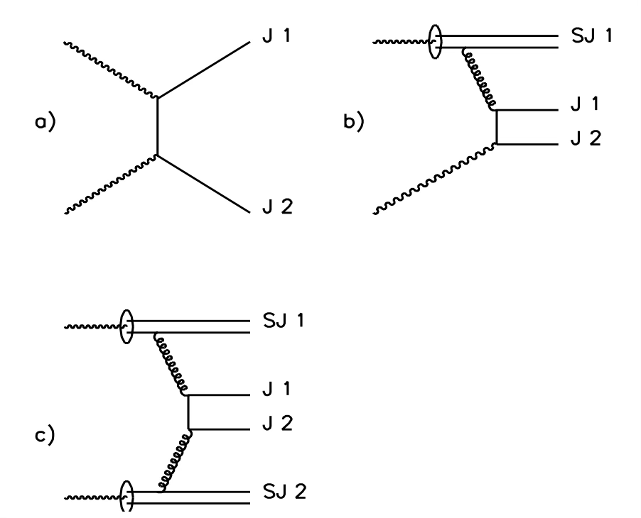
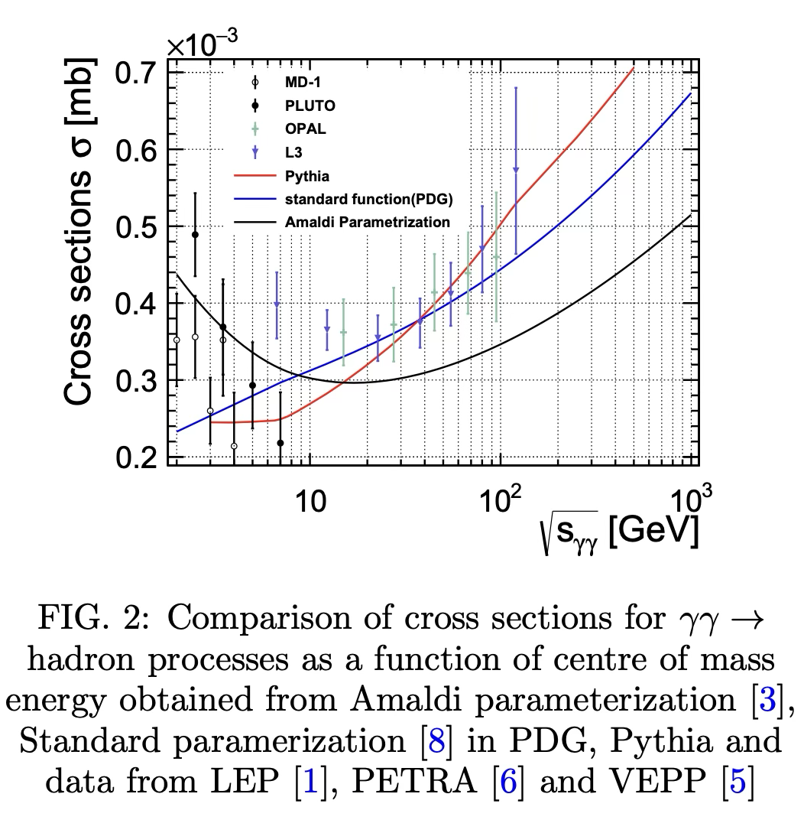
Hadron Photoproduction
Hadron photoproduction available in Guinea-pig but inaccurate
Detailed simulation developed by Tim Barklow and Micheal Peskin, interfaced to pythia
Requires photon luminosity spectra from collider passed into Whizard
arXiv:hep-ph/9305247

Slide 12
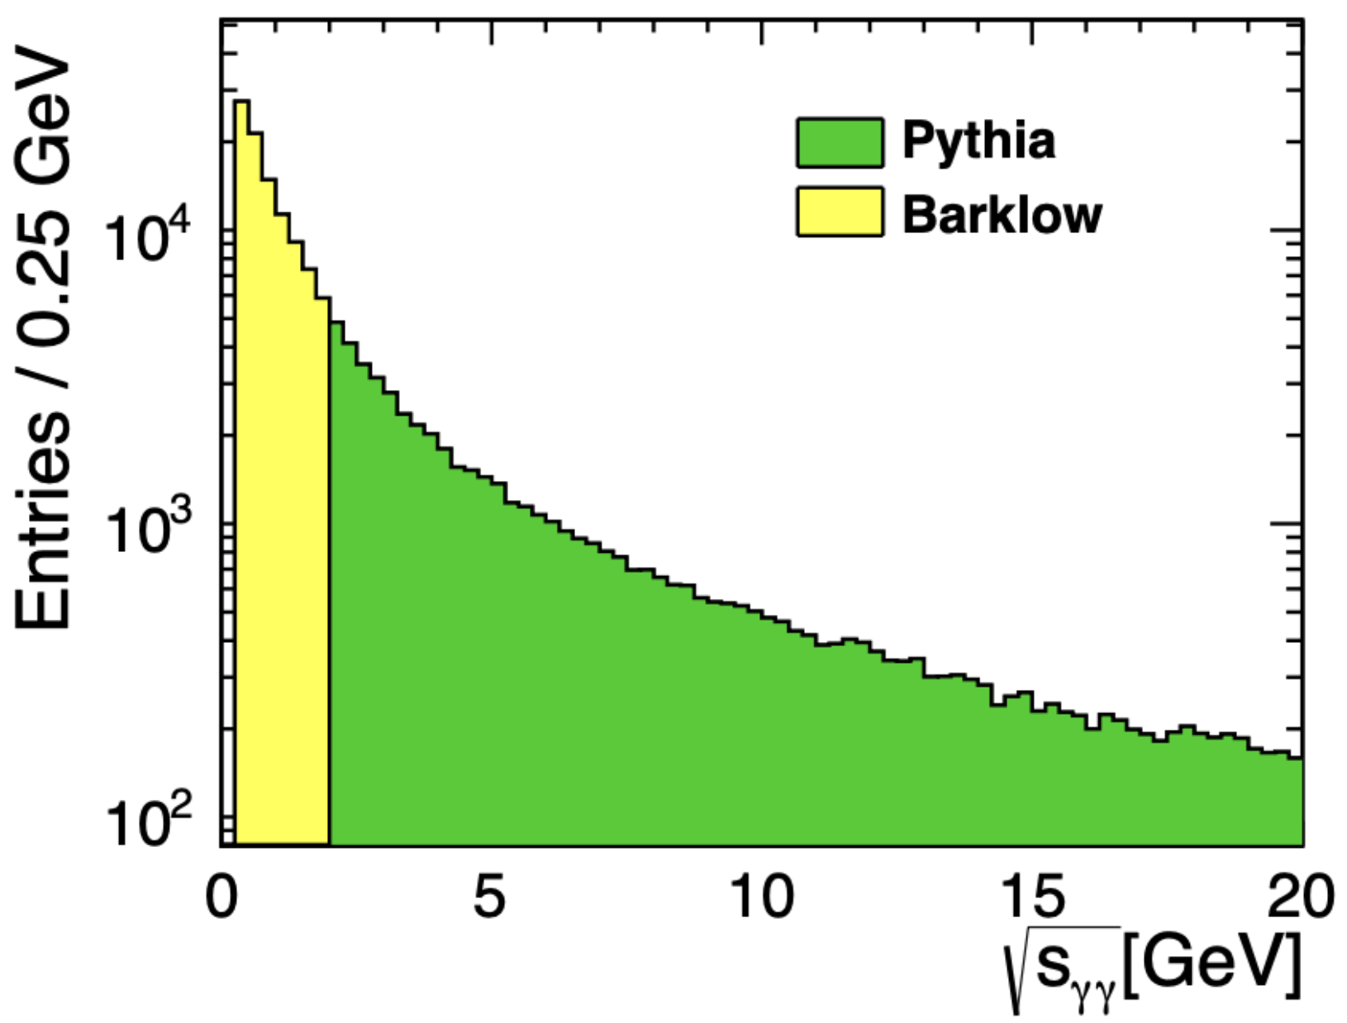
Hadron Photoproduction
Below tunable threshold, choose from kinematically available hadrons and pair produce
Above, pass diphoton center of mass to pythia and use its simulation

Slide 13
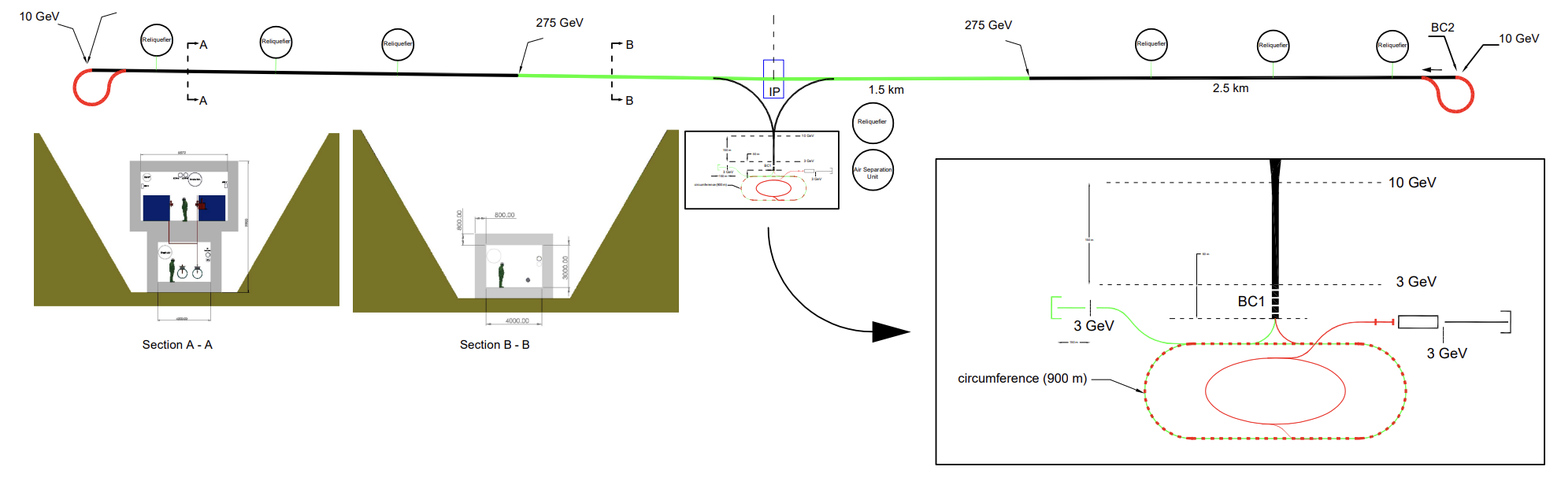
Studies at The Cool Copper Collider
C. Vernieri, et al. 2023 JINST 18 P07053
LN2-cooled copper provides high RF gradient and compact linear collider design
Short bunches, upgradeable to 550 GeV in same footprint, 1 TeV slightly larger
How does the LC physics case change under these conditions?

Slide 14
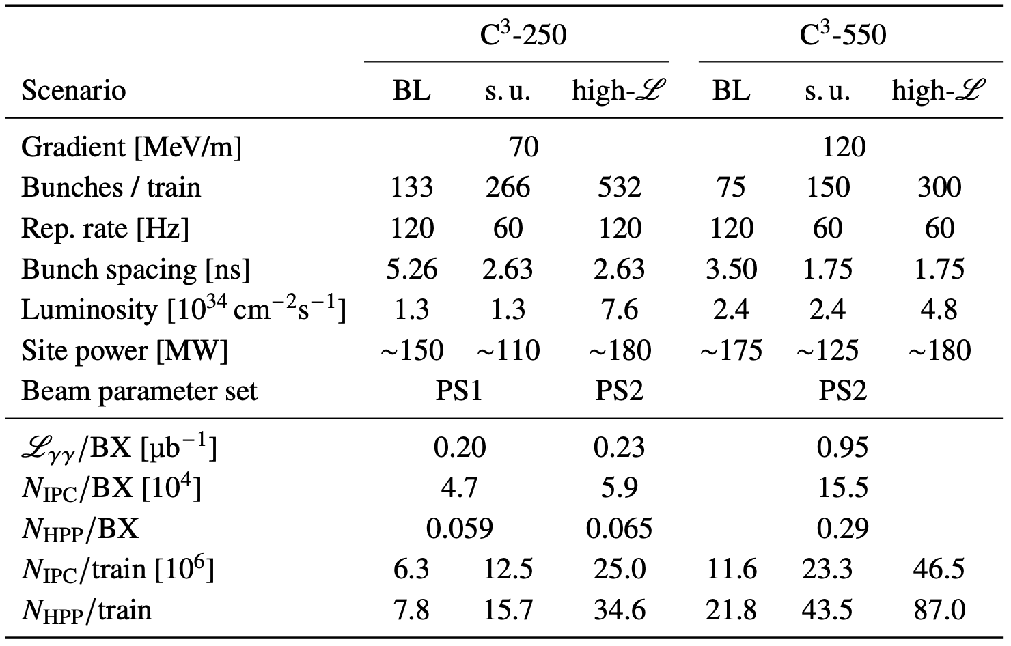
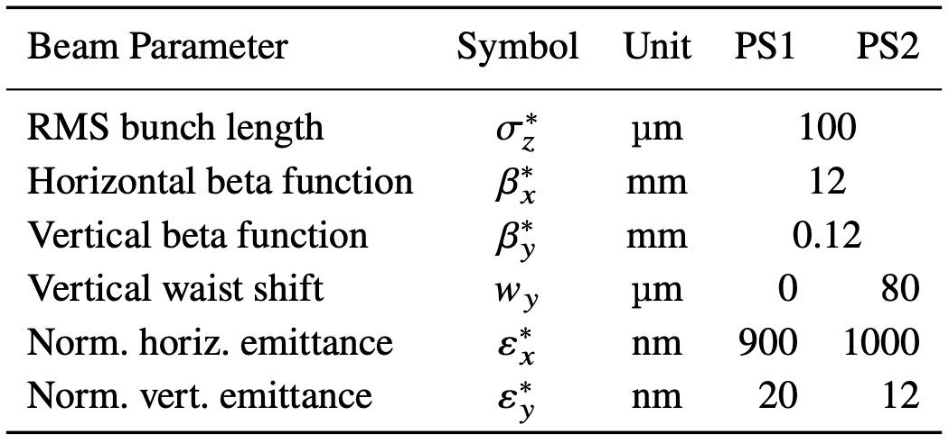
C3 Parameters
C3 has been optimized for luminosity delivery and power usage for proposed main operational ranges
Each luminosity configuration yields a different amount of background
arXiv:2511.01075

Slide 15
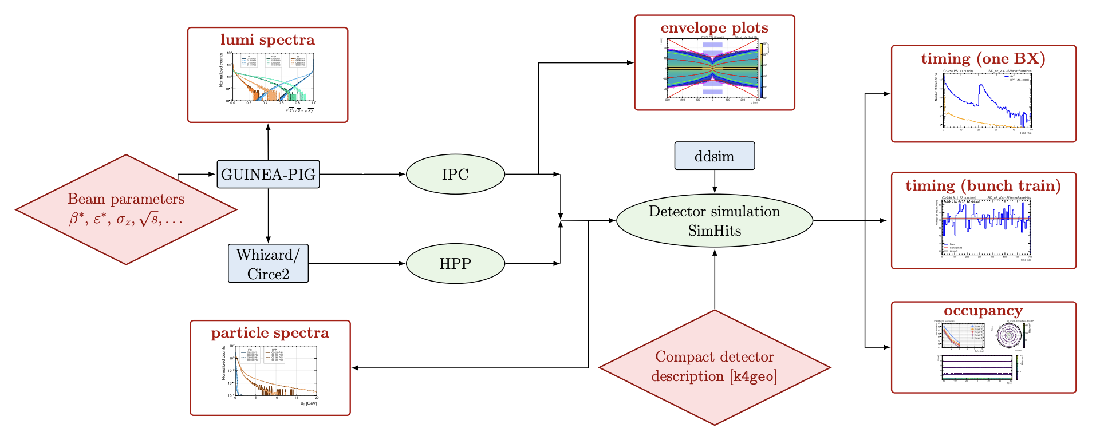
Analysis Framework
arXiv:2511.01075

Slide 16
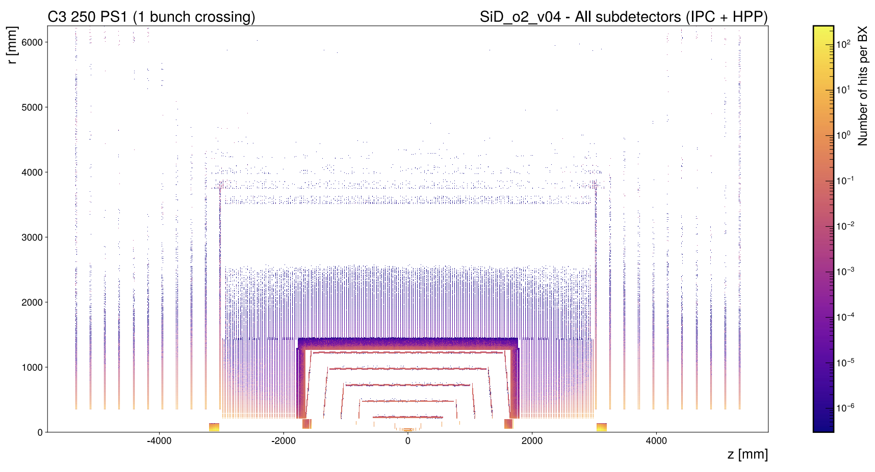
Occupancy Snapshot
arXiv:2511.01075

Slide 17
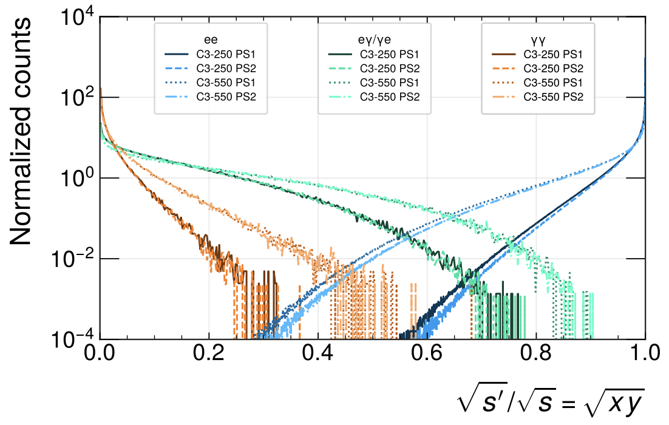
Luminosity Spectra
arXiv:2511.01075
C3, unlike FCCee, has significant photon luminosity at high energy
Easily hundreds of GeV, but most of luminosity still at design energy

Slide 18
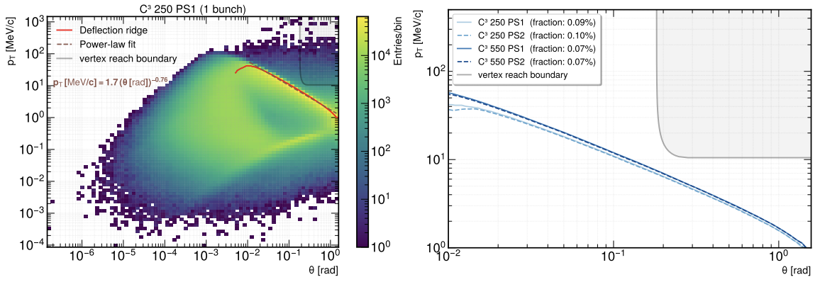
Reach of beam backgrounds into detector
Majority of beam induced background goes down beampipe (forward or curling)
Vertex detectors and rest of instrumentation sees deep tails of kinematics distributions
Instrumentation must avoid majority of background production (enormous flux)
arXiv:2511.01075

Slide 19
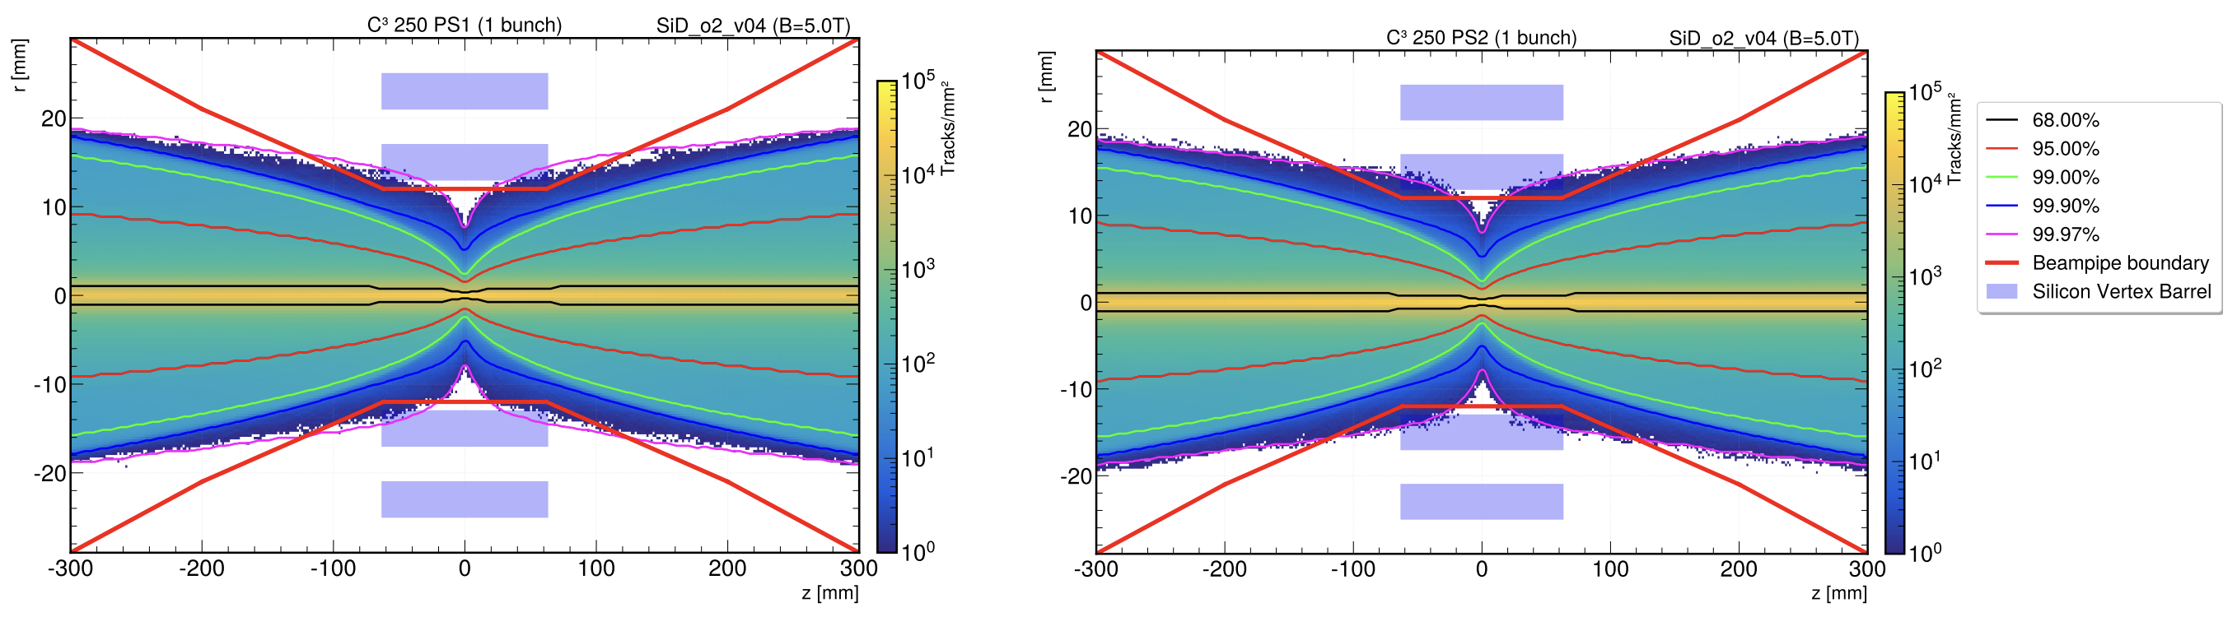
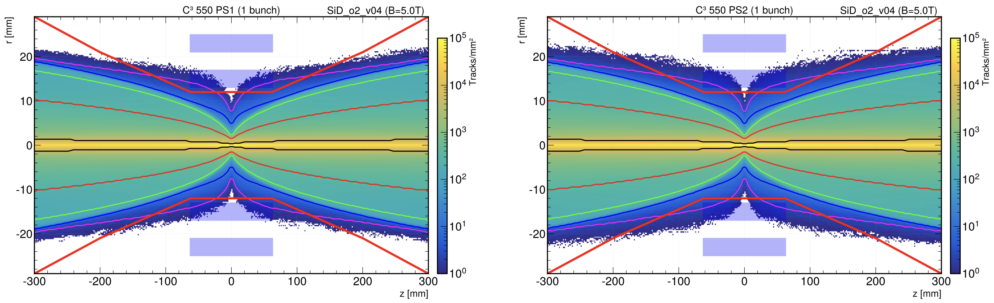
Envelope Plots
arXiv:2511.01075

Slide 20
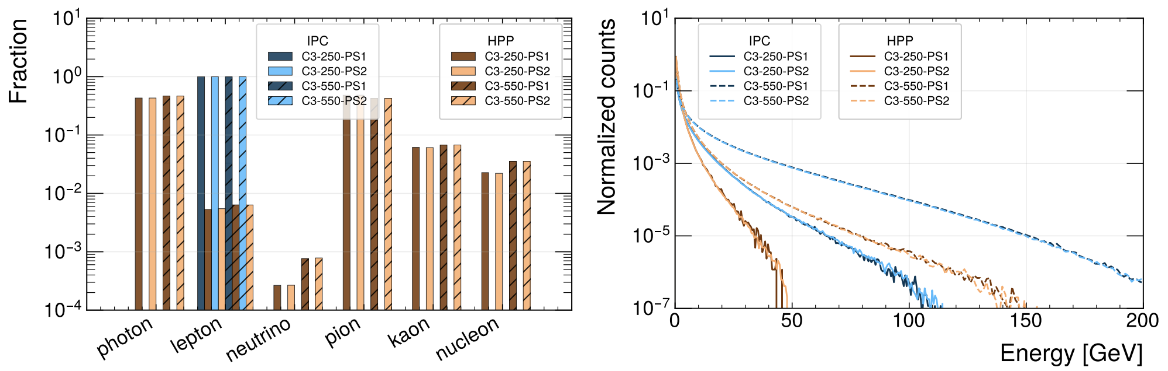
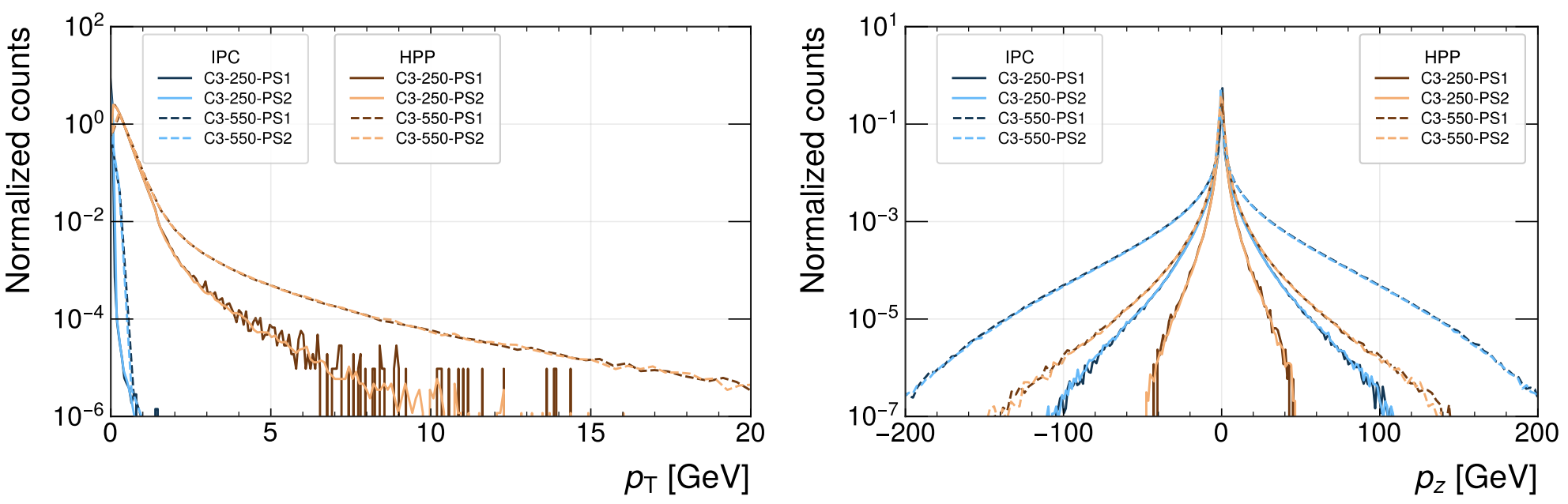
Particle Constituency and Kinematics
arXiv:2511.01075

Slide 21
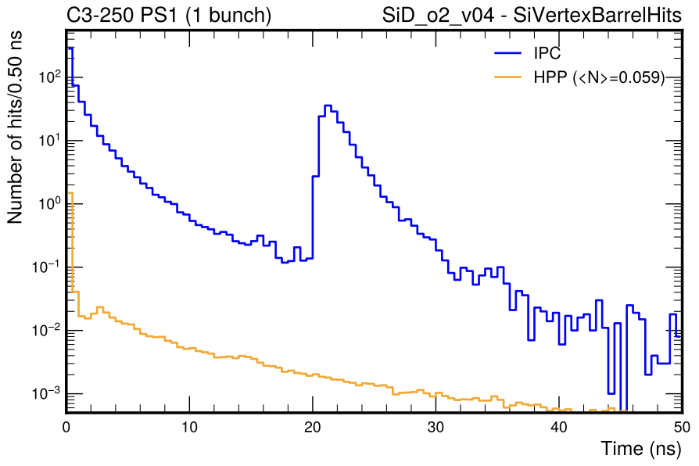
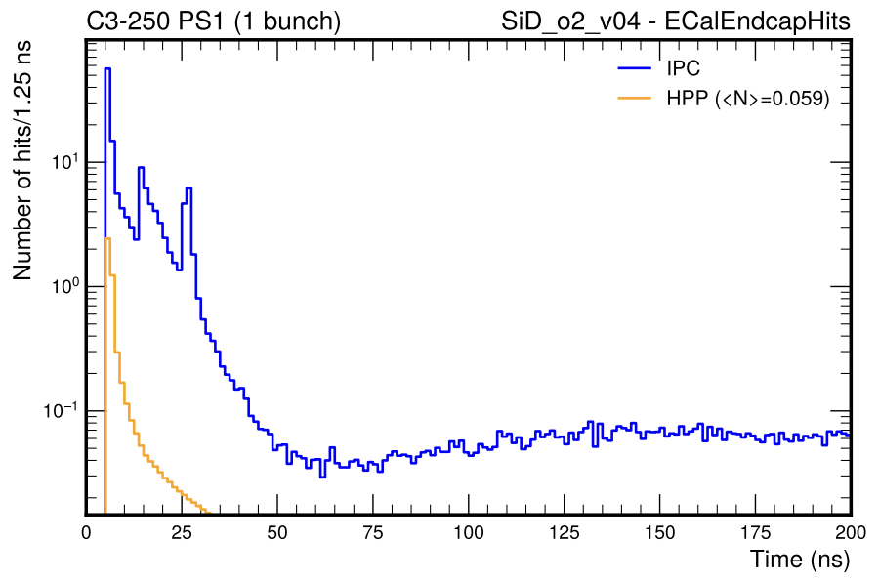
Hit Timing Distributions in Detectors
arXiv:2511.01075
Timing distribution reveals a wealth of information about detector
Can see secondary and tertiary electron production off of other detectors (calorimetry)
Hadron photoproduction vastly sub-leading at C3

Slide 22
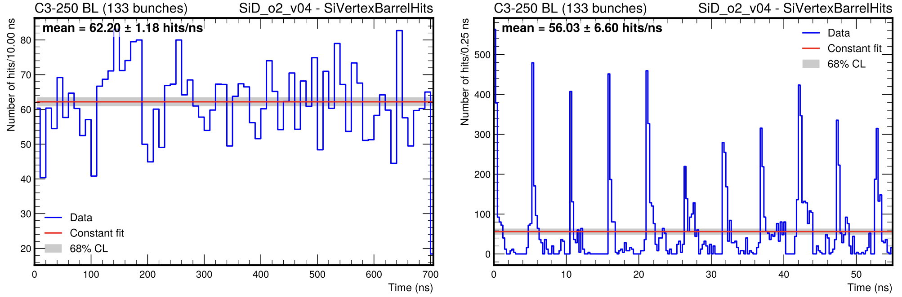
Hit Timing Distributions Across Bunches
Bunch-to-bunch variation also should be considered to understand operational aspects
At both linear and circular e+e- machines detectors will be streamed over integrated time segments, must be able to deal with bunch-to-bunch variations in occupancy
arXiv:2511.01075

Slide 23
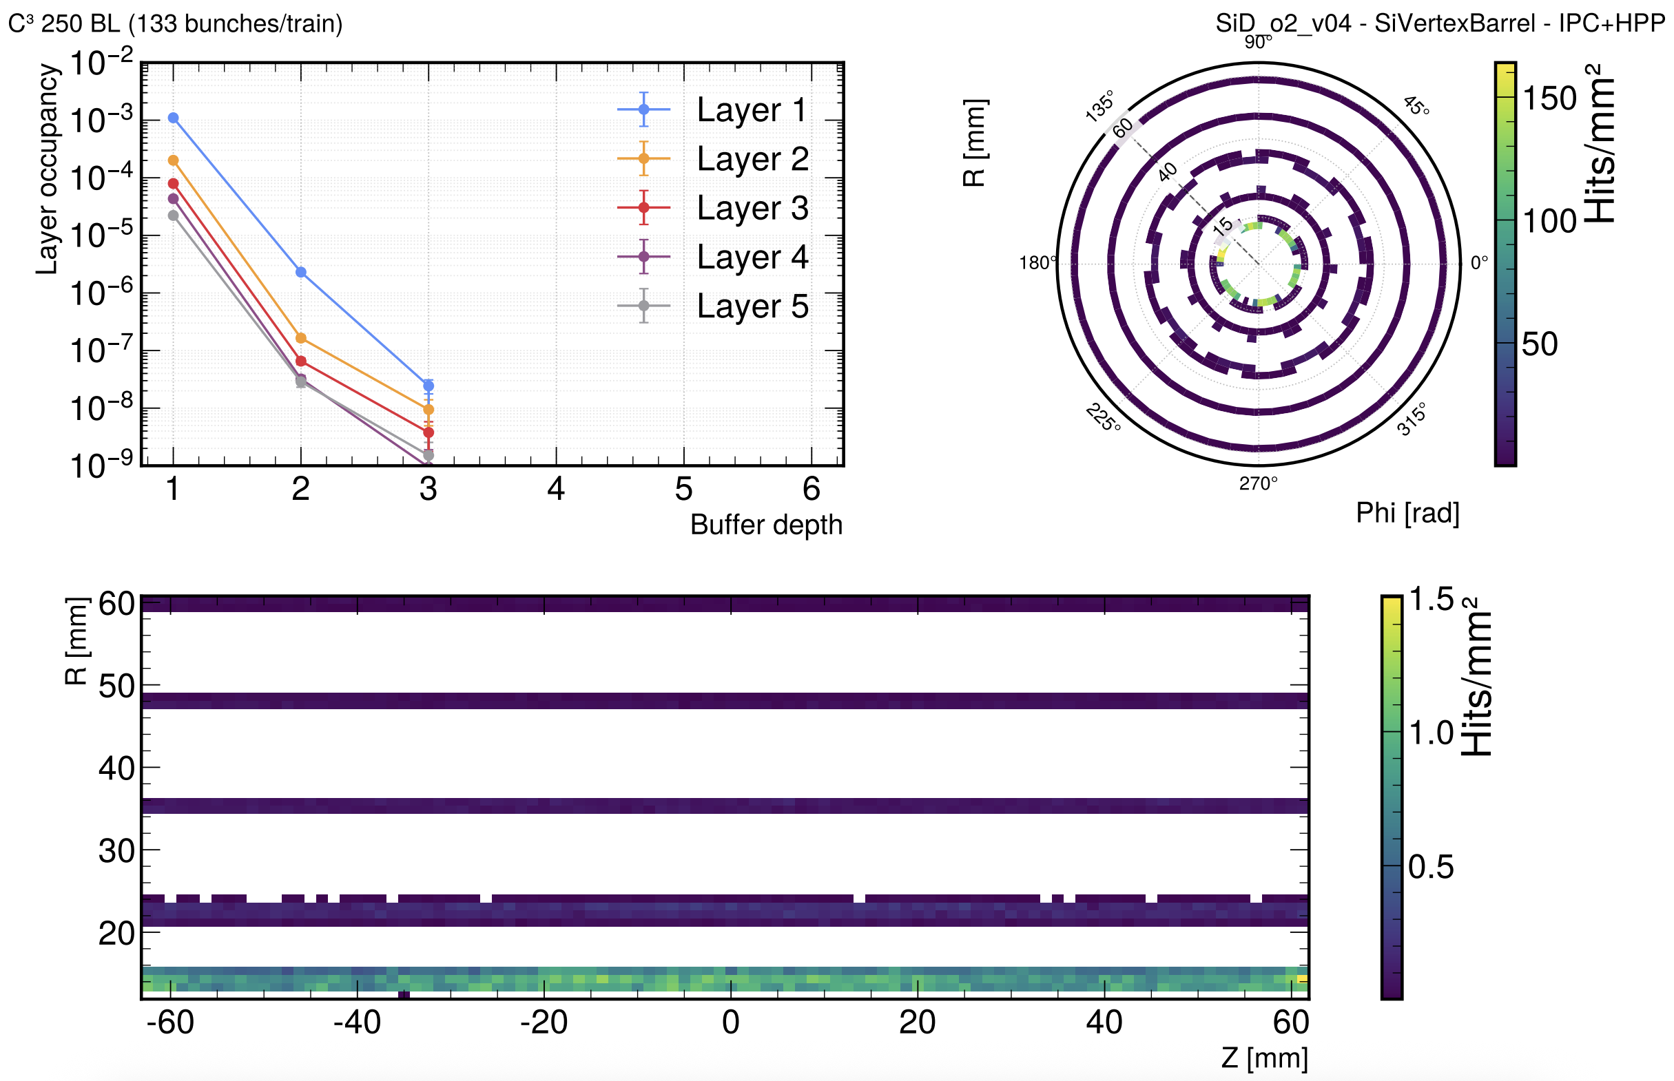
Examples of Detector Occupancy
arXiv:2511.01075

Slide 24
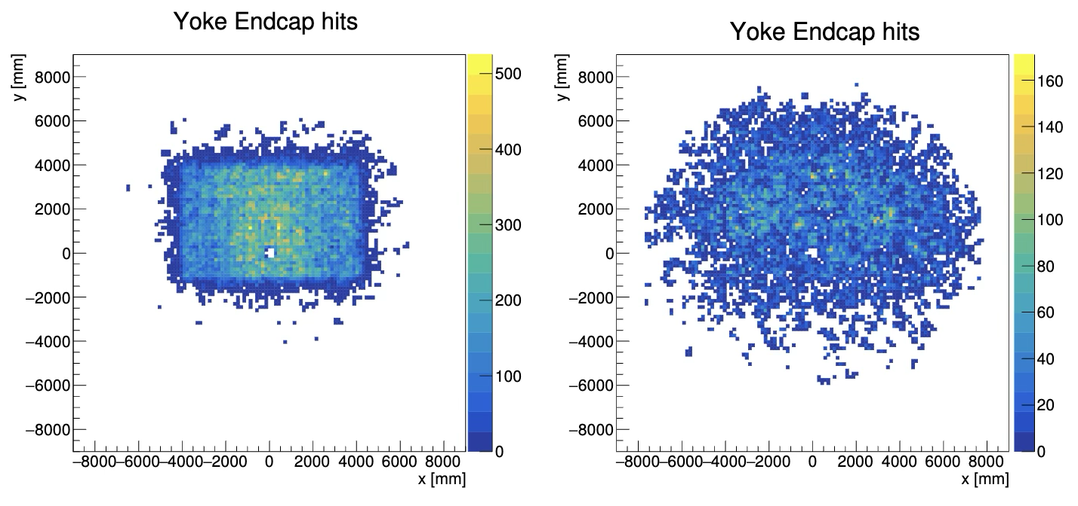
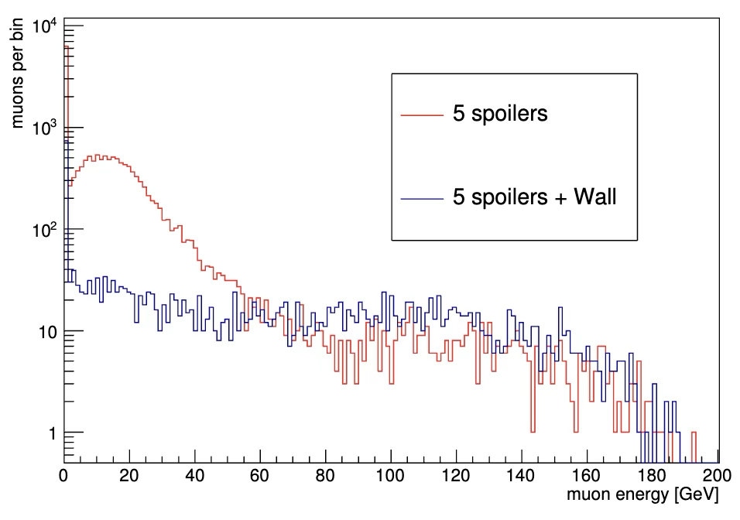
Accelerator Muons
ILD-TECH-PUB-2019-001
Last studies (that I know about) done by Daniel Jeans using previously generated MuCarlo outputs
Should update these studies with modern codes

Slide 25
Conclusions
Beam induced backgrounds are a fundamental design constraint at e+e-machines
  Especially with the material and power constraints that are expected for these vertex detectors
C3 has completed extensive studies of beam induced backgrounds
  A dedicated analysis framework compatible with key4hep has been developed and is shared for wide use
  Have ratified workflows for e+e- background as well as hadron photoproduction
We should take a more serious look at the accelerator muon background as we approach a rich understanding of the FCCee
Studies are ongoing to mitigate these backgrounds in a few fora
  smartpixels + FCCee study groups
  Everyone is talking to see if we can globally optimize

