Slide 1

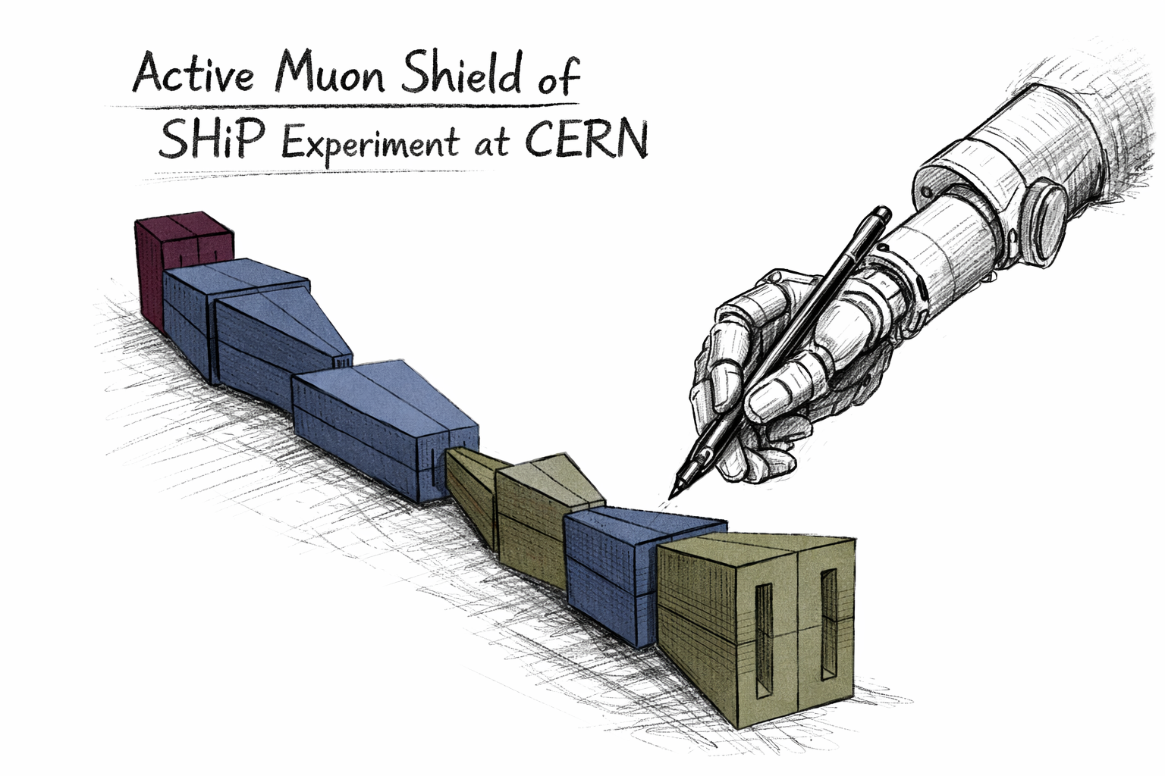
Artificial Intelligence in Instrument Design
From the SHiP Muon Shield to Future Experiments
KCETA Colloquium
Nico Serra
Department of Physics & DM³L
University of Zurich
Notes:
Thank you for the invitation. It is a pleasure to be here and discuss our proposal. I’m Nico Serra and I am professor at the Department of Physics of UZH, and with me is Alessio Figalli who is professor at the department of Mathematics of ETH. Alessio is well known in the field since, among other prizes, he is also the recipient of the Fields Medal 2018 for a mathematical theory known as Optimal Transport. I specialize in applied AI and large‑scale simulations to those large particle physics experiments that are underground below Geneva at CERN. Over the past years, through our consultancy with large companies, we kept seeing the same pain points in supply‑chain planning and logistics. So we realized our expertise could be useful in context, which led to this proposal.
FRase compatta che lancia la supply chain della consulenza
Comments: more or less fine
Thank you for the invitation, it is a pleasure to come here to present to you our Bridge Discovery Project.
Let me us start by introducing us.
Alessio is Professor in Mathematics at ETH Zurich, known for his work on Optimal Transport, and recipient of the Fields Medal 2018.
Nico is Professor at UZH and his research applies AI to complex, real‑world particle‑physics experiments
We have been collaborating for the past few years on interdisciplinary projects and as industrial consultants.
This project was born because we repeatedly saw that even very large companies struggle with supply‑chain planning, strategic decision‑making, and logistics.
Then we started to research this topic to understand where are the blank space and what is missing.
We studied the space to identify the key gaps and what’s missing… let me show you the gaps we targeted.

Slide 2
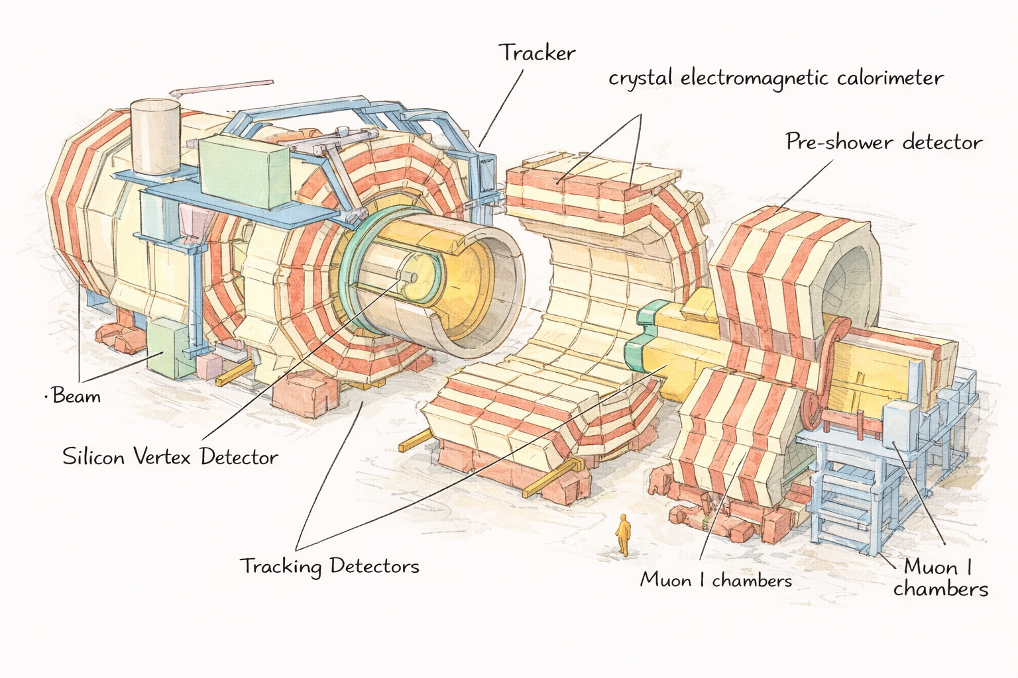
Artificial Intelligence in Instrument Design
Detector Design as an experimental bottleneck
Detector design traditionally relies on expert-driven, factorized, local optimization → slow, long iteration cycles
Complicated optimization problem:
  High-dimensional design space
  Hard engineering constraints
  Expensive, stochastic simulation
Why systematic optimization is feasible:
  High fidelity simulation
  Massive compute and accelerators
  New optimization methods
Notes:
Thank you for the invitation. It is a pleasure to be here and discuss our proposal. I’m Nico Serra and I am professor at the Department of Physics of UZH, and with me is Alessio Figalli who is professor at the department of Mathematics of ETH. Alessio is well known in the field since, among other prizes, he is also the recipient of the Fields Medal 2018 for a mathematical theory known as Optimal Transport. I specialize in applied AI and large‑scale simulations to those large particle physics experiments that are underground below Geneva at CERN. Over the past years, through our consultancy with large companies, we kept seeing the same pain points in supply‑chain planning and logistics. So we realized our expertise could be useful in context, which led to this proposal.
FRase compatta che lancia la supply chain della consulenza
Comments: more or less fine
Thank you for the invitation, it is a pleasure to come here to present to you our Bridge Discovery Project.
Let me us start by introducing us.
Alessio is Professor in Mathematics at ETH Zurich, known for his work on Optimal Transport, and recipient of the Fields Medal 2018.
Nico is Professor at UZH and his research applies AI to complex, real‑world particle‑physics experiments
We have been collaborating for the past few years on interdisciplinary projects and as industrial consultants.
This project was born because we repeatedly saw that even very large companies struggle with supply‑chain planning, strategic decision‑making, and logistics.
Then we started to research this topic to understand where are the blank space and what is missing.
We studied the space to identify the key gaps and what’s missing… let me show you the gaps we targeted.

Slide 3
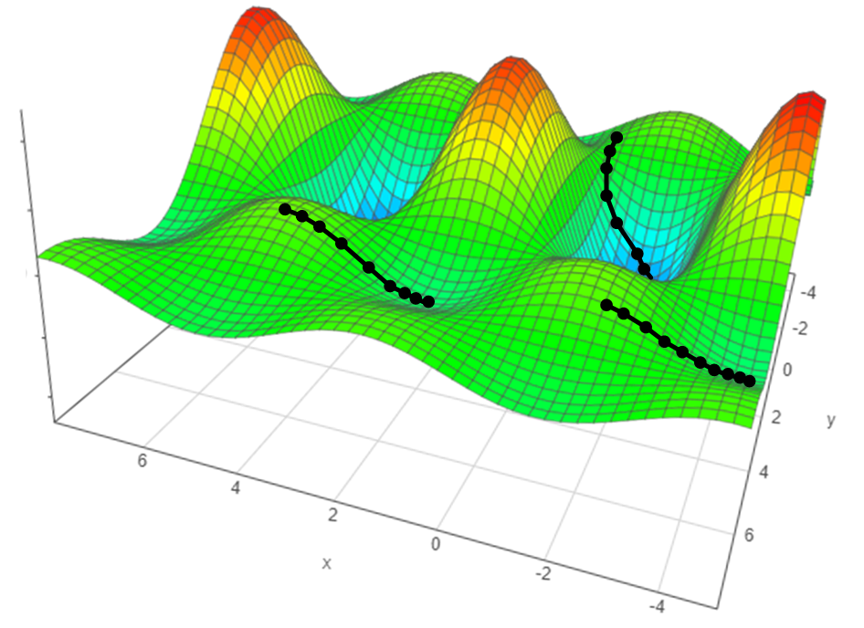
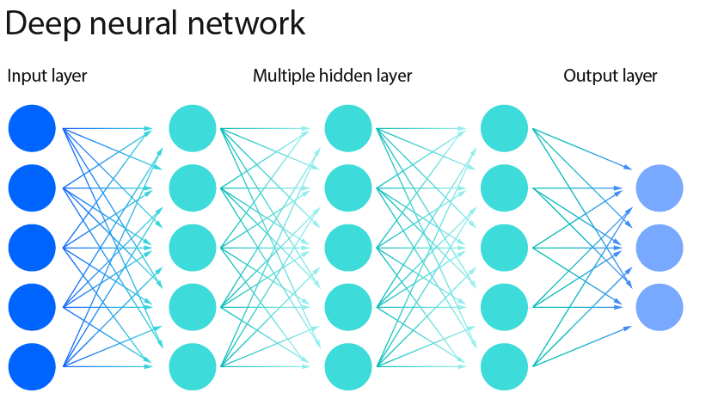
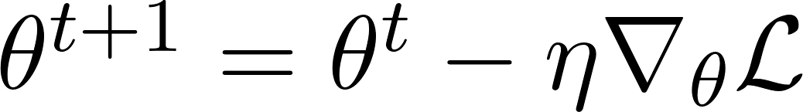

Artificial Intelligence in Instrument Design
AI approaches to detector design
Differentiable/gradient-based methods (MODE coll., see J. Kieseler talk)
Detector parameters
Learning rate
Loss
Powerful, but with intrinsic challenges:
• Sensitivity to local minima
• Handling discrete/non-differentiable quantities requires additional machinery
Score-based, black box methods (this talk)
backpropagation
• Optimize using only a scalar performance score
• No differentiability assumptions
• Naturally handle discrete and structural design choices
• Directly compatible with realistic MC simulation
Notes:
Thank you for the invitation. It is a pleasure to be here and discuss our proposal. I’m Nico Serra and I am professor at the Department of Physics of UZH, and with me is Alessio Figalli who is professor at the department of Mathematics of ETH. Alessio is well known in the field since, among other prizes, he is also the recipient of the Fields Medal 2018 for a mathematical theory known as Optimal Transport. I specialize in applied AI and large‑scale simulations to those large particle physics experiments that are underground below Geneva at CERN. Over the past years, through our consultancy with large companies, we kept seeing the same pain points in supply‑chain planning and logistics. So we realized our expertise could be useful in context, which led to this proposal.
FRase compatta che lancia la supply chain della consulenza
Comments: more or less fine
Thank you for the invitation, it is a pleasure to come here to present to you our Bridge Discovery Project.
Let me us start by introducing us.
Alessio is Professor in Mathematics at ETH Zurich, known for his work on Optimal Transport, and recipient of the Fields Medal 2018.
Nico is Professor at UZH and his research applies AI to complex, real‑world particle‑physics experiments
We have been collaborating for the past few years on interdisciplinary projects and as industrial consultants.
This project was born because we repeatedly saw that even very large companies struggle with supply‑chain planning, strategic decision‑making, and logistics.
Then we started to research this topic to understand where are the blank space and what is missing.
We studied the space to identify the key gaps and what’s missing… let me show you the gaps we targeted.

Slide 4
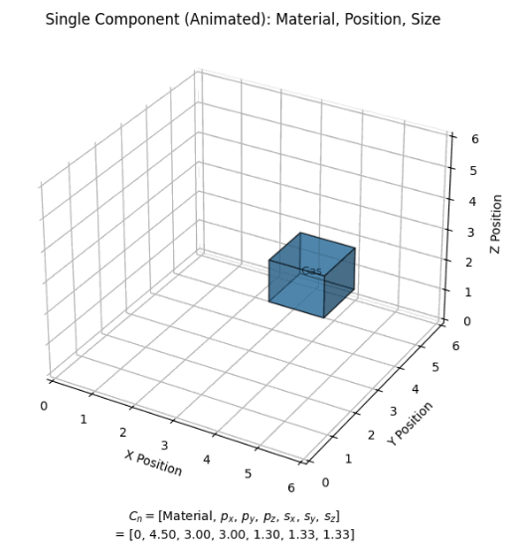


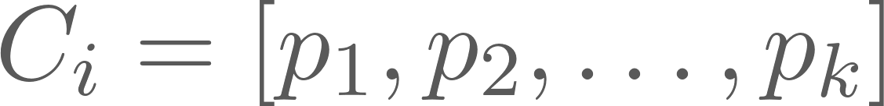
Artificial Intelligence in Instrument Design
Detector design as an optimization problem
A (sub-)detector consists of a set of components:
with variable N
Each component C_{i} is described by:
Parameters can be geometric, material, or technological and can be continuous or discrete
Example:
C_{i} = [silicon tracking layer, position, thickness, segmentation, …]
Notes:
Thank you for the invitation. It is a pleasure to be here and discuss our proposal. I’m Nico Serra and I am professor at the Department of Physics of UZH, and with me is Alessio Figalli who is professor at the department of Mathematics of ETH. Alessio is well known in the field since, among other prizes, he is also the recipient of the Fields Medal 2018 for a mathematical theory known as Optimal Transport. I specialize in applied AI and large‑scale simulations to those large particle physics experiments that are underground below Geneva at CERN. Over the past years, through our consultancy with large companies, we kept seeing the same pain points in supply‑chain planning and logistics. So we realized our expertise could be useful in context, which led to this proposal.
FRase compatta che lancia la supply chain della consulenza
Comments: more or less fine
Thank you for the invitation, it is a pleasure to come here to present to you our Bridge Discovery Project.
Let me us start by introducing us.
Alessio is Professor in Mathematics at ETH Zurich, known for his work on Optimal Transport, and recipient of the Fields Medal 2018.
Nico is Professor at UZH and his research applies AI to complex, real‑world particle‑physics experiments
We have been collaborating for the past few years on interdisciplinary projects and as industrial consultants.
This project was born because we repeatedly saw that even very large companies struggle with supply‑chain planning, strategic decision‑making, and logistics.
Then we started to research this topic to understand where are the blank space and what is missing.
We studied the space to identify the key gaps and what’s missing… let me show you the gaps we targeted.

Slide 5


Artificial Intelligence in Instrument Design
Score-based or black box methods
Define a scalar score function that quantifies detector performance
  E.g. momentum resolution, efficiency, background rate
The optimization problem is:
Optimization is typically multi-objective:
  Physics performance, cost, space, …
  Either combine into a single score (reduction function), or
  Optimize conditionally and explore trade-offs
Score is evaluated through (full) simulation
Notes:
Thank you for the invitation. It is a pleasure to be here and discuss our proposal. I’m Nico Serra and I am professor at the Department of Physics of UZH, and with me is Alessio Figalli who is professor at the department of Mathematics of ETH. Alessio is well known in the field since, among other prizes, he is also the recipient of the Fields Medal 2018 for a mathematical theory known as Optimal Transport. I specialize in applied AI and large‑scale simulations to those large particle physics experiments that are underground below Geneva at CERN. Over the past years, through our consultancy with large companies, we kept seeing the same pain points in supply‑chain planning and logistics. So we realized our expertise could be useful in context, which led to this proposal.
FRase compatta che lancia la supply chain della consulenza
Comments: more or less fine
Thank you for the invitation, it is a pleasure to come here to present to you our Bridge Discovery Project.
Let me us start by introducing us.
Alessio is Professor in Mathematics at ETH Zurich, known for his work on Optimal Transport, and recipient of the Fields Medal 2018.
Nico is Professor at UZH and his research applies AI to complex, real‑world particle‑physics experiments
We have been collaborating for the past few years on interdisciplinary projects and as industrial consultants.
This project was born because we repeatedly saw that even very large companies struggle with supply‑chain planning, strategic decision‑making, and logistics.
Then we started to research this topic to understand where are the blank space and what is missing.
We studied the space to identify the key gaps and what’s missing… let me show you the gaps we targeted.

Slide 6
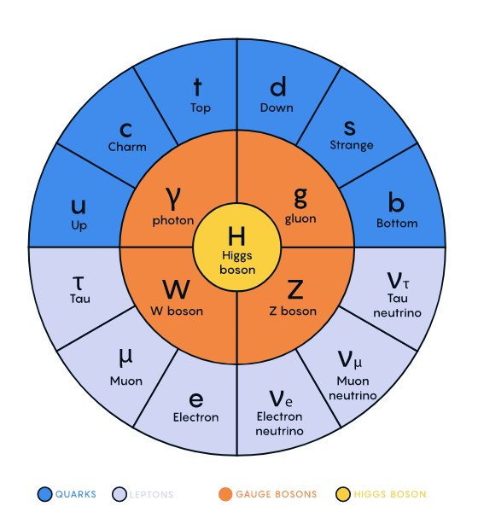


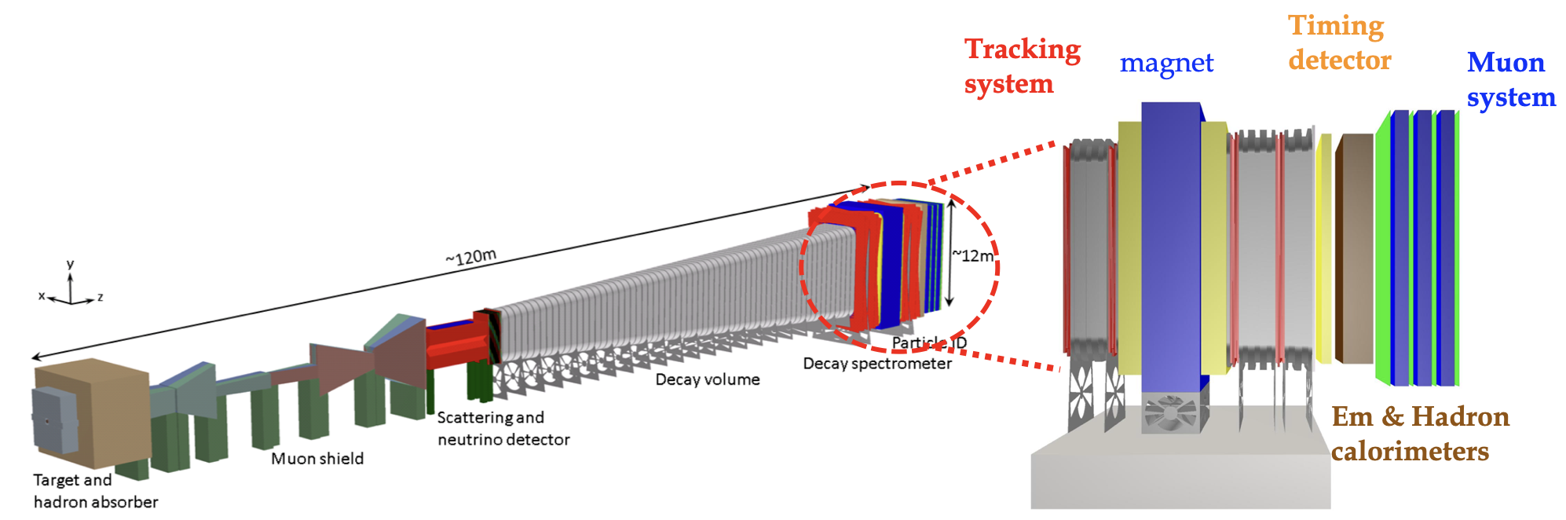
Artificial Intelligence in Instrument Design
The SHiP Experiment
SHiP is a dedicated experiment to search for Dark Sector particles (approved in March 2024)
Bonivento et al 2013
SHiP Tech. Proposal
Alekhin et al, SHiP Physics Case
SHiP ECN3 Proposal
Notes:
Thank you for the invitation. It is a pleasure to be here and discuss our proposal. I’m Nico Serra and I am professor at the Department of Physics of UZH, and with me is Alessio Figalli who is professor at the department of Mathematics of ETH. Alessio is well known in the field since, among other prizes, he is also the recipient of the Fields Medal 2018 for a mathematical theory known as Optimal Transport. I specialize in applied AI and large‑scale simulations to those large particle physics experiments that are underground below Geneva at CERN. Over the past years, through our consultancy with large companies, we kept seeing the same pain points in supply‑chain planning and logistics. So we realized our expertise could be useful in context, which led to this proposal.
FRase compatta che lancia la supply chain della consulenza
Comments: more or less fine
Thank you for the invitation, it is a pleasure to come here to present to you our Bridge Discovery Project.
Let me us start by introducing us.
Alessio is Professor in Mathematics at ETH Zurich, known for his work on Optimal Transport, and recipient of the Fields Medal 2018.
Nico is Professor at UZH and his research applies AI to complex, real‑world particle‑physics experiments
We have been collaborating for the past few years on interdisciplinary projects and as industrial consultants.
This project was born because we repeatedly saw that even very large companies struggle with supply‑chain planning, strategic decision‑making, and logistics.
Then we started to research this topic to understand where are the blank space and what is missing.
We studied the space to identify the key gaps and what’s missing… let me show you the gaps we targeted.

Slide 7
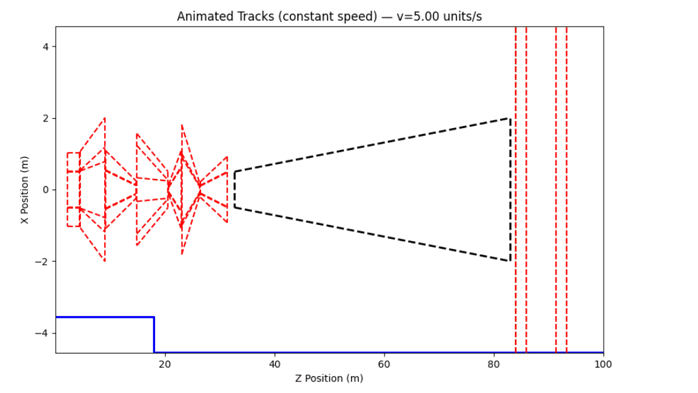
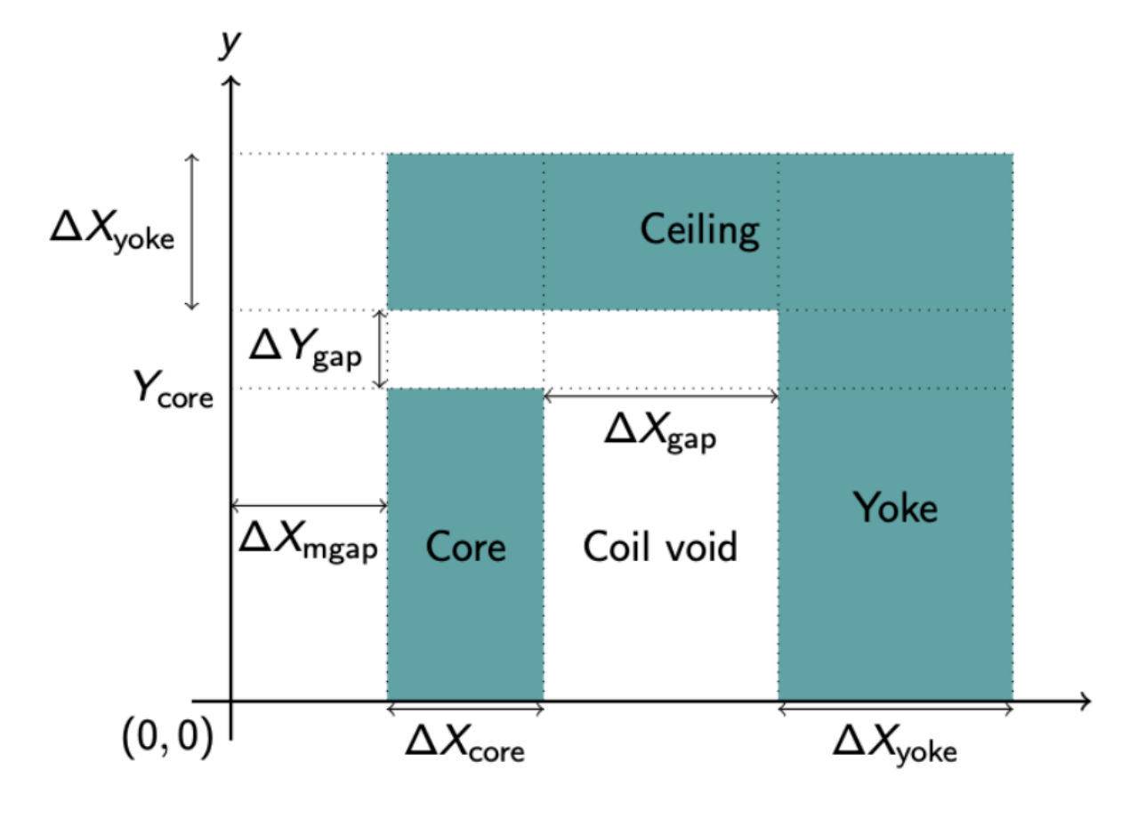
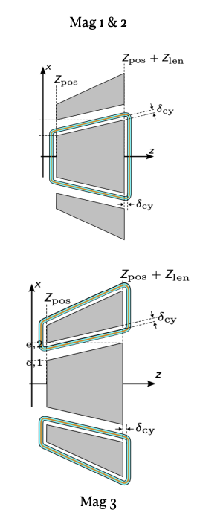
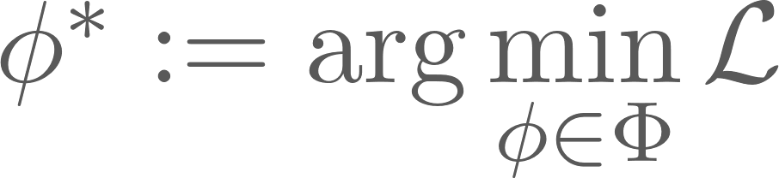
Artificial Intelligence in Instrument Design
The SHiP Muon Shield
After the target and hadron absorber only muon and neutrino survive
Expect 10¹¹ muon/s → Required < 10⁵ muon/s
Cost based on muon hits (weighted by their dangerouness)
SHiP Coll. arXiv:1703.03612
Total of about 100 parameters
Notes:
Thank you for the invitation. It is a pleasure to be here and discuss our proposal. I’m Nico Serra and I am professor at the Department of Physics of UZH, and with me is Alessio Figalli who is professor at the department of Mathematics of ETH. Alessio is well known in the field since, among other prizes, he is also the recipient of the Fields Medal 2018 for a mathematical theory known as Optimal Transport. I specialize in applied AI and large‑scale simulations to those large particle physics experiments that are underground below Geneva at CERN. Over the past years, through our consultancy with large companies, we kept seeing the same pain points in supply‑chain planning and logistics. So we realized our expertise could be useful in context, which led to this proposal.
FRase compatta che lancia la supply chain della consulenza
Comments: more or less fine
Thank you for the invitation, it is a pleasure to come here to present to you our Bridge Discovery Project.
Let me us start by introducing us.
Alessio is Professor in Mathematics at ETH Zurich, known for his work on Optimal Transport, and recipient of the Fields Medal 2018.
Nico is Professor at UZH and his research applies AI to complex, real‑world particle‑physics experiments
We have been collaborating for the past few years on interdisciplinary projects and as industrial consultants.
This project was born because we repeatedly saw that even very large companies struggle with supply‑chain planning, strategic decision‑making, and logistics.
Then we started to research this topic to understand where are the blank space and what is missing.
We studied the space to identify the key gaps and what’s missing… let me show you the gaps we targeted.

Slide 8

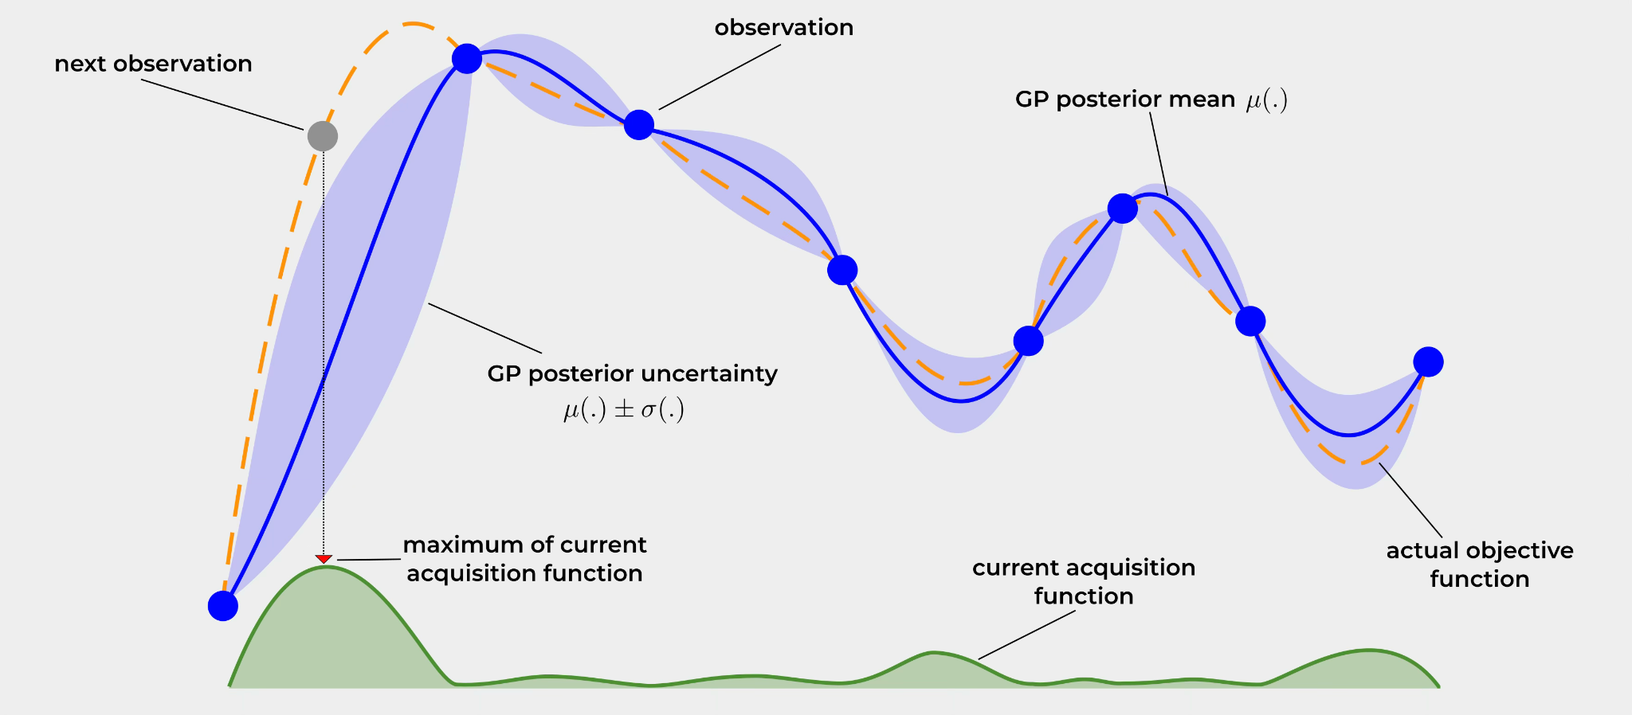
Artificial Intelligence in Instrument Design
Bayesian Optimization
Fixed number of continuous parameters:
• Treat the objective S(ϕ) as a black box
• Learn a probabilistic surrogate (Gaussian Process)
• Use an acquisition function to choose the next design
• Very sample efficient for expensive simulations
• Limited scalability for high-dimensional or discrete problems
Notes:
Thank you for the invitation. It is a pleasure to be here and discuss our proposal. I’m Nico Serra and I am professor at the Department of Physics of UZH, and with me is Alessio Figalli who is professor at the department of Mathematics of ETH. Alessio is well known in the field since, among other prizes, he is also the recipient of the Fields Medal 2018 for a mathematical theory known as Optimal Transport. I specialize in applied AI and large‑scale simulations to those large particle physics experiments that are underground below Geneva at CERN. Over the past years, through our consultancy with large companies, we kept seeing the same pain points in supply‑chain planning and logistics. So we realized our expertise could be useful in context, which led to this proposal.
FRase compatta che lancia la supply chain della consulenza
Comments: more or less fine
Thank you for the invitation, it is a pleasure to come here to present to you our Bridge Discovery Project.
Let me us start by introducing us.
Alessio is Professor in Mathematics at ETH Zurich, known for his work on Optimal Transport, and recipient of the Fields Medal 2018.
Nico is Professor at UZH and his research applies AI to complex, real‑world particle‑physics experiments
We have been collaborating for the past few years on interdisciplinary projects and as industrial consultants.
This project was born because we repeatedly saw that even very large companies struggle with supply‑chain planning, strategic decision‑making, and logistics.
Then we started to research this topic to understand where are the blank space and what is missing.
We studied the space to identify the key gaps and what’s missing… let me show you the gaps we targeted.

Slide 9
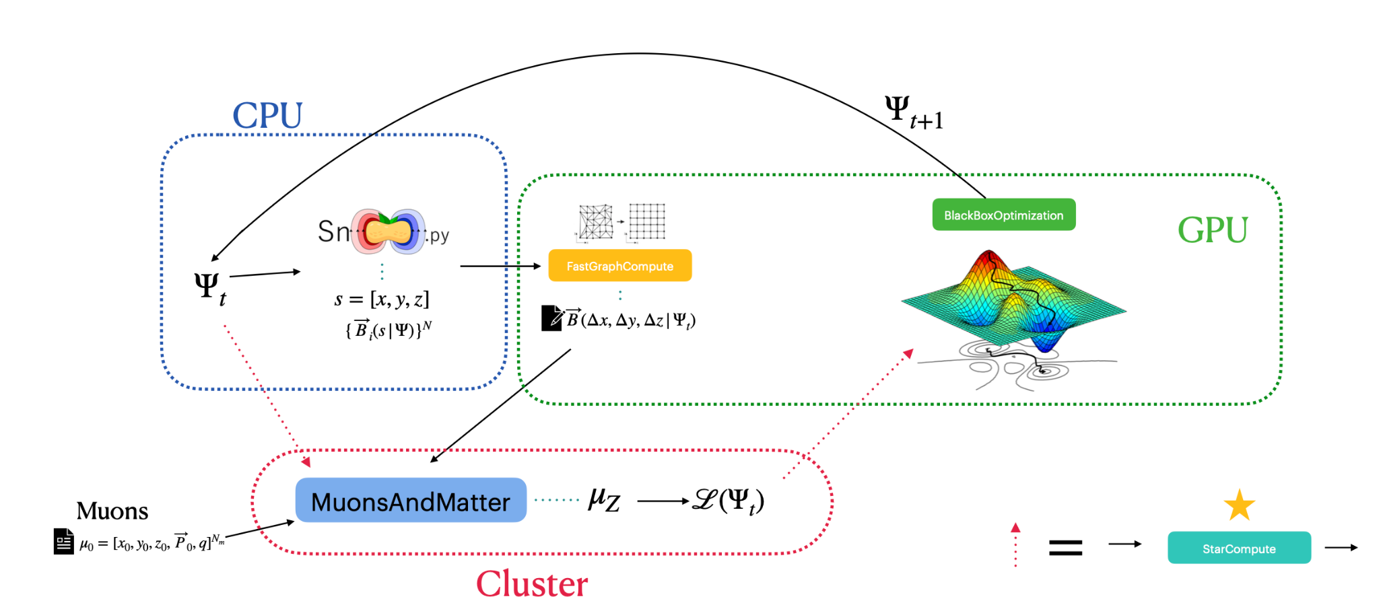
Artificial Intelligence in Instrument Design
From toy studies to realistic design
Muon shield optimization has become benchmark problem in detector design
(Baranov2017,Lantwin2018,Shirobokov2020,Kurbatov2024,Massoli2024)
Early studies relied on simplified field models and limited muon statistics
Realistic design required FEM field maps and very large muon statistics
GEANT4
Cattelan, Qasim, Owen, NS 2026
Notes:
Thank you for the invitation. It is a pleasure to be here and discuss our proposal. I’m Nico Serra and I am professor at the Department of Physics of UZH, and with me is Alessio Figalli who is professor at the department of Mathematics of ETH. Alessio is well known in the field since, among other prizes, he is also the recipient of the Fields Medal 2018 for a mathematical theory known as Optimal Transport. I specialize in applied AI and large‑scale simulations to those large particle physics experiments that are underground below Geneva at CERN. Over the past years, through our consultancy with large companies, we kept seeing the same pain points in supply‑chain planning and logistics. So we realized our expertise could be useful in context, which led to this proposal.
FRase compatta che lancia la supply chain della consulenza
Comments: more or less fine
Thank you for the invitation, it is a pleasure to come here to present to you our Bridge Discovery Project.
Let me us start by introducing us.
Alessio is Professor in Mathematics at ETH Zurich, known for his work on Optimal Transport, and recipient of the Fields Medal 2018.
Nico is Professor at UZH and his research applies AI to complex, real‑world particle‑physics experiments
We have been collaborating for the past few years on interdisciplinary projects and as industrial consultants.
This project was born because we repeatedly saw that even very large companies struggle with supply‑chain planning, strategic decision‑making, and logistics.
Then we started to research this topic to understand where are the blank space and what is missing.
We studied the space to identify the key gaps and what’s missing… let me show you the gaps we targeted.

Slide 10
Artificial Intelligence in Instrument Design
From toy studies to realistic design
Muon shield optimization has become benchmark problem in detector design
(Baranov2017,Lantwin2018,Shirobokov2020,Kurbatov2024,Massoli2024)
Early studies relied on simplified field models and limited muon statistics
Realistic design required FEM field maps and very large muon statistics
Slowest part of the simulation
GEANT4
Cattelan, Qasim, Owen, NS 2026
Notes:
Thank you for the invitation. It is a pleasure to be here and discuss our proposal. I’m Nico Serra and I am professor at the Department of Physics of UZH, and with me is Alessio Figalli who is professor at the department of Mathematics of ETH. Alessio is well known in the field since, among other prizes, he is also the recipient of the Fields Medal 2018 for a mathematical theory known as Optimal Transport. I specialize in applied AI and large‑scale simulations to those large particle physics experiments that are underground below Geneva at CERN. Over the past years, through our consultancy with large companies, we kept seeing the same pain points in supply‑chain planning and logistics. So we realized our expertise could be useful in context, which led to this proposal.
FRase compatta che lancia la supply chain della consulenza
Comments: more or less fine
Thank you for the invitation, it is a pleasure to come here to present to you our Bridge Discovery Project.
Let me us start by introducing us.
Alessio is Professor in Mathematics at ETH Zurich, known for his work on Optimal Transport, and recipient of the Fields Medal 2018.
Nico is Professor at UZH and his research applies AI to complex, real‑world particle‑physics experiments
We have been collaborating for the past few years on interdisciplinary projects and as industrial consultants.
This project was born because we repeatedly saw that even very large companies struggle with supply‑chain planning, strategic decision‑making, and logistics.
Then we started to research this topic to understand where are the blank space and what is missing.
We studied the space to identify the key gaps and what’s missing… let me show you the gaps we targeted.

Slide 11
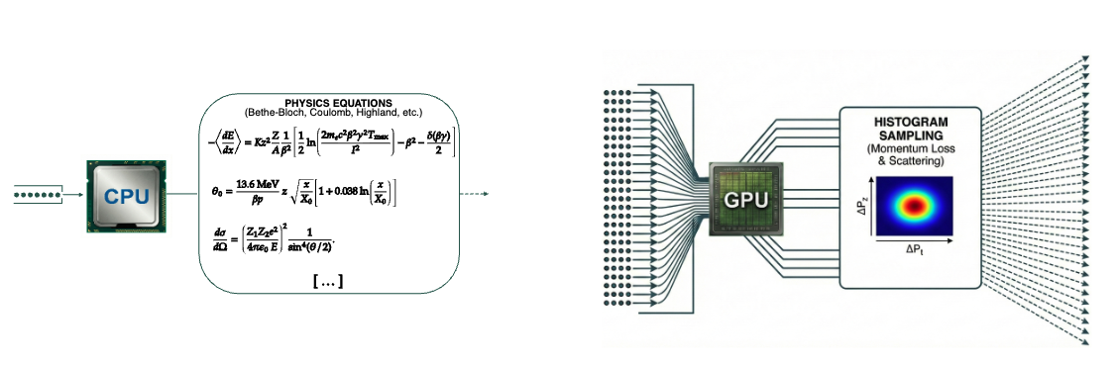
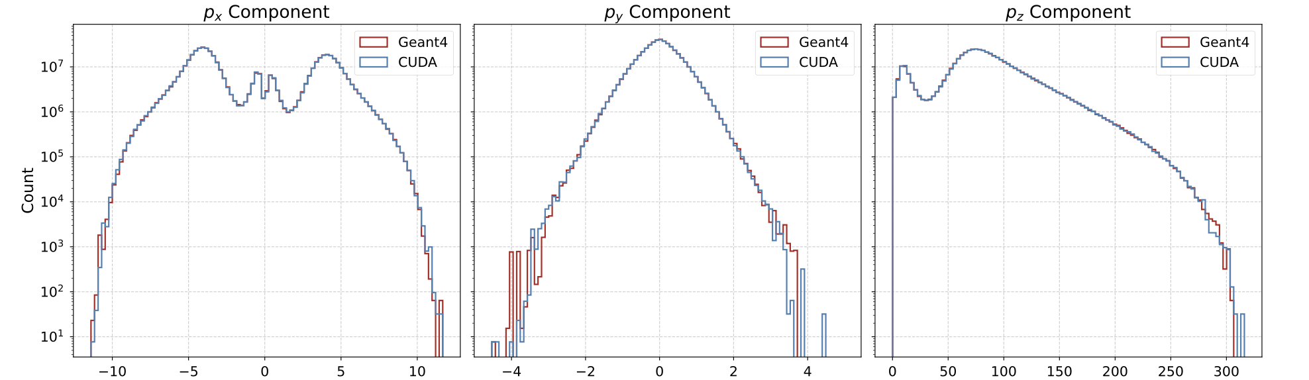
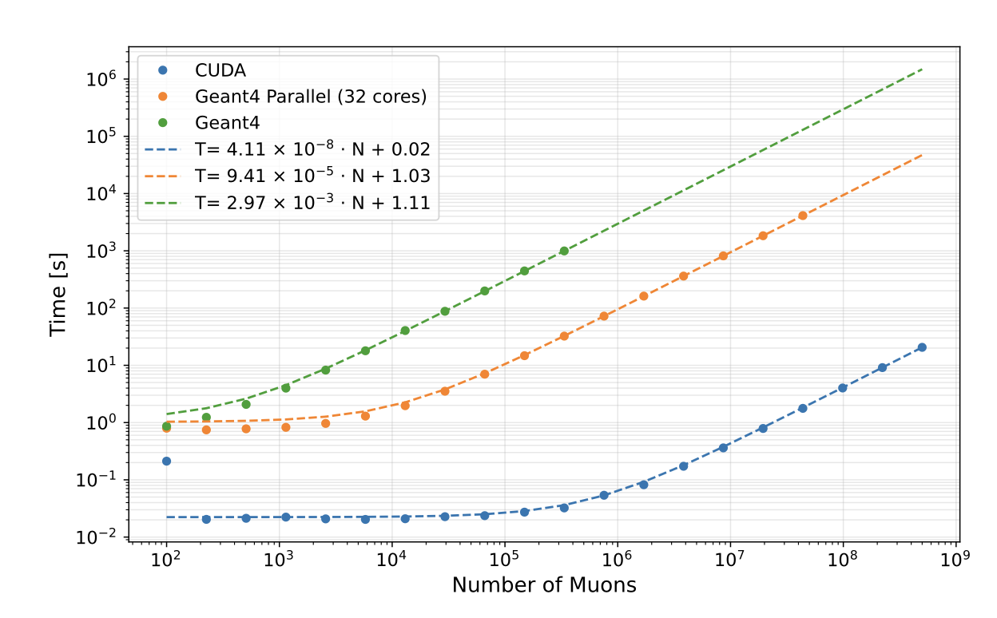
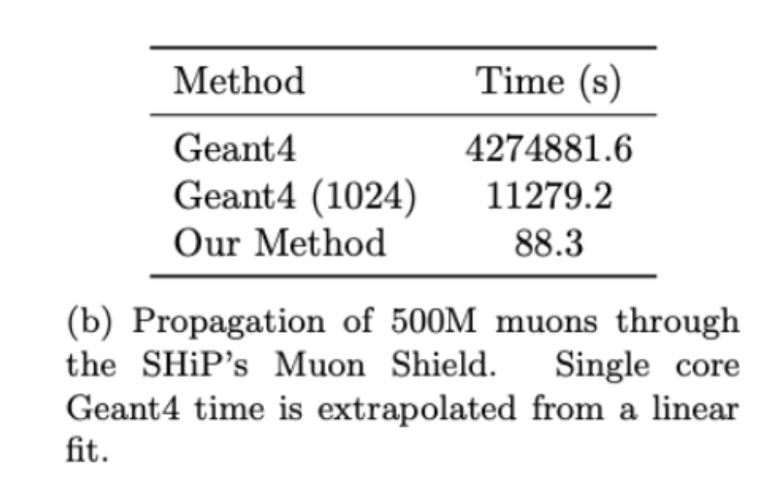
Artificial Intelligence in Instrument Design
Ultra-fast GPU simulation
Cattelan, Qasim, Owen, NS 2026
Ultra-fast simulation is essential for realistic, high statistics optimization
GEANT4 used offline to generate reference distributions
GPU simulation reproduce GEANT4 result at a fraction of the cost
Notes:
Thank you for the invitation. It is a pleasure to be here and discuss our proposal. I’m Nico Serra and I am professor at the Department of Physics of UZH, and with me is Alessio Figalli who is professor at the department of Mathematics of ETH. Alessio is well known in the field since, among other prizes, he is also the recipient of the Fields Medal 2018 for a mathematical theory known as Optimal Transport. I specialize in applied AI and large‑scale simulations to those large particle physics experiments that are underground below Geneva at CERN. Over the past years, through our consultancy with large companies, we kept seeing the same pain points in supply‑chain planning and logistics. So we realized our expertise could be useful in context, which led to this proposal.
FRase compatta che lancia la supply chain della consulenza
Comments: more or less fine
Thank you for the invitation, it is a pleasure to come here to present to you our Bridge Discovery Project.
Let me us start by introducing us.
Alessio is Professor in Mathematics at ETH Zurich, known for his work on Optimal Transport, and recipient of the Fields Medal 2018.
Nico is Professor at UZH and his research applies AI to complex, real‑world particle‑physics experiments
We have been collaborating for the past few years on interdisciplinary projects and as industrial consultants.
This project was born because we repeatedly saw that even very large companies struggle with supply‑chain planning, strategic decision‑making, and logistics.
Then we started to research this topic to understand where are the blank space and what is missing.
We studied the space to identify the key gaps and what’s missing… let me show you the gaps we targeted.

Slide 12
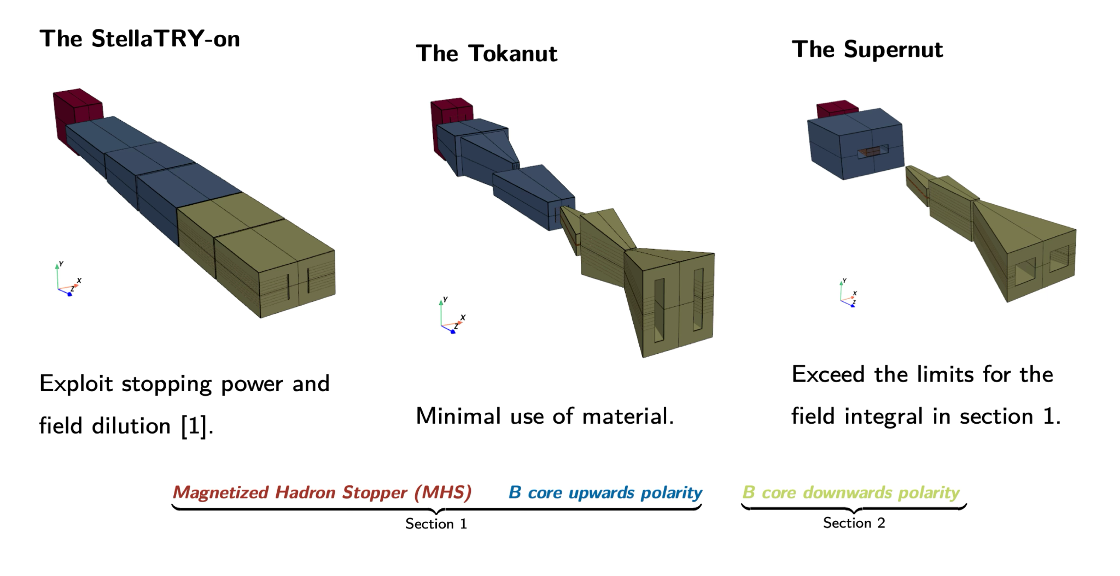
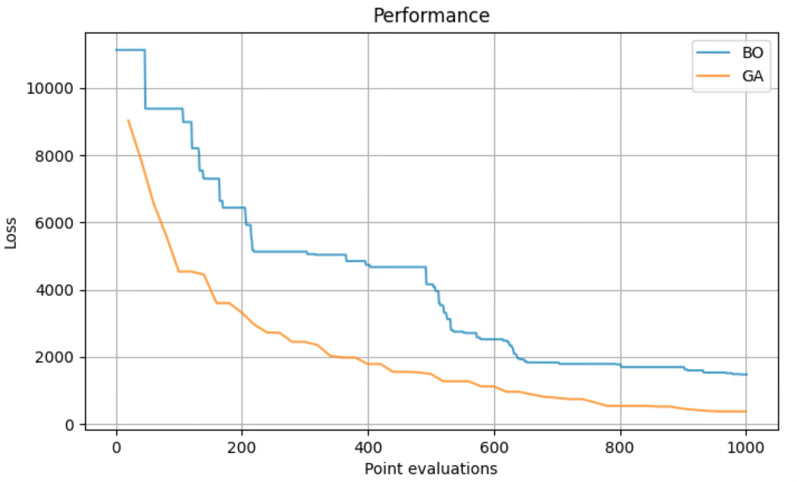

Artificial Intelligence in Instrument Design
Family of optimal muons shield solutions
SHiP Coll. 2026 in preparation
Different optimal design families
Superconducting magnet R&D by Tabea Arndt (KIT)
Best for SND
Cheapest Solution
Most compact
Other optimization methods can be easily plugged in
All designs achieve compatible expected muon rate (10kHz(CMA-ES)-60 kHz)
Notes:
Thank you for the invitation. It is a pleasure to be here and discuss our proposal. I’m Nico Serra and I am professor at the Department of Physics of UZH, and with me is Alessio Figalli who is professor at the department of Mathematics of ETH. Alessio is well known in the field since, among other prizes, he is also the recipient of the Fields Medal 2018 for a mathematical theory known as Optimal Transport. I specialize in applied AI and large‑scale simulations to those large particle physics experiments that are underground below Geneva at CERN. Over the past years, through our consultancy with large companies, we kept seeing the same pain points in supply‑chain planning and logistics. So we realized our expertise could be useful in context, which led to this proposal.
FRase compatta che lancia la supply chain della consulenza
Comments: more or less fine
Thank you for the invitation, it is a pleasure to come here to present to you our Bridge Discovery Project.
Let me us start by introducing us.
Alessio is Professor in Mathematics at ETH Zurich, known for his work on Optimal Transport, and recipient of the Fields Medal 2018.
Nico is Professor at UZH and his research applies AI to complex, real‑world particle‑physics experiments
We have been collaborating for the past few years on interdisciplinary projects and as industrial consultants.
This project was born because we repeatedly saw that even very large companies struggle with supply‑chain planning, strategic decision‑making, and logistics.
Then we started to research this topic to understand where are the blank space and what is missing.
We studied the space to identify the key gaps and what’s missing… let me show you the gaps we targeted.

Slide 13

Artificial Intelligence in Instrument Design
Robustness and sensitivity of optimized design
Cattelan, Qasim, Owen, NS 2026 in preparation
Optimized muon shield has O(100) parameters →
One-parameter scan ignores correlations
We want to study the neighbor of the optimum Φ*
Notes:
Thank you for the invitation. It is a pleasure to be here and discuss our proposal. I’m Nico Serra and I am professor at the Department of Physics of UZH, and with me is Alessio Figalli who is professor at the department of Mathematics of ETH. Alessio is well known in the field since, among other prizes, he is also the recipient of the Fields Medal 2018 for a mathematical theory known as Optimal Transport. I specialize in applied AI and large‑scale simulations to those large particle physics experiments that are underground below Geneva at CERN. Over the past years, through our consultancy with large companies, we kept seeing the same pain points in supply‑chain planning and logistics. So we realized our expertise could be useful in context, which led to this proposal.
FRase compatta che lancia la supply chain della consulenza
Comments: more or less fine
Thank you for the invitation, it is a pleasure to come here to present to you our Bridge Discovery Project.
Let me us start by introducing us.
Alessio is Professor in Mathematics at ETH Zurich, known for his work on Optimal Transport, and recipient of the Fields Medal 2018.
Nico is Professor at UZH and his research applies AI to complex, real‑world particle‑physics experiments
We have been collaborating for the past few years on interdisciplinary projects and as industrial consultants.
This project was born because we repeatedly saw that even very large companies struggle with supply‑chain planning, strategic decision‑making, and logistics.
Then we started to research this topic to understand where are the blank space and what is missing.
We studied the space to identify the key gaps and what’s missing… let me show you the gaps we targeted.

Slide 14
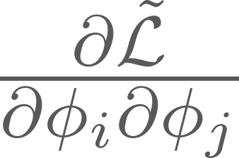
Artificial Intelligence in Instrument Design
Robustness and sensitivity of optimized design
Cattelan, Qasim, Owen, NS 2026 in preparation
Optimized muon shield has O(100) parameters →
One-parameter scan ignores correlations
We want to study the neighbor of the optimum Φ*
Notes:
Thank you for the invitation. It is a pleasure to be here and discuss our proposal. I’m Nico Serra and I am professor at the Department of Physics of UZH, and with me is Alessio Figalli who is professor at the department of Mathematics of ETH. Alessio is well known in the field since, among other prizes, he is also the recipient of the Fields Medal 2018 for a mathematical theory known as Optimal Transport. I specialize in applied AI and large‑scale simulations to those large particle physics experiments that are underground below Geneva at CERN. Over the past years, through our consultancy with large companies, we kept seeing the same pain points in supply‑chain planning and logistics. So we realized our expertise could be useful in context, which led to this proposal.
FRase compatta che lancia la supply chain della consulenza
Comments: more or less fine
Thank you for the invitation, it is a pleasure to come here to present to you our Bridge Discovery Project.
Let me us start by introducing us.
Alessio is Professor in Mathematics at ETH Zurich, known for his work on Optimal Transport, and recipient of the Fields Medal 2018.
Nico is Professor at UZH and his research applies AI to complex, real‑world particle‑physics experiments
We have been collaborating for the past few years on interdisciplinary projects and as industrial consultants.
This project was born because we repeatedly saw that even very large companies struggle with supply‑chain planning, strategic decision‑making, and logistics.
Then we started to research this topic to understand where are the blank space and what is missing.
We studied the space to identify the key gaps and what’s missing… let me show you the gaps we targeted.

Slide 15
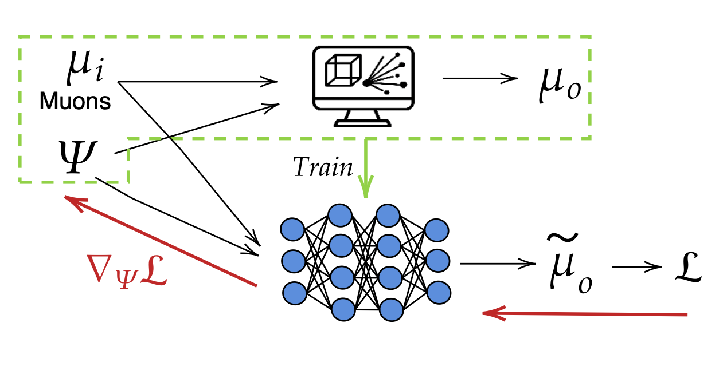
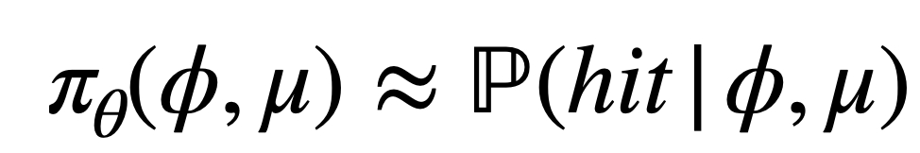
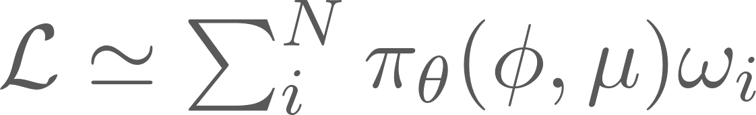
Artificial Intelligence in Instrument Design
Robustness and sensitivity of optimized design
Cattelan, Qasim, Owen, NS 2026 in preparation
Optimized muon shield has O(100) parameters →
One-parameter scan ignores correlations
We want to study the neighbor of the optimum Φ*
Built a classifier that approximate
NN parameters
Muon Shield parameters
Muon momentum & position
Notes:
Thank you for the invitation. It is a pleasure to be here and discuss our proposal. I’m Nico Serra and I am professor at the Department of Physics of UZH, and with me is Alessio Figalli who is professor at the department of Mathematics of ETH. Alessio is well known in the field since, among other prizes, he is also the recipient of the Fields Medal 2018 for a mathematical theory known as Optimal Transport. I specialize in applied AI and large‑scale simulations to those large particle physics experiments that are underground below Geneva at CERN. Over the past years, through our consultancy with large companies, we kept seeing the same pain points in supply‑chain planning and logistics. So we realized our expertise could be useful in context, which led to this proposal.
FRase compatta che lancia la supply chain della consulenza
Comments: more or less fine
Thank you for the invitation, it is a pleasure to come here to present to you our Bridge Discovery Project.
Let me us start by introducing us.
Alessio is Professor in Mathematics at ETH Zurich, known for his work on Optimal Transport, and recipient of the Fields Medal 2018.
Nico is Professor at UZH and his research applies AI to complex, real‑world particle‑physics experiments
We have been collaborating for the past few years on interdisciplinary projects and as industrial consultants.
This project was born because we repeatedly saw that even very large companies struggle with supply‑chain planning, strategic decision‑making, and logistics.
Then we started to research this topic to understand where are the blank space and what is missing.
We studied the space to identify the key gaps and what’s missing… let me show you the gaps we targeted.

Slide 16
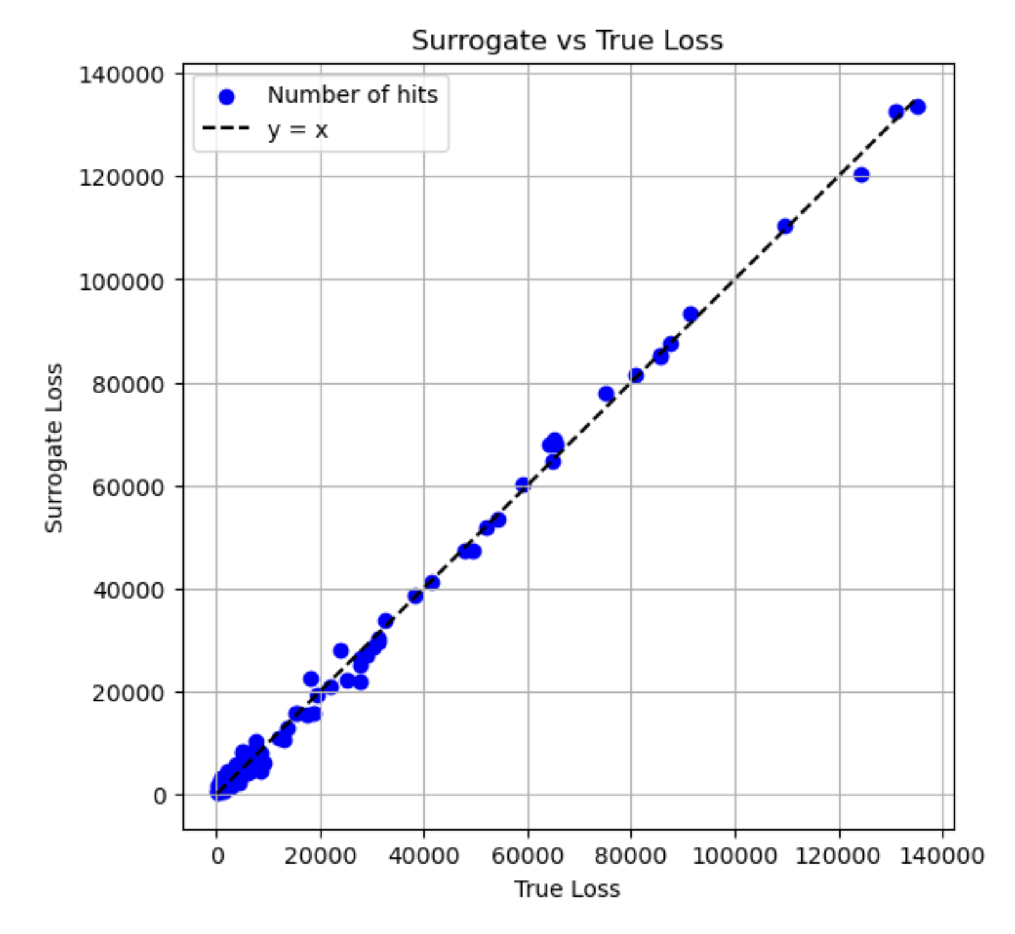
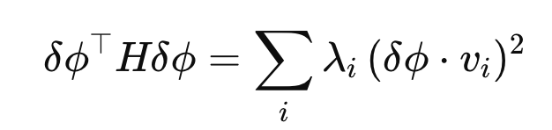
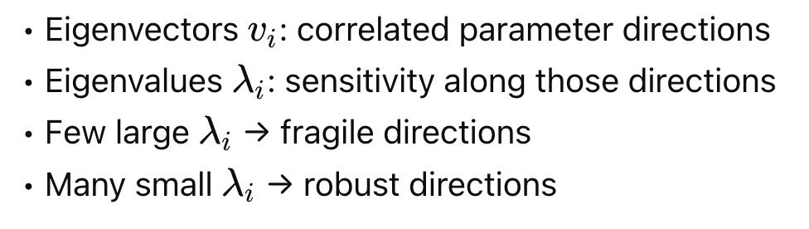
Artificial Intelligence in Instrument Design
Robustness and sensitivity of optimized design
Cattelan, Qasim, Owen, NS 2026 in preparation
Sample neighbor of Φ*
Build the Hessian
ongoing studies
Most eigenvalue are small
Most critical parameter is the current (within tolerance)
Notes:
Thank you for the invitation. It is a pleasure to be here and discuss our proposal. I’m Nico Serra and I am professor at the Department of Physics of UZH, and with me is Alessio Figalli who is professor at the department of Mathematics of ETH. Alessio is well known in the field since, among other prizes, he is also the recipient of the Fields Medal 2018 for a mathematical theory known as Optimal Transport. I specialize in applied AI and large‑scale simulations to those large particle physics experiments that are underground below Geneva at CERN. Over the past years, through our consultancy with large companies, we kept seeing the same pain points in supply‑chain planning and logistics. So we realized our expertise could be useful in context, which led to this proposal.
FRase compatta che lancia la supply chain della consulenza
Comments: more or less fine
Thank you for the invitation, it is a pleasure to come here to present to you our Bridge Discovery Project.
Let me us start by introducing us.
Alessio is Professor in Mathematics at ETH Zurich, known for his work on Optimal Transport, and recipient of the Fields Medal 2018.
Nico is Professor at UZH and his research applies AI to complex, real‑world particle‑physics experiments
We have been collaborating for the past few years on interdisciplinary projects and as industrial consultants.
This project was born because we repeatedly saw that even very large companies struggle with supply‑chain planning, strategic decision‑making, and logistics.
Then we started to research this topic to understand where are the blank space and what is missing.
We studied the space to identify the key gaps and what’s missing… let me show you the gaps we targeted.

Slide 17
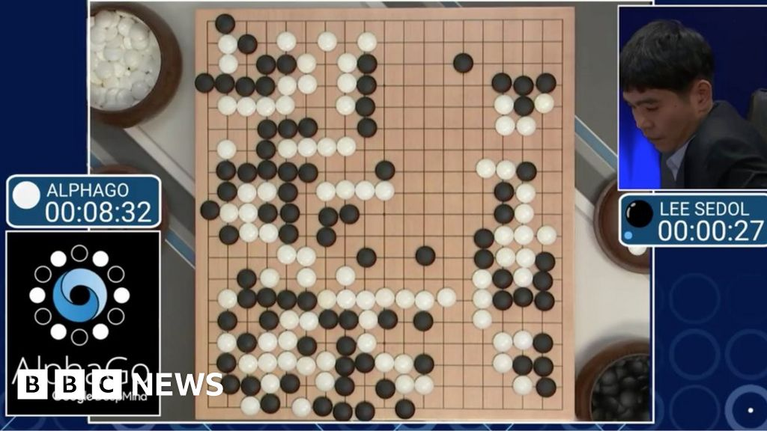
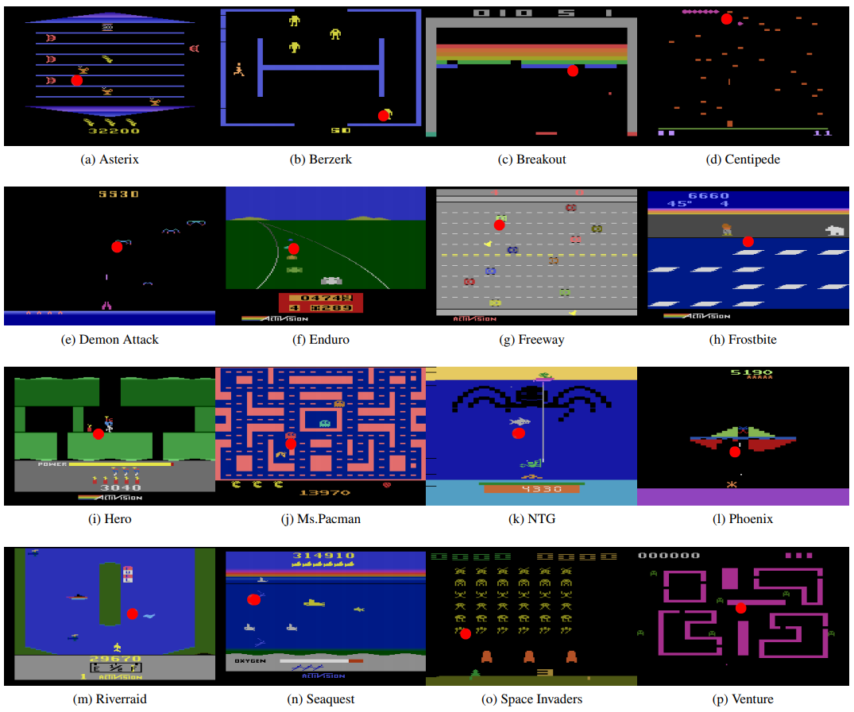
Artificial Intelligence in Instrument Design
Reinforcement Learning: Detector Design as a sequential decision process
BO problems
  Fixed number of parameters
  Poor scaling with dimensionality
  Discrete/structural choices difficult
Reinforcement Learning:
  Designed for sequential decision problems
  Proven at scale in large combinatorial search spaces (e.g. AlphaGo, ATARI)
  Naturally handles discrete, continuous
  Agent incrementally builds and modify a detector
  Data hungry → Fast simulation important
Notes:
Thank you for the invitation. It is a pleasure to be here and discuss our proposal. I’m Nico Serra and I am professor at the Department of Physics of UZH, and with me is Alessio Figalli who is professor at the department of Mathematics of ETH. Alessio is well known in the field since, among other prizes, he is also the recipient of the Fields Medal 2018 for a mathematical theory known as Optimal Transport. I specialize in applied AI and large‑scale simulations to those large particle physics experiments that are underground below Geneva at CERN. Over the past years, through our consultancy with large companies, we kept seeing the same pain points in supply‑chain planning and logistics. So we realized our expertise could be useful in context, which led to this proposal.
FRase compatta che lancia la supply chain della consulenza
Comments: more or less fine
Thank you for the invitation, it is a pleasure to come here to present to you our Bridge Discovery Project.
Let me us start by introducing us.
Alessio is Professor in Mathematics at ETH Zurich, known for his work on Optimal Transport, and recipient of the Fields Medal 2018.
Nico is Professor at UZH and his research applies AI to complex, real‑world particle‑physics experiments
We have been collaborating for the past few years on interdisciplinary projects and as industrial consultants.
This project was born because we repeatedly saw that even very large companies struggle with supply‑chain planning, strategic decision‑making, and logistics.
Then we started to research this topic to understand where are the blank space and what is missing.
We studied the space to identify the key gaps and what’s missing… let me show you the gaps we targeted.

Slide 18

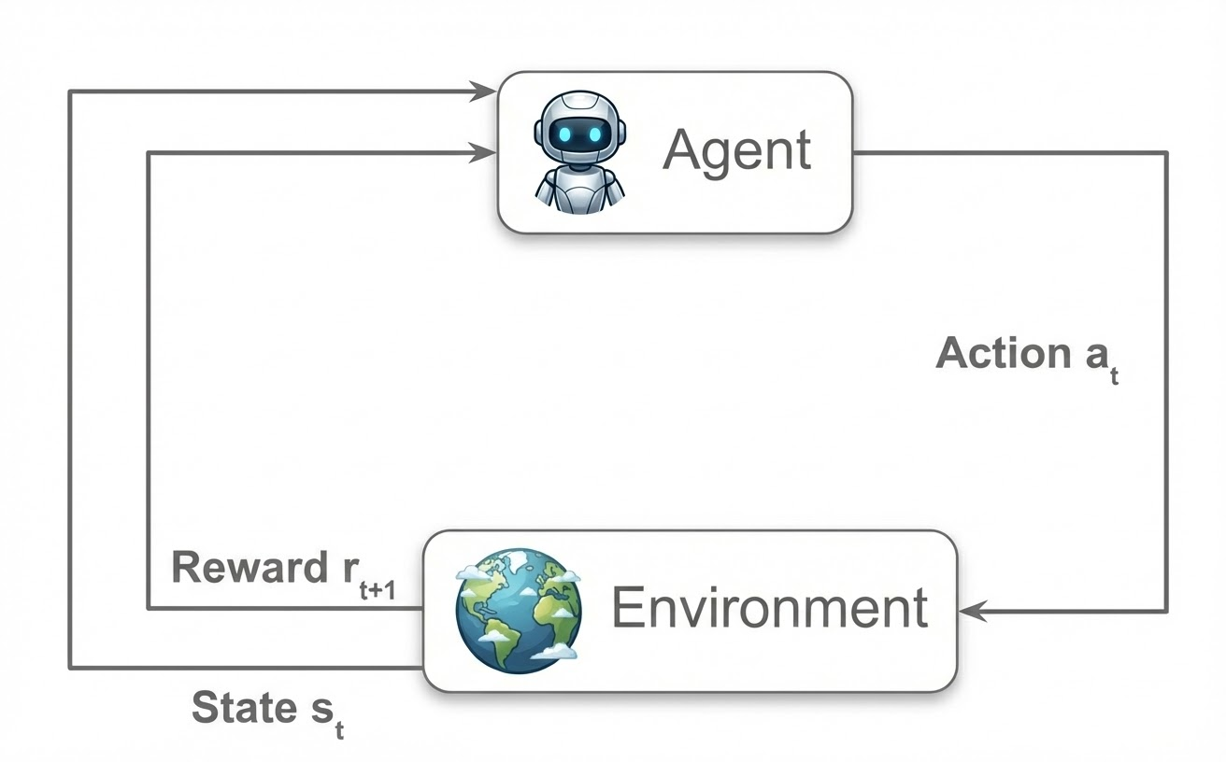
Artificial Intelligence in Instrument Design
What is Reinforcement Learning
An Agent interacts with the Environment
At each step the agent takes an action
The environment returns a reward and new state
The agent learns a policy that maximizes the cumulative reward
environment → detector simulation
state → current (partial) detector
action → add/modify detector component
reward → detector performance score
Notes:
Thank you for the invitation. It is a pleasure to be here and discuss our proposal. I’m Nico Serra and I am professor at the Department of Physics of UZH, and with me is Alessio Figalli who is professor at the department of Mathematics of ETH. Alessio is well known in the field since, among other prizes, he is also the recipient of the Fields Medal 2018 for a mathematical theory known as Optimal Transport. I specialize in applied AI and large‑scale simulations to those large particle physics experiments that are underground below Geneva at CERN. Over the past years, through our consultancy with large companies, we kept seeing the same pain points in supply‑chain planning and logistics. So we realized our expertise could be useful in context, which led to this proposal.
FRase compatta che lancia la supply chain della consulenza
Comments: more or less fine
Thank you for the invitation, it is a pleasure to come here to present to you our Bridge Discovery Project.
Let me us start by introducing us.
Alessio is Professor in Mathematics at ETH Zurich, known for his work on Optimal Transport, and recipient of the Fields Medal 2018.
Nico is Professor at UZH and his research applies AI to complex, real‑world particle‑physics experiments
We have been collaborating for the past few years on interdisciplinary projects and as industrial consultants.
This project was born because we repeatedly saw that even very large companies struggle with supply‑chain planning, strategic decision‑making, and logistics.
Then we started to research this topic to understand where are the blank space and what is missing.
We studied the space to identify the key gaps and what’s missing… let me show you the gaps we targeted.

Slide 19
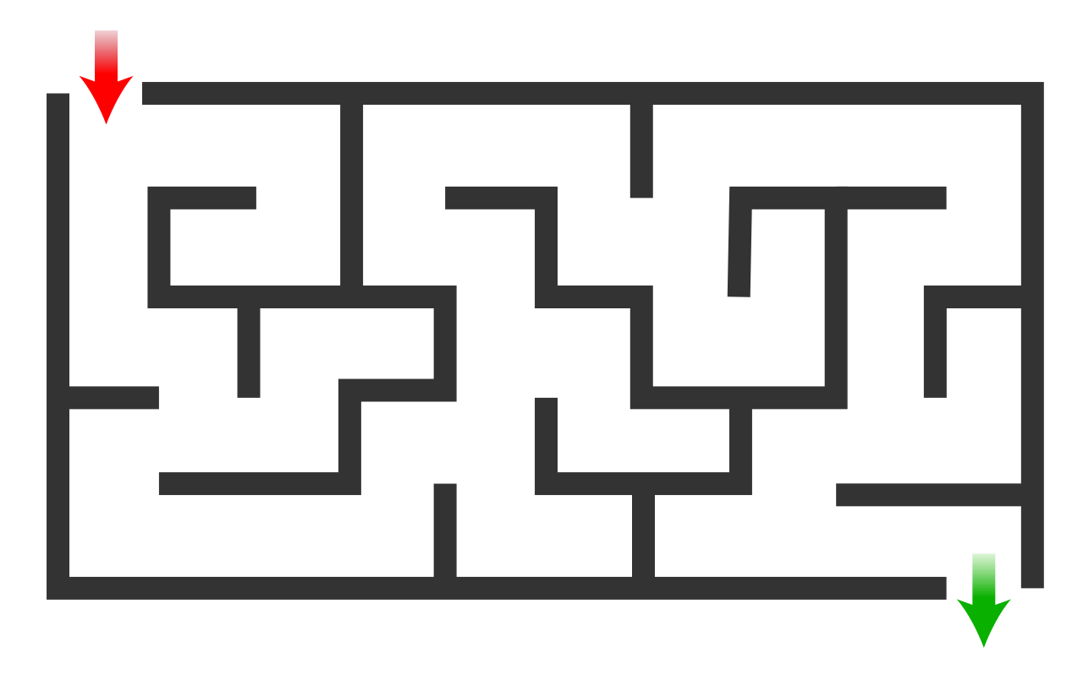
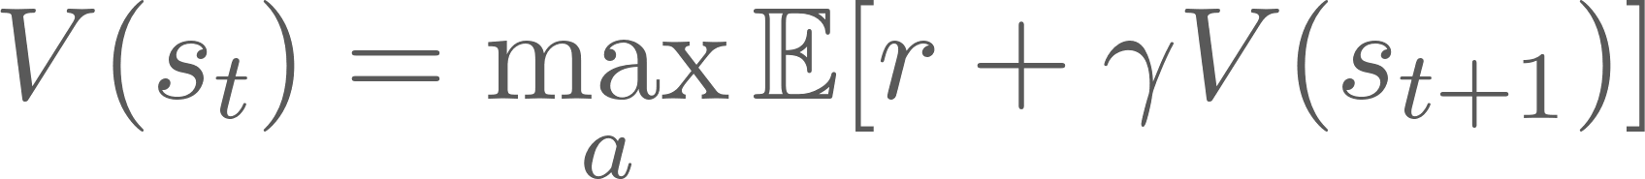
Artificial Intelligence in Instrument Design
How reinforcement learning works
RL is based on Bellman equations, which define optimal decisions recursively via future rewards
The optimal policy selects actions that maximize the value function, i.e. the expected cumulative reward
Notes:
Thank you for the invitation. It is a pleasure to be here and discuss our proposal. I’m Nico Serra and I am professor at the Department of Physics of UZH, and with me is Alessio Figalli who is professor at the department of Mathematics of ETH. Alessio is well known in the field since, among other prizes, he is also the recipient of the Fields Medal 2018 for a mathematical theory known as Optimal Transport. I specialize in applied AI and large‑scale simulations to those large particle physics experiments that are underground below Geneva at CERN. Over the past years, through our consultancy with large companies, we kept seeing the same pain points in supply‑chain planning and logistics. So we realized our expertise could be useful in context, which led to this proposal.
FRase compatta che lancia la supply chain della consulenza
Comments: more or less fine
Thank you for the invitation, it is a pleasure to come here to present to you our Bridge Discovery Project.
Let me us start by introducing us.
Alessio is Professor in Mathematics at ETH Zurich, known for his work on Optimal Transport, and recipient of the Fields Medal 2018.
Nico is Professor at UZH and his research applies AI to complex, real‑world particle‑physics experiments
We have been collaborating for the past few years on interdisciplinary projects and as industrial consultants.
This project was born because we repeatedly saw that even very large companies struggle with supply‑chain planning, strategic decision‑making, and logistics.
Then we started to research this topic to understand where are the blank space and what is missing.
We studied the space to identify the key gaps and what’s missing… let me show you the gaps we targeted.

Slide 20
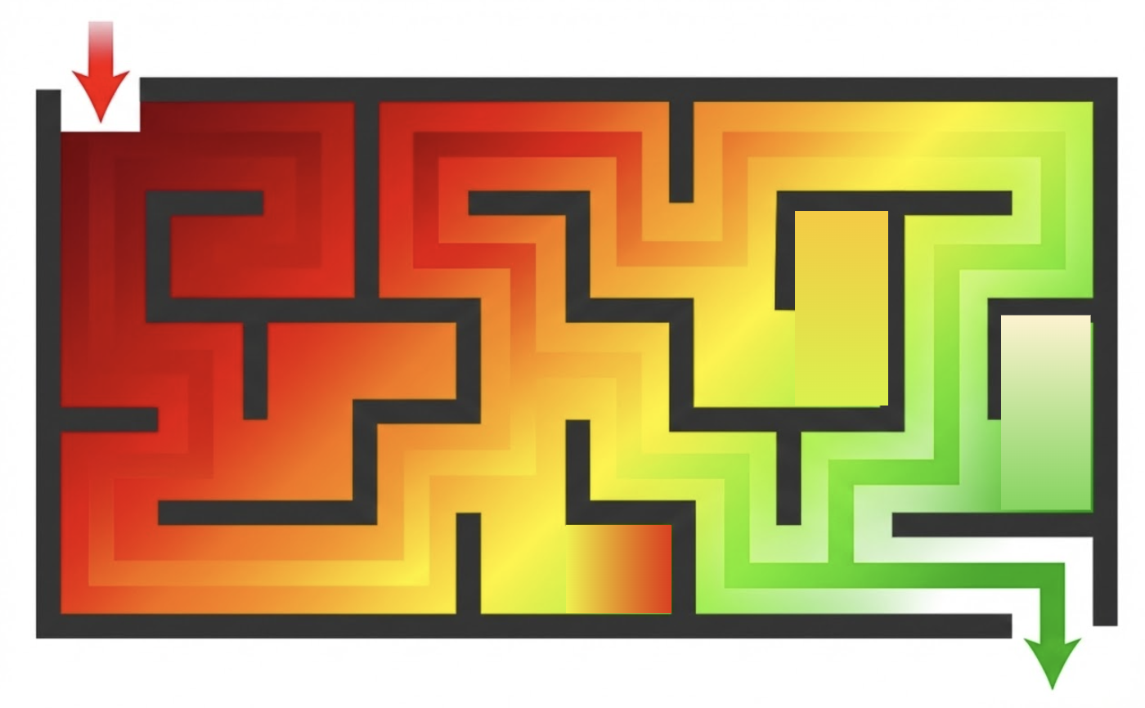
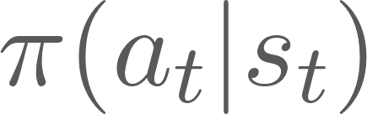

Artificial Intelligence in Instrument Design
How reinforcement learning works
RL is based on Bellman equations, which define optimal decisions recursively via future rewards
The optimal policy selects actions that maximize the value function, i.e. the expected cumulative reward
=
Notes:
Thank you for the invitation. It is a pleasure to be here and discuss our proposal. I’m Nico Serra and I am professor at the Department of Physics of UZH, and with me is Alessio Figalli who is professor at the department of Mathematics of ETH. Alessio is well known in the field since, among other prizes, he is also the recipient of the Fields Medal 2018 for a mathematical theory known as Optimal Transport. I specialize in applied AI and large‑scale simulations to those large particle physics experiments that are underground below Geneva at CERN. Over the past years, through our consultancy with large companies, we kept seeing the same pain points in supply‑chain planning and logistics. So we realized our expertise could be useful in context, which led to this proposal.
FRase compatta che lancia la supply chain della consulenza
Comments: more or less fine
Thank you for the invitation, it is a pleasure to come here to present to you our Bridge Discovery Project.
Let me us start by introducing us.
Alessio is Professor in Mathematics at ETH Zurich, known for his work on Optimal Transport, and recipient of the Fields Medal 2018.
Nico is Professor at UZH and his research applies AI to complex, real‑world particle‑physics experiments
We have been collaborating for the past few years on interdisciplinary projects and as industrial consultants.
This project was born because we repeatedly saw that even very large companies struggle with supply‑chain planning, strategic decision‑making, and logistics.
Then we started to research this topic to understand where are the blank space and what is missing.
We studied the space to identify the key gaps and what’s missing… let me show you the gaps we targeted.

Slide 21
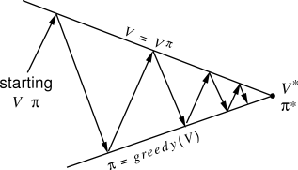
Artificial Intelligence in Instrument Design
How reinforcement learning works
RL is based on Bellman equations, which define optimal decisions recursively via future rewards
The optimal policy selects actions that maximize the value function, i.e. the expected cumulative reward
=
Notes:
Thank you for the invitation. It is a pleasure to be here and discuss our proposal. I’m Nico Serra and I am professor at the Department of Physics of UZH, and with me is Alessio Figalli who is professor at the department of Mathematics of ETH. Alessio is well known in the field since, among other prizes, he is also the recipient of the Fields Medal 2018 for a mathematical theory known as Optimal Transport. I specialize in applied AI and large‑scale simulations to those large particle physics experiments that are underground below Geneva at CERN. Over the past years, through our consultancy with large companies, we kept seeing the same pain points in supply‑chain planning and logistics. So we realized our expertise could be useful in context, which led to this proposal.
FRase compatta che lancia la supply chain della consulenza
Comments: more or less fine
Thank you for the invitation, it is a pleasure to come here to present to you our Bridge Discovery Project.
Let me us start by introducing us.
Alessio is Professor in Mathematics at ETH Zurich, known for his work on Optimal Transport, and recipient of the Fields Medal 2018.
Nico is Professor at UZH and his research applies AI to complex, real‑world particle‑physics experiments
We have been collaborating for the past few years on interdisciplinary projects and as industrial consultants.
This project was born because we repeatedly saw that even very large companies struggle with supply‑chain planning, strategic decision‑making, and logistics.
Then we started to research this topic to understand where are the blank space and what is missing.
We studied the space to identify the key gaps and what’s missing… let me show you the gaps we targeted.

Slide 22
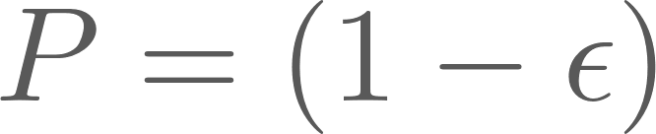
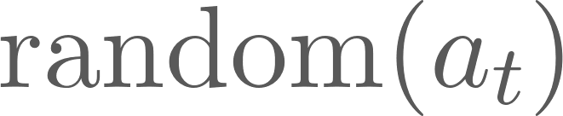

Artificial Intelligence in Instrument Design
How reinforcement learning works
RL is based on Bellman equations, which define optimal decisions recursively via future rewards
The optimal policy selects actions that maximize the value function, i.e. the expected cumulative reward
=
Notes:
Thank you for the invitation. It is a pleasure to be here and discuss our proposal. I’m Nico Serra and I am professor at the Department of Physics of UZH, and with me is Alessio Figalli who is professor at the department of Mathematics of ETH. Alessio is well known in the field since, among other prizes, he is also the recipient of the Fields Medal 2018 for a mathematical theory known as Optimal Transport. I specialize in applied AI and large‑scale simulations to those large particle physics experiments that are underground below Geneva at CERN. Over the past years, through our consultancy with large companies, we kept seeing the same pain points in supply‑chain planning and logistics. So we realized our expertise could be useful in context, which led to this proposal.
FRase compatta che lancia la supply chain della consulenza
Comments: more or less fine
Thank you for the invitation, it is a pleasure to come here to present to you our Bridge Discovery Project.
Let me us start by introducing us.
Alessio is Professor in Mathematics at ETH Zurich, known for his work on Optimal Transport, and recipient of the Fields Medal 2018.
Nico is Professor at UZH and his research applies AI to complex, real‑world particle‑physics experiments
We have been collaborating for the past few years on interdisciplinary projects and as industrial consultants.
This project was born because we repeatedly saw that even very large companies struggle with supply‑chain planning, strategic decision‑making, and logistics.
Then we started to research this topic to understand where are the blank space and what is missing.
We studied the space to identify the key gaps and what’s missing… let me show you the gaps we targeted.

Slide 23
Artificial Intelligence in Instrument Design
How reinforcement learning works
RL is based on Bellman equations, which define optimal decisions recursively via future rewards
The optimal policy selects actions that maximize the value function, i.e. the expected cumulative reward
=
In Deep Reinforcement Learning the value function and/or the policy are approximated by neural networks
Notes:
Thank you for the invitation. It is a pleasure to be here and discuss our proposal. I’m Nico Serra and I am professor at the Department of Physics of UZH, and with me is Alessio Figalli who is professor at the department of Mathematics of ETH. Alessio is well known in the field since, among other prizes, he is also the recipient of the Fields Medal 2018 for a mathematical theory known as Optimal Transport. I specialize in applied AI and large‑scale simulations to those large particle physics experiments that are underground below Geneva at CERN. Over the past years, through our consultancy with large companies, we kept seeing the same pain points in supply‑chain planning and logistics. So we realized our expertise could be useful in context, which led to this proposal.
FRase compatta che lancia la supply chain della consulenza
Comments: more or less fine
Thank you for the invitation, it is a pleasure to come here to present to you our Bridge Discovery Project.
Let me us start by introducing us.
Alessio is Professor in Mathematics at ETH Zurich, known for his work on Optimal Transport, and recipient of the Fields Medal 2018.
Nico is Professor at UZH and his research applies AI to complex, real‑world particle‑physics experiments
We have been collaborating for the past few years on interdisciplinary projects and as industrial consultants.
This project was born because we repeatedly saw that even very large companies struggle with supply‑chain planning, strategic decision‑making, and logistics.
Then we started to research this topic to understand where are the blank space and what is missing.
We studied the space to identify the key gaps and what’s missing… let me show you the gaps we targeted.

Slide 24
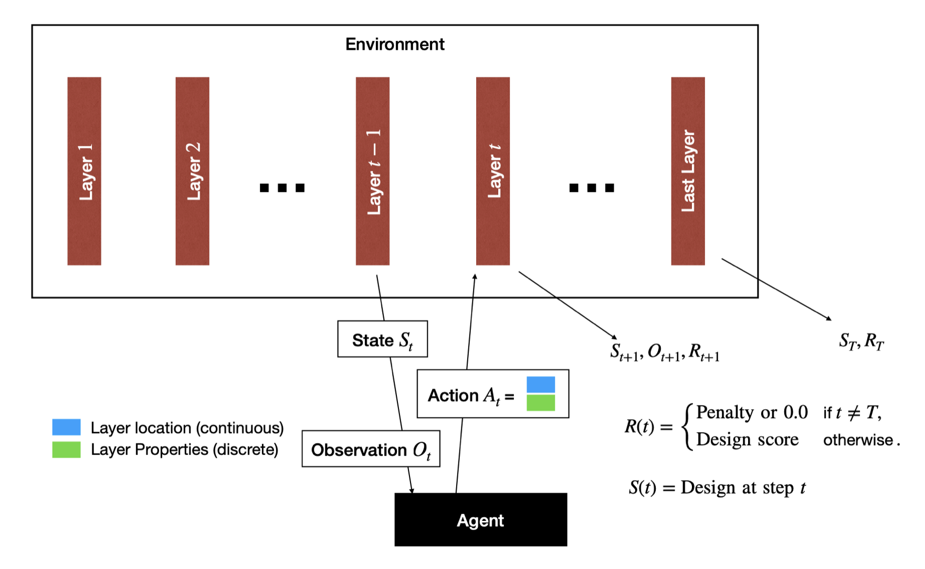
Artificial Intelligence in Instrument Design
Reinforcement Learning for Detector Design
Qasim, Owen, NS 2024
The agent sequentially places detector layers of different types
Constraints (space, budget, …) are enforced by action masking and/or large negative rewards
The reward is given only at the end of the episode when the detector design is complete
Notes:
Thank you for the invitation. It is a pleasure to be here and discuss our proposal. I’m Nico Serra and I am professor at the Department of Physics of UZH, and with me is Alessio Figalli who is professor at the department of Mathematics of ETH. Alessio is well known in the field since, among other prizes, he is also the recipient of the Fields Medal 2018 for a mathematical theory known as Optimal Transport. I specialize in applied AI and large‑scale simulations to those large particle physics experiments that are underground below Geneva at CERN. Over the past years, through our consultancy with large companies, we kept seeing the same pain points in supply‑chain planning and logistics. So we realized our expertise could be useful in context, which led to this proposal.
FRase compatta che lancia la supply chain della consulenza
Comments: more or less fine
Thank you for the invitation, it is a pleasure to come here to present to you our Bridge Discovery Project.
Let me us start by introducing us.
Alessio is Professor in Mathematics at ETH Zurich, known for his work on Optimal Transport, and recipient of the Fields Medal 2018.
Nico is Professor at UZH and his research applies AI to complex, real‑world particle‑physics experiments
We have been collaborating for the past few years on interdisciplinary projects and as industrial consultants.
This project was born because we repeatedly saw that even very large companies struggle with supply‑chain planning, strategic decision‑making, and logistics.
Then we started to research this topic to understand where are the blank space and what is missing.
We studied the space to identify the key gaps and what’s missing… let me show you the gaps we targeted.

Slide 25
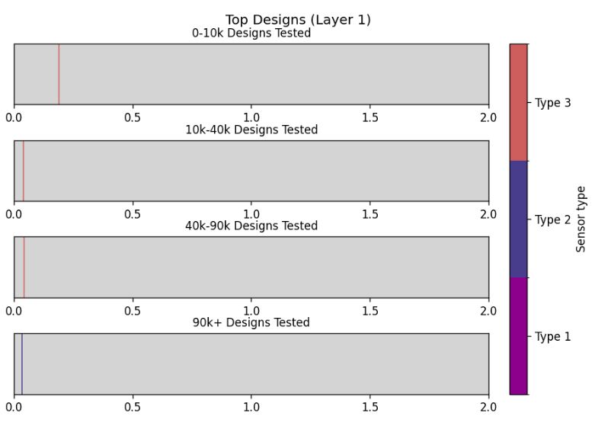
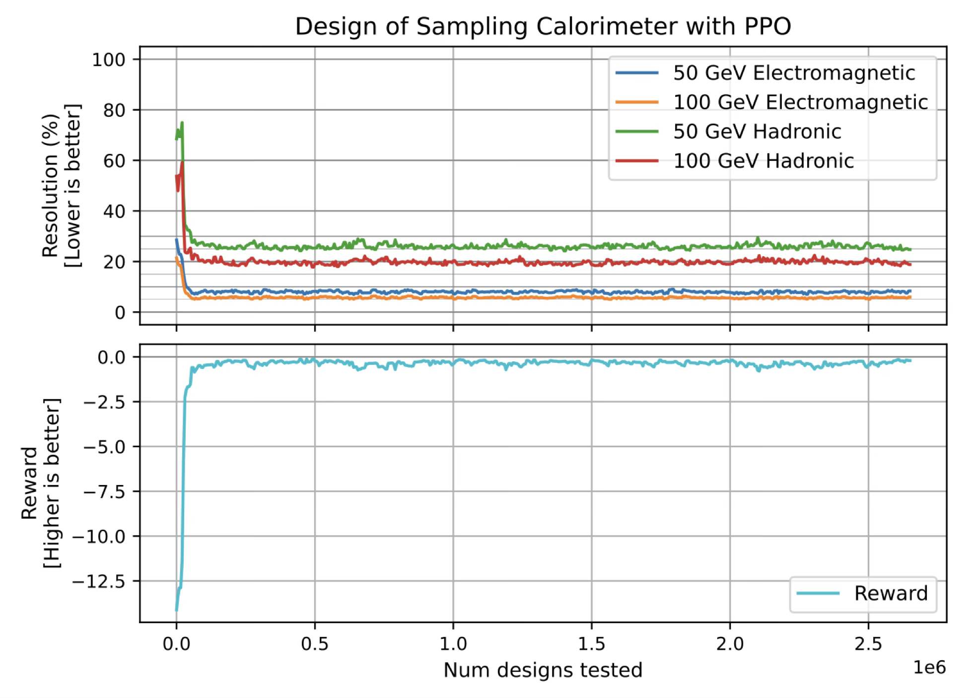
Artificial Intelligence in Instrument Design
Calorimeter Design with RL
Qasim, Owen, NS 2024
The agent sequentially puts sensitive layers
Reward based on em and hadronic energy resolution
The agent rapidly learns a non-uniform optimal configuration
Notes:
Thank you for the invitation. It is a pleasure to be here and discuss our proposal. I’m Nico Serra and I am professor at the Department of Physics of UZH, and with me is Alessio Figalli who is professor at the department of Mathematics of ETH. Alessio is well known in the field since, among other prizes, he is also the recipient of the Fields Medal 2018 for a mathematical theory known as Optimal Transport. I specialize in applied AI and large‑scale simulations to those large particle physics experiments that are underground below Geneva at CERN. Over the past years, through our consultancy with large companies, we kept seeing the same pain points in supply‑chain planning and logistics. So we realized our expertise could be useful in context, which led to this proposal.
FRase compatta che lancia la supply chain della consulenza
Comments: more or less fine
Thank you for the invitation, it is a pleasure to come here to present to you our Bridge Discovery Project.
Let me us start by introducing us.
Alessio is Professor in Mathematics at ETH Zurich, known for his work on Optimal Transport, and recipient of the Fields Medal 2018.
Nico is Professor at UZH and his research applies AI to complex, real‑world particle‑physics experiments
We have been collaborating for the past few years on interdisciplinary projects and as industrial consultants.
This project was born because we repeatedly saw that even very large companies struggle with supply‑chain planning, strategic decision‑making, and logistics.
Then we started to research this topic to understand where are the blank space and what is missing.
We studied the space to identify the key gaps and what’s missing… let me show you the gaps we targeted.

Slide 26
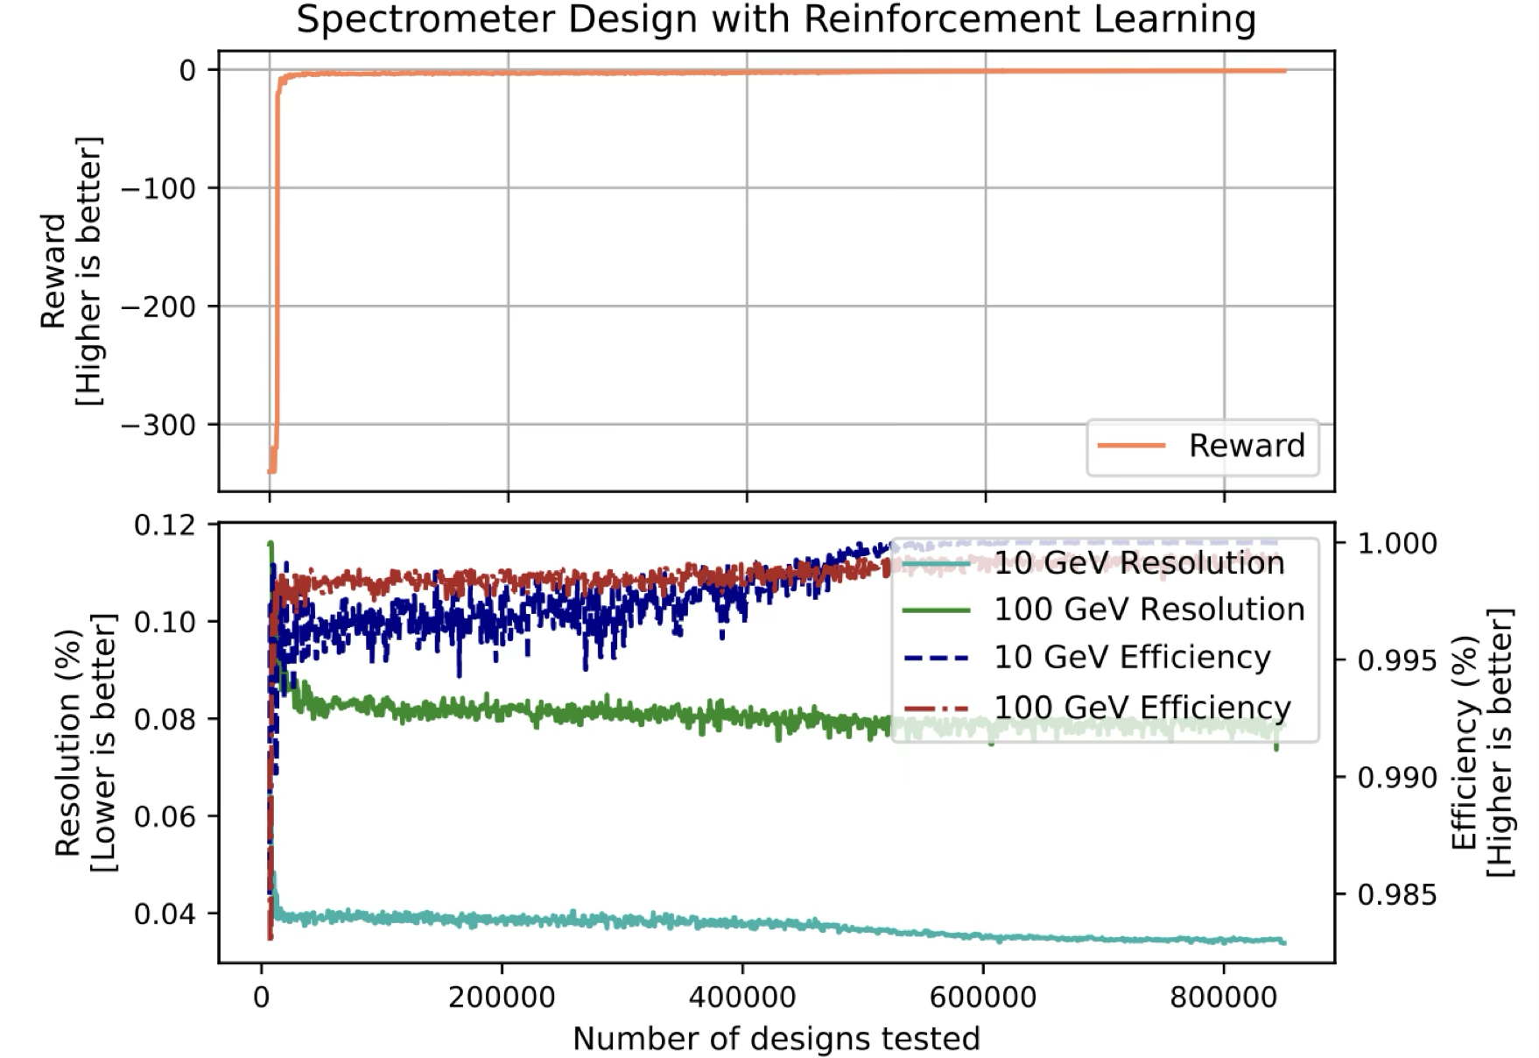
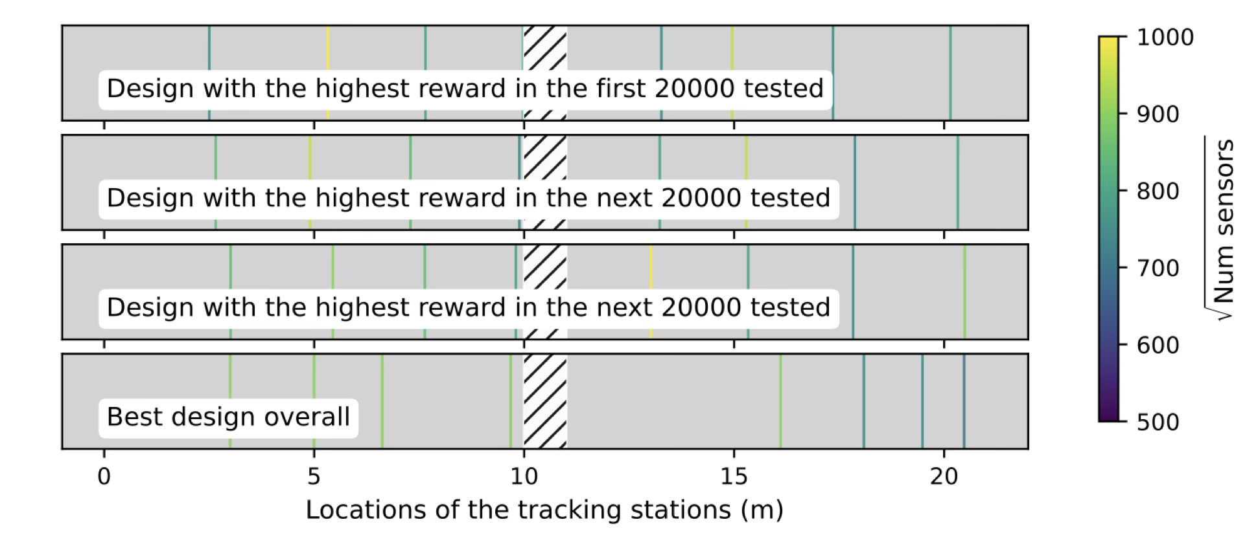
Artificial Intelligence in Instrument Design
Spectrometer Design with RL
Qasim, Owen, NS 2024
The agent sequentially puts sensitive layers deciding on the granularity
Track Fitting and multiple scattering simulated
Reward based on momentum resolution
Notes:
Thank you for the invitation. It is a pleasure to be here and discuss our proposal. I’m Nico Serra and I am professor at the Department of Physics of UZH, and with me is Alessio Figalli who is professor at the department of Mathematics of ETH. Alessio is well known in the field since, among other prizes, he is also the recipient of the Fields Medal 2018 for a mathematical theory known as Optimal Transport. I specialize in applied AI and large‑scale simulations to those large particle physics experiments that are underground below Geneva at CERN. Over the past years, through our consultancy with large companies, we kept seeing the same pain points in supply‑chain planning and logistics. So we realized our expertise could be useful in context, which led to this proposal.
FRase compatta che lancia la supply chain della consulenza
Comments: more or less fine
Thank you for the invitation, it is a pleasure to come here to present to you our Bridge Discovery Project.
Let me us start by introducing us.
Alessio is Professor in Mathematics at ETH Zurich, known for his work on Optimal Transport, and recipient of the Fields Medal 2018.
Nico is Professor at UZH and his research applies AI to complex, real‑world particle‑physics experiments
We have been collaborating for the past few years on interdisciplinary projects and as industrial consultants.
This project was born because we repeatedly saw that even very large companies struggle with supply‑chain planning, strategic decision‑making, and logistics.
Then we started to research this topic to understand where are the blank space and what is missing.
We studied the space to identify the key gaps and what’s missing… let me show you the gaps we targeted.

Slide 27
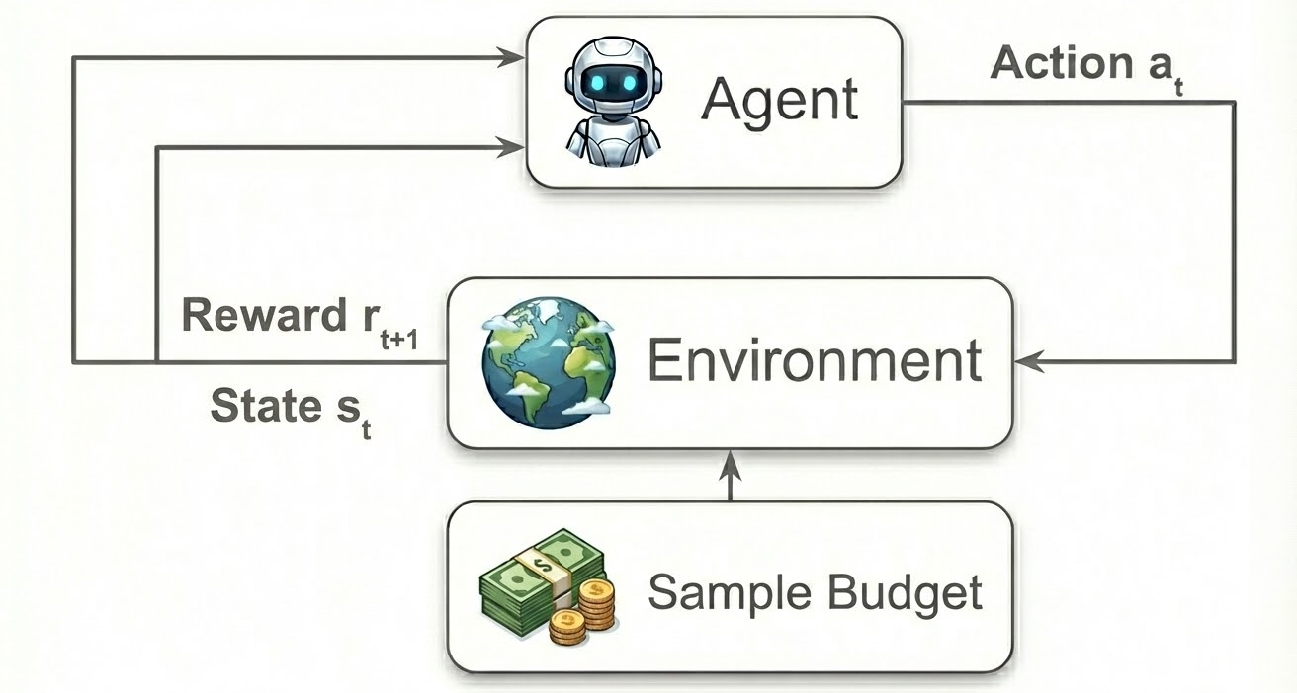
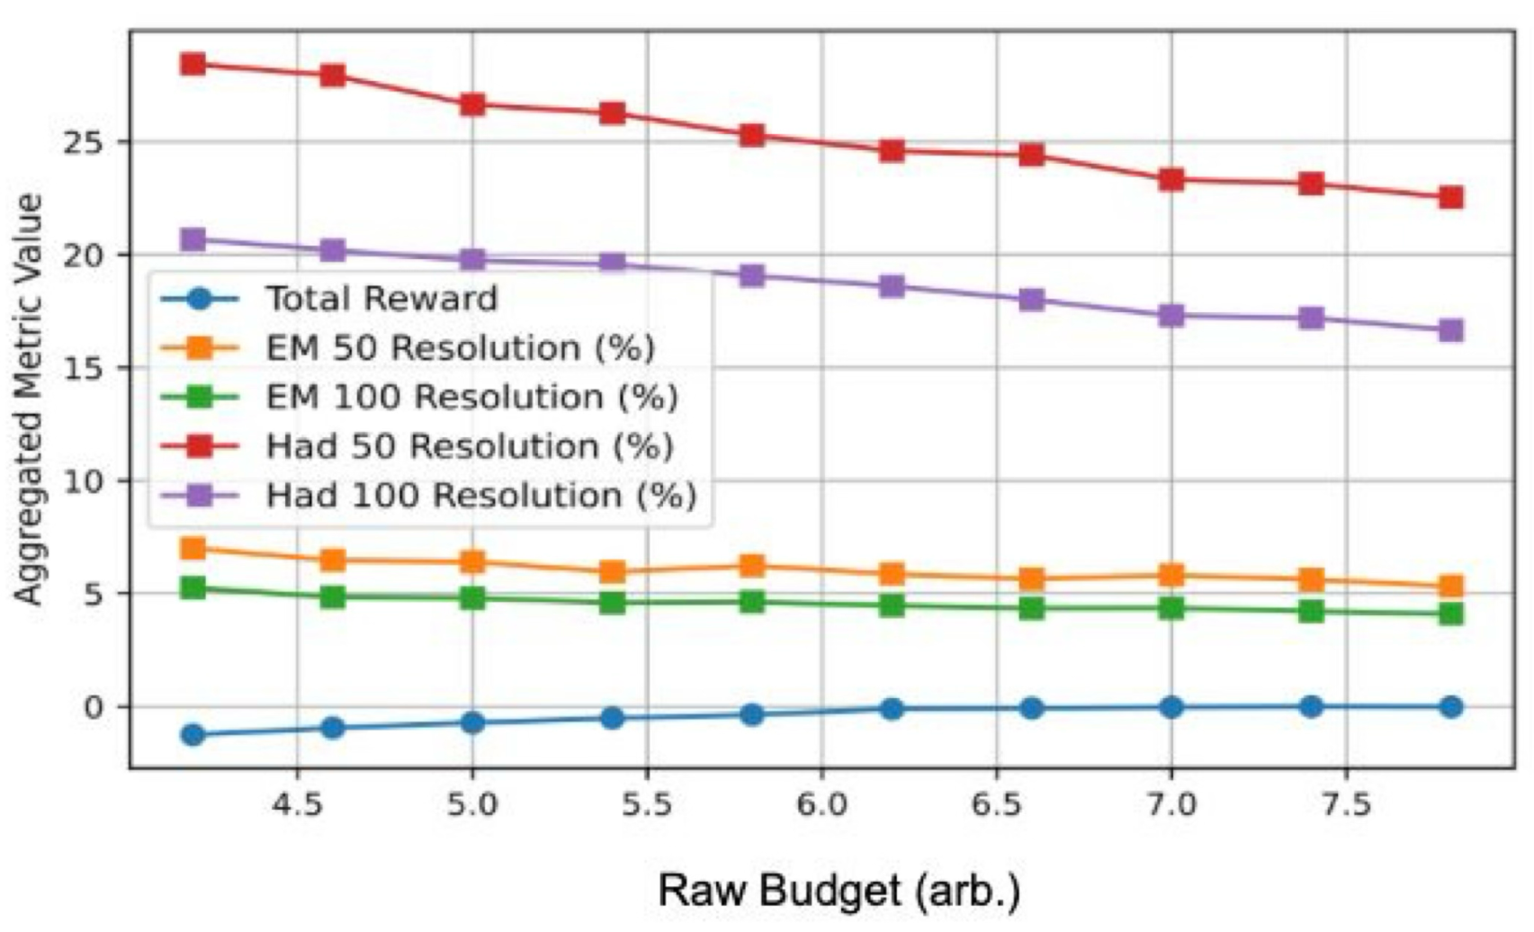
Artificial Intelligence in Instrument Design
Conditional Reinforcement Learning Training
Zoccheddu, Qasim, Owen, NS 2026 in preparation
Detector design is intrinsically multi-objective, and a single scalar score is often not fixed a priori (e.g. available budget)
We treat the budget as a conditioning variable, included in the agent observation
During training, the budget is randomly sampled at the beginning of each episode
The agent learns a policy that outputs the optimal design conditional on the budget
At inference time, new designs are generated instantly without retraining
Notes:
Thank you for the invitation. It is a pleasure to be here and discuss our proposal. I’m Nico Serra and I am professor at the Department of Physics of UZH, and with me is Alessio Figalli who is professor at the department of Mathematics of ETH. Alessio is well known in the field since, among other prizes, he is also the recipient of the Fields Medal 2018 for a mathematical theory known as Optimal Transport. I specialize in applied AI and large‑scale simulations to those large particle physics experiments that are underground below Geneva at CERN. Over the past years, through our consultancy with large companies, we kept seeing the same pain points in supply‑chain planning and logistics. So we realized our expertise could be useful in context, which led to this proposal.
FRase compatta che lancia la supply chain della consulenza
Comments: more or less fine
Thank you for the invitation, it is a pleasure to come here to present to you our Bridge Discovery Project.
Let me us start by introducing us.
Alessio is Professor in Mathematics at ETH Zurich, known for his work on Optimal Transport, and recipient of the Fields Medal 2018.
Nico is Professor at UZH and his research applies AI to complex, real‑world particle‑physics experiments
We have been collaborating for the past few years on interdisciplinary projects and as industrial consultants.
This project was born because we repeatedly saw that even very large companies struggle with supply‑chain planning, strategic decision‑making, and logistics.
Then we started to research this topic to understand where are the blank space and what is missing.
We studied the space to identify the key gaps and what’s missing… let me show you the gaps we targeted.

Slide 28
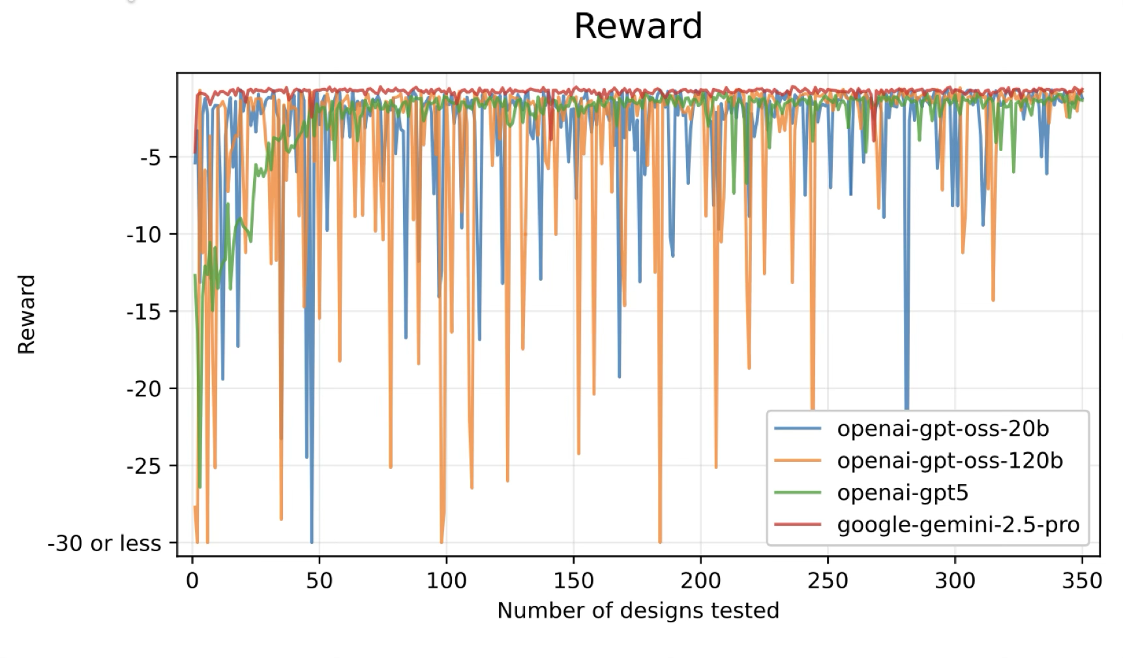
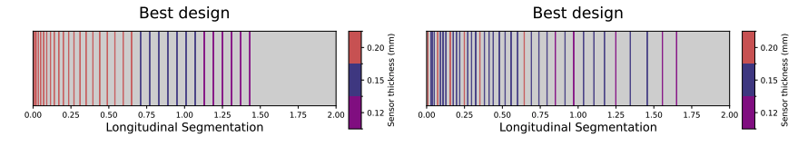
Artificial Intelligence in Instrument Design
Using Reasoning from LLMs
Zoccheddu, Qasim, Owen, NS 2026
Rewards in detector design are sparse, so RL spends substantial time exploring invalid/uninformative designs
LLMs can be used as meta-planners to reduce cold-start cost
LLMs consistently generate valid, resource aware, and physically meaningful designs
RL achieve the strongest final performance
LLM
LLM+TR refine
Notes:
Thank you for the invitation. It is a pleasure to be here and discuss our proposal. I’m Nico Serra and I am professor at the Department of Physics of UZH, and with me is Alessio Figalli who is professor at the department of Mathematics of ETH. Alessio is well known in the field since, among other prizes, he is also the recipient of the Fields Medal 2018 for a mathematical theory known as Optimal Transport. I specialize in applied AI and large‑scale simulations to those large particle physics experiments that are underground below Geneva at CERN. Over the past years, through our consultancy with large companies, we kept seeing the same pain points in supply‑chain planning and logistics. So we realized our expertise could be useful in context, which led to this proposal.
FRase compatta che lancia la supply chain della consulenza
Comments: more or less fine
Thank you for the invitation, it is a pleasure to come here to present to you our Bridge Discovery Project.
Let me us start by introducing us.
Alessio is Professor in Mathematics at ETH Zurich, known for his work on Optimal Transport, and recipient of the Fields Medal 2018.
Nico is Professor at UZH and his research applies AI to complex, real‑world particle‑physics experiments
We have been collaborating for the past few years on interdisciplinary projects and as industrial consultants.
This project was born because we repeatedly saw that even very large companies struggle with supply‑chain planning, strategic decision‑making, and logistics.
Then we started to research this topic to understand where are the blank space and what is missing.
We studied the space to identify the key gaps and what’s missing… let me show you the gaps we targeted.

Slide 29
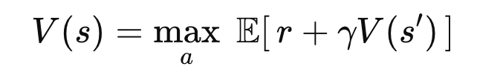
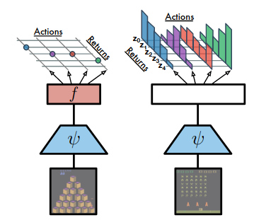
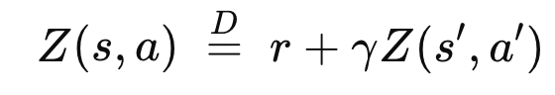


Artificial Intelligence in Instrument Design
Uncertainty aware optimization: distributional RL
Figalli, Qasim, Owen, NS 2026 (Frontiers in Physics)
Detector performance is inherently stochastic
Standard RL optimizes the expected reward only
Distributional RL learns the full distribution of returns, not just the mean
The agent reasons about variability, tails, and risk-sensitive outcomes
Bellemare 2022 - Distributional RL
Normal RL
Dist RL
Notes:
Thank you for the invitation. It is a pleasure to be here and discuss our proposal. I’m Nico Serra and I am professor at the Department of Physics of UZH, and with me is Alessio Figalli who is professor at the department of Mathematics of ETH. Alessio is well known in the field since, among other prizes, he is also the recipient of the Fields Medal 2018 for a mathematical theory known as Optimal Transport. I specialize in applied AI and large‑scale simulations to those large particle physics experiments that are underground below Geneva at CERN. Over the past years, through our consultancy with large companies, we kept seeing the same pain points in supply‑chain planning and logistics. So we realized our expertise could be useful in context, which led to this proposal.
FRase compatta che lancia la supply chain della consulenza
Comments: more or less fine
Thank you for the invitation, it is a pleasure to come here to present to you our Bridge Discovery Project.
Let me us start by introducing us.
Alessio is Professor in Mathematics at ETH Zurich, known for his work on Optimal Transport, and recipient of the Fields Medal 2018.
Nico is Professor at UZH and his research applies AI to complex, real‑world particle‑physics experiments
We have been collaborating for the past few years on interdisciplinary projects and as industrial consultants.
This project was born because we repeatedly saw that even very large companies struggle with supply‑chain planning, strategic decision‑making, and logistics.
Then we started to research this topic to understand where are the blank space and what is missing.
We studied the space to identify the key gaps and what’s missing… let me show you the gaps we targeted.

Slide 30



Artificial Intelligence in Instrument Design
Uncertainty aware optimization: Distributionally robust RL
The return distribution learned by RL is itself uncertain (modeling systematics)
Distributionally Robust RL assumes the true distribution lies in a set of plausible distributions
The policy is optimized against the worst-case distribution in the set
Trade peak performance for robustness
Iyengar 2005
Figalli, Qasim, Owen, NS 2026 (Frontiers in Physics)
Notes:
Thank you for the invitation. It is a pleasure to be here and discuss our proposal. I’m Nico Serra and I am professor at the Department of Physics of UZH, and with me is Alessio Figalli who is professor at the department of Mathematics of ETH. Alessio is well known in the field since, among other prizes, he is also the recipient of the Fields Medal 2018 for a mathematical theory known as Optimal Transport. I specialize in applied AI and large‑scale simulations to those large particle physics experiments that are underground below Geneva at CERN. Over the past years, through our consultancy with large companies, we kept seeing the same pain points in supply‑chain planning and logistics. So we realized our expertise could be useful in context, which led to this proposal.
FRase compatta che lancia la supply chain della consulenza
Comments: more or less fine
Thank you for the invitation, it is a pleasure to come here to present to you our Bridge Discovery Project.
Let me us start by introducing us.
Alessio is Professor in Mathematics at ETH Zurich, known for his work on Optimal Transport, and recipient of the Fields Medal 2018.
Nico is Professor at UZH and his research applies AI to complex, real‑world particle‑physics experiments
We have been collaborating for the past few years on interdisciplinary projects and as industrial consultants.
This project was born because we repeatedly saw that even very large companies struggle with supply‑chain planning, strategic decision‑making, and logistics.
Then we started to research this topic to understand where are the blank space and what is missing.
We studied the space to identify the key gaps and what’s missing… let me show you the gaps we targeted.

Slide 31
Artificial Intelligence in Instrument Design
Conclusions
Detector design is a high-dimensional, constrained, and simulation-driven optimization problem
AI methods can systematically explore design spaces beyond expert-driven iteration
I concentrated on score-based black-box methods:
  B0 → Fixed parameter tuning
  RL → Sequential design in high dimensional space
  Conditional RL → Explore different trade-offs
  LLMs → meta-planning
  Robust RL → Can explicitly incorporate uncertainties and risk
While many challenges remain, detector design is not only a beneficiary of AI methods, but also a valuable testbed for advancing reinforcement learning itself.
Notes:
Thank you for the invitation. It is a pleasure to be here and discuss our proposal. I’m Nico Serra and I am professor at the Department of Physics of UZH, and with me is Alessio Figalli who is professor at the department of Mathematics of ETH. Alessio is well known in the field since, among other prizes, he is also the recipient of the Fields Medal 2018 for a mathematical theory known as Optimal Transport. I specialize in applied AI and large‑scale simulations to those large particle physics experiments that are underground below Geneva at CERN. Over the past years, through our consultancy with large companies, we kept seeing the same pain points in supply‑chain planning and logistics. So we realized our expertise could be useful in context, which led to this proposal.
FRase compatta che lancia la supply chain della consulenza
Comments: more or less fine
Thank you for the invitation, it is a pleasure to come here to present to you our Bridge Discovery Project.
Let me us start by introducing us.
Alessio is Professor in Mathematics at ETH Zurich, known for his work on Optimal Transport, and recipient of the Fields Medal 2018.
Nico is Professor at UZH and his research applies AI to complex, real‑world particle‑physics experiments
We have been collaborating for the past few years on interdisciplinary projects and as industrial consultants.
This project was born because we repeatedly saw that even very large companies struggle with supply‑chain planning, strategic decision‑making, and logistics.
Then we started to research this topic to understand where are the blank space and what is missing.
We studied the space to identify the key gaps and what’s missing… let me show you the gaps we targeted.

Slide 32

Artificial Intelligence in Instrument Design
From the SHiP Muon Shield to Future Experiments
Thanks for the attention!
Notes:
Thank you for the invitation. It is a pleasure to be here and discuss our proposal. I’m Nico Serra and I am professor at the Department of Physics of UZH, and with me is Alessio Figalli who is professor at the department of Mathematics of ETH. Alessio is well known in the field since, among other prizes, he is also the recipient of the Fields Medal 2018 for a mathematical theory known as Optimal Transport. I specialize in applied AI and large‑scale simulations to those large particle physics experiments that are underground below Geneva at CERN. Over the past years, through our consultancy with large companies, we kept seeing the same pain points in supply‑chain planning and logistics. So we realized our expertise could be useful in context, which led to this proposal.
FRase compatta che lancia la supply chain della consulenza
Comments: more or less fine
Thank you for the invitation, it is a pleasure to come here to present to you our Bridge Discovery Project.
Let me us start by introducing us.
Alessio is Professor in Mathematics at ETH Zurich, known for his work on Optimal Transport, and recipient of the Fields Medal 2018.
Nico is Professor at UZH and his research applies AI to complex, real‑world particle‑physics experiments
We have been collaborating for the past few years on interdisciplinary projects and as industrial consultants.
This project was born because we repeatedly saw that even very large companies struggle with supply‑chain planning, strategic decision‑making, and logistics.
Then we started to research this topic to understand where are the blank space and what is missing.
We studied the space to identify the key gaps and what’s missing… let me show you the gaps we targeted.

Slide 33



Artificial Intelligence in Instrument Design
Gaussian Process
A GP defines a probability distribution over functions
covariance kernel function
Mean
Given a set of observations {x_{i}, y_{i}} GP provides:
  Predictive mean μ(x) and predictive variance σ²(x) at any test point x
  Point closer to observed data x_{i} have typically smaller uncertainty
Kernel family encodes prior assumptions about smoothness and correlations
Kernel hyperparameters (e.g. length scale, noise, …) are learned from data
Notes:
Thank you for the invitation. It is a pleasure to be here and discuss our proposal. I’m Nico Serra and I am professor at the Department of Physics of UZH, and with me is Alessio Figalli who is professor at the department of Mathematics of ETH. Alessio is well known in the field since, among other prizes, he is also the recipient of the Fields Medal 2018 for a mathematical theory known as Optimal Transport. I specialize in applied AI and large‑scale simulations to those large particle physics experiments that are underground below Geneva at CERN. Over the past years, through our consultancy with large companies, we kept seeing the same pain points in supply‑chain planning and logistics. So we realized our expertise could be useful in context, which led to this proposal.
FRase compatta che lancia la supply chain della consulenza
Comments: more or less fine
Thank you for the invitation, it is a pleasure to come here to present to you our Bridge Discovery Project.
Let me us start by introducing us.
Alessio is Professor in Mathematics at ETH Zurich, known for his work on Optimal Transport, and recipient of the Fields Medal 2018.
Nico is Professor at UZH and his research applies AI to complex, real‑world particle‑physics experiments
We have been collaborating for the past few years on interdisciplinary projects and as industrial consultants.
This project was born because we repeatedly saw that even very large companies struggle with supply‑chain planning, strategic decision‑making, and logistics.
Then we started to research this topic to understand where are the blank space and what is missing.
We studied the space to identify the key gaps and what’s missing… let me show you the gaps we targeted.

Slide 34

Artificial Intelligence in Instrument Design
Bayesian Optimization
BO is design to optimize expensive black-box functions
The score function S(x) is modeled by a probabilistic surrogate (e.g. GP)
An acquisition function selects the next point to test balancing exploitation (high predicted performance) and exploration (high uncertainty)
Common acquisition function:
Expected Improvement (EI)
Upper Confidence Bound (UCB)
Probability of Improvement (PI)
In high dimensions:
  Distance loses meaning
  Search space grows exponentially
  Acquisition optimization becomes expensive
Notes:
Thank you for the invitation. It is a pleasure to be here and discuss our proposal. I’m Nico Serra and I am professor at the Department of Physics of UZH, and with me is Alessio Figalli who is professor at the department of Mathematics of ETH. Alessio is well known in the field since, among other prizes, he is also the recipient of the Fields Medal 2018 for a mathematical theory known as Optimal Transport. I specialize in applied AI and large‑scale simulations to those large particle physics experiments that are underground below Geneva at CERN. Over the past years, through our consultancy with large companies, we kept seeing the same pain points in supply‑chain planning and logistics. So we realized our expertise could be useful in context, which led to this proposal.
FRase compatta che lancia la supply chain della consulenza
Comments: more or less fine
Thank you for the invitation, it is a pleasure to come here to present to you our Bridge Discovery Project.
Let me us start by introducing us.
Alessio is Professor in Mathematics at ETH Zurich, known for his work on Optimal Transport, and recipient of the Fields Medal 2018.
Nico is Professor at UZH and his research applies AI to complex, real‑world particle‑physics experiments
We have been collaborating for the past few years on interdisciplinary projects and as industrial consultants.
This project was born because we repeatedly saw that even very large companies struggle with supply‑chain planning, strategic decision‑making, and logistics.
Then we started to research this topic to understand where are the blank space and what is missing.
We studied the space to identify the key gaps and what’s missing… let me show you the gaps we targeted.

Slide 35

Artificial Intelligence in Instrument Design
Genetic Algorithm for black-box optimization
GA are population-based, derivative-free optimizers
Optimization proceeds via repeated generation of candidates:
  Selection → high fitness individuals
  Mutation → random perturbations
  Crossover → recombination of solutions
Naturally handles discrete and continuous variables
Simple to implement and highly paralellazible
Limitations:
  Sample inefficient
  Does not learn correlations
  Crossover might break validity of solutions
Notes:
Thank you for the invitation. It is a pleasure to be here and discuss our proposal. I’m Nico Serra and I am professor at the Department of Physics of UZH, and with me is Alessio Figalli who is professor at the department of Mathematics of ETH. Alessio is well known in the field since, among other prizes, he is also the recipient of the Fields Medal 2018 for a mathematical theory known as Optimal Transport. I specialize in applied AI and large‑scale simulations to those large particle physics experiments that are underground below Geneva at CERN. Over the past years, through our consultancy with large companies, we kept seeing the same pain points in supply‑chain planning and logistics. So we realized our expertise could be useful in context, which led to this proposal.
FRase compatta che lancia la supply chain della consulenza
Comments: more or less fine
Thank you for the invitation, it is a pleasure to come here to present to you our Bridge Discovery Project.
Let me us start by introducing us.
Alessio is Professor in Mathematics at ETH Zurich, known for his work on Optimal Transport, and recipient of the Fields Medal 2018.
Nico is Professor at UZH and his research applies AI to complex, real‑world particle‑physics experiments
We have been collaborating for the past few years on interdisciplinary projects and as industrial consultants.
This project was born because we repeatedly saw that even very large companies struggle with supply‑chain planning, strategic decision‑making, and logistics.
Then we started to research this topic to understand where are the blank space and what is missing.
We studied the space to identify the key gaps and what’s missing… let me show you the gaps we targeted.

Slide 36




Artificial Intelligence in Instrument Design
Covariance Matrix Adaptation Evolution Strategy (CMA-ES)
CMA-ES is a derivative-free optimizer for continuous, non-convex black-box functions
Candidate points are sampled from a normal distribution and ranked by performance
The mean and covariance are updated to move towards high performance regions
The covariance matrix learns correlations between parameters automatically
BO more sample efficient, CMA-ES better for local refinement
Limitations:
  Fixed continuous parameters
  Scales poorly with dimensionality
https://de.wikipedia.org/wiki/CMA-ES
Notes:
Thank you for the invitation. It is a pleasure to be here and discuss our proposal. I’m Nico Serra and I am professor at the Department of Physics of UZH, and with me is Alessio Figalli who is professor at the department of Mathematics of ETH. Alessio is well known in the field since, among other prizes, he is also the recipient of the Fields Medal 2018 for a mathematical theory known as Optimal Transport. I specialize in applied AI and large‑scale simulations to those large particle physics experiments that are underground below Geneva at CERN. Over the past years, through our consultancy with large companies, we kept seeing the same pain points in supply‑chain planning and logistics. So we realized our expertise could be useful in context, which led to this proposal.
FRase compatta che lancia la supply chain della consulenza
Comments: more or less fine
Thank you for the invitation, it is a pleasure to come here to present to you our Bridge Discovery Project.
Let me us start by introducing us.
Alessio is Professor in Mathematics at ETH Zurich, known for his work on Optimal Transport, and recipient of the Fields Medal 2018.
Nico is Professor at UZH and his research applies AI to complex, real‑world particle‑physics experiments
We have been collaborating for the past few years on interdisciplinary projects and as industrial consultants.
This project was born because we repeatedly saw that even very large companies struggle with supply‑chain planning, strategic decision‑making, and logistics.
Then we started to research this topic to understand where are the blank space and what is missing.
We studied the space to identify the key gaps and what’s missing… let me show you the gaps we targeted.

Slide 37

Artificial Intelligence in Instrument Design
Solving the Reinforcement Learning Problem
In RL the goal is always to maximize the expected reward over a policy (π)
Value based methods parametrize the values function
Learning proceeds by minimizing the Bellman error:
Policy-based methods try to directly find the best policy
Notes:
Thank you for the invitation. It is a pleasure to be here and discuss our proposal. I’m Nico Serra and I am professor at the Department of Physics of UZH, and with me is Alessio Figalli who is professor at the department of Mathematics of ETH. Alessio is well known in the field since, among other prizes, he is also the recipient of the Fields Medal 2018 for a mathematical theory known as Optimal Transport. I specialize in applied AI and large‑scale simulations to those large particle physics experiments that are underground below Geneva at CERN. Over the past years, through our consultancy with large companies, we kept seeing the same pain points in supply‑chain planning and logistics. So we realized our expertise could be useful in context, which led to this proposal.
FRase compatta che lancia la supply chain della consulenza
Comments: more or less fine
Thank you for the invitation, it is a pleasure to come here to present to you our Bridge Discovery Project.
Let me us start by introducing us.
Alessio is Professor in Mathematics at ETH Zurich, known for his work on Optimal Transport, and recipient of the Fields Medal 2018.
Nico is Professor at UZH and his research applies AI to complex, real‑world particle‑physics experiments
We have been collaborating for the past few years on interdisciplinary projects and as industrial consultants.
This project was born because we repeatedly saw that even very large companies struggle with supply‑chain planning, strategic decision‑making, and logistics.
Then we started to research this topic to understand where are the blank space and what is missing.
We studied the space to identify the key gaps and what’s missing… let me show you the gaps we targeted.

Slide 38








Artificial Intelligence in Instrument Design
Actor Critic Methods and PPO
Policy (actor) and value (critic) are two networks:
Defining the return and advantages
The updates are for policy and value are:
PPO is an actor-critic method designed to stablize the policy updates
Notes:
Thank you for the invitation. It is a pleasure to be here and discuss our proposal. I’m Nico Serra and I am professor at the Department of Physics of UZH, and with me is Alessio Figalli who is professor at the department of Mathematics of ETH. Alessio is well known in the field since, among other prizes, he is also the recipient of the Fields Medal 2018 for a mathematical theory known as Optimal Transport. I specialize in applied AI and large‑scale simulations to those large particle physics experiments that are underground below Geneva at CERN. Over the past years, through our consultancy with large companies, we kept seeing the same pain points in supply‑chain planning and logistics. So we realized our expertise could be useful in context, which led to this proposal.
FRase compatta che lancia la supply chain della consulenza
Comments: more or less fine
Thank you for the invitation, it is a pleasure to come here to present to you our Bridge Discovery Project.
Let me us start by introducing us.
Alessio is Professor in Mathematics at ETH Zurich, known for his work on Optimal Transport, and recipient of the Fields Medal 2018.
Nico is Professor at UZH and his research applies AI to complex, real‑world particle‑physics experiments
We have been collaborating for the past few years on interdisciplinary projects and as industrial consultants.
This project was born because we repeatedly saw that even very large companies struggle with supply‑chain planning, strategic decision‑making, and logistics.
Then we started to research this topic to understand where are the blank space and what is missing.
We studied the space to identify the key gaps and what’s missing… let me show you the gaps we targeted.

Slide 39

Artificial Intelligence in Instrument Design
Reinforcement Learning Methods
Detector design naturally maps to model-free, policy-based actor–critic methods.
We use PPO, which combines policy gradients with value-function learning to stabilize optimization under sparse, delayed rewards.
Notes:
Thank you for the invitation. It is a pleasure to be here and discuss our proposal. I’m Nico Serra and I am professor at the Department of Physics of UZH, and with me is Alessio Figalli who is professor at the department of Mathematics of ETH. Alessio is well known in the field since, among other prizes, he is also the recipient of the Fields Medal 2018 for a mathematical theory known as Optimal Transport. I specialize in applied AI and large‑scale simulations to those large particle physics experiments that are underground below Geneva at CERN. Over the past years, through our consultancy with large companies, we kept seeing the same pain points in supply‑chain planning and logistics. So we realized our expertise could be useful in context, which led to this proposal.
FRase compatta che lancia la supply chain della consulenza
Comments: more or less fine
Thank you for the invitation, it is a pleasure to come here to present to you our Bridge Discovery Project.
Let me us start by introducing us.
Alessio is Professor in Mathematics at ETH Zurich, known for his work on Optimal Transport, and recipient of the Fields Medal 2018.
Nico is Professor at UZH and his research applies AI to complex, real‑world particle‑physics experiments
We have been collaborating for the past few years on interdisciplinary projects and as industrial consultants.
This project was born because we repeatedly saw that even very large companies struggle with supply‑chain planning, strategic decision‑making, and logistics.
Then we started to research this topic to understand where are the blank space and what is missing.
We studied the space to identify the key gaps and what’s missing… let me show you the gaps we targeted.

Slide 40










Artificial Intelligence in Instrument Design
Reward for Calorimeter and Spectrometer design
Calorimeter score
Spectrometer Score
Notes:
Thank you for the invitation. It is a pleasure to be here and discuss our proposal. I’m Nico Serra and I am professor at the Department of Physics of UZH, and with me is Alessio Figalli who is professor at the department of Mathematics of ETH. Alessio is well known in the field since, among other prizes, he is also the recipient of the Fields Medal 2018 for a mathematical theory known as Optimal Transport. I specialize in applied AI and large‑scale simulations to those large particle physics experiments that are underground below Geneva at CERN. Over the past years, through our consultancy with large companies, we kept seeing the same pain points in supply‑chain planning and logistics. So we realized our expertise could be useful in context, which led to this proposal.
FRase compatta che lancia la supply chain della consulenza
Comments: more or less fine
Thank you for the invitation, it is a pleasure to come here to present to you our Bridge Discovery Project.
Let me us start by introducing us.
Alessio is Professor in Mathematics at ETH Zurich, known for his work on Optimal Transport, and recipient of the Fields Medal 2018.
Nico is Professor at UZH and his research applies AI to complex, real‑world particle‑physics experiments
We have been collaborating for the past few years on interdisciplinary projects and as industrial consultants.
This project was born because we repeatedly saw that even very large companies struggle with supply‑chain planning, strategic decision‑making, and logistics.
Then we started to research this topic to understand where are the blank space and what is missing.
We studied the space to identify the key gaps and what’s missing… let me show you the gaps we targeted.

Slide 41


Artificial Intelligence in Instrument Design
Ultra-fast simulation with GPU - Method
CPU offline (once):
  Run Geant4 generating reference multiple scattering and momentum loss
  Build material and momentum-dependent histograms
GPU (online):
  Sample energy loss and scattering from histograms
  Propagate particle with Lorentz force
  Geometry lookup and fields map in GPU
  Massive parallelization (one thread per particle)
Notes:
Thank you for the invitation. It is a pleasure to be here and discuss our proposal. I’m Nico Serra and I am professor at the Department of Physics of UZH, and with me is Alessio Figalli who is professor at the department of Mathematics of ETH. Alessio is well known in the field since, among other prizes, he is also the recipient of the Fields Medal 2018 for a mathematical theory known as Optimal Transport. I specialize in applied AI and large‑scale simulations to those large particle physics experiments that are underground below Geneva at CERN. Over the past years, through our consultancy with large companies, we kept seeing the same pain points in supply‑chain planning and logistics. So we realized our expertise could be useful in context, which led to this proposal.
FRase compatta che lancia la supply chain della consulenza
Comments: more or less fine
Thank you for the invitation, it is a pleasure to come here to present to you our Bridge Discovery Project.
Let me us start by introducing us.
Alessio is Professor in Mathematics at ETH Zurich, known for his work on Optimal Transport, and recipient of the Fields Medal 2018.
Nico is Professor at UZH and his research applies AI to complex, real‑world particle‑physics experiments
We have been collaborating for the past few years on interdisciplinary projects and as industrial consultants.
This project was born because we repeatedly saw that even very large companies struggle with supply‑chain planning, strategic decision‑making, and logistics.
Then we started to research this topic to understand where are the blank space and what is missing.
We studied the space to identify the key gaps and what’s missing… let me show you the gaps we targeted.

Slide 42


Artificial Intelligence in Instrument Design
LLMs for detector design - what goes in what comes out
Notes:
Thank you for the invitation. It is a pleasure to be here and discuss our proposal. I’m Nico Serra and I am professor at the Department of Physics of UZH, and with me is Alessio Figalli who is professor at the department of Mathematics of ETH. Alessio is well known in the field since, among other prizes, he is also the recipient of the Fields Medal 2018 for a mathematical theory known as Optimal Transport. I specialize in applied AI and large‑scale simulations to those large particle physics experiments that are underground below Geneva at CERN. Over the past years, through our consultancy with large companies, we kept seeing the same pain points in supply‑chain planning and logistics. So we realized our expertise could be useful in context, which led to this proposal.
FRase compatta che lancia la supply chain della consulenza
Comments: more or less fine
Thank you for the invitation, it is a pleasure to come here to present to you our Bridge Discovery Project.
Let me us start by introducing us.
Alessio is Professor in Mathematics at ETH Zurich, known for his work on Optimal Transport, and recipient of the Fields Medal 2018.
Nico is Professor at UZH and his research applies AI to complex, real‑world particle‑physics experiments
We have been collaborating for the past few years on interdisciplinary projects and as industrial consultants.
This project was born because we repeatedly saw that even very large companies struggle with supply‑chain planning, strategic decision‑making, and logistics.
Then we started to research this topic to understand where are the blank space and what is missing.
We studied the space to identify the key gaps and what’s missing… let me show you the gaps we targeted.

Slide 43

Artificial Intelligence in Instrument Design
Gradient-based optimization
Notes:
Thank you for the invitation. It is a pleasure to be here and discuss our proposal. I’m Nico Serra and I am professor at the Department of Physics of UZH, and with me is Alessio Figalli who is professor at the department of Mathematics of ETH. Alessio is well known in the field since, among other prizes, he is also the recipient of the Fields Medal 2018 for a mathematical theory known as Optimal Transport. I specialize in applied AI and large‑scale simulations to those large particle physics experiments that are underground below Geneva at CERN. Over the past years, through our consultancy with large companies, we kept seeing the same pain points in supply‑chain planning and logistics. So we realized our expertise could be useful in context, which led to this proposal.
FRase compatta che lancia la supply chain della consulenza
Comments: more or less fine
Thank you for the invitation, it is a pleasure to come here to present to you our Bridge Discovery Project.
Let me us start by introducing us.
Alessio is Professor in Mathematics at ETH Zurich, known for his work on Optimal Transport, and recipient of the Fields Medal 2018.
Nico is Professor at UZH and his research applies AI to complex, real‑world particle‑physics experiments
We have been collaborating for the past few years on interdisciplinary projects and as industrial consultants.
This project was born because we repeatedly saw that even very large companies struggle with supply‑chain planning, strategic decision‑making, and logistics.
Then we started to research this topic to understand where are the blank space and what is missing.
We studied the space to identify the key gaps and what’s missing… let me show you the gaps we targeted.

Slide 44


Artificial Intelligence in Instrument Design
Proxima Policy Optimization
Geant4 or GPU
The magnetic field B is pre-computed using dedicated simulation software and stored on a regular 3D grid, enabling efficient retrieval via nearest-neighbor interpolation
Notes:
Thank you for the invitation. It is a pleasure to be here and discuss our proposal. I’m Nico Serra and I am professor at the Department of Physics of UZH, and with me is Alessio Figalli who is professor at the department of Mathematics of ETH. Alessio is well known in the field since, among other prizes, he is also the recipient of the Fields Medal 2018 for a mathematical theory known as Optimal Transport. I specialize in applied AI and large‑scale simulations to those large particle physics experiments that are underground below Geneva at CERN. Over the past years, through our consultancy with large companies, we kept seeing the same pain points in supply‑chain planning and logistics. So we realized our expertise could be useful in context, which led to this proposal.
FRase compatta che lancia la supply chain della consulenza
Comments: more or less fine
Thank you for the invitation, it is a pleasure to come here to present to you our Bridge Discovery Project.
Let me us start by introducing us.
Alessio is Professor in Mathematics at ETH Zurich, known for his work on Optimal Transport, and recipient of the Fields Medal 2018.
Nico is Professor at UZH and his research applies AI to complex, real‑world particle‑physics experiments
We have been collaborating for the past few years on interdisciplinary projects and as industrial consultants.
This project was born because we repeatedly saw that even very large companies struggle with supply‑chain planning, strategic decision‑making, and logistics.
Then we started to research this topic to understand where are the blank space and what is missing.
We studied the space to identify the key gaps and what’s missing… let me show you the gaps we targeted.

Slide 45



Artificial Intelligence in Instrument Design
Muon Shield Loss
Loss:
Notes:
Thank you for the invitation. It is a pleasure to be here and discuss our proposal. I’m Nico Serra and I am professor at the Department of Physics of UZH, and with me is Alessio Figalli who is professor at the department of Mathematics of ETH. Alessio is well known in the field since, among other prizes, he is also the recipient of the Fields Medal 2018 for a mathematical theory known as Optimal Transport. I specialize in applied AI and large‑scale simulations to those large particle physics experiments that are underground below Geneva at CERN. Over the past years, through our consultancy with large companies, we kept seeing the same pain points in supply‑chain planning and logistics. So we realized our expertise could be useful in context, which led to this proposal.
FRase compatta che lancia la supply chain della consulenza
Comments: more or less fine
Thank you for the invitation, it is a pleasure to come here to present to you our Bridge Discovery Project.
Let me us start by introducing us.
Alessio is Professor in Mathematics at ETH Zurich, known for his work on Optimal Transport, and recipient of the Fields Medal 2018.
Nico is Professor at UZH and his research applies AI to complex, real‑world particle‑physics experiments
We have been collaborating for the past few years on interdisciplinary projects and as industrial consultants.
This project was born because we repeatedly saw that even very large companies struggle with supply‑chain planning, strategic decision‑making, and logistics.
Then we started to research this topic to understand where are the blank space and what is missing.
We studied the space to identify the key gaps and what’s missing… let me show you the gaps we targeted.

