Slide 1

Ultra-pure electroforming at Boulby deep underground laboratory
P. Knights, K. Nikolopoulos, G. Rogers, D. Spathara, P. Walters
DM-UK meeting – Birmingham
01/12/2025

Slide 2
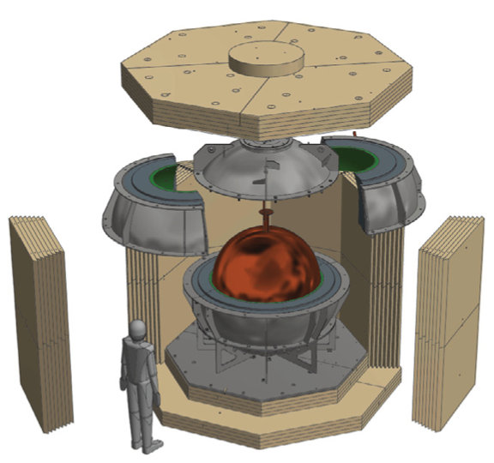
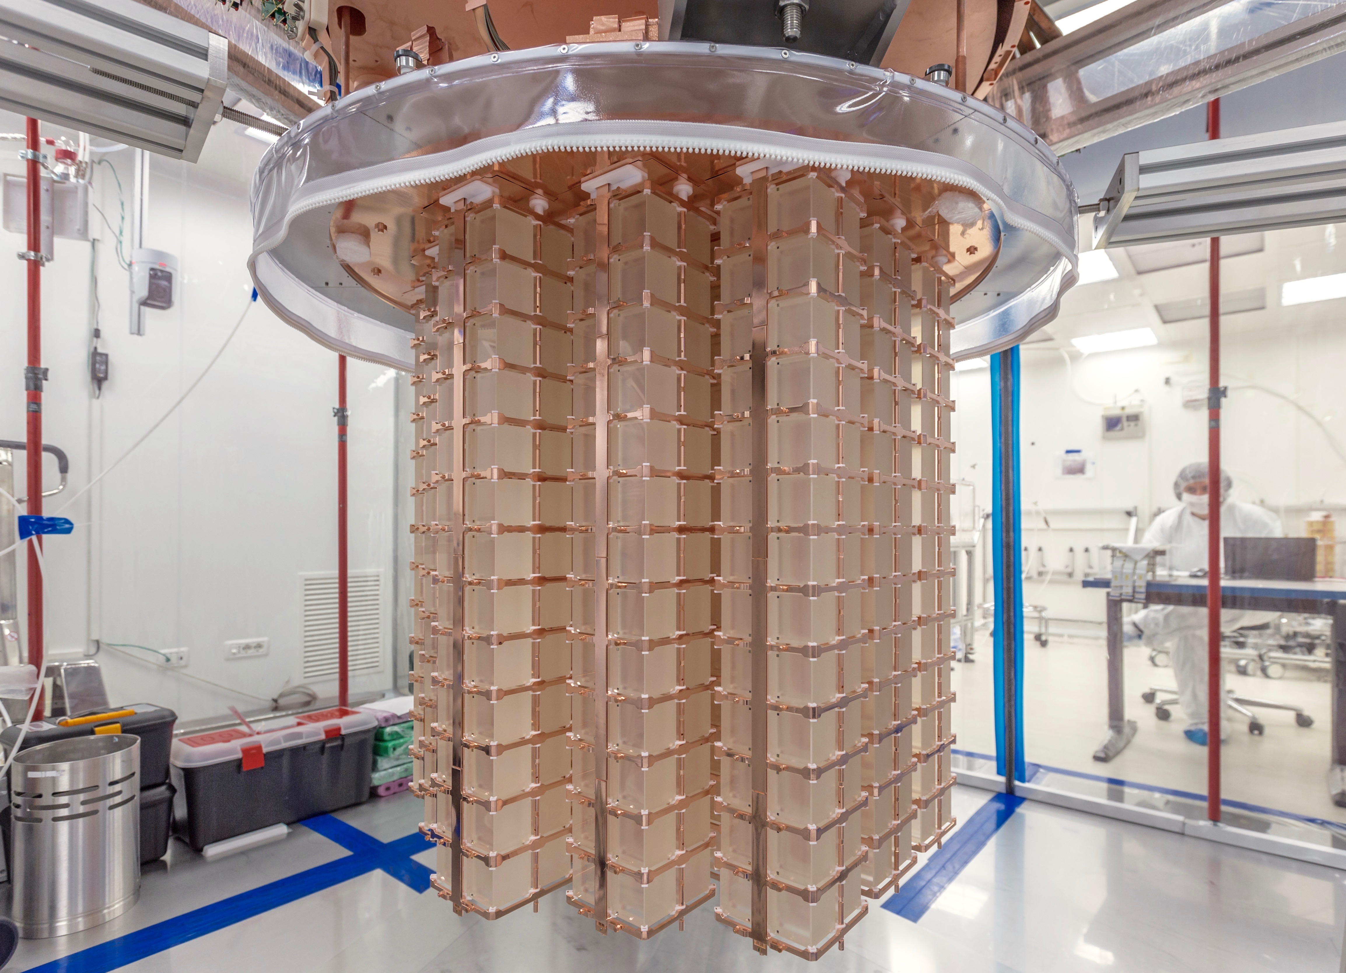

Setup
Copper as a detector material
Copper is a common detector material for rare event searches
  No long-lived radio-isotopes – longest ⁶⁷Cu: t_{1/2} = 62 h
  Commercially available at high-purity available
  Good mechanical and electrical properties
  Favorable electrochemical properties – more on this later!
NEWS-G collaboration
https://www.snolab.ca/experiment/news-g/
CUORE collaboration
https://cuoreexperiment.org

Slide 3
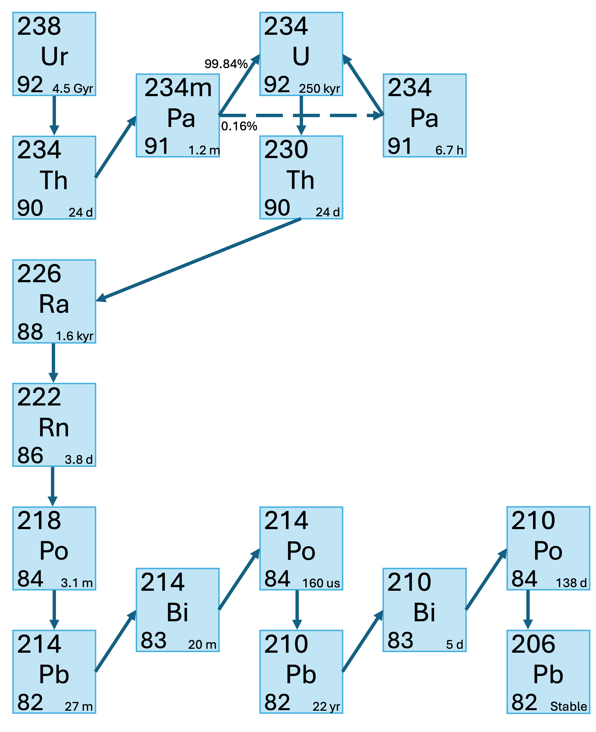
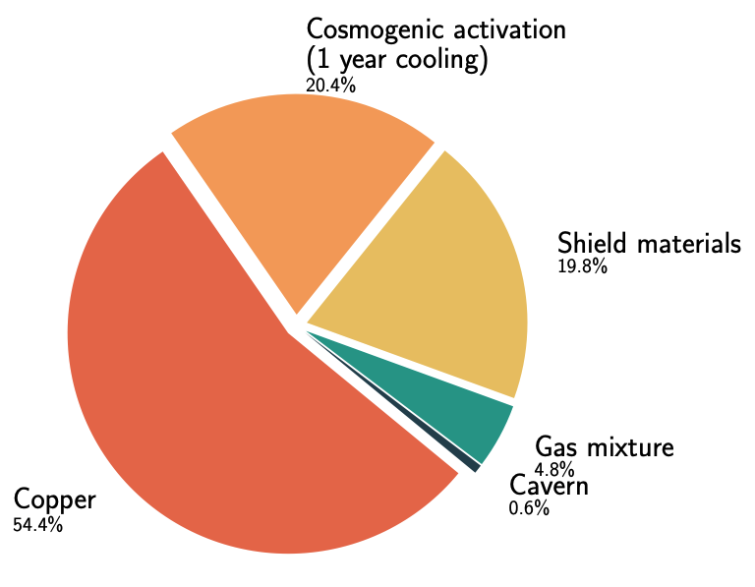
Setup
Copper background
Copper can still represent an important background
Commercial copper contaminated - ²³⁸U and ²³²Th decay chains:
  Natural ore contamination
  Implanted during manufacture and handling
  Cosmogenic activation - ⁶³Cu(n,⍺)⁶⁰Co t_{1/2} = 5.27 yr
²³⁸U decay chain
Simulated backgrounds for NEWS-G’s current detector

Slide 4
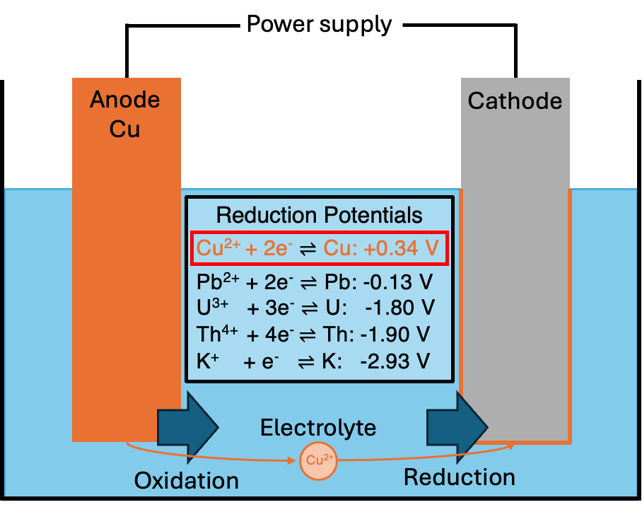
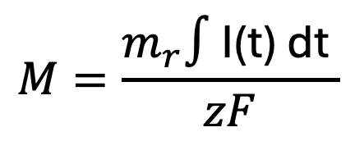
Setup
Electrodeposition
Deposit ions onto a cathode by applying a voltage
Governed by oxidation and reduction reactions
Deposited mass proportional to current
Molar mass
Current
$$M=\frac{m_{r}∫\text{I}\text{(}\text{t}\text{) }\text{dt} }{zF}$$
Faraday constant
No. e⁻
Ion
Current depends on
  Conductivity of solution -> electrolyte concentration
  Electrode separation
  Applied potential

Slide 5
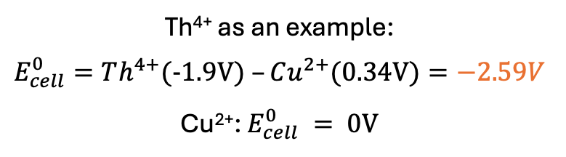



Copper electrodeposition
Species plating tendency governed by reduction potentials
$$E_{cell}^{0}=E_{Cathode}^{0}–E_{Anode}^{0}$$
I$f E_{cell}^{0}> 0 reaction is spontaneous$
Th⁴⁺ as an example:
$$E_{cell}^{0}=Th^{4+}(-1.9V) –Cu^{2+}(0.34V)=−2.59V$$
Cu²⁺: $E_{cell}^{0} = 0V$
Careful control of applied potential difference allows preferential plating of copper over contaminants
Used in industry to produce copper with excellent purity
$$E_{cell}=E^{0}−\frac{RT}{nF}ln\left(\frac{{\left[C\right]}^{c}{\left[D\right]}^{d}}{{\left[A\right]}^{a}{\left[B\right]}^{b}}\right)$$

Slide 6
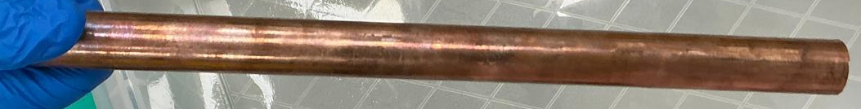
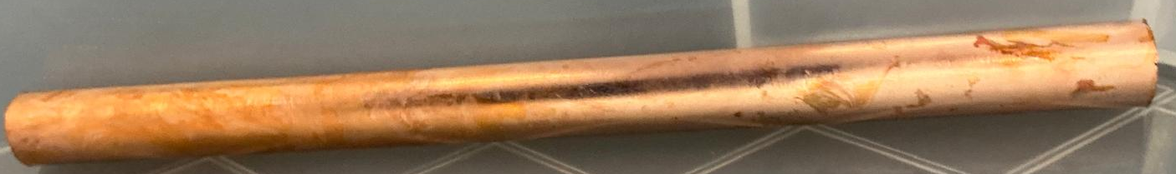
Ultra-pure copper electrodeposition
How this differs from industry – prioritise purity
Pipework preparation
Cu preparation
Procedure principally developed by PNNL for Majorana Demonstrator
Additive free electrolyte
Prioritise purity over speed -> careful voltage selection
Cleanroom environment
Stringent radiopure material and reagent selection
Purity monitoring
Comprehensive cleaning procedures built over years of PNNL experience
Plating underground -> reduce cosmogenic activation
Start with ultrapure pipework used in Si industry
Start with commercially pure copper feedstock
Remove surface contaminants
Micro-90 followed by etching with acidified peroxide
Circulate nitric acid to leach plastic of contaminants
NIMA 579 (2007) 486-489
RCTR 277 (2008) 103-110
Build copper sulphate electrolyte
Commercial too impure so electropolish our own
Constant solution filtration
Cu preparation

Slide 7
Results – ICPMS
Sample of copper | ²³²Th [uBq/kg] | ²³⁸Ur [uBq/kg]
Commercial C10100 | 8.7 ± 1.6 | 27.9 ± 1.9
NEWS-G plated copper NIMA 988 (2021) 164844 | <0.24 | <0.11
Majorana demonstrator electroformed NIMA 828 (2016) 22-36 | <0.119 | <0.099
Orders of magnitude improvement over commercial copper
Purity results often limited by available assay techniques -> can only set limits

Slide 8
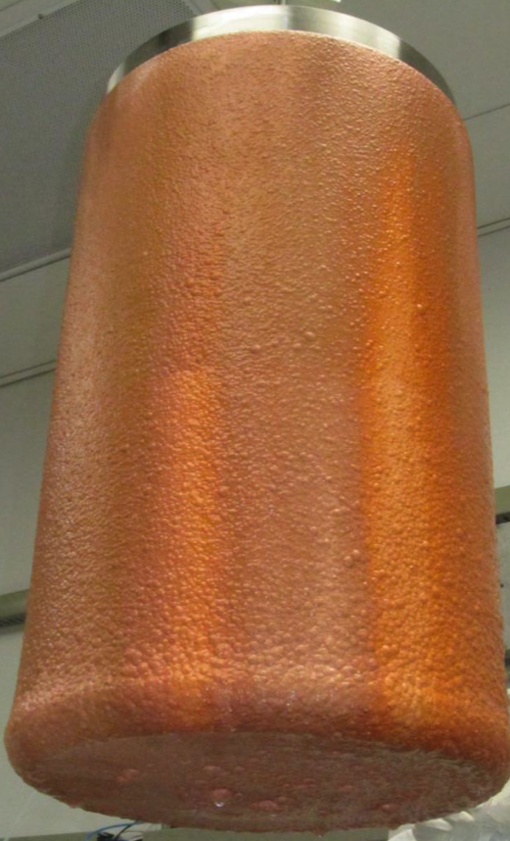
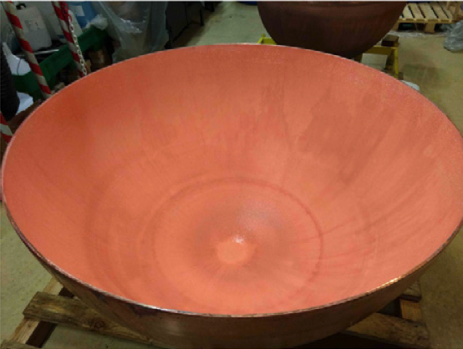
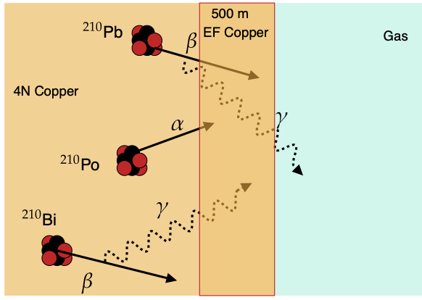

How this is/can be used for experiments
Electroplating
Electroforming
Majorana Demonstrator
Electroformed Cu
OSTI (2012) 1039850
Cu plated onto existing structure (i.e. cryostat) or components
Acts as an ultra-pure shield
Could be used to radon emanation
Cu plated onto a mould (called mandrel)
Remove the mandrel leaving a pure copper structure
Construct large structures
NEWS-G electroplated Cu
NIMA 988 (2021) 164844
$$μ$$

Slide 9
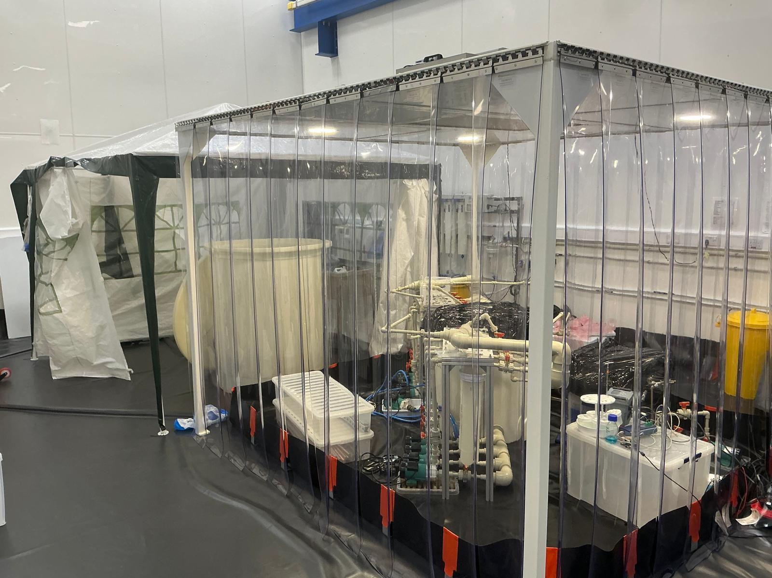
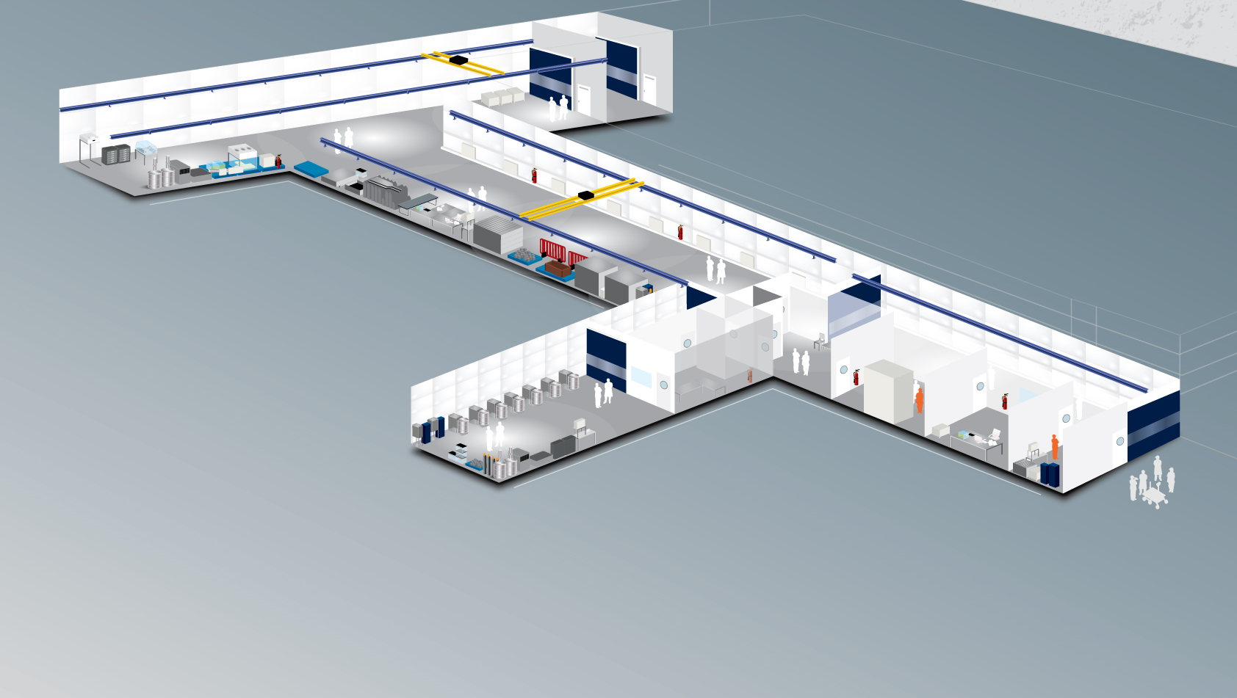
Setup
Electroforming facility at Boulby
1.1km underground at the UK’s deep underground laboratory Boulby
Dedicated ISO-6 cleanroom within the larger Boulby cleanroom
XIA UltraLow-1800 + ICP-MS on site at Boulby
Front. Phys. 2023 11:1310146
JINST 2025 20 P06010
Boulby underground lab
https://www.boulby.stfc.ac.uk/Pages/home.aspx

Slide 10
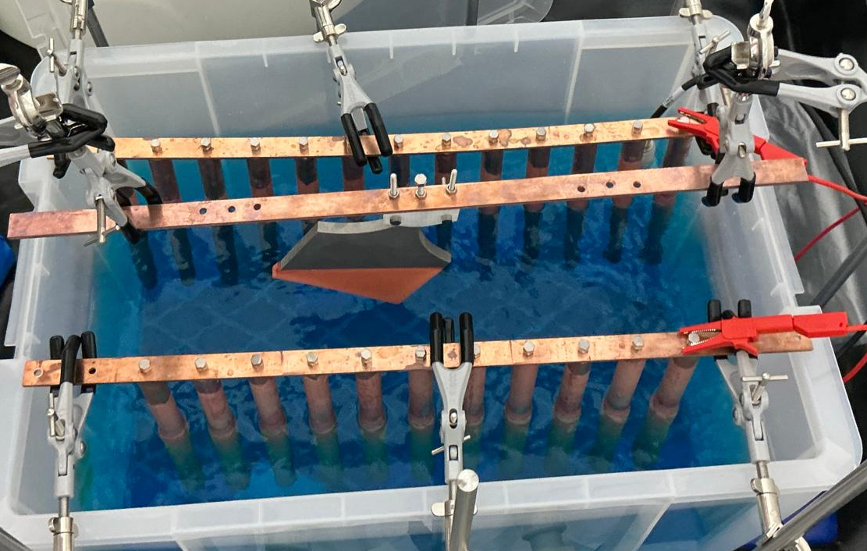
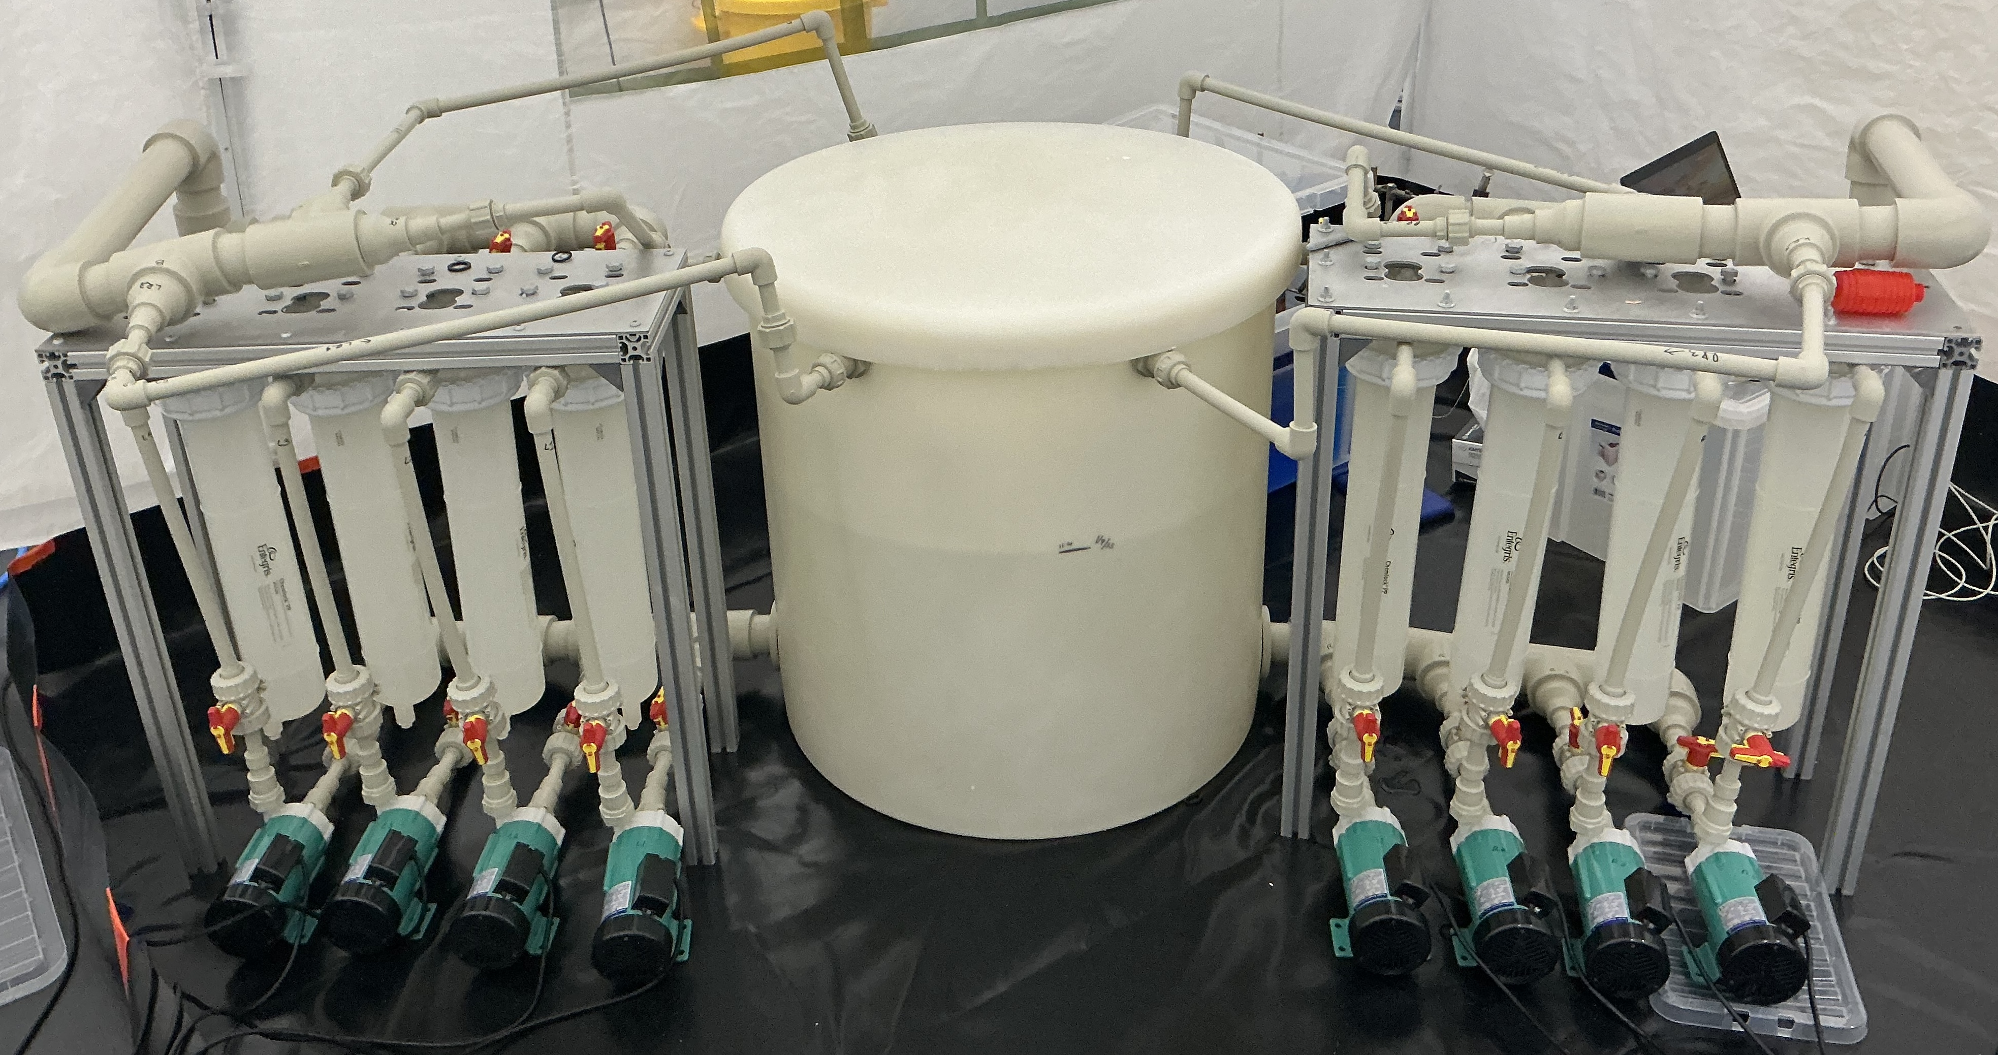
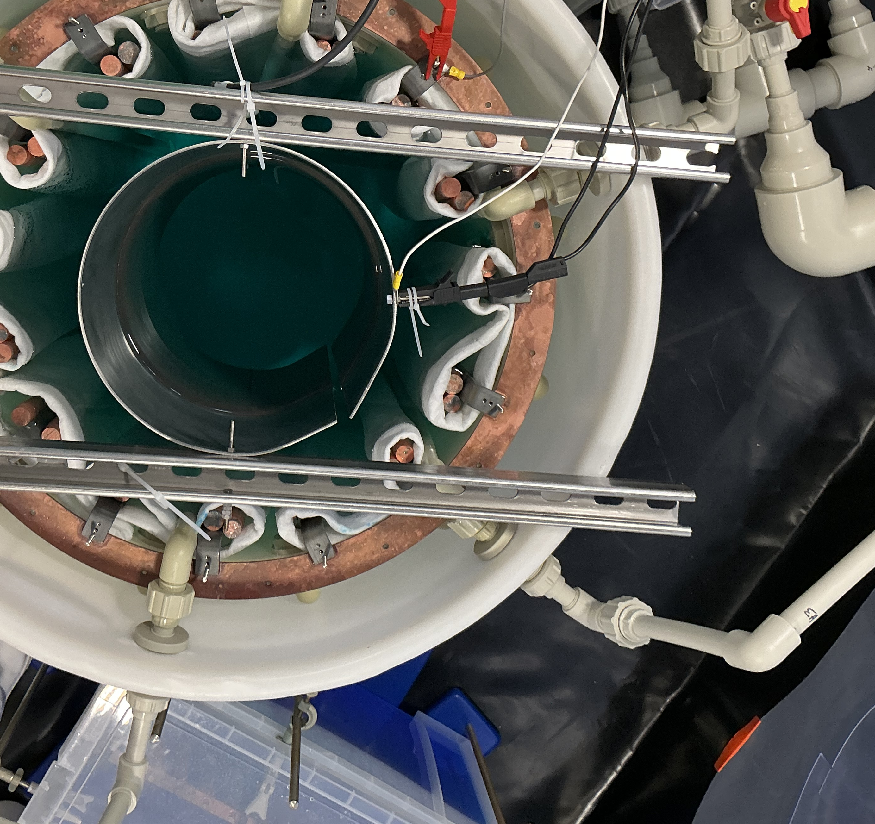
Electroforming facility at Boulby
Small setup used to plate smaller components
Larger setup’s first goal to electroform a 30 cm spherical proportional counter: DarkSPHERE-30
5.5N Cu feedstock
CuSO₄ electrolyte
5.5N Cu feedstock
Recirculating filters
Inlets
CuSO₄ electrolyte
Ti anodes
Cu bus bar
Electroforming bath at Boulby
Steel cylindrical mandrel

Slide 11
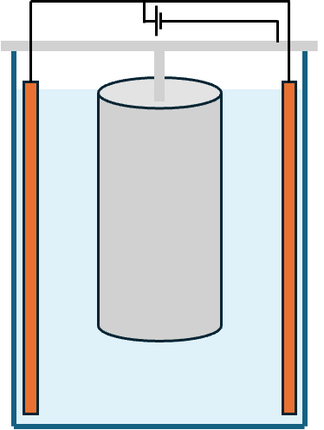
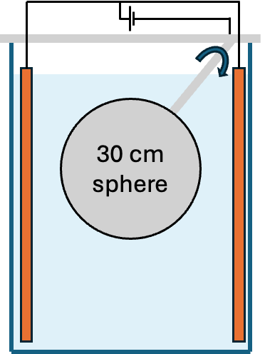
Electroforming facility at Boulby
Geometry of bath and electrodes important for uniform plating
Large bath setup for depositing onto a cylindrical and spherical mandrels
Copper removed from mandrel by thermal shocking if metal or chemically dissolving if plastic
30 cm sphere
Near-future plan
Currently operating at Boulby

Slide 12
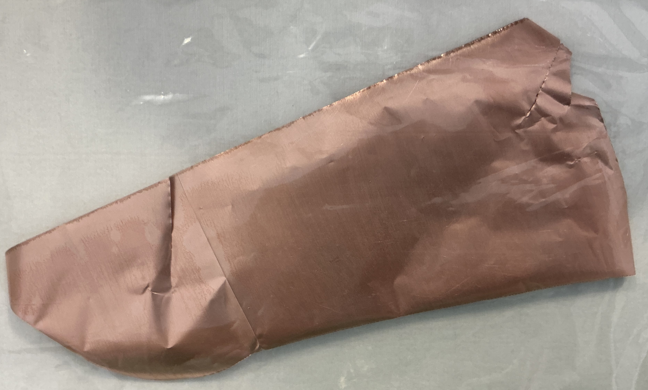
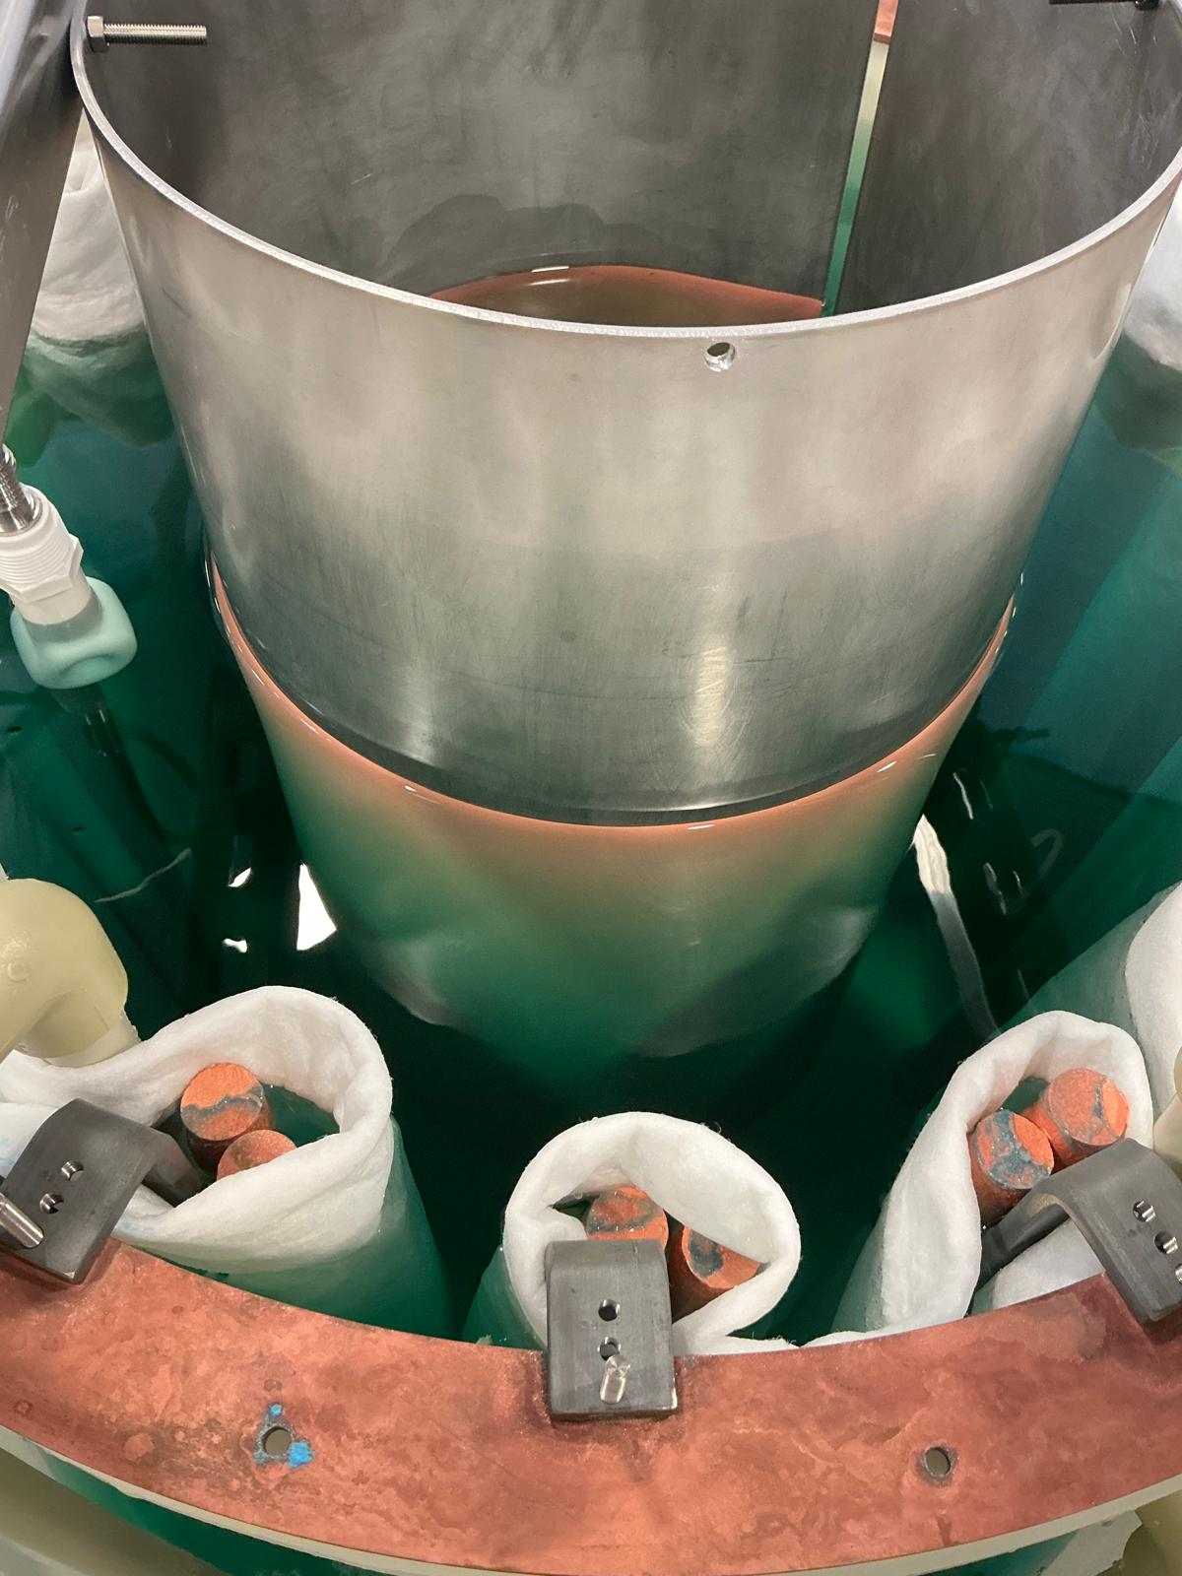
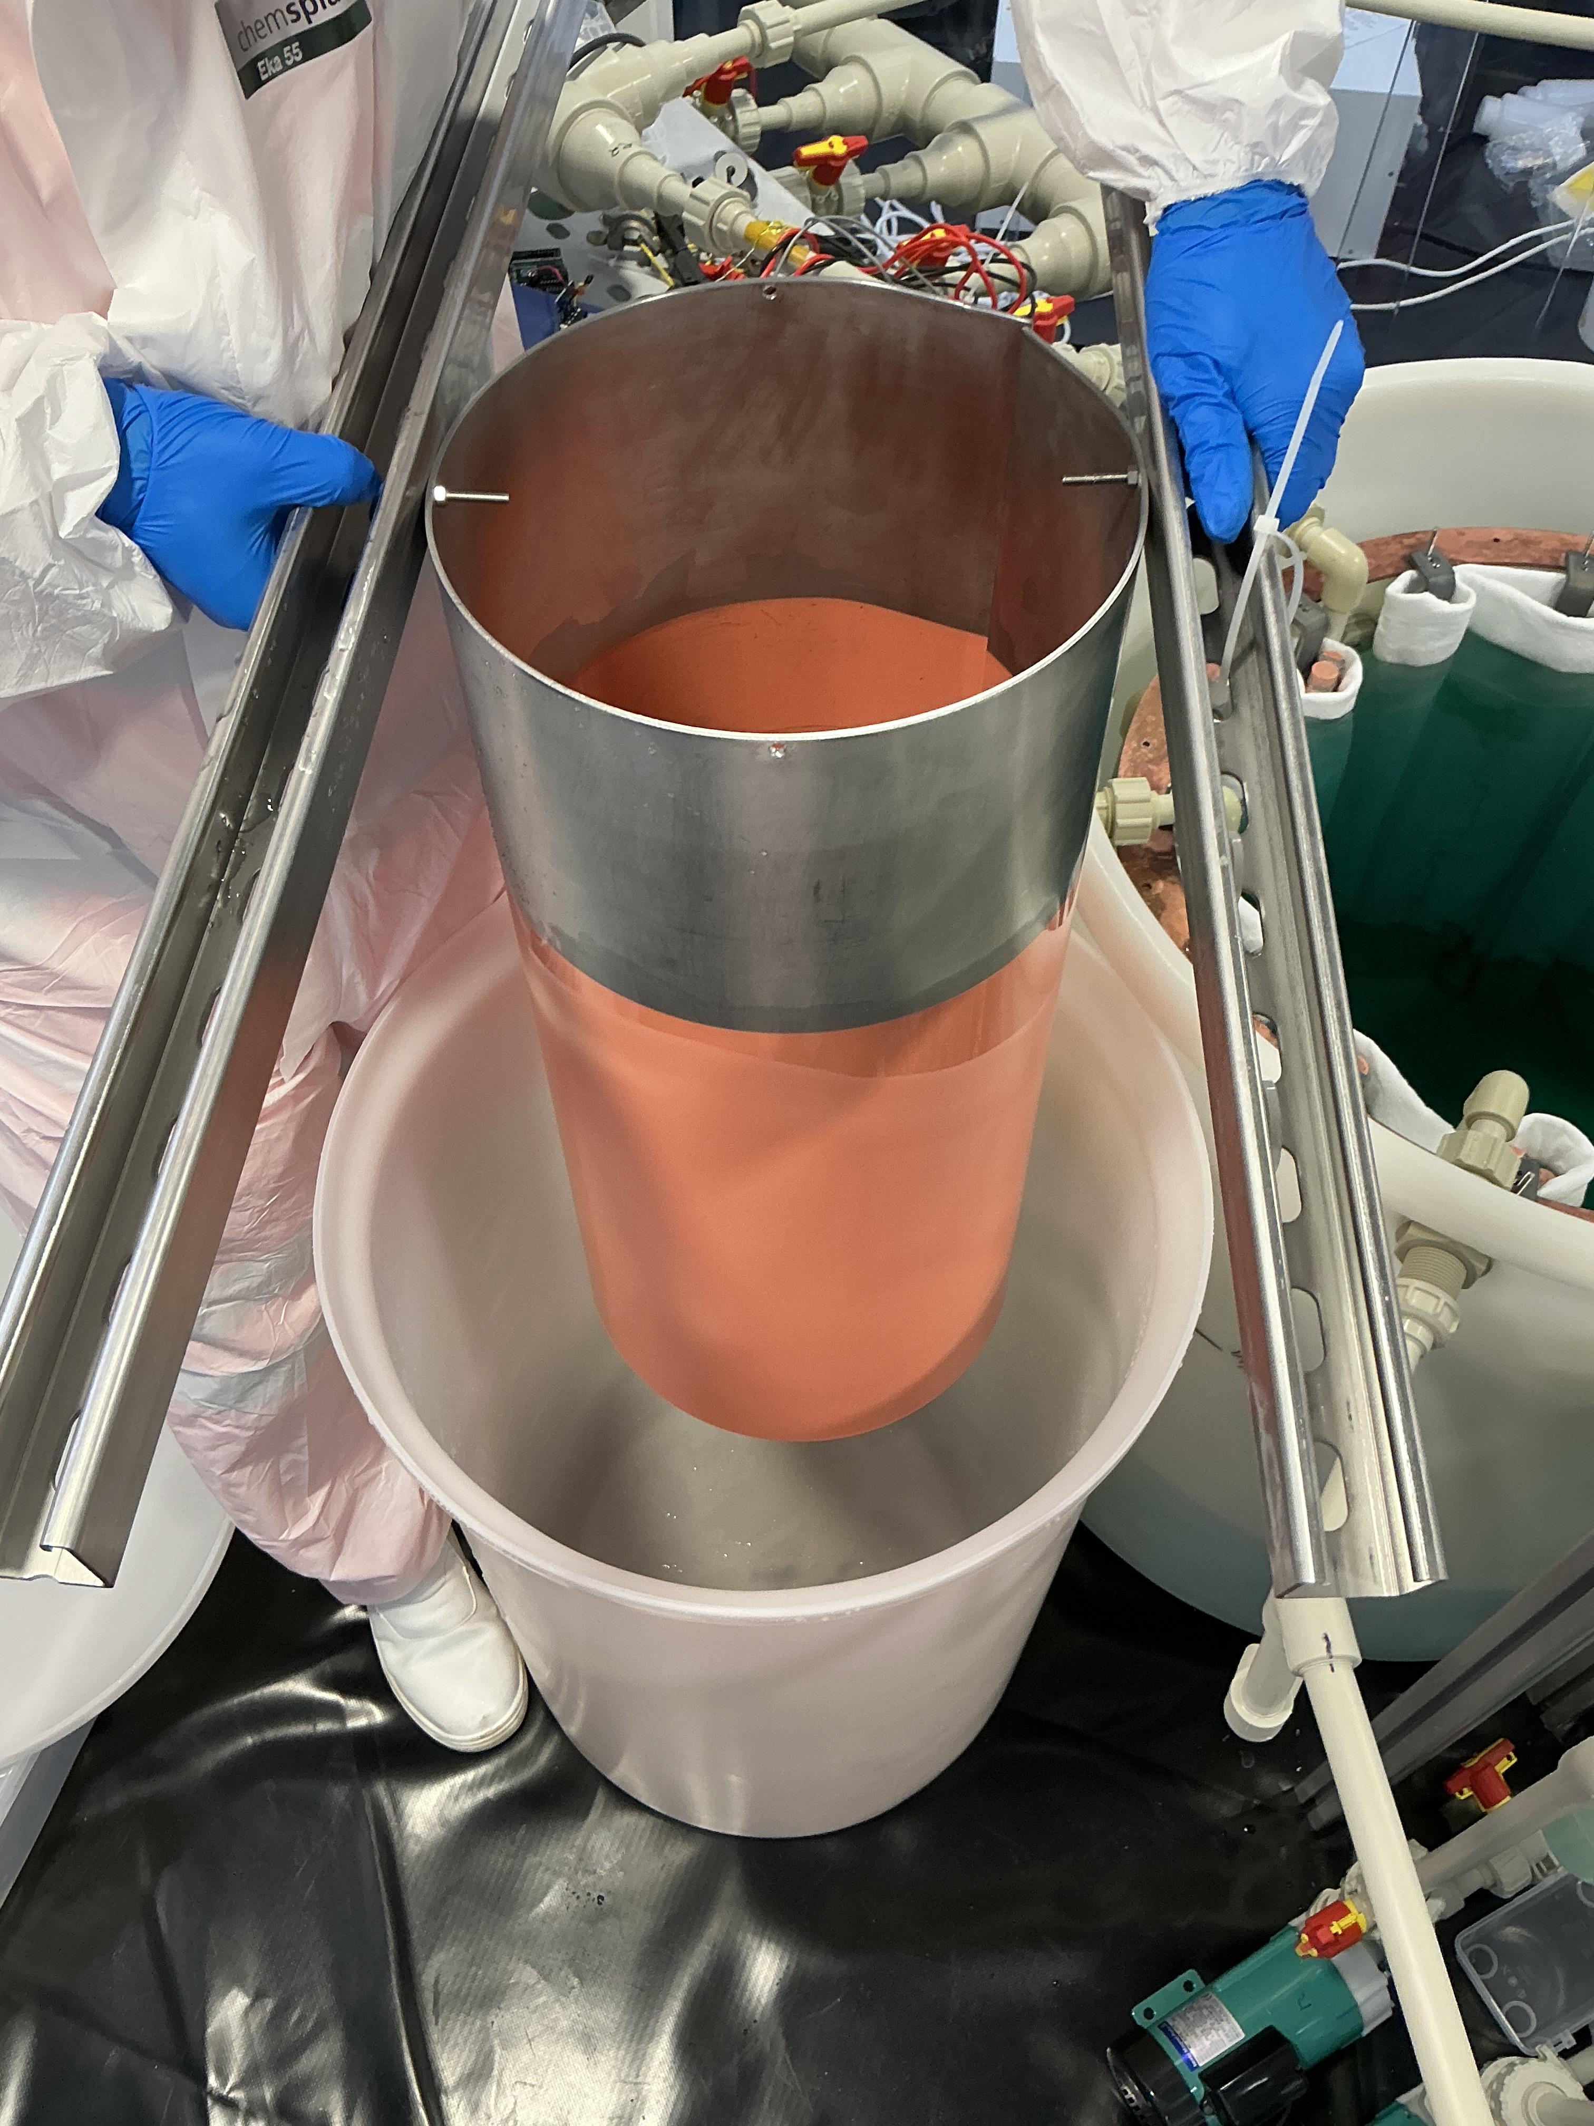
Setup
Current status
Copper plated onto stainless steel cylinder
Peeled copper off mandrel -> ICPMS and XIA results pending
Can use flattened copper from cylindrical mandrel as tray for XIA

Slide 13
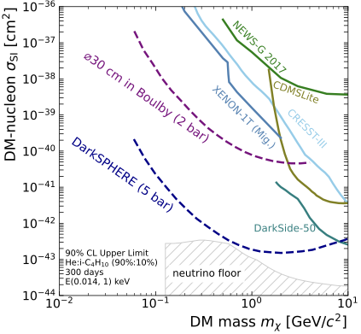
Physics Potential
Fully electroformed spherical proportional counters will have world leading sensitivity to low-mass dark matter
DarkSPHERE-30 will begin construction in the coming months
Alloys being explored to improve the properties of electroformed copper – PureAloys project
  NIMA 1082 (2026) 170970
  Communications Physics (2025) 8 464
Dimitra’s talk
O(
)
Phys. Rev. D 108, 112006
Kostas’ talk

Slide 14
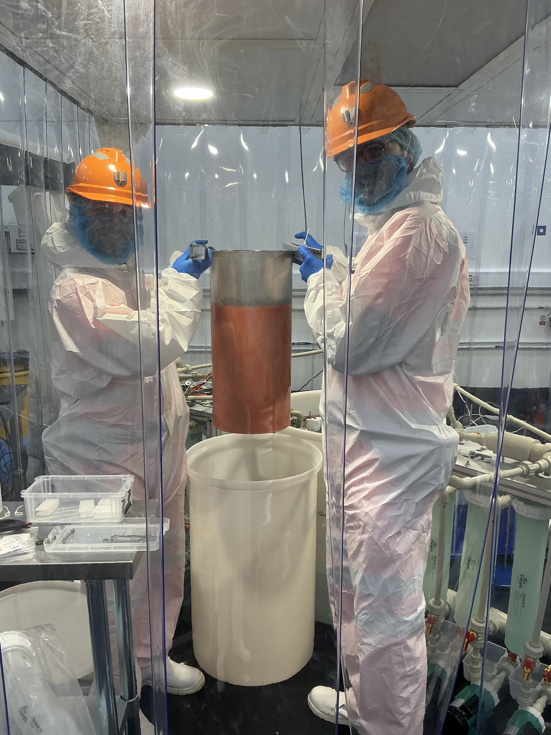
Summary
Copper electroforming for radio-pure detectors
Orders of magnitude improvement in radiopurity over commercial Cu
Electroforming facility constructed at Boulby
First copper produced
Electroforming a ⌀30cm SPC in the coming months
Many experiments exploring the use of electroformed and plated Cu

