Slide 1


Searching for ultralight dark matter
using highly charged ion clocks
Mingyao Xu, Leonid Prokhorov, Aaron Smith, Vera Guarrera, and Giovanni Barontini

Slide 2
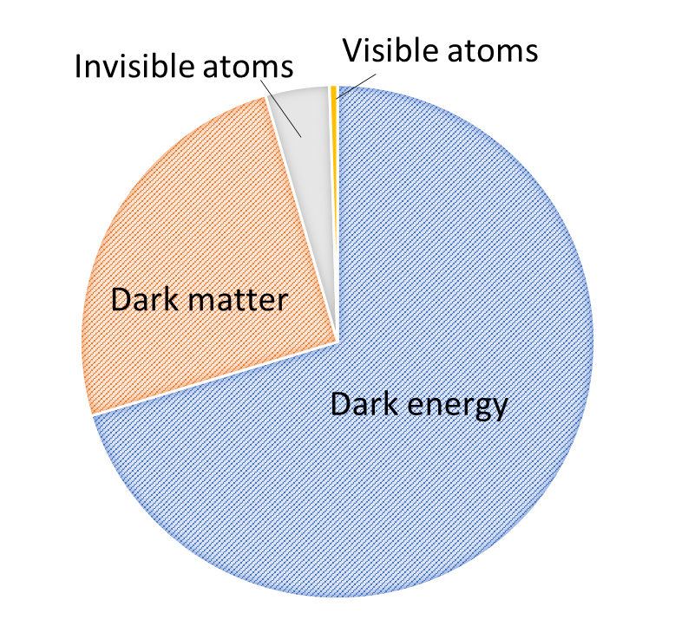
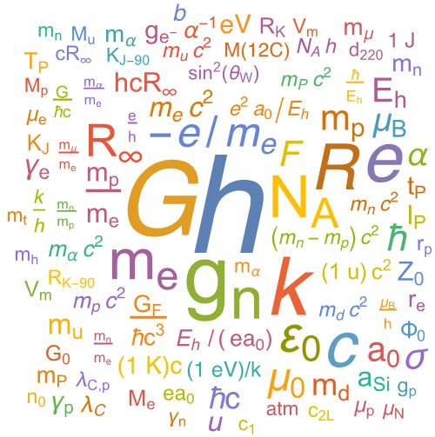
Motivation
The Standard Model and ΛCDM are very successful theories but…
The ΛCDM model postulates that 95% of the energy content of the universe is dark matter and dark energy. Their exact nature is unknown. Only the remaining 5% is described by the SM.
Both models have several parameters, supposed to be immutable, called fundamental constants.
Challenging this assumption could be the key to solving the dark matter and dark energy enigmas

Slide 3
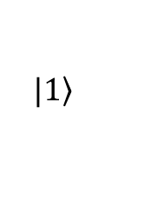
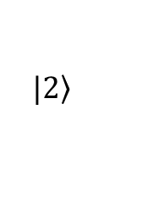


Why clocks?
All atomic and molecular energy spectra depend on the fundamental constants of the Standard Model
Spectroscopy lends itself to measure variations of:
Atomic and molecular spectra can be measured with extreme precision using atomic clocks
Grand unification physics fixes relations between fundamental constants (if one changes with time, others will as well)
$$|\left.2\right\rangle$$
$$α=\frac{1}{4πε_{0}}\frac{e^{2}}{ℏc}$$
α
μ
$$μ=\frac{m_{p}}{m_{e}}$$
ℏω(α)
$$|\left.1\right\rangle$$

Slide 4

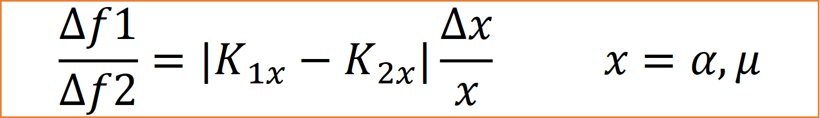
The QSNET project
Search for variations of fundamental constants of the Standard Model, using a network of clocks
A unique network of clocks chosen for their different sensitivities to variations of α and μ
The clocks will be linked, essential to do clock-clock comparisons
Barontini et al., Measuring the stability of fundamental constants with a network of clocks, EPJ Quantum Technol. 9, 12 (2022)

Slide 5
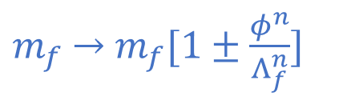
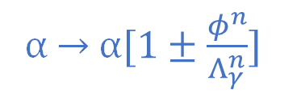
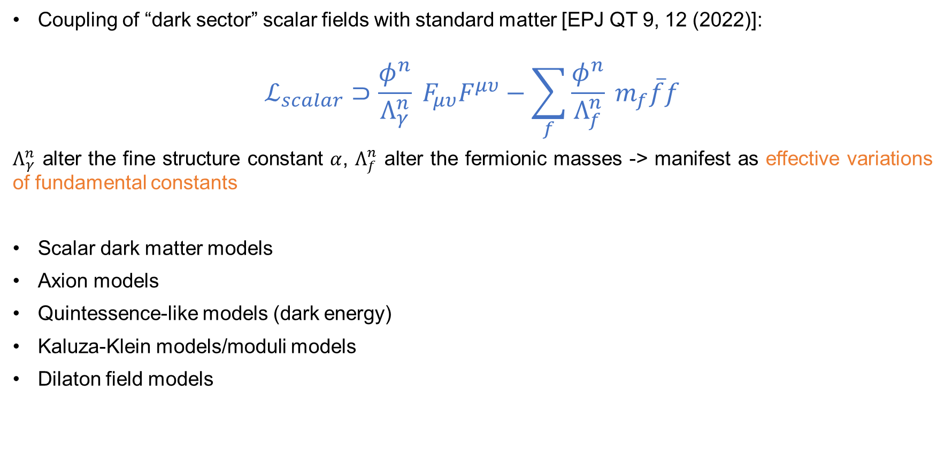
Scalar dark matter detection
Coupling of “dark sector” scalar fields with standard matter [EPJ QT 9, 12 (2022)]:
$$ℒ_{scalar}⊃\frac{φ^{n}}{Λ_{γ}^{n}} F_{μυ}F^{μυ}−\sum_{f}{\frac{φ^{n}}{Λ_{f}^{n}}} m_{f}\overline{f}f$$
$Λ_{γ}^{n}$ alter the fine structure constant $α$, $Λ_{f}^{n}$ alter the fermionic masses -> manifest as effective variations of fundamental constants
Scalar dark matter models
Axion models
Quintessence-like models (dark energy)
Kaluza-Klein models/moduli models
Dilaton field models
α → α$[1±\frac{φ^{n}}{Λ_{γ}^{n}}]$
$m_{f}$→ $m_{f}[1±\frac{φ^{n}}{Λ_{f}^{n}}]$

Slide 6
The QSNET estimated constraint
Linear Quadratic
α
μ
Barontini et al., Measuring the stability of fundamental constants with a network of clocks, EPJ Quantum Technol. 9, 12 (2022)

Slide 7
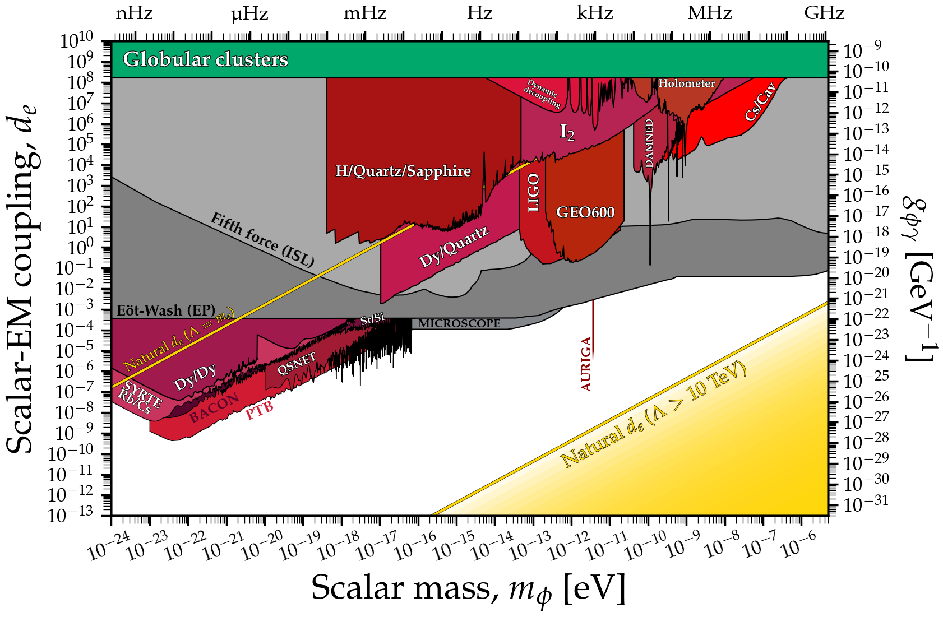
The QSNET results
α
cajohare, n.d. ScalarPhoton. GitHub. Available at: https://raw.githubusercontent.com/cajohare/AxionLimits/master/plots/plots_png/ScalarPhoton.png
N. Sherrill et al., New J. Phys. 25 093012 (2023)

Slide 8
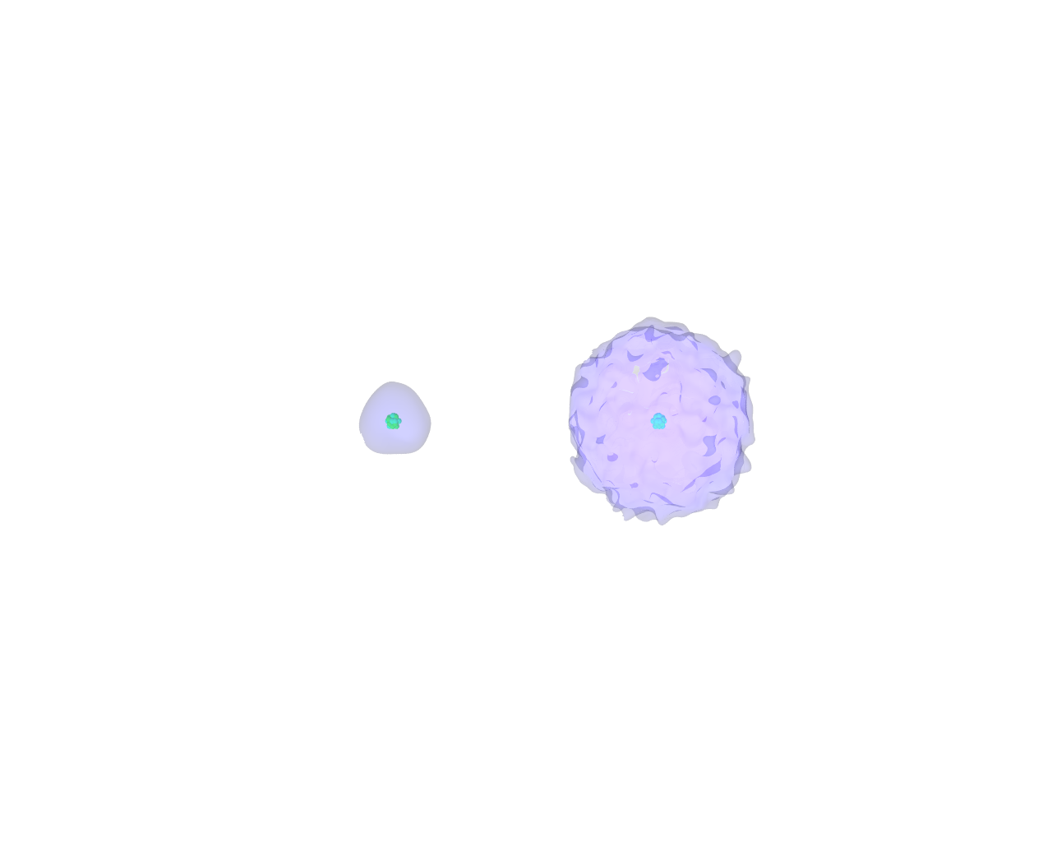
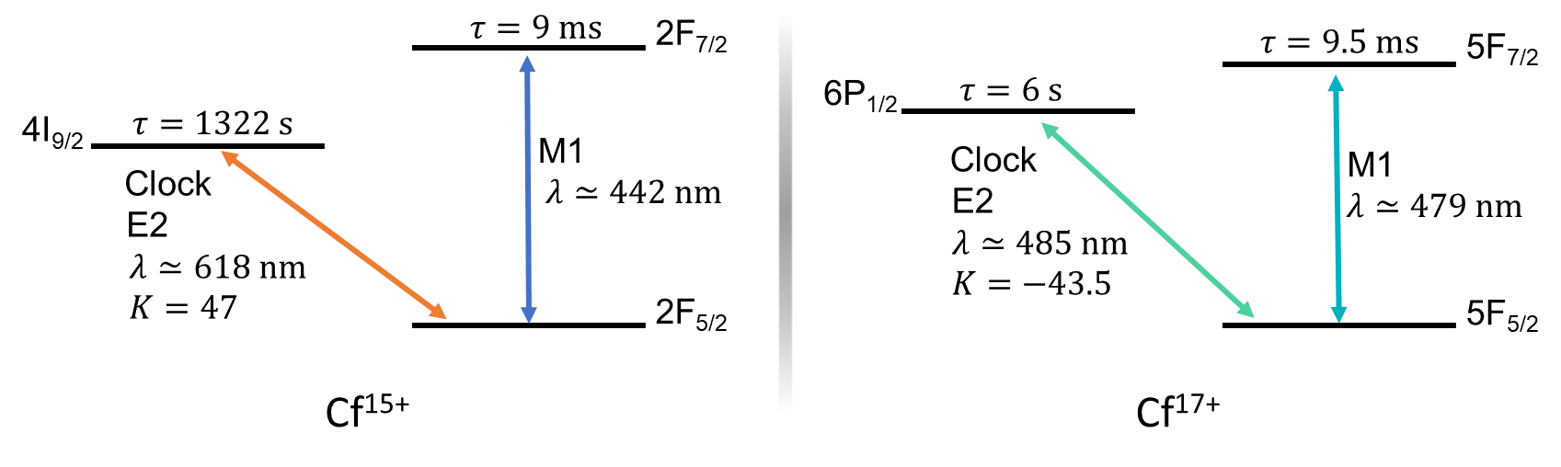
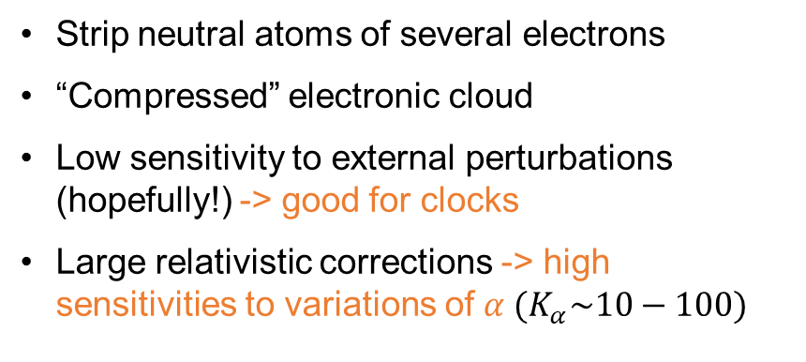
The Bham node: Cf highly charged ions (HCIs)
Cf
Cf¹⁵⁺
Strip neutral atoms of several electrons
“Compressed” electronic cloud
Low sensitivity to external perturbations (hopefully!) -> good for clocks
Large relativistic corrections -> high sensitivities to variations of$α (K_{α}\sim 10−100)$
Cf is a synthetic element produced in reactors
²⁴⁹Cf has a half-life of 350 y, ²⁵²Cf of 2.65 y
Both ionisation states feature a clock transition in the visible range and a strong-ish transition also in the visible range
The two clock transitions have large Ks with opposite sign

Slide 9
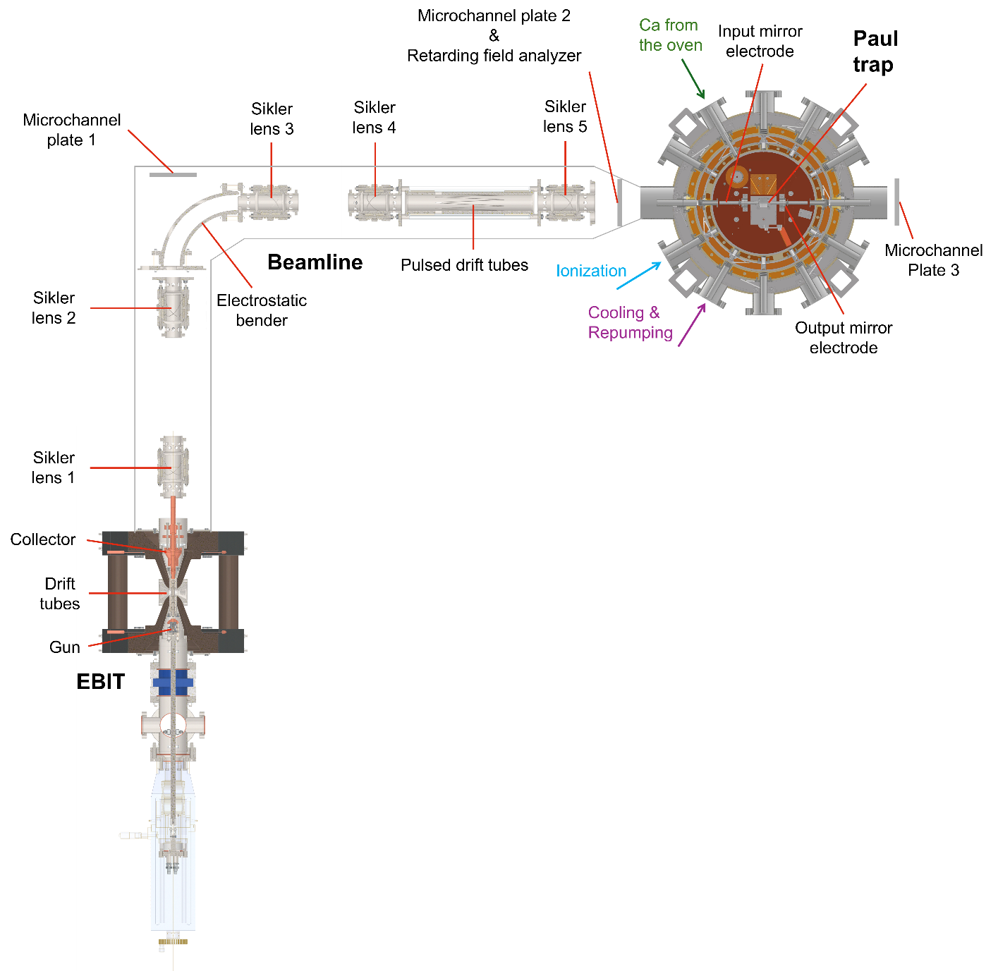
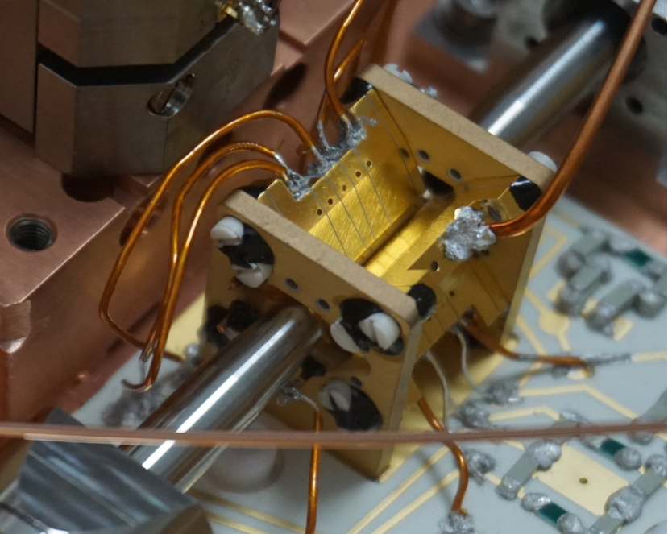

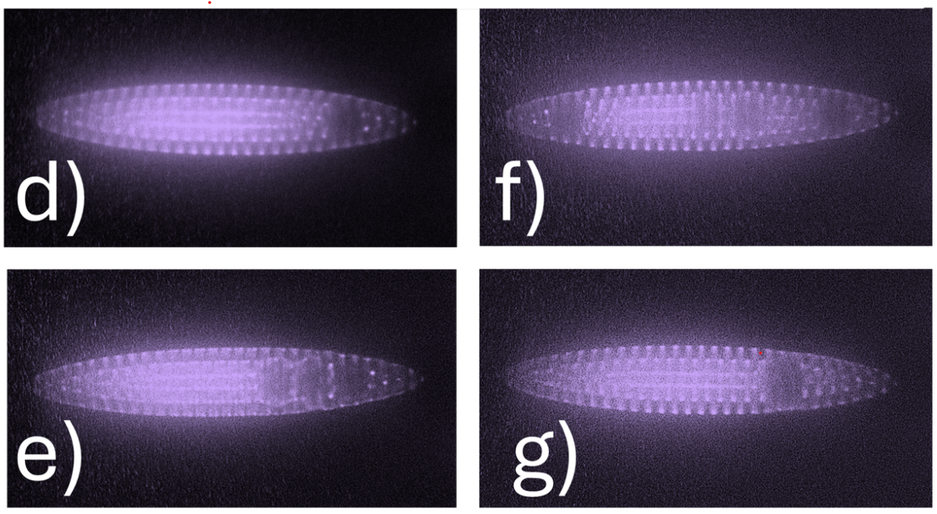

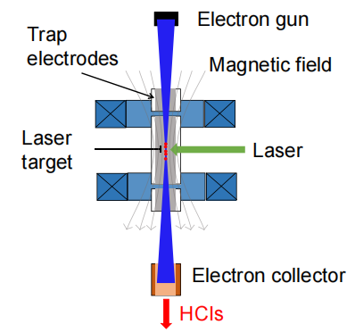
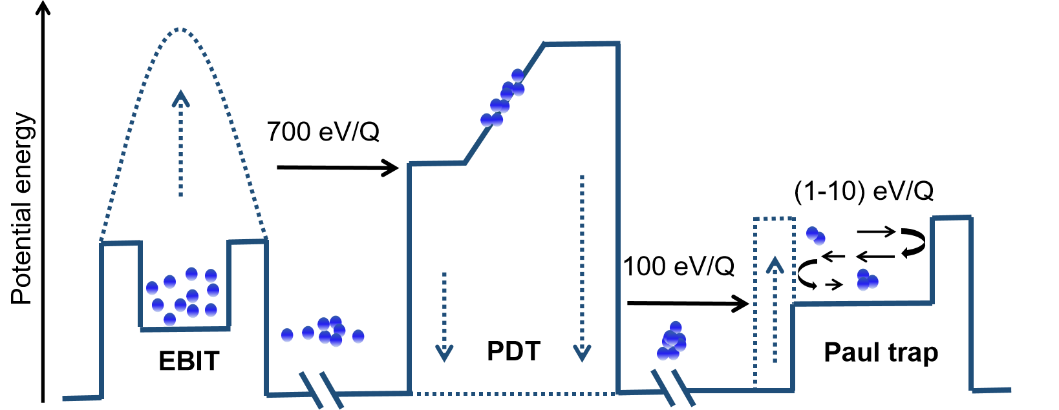

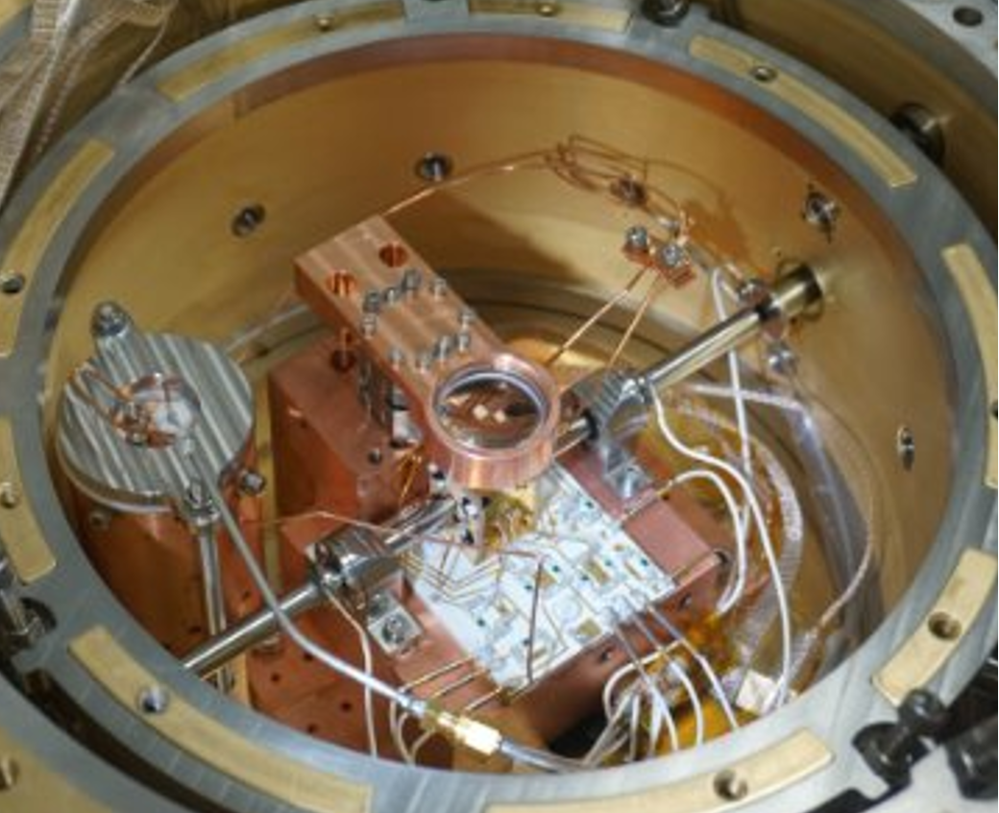


Production, cooling and trapping of HCIs
Cryogenic Paul trap:
In collaboration with
EBIT produces HCIs
Beamline for charge selection, focusing and cooling
Compact EBIT
In collaboration with
MK--------------------------------------------------->mK

Slide 10
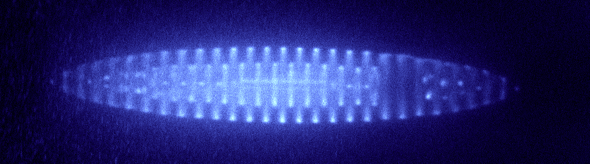
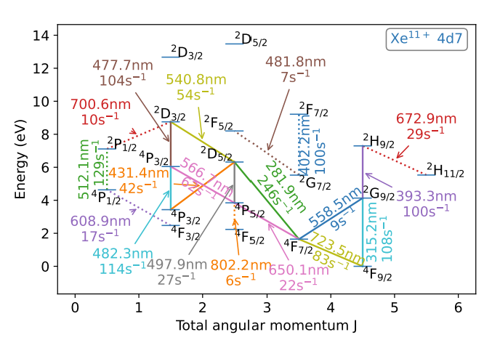
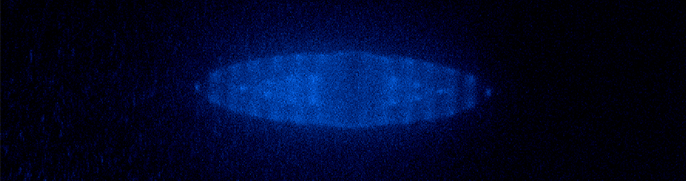

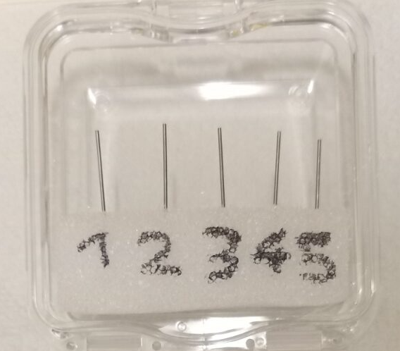
Current status & Next steps
We produced Xe HCIs and sympathetically cooled them with a Ca⁺ Coulomb crystals.
Ca⁺ Coulomb crystals with an Xe¹¹⁺ HCI implanted
Xe HCI Quantum Logic Spectroscopy -> lead us to clocks.
Towards Cf HCI clocks.
Xe¹¹⁺
Cf-249 sample
Nils-Holger Rehbehn et al. (2023). Narrow and Ultranarrow Transitions in Highly Charged Xe Ions as Probes of Fifth Forces. Physical Review Letters, 131(16).
Micke et al., Coherent laser spectroscopy of highly charged ions using quantum logic, Nature 578, 60 (2020)

Slide 11

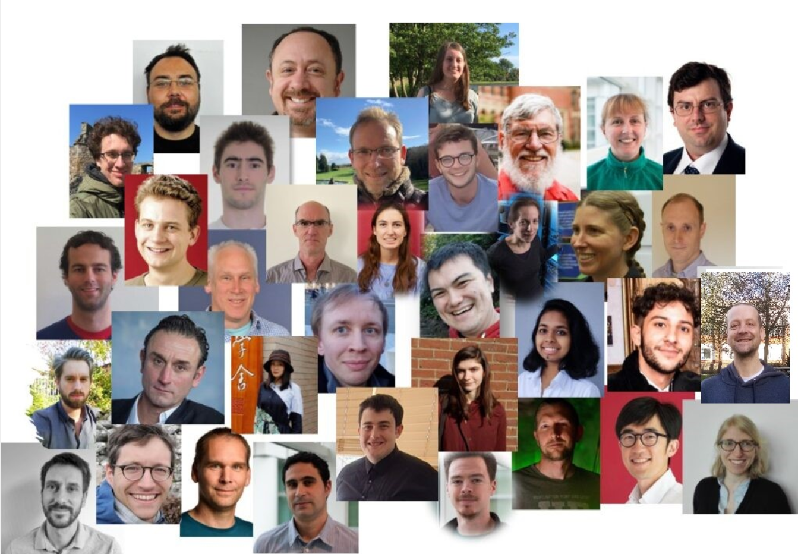
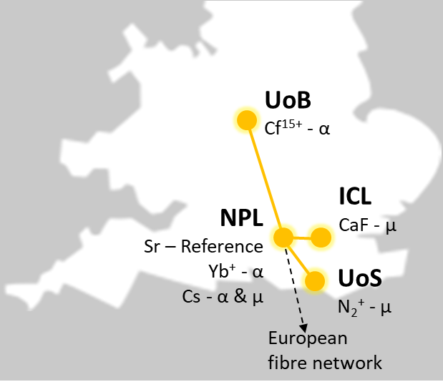
Summary
A world-unique network of next-generation clocks.
Delivered world leading constraints on detecting scalar ultra-light dark matter.
At Birmingham, we are developing the 1st HCI clock in the UK, 3rd worldwide.
Succeeded in producing Xe HCIs and trapping them in a Ca⁺ Coulomb crystal. The only one uses Ca⁺ ions.
Working to Xe HCI Quantum Logic Spectroscopy.
Working towards Cf HCI clocks.
Thankyou!

Slide 12
Appendix

Slide 13

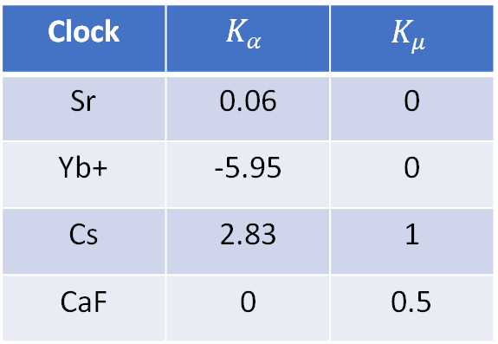

How to measure variations of fundamental constants
Different clock transitions have different sensitivities to fundamental constants
Hyperfine transitions $υ_{Hf}=Aμα^{2}F_{Hf}\left(α\right)R_{∞}$
Optical transitions $υ_{Opt}=BF_{Opt}\left(α\right)R_{∞}$
Vibrational transitions $υ_{vib}=Cμ^{1/2}R_{∞}$
Clock | $$K_{α}$$ | $$K_{μ}$$
Sr | 0.06 | 0
Yb+ | -5.95 | 0
Cs | 2.83 | 1
CaF | 0 | 0.5
$$\frac{dE}{E_{0}}=K_{X}\frac{dX}{X_{0}}$$

Slide 14

HCIs and variations of $α$
Visible range
High values of K
Other groups too unstable

Slide 15
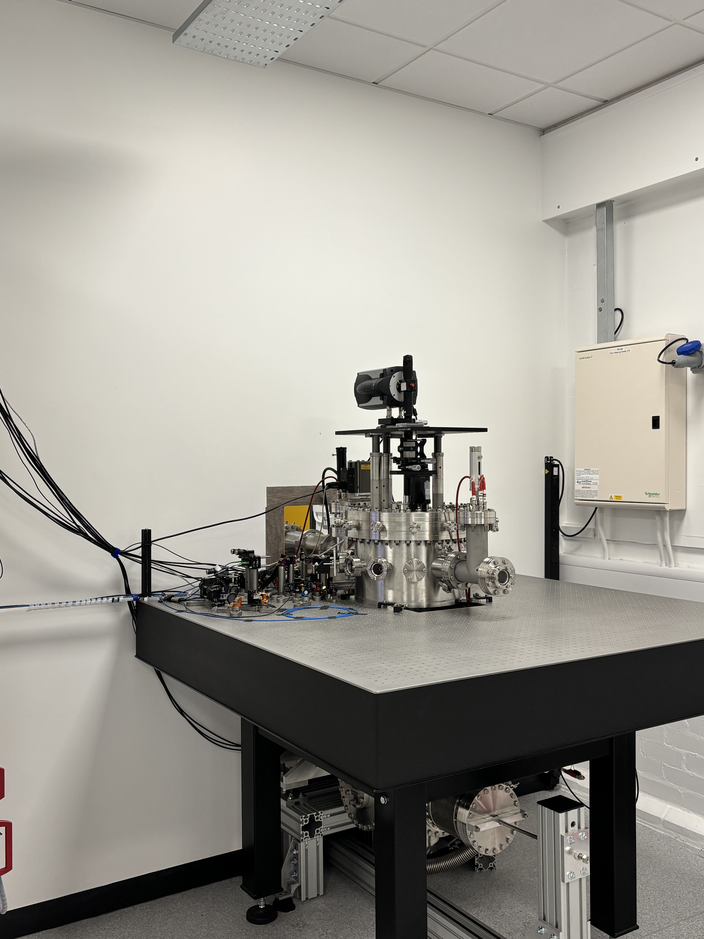
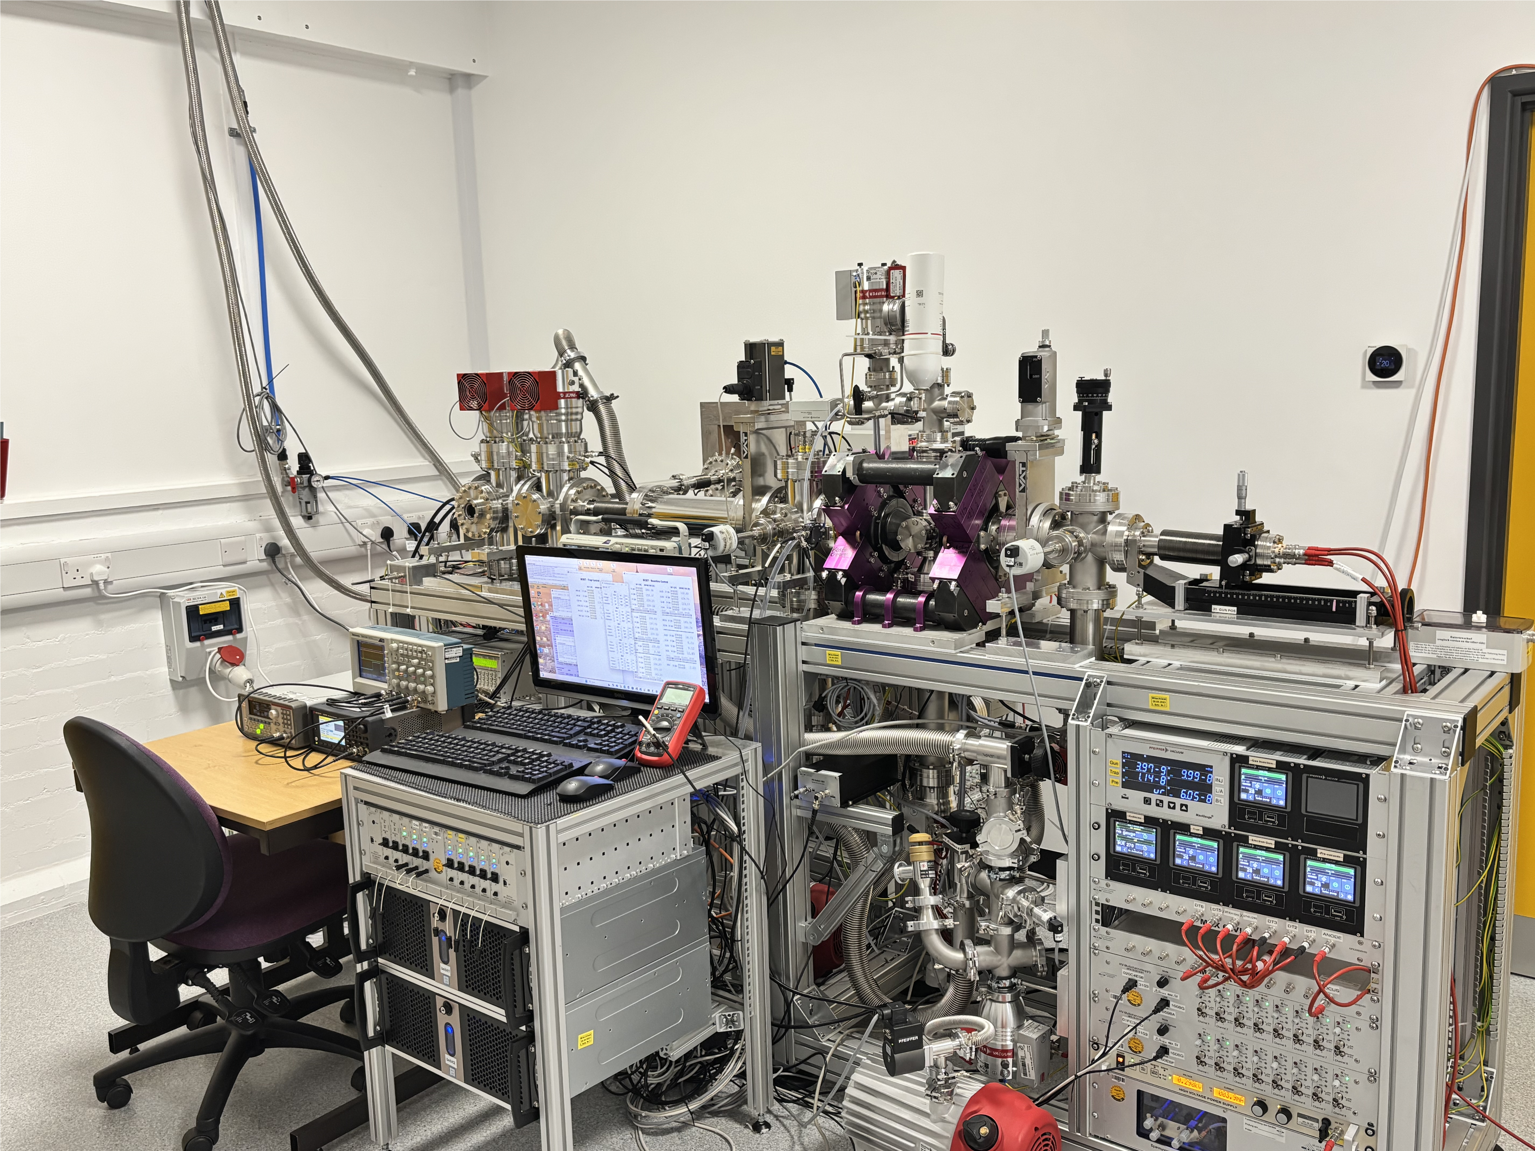
The Bham EBIT + Beamline + Cryogenic Paul trap

