Slide 1





A high quality factor dielectric Fabry-Perot cavity for detecting dark matter axions
1
Jonathan Gosling

Slide 2
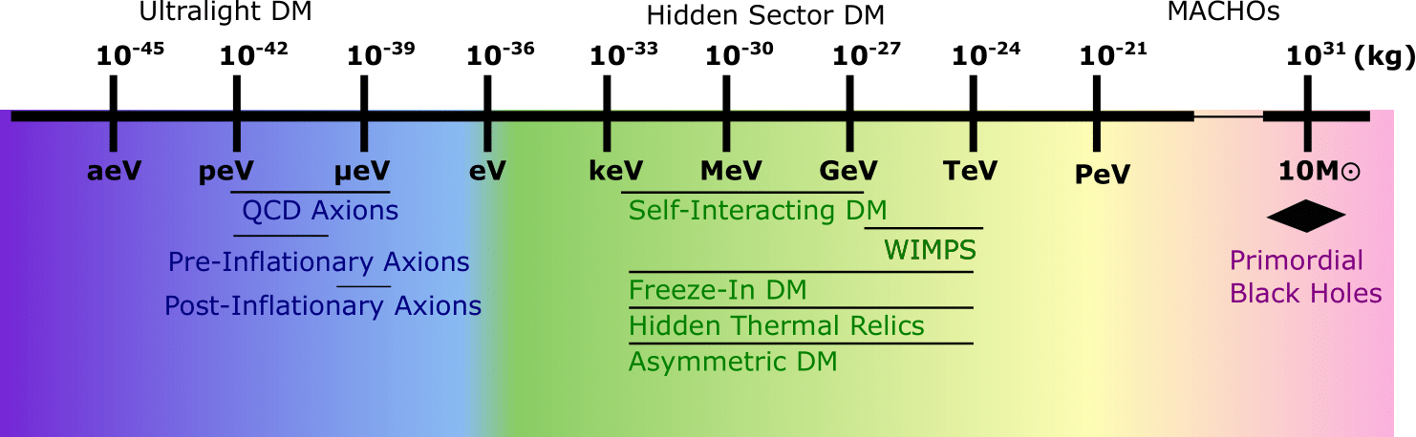
2
Dark matter landscape
E. Killian, et al., AVS Quantum Sci. 6, 030503 (2024)

Slide 3
2
Dark matter landscape
Solves the “strong”-CP problem
E. Killian, et al., AVS Quantum Sci. 6, 030503 (2024)

Slide 4
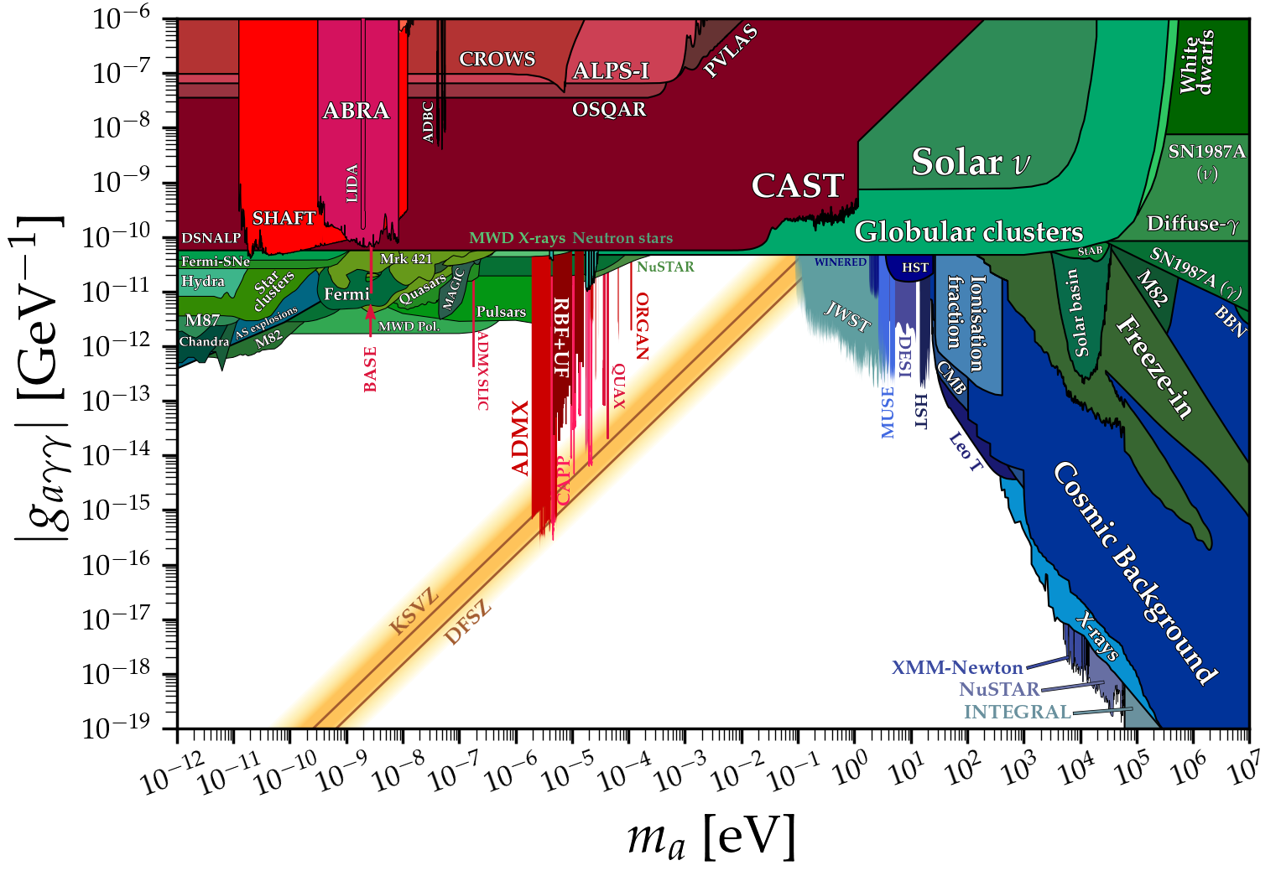
3
Axion parameter space
Limits from cajohare.github.io/AxionLimits/docs/ap.html

Slide 5

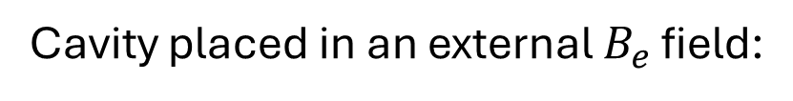

4
Axion detection with microwave cavities
Cavity placed in an external $B_{e}$ field:
$$B_{e}$$
M. E. Tobar et al., Physics of the Dark Universe 26 (2019)

Slide 6
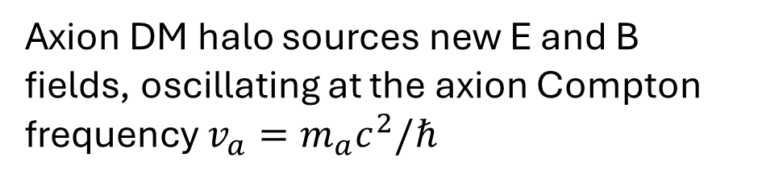
4
Axion detection with microwave cavities
Cavity placed in an external $B_{e}$ field:
Axion DM halo sources new E and B fields, oscillating at the axion Compton frequency $v_{a}=m_{a}c^{2}/ℏ$
Detector
$$B_{e}$$
M. E. Tobar et al., Physics of the Dark Universe 26 (2019)

Slide 7




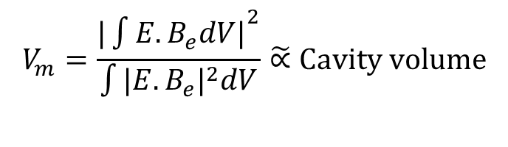


4
Axion detection with microwave cavities
Cavity placed in an external $B_{e}$ field:
Axion DM halo sources new E and B fields, oscillating at the axion Compton frequency $v_{a}=m_{a}c^{2}/ℏ$
Detector
Rate of photons emitted at optimum cavity coupling is
$$B_{e}$$
$$\text{Rate} \left[s^{−1}\right]≈5 ×{10}^{−4}{C_{aγγ}}^{2} Q V_{m}B^{2}$$
$$V_{m}=\frac{{|\int{E.B_{e}dV|}}^{2}}{\int{{|E.B_{e}|}^{2}dV}}\tilde{∝}Cavity volume$$
$$g_{aγγ}∝C_{aγ}m_{a}$$
$$Q=\frac{Q_{c}Q_{a}}{Q_{c}+Q_{a}}$$
$$Q_{c}$$
Cavity Q-factor
$$(C_{aγ}\sim O\left(1\right))$$
$$Q_{a}$$
Axion Q-factor
M. E. Tobar et al., Physics of the Dark Universe 26 (2019)
$$\sim {10}^{6}$$

Slide 8
4
Axion detection with microwave cavities
Cavity placed in an external $B_{e}$ field:
Axion DM halo sources new E and B fields, oscillating at the axion Compton frequency $v_{a}=m_{a}c^{2}/ℏ$
Detector
Rate of photons emitted at optimum cavity coupling is
$$B_{e}$$
$$\text{Rate} \left[s^{−1}\right]≈5 ×{10}^{−4}{C_{aγγ}}^{2} Q V_{m}B^{2}$$
$$V_{m}=\frac{{|\int{E.B_{e}dV|}}^{2}}{\int{{|E.B_{e}|}^{2}dV}}\tilde{∝}Cavity volume$$
$$g_{aγγ}∝C_{aγ}m_{a}$$
$$Q=\frac{Q_{c}Q_{a}}{Q_{c}+Q_{a}}$$
$$Q_{c}$$
Cavity Q-factor
$$(C_{aγ}\sim O\left(1\right))$$
$$Q_{a}$$
Axion Q-factor
M. E. Tobar et al., Physics of the Dark Universe 26 (2019)
$$\sim {10}^{6}$$

Slide 9
4
Axion detection with microwave cavities
Cavity placed in an external $B_{e}$ field:
Axion DM halo sources new E and B fields, oscillating at the axion Compton frequency $v_{a}=m_{a}c^{2}/ℏ$
Detector
Rate of photons emitted at optimum cavity coupling is
$$B_{e}$$
$$\text{Rate} \left[s^{−1}\right]≈5 ×{10}^{−4}{C_{aγγ}}^{2} Q V_{m}B^{2}$$
$$V_{m}=\frac{{|\int{E.B_{e}dV|}}^{2}}{\int{{|E.B_{e}|}^{2}dV}}\tilde{∝}Cavity volume$$
$$g_{aγγ}∝C_{aγ}m_{a}$$
$$Q=\frac{Q_{c}Q_{a}}{Q_{c}+Q_{a}}$$
$$Q_{c}$$
Cavity Q-factor
$$(C_{aγ}\sim O\left(1\right))$$
$$Q_{a}$$
Axion Q-factor
M. E. Tobar et al., Physics of the Dark Universe 26 (2019)
$$\sim {10}^{6}$$

Slide 10
4
Axion detection with microwave cavities
Cavity placed in an external $B_{e}$ field:
Axion DM halo sources new E and B fields, oscillating at the axion Compton frequency $v_{a}=m_{a}c^{2}/ℏ$
Detector
Rate of photons emitted at optimum cavity coupling is
$$B_{e}$$
$$\text{Rate} \left[s^{−1}\right]≈5 ×{10}^{−4}{C_{aγγ}}^{2} Q V_{m}B^{2}$$
$$V_{m}=\frac{{|\int{E.B_{e}dV|}}^{2}}{\int{{|E.B_{e}|}^{2}dV}}\tilde{∝}Cavity volume$$
$$g_{aγγ}∝C_{aγ}m_{a}$$
$$Q=\frac{Q_{c}Q_{a}}{Q_{c}+Q_{a}}$$
$$Q_{c}$$
Cavity Q-factor
$$(C_{aγ}\sim O\left(1\right))$$
$$Q_{a}$$
Axion Q-factor
M. E. Tobar et al., Physics of the Dark Universe 26 (2019)
$$\sim {10}^{6}$$

Slide 11
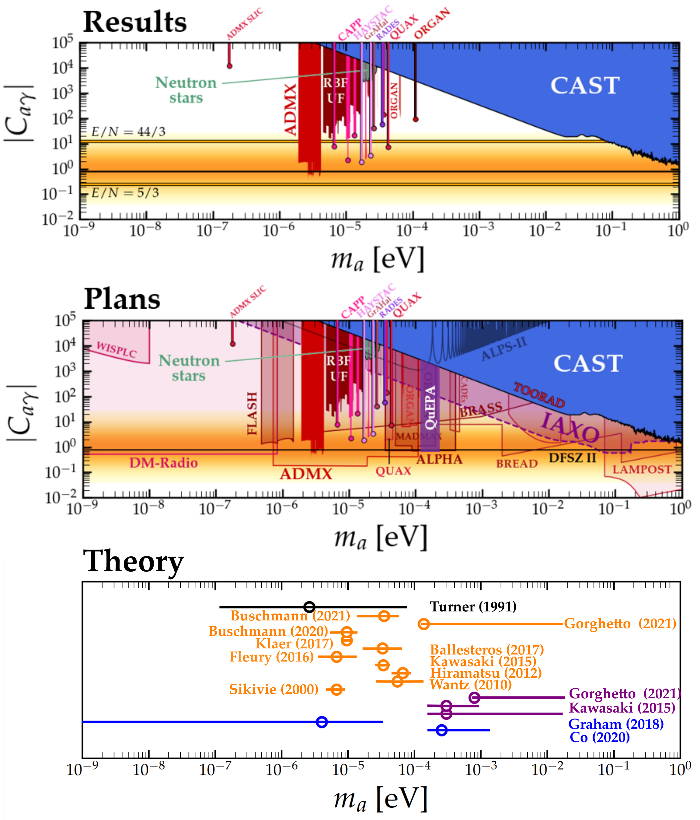
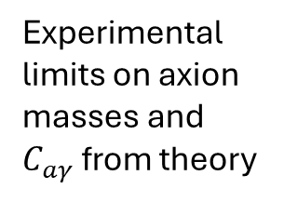
5
Axion parameter space
$$f_{a}$$
Experimental limits on axion masses and $C_{aγ}$ from theory
DFSZ
Model predictions
Axions formed pre-inflation
Axion masses consistent with Big Bang cosmology and DM density
Axions formed post-inflation with 1 domain wall
>1 domain wall
Other models
Huge range of viable axion masses to be explored
Top: limits from cajohare.github.io/AxionLimits/docs/ap.html
Bottom: Theory plot adapted from Javier Redondo’s talk at TAUP 2021, reproduced with permission

Slide 12
5
Axion parameter space
$$f_{a}$$
Experimental limits on axion masses and $C_{aγ}$ from theory
DFSZ
Model predictions
Axions formed pre-inflation
Axion masses consistent with Big Bang cosmology and DM density
Axions formed post-inflation with 1 domain wall
>1 domain wall
Other models
Huge range of viable axion masses to be explored
Top: limits from cajohare.github.io/AxionLimits/docs/ap.html
Bottom: Theory plot adapted from Javier Redondo’s talk at TAUP 2021, reproduced with permission

Slide 13
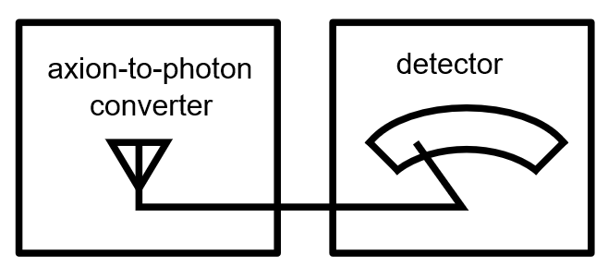
6
Axion haloscope

Slide 14
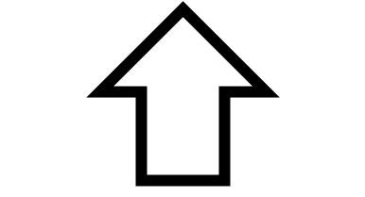
6
Axion haloscope
Problem 1: Decreasing volume
(and Q factor)

Slide 15
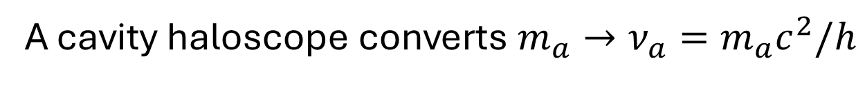
7
Decreasing volume
A cavity haloscope converts $m_{a}→ν_{a}=m_{a}c^{2}/h$
C. Boutan, et al., Phys. Rev. Lett. 121 (2018)

Slide 16
7
Decreasing volume
A cavity haloscope converts $m_{a}→ν_{a}=m_{a}c^{2}/h$
$$\text{Rate} \left[s^{−1}\right]≈5 ×{10}^{−4}{C_{aγγ}}^{2} Q V_{m}B^{2}$$
C. Boutan, et al., Phys. Rev. Lett. 121 (2018)

Slide 17
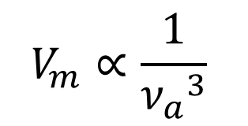
7
Decreasing volume
A cavity haloscope converts $m_{a}→ν_{a}=m_{a}c^{2}/h$
$$\text{Rate} \left[s^{−1}\right]≈5 ×{10}^{−4}{C_{aγγ}}^{2} Q V_{m}B^{2}$$
Volume factor scales with frequency
$$V_{m}∝\frac{1}{{ν_{a}}^{3}}$$
C. Boutan, et al., Phys. Rev. Lett. 121 (2018)

Slide 18
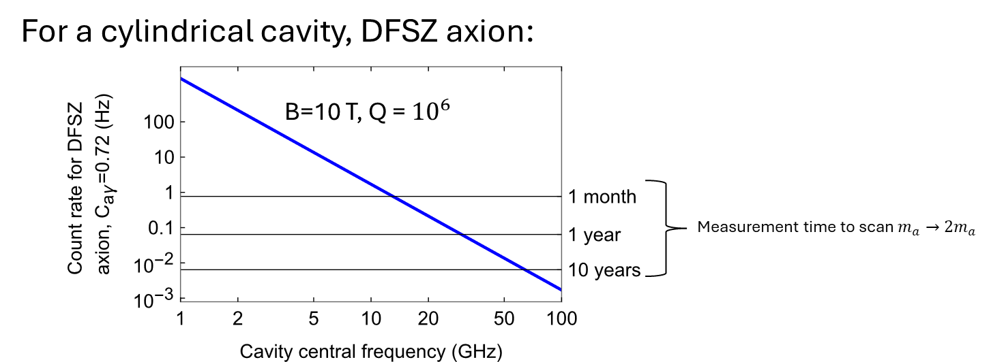
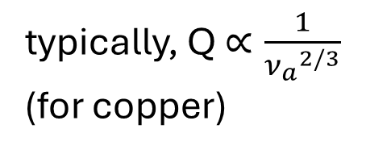
7
Decreasing volume
A cavity haloscope converts $m_{a}→ν_{a}=m_{a}c^{2}/h$
$$\text{Rate} \left[s^{−1}\right]≈5 ×{10}^{−4}{C_{aγγ}}^{2} Q V_{m}B^{2}$$
Volume factor scales with frequency
$$V_{m}∝\frac{1}{{ν_{a}}^{3}}$$
typically, Q $∝\frac{1}{{ν_{a}}^{2/3}}$ (for copper)
C. Boutan, et al., Phys. Rev. Lett. 121 (2018)

Slide 19
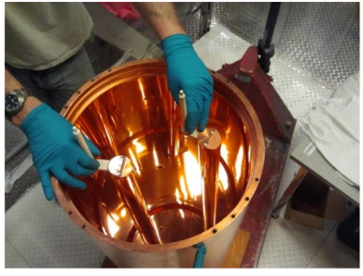
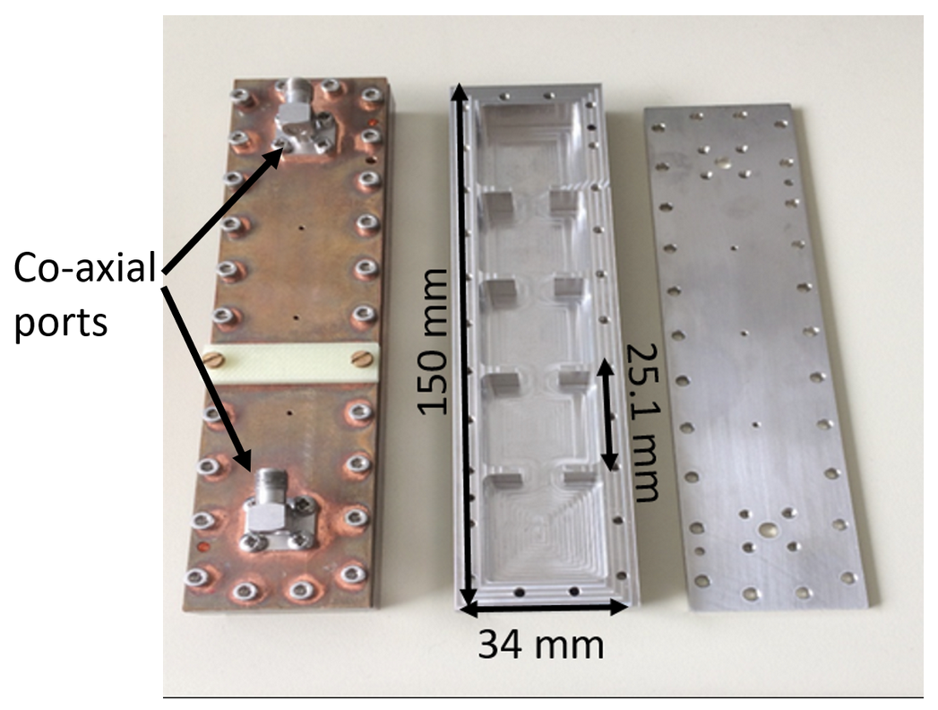
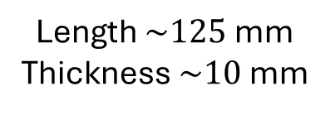
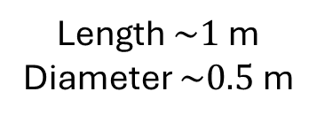

8
Microwave cavities
$$m_{a}$$
Length $\sim 1$ m
Diameter $\sim 0.5$ m
Length $\sim 125$mm
Thickness $\sim 10$ mm
Size
RADES: min frequency ~8.4 GHz
ADMX: min frequency ~640 MHz
A. Melcón, et al. J. High Energ. Phys. 2021, 75 (2021)
S. K. Lamoreaux, et al., Phys. Rev. D 88, 035020 (2013)

Slide 20
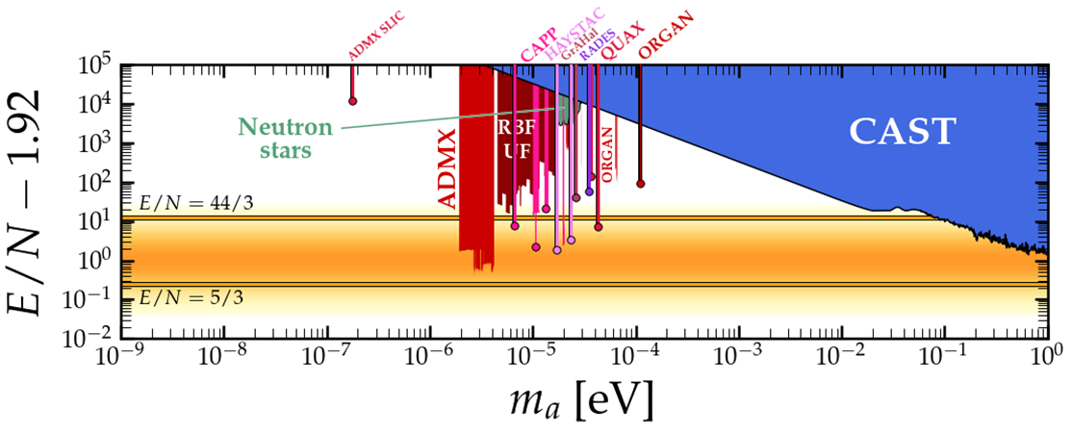
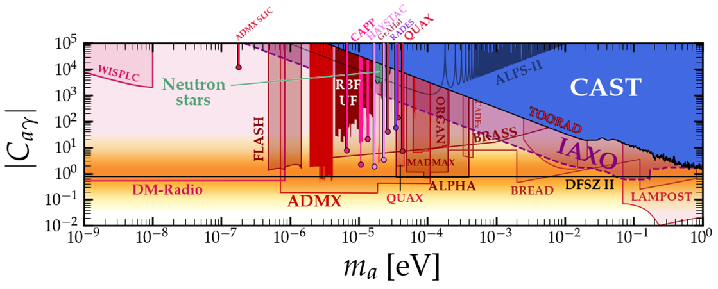
9
Other detection options >30 GHz
Results
Dielectric cavities
ORGAN
QDM lab (Univ. Western Australia)
Lead by Dr. Michael Tobar
TEM_{00q} Fabry-Perot
ORPHEUS
Rybka et al.
Plasma haloscope
Projections
ALPHA
Frank Wilczek et al.
“Magnetized mirrors”…
BRASS
University of Hamburg
BREAD
Cambridge/Fermilab, higher m_{a}
.. with dielectric boost
MADMAX
Big effort at DESY, lower m_{a} initially
Many, more new ideas between 5-30 GHz
https://cajohare.github.io/AxionLimits/docs/ap.html

Slide 21

9
Other detection options >30 GHz
Results
Dielectric cavities
ORGAN
QDM lab (Univ. Western Australia)
Lead by Dr. Michael Tobar
TEM_{00q} Fabry-Perot
ORPHEUS
Rybka et al.
Plasma haloscope
Projections
ALPHA
Frank Wilczek et al.
“Magnetized mirrors”…
BRASS
University of Hamburg
BREAD
Cambridge/Fermilab, higher m_{a}
.. with dielectric boost
MADMAX
Big effort at DESY, lower m_{a} initially
Many, more new ideas between 5-30 GHz
https://cajohare.github.io/AxionLimits/docs/ap.html

Slide 22


10
Dielectric Fabry-Perot Cavity
Operating with the fundamental mode
$$d\sim mλ/2$$
$$d$$

Slide 23
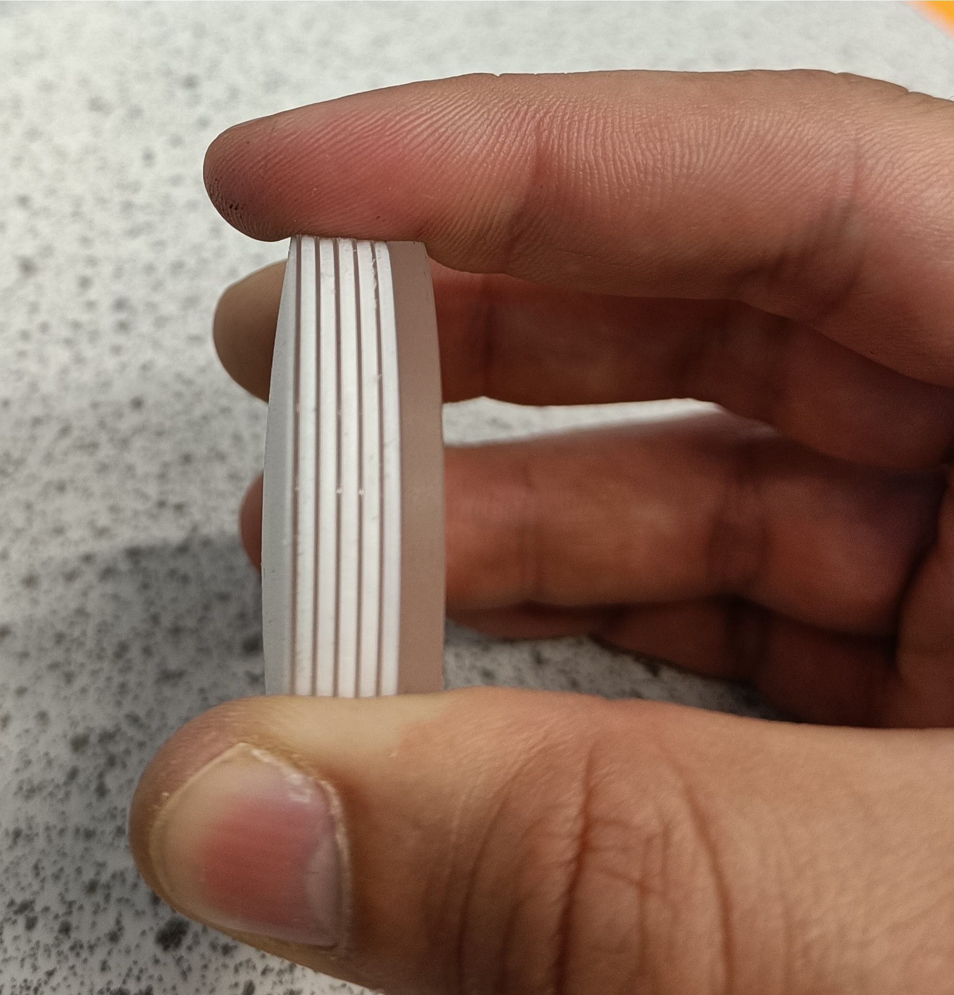
10
Dielectric Fabry-Perot Cavity
Operating with the fundamental mode
$$d\sim mλ/2$$
$$d$$

Slide 24
10
Dielectric Fabry-Perot Cavity
Operating with the fundamental mode
$$d\sim mλ/2$$
$$d$$
Teflon/
Sapphire
stack

Slide 25
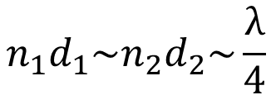
10
Dielectric Fabry-Perot Cavity
Operating with the fundamental mode
$$d\sim mλ/2$$
$$n_{1}d_{1}\sim n_{2}d_{2}\sim \frac{λ}{4}$$
$$d$$
Teflon/
Sapphire
stack

Slide 26
11
Why a dielectric Fabry-Perot Cavity?

Slide 27
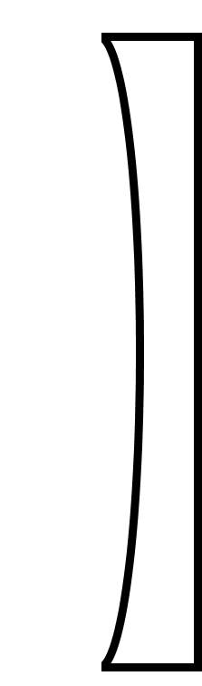
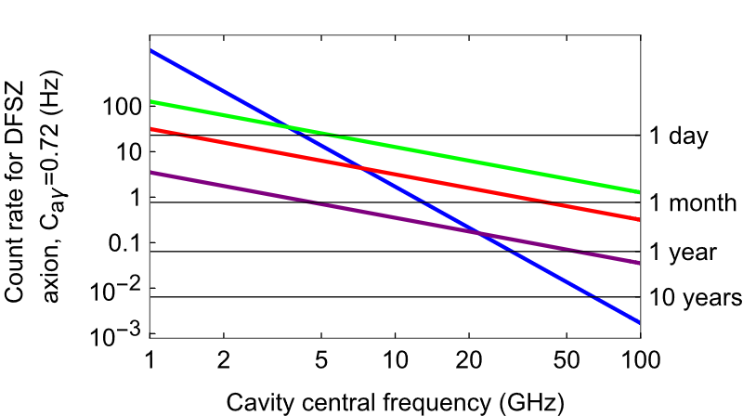







11
Why a dielectric Fabry-Perot Cavity?
$$\text{Rate} \left[s^{−1}\right]≈5 ×{10}^{−4}{C_{aγγ}}^{2} Q V_{m}B^{2}$$
1) Favourable $V_{m}$ scaling with $ν_{a}$
B
At the optimum design frequency, $V_{m}=\frac{8}{π}\frac{c w^{2}}{ν_{a}}$
B=10T, Q=10⁶
$w≫λ_{a}$/2
$$λ_{a}/2$$
Measurement time to scan $m_{a}→2m_{a}$
Cylindrical cavity
FP $∅ 50$ mm
FP $∅ 150$ mm
FP $∅ 300$ mm

Slide 28
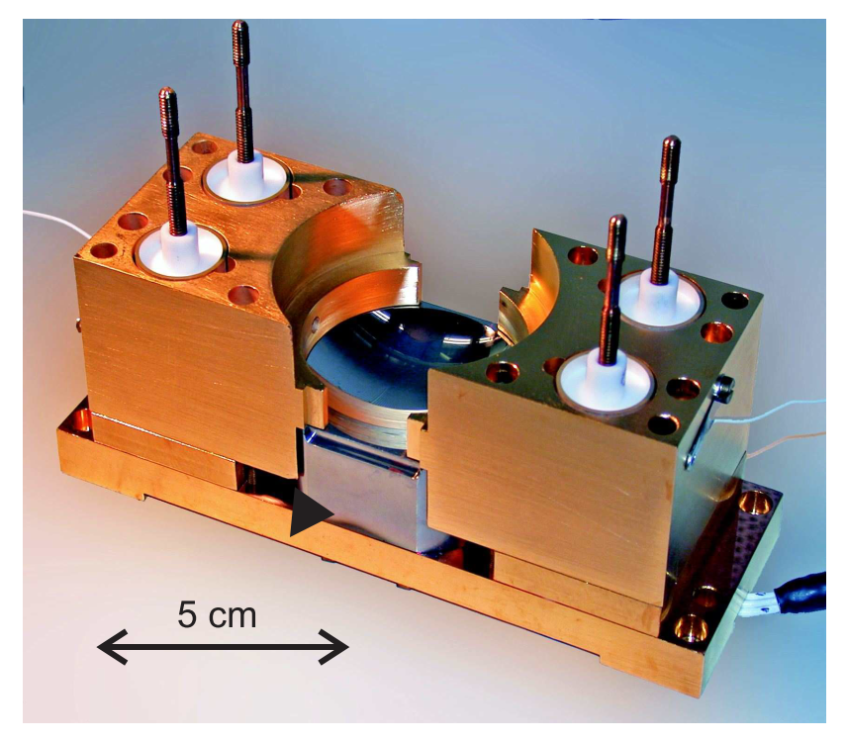
11
Why a dielectric Fabry-Perot Cavity?
$$\text{Rate} \left[s^{−1}\right]≈5 ×{10}^{−4}{C_{aγγ}}^{2} Q V_{m}B^{2}$$
1) Favourable $V_{m}$ scaling with $ν_{a}$
2) High Q possible in this open geometry
B
Q=4.2x10¹⁰
At the optimum design frequency, $V_{m}=\frac{8}{π}\frac{c w^{2}}{ν_{a}}$
B=10T, Q=10⁶
$w≫λ_{a}$/2
S. Kuhr et al., Appl. Phys. Lett. 90, 164101 (2007)
$$λ_{a}/2$$
Measurement time to scan $m_{a}→2m_{a}$
Cylindrical cavity
FP $∅ 50$ mm
FP $∅ 150$ mm
FP $∅ 300$ mm

Slide 29
11
Why a dielectric Fabry-Perot Cavity?
$$\text{Rate} \left[s^{−1}\right]≈5 ×{10}^{−4}{C_{aγγ}}^{2} Q V_{m}B^{2}$$
1) Favourable $V_{m}$ scaling with $ν_{a}$
2) High Q possible in this open geometry
B
Q=4.2x10¹⁰
At the optimum design frequency, $V_{m}=\frac{8}{π}\frac{c w^{2}}{ν_{a}}$
B=10T, Q=10⁶
$w≫λ_{a}$/2
S. Kuhr et al., Appl. Phys. Lett. 90, 164101 (2007)
$$λ_{a}/2$$
Measurement time to scan $m_{a}→2m_{a}$
3) High B-field compatible
Dielectric Bragg mirrors
All dielectric design – ultralow loss even in high B field
Large sapphire wafers available: 10-12 inch
Less likely to crack under differential expansion
Cylindrical cavity
FP $∅ 50$ mm
FP $∅ 150$ mm
FP $∅ 300$ mm

Slide 30
11
Why a dielectric Fabry-Perot Cavity?
$$\text{Rate} \left[s^{−1}\right]≈5 ×{10}^{−4}{C_{aγγ}}^{2} Q V_{m}B^{2}$$
1) Favourable $V_{m}$ scaling with $ν_{a}$
2) High Q possible in this open geometry
B
Q=4.2x10¹⁰
At the optimum design frequency, $V_{m}=\frac{8}{π}\frac{c w^{2}}{ν_{a}}$
B=10T, Q=10⁶
$w≫λ_{a}$/2
S. Kuhr et al., Appl. Phys. Lett. 90, 164101 (2007)
$$λ_{a}/2$$
Measurement time to scan $m_{a}→2m_{a}$
3) High B-field compatible
Dielectric Bragg mirrors
All dielectric design – ultralow loss even in high B field
Large sapphire wafers available: 10-12 inch
Less likely to crack under differential expansion
Cylindrical cavity
FP $∅ 50$ mm
FP $∅ 150$ mm
FP $∅ 300$ mm
Other considerations: Frequency adjustment easy, relatively compact, broad tuning range, easy to model, simulate and measure electric fields.

Slide 31
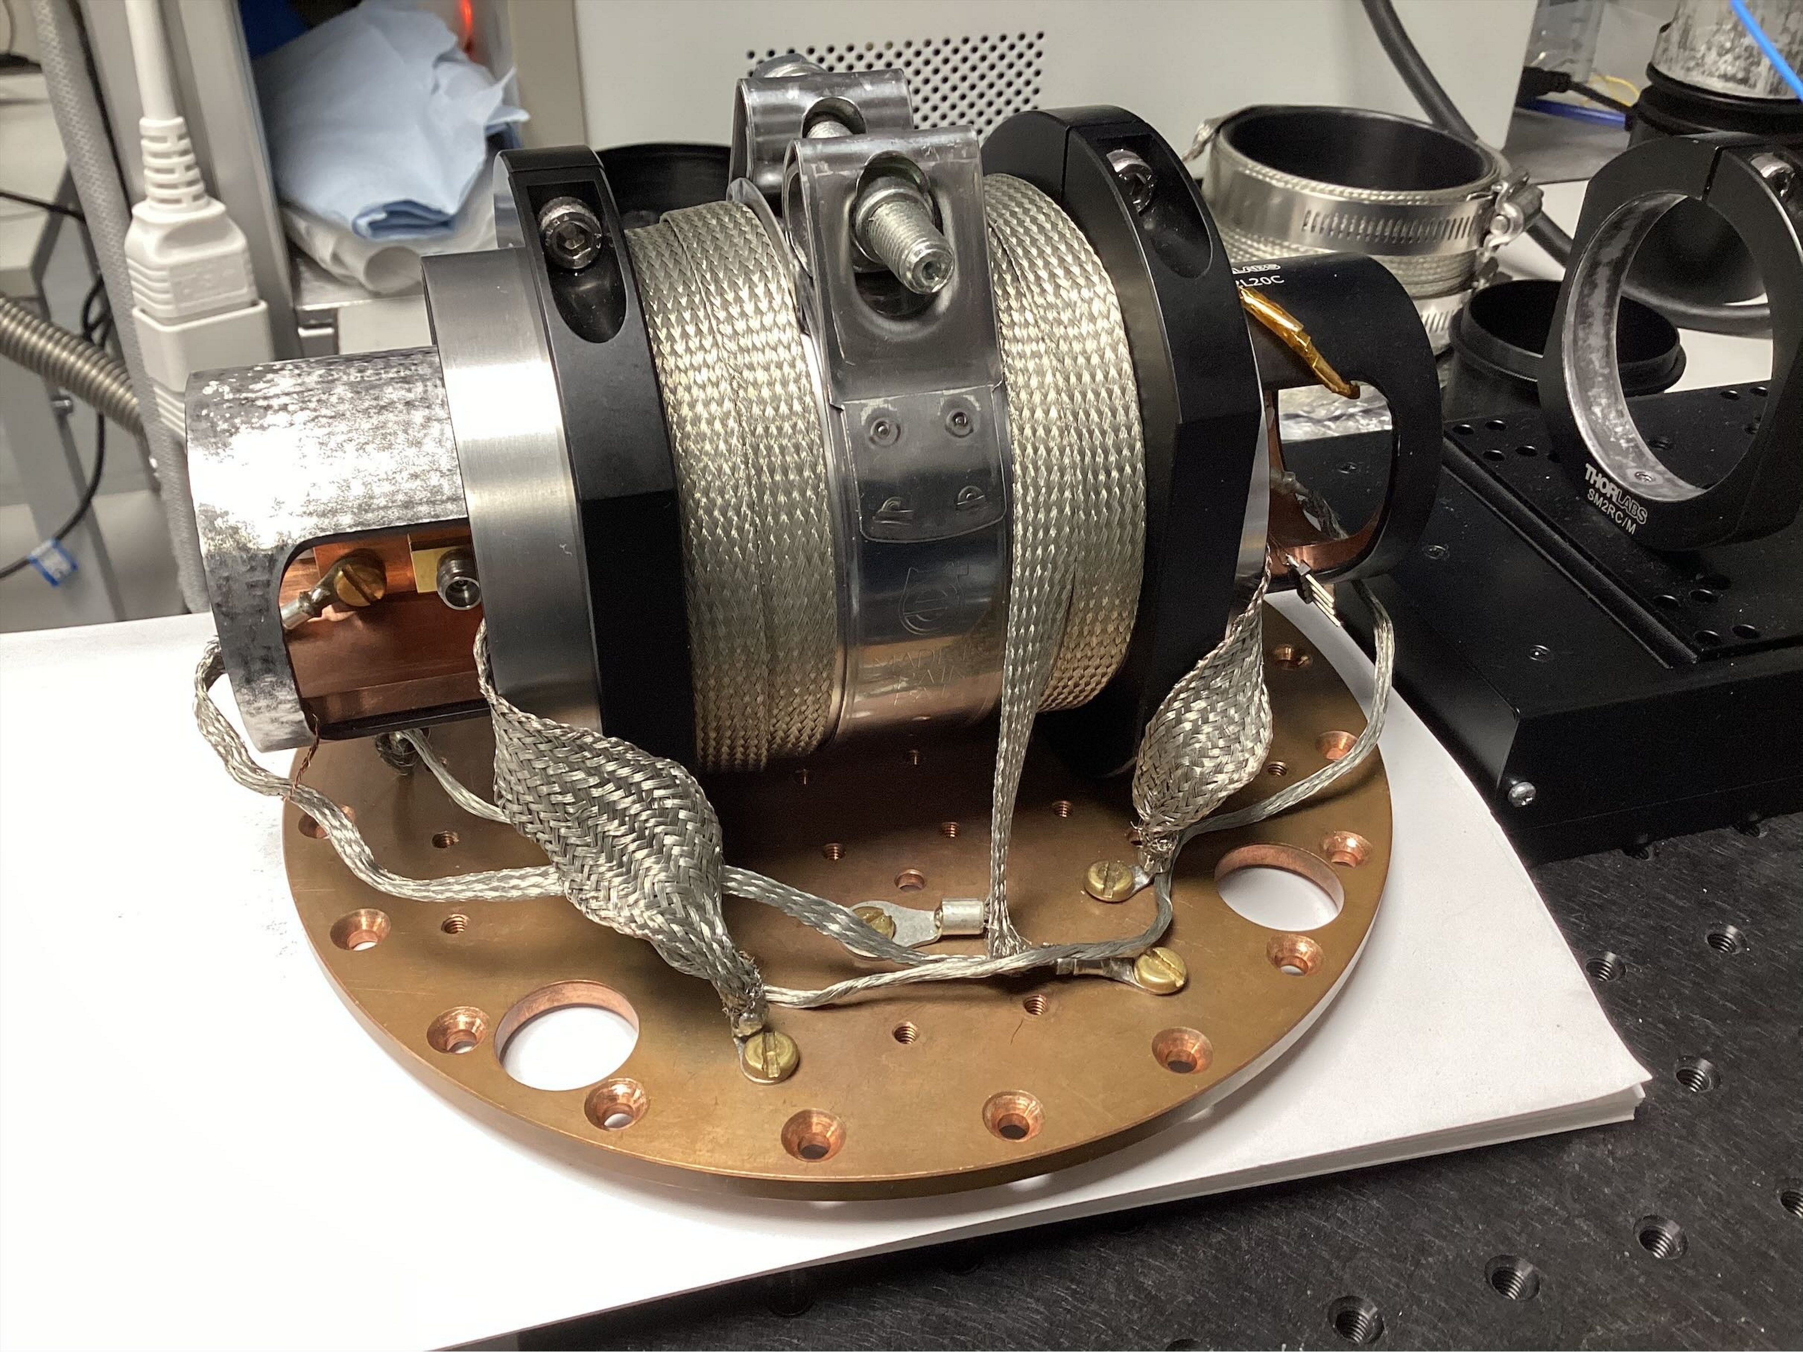
12
2 inch prototype
Initial testing at room temperature and 4K.

Slide 32
13
Characterising cavity

Slide 33
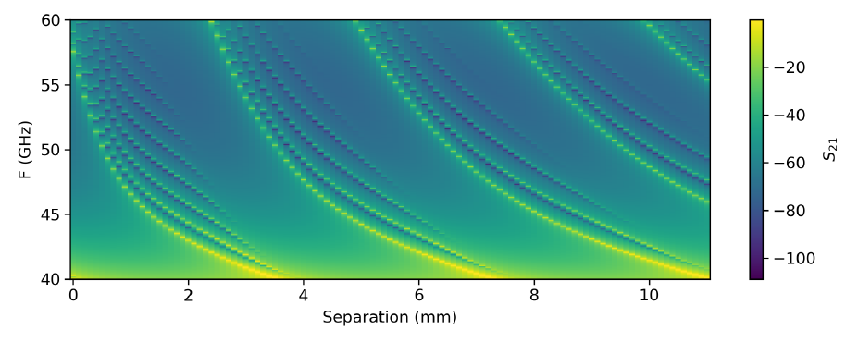
13
Characterising cavity
Simulations

Slide 34
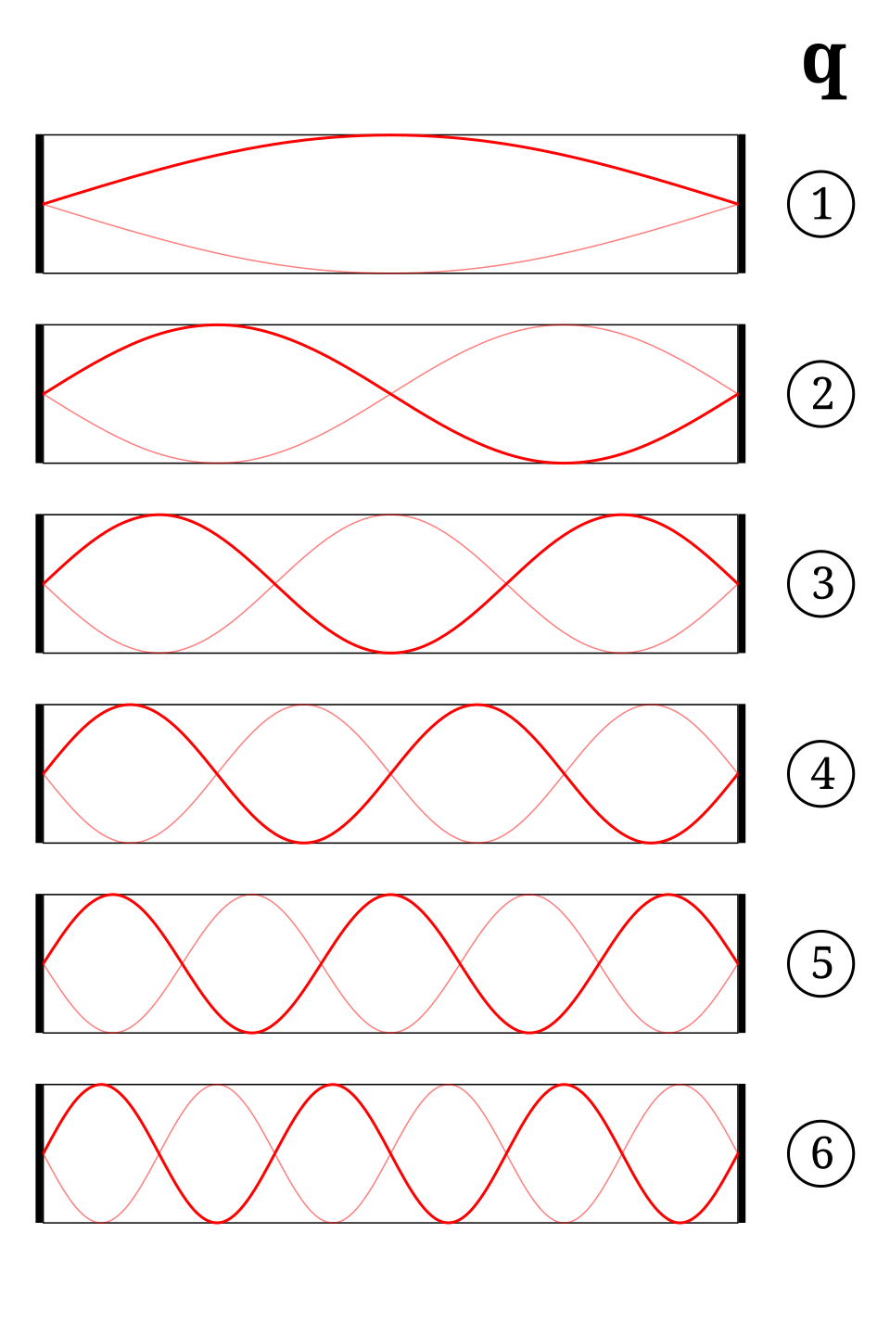
13
Characterising cavity
Simulations
q=5
q=4
q=1
q=2
q=3

Slide 35
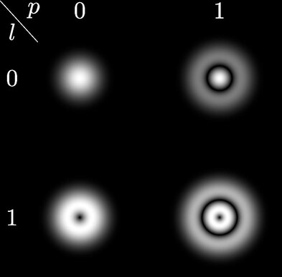
13
Characterising cavity
Simulations
q=5
q=4
q=1
q=2
q=3

Slide 36
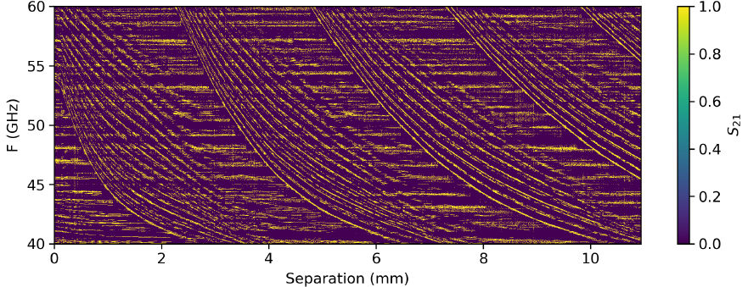
13
Characterising cavity
Simulations
q=5
q=4
q=1
q=2
q=3
Measured

Slide 37
14
Measuring Quality factor
$$\text{Rate} \left[s^{−1}\right]≈5 ×{10}^{−4}{C_{aγγ}}^{2} Q V_{m}B^{2}$$

Slide 38
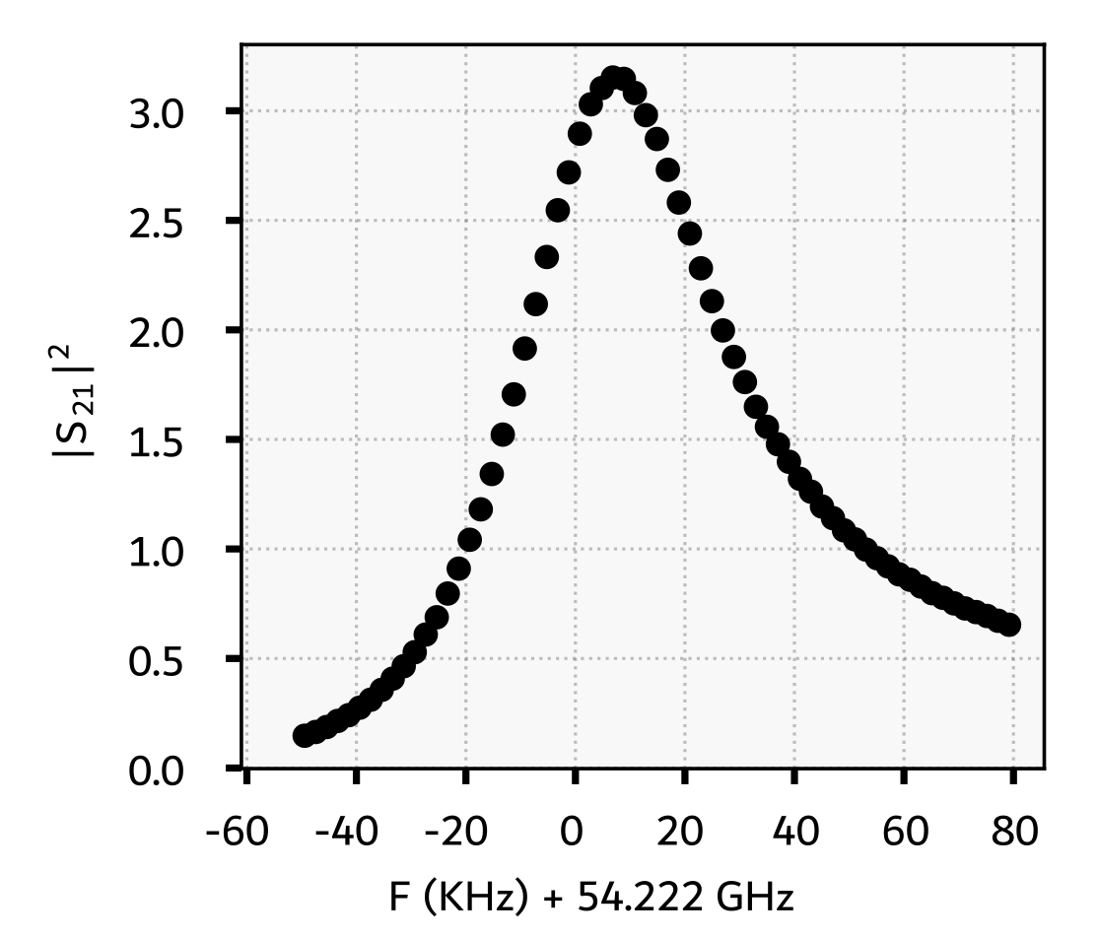
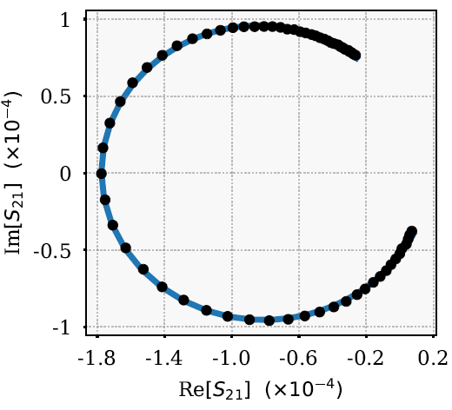
14
Measuring Quality factor
$$\text{Rate} \left[s^{−1}\right]≈5 ×{10}^{−4}{C_{aγγ}}^{2} Q V_{m}B^{2}$$

Slide 39
14
Measuring Quality factor
$$\text{Rate} \left[s^{−1}\right]≈5 ×{10}^{−4}{C_{aγγ}}^{2} Q V_{m}B^{2}$$
Measured Q factor in excess of 100,000

Slide 40
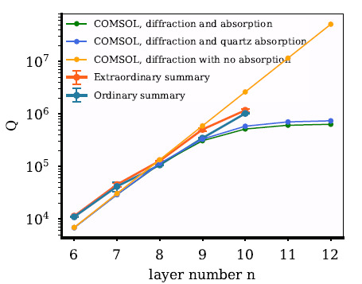
14
Measuring Quality factor
$$\text{Rate} \left[s^{−1}\right]≈5 ×{10}^{−4}{C_{aγγ}}^{2} Q V_{m}B^{2}$$
Simulations
Q factor vs layers in Bragg mirror
Measured Q factor in excess of 100,000
Experiment

Slide 41
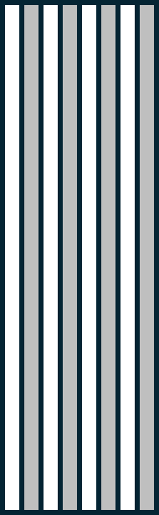


15
Cavity Modes
$$∆f\left(x\right)∝{\left|E_{x}(x)\right|}^{2}$$
$$x$$

Slide 42
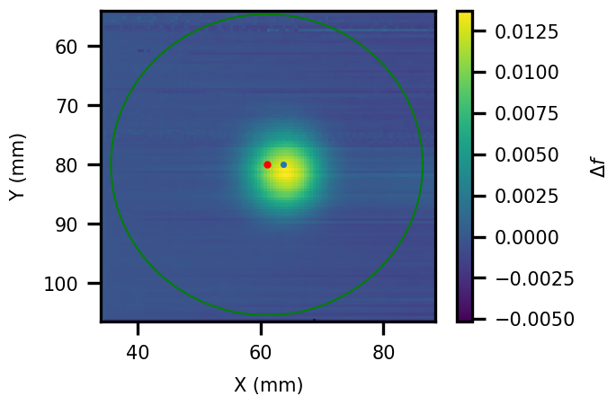
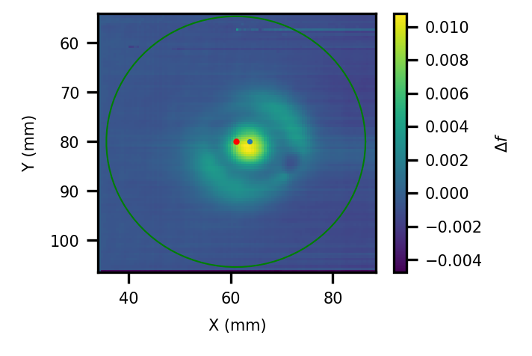
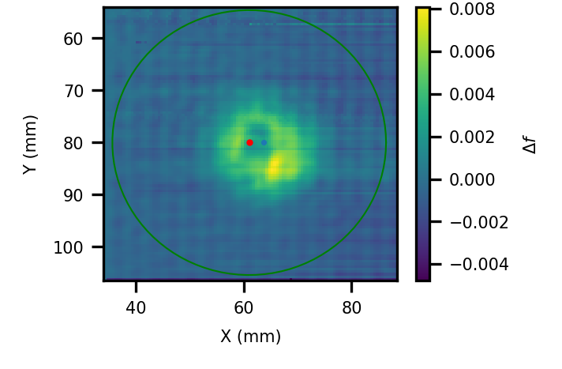



15
Cavity Modes
$$∆f\left(x\right)∝{\left|E_{x}(x)\right|}^{2}$$
$f\sim 43$ GHz
$f\sim 45$ GHz
$$x$$
$f\sim 44$ GHz

Slide 43
15
Cavity Modes
$$∆f\left(x\right)∝{\left|E_{x}(x)\right|}^{2}$$
$f\sim 43$ GHz
$f\sim 45$ GHz
$$x$$
$f\sim 44$ GHz

Slide 44
16
Axion haloscope
Problem 1: Decreasing volume
(and Q factor)

Slide 45
16
Axion haloscope
Problem 1: Decreasing volume
(and Q factor)
Problem 2: Increasing noise

Slide 46
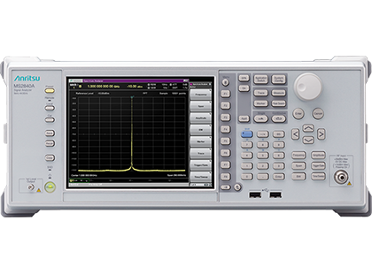
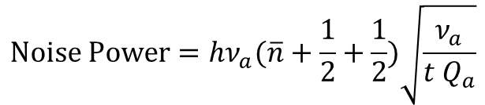

17
Increasing noise
Classical readout: linearly amplify signal and use a signal analyzer
$$B_{e}$$
$$\text{Noise} \text{Power}=hν_{a}(\overline{n}+\frac{1}{2}+\frac{1}{2})\sqrt{\frac{ν_{a}}{t Q_{a}}}$$
Noise from finite temperature
Zero-point noise from using a normal, Gaussian state of the cavity
Fundamental quantum amplification noise limit
Standard Quantum Limit (SQL)
S. K. Lamoreaux, et al., Phys. Rev. D 88, 035020 (2013)

Slide 47
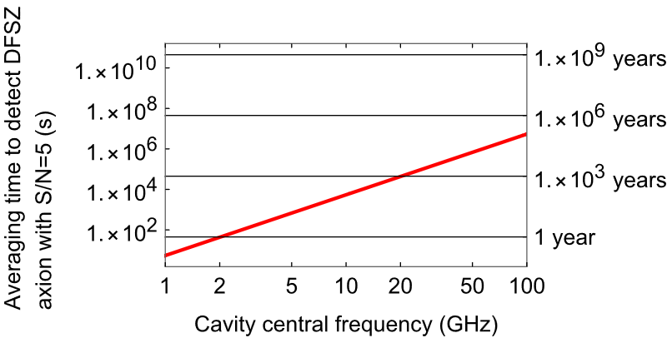

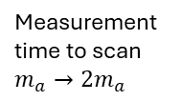
17
Increasing noise
Classical readout: linearly amplify signal and use a signal analyzer
Cylindrical cavity, DFSZ axion
Considering the effect just due to the noise contribution with no decrease in volume
$$B_{e}$$
$$\text{Noise} \text{Power}=hν_{a}(\overline{n}+\frac{1}{2}+\frac{1}{2})\sqrt{\frac{ν_{a}}{t Q_{a}}}$$
B=10 T, Q = ${10}^{6}$
Measurement time to scan $m_{a}→2m_{a}$
Noise from finite temperature
Zero-point noise from using a normal, Gaussian state of the cavity
Fundamental quantum amplification noise limit
Standard Quantum Limit (SQL)
S. K. Lamoreaux, et al., Phys. Rev. D 88, 035020 (2013)

Slide 48
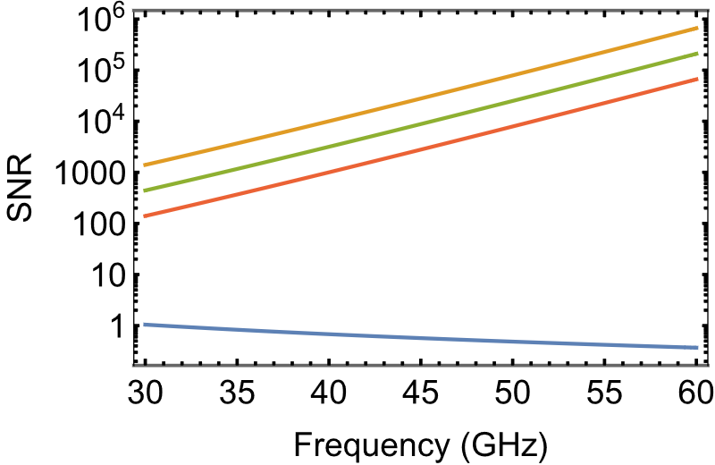
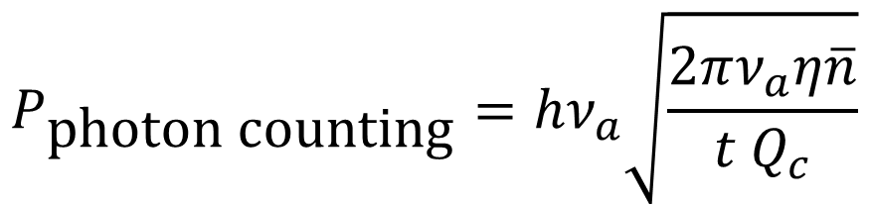
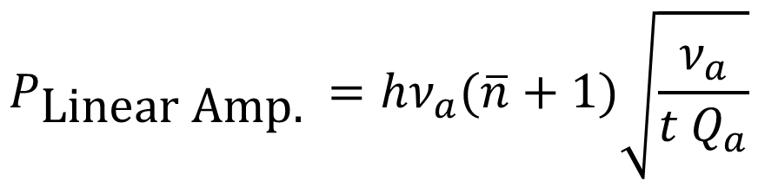




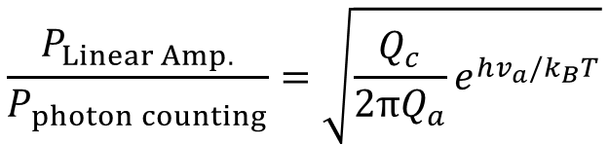
18
Photon counting to beat SQL
$$P_{\text{Linear} \text{Amp}\text{.} }=hν_{a}(\overline{n}+1)\sqrt{\frac{ν_{a}}{t Q_{a}}}$$
$$P_{\text{photon} \text{counting}}=hν_{a}\sqrt{\frac{2πν_{a}η\overline{n}}{t Q_{c}}}$$
vs.
@100 mK
$$\frac{P_{Linear Amp.}}{P_{photon counting}}=\sqrt{\frac{Q_{c}}{2πQ_{a}}e^{hv_{a}/k_{B}T}}$$
Photon counting
$$η=1$$
Efficiency
$$η=0.1$$
for $k_{b}T/hν_{a}≪1$
$$η=0.01$$
Standard Quantum Noise Limit
S. K. Lamoreaux, et al., Phys. Rev. D 88, 035020 (2013)

Slide 49
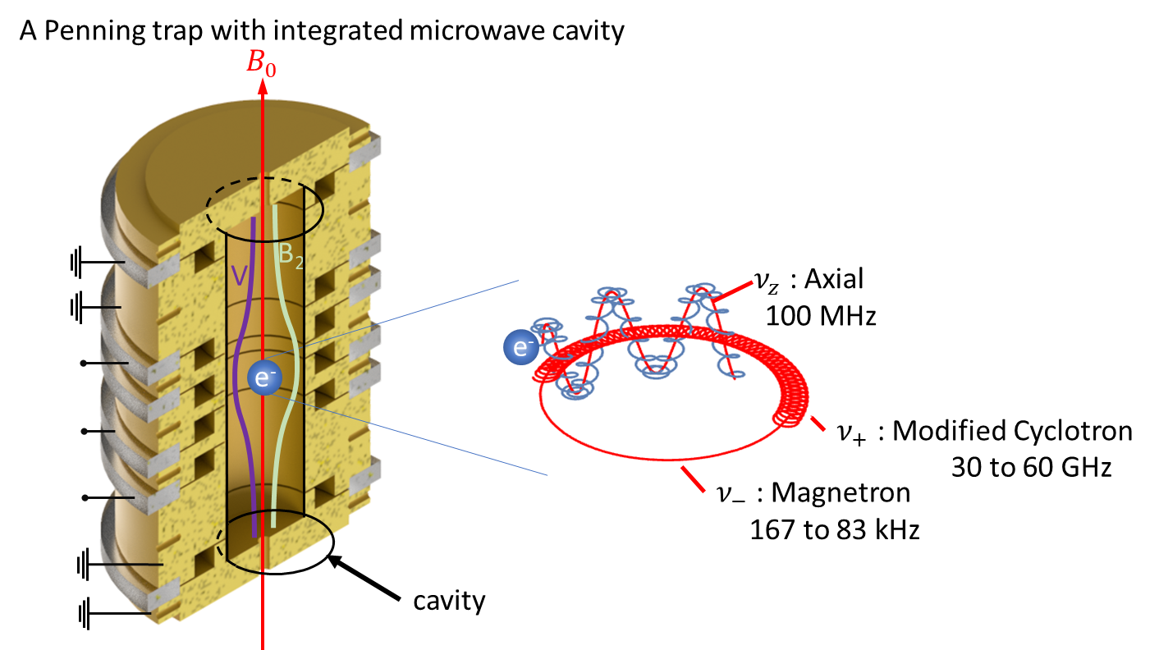
19
Detecting photons with a single trapped electron
X. Fan, et al., Photonics, Phys. Rev. D 111, 075022 (2025)
A. Cridland, et al., Photonics, 3(4), 59 (2016)
S. Peil and G. Gabrielse, Phys. Rev. Lett. 83, 1287 (1999)
D. Hanneke, S. Fogwell Hoogerheide, and G. Gabrielse, PRA 83, 052122 (2011)

Slide 50
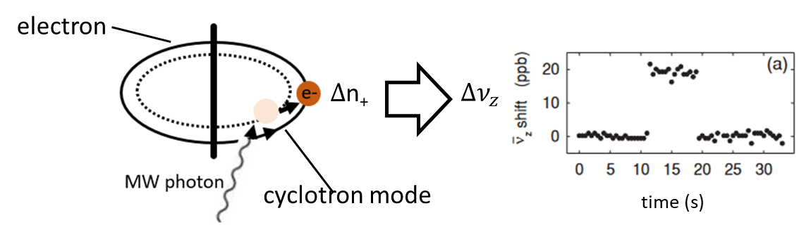
19
Detecting photons with a single trapped electron
X. Fan, et al., Photonics, Phys. Rev. D 111, 075022 (2025)
A. Cridland, et al., Photonics, 3(4), 59 (2016)
S. Peil and G. Gabrielse, Phys. Rev. Lett. 83, 1287 (1999)
D. Hanneke, S. Fogwell Hoogerheide, and G. Gabrielse, PRA 83, 052122 (2011)

Slide 51
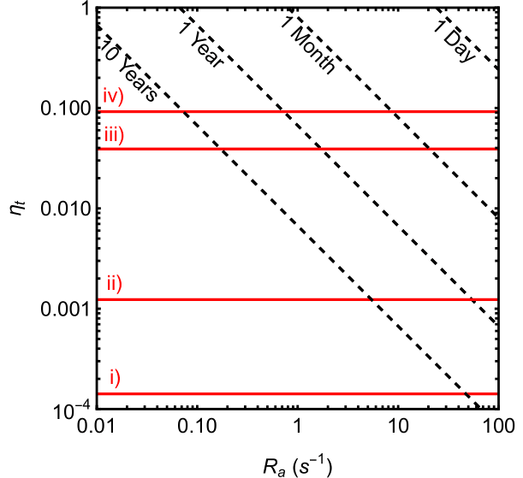

19
Detecting photons with a single trapped electron
Time to scan $m_{a}→2m_{a}$
Photon counting efficiency
Photon emission rate
X. Fan, et al., Photonics, Phys. Rev. D 111, 075022 (2025)
A. Cridland, et al., Photonics, 3(4), 59 (2016)
S. Peil and G. Gabrielse, Phys. Rev. Lett. 83, 1287 (1999)
D. Hanneke, S. Fogwell Hoogerheide, and G. Gabrielse, PRA 83, 052122 (2011)

Slide 52
19
Detecting photons with a single trapped electron
Time to scan $m_{a}→2m_{a}$
Photon counting efficiency
Photon emission rate
X. Fan, et al., Photonics, Phys. Rev. D 111, 075022 (2025)
A. Cridland, et al., Photonics, 3(4), 59 (2016)
S. Peil and G. Gabrielse, Phys. Rev. Lett. 83, 1287 (1999)
D. Hanneke, S. Fogwell Hoogerheide, and G. Gabrielse, PRA 83, 052122 (2011)

Slide 53
19
Detecting photons with a single trapped electron
Time to scan $m_{a}→2m_{a}$
Photon counting efficiency
Photon emission rate
X. Fan, et al., Photonics, Phys. Rev. D 111, 075022 (2025)
A. Cridland, et al., Photonics, 3(4), 59 (2016)
S. Peil and G. Gabrielse, Phys. Rev. Lett. 83, 1287 (1999)
D. Hanneke, S. Fogwell Hoogerheide, and G. Gabrielse, PRA 83, 052122 (2011)

Slide 54






20
Trapped electrons
Cryo infrastructure
Penning trap assembly
Penning trap
Electron source
Dilution fridge installed October 2024
Base temperature < 50 mK at 2T field
Vibrations at sample space investigated and found to be acceptable
Cloud of >1000 electrons

Slide 55
21
Next Steps
Test run with 2 inch Fabry-Perot cavity.
Reduce number of electrons trapped to a single electron.

Slide 56



21
Next Steps
Test run with 2 inch Fabry-Perot cavity.
Reduce number of electrons trapped to a single electron.
Goal: Search $m_{a}\sim 125 −250 μeV$
@ DFSZ sensitivity

Slide 57




22
Quantum Enhanced Particle Astrophysics Team
Richard
Thompson
Thank you for listening
Dr. Kanika
+ Mike Tarbutt
Marios Telemachou & Mingyao Xu
Maddie Fisher
Horacio Septien-Gonzalez
Toren Dofher
Marko Wojtkowiak
JAD
Shreyak Banhatti
He Zhang
Jiacheng Shi

Slide 58



Single photon counters
Solid-state devices
Alternative AMO devices
CARRACK I & II Rydberg atoms
Good performance, ultimately effort was not sustained.
Now Rydberg Axions at Yale (RAY) D. Speller, & S. Ghosh
A. V. Dixit, et al., Phys. Rev. Lett. 126 141302 (2021)
M. Tada et al., Nuclear Physics B (Proc. Suppl.) 72 164 (1999)
A. Ghirri et al., Sensors 20(14), 4010 (2020)
M. Tada et al., Physics Letters A 349 6 488 (2006)

Slide 59


