Slide 1
Quantum limited superconducting resonator amplifiers for high frequency Axion dark matter search
Valerio Gilles
University of Manchester
valerio.gilles@manchester.ac.uk
01/12/2025

Slide 2
Contents
Interest in quantum amplifiers
Non-linearity and mixing
Quantum limited resonator amplifier
  Design
  Fabricated samples
  Gain and transmission
  Compression and noise measurements
  Tunability (unpublished)

Slide 3
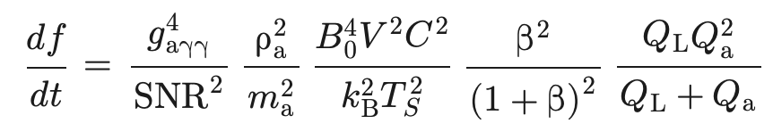


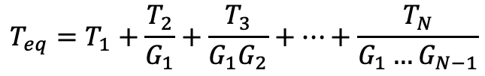




Interest in quantum amplifiers
Frii’s formula:
Scanning rate (haloscope):
Amplifying section of the detection chain:
[1]
$$G_{1}, T_{1}$$
$$G_{2}, T_{2}$$
$$G_{3}, T_{3}$$
$$G_{N}, T_{N}$$
$$T_{eq}=T_{1}+\frac{T_{2}}{G_{1}}+\frac{T_{3}}{G_{1}G_{2}}+…+\frac{T_{N}}{G_{1}…G_{N−1}}$$
$$T_{HEMT}≈10 T_{1}$$
Who’s using quantum amplifiers?
ADMX: Josephson Parametric Amplifier (JPA)
HAYSTAC: JPA
CAPP: JPA
18 T HTS haloscope: Josephson Parametric Converter
QSHS: JPA
Figure 1: Frii’s formula for a cascade of amplifiers.
[2]
Pump
LO
[3]
[4]
Cavity
$$T_{cold}$$
QA
HEMT
Warm LNA
4 K
[5]
Figure 2: Simple schematic of a standard detection chain.
[6]

Slide 4
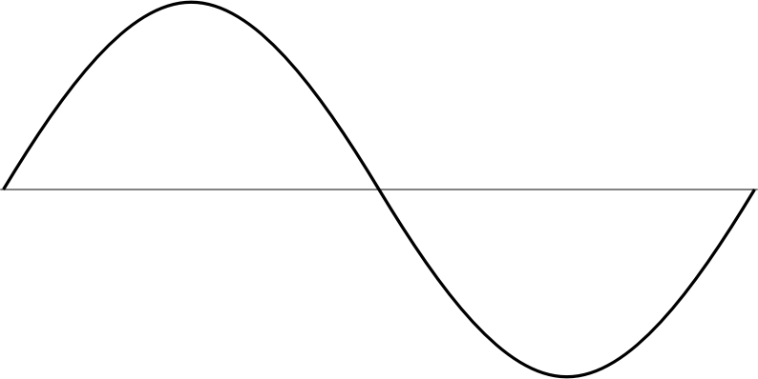


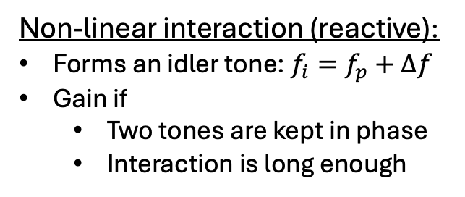

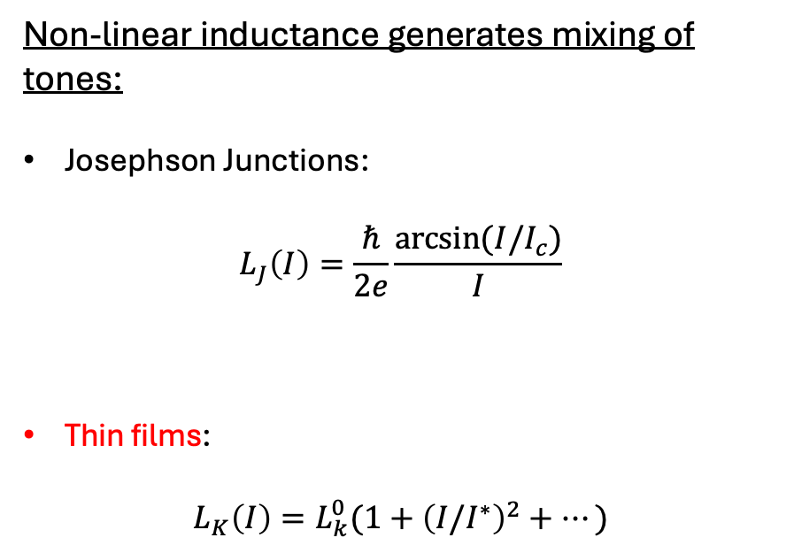
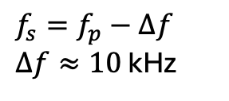


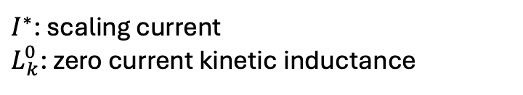

Non-linearity and mixing
Non-linear inductance generates mixing of tones:
Josephson Junctions:
$$L_{J}\left(I\right)=\frac{ℏ}{2e}\frac{arcsin⁡(I/I_{c})}{I}$$
Thin films:
$$L_{K}\left(I\right)=L_{k}^{0}(1+{\left(I/I^{∗}\right)}^{2}+…)$$
Four Wave Mixing (4-wave degenerate):
$$f_{s}=f_{p}−Δf$$
$Δf≈10$ kHz
$$ΔE$$
$$f_{p1}$$
$$f_{s}$$
Signal
=
$$f_{p2}$$
$$f_{i}$$
$I_{c}$: critical current
Pump
Figure 3: Four wave mixing process.
Non-linear interaction (reactive):
Forms an idler tone: $f_{i}=f_{p}+Δf$
Gain if
  Two tones are kept in phase
  Interaction is long enough
$I^{∗}$: scaling current
$L_{k}^{0}$: zero current kinetic inductance

Slide 5
Quantum limited tunable resonator amplifier

Slide 6
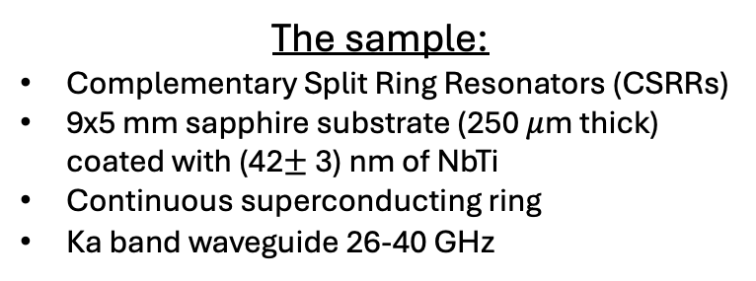
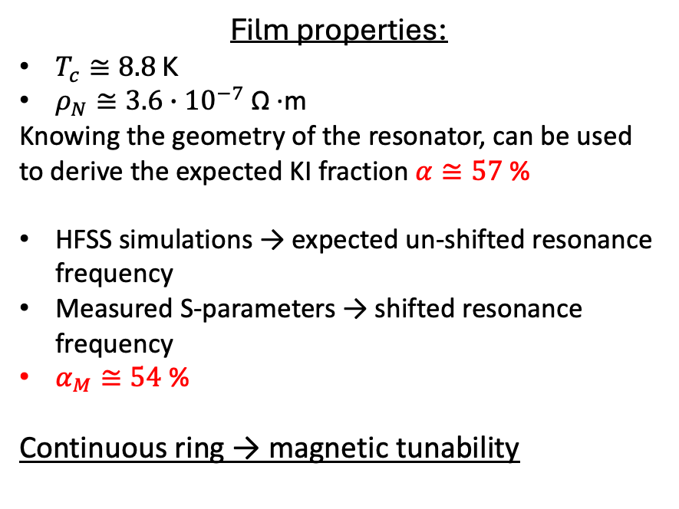
Design
Gilles V. et al.: “A cm-wave quantum noise limited resonant Superconducting Parametric Amplifier”, Under Review.
The sample:
Complementary Split Ring Resonators (CSRRs)
9x5 mm sapphire substrate (250 $μ$m thick) coated with (42$±$ 3) nm of NbTi
Continuous superconducting ring
Ka band waveguide 26-40 GHz
Film properties:
$T_{c}≅8.8$ K
$ρ_{N}≅3.6∙{10}^{−7}$ Ω ∙m
Knowing the geometry of the resonator, can be used to derive the expected KI fraction $α≅57$ %
HFSS simulations → expected un-shifted resonance frequency
Measured S-parameters → shifted resonance frequency
$α_{M}≅54$ %
Continuous ring → magnetic tunability
Ka band waveguide
Sapphire
NbTi
Figure 4: (left) Design of the amplifying chip with four resonators. (right) CSRR with one continuous ring.

Slide 7
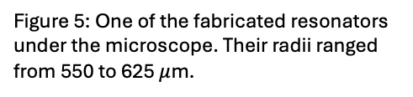
Fabricated samples
Capacitative gap
Continuous ring
Figure 5: One of the fabricated resonators under the microscope. Their radii ranged from 550 to 625 $μ$m.
Figure 6: Zoom-in on the capacitative gap of one of the resonators obtained using a Scanning Electron Microscope.
Figure 7: Amplifying chip inside the sample holder. Indium solder and a RF choke are used to avoid RF leakage.

Slide 8



Gain and transmission
By design: resonances spaced by 1 GHz
$P_{s}=−95.0$ dBm
$P_{P}=−30.2$ dBm
1 GHz
$$Q≈{10}^{4}$$
Loss of WG $≈− 4.5$ dB
Figure 8: Transmission profile of the chip made of four resonators measured at 400 mK using a 7He sorption cooler.
Figure 9: Schematic of the experimental setup used to measure the signal gain.
Figure 10: Signal gain of resonance 3 measured keeping the pump at bifurcation at the centre of the resonance and sweeping the signal across.

Slide 9


Compression and noise measurements
1 dB compression at $≈−105$ dBm
$N_{HEMT}≈0.15 hν/2$ →
$N_{QA}=\left(1.2±0.1\right)$ $hν/2$
Figure 13: Output noise as a function of the temperature of the variable temperature load in input of the amplifier.
Figure 11: Compression point plot for resonance 2 measured at 400 mK.
Figure 12: Diagram of the experimental setup used to measure the noise.

Slide 10
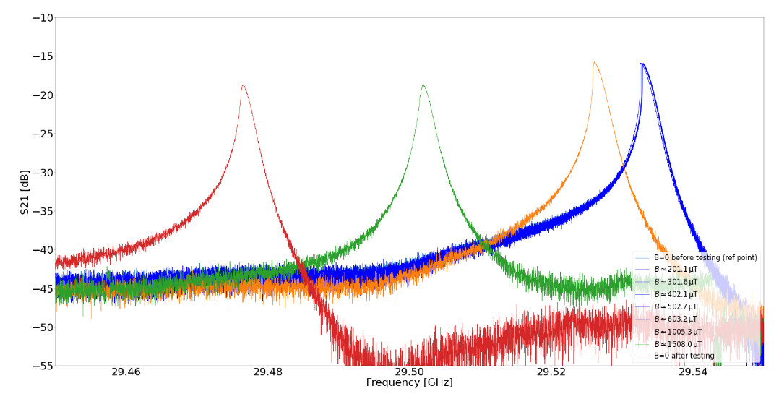
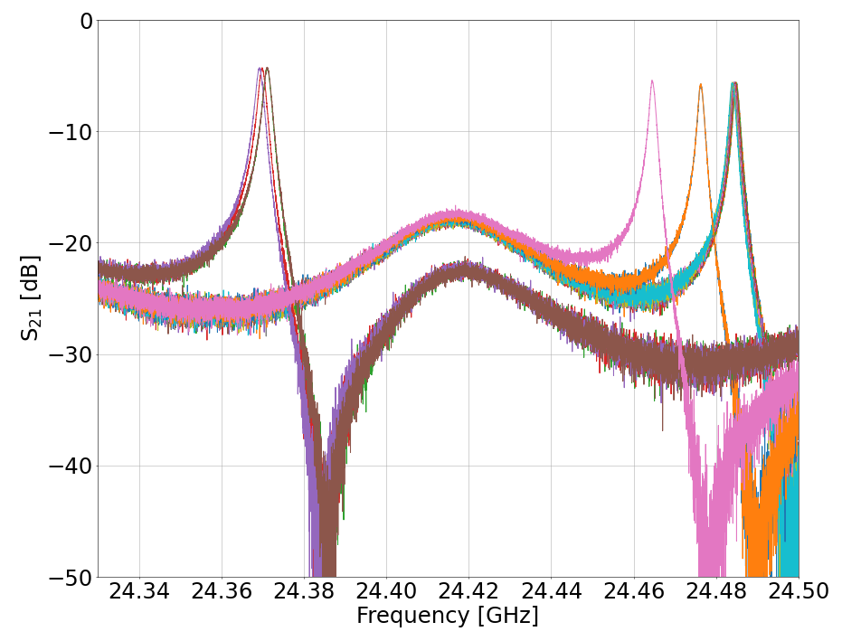
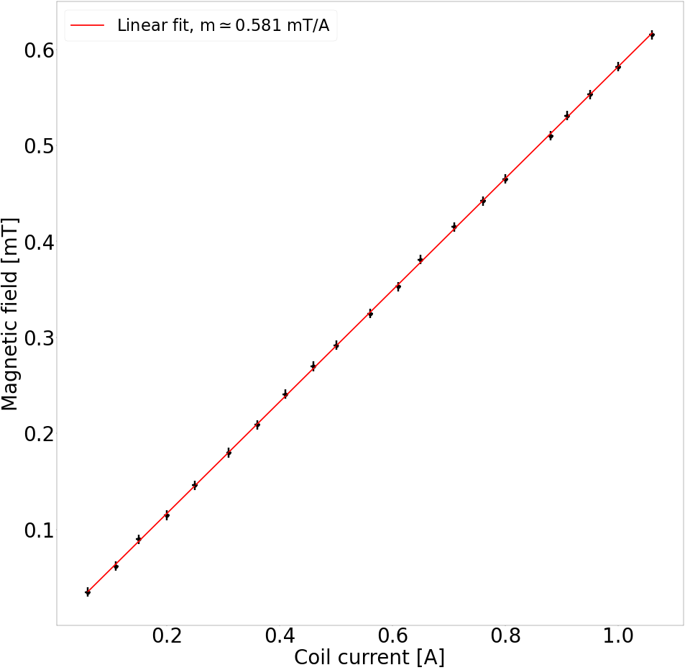
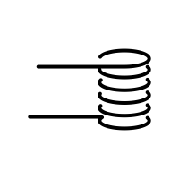
Tunability
One resonator chip:
Four resonators chip:
Calibration run for the superconducting coil:
Current increasing
High temperature superconducting tape
Figure 14: Magnetic field measured by the Gauss meter as a function of the current flowing in the superconducting coil.
Figure 15: (left and right) Resonance frequency shift for different magnetic fields threading through the sample. Once maximum tunability is reached, the magnetic field is expelled and the resonance shifts back to its original position.

Slide 11
Summary
Interest in quantum amplifiers: increased in recent years due to the promise of quantum limited amplification
Non-linearity and mixing: non-linear inductance generates mixing
Quantum limited resonator amplifier
  Design: CSRRs made of NbTi thin films on sapphire
  Fabricated samples: SEM and microscope images of sample with four resonators
  Gain and transmission: 30 dB of maximum gain and high transmission
  Compression and noise measurements: 3 dB compression at – 95 dBm and a noise of 1.2 half quanta
  Tunability: modest tunability for each resonator

Slide 12
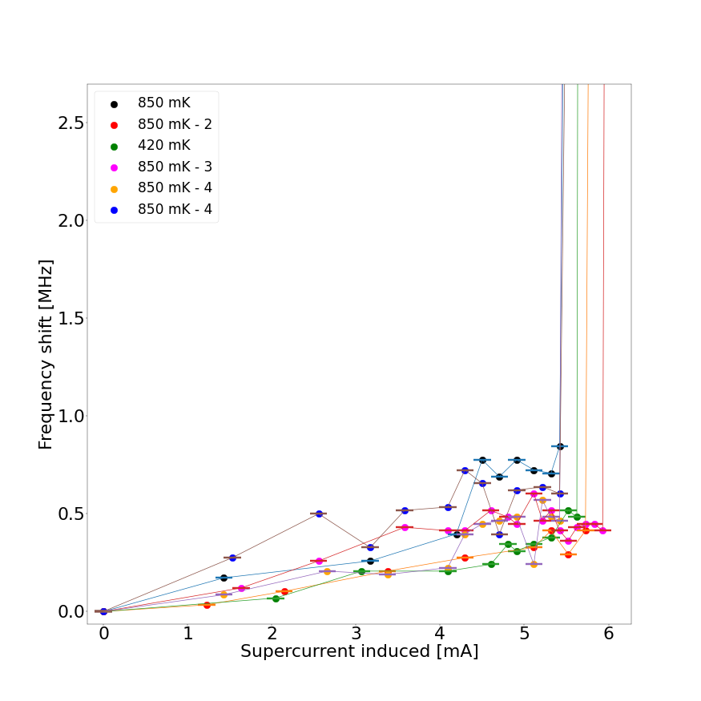
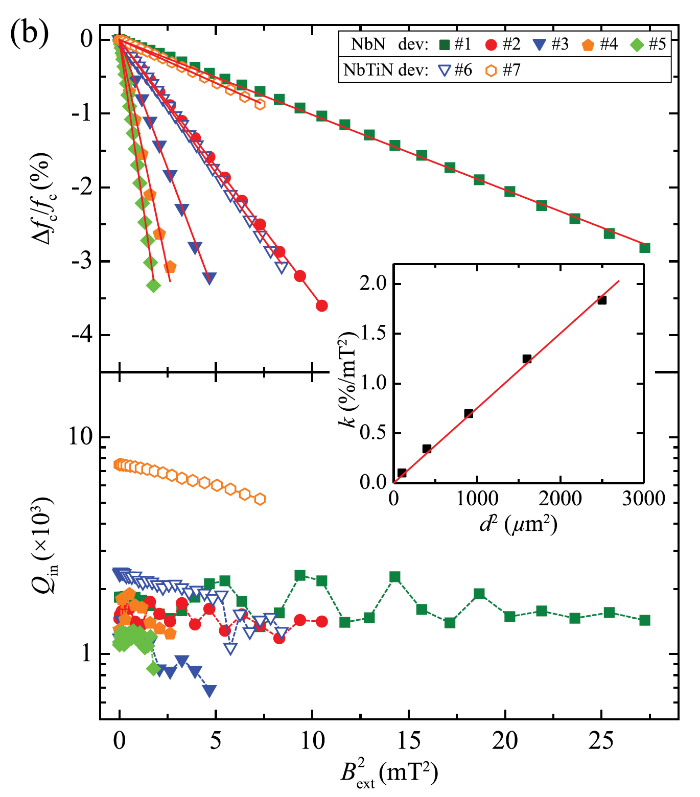
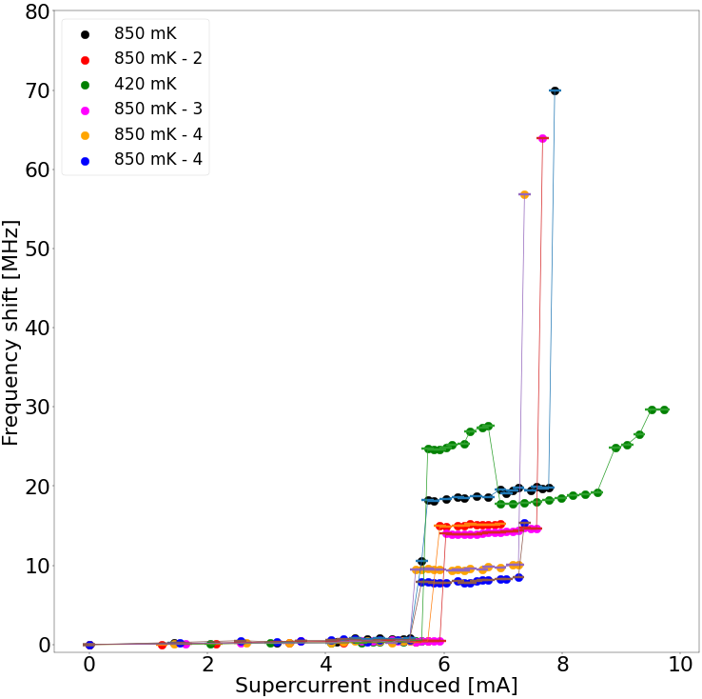
Supplementary material
Expected
Measured
Figure 11: Measured frequency shift as a function of the estimated induced current flowing in the continuous ring.
Why?

