Slide 1

Simulating Dark Matter Detection with GEANT4 and G4VR
Nicholas Farhadian

Slide 2
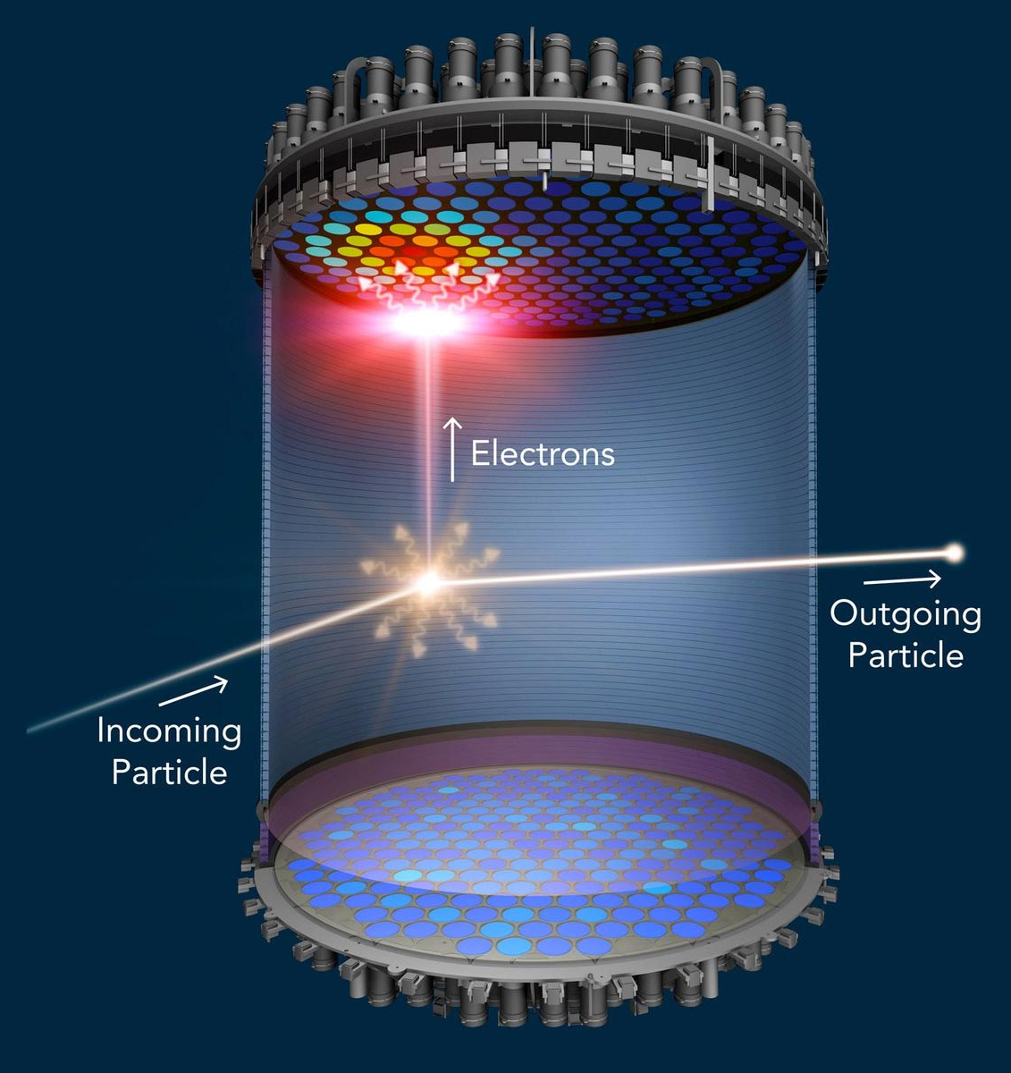
Cali-X TPC
Incident particle interacts with xenon nucleus → scintillation light (S1) detected by photomultiplier tubes (PMTs)
Interaction ionizes atoms, freeing electrons, which travel upward due to electric field
Electrons reach the top → produce second signal (S2)
Timing of S1 and S2, PMT data used to reconstruct initial particle trajectories
Fig. 1: Example of scintillation process in LZ detector [8]

Slide 3
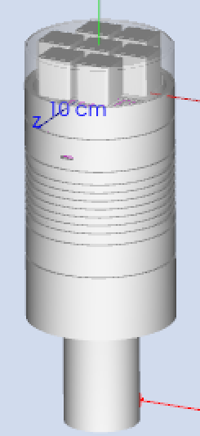
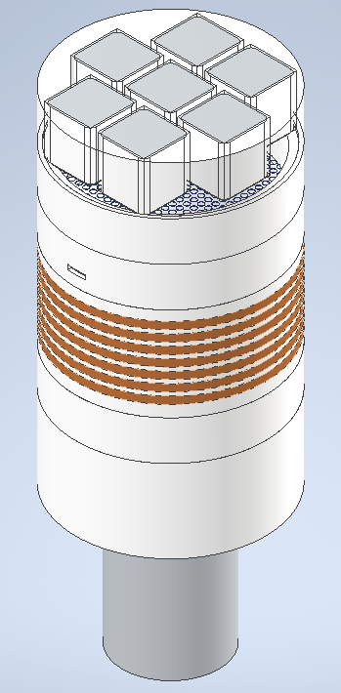
Cali-X TPC
Fig. 2: GEANT4 Simulation of Cali-X TPC
Fig. 3: CAD Drawing of Cali-X TPC [4]

Slide 4

What is GEANT4?
GEANT4 = GEometry ANd Tracking 4
“Toolkit for the simulation of the passage of particles through matter”
C++ based platform that uses Monte Carlo methods to simulate interactions between particles

Slide 5
Designing the Simulation
Detector Geometry
Particles and Sources
Can manually build volumes in C++ or import CAD files
3 Types of Volumes
Solid
Shape of component
Logical
Material, visual attributes, detection properties
Physical
Location, orientation
Particle Gun
Point source
Specified direction, momentum
Best for simple monoenergetic sources
General Particle Source (GPS)
Point or volume source
Better for more complex sources
Notes:
Mention different ways to import CAD files (GDML, CADMesh)
Project started by manually designing TPC with simple solids, then switched to CADMesh, then GDML files

Slide 6
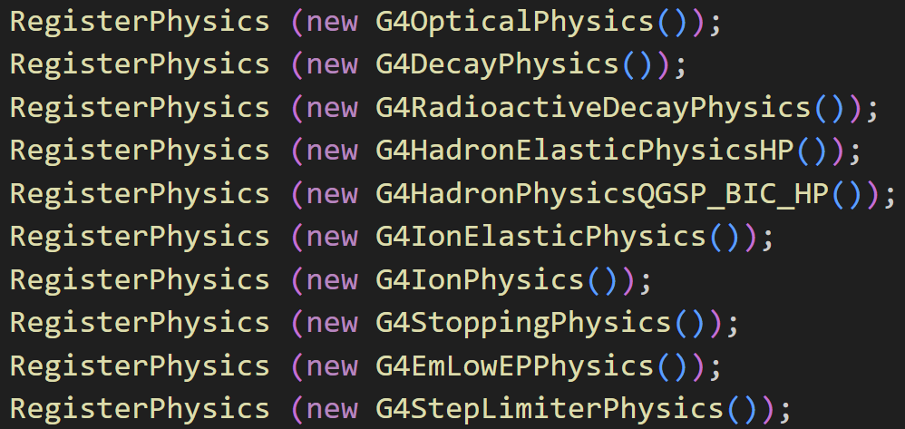
Designing the Simulation
Physics and Fields
Specify desired physics
Reduce computation cost
prevent unwanted interactions (e.g. gravitational force)
Implement electric fields in liquid xenon
Implement Noble Element Simulation Technique (NEST) package to accurately determine photon and electron yields from scintillation
Fig. 4: GEANT4 physics lists included in experiment

Slide 7
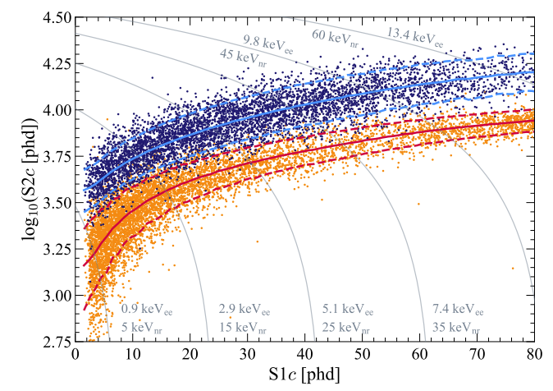
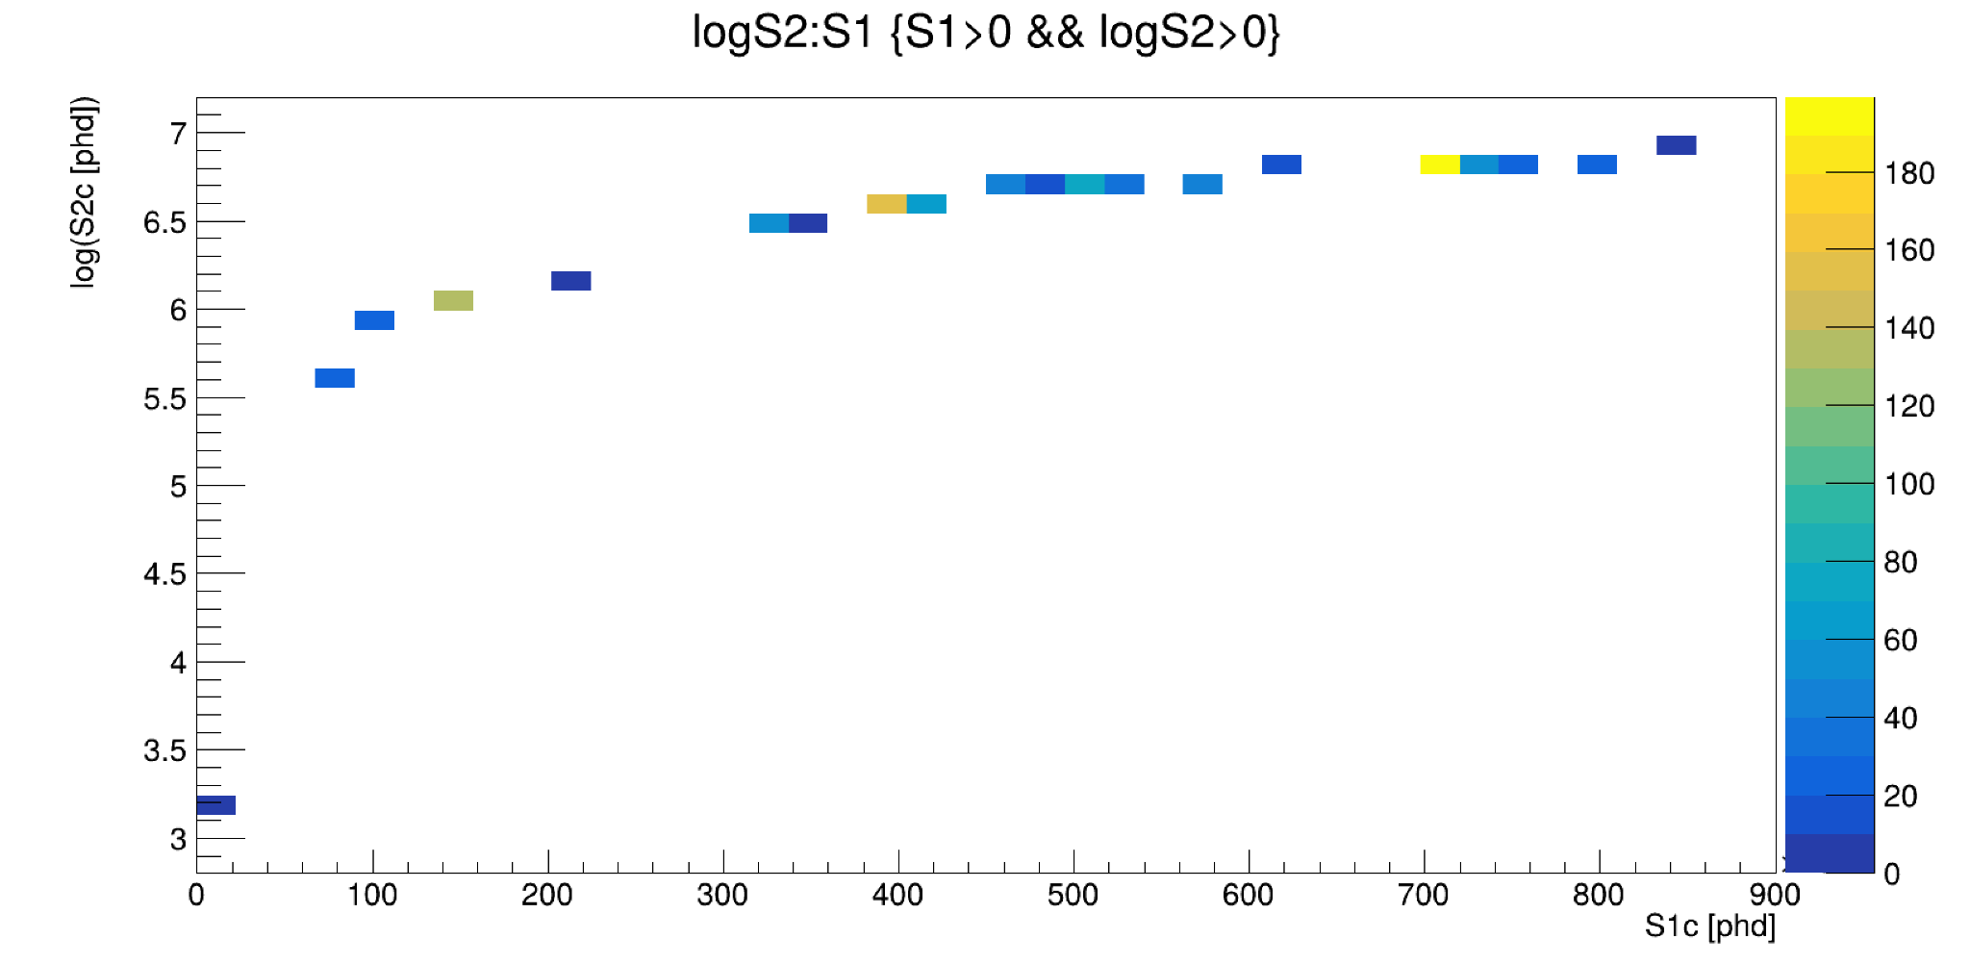
Designing the Simulation
Data Collection
Data analysis done through ROOT
Can export histograms, N-tuples,etc.
Energy depositions, hits, etc. can be analyzed
--- Electron recoil (ER)
--- Nuclear recoil (NR)
Fig. 5 (Above): Expected ratio of S1 to S2 photons from LZ experiment [13]
Fig. 6 (Left): Ratio of S1 to S2 photons in GEANT4 simulation

Slide 8
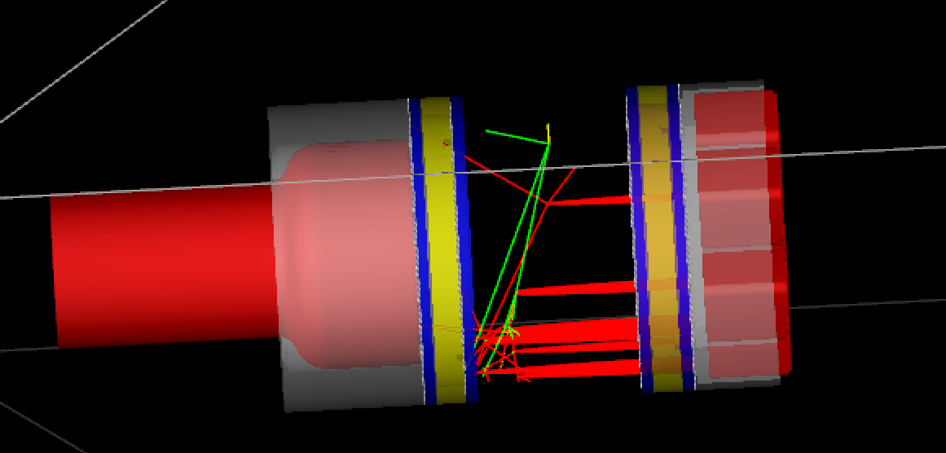
— Electrons
— Neutrons
— Photons
Fig. 7: S2 event as seen in GEANT4 viewer

Slide 9
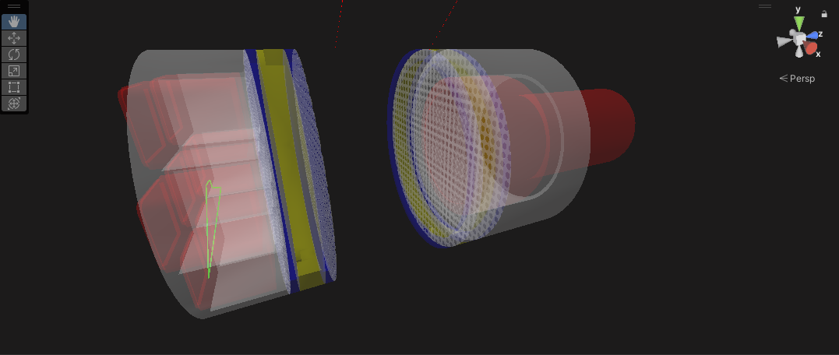
Visualization in Virtual Reality
G4VR is a visualization tool developed by Benjamin Jobilal that allows GEANT4 runs to be viewed in virtual reality
View energy depositions in specific volumes, energy depositions of specific tracks
Time evolution for GEANT4 example scenes
G4XR saves scene geometry as a .glb file and each run as an individual .csv file
This data is stored on a local server and parsed by G4VR to produce the scenes we see in VR
Fig. 8: CALI-X TPC as seen in G4VR

Slide 10
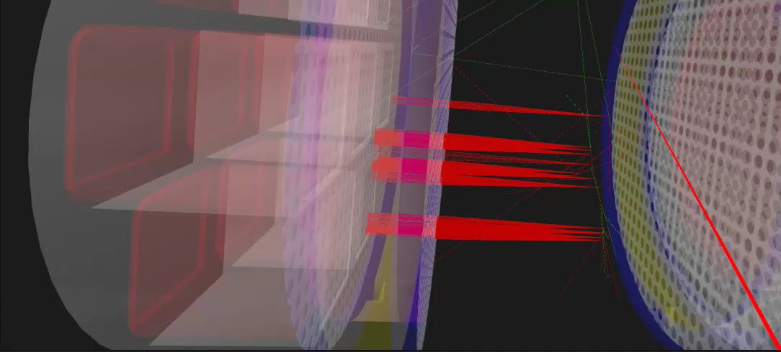
Fig. 8: Example event in GEANT4 simulation viewed in virtual reality via G4VR

Slide 11
Simulating Dark Matter in GEANT4
DMG4
DMG4 is a GEANT4 add-on developed by Mikhail Kirsanov
Simulates dark matter production in electron, muon, and positron beams
Plan to implement this in simulation when testing additional sources
NEST
NEST has options for simulating yields for WIMP collisions
Plan to explore this further to see what impacts in can have

Slide 12
Next Steps
Test more sources to try to replicate results from real detector (AmBe, DD, tritium, etc.)
Compare electron drift time and drift velocity to real-world results
Fix scintillation ratios to be more accurate
Create completely accurate visualization of electric field lines inside the TPC using FEniCS software

Slide 14
References
[1] Geant4 - A Simulation Toolkit, S. Agostinelli et al., Nucl. Instrum. Meth. A 506 (2003) 250-303. https://www.sciencedirect.com/science/article/pii/S0168900203013688.
[2] Geant4 Developments and Applications, J. Allison et al., IEEE Trans. Nucl. Sci. 53 (2006) 270-278. https://ieeexplore.ieee.org/xpls/abs_all.jsp?isnumber=33833&arnumber=1610988&count=33&index=7.
[3] Recent Developments in Geant4, J. Allison et al., Nucl. Instrum. Meth. A 835 (2016) 186-225. https://www.sciencedirect.com/science/article/pii/S0168900216306957.
[4] Prototype Detector Final Version, Luca Niu, et al., Kamaha Group, UCLA (2025). https://docs.google.com/presentation/d/15N71nAC3xxZmDA2WFhQfdvlNhiy-njhQEvkuFIxO7SQ/edit?slide=id.p#slide=id.p.
[5] CADMesh GitHub Repository, Christopher Poole, MIT (2020). https://github.com/christopherpoole/CADMesh.
[6] NESTCollaboration/nest: Geant4 Integration Fixes and Updates (v2.0.1beta), Jason Brodsky, Chris Tunnell, M. Szydagis, J Balajth, Vetri Velan, & Junying Huang, (2019). Zenodo. https://doi.org/10.5281/zenodo.2535713.
[7] The LUX-ZEPLIN (LZ) Experiment, D.S. Akerib, et. al., The LZ Collaboration (2019). https://arxiv.org/pdf/1910.09124.
[8] NNSA explores unsolved mysteries of science: What is dark matter?, National Nuclear Security Administration (2018). https://www.energy.gov/nnsa/articles/nnsa-explores-unsolved-mysteries-science-what-dark-matter.
[9] Dark matter detection receives 10-ton upgrade, Eric Hamilton (2017). https://news.wisc.edu/dark-matter-detection-receives-10-ton-upgrade/.
[10] Geant4 Tutorials, Physics Matters (2021-2022). https://www.youtube.com/playlist?list=PLLybgCU6QCGWgzNYOV0SKen9vqg4KXeVL.
[11] CERN ROOT Tutorials, Physics Matters (2020-2022). https://www.youtube.com/playlist?list=PLLybgCU6QCGWLdDO4ZDaB0kLrO3maeYAe.
[12] Fully Geant4 compatible package for the simulation of Dark Matter in fixed target experiments, M. Bondi (2021). https://arxiv.org/abs/2101.12192v3.
[13] First Dark Matter Search Results from the LUX-ZEPLIN (LZ) Experiment, J. Aalbers, et al., (2023). https://arxiv.org/abs/2207.03764.

