Slide 1
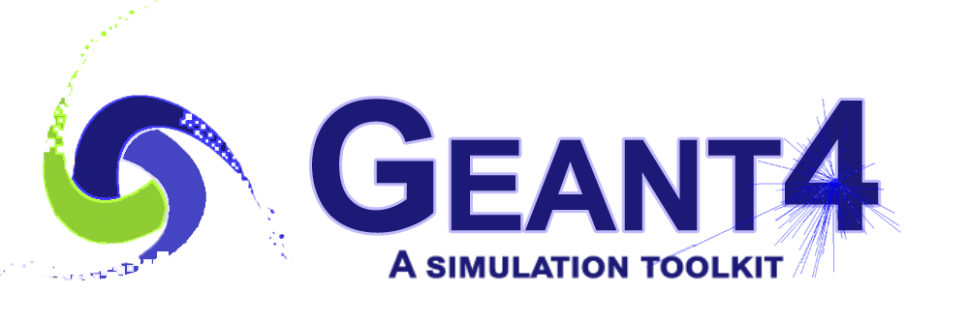
G4VR: A Virtual Reality Extension for GEANT4
Benjamin Jobilal¹, Stewart Boogert², Muhammed Ansar Iqbal¹, Jay Hauser¹
¹ University of California Los Angeles (UCLA)
² The University of Manchester

Slide 2
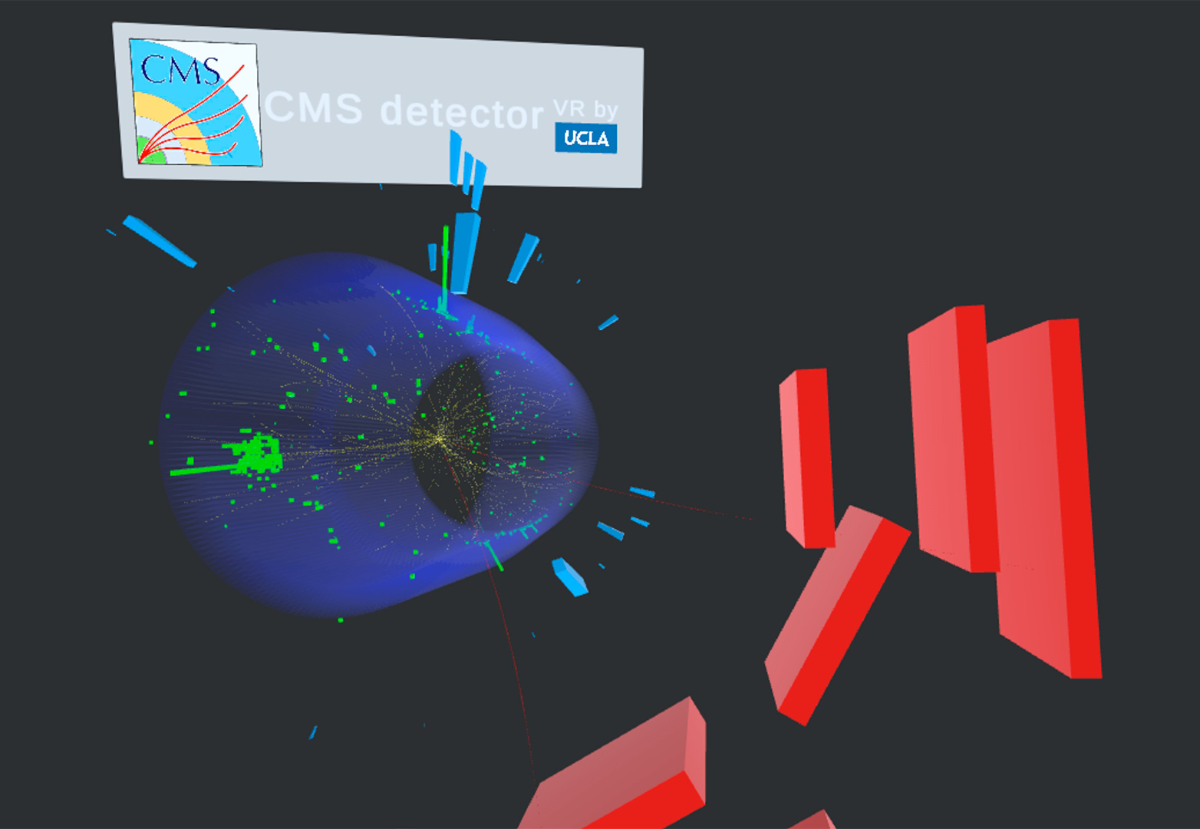
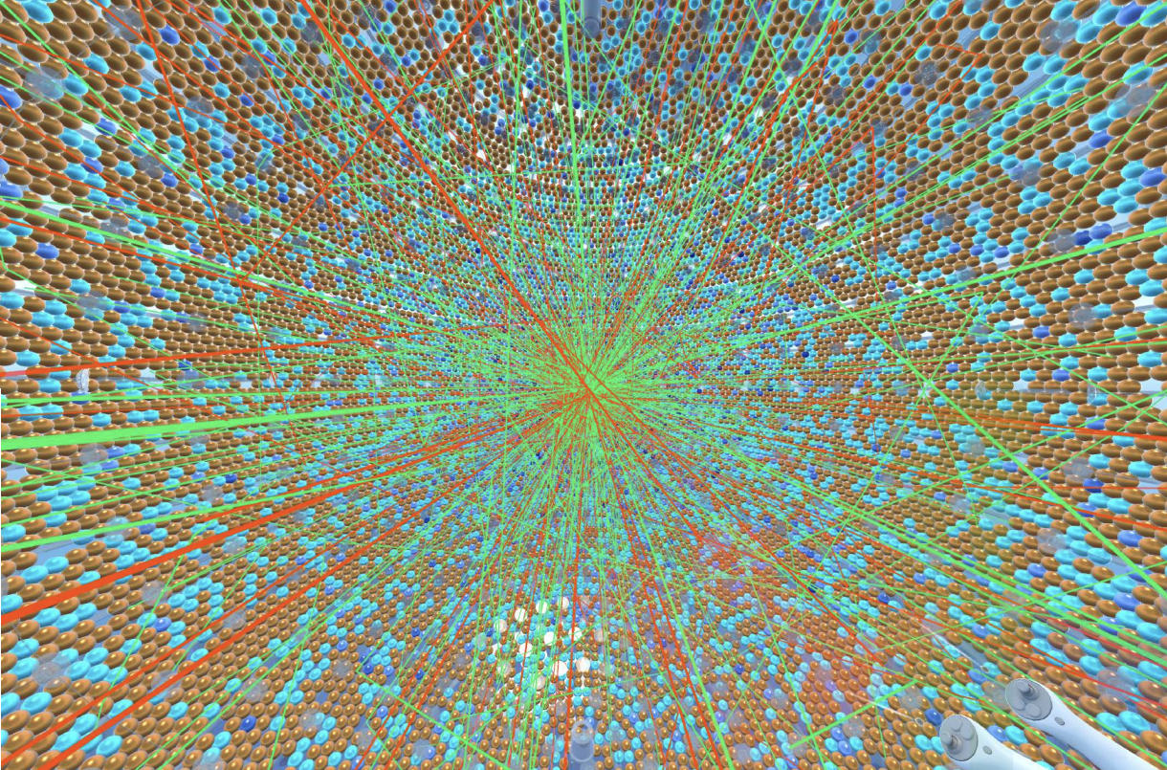
Virtual Reality in Science
Virtual Reality (VR) applications in science allow for a more instinctive and immersive understanding of scientific phenomena.
  Some efforts have already been made in this direction with the Belle II and JUNO experiments [1][2].
  The UCLA Physics VR lab has produced a range of applications in science, most notably VR SPY for CMS [3].
VR devices such as the Oculus Quest Series and Apple Vision Pro are scaling → potential for scientific applications!
VR SPY [3]
JUNO VR [2]

Slide 3
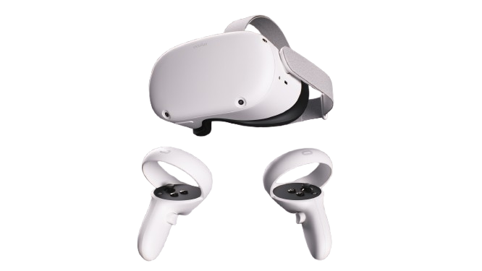
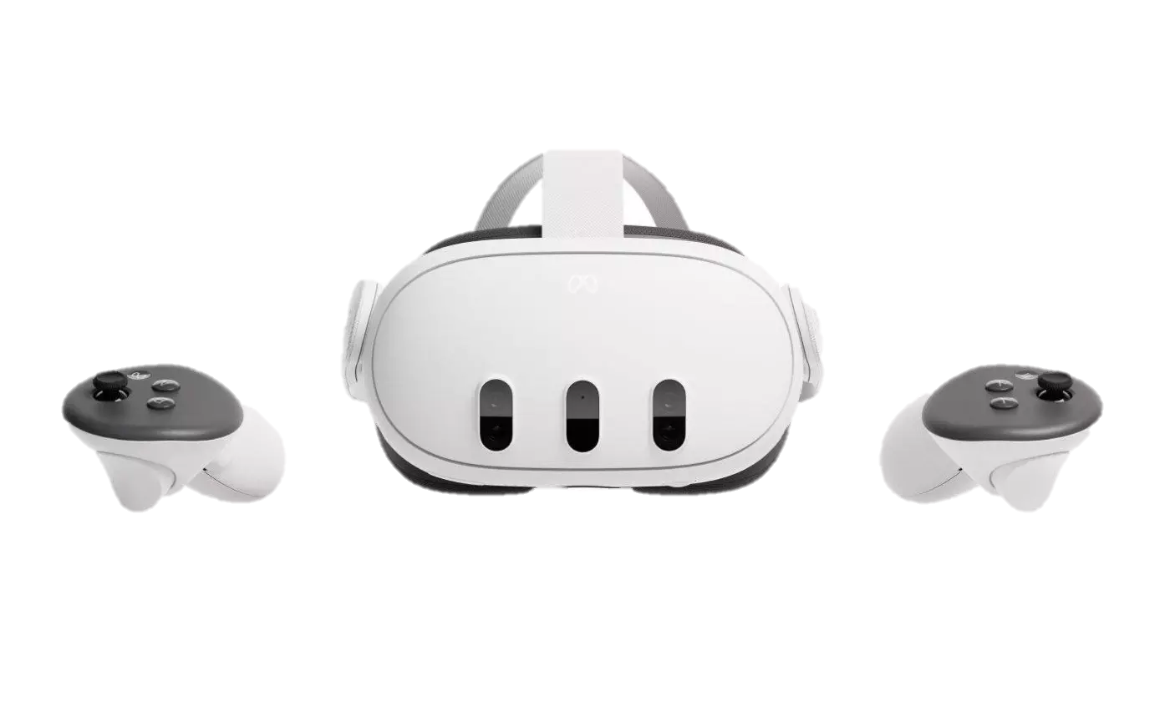
The VR Toolkit
The UCLA Physics VR Lab develops VR apps (APKs) in Unity – a game development platform with VR features.
  We use Meta Oculus integration packages to integrate VR features.
To use any APK, the user must have an Oculus headset (Quest 2+) and controllers.
Oculus Quest 3
Oculus Quest 2
Notes:
Add slide numbers

Slide 4
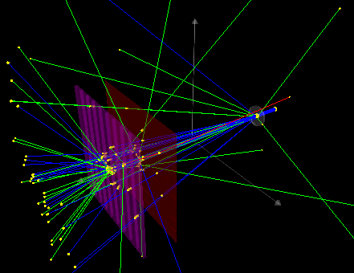
A Short Introduction to GEANT4
A widely used Monte-Carlo package to simulate the passage of particles through matter [4].
It has a wide range of applications in science, medicine, engineering, etc. For example, all LHC experiments use GEANT4!
Users can define their own geometries, radiation sources, materials, simulate them, and examine the results of simulations with in-built GUI and data analysis tools.

Slide 5
From GEANT4 to G4VR
The UCLA Physics VR lab has, over the last year, developed G4VR – a GEANT4 VR event display.
G4VR can be run on any Oculus-based headset and produces the GEANT4 scene given the experiment geometries and tracks (assets).
Idea:
  Allow users to run a standard GEANT4 experiment with a novel XR driver.
  XR driver interfaces with the VR headset to allow asset transfer.
  Data is received by G4VR and processed to produce the scene.
The implementation of each step is discussed in the following slides.

Slide 6
I. XR Driver
Facilitate data transfer to VR → develop a new vis driver for GEANT4.
  Named “XR” to accommodate expansion to AR in the future.
The driver performs three functions:
  Collects experiment geometries → writes them to GLB binaries (fast, resource efficient 3D asset format).
  Collects track data (steps, positions, times, energies, etc.) by accessing scene trajectories → writes them to CSV.
  Launches a local server → assets are posted here, and G4VR collects them from this address.

Slide 7
I. XR Driver
From the user’s point of view, the use of the driver is simplified:
  Execute the GEANT4 program.
  Enter /vis/open Xr in the GEANT4 console.
  Run the desired number of runs.
The server is set up to store the data of each run separately so that the user can switch between the results of each run in VR.

Slide 8
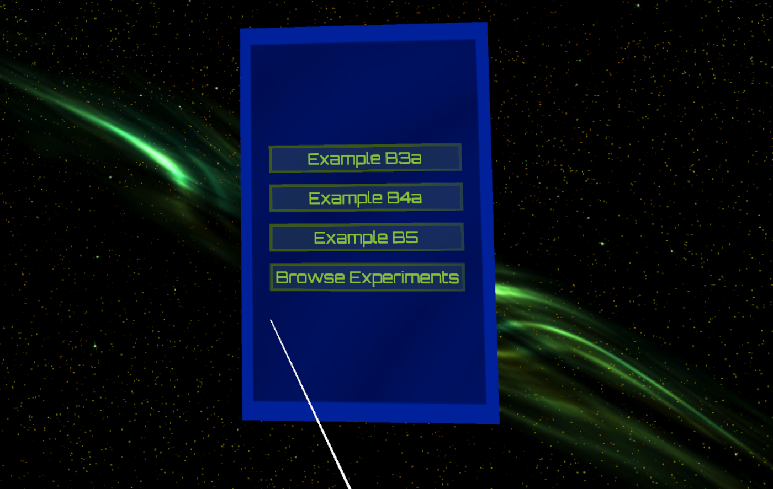
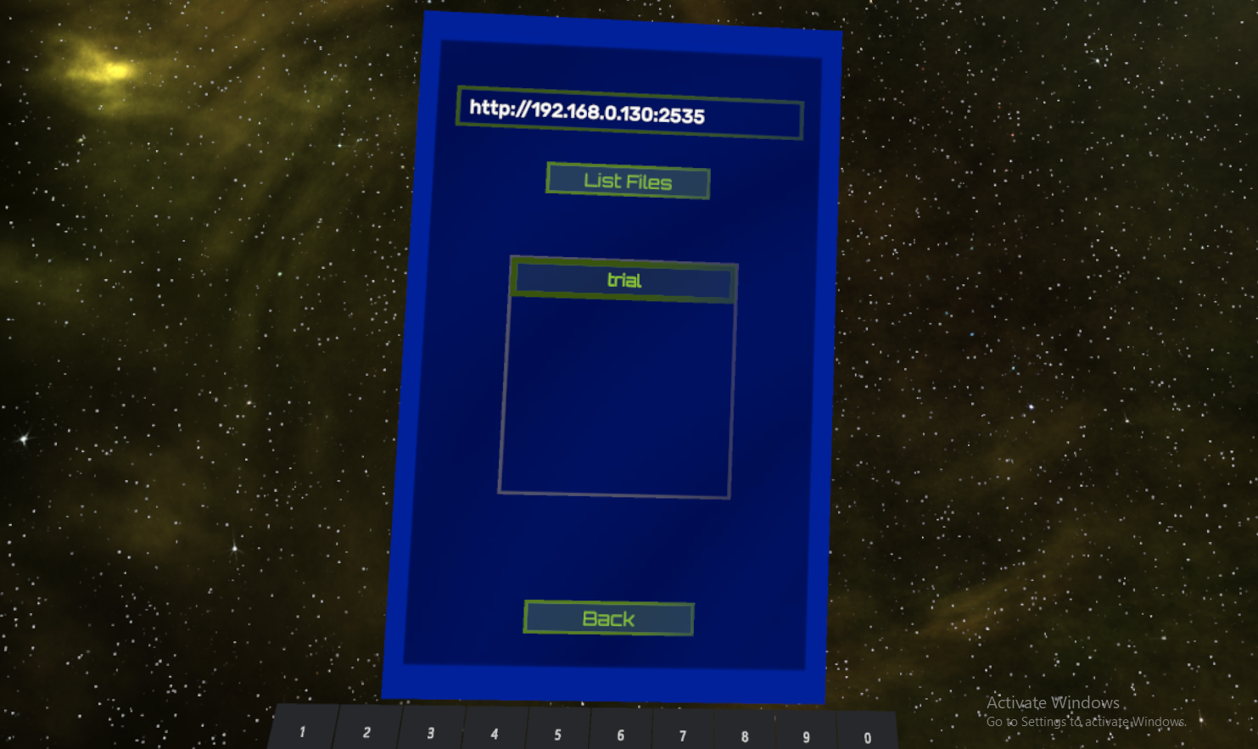
II. Asset Transfer
During runtime, G4VR is set up to read from a specific input URL and import the experiment data from that address.
  A UI is enabled that the user can interact with to enter the address and select the experiment.
Experiment named “trial” can be loaded

Slide 9
III. Event Display
From the CSV → reconstruct the tracks.
From the GLB → instantiate the geometries.
  G4VR is developed using Unity, which supports GLB parsing to GameObjects (Unity scene objects).
The event display has a range of functionalities useful for analysis:
  Track Analysis
  Energy Deposit Analysis
  Time Evolution

Slide 10
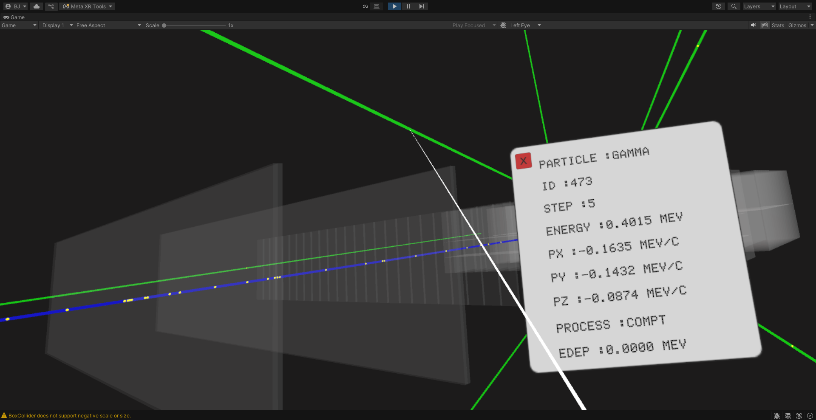
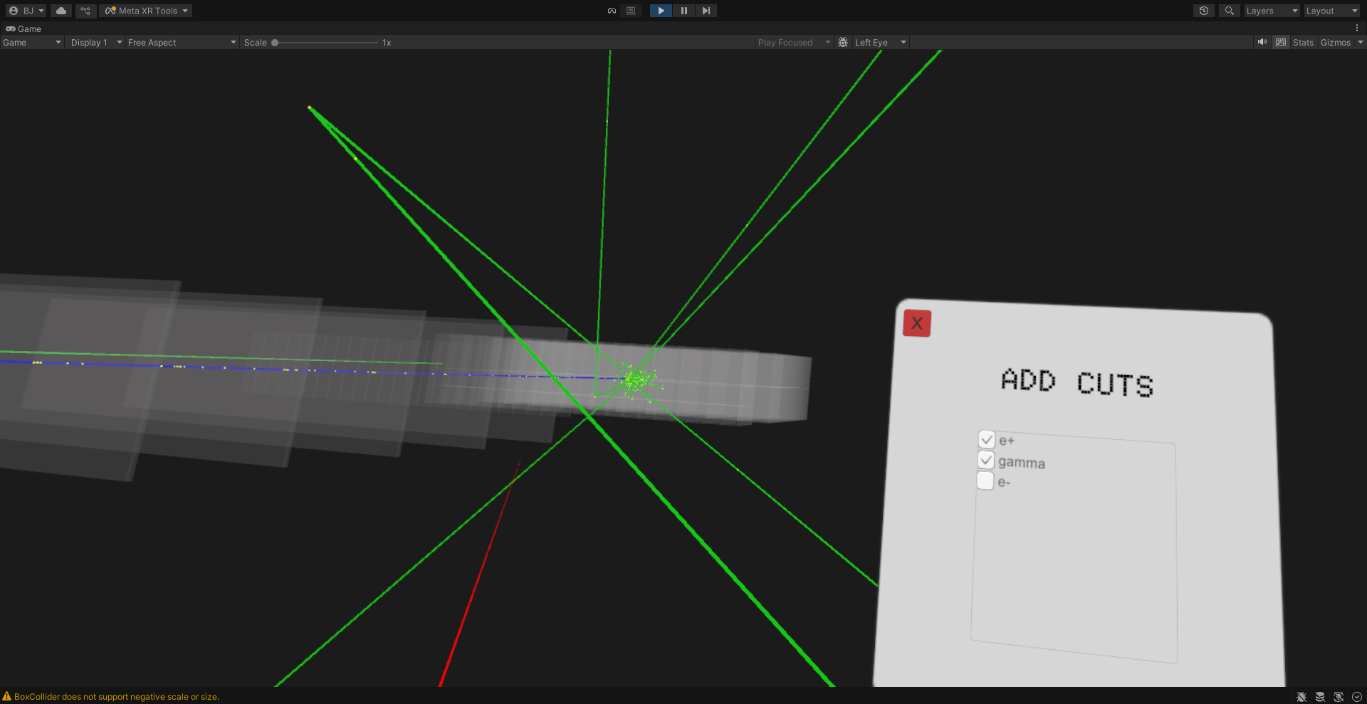
III. Event Display – Track Analysis
One would otherwise see an electron here
Interaction with tracks to get track data
Employ filters/cuts on specific particles
Controller ray
Controller ray

Slide 11
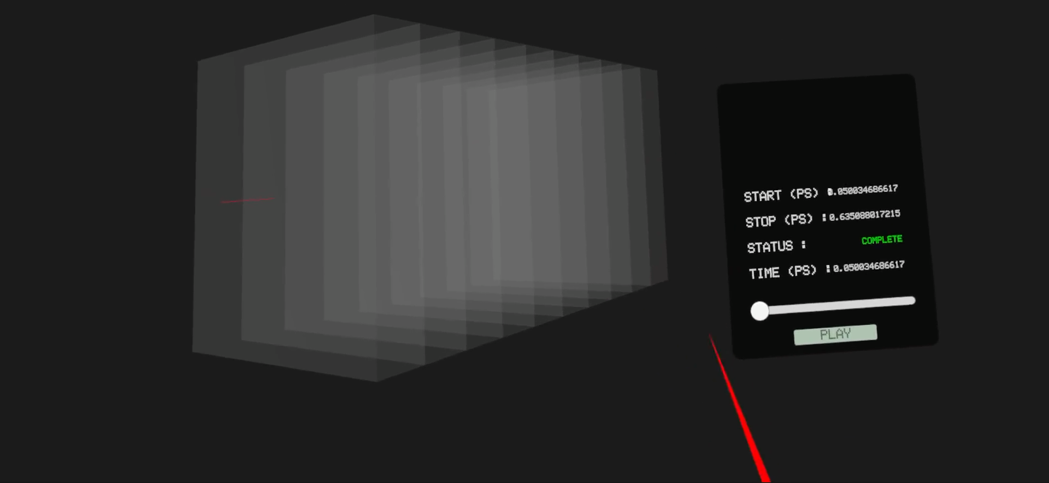
III. Event Display – Time Control

Slide 12
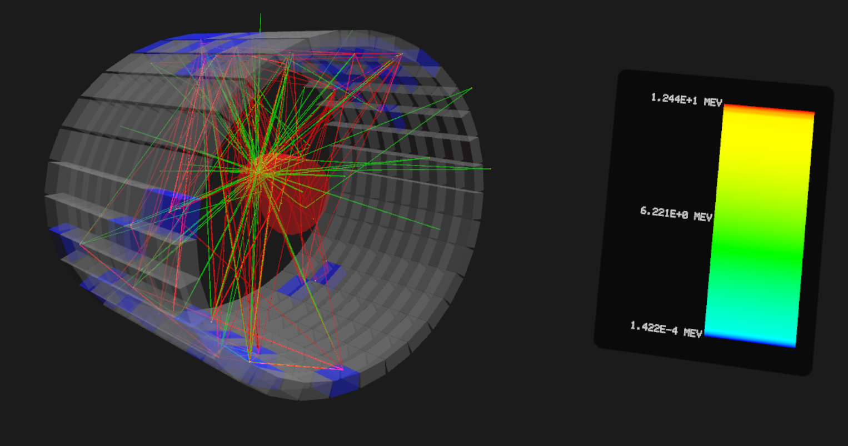
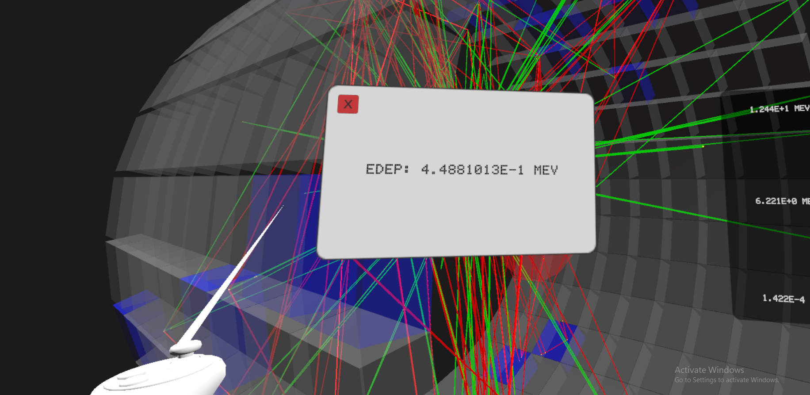
III. Event Display – Edep Analysis
Controller selecting the crystal

Slide 13
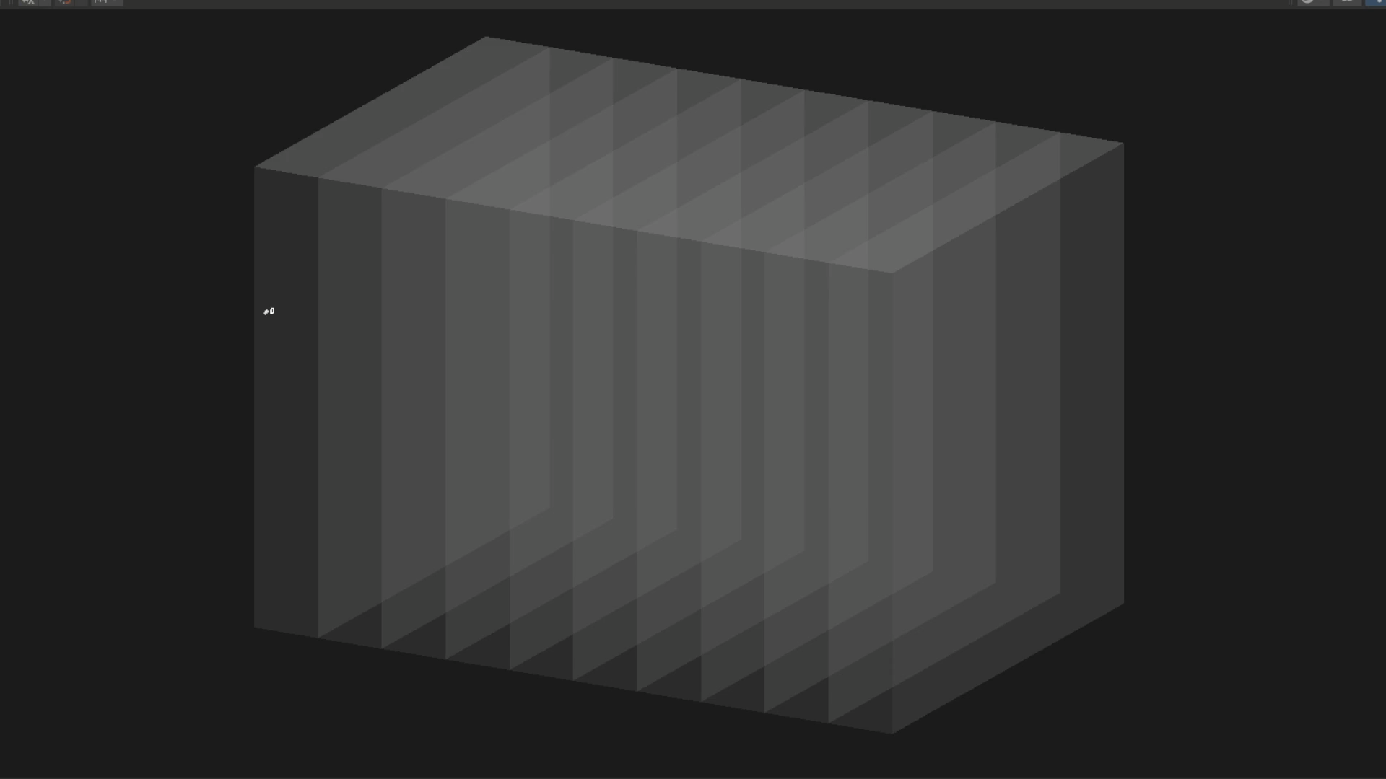
III. Event Display - Movies
An interesting feature still in development is a replication of GEANT4 movies. Below example of this in G4VR outside of the headset.

Slide 14
Looking Forward
An alpha release of G4VR is set to be out early November 2025. It will contain three example scenes as well as a custom scene.
  The custom scene can only be used once the XR driver is fully deployed with GEANT4. It currently sits on a dev branch.
  The APK will be launched on the UCLA Physics VR website [3].
The XR driver is limited to hosting local servers. In the future, we hope to expand this to remote servers for more flexible use.
We hope that you can test the driver and VR app to give us feedback and suggestions!

Slide 15
References
[1] Piilonen, Leo, et al. “Belle2VR: An Interactive Virtual Reality Visualization of GEANT4 Event Histories.” EPJ Web of Conferences, vol. 245, Jan. 2020, p. 08003. https://doi.org/10.1051/epjconf/202024508003.
[2] Huang, Kai-Xuan, et al. “Unity Based Virtual Reality for Detector and Event Visualization in JUNO Experiment.” arXiv (Cornell University), Sept. 2025, https://doi.org/10.48550/arxiv.2509.16285.
[3] UCLA Physics VR Lab. UCLA Physics VR. https://vr.physics
.ucla.edu/
[4] S. Agostinelli et al., Nucl. Instrum. Meth. A 506 (2003) 250-303

