Slide 1
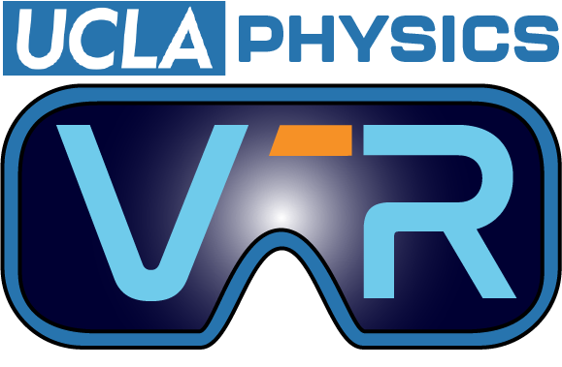

Electric Fields in Virtual Reality with VR Fields + Hypercubes and Data VR
Nathan Abraham Joshua
Undergrad, UCLA
nathanjoshua@g.ucla.edu
Presentation Date: Sunday Nov 9th
Presentation Time: 10:00 AM - 10:10 AM
Session: Virtual Reality for Science
Room: PAB 1-434

Slide 2
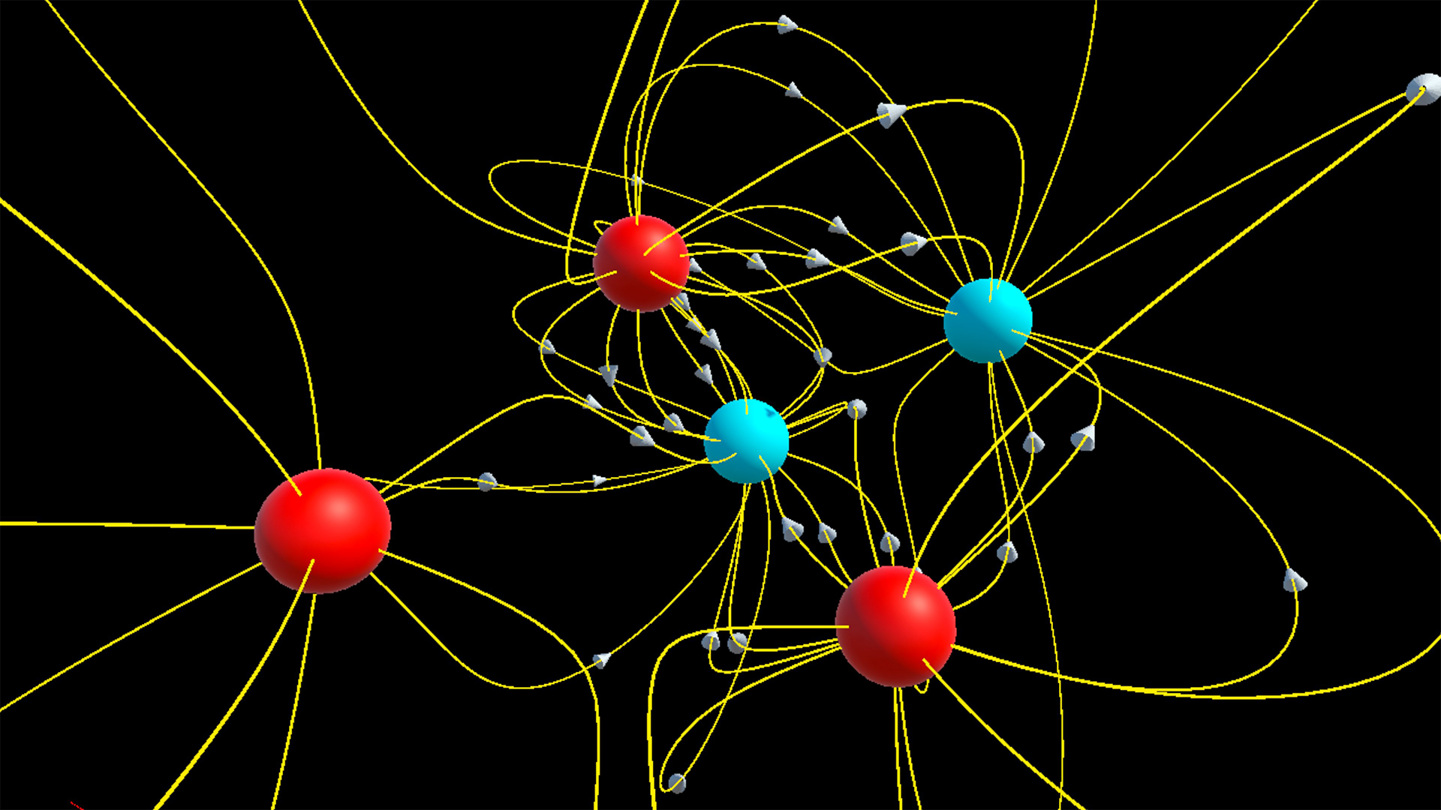
VR Fields

Slide 3


What is VR Fields?
VR Fields is a virtual reality (VR) application developed using Unity Game Engine to simulate 3 dimensional electric field lines generated by a user customized (discrete) charge distribution.
It uses 2 simple rules to generate the field lines:
Coulomb’s Law
Field Line Construction Algorithm

Slide 4
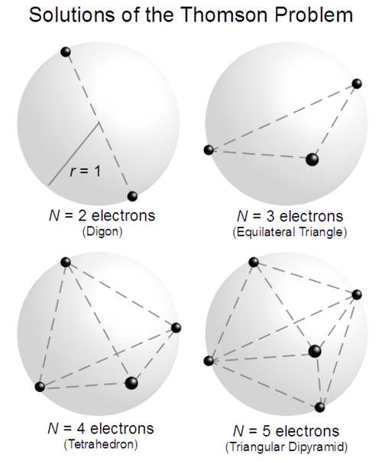
Evenly distributing N points on a sphere
Actually, there’s a secret third rule.
The field line construction algorithm requires starting points. Since VR Fields models point charges as tiny spheres, ideally you would choose N starting points distributed evenly on a sphere.
Unfortunately, this is mathematically impossible except for a few special cases (N = 2, 3, 4, 6, 8, 12, 20).

Slide 5
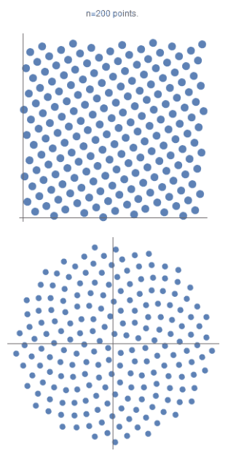


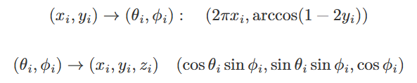

Optimized Fibonacci Lattice Algorithm
An approximate solution to this problem can be found numerically using an optimized Fibonacci lattice algorithm.
Regular Fibonacci lattice distribution of n points on a unit square
=>
Perform cylindrical equal area projection:-
VRFields uses an optimized version of this – developed by Dr. Martin Roberts (images used on this slide are also his)

Slide 6
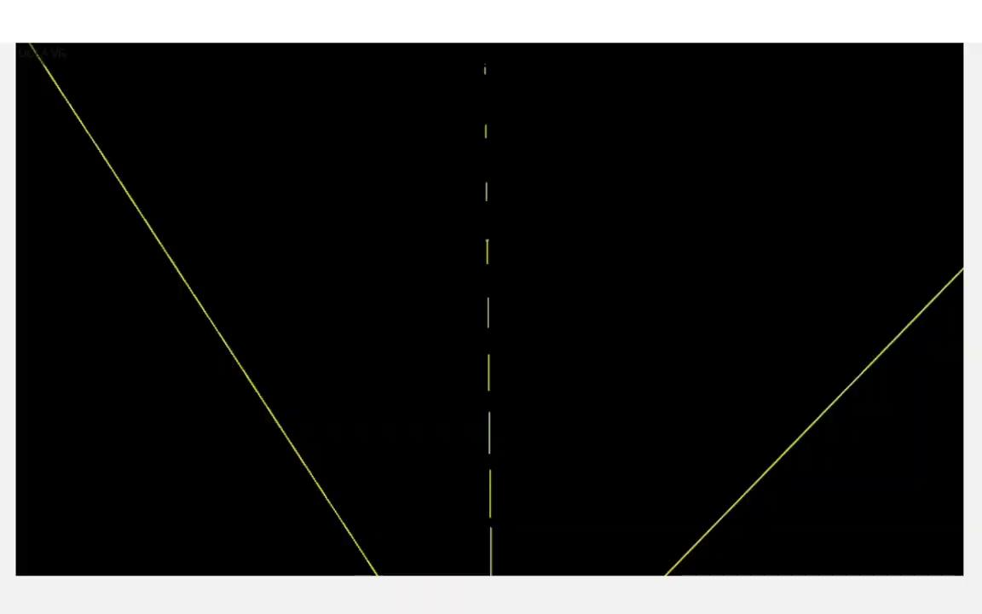
VR Fields in action

Slide 7
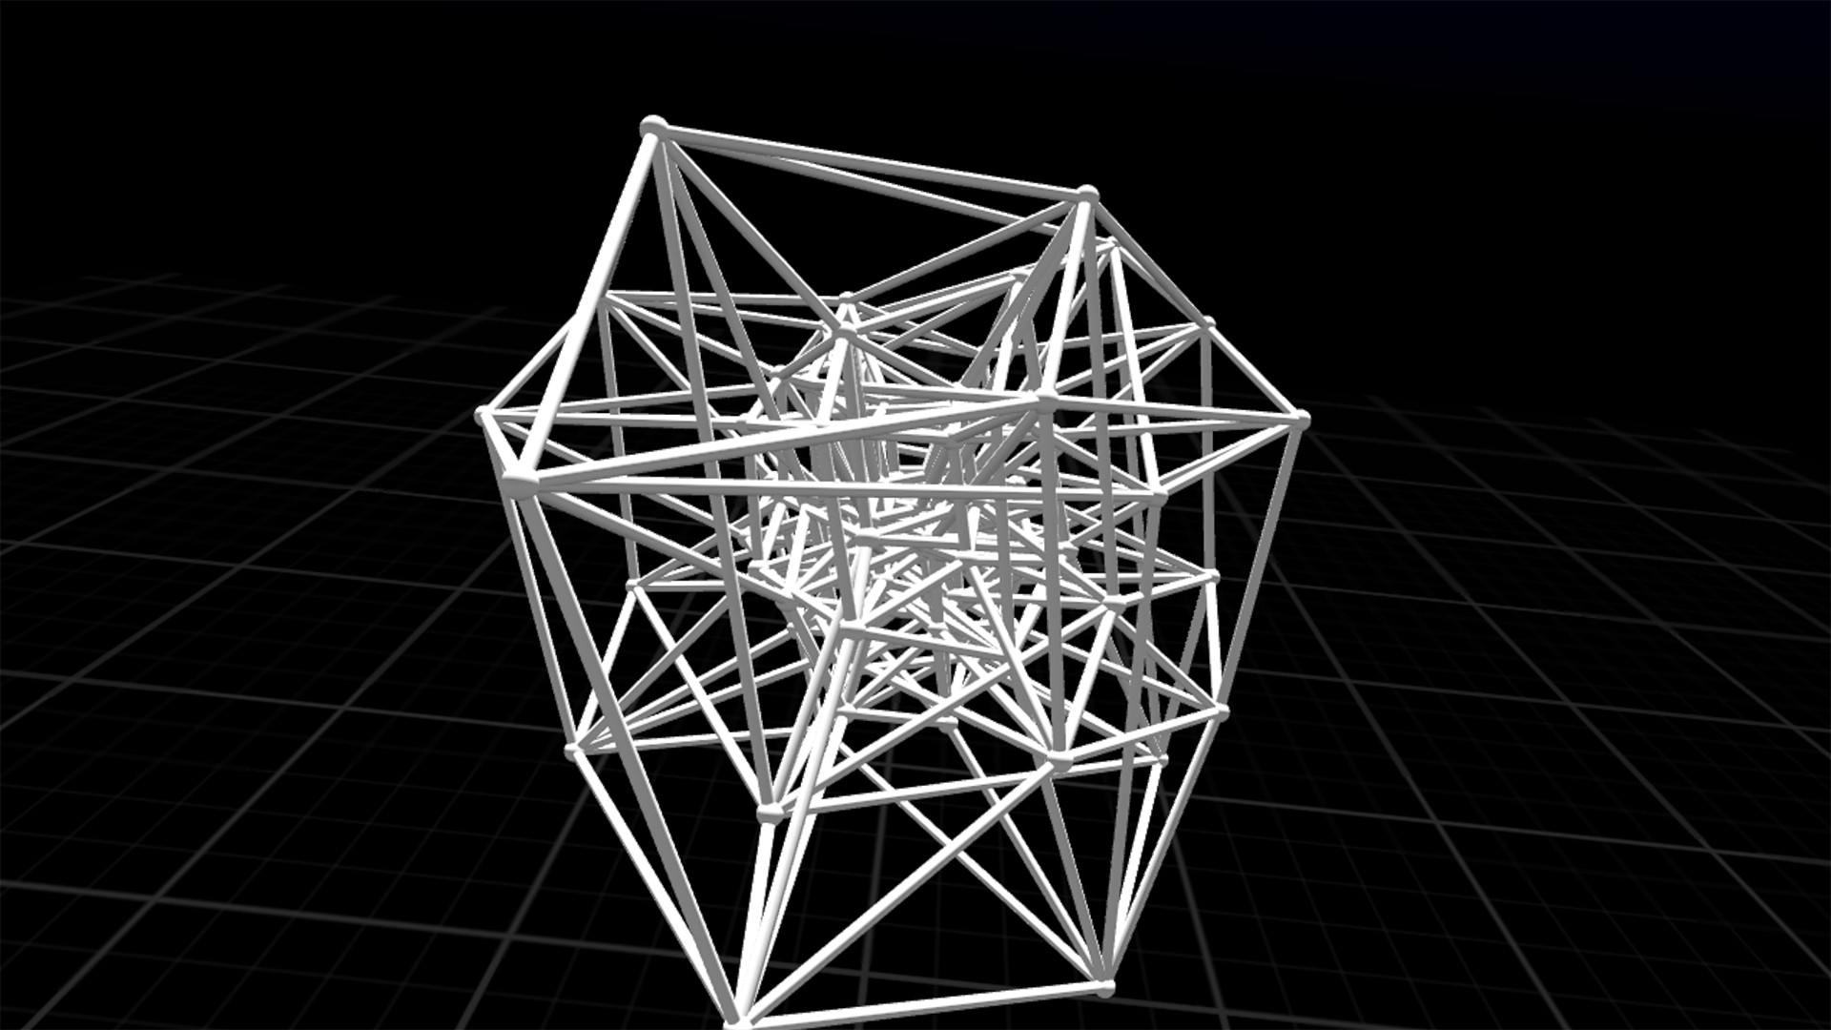
Hypercubes

Slide 8
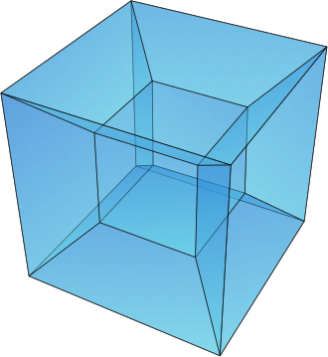
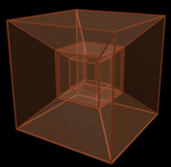
What are Hypercubes?
Hypercubes are n-dimensional analogues of squares (n=2) and cubes (n=3)
To construct an n-dimensional hypercube, you take one hypercube of dimension (n-1) and move it one unit length in the nth direction.
You can visualize their projections in 3D. Examples:-
Tesseract (4-cube)
Penteract (5-cube)

Slide 9
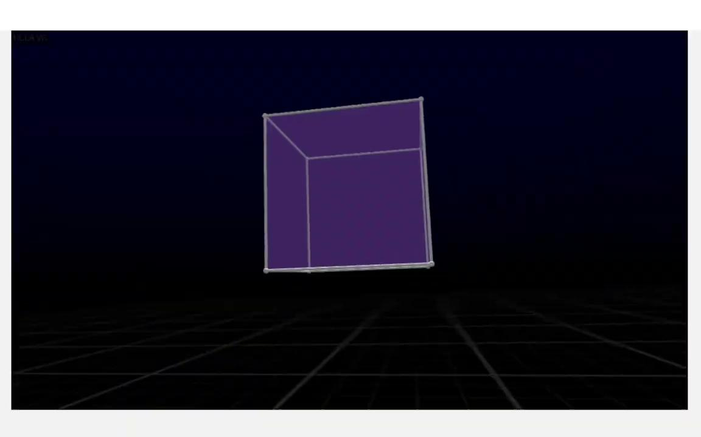
Hypercubes in action

Slide 10
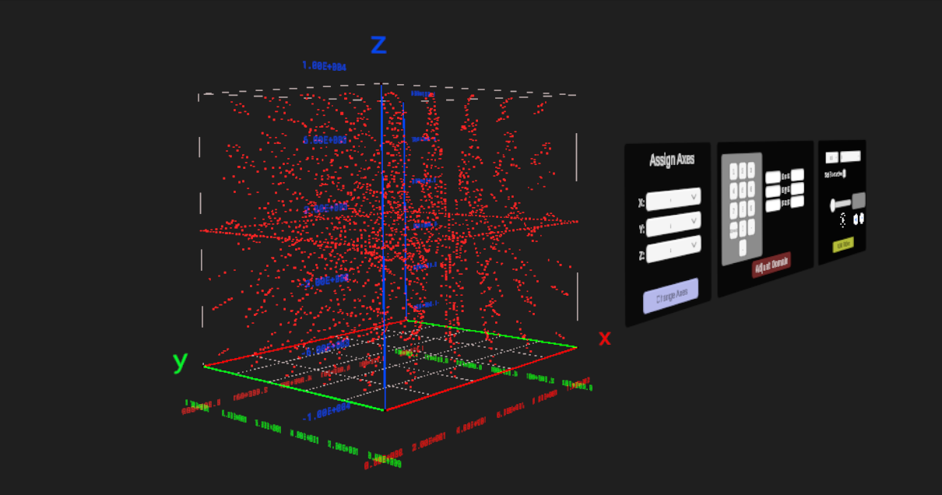
Data VR

Slide 11
What is Data VR?
Data VR is a VR application that allows users to visualize multi-dimensional data in scatter or binned (lego) plots using sliders.
You can load in data in the CSV or ROOT format, which is processed using a custom parser called Data VR bridge (developed for Windows) and generate corresponding plots in VR.
It helps you visualize trends in large and complex datasets with many dependent and independent variables.

Slide 12
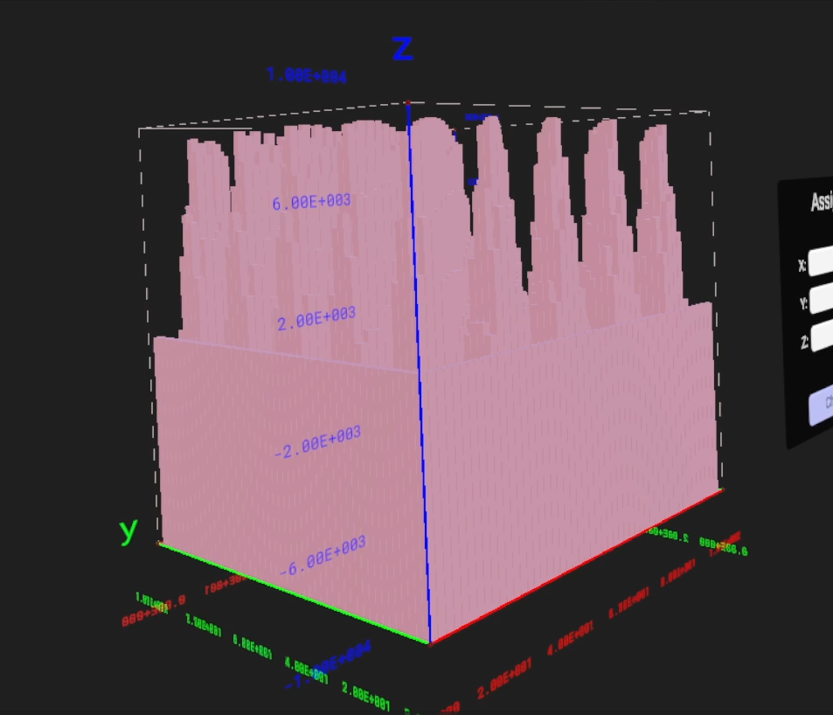
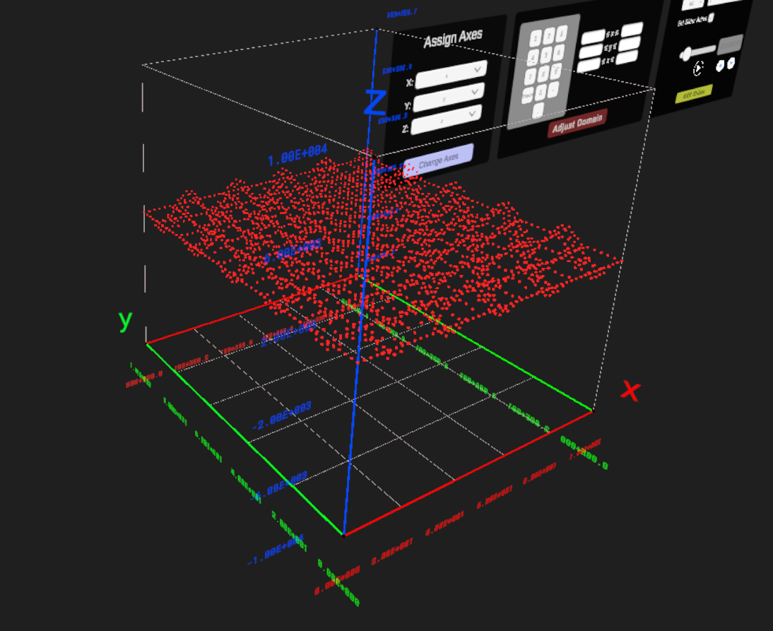
Images from Data VR
Histogram plot from Data VR.
Scatter plot from Data VR.

Slide 13



Acknowledgements
Ansar Iqbal (Postdoc)
Developer of Hypercubes
Jay Hauser (Professor)
Group Leader
Benjamin Jobilal
Developer of Data VR

Slide 14
BACKUP

Slide 15
Why even simulate electric field lines in VR?
3D electric field lines are difficult to visualize for even slightly complex charge distributions despite how useful they are in aiding our intuition.
Computing coulomb’s law by hand is tedious: a job better left to computers.
Need for a general purpose science tool that can quickly compute and visualize busy geometries
=> You can make it in Virtual Reality!

Slide 16
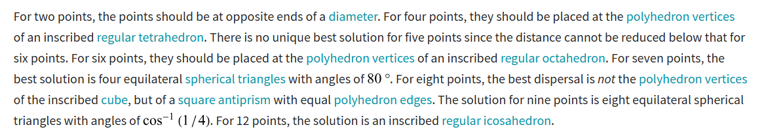
Exact Solutions according to Wolfram Mathworld
Exact solutions to n points on a sphere problem:

Slide 17


Canonical Lattice and Optimized Fibonacci algorithm
Canonical Lattice (slight improvement)
Offset Fibonacci lattice with ε obtained from empirical simulation (even better)

