Slide 1

Introduction to CMS VR and VR Spy
Andrew Su

Slide 2
CMS VR

Slide 3
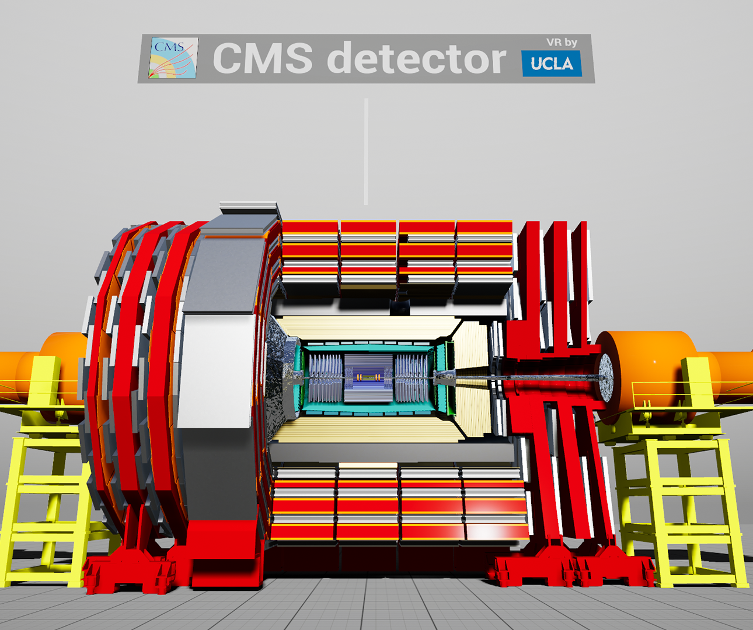
CMS VR - Overview
Created by Dr. Iqbal at CERN
Used to explore the Compact Muon Solenoid (CMS) detector at the Large Hadron Collider (LHC)
Includes:
  Model of the detector
  Hallway tour
  Geographic positioning of CMS in Switzerland

Slide 4
VR Spy

Slide 5
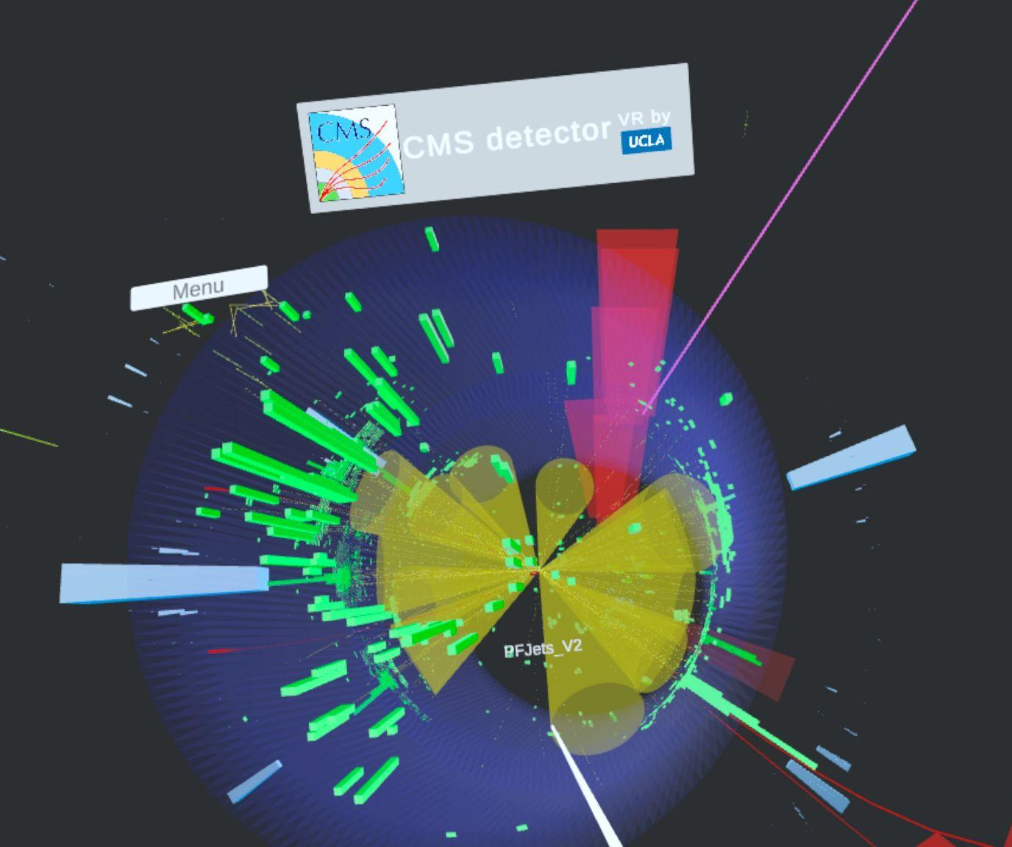
VR Spy - Purpose & Scope
Display collision events from the CMS Detector at the LHC
Tool for researchers to survey events and quickly gain insight into key phenomenon

Slide 6
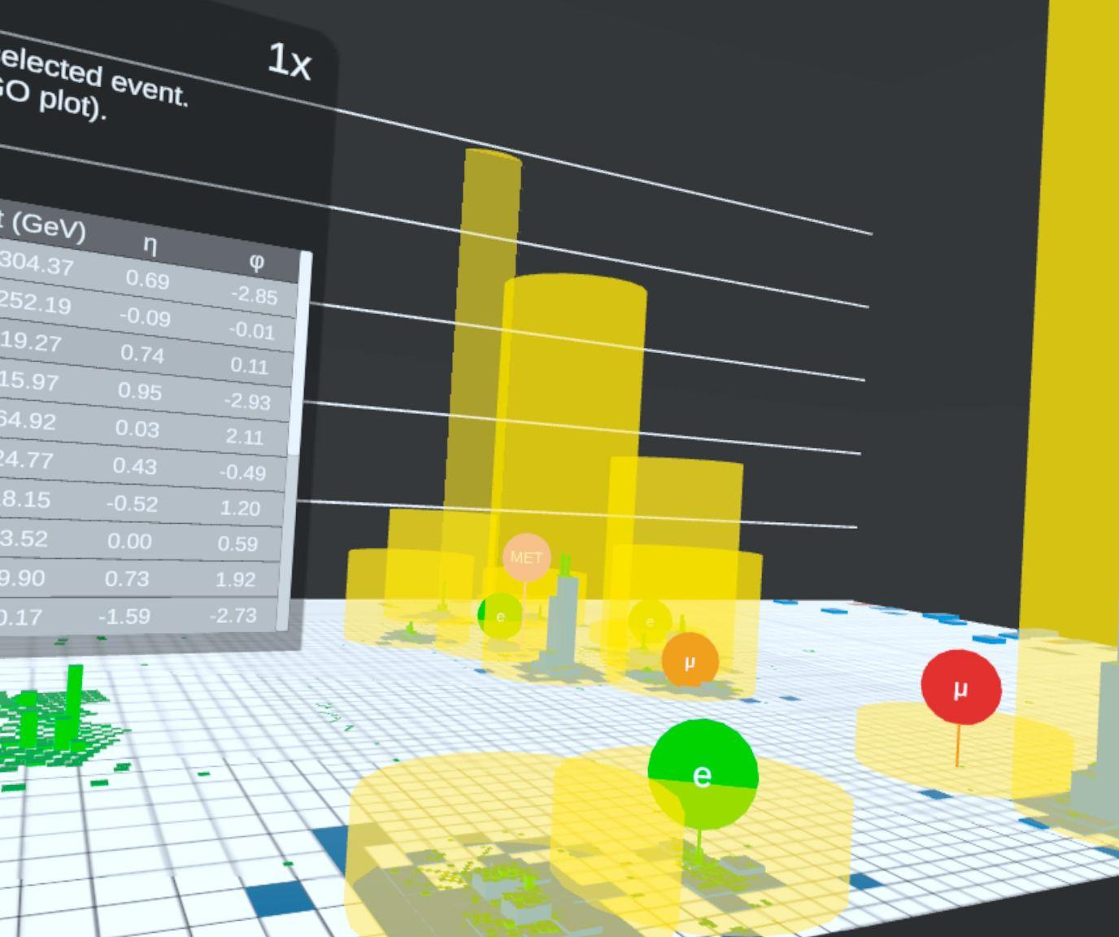
VR Spy - Timeline of Development (1/2)
Started by Joseph Malham and Ethan Hsu in 2023
Taken over by Andrew and Nathan in 2024
Version 2.1 released in Feb 2025
  Lego plot
  Hovering data labels
Version 2.2 released in May 2025
  Multiple events
  Updated menus
  Highlighted subitems

Slide 7
VR Spy - Timeline of Development (2/2)
Version 2.3 released in July 2025
  Lego plot additions
  Updated menus & useful controls
  Dynamic track resizing
Version 2.4 released in November 2025
  Animations
  Error-scaled vertices
  Lego plot improvements

Slide 8

VR Spy - Key Features
Energy Leaderboard
Lego Plot
Data Cuts
Multiple events
Subitem highlighting
Error-scaled vertices

Slide 9
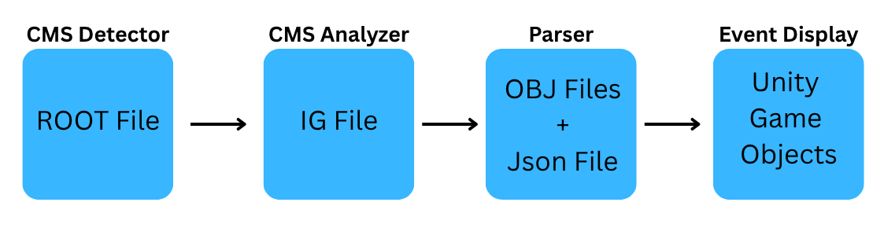
VR Spy - Implementation & Usage
Implementation:
Event Display: built using C# in Unity
Companion Parser: built using C#, command-line interface

Slide 10
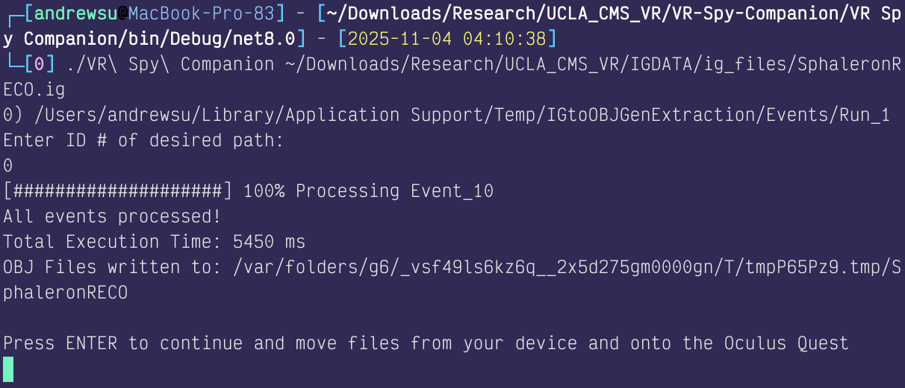
VR Spy - Implementation & Usage
Usage:
Generate IG file from CMS Analyzer
Plug in headset & use our companion parser to upload OBJ files
Run custom scene in the application

Slide 11
VR Spy - Future Plans
Expert/Explorer Modes
Error scaled CSC Hits
Improved menus with multiple parameter sort
Rendering speed optimizations
Music

