Slide 1


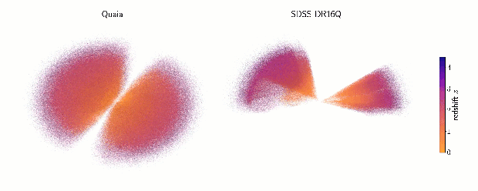
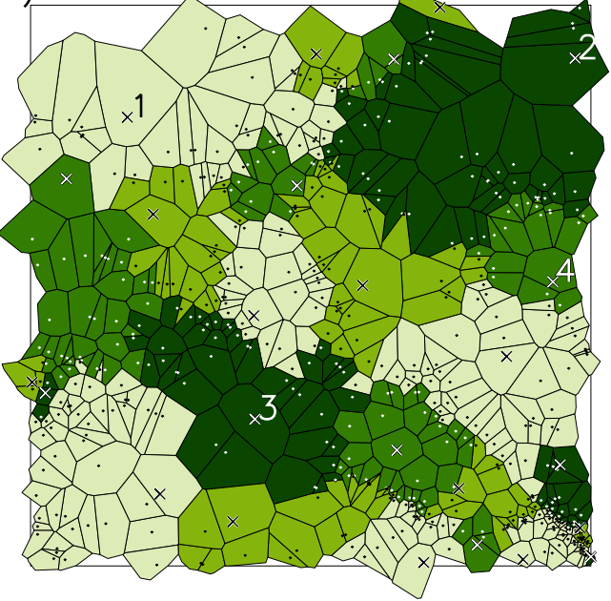
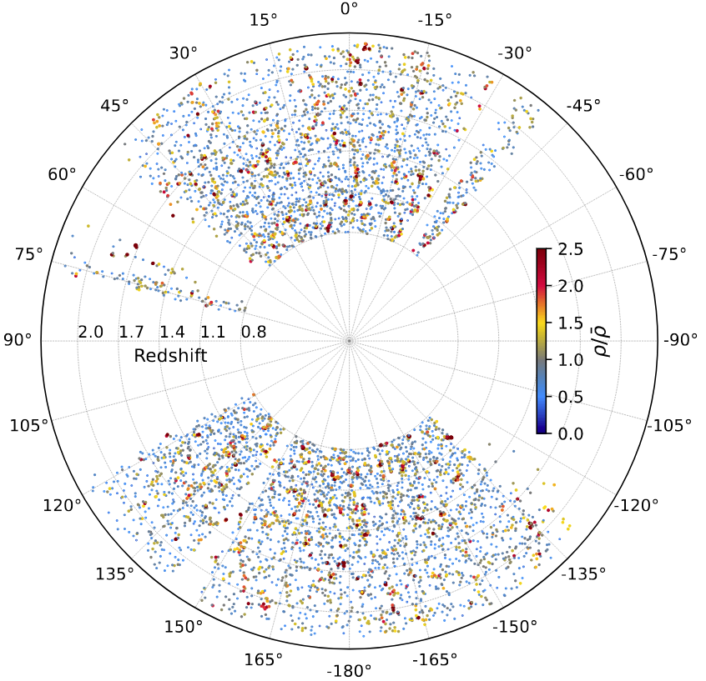
Cosmology with Gaia — catalogs of clusters, voids and local densities based on quasars
Nestor Arsenov, Mar Perez et al. | PhD student at IA, Sofia & Konkoly Observatory, Budapest
tesselation, void finding with Revolver
Storey-Fisher et al., 2024
cat. of local densities
in 0.8< z < 2.2
cat. of voids and clusters
Notes:
‹#›

Slide 2
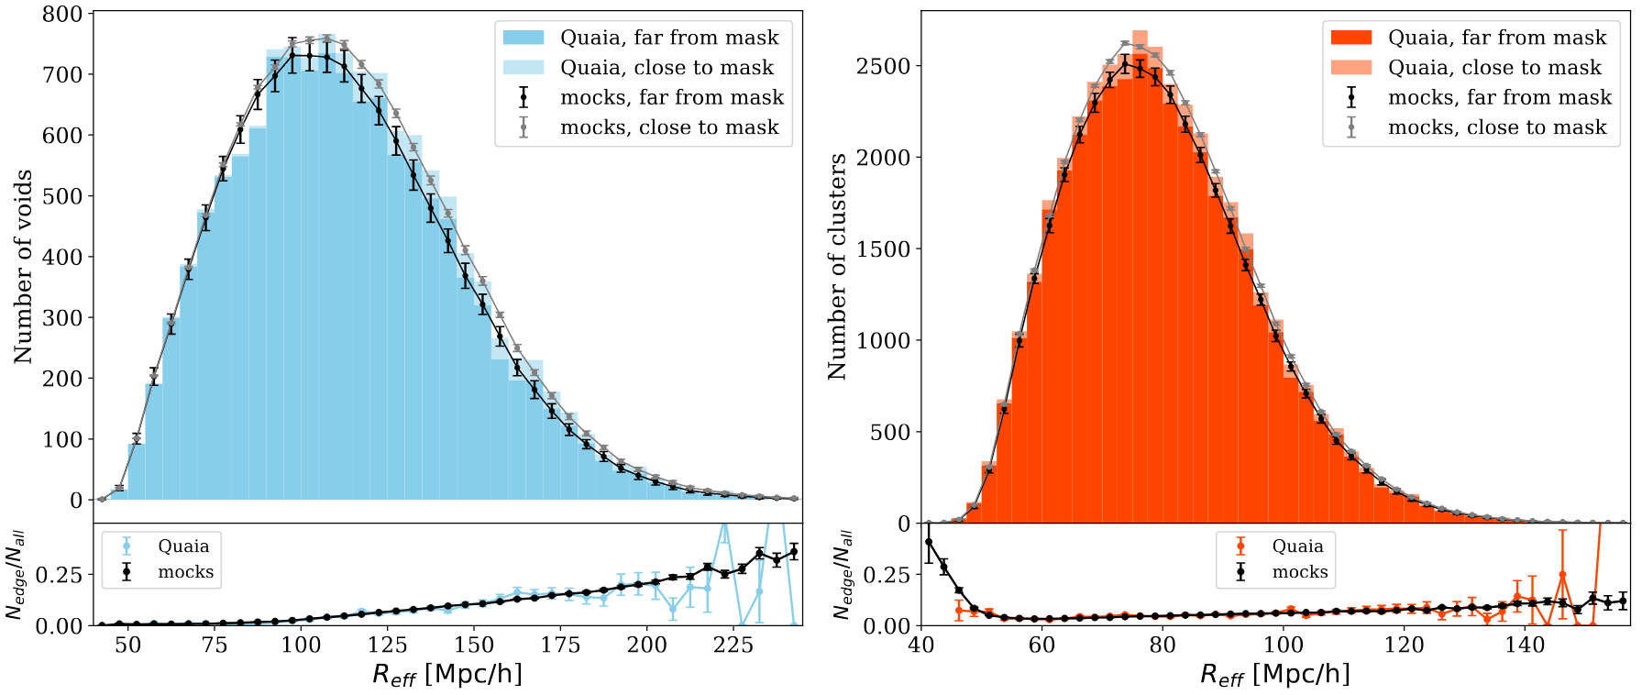
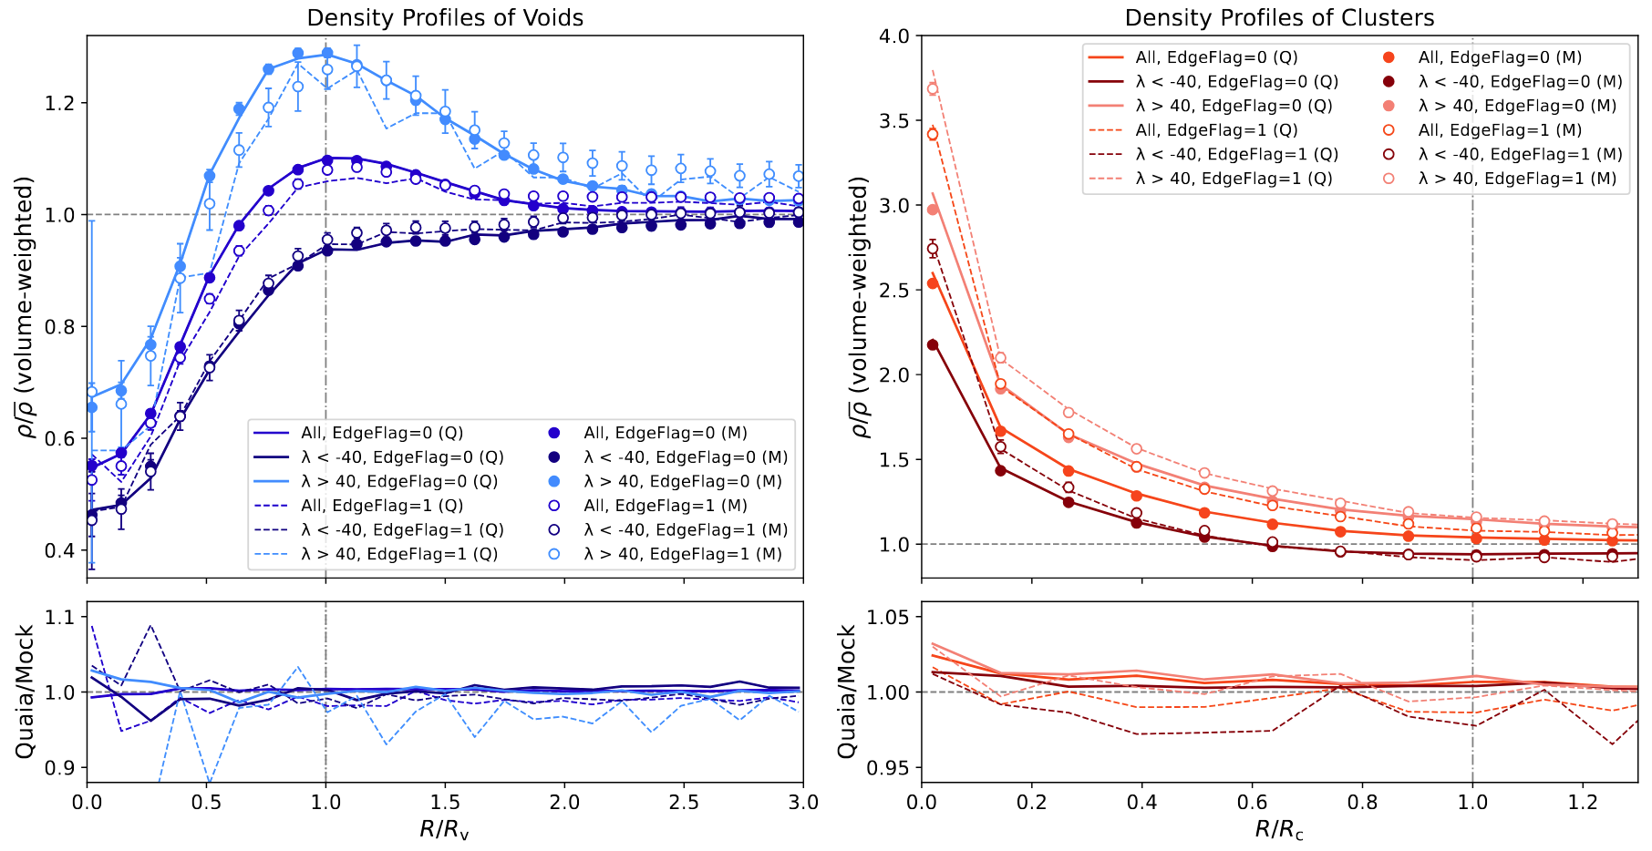
size distribution of voids and clusters
density profiles of voids and clusters
public catalogs of clusters, voids and local densities based on quasars from the largest quasar survey so far! Mock data, too, from Sinigaglia et al. 2025
Exciting data for further work:
  cross-match with CMB! (ISW, SZ…?)
  cross-match with quasar qualities (e.g. radio-loudness from Arsenov et al. 2025)
  cross-match with other surveys and other tracers!
Stay tuned for Gaia DR4 and improvement of the cat
Data: https://cdsarc.cds.unistra.fr/viz-bin/cat/J/A+A/706/A362 ✉ nestorarsenov@gmail.com
Notes:
‹#›

Slide 3
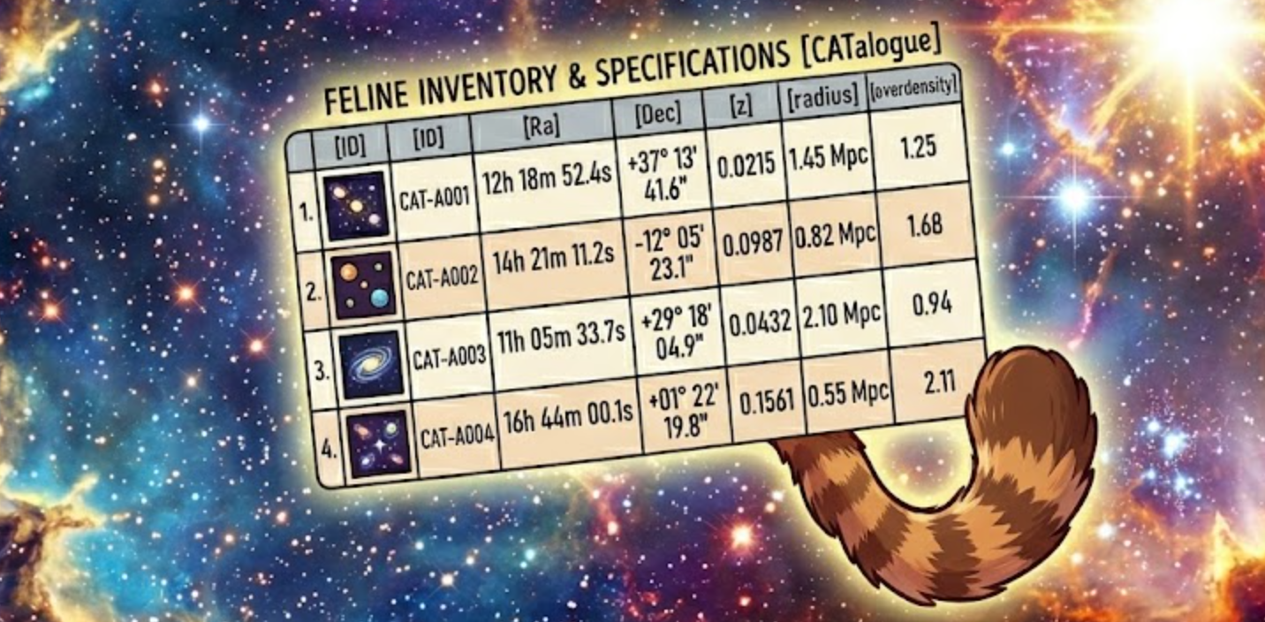
size distribution of voids and clusters
density profiles of voids and clusters
public catalogs of clusters, voids and local densities based on quasars from the largest quasar survey so far! Mock data, too, from Sinigaglia et al. 2025
Exciting data for further work:
  cross-match with CMB! (ISW, SZ…?)
  cross-match with quasar qualities (e.g. radio-loudness from Arsenov et al. 2025)
  cross-match with other surveys and other tracers!
Stay tuned for Gaia DR4 and improvement of the cat
Data: https://cdsarc.cds.unistra.fr/viz-bin/cat/J/A+A/706/A362 ✉ nestorarsenov@gmail.com
Notes:
‹#›

