Slide 1
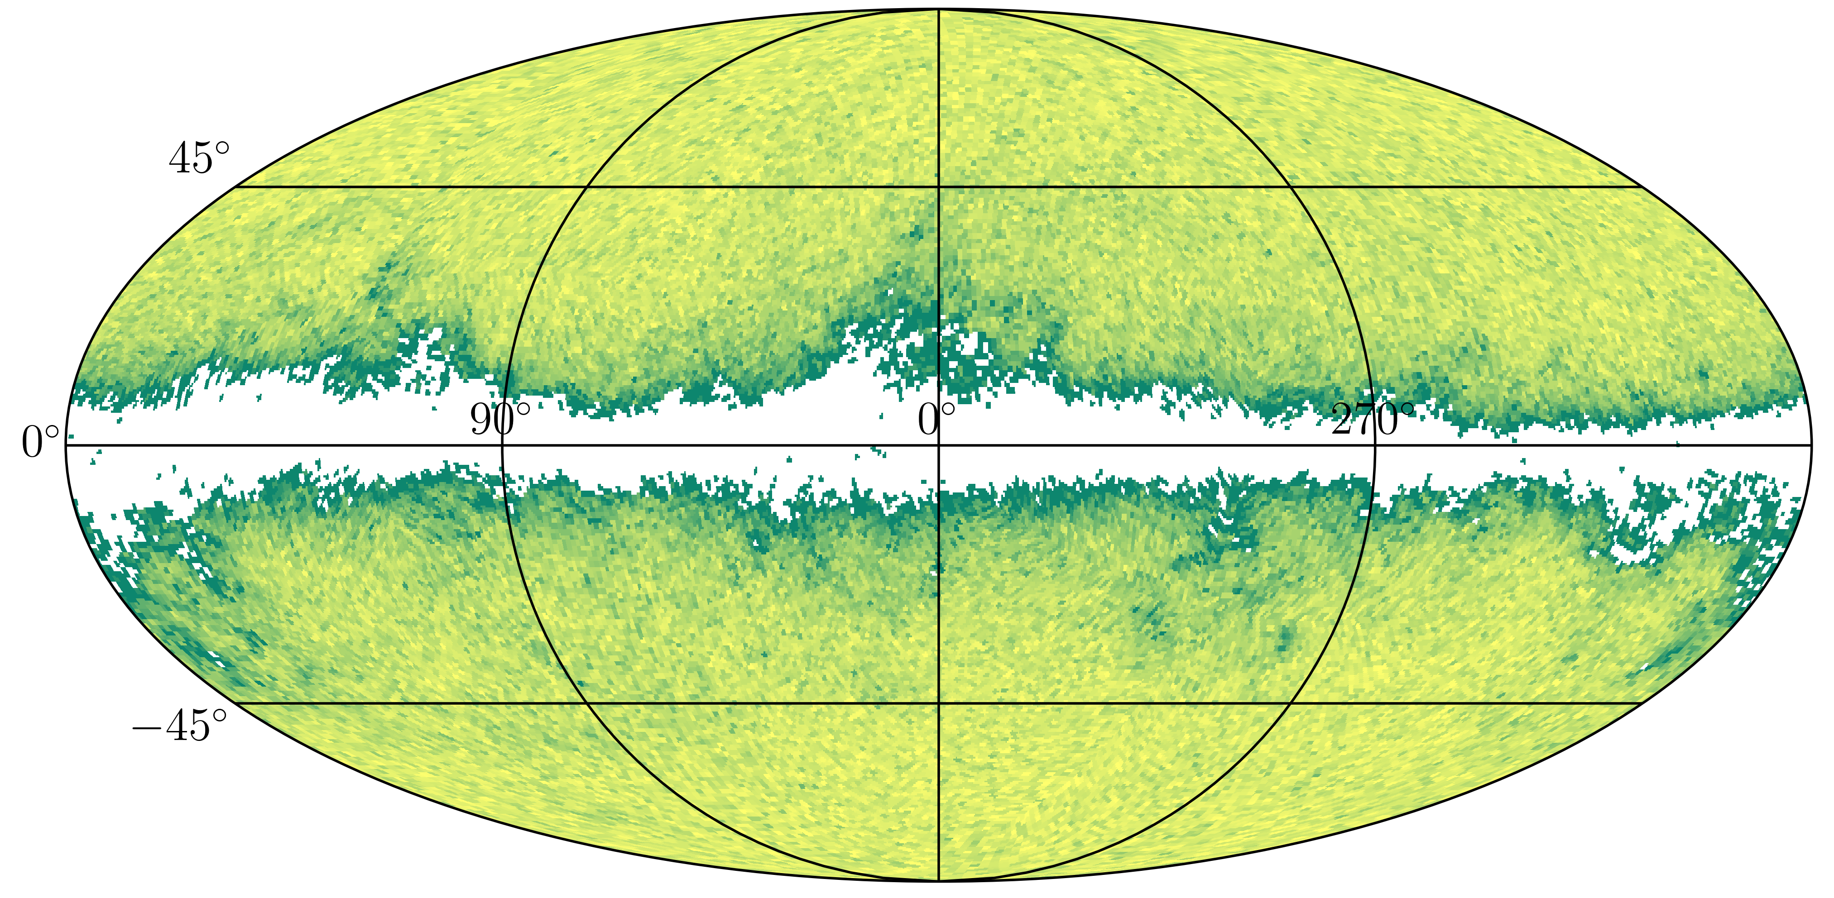
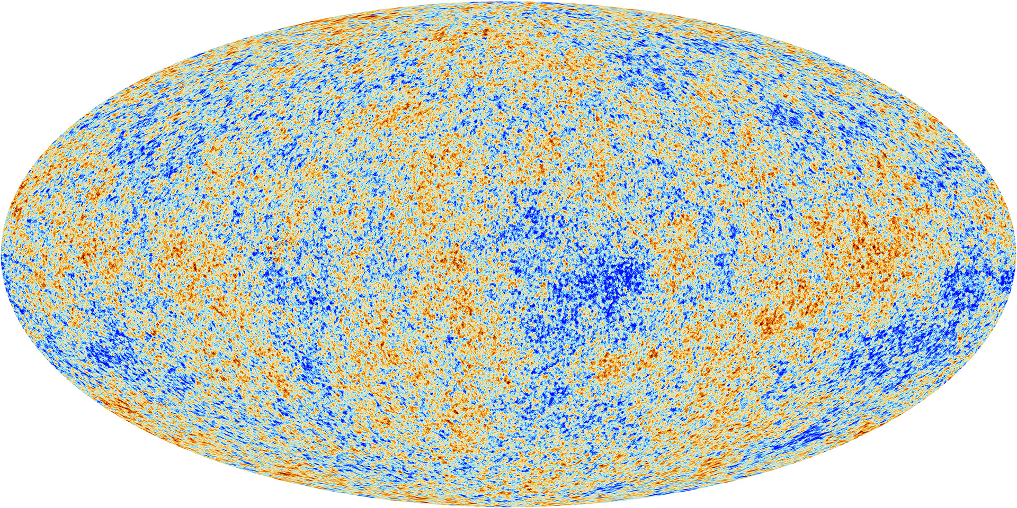
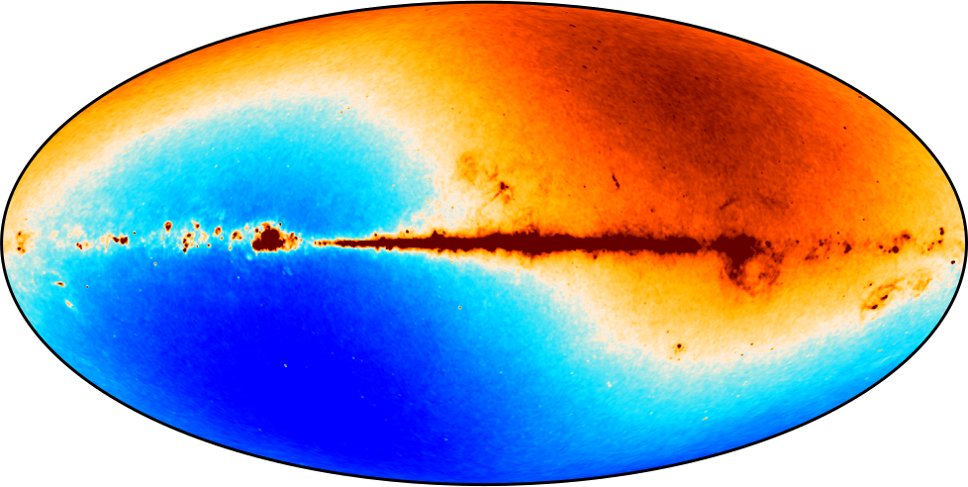
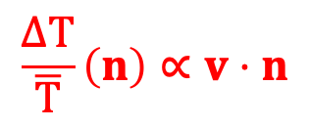
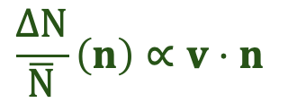
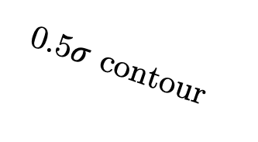
Is the Universe Isotropic? – Maybe!!
Vasudev Mittal
University of Sydney
Kinematic dipole [CMB: Planck]
Matter dipole [Quaia quasars: Gaia]
Milky way
$$\frac{ΔT}{\overline{T}}\left(n\right)∝v⋅n$$
v (km/s)
369
$$\frac{ΔN}{\overline{N}}\left(n\right)∝v⋅n$$
v (km/s)
369 1040
Dipole in
Temperature Map
0.5$σ$ contour
Dipole in
Source distribution
doi.org/10.1093/mnras/stad3706

