Slide 1








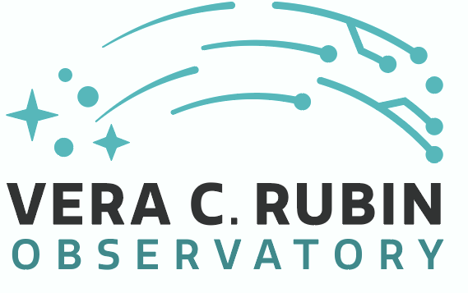

CosmoVerse School@Sofia 2026
Measuring stellar abundaces
Teresa Sicignano
PhD student at ESO (Garching) - Scuola Superiore Meridionale - INAF – OACN (Naples)
Notes:
Good evevning everyone.
.This evening I will talk about how we measure stellar abundances, and more generally how we extract physical information from stellar spectra.
This topic is extremely important in modern astrophysics because spectroscopy allows us to study not only stars themselves, but also stellar evolution, the formation history of galaxies, and ultimately the chemical evolution of the Universe.
In this lecture I will first introduce the basic concept of a spectrum, then I will discuss the main techniques used to derive stellar parameters and chemical abundances, focusing especially on the Curve of Growth method and Spectral Synthesis.
I will also briefly discuss some of the challenges that arise when studying Cepheids, since their atmospheres are dynamic and therefore more difficult to model.
So let’s start from the very beginning: what exactly is a spectrum?”

Slide 2
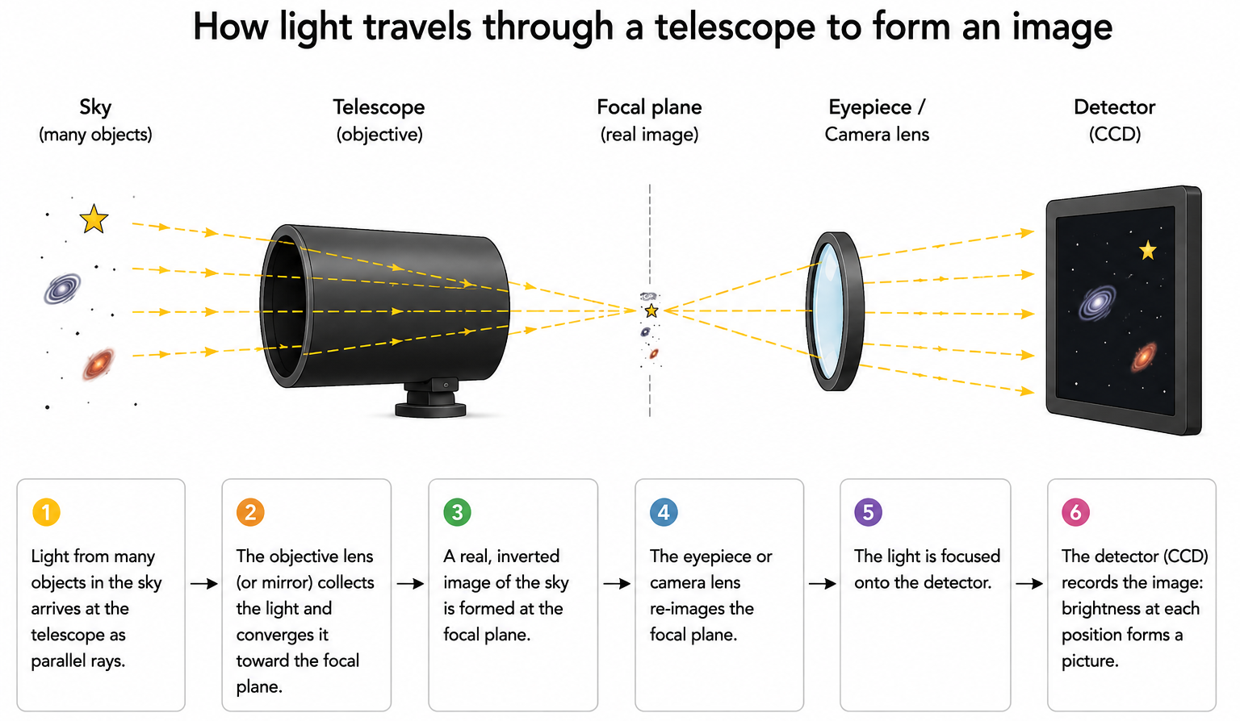
Notes:
When we observe the sky with a telescope, we can obtain two types of information.
The first is an image.
An image tells us where objects are located and how bright they are, that means with an image we don’t lose the spatial information.

Slide 3
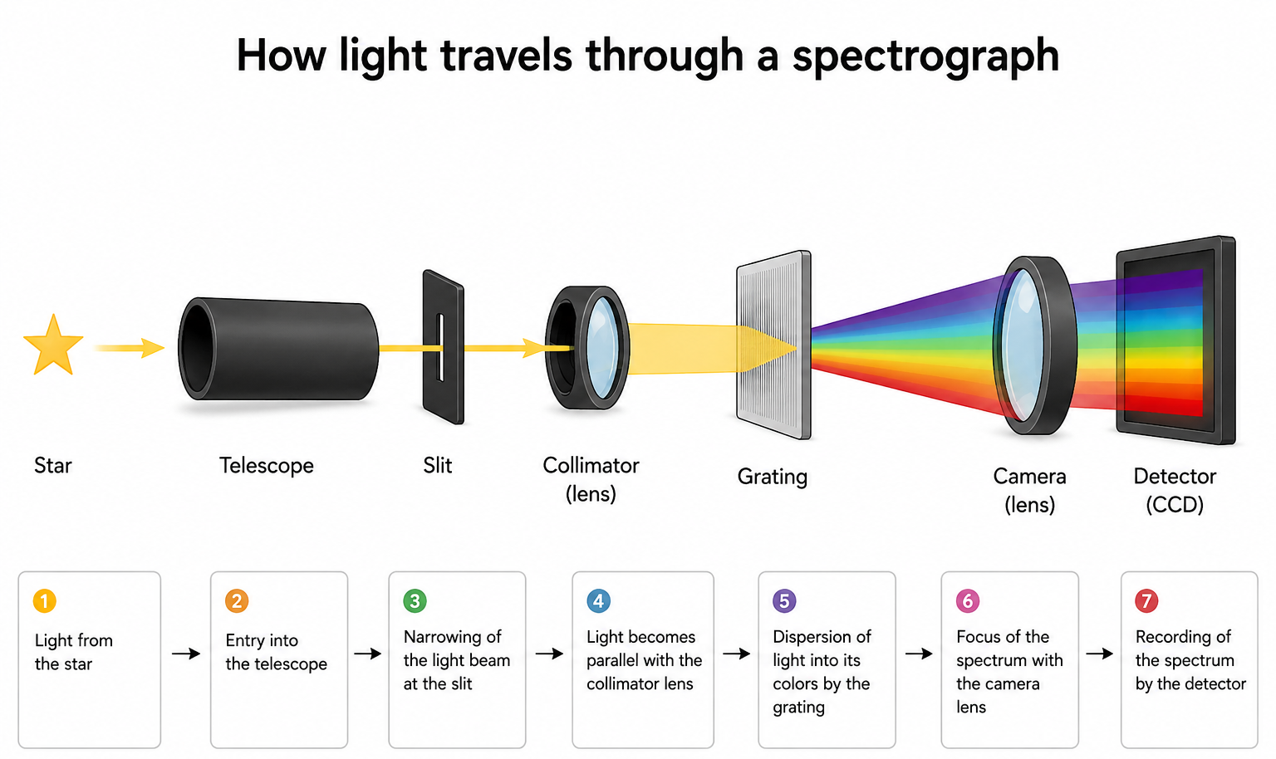
Notes:
But if we disperse the light through a spectrograph, we obtain a spectrum.
A spectrum is much more powerful because it contains physical information encoded in the distribution of light as a function of wavelength.
Instead of just seeing a star as a point of light, spectroscopy allows us to investigate its atmosphere.
In other words, imaging tells us ‘where’, while spectroscopy tells us ‘what’ and ‘how’.
This is why spectroscopy is one of the most important tools in astrophysics.

Slide 4
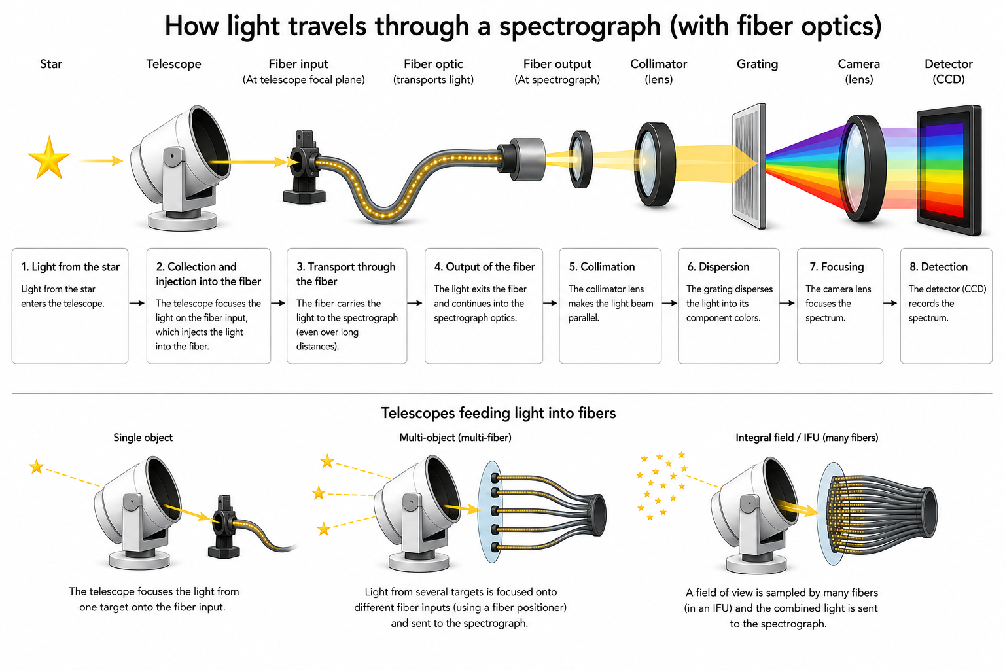

Slide 5
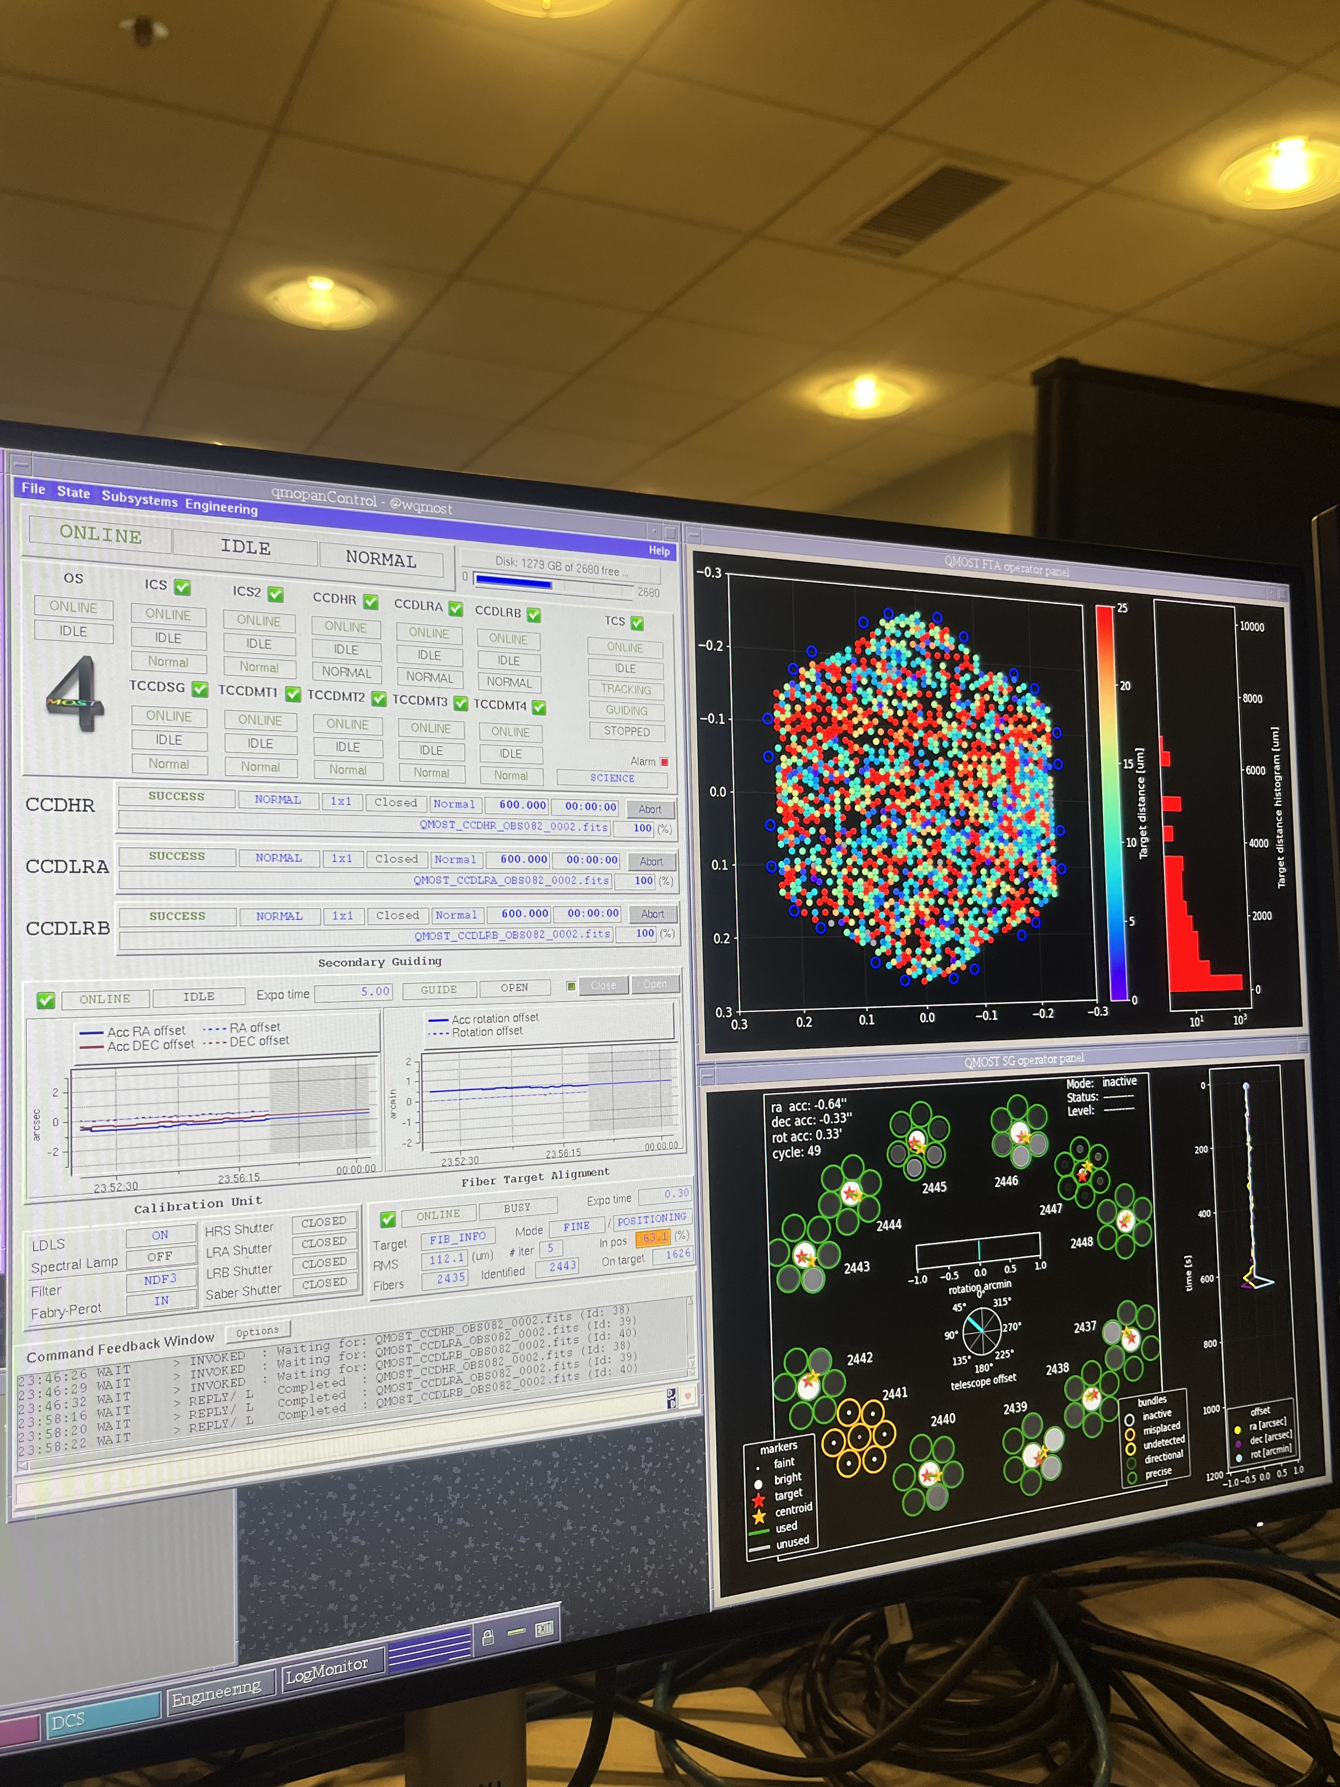
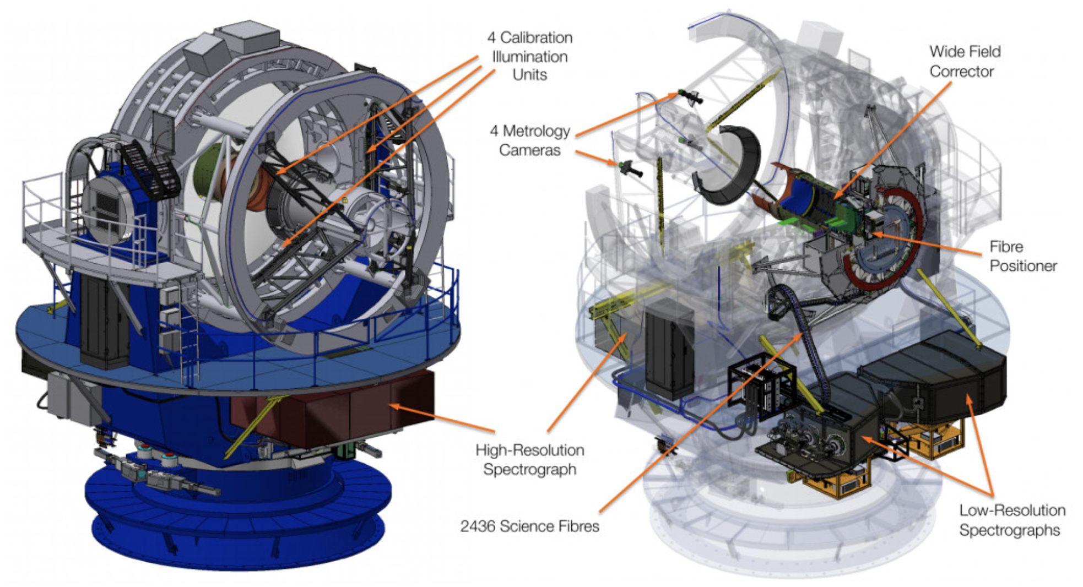
4MOST
Optical spectroscopic survey facility mounted on ESO's 4-m-class telescope VISTA.
2.5-degree diameter field-of-view with 2436 science fibres in the focal plane.
Notes:
In 4MOST, the fibers themselves do not determine the spectral resolution.
The fibers only transport the light from the telescope focal plane to different spectrographs.
Some fibers are connected to the Low-Resolution Spectrographs, while others are connected to the High-Resolution Spectrograph.
The spectral resolution is then determined by the optical design of each spectrograph. Il grating impone la risoluzione

Slide 6
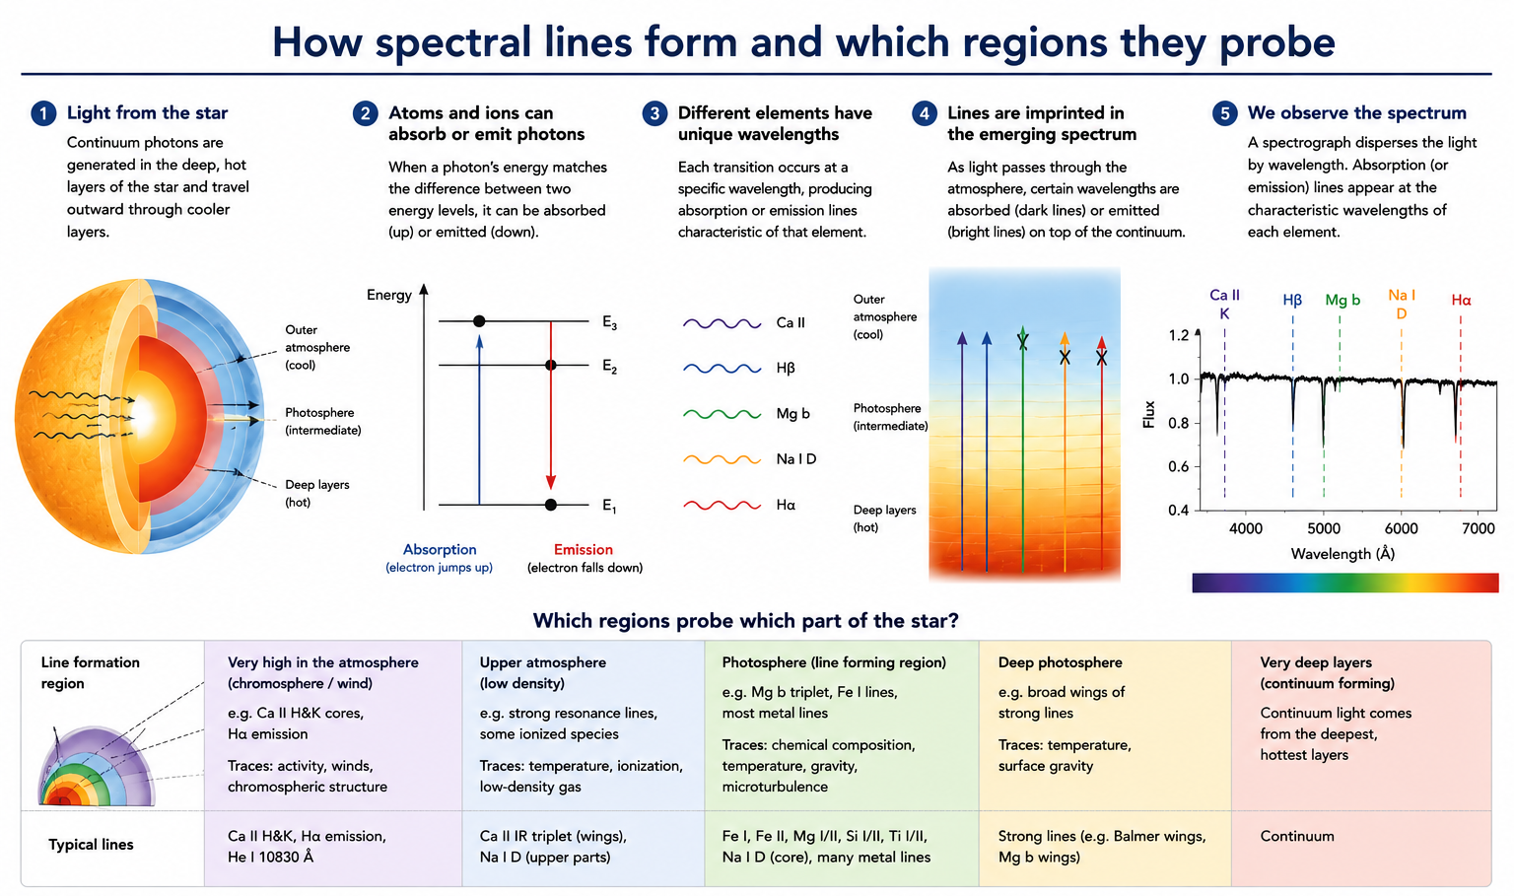
Notes:
Different spectral lines form preferentially at different depths in the stellar atmosphere because each atomic transition requires specific physical conditions, such as temperature, density, and ionization state.
By modelling these conditions with radiative transfer calculations, we can determine which layers of the star are being probed by different spectral lines.
Sappiamo in quale regione si formano le line grazie a fisica atomica (livelli energetici, probabilità di transizione, sezioni d’urto), modelli di atmosfera.

Slide 7
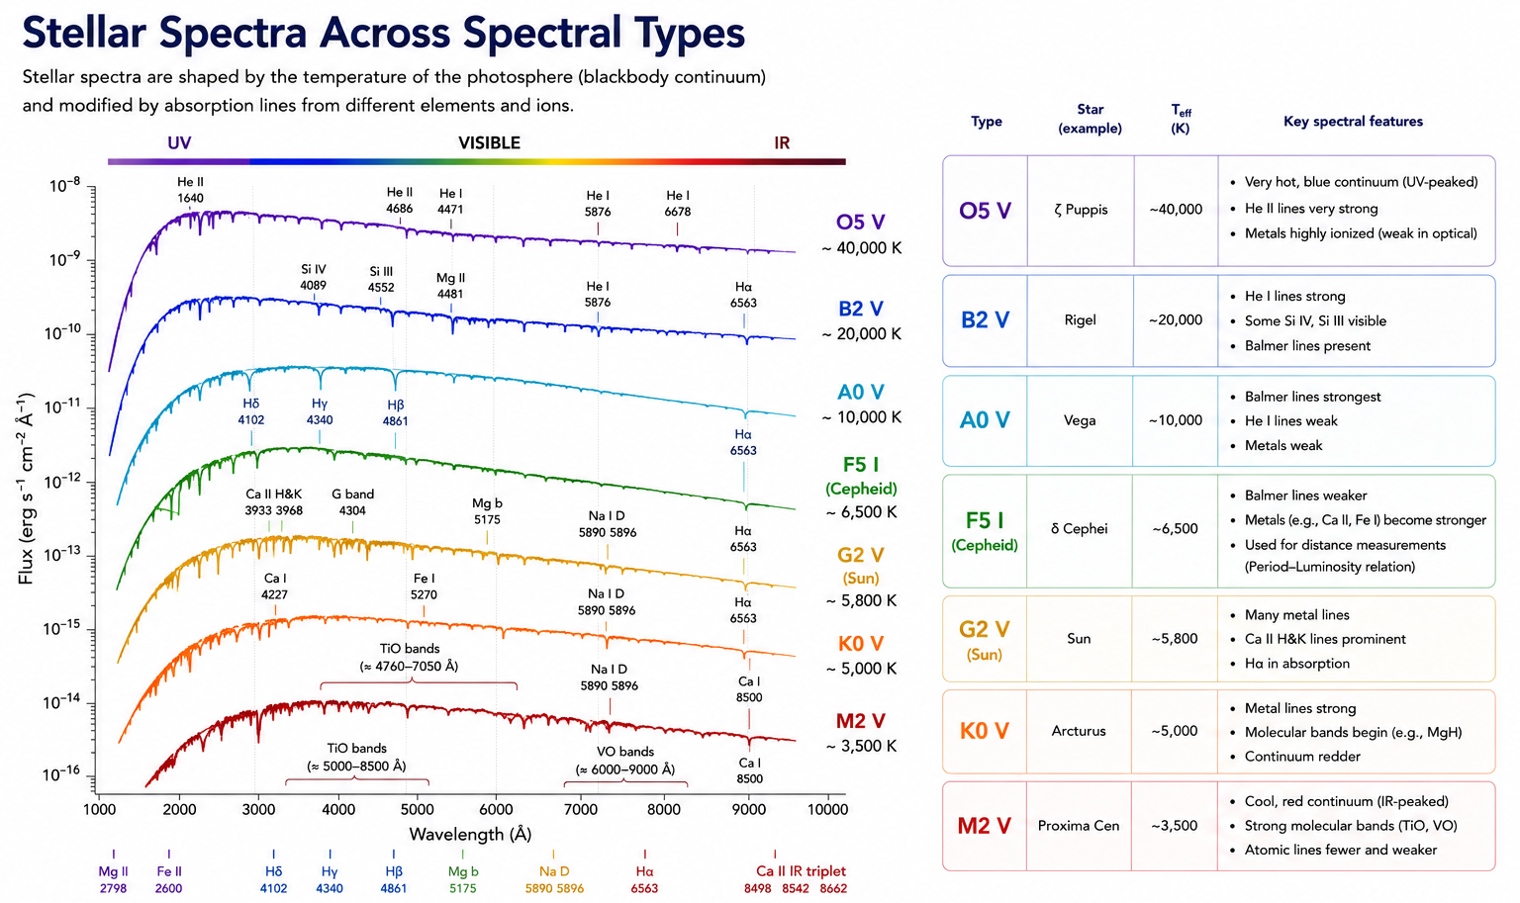

Slide 8
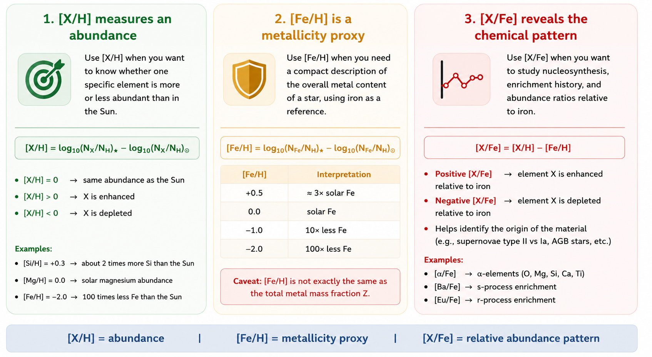
Notes:
Absorption line: the core of the stars emits like a black body, the atmosphere ( the atoms in the atmosphere) absorbs. Given the atomic features, the EW of a line varies according to the condition of the star. To know the condition of the star we need to calculate the stellar parameters

Slide 9
Notes:
Absorption line: the core of the stars emits like a black body, the atmosphere ( the atoms in the atmosphere) absorbs. Given the atomic features, the EW of a line varies according to the condition of the star. To know the condition of the star we need to calculate the stellar parameters

Slide 10
Notes:
Absorption line: the core of the stars emits like a black body, the atmosphere ( the atoms in the atmosphere) absorbs. Given the atomic features, the EW of a line varies according to the condition of the star. To know the condition of the star we need to calculate the stellar parameters

Slide 11
HOW TO DERIVE INFORMATION?
NORMALIZATION OF THE SPECTRUM
Notes:
So how do we actually extract information from a spectrum?
The first step is normalization.
Normalization means defining the continuum level of the spectrum. This is essential because absorption lines are measured relative to the continuum.
However, continuum placement is not always straightforward, especially in cool stars where line crowding is severe.
After normalization, we apply the radial velocity correction.
Because stars move relative to us, spectral lines are Doppler shifted.
If we want to compare observed spectra with laboratory wavelengths or synthetic spectra, we must first correct for this velocity shift.
Only after these preprocessing steps can we start deriving physical parameters and abundances.”

Slide 12
HOW TO DERIVE INFORMATION?
NORMALITATION OF THE SPECTRUM
RADIAL VELOCITY CORRECTION
Notes:
So how do we actually extract information from a spectrum?
The first step is normalization.
Normalization means defining the continuum level of the spectrum. This is essential because absorption lines are measured relative to the continuum.
However, continuum placement is not always straightforward, especially in cool stars where line crowding is severe.
After normalization, we apply the radial velocity correction.
Because stars move relative to us, spectral lines are Doppler shifted.
If we want to compare observed spectra with laboratory wavelengths or synthetic spectra, we must first correct for this velocity shift.
Only after these preprocessing steps can we start deriving physical parameters and abundances.”

Slide 13
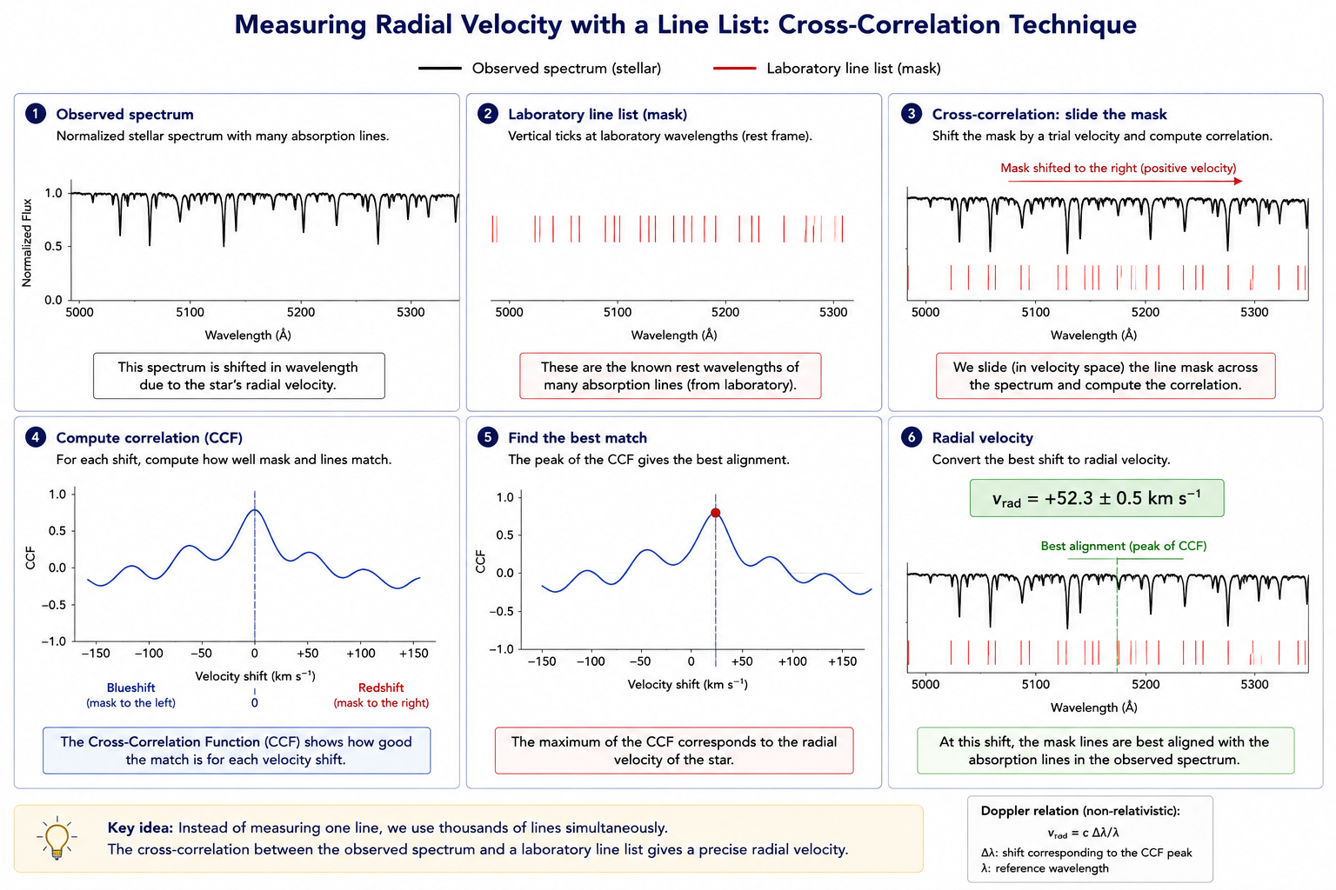
Notes:
Moto terra intorno al sole e moto stella

Slide 14
EXAMPLES OF UVES (VLT) SPECTRA
Red Mode Central Wlgt | 580 nm
Red Slit Width | 1
Red Readout Mode | 225kHz,1x1,low
PI A. Bhardwaj
SNR>40@587nm
Notes:
Absorption line: the core of the stars emits like a black body, the atmosphere ( the atoms in the atmosphere) absorbs. Given the atomic features, the EW of a line varies according to the condition of the star. To know the condition of the star we need to calculate the stellar parameters
These examples show how spectra can change depending on stellar properties.
Different stars exhibit different line strengths and continuum shapes.
This diversity is exactly what allows us to classify stars and determine their parameters.
One important aspect to remember is that the interpretation of a spectrum is never direct. We always need models.
The observed spectrum must be compared with theoretical expectations in order to derive physical quantities.
This is where stellar atmosphere models become fundamental.

Slide 15
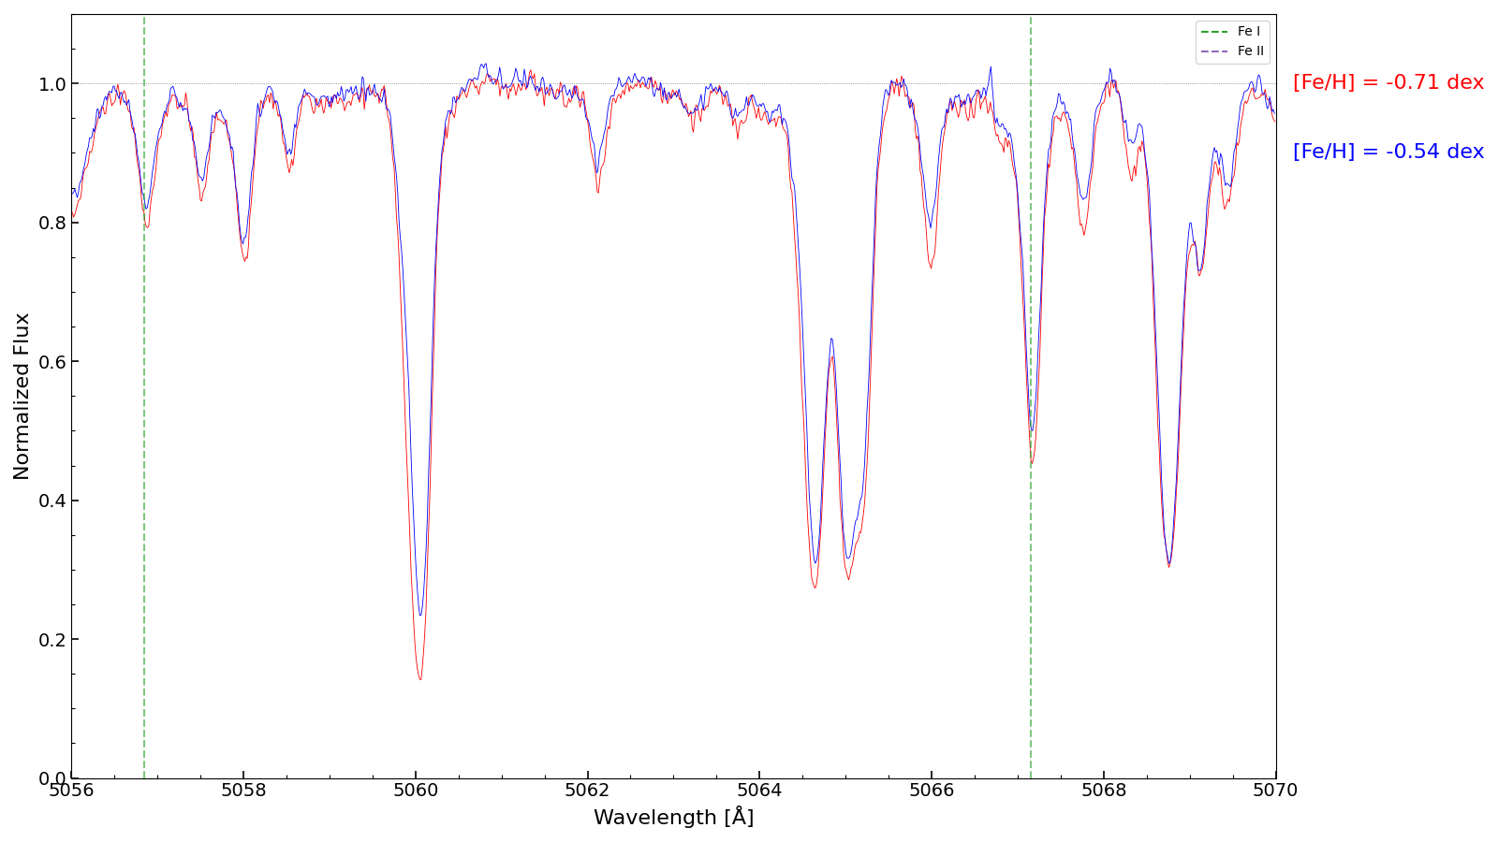
EXAMPLES OF UVES (VLT) SPECTRA
Red Mode Central Wlgt | 580 nm
Red Slit Width | 1
Red Readout Mode | 225kHz,1x1,low
PI A. Bhardwaj
SNR>40@587nm
Notes:
Here we see an example of a stellar spectrum.
At first glance it may simply look like a collection of lines, but in reality every absorption feature contains physical information.
From the spectrum we can derive:
the effective temperature,
the surface gravity,
the chemical abundances,
and even information about stellar interiors and the history of the cosmos.
Each absorption line corresponds to a transition of atoms or ions in the stellar atmosphere.
The depth, width, and shape of these lines depend on the physical conditions of the star.
For example:
hotter stars excite atoms differently,
surface gravity affects pressure broadening,
and abundances determine how strong specific lines appear.
So essentially, the spectrum is like the fingerprint of a star.

Slide 16
DIFFERENT TECNIQUES
Curve of growth
Spectral synthesis
Artificial Intelligence/ Neural Networks..
Notes:
There are several methods used in spectroscopy.
The most classical techniques are:
the Curve of Growth method,
spectral synthesis,
and more recently machine learning and neural networks.
Each method has strengths and limitations.
Classical methods are physically transparent and well understood. Machine learning approaches are extremely powerful for large surveys, but sometimes less interpretable.
Today I will mainly focus on the first two methods because they remain fundamental in high-precision stellar spectroscopy.

Slide 17
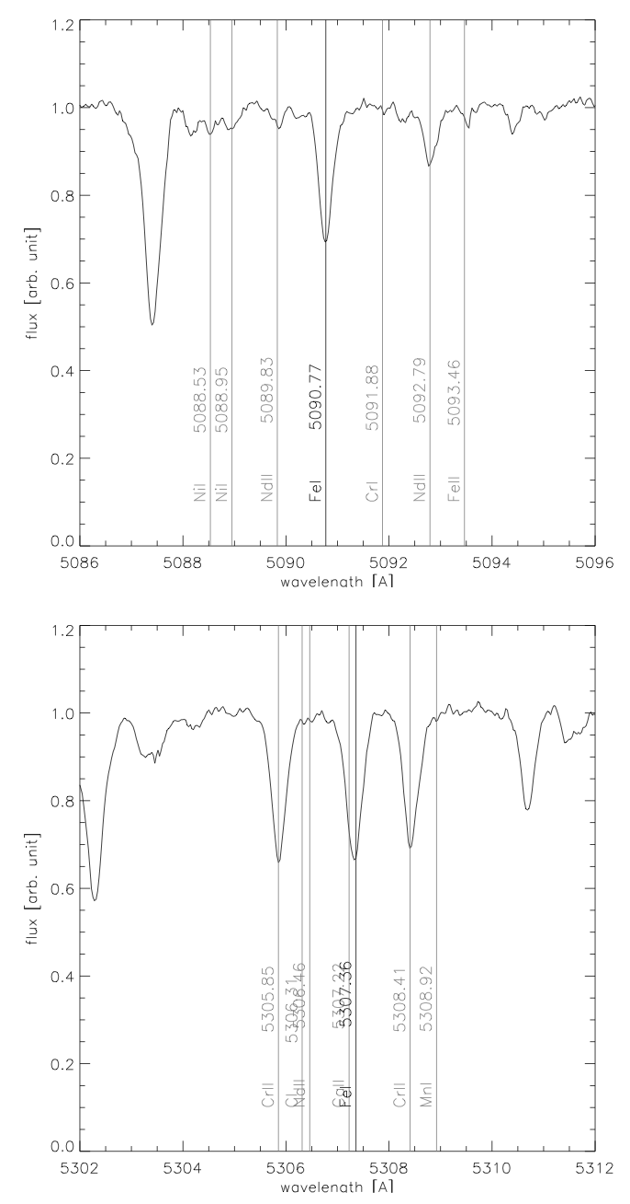
WHAT TO TAKE INTO ACCOUNT:
Clean line
Model atmospheres: LTE, NLTE, plane parallel, multi-dimensional geometry, …
Caveat: static models applied to dynamic Cepheid atmospheres
Atomic physics: oscillator strength, excitation potential, damping constants
Line list / spectral inclusion regions
Continuum estimation
Zero point: abundances usually expressed wrt solar value
The details of the analysis
What/how to reject/keep, fitting techniques, ML training, …
Blended line
Courtesy of M. Romaniello
Notes:
At this point it is important to emphasize that abundance measurements depend on many ingredients.
First of all, we need stellar atmosphere models. These models can assume LTE or NLTE conditions, plane-parallel geometry, or more sophisticated multidimensional structures.
For Cepheids this becomes even more complicated because their atmospheres are dynamic.
Then we need accurate atomic physics:
oscillator strengths,
excitation potentials,
damping constants.
The quality of the line list is also extremely important. Ideally we want clean and isolated spectral lines.
Another key aspect is the continuum estimation. A small error in continuum placement can introduce systematic errors in abundance measurements.
Finally, abundances are usually expressed relative to the Sun. Therefore, even updates in the solar composition can affect our measurements.
For example, the revision by Asplund and collaborators changed the solar oxygen abundance significantly.
So abundance analysis is not just about measuring lines. It is a complex chain where every ingredient matters.

Slide 18
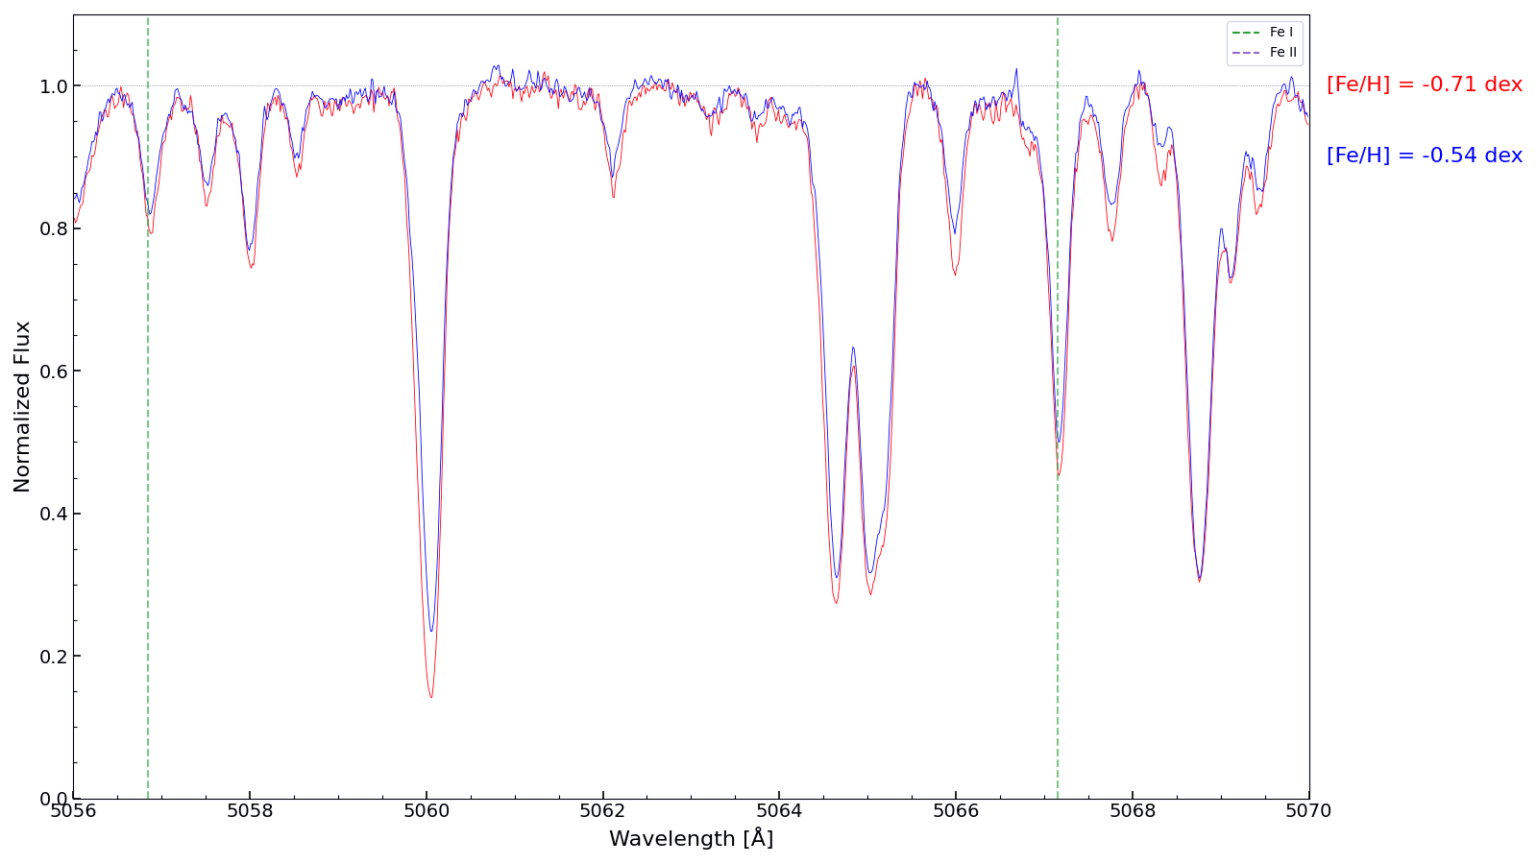
INFORMATIONS FROM A SPECTRUM
EFFECTIVE TEMPERATURES
SURFACE GRAVITY
MICROTURBOLENCE VELOCITY
CHEMICAL ABUNDANCES
STELLAR INTERIORS
HISTORY OF THE COSMOS
Notes:
Here we see an example of a stellar spectrum.
At first glance it may simply look like a collection of lines, but in reality every absorption feature contains physical information.
From the spectrum we can derive:
the effective temperature,
the surface gravity,
the chemical abundances,
and even information about stellar interiors and the history of the cosmos.
Each absorption line corresponds to a transition of atoms or ions in the stellar atmosphere.
The depth, width, and shape of these lines depend on the physical conditions of the star.
For example:
hotter stars excite atoms differently,
surface gravity affects pressure broadening,
and abundances determine how strong specific lines appear.
So essentially, the spectrum is like the fingerprint of a star.

Slide 19
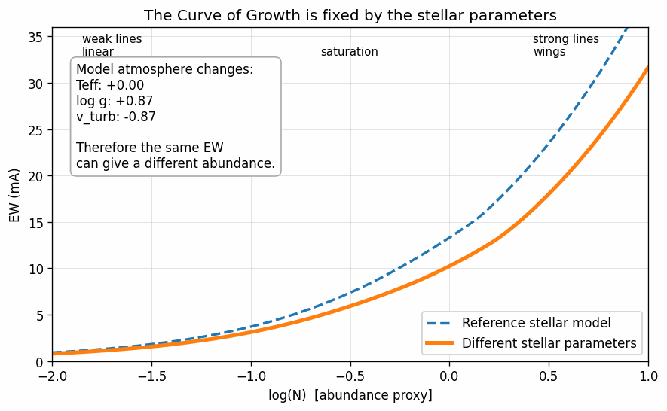
THE CURVE OF GROWTH METHOD
Solving the radiative transfer in stellar atmospheres yields a relation between the Equivalent Width of a line of an element and its abundance: that’s the Curve of Growth
The physics of the particular transition: oscillator strength, excitation potential, damping constants
The stellar parameters: T_{eff}, log(g), v_{turb}
Notes:
Equivalent Width = flux in the line wrt to neighbouring continuum

Slide 20
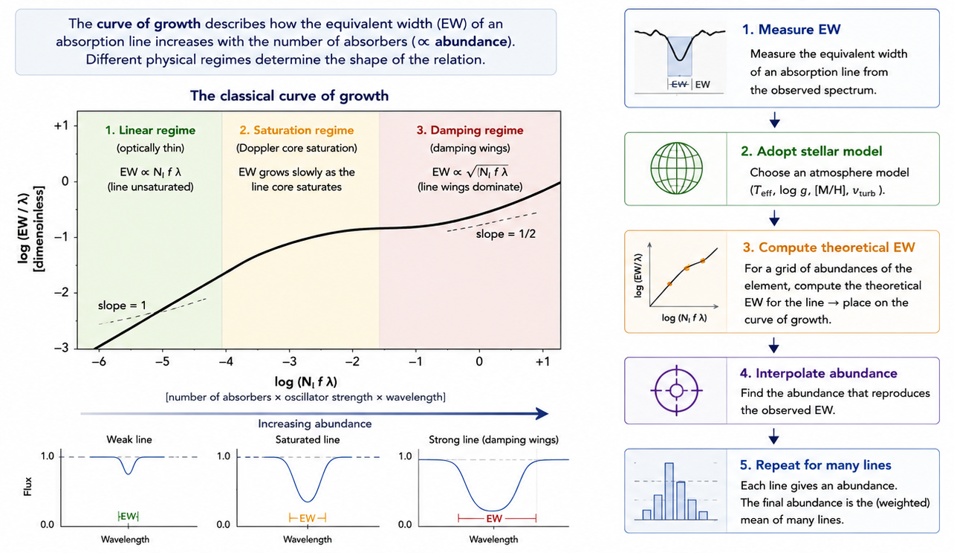
THE CURVE OF GROWTH METHOD

Slide 21
THE CURVE OF GROWTH METHOD
T_{eff} by excitation equilibrium: no residual correlation between the iron abundance and the excitation potential of neutral iron lines
Surface gravity by ionization equilibrium: same abundance within the uncertainties FeI and FeII
Microturbulent velocity: no residual correlation between the iron abundance and EW
Iron abundance is the mean of the ones from the individual lines in the convergence iteration
Notes:
In practice, we determine the stellar parameters through different equilibrium conditions.
The effective temperature is derived through excitation equilibrium. This means that iron abundances should not correlate with excitation potential.
Surface gravity is derived through ionization equilibrium. The abundances obtained from Fe I and Fe II lines should agree.
Microturbulent velocity is adjusted so that abundances do not correlate with equivalent width.
Finally, the iron abundance is computed as the average abundance obtained from individual lines.

Slide 22
THE CURVE OF GROWTH METHOD
Method consistency checks
No dependence of the abundance on the parameters
T_{eff}
v_{turb}
log(g)
Courtesy of M. Romaniello
Notes:
These plots illustrate consistency checks.
The goal is always to remove trends between abundances and stellar parameters.
If correlations remain, it means the adopted parameters are not correct.

Slide 23
THE CURVE OF GROWTH METHOD
Cepheid-specific consistency checks
Iron independent of period
The temperature follows the phase
Parameters depend on period
Courtesy of M. Romaniello
Notes:
Cepheids introduce additional complexity.
Because they pulsate, their atmospheric parameters change with phase.
For example, temperature varies significantly during the pulsation cycle.
Therefore, when analyzing Cepheids we must verify that the derived abundances remain physically consistent across phases.

Slide 24
THE SPECTRAL SYNTHESIS
The curve of growth is still implicitly present in spectral synthesis, but the full spectral profile is modeled instead of only the equivalent width.
Synthetic spectrum ,T_{eff} , microturbulence, log g, V_{broad}
➡️ chemical abundances
Notes:
Let us now move to the spectral synthesis approach.
Spectral synthesis is conceptually based on the same physics as the curve-of-growth method.
The abundance still determines the strength of spectral lines through radiative transfer.
However, instead of using only equivalent widths, spectral synthesis fits the entire line profile.
Instead of measuring equivalent widths individually, spectral synthesis compares the observed spectrum directly with synthetic spectra.
The synthetic spectra are generated using stellar atmosphere models and atomic data.
We vary parameters such as:
effective temperature,
gravity,
microturbulence,
radial velocity,
rotational broadening,
and abundances,
until the synthetic spectrum reproduces the observations.
This method is especially powerful in crowded spectral regions or when lines are blended.

Slide 25
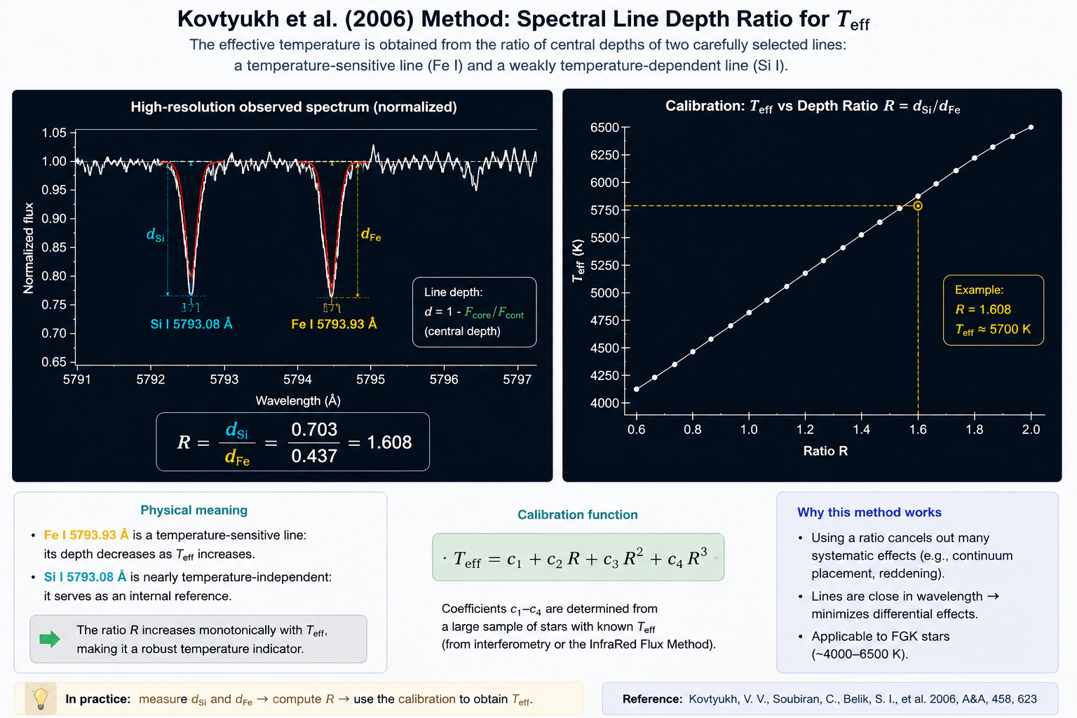
THE SPECTRAL SYNTHESIS
T_{eff} from Line Deep Ratio method (Kovtyukh + 2006)
Notes:
Another interesting method is the Line Depth Ratio technique.
This method uses the ratio between the depths of two spectral lines with different temperature sensitivities. The choosed lines should be close in wavelenght, so that the continuum placement is the same ( right or wrong at least should not add systematics)
One line should be very sensitive to temperature and one insensitive so that the ratio is sensitive and provides a very precise temperature diagnostic.

Slide 26
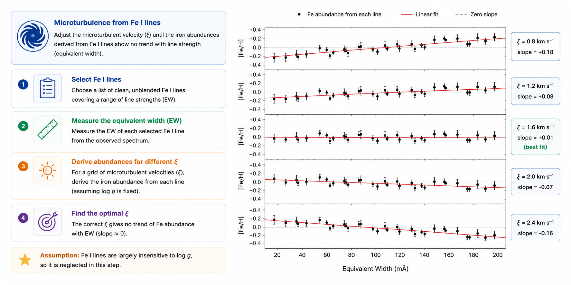
THE SPECTRAL SYNTHESIS
Notes:
Microturbulence is another key parameter.
Physically, it represents unresolved small-scale motions in the stellar atmosphere.
If microturbulence is not properly accounted for, strong lines and weak lines will give inconsistent abundances.
Therefore, we determine the microturbulent velocity by minimizing abundance trends with equivalent width.
Again, this is an iterative process.
Although microturbulence may sound like a technical detail, it has a significant impact on high-precision abundance analysis

Slide 27
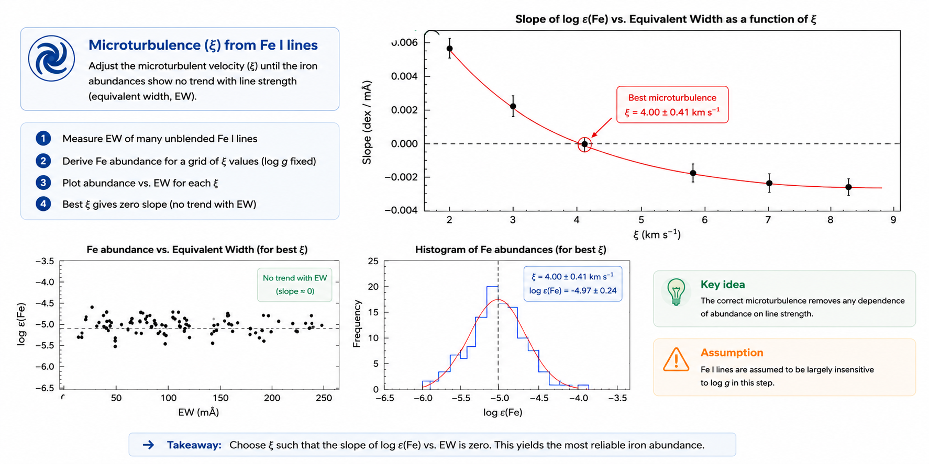
THE SPECTRAL SYNTHESIS
Notes:
Microturbulence is another key parameter.
Physically, it represents unresolved small-scale motions in the stellar atmosphere.
If microturbulence is not properly accounted for, strong lines and weak lines will give inconsistent abundances.
Therefore, we determine the microturbulent velocity by minimizing abundance trends with equivalent width.
Again, this is an iterative process.
Although microturbulence may sound like a technical detail, it has a significant impact on high-precision abundance analysis

Slide 28
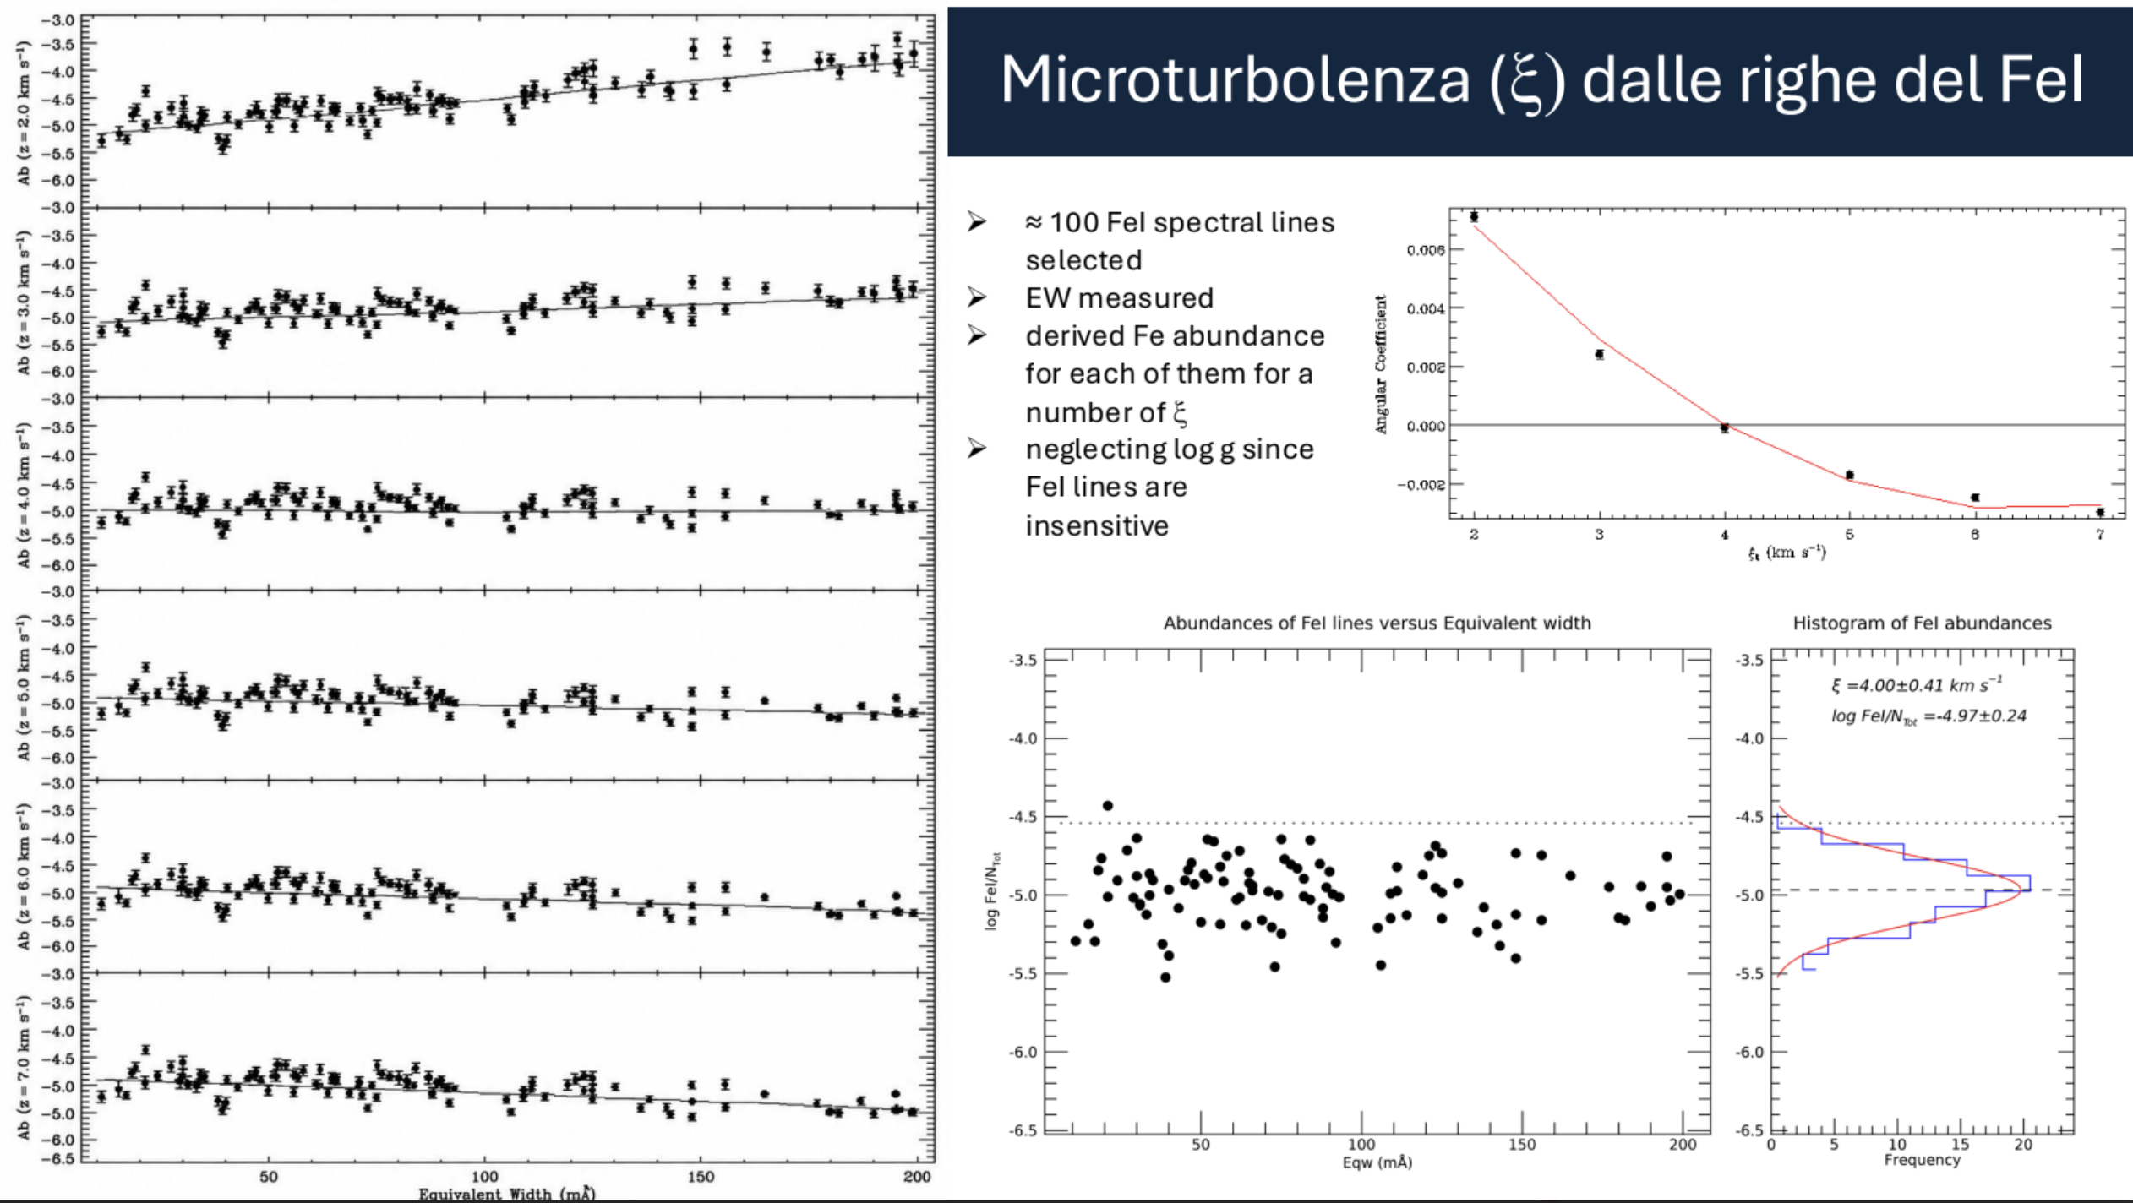
THE SPECTRAL SYNTHESIS
Microturbulence from FeI lines

Slide 29
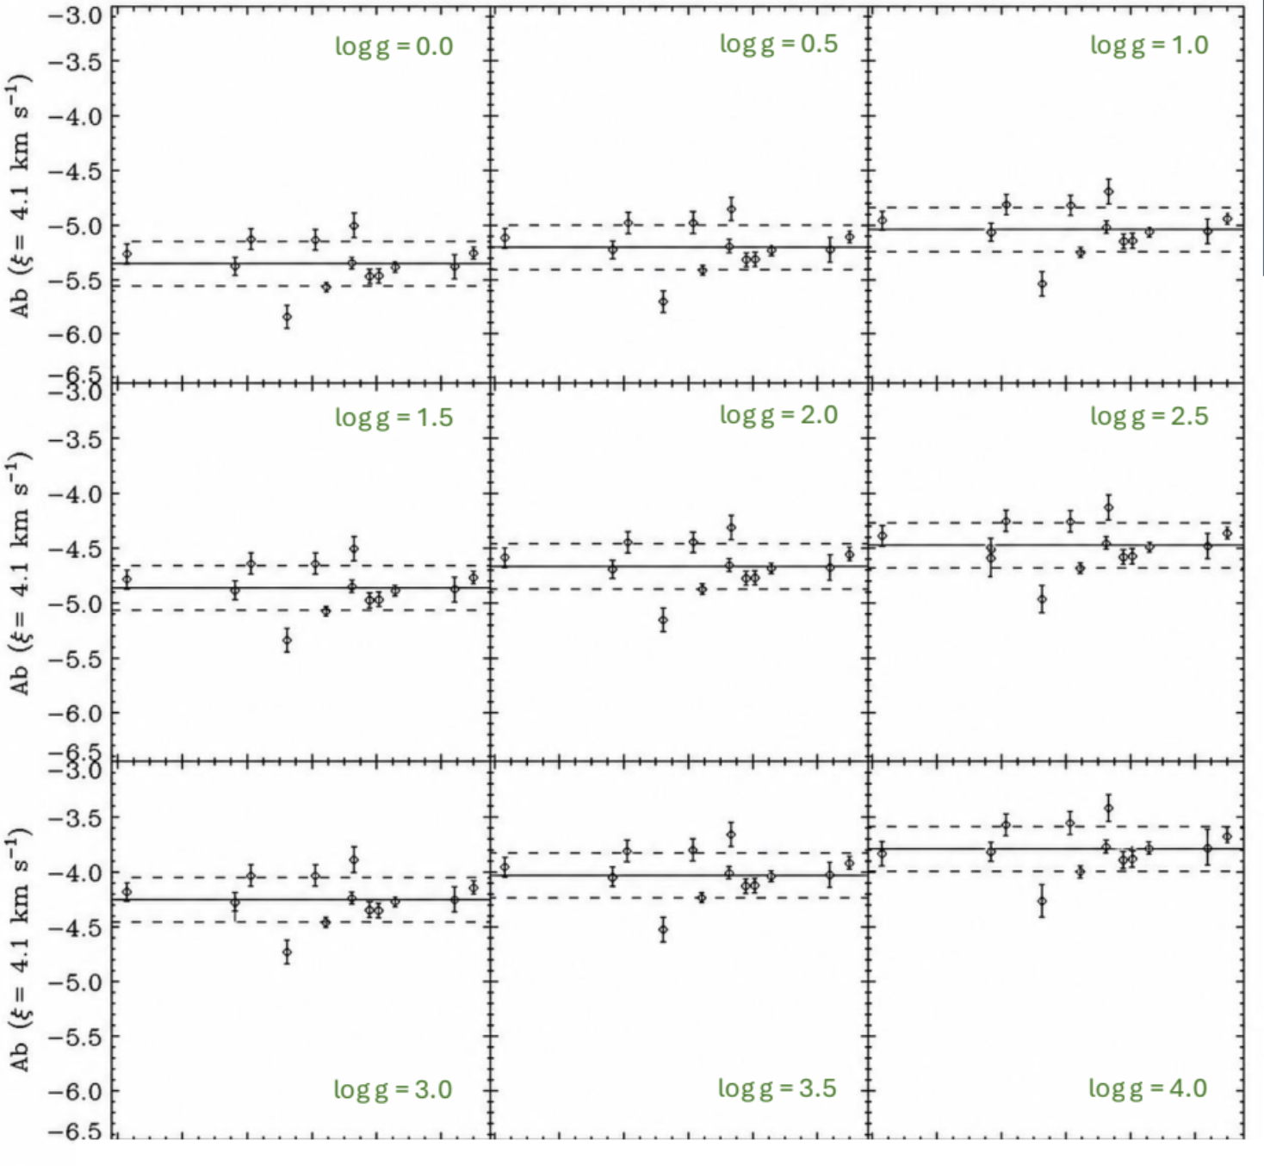
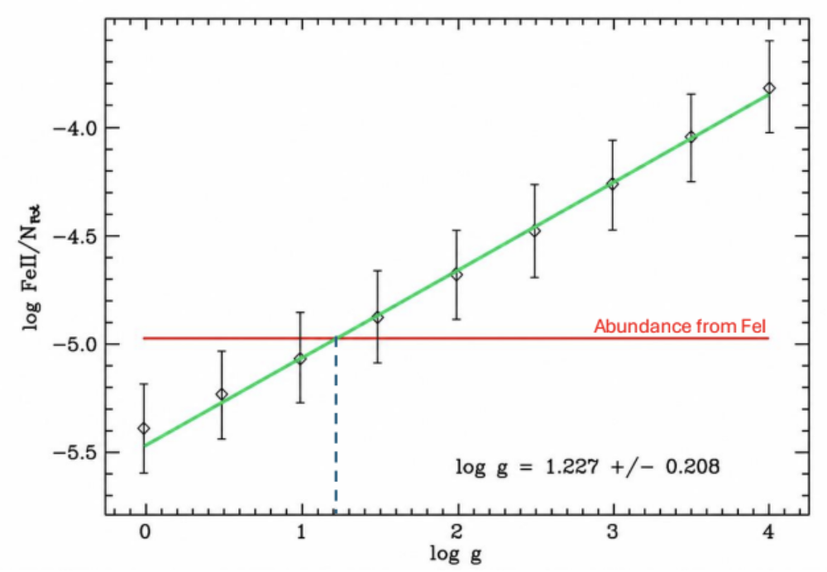
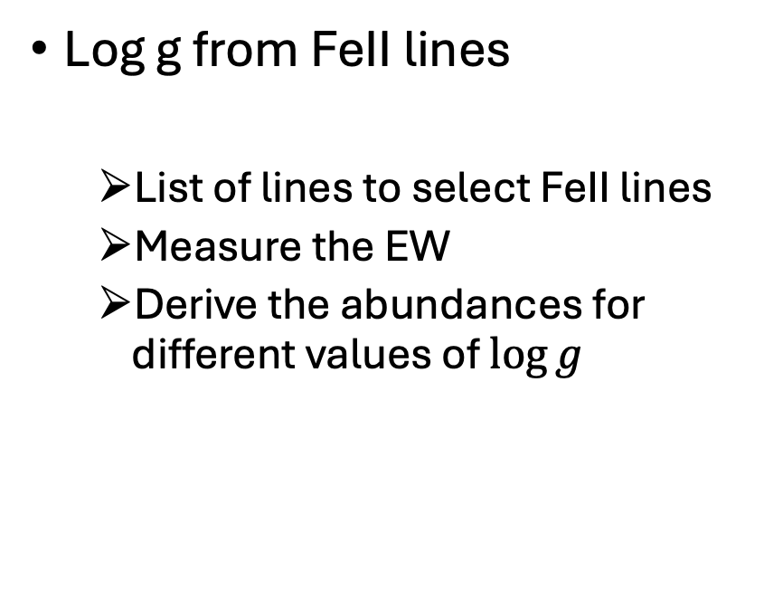
THE SPECTRAL SYNTHESIS
Log g from FeII lines
List of lines to select FeII lines
Measure the EW
Derive the abundances for different values of $\log{g}$
Notes:
Surface gravity is mainly constrained using Fe II lines.
Ionized lines are more sensitive to gravity than neutral lines.
By requiring agreement between Fe I and Fe II abundances, we can estimate log g.
This method is known as ionization equilibrium.
It is one of the classical spectroscopic diagnostics used in stellar atmosphere analysis.

Slide 30
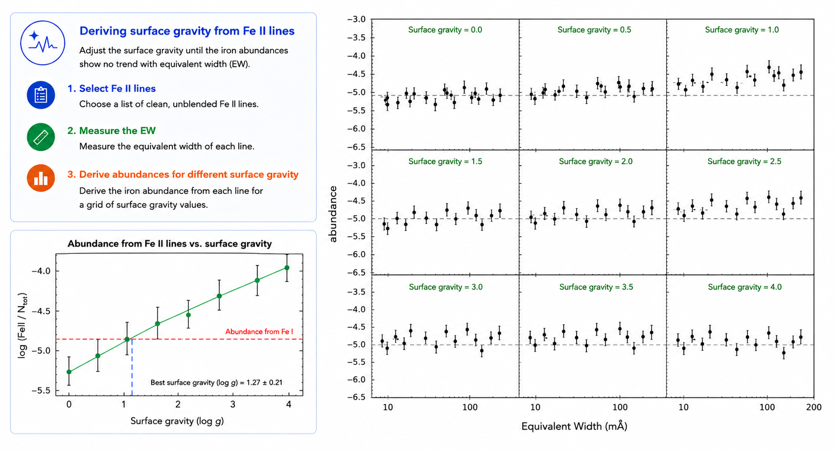
THE SPECTRAL SYNTHESIS
Notes:
Microturbulence is another key parameter.
Physically, it represents unresolved small-scale motions in the stellar atmosphere.
If microturbulence is not properly accounted for, strong lines and weak lines will give inconsistent abundances.
Therefore, we determine the microturbulent velocity by minimizing abundance trends with equivalent width.
Again, this is an iterative process.
Although microturbulence may sound like a technical detail, it has a significant impact on high-precision abundance analysis

Slide 31
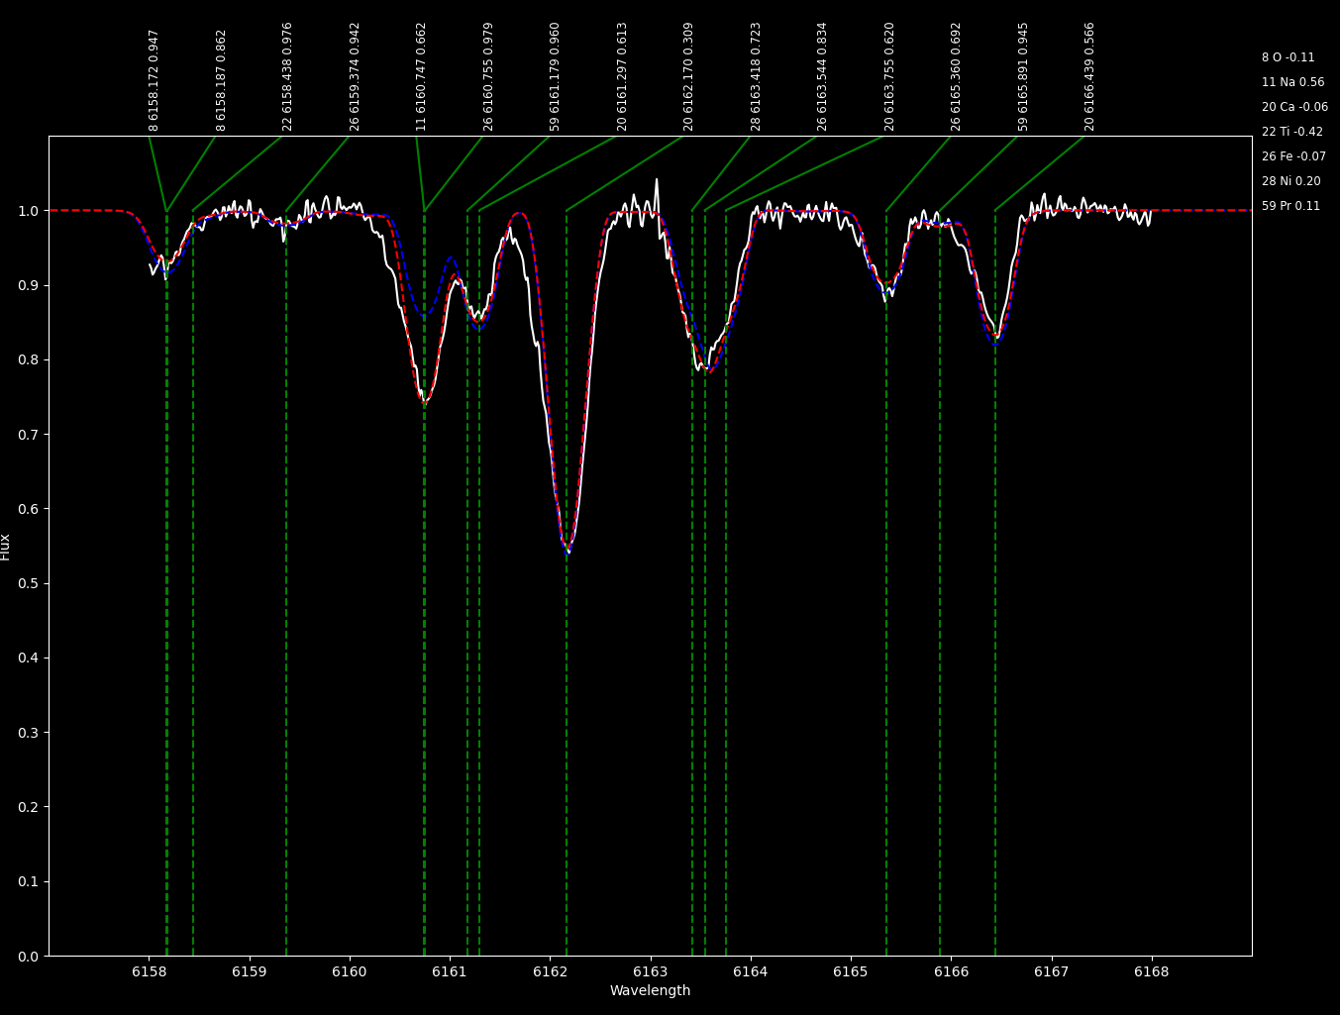
THE SPECTRAL SYNTHESIS
Chemical pattern through spectral synthesis
Compare the observed spectrum with synthetic spectra
Adjust elemental abundances until the line profiles match*
Notes:
Once the stellar parameters are determined, we can derive the chemical pattern of the star.
This means measuring abundances for many different elements.
Chemical patterns provide crucial information about:
stellar evolution,
nucleosynthesis,
and galactic chemical evolution.
For example:
alpha-elements trace core-collapse supernovae,
iron-peak elements trace Type Ia supernovae,
and neutron-capture elements trace more exotic enrichment channels.

Slide 32
THE SPECTRAL SYNTHESIS
Iron independent of period
Type II Cepheid-specific consistency checks
Parameters depend on period

Slide 33
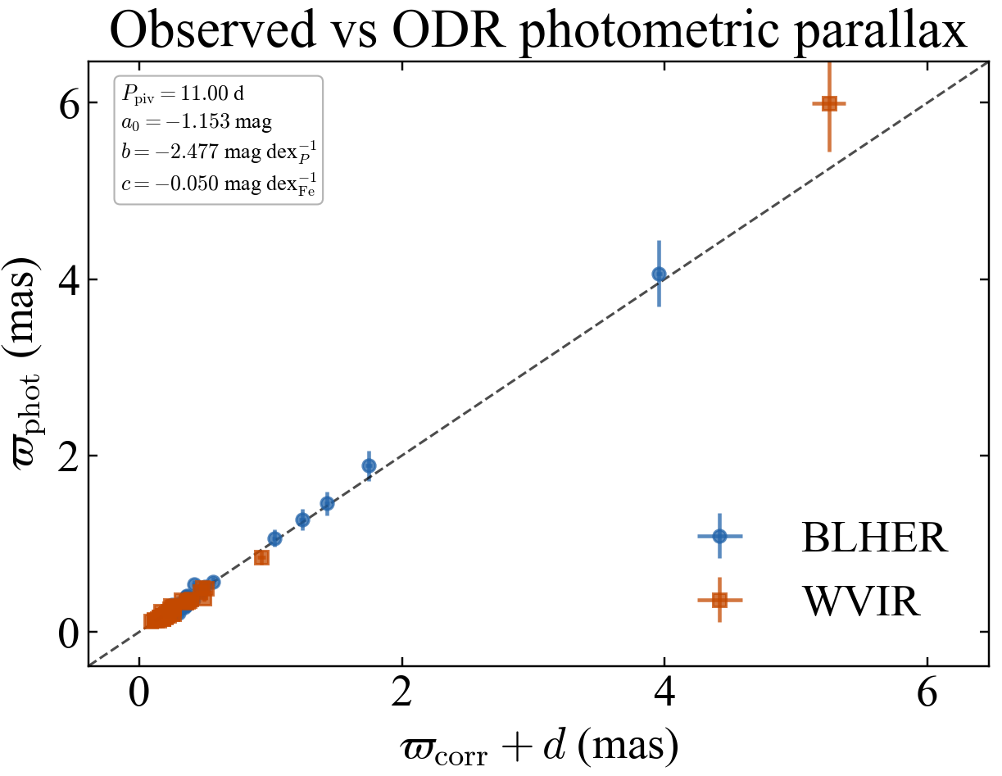

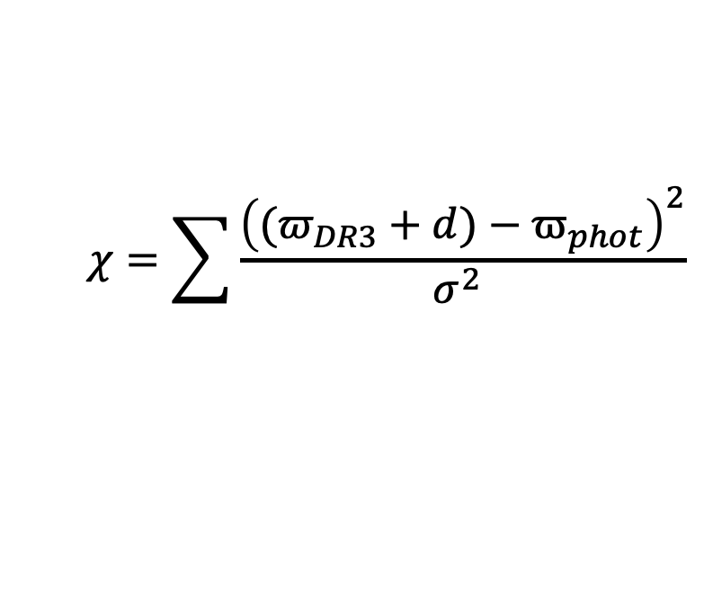

PRELIMINARY RESULTS ON TYPE II CEPHEIDS
$$ϖ_{phot}\text{= }{\text{10}}^{\text{−0.2(}\text{w}\text{−}\text{W}\text{−10)}}$$
$$W=a+b⋅\log{P}+c⋅[Fe/H]$$
$$χ=\sum{\frac{{\left((π_{DR3}+d)−ϖ_{phot}\right)}^{2}}{σ^{2} }}$$

Slide 34
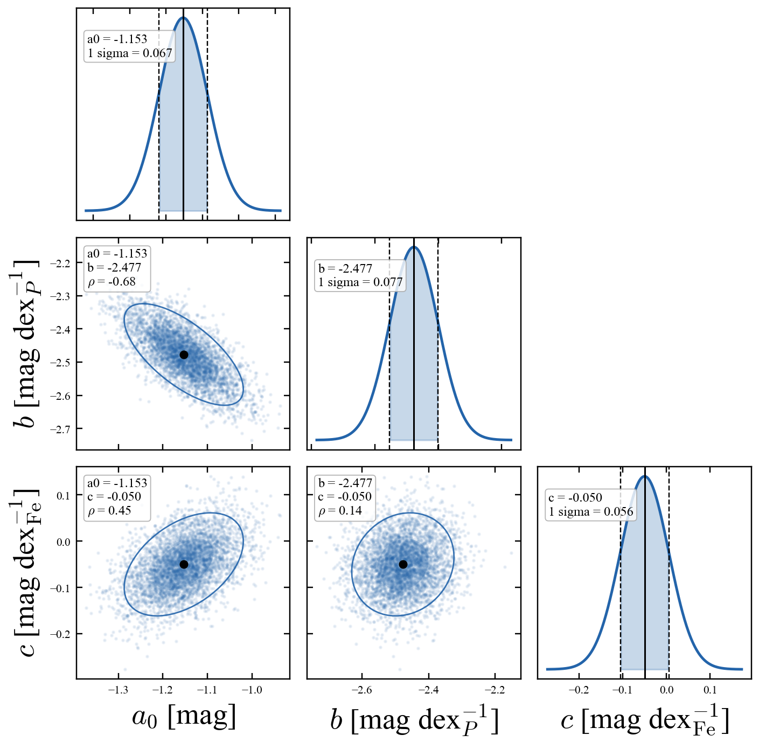
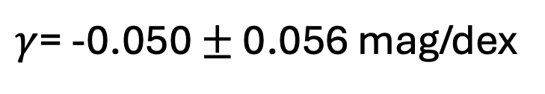
PRELIMINARY RESULTS ON TYPE II CEPHEIDS
$γ$= -0.050 $±$ 0.056 mag/dex

Slide 35
TAKE HOME MESSAGES
Spectra contain information about the stellar atmospheric composition.
Every choice made during the analysis process can introduce systematic effects.
The curve of growth links stellar parameters to the EW.
Spectral synthesis fits the entire line profile.
A good standard candle should be affected by as few systematics as possible.

Slide 36

Thank you for your attention!
teresa.sicignano@inaf.it

Slide 37
BACKUP SLIDES

Slide 38
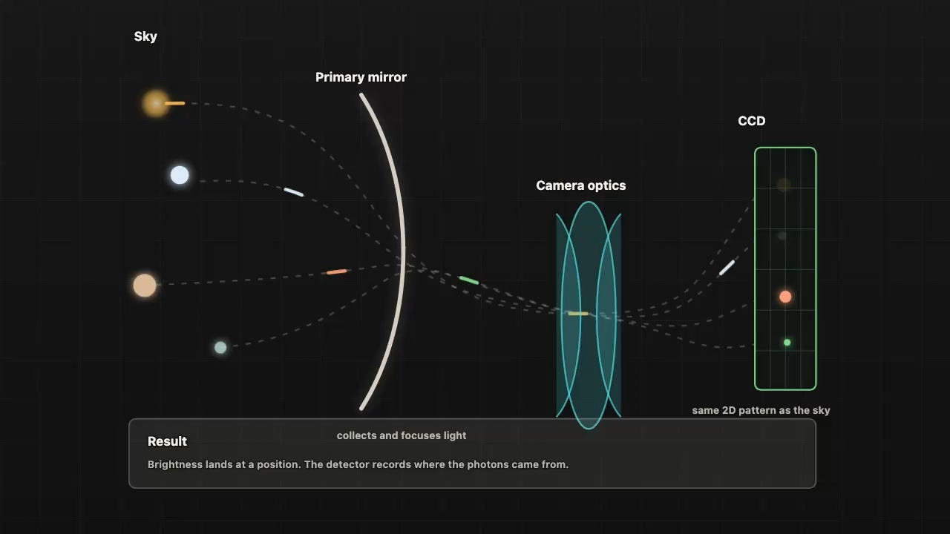
SPECTRUM VS IMAGE
Notes:
When we observe the sky with a telescope, we can obtain two types of information.
The first is an image.
An image tells us where objects are located and how bright they are, that means with an image we don’t lose the spatial information.

Slide 39
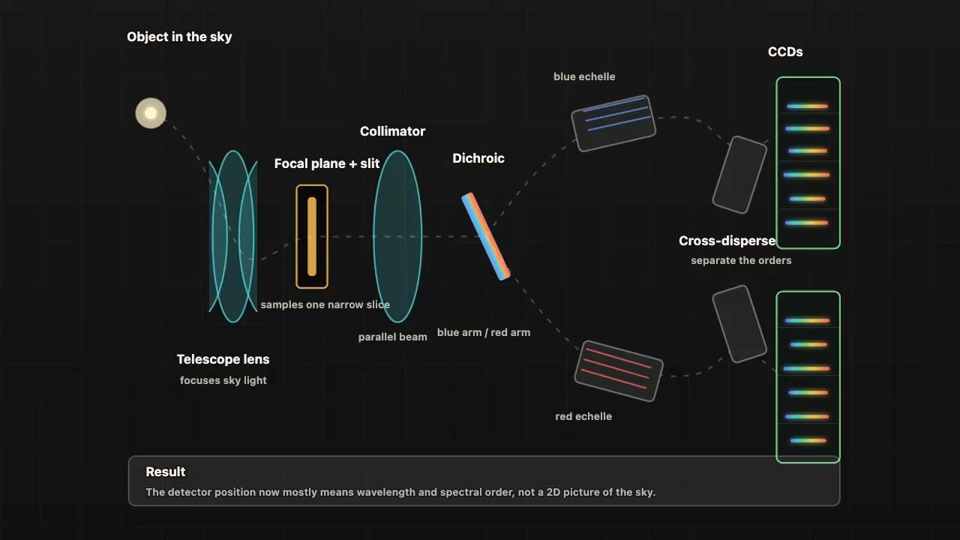
SPECTRUM VS IMAGE
Notes:
But if we disperse the light through a spectrograph, we obtain a spectrum.
A spectrum is much more powerful because it contains physical information encoded in the distribution of light as a function of wavelength.
Instead of just seeing a star as a point of light, spectroscopy allows us to investigate its atmosphere.
In other words, imaging tells us ‘where’, while spectroscopy tells us ‘what’ and ‘how’.
This is why spectroscopy is one of the most important tools in astrophysics.

Slide 40
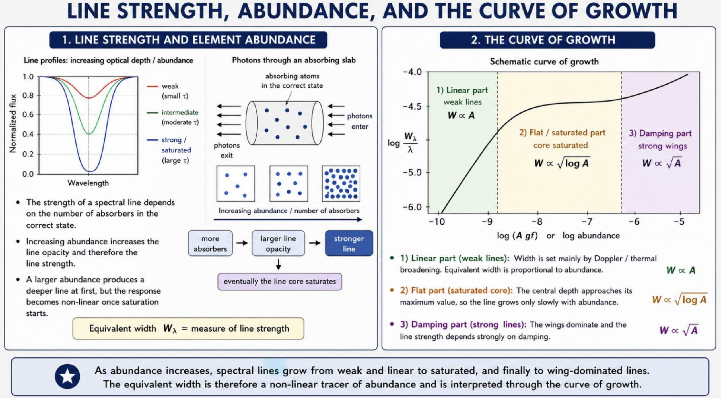

Slide 41
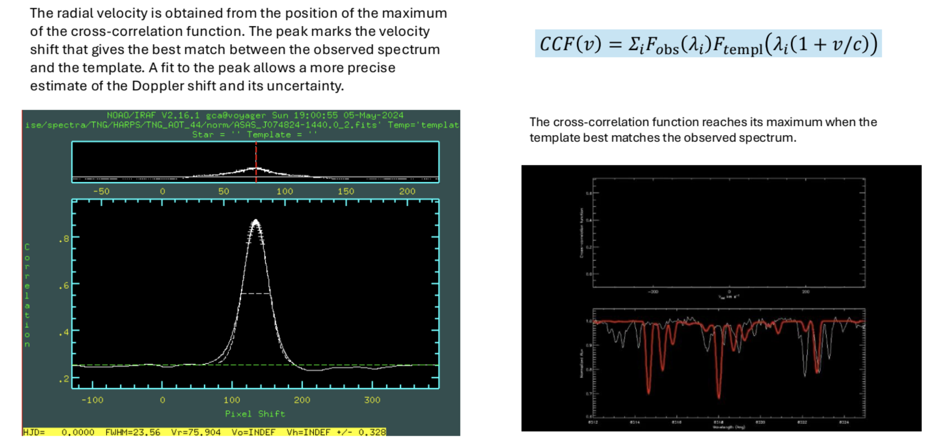
Radial velocity from cross correlation function
Notes:
One important step in spectral synthesis is the determination of radial velocity.
This is often done through cross-correlation techniques.
The observed spectrum is compared with a template spectrum. The shift that maximizes the correlation gives the radial velocity.
This method is robust and widely used in stellar spectroscopy

