Slide 1


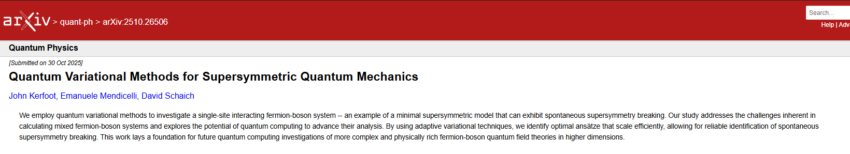
Quantum Variational Methods for Supersymmetric Quantum Mechanics
John Kerfoot

Slide 2
Presentation Outline
  Quantum computing crash course
  Supersymmetric Quantum Mechanics
  Digitization & Mapping
  Variational Quantum Eigensolver (VQE)
  Choosing a suitable ansatz & optimizer
  Adaptive-VQE (AVQE)
  Variational Quantum Deflation (VQD)

Slide 3
Quantum Computing
Crash Course

Slide 4
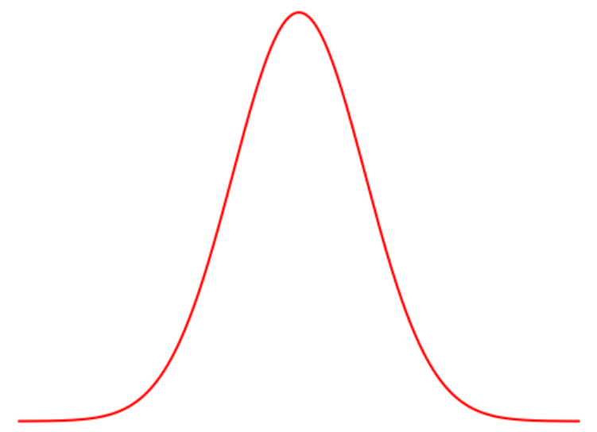
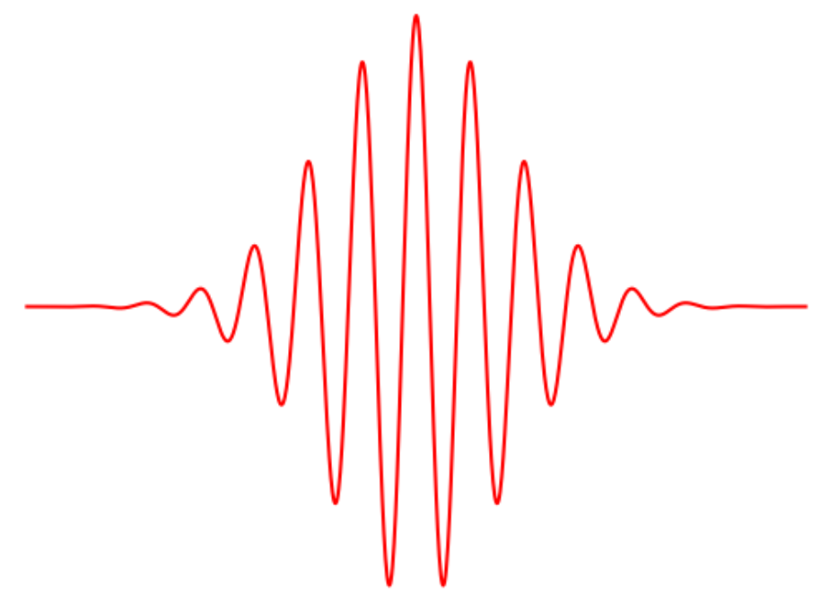
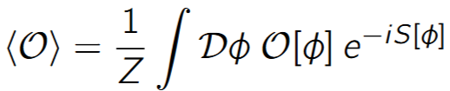
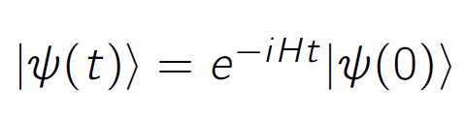

Why Quantum Computing for Lattice?
Sign problem
Quantum computers → Real time evolution
→ Pauli decomposition
Quantum devices offer native ways of simulating fermions/bosons
  Transmon → Fermions
  Continuous Variable → Bosons
Notes:
In lattice simulations of quantum field theories we often use MC importance sampling
Often suffer from sign problems, especially in real-time dynamics - action becomes iS
Main aim is not to probe new physics with these simulations but more so to begin testing the VQAs for QFT
SUSY exhibits the sign problem at low dimensions while still having interesting physics 1+1D still suffers from sign problem and still exhibits susy breaking

Slide 5
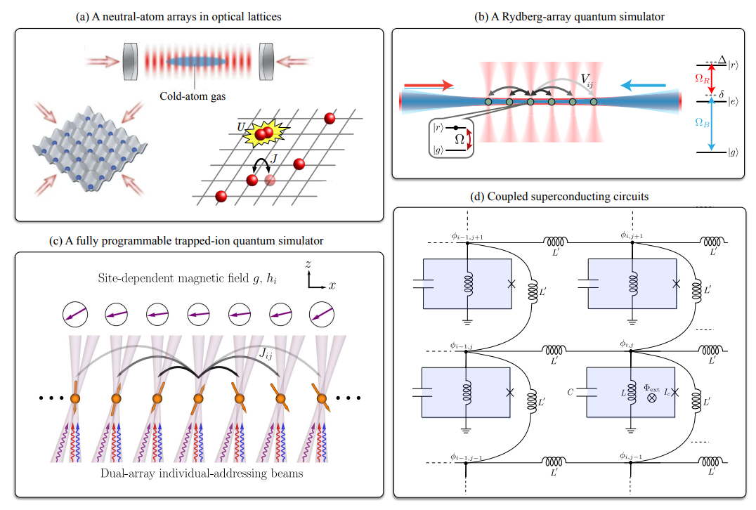
Quantum
Devices
Notes:
- trap cold atoms in optical lattice using interference patterns from lasers – 2 long lived energy states, us gates
- rhyberg high excited state – qubits interact weakly = long coherence times, us gates
- charged atoms held in place with EM field and controlled with lasers – good coherence times but slow gate operations, us gates
-

Slide 6
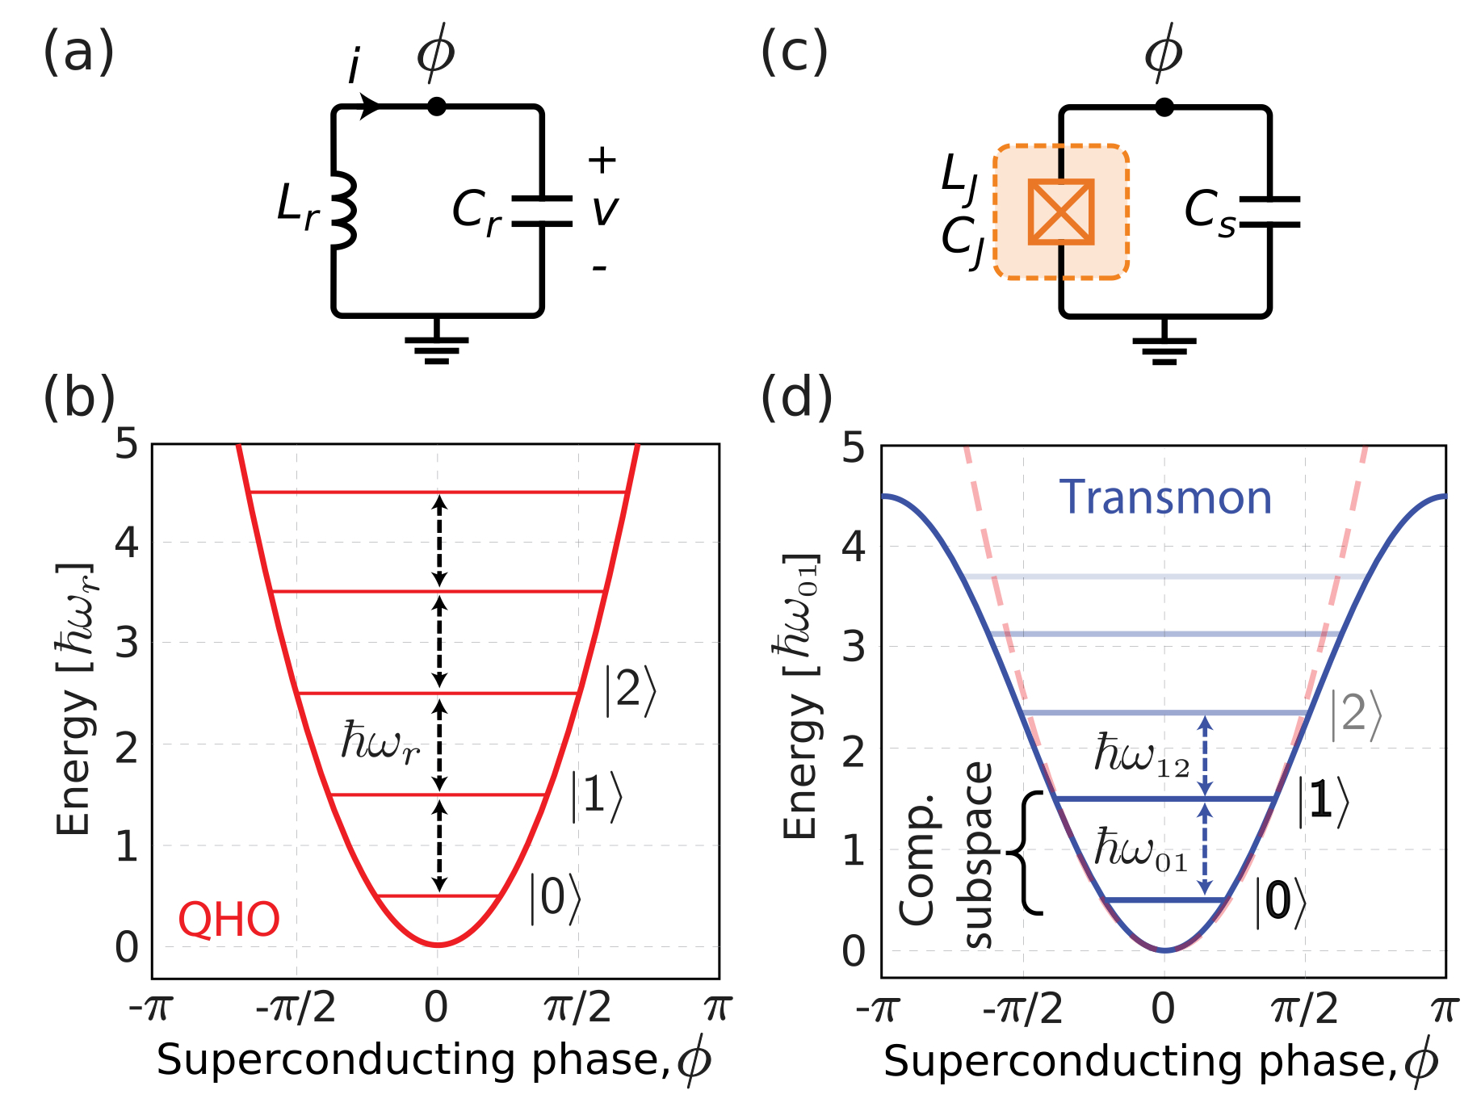
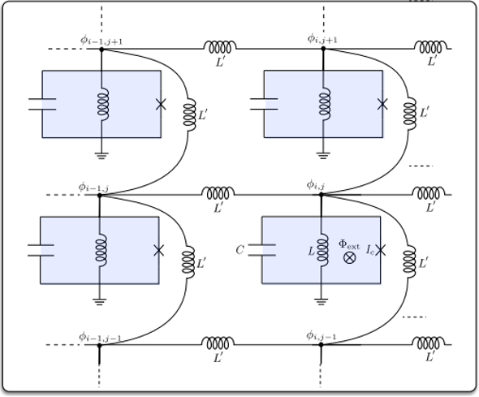
Quantum Devices – Superconducting Qubit
Non-linear Josephson junction
Notes:
JJ – 2 superconductors separated by a thin isulator

Slide 7
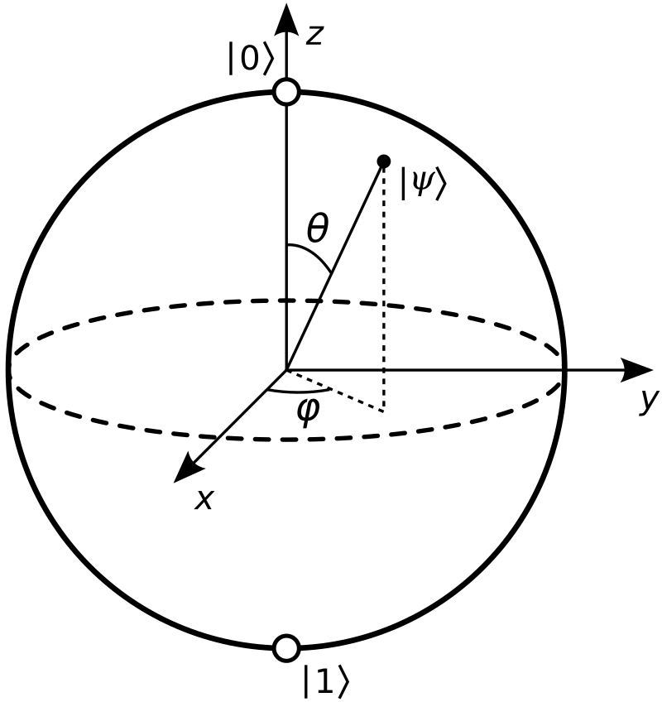
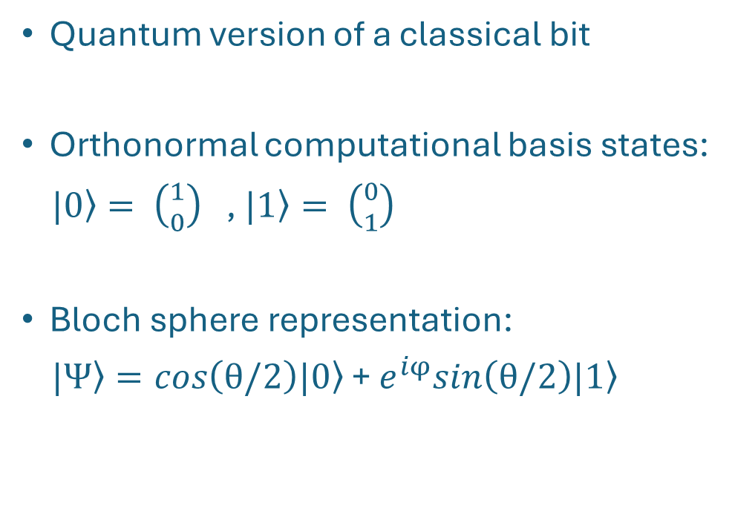
What is a Qubit?
Quantum version of a classical bit
Orthonormal computational basis states:
$\left.|0\right\rangle = \left({1 \atop 0}\right)$ ,$\left. |1\right\rangle = \left({0 \atop 1}\right)$
Bloch sphere representation:
$\left.|Ψ\right\rangle =cos\left(θ/2\right)\left.|0\right\rangle$ + $e^{iφ}sin\left(θ/2\right)\left.|1\right\rangle$

Slide 8
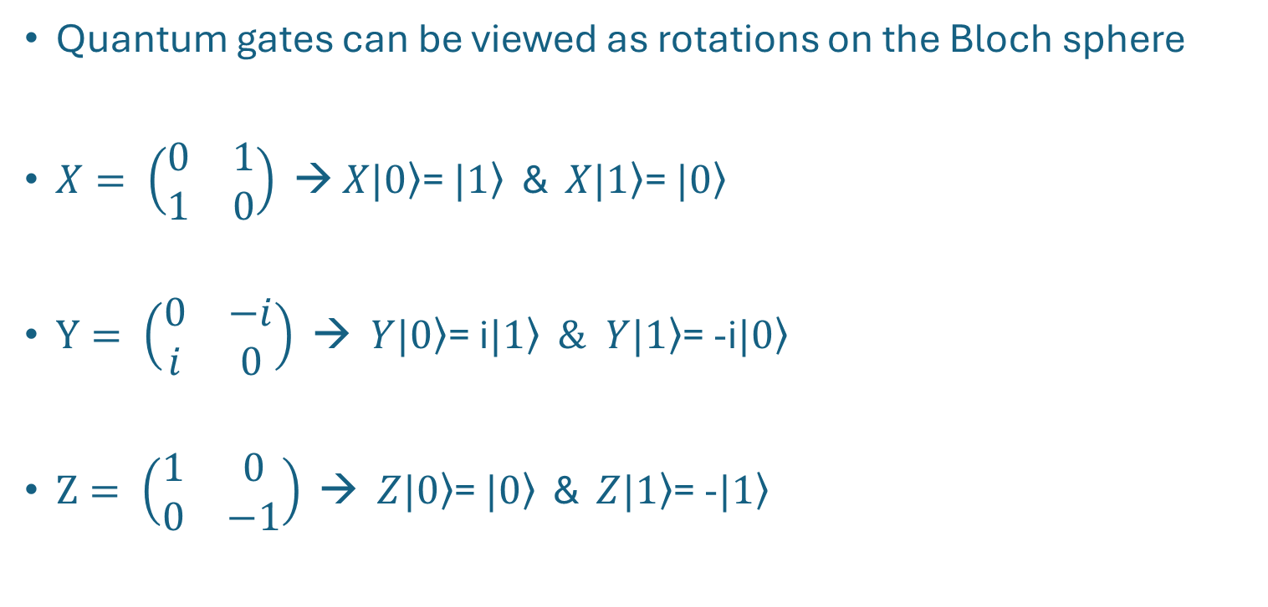
Quantum Gates – Pauli Gates
Quantum gates can be viewed as rotations on the Bloch sphere
$X= \left(\begin{matrix}0 & 1 \\ 1 & 0\end{matrix}\right)$ → $X\left.|0\right\rangle$= $\left.|1\right\rangle$ & $X\left.|1\right\rangle$= $\left.|0\right\rangle$
$Y= \left(\begin{matrix}0 & −i \\ i & 0\end{matrix}\right)$ → $Y\left.|0\right\rangle$= i$\left.|1\right\rangle$ $\& Y\left.|1\right\rangle$= -i$\left.|0\right\rangle$
$Z= \left(\begin{matrix}1 & 0 \\ 0 & −1\end{matrix}\right)$ → $Z\left.|0\right\rangle$= $\left.|0\right\rangle$ & $Z\left.|1\right\rangle$= -$\left.|1\right\rangle$

Slide 9
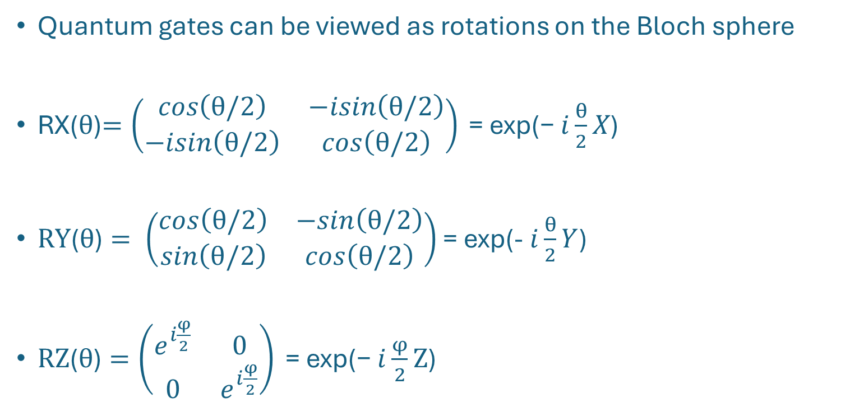
Quantum Gates – Pauli Rotation Gates
Quantum gates can be viewed as rotations on the Bloch sphere
RX($θ$)$=\left(\begin{matrix}cos\left(θ/2\right) & −isin\left(θ/2\right) \\ −isin\left(θ/2\right) & cos\left(θ/2\right)\end{matrix}\right)\text{ = }\text{exp}\text{(− }i\frac{θ}{2}X\text{)}$
$RY\text{(}θ\text{)}= \left(\begin{matrix}cos\left(θ/2\right) & −sin\left(θ/2\right) \\ sin\left(θ/2\right) & cos\left(θ/2\right)\end{matrix}\right)$ = exp(- $i\frac{θ}{2}Y$)
$RZ\text{(}θ\text{)}=\left(\begin{matrix}e^{i\frac{φ}{2}} & 0 \\ 0 & e^{i\frac{φ}{2}}\end{matrix}\right)\text{ = }\text{exp}\text{(− }i\frac{φ}{2}\text{Z}\text{)}$

Slide 10
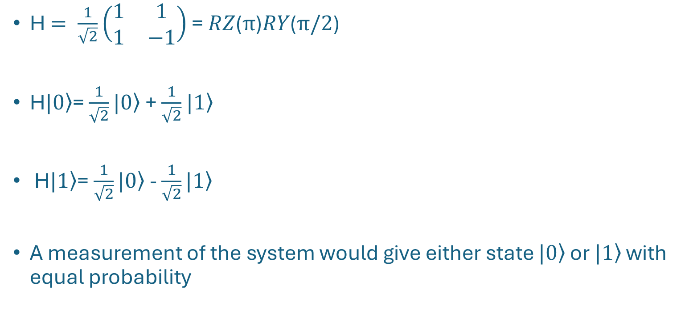
Quantum Gates – Hadamard Gate
H $= \frac{1}{\sqrt{2}}\left(\begin{matrix}1 & 1 \\ 1 & −1\end{matrix}\right)$ = $RZ\text{(}π\text{)}RY\text{(}π/2\text{)}$
H$\left.|0\right\rangle$= $\frac{1}{\sqrt{2}}\left.|0\right\rangle$ + $\frac{1}{\sqrt{2}}$ $\left.|1\right\rangle$
H$\left.|1\right\rangle$= $\frac{1}{\sqrt{2}}\left.|0\right\rangle$ - $\frac{1}{\sqrt{2}}\left.|1\right\rangle$
A measurement of the system would give either state $\left.|0\right\rangle$ or $\left.|1\right\rangle$ with equal probability

Slide 11
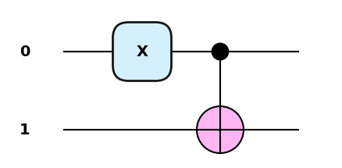
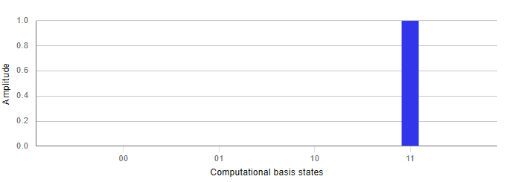

Quantum Gates – Controlled Gates
2 qubit gate with one control qubit and one target qubit
If the control is in $\left.|0\right\rangle$ then the gate on the target does not act
If the control is in $\left.|1\right\rangle$ then the target gate will act on the target qubit

Slide 12
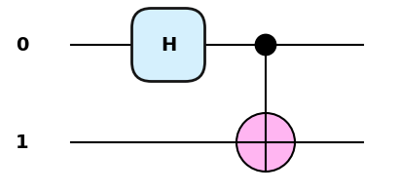
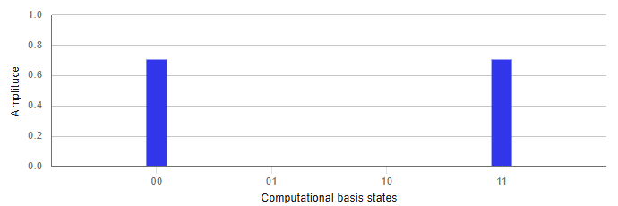
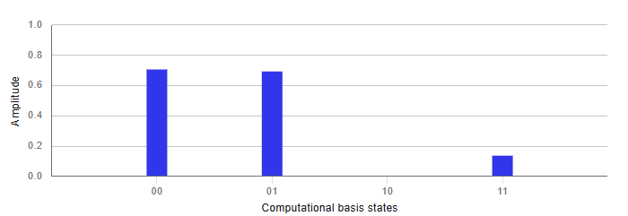
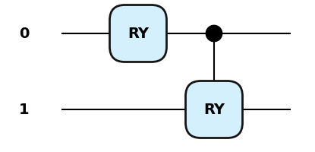
Quantum Gates – Controlled Gates

Slide 13
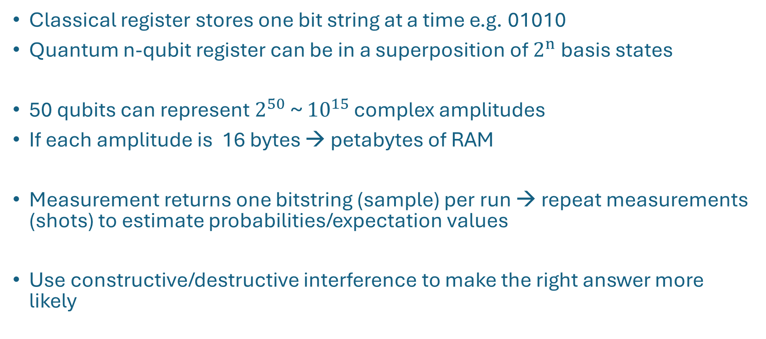
The Power of Quantum Computing
Classical register stores one bit string at a time e.g. 01010
Quantum n-qubit register can be in a superposition of $2^{n}$basis states
50 qubits can represent $2^{50}$~ ${10}^{15}$ complex amplitudes
If each amplitude is 16 bytes → petabytes of RAM
Measurement returns one bitstring (sample) per run → repeat measurements (shots) to estimate probabilities/expectation values
Use constructive/destructive interference to make the right answer more likely

Slide 14
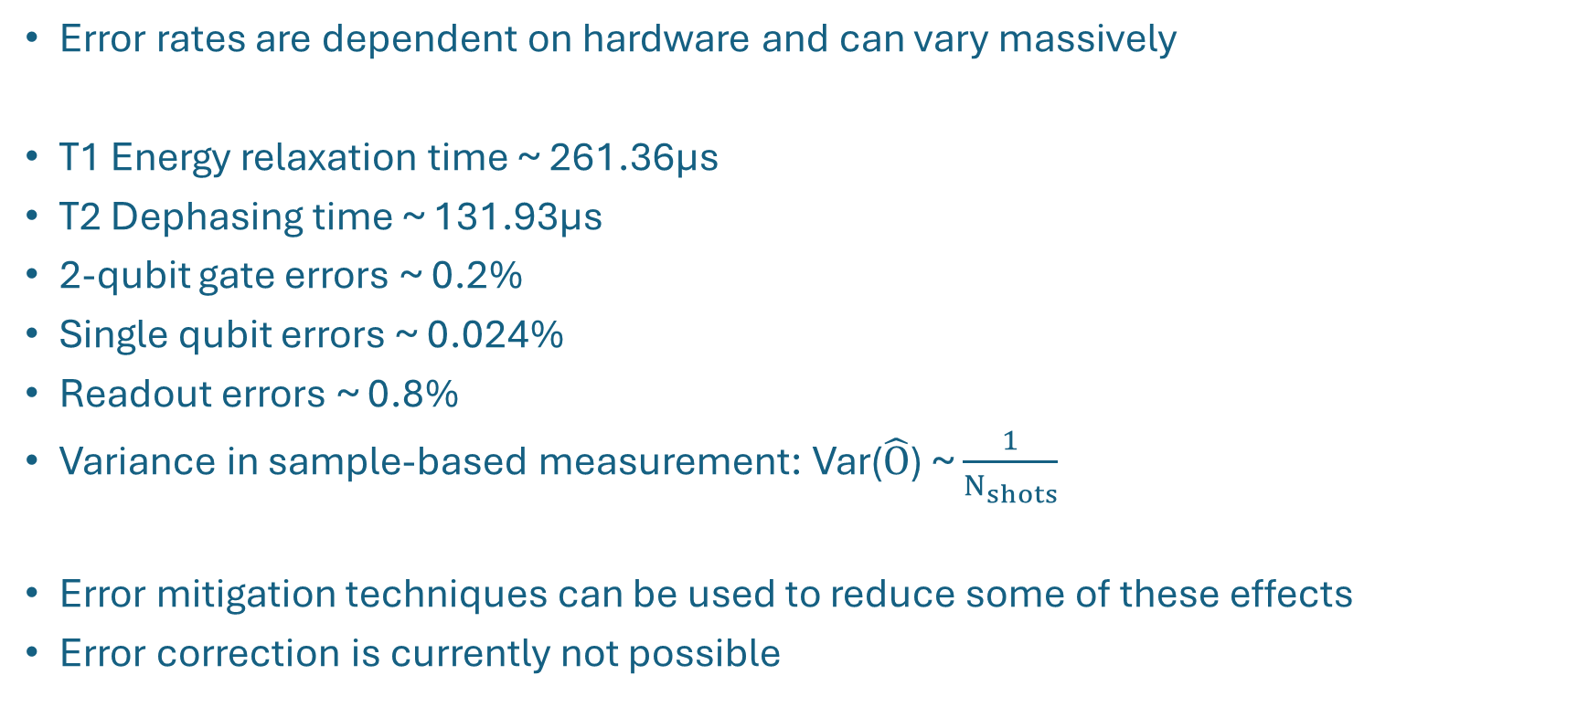
Quantum Computers are not Perfect
Error rates are dependent on hardware and can vary massively
T1 Energy relaxation time ~ 261.36μs
T2 Dephasing time ~ 131.93μs
2-qubit gate errors ~ 0.2%
Single qubit errors ~ 0.024%
Readout errors ~ 0.8%
Variance in sample-based measurement: Var($\hat{O}$) ~ $\frac{1}{N_{shots}}$
Error mitigation techniques can be used to reduce some of these effects
Error correction is currently not possible
*error rates taken for Ibm_Kingston device
Notes:
Gate times are in order of 50-100ns
Error Mitigations – ZNE, Dynamical Decoupling …

Slide 15
Supersymmetric Quantum Mechanics

Slide 16
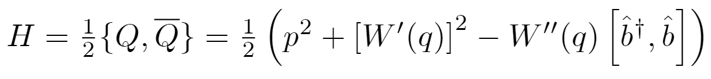


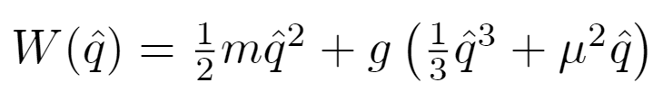
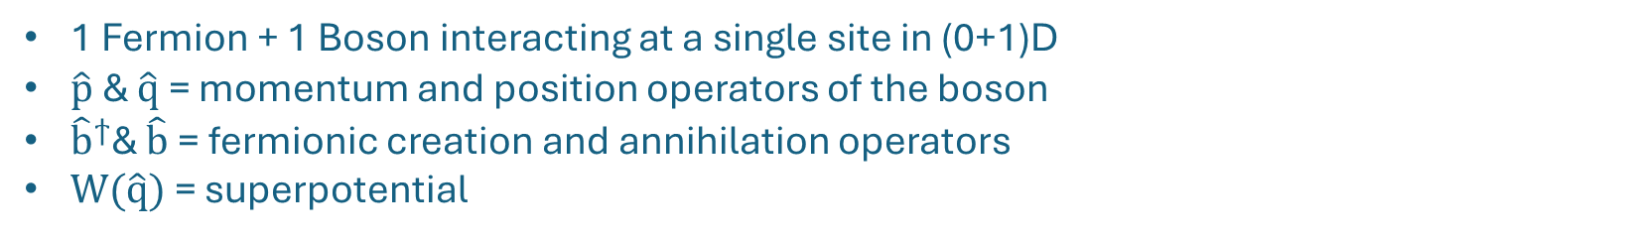
Supersymmetric Quantum Mechanics
1 Fermion + 1 Boson interacting at a single site in (0+1)D
$\hat{p}$ & $\hat{q}$ = momentum and position operators of the boson
${\hat{b}}^{ϯ}$& $\hat{b}$ = fermionic creation and annihilation operators
$W(\hat{q})$ = superpotential
Harmonic Oscillator
Anharmonic Oscillator
Double Well
Preserved supersymmetry
Preserved supersymmetry
Supersymmetry breaking

Slide 17
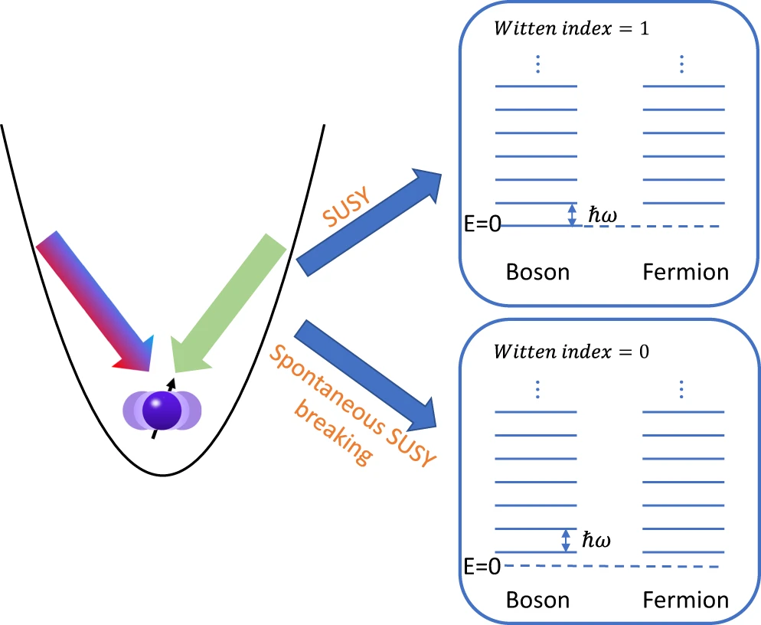
Supersymmetry Breaking
Preserved supersymmetry →
Single E=0 ground state with paired excited states
Supersymmetry breaking →
Degenerate states with ground state E > 0
Source: Du et al., Nature Communications, 2022, Figure 1, https://doi.org/10.1039/s41467-022-31058-0.
Notes:
In SUSY QM, nonzero-energy eigenstates always come in boson-fermion pairs (superpartners)
A zero-energy state with Q∣ψ⟩=Q†∣ψ⟩=0 cannot have a superpartner.
Bosons = Even F , Fermion odd
Δ – similar to partition function – when Δ=0 fermion-boson cancellations cause maximal sign problem (periodic fermion BCs)
The Witten index counts the net number of zero-energy states: bosons minus fermions. If Δ≠0 there must be at least one unpaired E=0 ground state.

Slide 18
Digitization and Mapping

Slide 19
Regularization
We need to map an infinite dimensional bosonic Hilbert space to a finite number of resources
Restrict the allowed bosonic modes by introducing a cutoff - Λ
Introducing Λ produces unphysical artifacts - need to take Λ → ∞
AHO
DW
QHO

Slide 20
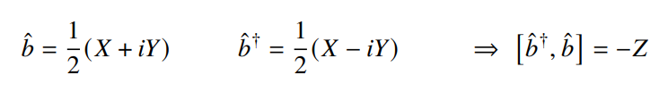
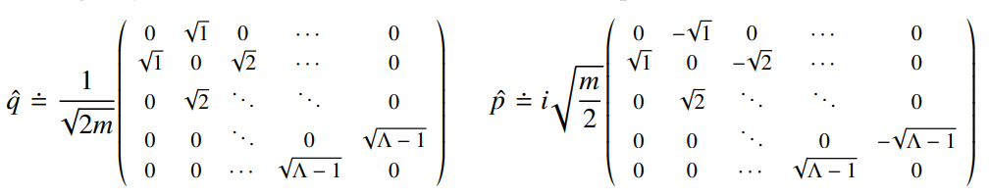
Digitisation and Mapping
Type | Mapping | Truncation | Num Qubits
Fermion | Jordan-Wigner | No | 1
Boson | Fock basis | Yes (Λ) | log₂(Λ)
Jordan-Wigner Mapping:
Fock basis:

Slide 21
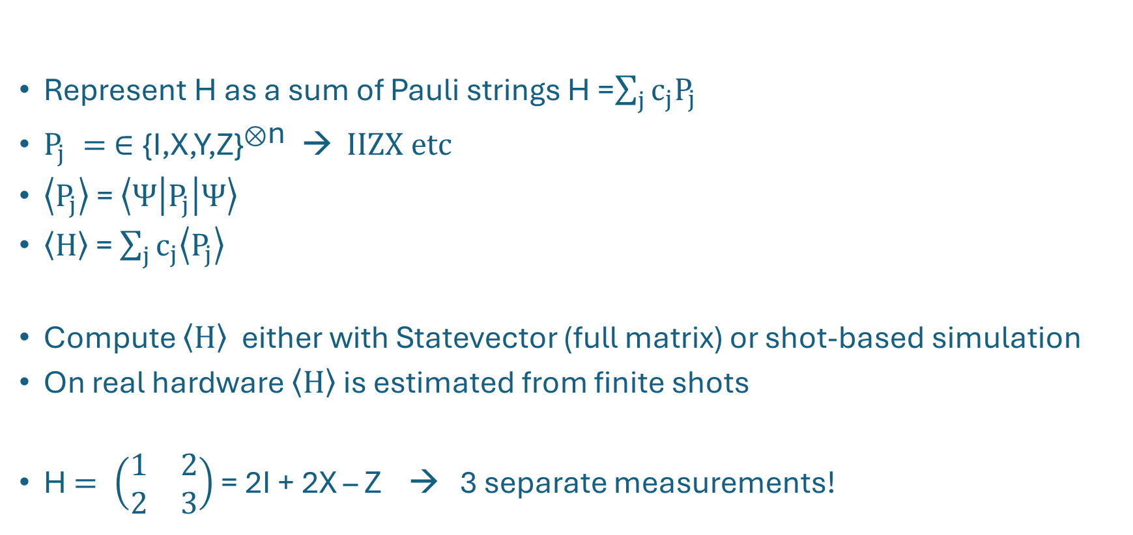
Pauli Decomposition
Represent H as a sum of Pauli strings H =$\sum_{j}{c_{j}P_{j}}$
$P_{j} = ∈{\text{\{}\text{I}\text{,}\text{X}\text{,}\text{Y}\text{,}\text{Z}\text{\}}}^{⊗\text{n}} \text{→} IIZX etc$
$\left\langle P_{j}\right\rangle$ = $\left\langle Ψ | P_{j} | Ψ\right\rangle$
$\left\langle H\right\rangle$ = $\sum_{j}{c_{j}\left\langle P_{j}\right\rangle }$
Compute $\left\langle H\right\rangle$ either with Statevector (full matrix) or shot-based simulation
On real hardware $\left\langle H\right\rangle$ is estimated from finite shots
H $= \left(\begin{matrix}1 & 2 \\ 2 & 3\end{matrix}\right)$ = 2I + 2X – Z → 3 separate measurements!

Slide 22
Resource scaling
Number of Pauli strings required to encode the Hamiltonian grows as we increase Λ=$2^{N−1}$
AHO
DW
QHO
Notes:
In our basis representation
Some coeffs are negligible
Paulis can be grouped before measurement

Slide 23
Variational Quantum Algorithms

Slide 24
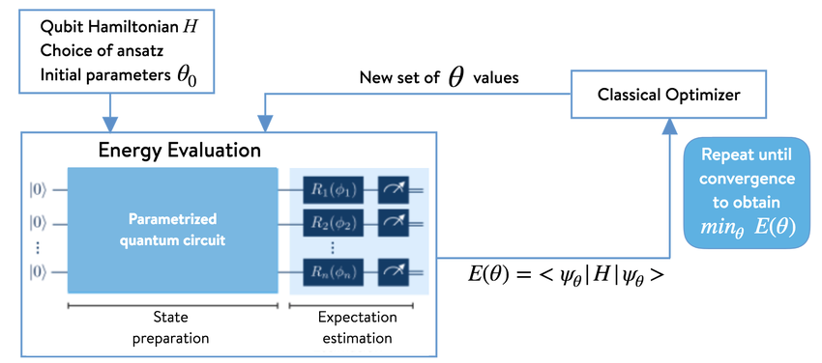


Variational Quantum Eigensolver (VQE)
Prepare ansatz
Measure
Using a classical optimizer, vary θ to minimize E(θ)
Repeat steps 2 and 3
Image source: 1QBit, OpenQEMIST Documentation, http://openqemist.1qbit.com/docs/vqe_microsoft_qsharp.html.
Notes:
Hybrid quantum-classical algorithm
Mention E can be calculated with/without shot noise - can have a big effect

Slide 25
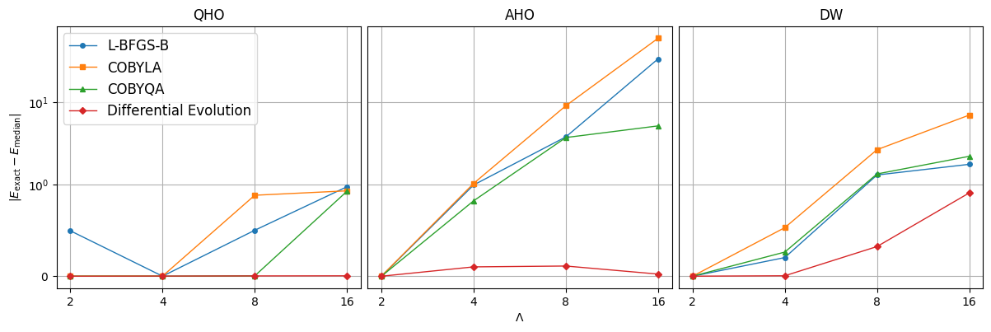
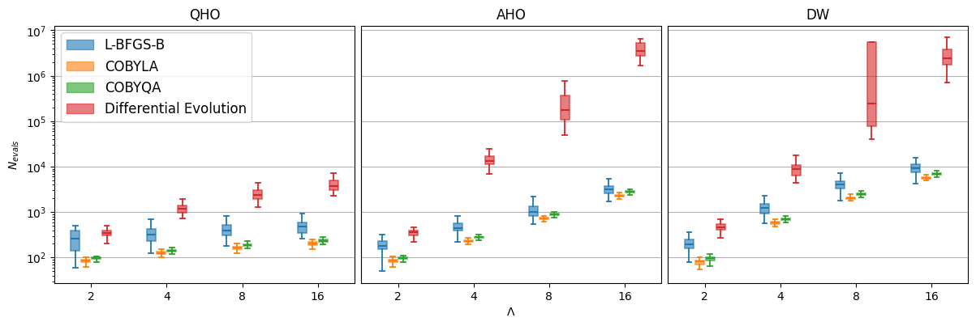
Choosing an Optimizer
100 VQE runs
Real Amplitudes ansatz
10,000 shots
PennyLane’s default.qubit simulator

Slide 26
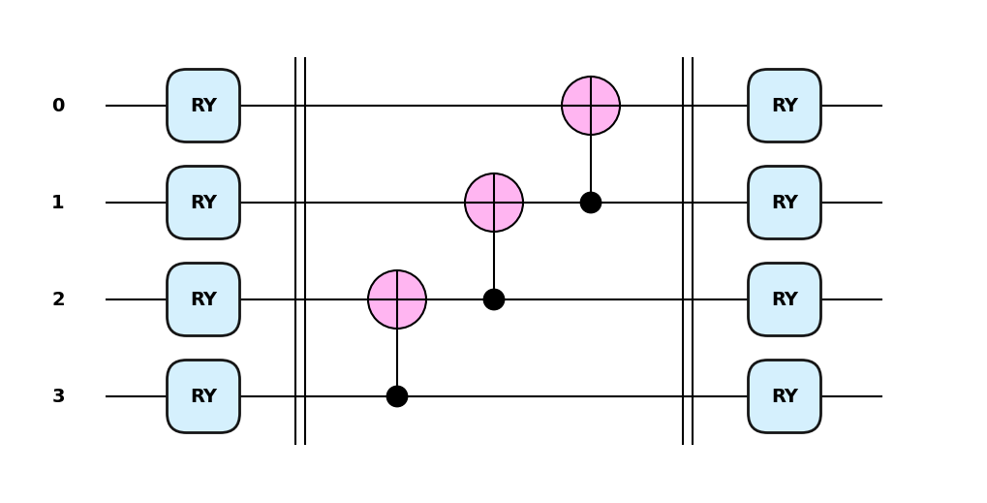
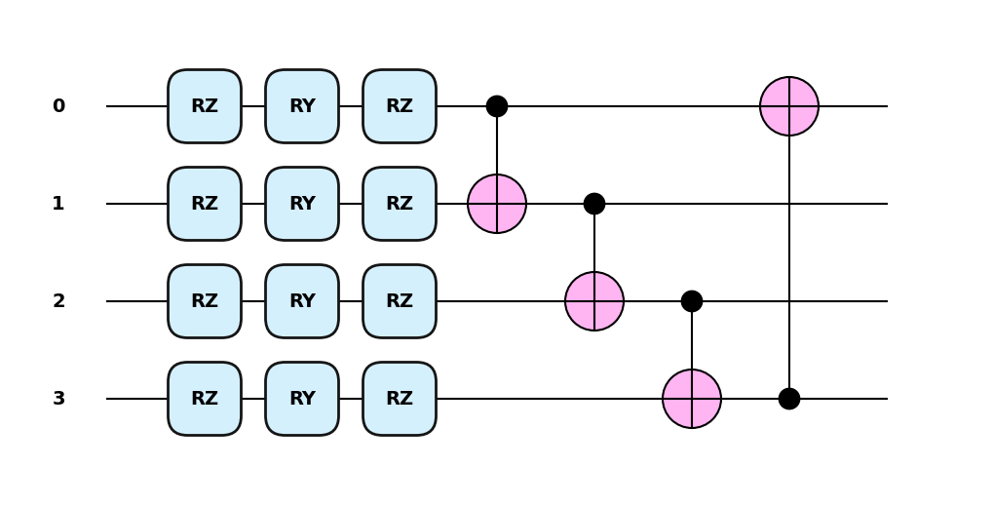
Choosing an Ansatz
Ansatz | Num Params | Num Entangling
Real Amplitudes | 2 x N | N - 1
Strongly Entangling Layers | 3 x N x L | N x L
More gates → more params → harder for optimiser to converge
Solution? → Adaptive-VQE!

Slide 27
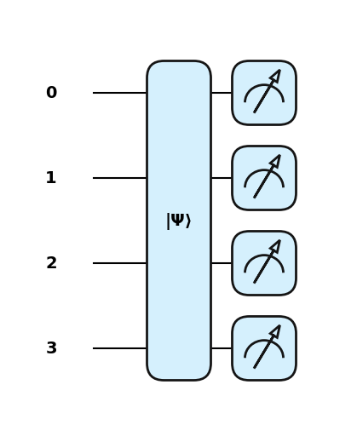
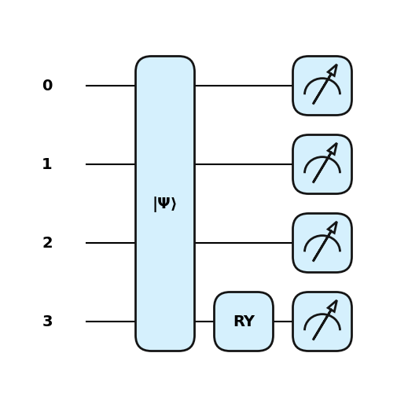
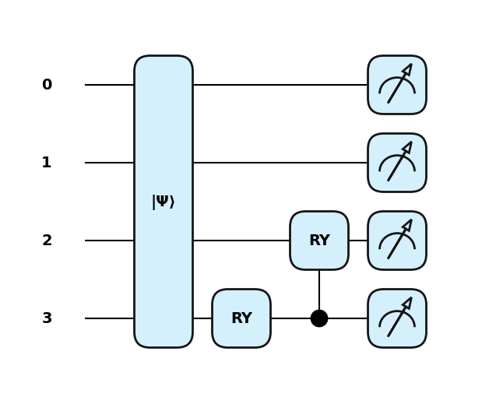
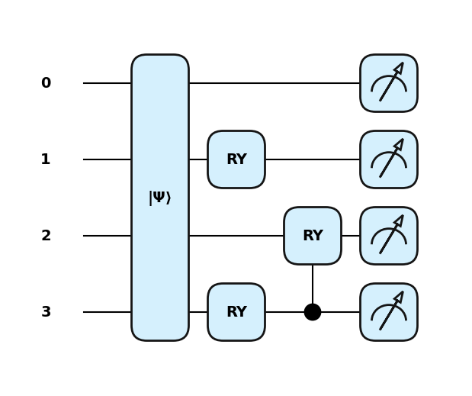
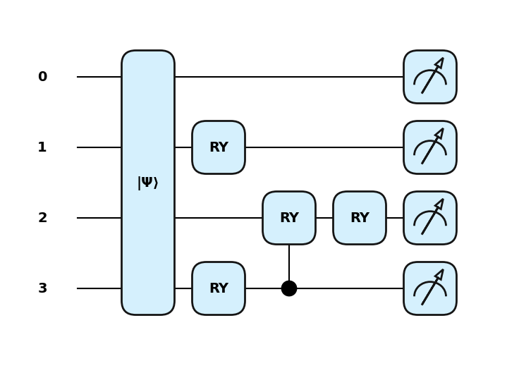



Adaptive-VQE Algorithm
Define an operator pool
Initialise ansatz state
While energy not converged
  For each operator in the pool acting on each qubit
    Measure the gradient of the expectation value of the Hamiltonian
  Add to the ansatz the operator that returns largest gradient
  Perform a VQE using the new ansatz
*Performed using statevector simulation

Slide 28
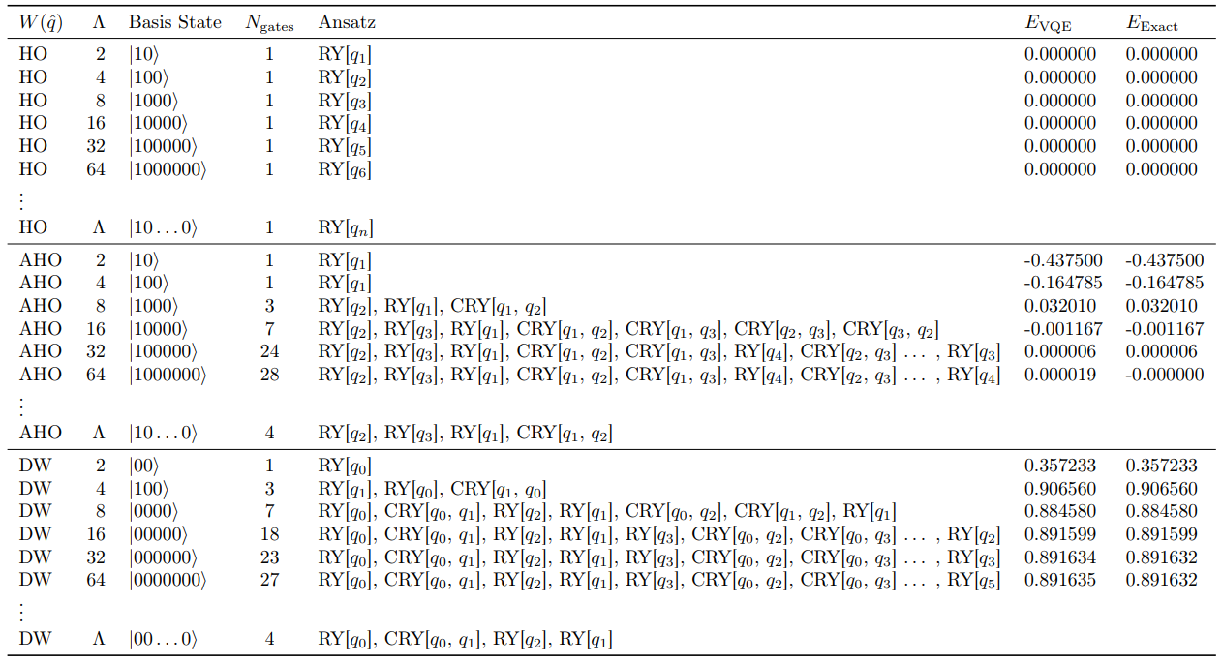
Adaptive-VQE Results

Slide 29
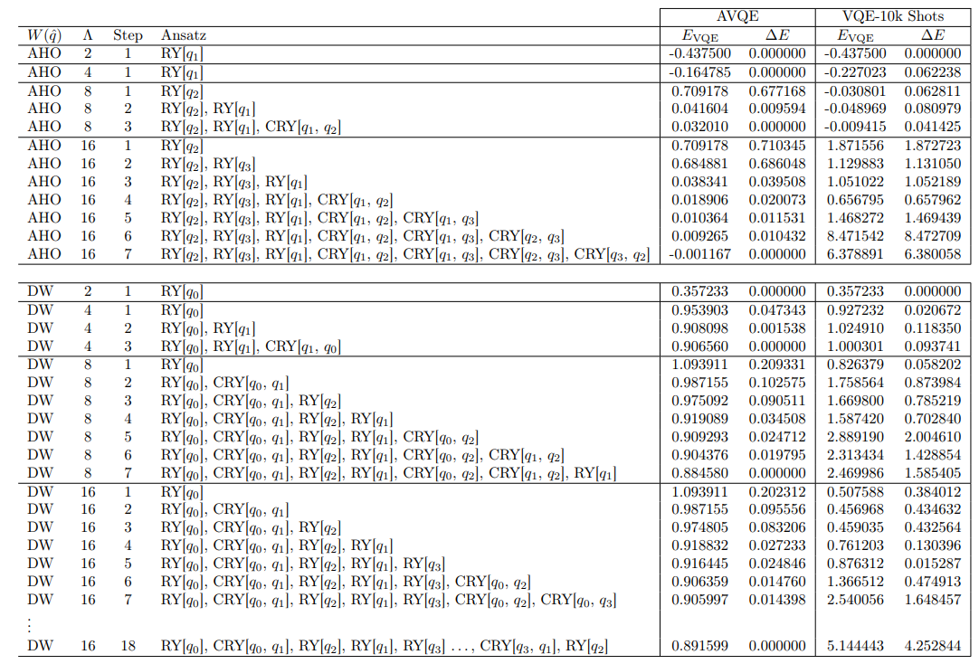
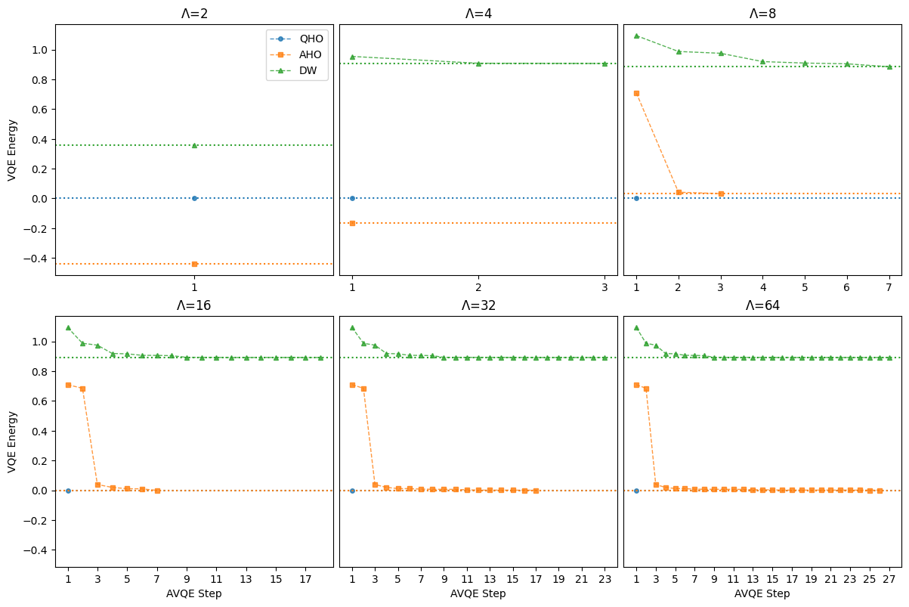
Adaptive-VQE Limitations
More gates → more shot noise
Optimizer struggling?

Slide 30
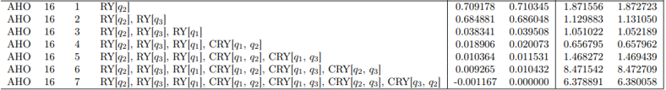
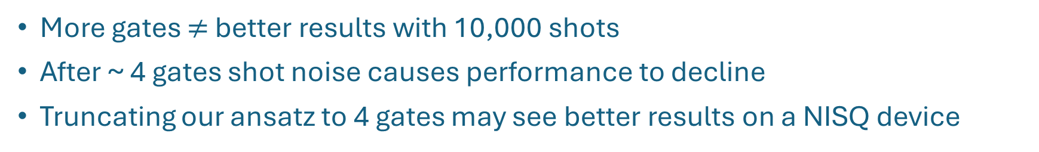
Adaptive-VQE Ansatz Truncation
More gates $≠$ better results with 10,000 shots
After ~ 4 gates shot noise causes performance to decline
Truncating our ansatz to 4 gates may see better results on a NISQ device

Slide 31
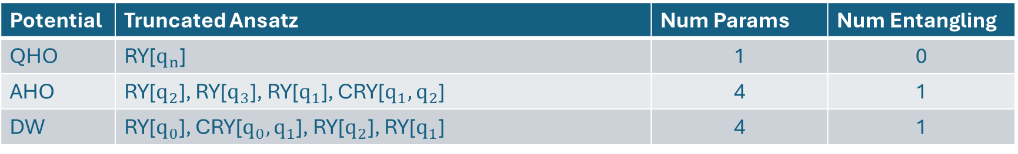
Adaptive – VQE Ansatz Resources
Potential | Truncated Ansatz | Num Params | Num Entangling
QHO | RY[$q_{n}$] | 1 | 0
AHO | RY[$q_{2}$], RY[$q_{3}$], RY[$q_{1}$], CRY[$q_{1},q_{2}$] | 4 | 1
DW | RY[$q_{0}$], CRY[$q_{0},q_{1}$], RY[$q_{2}$], RY[$q_{1}$] | 4 | 1
Ansatz | Num Params | Num Entangling
Real Amplitudes | 2 x N | N - 1
Strongly Entangling Layers | 3 x N x L | N x L
The number of parameters now remains constant with increasing cutoff!
$N=1+\log_{2}\left(Λ\right)$

Slide 32
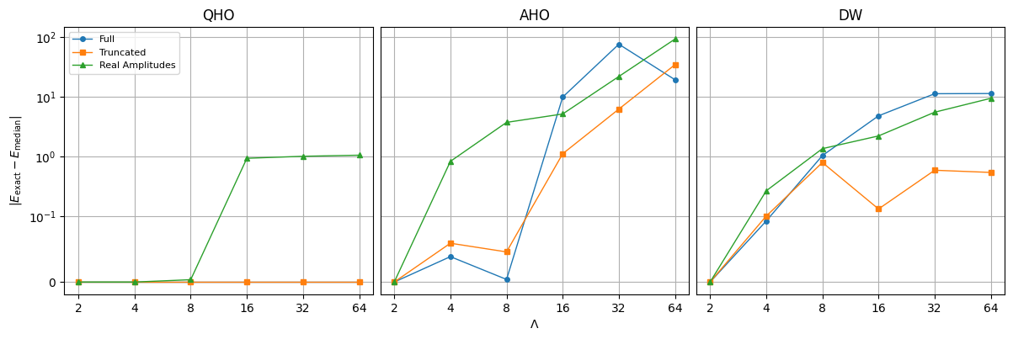
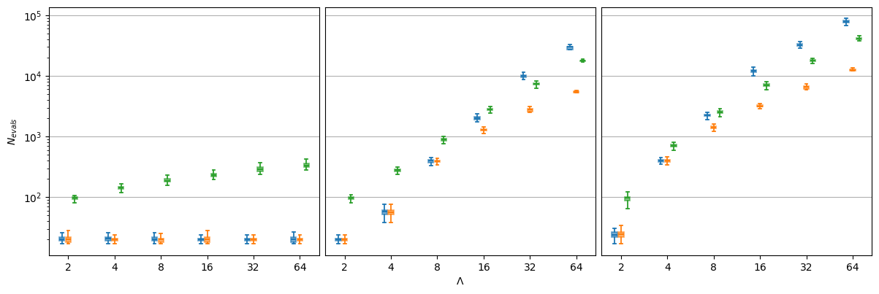
VQE Results – 10K shots

Slide 33
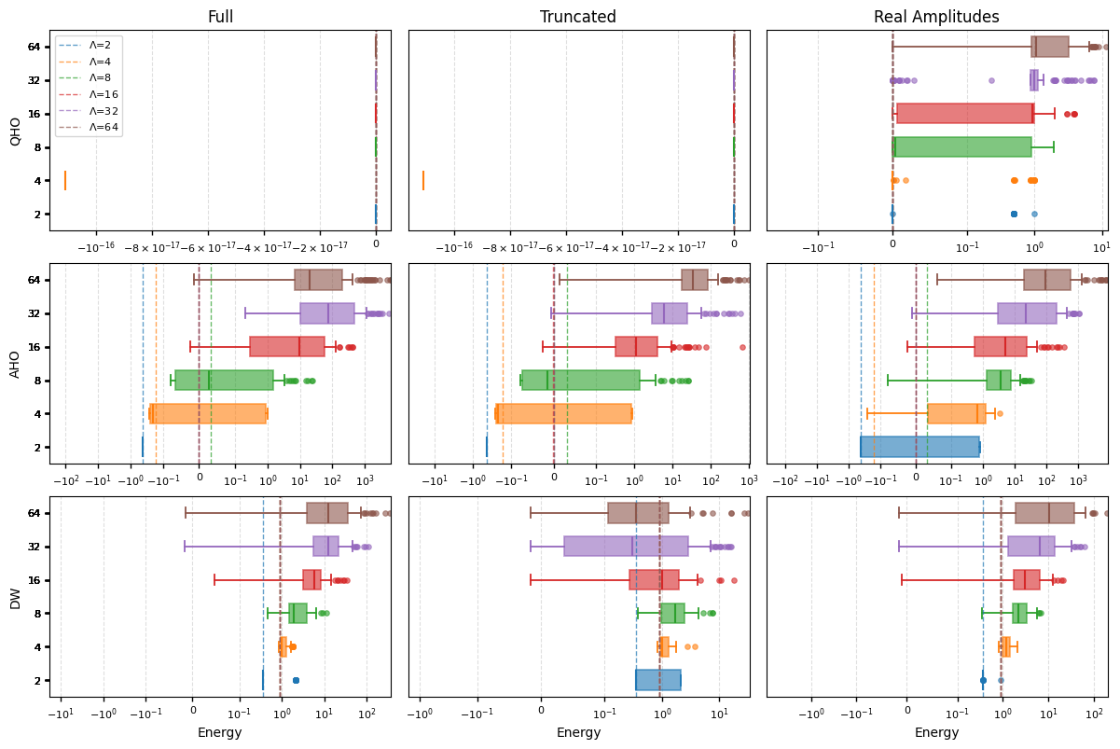
VQE Results – 10K shots

Slide 34
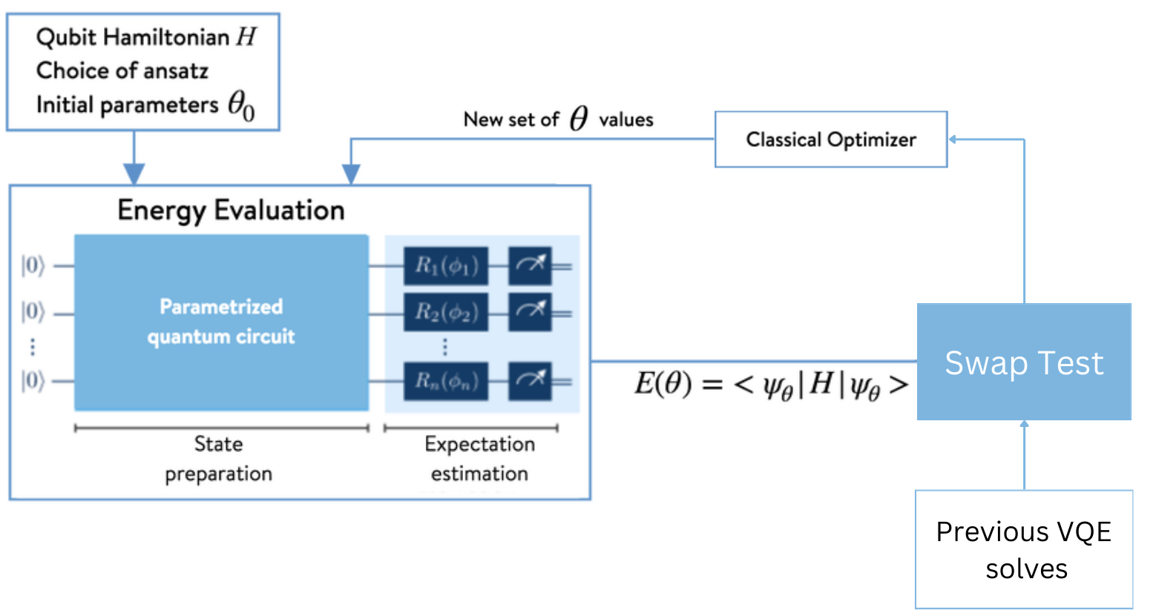





Variational Quantum Deflation
Prepare ansatz:
Measure:
Measure overlap with i previous states
Using a classical optimizer, vary θ to minimize
Repeat steps 2 to 4

Slide 35

Classifying SSB
We can look to the ratio of energy levels to determine pairing structure
Preserved supersymmetry → Single $E_{0}=0 and{ E}_{1}={ E}_{2}>0$→ R = 0
Supersymmetry breaking → ${ E}_{0}={ E}_{1}>0$→ R = 1
We do not need perfect VQE results just clear spacing between energy levels!
Notes:
Talk about motivation – don’t need perfect results we just need clear spacing

Slide 36
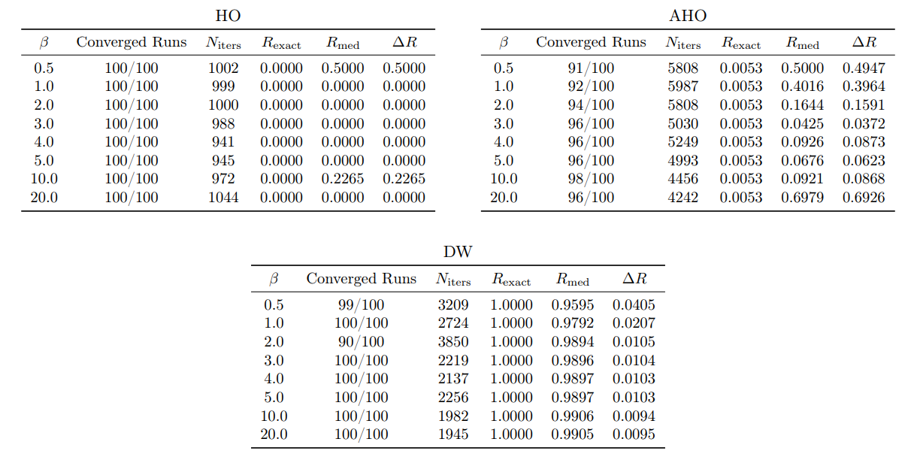
Choosing β
Statevector simulation
Λ=16
On average across all Λ β = 5.0 was optimal

Slide 37


Results - Statevector
Λ =16

Slide 38

Results – 10k shots

Slide 39
Conclusion
Quantum computing offers promising avenue for studying SSB
Choosing a suitable optimizer and ansatz is important
AVQE to find reduced ansatz
  Still limited by the optimizer
  Shot noise effects ansatz with large gate counts
  Truncated ansatz could possibly help mitigate shot noise
VQD to study SSB by looking at pairing of energy levels
  Shot noise is too severe to extract meaningful results
Future & Ongoing Work
AVQD to find excited states for use in VQD
Wess-Zumino (1+1)D
Alternative quantum devices e.g. qumodes to better simulate bosons + hybrid approaches
Currently running small systems on real IBM devices

