Slide 1


Analysis of hot region in HPK IV production data delivery May-December 2023
Ebru Simsek
December 3, 2024
for the CERN HGCAL silicon sensor team

Slide 2
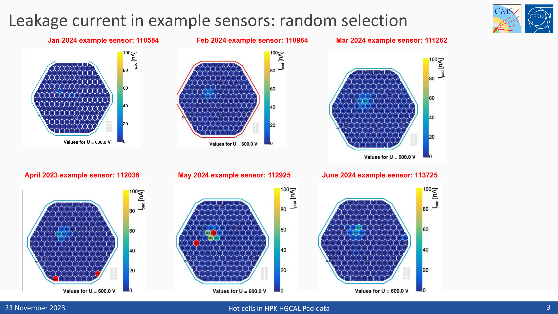
​
Analysis of hot region in HPK IV production data​
High currents in the same region for random sensors. Coincidence or a pattern?

Slide 3
​
Analysis of hot region in HPK IV production data​
    Scope and Purpose
    To analyze clusters of hot cells in 8-inch LD Full Geometry sensors.
    Hot cells often cluster slightly top-left of the sensor center across datasets.
    Methodology
    Extracted voltage, current, and cell data from HPK.txt files.
    Created dataframes for monthly sensor deliveries.
    Defined hot cells as those with leakage currents of 5–200 nA.
    Calculated occurrence percentages for normalization.
    Generated visualizations using HexPlot with voltage, cell, and percentage data.
Analysis Notes
Focused on 300um LD full May-December 2023 data.
Selected the 5–200 nA range as most cells fell within this interval.
Used a broader range to avoid missing important data.

Slide 4
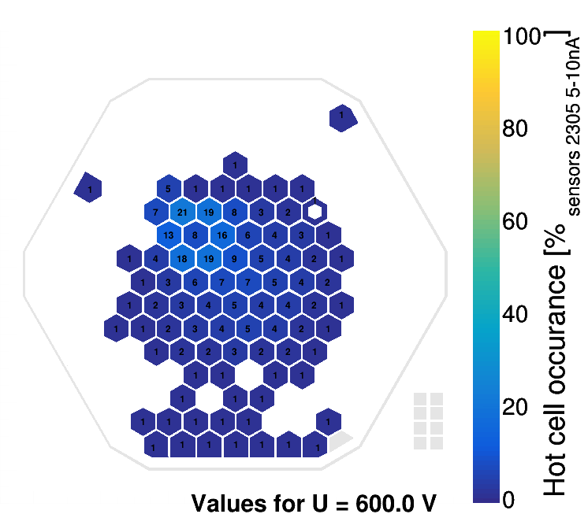
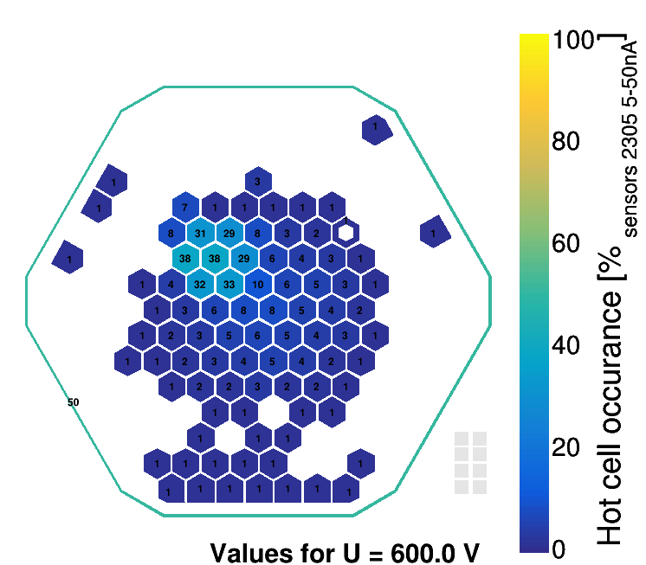


​
Analysis of hot region in HPK IV production data​
Delivery 05/23 at different current ranges
Observed that the range of 5-200 nA effectively covers the data.

Slide 5
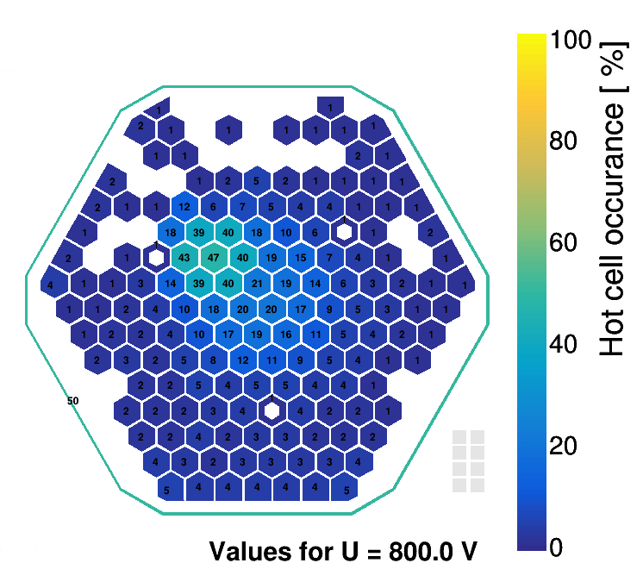
​
Analysis of hot region in HPK IV production data​:Delivery 05/23
Each page includes plots for each month, showing the distribution of hot cells.
The values on the cells indicate the percentage of sensors in that delivery where the specific cell was identified as hot.
White areas indicate regions with no hot cells.
Color gradient from blue to yellow represents an increasing percentage of hot cell occurrences.

Slide 6
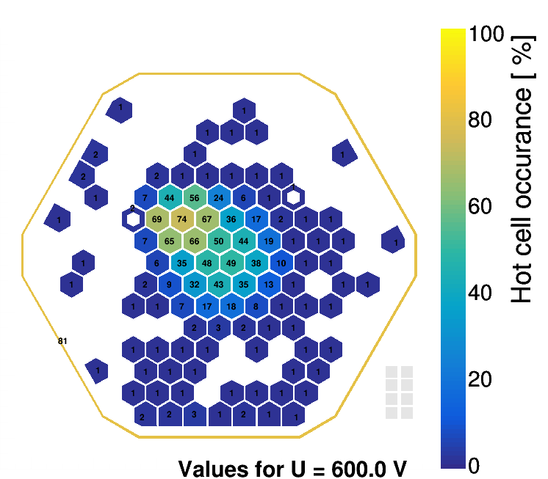
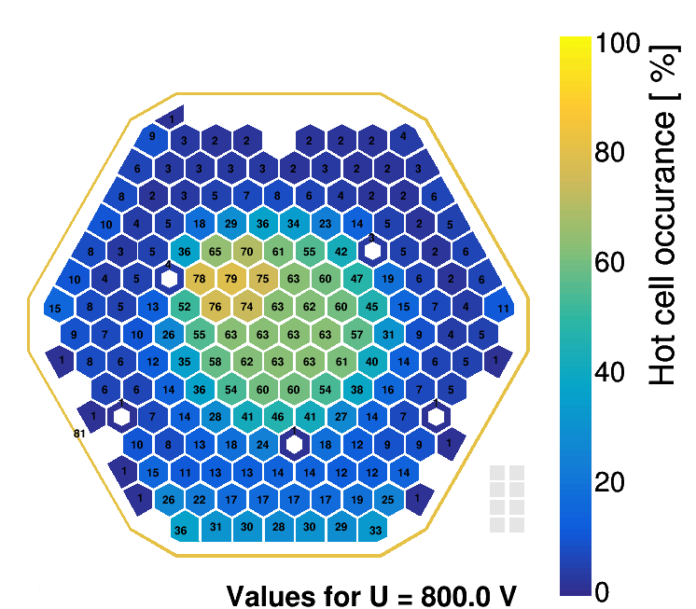
Analysis of hot region in HPK IV production data :Delivery 06/23
The highest hot cell percentage is observed in the June delivery, with a clear concentration around the 72nd cell.
The affected area is larger than in the May delivery.

Slide 7
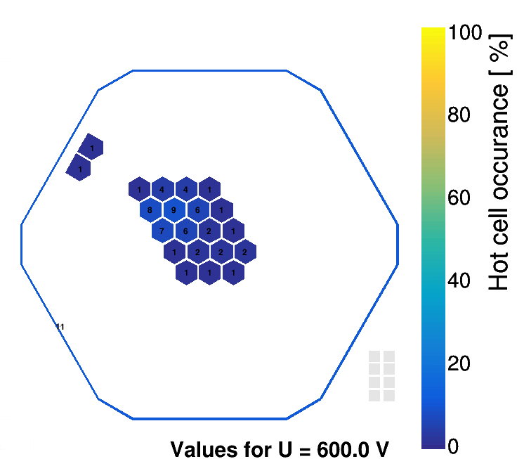
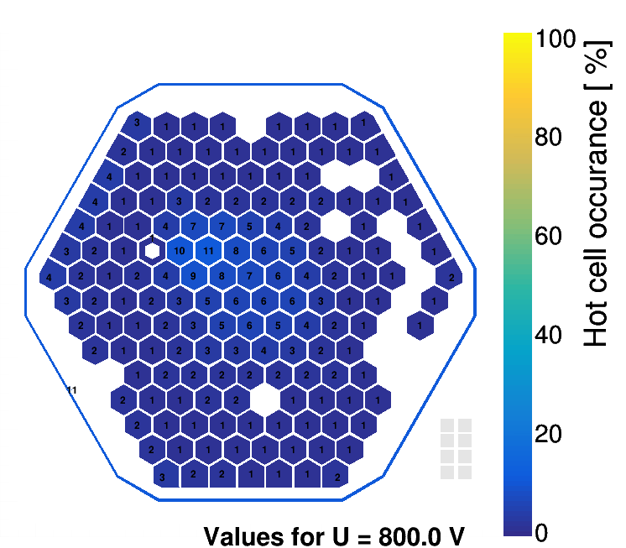
Analysis of hot region in HPK IV production data :Delivery 07/23
In July, the hot cell percentage peaks at around 10%, much lower than in previous months.
The cause of variability across the three months remains unclear. However, the highest percentages are still concentrated in the same region.

Slide 8
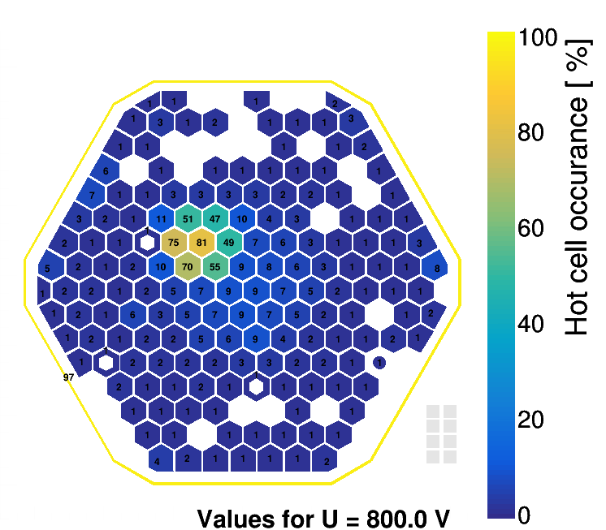
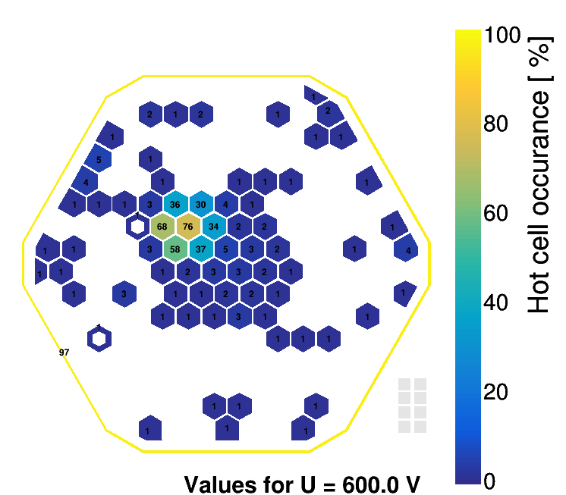
Analysis of hot region in HPK IV production data :Delivery 08/23
In August, a hot region is again observed around the 72nd cell, with the percentage rising to 80%.

Slide 9
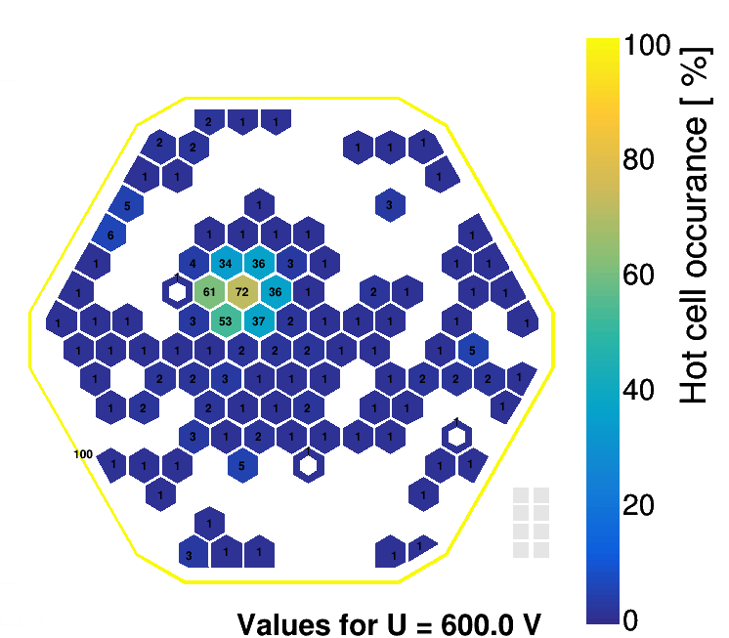
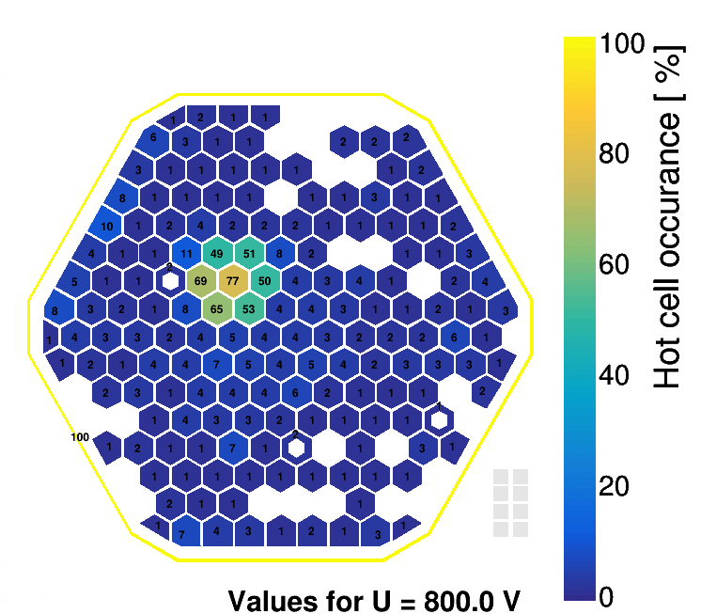
Analysis of hot region in HPK IV production data :Delivery 09/23
Similar to August, in September, a hot region is again observed around the 72nd cell, with the percentage rising to 77%.

Slide 10
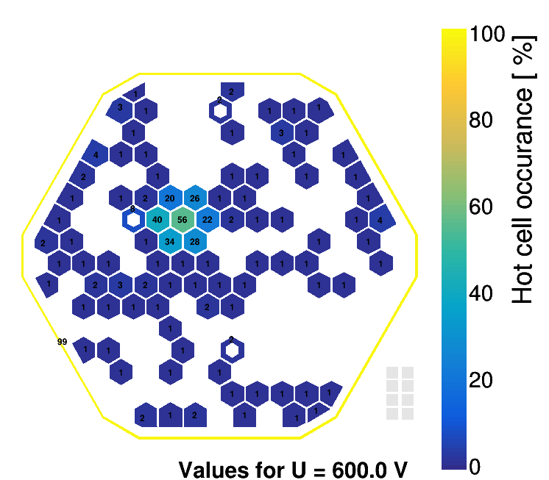
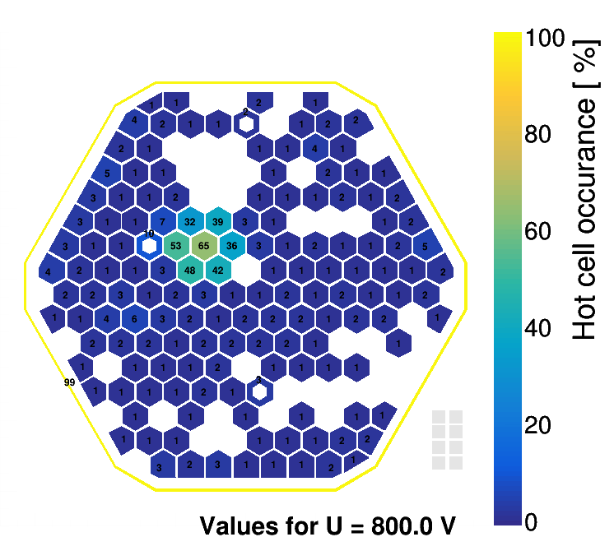
Analysis of hot region in HPK IV production data :Delivery 10/23
In October, a hot region is again observed at same region with the percentage reaching up to 60%.​

Slide 11
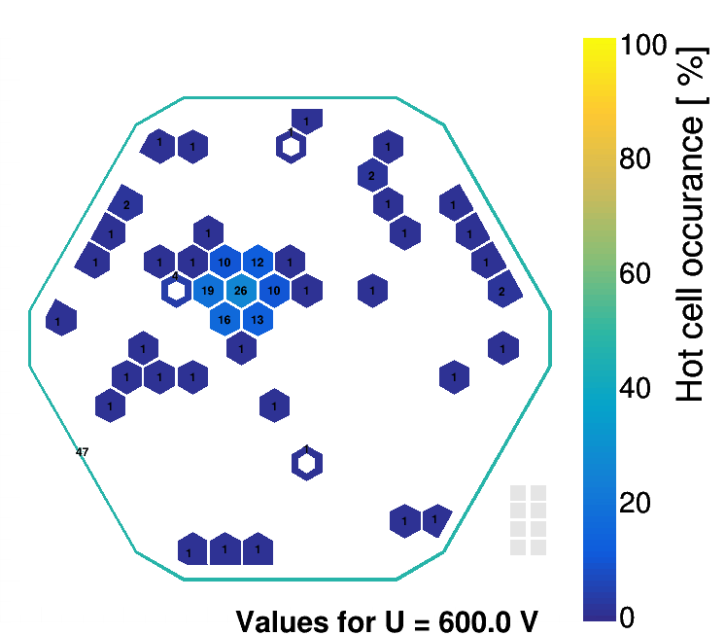
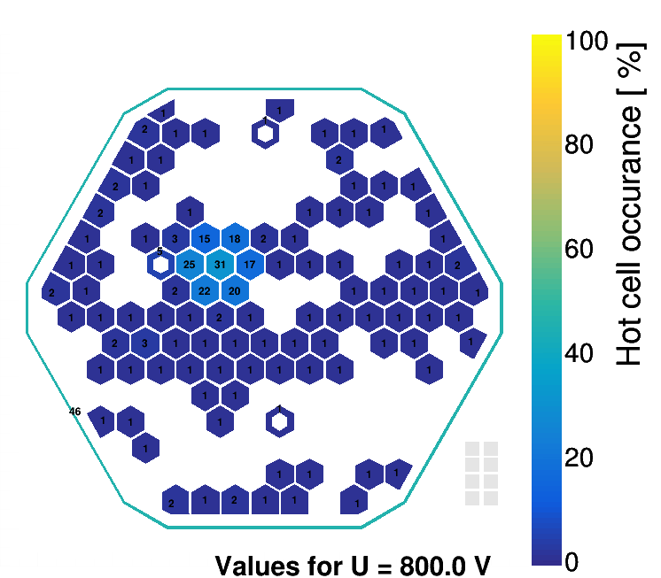
Analysis of hot region in HPK IV production data :Delivery 11/23
In November, the hot region is again observed in the same area, but the percentage drops to around 30%.

Slide 12
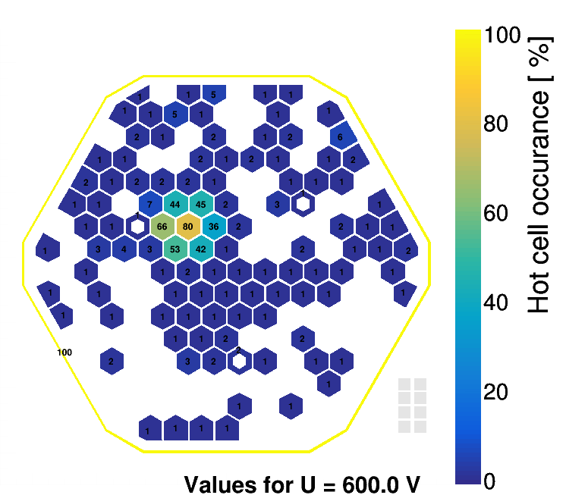
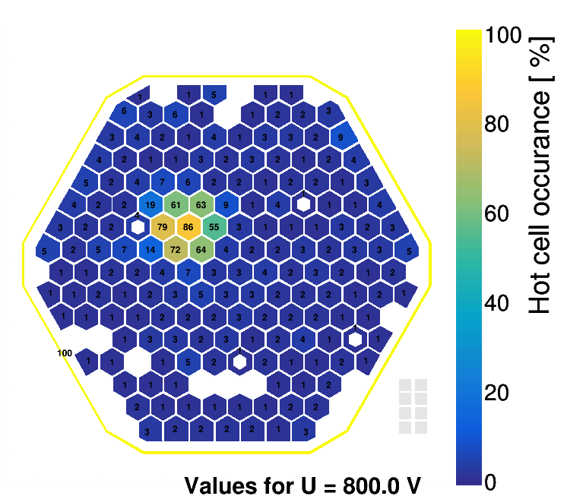
Analysis of hot region in HPK IV production data :Delivery 12/23
In December, the hot cell percentage in the same region rises again, reaching up to 86%.

Slide 13
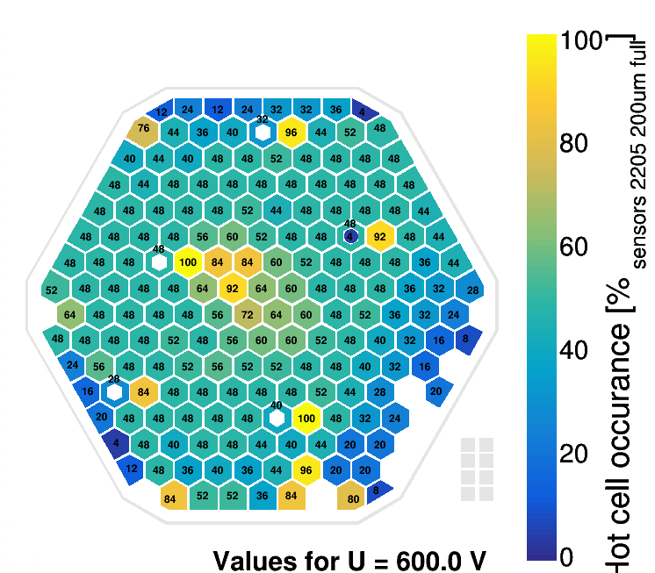
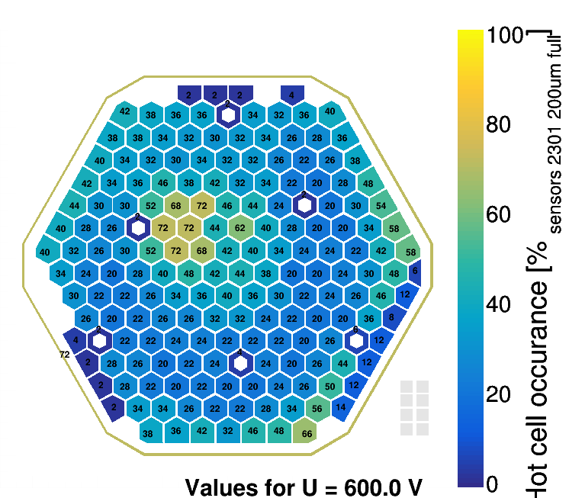
Analysis of hot region in HPK IV production data
200um LD Full 2204&2301

Slide 14
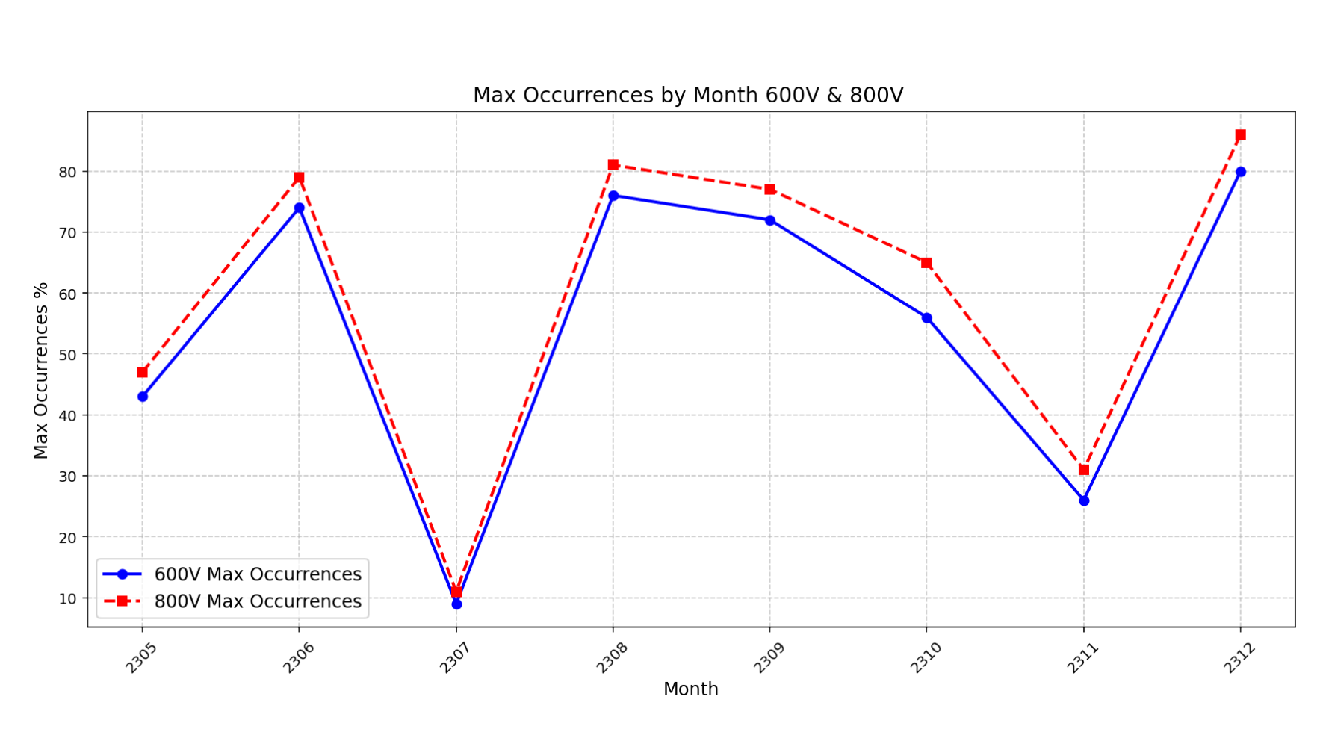
RESULTS​
Hot regions were consistently observed in the same area, primarily around the 72nd cell.​
The hot cell percentages varied significantly across months:​
    Peaked at 80% in August and December.​
    Dropped to 10% in July and 30% in October.
The June delivery had the largest affected area, while other months showed smaller clusters.
The variability in hot cell percentages across months suggests possible delivery-dependent factors or environmental influences.

Slide 15
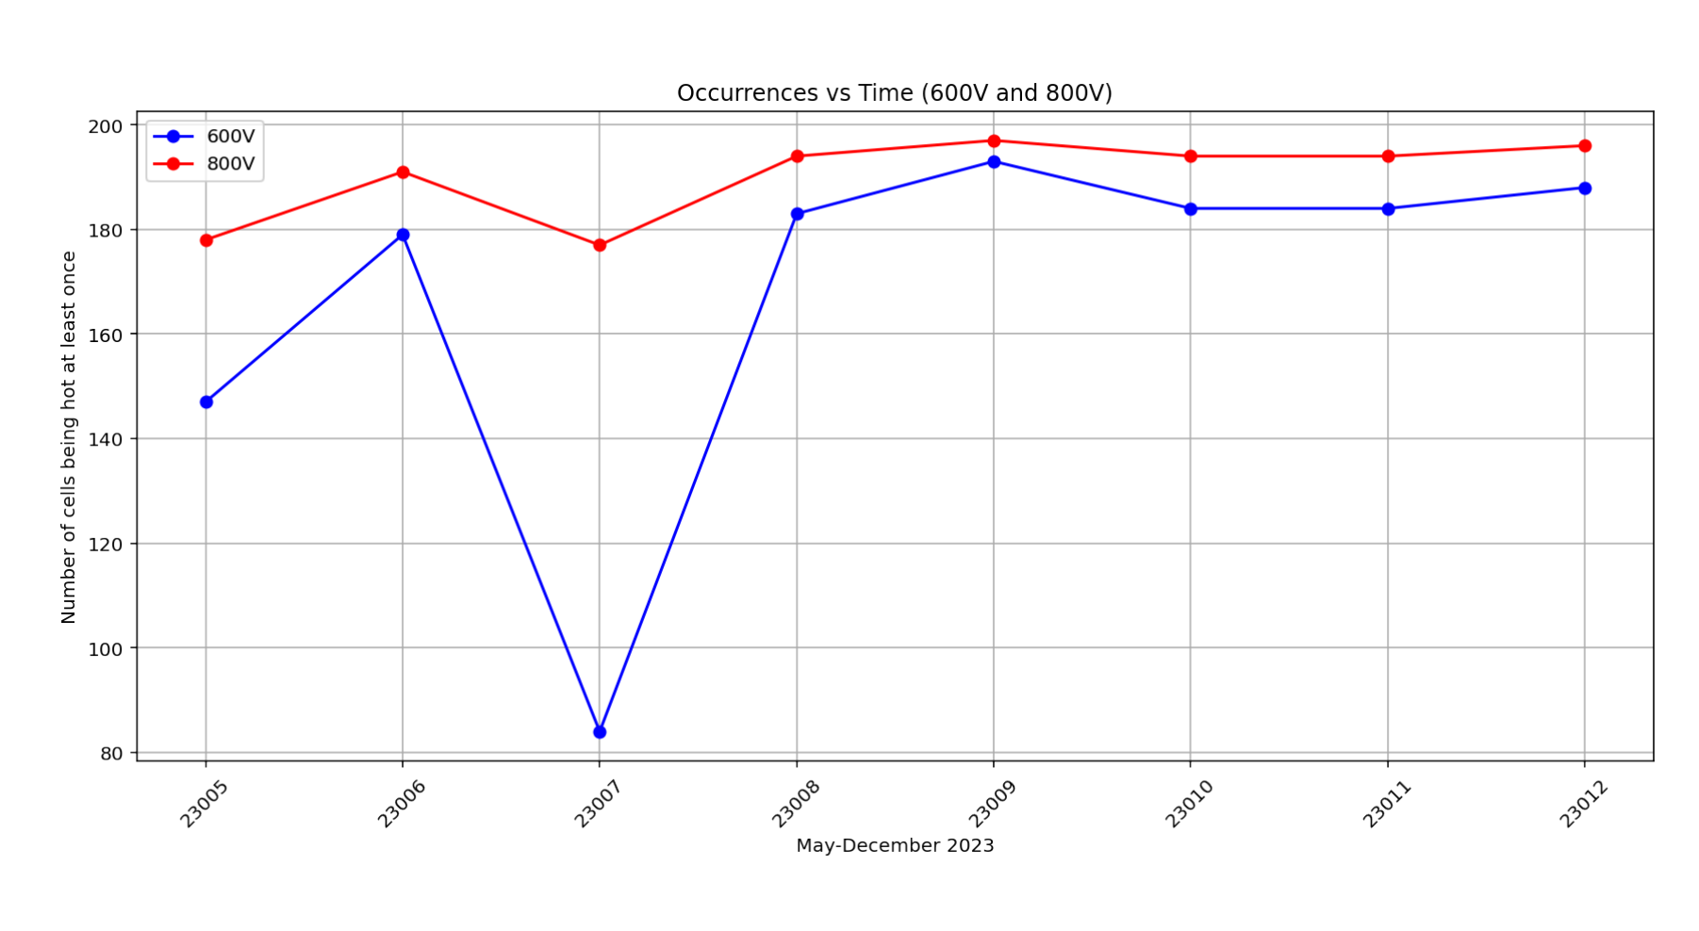
RESULTS​
Hot regions were consistently observed in the same area, primarily around the 72nd cell.​
The hot cell percentages varied significantly across months:​
    Peaked at 80% in August and December.​
    Dropped to 10% in July and 30% in October.
The June delivery had the largest affected area, while other months showed smaller clusters.
The variability in hot cell percentages across months suggests possible delivery-dependent factors or environmental influences.

