Slide 1

Detector at LHC$ν$ FAR

Slide 2
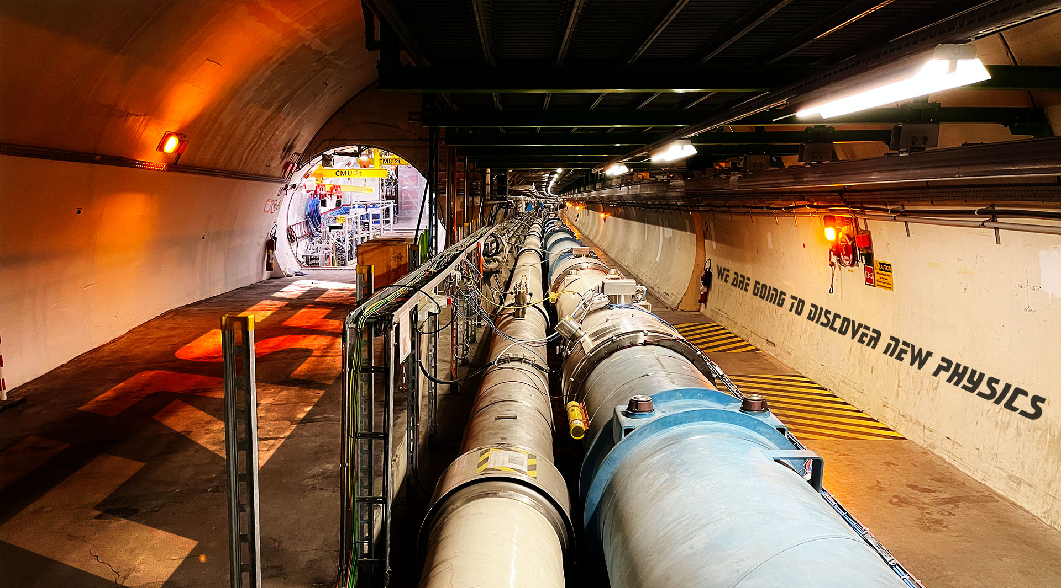

Slide 3
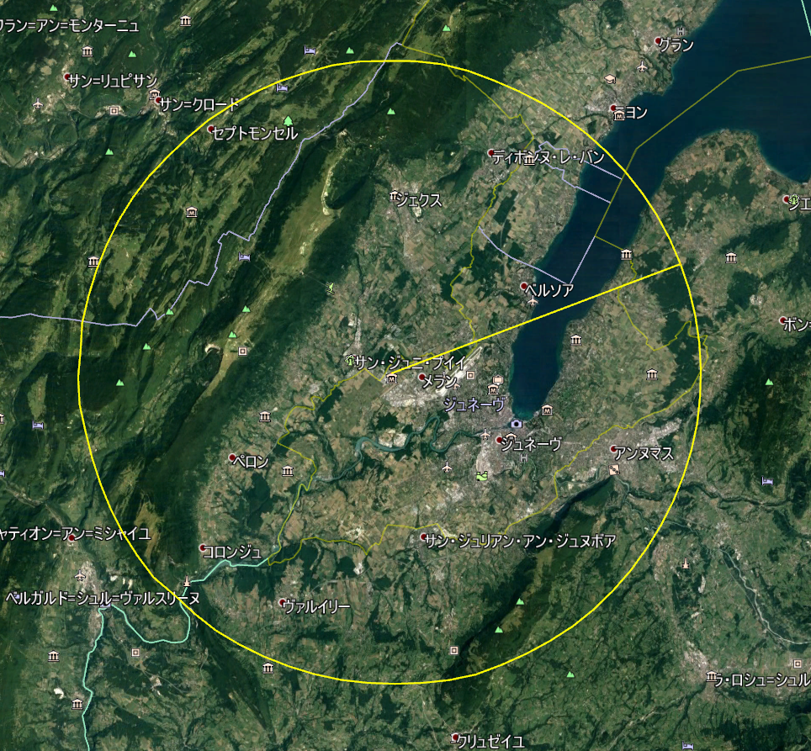
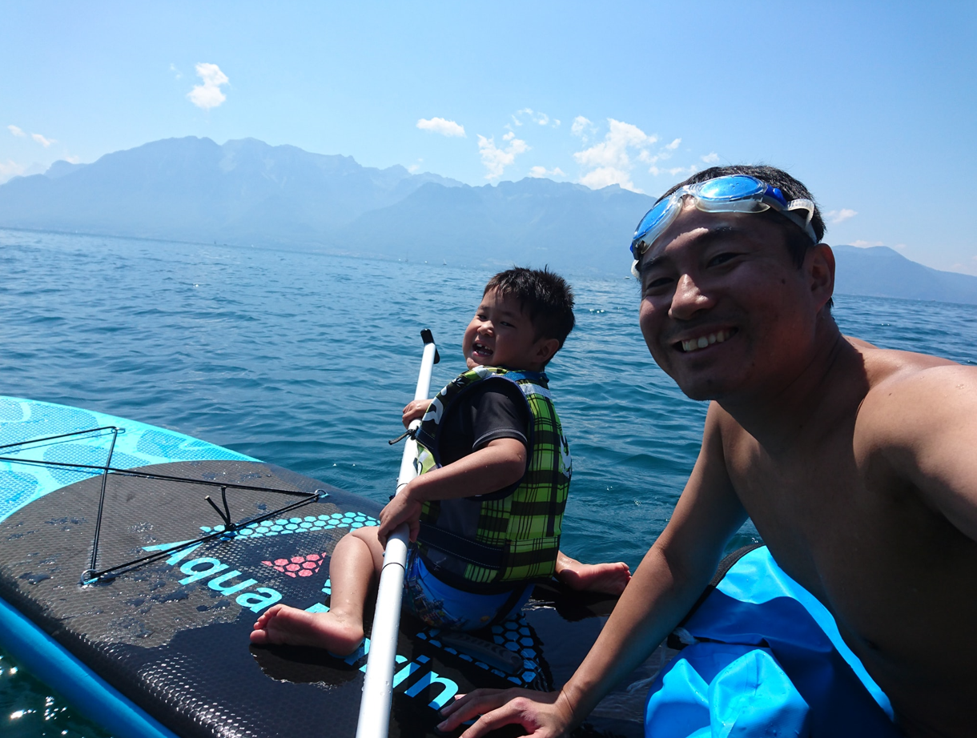
Before FASER was established, we thought
LHCb LOS
Visit to Lake Leman (Vevey) in 2019 to see possibility of IceCube like experiment. But found that the water transparency is not great…

Slide 4
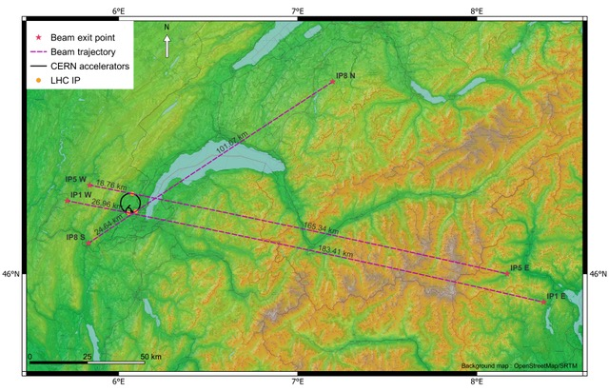
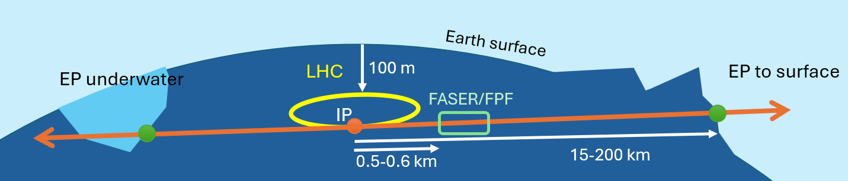
Far sites at the emergence point
LHC is 100m underground
LOS appears to surface or underwater
CERN survey team provided us the coordinates

Slide 5
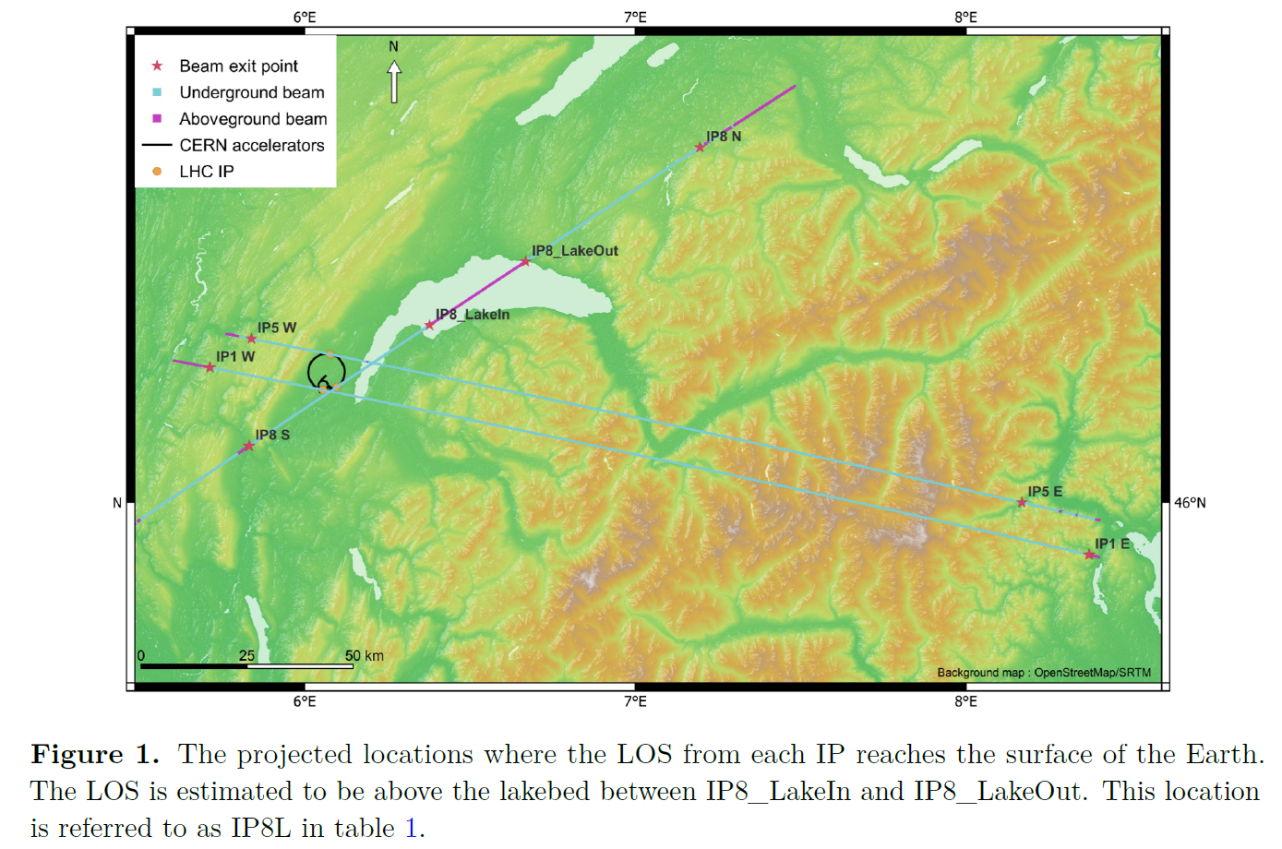

Slide 6
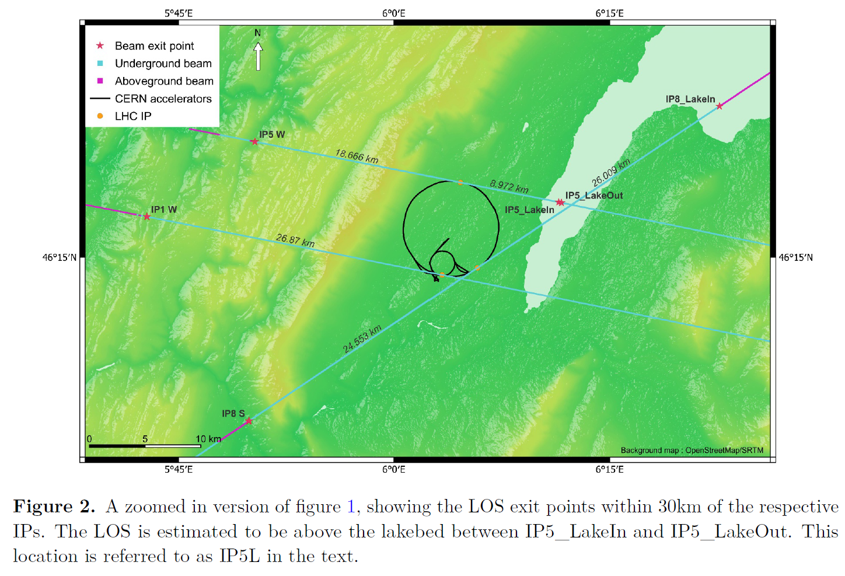

Slide 7
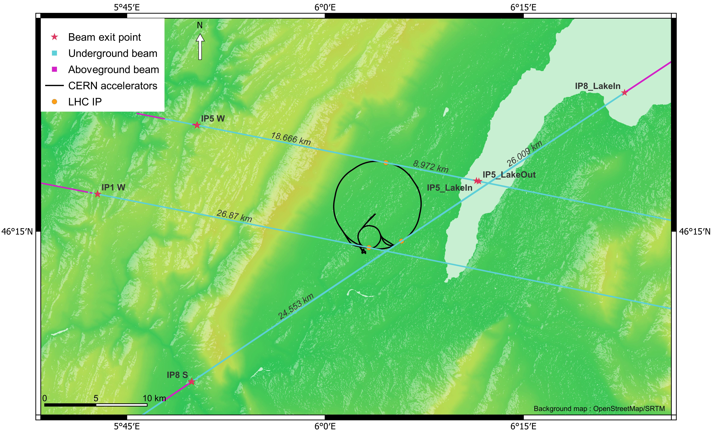
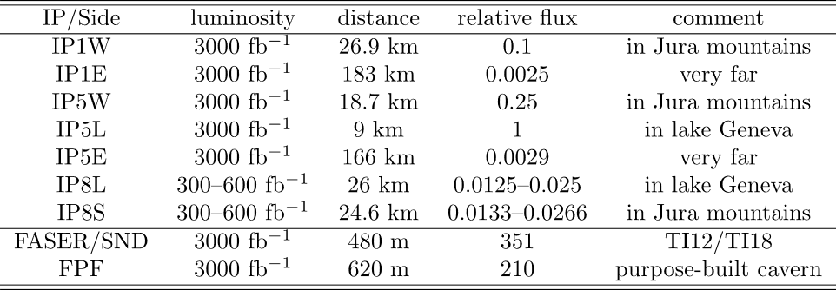

Beam LOS exit points
The emergence points of the lines of sight from all IPs are identified
C. Vendeuvre and B. Weyer used the most accurate model of the LHC ring and state-of-the art tools for surface / lake depth determination
To maximize event rates, a surface detector should be as close to a high-lumi IP as possible
Most promising locations west of IP5, on the Jura, and east of IP5, in lake Geneva
ATLAS
CMS
Closest! (reference)
10-20% of IP5/IP1 lumi expected at IP8!
LHCb

Slide 8
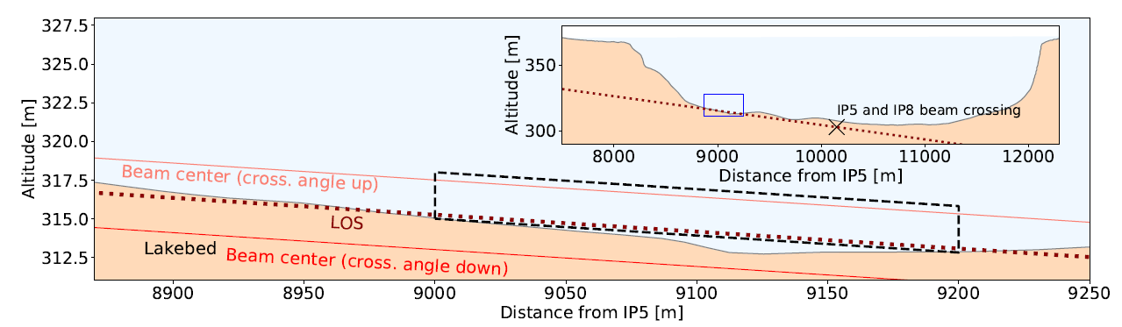
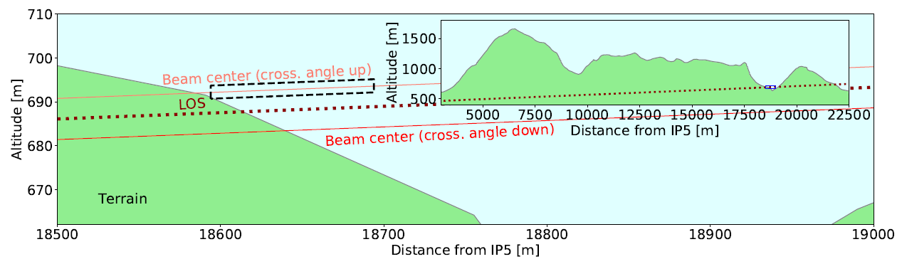

Slide 9
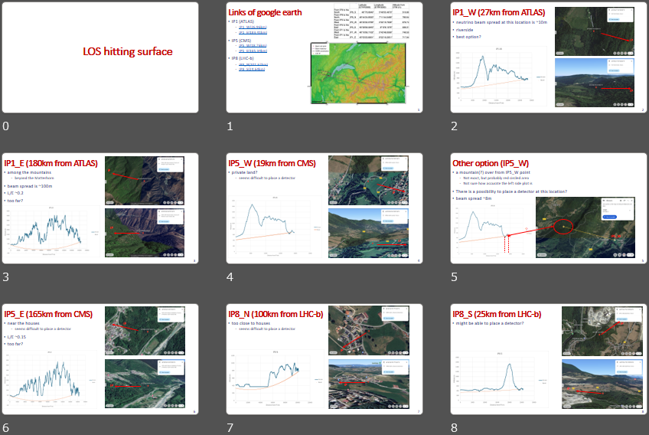

Slide 10
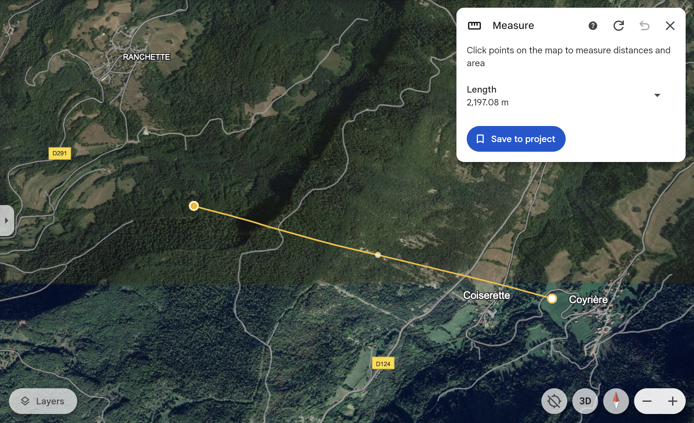
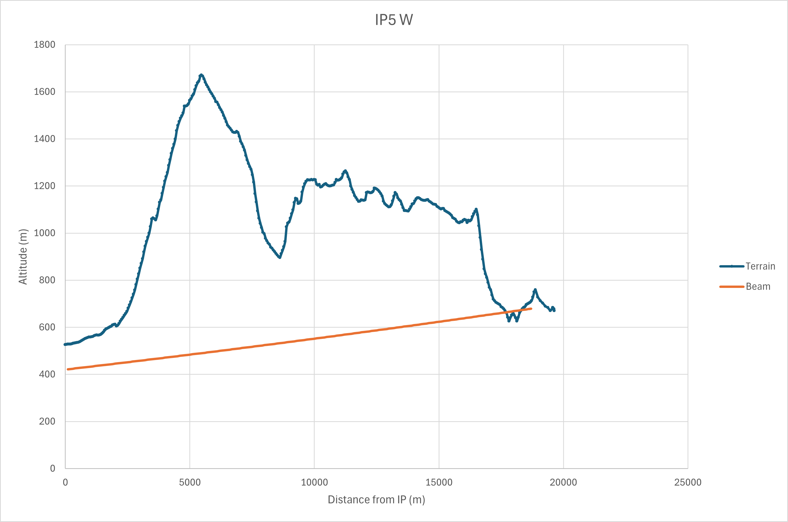
IP5_W
In the Jura mountains
There is a possibility to place a detector at this location?
beam spread ~8m
？
EP5_W

Slide 11
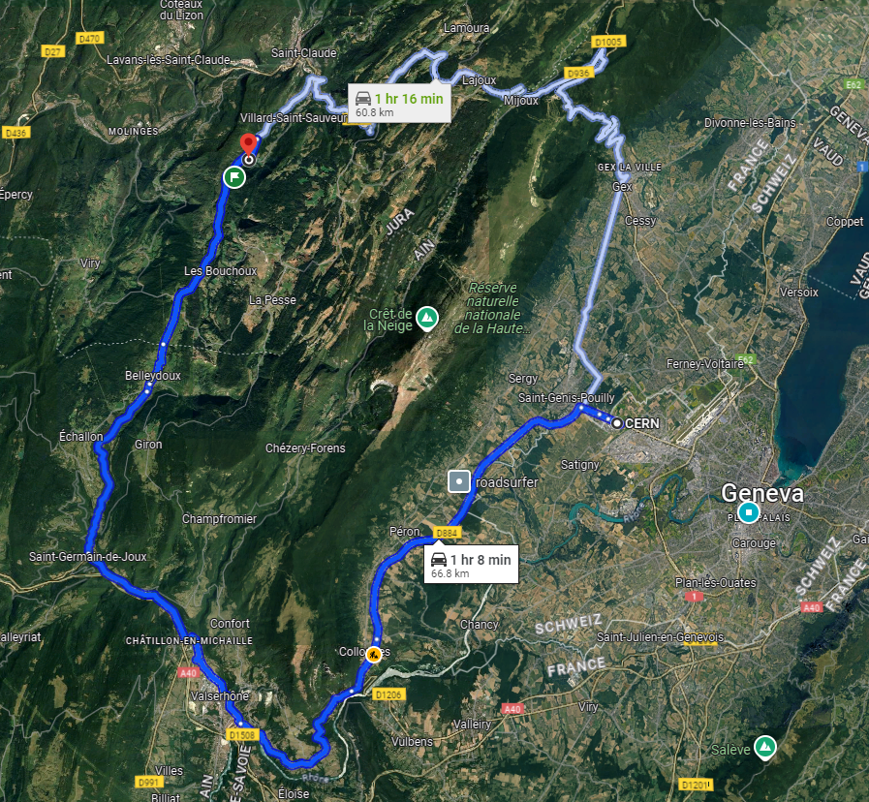
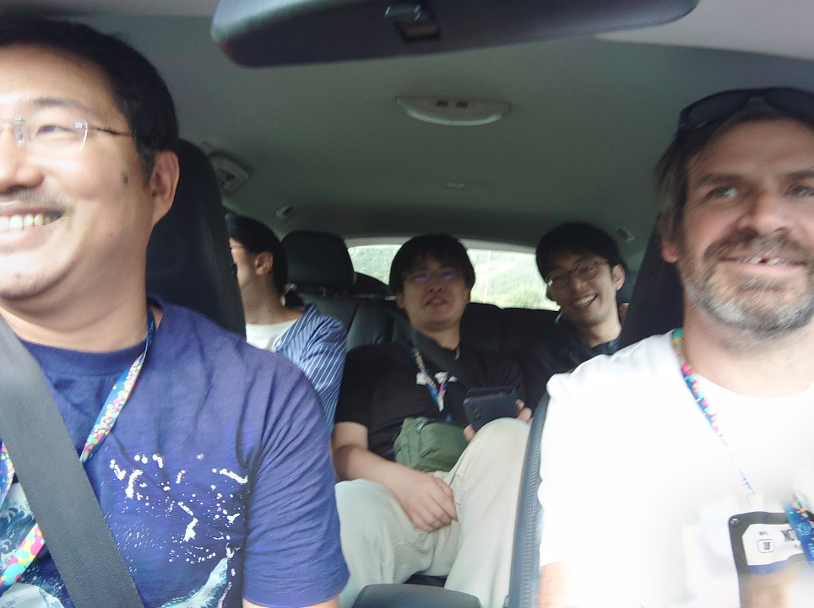
Field trip to IP5_W
On Aug 29 2024, Jeremy, Aki and a few more people

Slide 12
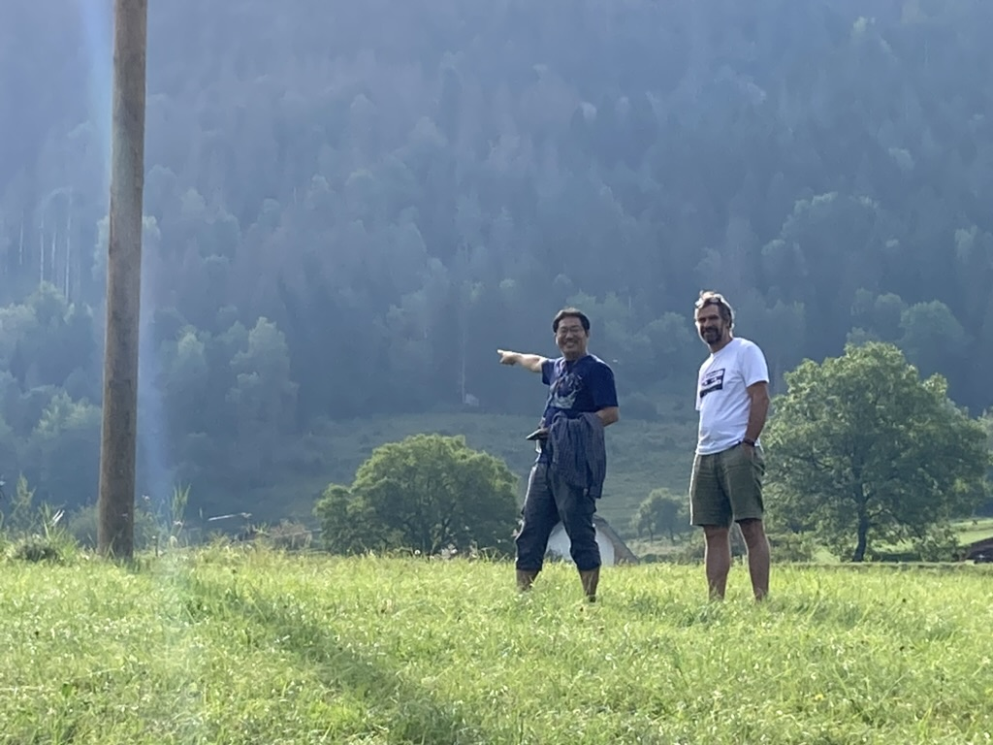
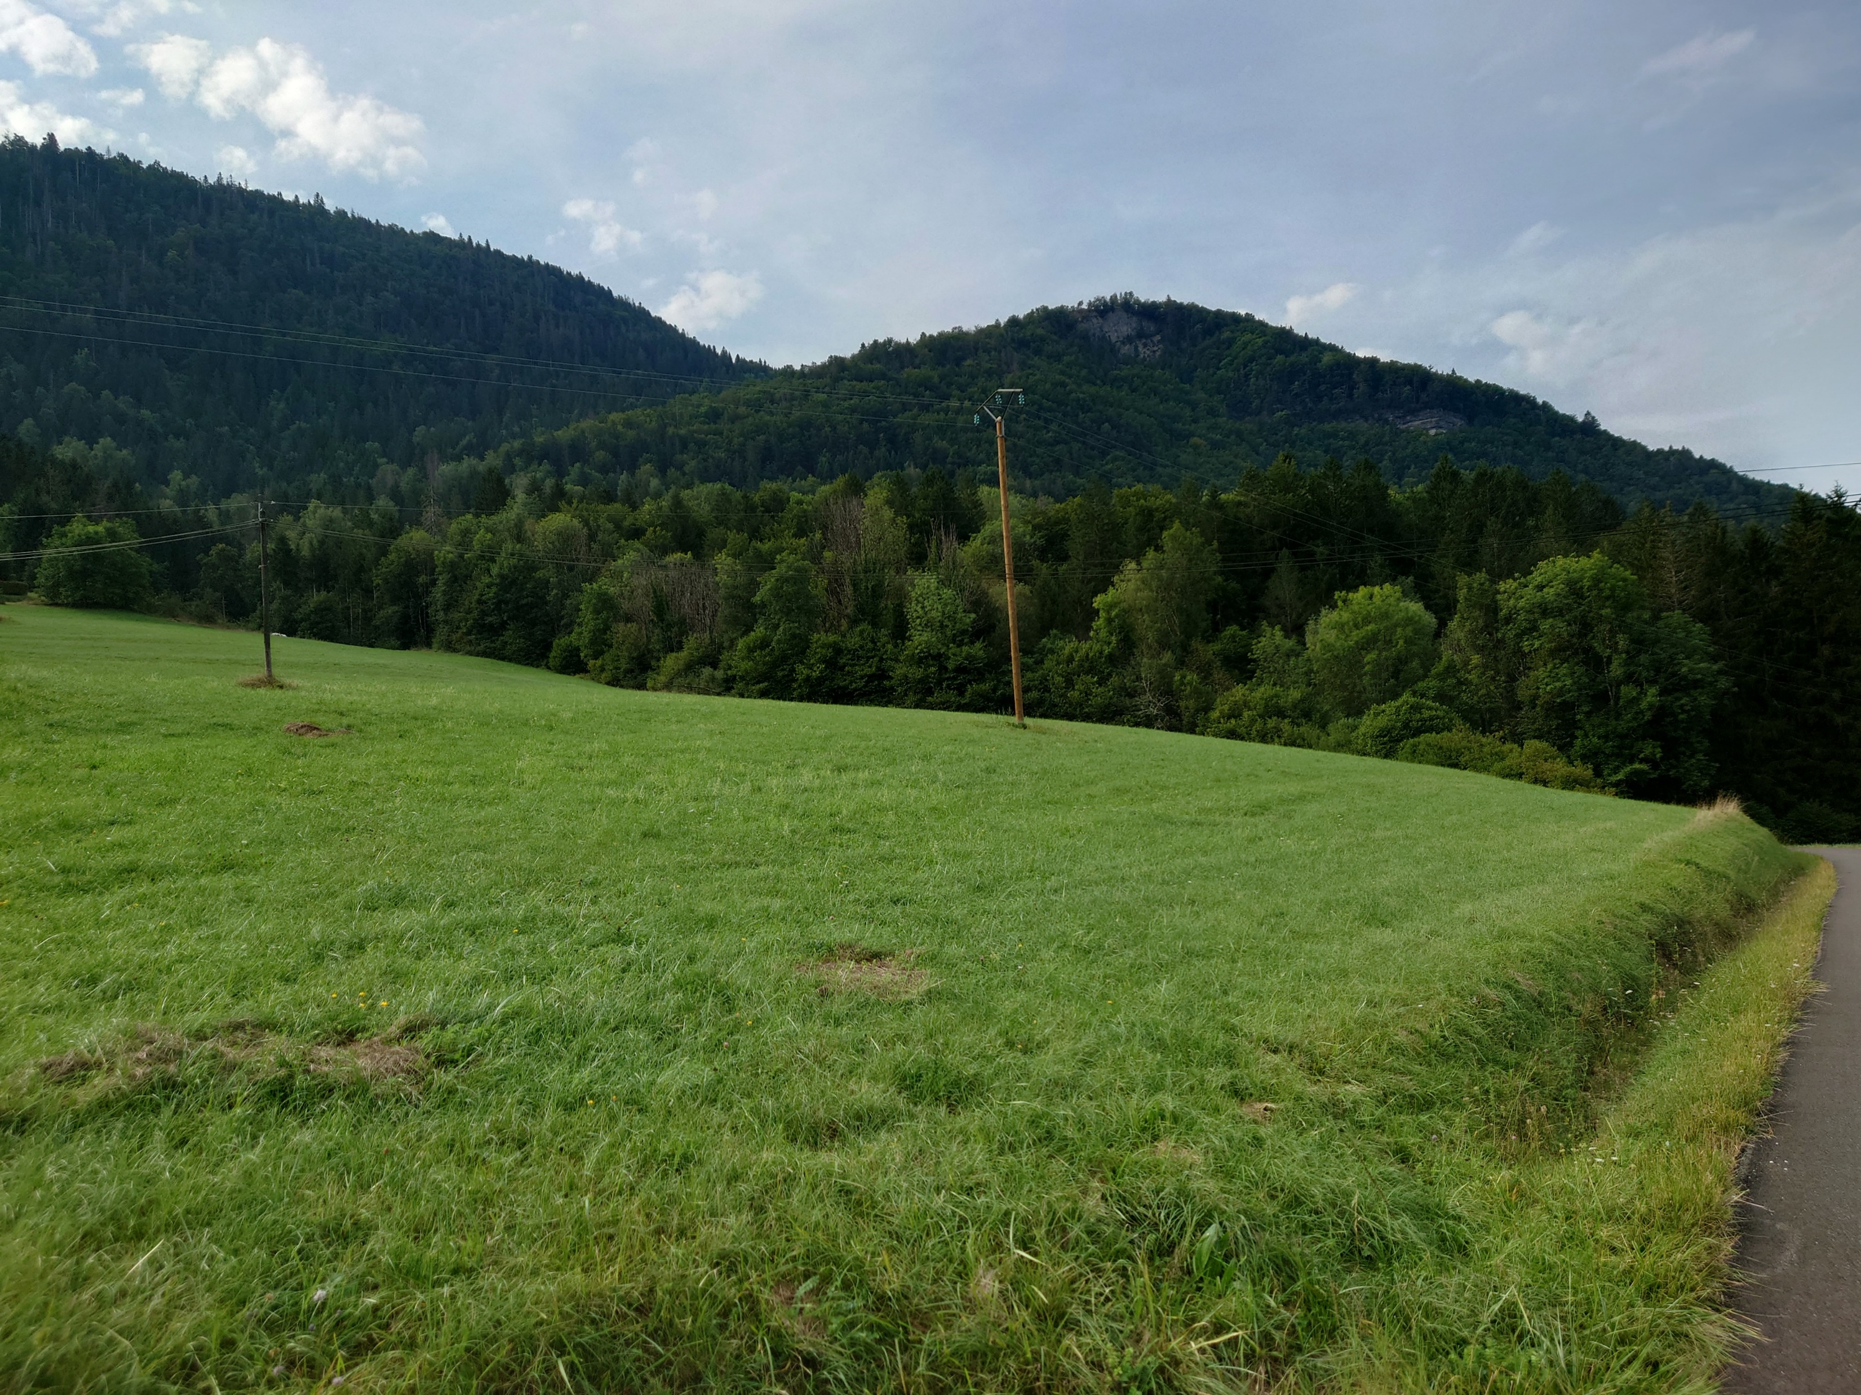
Field trip to IP5_W
The EP5 is located in the middle of a field.
Jura mountains
Side view
Jura mountains
EP5-W
France
CERN
CERN
EP5-W
France

Slide 13
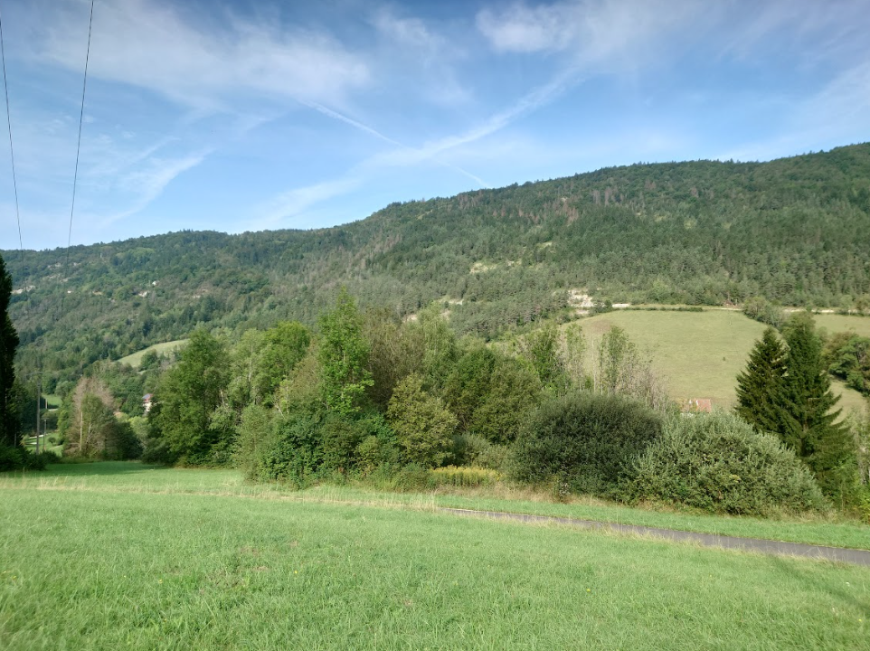
Two sides of the valley

Slide 14
Any idea about detector?

Slide 15
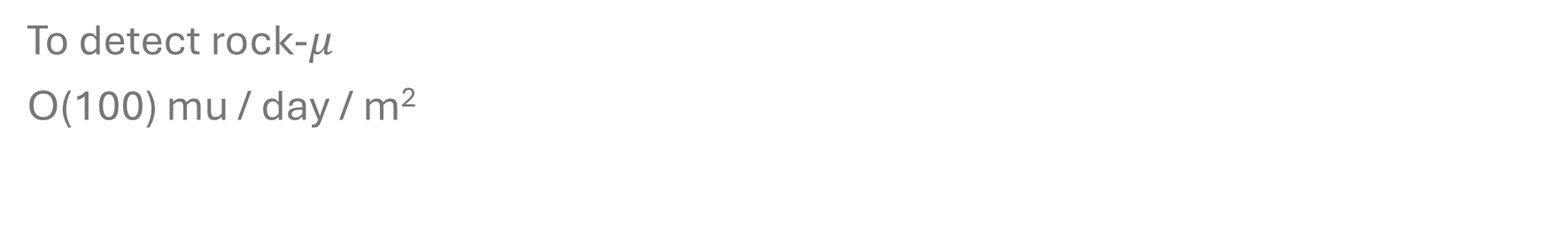
Can we put a simple detector in next year?
To detect rock-$μ$
O(100) mu / day / m²

Slide 16
Possible detector?
Too small flux for emulsion anyway
Effective with WC or NuTeV like massive detectors
Detector may on a rail for an off-axis coverage
Putting a simple scintillator to count “rock-muon” rate in Run 3 could already be interesting
Detector on a rail
Neutrino beam ~ 8m wide

Slide 17
Possible detector?
Maybe we could also consider other side
If we want just detect neutrino rate, we could have simple coincidence detector
detector 2
detector 1
Neutrino beam ~ 8m wide
1 km

