Slide 1
Accelerator Ambassador Program
Dr Mitko Oldfield

Slide 2
Five Ambassador Nodes have been selected
Jade Fischer & Olivia Masella (Canada)
Dr Maria Paula Rey-Barrera (Colombia / Switzerland)
Dr Hannah Wakeling (United Kingdom)
Annabella Zamora (Switzerland)
Dr Sanae Samsam (Morocco / Italy)
Other unsuccessful applicants have been asked to join our Accelerators Network (two have accepted so far)

Slide 3
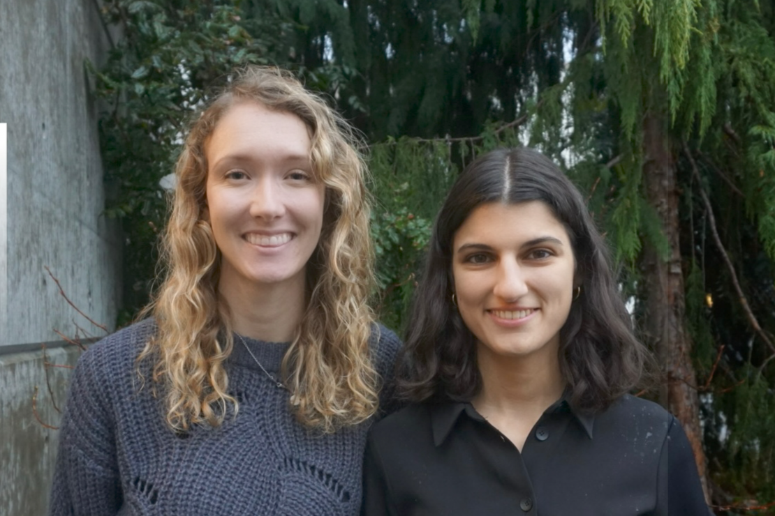
Jade Fischer & Olivia Masella
Jade Fischer and Olivia Masella are 4th-year PhD students in medical physics based at the University of Victoria, Canada. Jade specializes in radiation therapy using very high-energy electrons (VHEE). Olivia is focused on the development of a novel low-cost radiotherapy device to increase access in low-resource settings such as low- and middle-income countries and rural regions. Jade is passionate about accelerator outreach and aims to demystify these technologies by highlighting the remarkable advances made in recent decades. As a future medical physicist, she believes part of her role is to contribute to initiatives that build trust in science and promote public understanding. Olivia is passionate about medical physics outreach to encourage young minds to pursue the field. Having discovered medical physics later in her life, Olivia would love to showcase this interdisciplinary field.
“We’re thrilled to be Accelerator Ambassadors and to teach kids about everything from radiotherapy to CT imaging. We want this program to build public trust in radiation and accelerator-based medical technologies by highlighting their role in cancer diagnosis and treatment. We believe interactive and accessible content will help inspire future scientists.”
Project: Particles That Heal: Discovery Day
1-day workshop for students aged 11 - 16

Slide 4
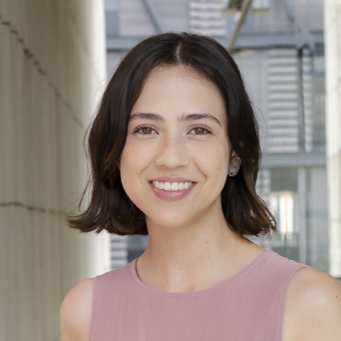
Dr Maria Paula Rey-Barrera
Maria is a Colombian researcher in Accelerator Physics, conducting her PhD at the Paul Scherrer Institute (PSI) in affiliation with EPFL. Her current research focuses on synchrotron light diagnostics for the Swiss Light Source (SLS) 2.0. Alongside her work as a scientist, she’s also a writer. She enjoys storytelling and would not be the scientist she is today without her art. She draws from this to create science communication that feels human, creative, and resonates with people.
“I am ecstatic to be an Accelerator Engagement Ambassador because I believe science communication isn’t just about translating complex ideas, it’s about opening doors. I hope to faithfully represent Latin American women’s voices in spaces where we are still underrepresented.”
Project: Historias Sincotronicas
Bilingual social media short-form content series

Slide 5
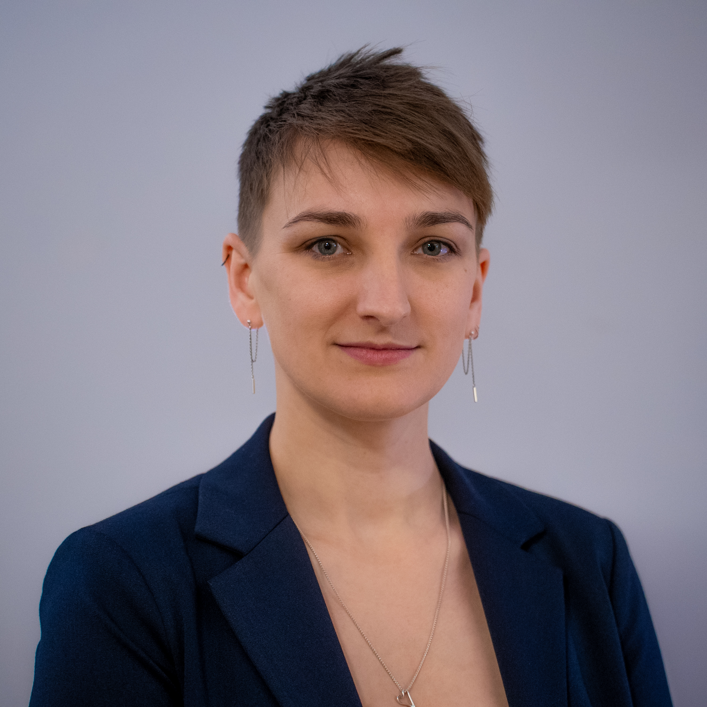
Dr Hannah Wakeling
Hannah is a researcher in particle accelerator environmental sustainability at the John Adams Institute for Accelerator Science, University of Oxford. In her work, she evaluates the environmental impact of particle accelerators throughout their lifetime, and investigates how we can reduce these impacts. Her main project is working on the Life Cycle Assessment of the ISIS-II Neutron and Muon Source, an accelerator that is proposed to supply the next generation of neutron and muon science in the UK and beyond. She is working with the ISIS-II team to design a state-of-the-art machine, built with the environment in mind from start to finish.
“I’m excited to be an Accelerator Ambassador to share the brilliant work we are doing as a community to reduce particle accelerator environmental impact. Most of all I am looking forward to meeting many bright, inquisitive minds and exploring the world of particle accelerators together!”
Project: Accelerating Sustainability
Public-facing talks about promoting sustainability for accelerators

Slide 6
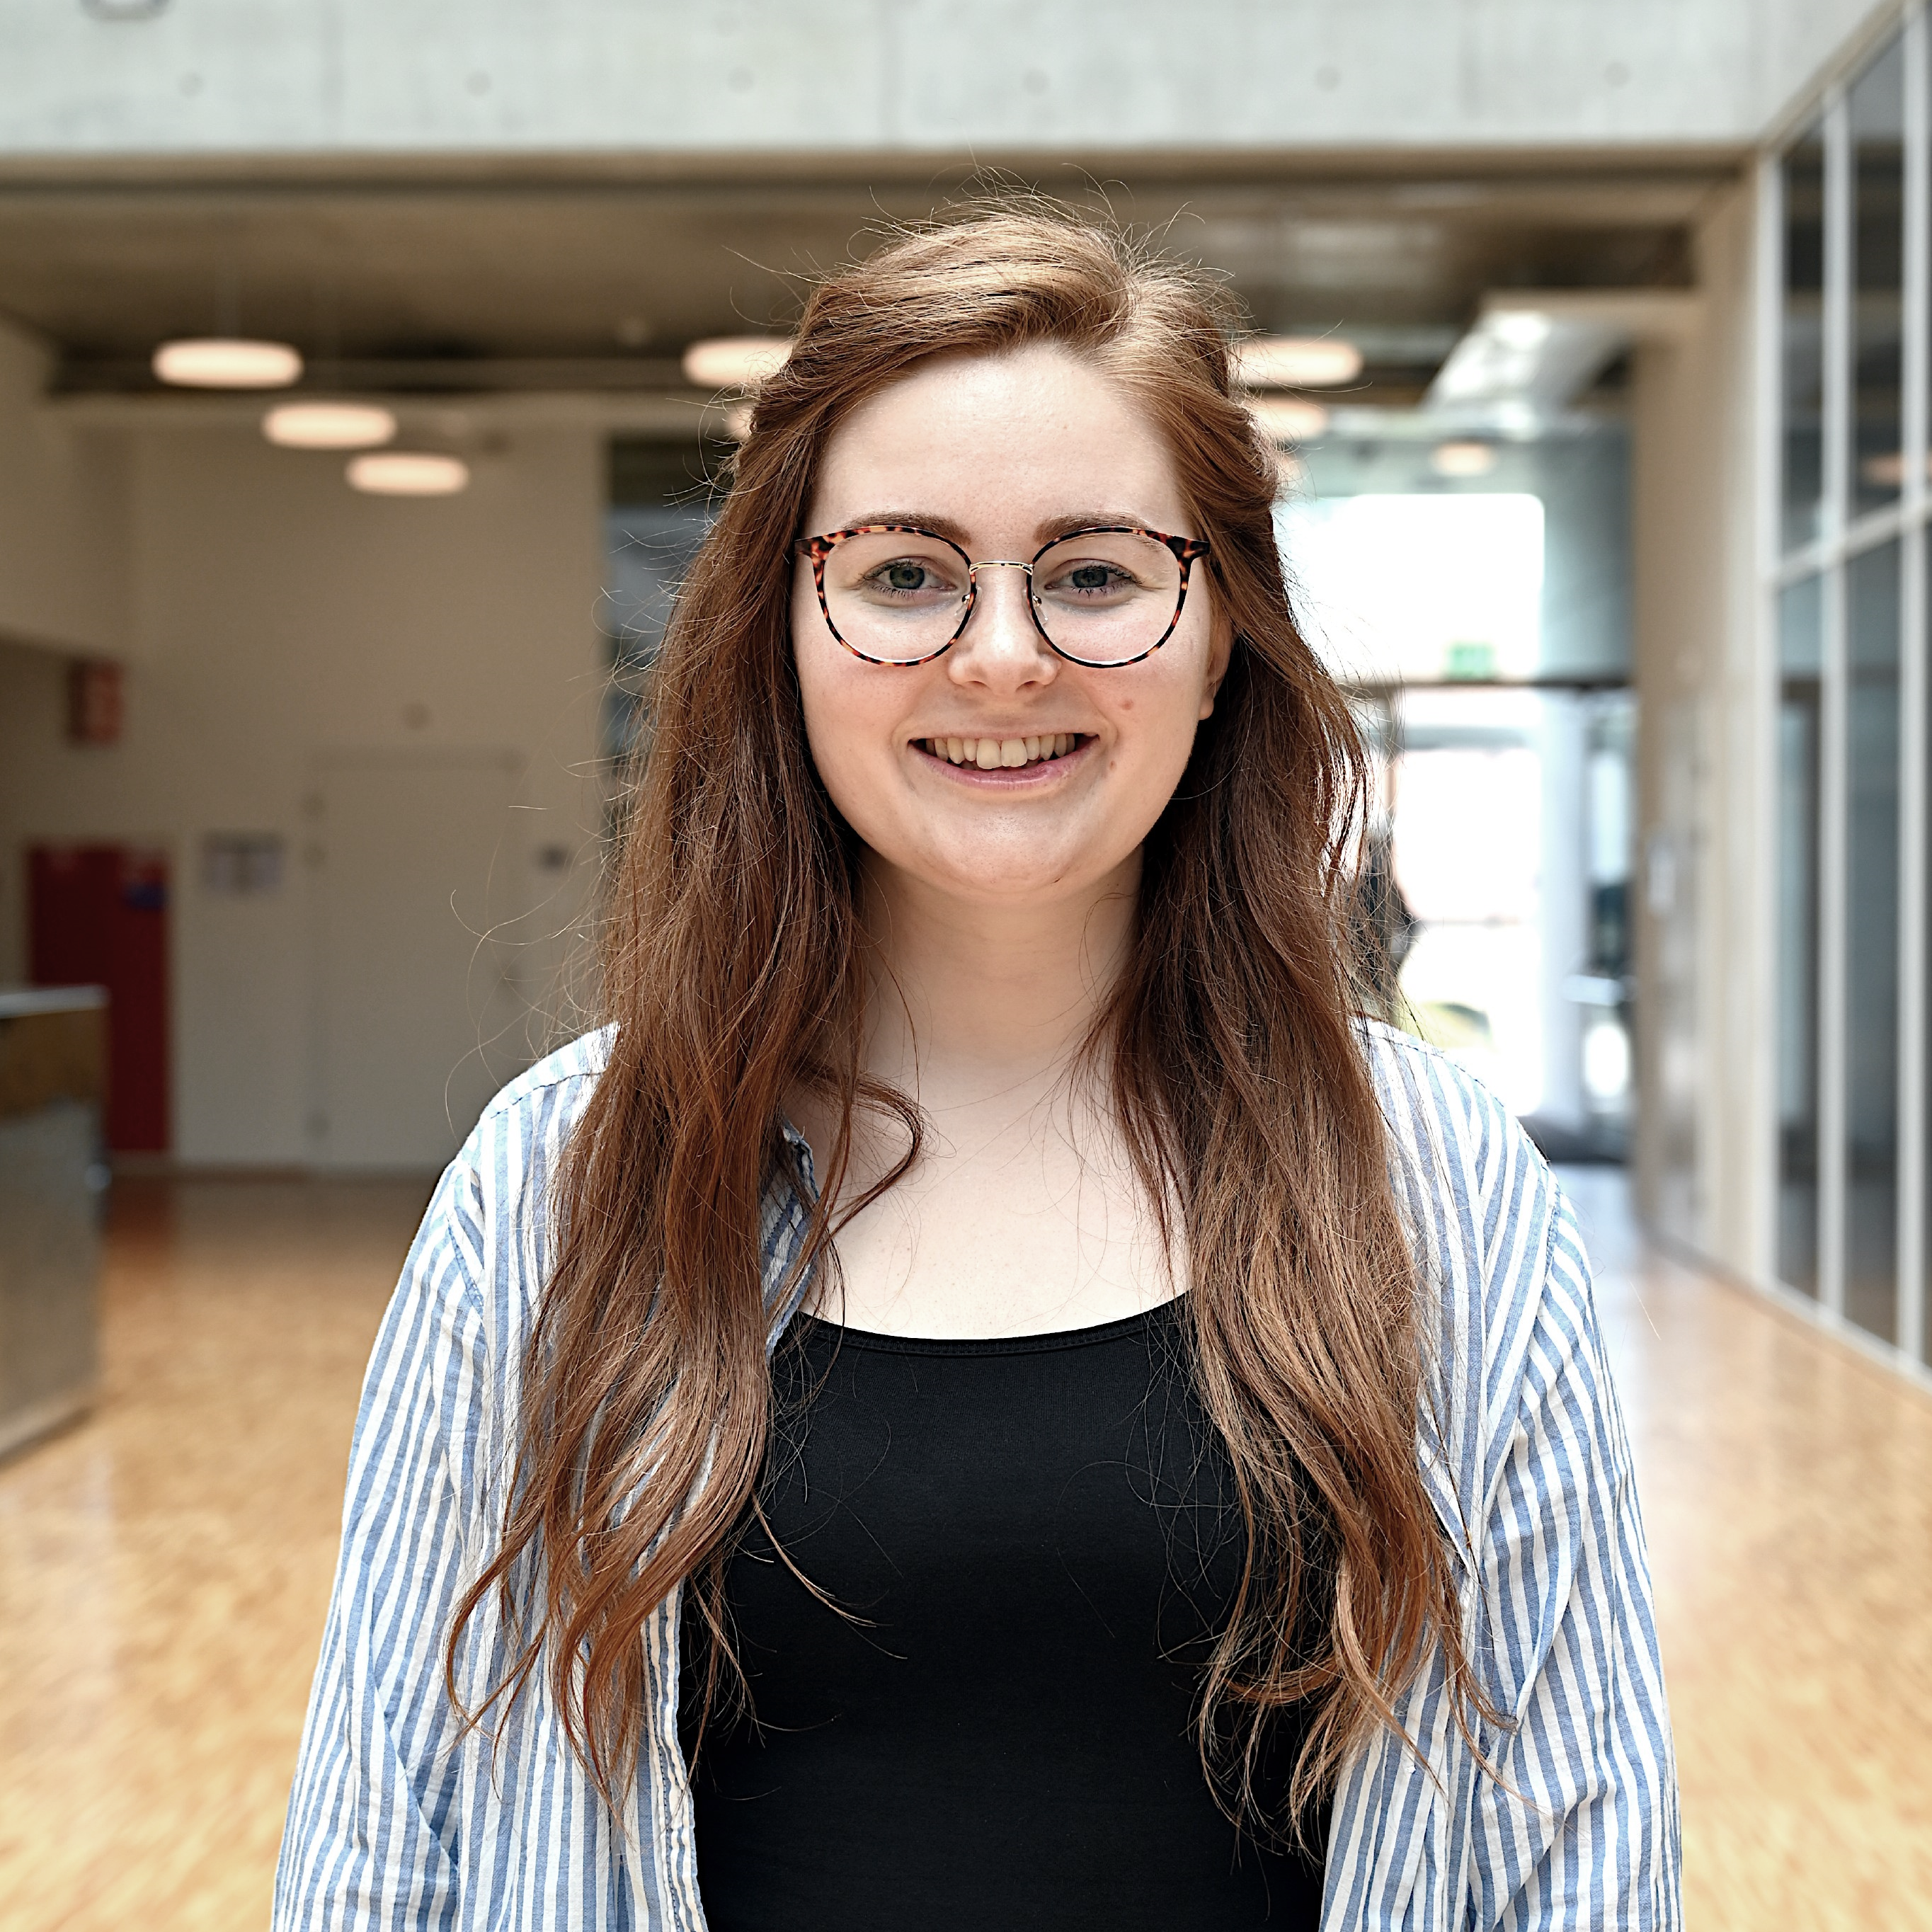
Annabella Zamora
Annabella is a PhD candidate and teaching associate at the University of Lausanne, specialising in social studies of science and technology. Her research explores how particle accelerators are embedded in society, drawing on qualitative fieldwork, situated knowledge practices and sociomaterial approaches. Her project examines scientific instrumentation as infrastructure and how accelerators mediate relations between experts, institutions and the wider public, with much of her ethnographic fieldwork taking place at CERN.
“I am excited to be an Accelerator Ambassador and to bring a social science perspective to broader conversations, highlighting accelerators as complex sociotechnical worlds shaped by diverse forms of expertise, labour and care.”
Project: Behind the Beamlines
Podcast series highlighting overlooked human stories

Slide 7
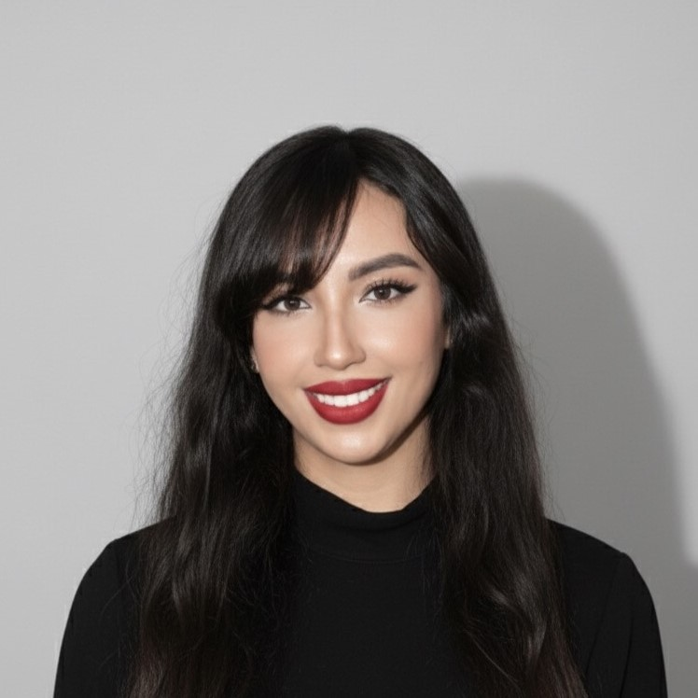
Dr Sanae Samsam
Sanae is a postdoctoral accelerator physicist based in Italy, where she is researching beam dynamics and compact light source development. Her current work focuses on STAR: the Compton-based X-ray source at Unical, where she studies beam–laser interactions, simulation frameworks, and the broader applications of compact photon sources. Beyond her research, she is deeply committed to advancing accelerator science in Africa. She serves on the IOC of the African Conference of Physics, where she teaches and mentors young researchers, and she is the convener of the accelerator chapter of the ASFAP strategy, helping to shape a long-term vision for accelerator development on the continent. Her project, Accelerator Futures: From Africa to the World, reflects a clear mission: to strengthen a field that is still emerging across the continent.
“As an Accelerator Ambassador, I aim to build bridges between established labs and African institutions, create pathways for training, and support the first concrete steps toward locally driven accelerator science. This role offers the platform needed to help the field grow where it is most needed.”
Project: Accelerator Futures: From Africa to the World
Training and outreach program targeting students in Africa

