Slide 1

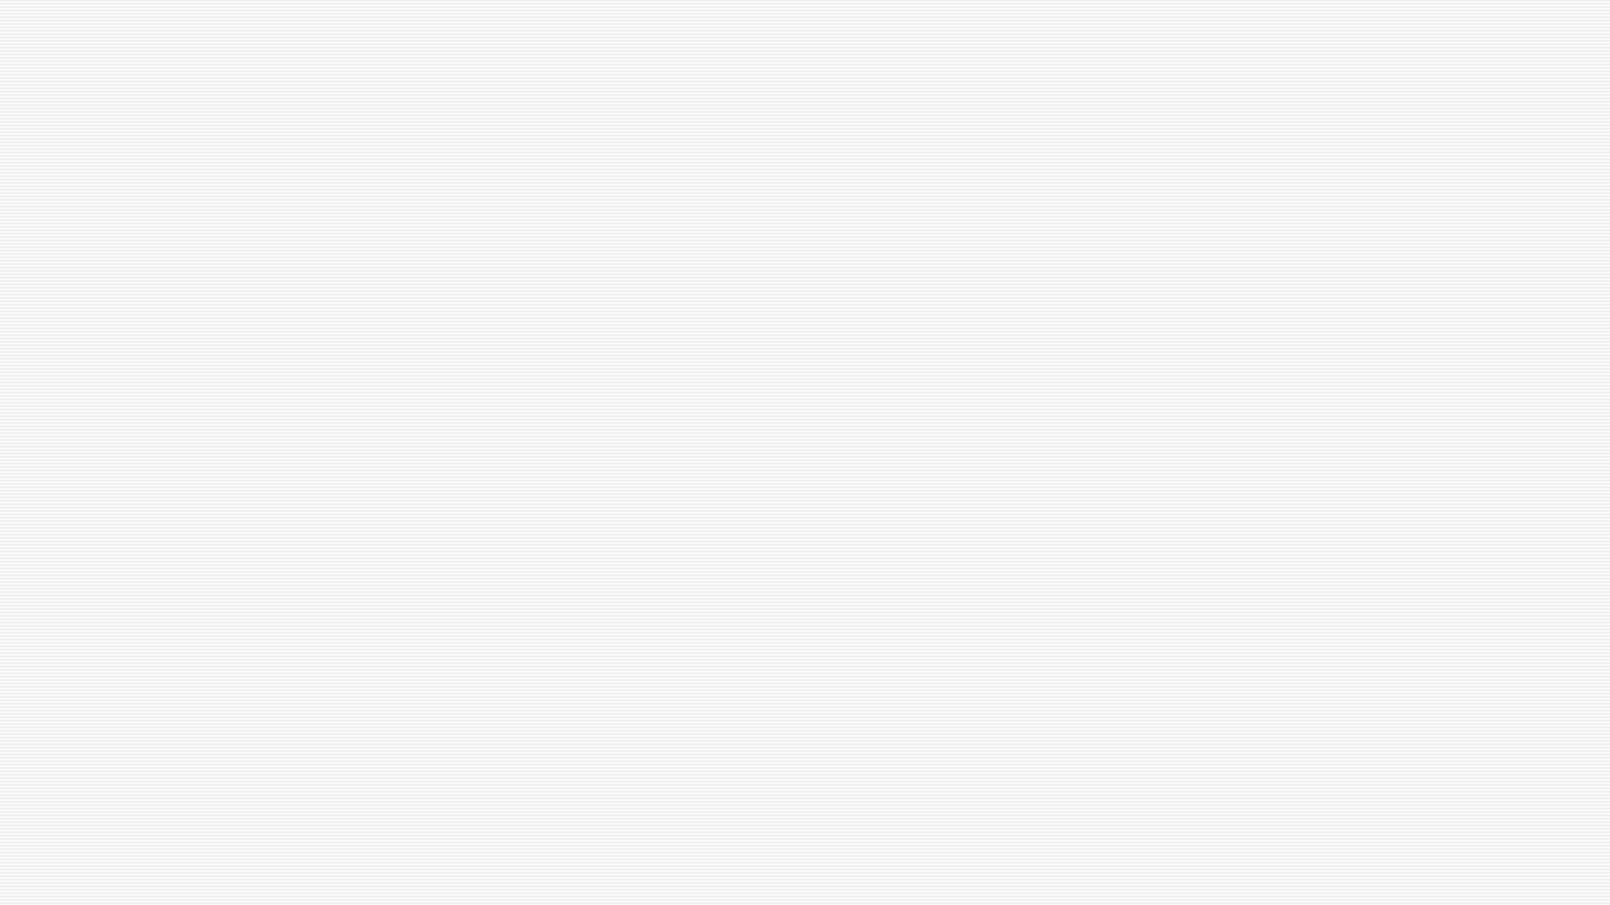


How galaxy properties and evolution shape their intrinsic alignments in hydrodynamical simulations
Marloes van Heukelum, PhD candidate
Supervisor: Elisa Chisari

Slide 2
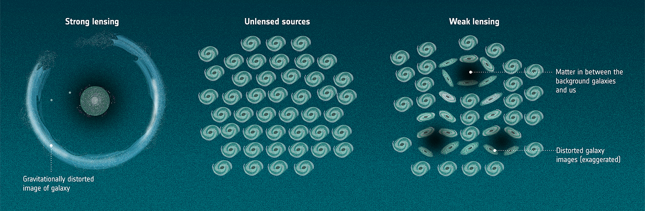
Weak gravitational lensing
Measuring cosmological parameters Ω_{m} and σ₈
1
Source: EUCLID consortium
Notes:
Lambda CDM model parameters. Explain WL as a statistical spatial correlation of galaxy shapes

Slide 3
Intrinsic alignments
Shape galaxies
Local alignment of objects
Weak Lensing contaminant
2pt correlation between positions and shapes
r
Radial (>0)
Position galaxy
Tangential (<0)
2
Notes:
Relation WL and intrinsic aligments: contaminant. How it is measured: pos and shape sample, separation vector (rp, pi), phi, e+, counting pairs, types of alignements. Bridge: understanding mechanisms & drivers

Slide 4
Intrinsic alignment and galaxy properties
More massive galaxies are more aligned
Brighter galaxies are more aligned
Red galaxies are more aligned than blue
Mergers influence alignment
Galaxies are aligned with their host haloes
Satellite galaxies trace their host halo shape
3

Slide 5
Hydrodynamical simulations
e.g. COLIBRE
Calibration + subgrid-models
Box size vs resolution
4
Schaye et al. 2026
Notes:
Box with particles – models and calibration – subgrid-physics – boxsize and resolution and CPU time

Slide 6
Intrinsic alignment of disks and ellipticals across hydrodynamical simulations
TNG300, EAGLE, Horizon-AGN
Simple & reduced inertia tensors
z=0 and z=1
Multiple disk/elliptical definitons
https://arxiv.org/abs/2510.11118 (MvH & N.E. Chisari 2026)
5

Slide 7
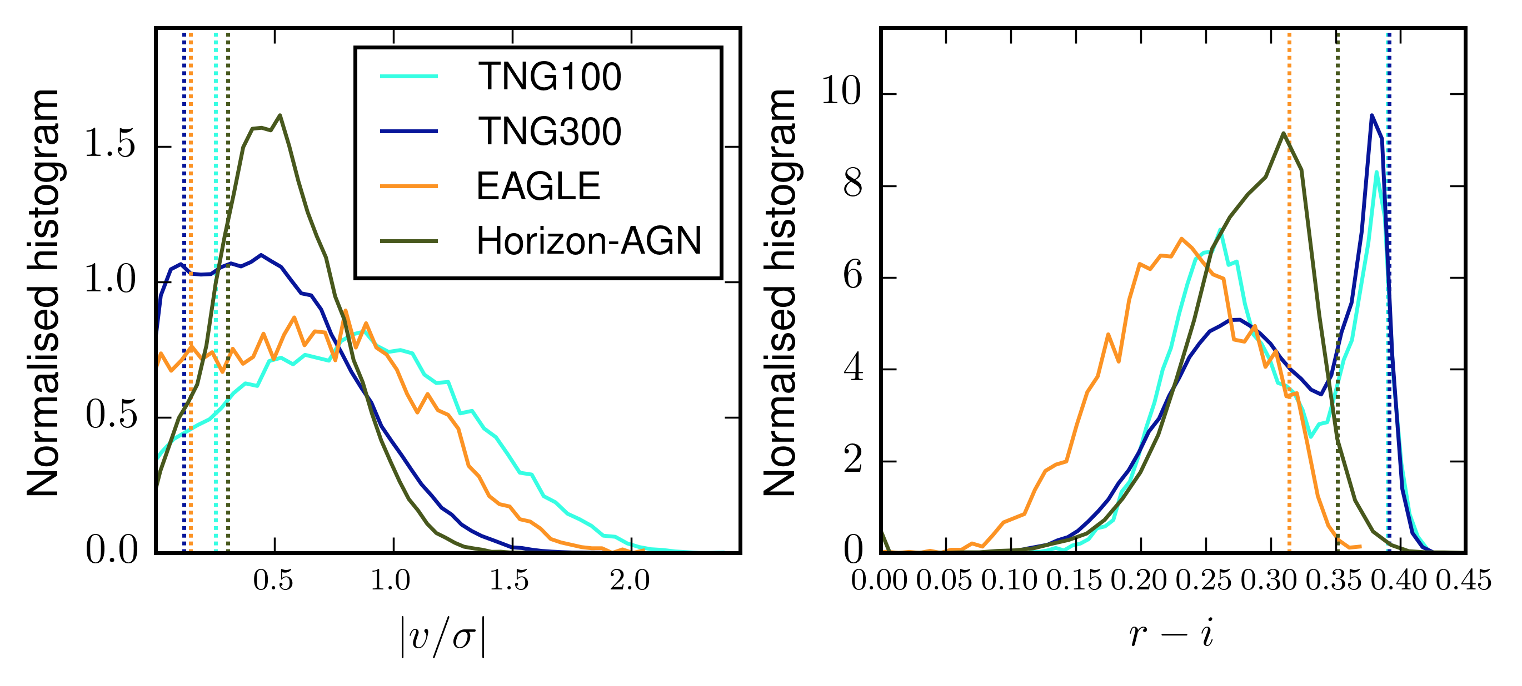
Defining disks and ellipticals
Distributions of disk and elliptical defining variables at z=0
3 simulation suites: TNG,
EAGLE, Horizon-AGN
|v/σ| = rotational velocity / dispersion
D:E = 90:10
6
Notes:
Explain variables, TNG100 and TNG300 differences because of resolution. Dilemma: how to choose definitons?

Slide 8
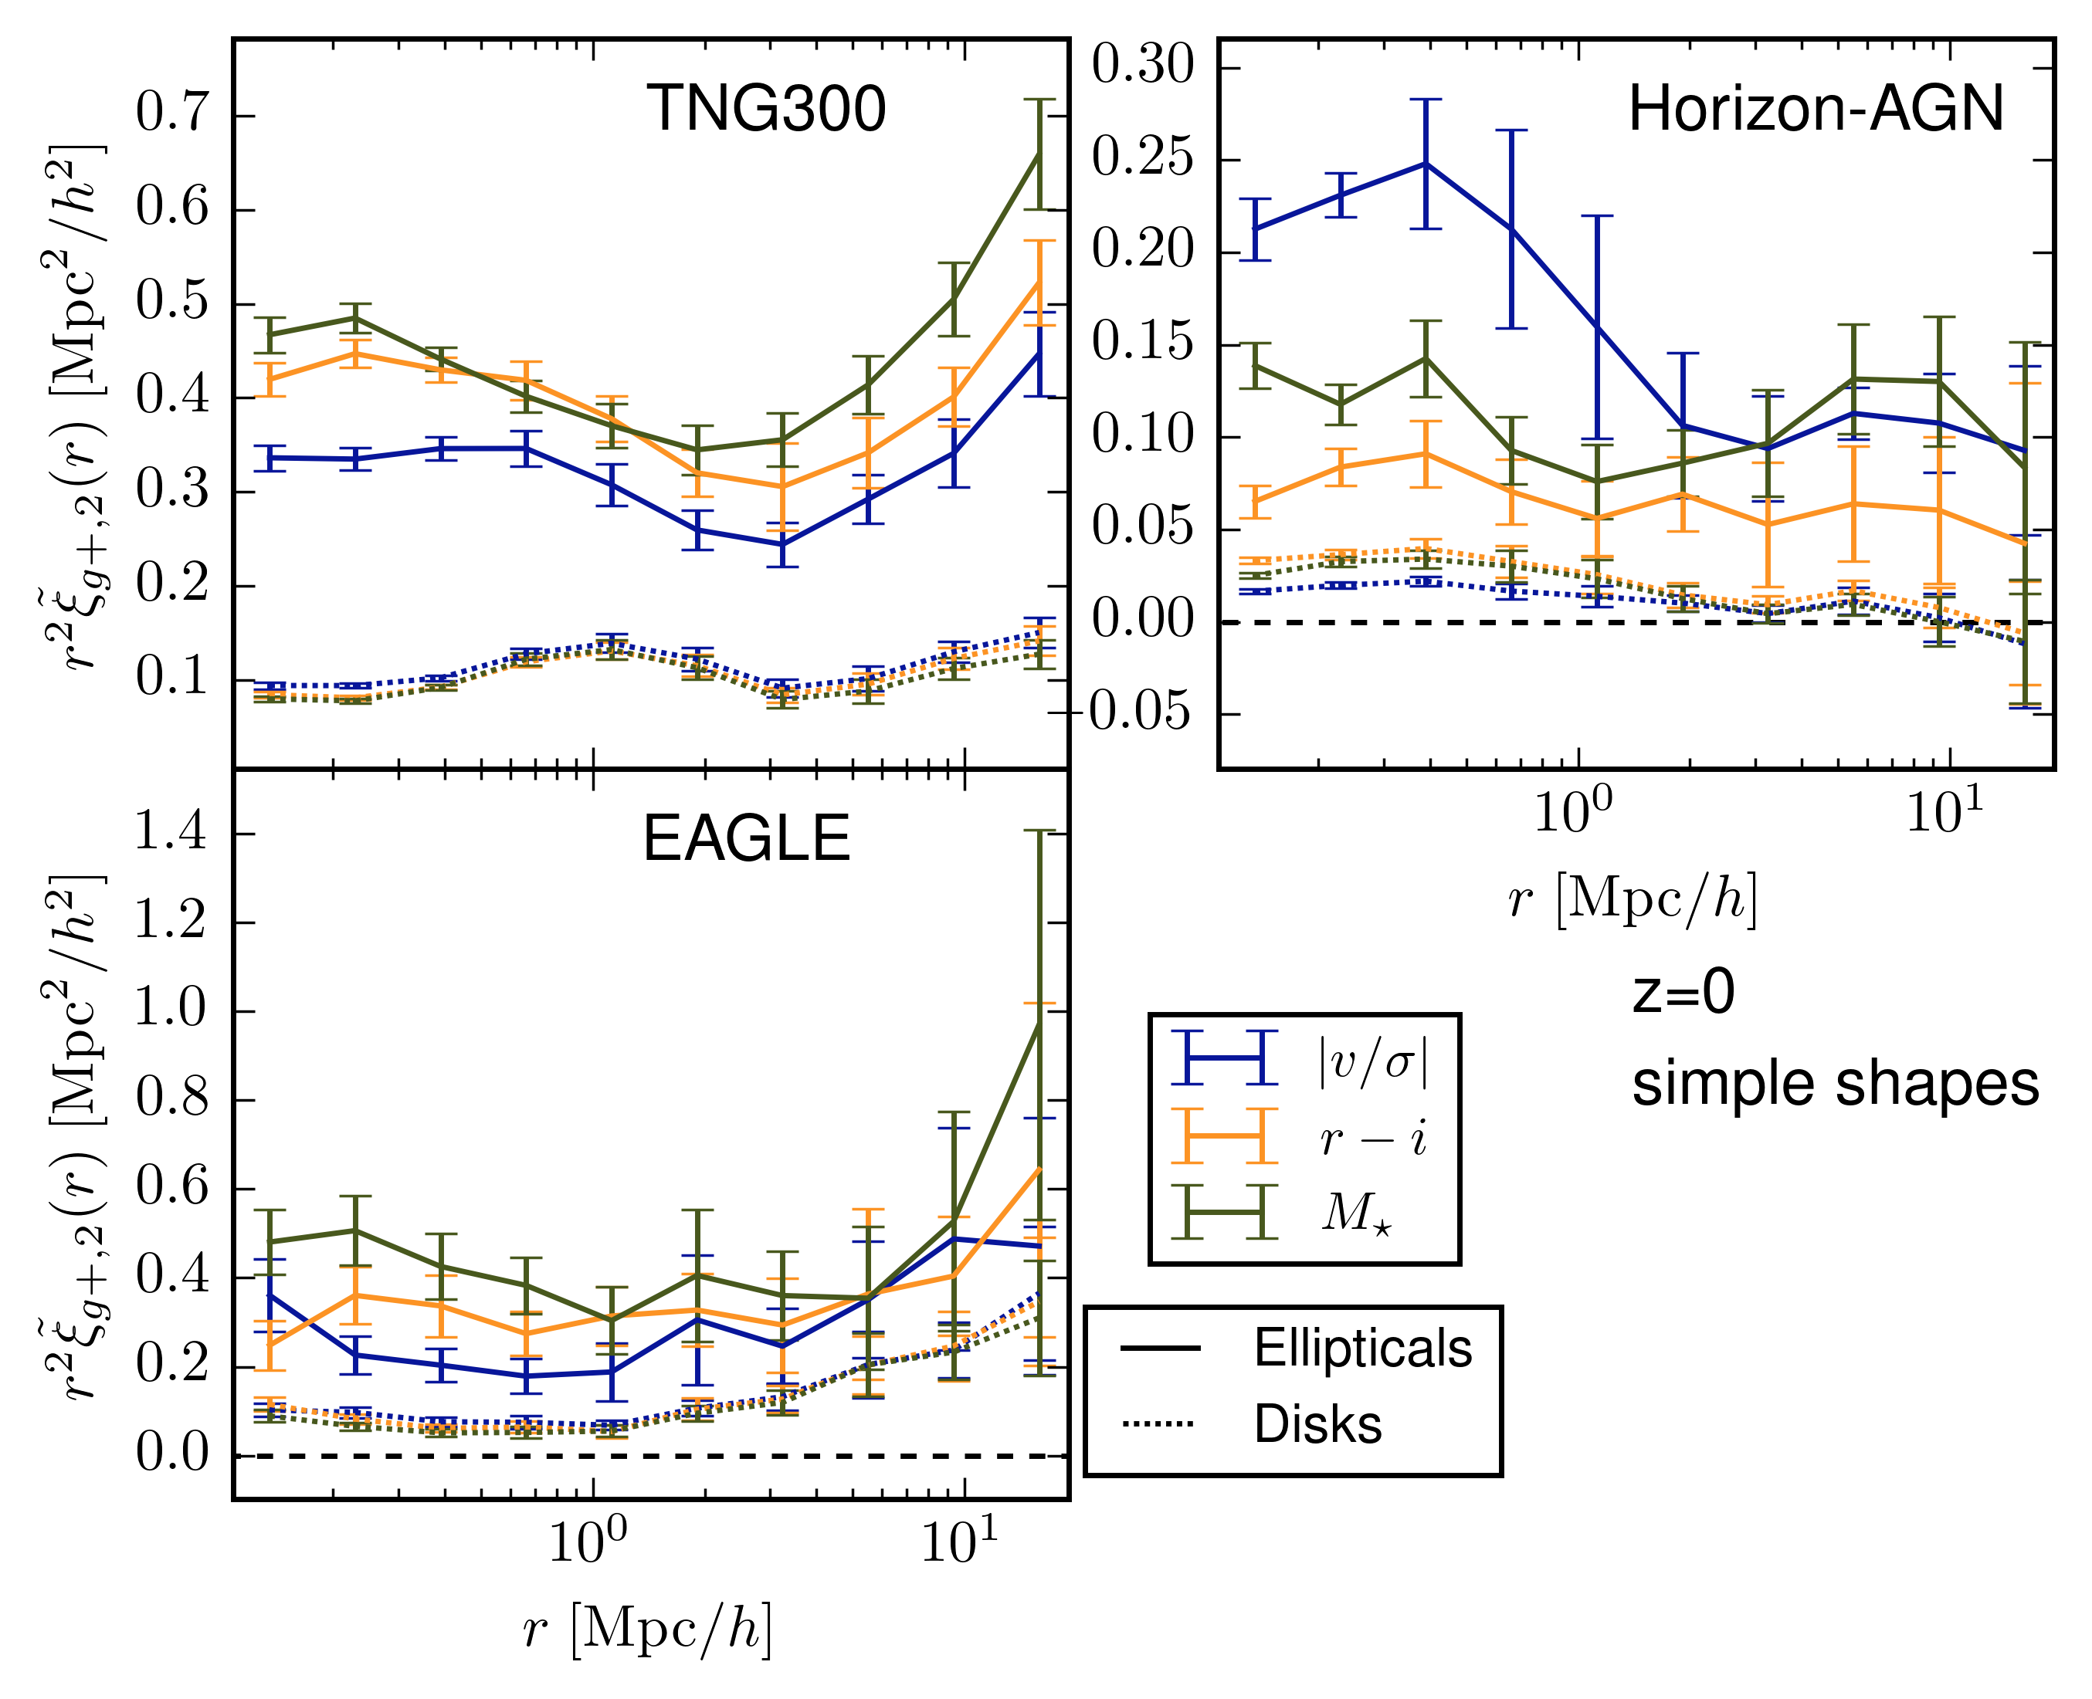
Disks and ellipitcals around galaxies
Similar but not the same
Disk signal > 0
Influenced heavily
by underlying
mass distribution
7
Notes:
Mass sample. E>D in all sims, >0 in all sims. EAGLE not big enough. TNG and underlying mass distr. Horizon and underlying mass distributions

Slide 9
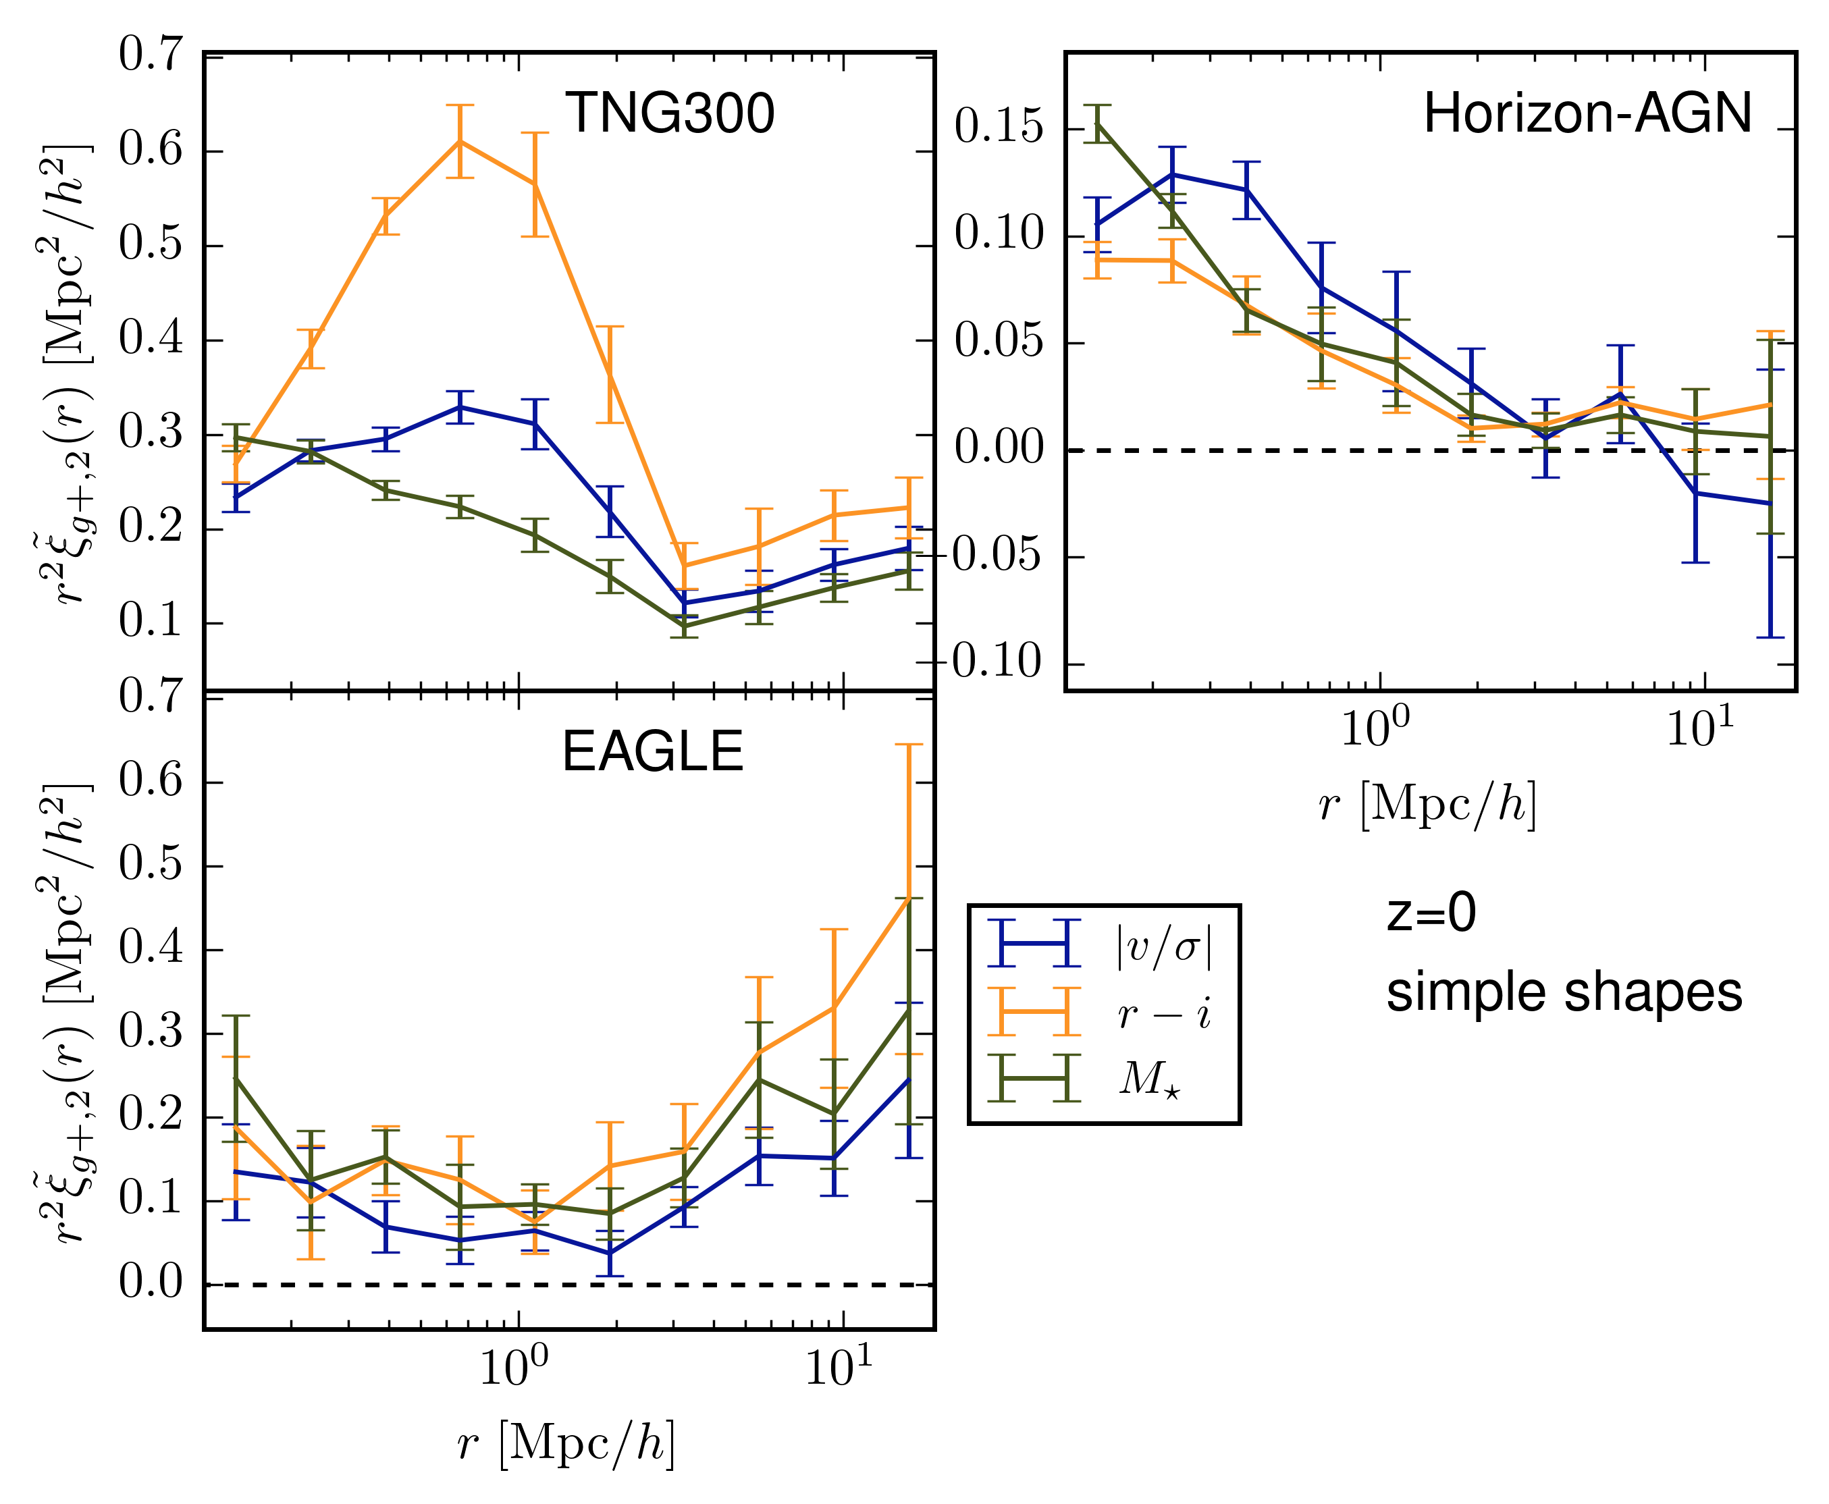
Disks around ellipticals
Scale dependence differs
Hints of < 0 signal
(Horizon-AGN)
8
Notes:
Different type of signal (CH paper). Motviated by how galaxies are distributed. Quite different for each sim. Horizon shows possible <0 signal

Slide 10
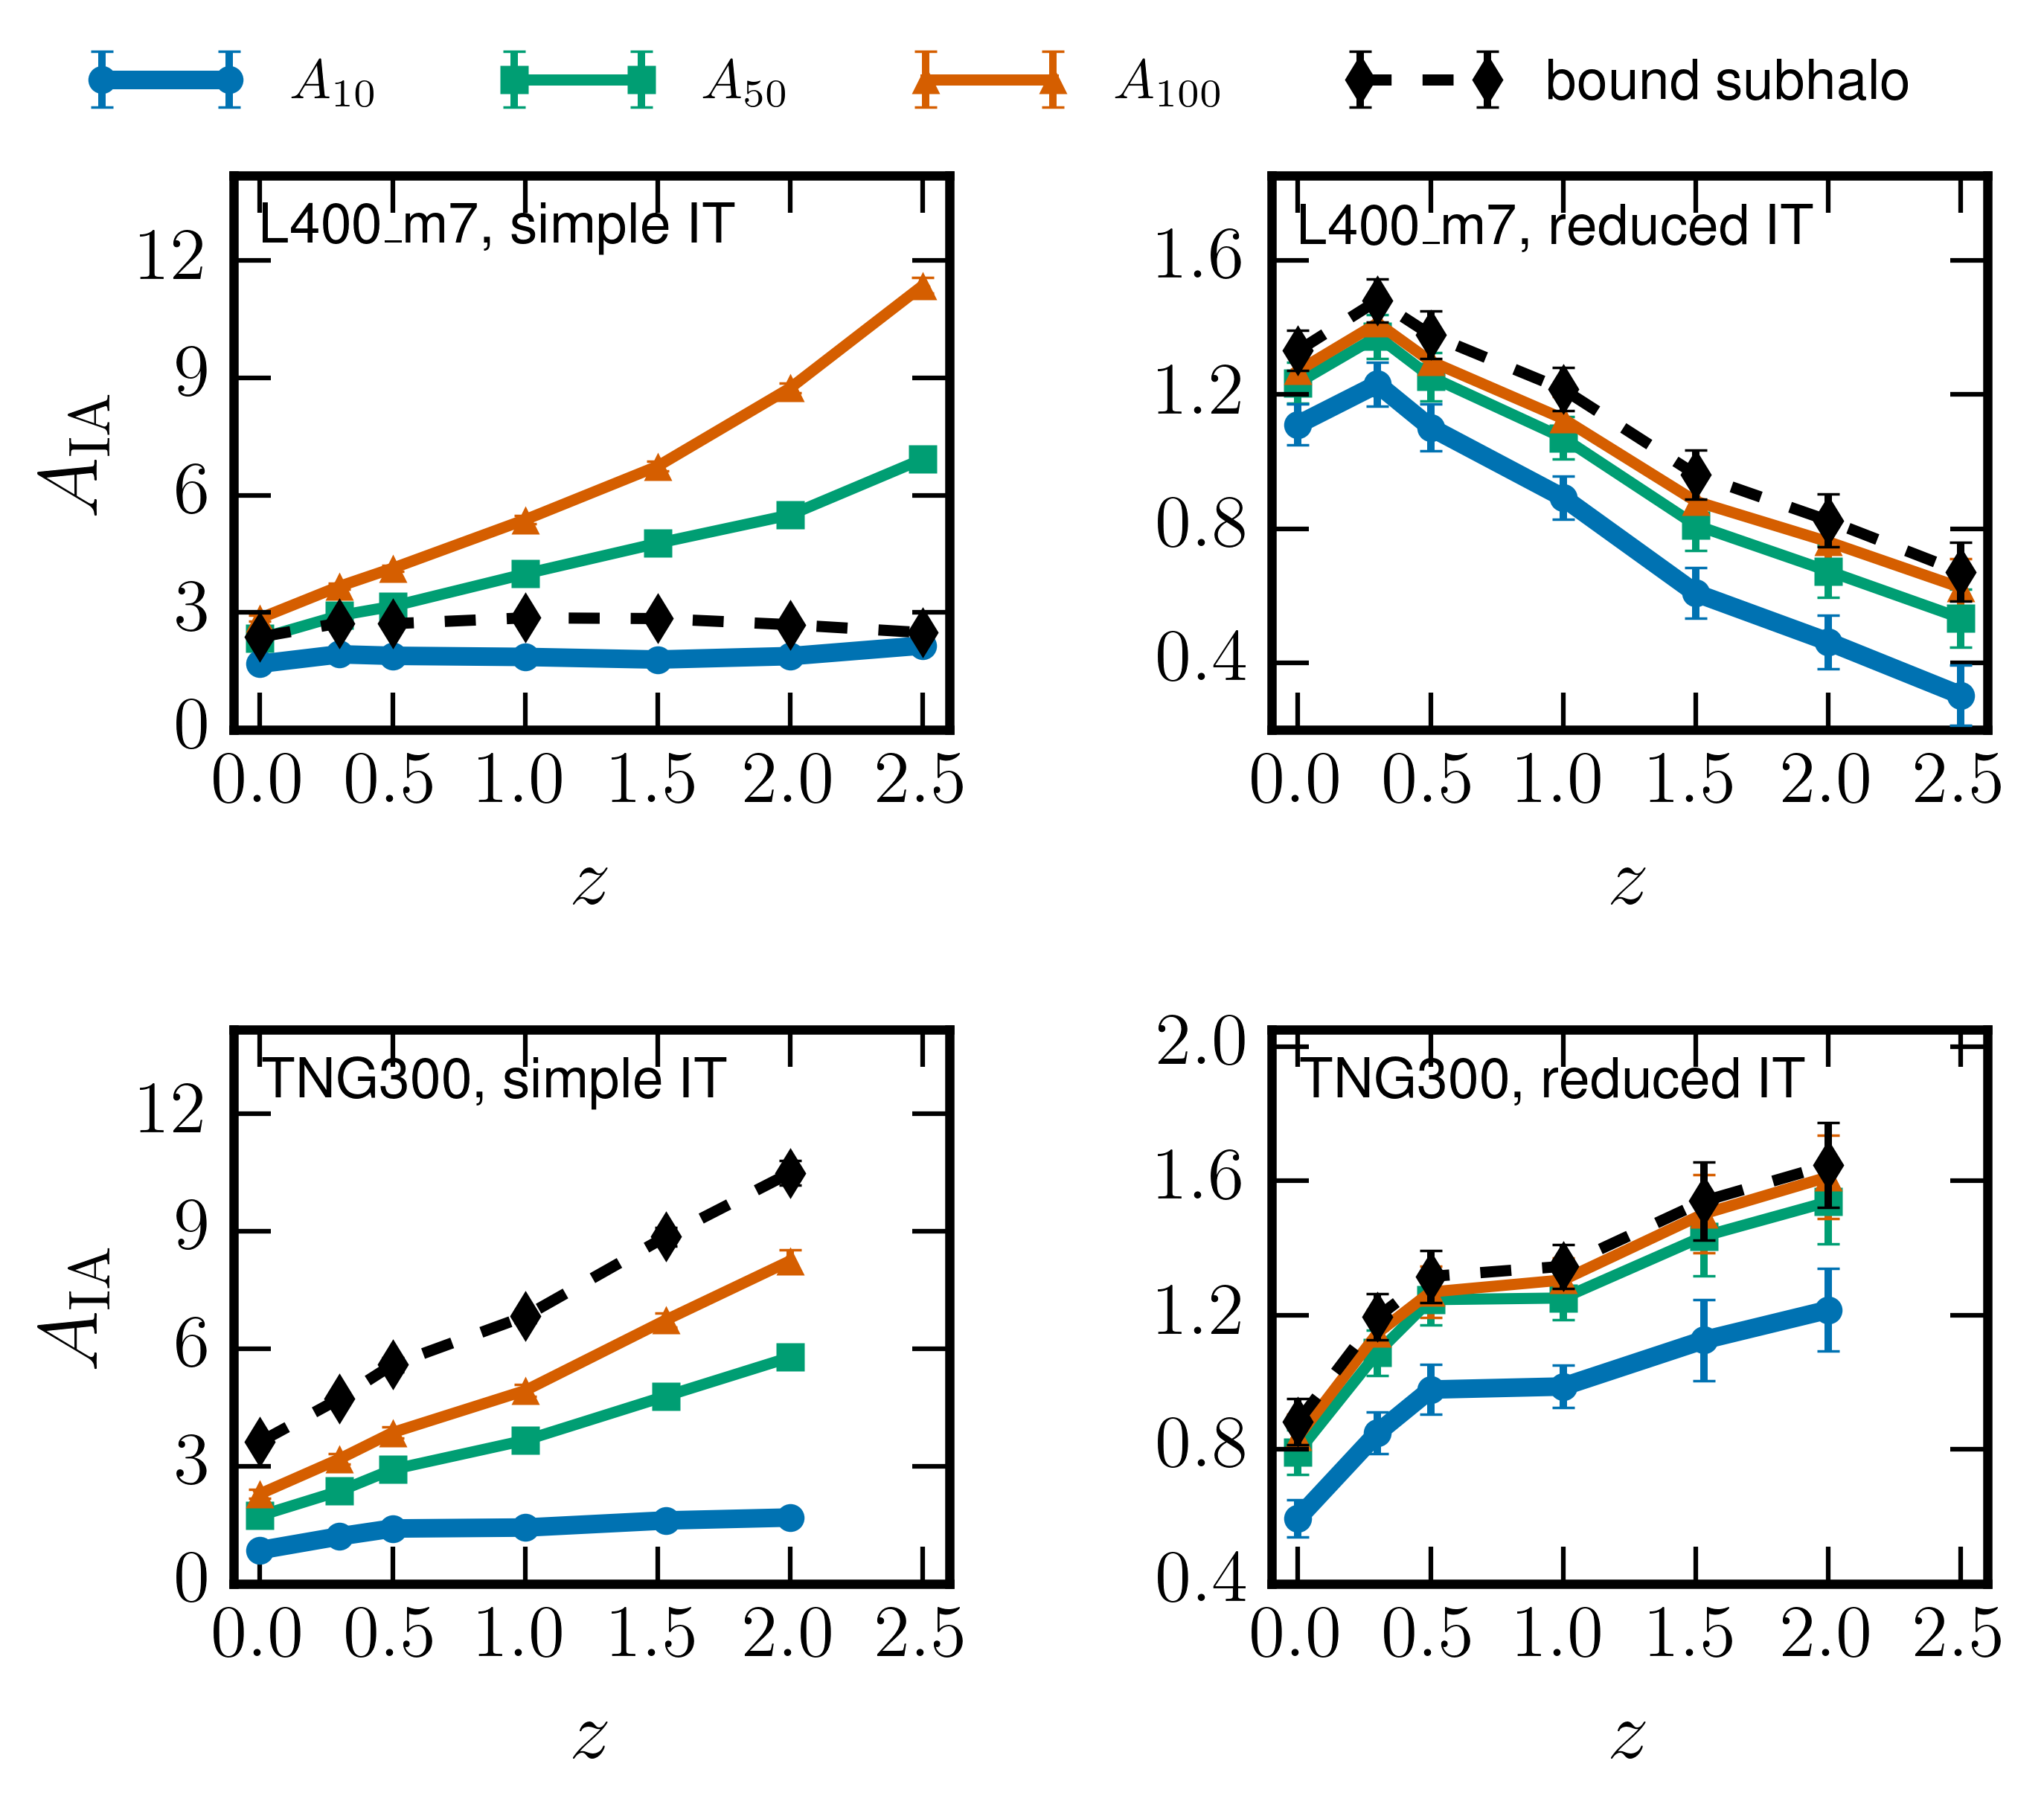
Redshift evolution
Alignment amplitude, A_{IA}
Shape and subhalo definition
PRELIMINARY
9

Slide 11
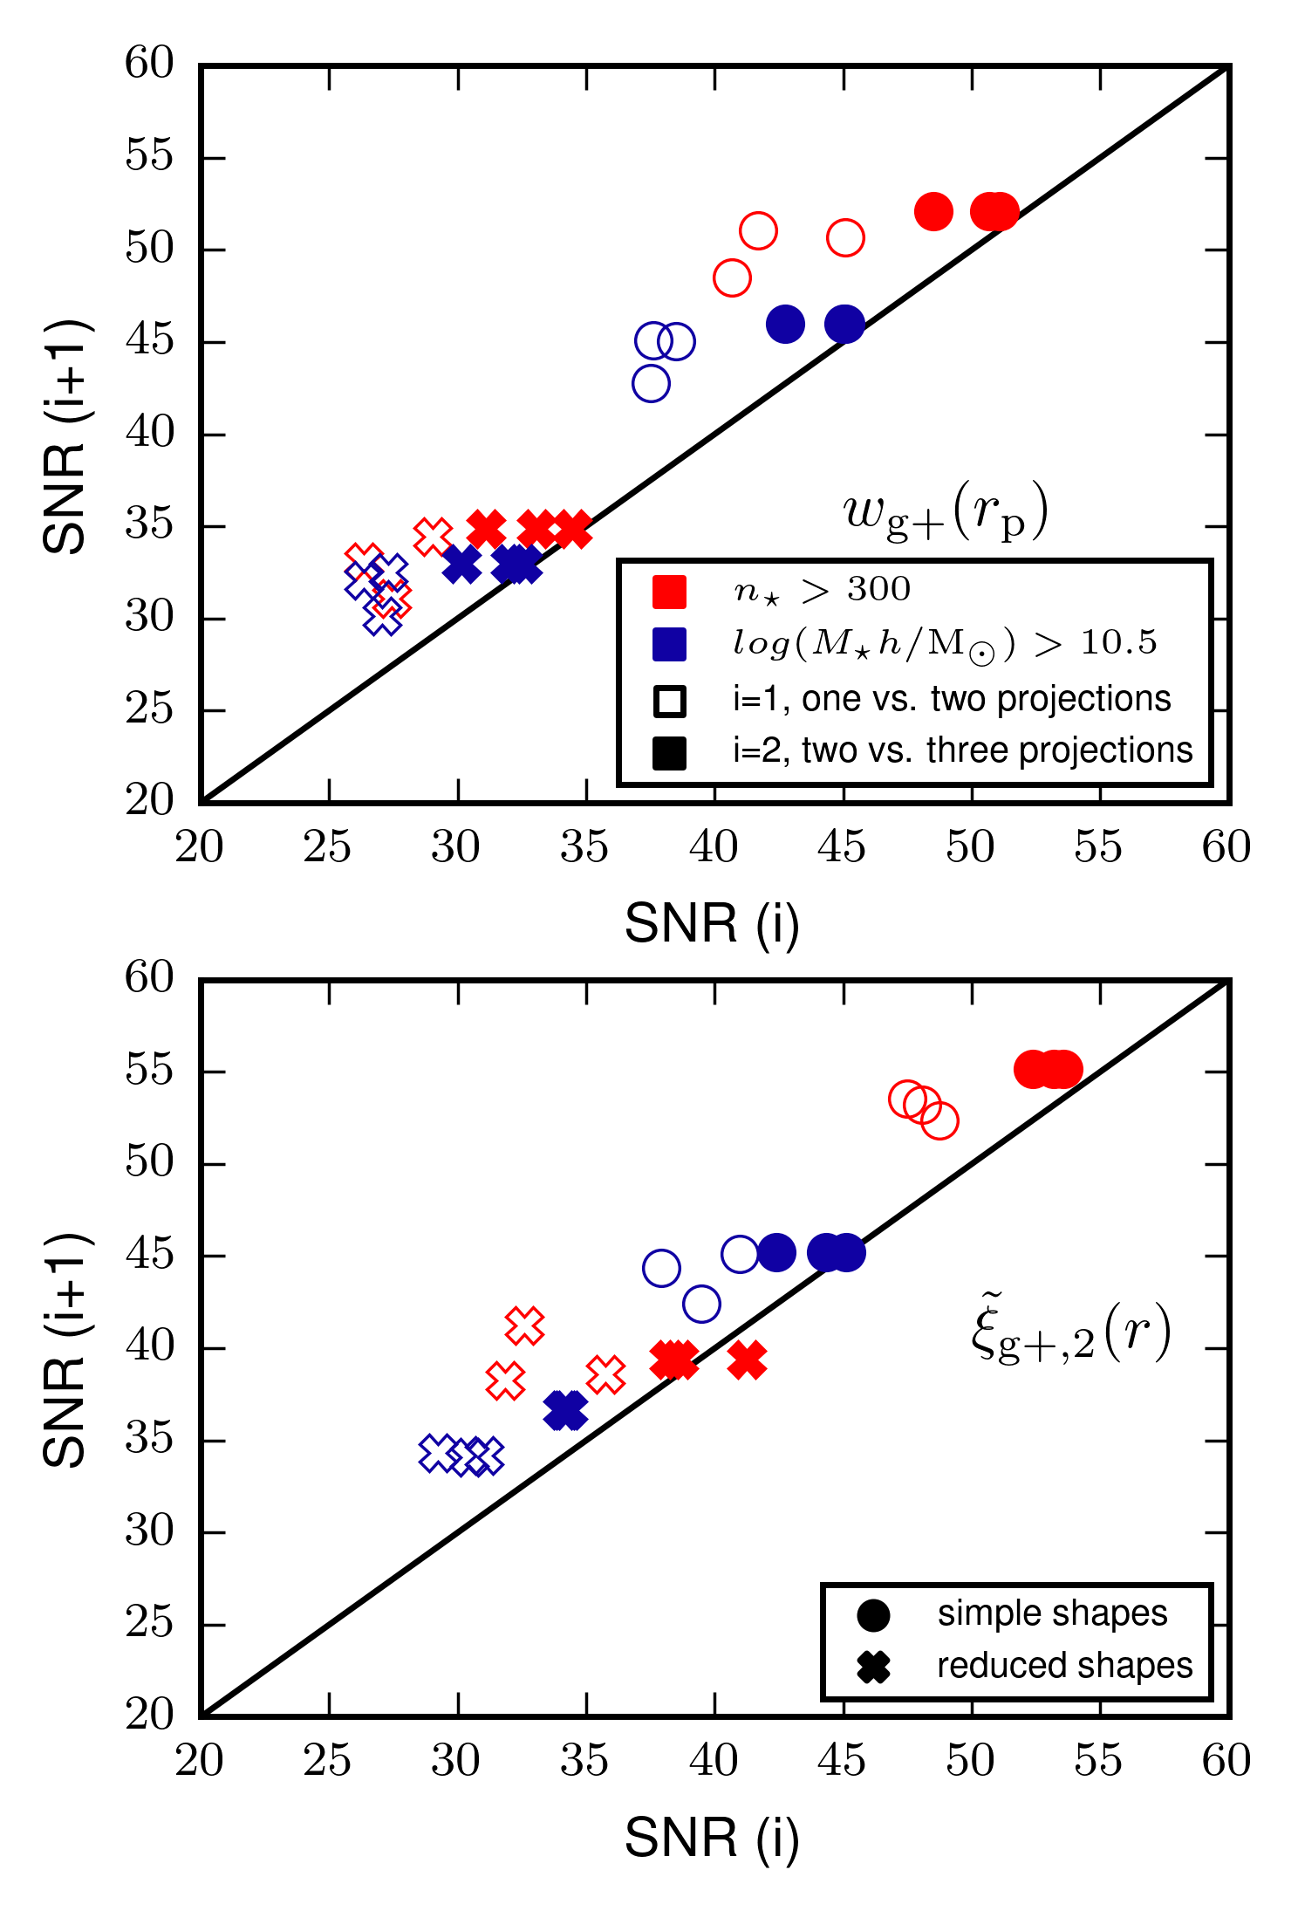
Combining multiple projections increases SNR!
Robust gains across samples, estimators, shape type (and more)
Includes cross-covariance
SNR Gain 1->2 > SNR Gain 2->3
Also SNR gain in NLA fitting amplitude
https://arxiv.org/abs/2509.07734 (MvH, D. Neumann, M.G. Escobar, N.E. Chisari & H. Hoekstra 2026)
10

Slide 12
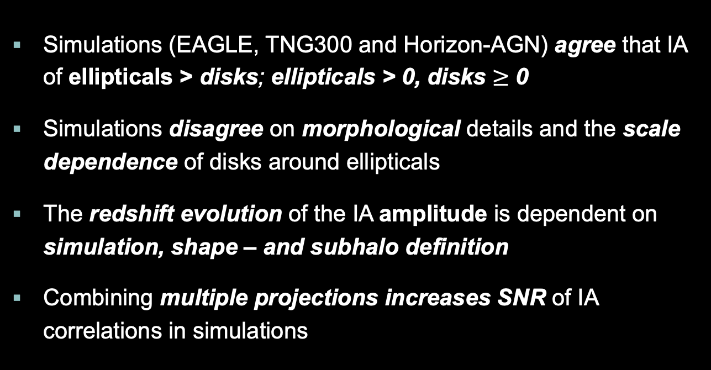
Key takeaways
Simulations (EAGLE, TNG300 and Horizon-AGN) agree that IA of ellipticals > disks; ellipticals > 0, disks $≥$ 0
Simulations disagree on morphological details and the scale dependence of disks around ellipticals
The redshift evolution of the IA amplitude is dependent on simulation, shape – and subhalo definition
Combining multiple projections increases SNR of IA correlations in simulations
11

Slide 13
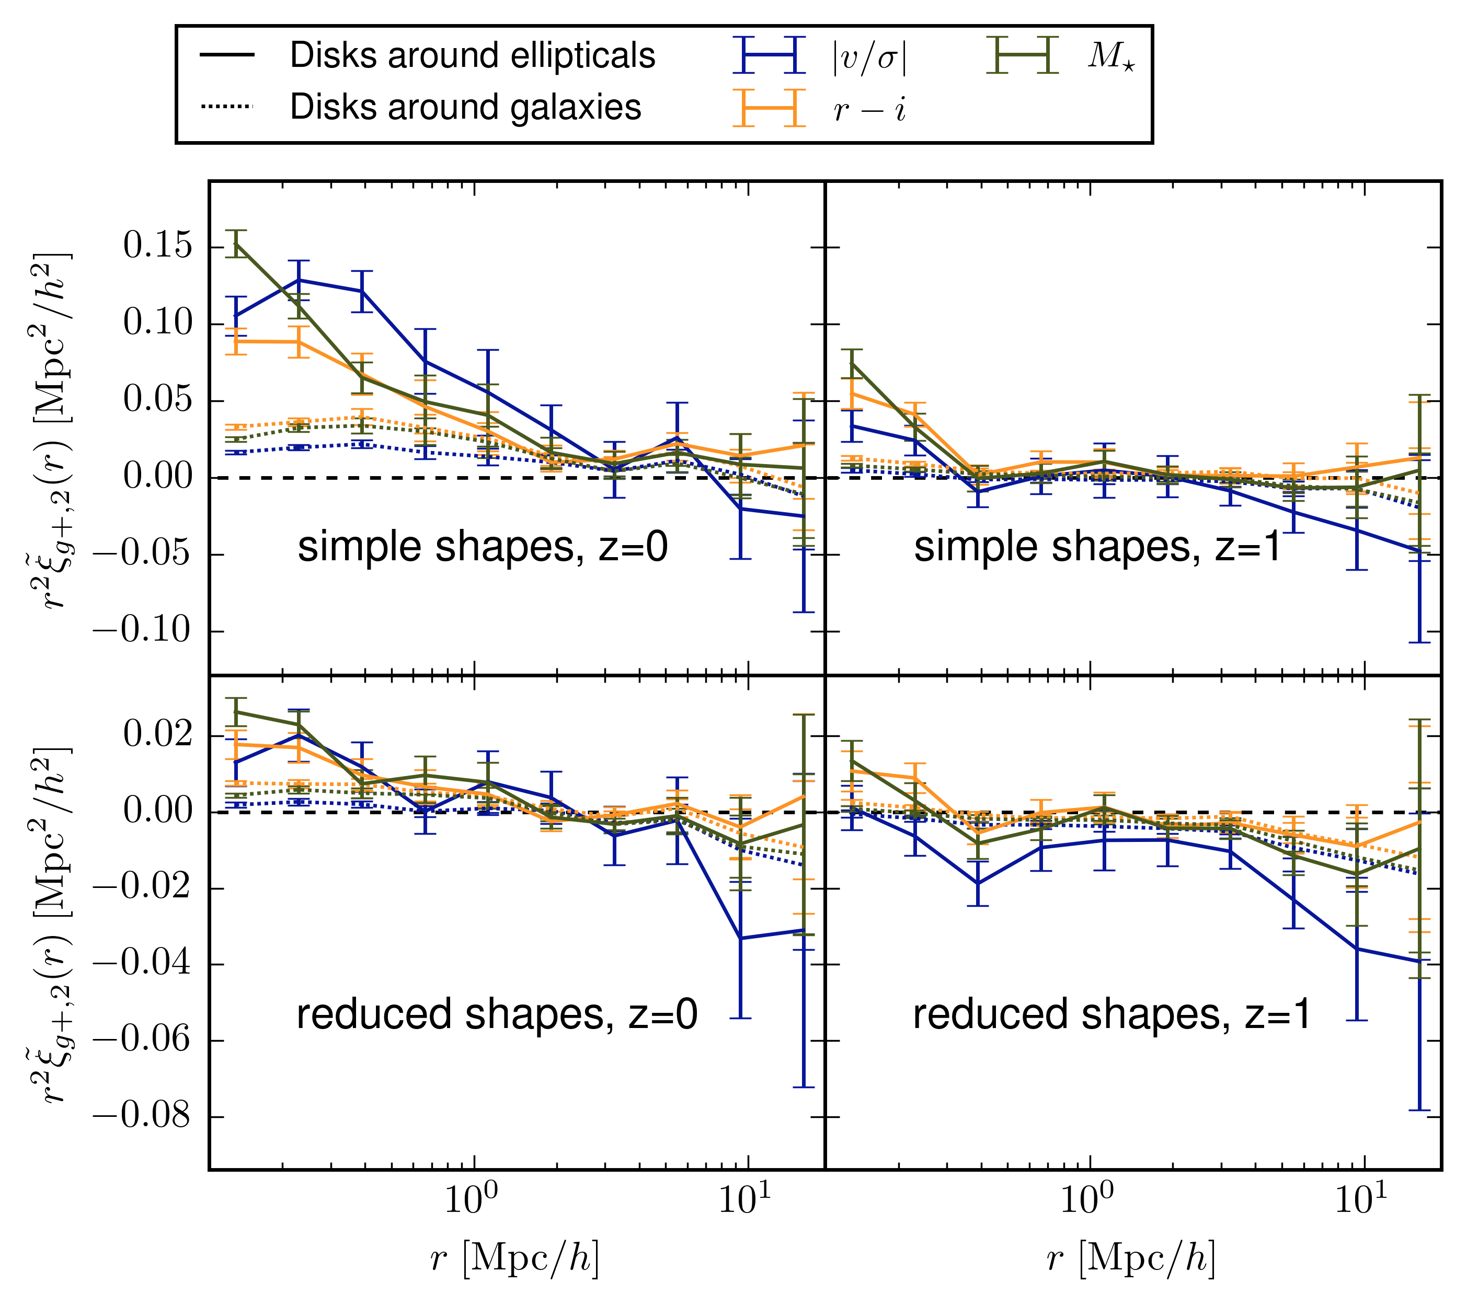
Disk signal in Horizon-AGN
Disks around galaxies and disks around ellipticals
< 0 disk signal depends on
measurement choices
13
Notes:
DxE and AB signals. Diminsh at higher z and for reduced. R1 shows negative signals (visg)

Slide 14
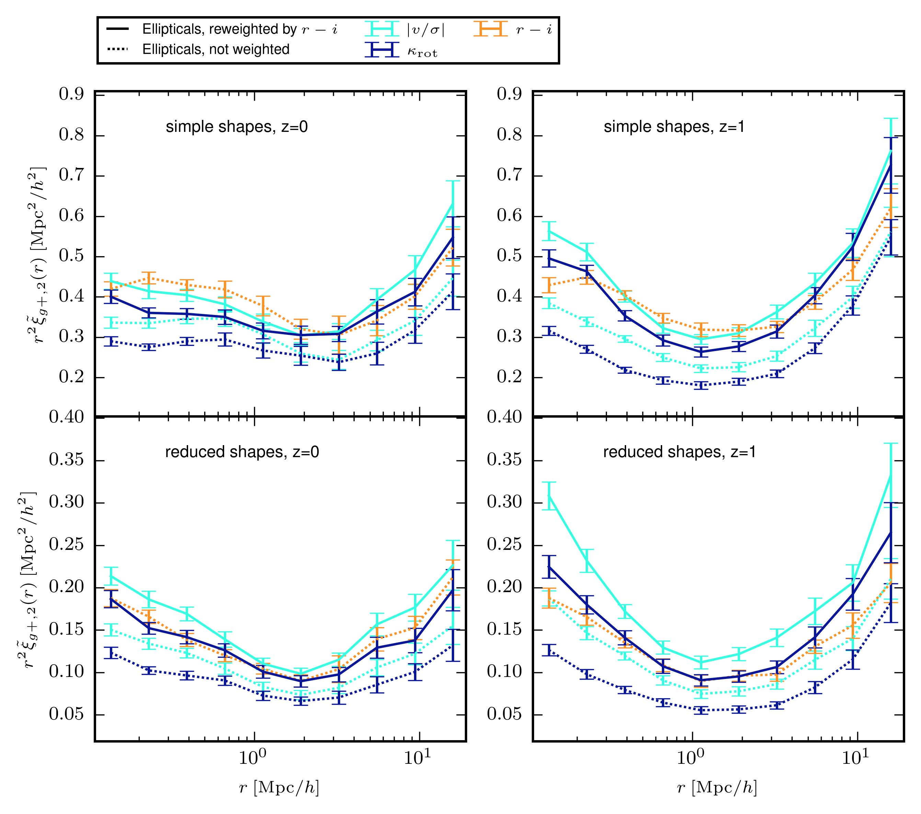
Mass relations
Reweighted by r-i stellar mass distributions
w_{j} = p_{r−i} / p_{e}
Mostly dominated by mass, not physics

Slide 15
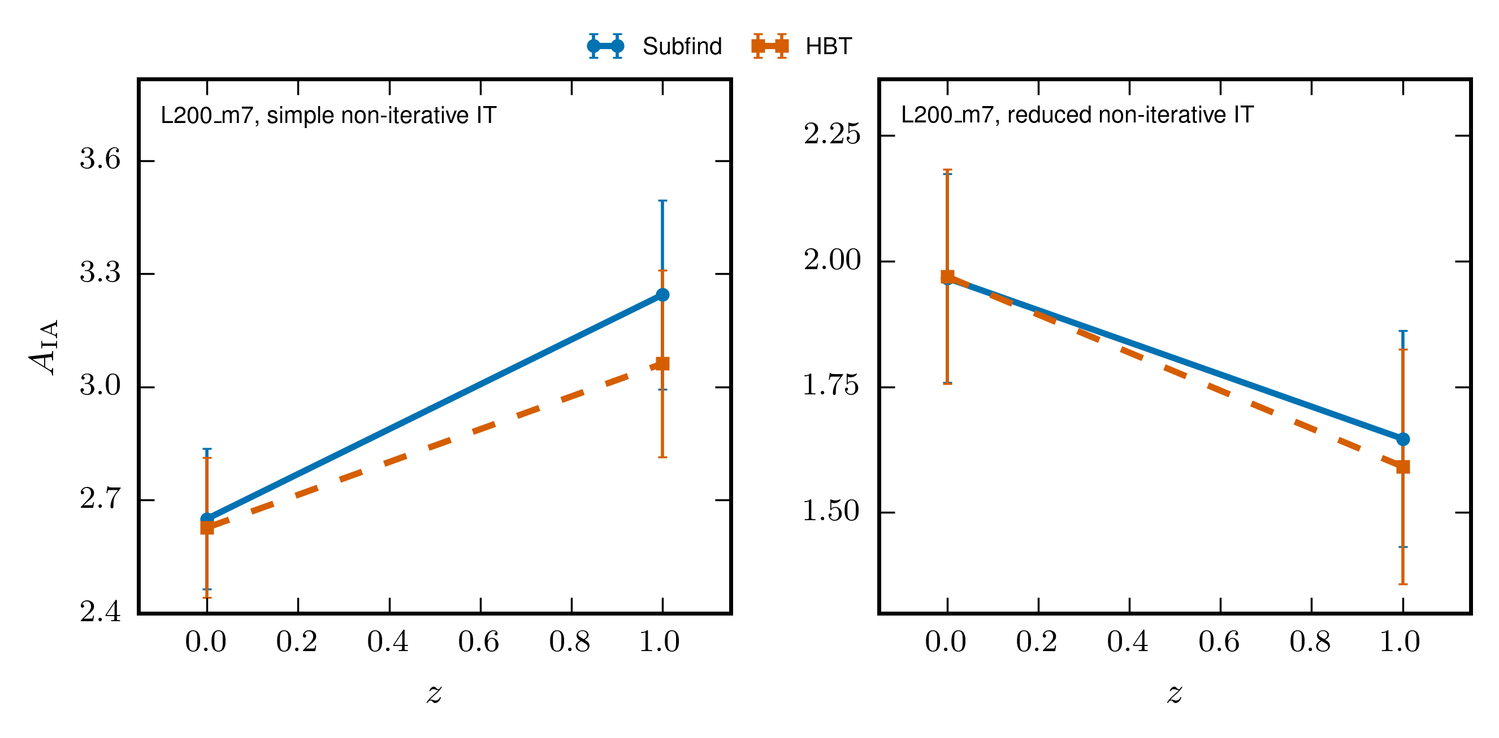
Impact halo finder
Halo finders agree
PRELIMINARY

Slide 16
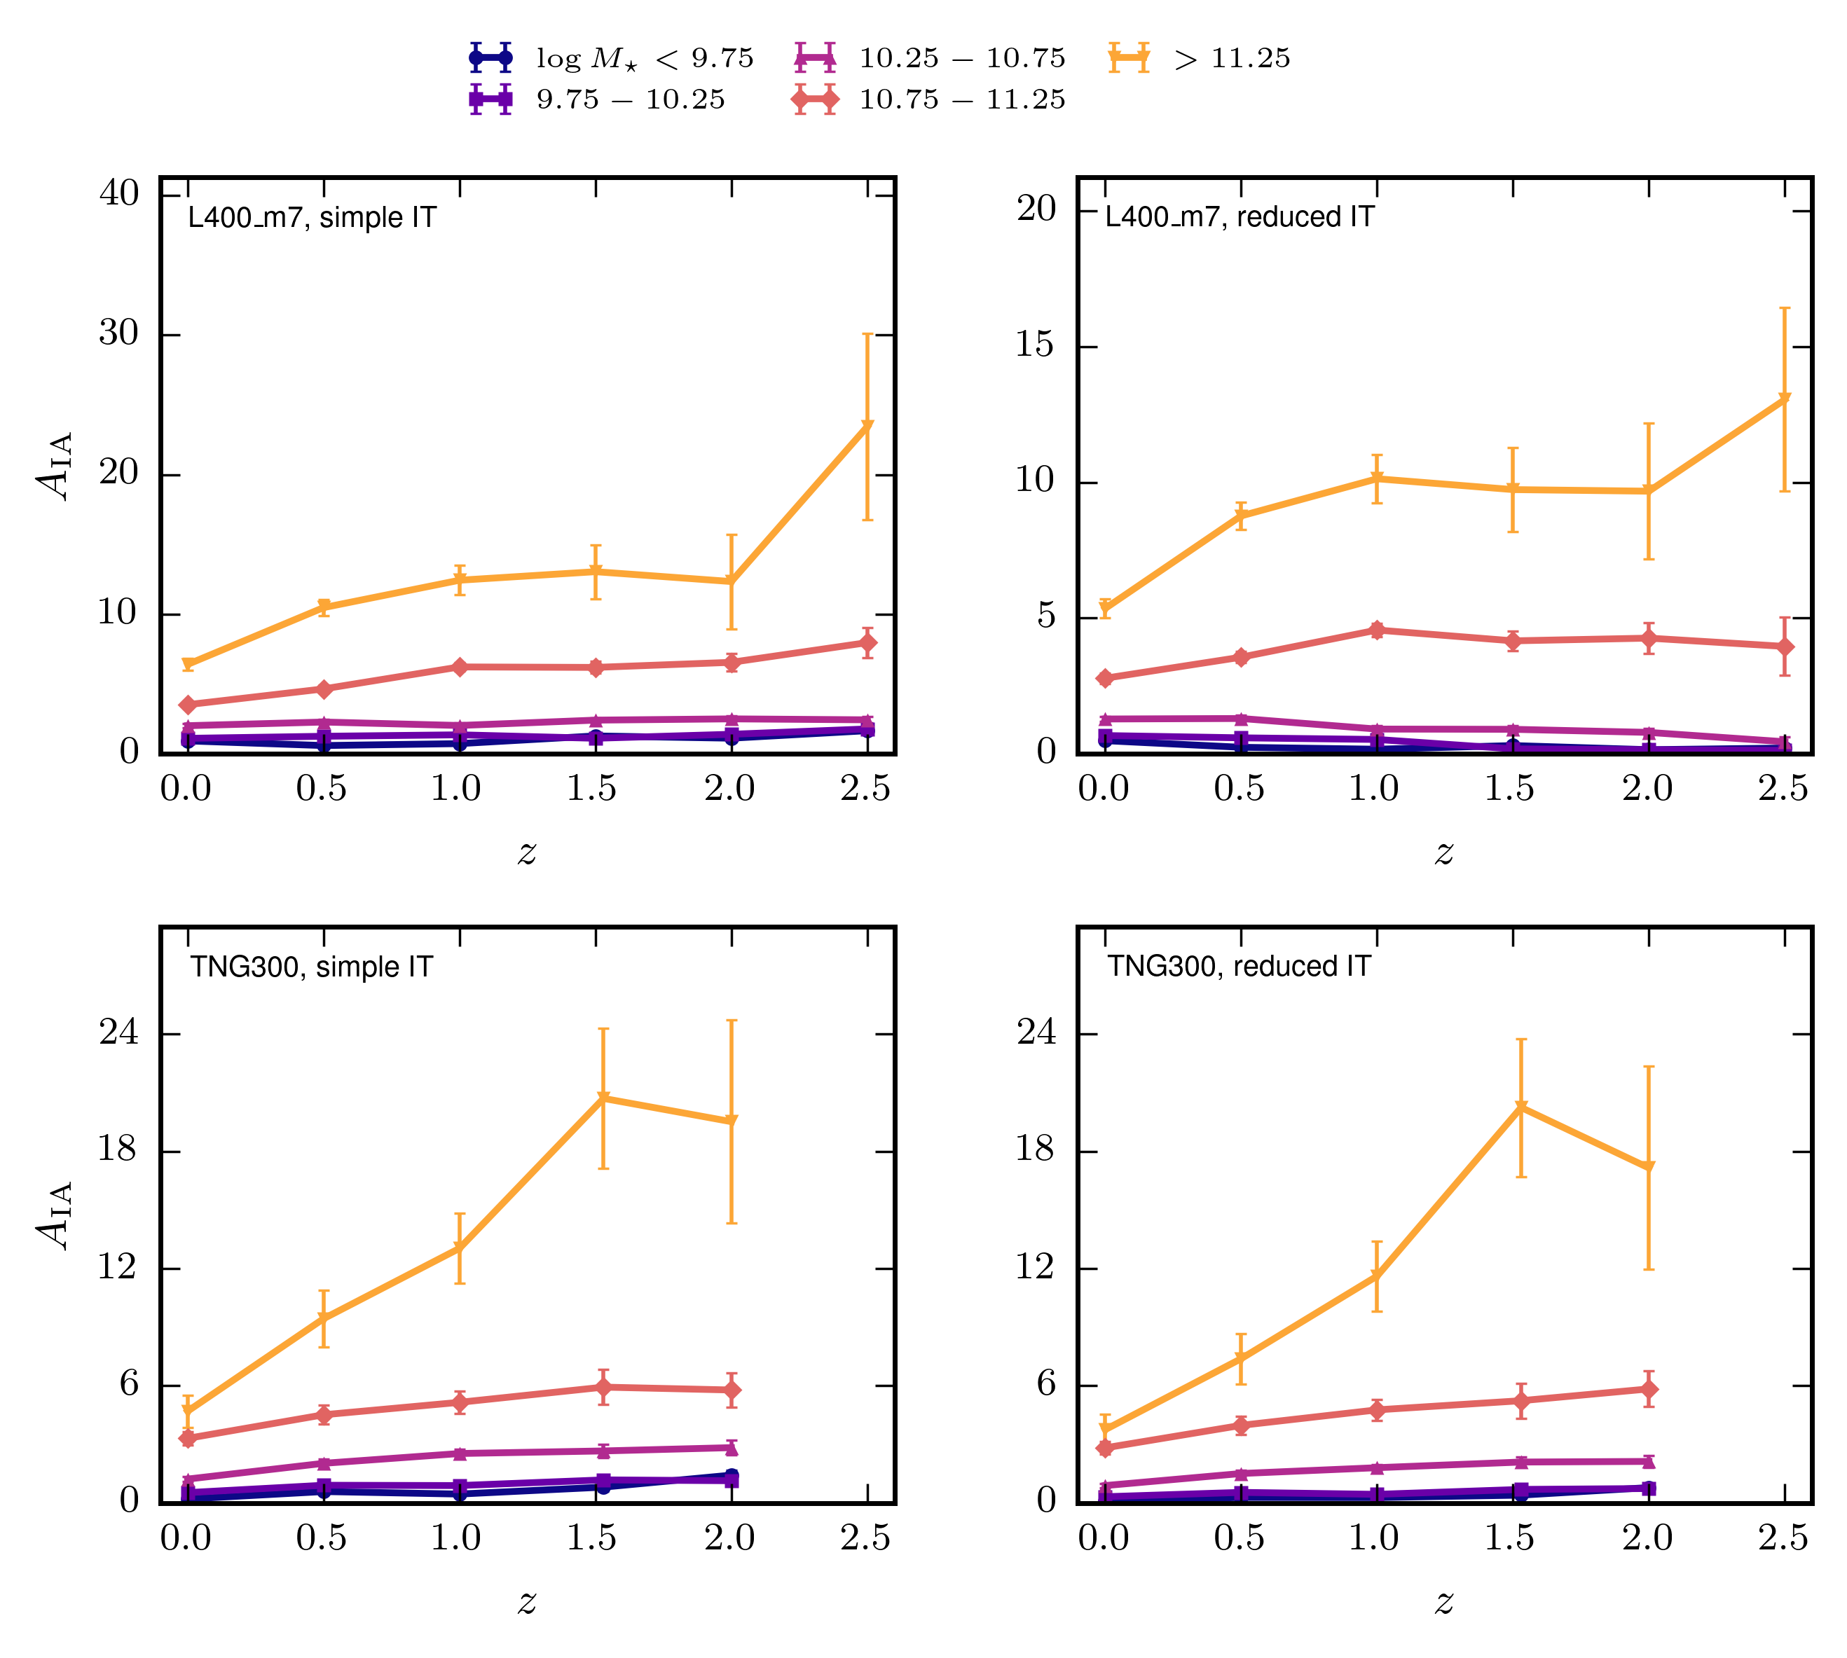
Redshift evolution per mass bin
PRELIMINARY

Slide 17
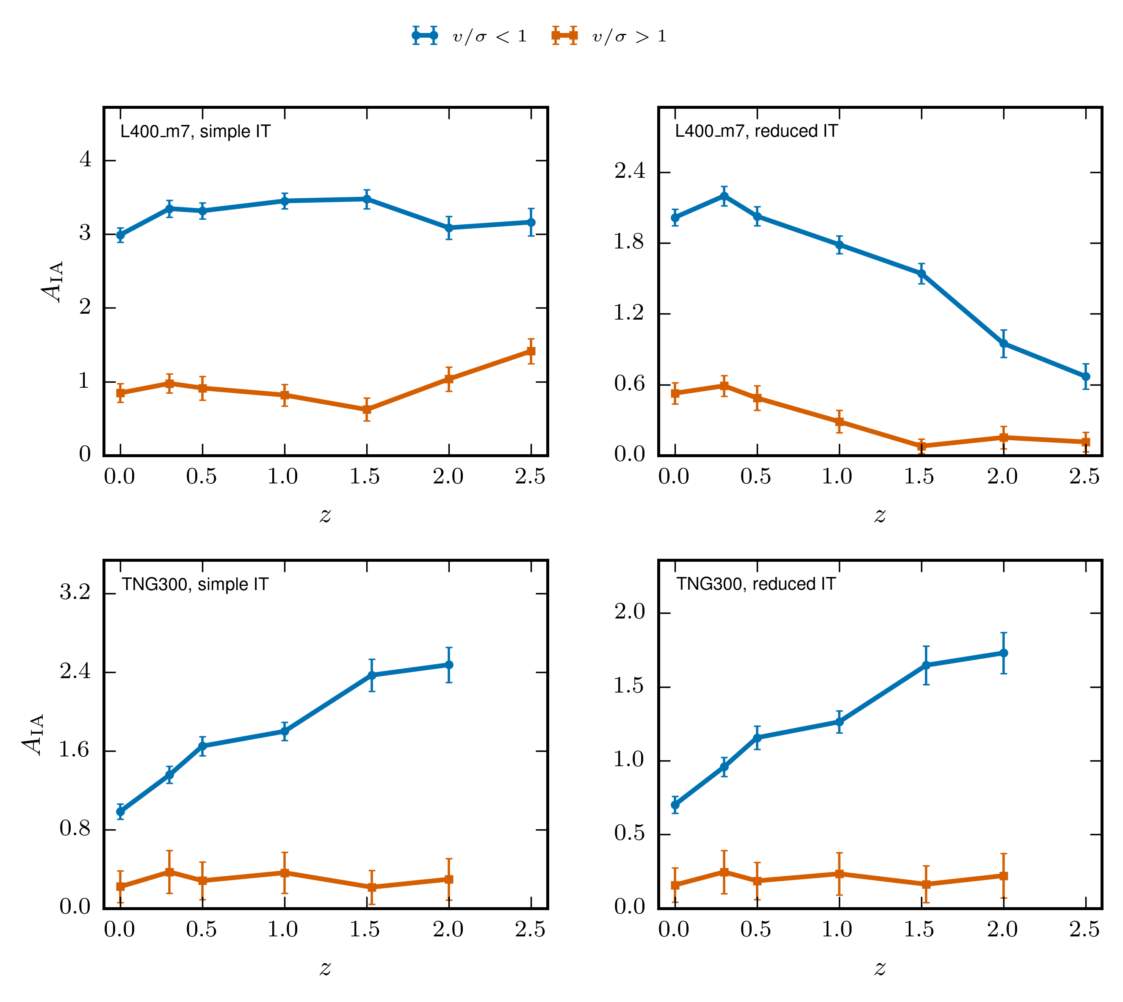
Disks and ellipticials and redshift evolution
PRELIMINARY

