Slide 1
End of Year Talk
Barry Tan

Slide 2
A little bit about me
Name: Barry (Xinyuan) Tan
Office: 326a
Role:
  Andy Buckley’s PhD student;
  Demonstrator;
  Son of my father…

Slide 3
Things I did
EIC:
  Validated the software chain (MC simulation and analysis) in the EIC software environment, using inclusive dijet photoproduction and DIS dijet production.
  Developed Rivet routine of exclusive photoproduction process for EIC MC generator validation, in collaboration with the Nuclear Physics group.
FastJet/Rivet:
  Developed a more complete version of QCDAware FastJet plugin jet algorithm to include flavour information – better separation of QCD and QED radiation; more precise lepton dressing in Rivet, etc.
ATLAS QT:
  Validate Sherpa LO and NLO configurations in top quark MC modelling. Contribute new Rivet top analyses.
  Investigate the impact of Sherpa colour-reconnection (CR) modelling on top quark observables.

Slide 4
Things I am going to do
Complete ATLAS QT:
  Identify observables with deficient modelling.
  Improve Sherpa colour reconnection model.
  Tune the Sherpa process configuration and parameters.
Investigate observables in H/Z -> bb sensitive to colour reconnection.
LTA (probably not CERN but somewhere on the earth…)

Slide 5
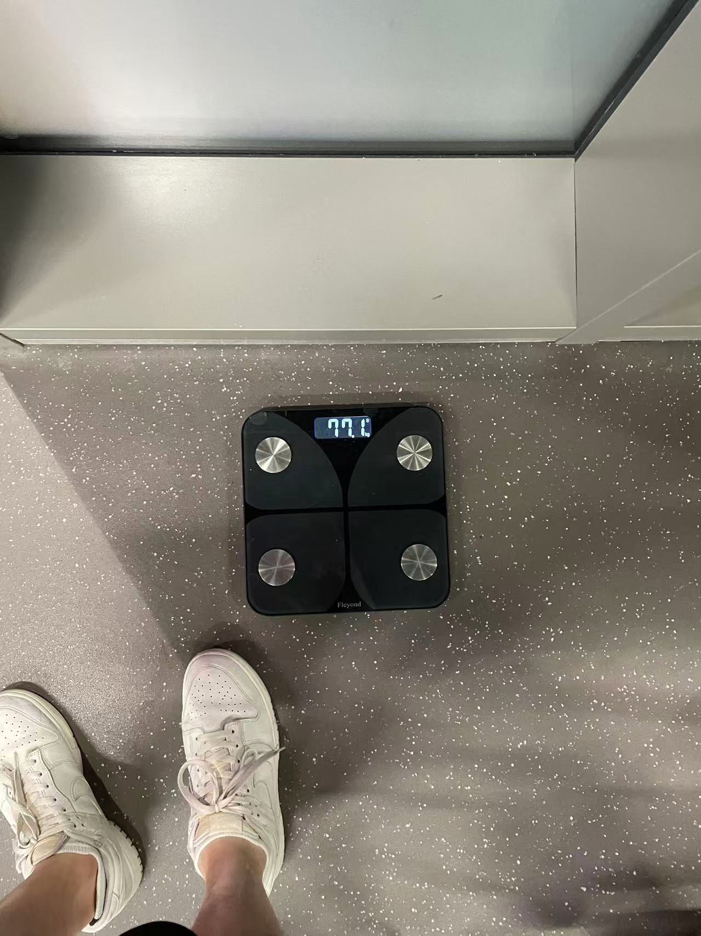
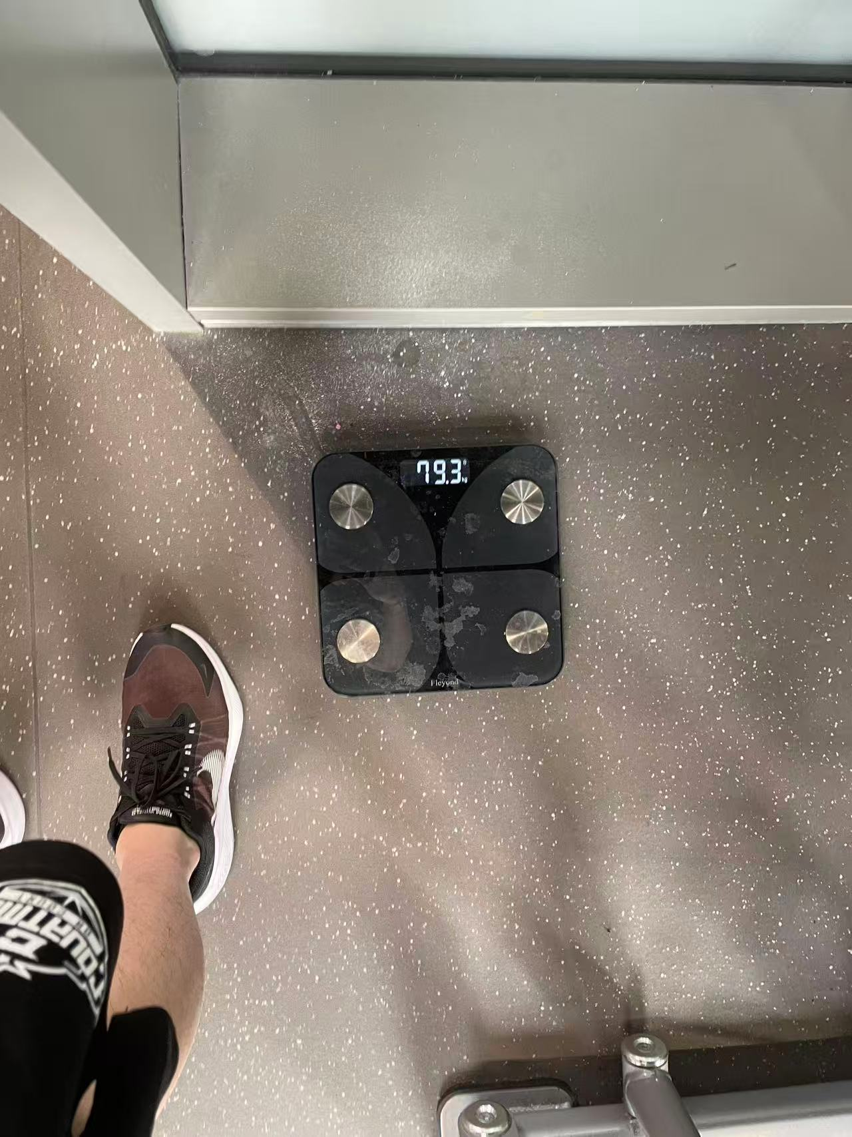
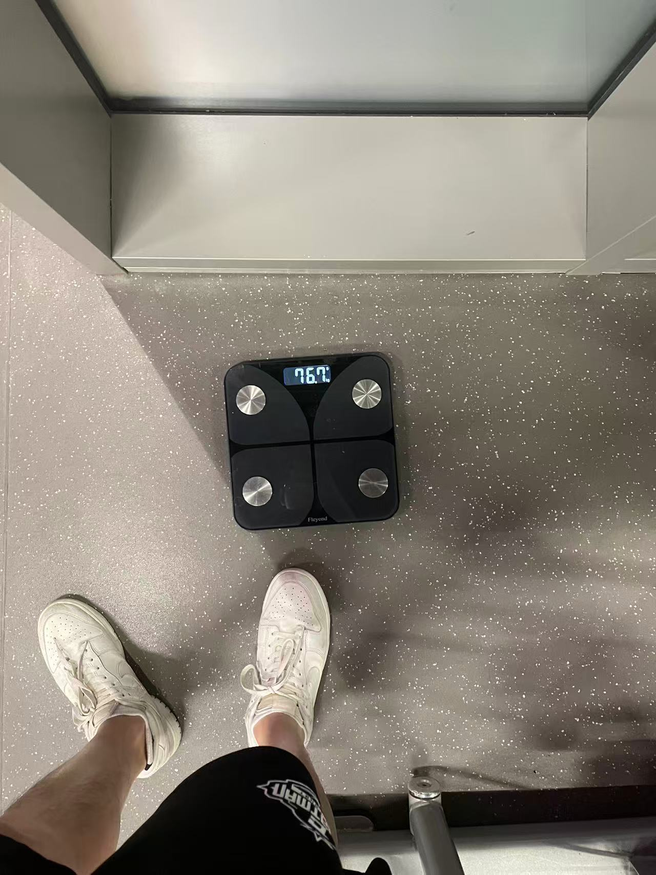
Bulking
77.1
79.3
76.7
March
Before summer school
After summer school

Slide 6
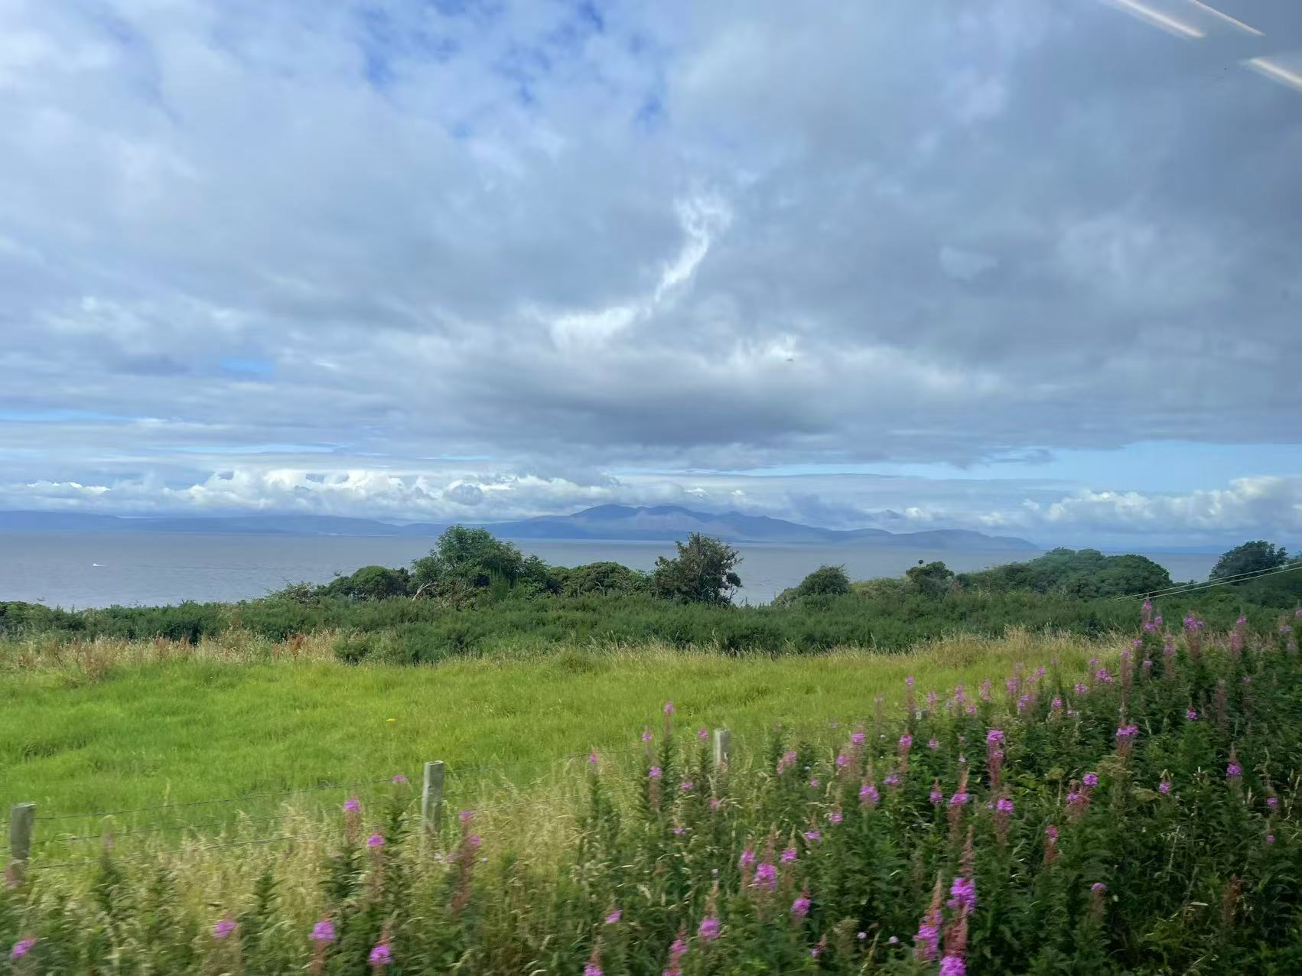
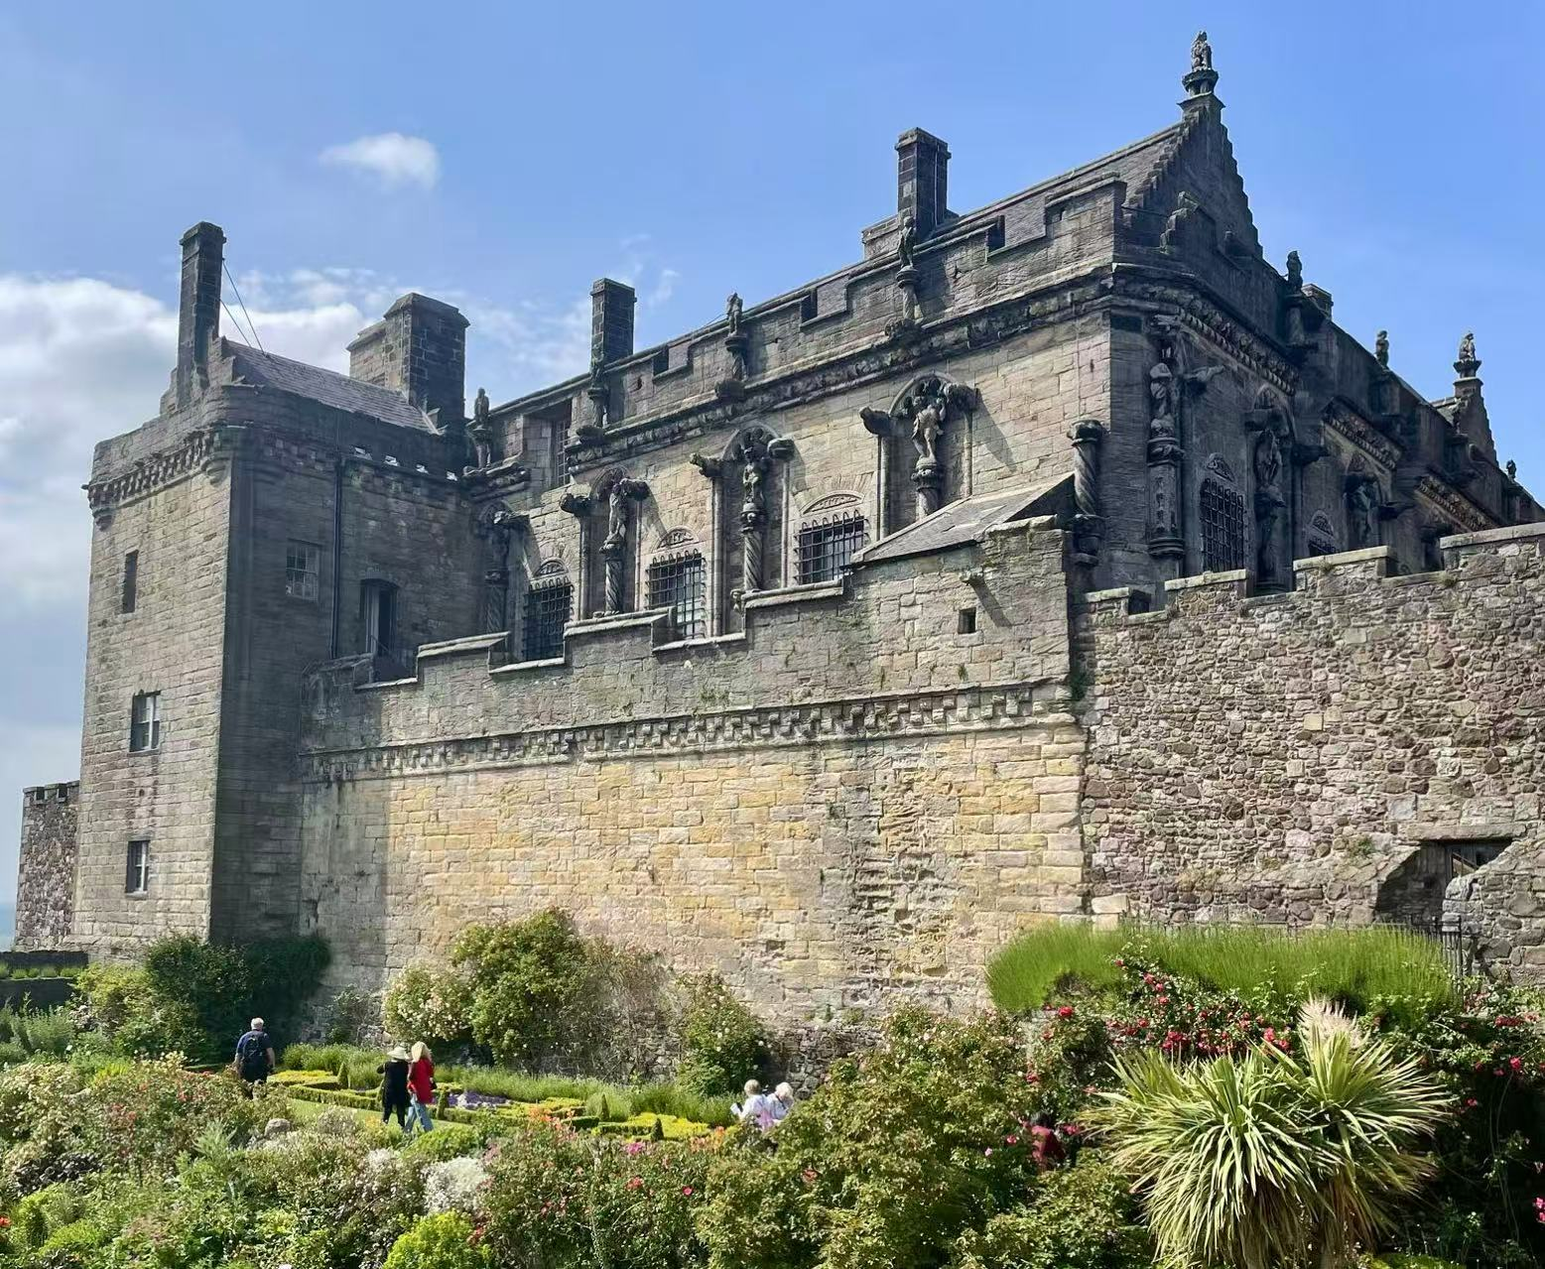
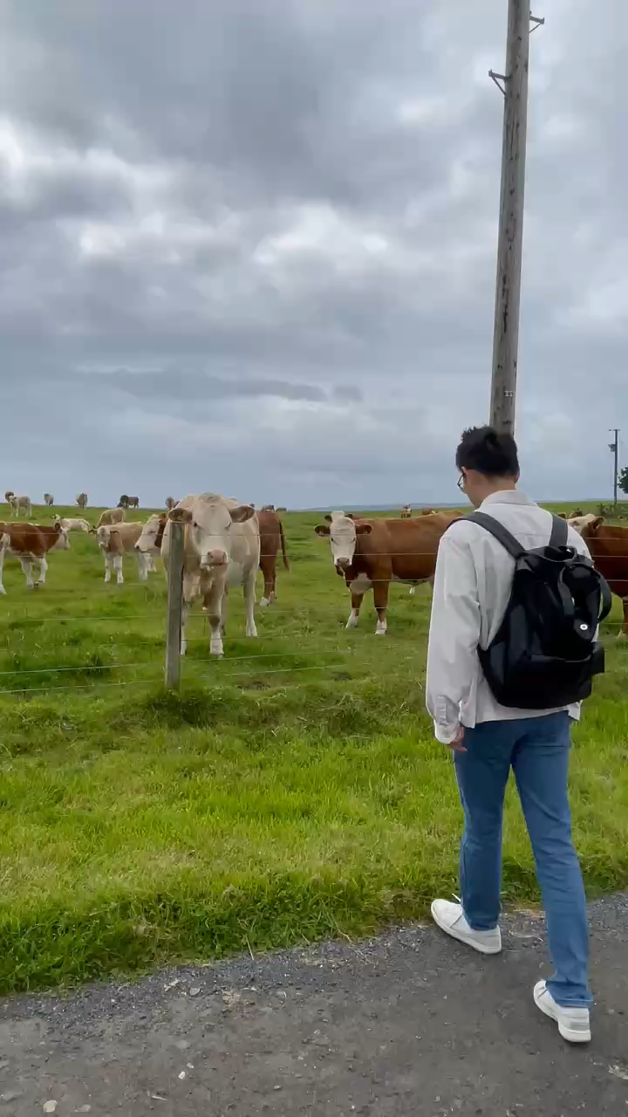
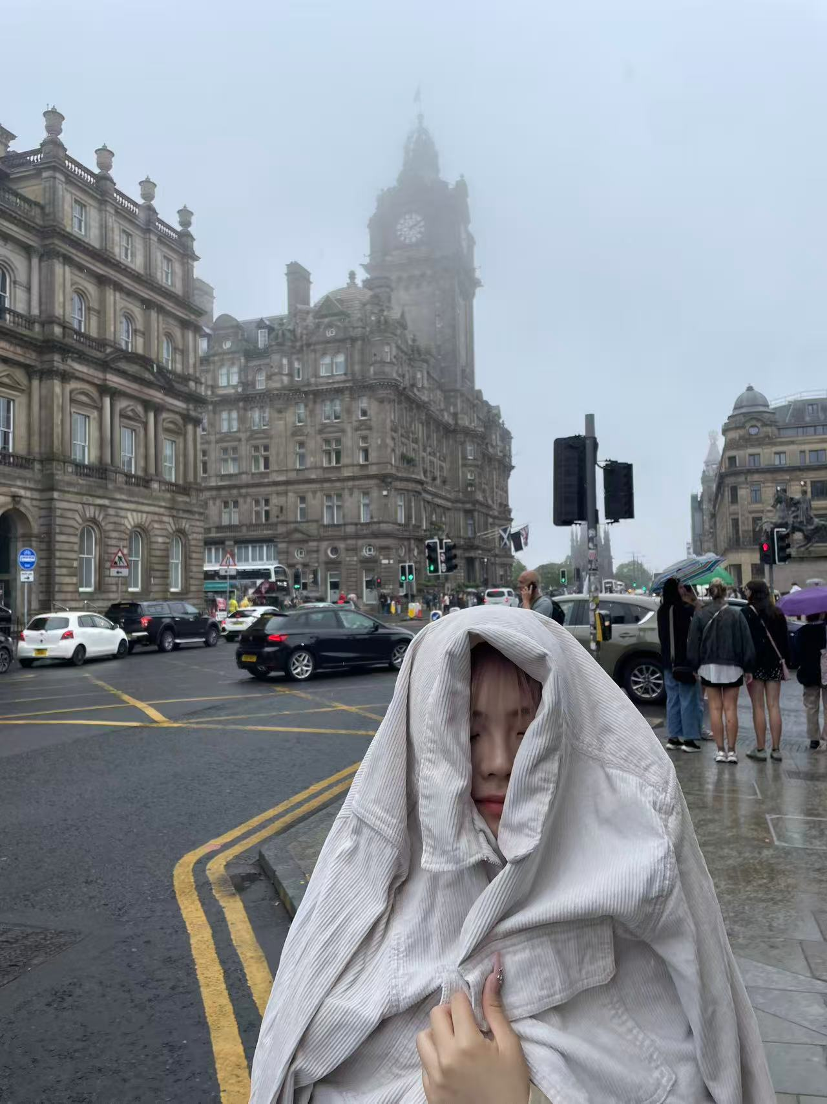
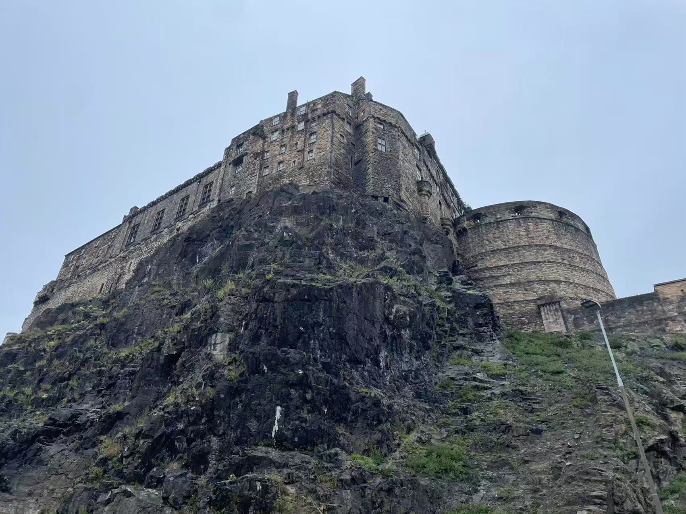
Scotland

Slide 7
Merry Christmas!

