Slide 1
GridPP & other things PPE/PPT Wintermas 2025
Sam Skipsey

Slide 2
The obligatory “Physics Slide”*
Getting to know decoloniality through dialogue: a critical reflection from students and educators DD Hosseini, A Bańkowicz, C Mair, N Riaz, S Skipsey, L Tansley, ...
in The Palgrave Handbook of Decolonising the Educational and Language Sciences
Julia in HEP GA Stewart, AM Briceño, P Gras, B Hegner, UH Acosta, T Gal, J Ling, S Skipsey...
Heterogeneous Computing and Power Efﬁciency in HEP E Simili, G Stewart, S Skipsey, A Borbely, D Britton
On-Grid GPU development-Via, interactive HT-Condor jobs and Analysis Facility style workflows A Borbely, D Britton, E Simili, S Skipsey, G Stewart
Carbon Compromises: Minimising the Carbon-Cost and Power-Use of Grid Sites D Britton, A Borbely, S Lloyd, D Protopopsecu, E Simili, S Skipsey, ...
Carbon costs of storage: a UK perspective A Packer, SC Skipsey
Taking on RISC for Energy-Efﬁcient Computing in HEP E Simili, T Boccali, S Muzaﬀar, G Stewart, S Skipsey, A Borbely, D Britton
Comparative efficiency of HEP codes across languages and architectures SC Skipsey, GA Stewart
in EPJ Web of Conferences 337
The network programme… has just about reached us (we’re in the design phase), so you may see changes by end 2026…
We’ve done many internal updates to the ScotGrid cluster (most of which are invisible to the outside, but are quite involved internally)
Bruno has done a lot of work on GPU benchmarking, orchestration for analysis and efficiency [and can’t be here today because he’s at the WLCG Heterogenous Computing Workshop re this]
Many conference papers and other publications (not listed: talks and other presentations; workshops; works not yet published – 5 book chapters, 1 workshop report, 2+ papers)
Gordon and I are rewriting P2T Labs as “advanced Python / basic software engineering” not “C for beginners” … before next semester…
...and I am probably co-writing a C4L course if it’s approved (tba!)
*although, when you think about it, everything follows physical laws, so really
all slides are physics slides. Unless possibly they’re about ghosts, like the christmas spirit.

Slide 3
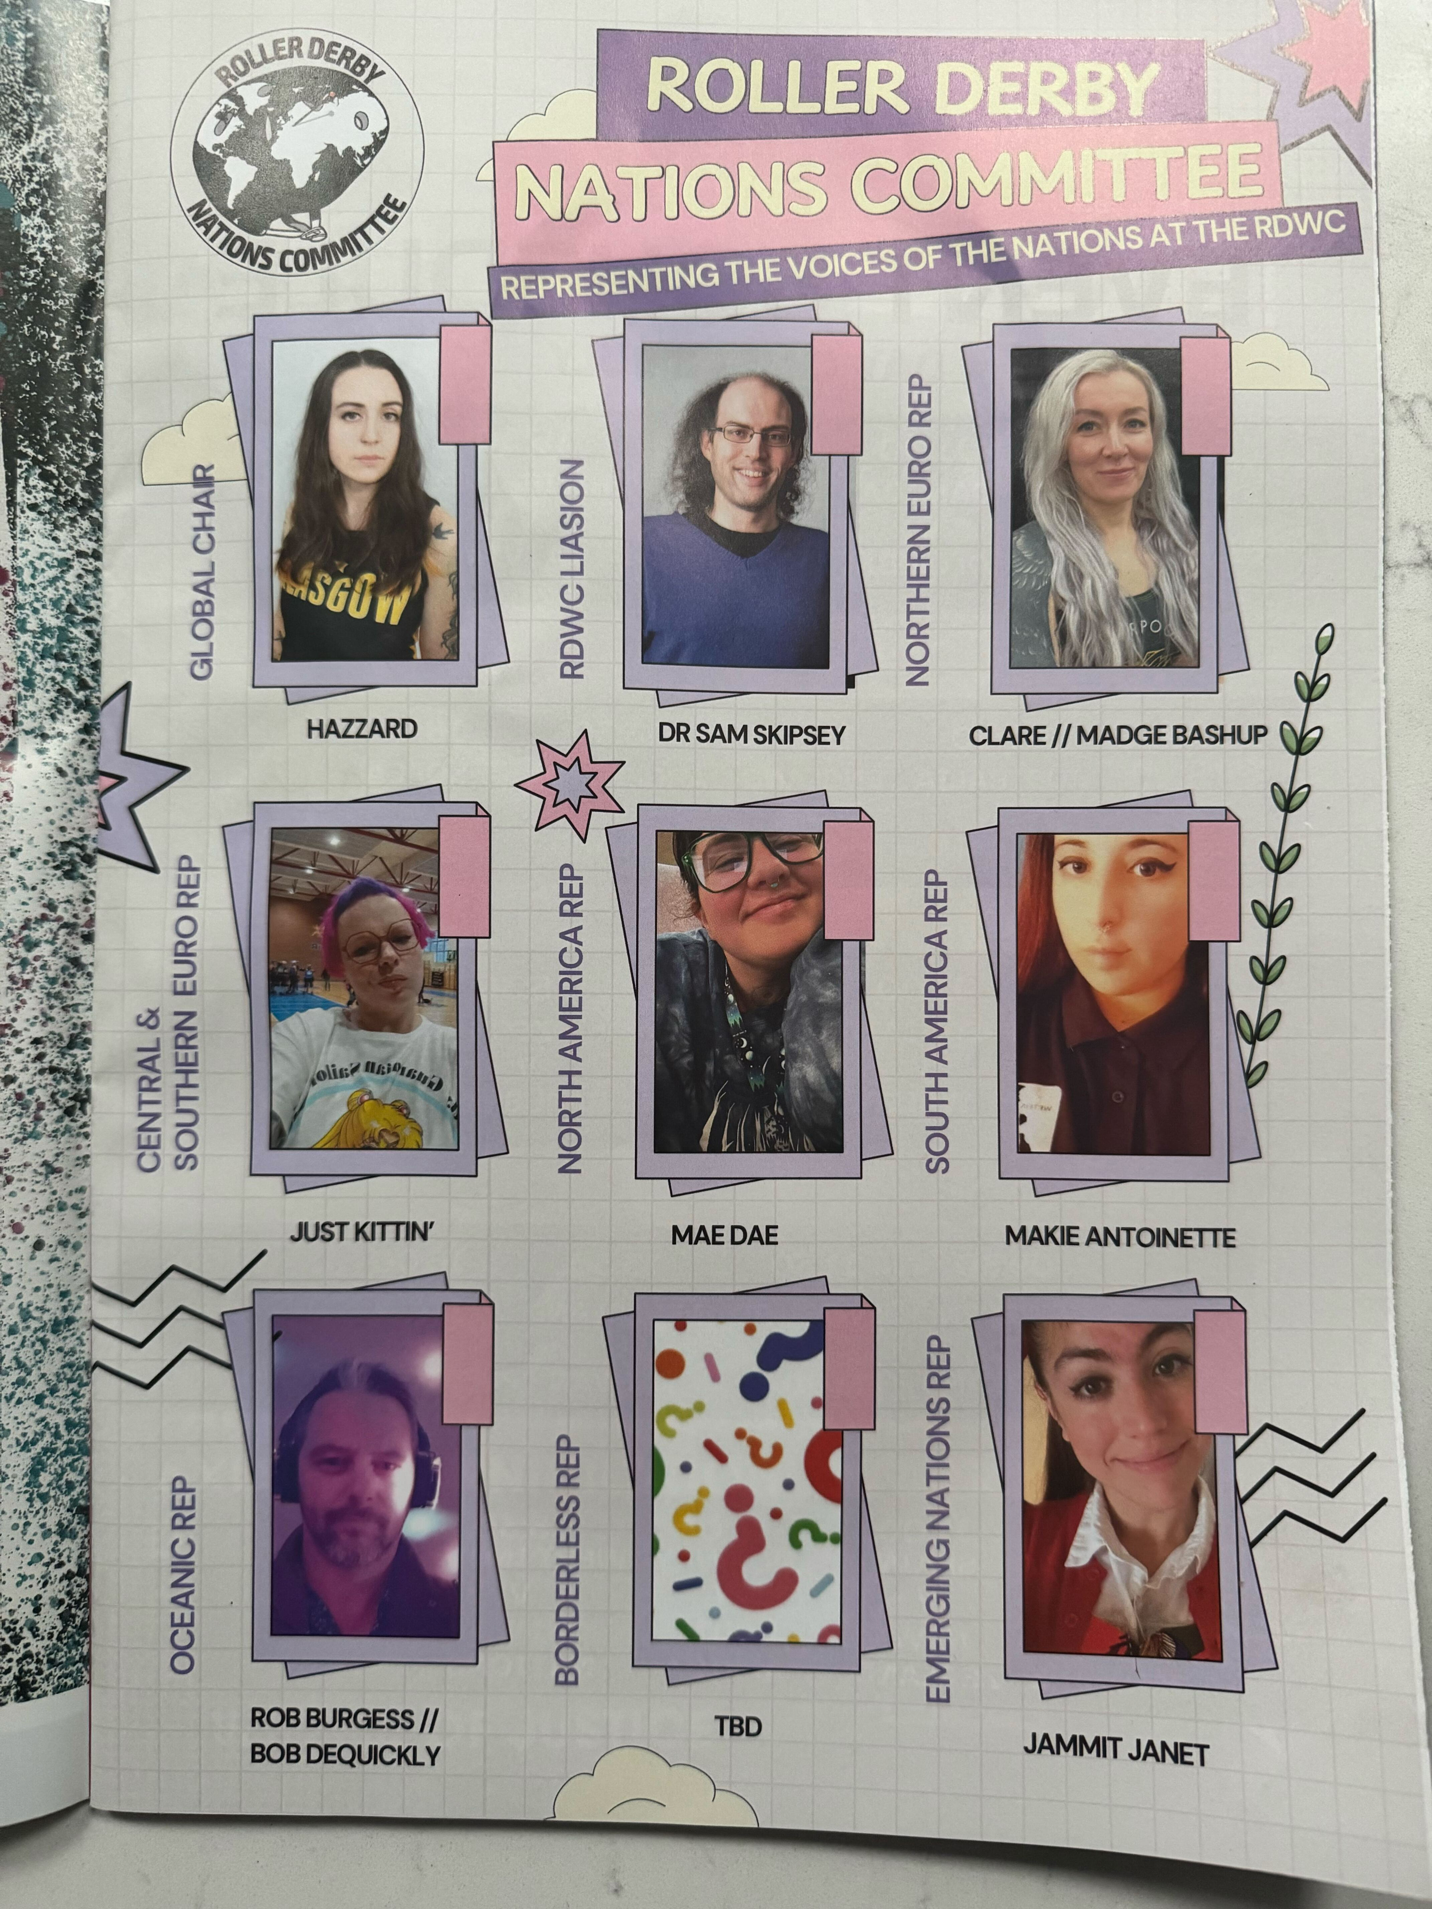
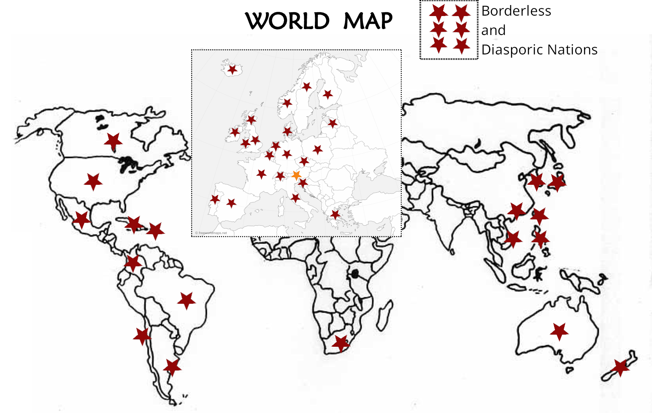
Roller Derby World Cup 2025
The other thing that kept me busy this year...
3-6 July 2025
Largest ever Roller Derby event – 48 teams, 5 tracks, 80 games!
58 announcers, 200 officials
Attendance (spectators) ~2000
Scheduling!
Politics!
Much like an academic conference*, except it makes people happy and no-one gets paid to be there.
https://www.youtube.com/playlist?list=PLRFtKHAGS54xzGh4q6WxisYMssRbgYSdO
*in fact, I have a paper in progress (along with WFTDA’s competitive play board) on the ranking system we used, which is also being used by the international governing body as of this year.

Slide 4

Other things
Dropped Duolingo for Russian for ethical reasons
Duolingo’s owner is very pro firing people in favour of LLMs
Now Russian via Memrise and reading Russian translations of “The Rules of Flat Track Roller Derby” instead
Advent of Code is here… and I’m doing all in uiua this time!
Day 4 Pt 2 of AoC:
Parse ← ≡₀°□=@@⊜□⊸≠@\n &fras
Kernel ← [1_1_1 1_0_1 1_1_1]
Pad ← ↻⊙∩⌞(⬚0↙)∩(˙⊂)◡(⌊÷₂⟜(-₁+)∩⧻)
Init ← 1 Pad Kernel Parse⟜(0)
Convolve ← ⌵⁅×°fft×∩fft⊃(⊙⋅)(⟜⧻⋅∘)
Mask ← ⊸₂(×⊙⋅∘)<4
Apply ← /+/+⟜₂(⍜⊡(×0)⊚ ⊙◌)
Accum ← ⟜₃(+⊙⋅⋅∘)
⋅⋅⋅∘⍢(Accum Apply Mask ◡Convolve◌|≠0) Init "input"
Output
Visualisation
(from uiua)

