Slide 1

Detector Development

Slide 2

Things to cry about
STFCs lack of money to fund
  UK DRD SoI
  DRD CG
  Early stage Research and Development scheme
    LGAD collaboration
    CMOS sensors
    Beam line at SCAPP – Strathclyde's Laser-plasma wake-field accelerator
  DRD summer school
Reasons to be cheerful
Health service glasses
Gigolos and brasses
Round or skinny bottoms
Take your mum to Paris
Lighting up the chalice
Wee Willy Harris
Bantu Stephen Biko, listening to Rico
Harpo, Groucho, Chico
Cheddar cheese and pickle, the Vincent motorsickle

Slide 3

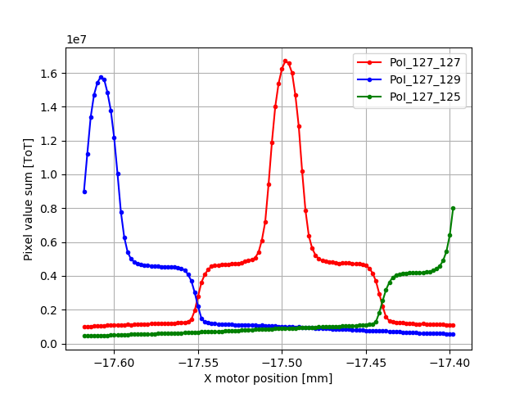
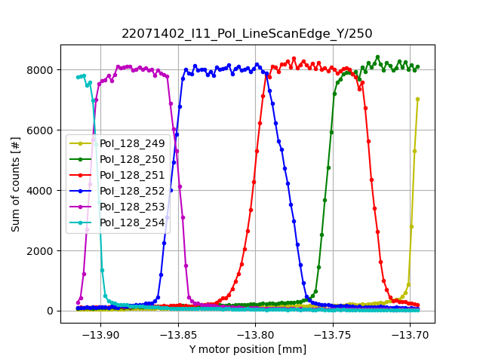
LGAD – Low Gain Avalanche detectors
Fast timing resolution and sub-threshold energy detection
New PhD student Parisa Rezaei Mianroodi
  Started Jan 2025
  Funded by the last STFC CASE award & Micron Semiconductor
Close collaboration with CNM
  Neil Moffat and Giulio Pellegrini
  Both ex-Glasgow PhDs
PhD Aims
  Improve Micron LGADs uniformity, gain and obtain 100% fill factor for small pixels
  Develop low energy X-ray window with LGAD device
Beamtest at ELI : THE EXTREME LIGHT INFRASTRUCTURE
  Understand trench isolated LGAD
  Paper in preparation
DRD3 collaboration presentation on ELI work
Lab based Electrical, Gain, Timing, SEM characterization of LGADs
  Internal grant on GEMS SEM
New Design and Fabrication to follow simulation
Papers
30 ps time resolution with 50 m thick silicon Low Gain Avalanche Detectors fabricated by Micron Semiconductor Ltd
Characterization of Ultra-Fast Silicon Detectors (UFSD) for high energy physics applications
Achieving near 100% Fill factor for small pixel LGADs: Study of First Trench Isolated LGADs fabricated at Micron Semiconductor Ltd
New results from fast timing iLGAD sensor on Timepix4
Next Paper : Diamond Beam test demonstrating iLGAD full charge collection
Also this year
  2 summer projects (PGT and placement)
  3 final year projects

Slide 4
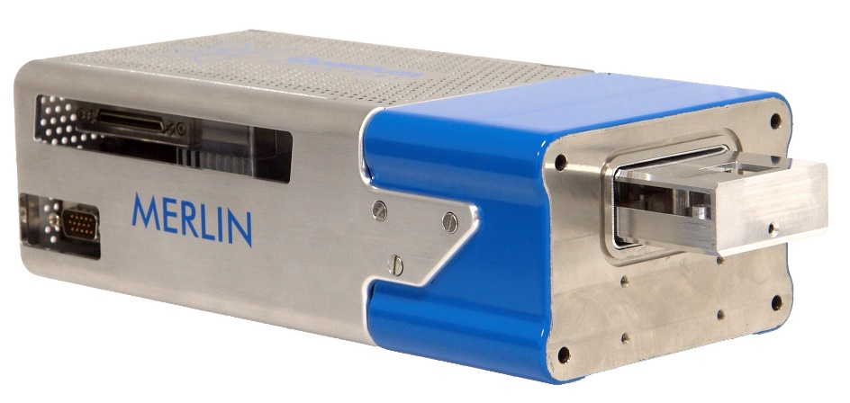

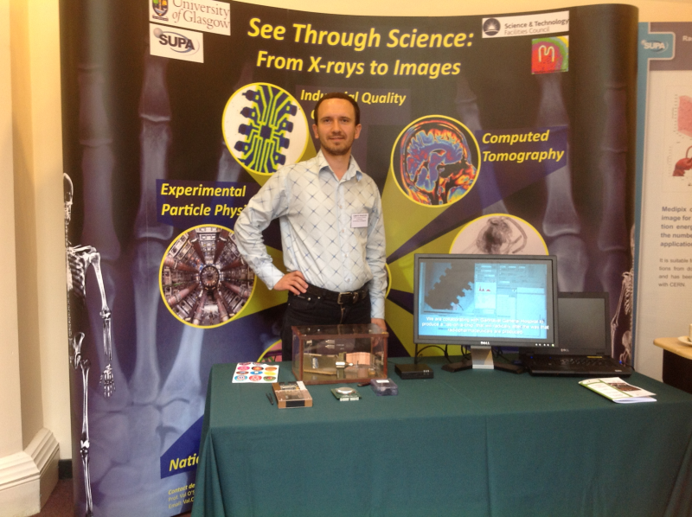
Medipix
3D sensors at Diamond Light Source
Still the best thing since sliced bread
Wider Glasgow activities include
  EIC – Nuclear structures group
    Might even use LGAD sensors
  MCNP + Quantum Detectors
    IAA to develop TEM TimePix4 module
    Followed up from the licensed technology for Medipix3
Many applications over the years
  Characterization of detectors
  Laser-plasma wake-field accelerator beam diagnostics
  Public engagement and teaching

Slide 5

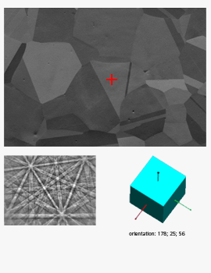
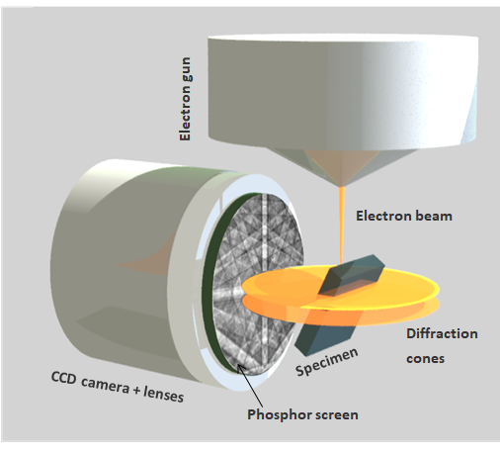
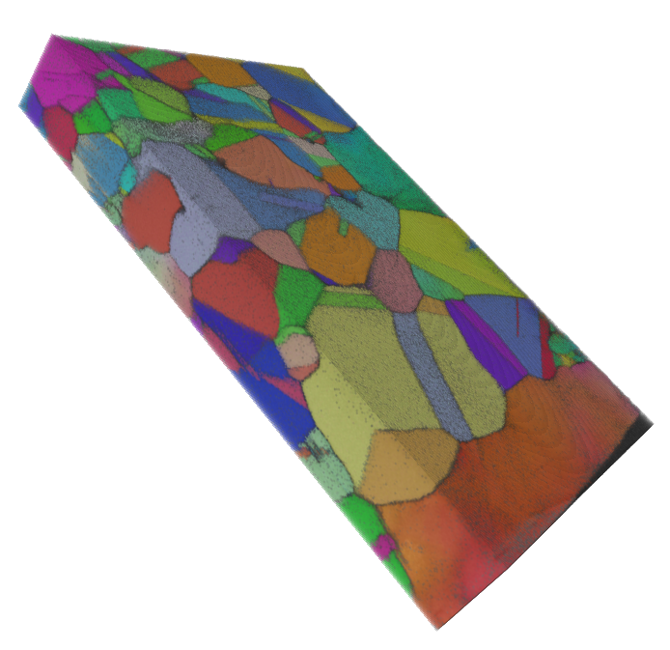
Scanning Electron Microscopy and EBSD
Rory McFeely PhD student 2nd year
  EPSRC CASE with Oxford Instruments
In collaboration with Strathclyde Solid state physics & NPL
A comparative response study of a Medipix3 silicon detector using X-rays and electrons
  IWorid 2025 conference
Comparison of a Medipix3 Silicon Sensor Detector Response to X-rays and Electrons in the 5-30keV Energy Range
  Hiroshima Symposium on S/C tracking detectors
Research agenda and motivation
Electron BackScatter Diffraction – tool to study crystallography of new materials:
  Metals
  Semiconductors
  Ceramics
  Geological minerals
Indirect imaging (electron-to-light) using CCD suffers poor sensitivity, slow, noisy etc.
Direct CMOS imagers can be prohibitively expensive
No energy information
No time information
http://www.ebsd.com/index.php/component/content/article/83-ebsd-for-beginners/125-introduction
Typical EBSD measurements
Crystal orientation
Misorientation
Grain size
Grain boundary characterization
Texture
Strain analysis
Phase identification
Phase distribution
3D reconstruction

Slide 6

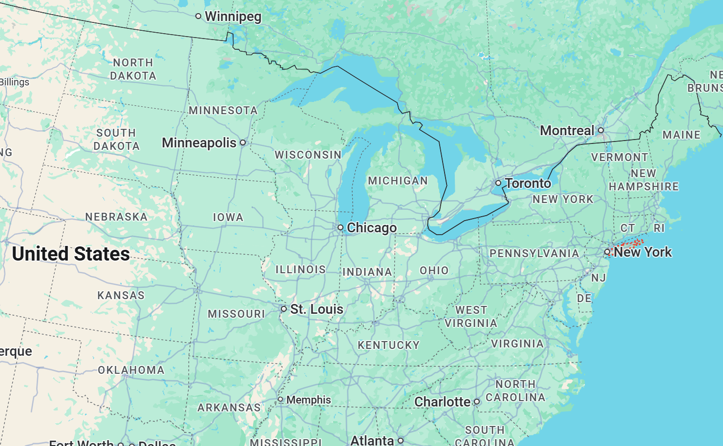
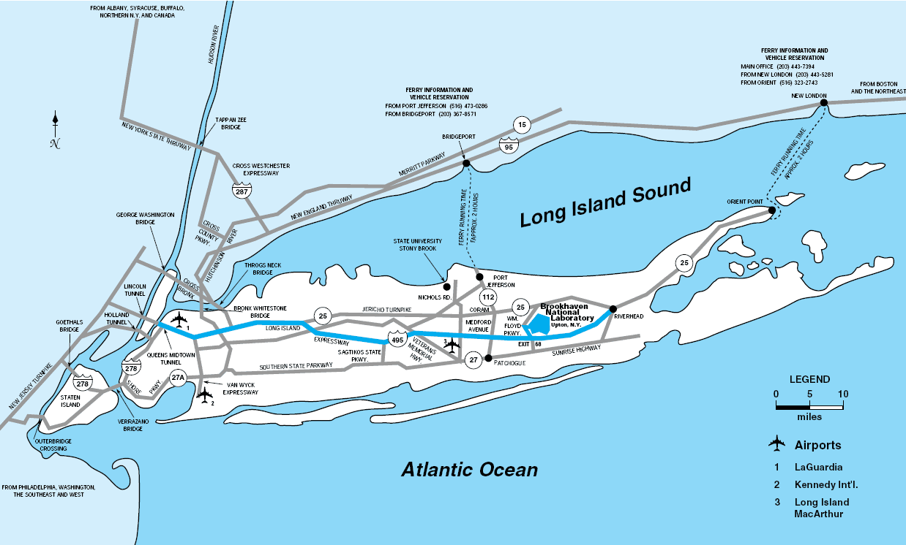
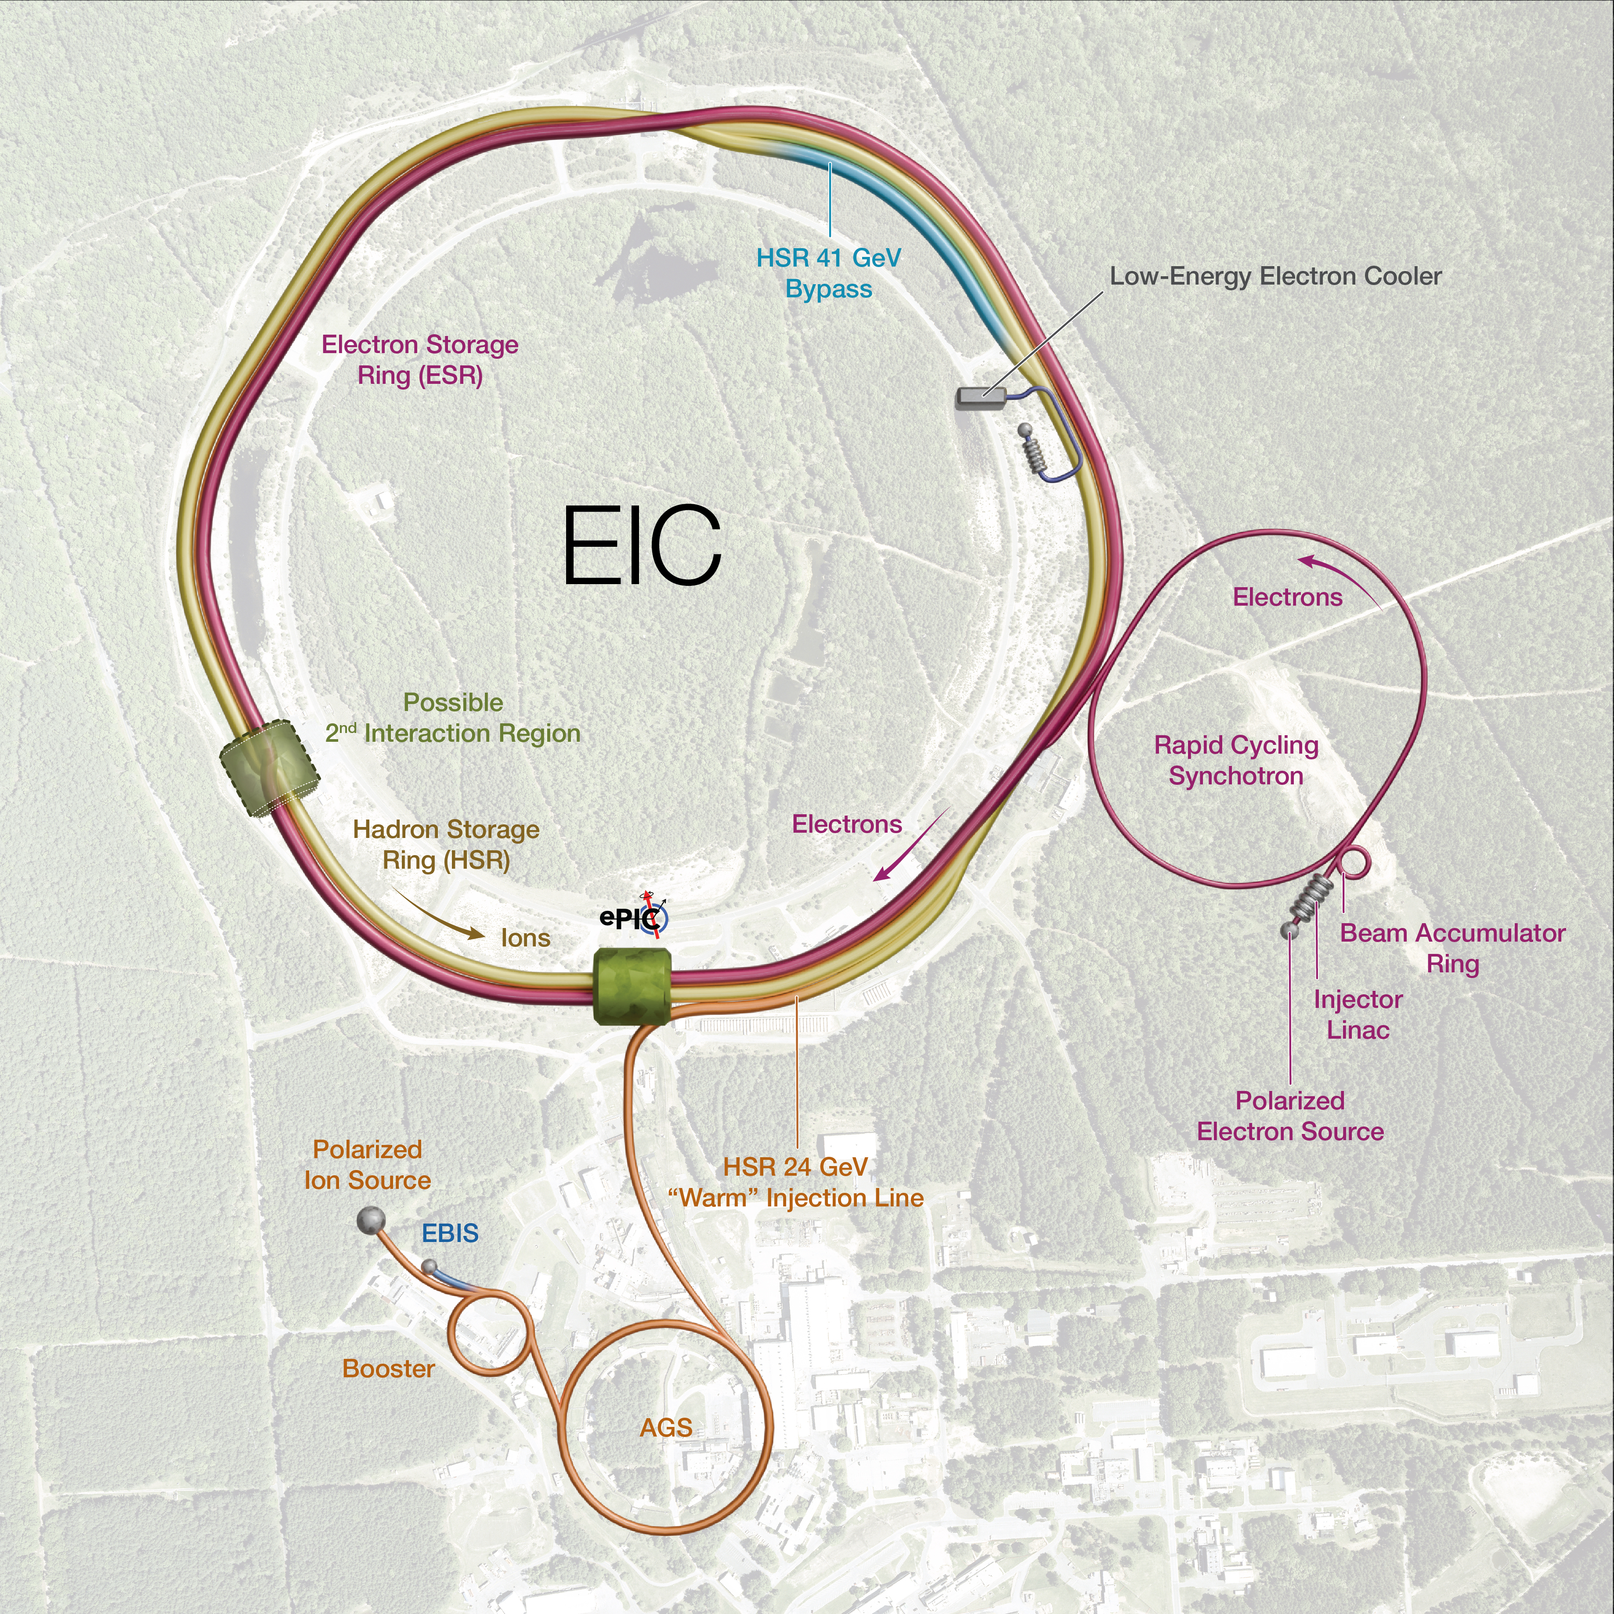
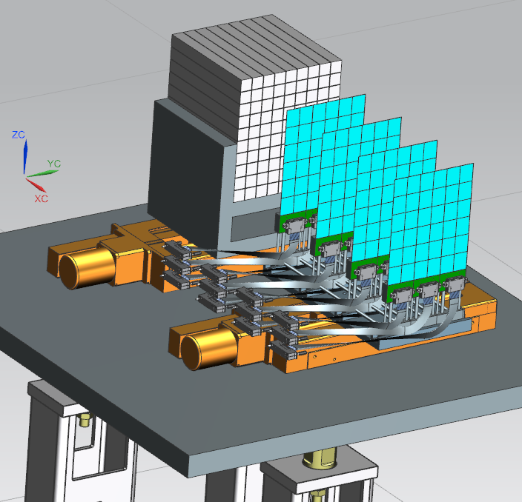
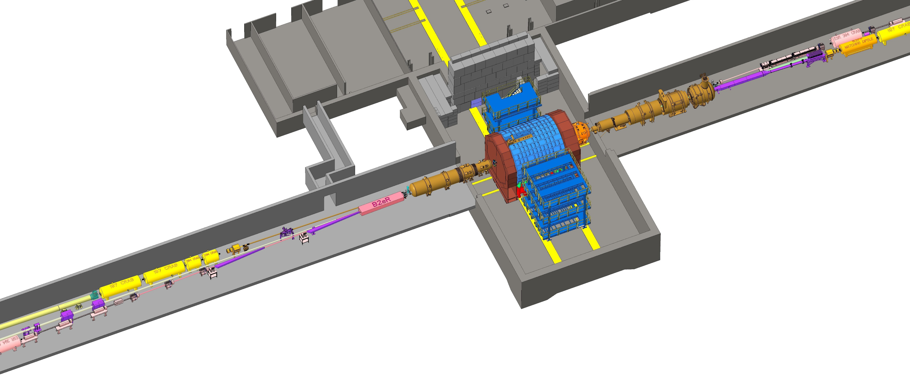
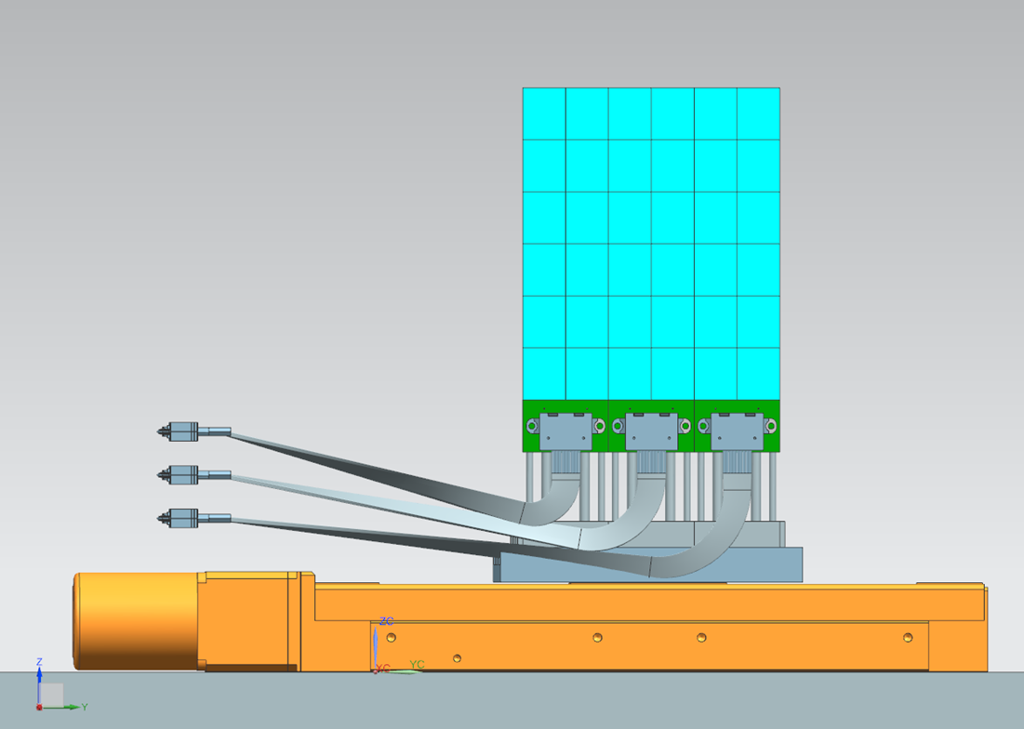

Timepix4 Tracker for the ePIC detector at the EIC
2xStations to measure scattered electrons of different momenta, each with 4 layers of Timepix4
EIC at BNL, USA
“A machine that will unlock the
secrets of the strongest force in
Nature”.
Construction: 2026
Data taking early 2030’s
UoG building Low-Q2 Taggers.
Only Timepix4 can operate at the required data density rates
Timepix4
Front End Board

Slide 7
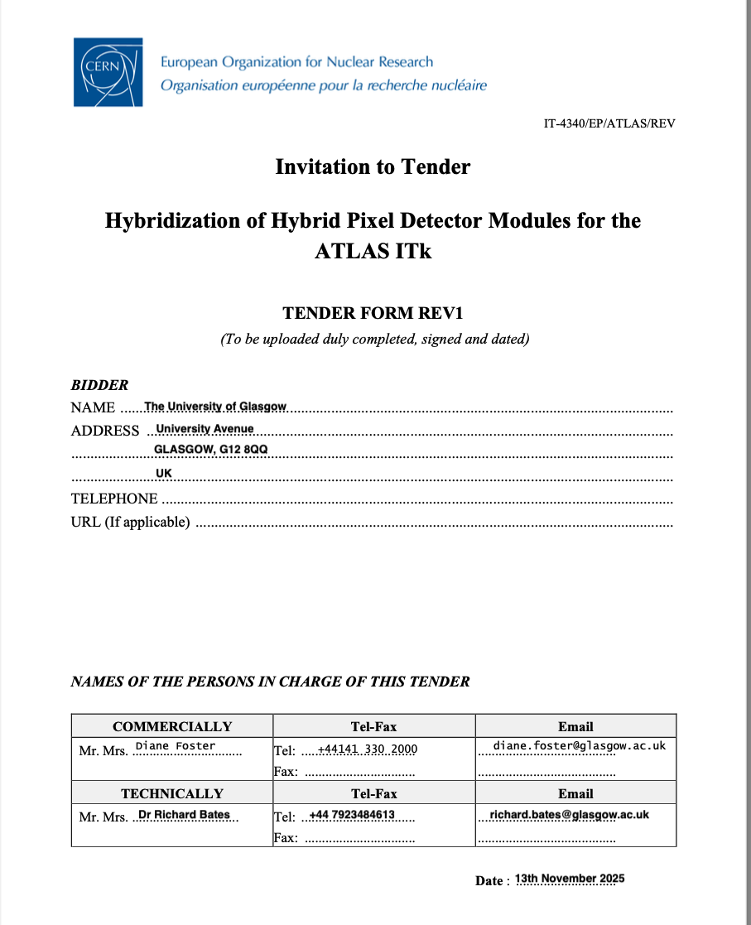
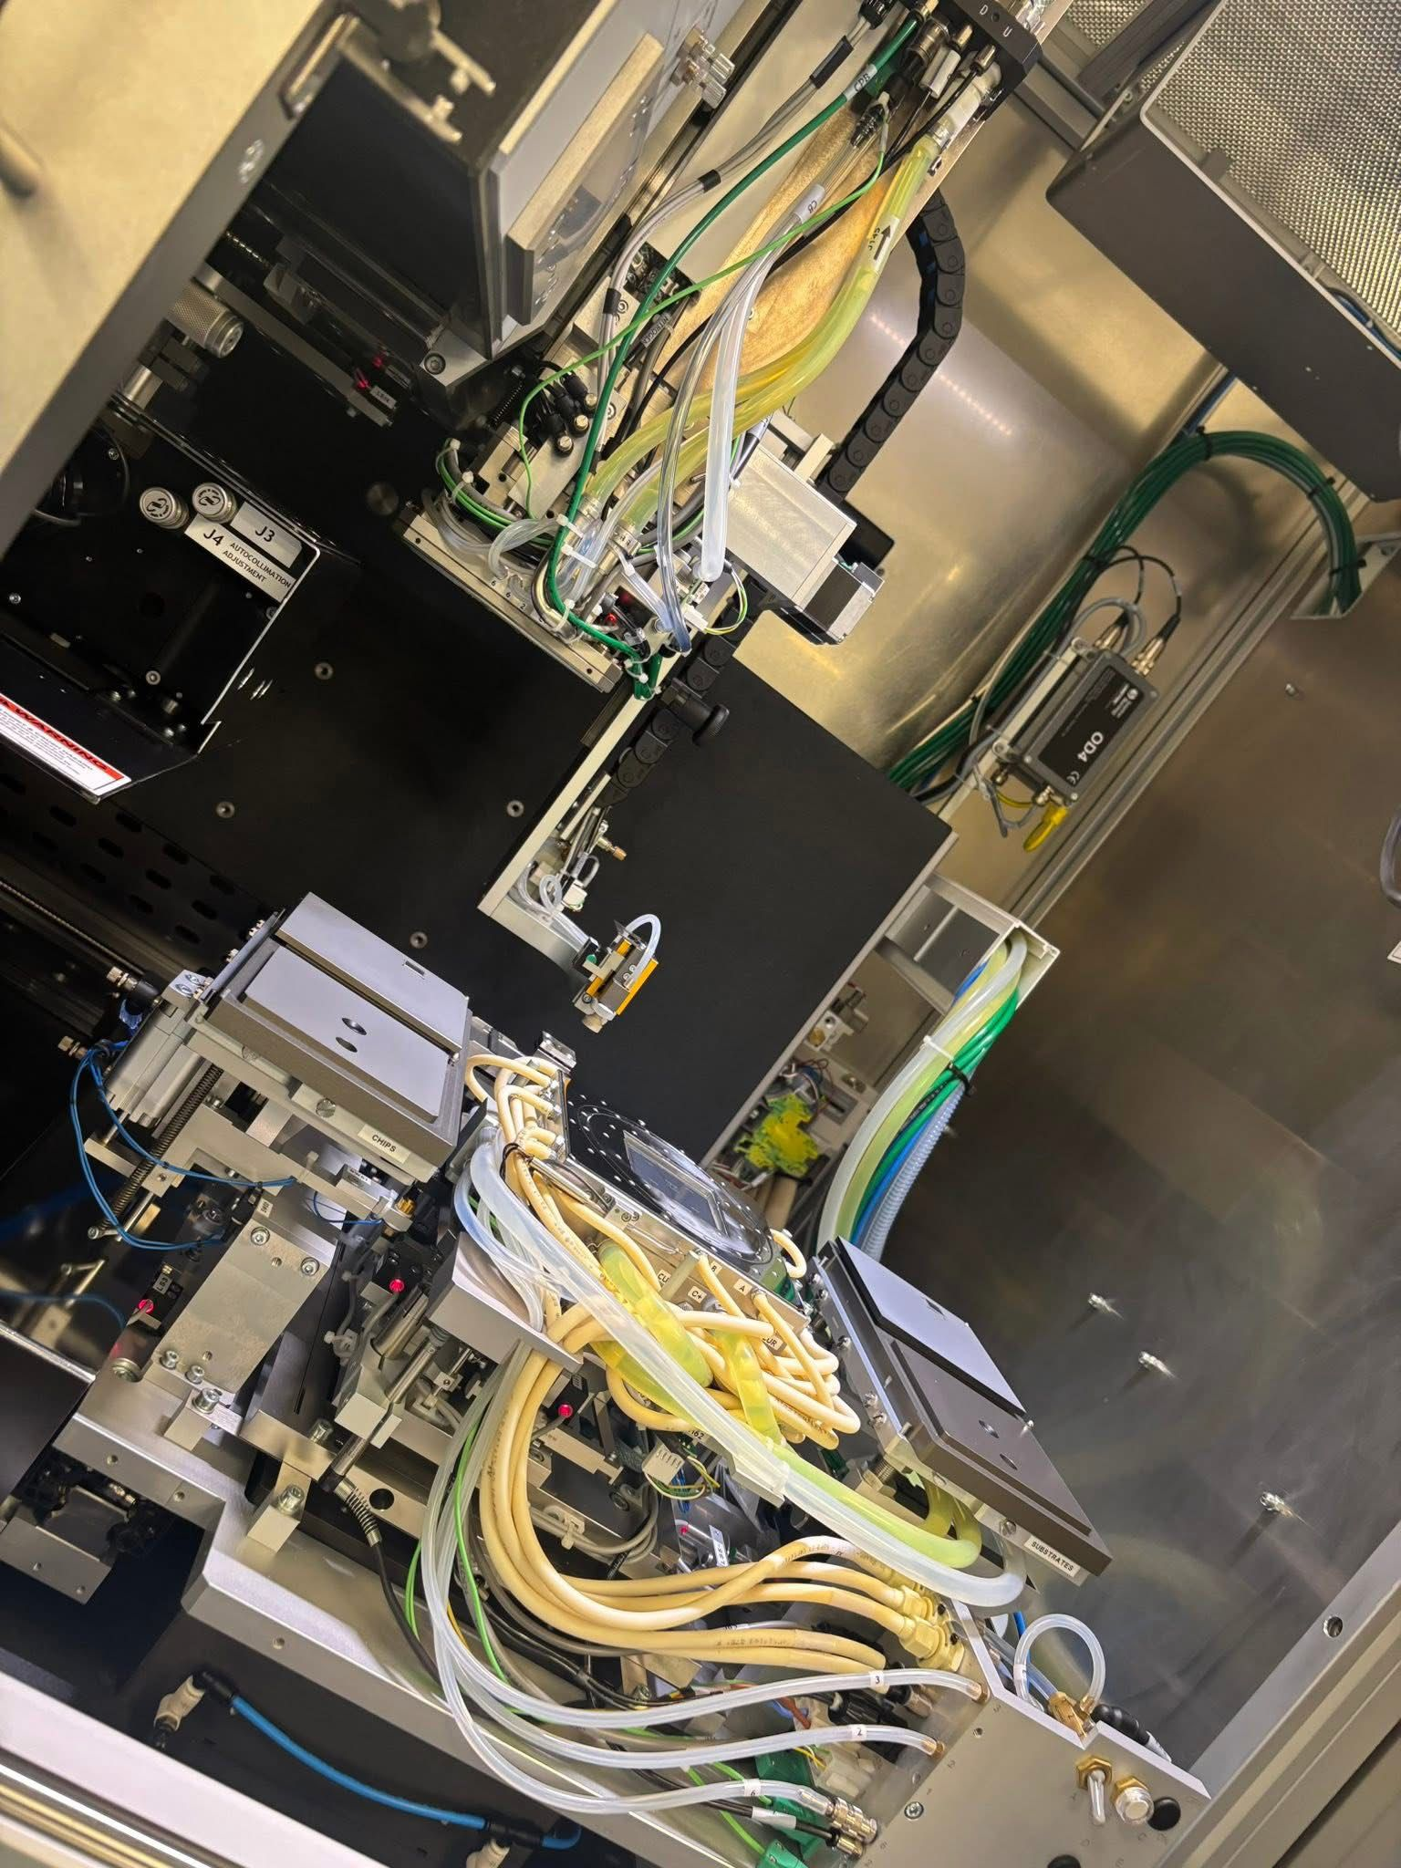
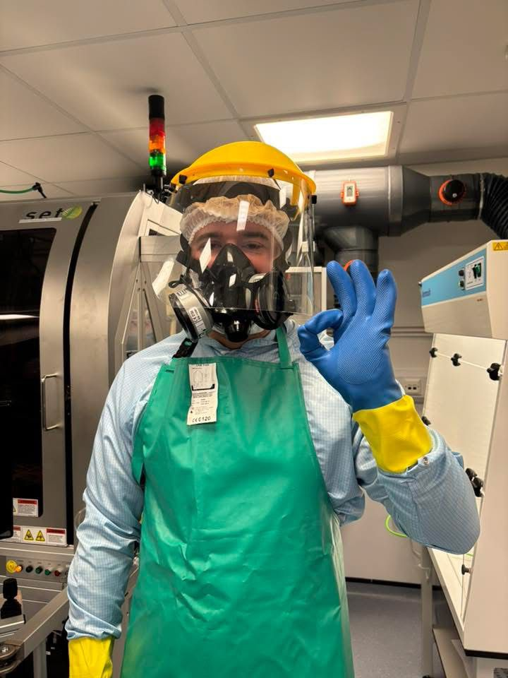
Flip-chip
ATLAS contract for flip-chip of 3D assemblies about to be signed
These are for the Layer-0 barrel modules
The most important modules in the ITk
680 modules to build by March 2027
  Shared between Glasgow and RAL
Total contract value of £200k.
We have started the development
  Building on the successful qualification for the RD53A half-sized modules in 2024
Uses
  FC150 - Serviced
  Nikon Xray machine – Upgraded
  Evident Microscope, CT100 and BATY
  Pixel characterization

Slide 8
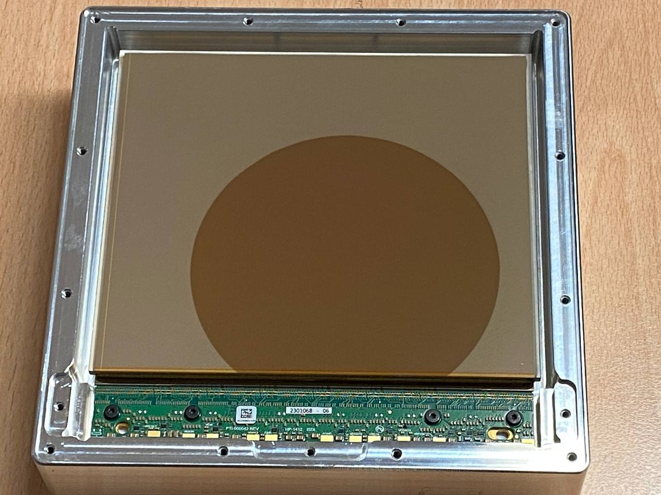
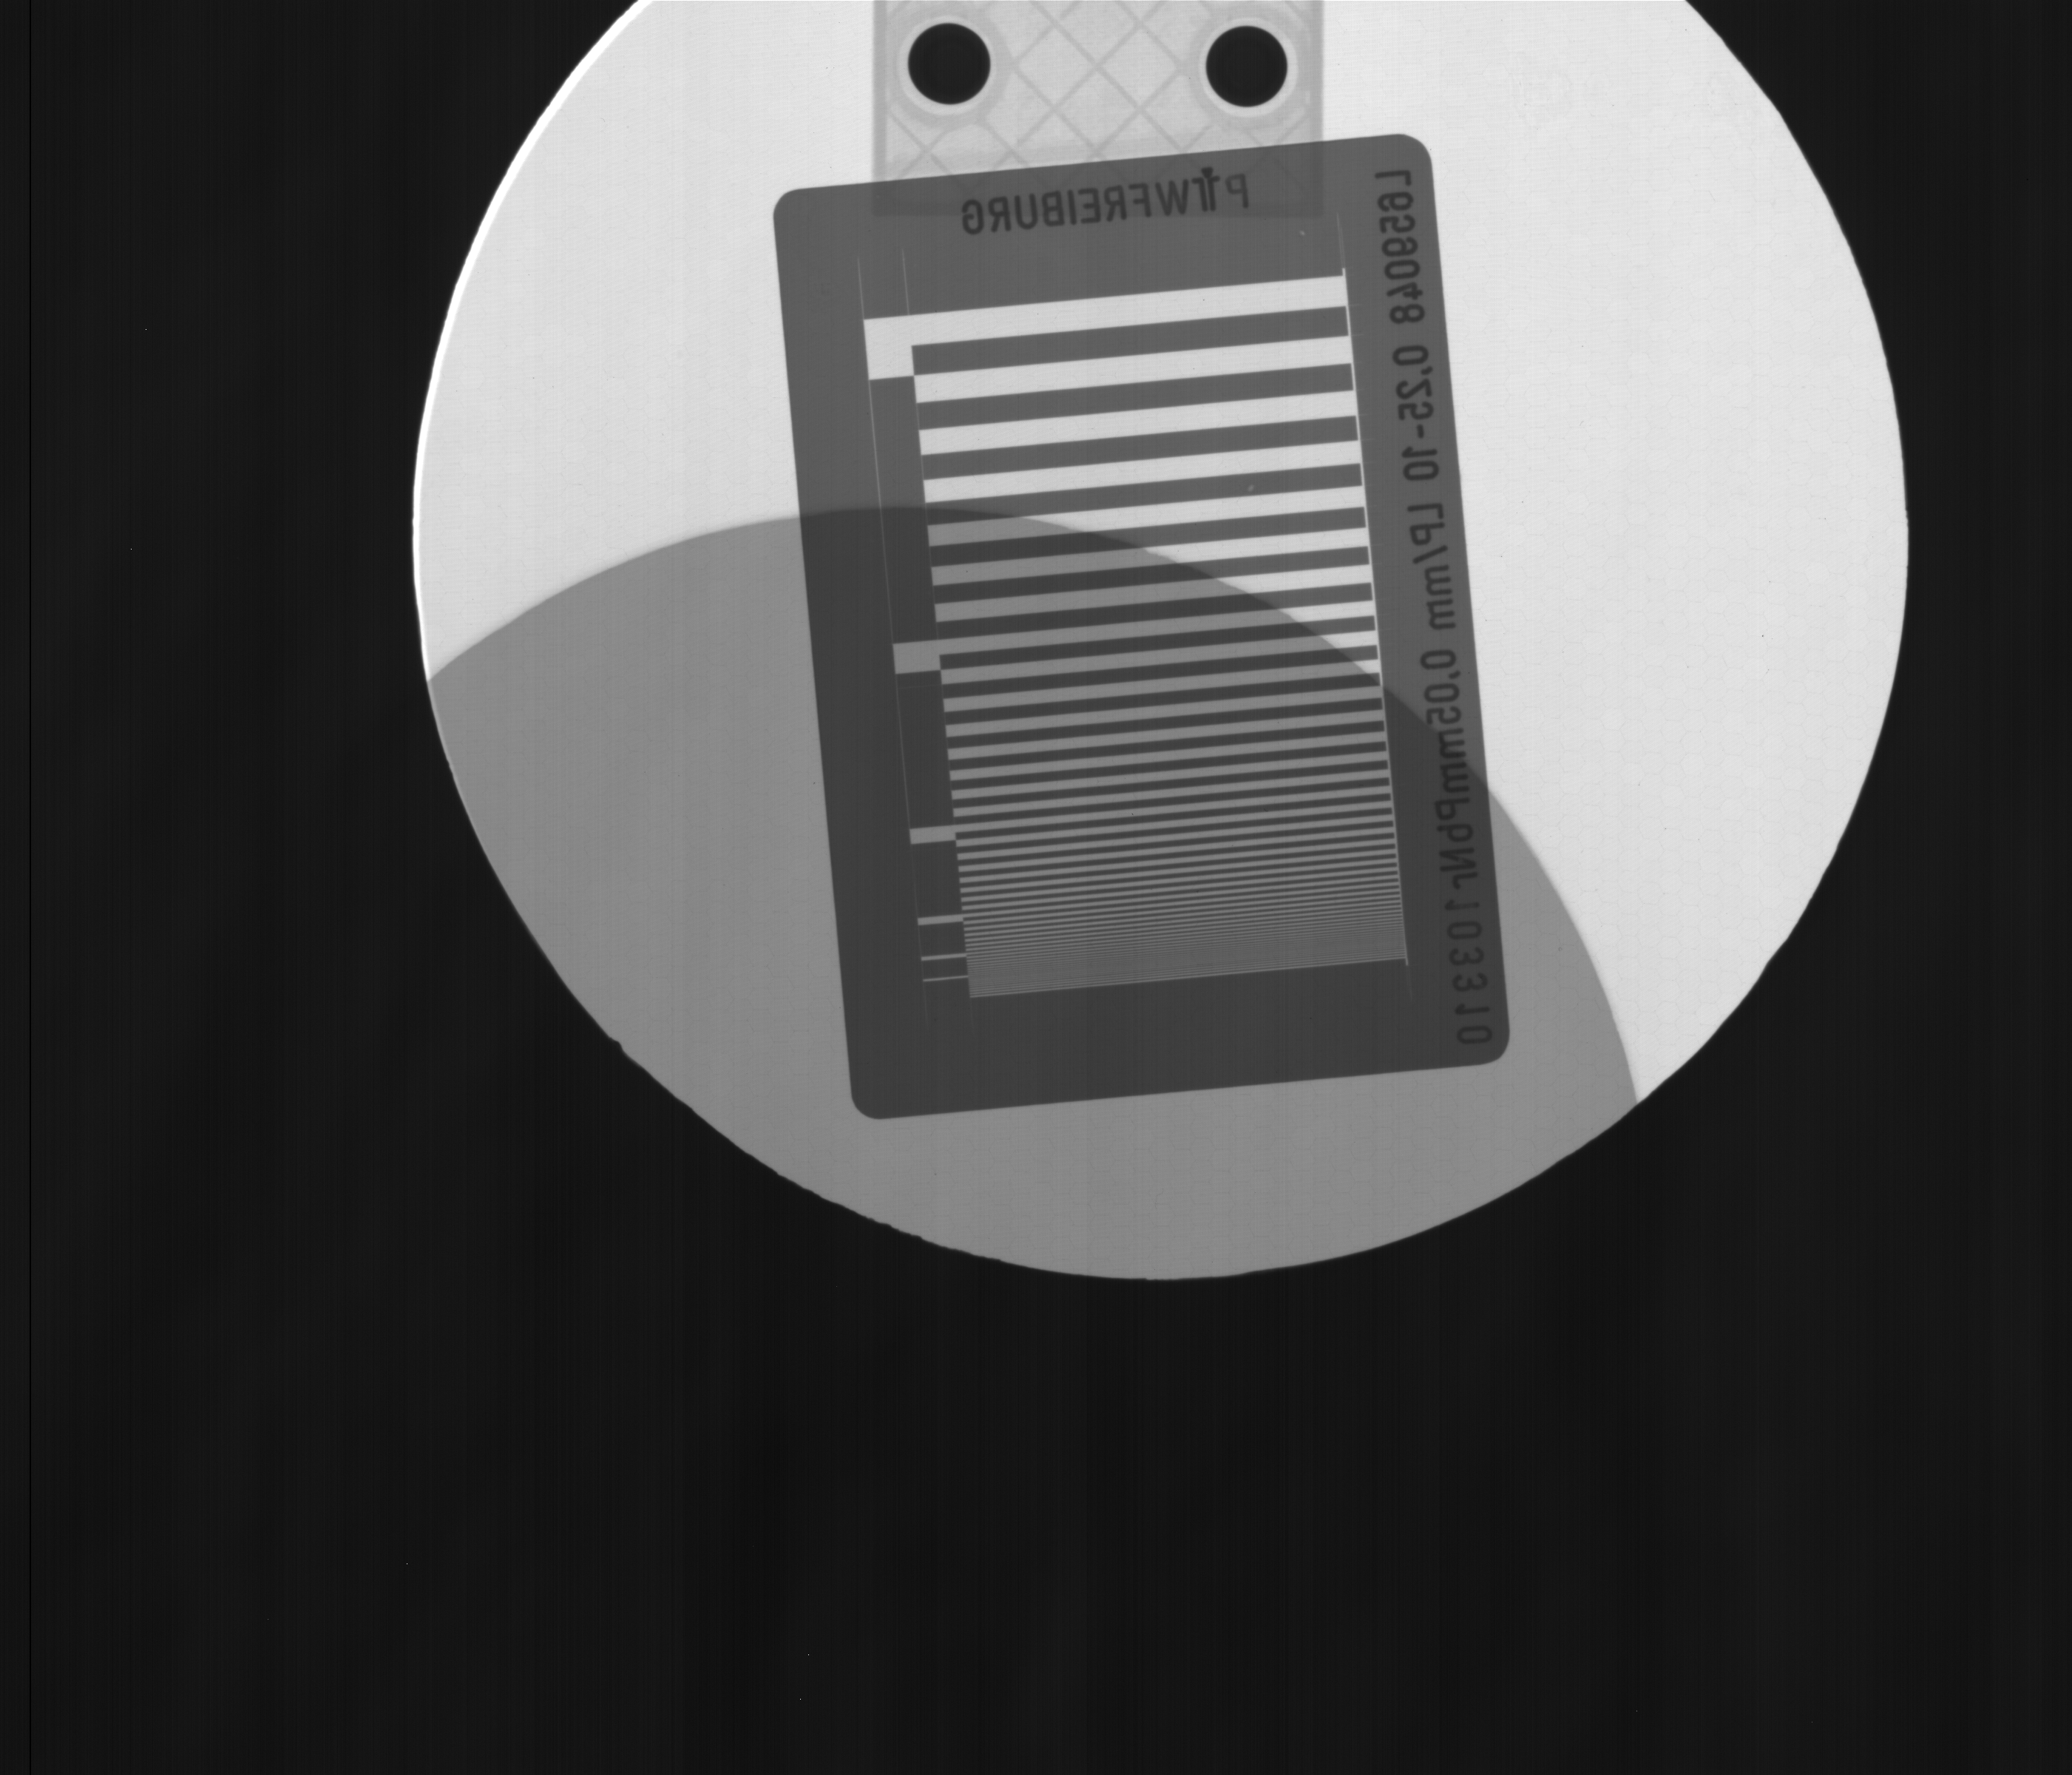
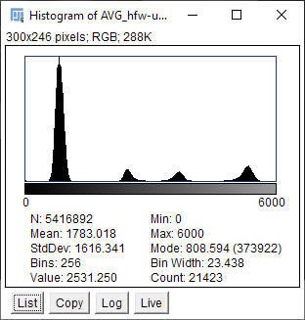
Commercial work
No damage
CMOS sensor irradiation for ISDI CMOS
  Spin-out from the EPSRC Bastic technology grant that funded Andy and Dima (2005 to 2008)
  Develop innovative CMOS sensors for radiography applications
Sensors routinely exposed to TID radiation and degrade over time
Glasgow helped ISDI to expose a sensor prototype to X-rays and understand radiation damage
  Funds received contributed to the Medipix4 collaboration sign up fees
  We ended up with a still OK functional CMOS imager worth £20k retail price.
Damage
Rotated scintillator to visualise damage

Slide 9

TauProbes
Spin-out in October 2022
Design and manufacture of advanced probes and supporting hardware for the semiconductor test industry
Patent granted in USA and Japan for probe technology
Funding
Initial funding from SE
Obtained additional SE Smart grant and UK Innovate grant
2025 IAA funding to develop Probe head assembly
  Utilizes Flip-chip machine and laser drilling
  Submitting SE Smart grant for 2026 funding
  Aim for sells Q4 2026
First sells this November!
  Probe development with French company
  Initial design phase with hope for prototype sells mid-2026

Slide 10
Silicon summer school
UK Advanced instrumentation Training
Annual graduate lecture course on silicon detectors, electronics and mechanics
Devised by Daniel Hynds
Steering committee members include
  Kenny Wraight for Glasgow
21 Lecturers; 4 Glaswegians
  Richard Bates
  Andy Blue
  Sneha Naik
  Kenny Wraight
Summer school
Directors:
  Richard Bates & Daniel Hynds
Next one in 2026

Slide 11

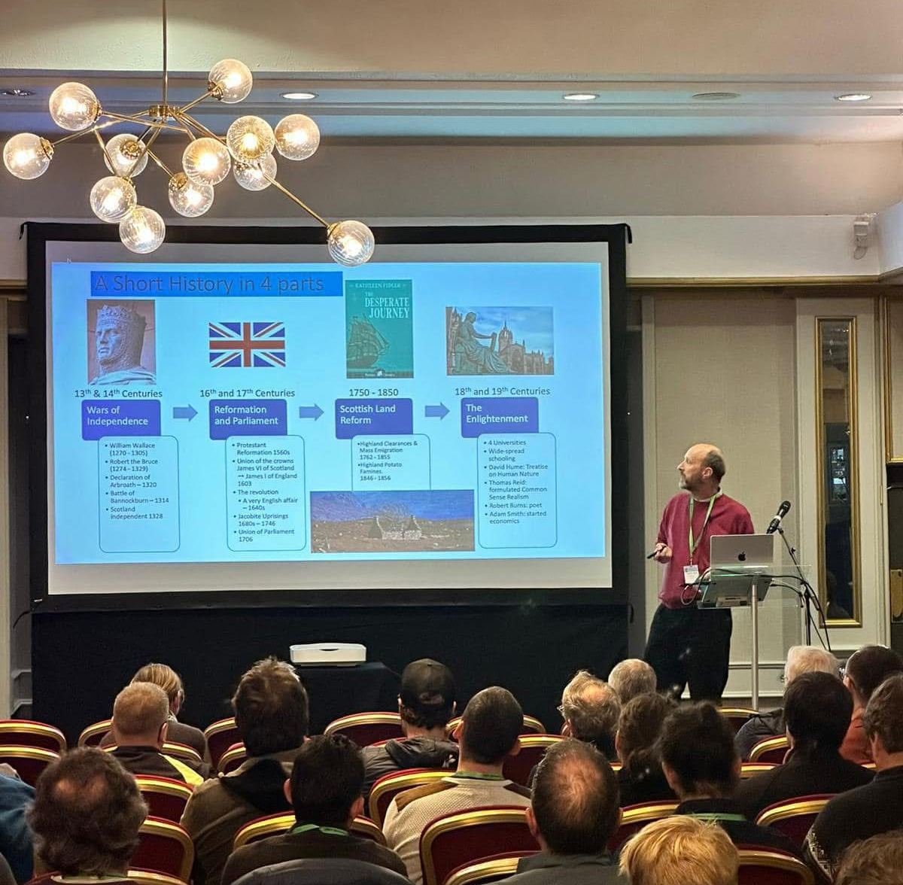
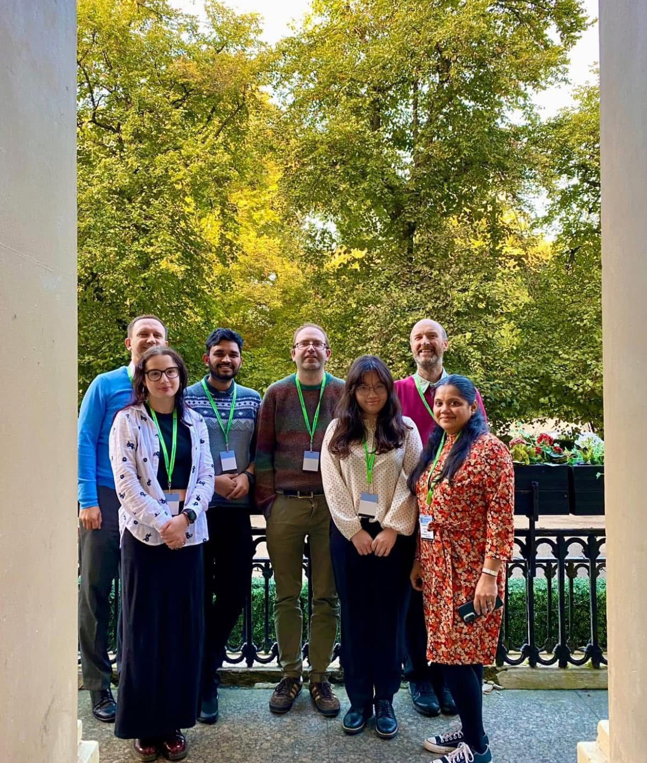
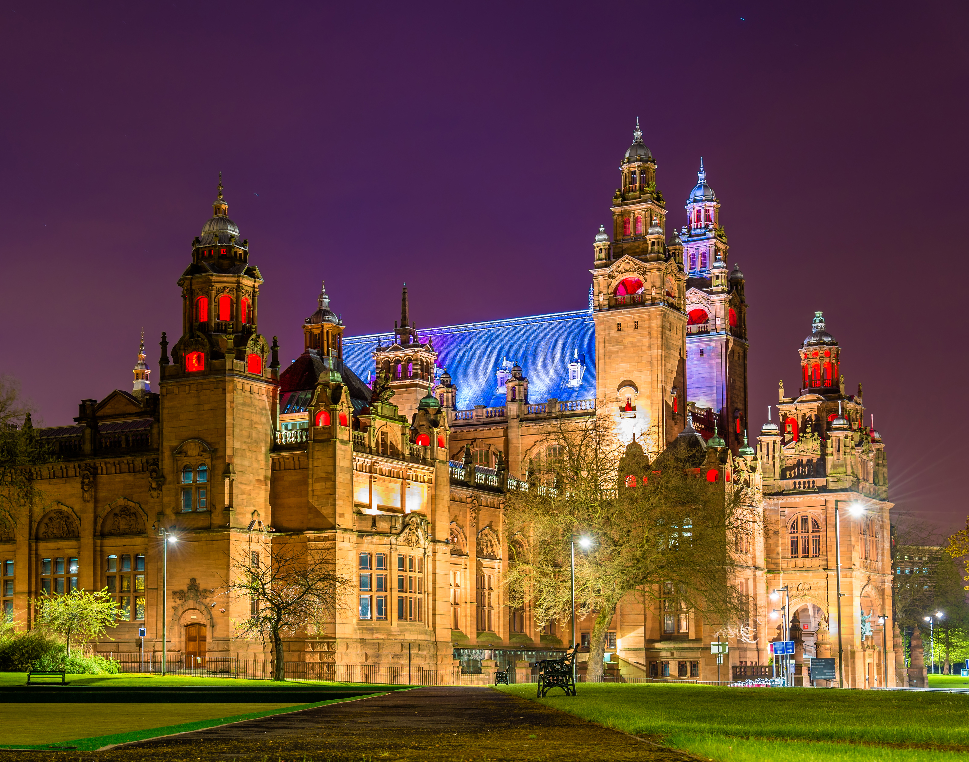
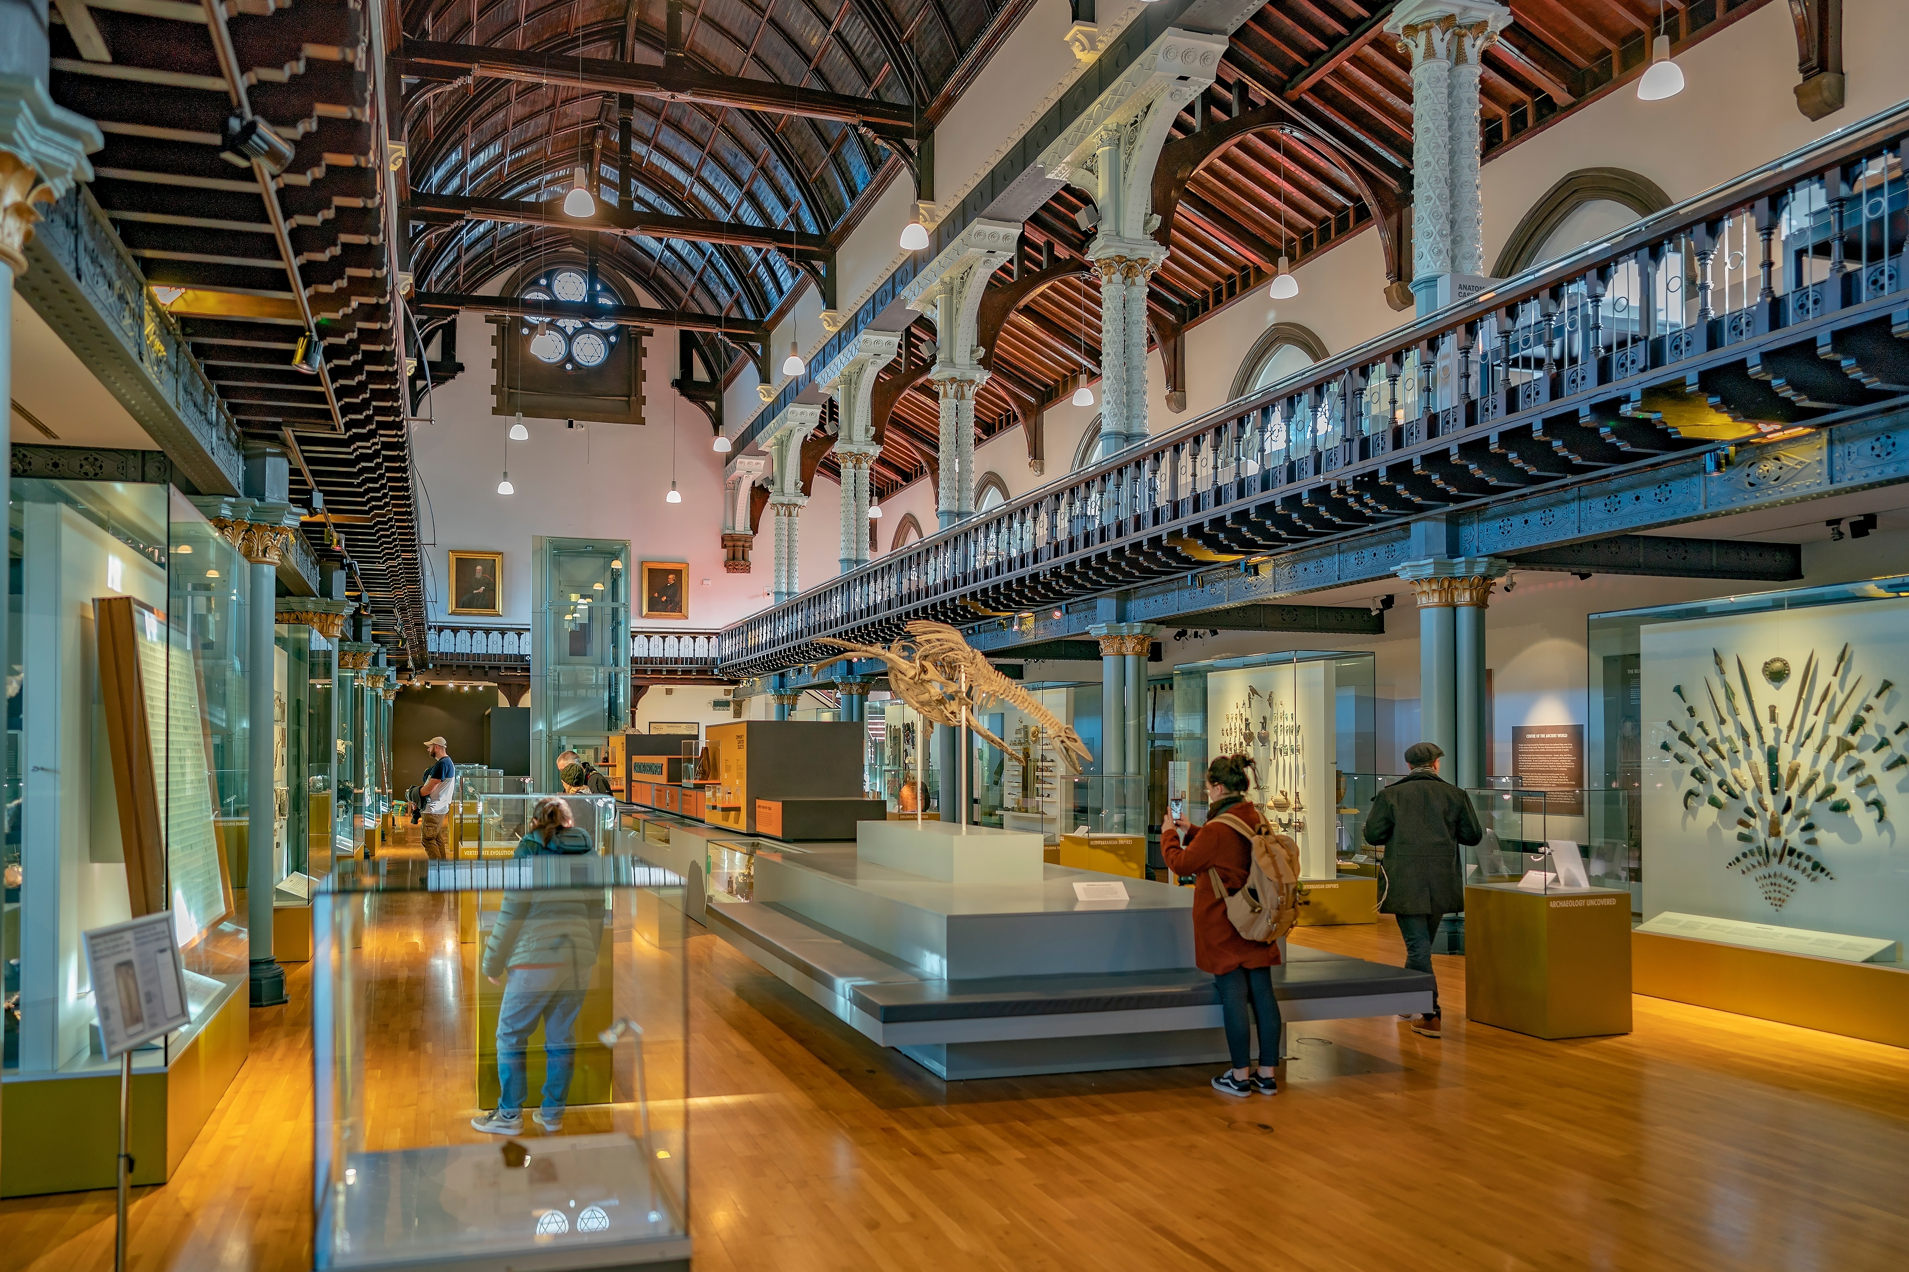
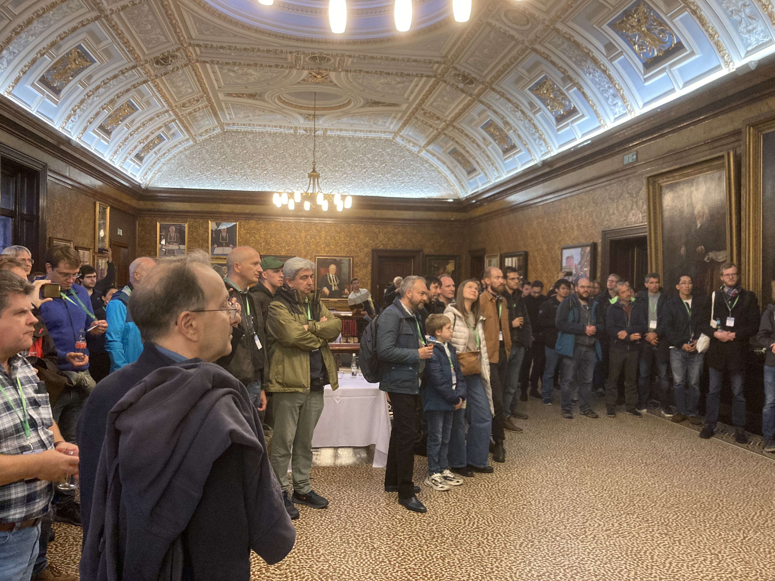
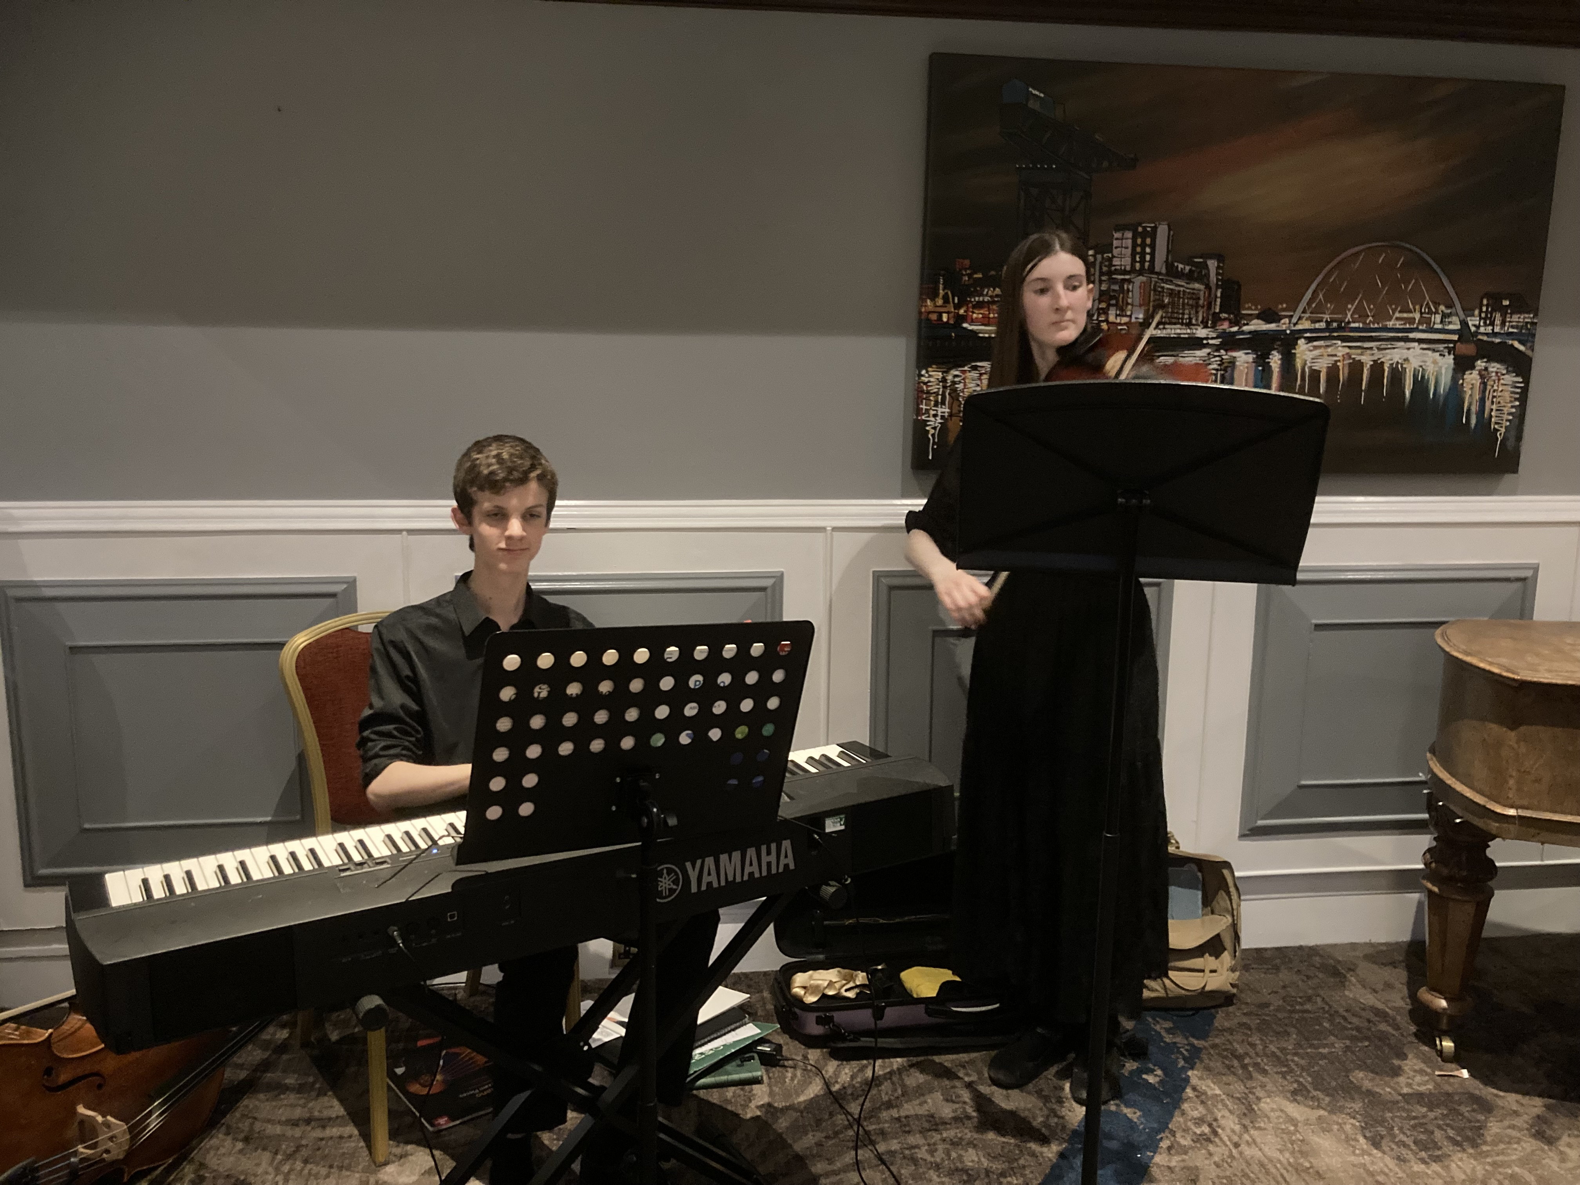
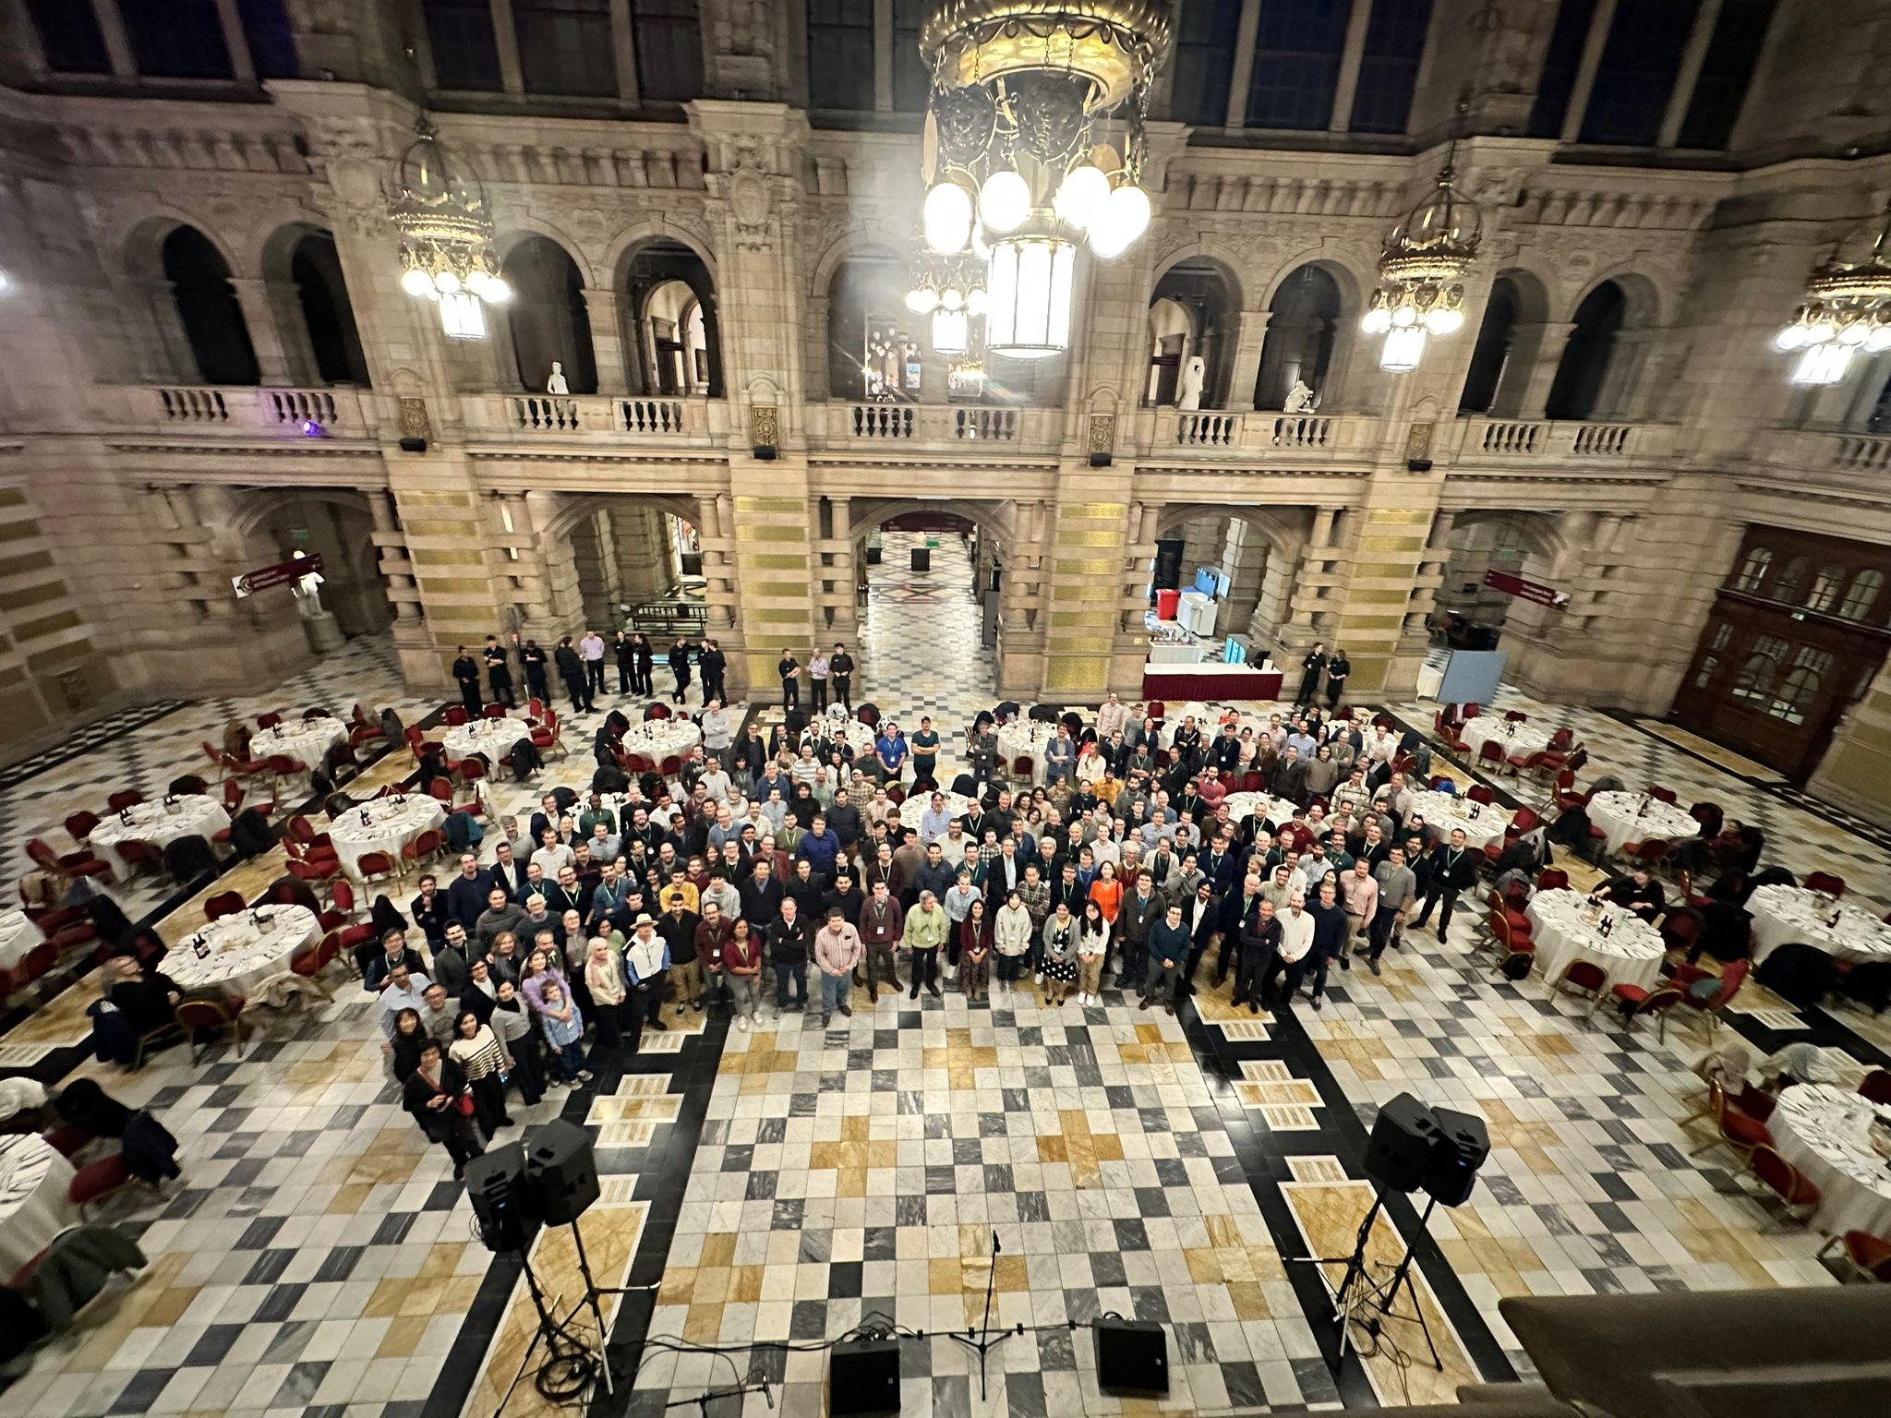
TWEPP
Last year but it was good
Social Event at Distilleries
Dinner and ceilidh at the Kelvingrove
City Chambers
Industrial Exhibition welcome drinks with music
Reception at the Hunterian
Topical Workshop on Electronics for Particle Physics
Held at the Grosvenor
220 Participants
87 Talks
90 posters
½ day tutorial on Cadance tools
Industrial exhibition
And Social events
And we broke even

