Slide 1

12 months in Neutrino-land
Paul Soler, 5th December 2025
Members Neutrinos Group:
Academics: Phill Litchfield, Paul Soler
Research Associates: Veera Mikola, Lucas Machado, Patrick Spradlin
Students: David Riley, Paul Morrison, Richarnie Burrows-Chambers
Technical Staff: Vincent Lam, Sneha Naik
Comings and goings:
Welcome to Richarnie Burrows-Chambers, new PhD student, to work on T2K and Hyper-K
Paul Morrison submitted his PhD thesis on 26 September 2025, waiting for his viva
Evan Goodman received his PhD in 2024
What do we work on?
Mainly neutrino oscillations and searches for new physics at T2K
Physics sensitivity and Outer Detector electronics at Hyper-K
Beam simulations for both T2K and Hyper-K
Reactor neutrino analyses and pre-supernova triggers at Super-K
Preparation for lepton-flavour violation searches at COMET
1

Slide 2
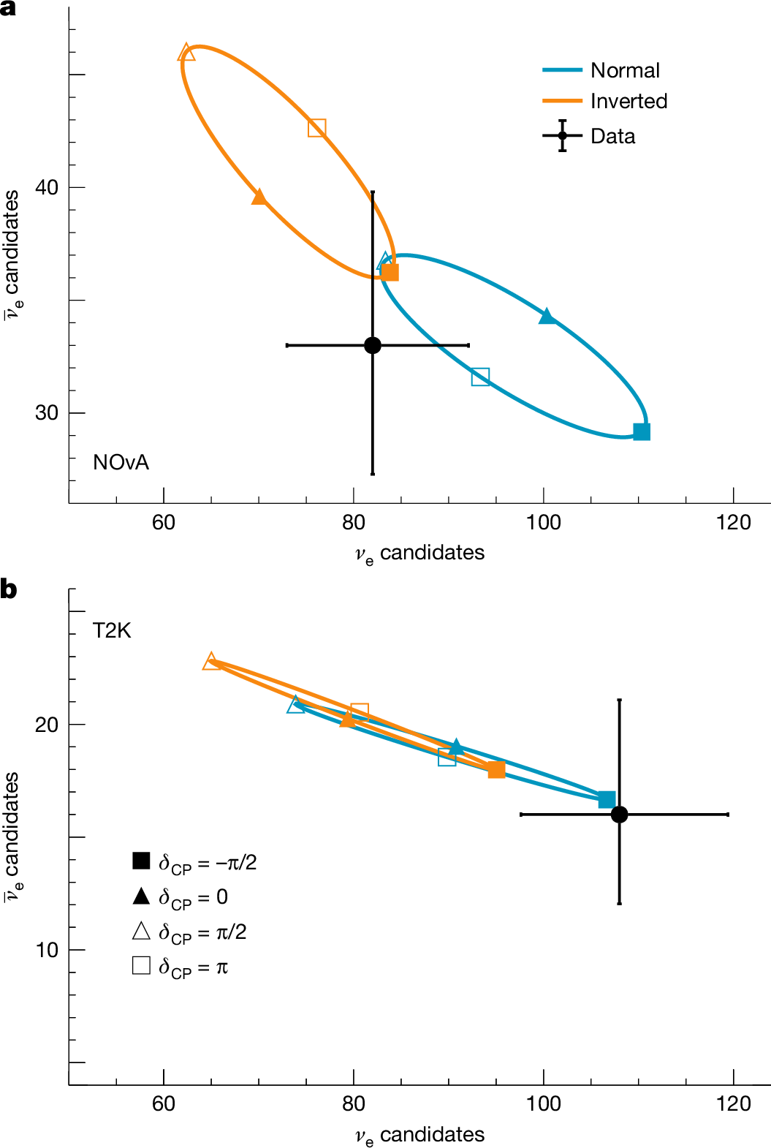
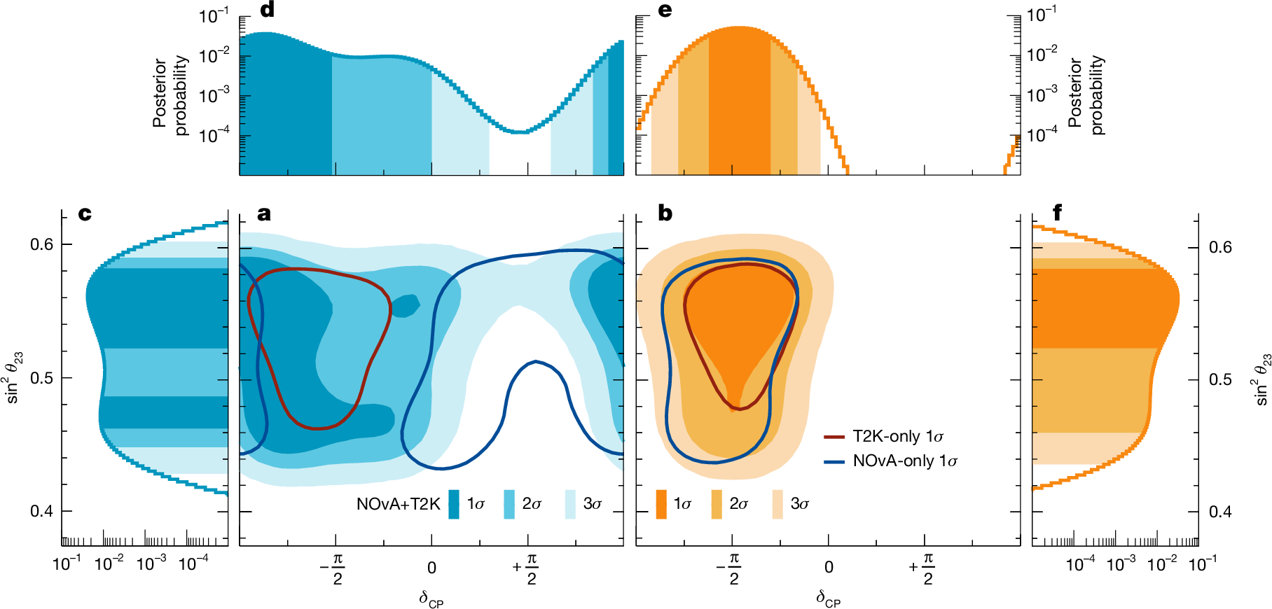
Highlight: T2K-NOvA search for CP violation in neutrinos
Evan Goodman, Veera, Phill
Published paper in Nature on 22 October 2025: Nature 646, 818-824 (2025)
University press release: https://www.gla.ac.uk/news/headline_1221467_en.html
T2K-NOvA collaboration was unique as two “rival” experiments carried out joint neutrino oscillation analysis across two collaborations
Main topic of Evan Goodman’s thesis, and lots of work by Phill and Veera to verify that the two data sets were statistically compatible
Main message: exclude CP violation at >3σ for inverted mass ordering, but more data required for more definitive statement for normal ordering
Normal ordering
Inverted ordering
2

Slide 3
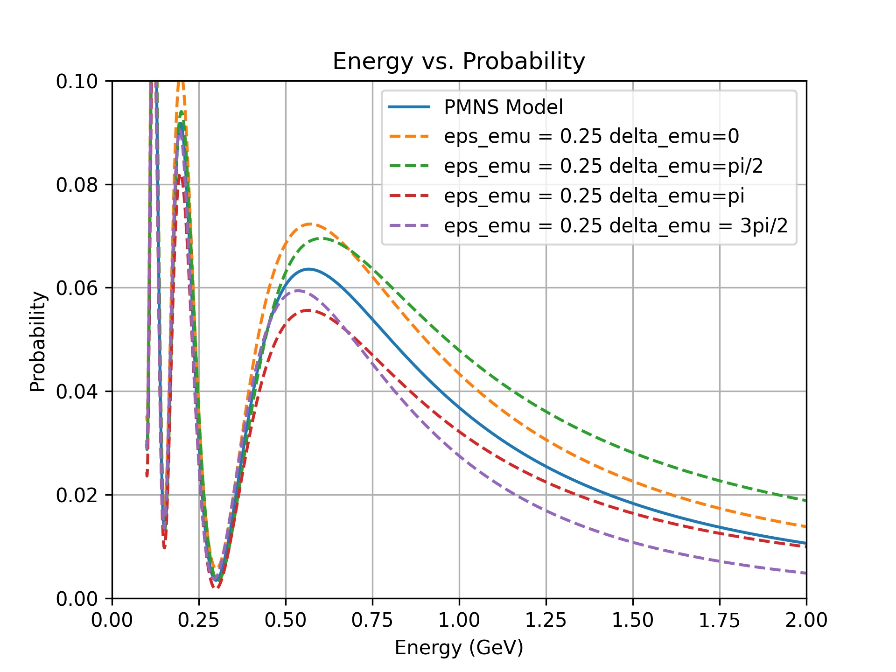
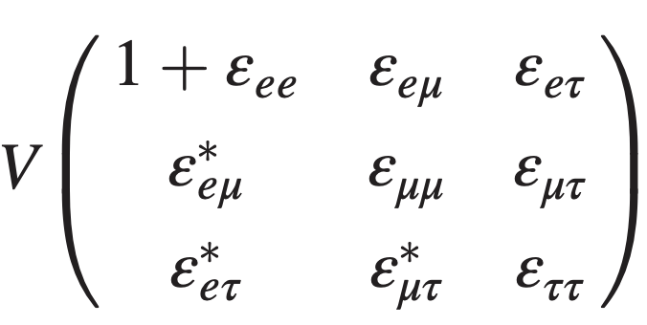
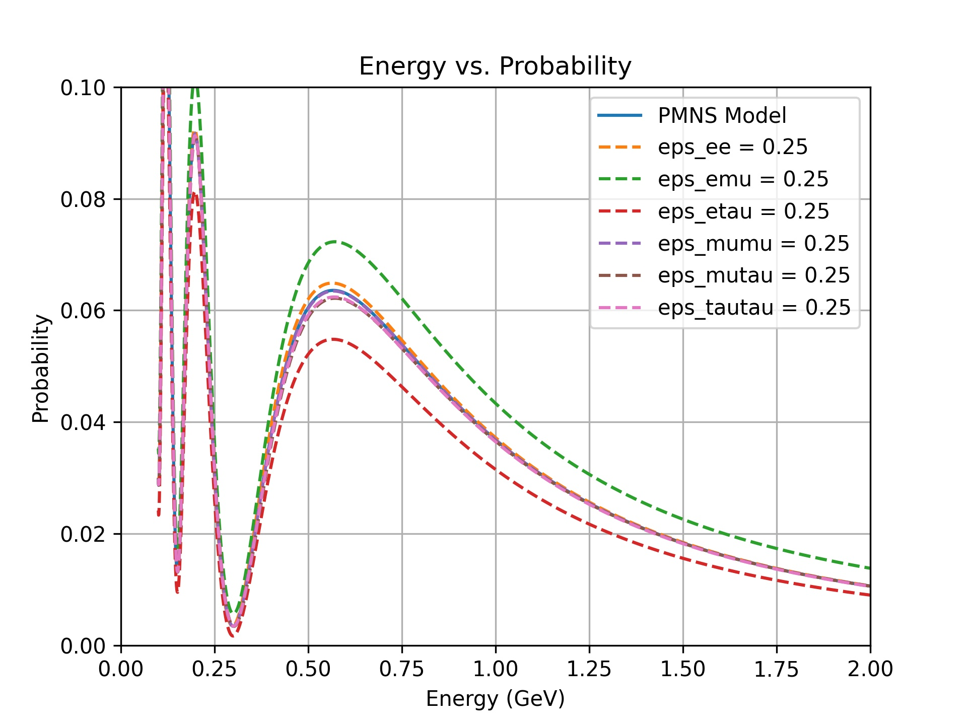
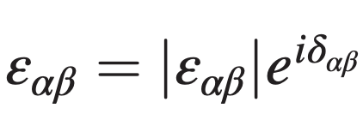

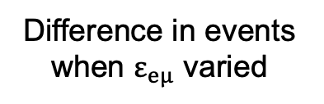
Non-Standard Interactions (NSI) in Neutrino Oscillations
Veera, Phill
Sub leading neutrino interactions with matter, introduces a possibility of flavour conversion through non-standard neutral current (NC) processes
T2K and NOvA results prefer normal ordering but have overlapping contours in inverted ordering, and the joint fit prefers inverted ordering. NSI was suggested as a solution https://doi.org/10.1103/PhysRevLett.126.051802
Phill is now convenor of T2K exotics group
$$H=U^{†}H_{0}U+H_{matter}+H_{NSI}$$
ε_{eμ}
Changes to T2K oscillation probability in presence of NSI
Difference in events when $ε_{eμ}$ varied
T2K has highest sensitivity to these parameters
3

Slide 4
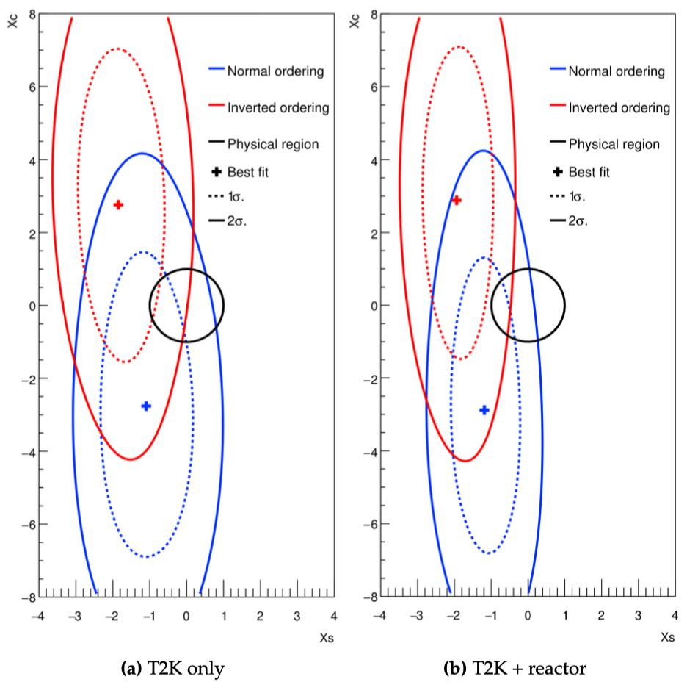
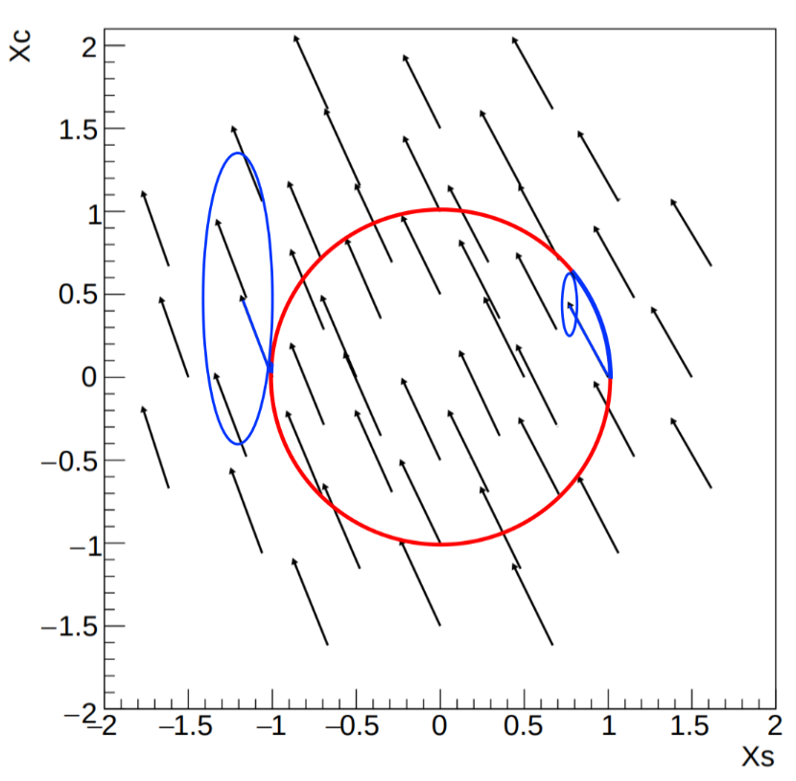
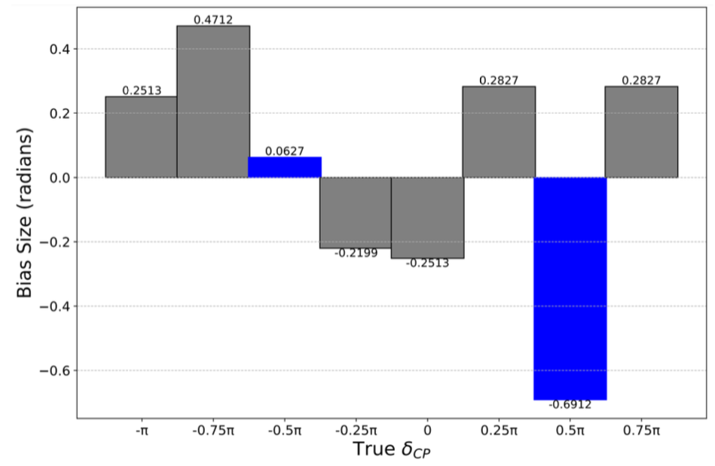

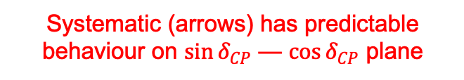
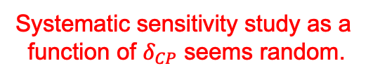


Paul Morrison, Phill
Second thesis on T2K – Paul Morrison
Paul submitted his thesis on extracting separate constraints on $\sin{δ_{CP}}$ and $\cos{δ_{CP}}$
Viva now set for 19th Jan.
Showed that T2K has much stronger sensitivity to $\sin{δ_{CP}}$($ν$ vs $\overline{ν}$) than to $\cos{δ_{CP}}$.
Also discovered this is a powerful tool for understanding systematic uncertainties and quickly computing accurate intervals.
$$X_{c}\sim \sin{δ_{CP}}$$
T2K data only
T2K + reactors
Systematic sensitivity study as a function of $δ_{CP}$ seems random.
Systematic (arrows) has predictable behaviour on $\sin{δ_{CP}}$ — $\cos{δ_{CP}}$ plane
$$X_{s}\sim \sin{δ_{CP}}$$
4

Slide 5
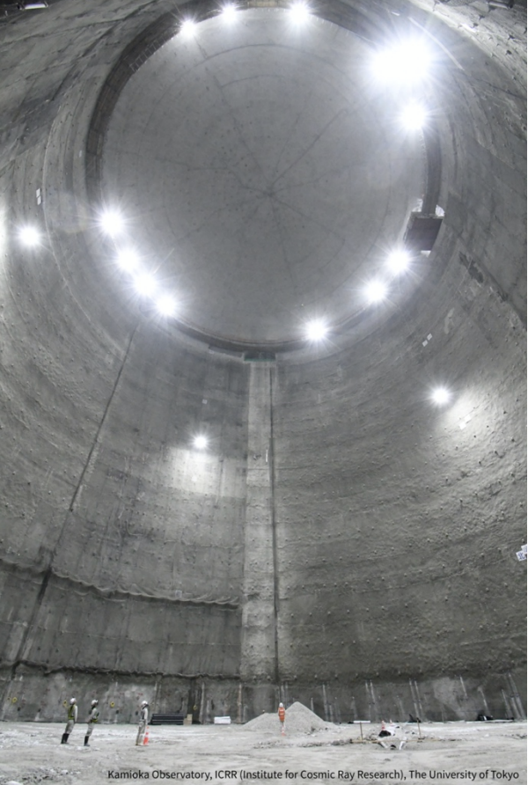
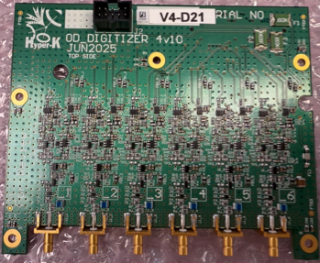
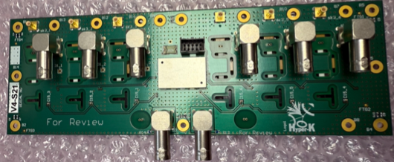
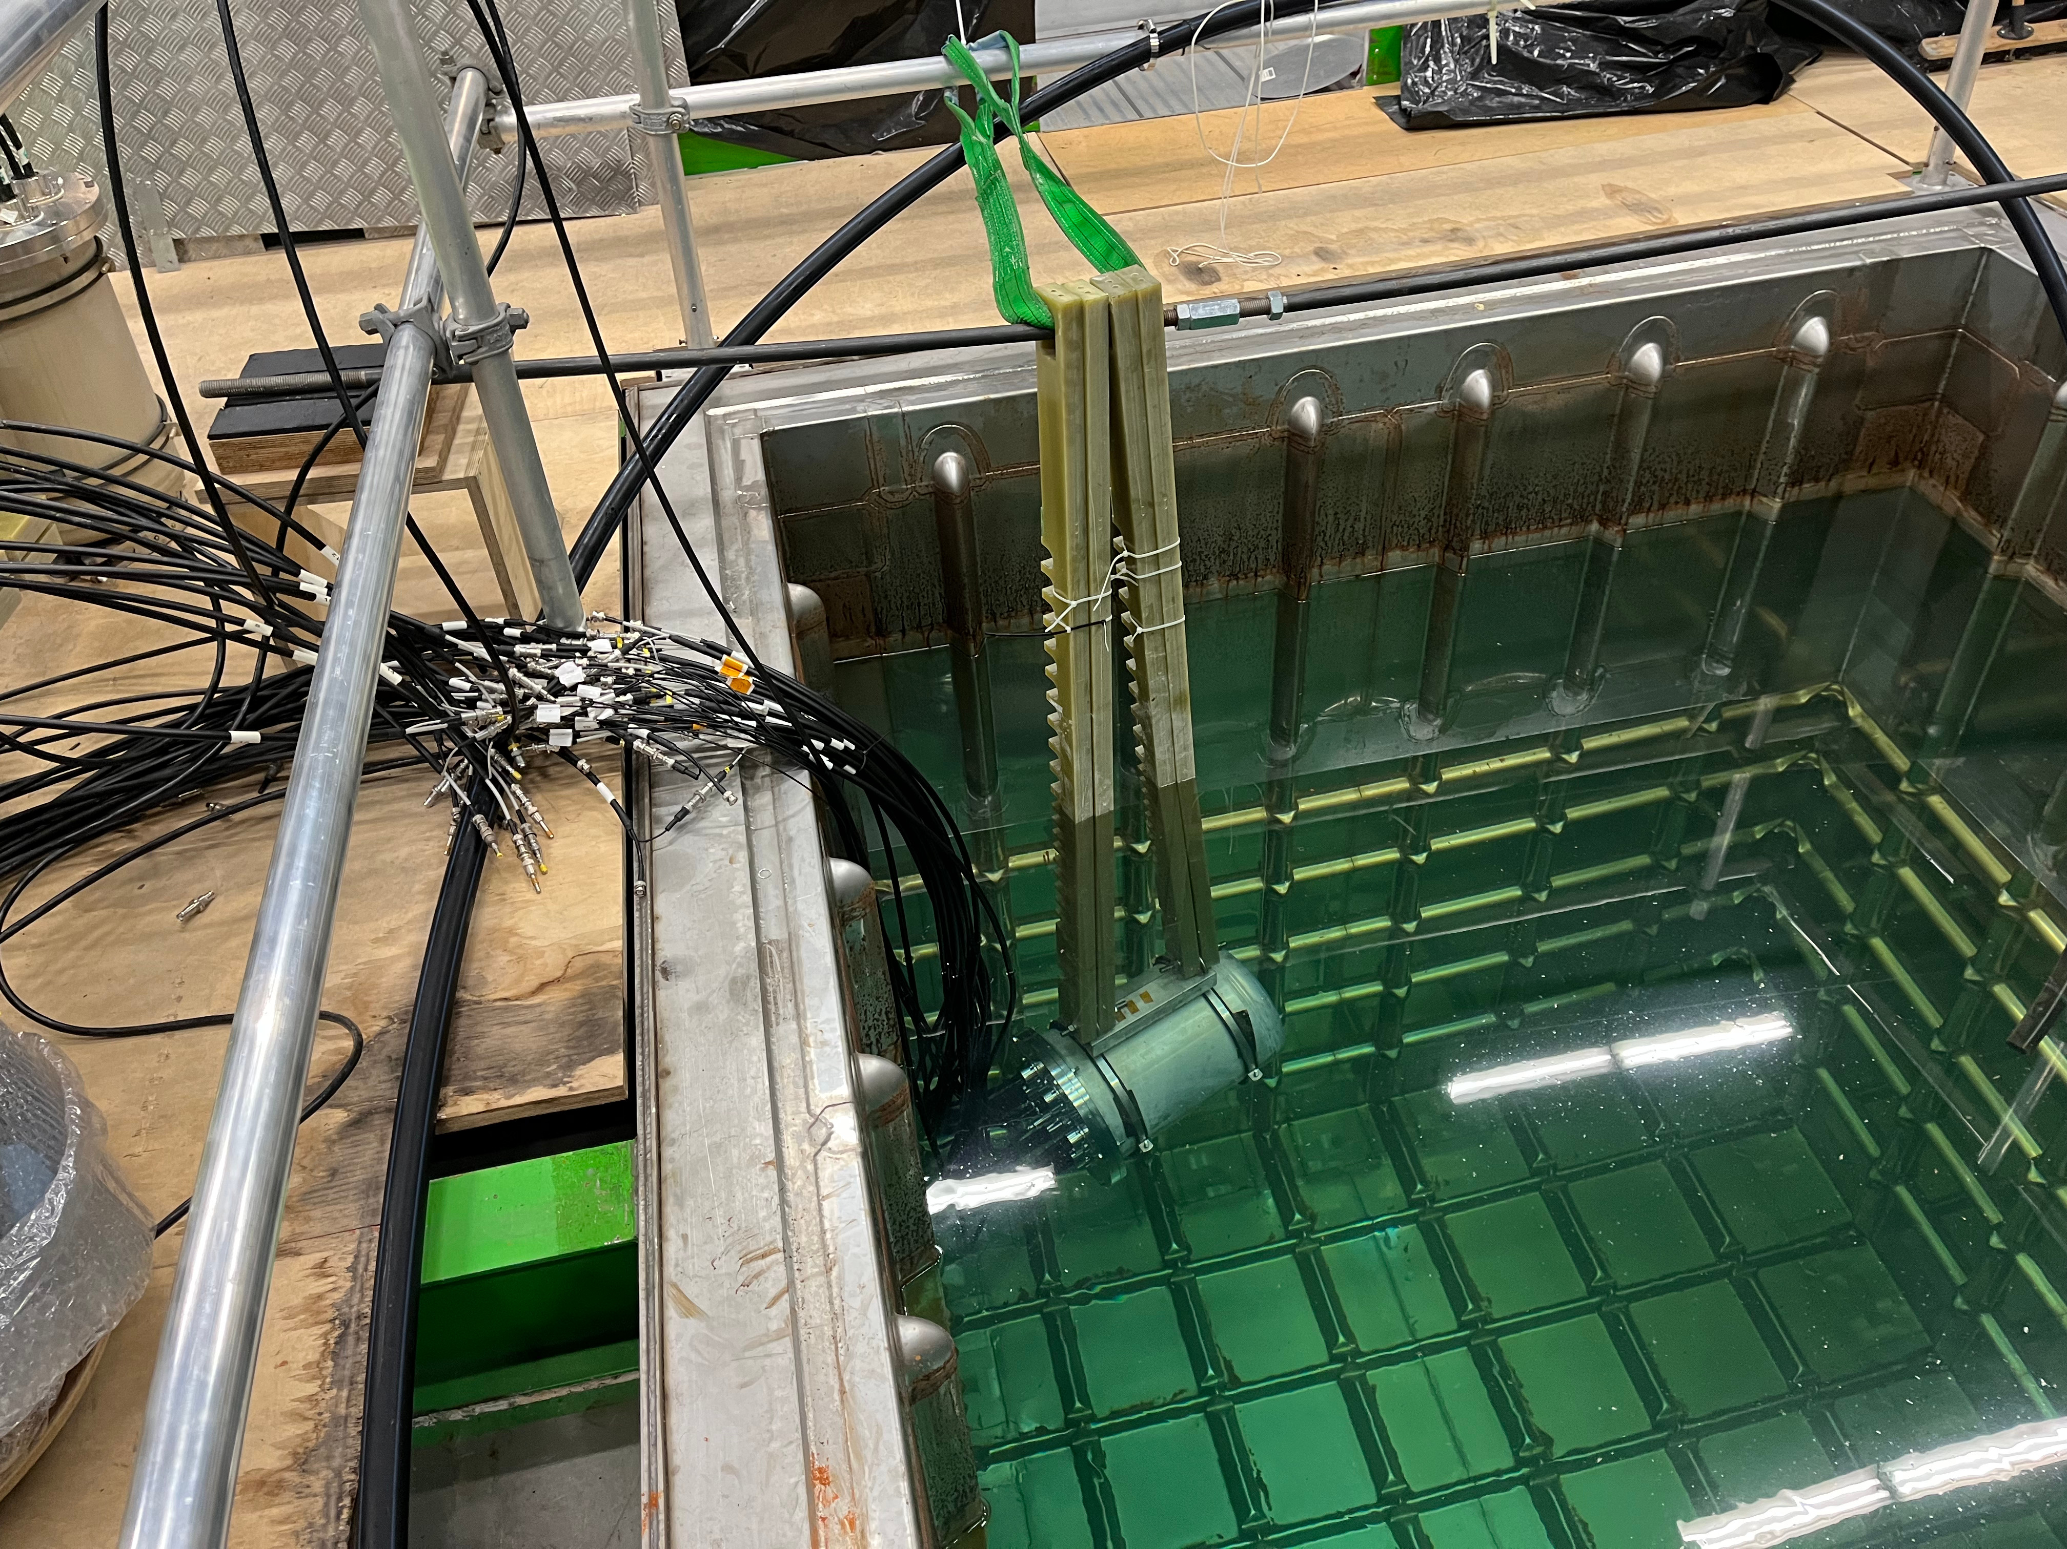
Hyper-K construction and physics sensitivity
Construction going very well: expected to commence data taking 2028
Largest underground cavern ever excavated (70 m x 70 m)
Outer Detector (OD) electronics:
Electronics vessel in water at CERN
Hyper-K sensitivity paper accepted publication: arXiv:2505.15019
Electronics vessel in water
70 m
Vincent, Lucas, David, Sneha
70 m
5

Slide 6
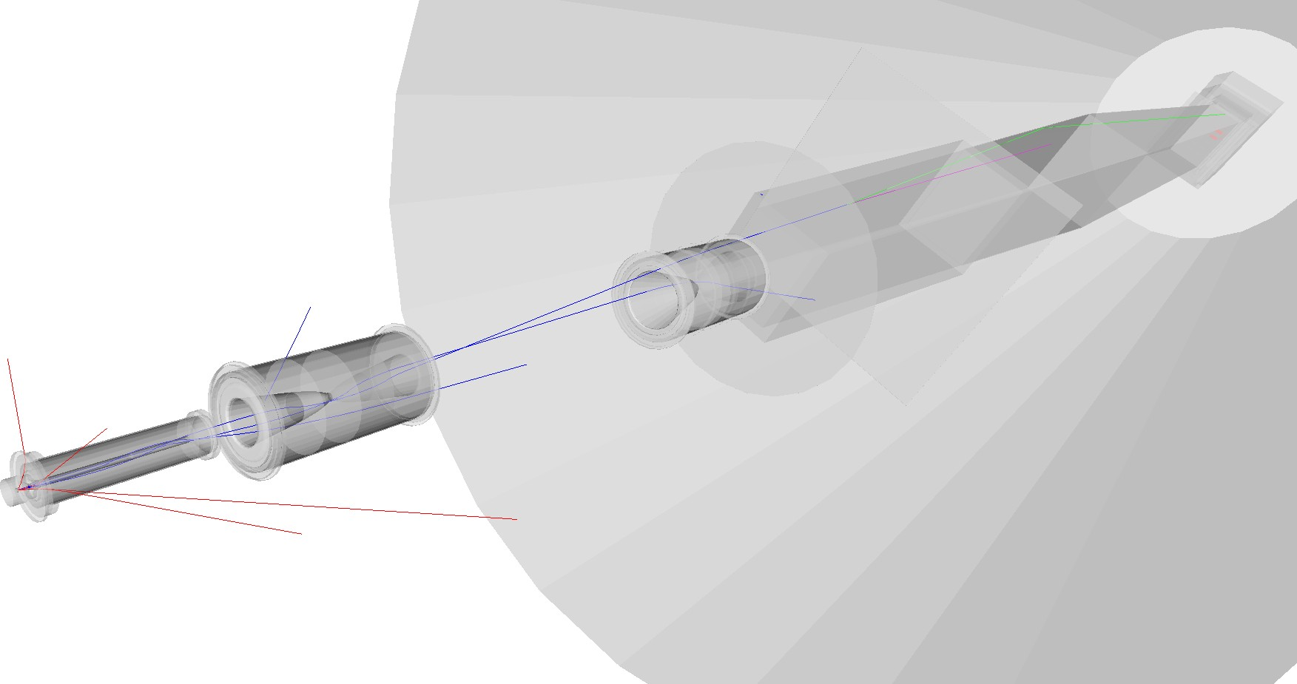
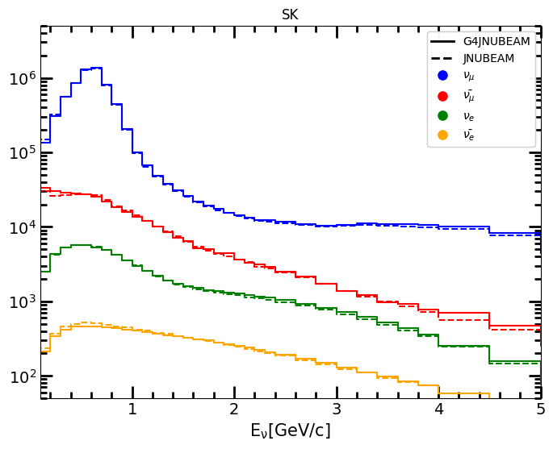
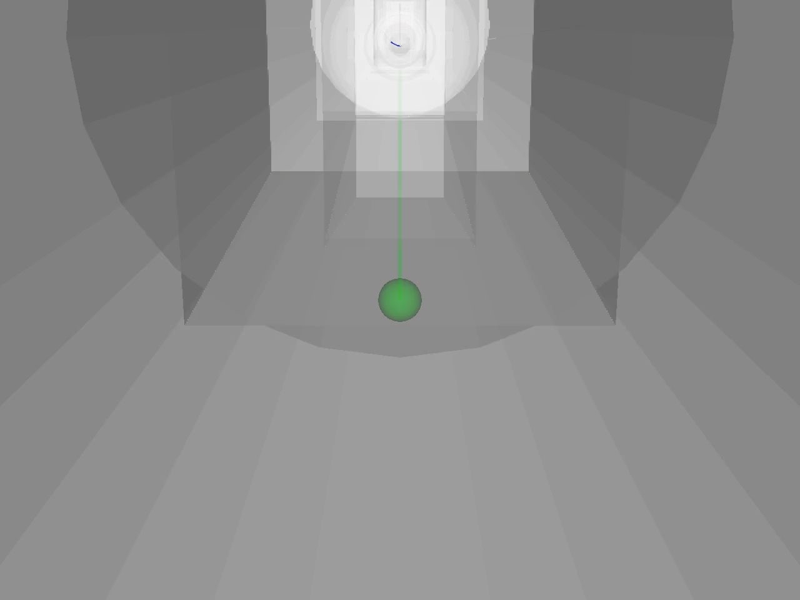
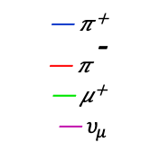
GEANT4 Neutrino Beam Monte Carlo Simulation
G4JNUBEAM beam simulation:
Monte Carlo simulation based on GEANT4, describing all physical processes from proton interactions in the target to the decay of hadrons and muons producing neutrinos.
Framework now fully developed and already being used by T2K
Fluxes will be used for next T2K oscillation analysis!
Lucas T2K Beam MC convener
Lucas
— 𝜋⁺
— 𝜋⁻
— 𝜇⁺
— $υ_{μ}$
Animation based on G4JNUBEAM to illustrate how neutrino beam is produced
Green: proton
Blue: π⁺
Yellow: ν_{μ}
6

Slide 7
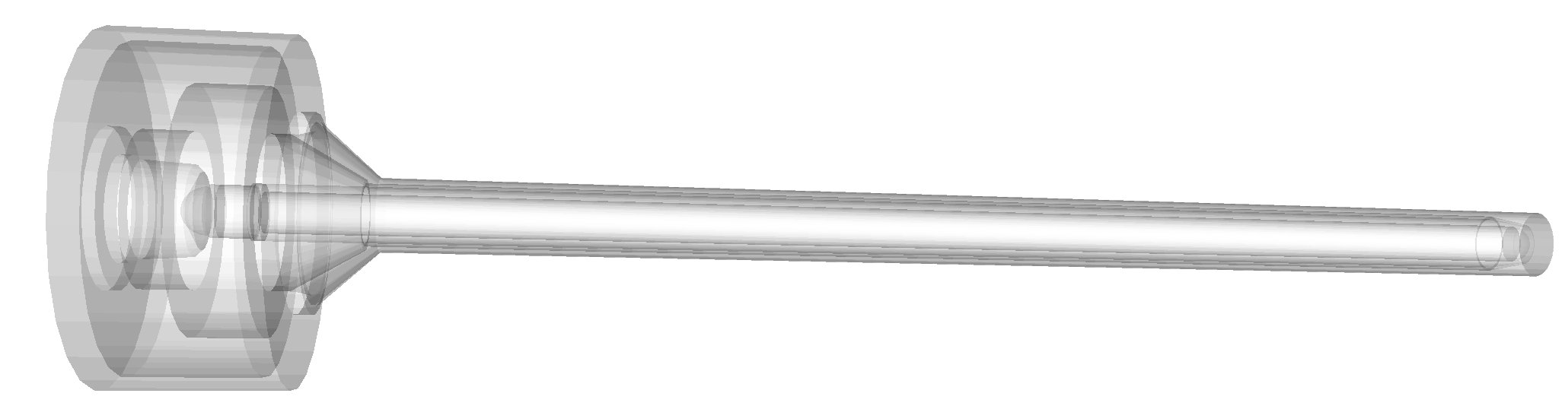
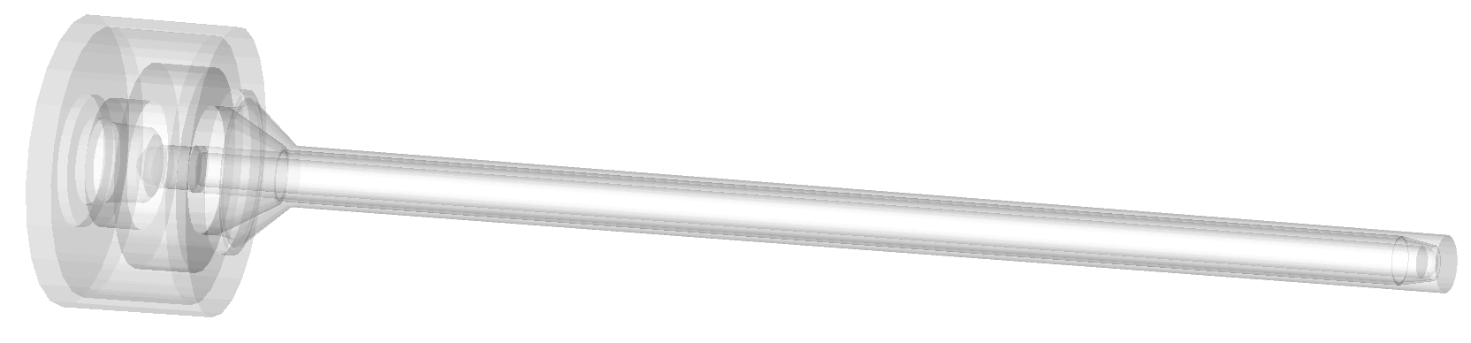
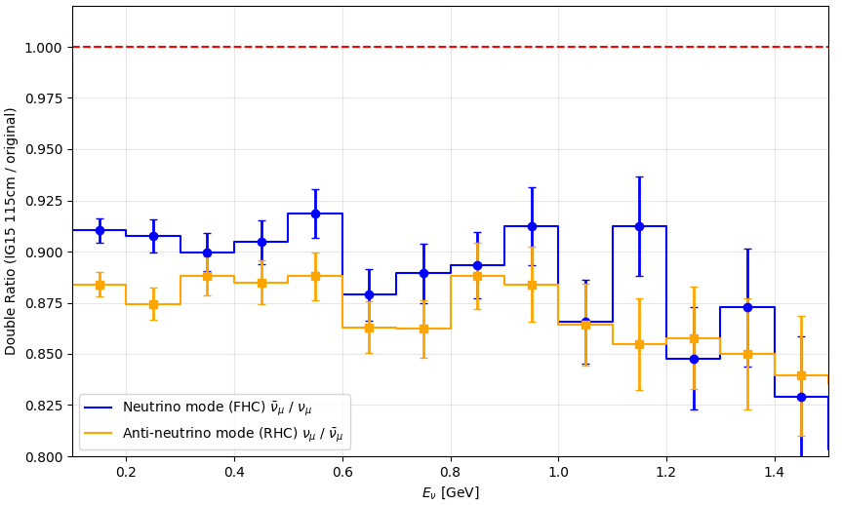
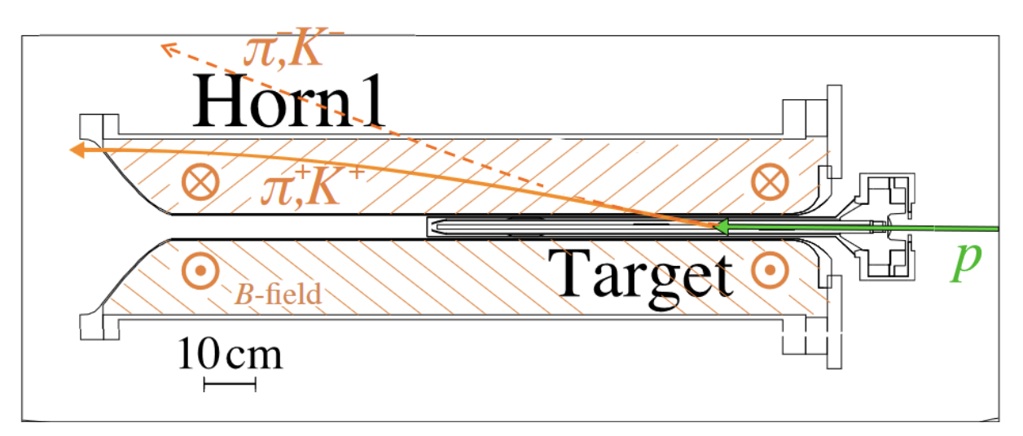
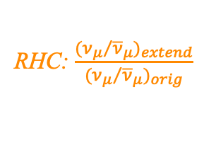
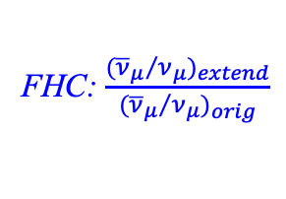
Optimisation Neutrino Beam Target for Hyper-K
Original Target: 90-cm graphite (IG-43 1.82 g/cm³) rod
Lucas
Target optimisation:
In an ideal (anti)neutrino-mode beam, all π⁺ (π⁻) are focused into the decay volume and all π⁻ (π⁺) are defocused and absorbed before decaying.
A fraction of high-momentum/forward-going π⁻ (π⁺) escape magnetic field of horns and travel downstream → wrong-sign flux, reducing sensitivity to CP violation.
Improved with longer target, trading fewer direct pions for more horn-focused pions.​
115-cm graphite rod, with IG-45 (1.88 g/cm³) and IG-15 (1.90 g/cm³)
Double ratio to illustrate wrong sign contamination reduction
+25 cm target (total 115 cm).
Density: 1.82 → 1.90 g/cm³
FHC: $\frac{{({{\overline{ν}}_{μ}}/{ν_{μ}})}_{extend}}{{({{\overline{ν}}_{μ}}/{ν_{μ}})}_{orig}}$
RHC: $\frac{{({ν_{μ}}/{{\overline{ν}}_{μ}})}_{extend}}{{({ν_{μ}}/{{\overline{ν}}_{μ}})}_{orig}}$
90 cm
+25 cm
Animation based on G4JNUBEAM to illustrate how neutrino beam is produced
Green: proton
Blue: π⁺
Yellow: ν_{μ}
About 60cm available in Horn 1 to extend the target.
David, Veera, Lucas now studying the impact in the CPV sensitivity with the extended/denser target.
7

Slide 8
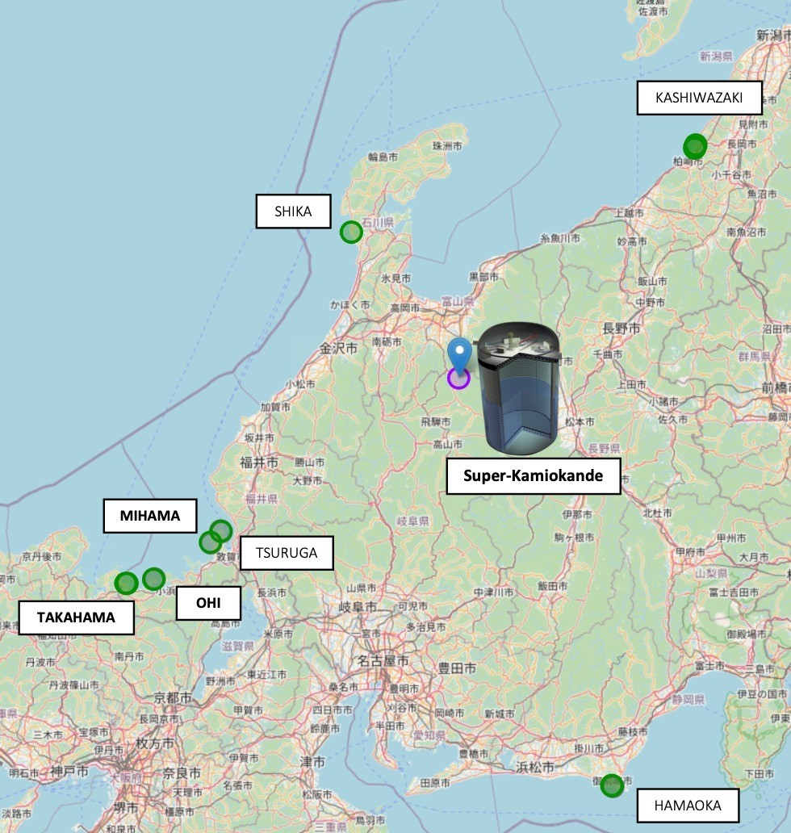
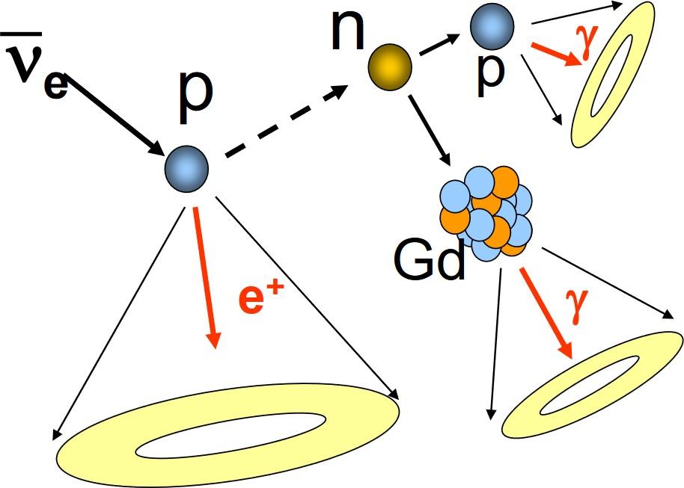
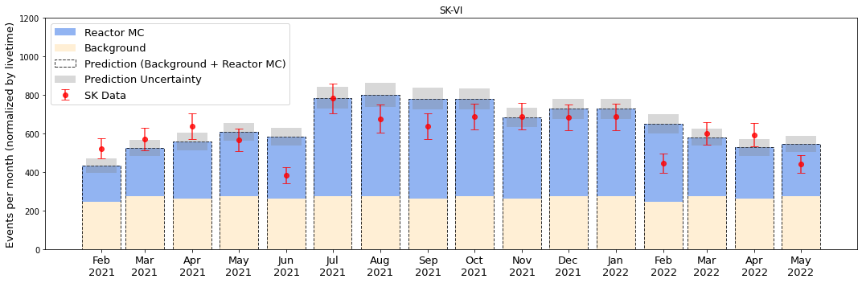
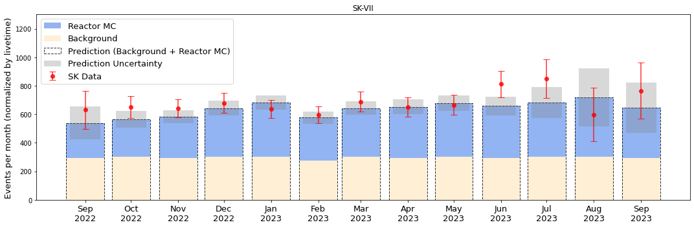
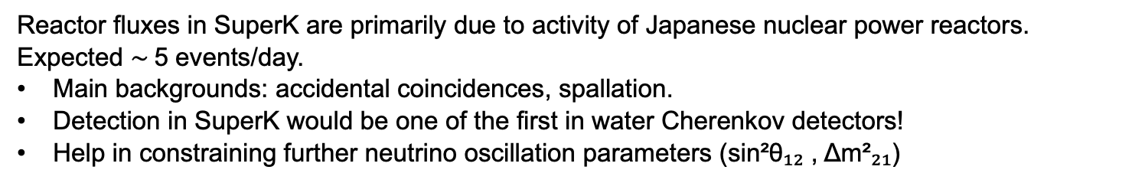
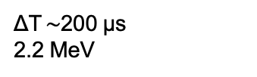

Lucas
Reactor Neutrino Analysis Super-K
Super-Kamiokande with Gadolinium: Enhance sensitivity to low energy electron anti-neutrinos.
ΔT $\sim$200 µs
2.2 MeV
SK-VI:
July/August 2020
13 tons Gd₂(SO₄)₃ * 8H₂O
0.01% Gd
SK-VII/
SK-VIII:
June/July 2022
40 tons Gd₂(SO₄)₃ * 8H₂O
0.03% Gd
~8 MeV ΔT_{0.03% Gd} $\sim$60 µs
Reactor fluxes in SuperK are primarily due to activity of Japanese nuclear power reactors.
Expected $\sim$5 events/day.
Main backgrounds: accidental coincidences, spallation.
Detection in SuperK would be one of the first in water Cherenkov detectors!
Help in constraining further neutrino oscillation parameters (sin²θ₁₂ , Δm²₂₁)
Full analysis of both SK-VI and SK-VII data from 2020 to 2023:
SK-VI preliminary
SK-VII preliminary

Slide 9
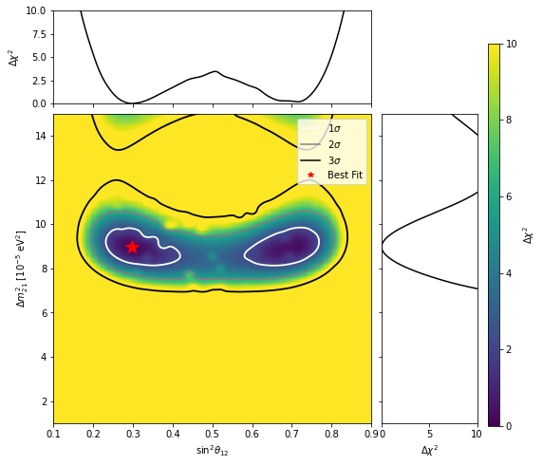
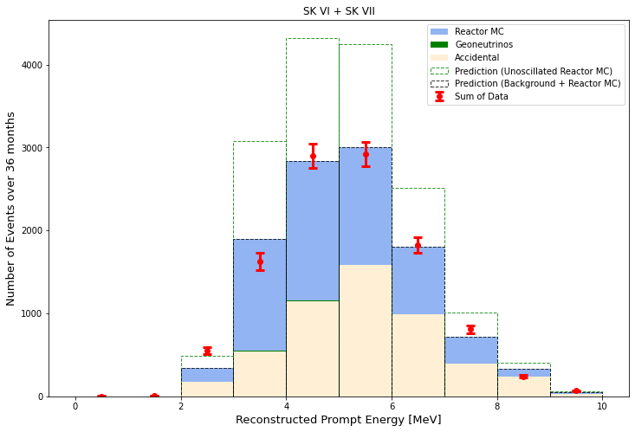
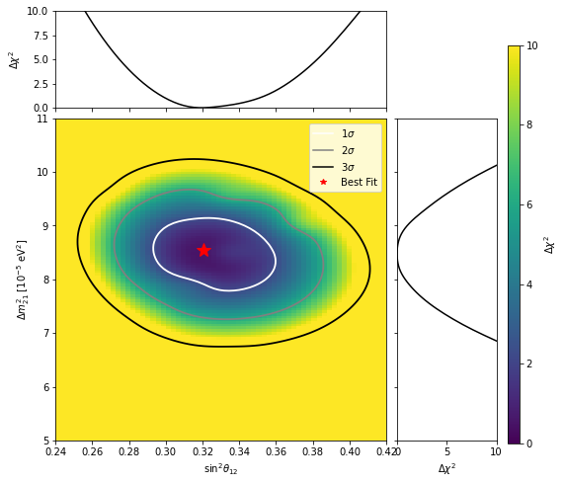

Lucas
Reactor Neutrino Analysis Super-K
First combined Solar + Reactor Oscillation Analysis performed by a single experiment.
A direct CPT test comparing oscillation parameters extracted from solar and reactor antineutrinos within Super-K: solar and reactor measurements within Super-K are fully consistent, in agreement with CPT invariance.
Agreement with recent JUNO results.
Paper in preparation!
SK Reactor
SK preliminary
Best fit:
sin²θ₁₂ = 0.299 (+0.068 -0.047)
Δm²₂₁ = 8.996 (+0.553 -0.586) eV²
Oscillated neutrinos:
χ²/df = 19.36/16 = 1.21
Unoscillated neutrinos:
χ²/df = 173.24/16 = 10.83
Significance = 23$σ$
SK Solar + Reactor
SK preliminary
SK preliminary
sin²θ₁₂ = 0.3208 (+0.0286 -0.0193)
Δm²₂₁ = 8.549 (+0.428 -0.575) eV²

Slide 10
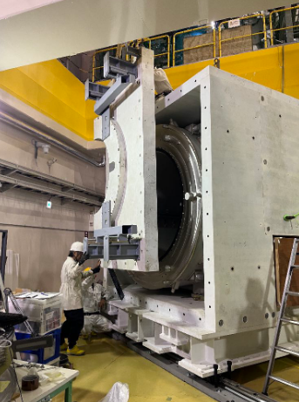
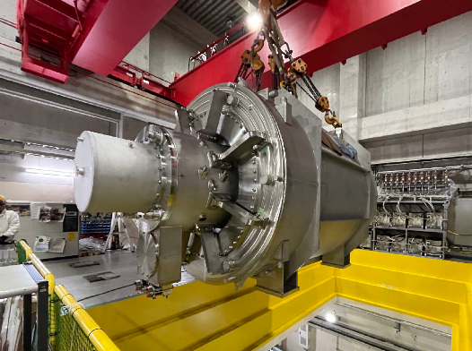
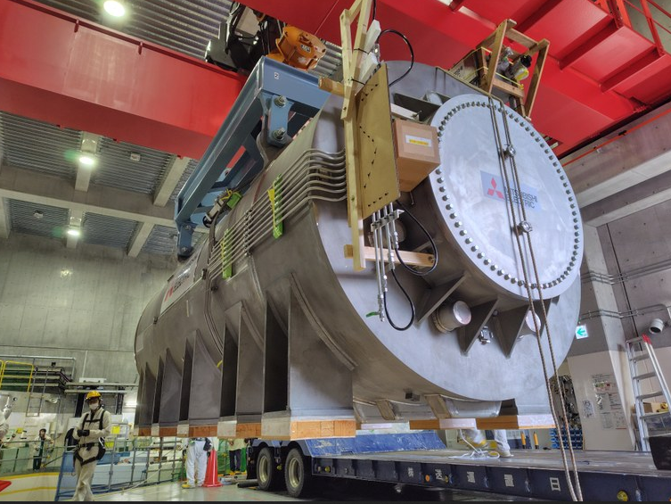
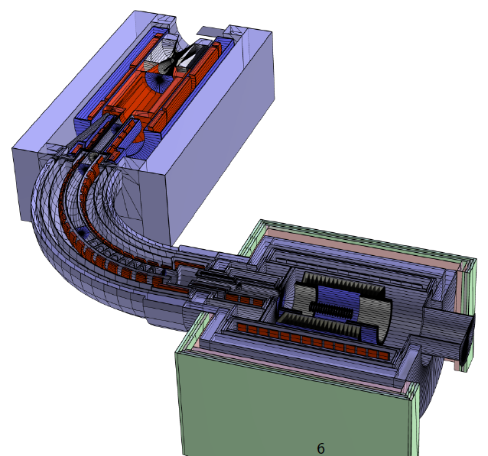
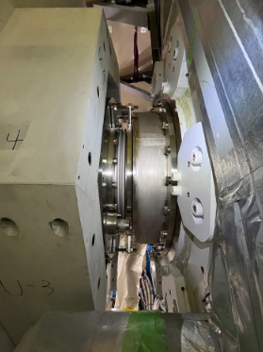

Phill
COMET: Charged Lepton Flavour Violation Experiment at J-PARC
Search for μ−e conversion: $μ^{−}+Al⟶e^{−}+Al$
Goal: BR$<{10}^{−16}$
5T Pion capture solenoid (New)
1T Detector & Bridge solenoids (New)
5m
Completed installation of magnets Oct 28th.
Cold test in 2026
3T Transport solenoid (Already installed)

