Slide 1

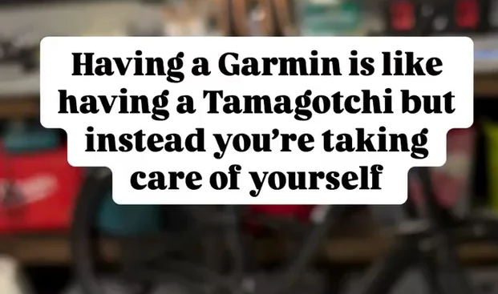
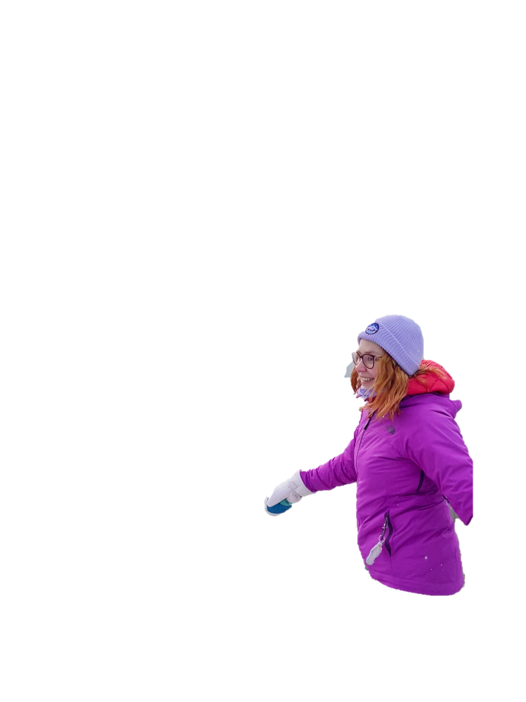






My Year in Useless Stats

Slide 2



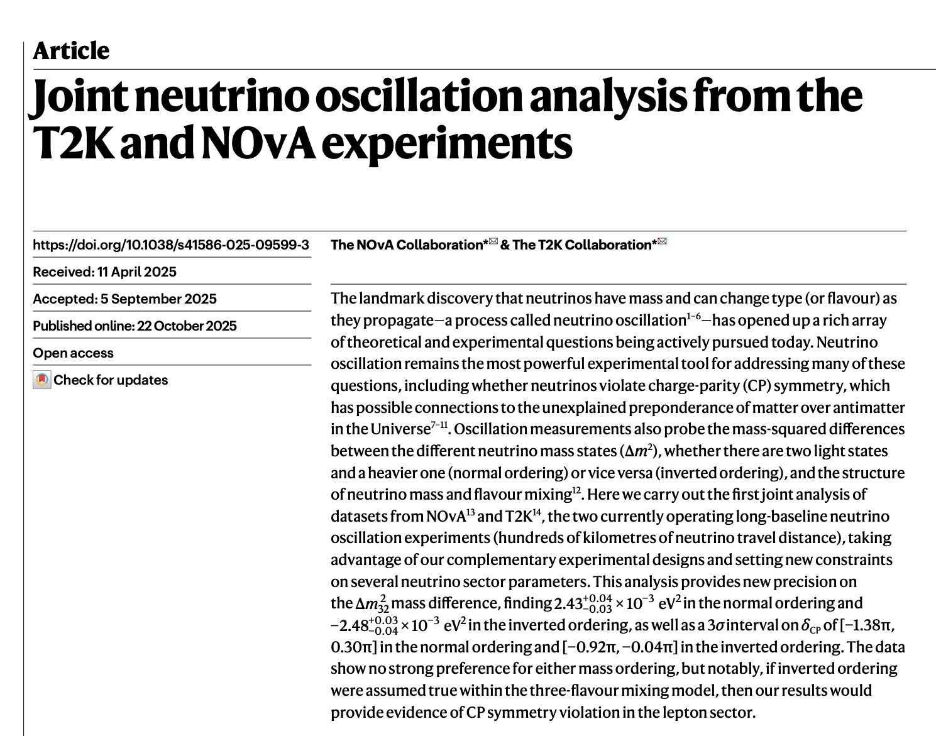
Actual Work
One paper in Nature

Slide 3
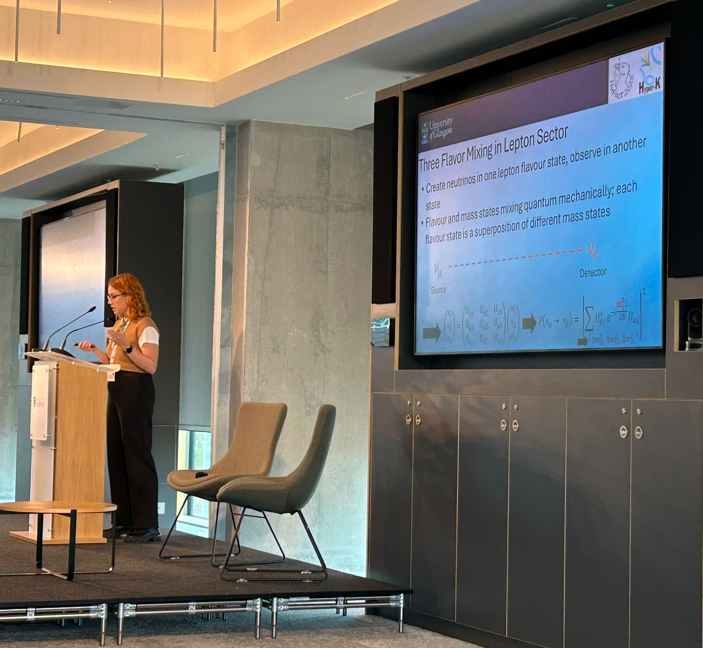
Actual Work
One paper in Nature
One conference plenary talk

Slide 4
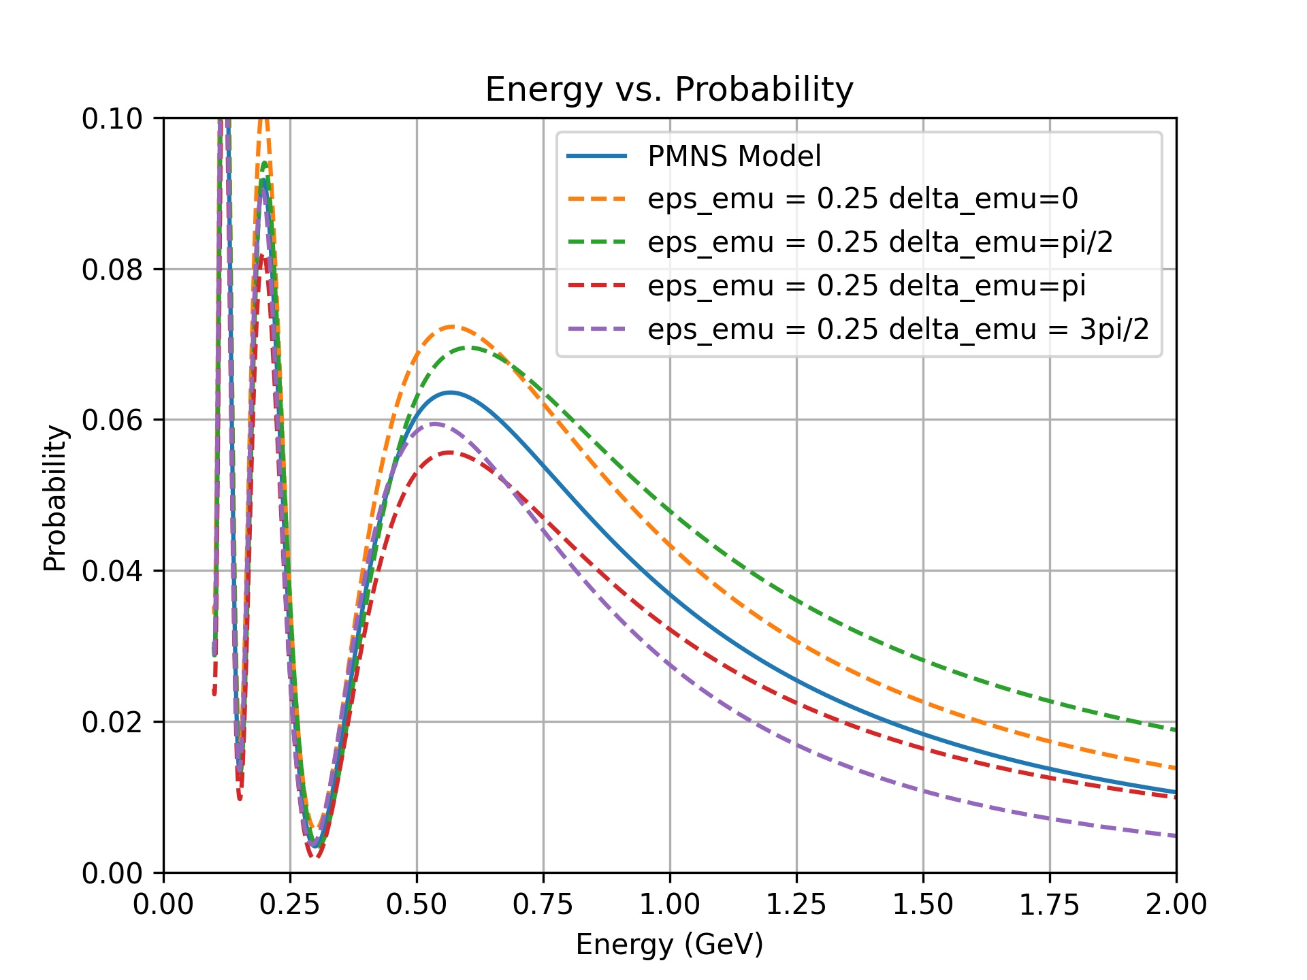
Actual Work
One paper in Nature
One conference plenary talk
9 update talks on T2K NSI analysis

Slide 5
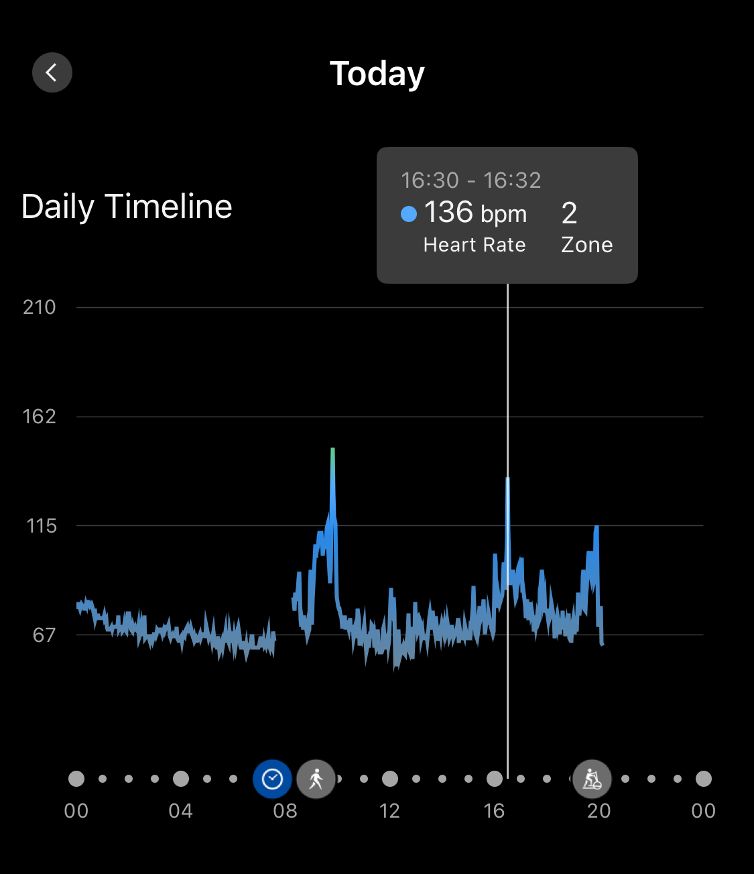
Actual Work
One paper in Nature
One conference plenary talk
9 update talks on T2K NSI analysis
One set of deleted outputs on the /data/neutrino02/

Slide 6
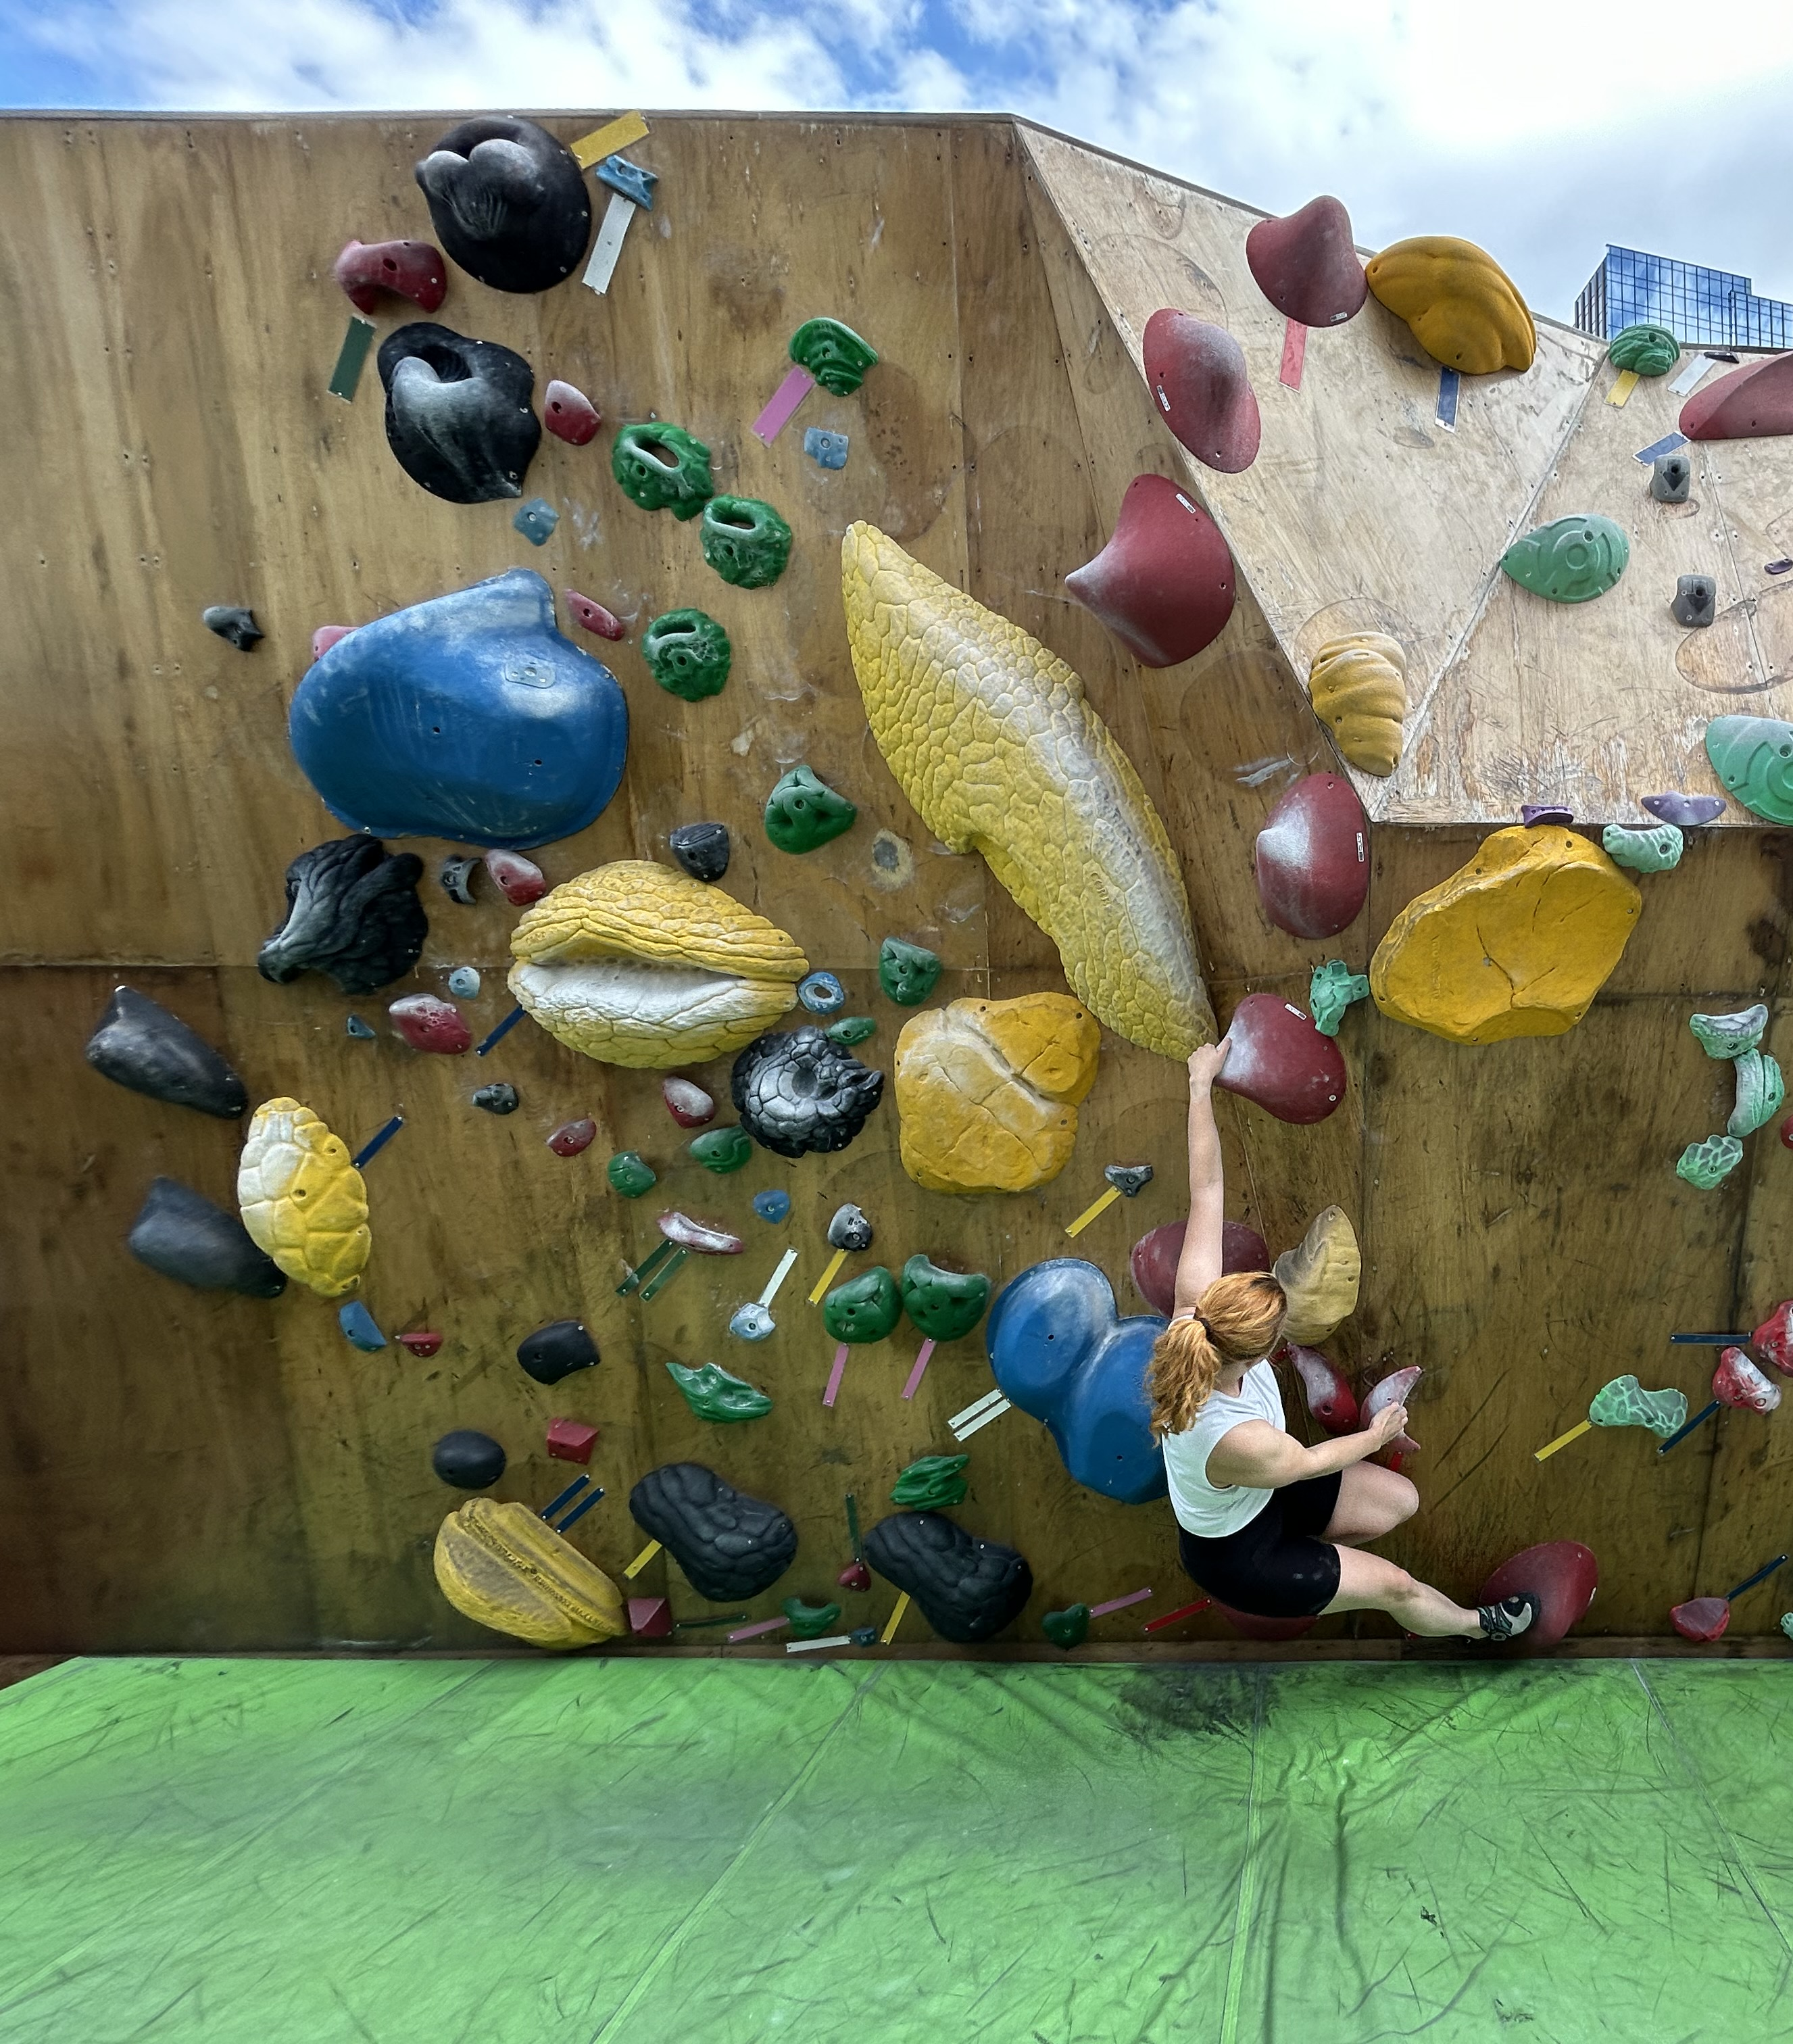
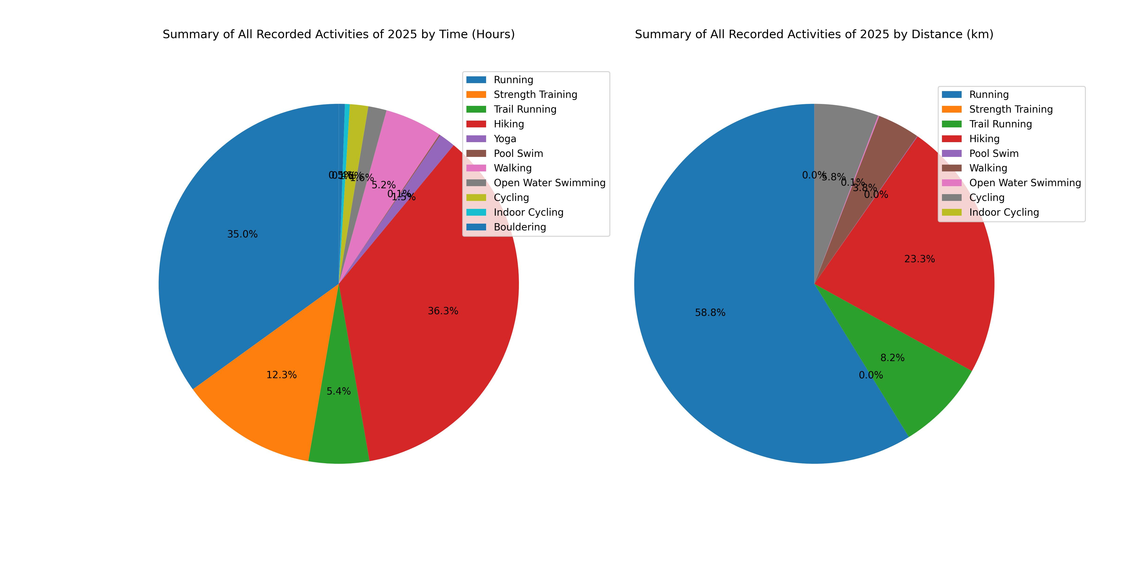
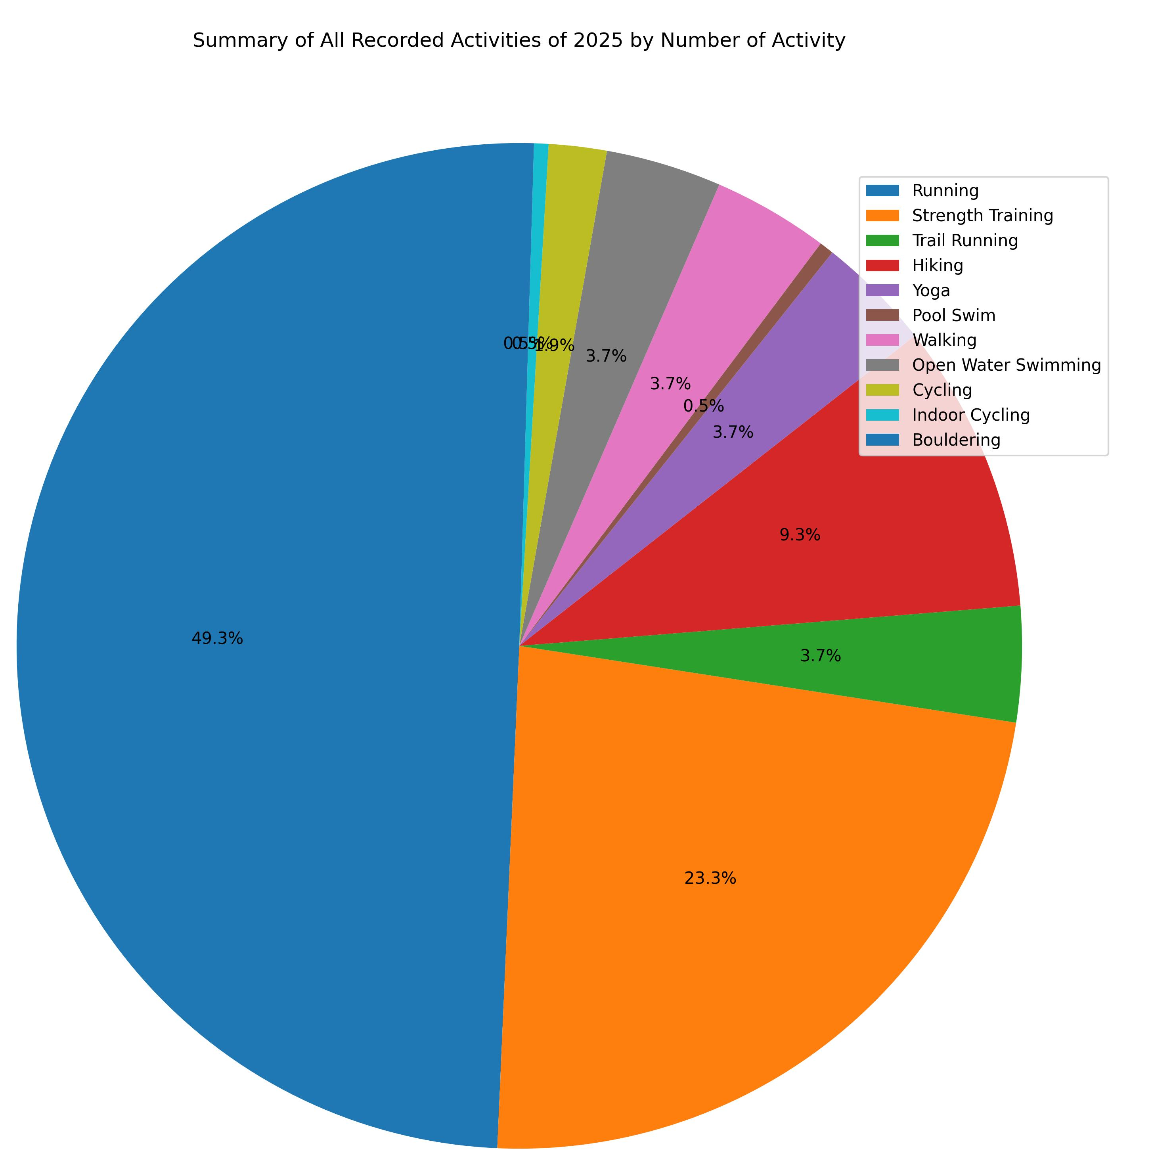
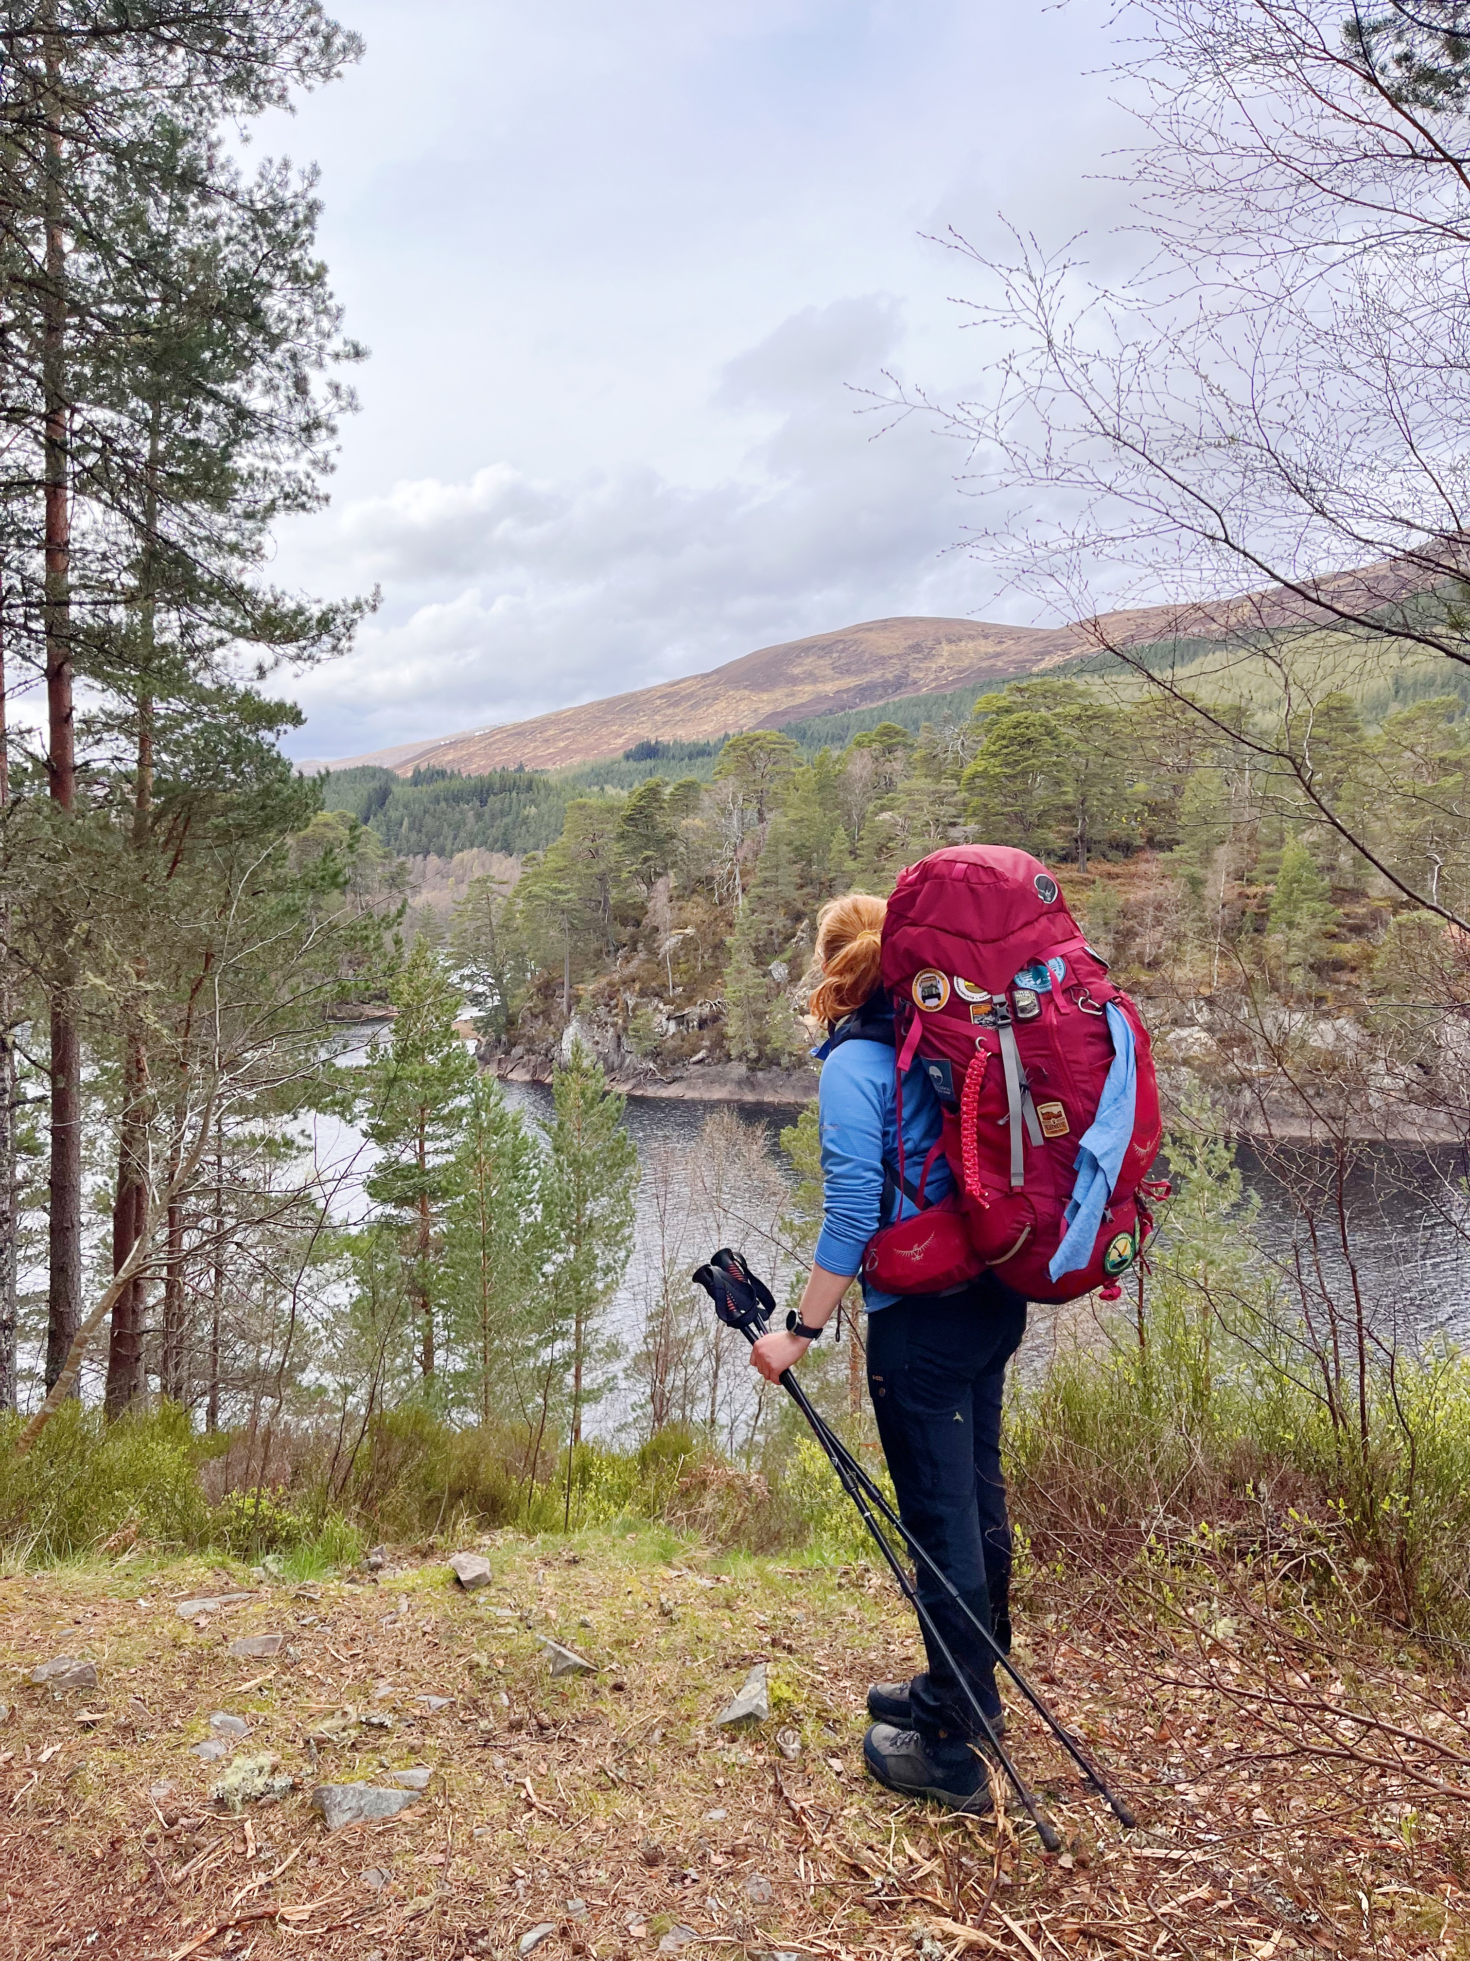
Year in Activities

Slide 7
Year in Activities
What does this teach us?

Slide 8
Year in Activities
What does this teach us?
Running is faster than walking

Slide 9
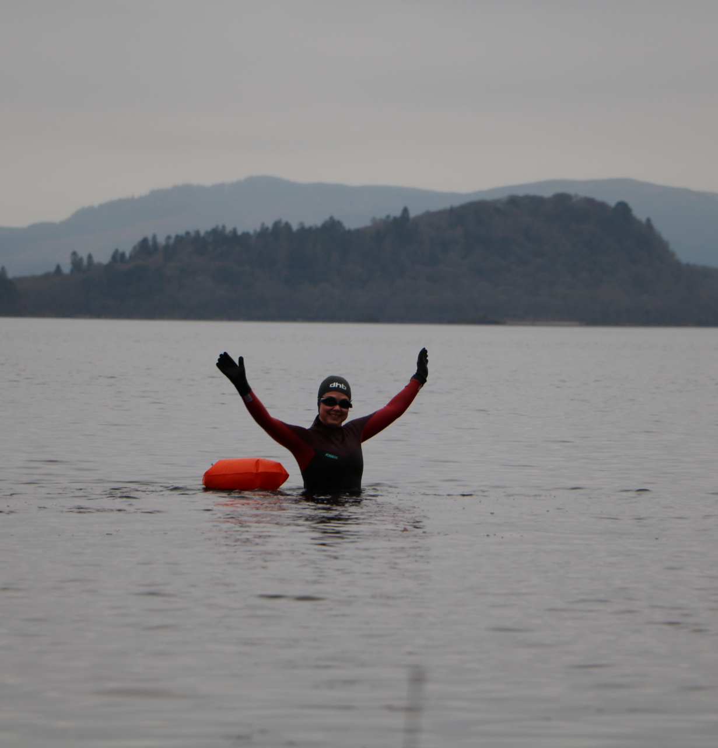
Year in Activities
What does this teach us?
Running is faster than walking
Walking is faster than swimming

Slide 10
Year in Activities
What does this teach us?
Running is faster than walking
Walking is faster than swimming
Recording climbing isn’t worth the scratches to the watch

Slide 11
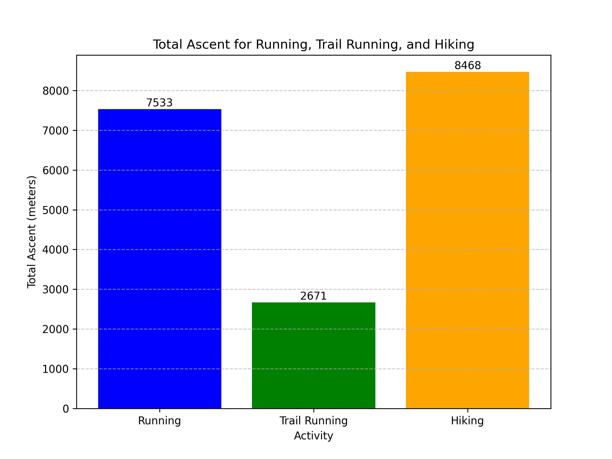
Ascent

Slide 12
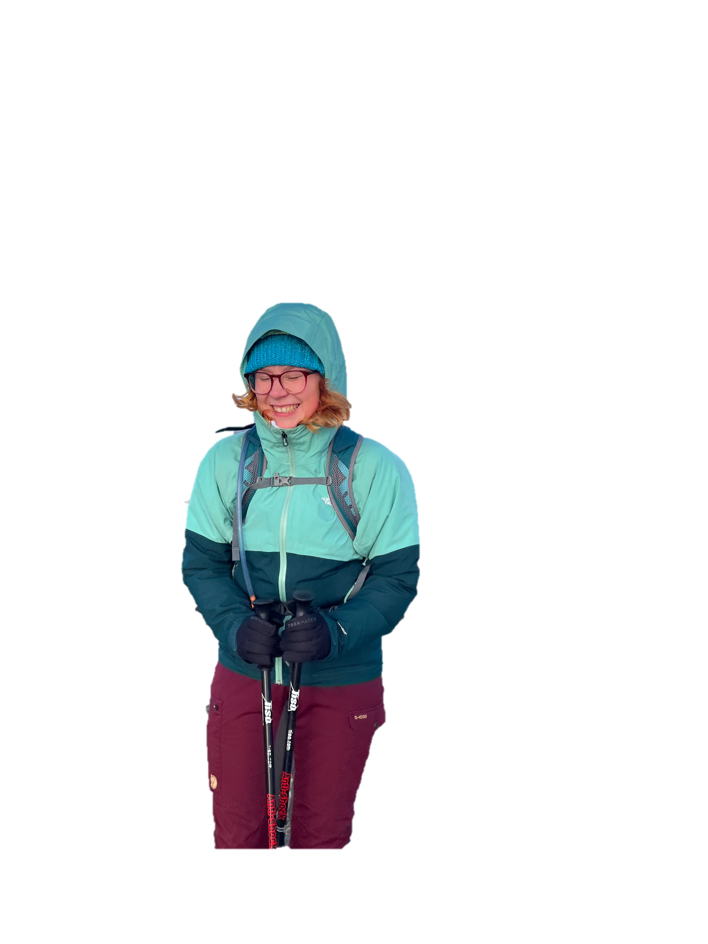
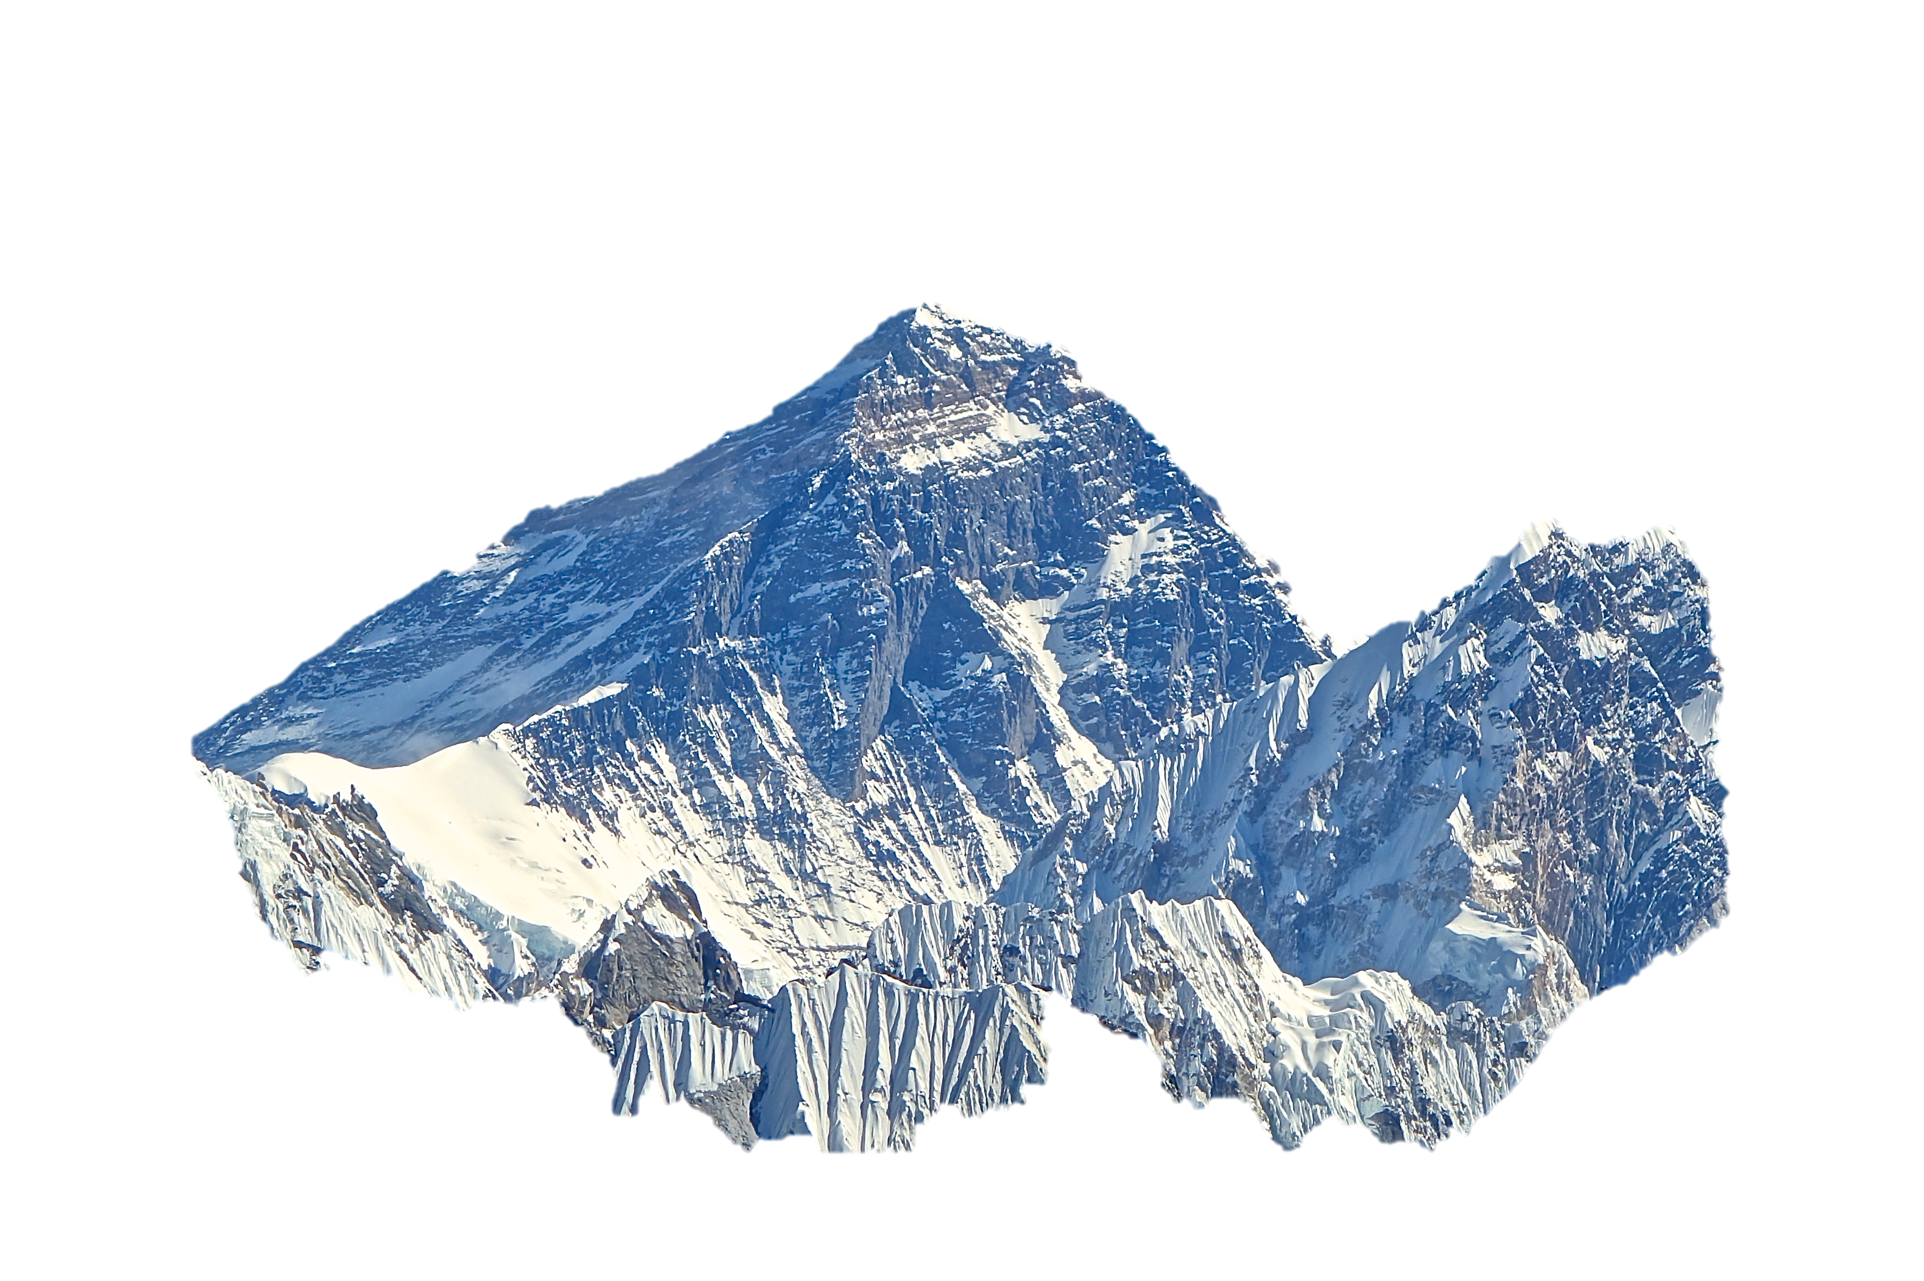
Ascent
~2.1 * Everest

Slide 13
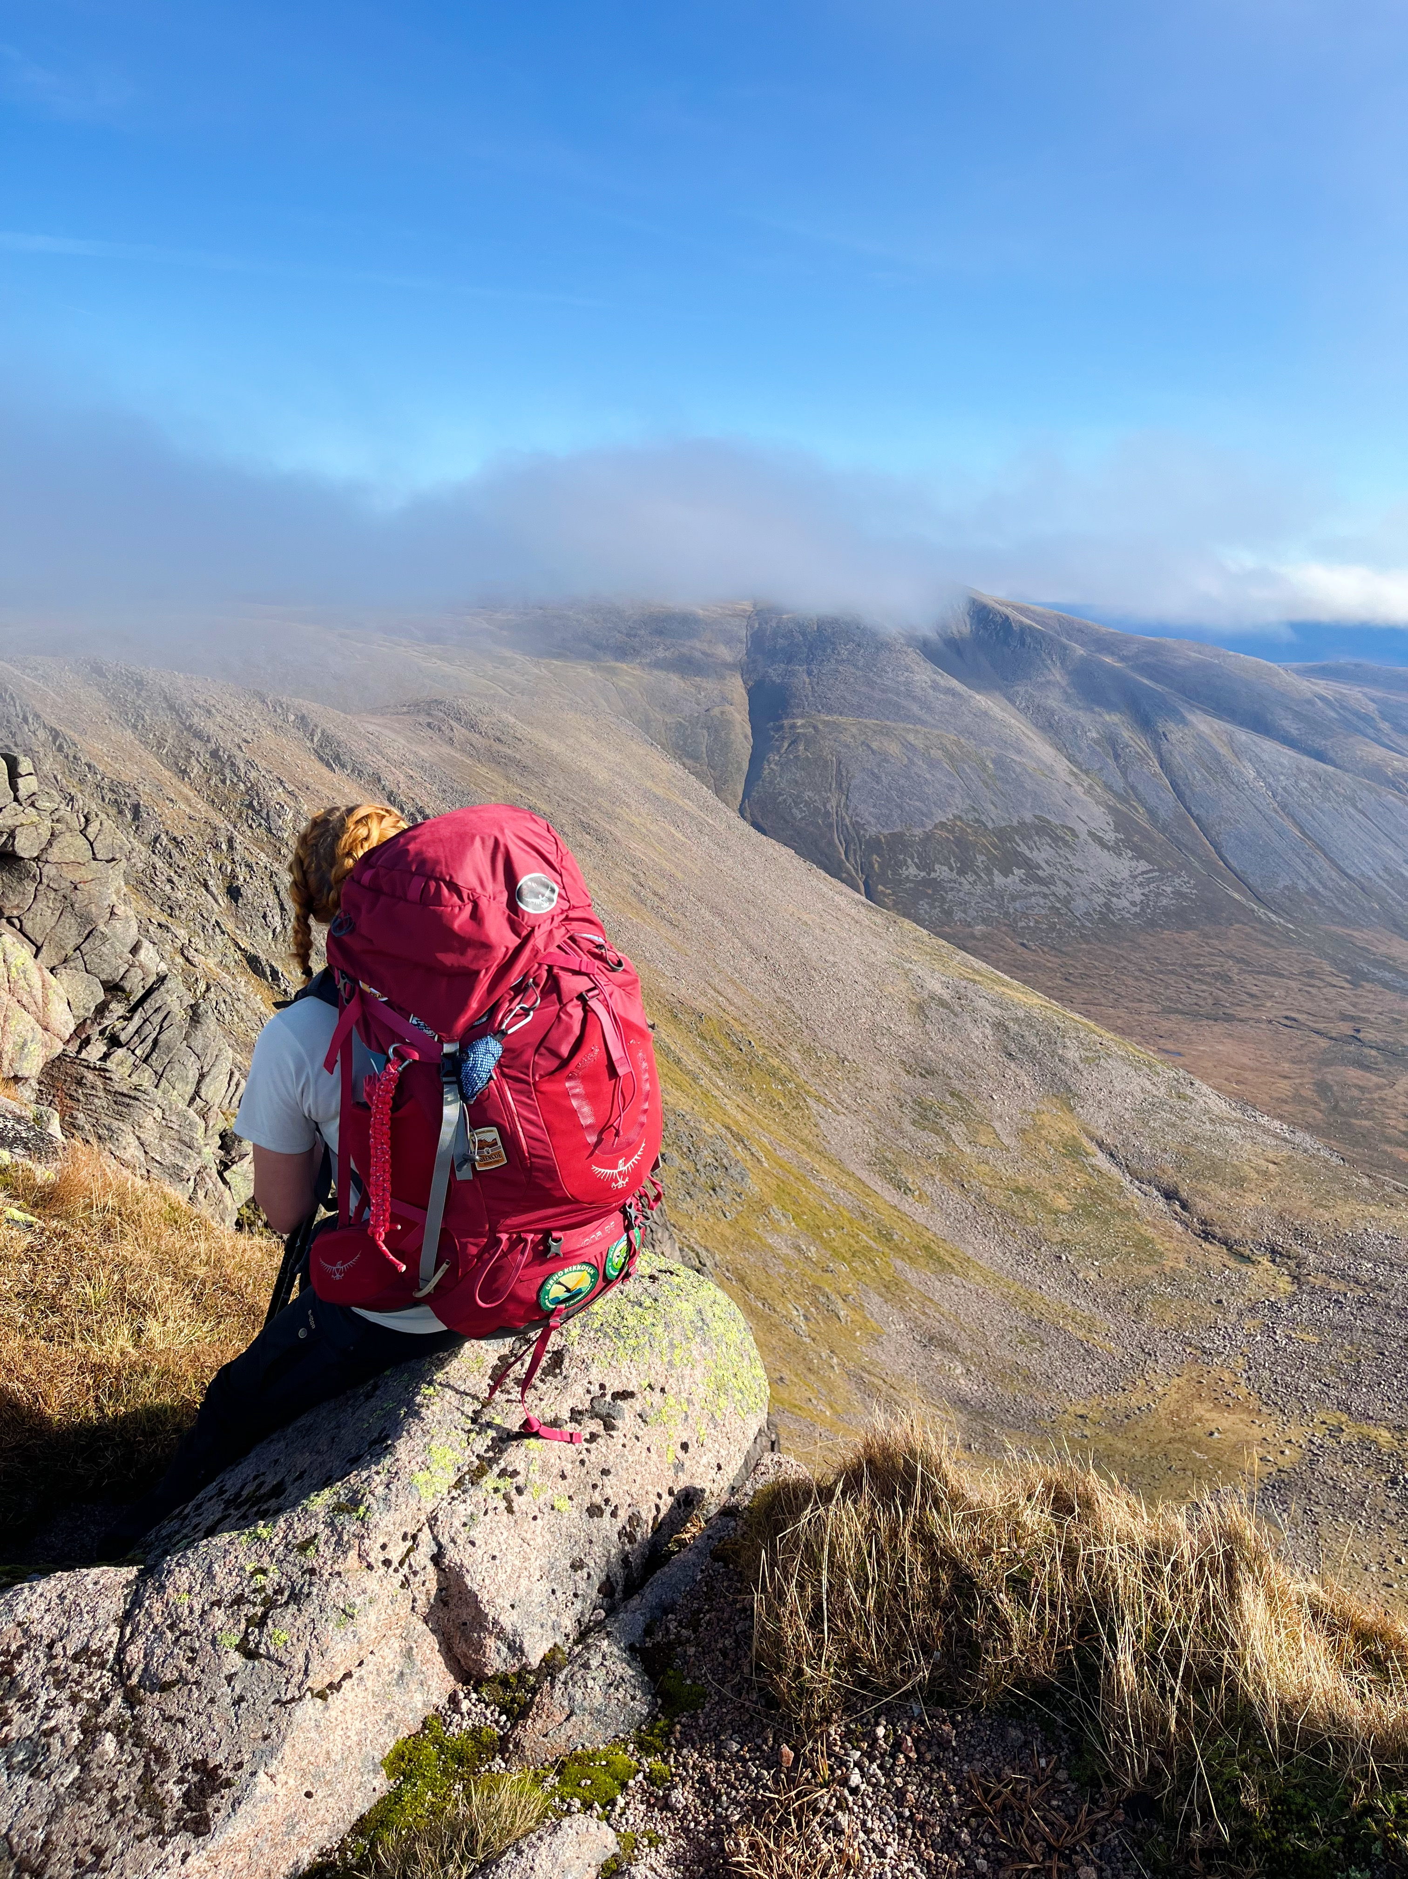
Ascent
Highest Point 1296 m
~2.1 * Everest

Slide 14
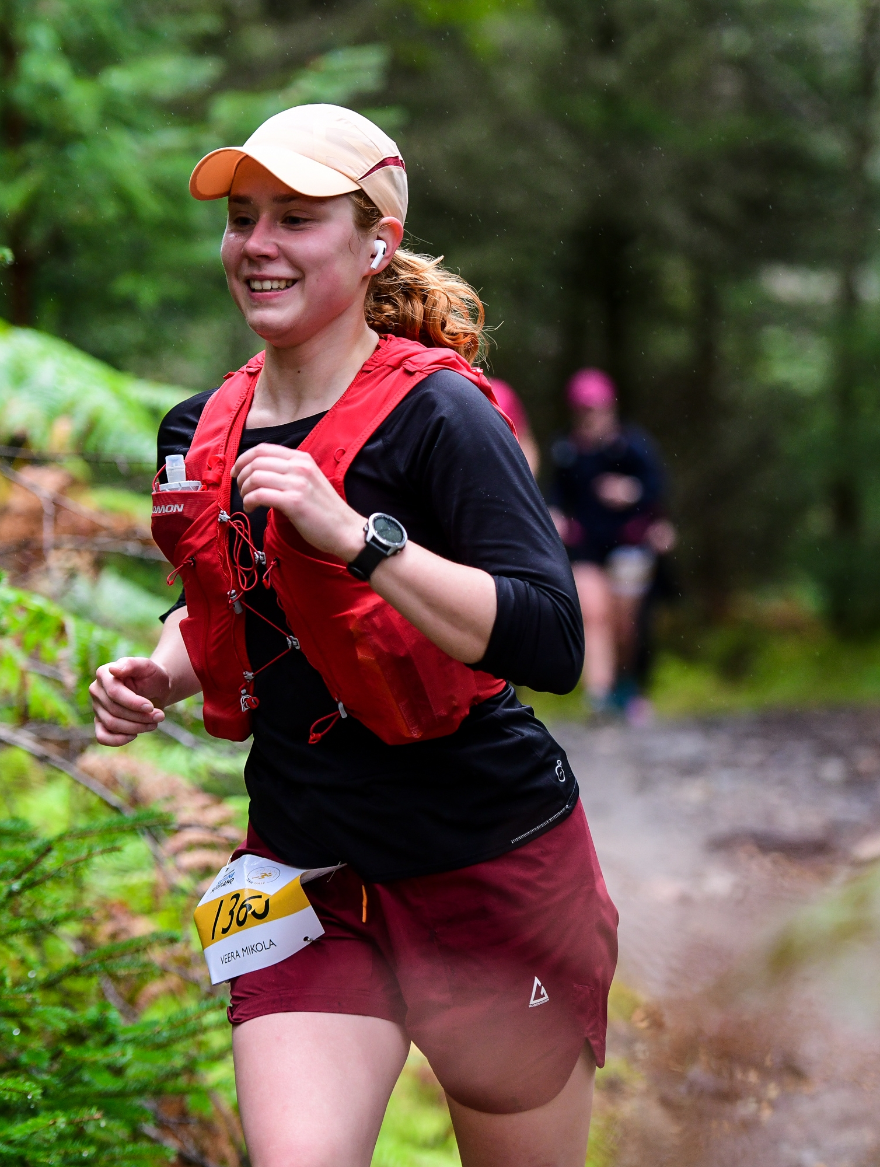
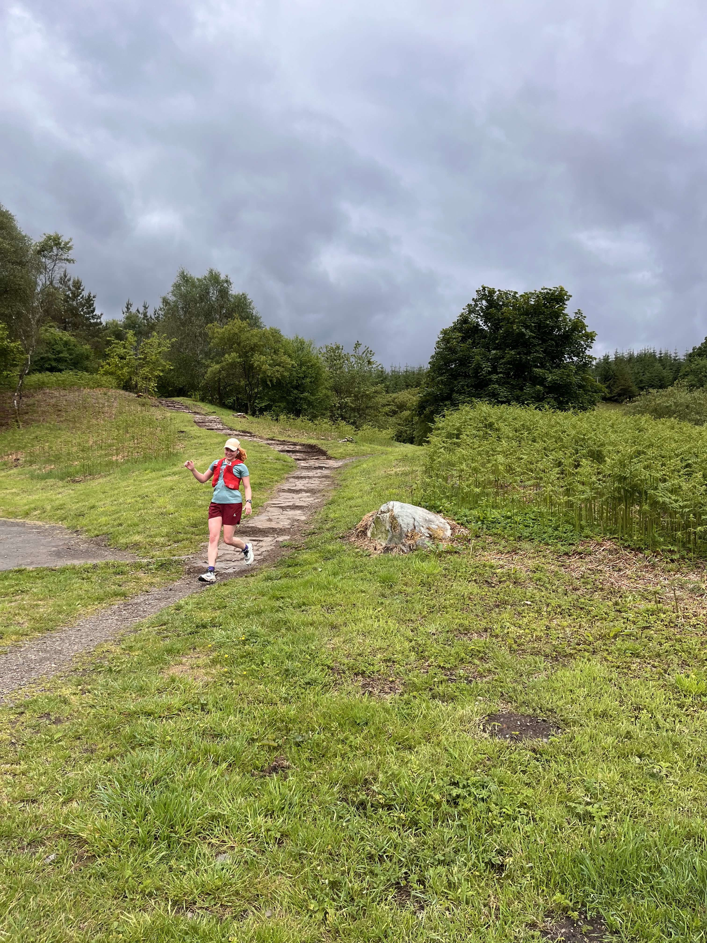
Calories

Slide 15
Calories
Total calories burned running: 52 632 kcal ~ 220.2 MJ

Slide 16
Calories
Total calories burned running: 52 632 kcal ~ 220.2 MJ
Boils 650 liters of water
Drives a car (2 MJ) for 110km
66km of 0.3km per MJ per passenger of flying a large commercial airplane

Slide 17
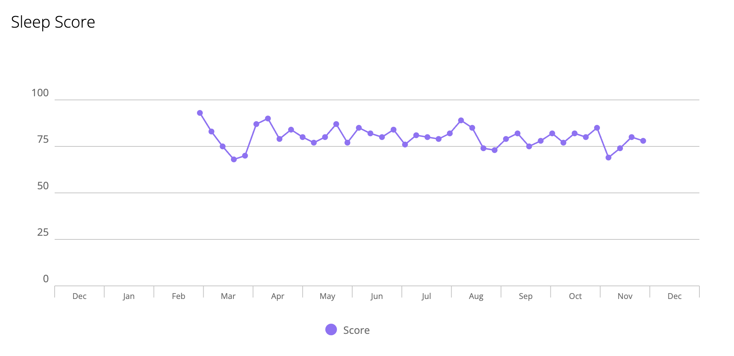
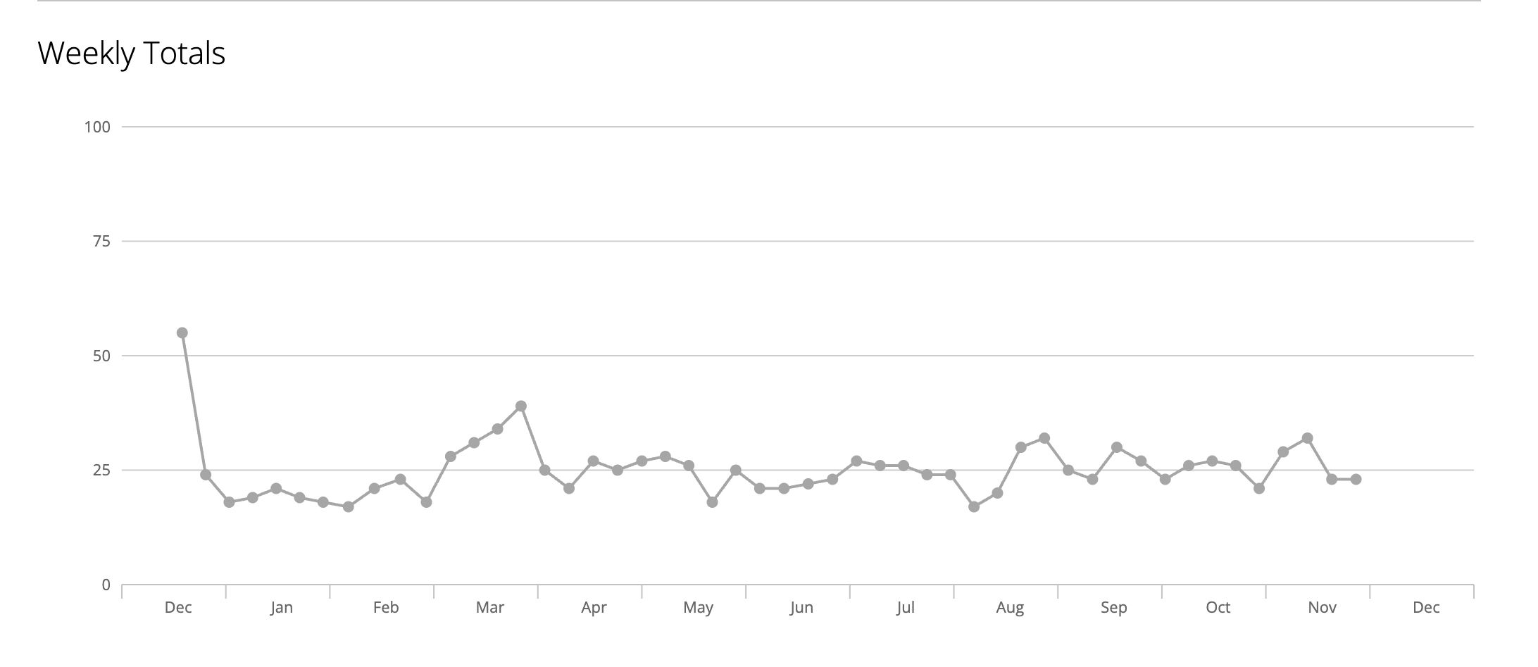
Sleep and Stress

Slide 18
Sleep and Stress
T2K CM 1
T2K CM 1

Slide 19
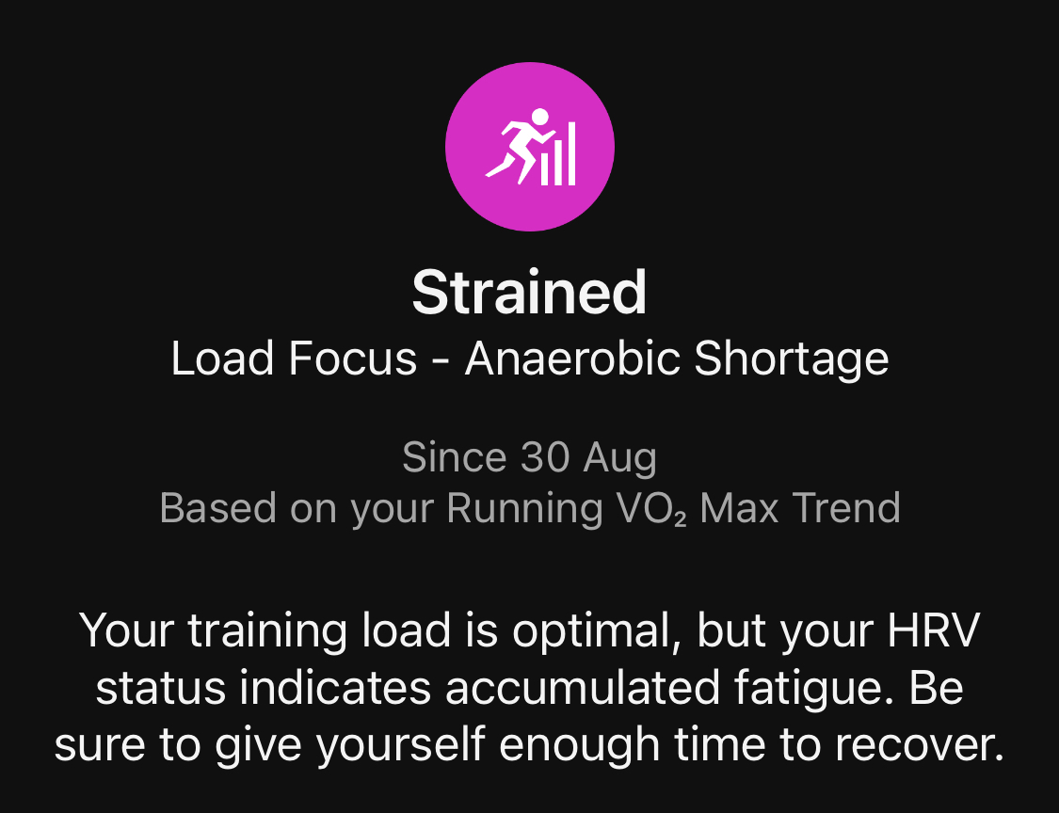
Sleep and Stress
NuFact
T2K CM 1
NuFact
T2K CM 1

Slide 20
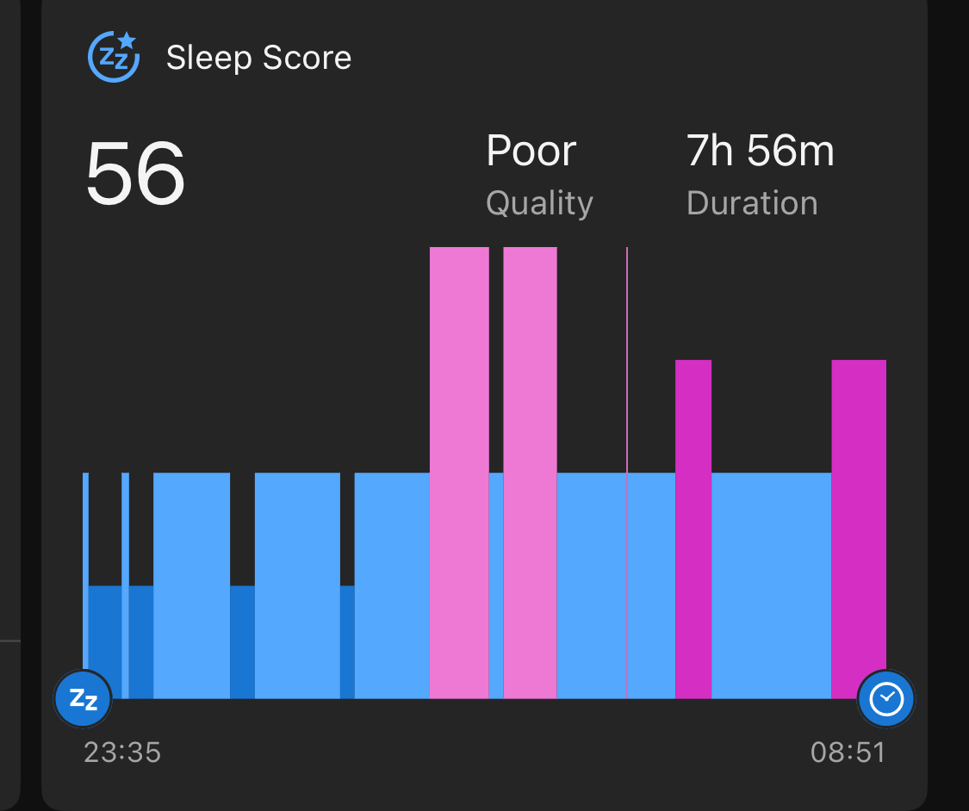
Sleep and Stress
T2K CM 2
NuFact
T2K CM 1
NuFact
T2K CM 2
T2K CM 1

Slide 21
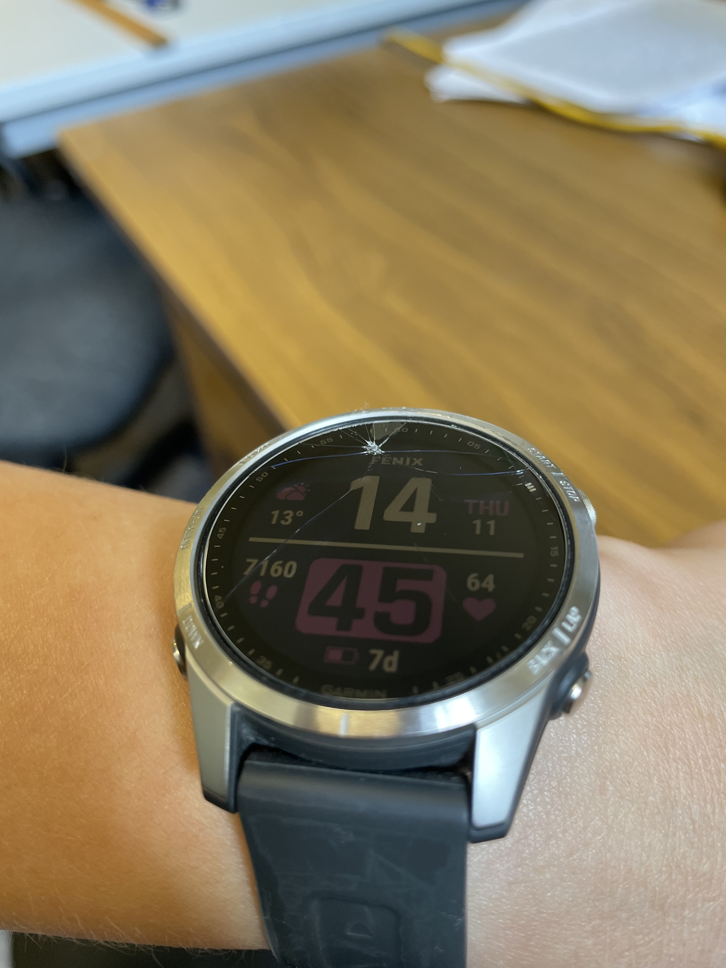
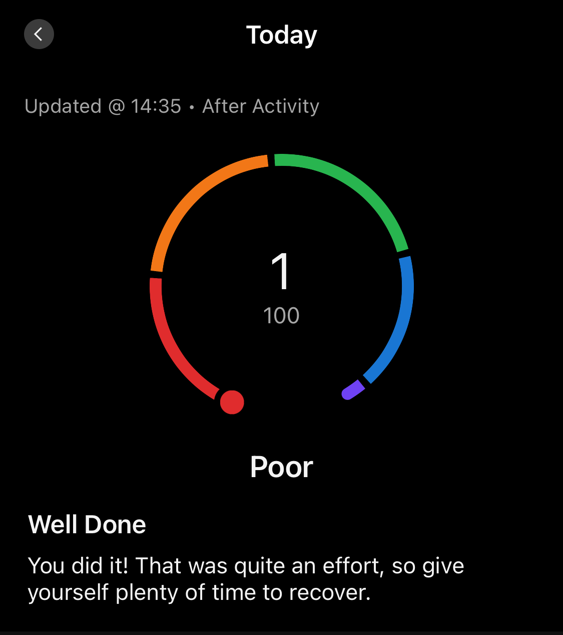
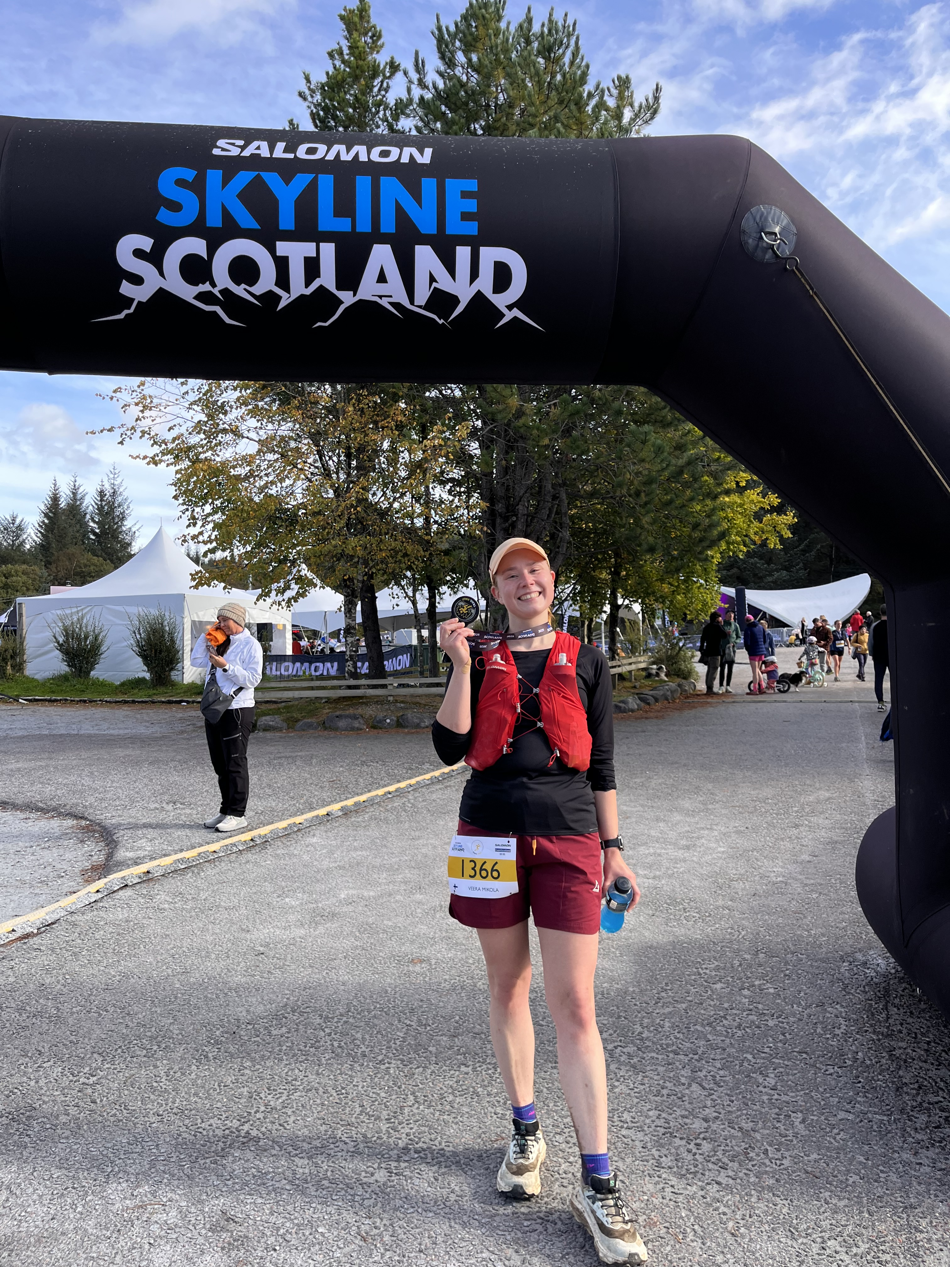
Sleep and Stress
T2K CM 2
NuFact
T2K CM 1
NuFact
T2K CM 2
T2K CM 1
Got hit by a bike and did a trail race

Slide 22
Other Stats

Slide 23

Other Stats
Hitaammin Hautaan = Slower to the Grave
Most listened song 605 times equivalent to ~ 30 hours

Slide 24
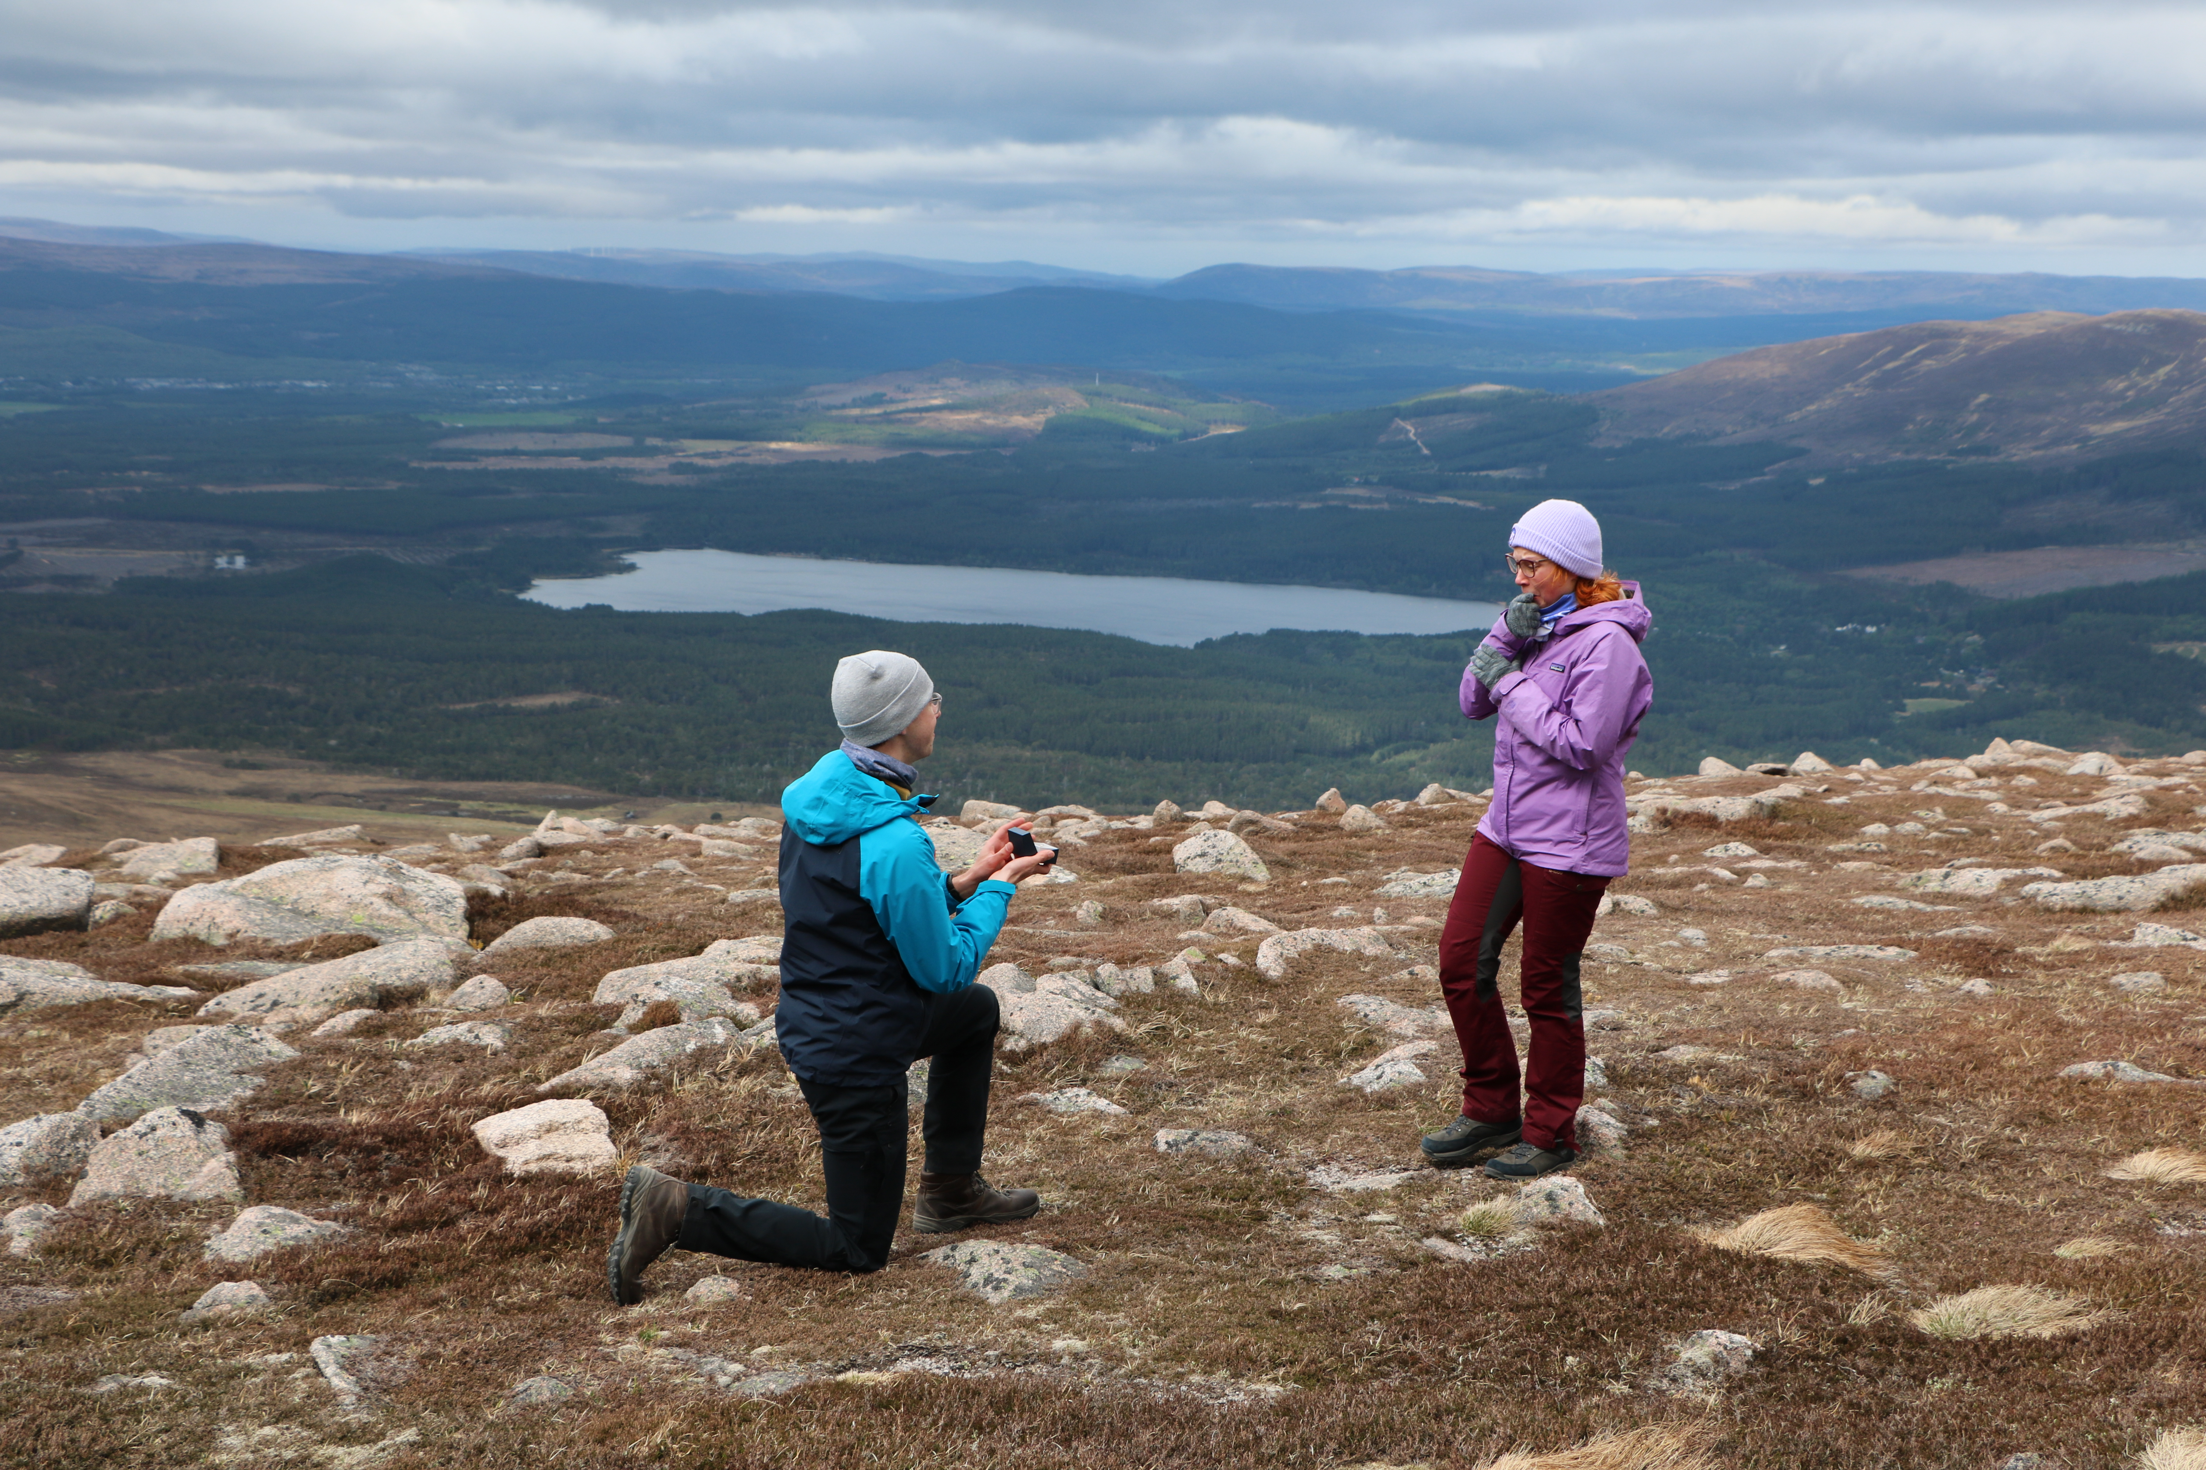
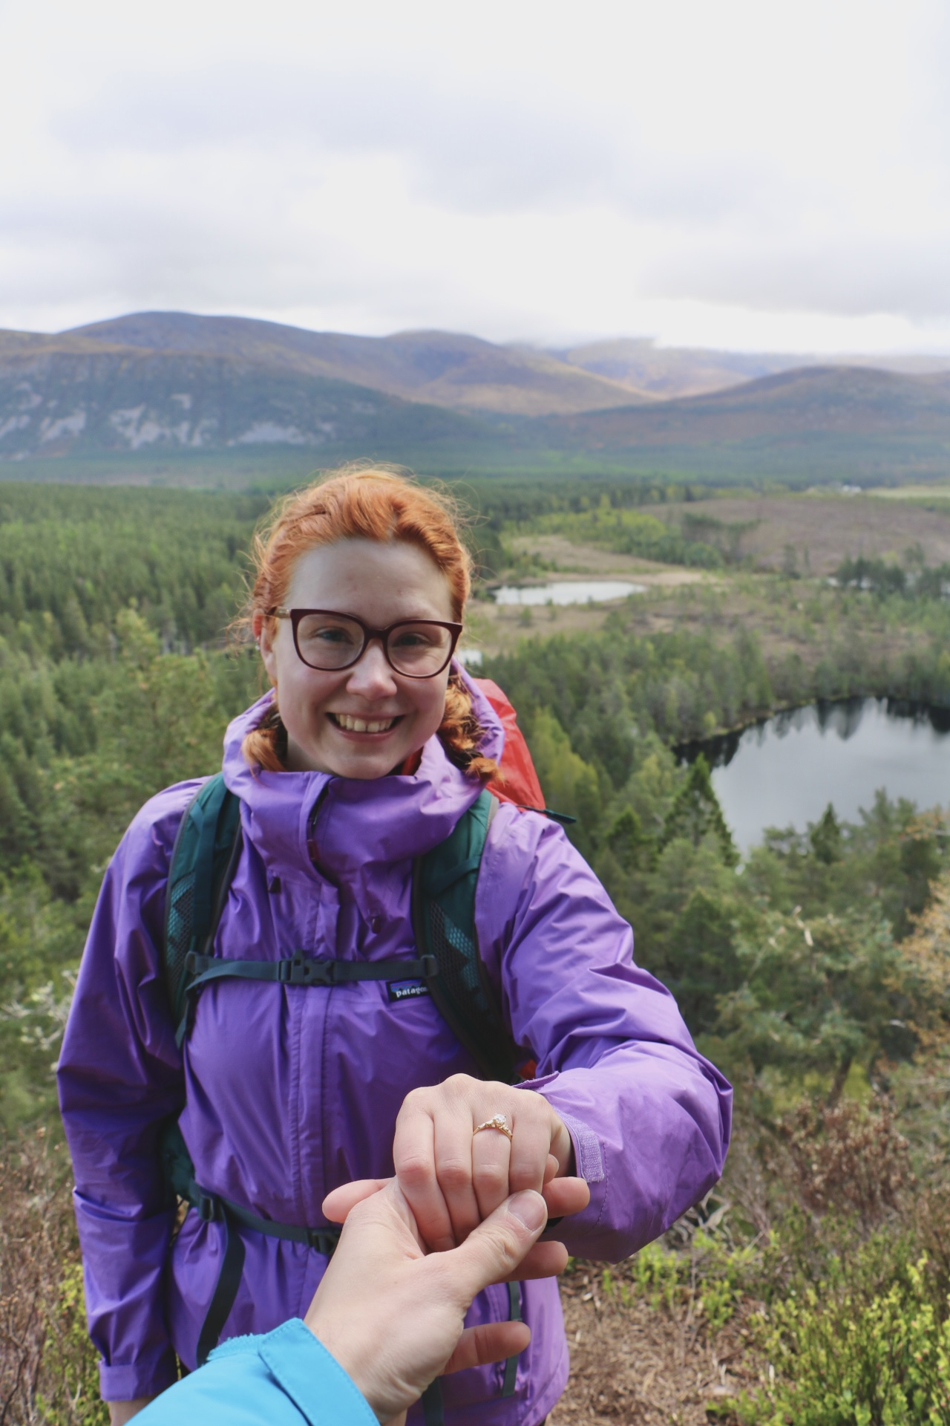
Other Stats
Hitaammin Hautaan = Slower to the Grave
One fiancé gained
Most listened song 650 times equivalent to ~ 32 hours

Slide 25
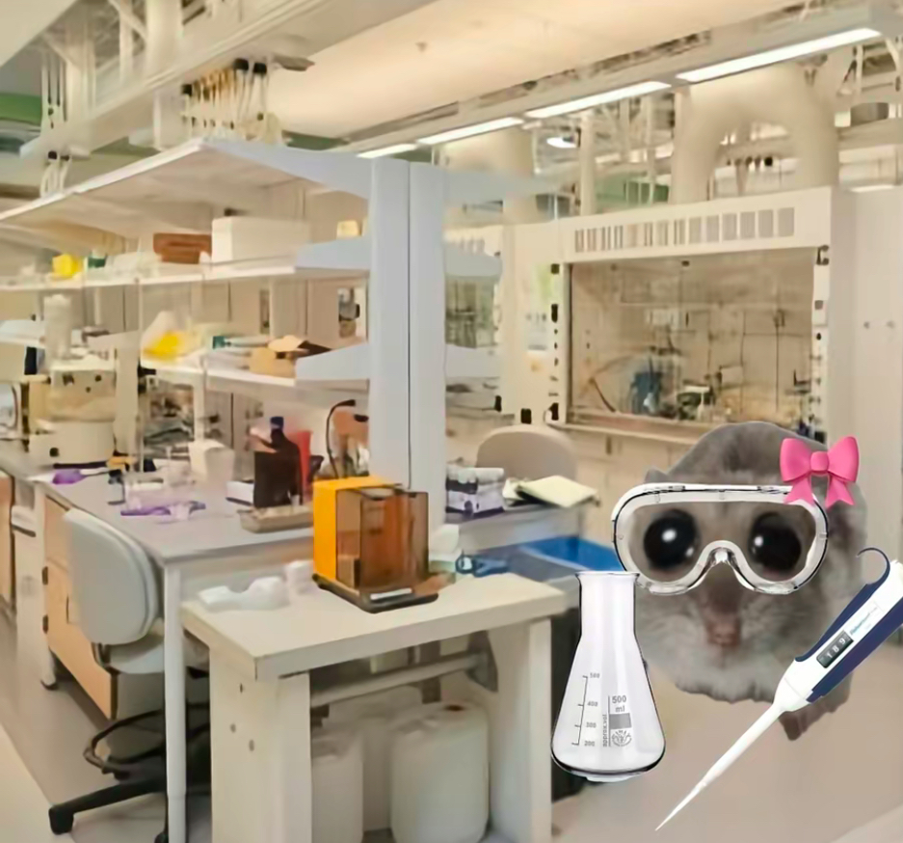
OKAY BYE

