Slide 1

The Taiwan Effect
How East Asia Destroys Financial Responsibility

Slide 2
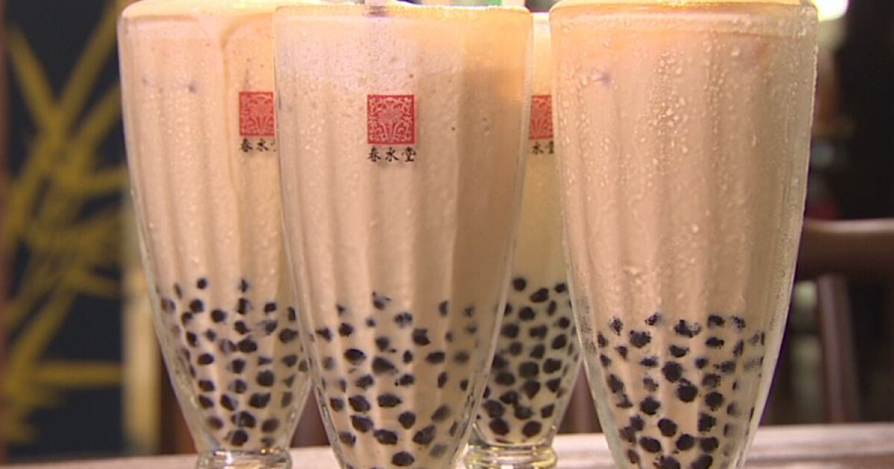
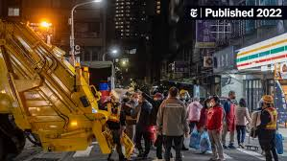
Taiwan Stats
Population – 23.4 M
Industries – Semiconductors (TSMC), bikes (Giant)
Invented bubble tea
Their bin trucks operate like ice cream vans – it is incredibly annoying

Slide 3
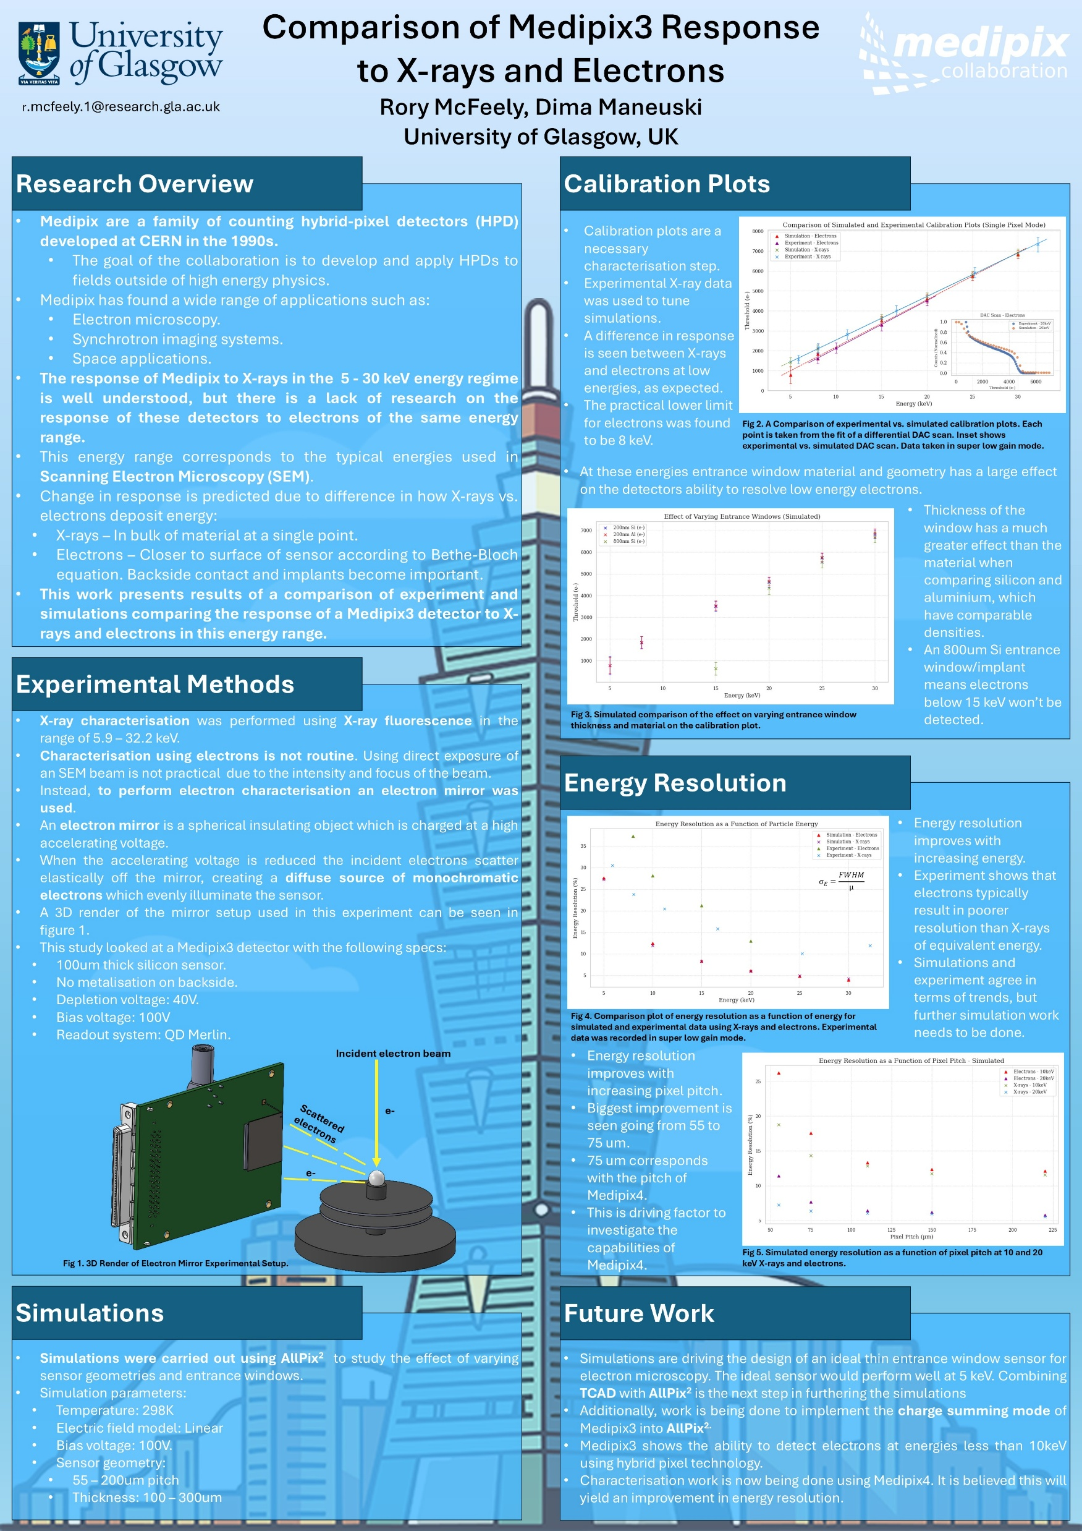
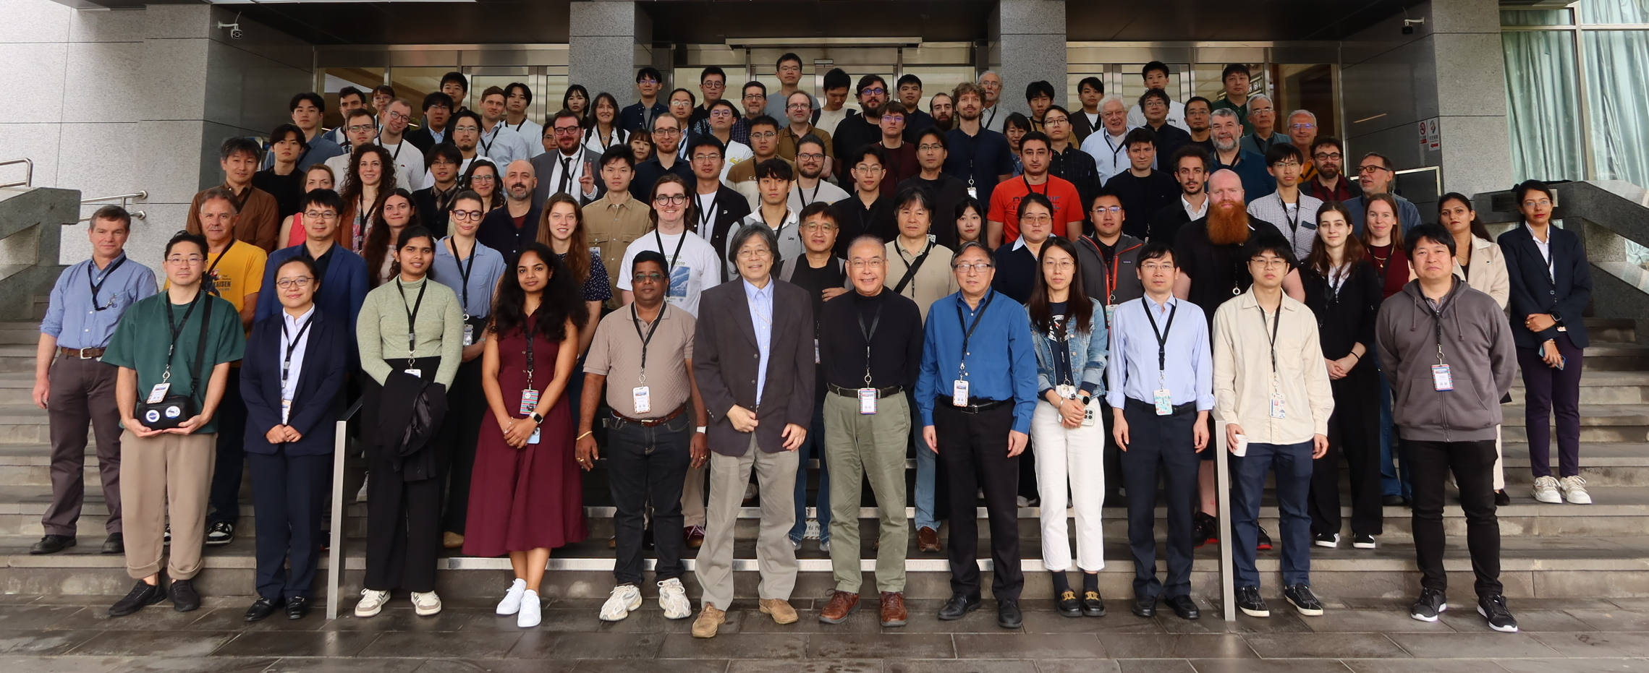
Why was I in Taiwan?
14th Hiroshima Symposium on Development and Application of Semiconductor Tracking Detectors.
Week long conference – small numbers, no parallel sessions. Conference was setup to have a detector conference based around the pacific.
I presented a poster on work I had done on characterisation of Medipix3 using low energy electrons and how this differs from X-rays

Slide 4
Why Should YOU be in Taiwan?
I spent 12 days post conference exploring Taiwan on your behalf.
This is a report on my findings
In this talk I will allow you to live vicariously through me as we take a journey from Taipei, down the West Coast, before cutting East and seeing what delights await us there.

Slide 5
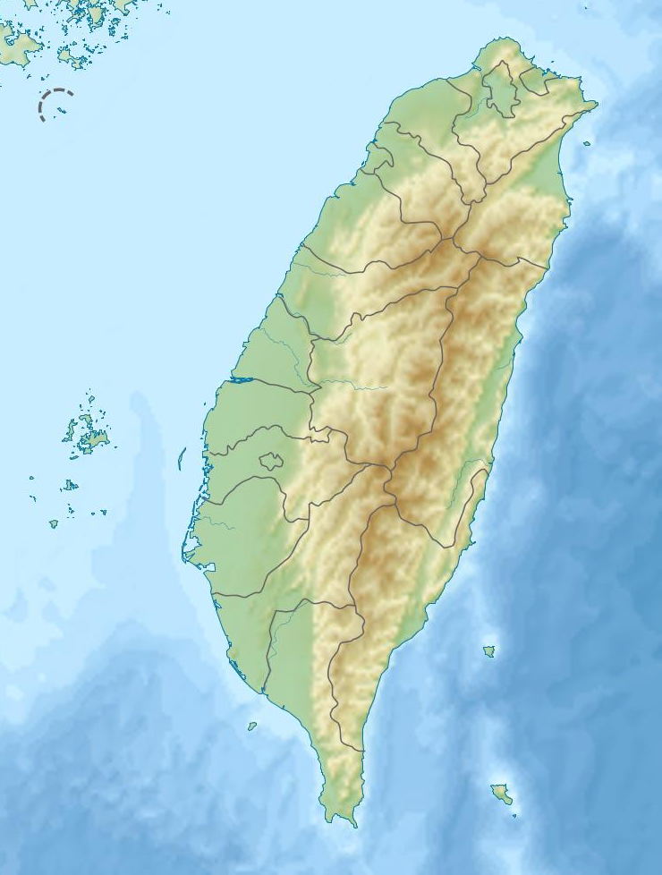
The Route
Taipei
Glasgow to Taipei:
~24 hour journey via Dubai
Taipei to Taichung:
High Speed Rail
Taichung to Chiayi:
High Speed Rail
Chiayi to Taitung:
Local rail through southern central mountains
Taitung to Glasgow:
Local train to Taipei:
20 hours from Taipei to Glasgow
~34 hours total journey time
Taichung
Chiayi
Taitung

Slide 6
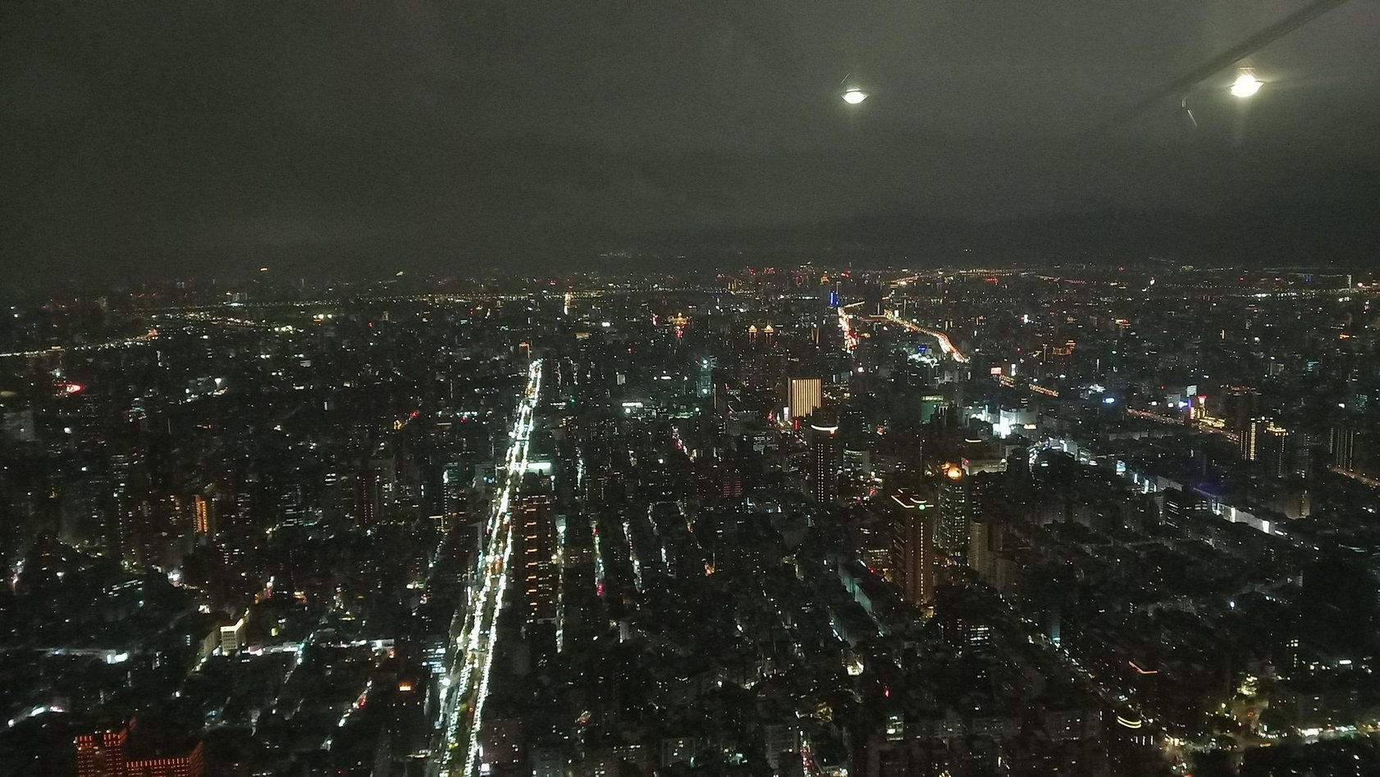
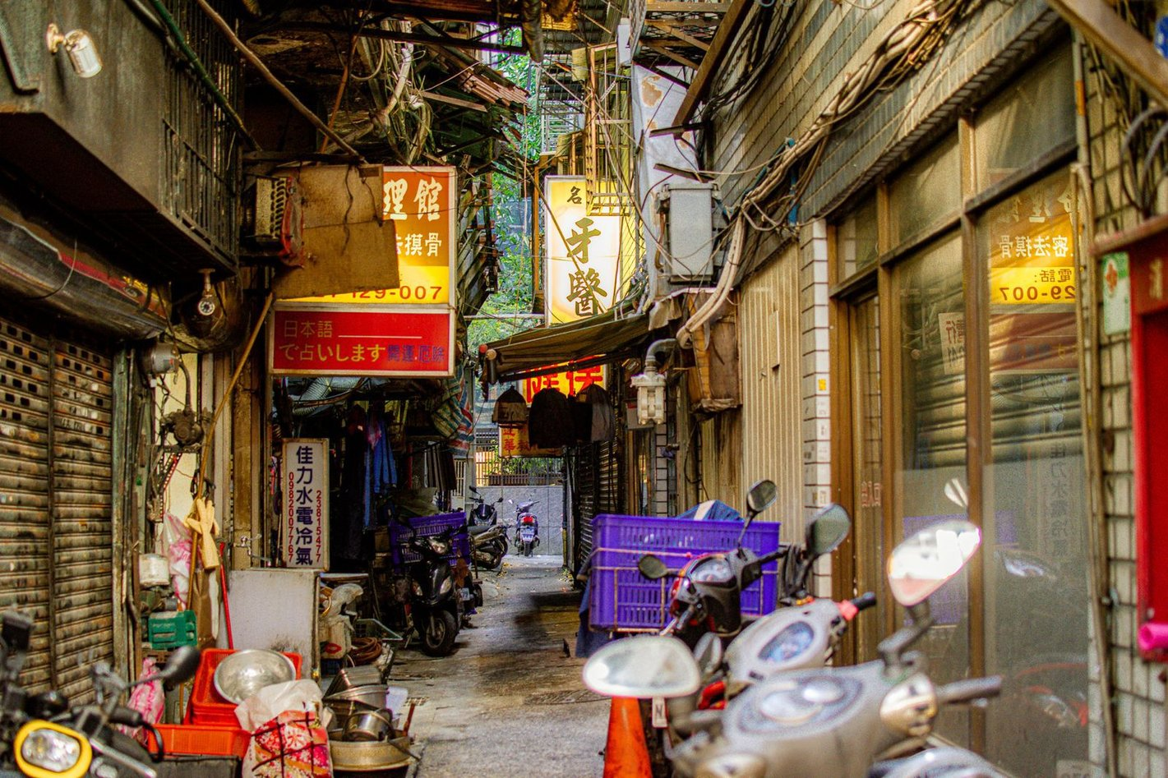
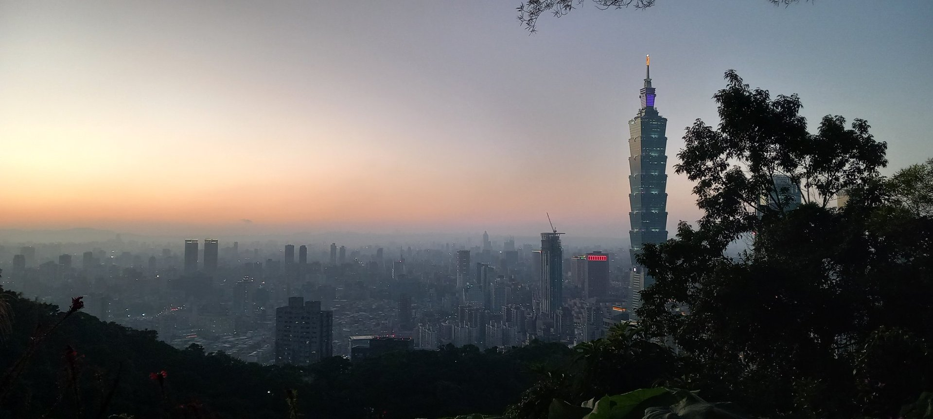
Taipei

Slide 7
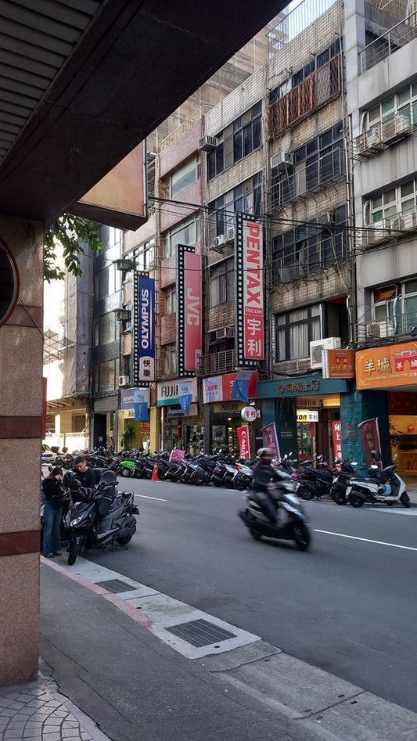
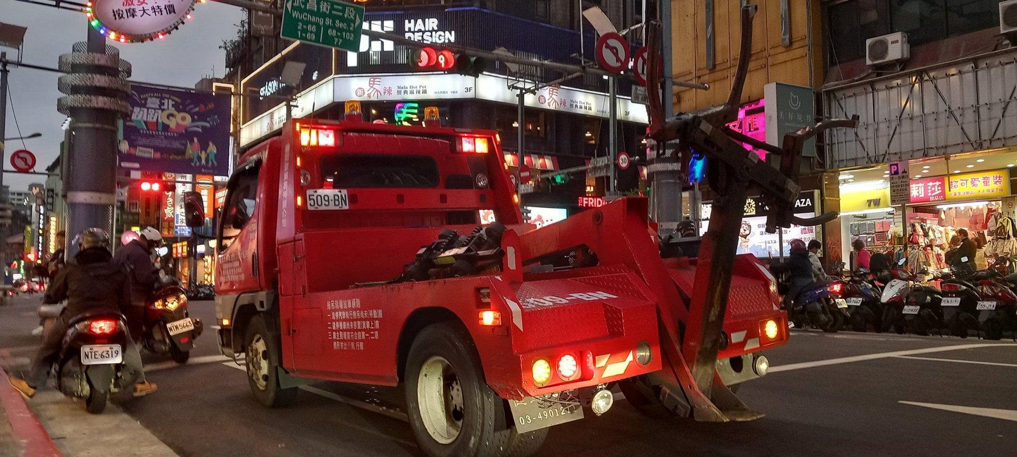
Taipei

Slide 8
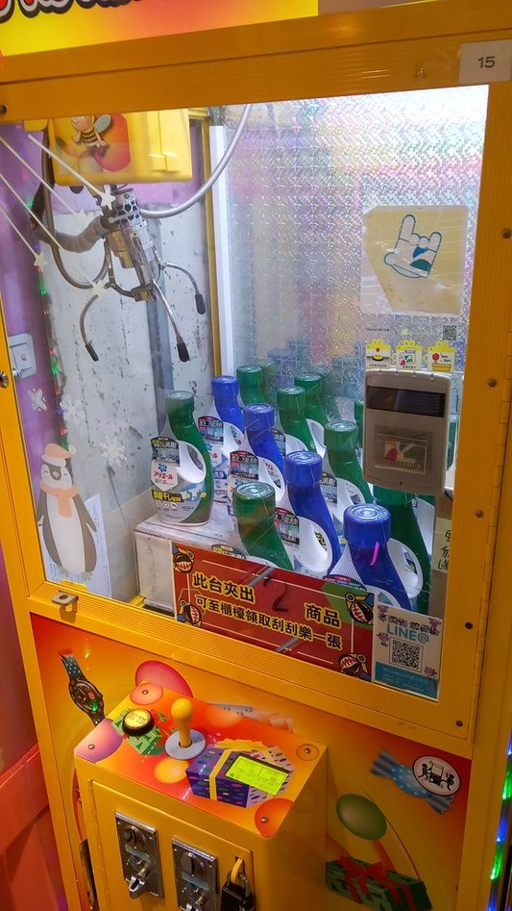

Taipei – Claw Machines

Slide 9
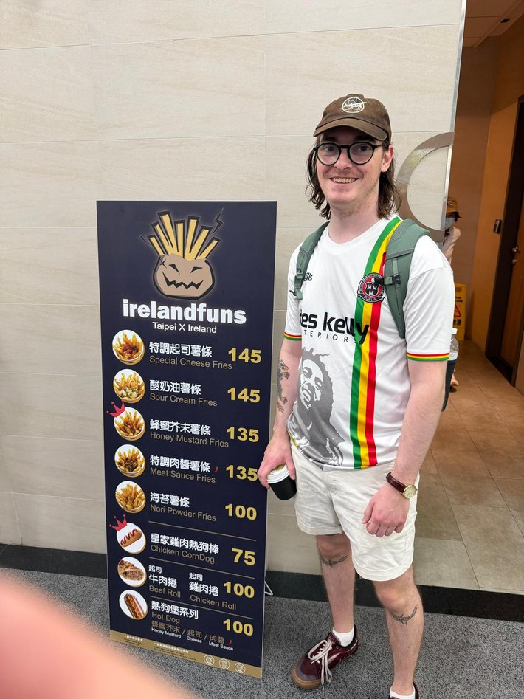
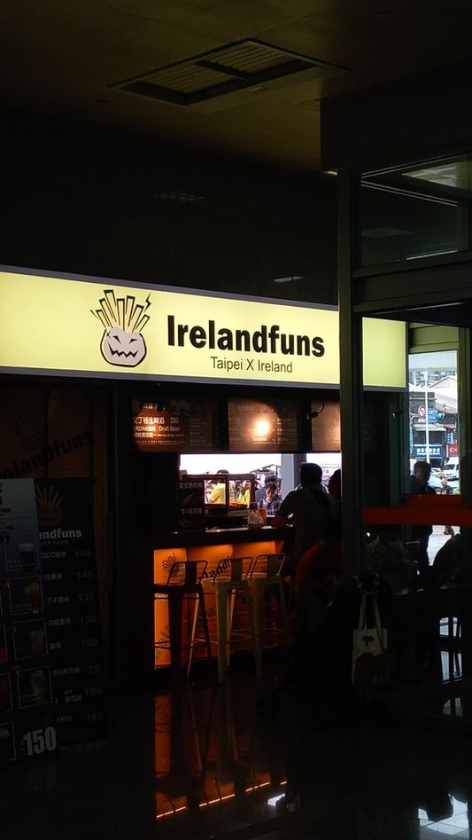
Taipei – Ireland?

Slide 10
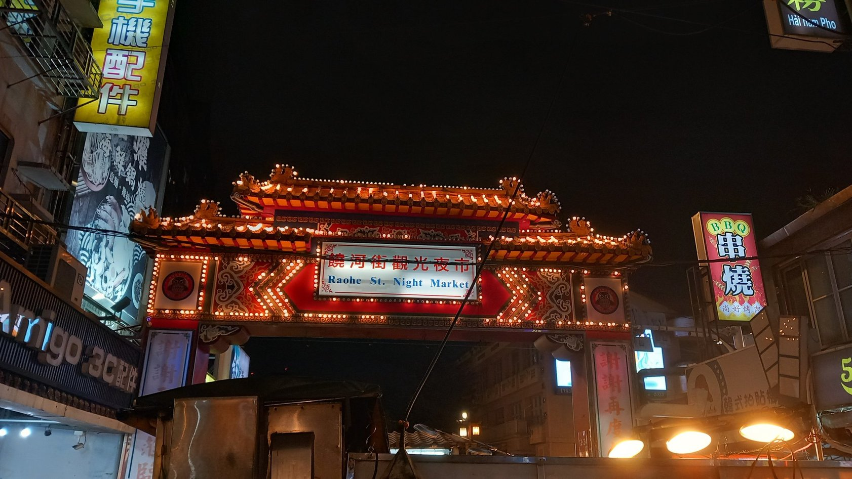
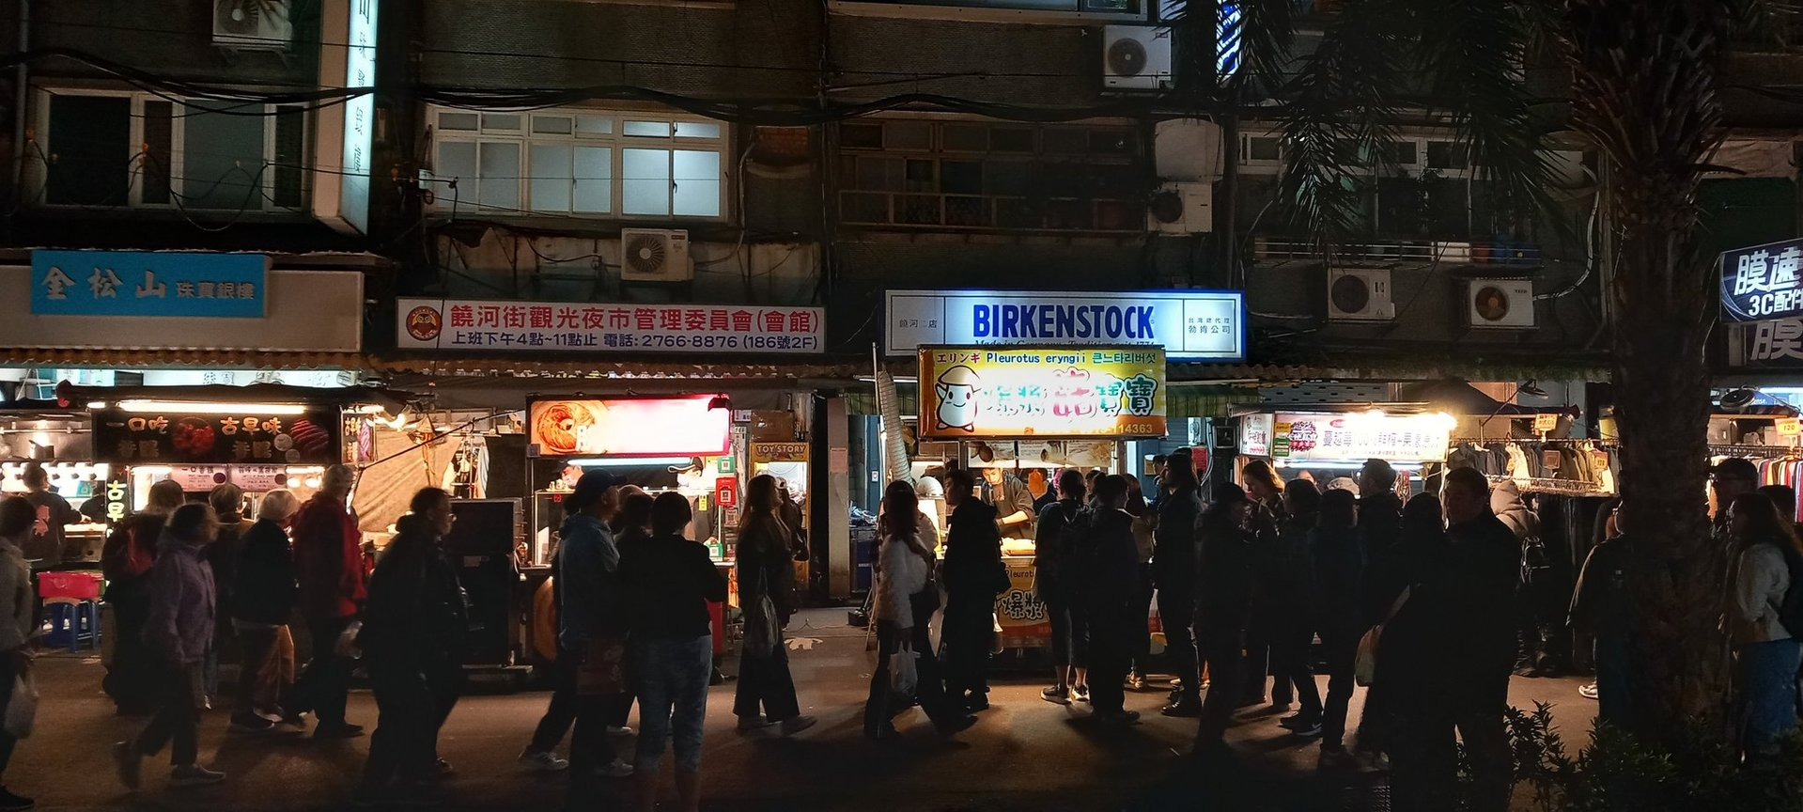
Taipei – Food

Slide 11
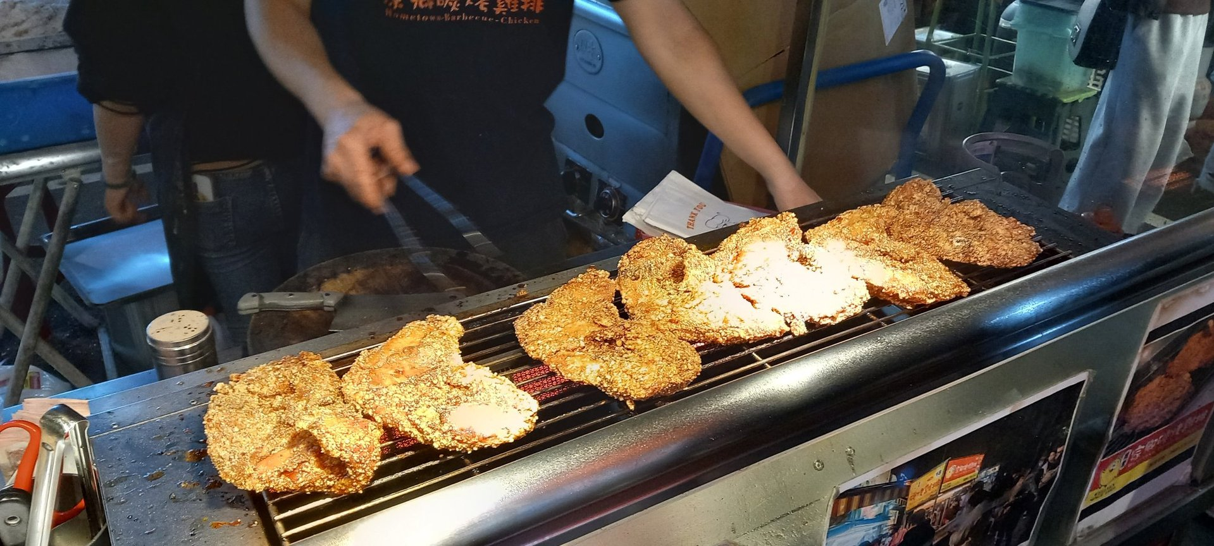
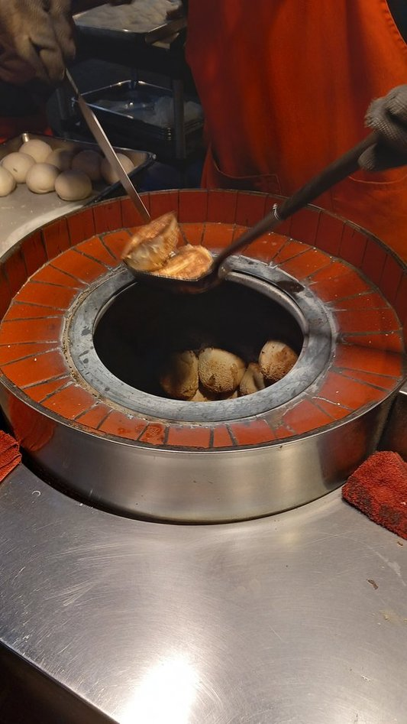
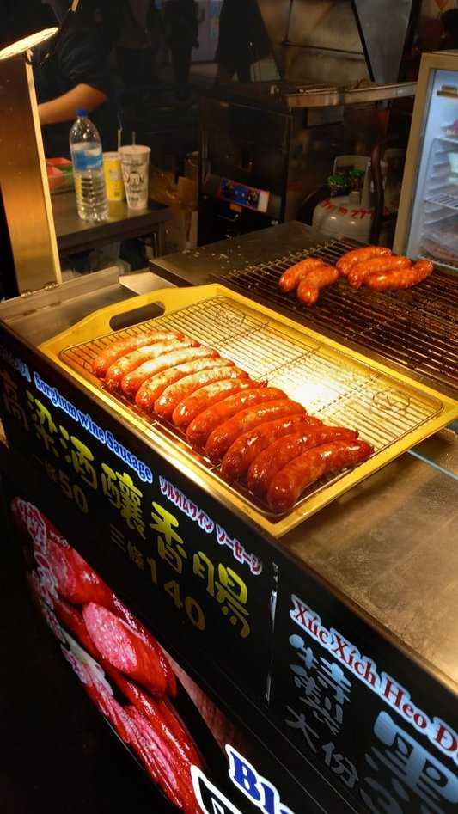
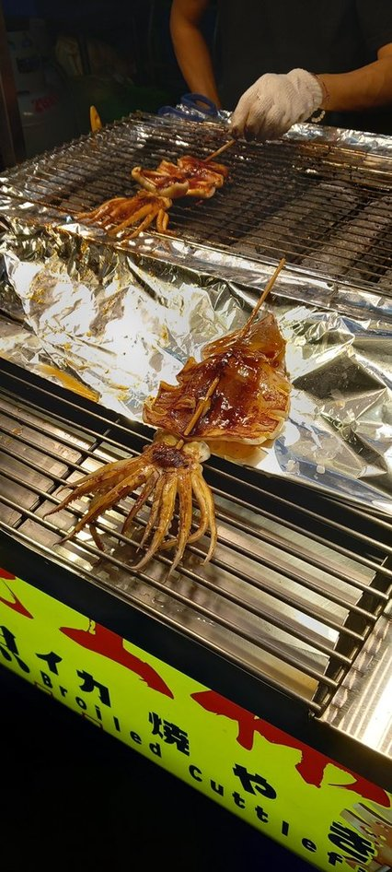
Taipei – Food

Slide 12
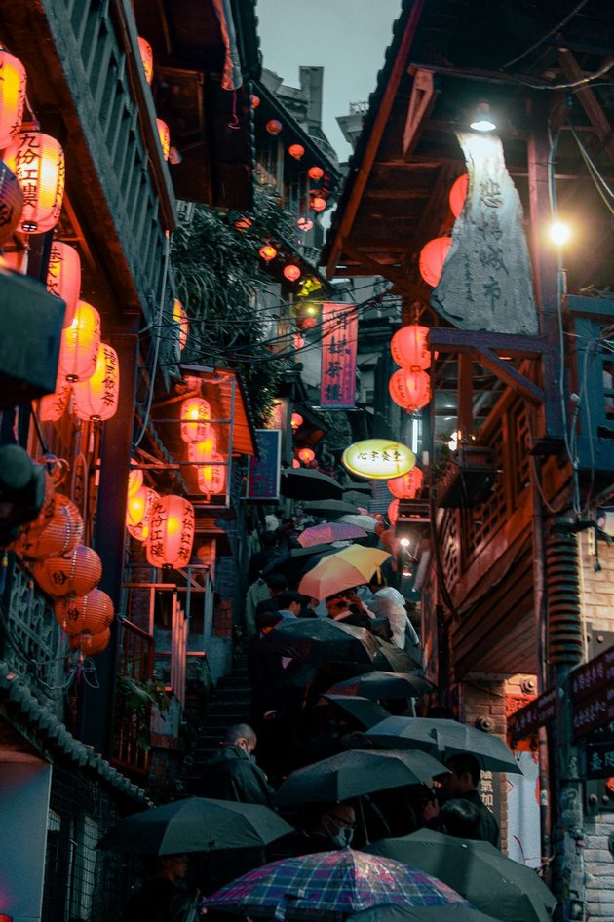
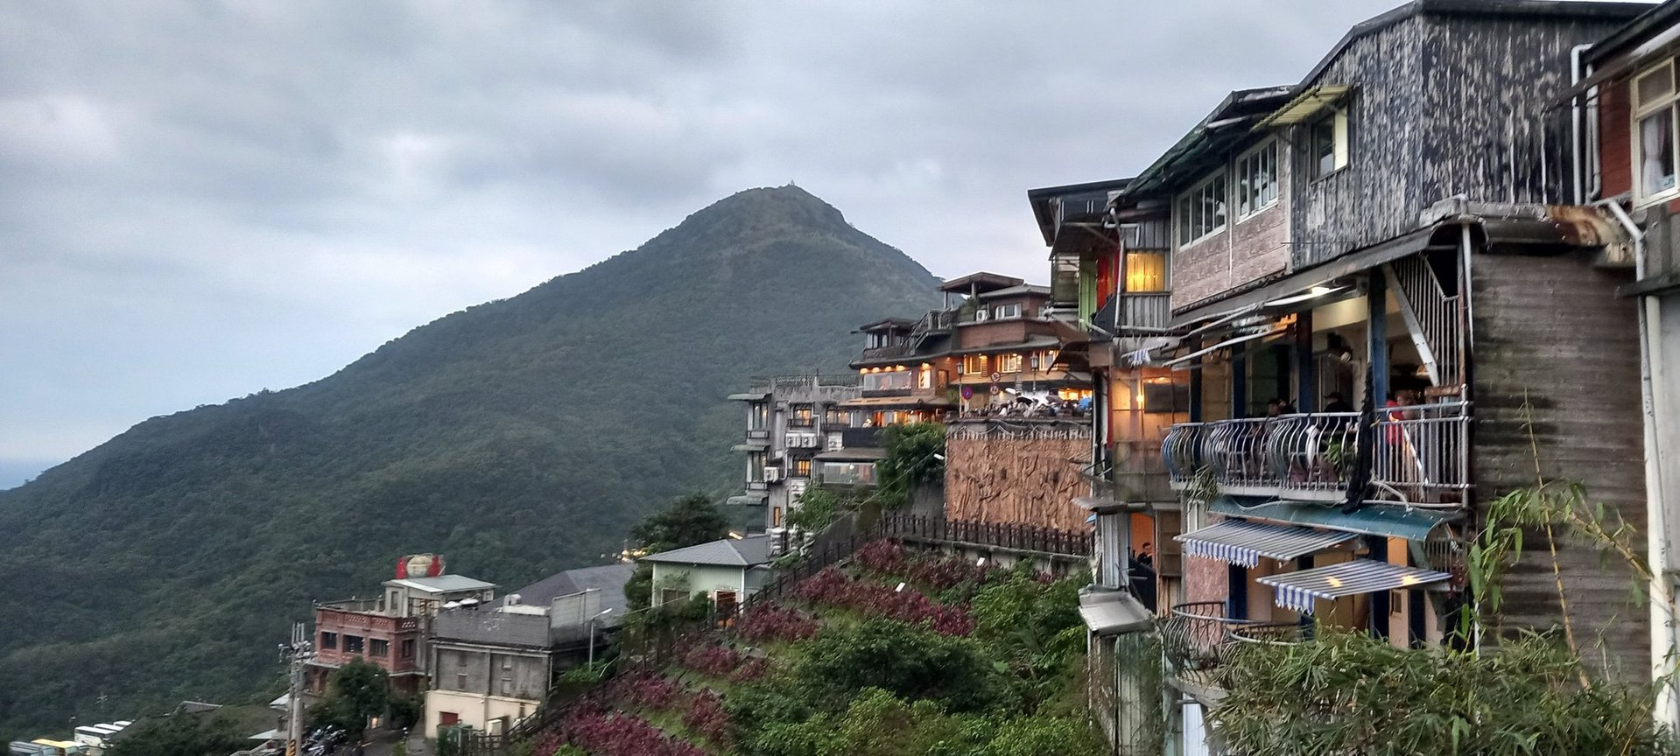
Taipei – Jiufen

Slide 13
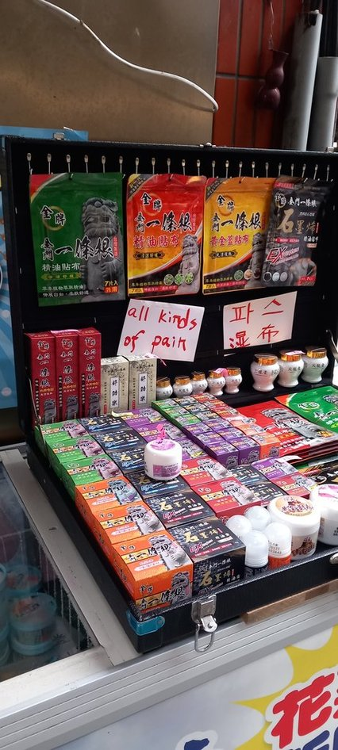
Taipei – Jiufen

Slide 14
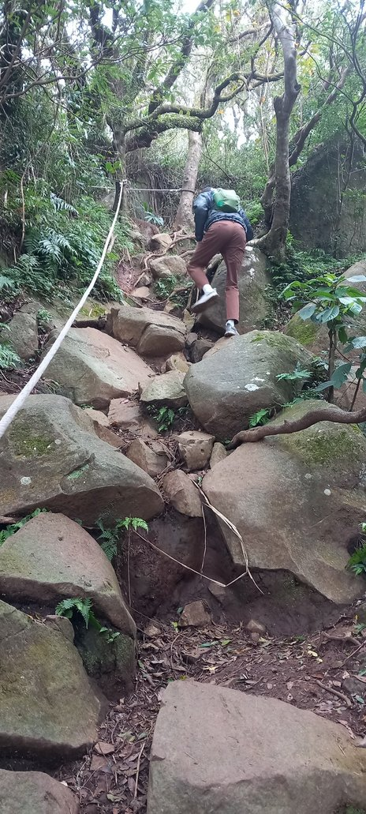
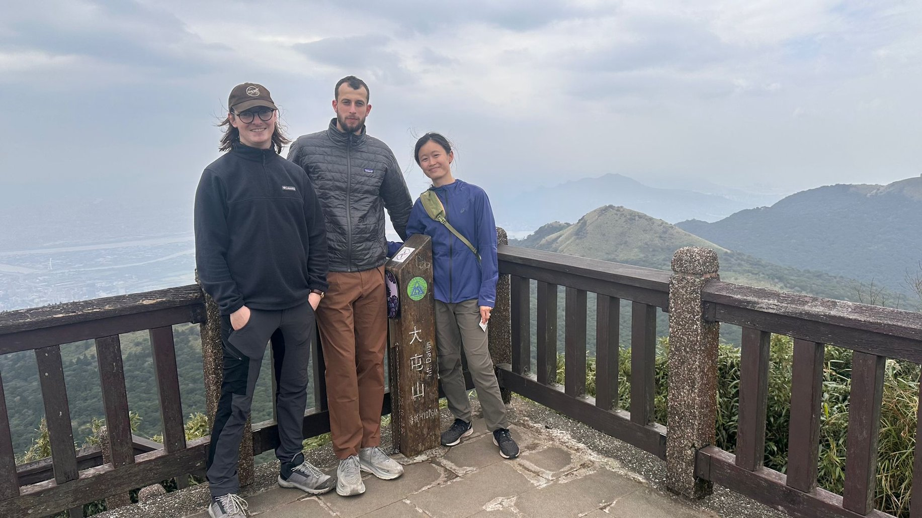
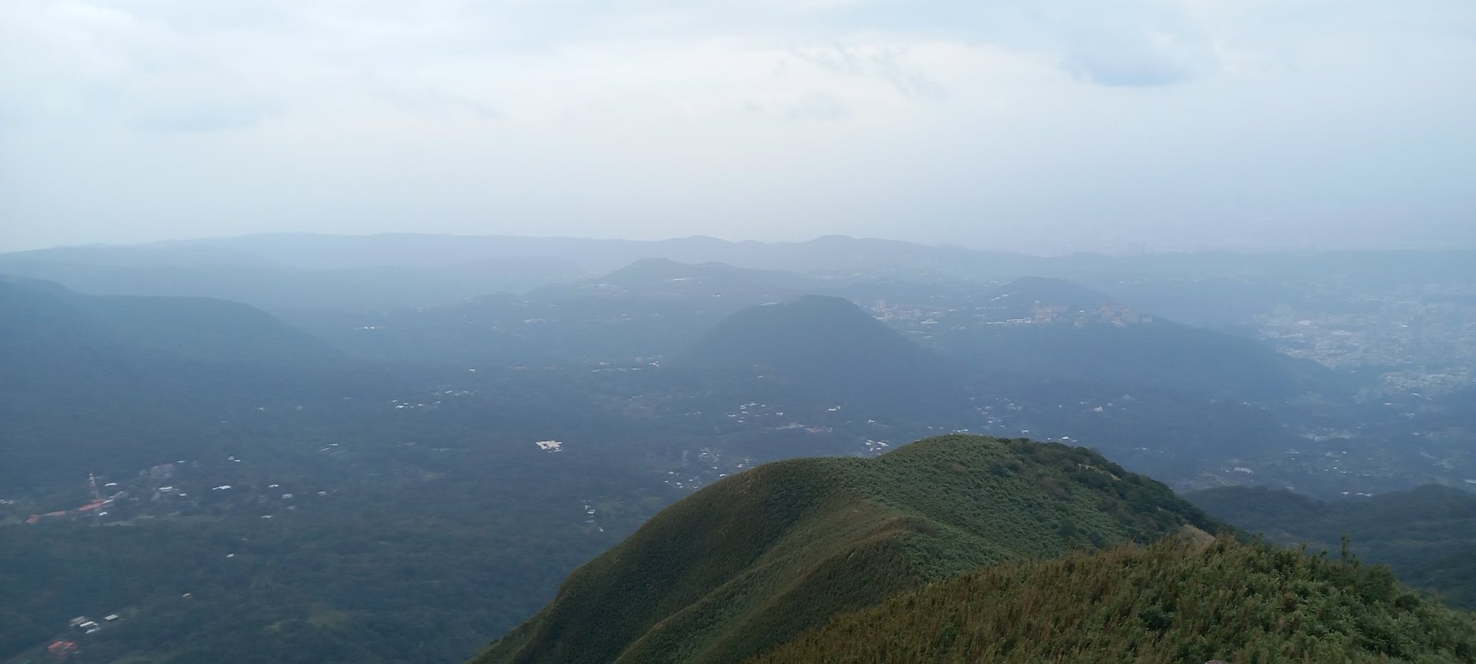
Taipei – Mountains

Slide 15
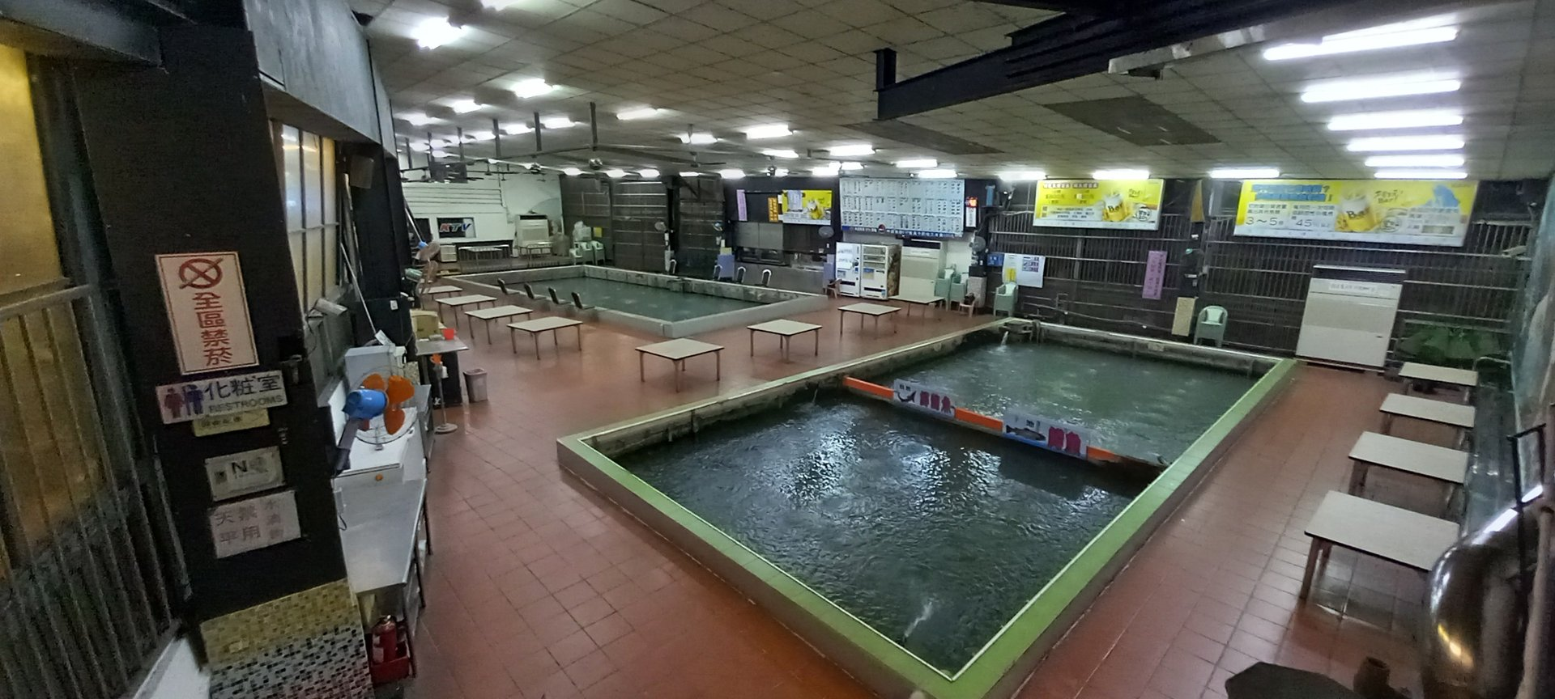
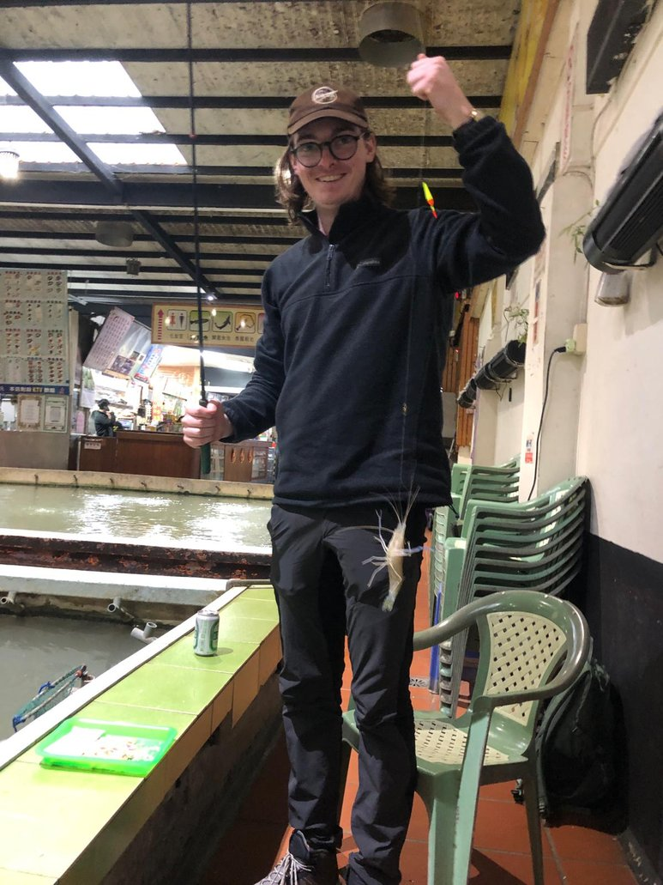
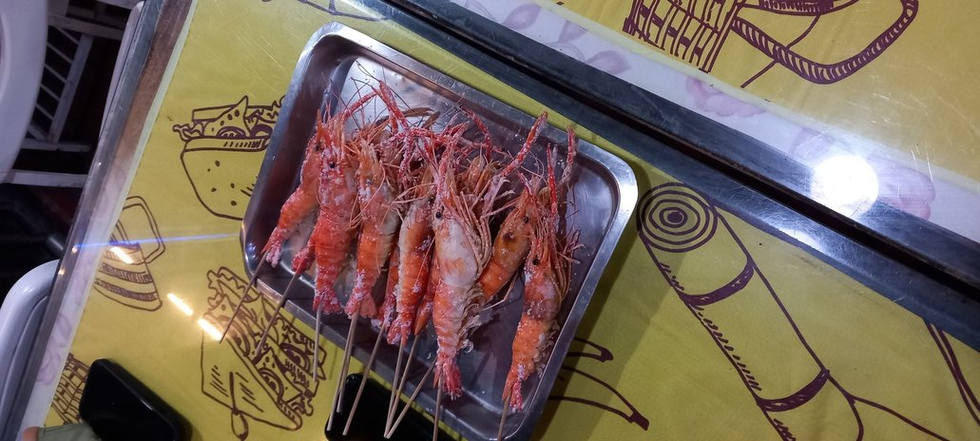
SHRIMP FISHING

Slide 16
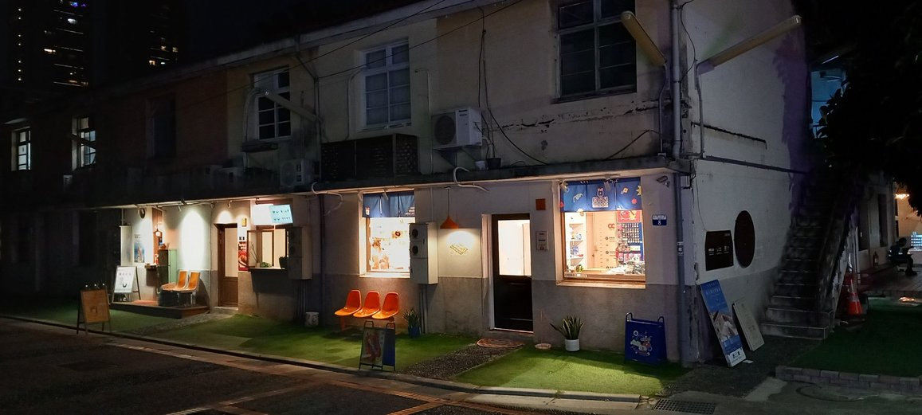
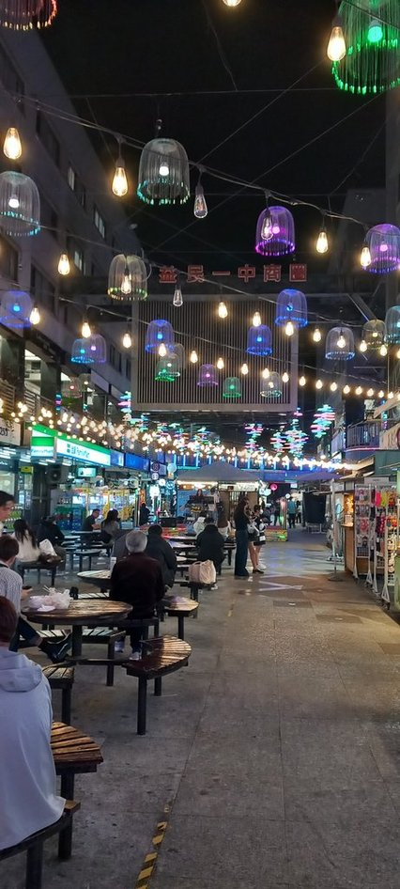
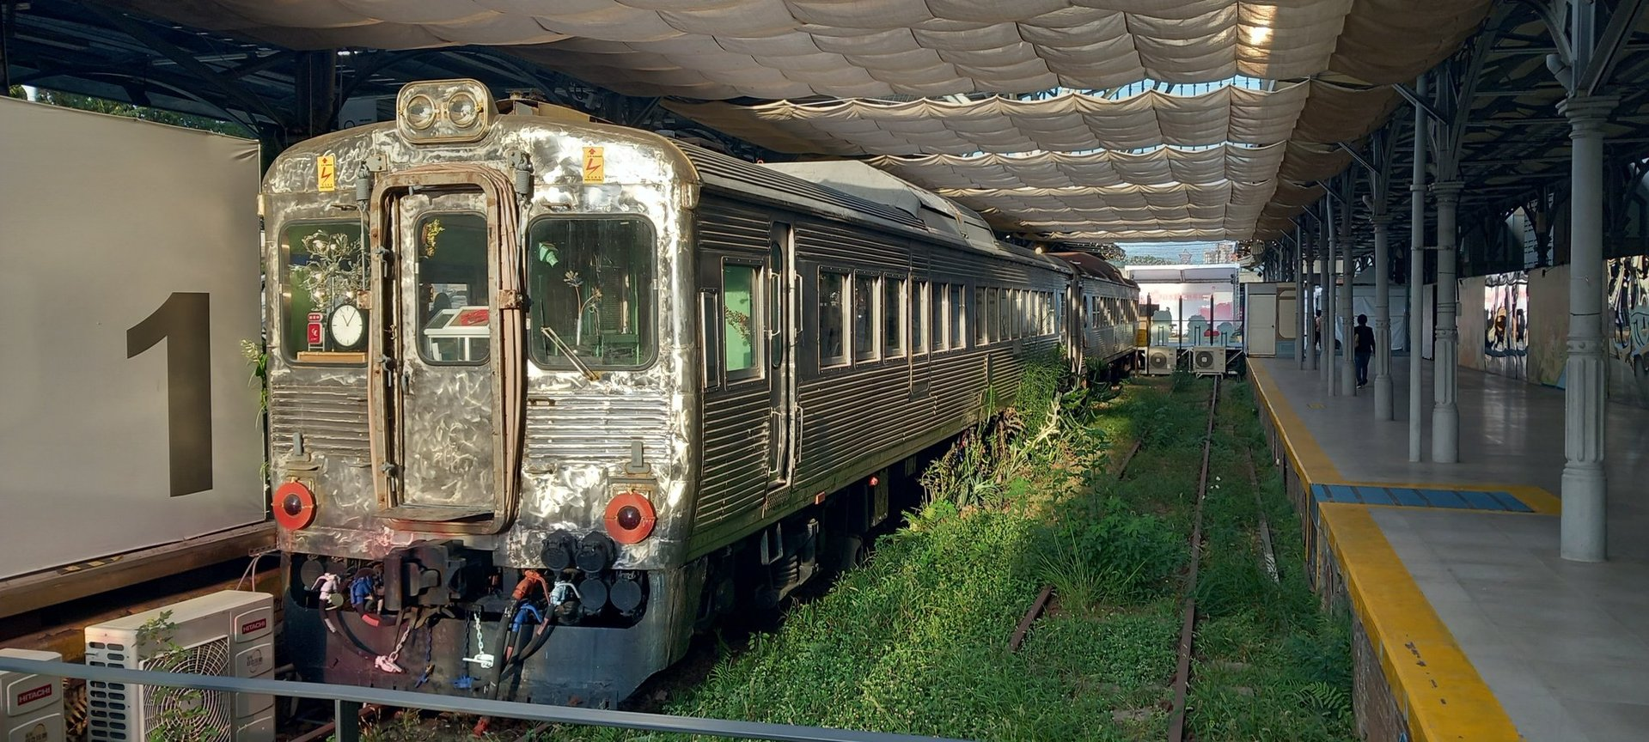
Taichung

Slide 17
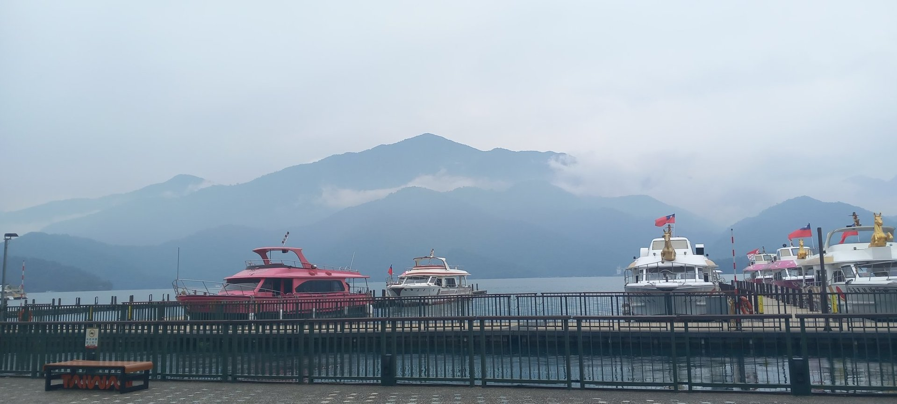
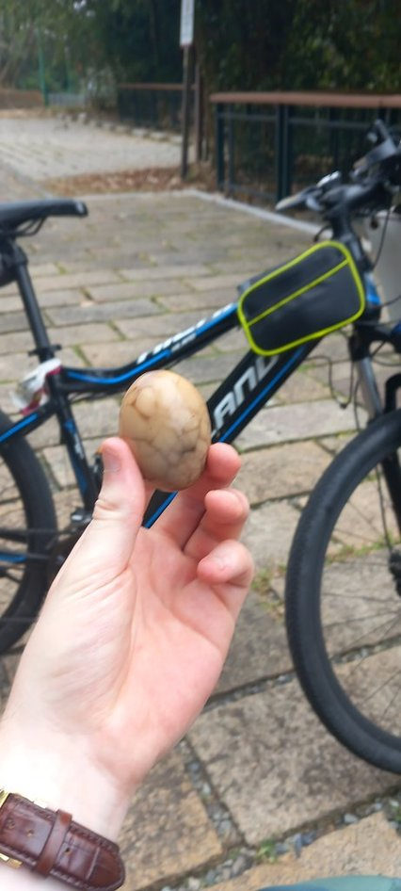


Sun Moon Lake

Slide 18
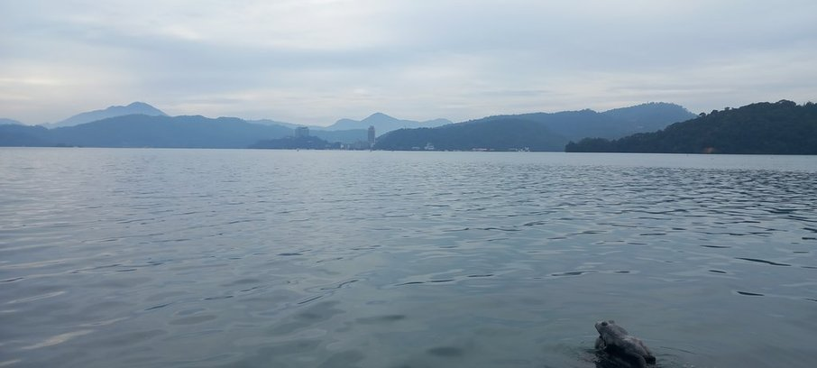
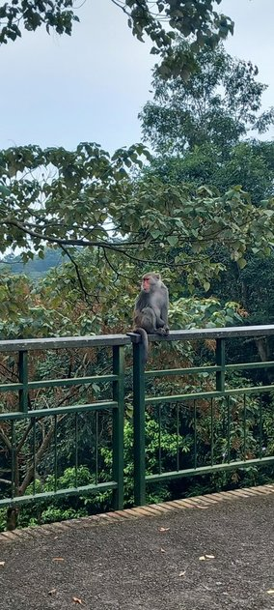
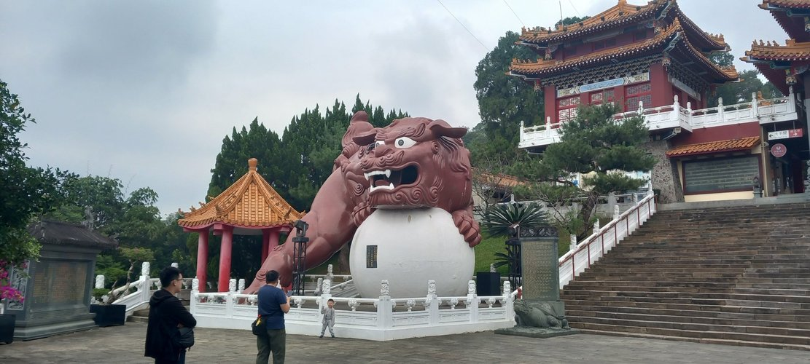
Sun Moon Lake

Slide 19
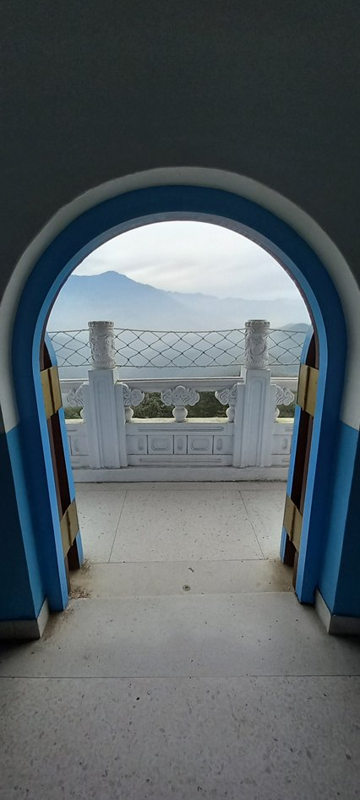
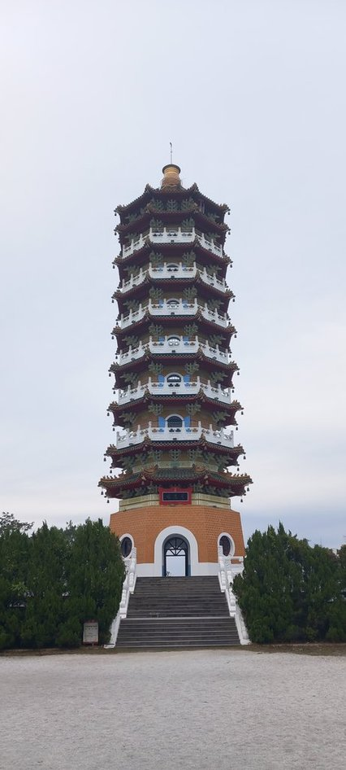
Sun Moon Lake

Slide 20
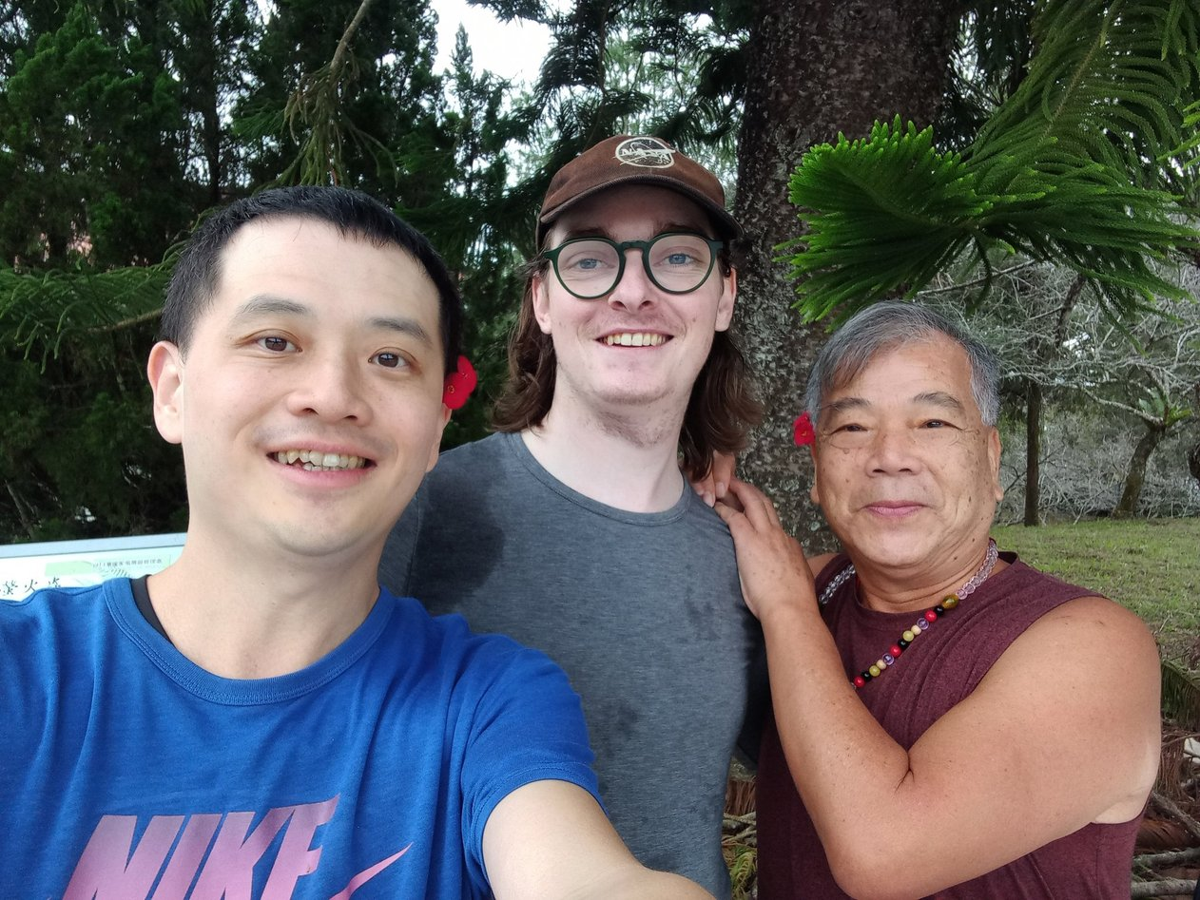
Sun Moon Lake

Slide 21
Taiwanese Bathroom Innovation – Case 1

Slide 22
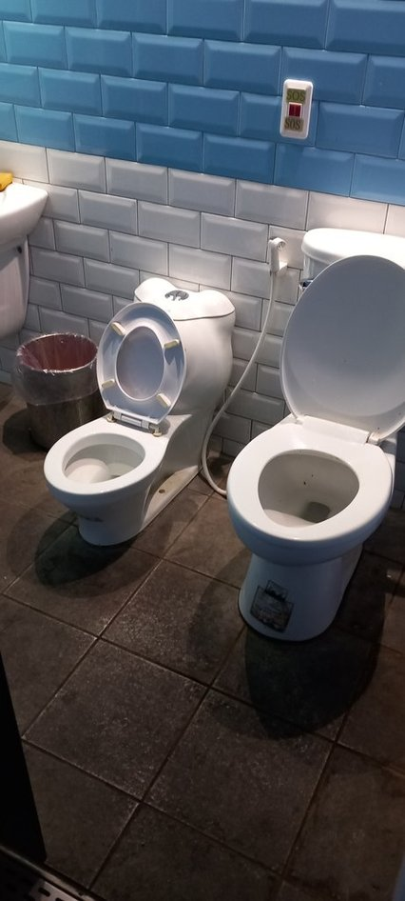
Taiwanese Bathroom Innovation – Case 1

Slide 23
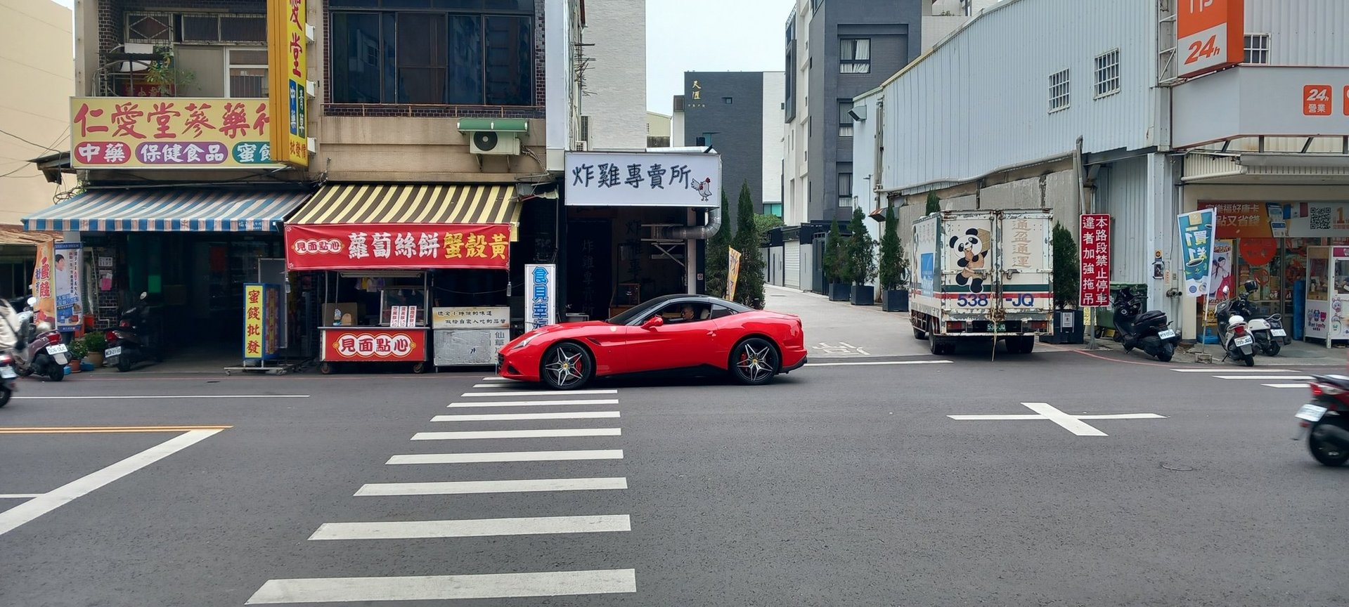
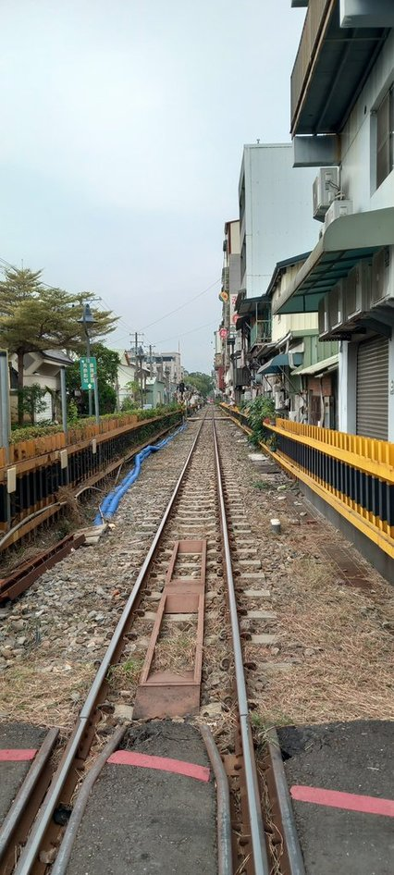
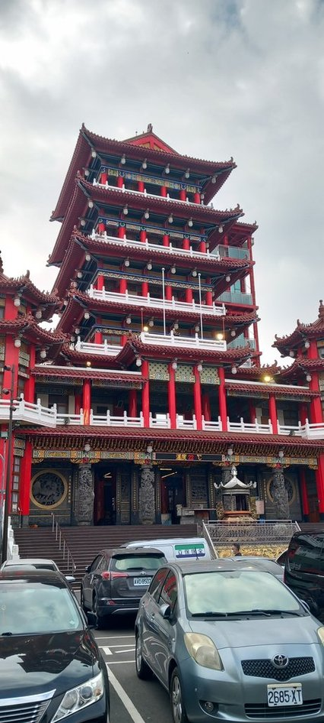
Chiayi

Slide 24
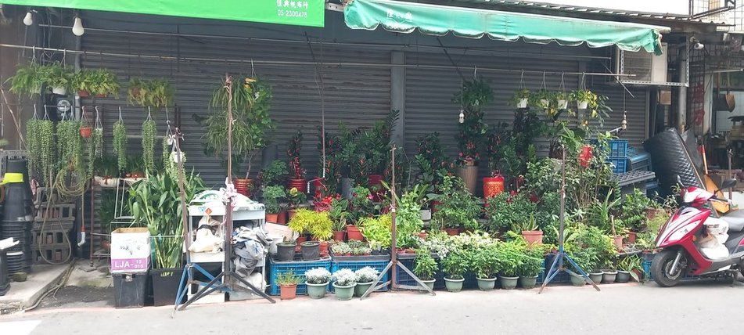
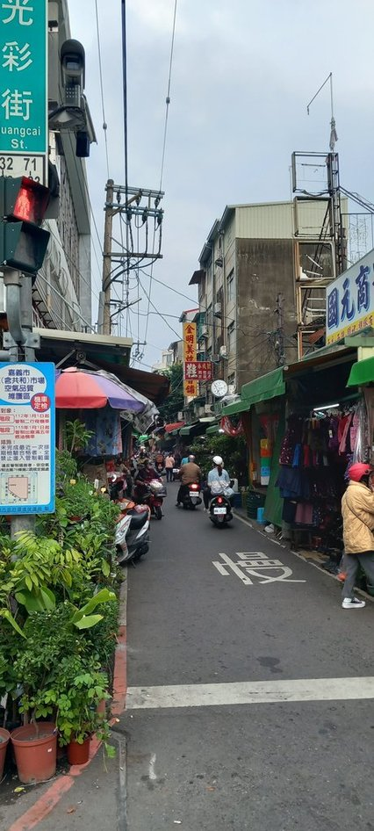

Chiayi

Slide 25
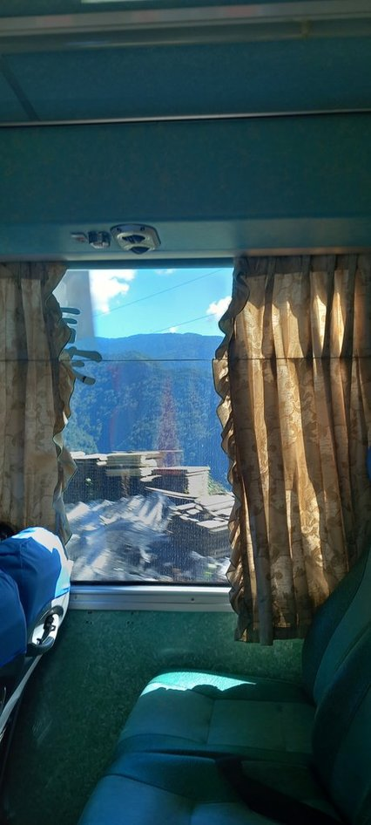
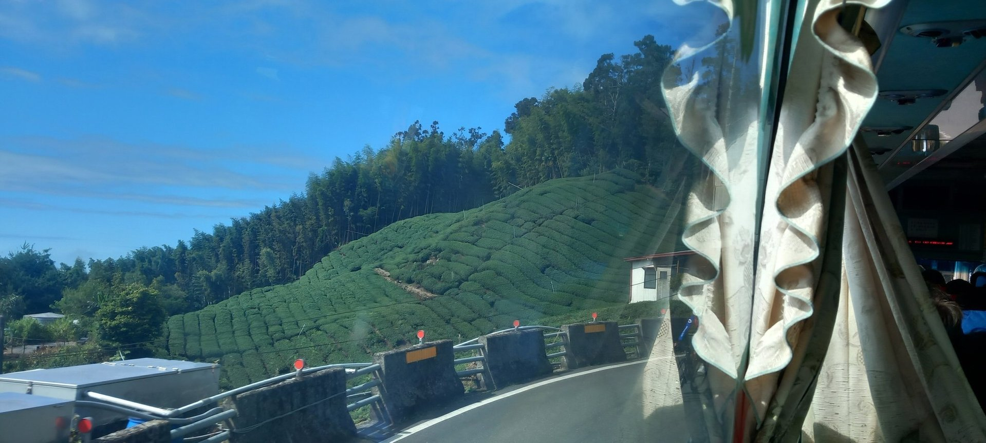
Alishan

Slide 26
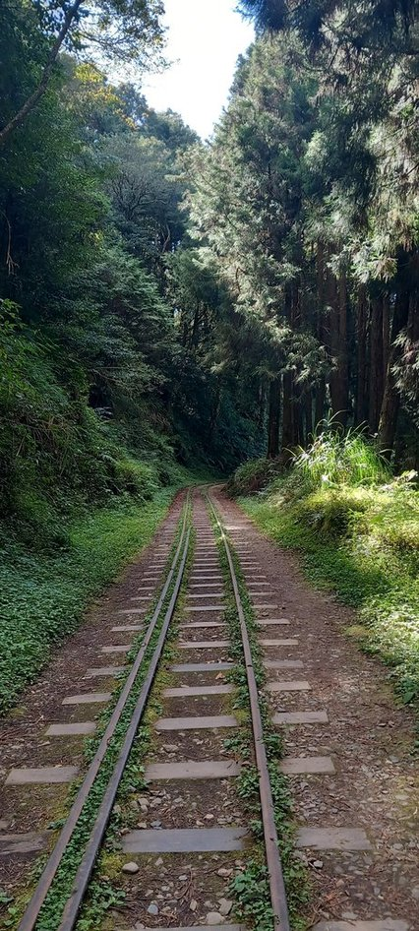
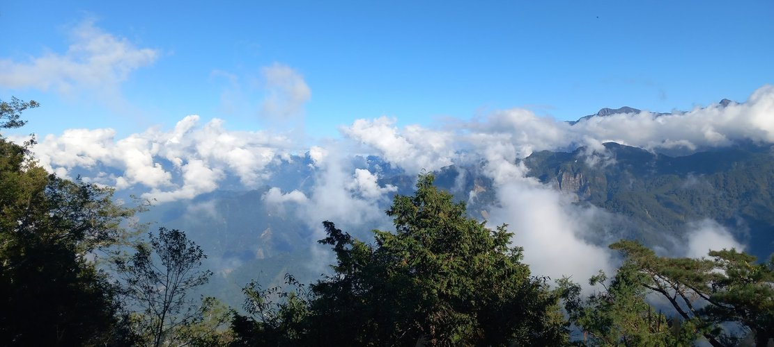
Alishan

Slide 27
Alishan

Slide 28
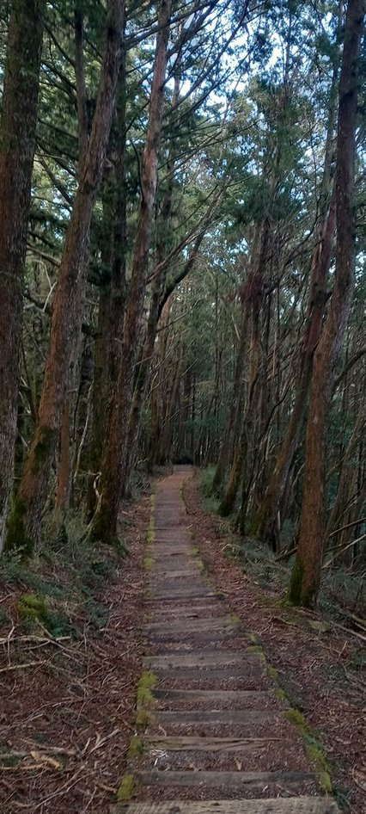

Alishan

Slide 29

Alishan

Slide 30

Alishan

Slide 31


Taitung

Slide 32

Dulan

Slide 33


Dulan

Slide 34

Dulan

Slide 35


Hot Springs

Slide 36

Hot Springs

Slide 37



Back to Taipei, then home ☹

Slide 38
Taiwanese Toilet Innovation – Pt. 2

Slide 39

Taiwanese Toilet Innovation – Pt. 2

Slide 40

Financial (ir)responsibility

Slide 41

Financial (ir)responsibility

Slide 42

Financial (ir)responsibility

