Slide 1
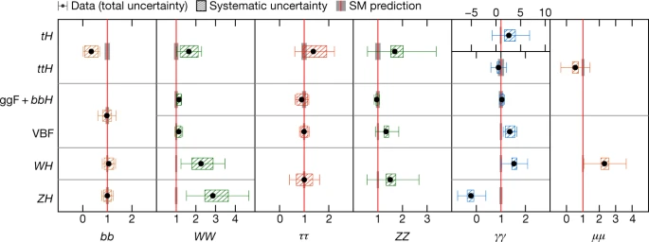

All-hadronic ttH Ideas… Top Corner of Higgs Production
Bruno Borbely, Giuseppe Callea,
Tony Doyle, Mark Owen, Zefran Rozario

Slide 2
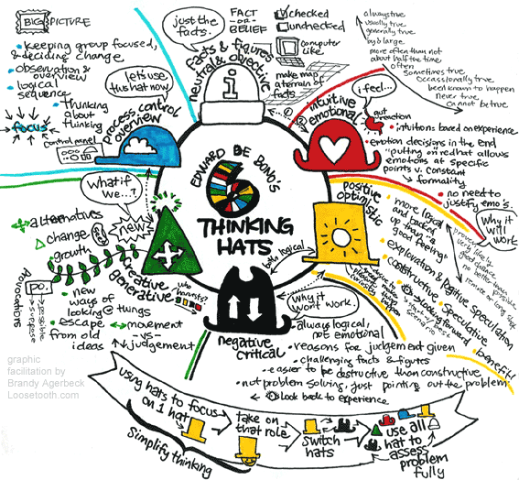
Role of Technical Director
New hat

Slide 3

Pilgrim’s Path
Top Corner
Historical Perspective
ttH Process
Semi-leptonic Channel
Transformers
All-hadronic Channel
Run-1 Perspective
Transformers?
Improvements

Slide 4

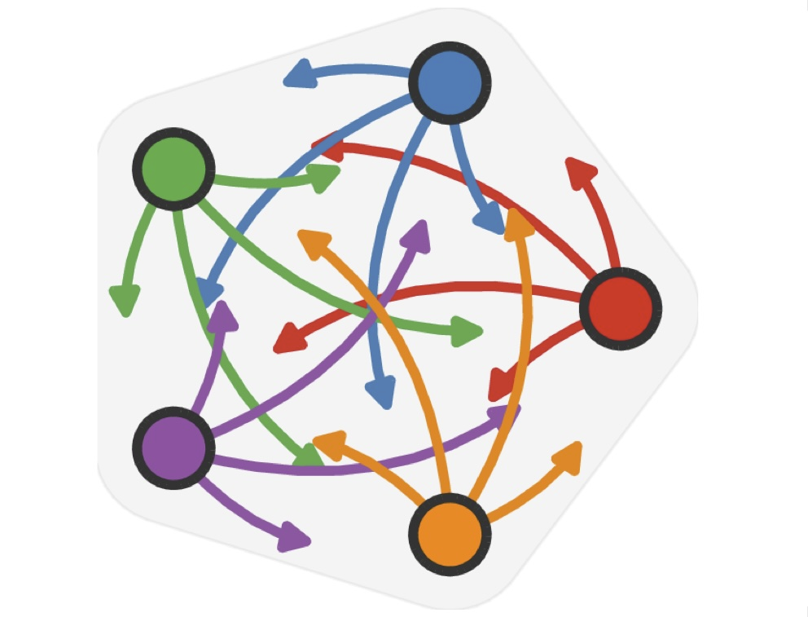
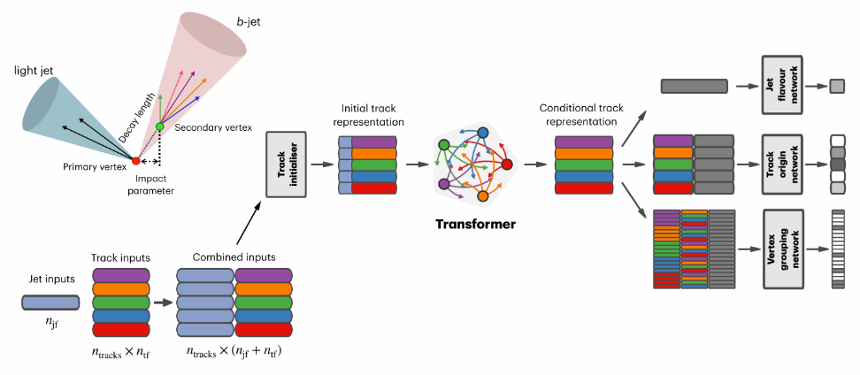
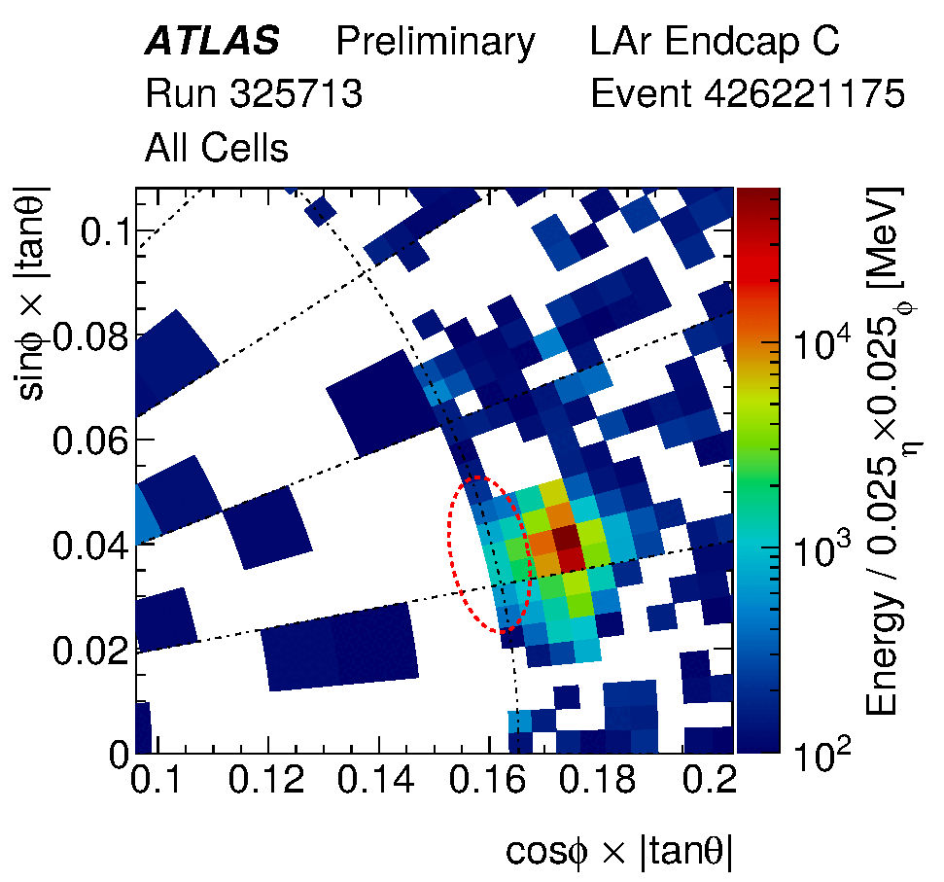

ATLAS Transformers
AI used for Signal-Background Separation (and Higgs reconstruction, and b-tagging, and event reconstruction, and anomaly detection..)
Data Analysis:
AI algorithms are trained on large datasets where signals and backgrounds are present
Feature Extraction:
The AI identifies distinct features that differ between the signal and backgrounds
Pattern Recognition:
By learning these patterns, the AI develops the ability to classify incoming data
Disentanglement:
The learned model then processes unseparated data to isolate and extract the signal
Find the (one in ten billion) Higgs signal events using subtle correlations (and correlations of correlations), whilst monitoring the (hundreds of) systematics…
Beware the decepticons…

Slide 5
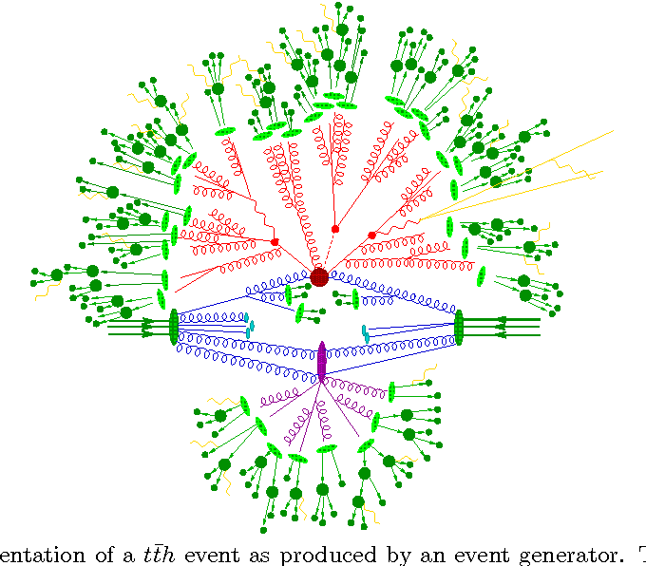
Process: Higgs + Associated Top
Higgs analyses require sophisticated theory predictions
Higher-order perturbative calculations
Resummations
Reliable non-perturbative tools:
PDFs
Parton Showers
Jets
Everything Everywhere All Time Ordered
Sherpa semi-leptonic ttH event

Slide 6
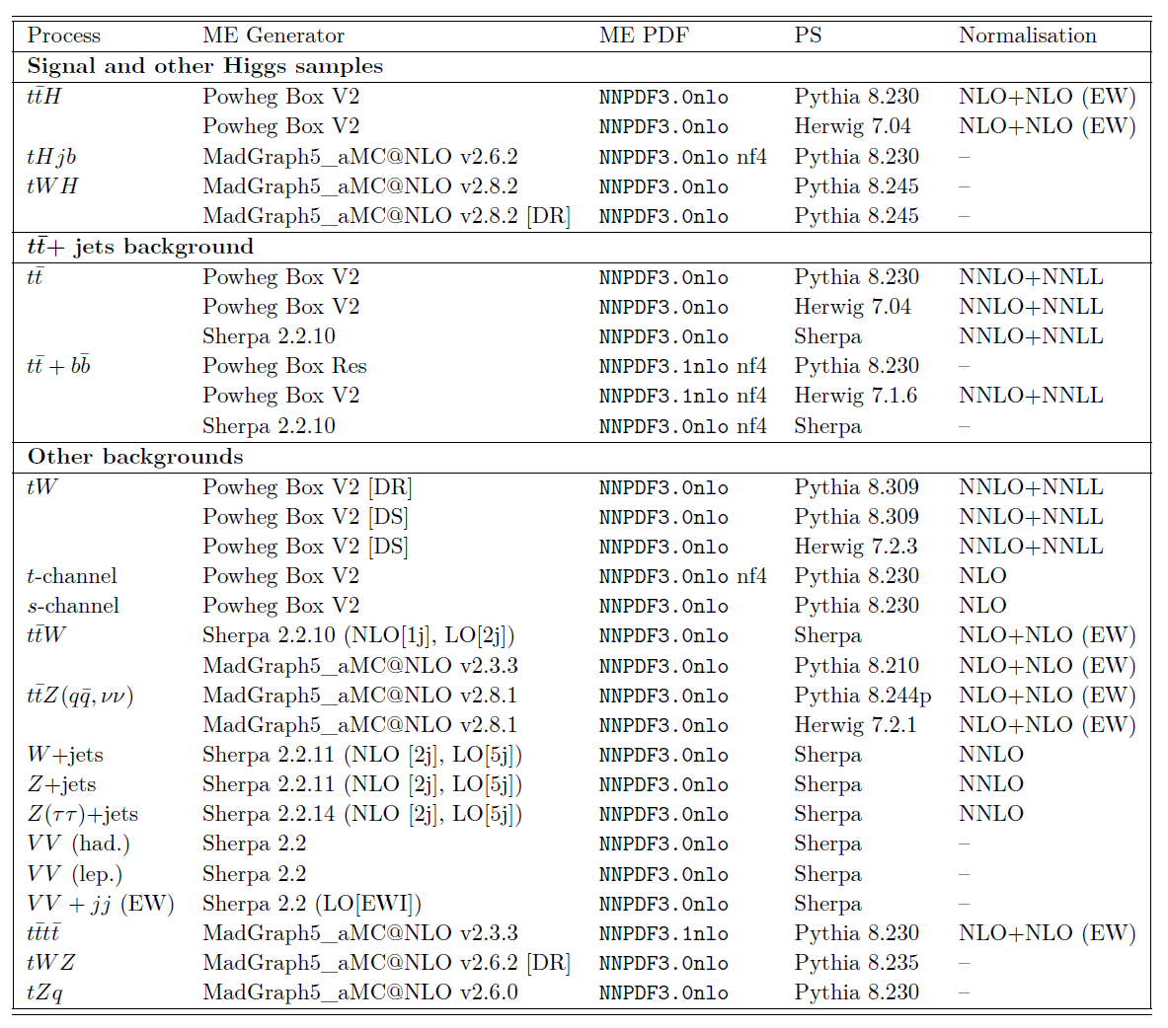
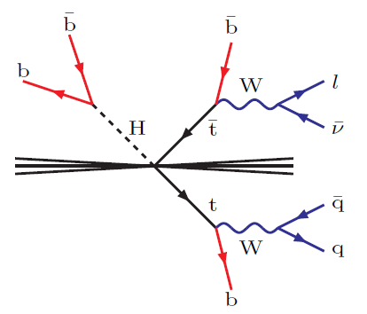
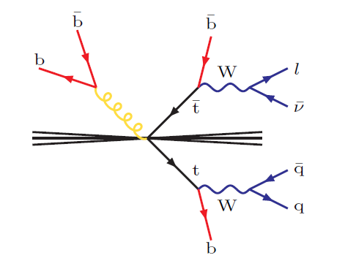
Backgrounds everywhere.. +signal Dominating the uncertainties

Slide 7
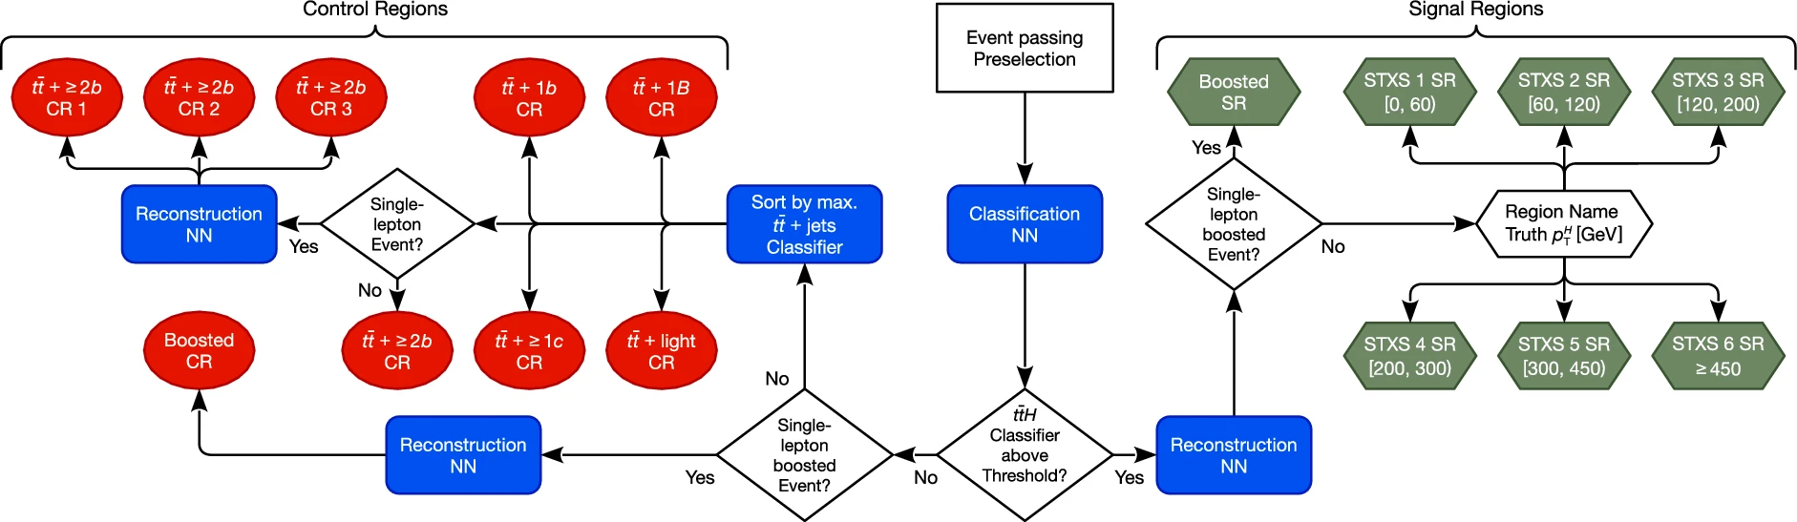
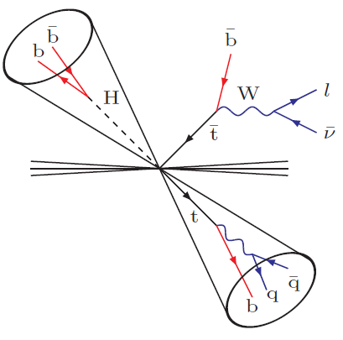
Physics Pilgrimage.. From A to B to Z.. 25 years analysing ttH..
“b quark tagging performance and Higgs detection via top production using the ATLAS detector” Andrew Pickford (2001)
“Measurement of the associated production of a top quark pair and a Higgs boson (ttH) with boosted topologies” Bruno Borbely (2023)
Driven by the Backgrounds
To observe a Signal
“Measurement of the ttH(bb) process using the ATLAS detector and its effective field theory interpretation” Zefran Rozario (2025)
https://doi.org/10.1140/epjc/s10052-025-13740-x

Slide 8
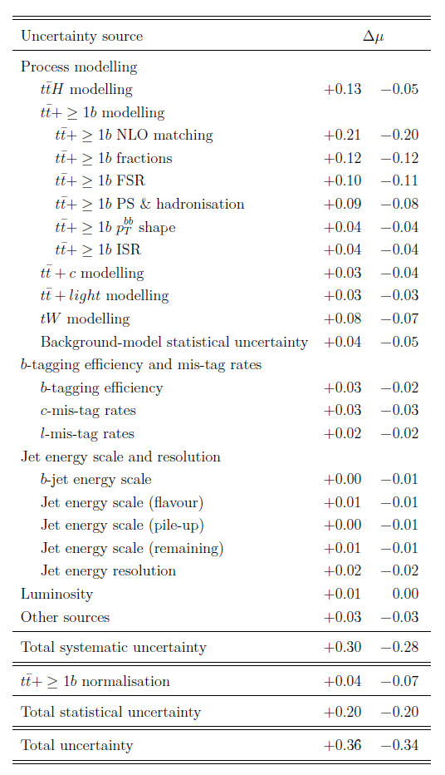
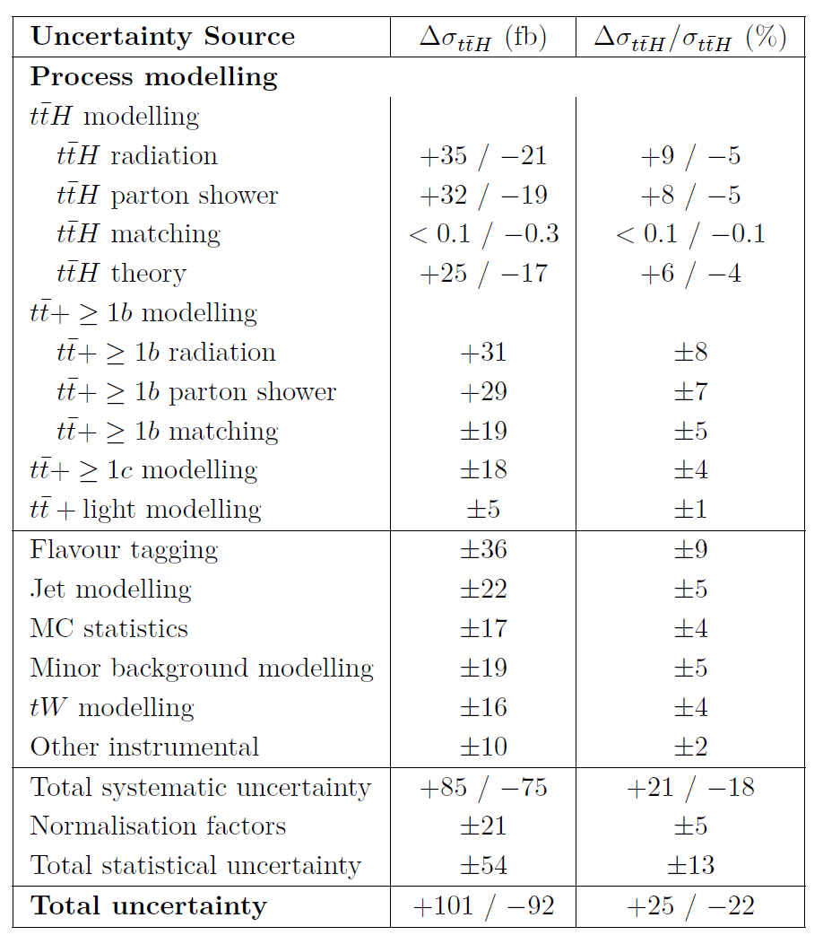
Must Improve the background modelling, and the S/B classification.. and the Higgs reconstruction, and the b-tagging..
2022 Result
(Bruno’s thesis)
2025 Result
(Zef’s thesis)
tt+b(b)
modelling

Slide 9
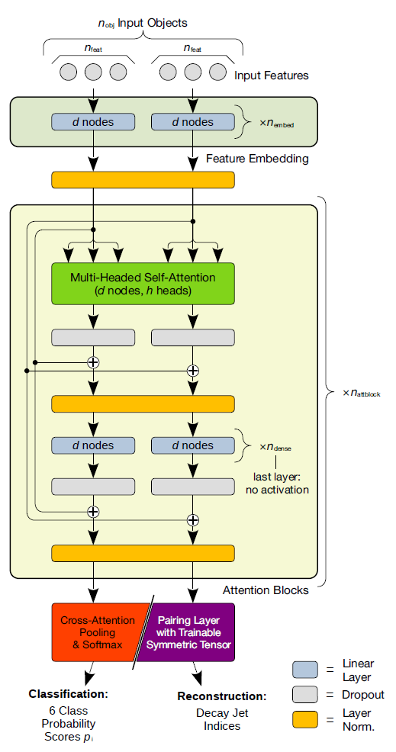
ttH Transformer Networks
Classification Network:
Output of the final attention block is aggregated by a cross-attention pooling layer
Pooled features mapped through a softmax layer to produce class probabilities
Class probabilities are transformed into discriminant observables to improve S/B separation
Discriminant observables define the signal and control regions
Reconstruction Network: jet-pairing layer to identify jets associated with the Higgs boson (p_{T}^{H})

Slide 10
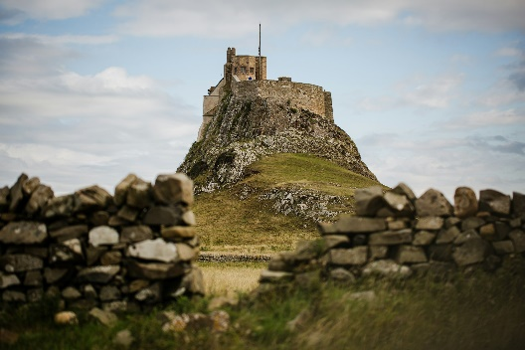

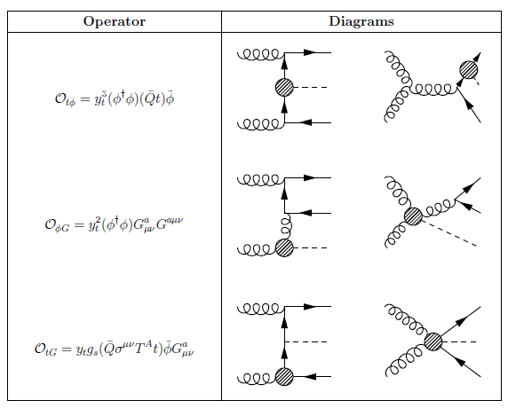
Improvements Pilgrimage.. towards an observation
Looser selection requirements
Enhanced b-tagging
Raised the overall signal acceptance
Classification network
Control regions enriched in different tt+jets components
Dedicated simulation and systematic models for the tt+1b background
Data-driven corrections for the tt+ 1c and tt+light jets
Greater control of backgrounds
Reconstruction network
Improved Higgs reconstruction
New high p_{T} extrapolation uncertainties
Overall sensitivity
SM interpretation: signal strength μ
SMEFT: Chromomagnetic c_{tG}
and Yukawa-like c_{tϕ} Wilson Coefficients
Improved by ~factor 2
Enough for an observation?

Slide 11
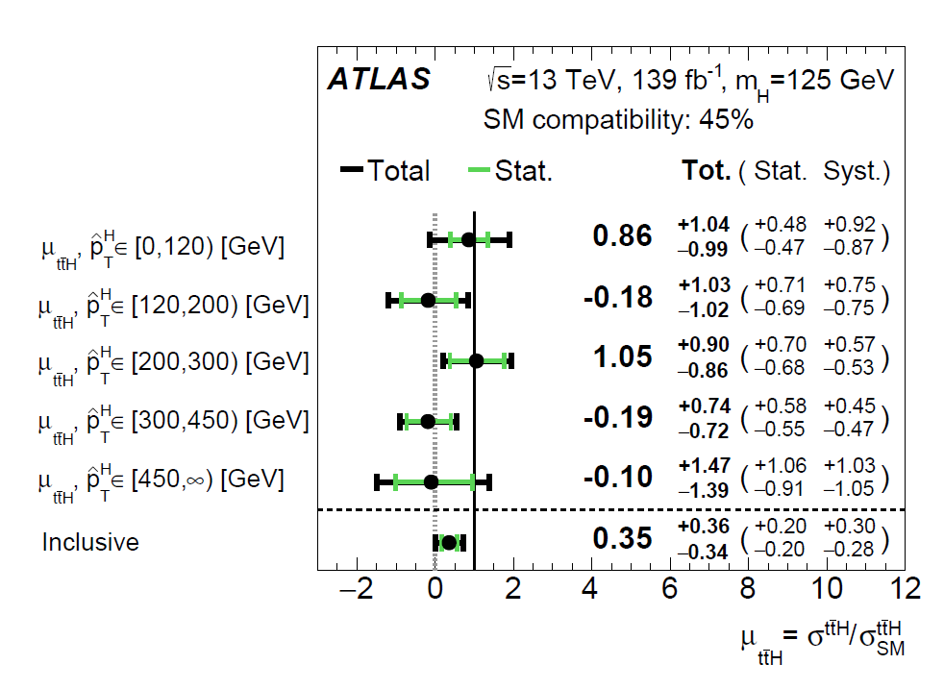
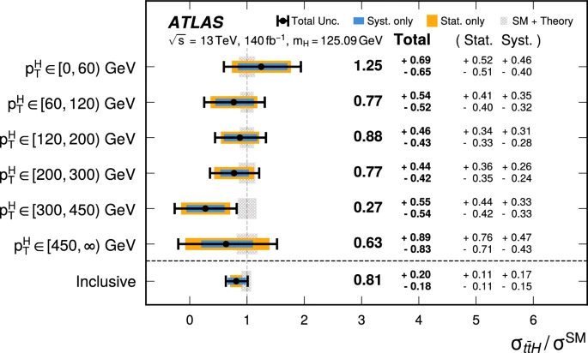

ttH Run-2 (almost an) observation.. μ precision improved by ~factor 2
2022 Result
Same Scale
Same Data
4.6σ observed
(5.4σ expected)
2025 Result

Slide 12
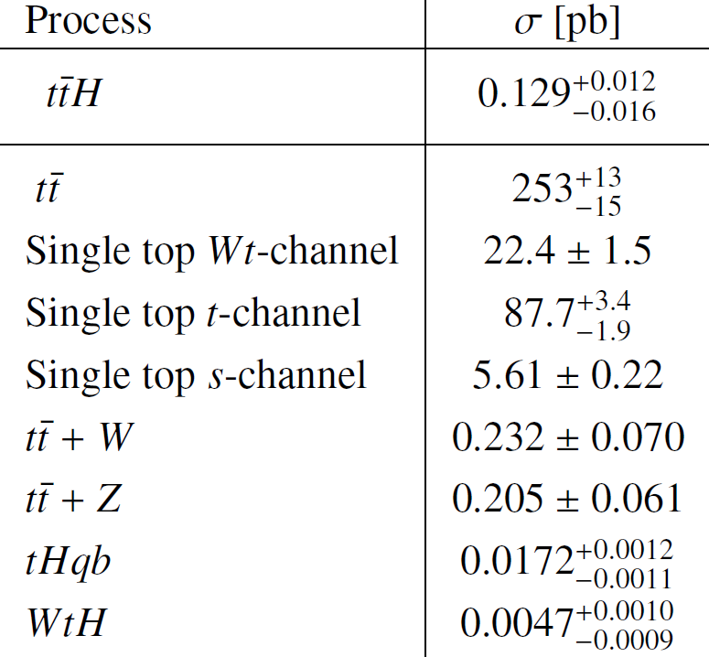
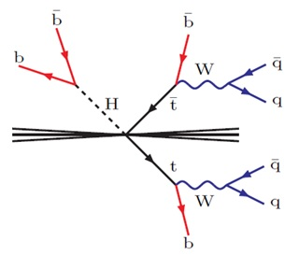
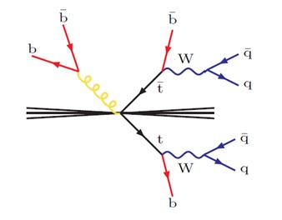
All-hadronic Backgrounds everywhere.. +signal Really dominating the uncertainties

Slide 13
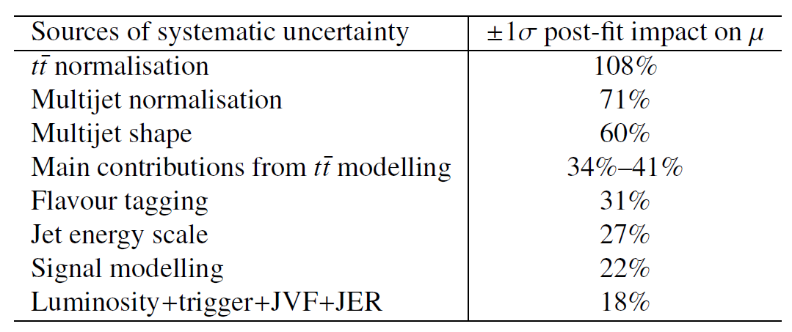
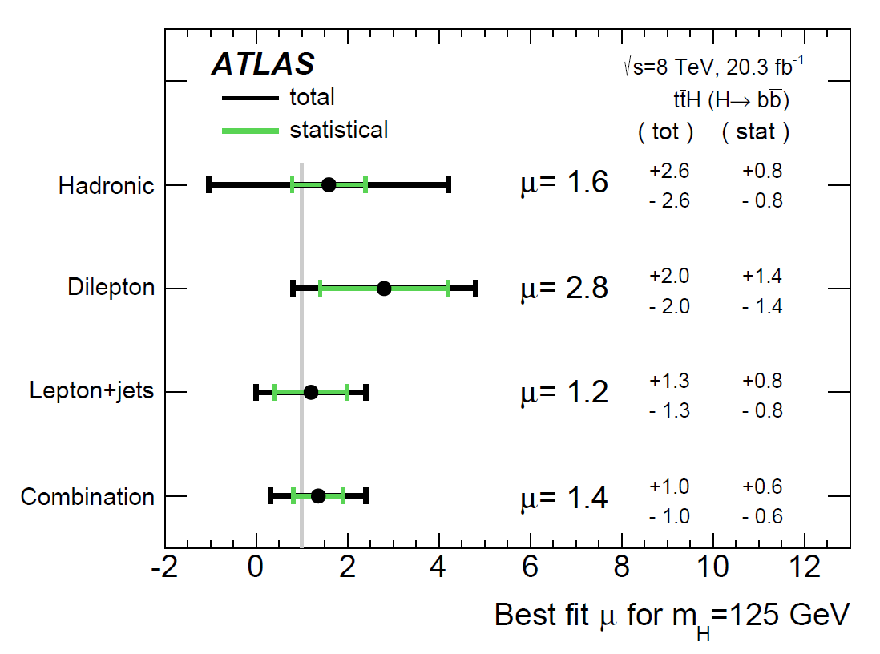
2016 Run-1 Result: μ = 1.6 ± 2.6
Dominated by the systematics…
Can we improve with Run-2 + Run-3 data?
Especially in the boosted region?

Slide 14
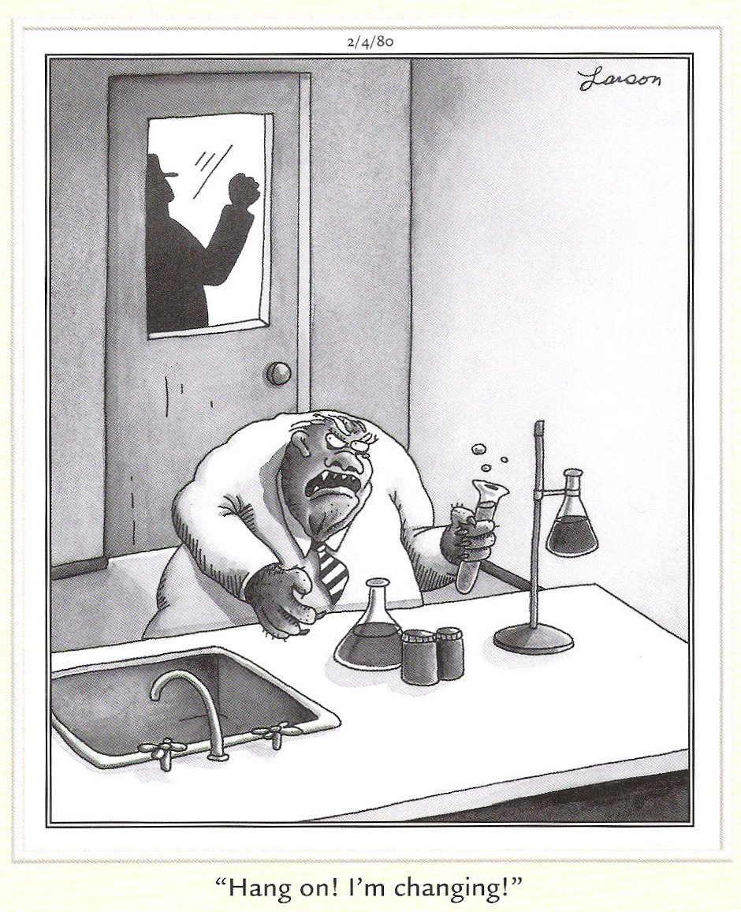
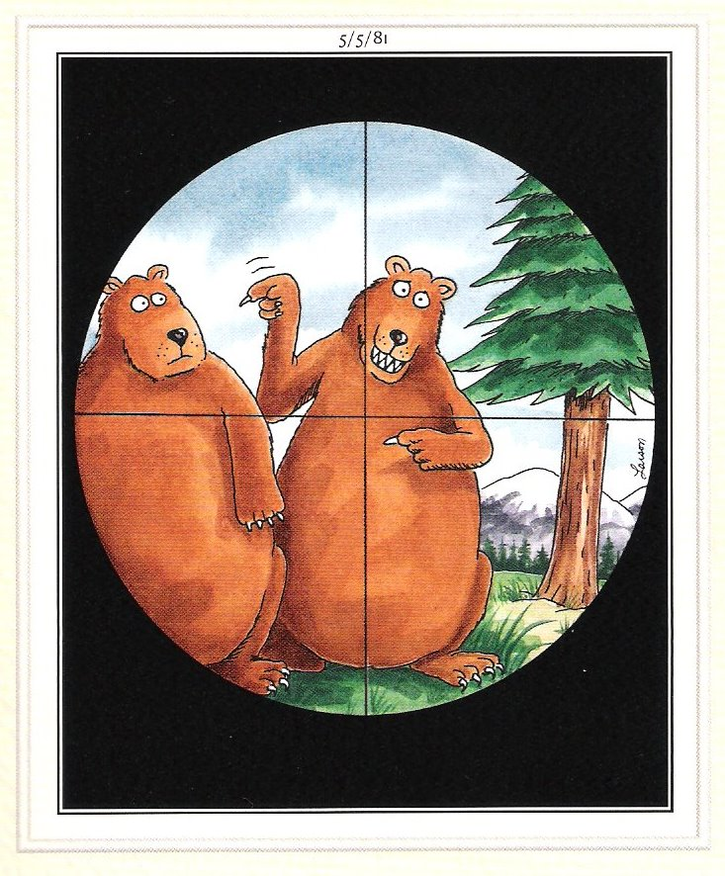
Tony’s new HAT Higgs plus Associated Top
Top HAT
Old Hat
At least SIX transformed thinking hats to assess the backgrounds fully

Slide 15
Role of Technical Director
New hat

