Slide 1

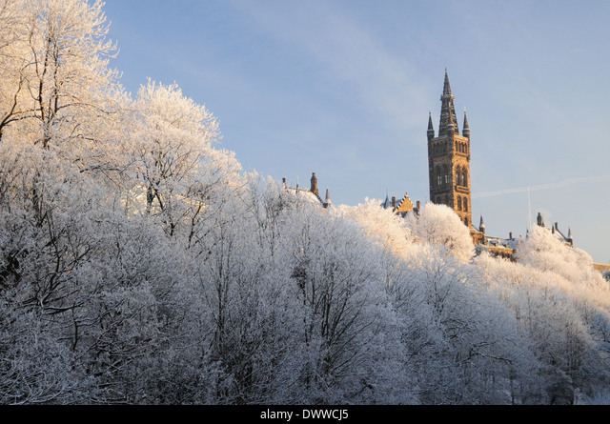



LHCb Glasgow 2025
Lucia Grillo, Paul Soler, Mark Whitehead
Christmas meeting 2025

Slide 2
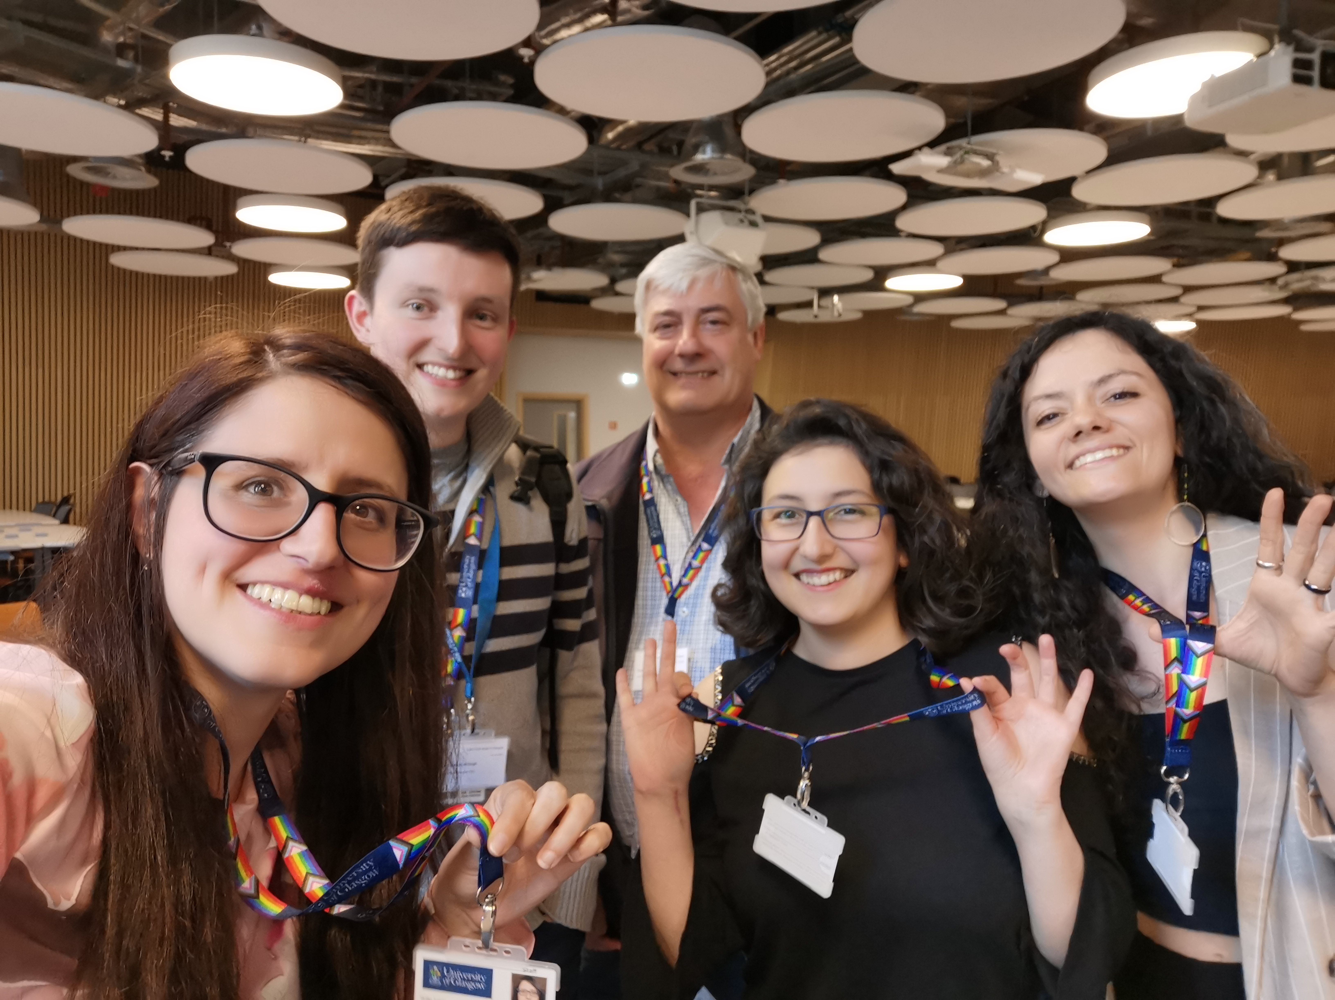
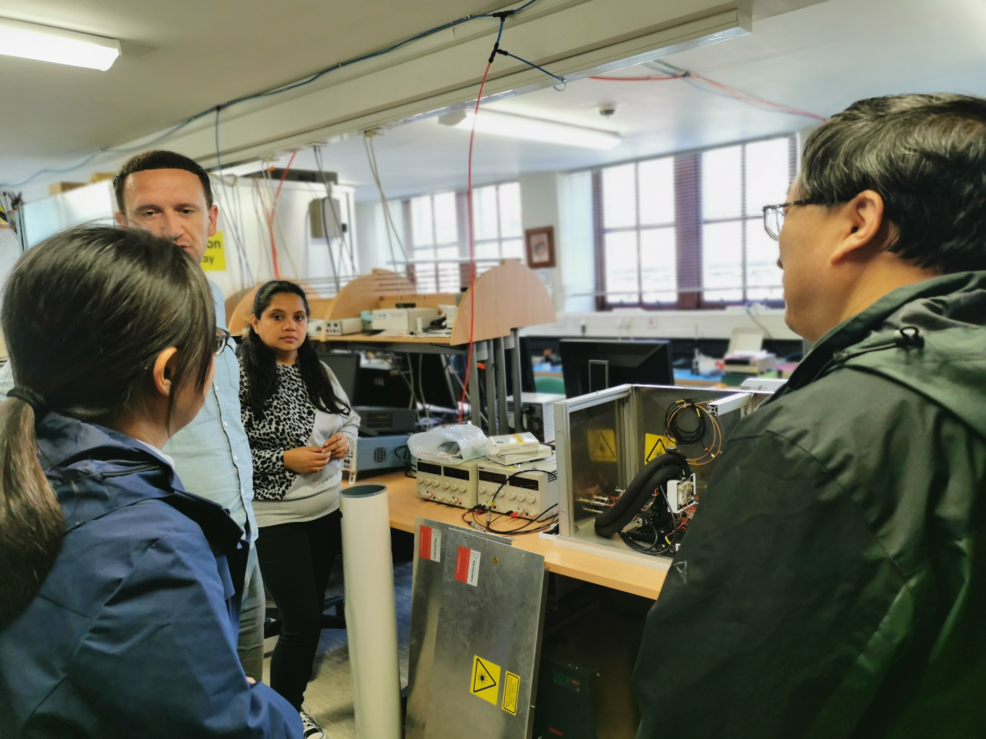
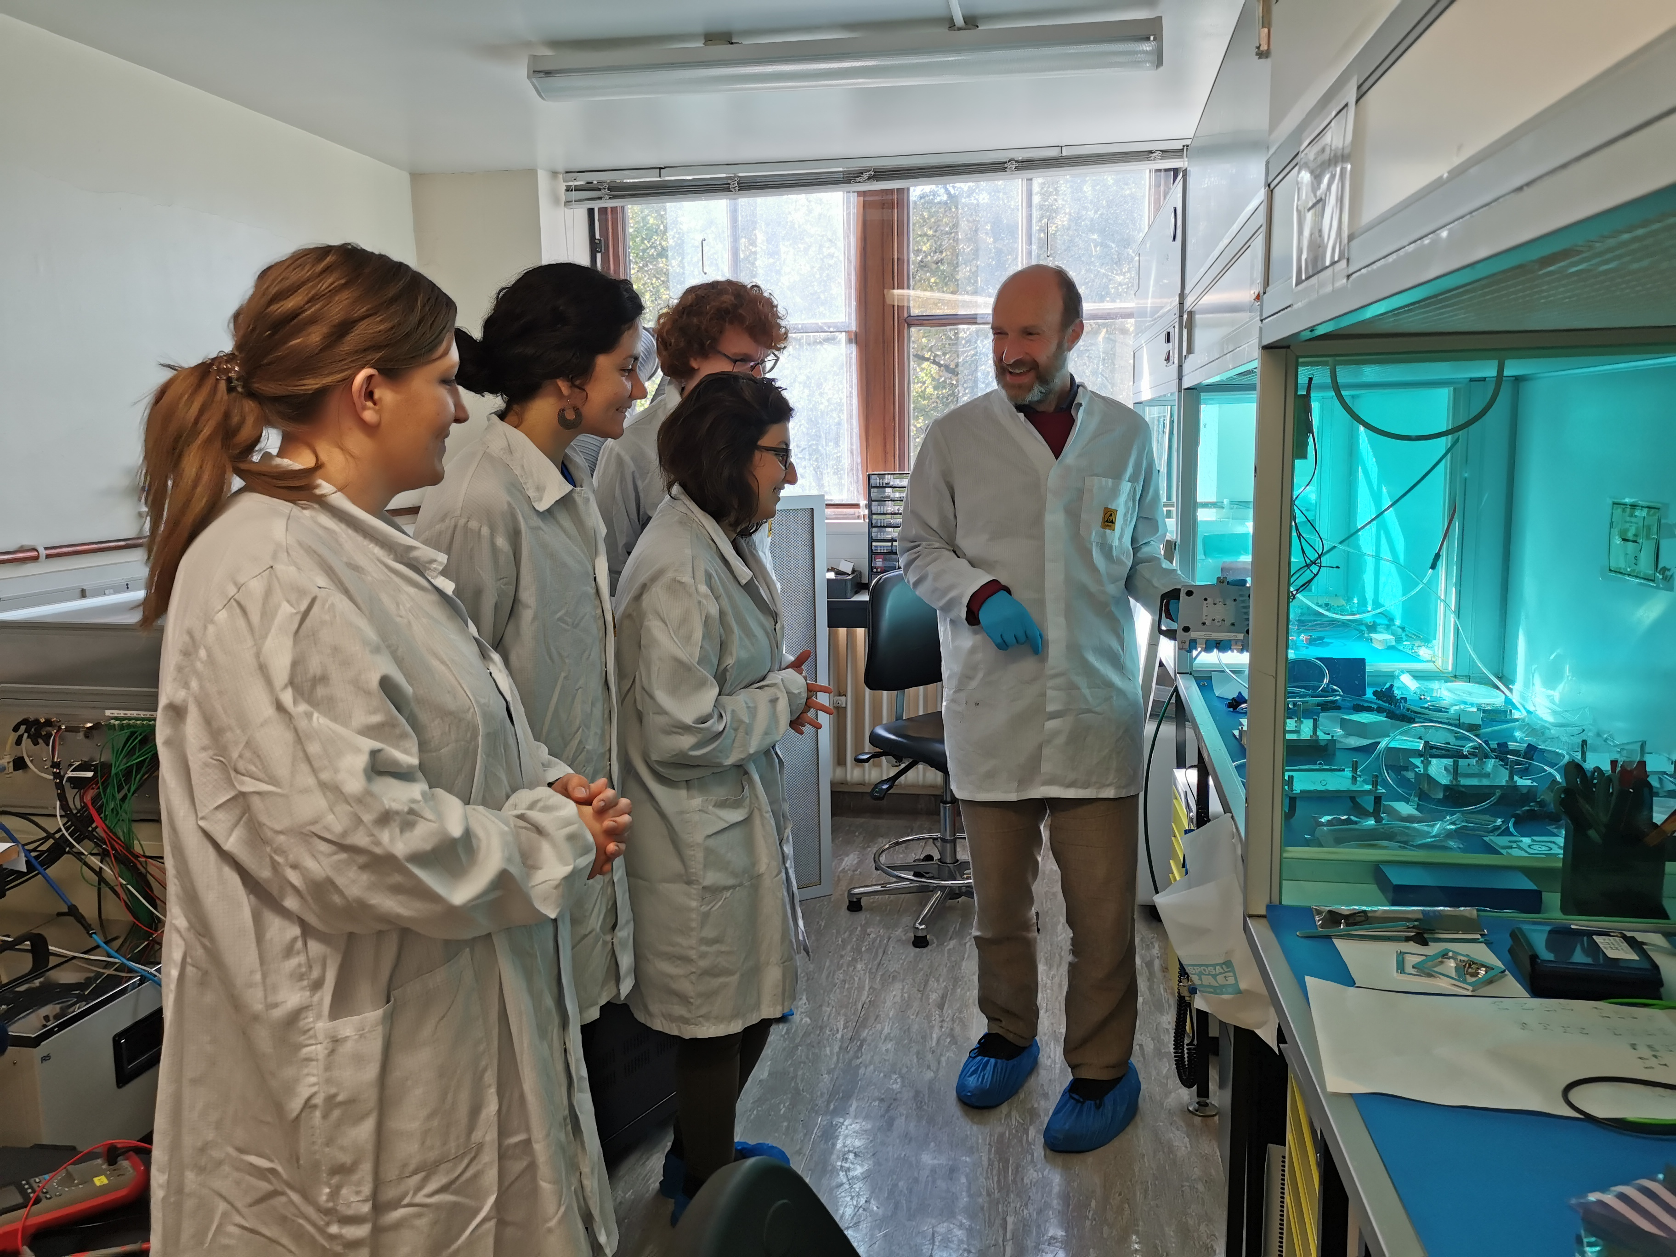
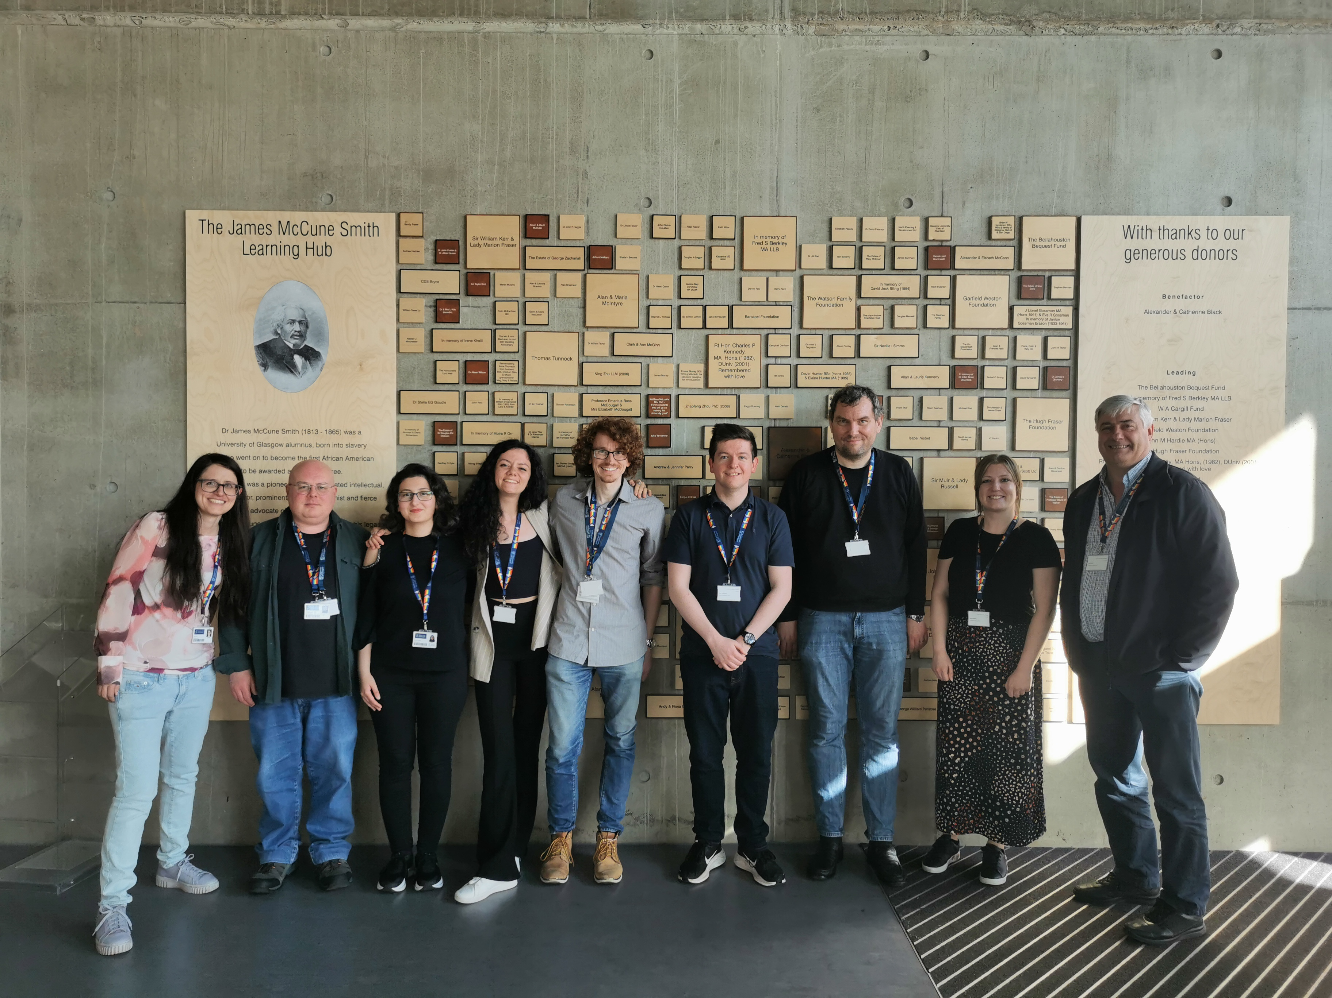
The LHCb group
+Dylan (Oct 2024)
+ Will (Oct 2025)
LHCb week June 2024

Slide 3
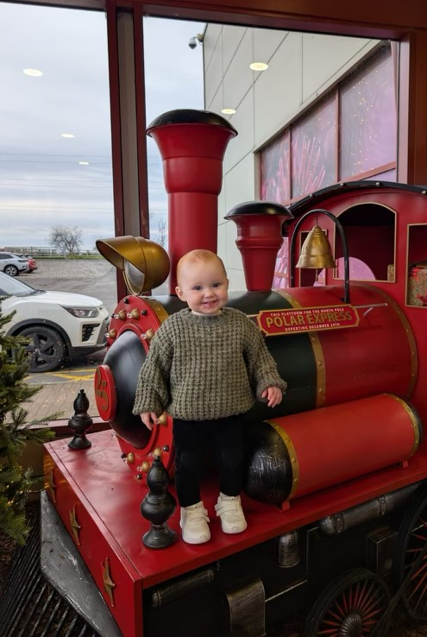
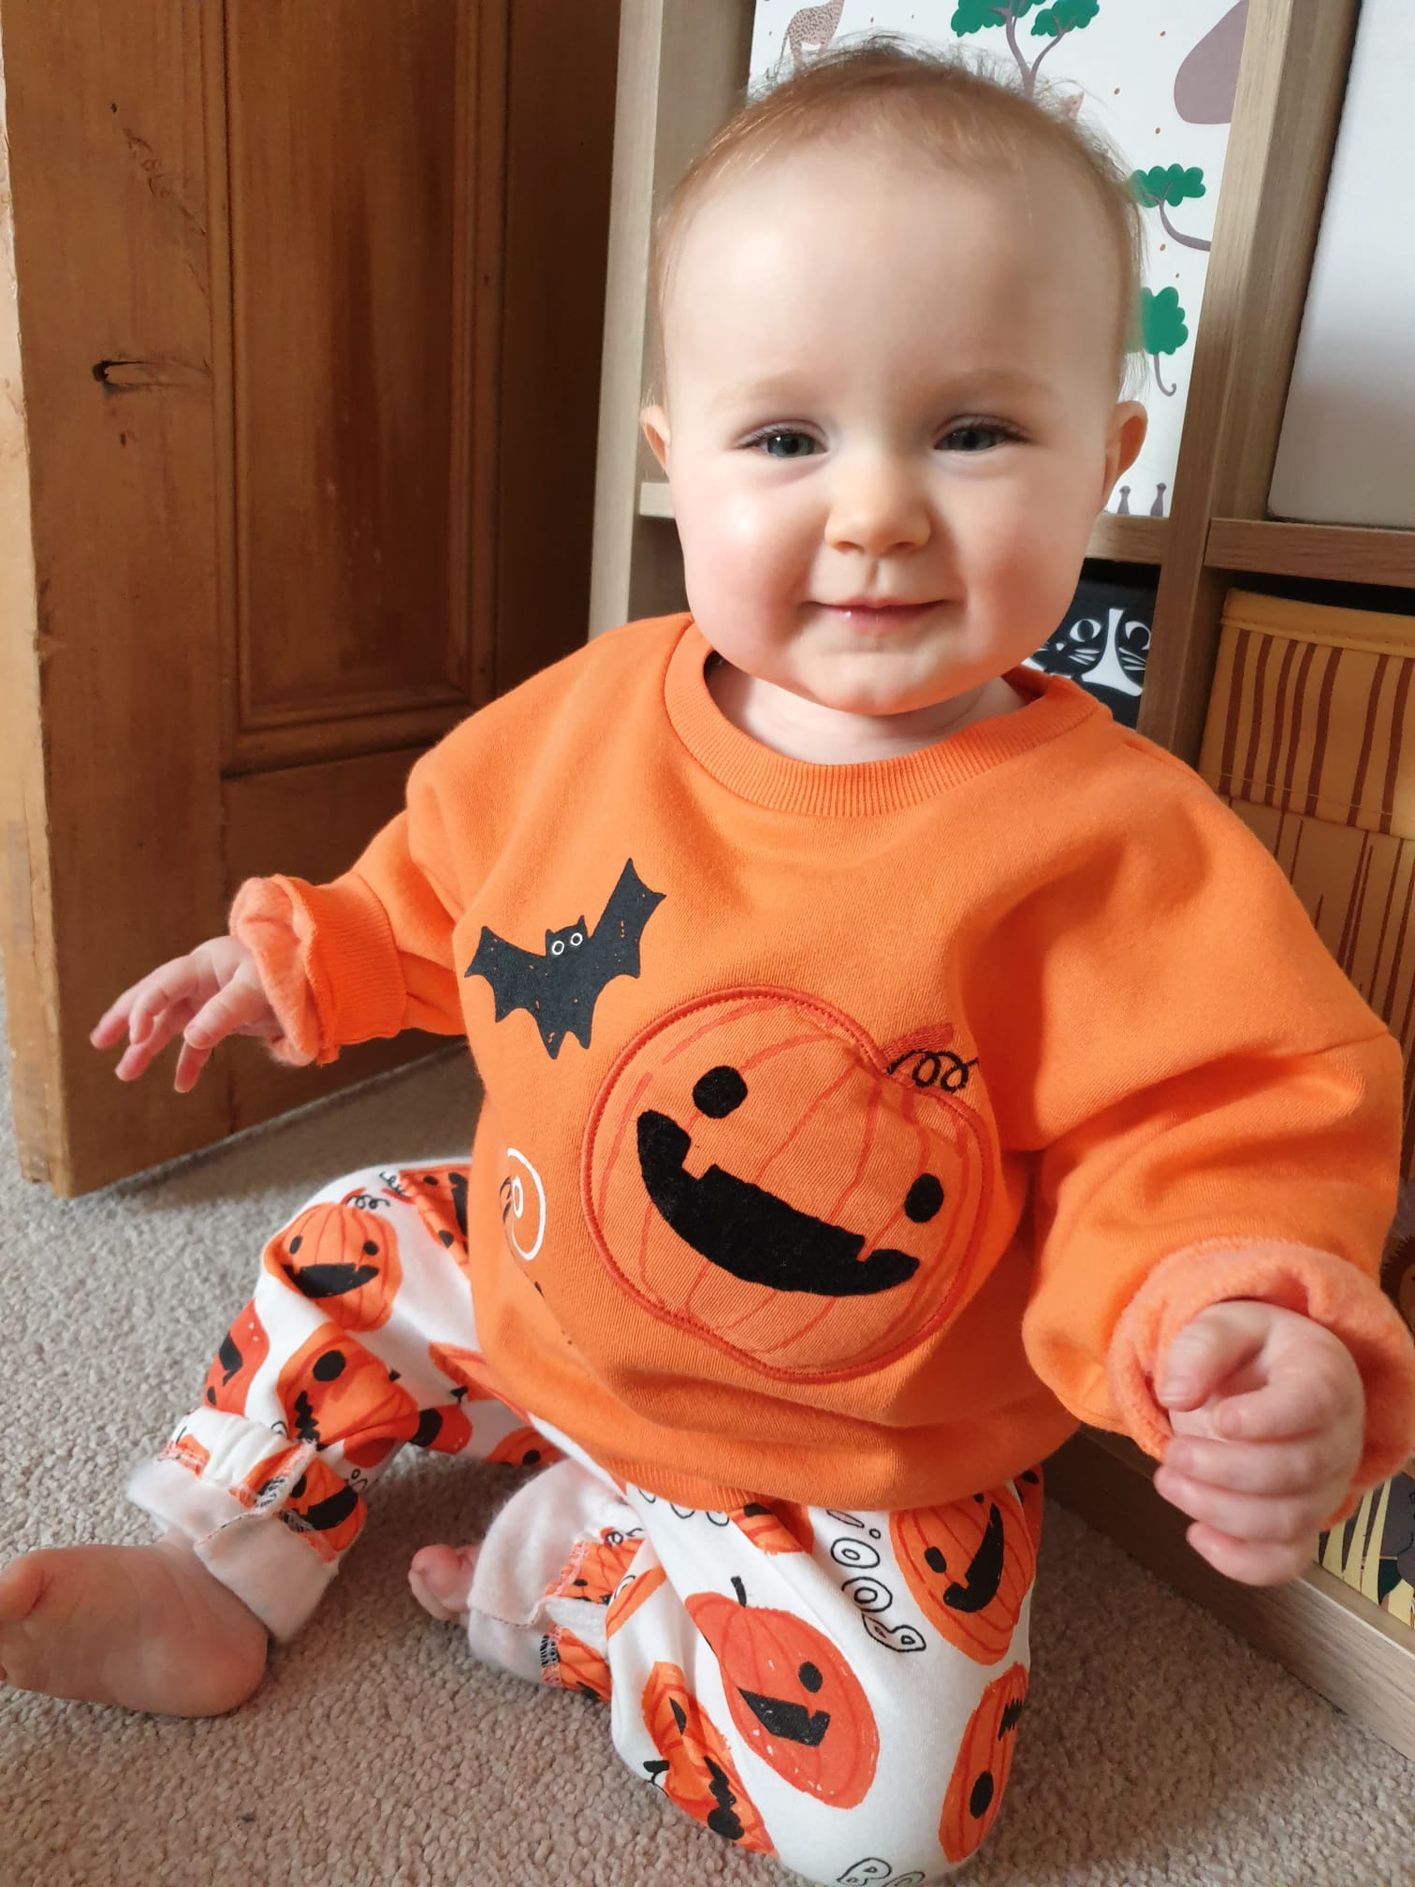
And our little helpers
Who is Meadhbh McHugh and who is Gemma Whitehead?

Slide 4

This year
Dear STFC, This year…

Slide 5
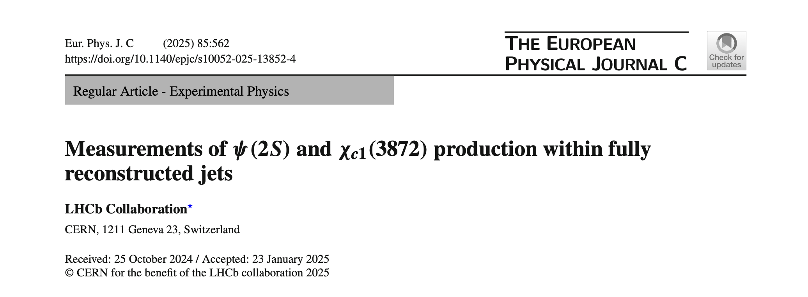
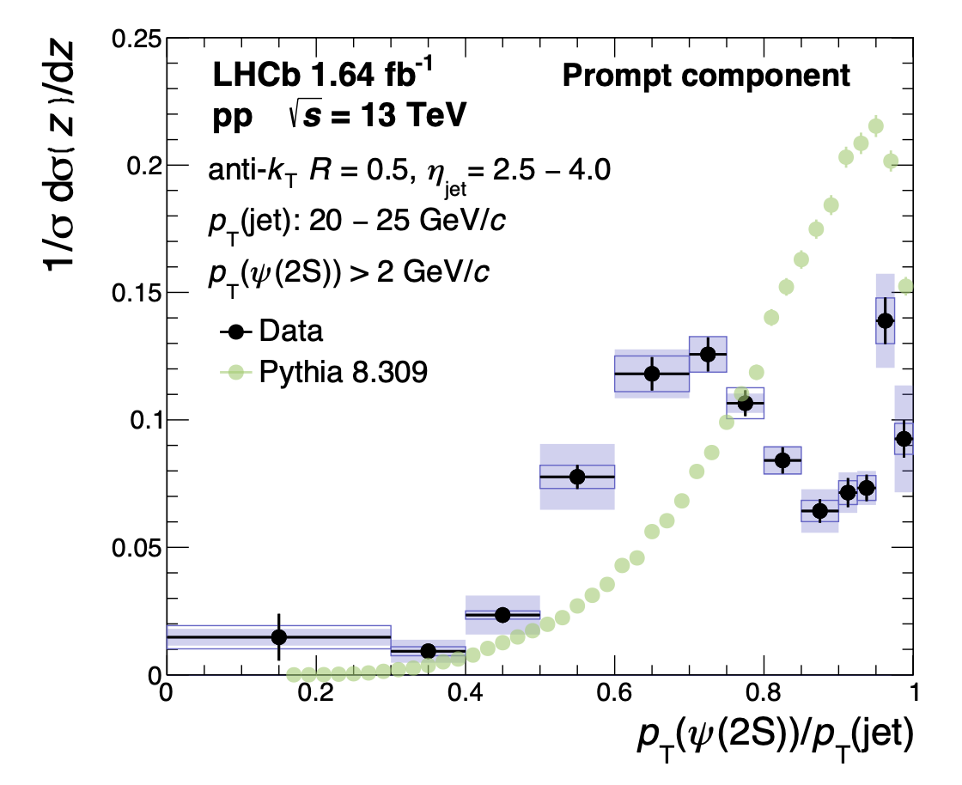
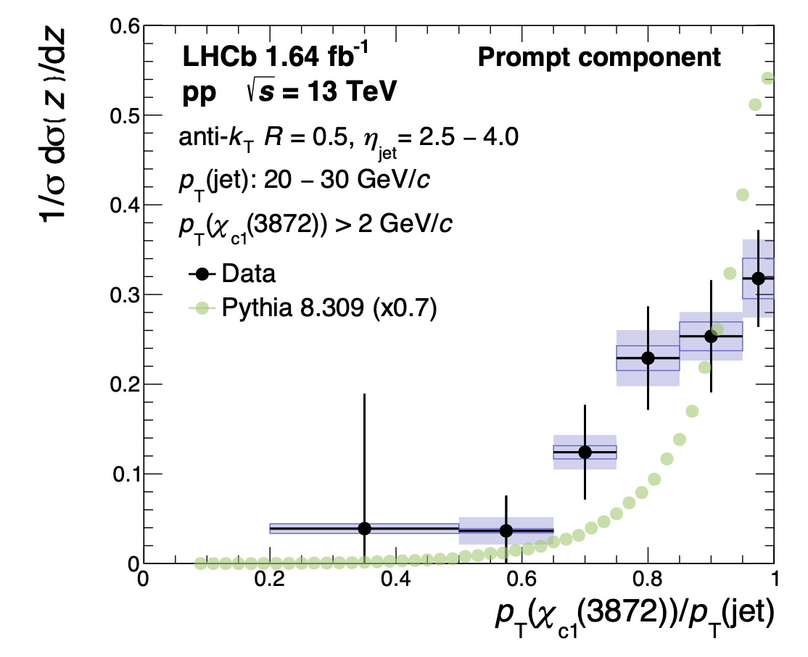

$ψ(2S)$ and $χ_{c1}(3872)$
Naomi: First measurement of $ψ(2S)$ and $χ_{c1}(3872)$ production within fully reconstructed jets
[Eur . Phys. J. C 85 (2025) 562]
Distributions are not described by hard process Pythia 8 predictions - Luckily Naomi is also a Pythia author!
We published papers

Slide 6
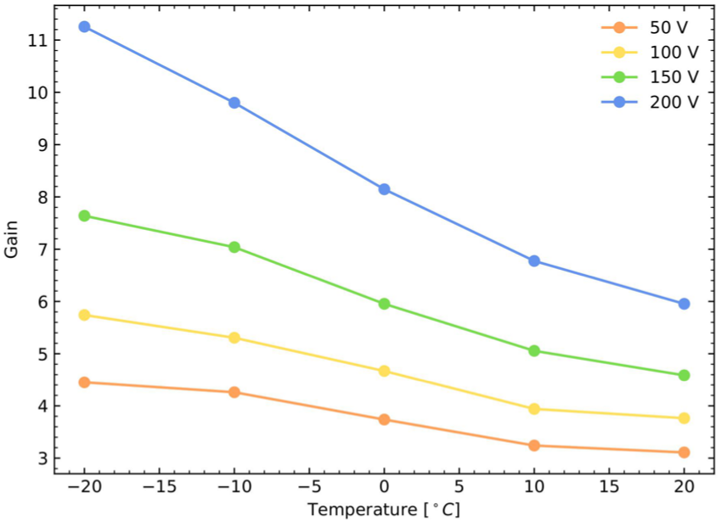

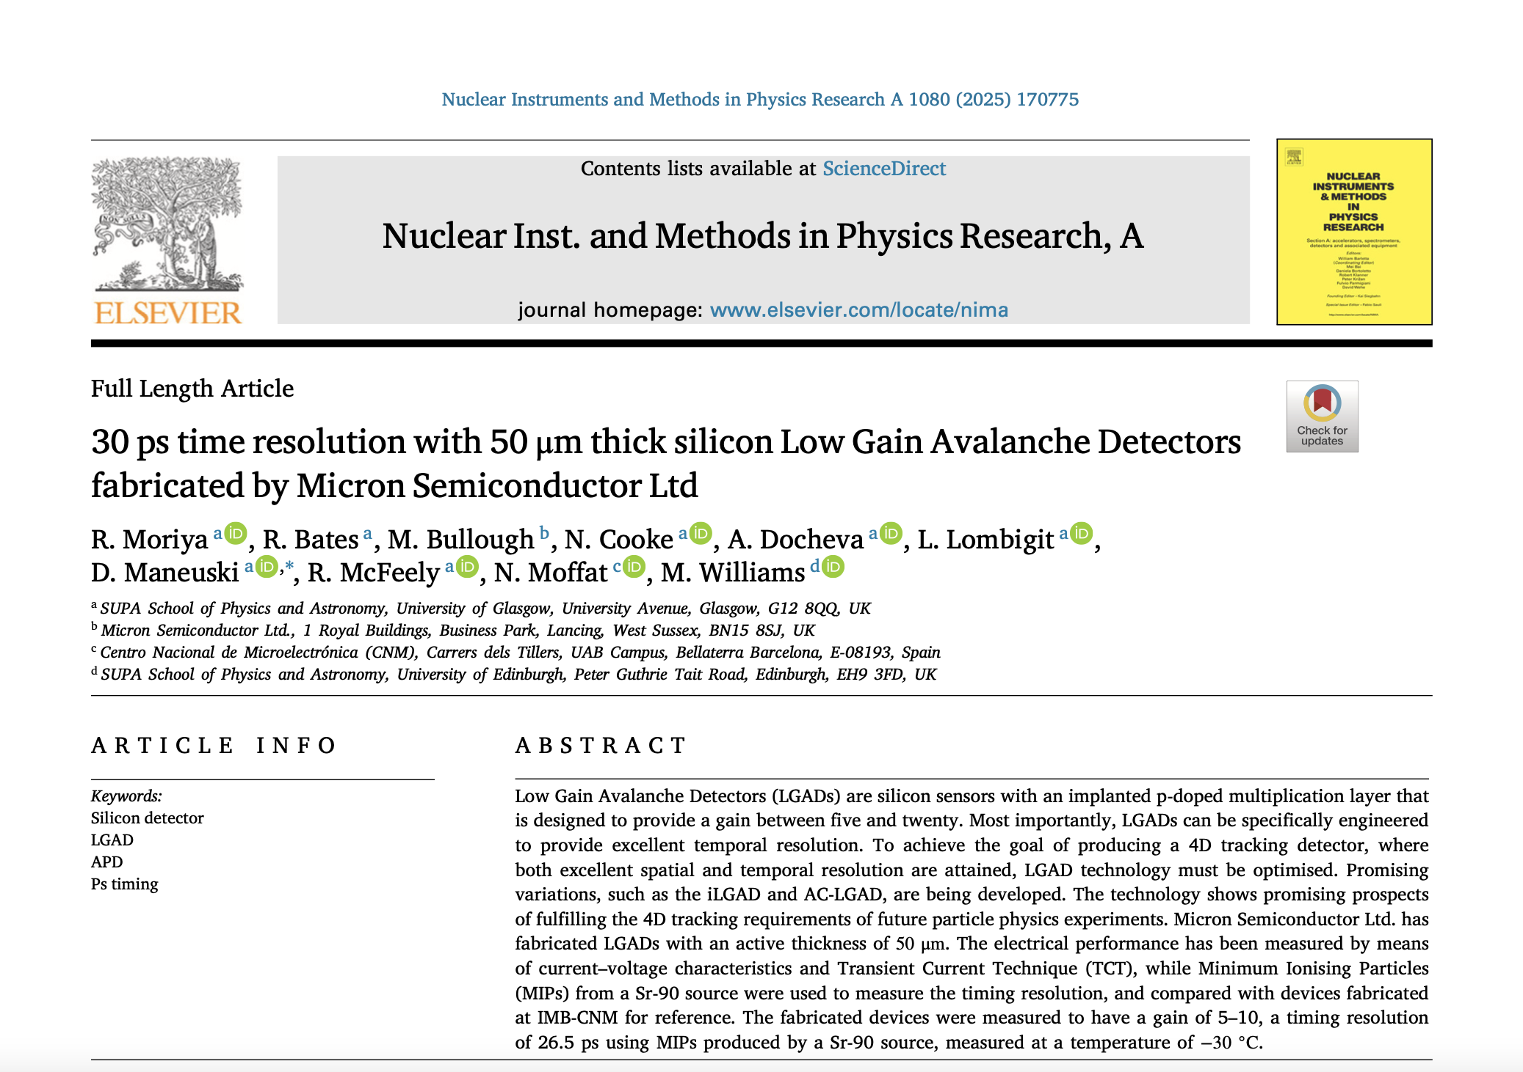
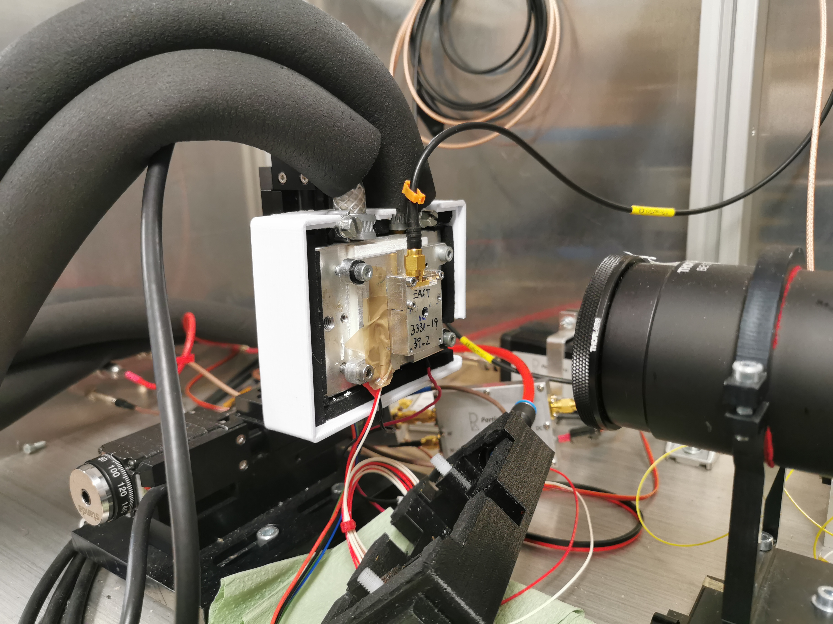

Sensor characterisation
Dima, Richard, Rory, Naomi, Aleks et al: sensor R&D (wrapping up for Timing Velo…)
Characterisation of 50$μm$ LGAD devices
https://doi.org/10.1016/j.nima.2025.170775
We published long-awaited papers

Slide 7
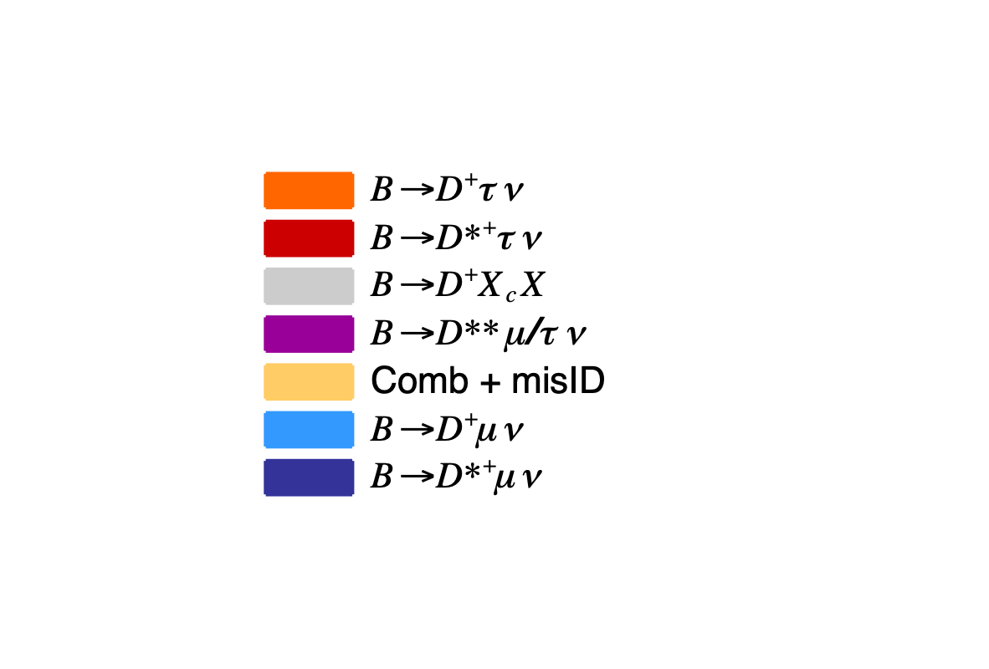
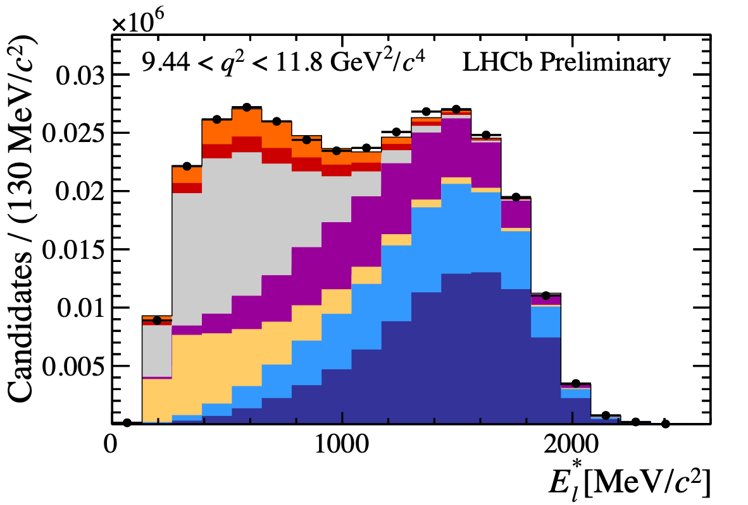
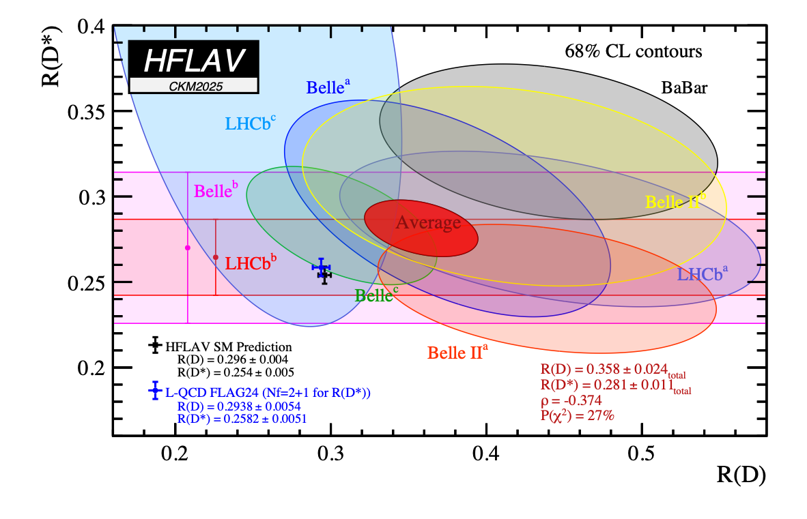

Lepton Flavour Universality
Phys. Rev. Lett. 134 (2025) 061801
First LHCb $R(D^{(*)+})$ measurement using the $D^{+}$ ground state, with $D^{+}→K^{-}π^{+}π^{+}$, muonic-tau decay
$$R(D^{(*)+})=\frac{B(B→D^{(*)+}τν)}{B(B→D^{(*)+}μν)}$$
Fit to kinematic variables to separate signal from normalisation and (copious) backgrounds
$$R(D^{+})=0.240±0.043(stat)±0.047(syst)$$
$$R(D^{*+})=0.402±0.081(stat)±0.085(syst)$$
$$ρ=-0.39$$
We published long-awaited papers

Slide 8
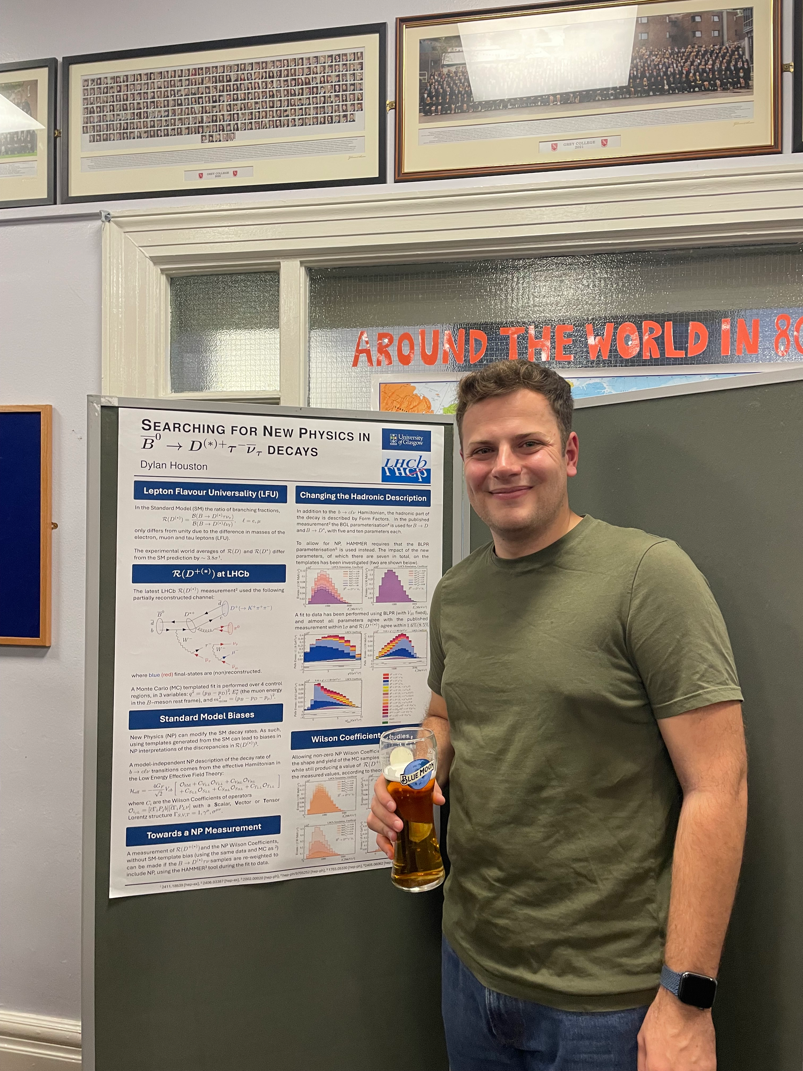

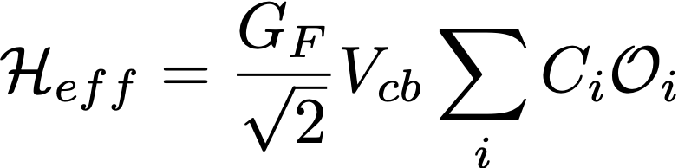
Lepton Flavour Universality
Wilson coefficients
Effective operators
HAMMER tool (F. Bernlochner, et. al., Eur. Phys. J. C 80, 883 (2020) ) to re-weight MC events and obtain “dynamic” templates, (for-)folding in the experimental resolution
Extract Wilson Coefficients and hadronic Form Factor parameters from a fit to data (JINST 17 T04006)
We searched for NP (still looking)

Slide 9
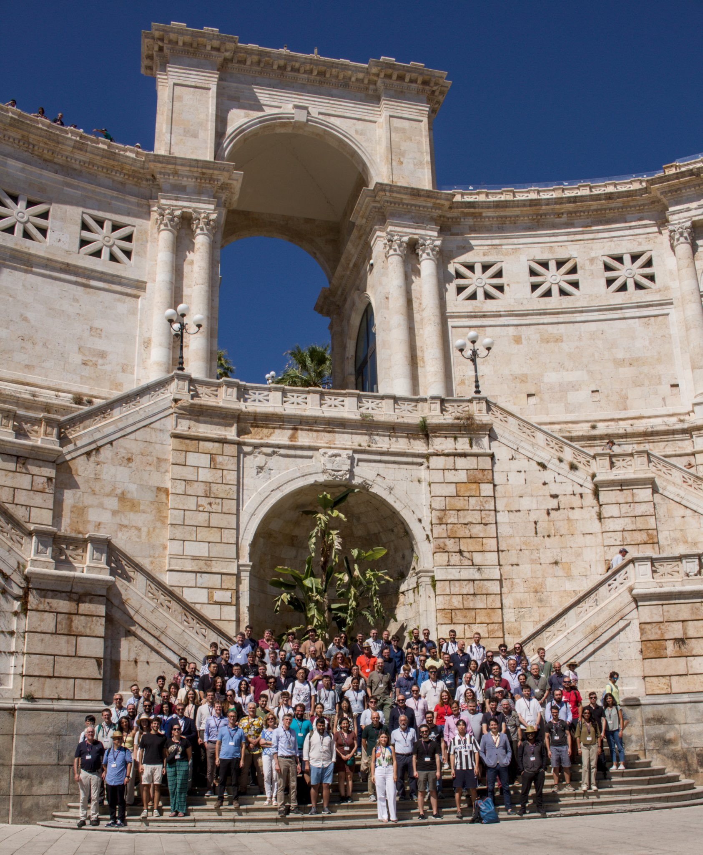
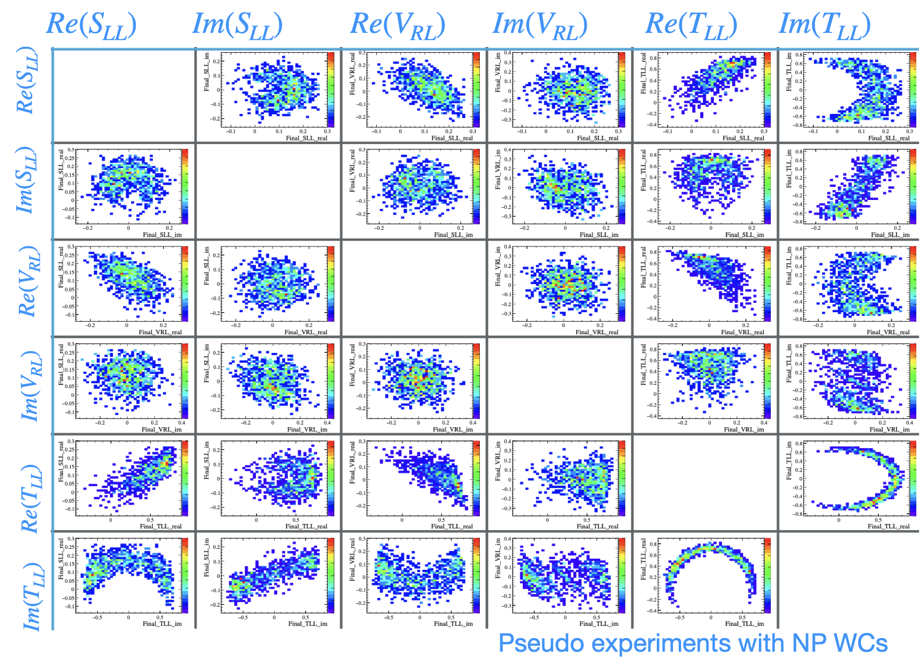
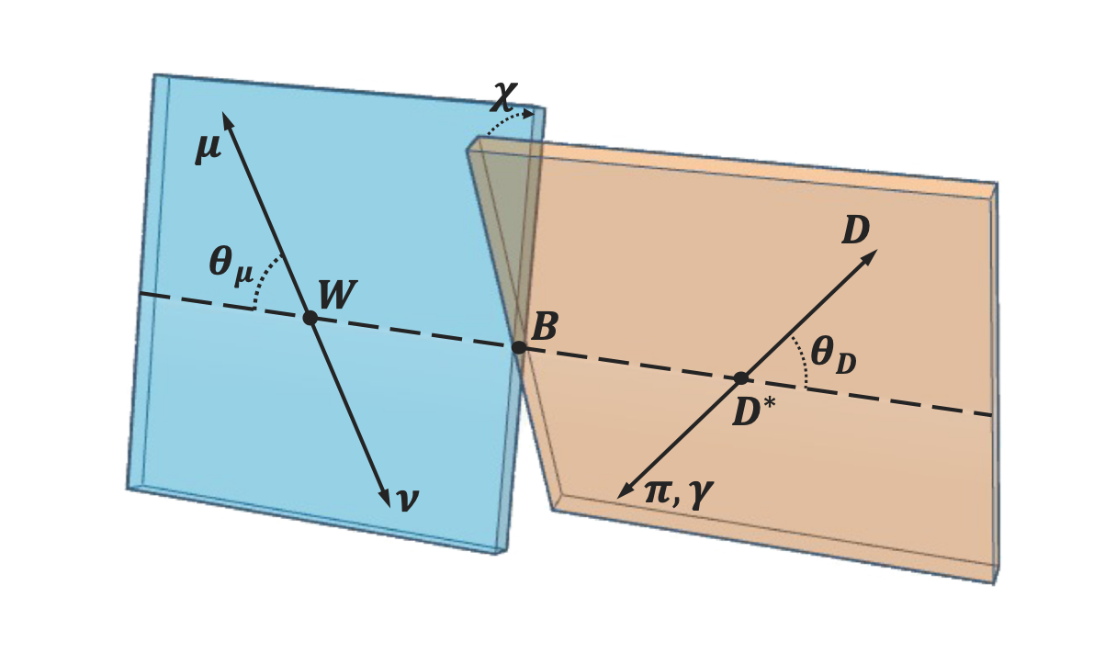

Differential decay rate
Spot Hasret @CKM2025
$$B^{0}→D^{*+}μ^{+}ν_{μ}$$
We searched for NP (still looking)

Slide 10
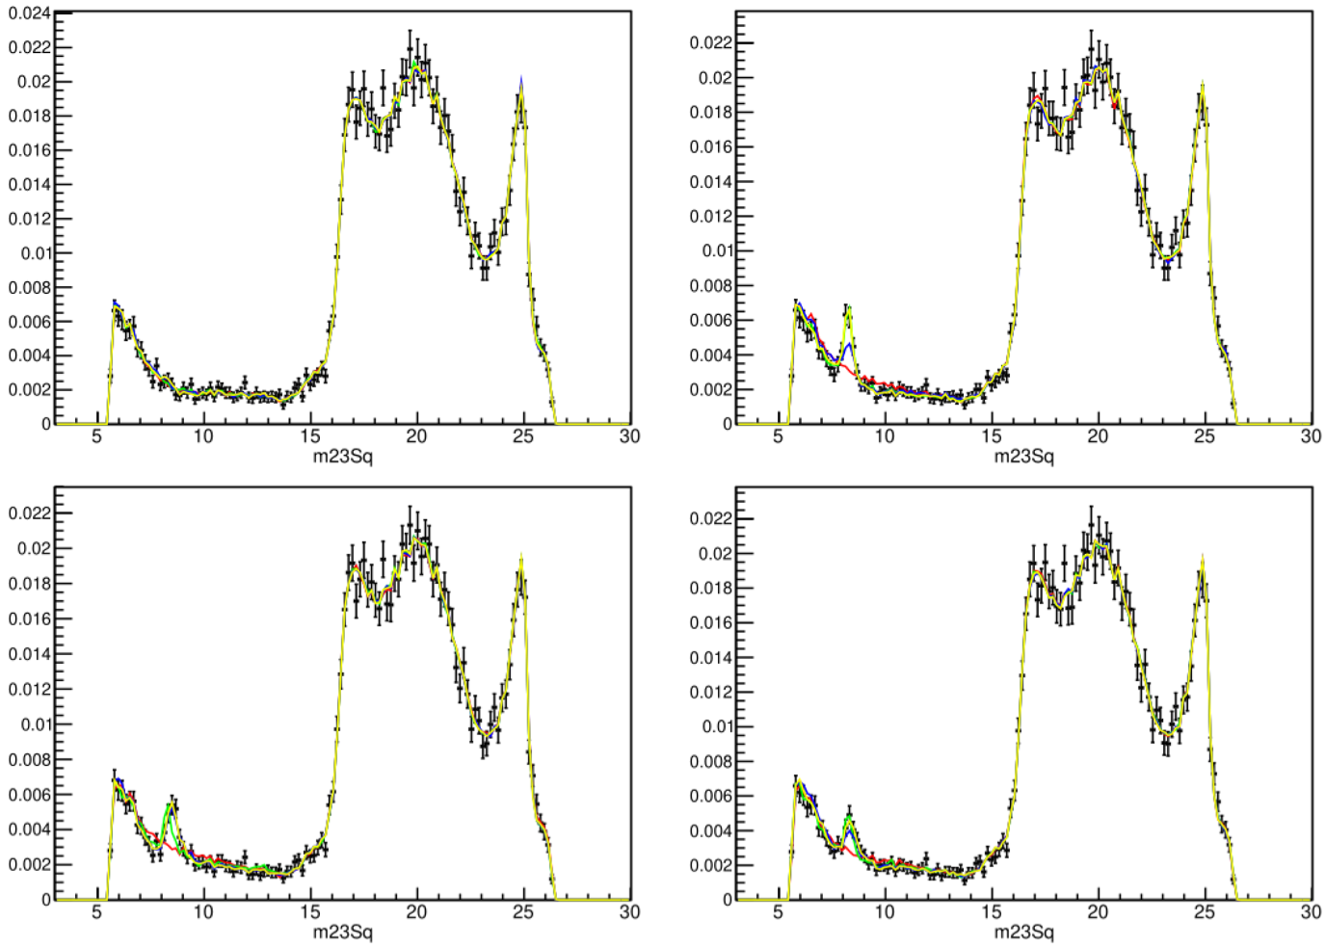





Spectroscopy
Toys of different unblinding scenarios… have we been naughty or nice?
$$B^{+}→D^{-}K^{+}π^{+}$$
$$q{\overline{q}}^{′}$$
$$q{\overline{q}}^{′}$$
$$q$$
$$q$$
$$\overline{q}$$
$$q$$
Plots by Will & Aleksandrina
$$q$$
$$q{\overline{q}}^{′}$$
$$qq^{′}q^{′′}$$
$$\overline{q}$$
$$q$$
$$q$$
$$\overline{q}$$
And for Tetraquarks

Slide 11
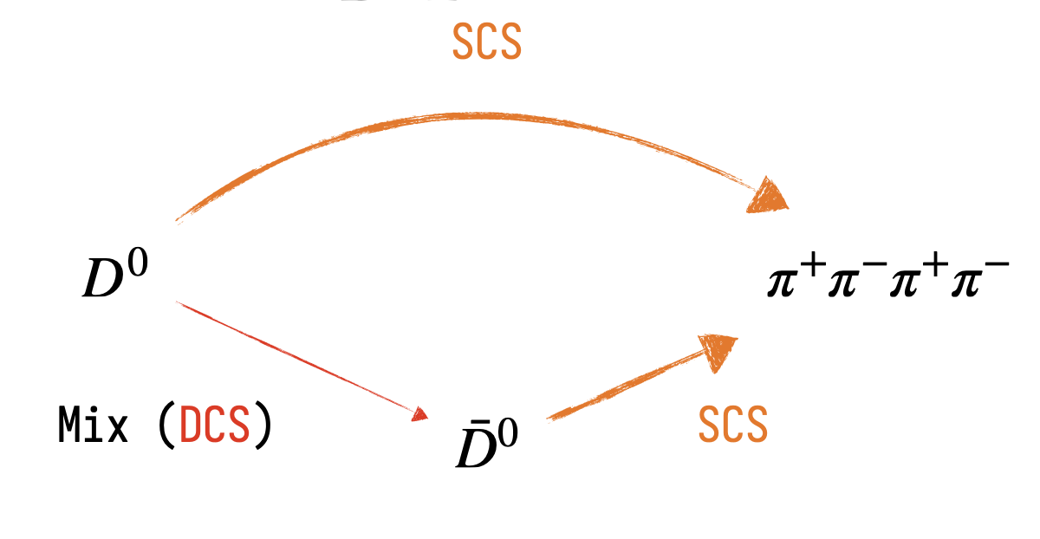
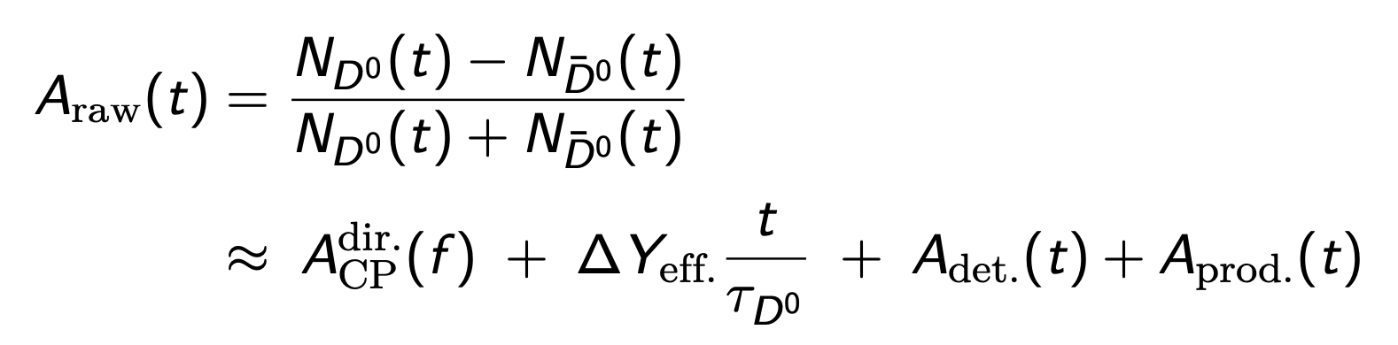
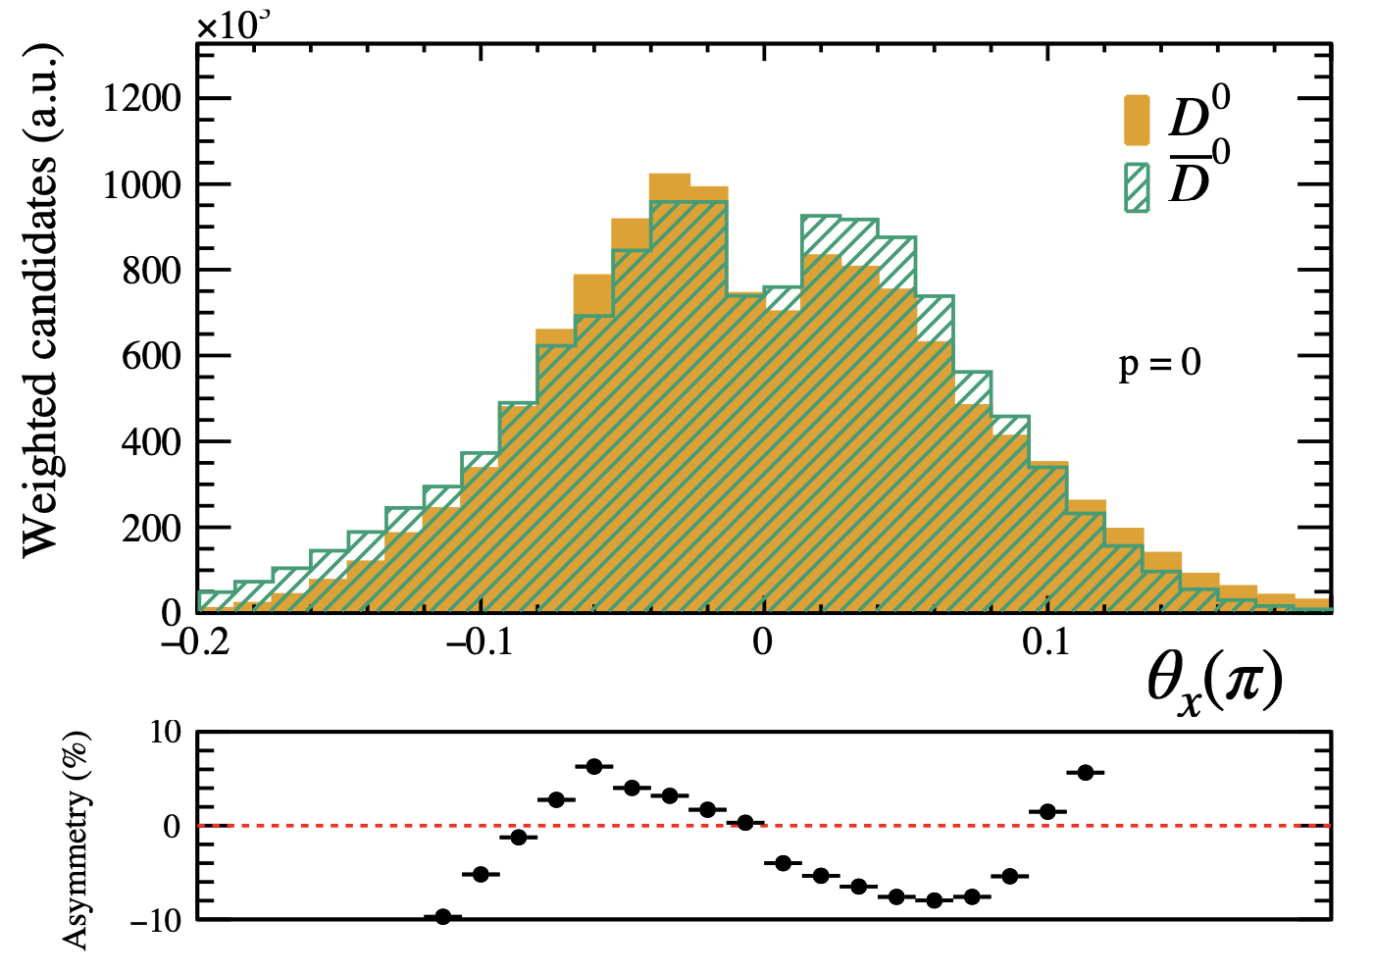
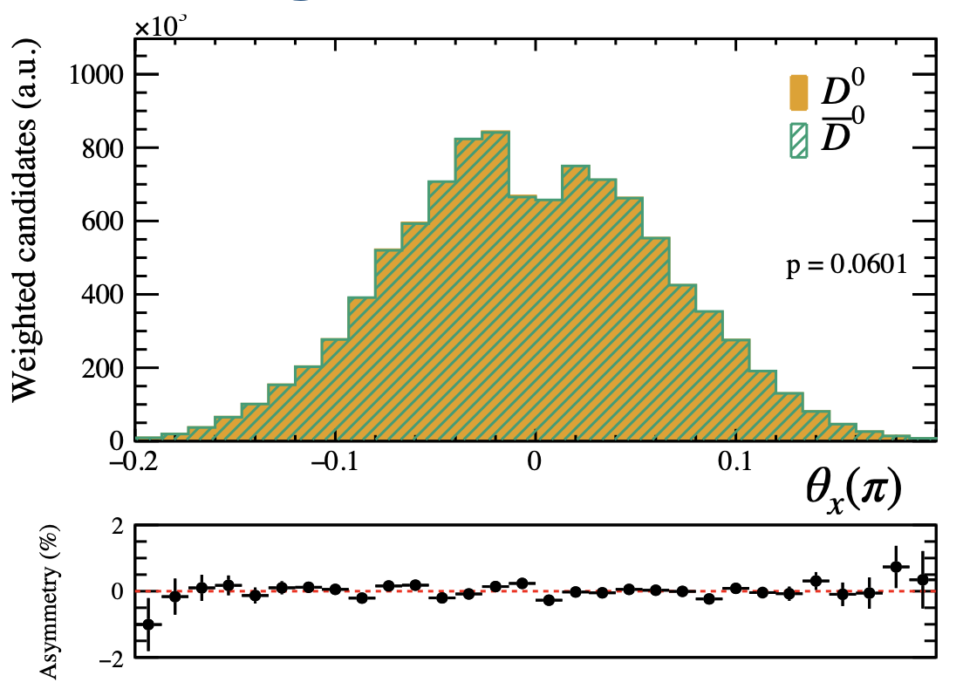
Charm
Niall, Paul, Patrick, Michael, Lauren, Lars: Time-dependent CP violation in multi-body charm decays
Weights to correct nuisance asymmetries
And for CP-Violation

Slide 12
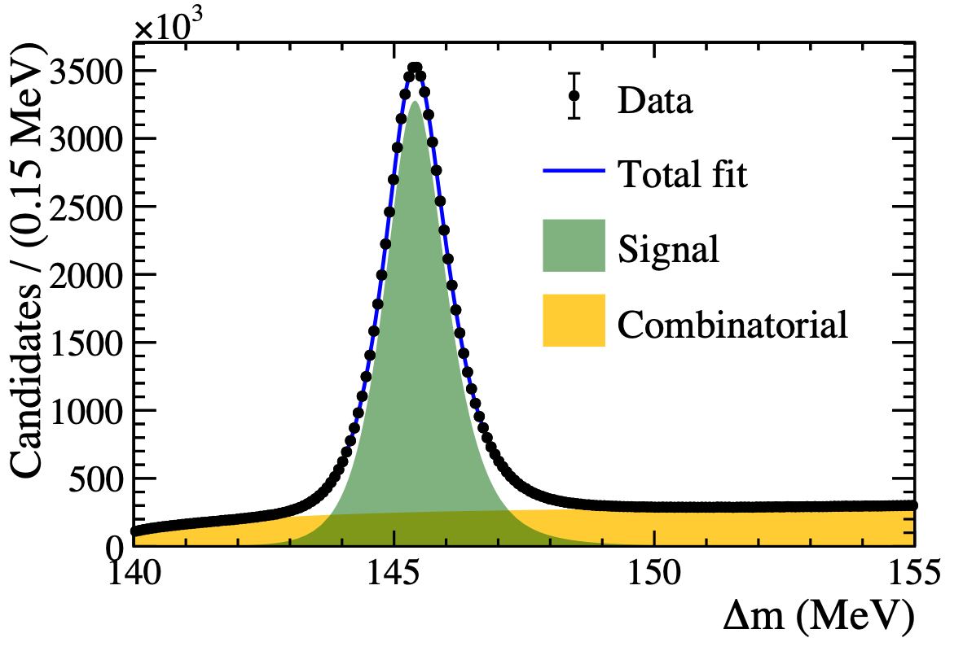
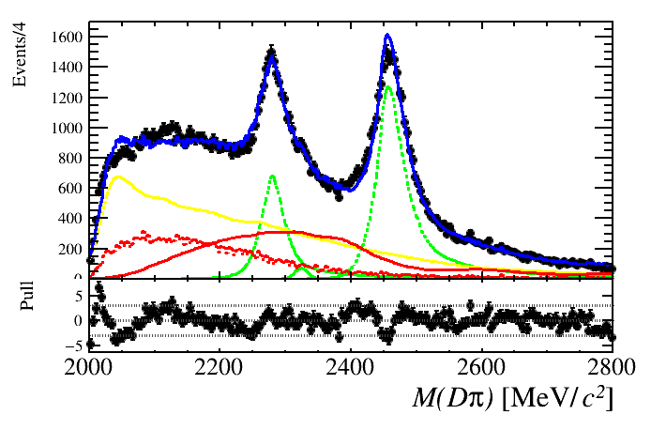
Run 3
Finally get to use Run 3 data!
$$D^{0}→π^{+}π^{-}π^{+}π^{-}$$
$$B^{0}→D^{+}π^{-}μ^{+}ν_{μ}$$
Plot by Gary & Daniel Evans
Plot by Niall
O(60M) 2024 signal candidates
Yield/lumi increased by ~3x: great charm triggers!
Student project measuring $B→D^{**}μν$ backgrounds for $R(D^{*})$
We explored Run 3 datasets

Slide 13
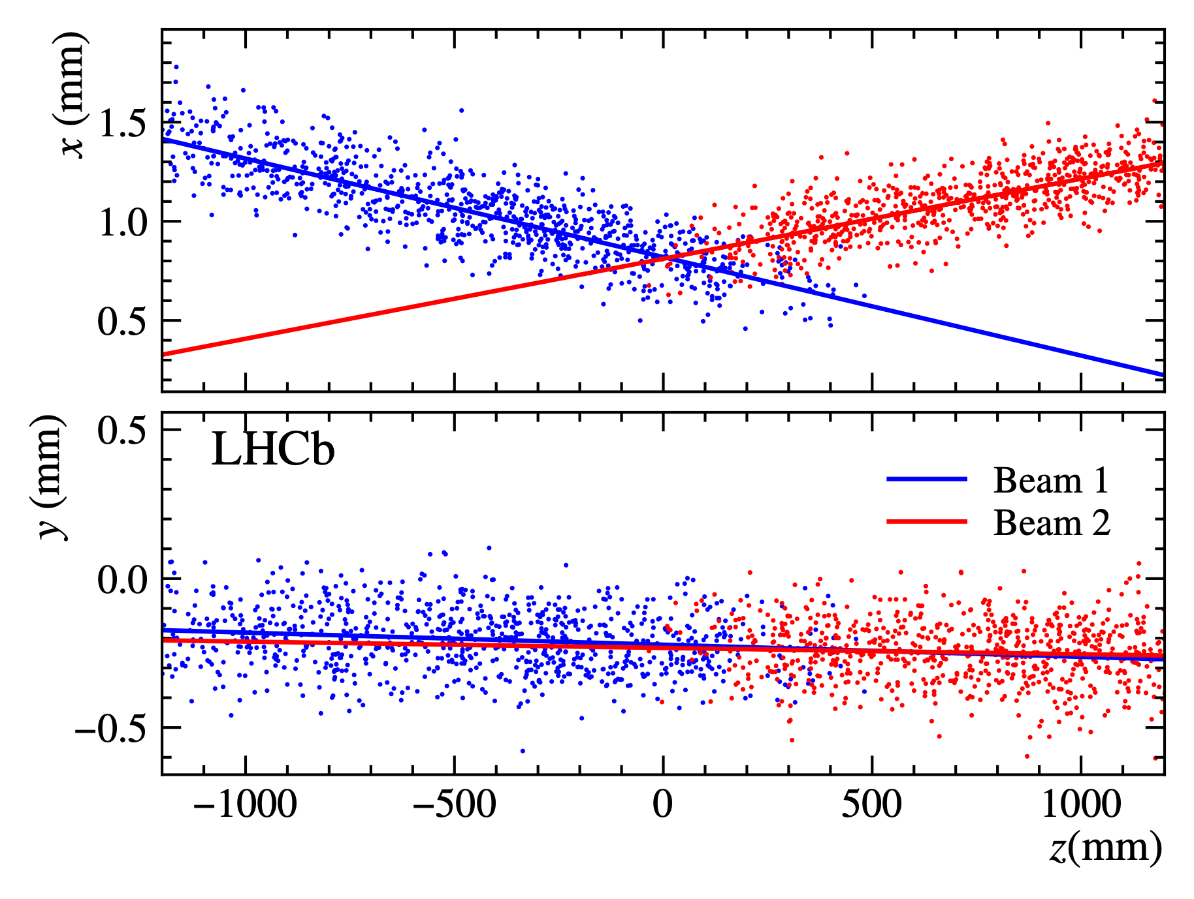
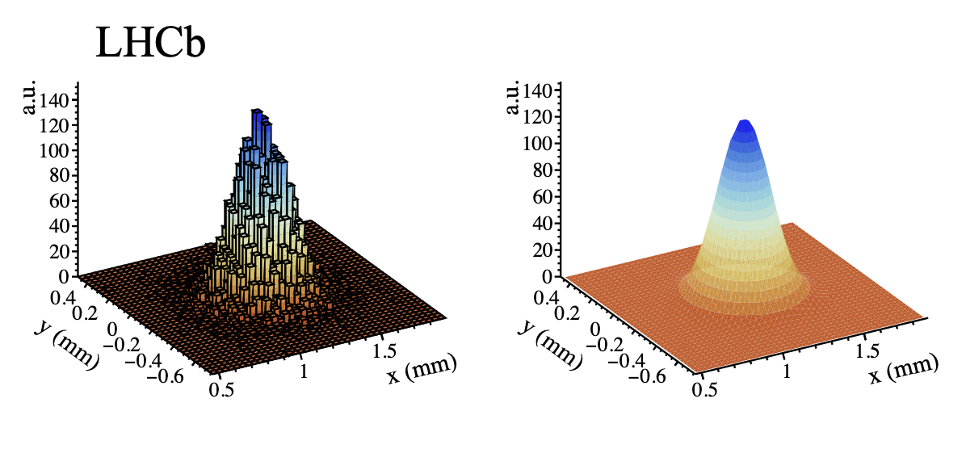
Luminosity
Niall, Patrick, Paul: absolute luminosity calibration
Beam-Gas Imaging (BGI): Direct imaging of beam profiles from beam-gas interactions: exploiting Vertex resolution and SMOG
$$L=nN_{1}N_{2}K∫ρ_{1}(\overset{⃗}{x},t)ρ_{2}(\overset{⃗}{x},t)d\overset{⃗}{x}dt$$
Example fit of the transverse bunch profile
Patrick
Niall
Excellent precision achieved with BGI in Run 2 - paper ready
Paul
We got bright results,

Slide 14
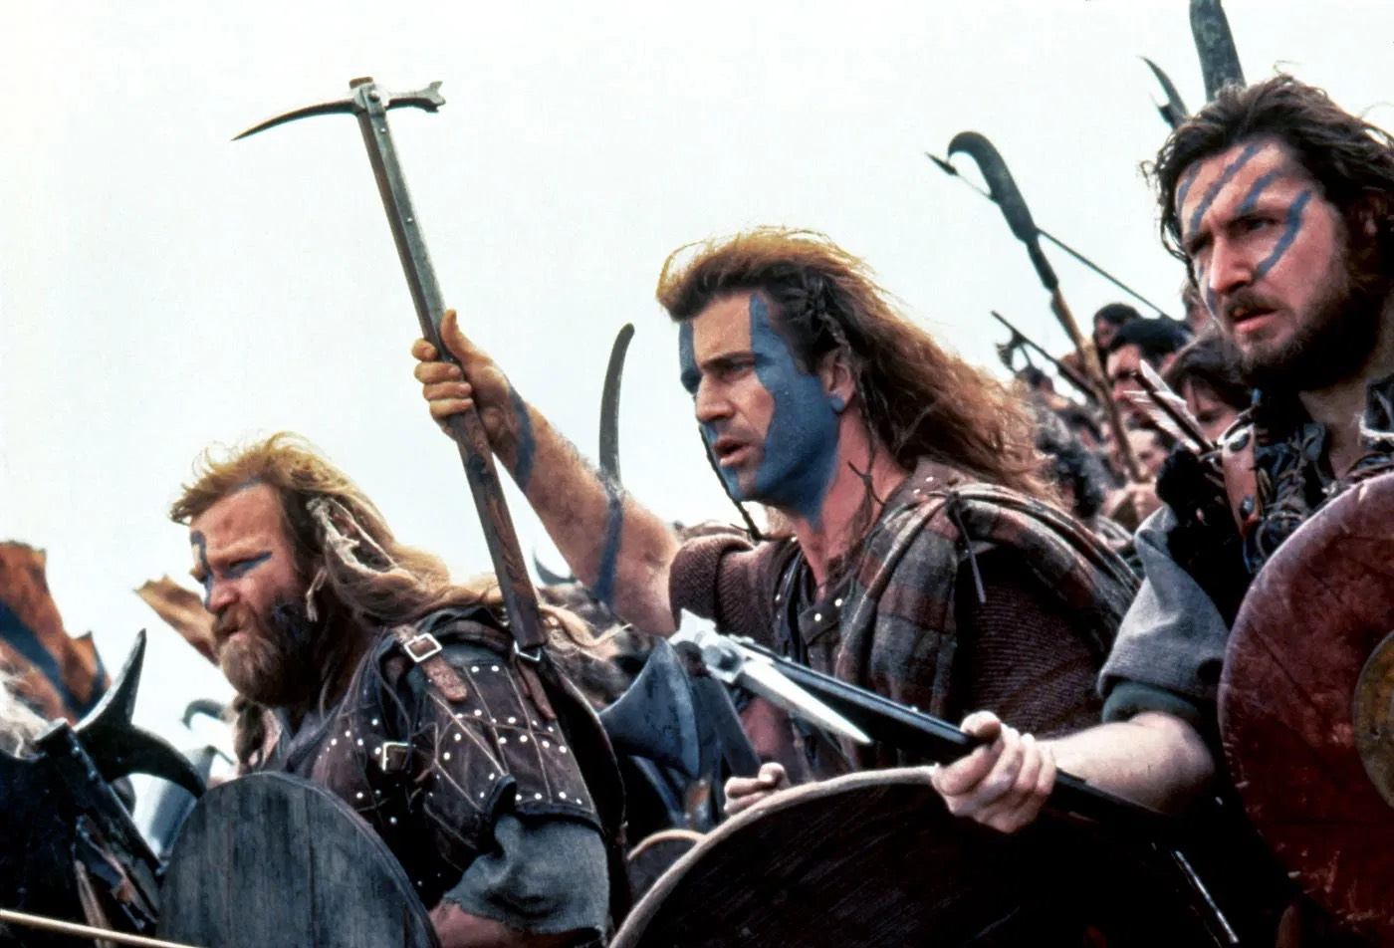
Luminosity
Patrick
Niall
Paul
We fought hard for them

Slide 15
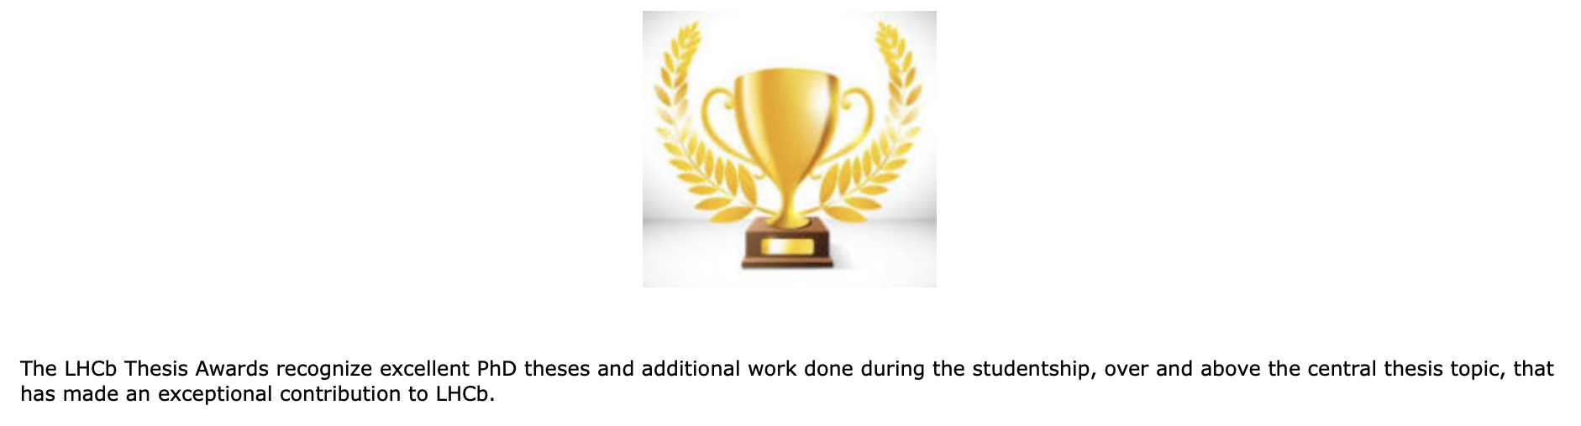

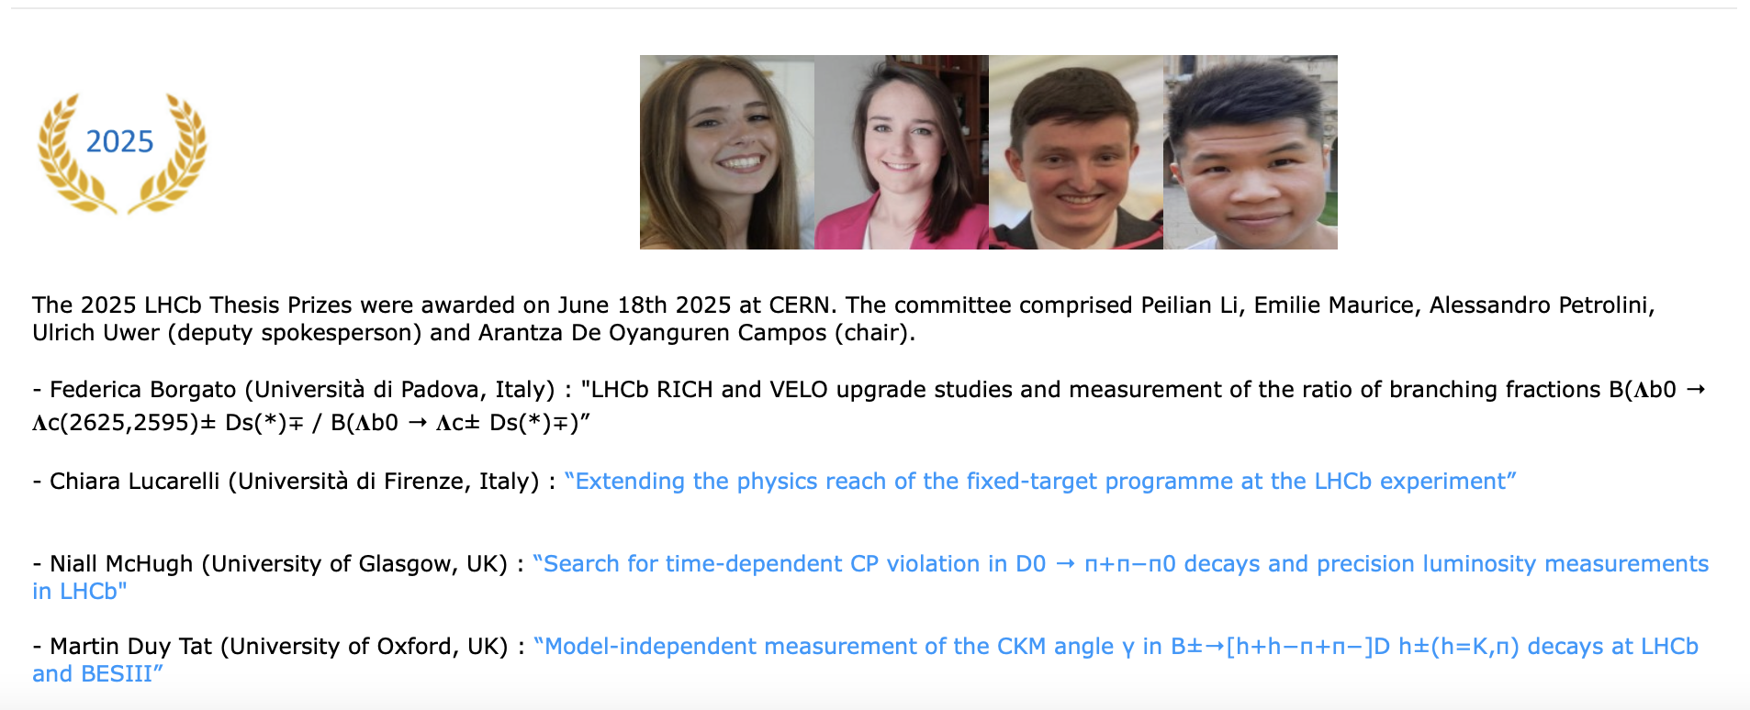
Prizes
Niall
Patrick
Paul
We (Niall) won!

Slide 16
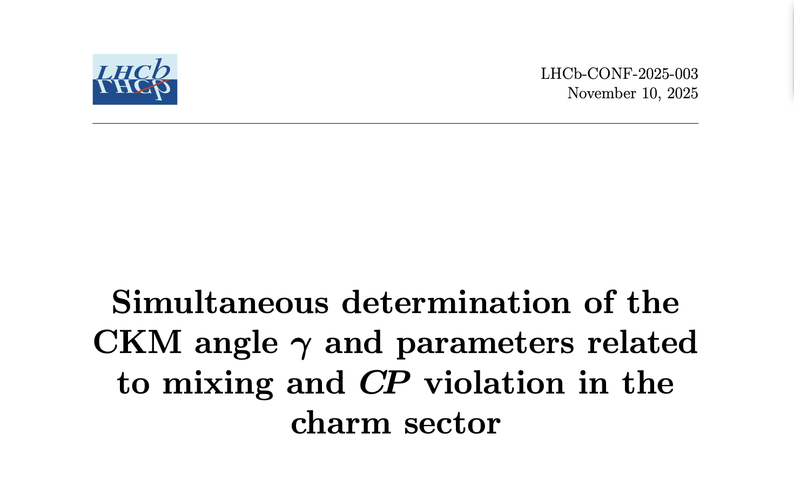
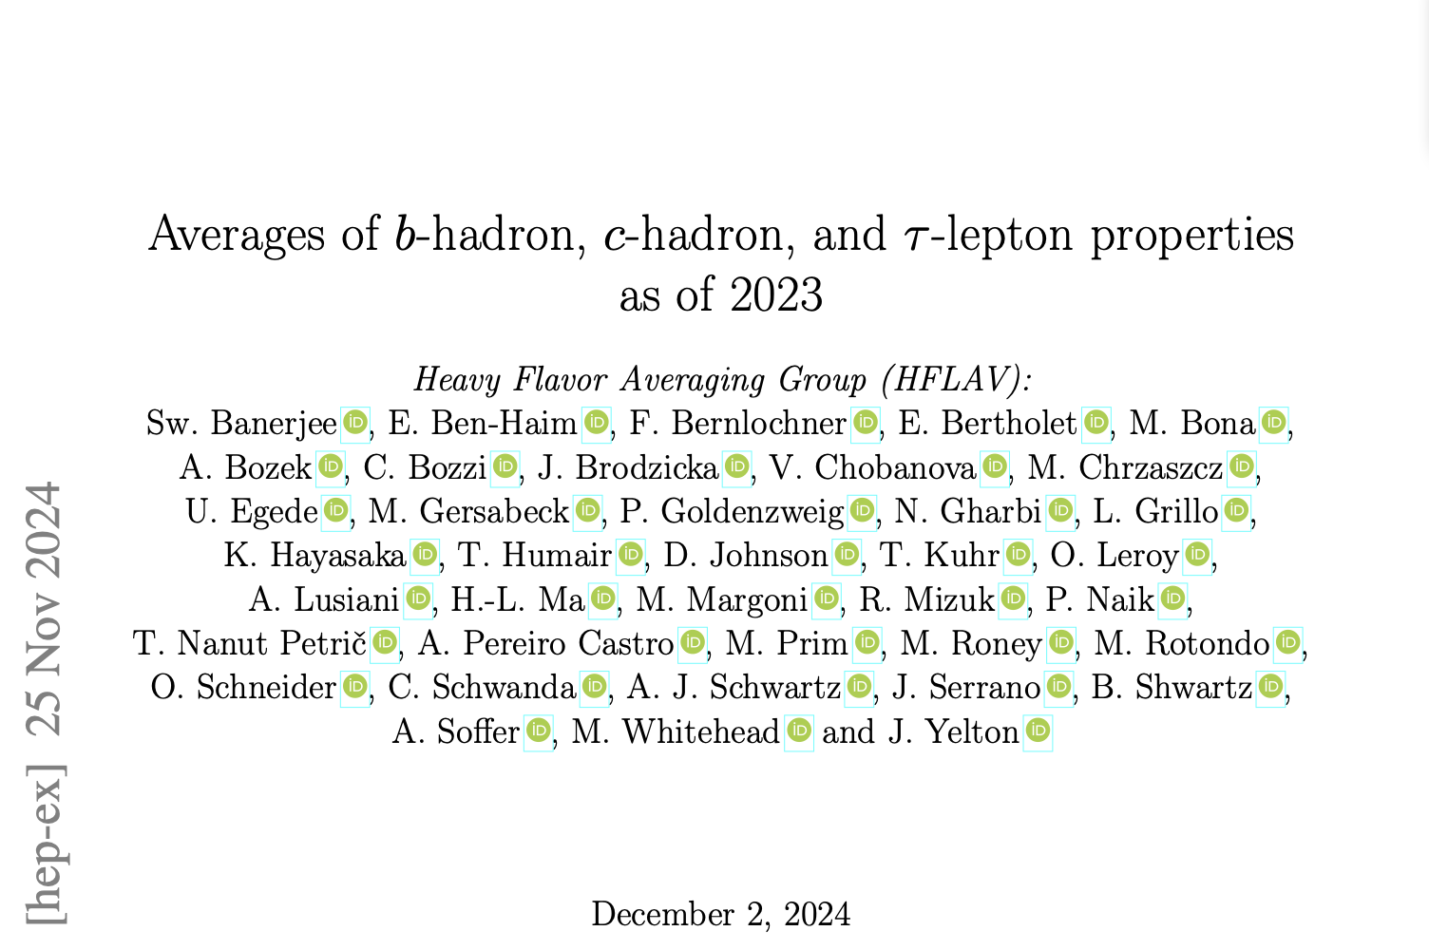
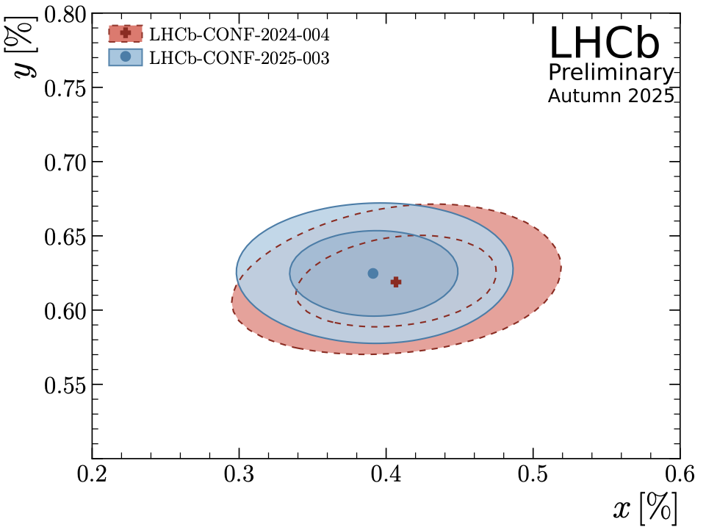
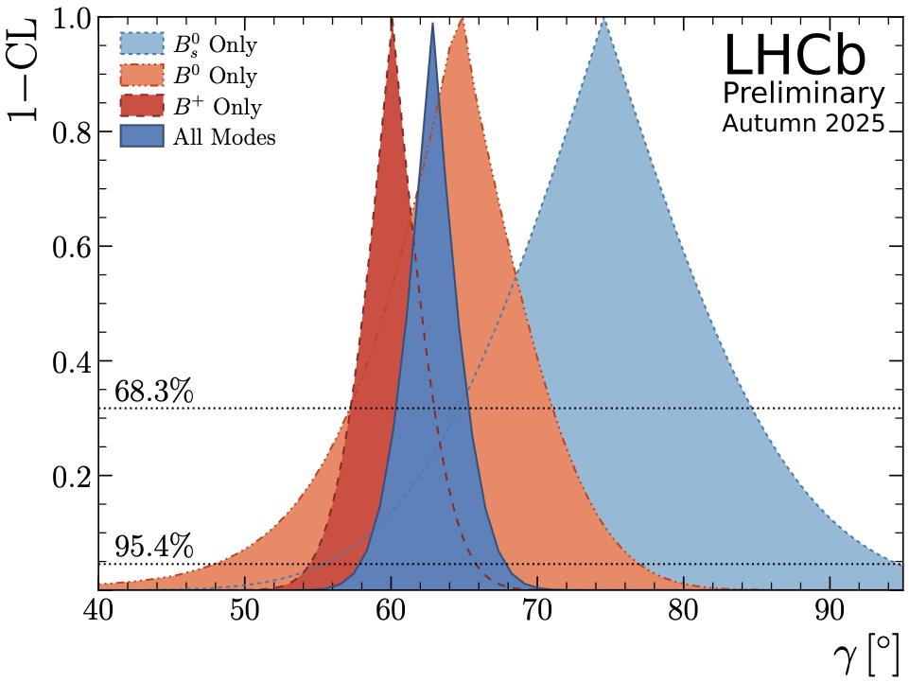
Combinations
Hot-off-the-press: LHCb’s new $γ$ combination! (Mark)
HFLAV report officially in the long-awaited list…
$$γ=(62.8±2.6)^{∘}$$
https://arxiv.org/pdf/2411.18639
We also excelled at being average

Slide 17


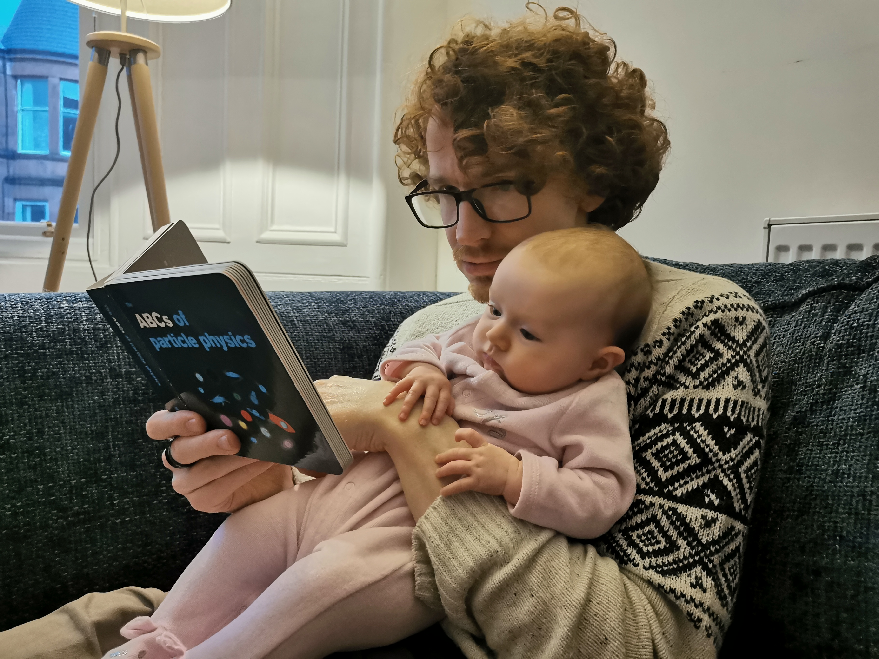
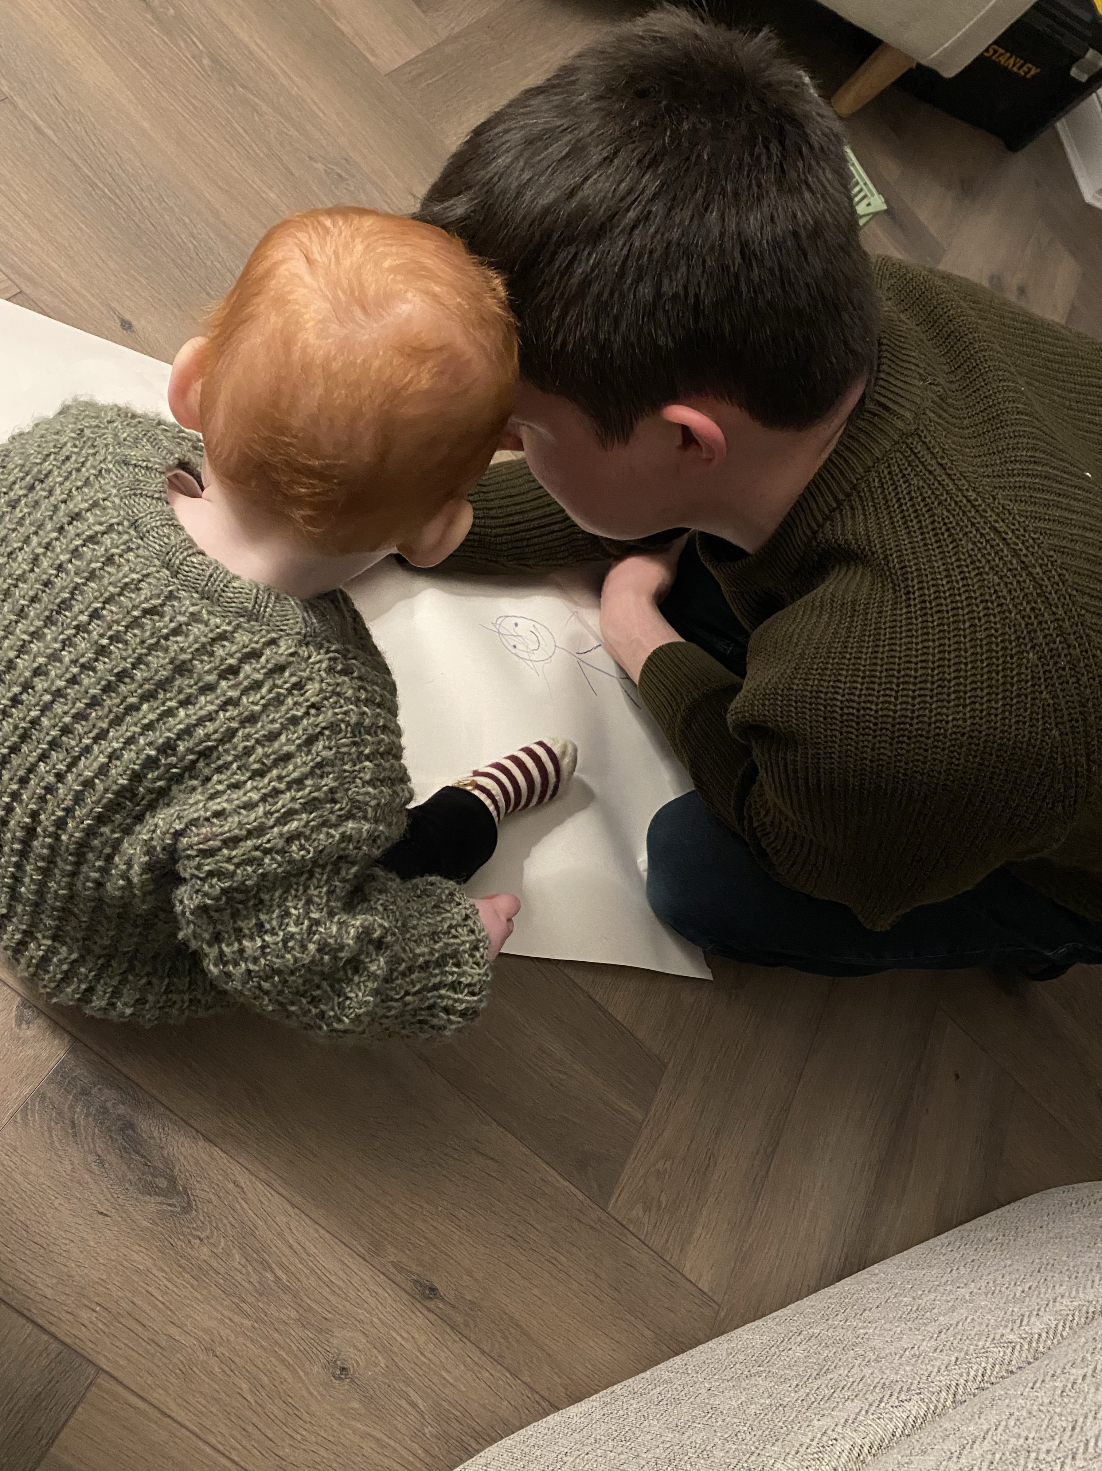
Teaching & learning
ExCos
Problem solving workshop
SUPA C++ course
Projects
Supervisions
Dynamical Astronomy
PGCAP
P2 Labs
SUPA flavour course
We did our best to improve our teaching

Slide 18
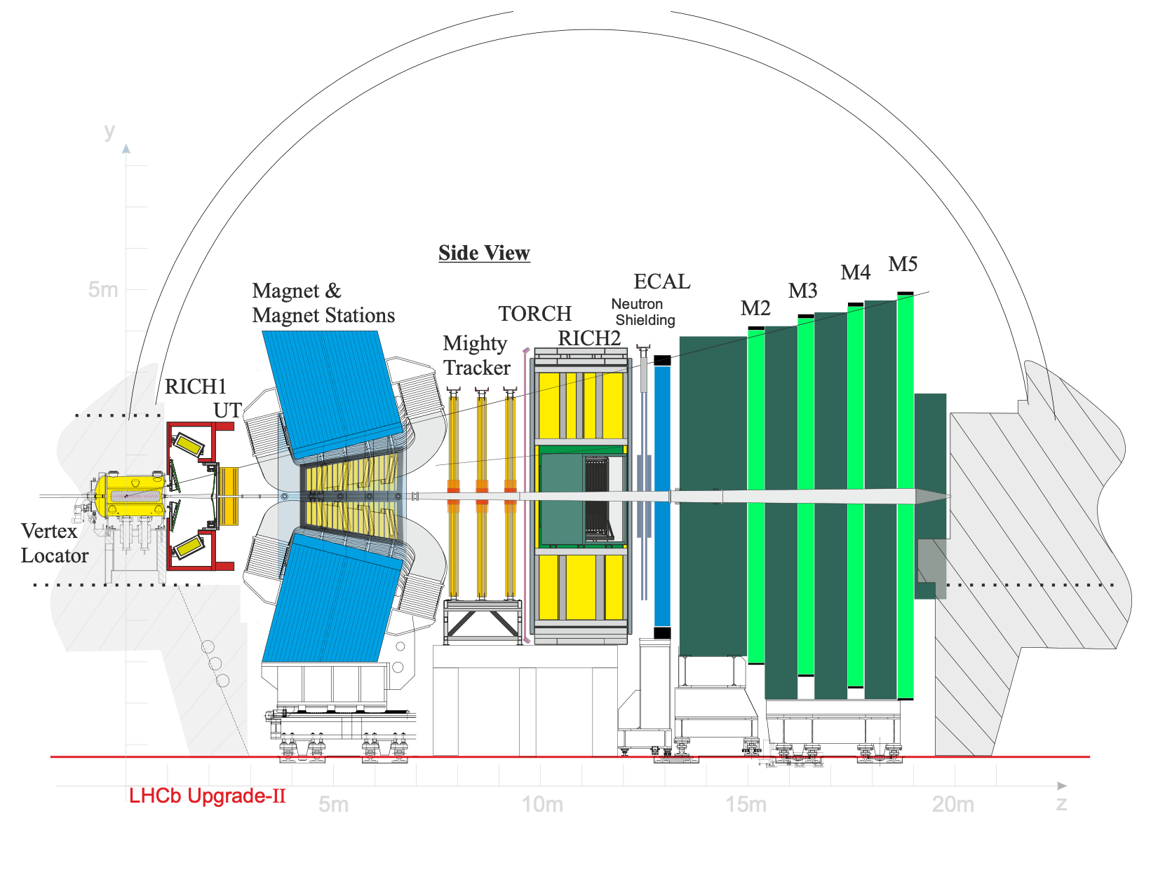
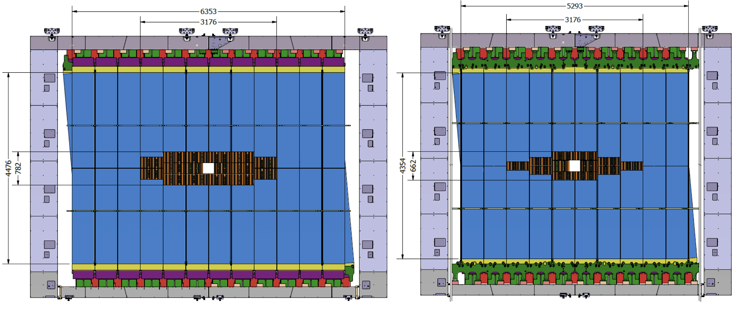

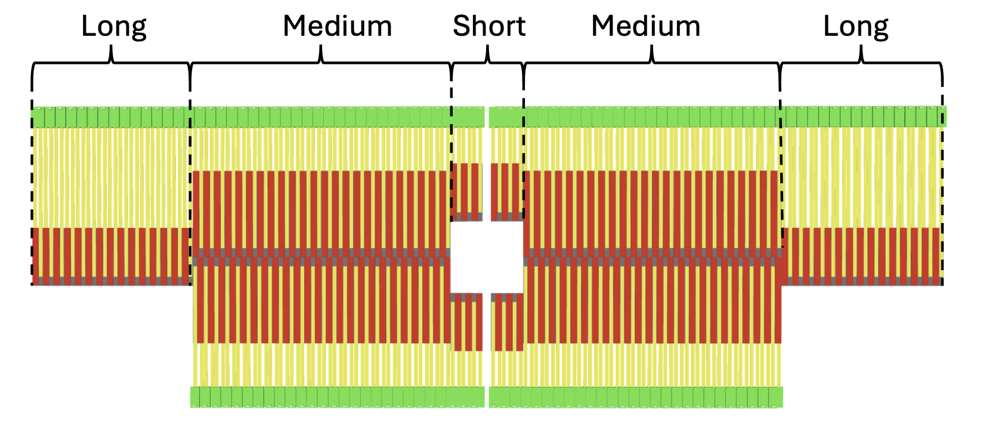
Upgrade II
Sneha: HDI design & production
Haythem: QC system for HDI, RadPix, DAQ
Dima & Richard: wafer probing
We got serious about our future

Slide 19

Upgrade II
ONE DOES NOT SIMPLY
SIMULATE LHCb UPGRADE II
Gary: Mighty Tracker geometry
Hasret, Manuel: A first digitisation chain, track reconstruction study
Niall: Upgrade II pile-up and spill-over
We got serious about our future

Slide 20
This year
We had a great year! But, to keep up with all of this

Slide 21
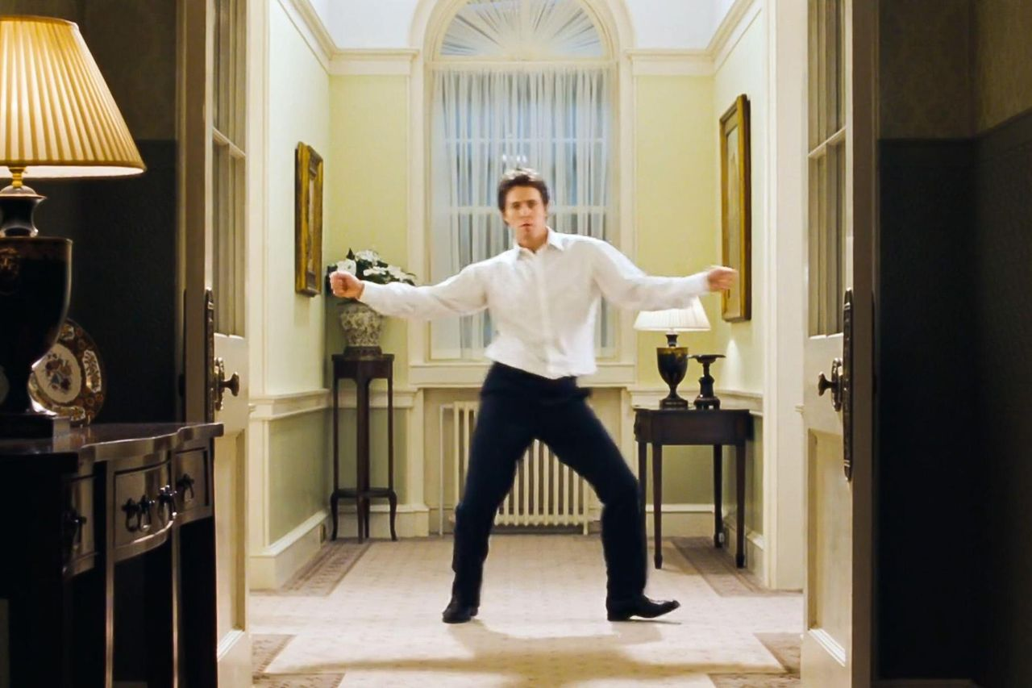
This year
We could really use a Huge Grant

Slide 22

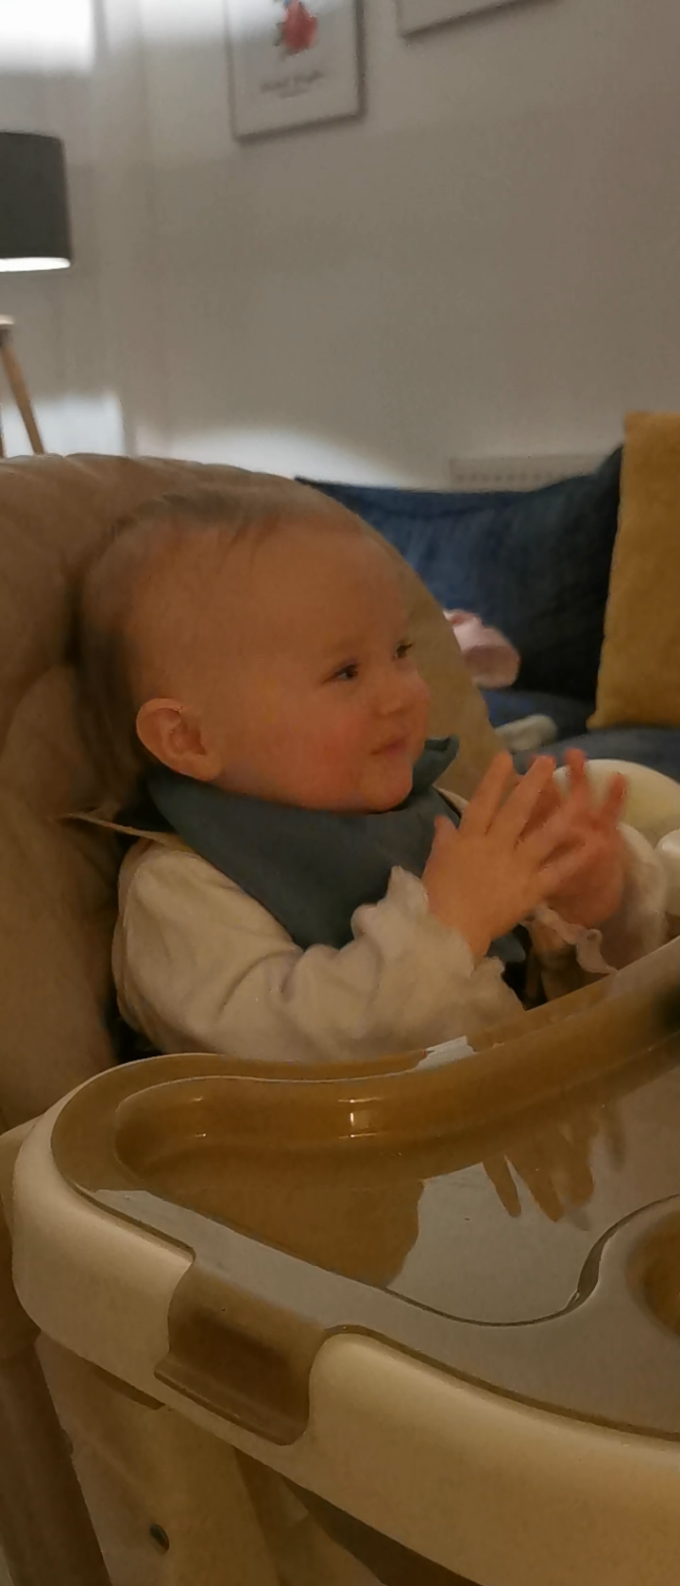
Well done everyone!
Thank you for this year !
Merry Christmas and have great holidays !

