Slide 1

Fine-tuning in inflation:
effects, constraints, and case studies
Wenqi Ke
University of Minnesota
Based on:
2504.12283,
2510.15137,
2603.02389
SI 2026

Slide 2
Two related topics:
I – Inflation is fine-tuned
How much fine-tuning is allowed?
II – Inflation gets radiative corrections
What’s the constraint on the couplings?

Slide 3
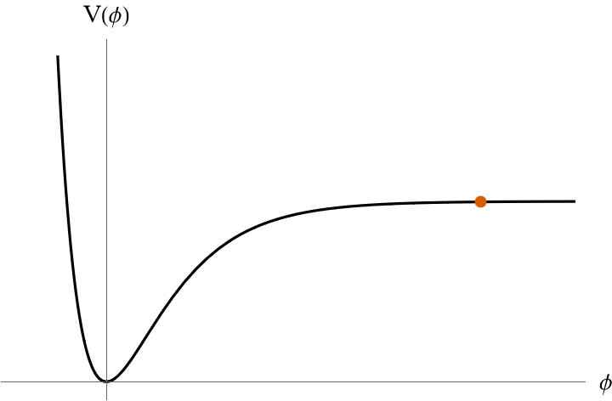

Single-field inflation
e.g. Starobinsky potential
Slow-roll inflation
Universe expands
$$a∼e^{Ht}$$
Reheating
Inflaton oscillations
+ Particle production

Slide 4
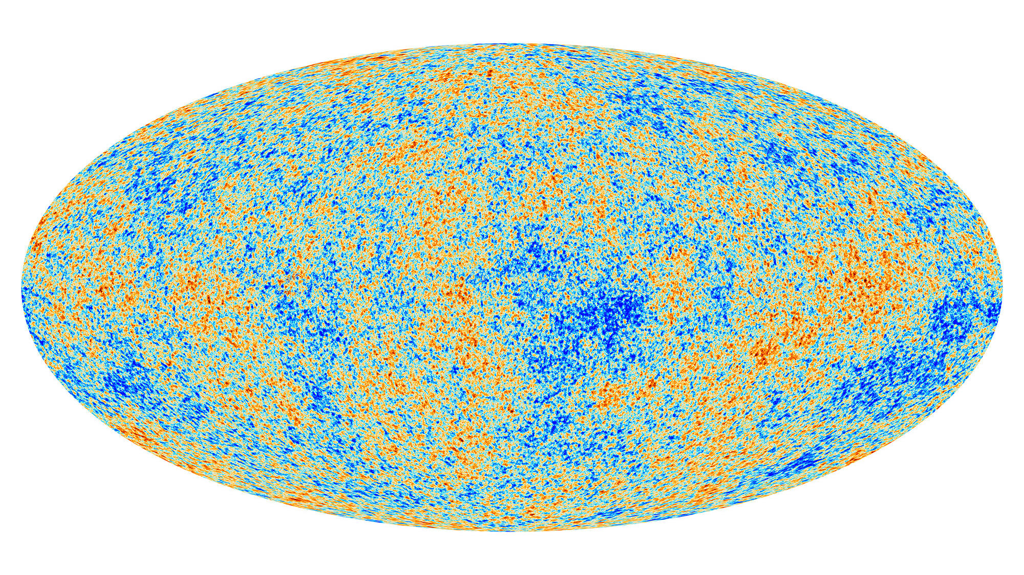
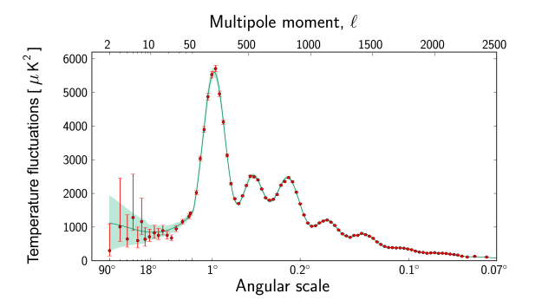
Single-field inflation
Inflation is testable
e.g. Starobinsky potential
Slow-roll inflation
Universe expands
$$a∼e^{Ht}$$
Reheating
Inflaton oscillations
+ Particle production

Slide 5
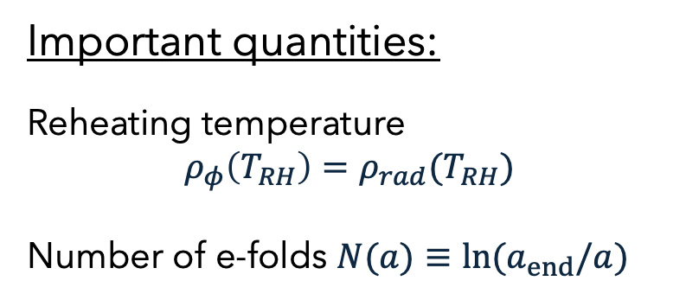





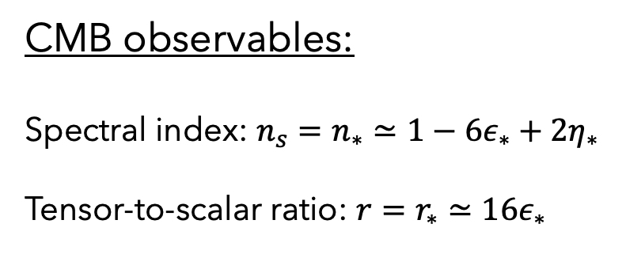



Single-field inflation
CMB observables:
Spectral index: $n_{s}=n_{∗}≃1−6ε_{∗}+2η_{∗}$
Tensor-to-scalar ratio: $r=r_{∗}≃16ε_{∗}$
e.g. Starobinsky potential
at the pivot scale
Slow-roll inflation
Important quantities:
Reheating temperature
$$ρ_{φ}\left(T_{RH}\right)=ρ_{rad}(T_{RH})$$
Number of e-folds $N(a)≡ln⁡(a_{end}/a)$
Universe expands
$$a∼e^{Ht}$$
Reheating
Inflaton oscillations
+ Particle production

Slide 6
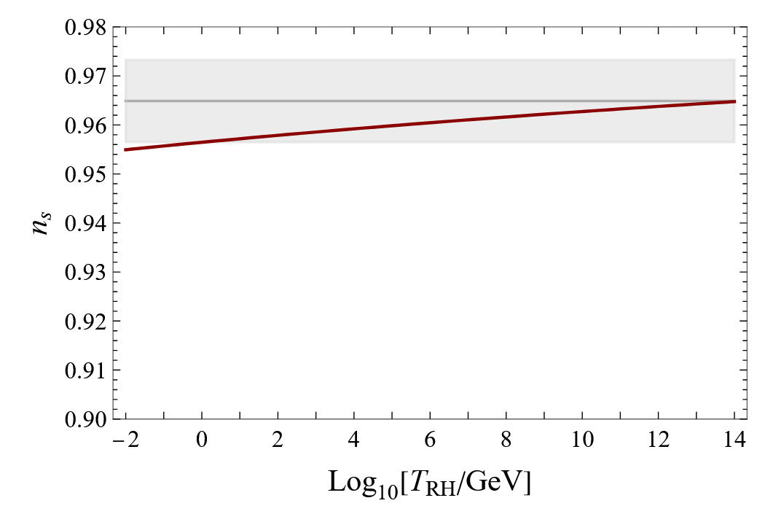
Single-field inflation
So far very successful
e.g. Starobinsky potential
Slow-roll inflation
Planck 2018
Universe expands
$$a∼e^{Ht}$$
Starobinsky
Reheating
Inflaton oscillations
+ Particle production

Slide 7
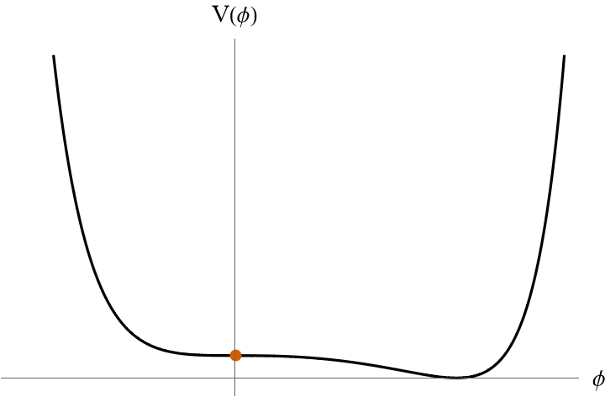
Inflation is fine-tuned, for example:
The potential has to be flat enough
The inflaton should sit at the right place initially
Linde, Westphal [0712.1610]

Slide 8
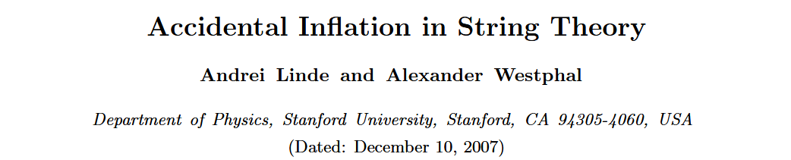
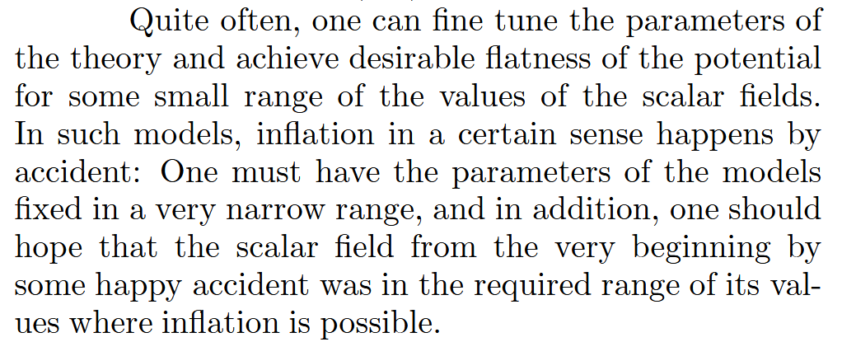
Inflation is fine-tuned, for example:
The potential has to be flat enough
The inflaton should sit at the right place initially
Linde, Westphal [0712.1610]

Slide 9
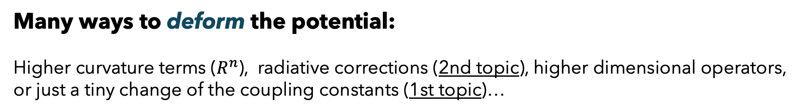
Inflation is fine-tuned, for example:
The potential has to be flat enough
The inflaton should sit at the right place initially
Linde, Westphal [0712.1610]
Many ways to deform the potential:
Higher curvature terms ($R^{n}$), radiative corrections (2nd topic), higher dimensional operators,
or just a tiny change of the coupling constants (1st topic)…

Slide 10

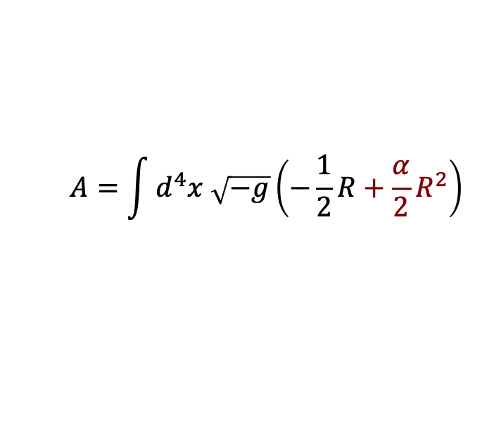
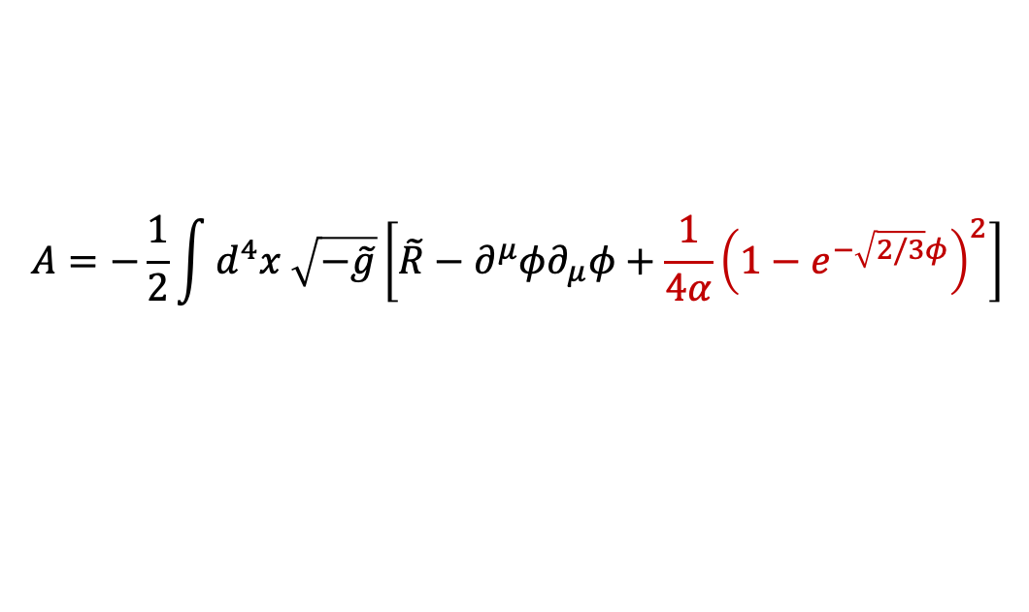
How much can the parameters vary?
Example: Starobinsky inflation
Two ways to get the potential:
Modified gravity
$$A=\int{d^{4}x \sqrt{−g}\left(−\frac{1}{2}R+\frac{α}{2}R^{2}\right)}$$
Starobinsky potential
$$A=−\frac{1}{2}\int{d^{4}x \sqrt{−\tilde{g}}\left[\tilde{R}−∂^{μ}{φ∂}_{μ}φ+\frac{1}{4α}{\left(1−e^{−\sqrt{2/3}φ}\right)}^{2}\right]}$$

Slide 11

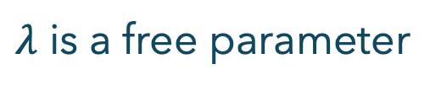
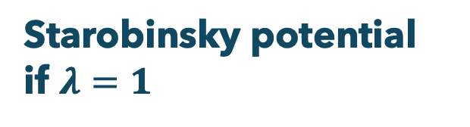

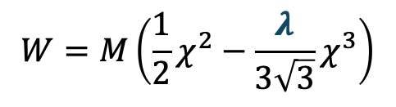

How much can the parameters vary?
Example: Starobinsky inflation
Two ways to get the potential:
Supergravity
Kähler potential
Superpotential
$$W=M\left(\frac{1}{2}χ^{2}−\frac{λ}{3\sqrt{3}}χ^{3}\right)$$
$$K=−3\ln{(T+T^{∗}−{\left|χ\right|}^{2}/3)}$$
$λ$ is a free parameter
Scalar potential:
$$V=e^{K}\left[g^{m\overline{n}}D_{m}WD_{\overline{n}}W^{∗}−3{\left|W\right|}^{2}\right]$$
Starobinsky potential
if $λ=1$

Slide 12
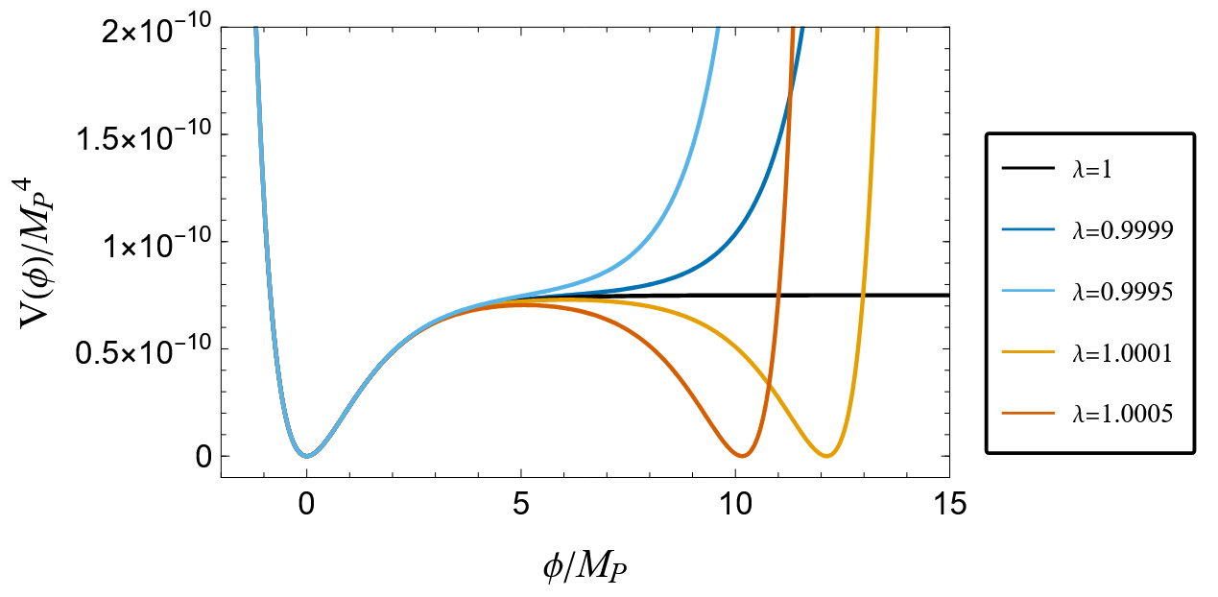


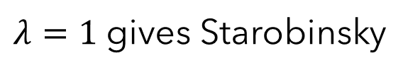
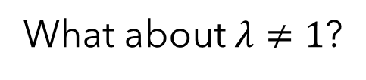
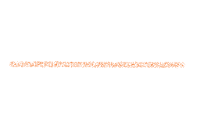
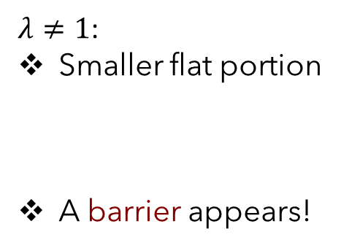

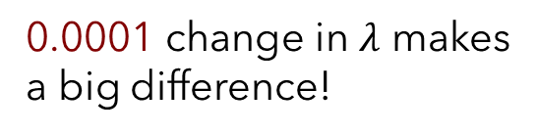

How much can the parameters vary?
$λ=1$ gives Starobinsky
What about $λ≠1$?
I. Antoniadis, J. Ellis, WK, D. Nanopoulos, K. Olive [2504.12283]
General scalar potential:
0.0001 change in $λ$ makes
a big difference!
$λ≠1$:
Smaller flat portion
A barrier appears!
Inflation may not be successful
Affects the initial condition

Slide 13





How much can the parameters vary?
$λ=1$ gives Starobinsky
What about $λ≠1$?
Compare with the experiments!
2018
Planck+BICEP/Keck:
$$n_{s}=0.9649±0.0084 (2σ)$$
0.0001 change in $λ$ makes
a big difference!
$$r<0.036$$
Last year
$λ≠1$:
Smaller flat portion
A barrier appears!
ACT DR6 (DESI+Planck):
$$n_{s}=0.9743±0.0068 (2σ)$$
Inflation may not be successful
Affects the initial condition

Slide 14
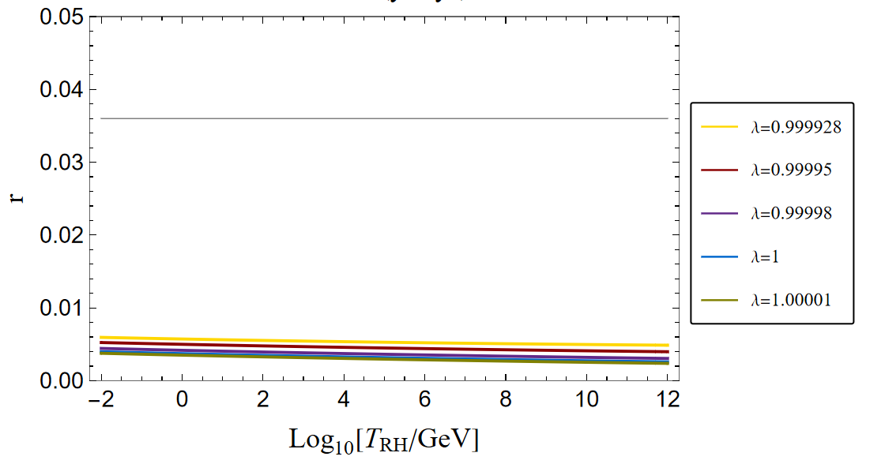
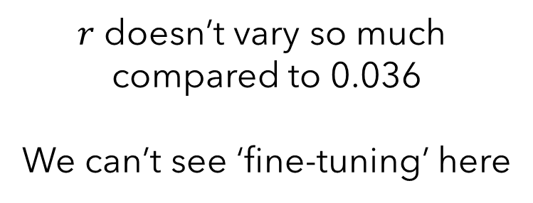

CMB observables for different $λ$
r=0.036
$r$ doesn’t vary so much
compared to 0.036
We can’t see ‘fine-tuning’ here

Slide 15

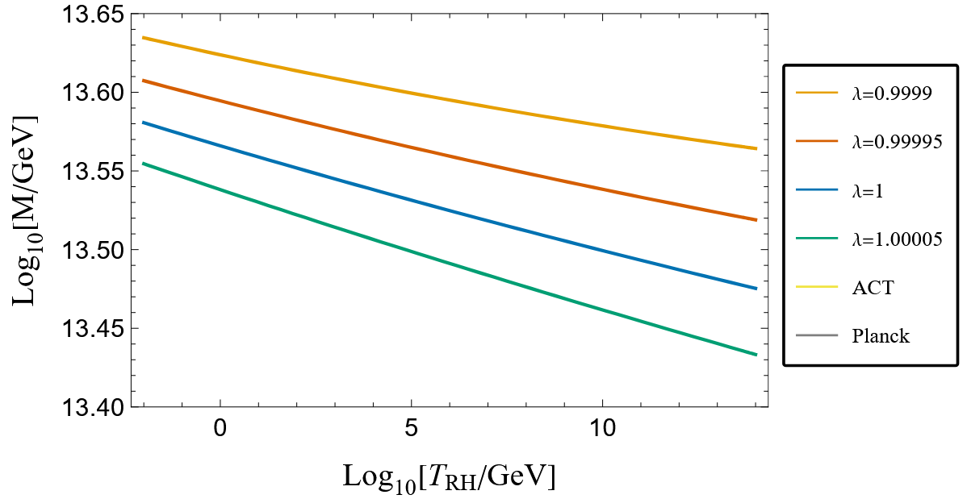
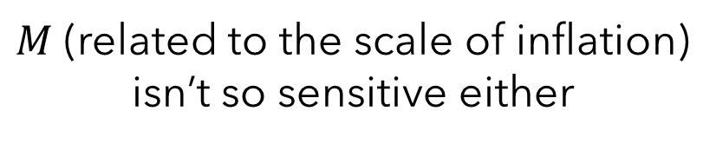
CMB observables for different $λ$
$M$ (related to the scale of inflation)
isn’t so sensitive either

Slide 16
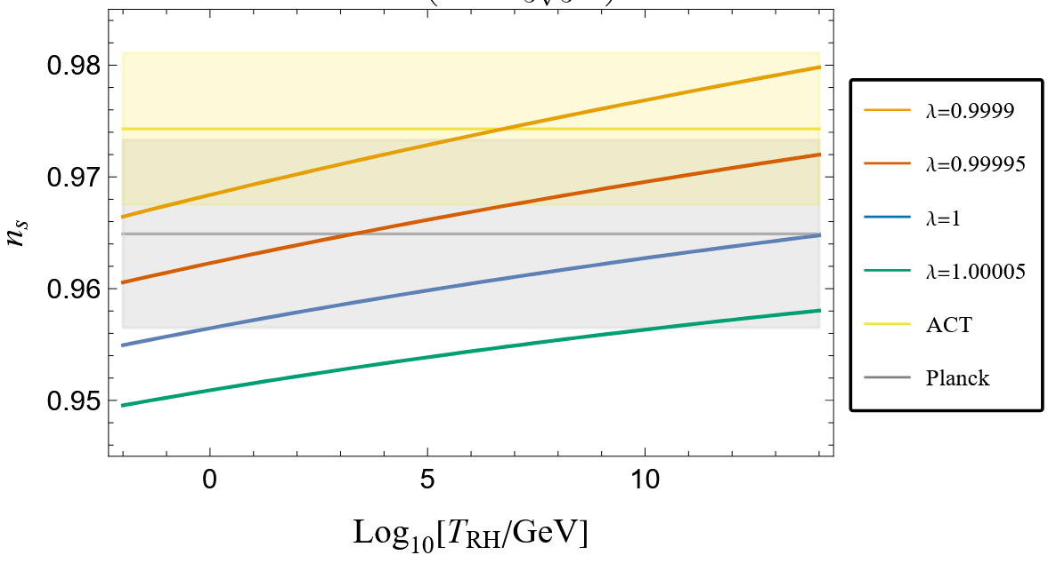


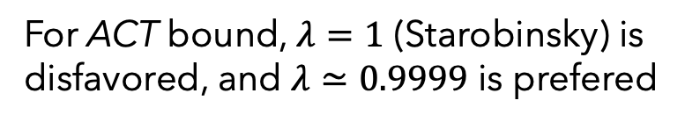

CMB observables for different $λ$
$$±2σ$$
But$n_{s}$ does vary a lot!
For ACT bound, $λ=1$ (Starobinsky) is disfavored, and $λ≃0.9999$ is prefered
Lower bound on $T_{RH}$ from BBN
Lower bound on $λ>0.99984$ (combined with Planck bound)

Slide 17
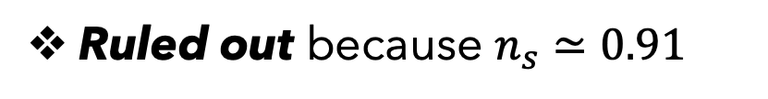

Not just one model!
$$V\left(φ\right)≃M^{2}\left(1−4φ^{3}+\frac{13}{2}φ^{4}+⋯\right)$$
Example of « new inflation »
Holman, Ramond, Ross (1984)
Ruled out because $n_{s}≃0.91$
Fine-tuning can save this model
and many other examples…

Slide 18
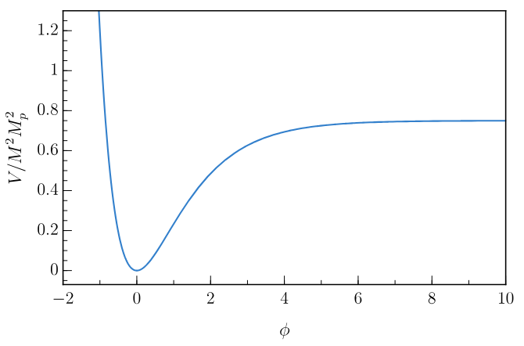
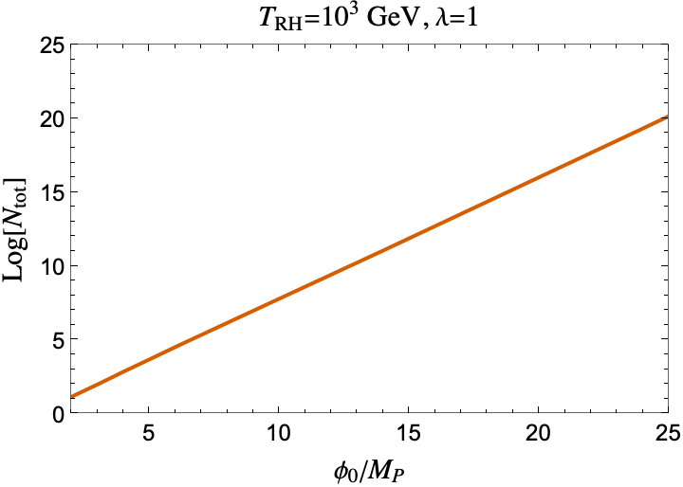

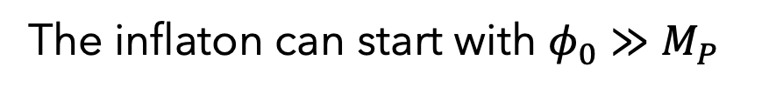
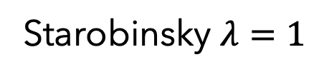
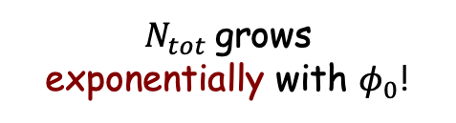
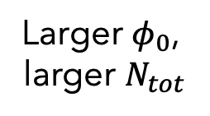
An issue with the initial value
Back to Starobinsky… What’s the initial field value?
Starobinsky $λ=1$
$N_{tot}$ grows
exponentially with $φ_{0}$!
$$φ_{0}$$
Larger $φ_{0}$,
larger $N_{tot}$
The inflaton can start with $φ_{0}≫M_{P}$

Slide 19








An issue with the initial value
Total number of efolds:
$$N_{tot}≡ln⁡(a_{end}/a_{0})$$
Total growth of volume:
$${V∼e}^{3N_{tot}}$$
$$φ_{0}$$
More probable that
we come from a patch
with a larger initial value!
$$φ_{1}>φ_{0}$$
$$φ_{2}<φ_{0}$$
(May be problematic)

Slide 20
An issue with the initial value
Transplanckian field value Quantum gravity regime
Swampland Distance Conjecture
H. Ooguri, C. Vafa (hep-th/0605264)
Transplanckian field excursion
Tower of light states
Breakdown of the EFT
Including massive spin 2
Spin 2 ligher than Hubble violates unitarity
Limit on the field excursion: $\frac{δφ}{M_{P}}<c\ln{\frac{M_{P}}{H}}≃O\left(10\right)$

Slide 21
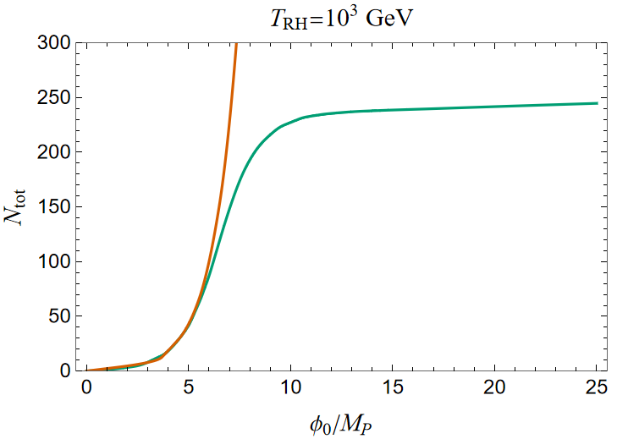
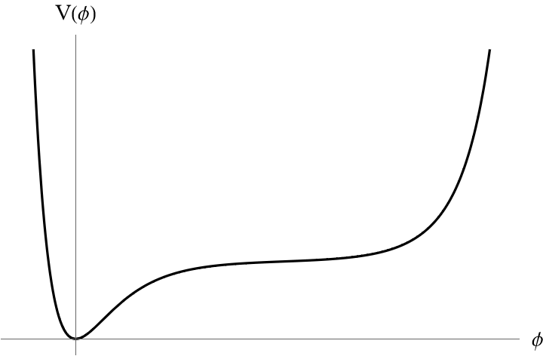

Effect of the fine-tuning: a barrier appears!
$$λ=0.99995$$
Deformation of Starobinsky potential
fast fall
slow roll
Generates most of the efolds

Slide 22
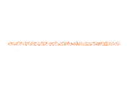


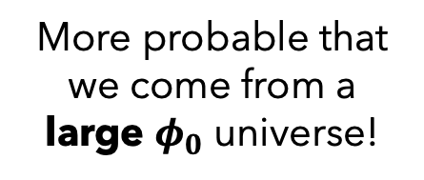


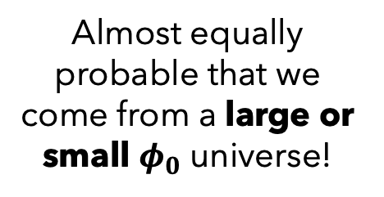

Effect of the fine-tuning: a barrier appears!
$$λ=0.99995$$
Deformation of Starobinsky potential
$$λ=1$$
More probable that we come from a large $φ_{0}$ universe!
$$λ=0.99995$$
fast fall
Almost equally probable that we come from a large or small $φ_{0}$ universe!
slow roll
Generates most of the efolds

Slide 23
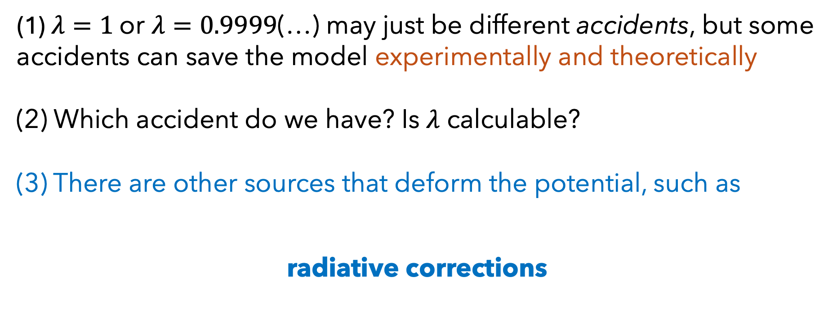
Main messages (about fine-tuning)
(1) $λ=1$ or $λ=0.9999$(…) may just be different accidents, but some accidents can save the model experimentally and theoretically
(2) Which accident do we have? Is $λ$ calculable?
(3) There are other sources that deform the potential, such as
radiative corrections

Slide 24

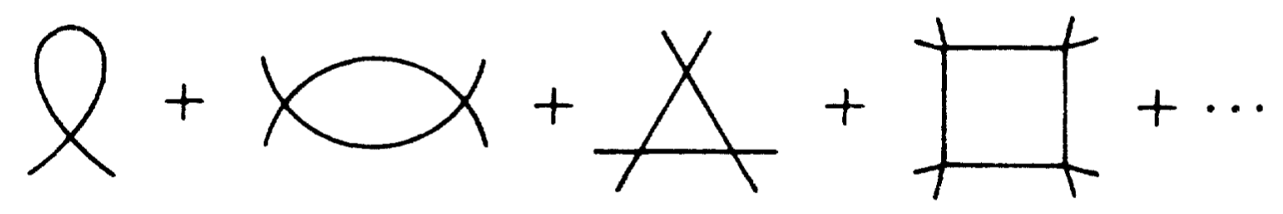
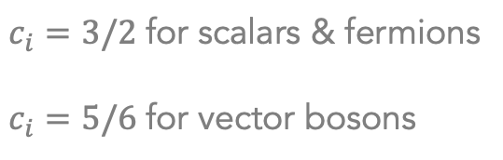
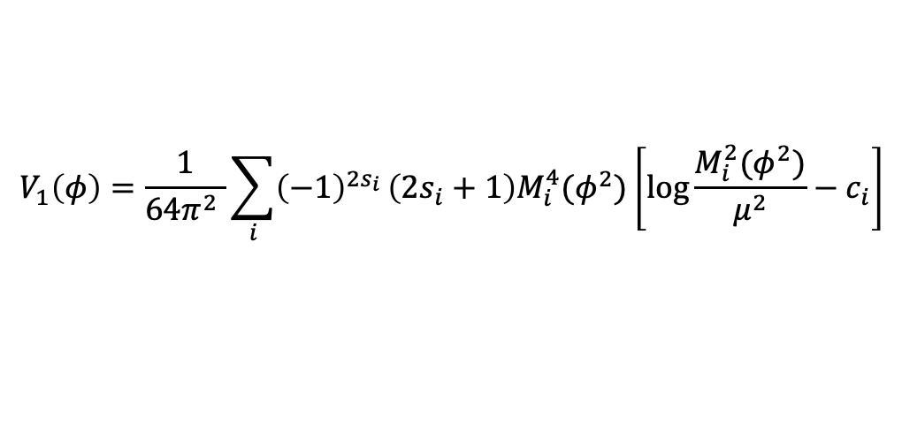
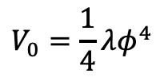
Radiative corrections
The effective scalar potential
e.g.
$$V_{0}=\frac{1}{4}λφ^{4}$$
Tree-level:
One-loop:
Summing up one-particle-irreducible diagrams
  More generally, if the scalar couples to other fields. We have:
$$V_{1}\left(φ\right)=\frac{1}{64π^{2} }\sum_{i}{{\left(−1\right)}^{2s_{i}}}\left(2s_{i}+1\right)M_{i}^{4}(φ^{2})\left[\log{\frac{M_{i}^{2}(φ^{2})}{μ^{2}}}−c_{i}\right]$$
$c_{i}=3/2$ for scalars & fermions
$c_{i}=5/6$ for vector bosons
$M_{i}^{2}(φ^{2})$: the field-dependent mass of the particle $i$
Radiative corrections are always there: from the self coupling, or coupling to other fields

Slide 25

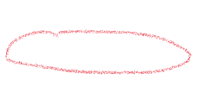
Two subtleties in inflation (1)
$≈$de Sitter
We need the one-loop potential in de Sitter
CMB observables
Markkanen, Nurmi, Rajantie, Stopyra [1804.02020]
What changes in curved spacetime?
#1: Curvature contributes to the effective mass.
#2: Curvature adds extra pieces in the potential.

Slide 26


Two subtleties in inflation (1)
$≈$de Sitter
We need the one-loop potential in de Sitter
CMB observables
Markkanen, Nurmi, Rajantie, Stopyra [1804.02020]
What changes in curved spacetime?
#1: Curvature contributes to the effective mass.
#2: Curvature adds extra pieces in the potential.
For inflaton potential, the dS correction is actually negligible
$${(V}_{1}∼H^{4})≪(V_{0}∼M_{P}^{2}H^{2})$$

Slide 27

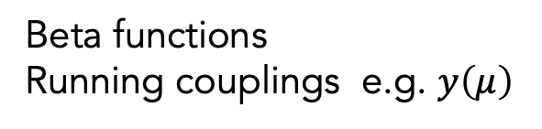

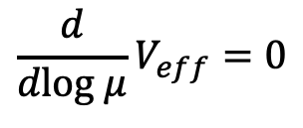

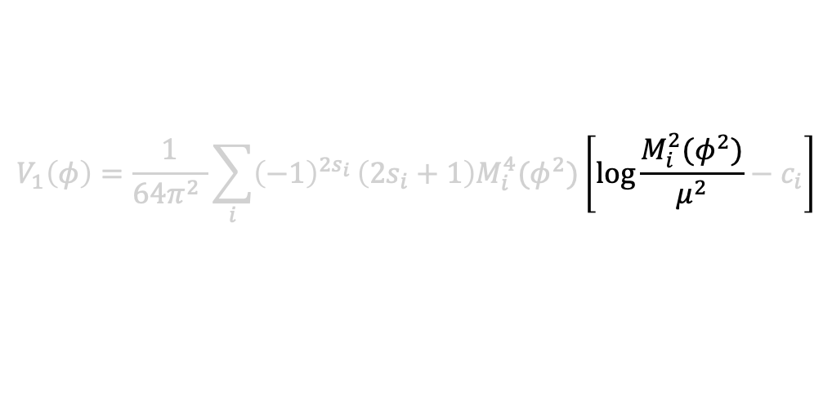
Two subtleties in inflation (2)
The effective mass evolves with time
e.g. $yφ(t)\overline{f}f$
can vary from ${y M}_{P}$ to 0
$$V_{1}\left(φ\right)=\frac{1}{64π^{2} }\sum_{i}{{\left(−1\right)}^{2s_{i}}}\left(2s_{i}+1\right)M_{i}^{4}(φ^{2})\left[\log{\frac{M_{i}^{2}(φ^{2})}{μ^{2}}}−c_{i}\right]$$
Avoid large log’s!
RG-improve the scalar potential:
$$\frac{d}{dlog μ}V_{eff}=0$$
Beta functions
Running couplings e.g. $y\left(μ\right)$

Slide 28

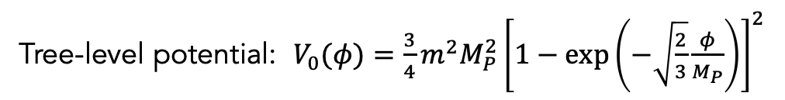
Radiative corrections in Starobinsky model
J. Ellis, T. Gherghetta, K. Kaneta, WK, K. Olive [2510.15137]
Tree-level potential: $V_{0}(φ)=\frac{3}{4}m^{2}M_{P}^{2}{\left[1−\exp\left(−\sqrt{\frac{2}{3}}\frac{φ}{M_{P}}\right)\right]}^{2}$
- Inflaton self-coupling -
Effective mass: $M^{2}\left(φ\right)≃V^{′′}\left(φ\right)−2H^{2}$
One-loop potential: $V_{1}\left(φ\right)≃\frac{1}{64π^{2} }\left[M^{4}\left(φ\right)\left(\log{\frac{\left|M^{2} (φ)\right|}{μ^{2}}}−\frac{3}{2}\right)−\frac{2H^{4}}{15}\log{\frac{\left|M^{2} (φ)\right|}{μ^{2}}}\right]$
$$V_{0}≃3M_{P}^{2}H^{2}≫V_{1}$$
tiny

Slide 29
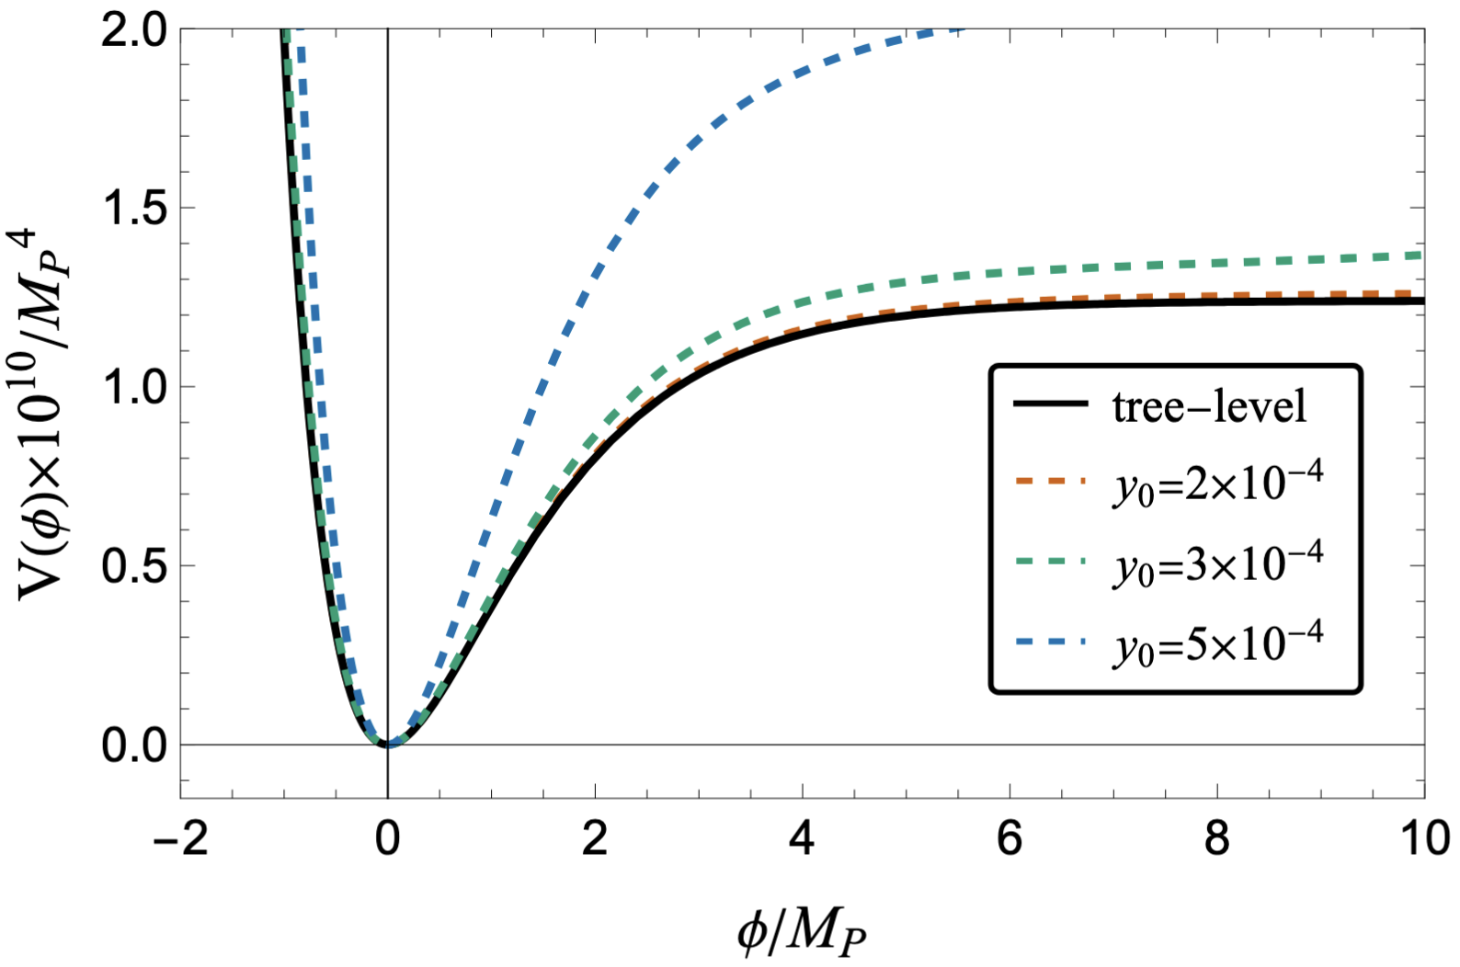

- Coupling to a fermion -
$yφ{\overline{f}}^{c}f/2$ ($f$ is massless)
Tree-level
vs.
One-loop corrected potential
CMB observables change
Bound on Yukawa coupling

Slide 30









- Coupling to a fermion -
$$r=0.036$$
$$±2σ$$
$$±2σ$$
Stronger constraint from $n_{s}$!
Reheating temperature
$$\frac{π^{2}}{30}g_{RH}T_{RH}^{4}=\frac{12}{25}{\left(Γ_{φ}M_{P}\right)}^{2}$$
Planck: $y≤4.5×{10}^{−4}$
ACT: $3.8×{10}^{−4}≤y≤5.6×{10}^{−4}$
Planck: $T_{RH}≤2×{10}^{11}GeV$
ACT: $1.7×{10}^{11}≤T_{RH}≤2.8×{10}^{11}GeV$

Slide 31





- Massive fermion -
$yφ{\overline{f}}^{c}f/2$ $+m_{f}{\overline{f}}^{c}f/2$
$n_{s}$ constrains the Yukawa coupling AND the bare mass
e.g. For $y≃0.0002:$
Planck implies $m_{f}≲O\left({10}^{16}\right)GeV$
ACT implies $m_{f}≃O\left({10}^{16}\right)GeV$

Slide 32




Similarly for other couplings
- Coupling to a scalar -
$κφs^{2}/2$
Planck: $κ≤4×{10}^{12}GeV$
- Massive scalar -
$$κφs^{2}/2+m_{s}^{2}s^{2}/2$$
etc…
Radiative corrections must be kept under control

Slide 33
Similarly for other couplings
- Coupling to a scalar -
$κφs^{2}/2$
Planck: $κ≤4×{10}^{12}GeV$
- Massive scalar -
$$κφs^{2}/2+m_{s}^{2}s^{2}/2$$
etc…
Radiative corrections must be kept under control
Can any symmetry do that?

Slide 34




J. Ellis, T. Gherghetta, K. Kaneta, WK, K. Olive [2603.02389]
Radiative corrections in supergravity
= Supersymmetric gravity
Inflation from supergravity
Kähler potential
Superpotential
$$W=M\left(\frac{1}{2}χ^{2}−\frac{λ}{3\sqrt{3}}χ^{3}\right)$$
$$K=−3\ln{(T+T^{∗}−{\left|χ\right|}^{2}/3)}$$
Scalar potential:
$$V=e^{K}\left[g^{m\overline{n}}D_{m}WD_{\overline{n}}W^{∗}−3{\left|W\right|}^{2}\right]$$
Starobinsky potential
if $λ=1$

Slide 35




J. Ellis, T. Gherghetta, K. Kaneta, WK, K. Olive [2603.02389]
Radiative corrections in supergravity
= Supersymmetric gravity
Inflation from supergravity
Kähler potential
Superpotential
Protected by SUSY
Determines the scalar kinetic term
‘’Non-renormalization theorem’’
Gets loop corrections
Scalar potential:
$$V=e^{K}\left[g^{m\overline{n}}D_{m}WD_{\overline{n}}W^{∗}−3{\left|W\right|}^{2}\right]$$

Slide 36


Some models have better controlled corrections
Symmetry badly broken
Symmetry breaking kept small
e.g. ‘‘Cecotti model’’
e.g. ‘‘Wess-Zumino model’’
Radiative corrections are tiny!

Slide 37

Main messages (about radiative corrections)
Inflation generically gets radiative corrections!
CMB bounds constrain the inflaton couplings & reheating temperature
Generally, inflation is sensitive to many sources of deformation
e.g. $R^{n}$ higher curvature terms, higher dim operaters
How is inflation protected from these deformations?
Bottom-up: constrain these operators using experiments
Top-down: any symmetries constraining these operators?

Slide 38
Thank you!

Slide 39
Backup slides

Slide 40





$$k_{∗}=a_{∗}H_{∗}$$
$$\ln{\frac{k_{∗}}{a_{0}H_{0}}}=\ln\left(\frac{a_{∗}}{a_{e}}\frac{a_{e}}{a_{rad}}\frac{a_{rad}}{a_{0}}\frac{H_{∗}}{H_{0}}\right)$$
$$\sqrt{V_{∗}/3M_{P}^{2}}$$
$$N_{∗}$$
$${\left(\frac{g_{0}}{g_{reh}}\right)}^{\frac{1}{3}}T_{0}/T_{rad}$$
Assuming entropy conservation after reheating
$$\ln{\frac{a_{e}}{a_{rad}}}=\frac{1}{3(1+w_{int})}\ln{\frac{ρ_{rad}}{ρ_{end}}}$$

Slide 41





Depend on $T_{RH}$
$N_{∗}$ and $T_{RH}$are related
1) Scalar power spectrum amplitude$: A_{s}≃\frac{V_{∗}}{24π^{2}ε_{∗}M_{P}^{4}}$
2) Scalar spectral index: $n_{s}=n_{∗}≃1−6ε_{∗}+2η_{∗}$
3) Tensor-to-scalar ratio: $r=r_{∗}≃16ε_{∗}$
Observables:
They also depend on $T_{RH}$

Slide 42







Scalar coupling $κφs^{2}/2$ ($s$ is massless & real)
$M^{2}\left(φ\right)≫H^{2}$ requires $κ≫{10}^{7}GeV$
The scalar coupling bends down the inflaton potential at large field value
The initial inflaton value has an upper bound!
$$Max[φ_{0}]$$

Slide 43




Scalar coupling $κφs^{2}/2$ ($s$ is massless & real)
$M^{2}\left(φ\right)≫H^{2}$ requires $κ≫{10}^{7}GeV$
Different from the fermion case, the scalar coupling reduces $n_{s}$ for large $κ$
The ACT bound is never satisfied
Reheating temperature
$$\frac{π^{2}}{30}g_{RH}T_{RH}^{4}=\frac{12}{25}{\left(Γ_{φ}M_{P}\right)}^{2}$$
Planck: $κ≤4×{10}^{12}GeV$
Planck: $T_{RH}≤4.2×{10}^{13}GeV$

Slide 44


Coupling with massive scalar $κφs^{2}/2+m_{s}^{2}s^{2}/2$
Again, the one-loop correction from the scalar coupling reduces $n_{s}$
Again, the ACT bound is never satisfied
Planck bound on $n_{s}$ gives an upper limit on $m_{s}^{ }$ for each $κ$

