Slide 1
US Neutrino Programme - from short to long baselines
DPF Community Meeting
Stefan Söldner-Rembold
Imperial College London
19 December 2025

Slide 2
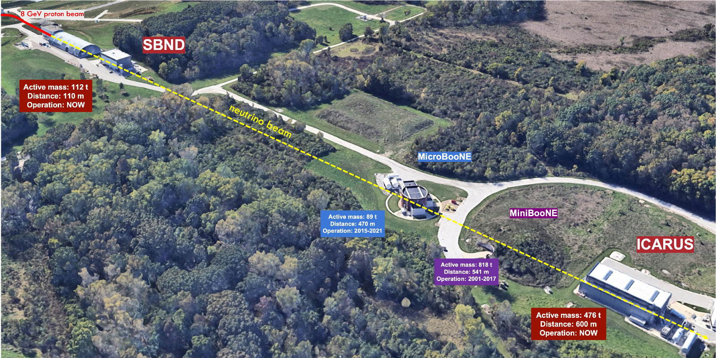
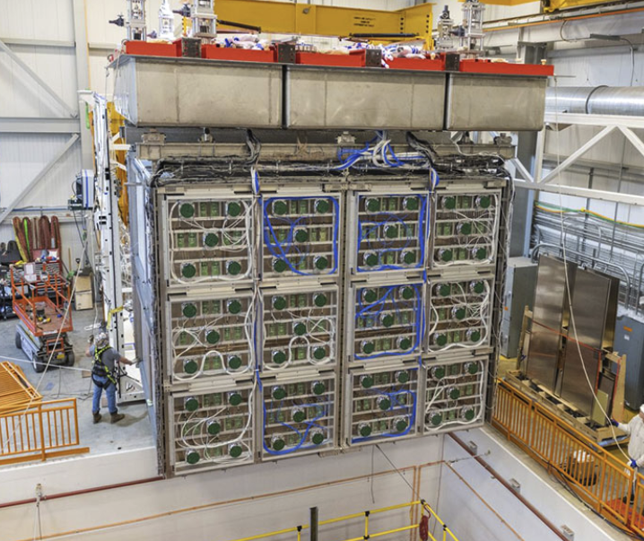
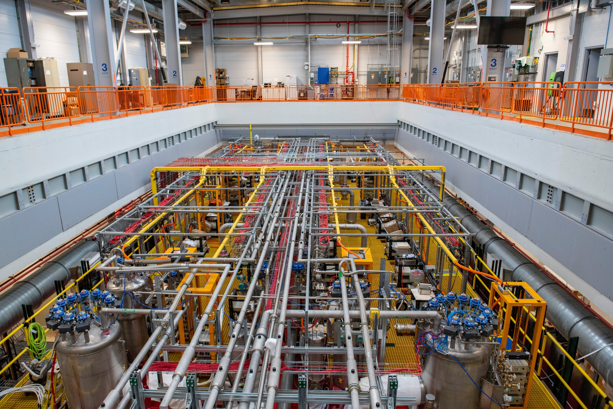
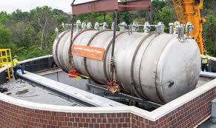
Fermilab short-baseline programme
Detector | Distance from Target | Instrumented LAr Mass
SBND | 110 m | 112 ton
MicroBooNE | 470 m | 87 ton
ICARUS | 600 m | 476 ton
Studying oscillations at short baselines

Slide 3
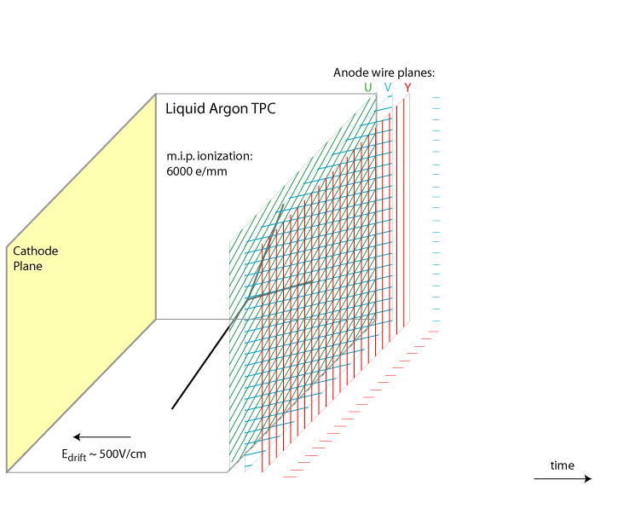
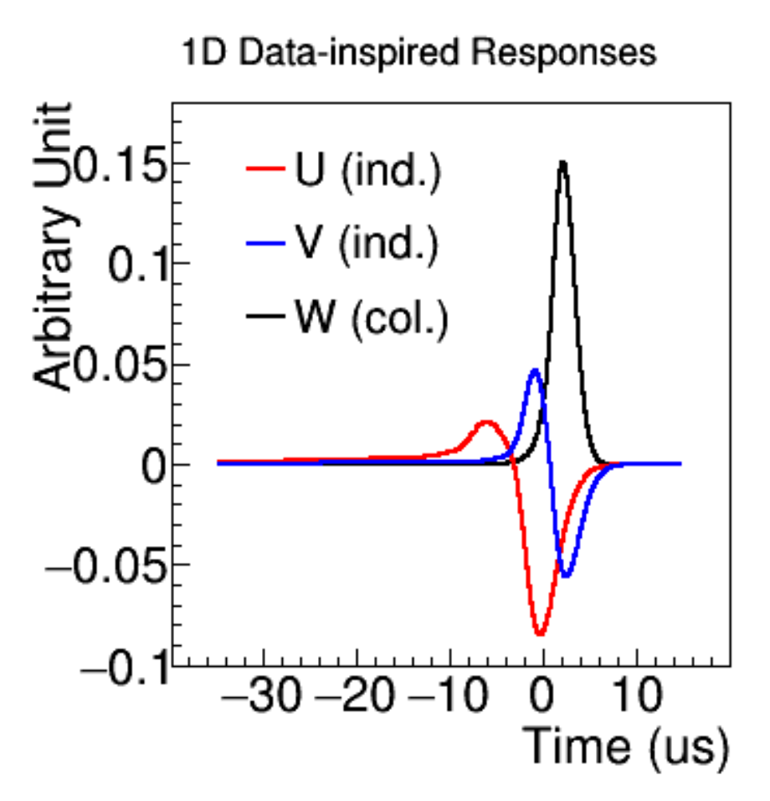
Liquid-argon Time Projection Chambers
170 kV
3.4 m → about 2 ms

Slide 4
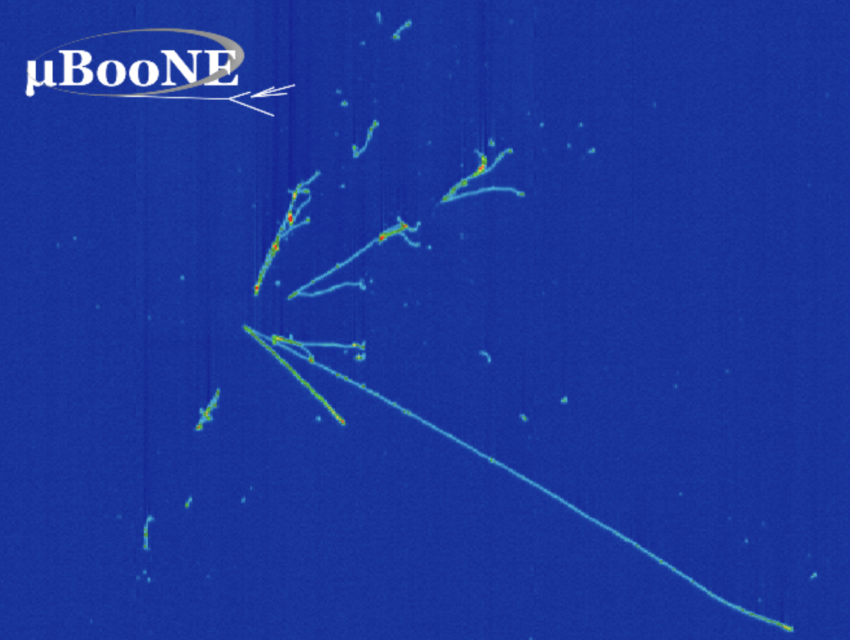
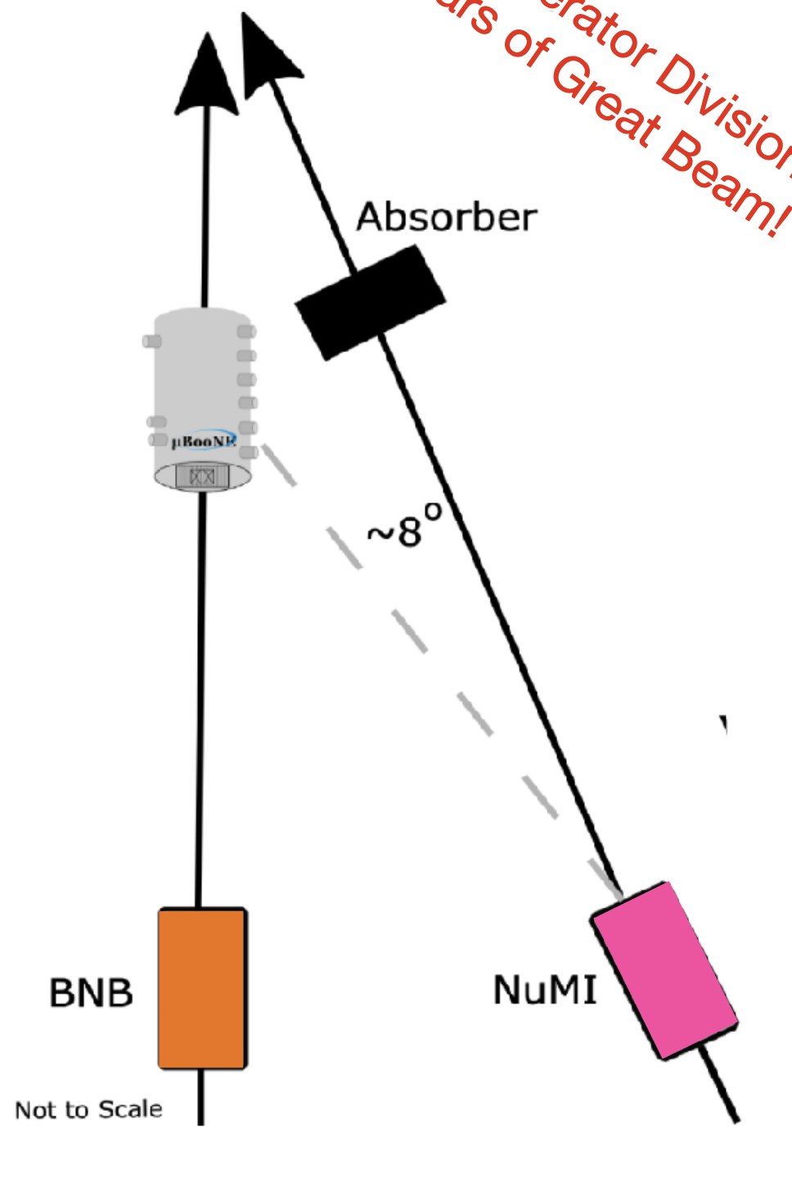
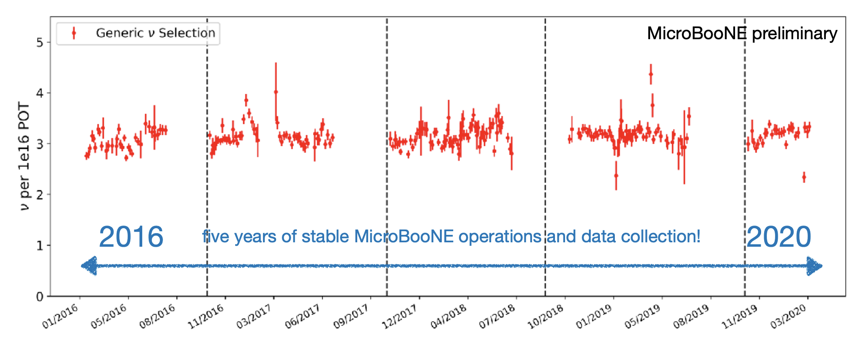
MicroBooNE
Five years of data
1x10²¹ POT from the BNB
2x10²¹ POT from the NuMI beam
800k neutrino interactions
84 scientific publications and 76 PhD students graduated.
Demonstrated that a large LArTPC could run stably for many years and deliver a broad, world-class physics programme.
187 scientists
41 institutions
6 countries

Slide 5
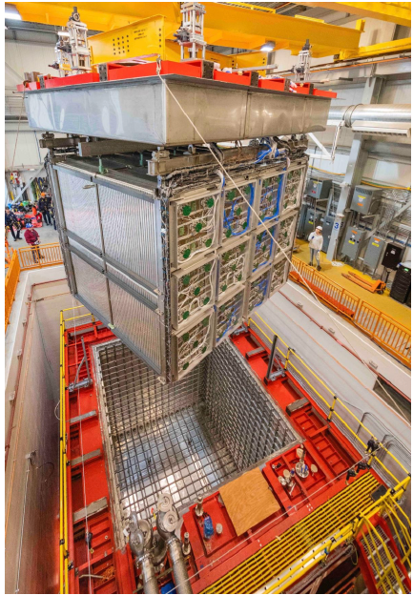
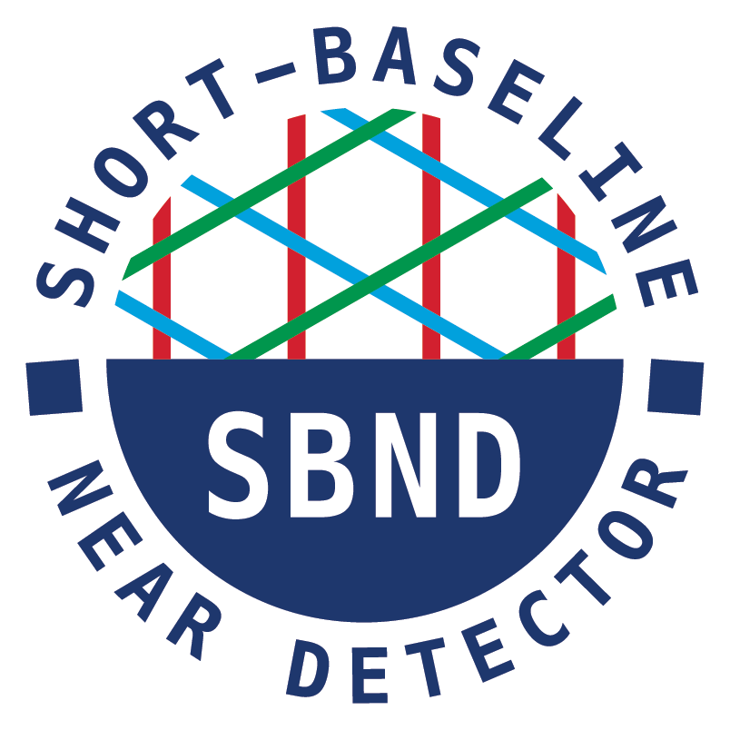
SBND – Near Detector of SBN Programme
112 tons active argon mass
2 TPCs instrumented with wire planes.
2m drift, -100 kV HV at the cathode
high efficiency light collection system composed of 120 PMTs, 192 X-ARAPUCA’s, and wavelength-shifting foils on the TPC cathode.
4π coverage with Cosmic Ray Tagger panels
600 m from the Booster Neutrino Beam target
Operations started in June 2022
First Physics Run complete
Second Physics Run in Progress
250 scientists
40 institutions
5 countries

Slide 6
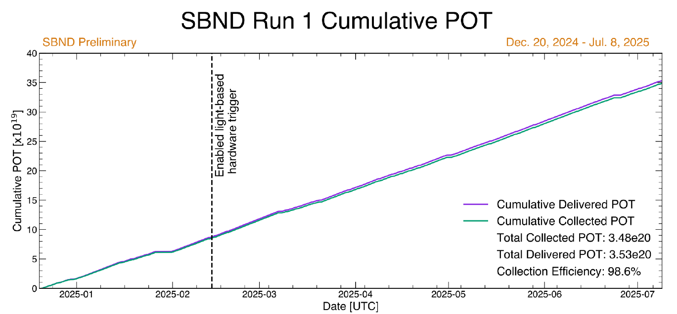
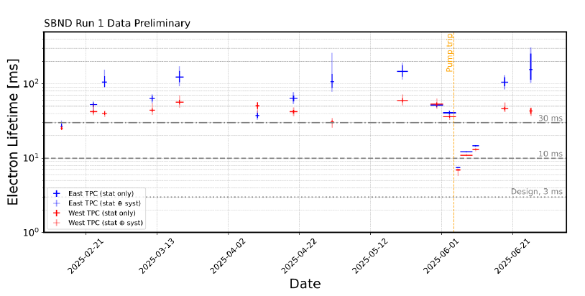
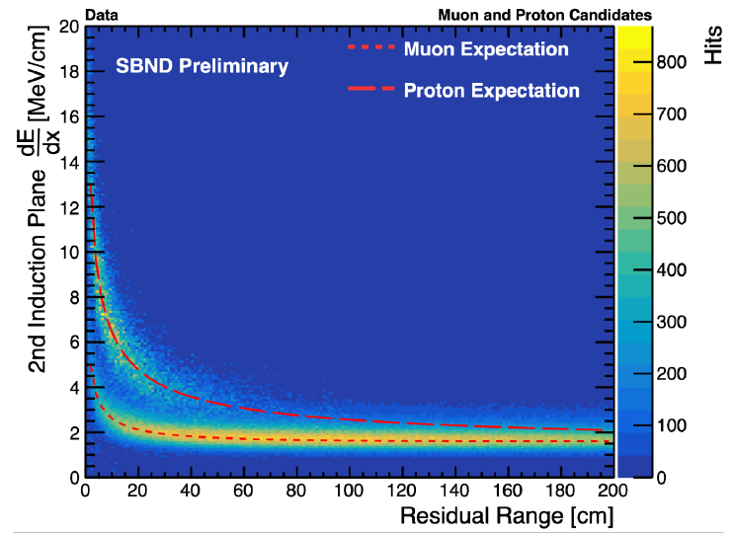
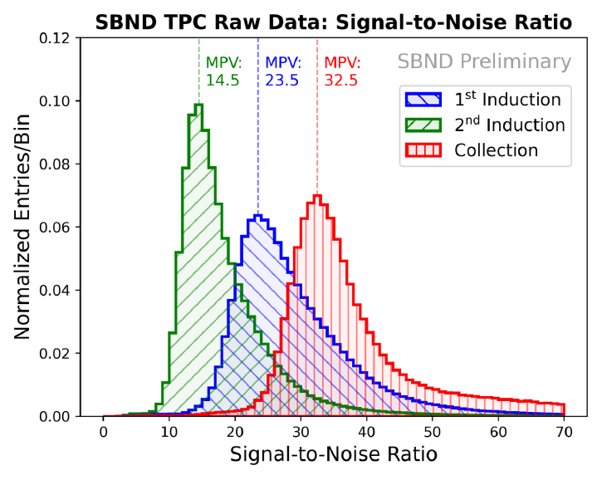
SBND Detector Performance
99.4% working channels and >98% uptime
Excellent lifetime (>30ms).
Calibration

Slide 7
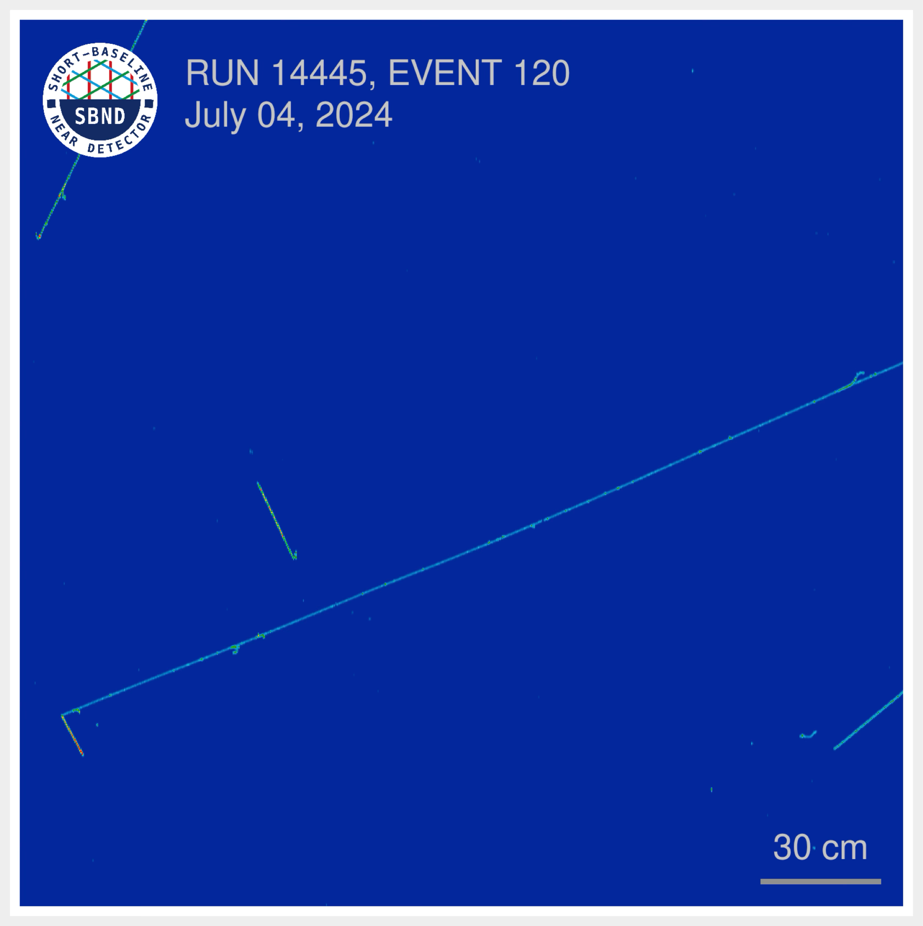
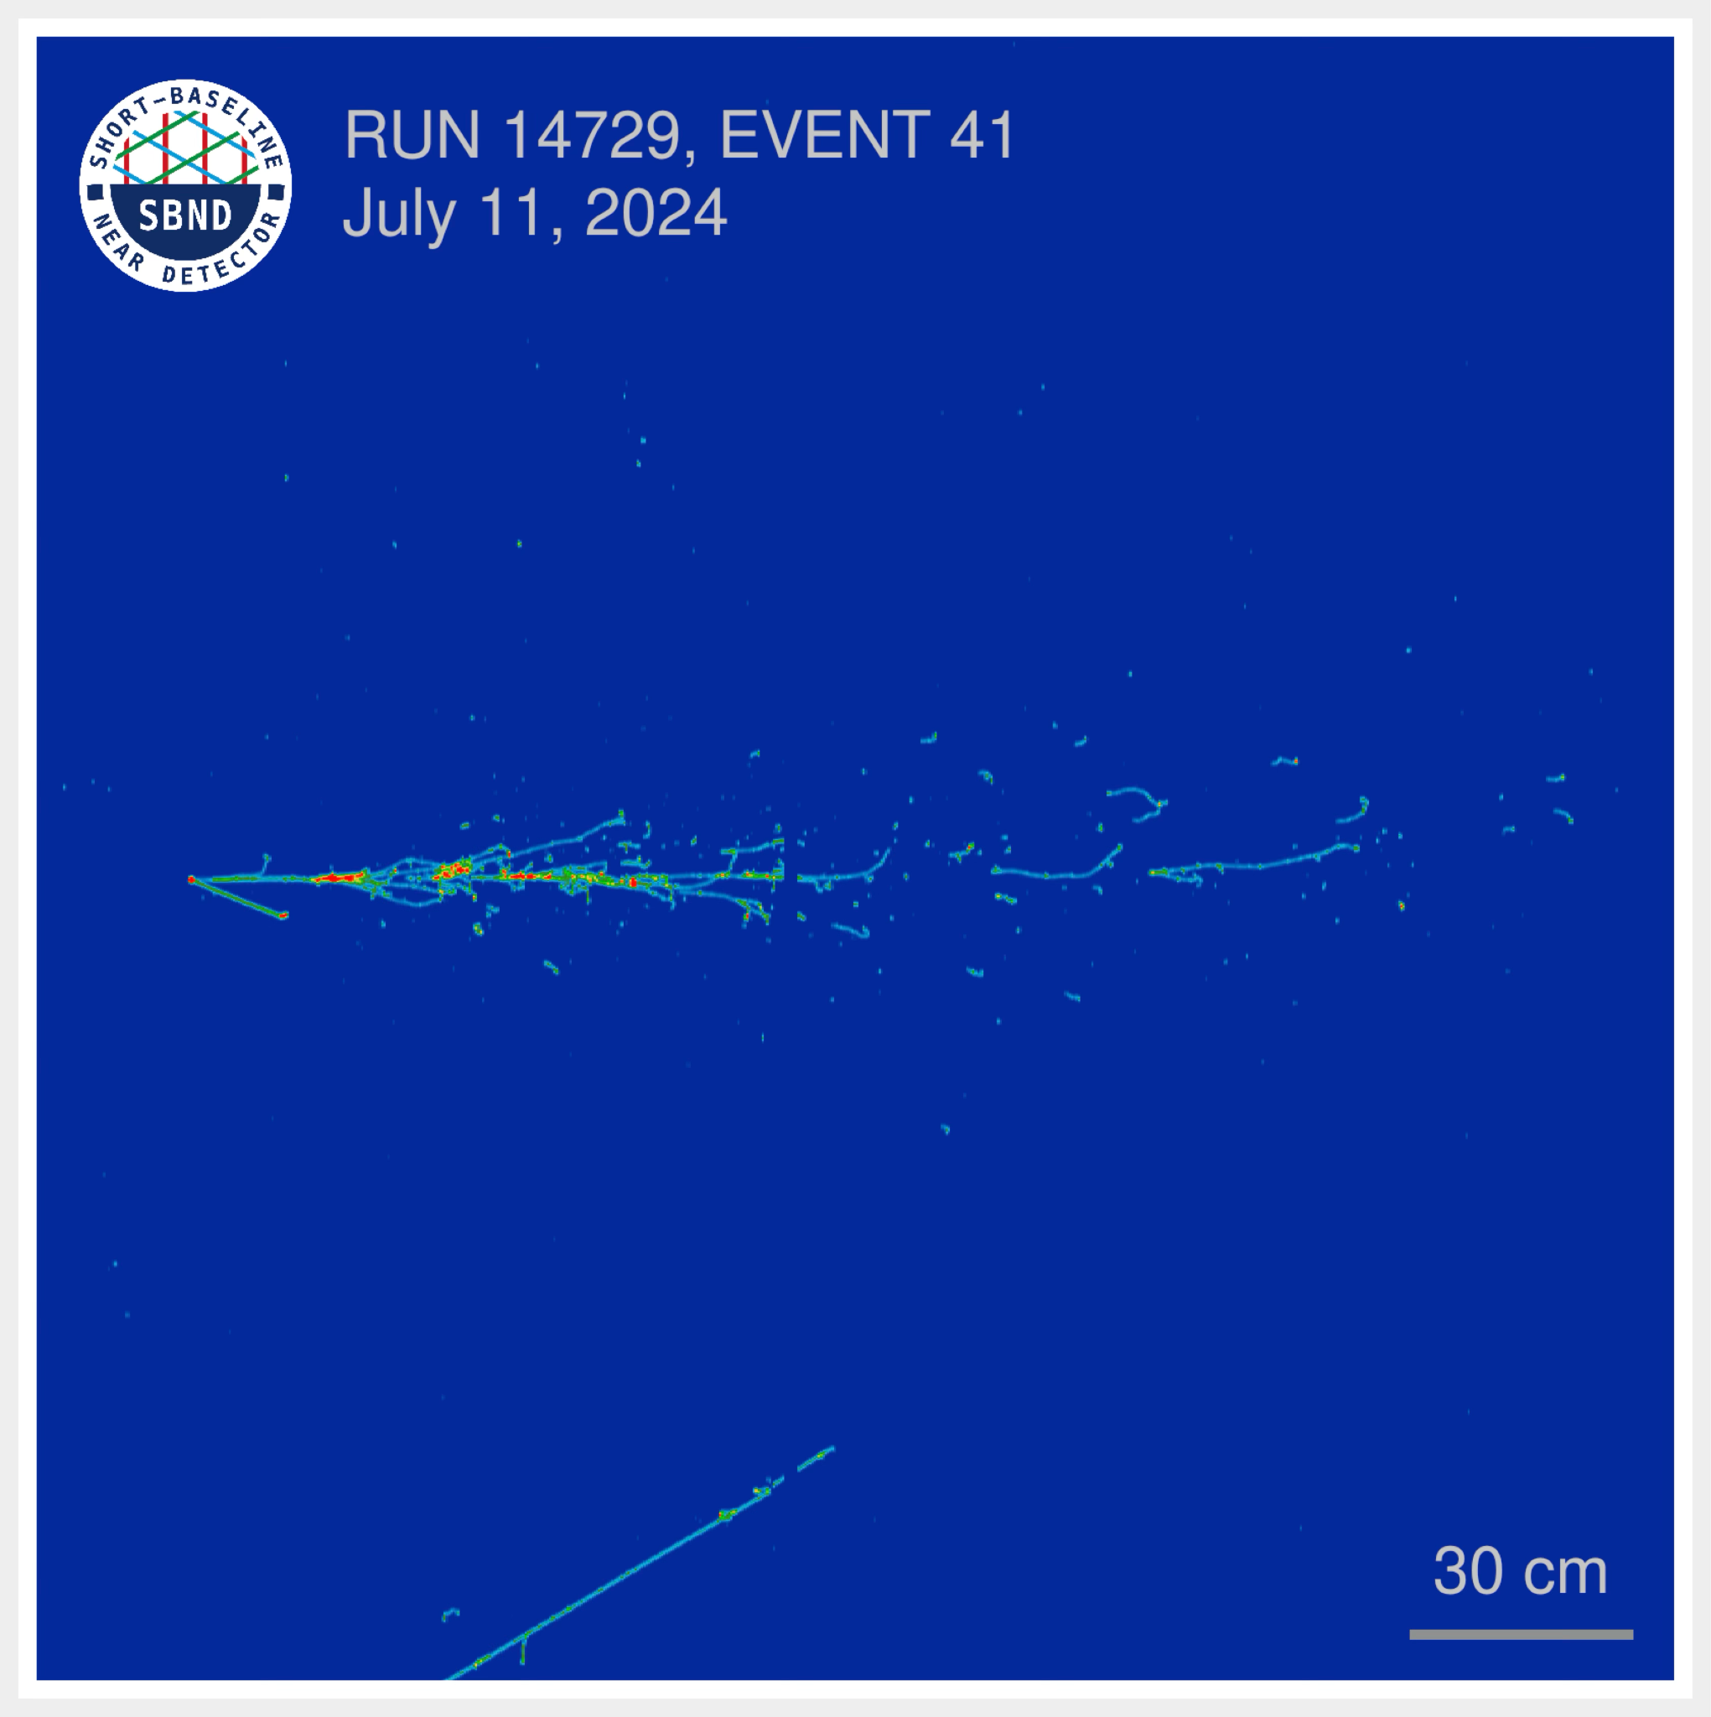
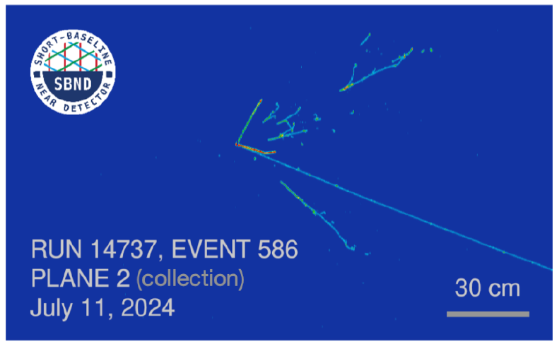
SBND Neutrino Event Displays
SBND Data: ν_{μ} CC Candidate
SBND Data: ν_{e} CC Candidate
SBND Data: CC with 𝜋⁰s Candidate
collection plane, zoomed
collection plane, zoomed
collection plane, zoomed
Time tick
Time tick
Time tick
Wire #
Wire #
Wire #

Slide 8
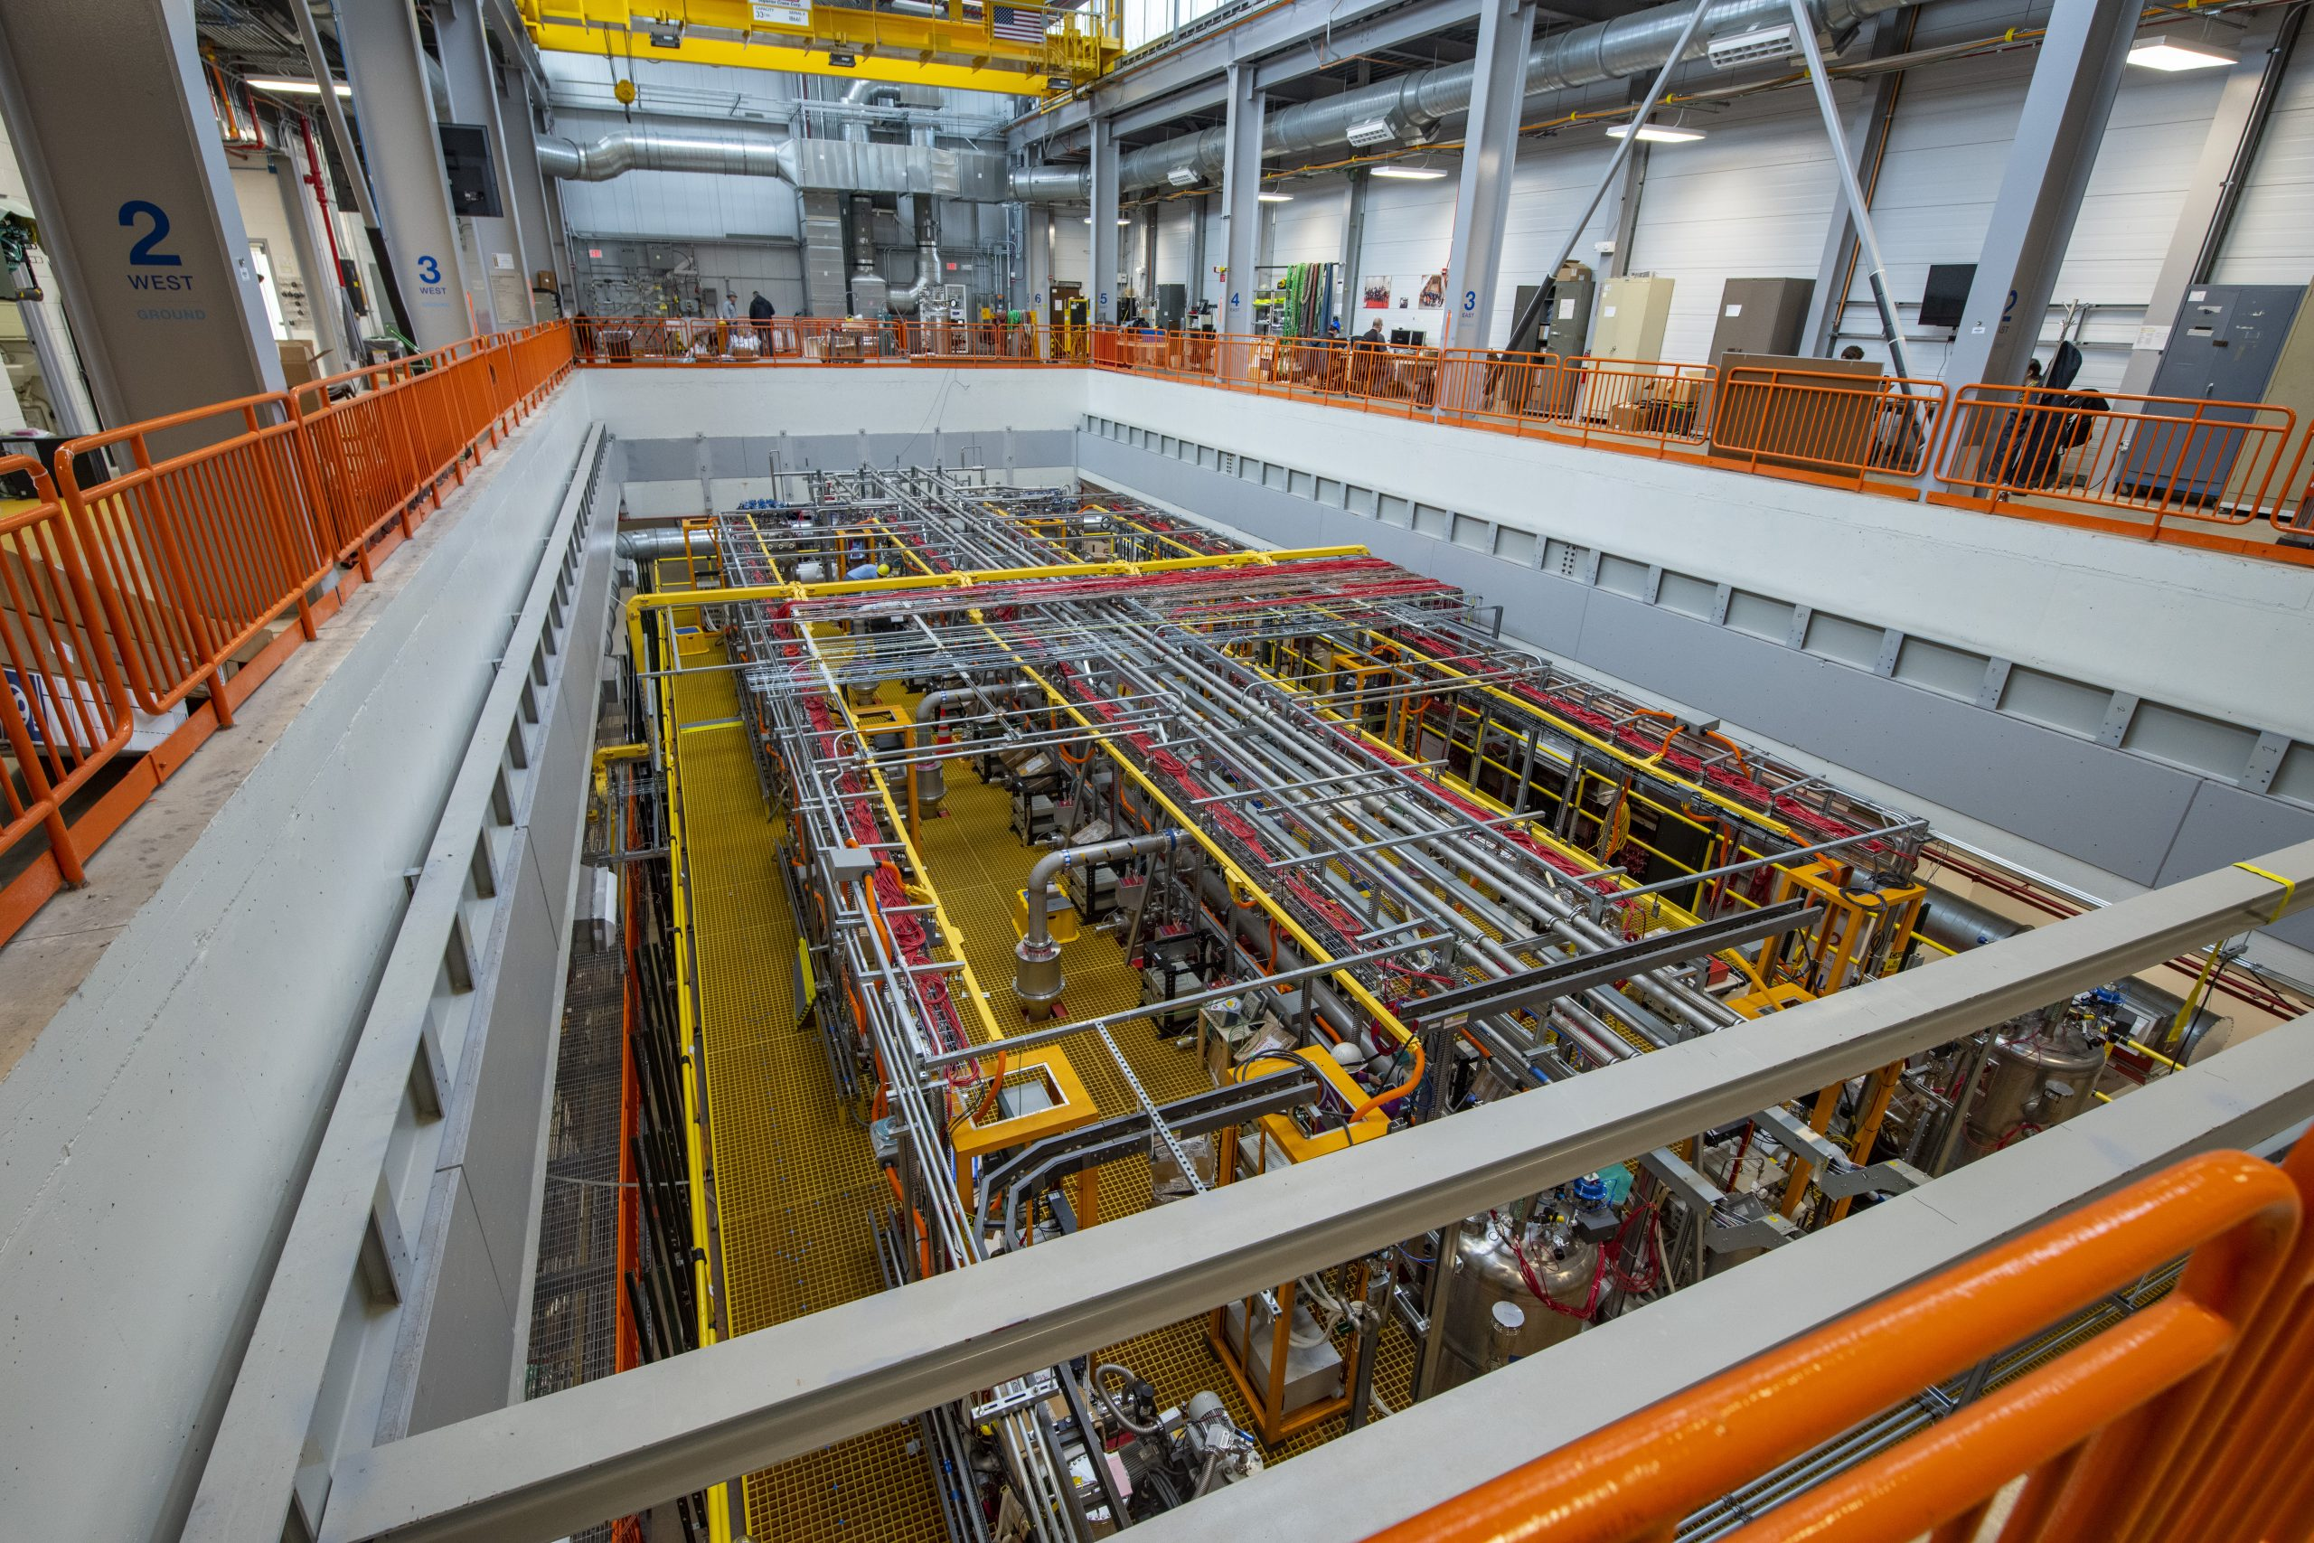
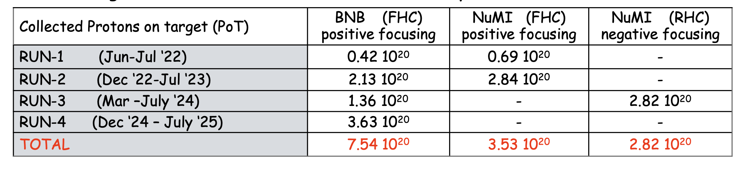
ICARUS – Far Detector of the SBN Programme
476 tons active argon mass
2 modules, with 2 TPCs
1.5m drift, Drift field 500 V/cm
high efficiency light collection system (360 8’’ PMTs)
110 meters from the Booster Neutrino Beam target

Slide 9
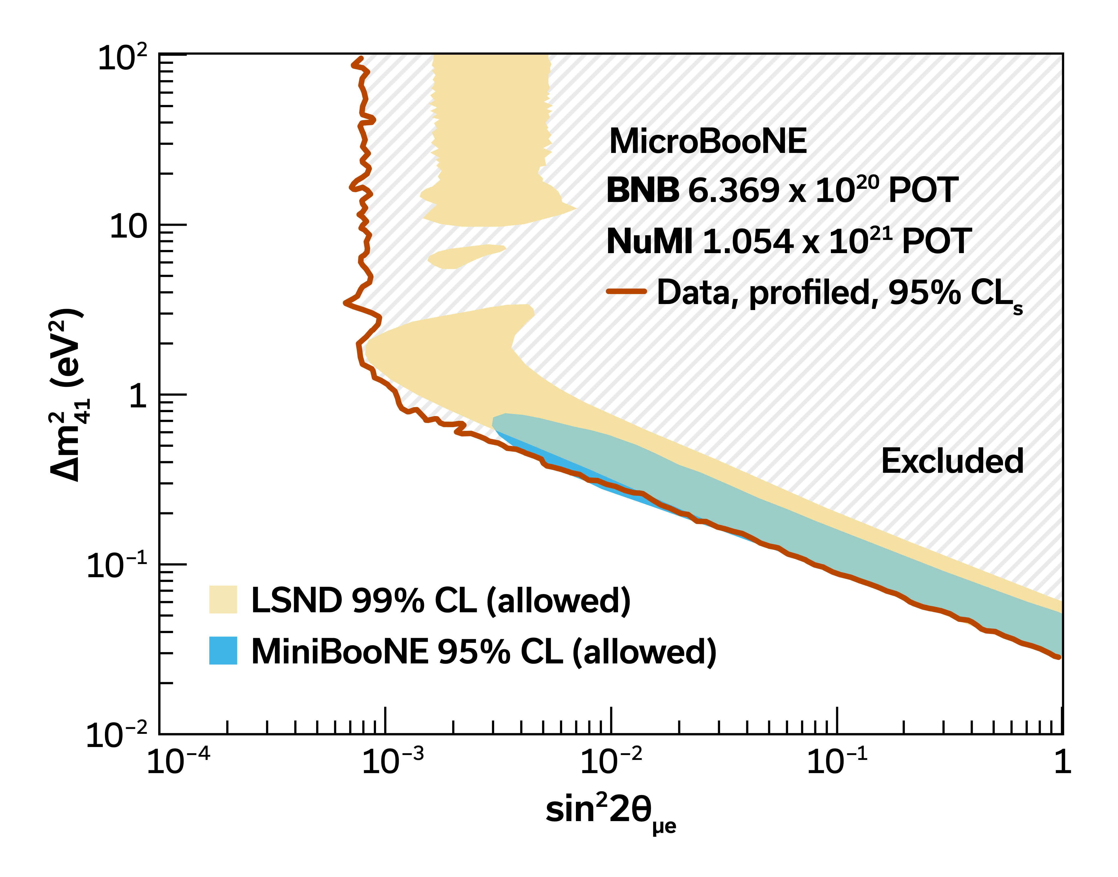
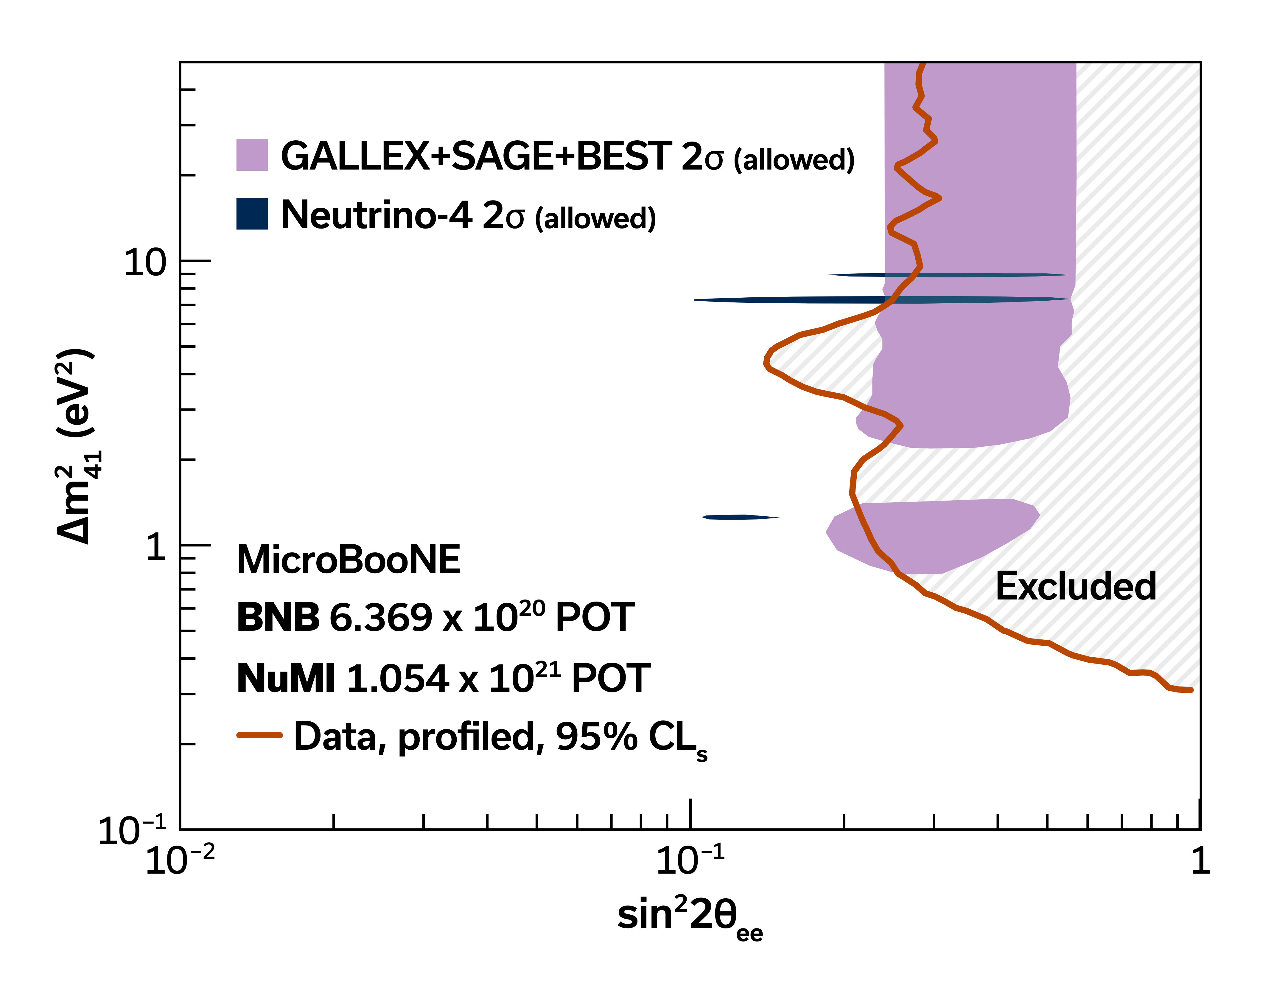
MicroBooNE: two-beam sterile neutrino search
Uses data from the BNB and the NuMI beam simultaneously to break appearance-disappearance degeneracies.
Excludes, at 95% CL, the 3+1 explanation of the LSND and MiniBooNE anomalies.
Excludes much of the regions allowed by the gallium and Neutrino-4 anomalies.
Closes the window on the 3+1 model as an explanation to the long-standing LSND and MiniBooNE anomalies.
Nature 648, 64 (2025)

Slide 10
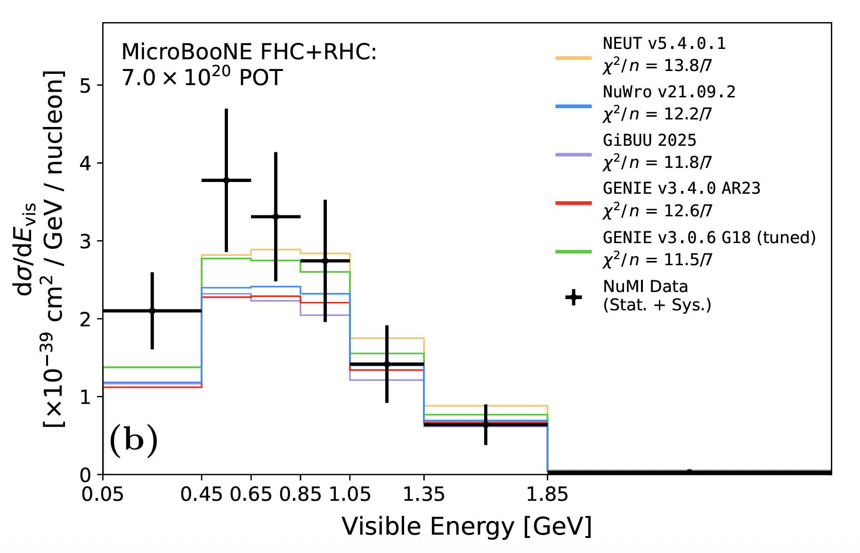
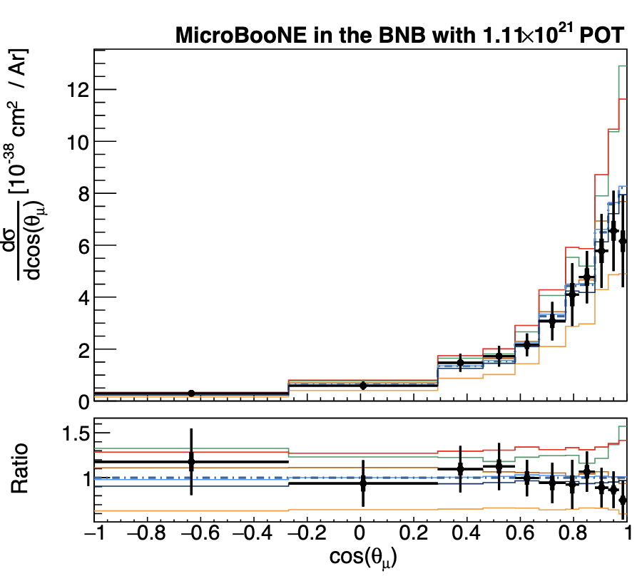
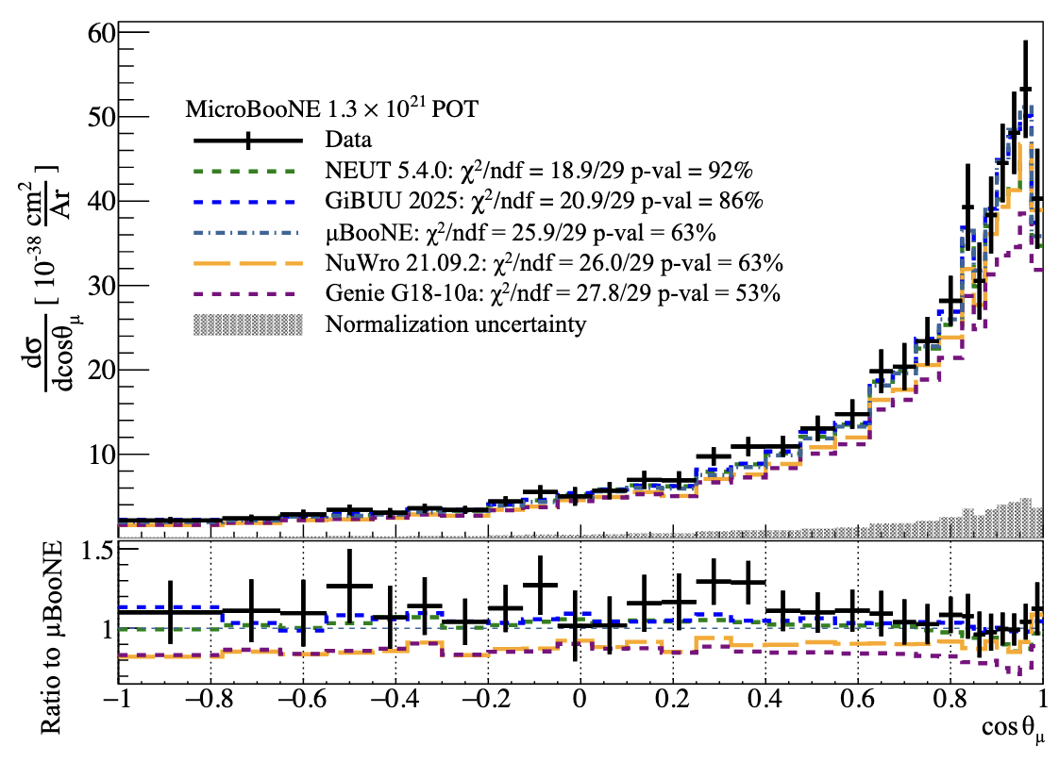
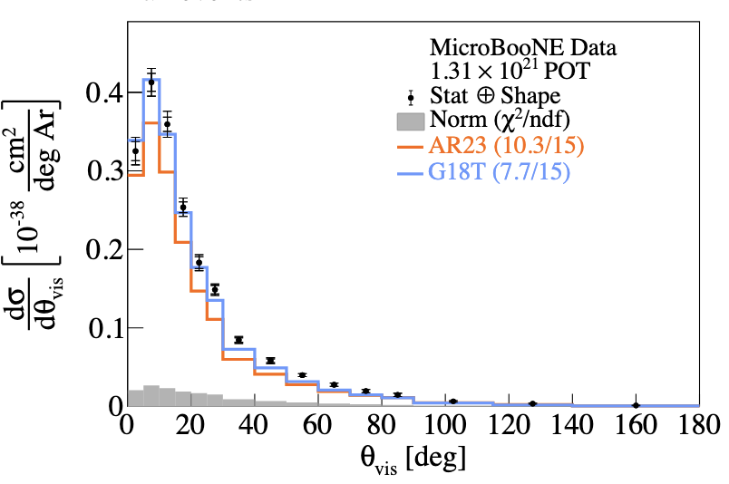
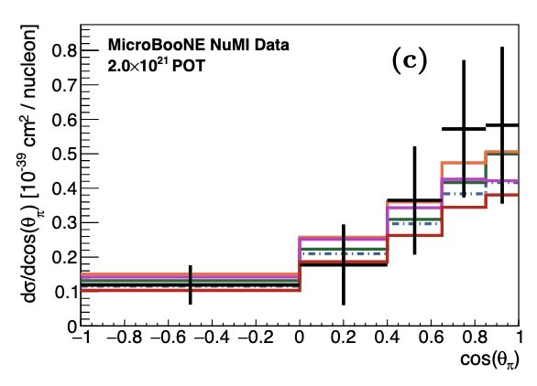
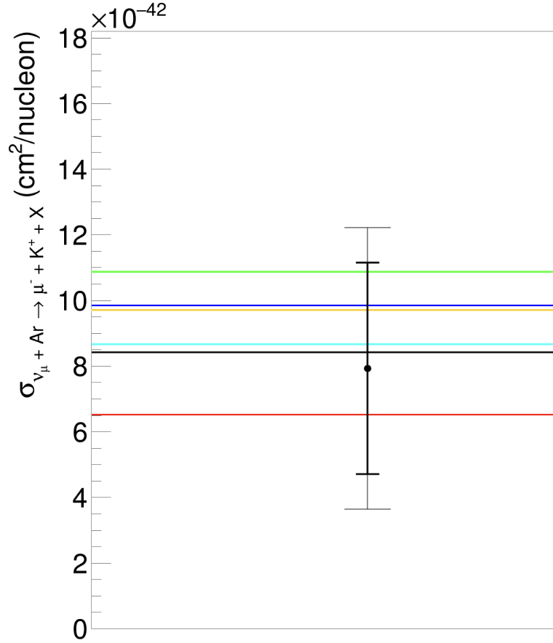
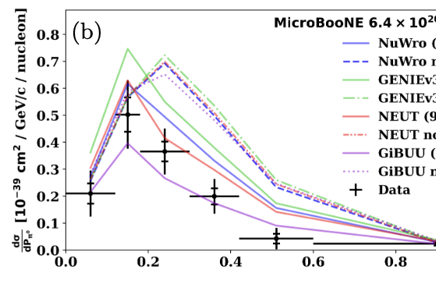
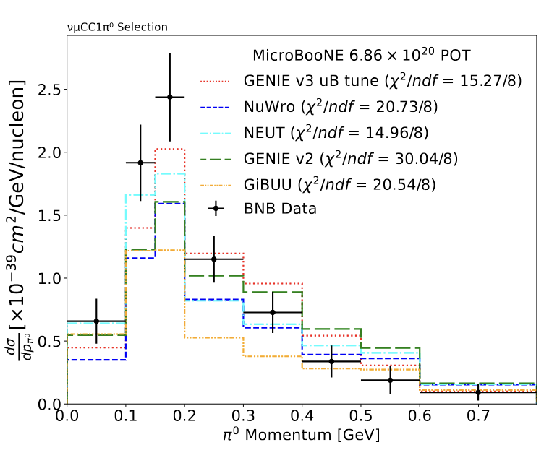
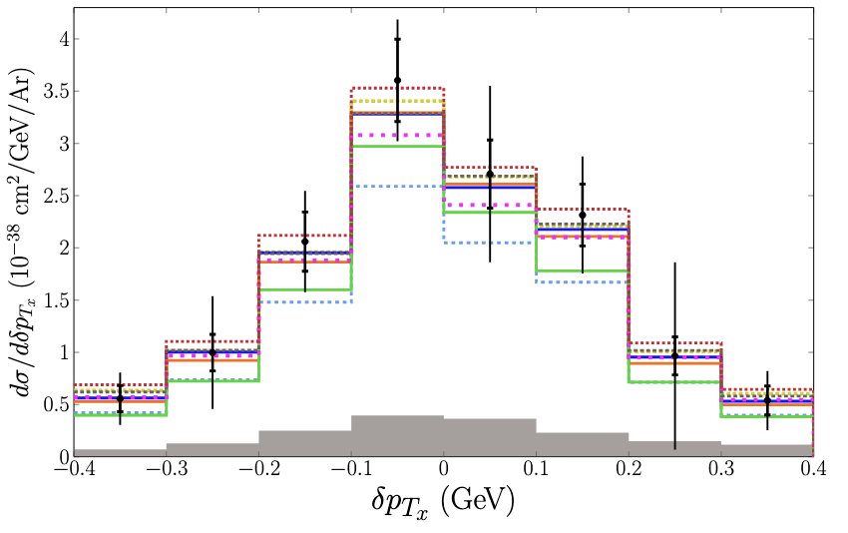
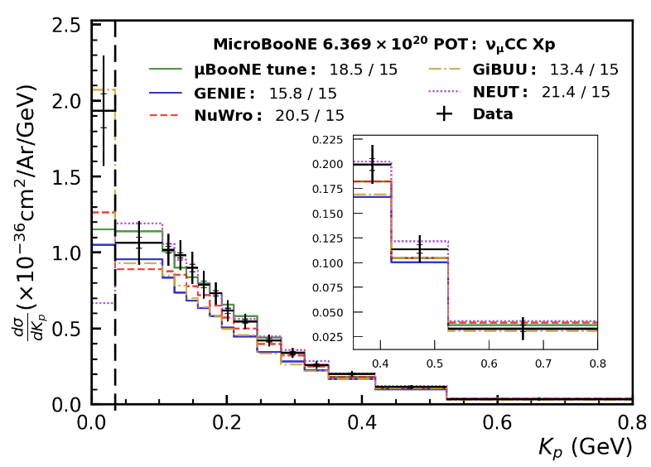
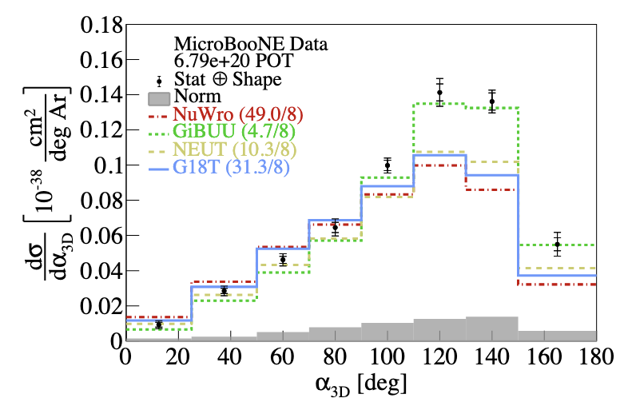
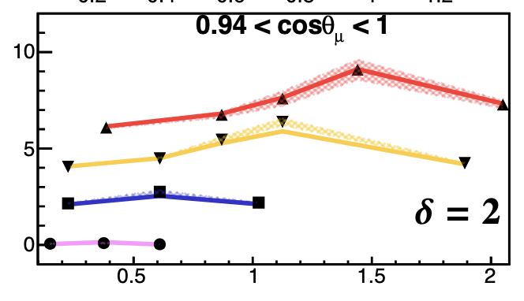
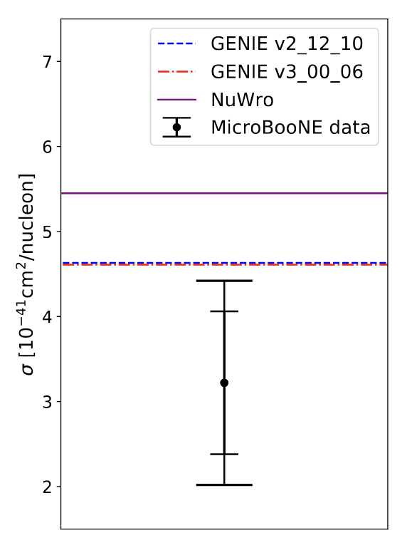
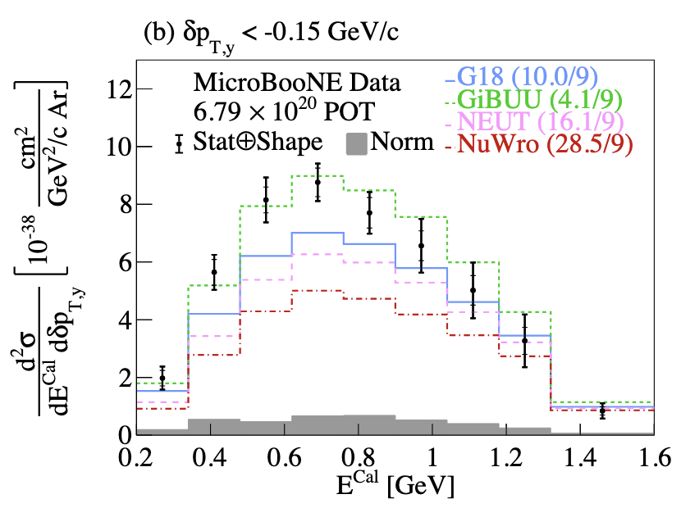
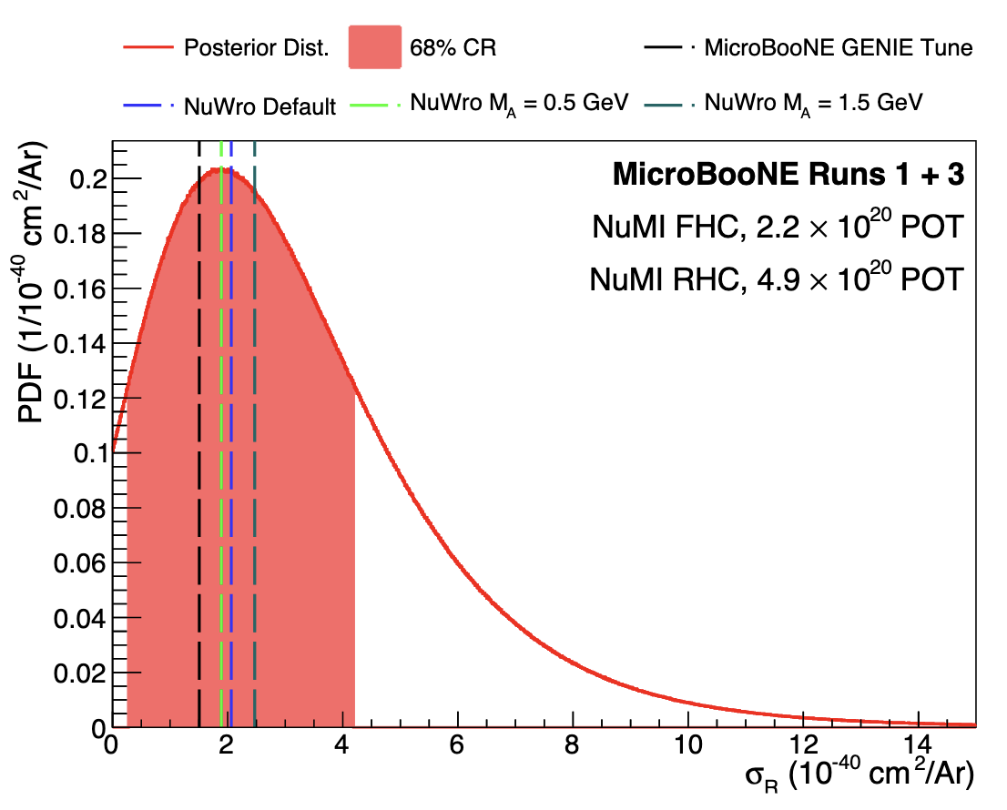
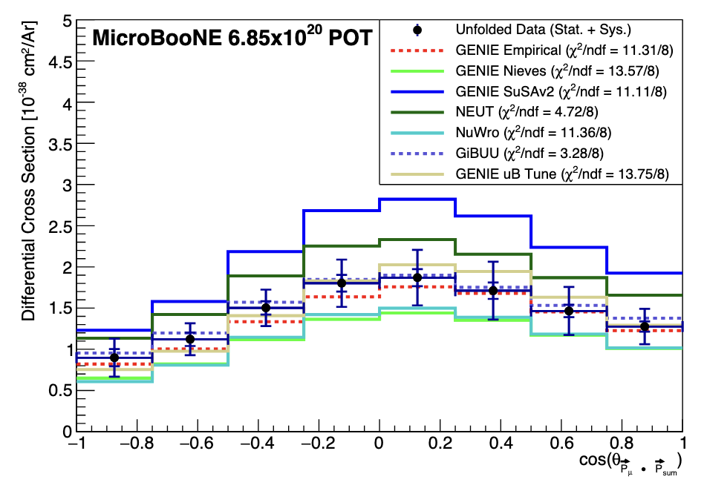
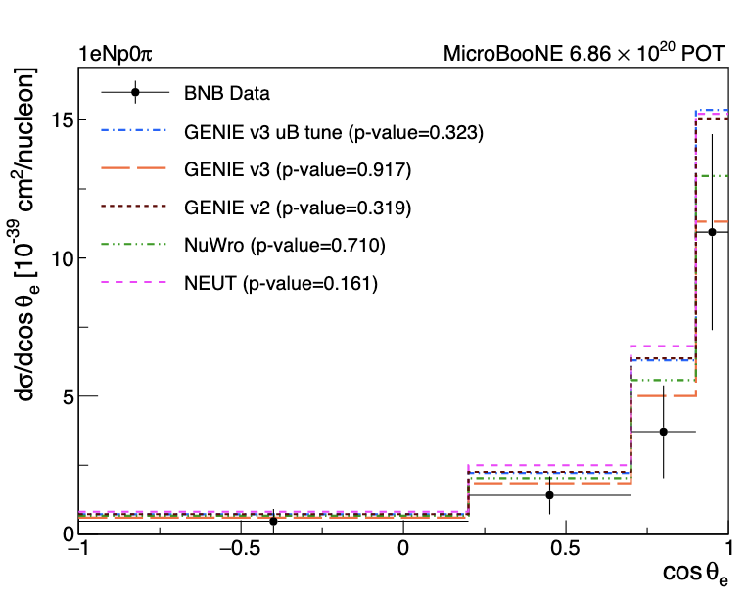
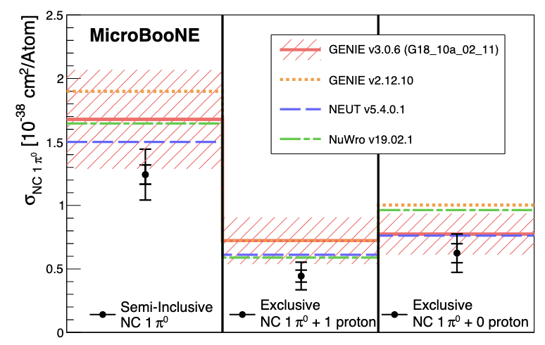
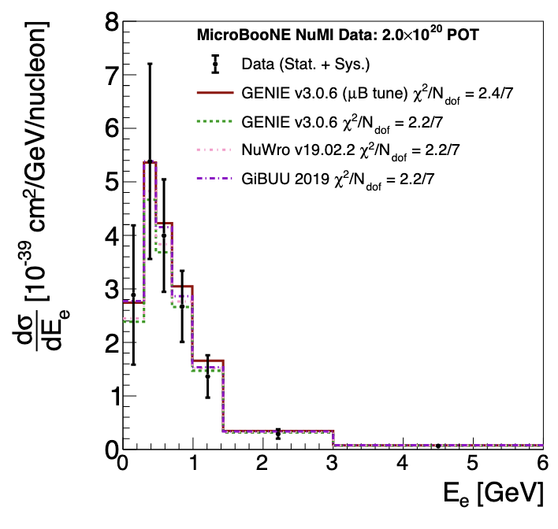
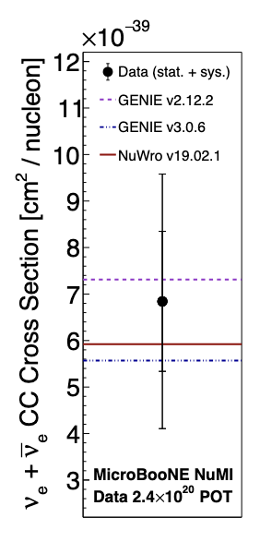
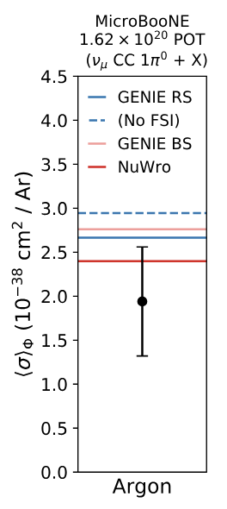
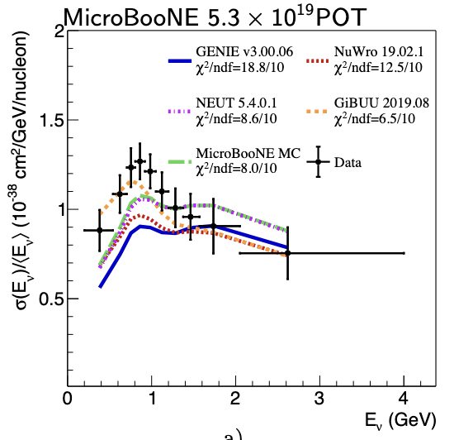
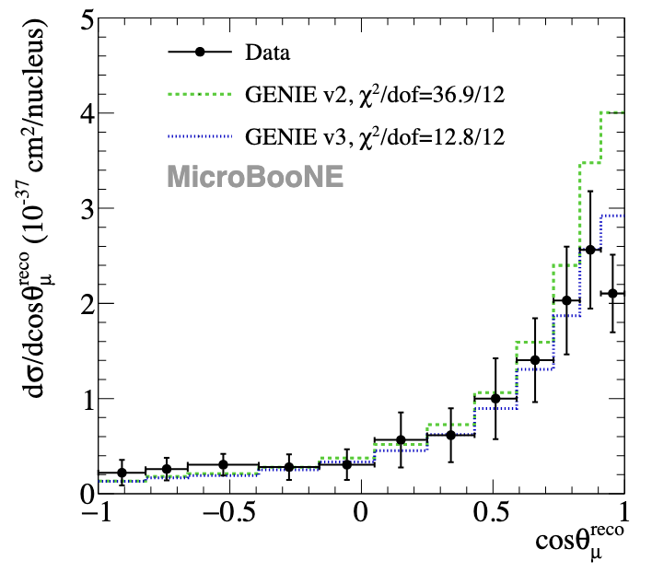
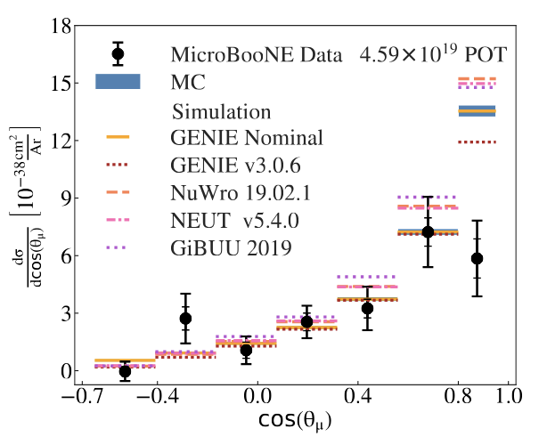
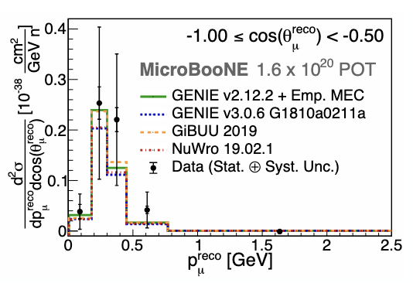
Neutrino-Argon Scattering
[1] Nue CC 0pi Np
[2] CC charged pion
[3] CC 0piNp (2D)
[4] CC 1p neutrino direction
[5] Nue CC charged pion
[6] Kaon production
[7] NC pi0 (2D)
[8] CC pi0
[9] CC Np0pi
[10,11] CC inclusive 0p/Np
[12] QE-like GKI
[13] 3D CC inclusive
[14] Eta production
[15,16] QE-like TKI 2D
[17] Lambda production
[18] CC 2p
[19] Nue CC 0pi
[20] NC pi0
[21] CC inclusive Enu
[22] Nue inclusive 1D
[23] Nue inclusive integrated
[24] CC Np0pi
[25] CC QE-like
[26] CC inclusive 2D
[27] CC pi0
[1]
[2]
[3]
[5]
[4]
[6]
[9]
[7]
[10,11]
[8]
[12]
[13]
[18]
[15,16]
[14]
[17]
[19]
[25]
[24]
[20]
[21]
[22]
[26]
[23]
[27]

Slide 11
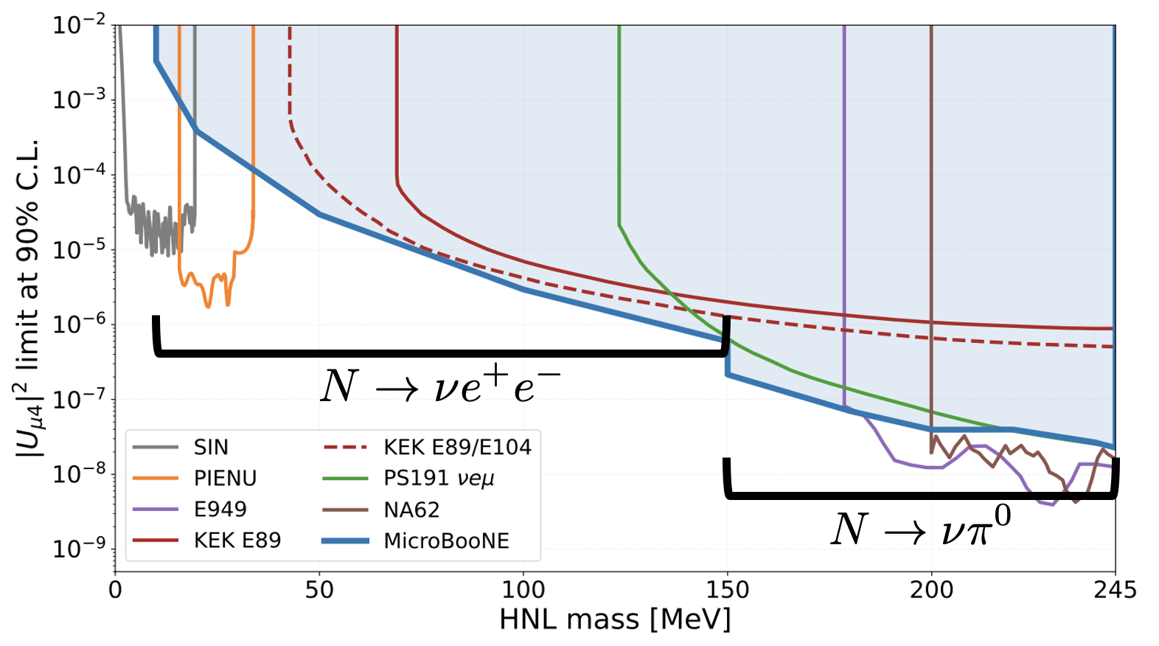
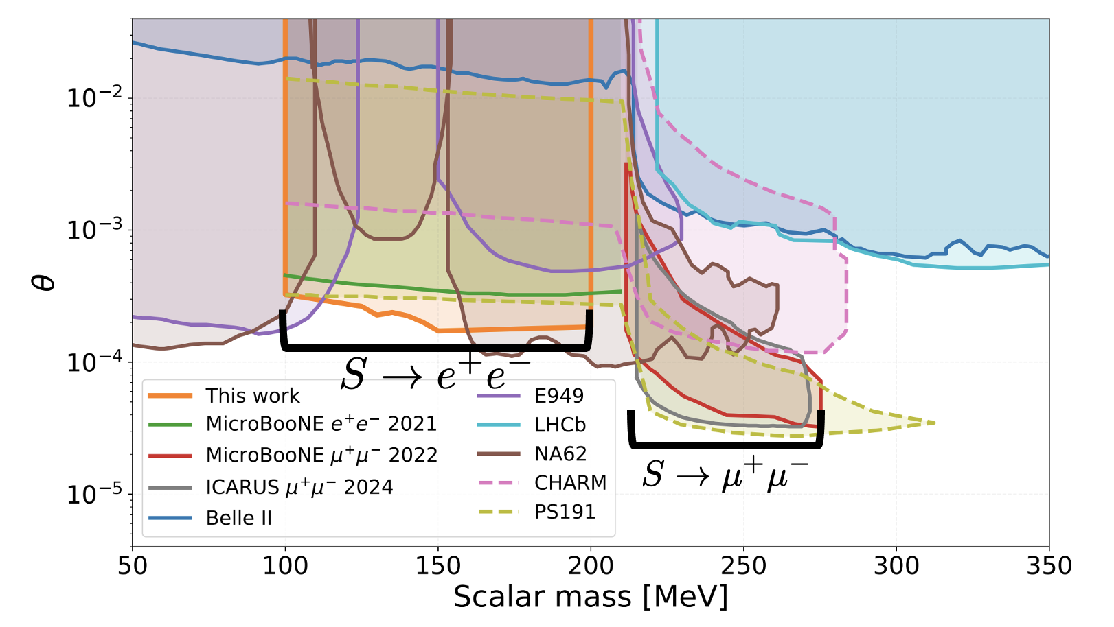
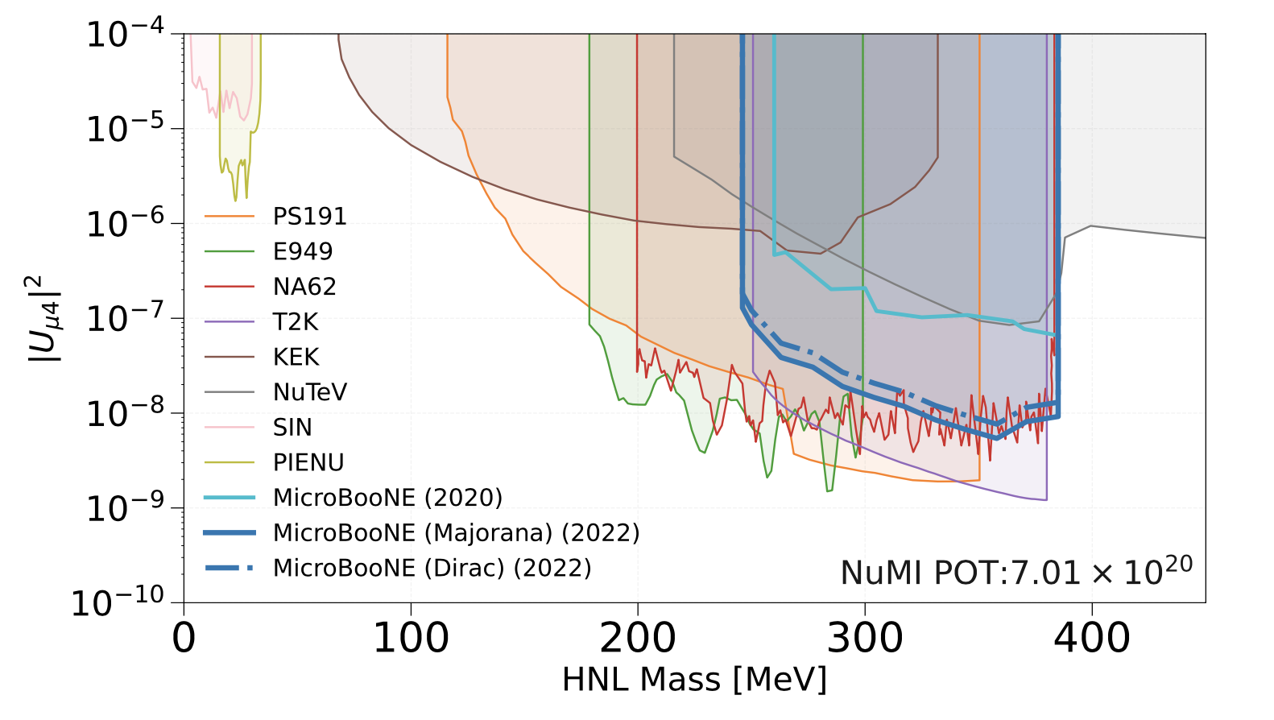

Beyond the Standard Model
Heavy neutral leptons
PRL 132, 041801 (2024)
Higgs portal
scalars
arXiv:2501.08052,
PRL 127, 151803 (2021),
PRD 106, 092006 (2022)
PRD 101, 052001 (2020),
PRD 106, 092006 (2022)
Dark tridents
PRL 132, 241801 (2024)

Slide 12



SBND cross-section programme and first results
First SBND physics run is already the largest sample of neutrino interactions on argon (~3.5M neutrino interactions).
Rich physics programme (cross-sections, BSM, sterile ν)
SBND can exploit “internal” PRISM effect.
ν_{μ}CC1p0π
Covers most of DUNE phase space
- including 1st and 2nd oscillation maxima.
~ 3 days of data

Slide 13


SBN Physics (SBN=“SBND+ICARUS”)
Short baseline oscillations (near detector): comprehensive, multi-channel exploration of short baseline anomalies:
arXiv:2508.20239[hep-ex]

Slide 14



NOvA Experiment
NuMI beam: ν_{μ} or ν̅_{μ}
Two functionally identical, tracking calorimeter detectors
Near: 300 T underground
Far: 14 kT on the surface
810 km baseline
Longest baseline of current experiments.
Data taking started in 2014 and will end late 2026/early 2027.

Slide 15


NOvA: Mass Ordering and CP Results
Using Daya Bay to constrain both θ₁₃ and Δm²
NOvA data favour Normal Mass Ordering by ~7:1 odds.
Normal MO: data prefer small δ_{CP} values
Inverted MO: data prefer maximal CP-violation,
δ_{CP}=0,π not in 3σ allowed interval

Slide 16


NOvA and T2K Comparisons
Comparisons of 1σ contours in sin²θ₂₃ vs. δ_{CP} between NOvA, T2K, and joint:
Normal MO: NOvA and T2K prefer different regions in δ_{CP}
Inverted MO: NOvA and T2K contours overlap
Note: NOvA+T2K contours from smaller data set (both NOvA and T2K)

Slide 17


Joint NOvA and T2K Oscillation Fit
 | Preferred Mass Ordering | Bayes Factor | Odds
No Reactor | Inverted | 2.47 | 71% : 29%
Daya Bay θ₁₃ | Inverted | 1.34 | 57% : 43%
Daya Bay 2D | Normal | 1.44 | 59% : 41%

Slide 18



DUNE as the flagship long-baseline neutrino oscillation experiment
1300 km
FD
ND
Four key ingredients:
The high-power, wide-band neutrino beam.
The Far Detector with a long baseline of about 1300 km.
The liquid-argon technology providing flavour and topology reconstruction as a function of energy (L/E).
A movable, highly capable Near Detector.

Slide 19


A global collaboration

Slide 20



DUNE is envisaged in two phases (Phase I + Phase II)
Near Detector (ND)
Far Detector (FD)
Phase I
FD: 2 x 17 kt LArTPC modules
ND: ND-LAr+TMS (with PRISM) + SAND
Beam: 1.2 MW beam line (PIP-II)
LArTPC: Liquid Argon Time Projection Chamber
ND-LAr: Liquid argon-based ND
TMS: Temporary Muon Spectrometer
SAND: System for on-axis ND
MCND: More Capable ND
ND-GAr: Gaseous argon-based ND
PRISM: movable ND capability for off-axis beam measurements
PIP-II: Proton Improvement Plan-II
ACE: Accelerator Complex Evolution at Fermilab
Phase II
FD: 2 additional modules (total: 4 x 17 kt LAr-equivalent)
MCND: ND-LAr+ND-GAr (with PRISM) + SAND
Beam: > 2 MW beam line (ACE Upgrades)
Current LBNF/DUNE-US project covers facility and Phase-I detector.

Slide 21

ProtoDUNE critical – they taught us how to build liquid-argon TPCs with:
several metres of drift
excellent ionisation charge and scintillation light collection

Slide 22


Slide 23




ProtoDUNEs at CERN (HD and VD)

Slide 24


A ProtoDUNE Data Event

Slide 25

DUNE Phase-I Timeline
Phase I being on schedule is paramount for DUNE’s success

Slide 26



Phase I: Excavation and Cryostat Installation at SURF
Excavation of caverns at SURF is complete
All cryostat material delivered to SURF
Cryostat construction and assembly in early 2026
Followed by installation of the first two modules (VD and HD).

Slide 27

DUNE Near Detector
Near Detector will comprise four components (ND-LAr, TMS, PRISM, SAND) with a gas-argon TPC replacing TMS for Phase-II.
A highly capable Near Detector is essential for achieving DUNE physics goals.
DOE in September removed the $200M cost cap set by CD-1RR and provides a clear path for US-ND to deliver fully qualified detectors for DUNE Phase I.
Near Site Civil construction at Fermilab remains a challenge – LBNF/DUNE-US project and DUNE Collaboration are exploring different options to address this issue.

Slide 28


Near Detector Prototyping (ND-LAr)
Successful start of Run-2 at Fermilab this October
University of Bern, Switzerland

Slide 29

Near Detector uses pixel technology
One beam spill at ND-Lar (7.5E13 POT)
DUNE ND-LAr has a new challenge: LBNF is really intense
To reconstruct individual neutrinos with inherently slow LArTPC requires:
Pixelated readout to segment charge signals
Optical modularity to segment light signals

Slide 30

Early DUNE Physics Highlight: Mass Ordering
DUNE’s mass ordering sensitivity depends on true oscillation parameters
In the “easy” scenario, DUNE surpasses 5σ in <1 yr
But even in the most pessimistic scenario, DUNE reaches >5σ in about 5 yrs
Other techniques (e.g. atmospherics) take far longer, or never reach 5σ in unfavourable scenarios

Slide 31

CPV and Precision Oscillation Physics
Phase-II elements (ACE-MIRT, FD3, FD4, and MCND) are essential to achieve DUNE’s full physics potential

Slide 32


CPV and Precision Oscillation Physics
DUNE has the best ultimate δ_{CP} resolution, especially if CP is violated.
DUNE can resolve degeneracies between different values of δ_{CP} with broad L/E spectrum.

Slide 33




Beyond oscillations: unique reach in supernova physics
10 kpc supernova burst
Time and energy profile of SNB neutrino flux is rich in supernova astrophysics
~5° pointing resolution depending on SNB location
Flux includes ν_{e}, ν_{e}, and other flavours (ν_{x}), only DUNE measures ν_{e} due to Ar target
DUNE is uniquely sensitive to mass ordering via SNB detection
DUNE supernova program starts the moment FD1 is turned on, reach extends beyond the Milky Way with additional modules
DUNE ν_{e}

Slide 34



The path towards Phase-II
P5 Recommendation:
White Paper published in JINST
LoI for ProtoDUNE-III Run at NP02:

Slide 35



European Strategy Update – Recommendations by Strategy Group
“The CERN Neutrino Platform is a focal point of European participation in the global long-baseline neutrino programme. In particular, the current commitments to the LBNF/DUNE project have been decisive and remain a priority for CERN.”
“The origin of neutrino masses is one of the most important open questions in particle physics. The long-baseline experiments DUNE and Hyper-K, along with other neutrino experiments, will be key to determining the neutrino parameters.”

Slide 36
Summary
The US neutrino programme covers both short- and long-baseline neutrino physics exploiting the unique capabilities of the Fermilab accelerator complex.
The short-baseline programme (MicroBooNE, SBND, ICARUS) is demonstrating the power of the liquid-argon technology with a rich physics programme of cross-section measurements, providing sterile neutrino constraints, and BSM physics.
NOvA’s data continues to provide intriguing hints regarding possible CPV in the neutrino sector and the neutrino mass ordering.
DUNE is designed to test the three-flavour paradigm. If the three-flavour picture is correct, DUNE will make the most precise measurements of its parameters, leveraging spectral information to break degeneracies. DUNE also has qualitatively superior ability to determine the neutrino mass ordering definitively.
The wideband beam, very long baseline, liquid-argon technology, and the movable near detector are key in enabling DUNE’s unique science reach.

