Slide 1
Dark Matter Direct Search 10-year Roadmap
December, 2025
DOE/SC Office of High-Energy Physics (HEP)
Cosmic Frontier Subprogram
Presented by
Manuel Bautista (manuel.bautista@science.doe.gov)
Kathy Turner (kathy.turner@science.doe.gov)
Bryan J. Field (bryan.field@science.doe.gov)

Slide 2
A Lean, Agile, and Fiscally Responsible Path to Discovery
DOE's Unique Position: The DOE, with its unparalleled capabilities is uniquely positioned to lead this global quest to unravel the cosmic mystery of dark matter. Our National Laboratories and university collaborators possess the expertise, infrastructure, and collaborative ethos to drive this endeavor.
DOE's Core Strengths: Fundamental physics, advanced detectors, AI/ML, Quantum Information Science (QIS), theoretical underpinnings
Strategic Role: Continue to be a leader in the global effort
Fiscal Reality: DOE’s Office of Science is facing a converging set of substantial project commitments and nascent initiatives. This leads to highly constrained budgets for the rest of this decade. This demands careful planning prioritizing prudent investments that maximize return in discovery potential and technology development.

Slide 3
A 10-Year Strategic Framework
DOE has been a world leader in DM direct detection experiments, setting sensitivity limits, developing technologies, probing parameter space, and building the first generation of experiment.
A Lean, Agile, and Fiscally Responsible Path to Discovery
A focused, agile, and fiscally responsible strategy balances discovery potential across multiple dark matter candidates.
Vision: To strategically pursue the most promising dark matter candidates, leading to discovery or definitive constraints, and solidifying DOE's leadership.
Core Strategy: Balance WIMP, Light Dark Matter (LDM), and Axion searches within a lean budget, leveraging U.S. technical leadership and international partnerships.
Benefits: Maximizes discovery probability. Push the development of new powerful tools and technologies for the benefit of our nation.

Slide 4
Multi-faceted Approach

Slide 5

PILLAR 1: WIMPs ($m_{DM}>1 GeV/c^{2}$ )
Weakly Interacting Massive Particles (WIMPs)
Core Concept: WIMPs are hypothetical particles that interact with regular matter via the weak nuclear force and gravity. Their defining characteristic is their mass, typically in the GeV to TeV range, and their interaction strength, which is comparable to that of neutrinos.
WIMPs are not part of the Standard Model. There is no predicted minimum or maximum WIMP interaction cross-section with ordinary matter.
  The Neutrino Fog is the critical practical limit for direct detection, not a fundamental limit on the WIMP itself. As WIMP detectors become increasingly sensitive, they reach a point where they begin to detect coherent elastic neutrino-nucleus scattering events originating from astrophysical neutrinos (see latest LZ results from 8 December).

Slide 6
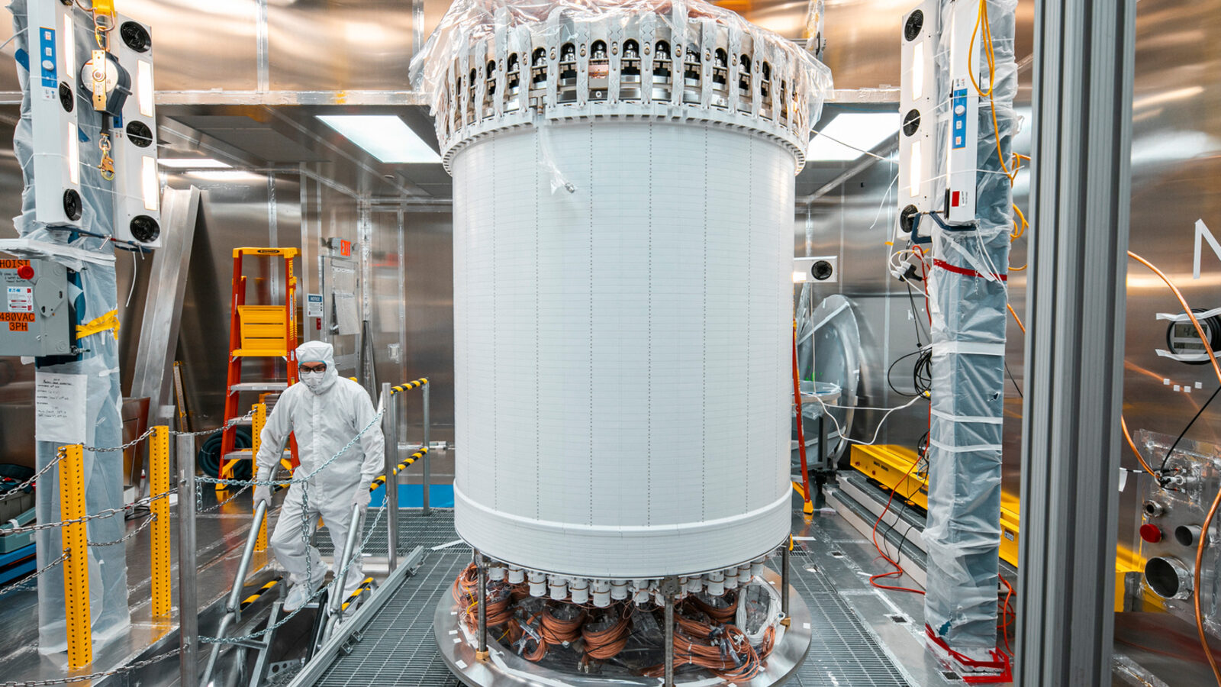
PILLAR 1: WIMPs
Current Techniques for Direct Detection:
Direct detection experiments aim to observe the rare interaction of WIMPs with ordinary matter.
Principle: WIMPs passing through the Earth collide with atomic nuclei in a very sensitive detector, causing the nucleus to recoil. This recoil produces a detectable signal (keV range).
Common Detection Technologies:
  Cryogenic Noble Liquids (e.g., Xenon, Argon): Large tanks of ultra-pure liquid xenon, housed deep underground (e.g., LUX-ZEPLIN (LZ), XENONnT, PandaX) or argon (e.g., DarkSide).
The LZ Experiment:
1 mile underground at SURF; Time Projection Chamber with 7 tons liquid Xenon
First Results: July 2022. Continuing operations planned through 2028.
Partners: DOE-only (+ international)
DOE project Cost ~ $55M

Slide 7
LZ’s results (416.5 live days)
World-leading limits > 5 GeV/c2
● < 9 GeV DM searches of similar or greater cross-sections are limited by solar neutrinos
● Higher mass DM searches are not yet entering the neutrino fog
○ Fog is set by atmospheric neutrinos
● Interesting model space to probe at higher masses!
Measurement of ⁸B CE𝜈NS
● flavor-independent measure of solar neutrino flux
● Measure weak-mixing angle (sin2𝛳W) at low momentum transfer (Q)
LZ continues to operate and take data towards a
1000 day DM discovery dataset by end 2027!

Slide 8
PILLAR 1 Plan
Operate the LZ Experiment:
  Currently planned through 2028
  The community is actively working a possible proposal for LZ upgrades and extended operations (2028+).
  Expected improvements: background reduction, enhanced sensitivity, increased operational lifetime, incorporate AI/ML capabilities.
  Defer possible start of large next generation experiments:
  XLZD being planned by the community for an offshore location can not be started under current budgetary conditions.

Slide 9
PILLAR 2: LDM (particle-like DM, $m_{DM}<1 GeV/c^{2}$ )
Light Dark Matter (LDM):
Broad class of hypothetical particle-like dark matter particles lighter than WIMPs.
Theoretical Models often involve a "dark sector" that is weakly coupled to the Standard Model (SM) through a "portal".
There is no single sensitivity limit for LDM. Coupling strengths vary depending on the portal and the detection technique.
Direct detection techniques:
Nuclear recoils (superfluids, e.g. LHe)
Electron recoil measurements (Skipper CCDs, Superconducting Qubits/calorimeters, Scintillators)
Quantum excitations on superconducting targets (quasiparticles and phonons)

Slide 10
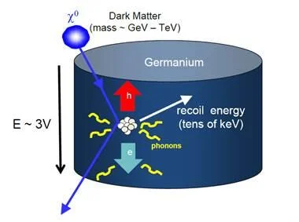
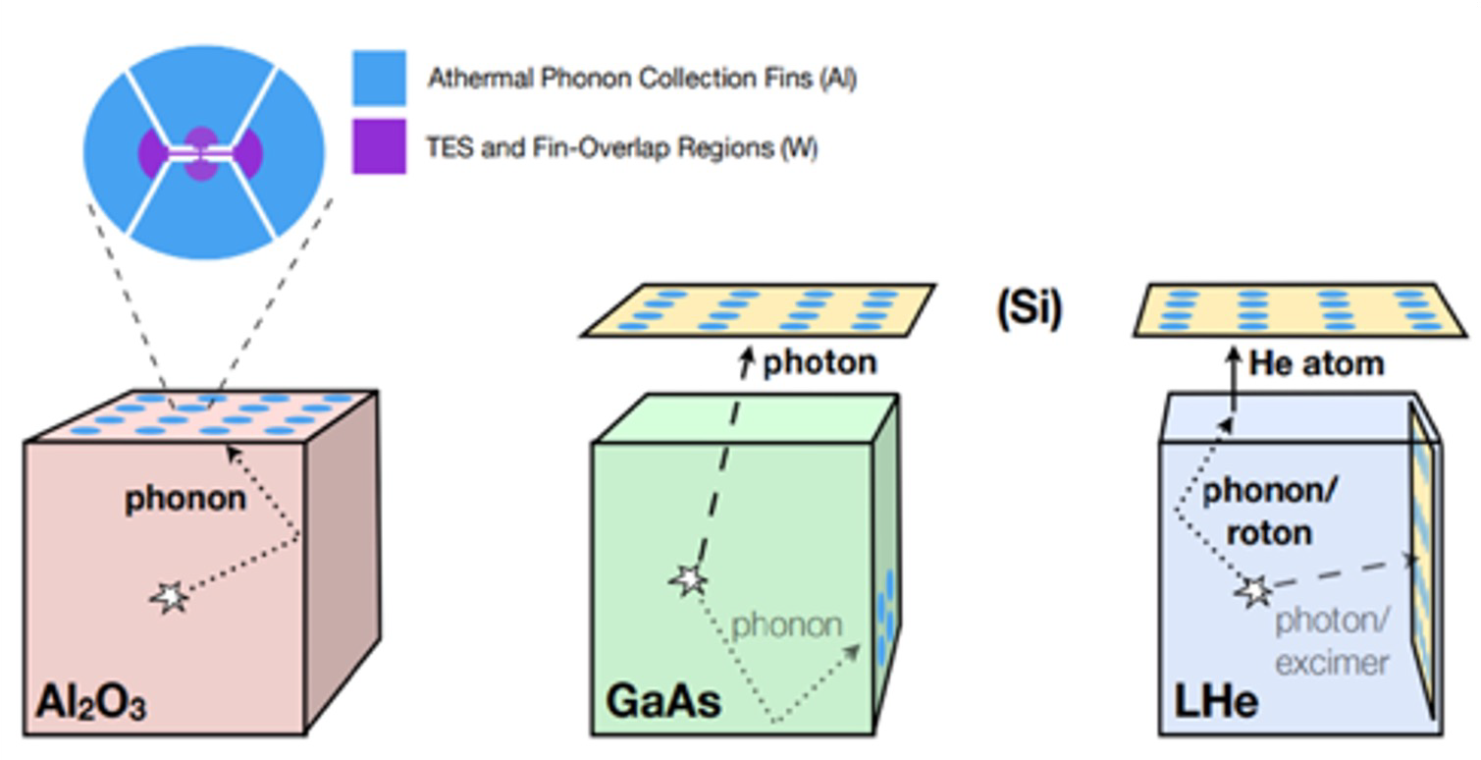
PILLAR 2: LDM
    SuperCDMS
    Lead lab SLAC
    At SNOLAB in Sudbury Canada
    Cryogenic solid-state crystal germanium and silicon detectors
    DOE-HEP, NSF-PHY, Canada
    Science starts in 2026, initial 3-year run
    Project cost ~$24M (DOE) (from ~$40M total)
    TESSERACT
Lead Lab LBNL; partner with France; located in France
Detector basics - Multiple targets: sapphire, silica,
  gallium arsenide, superfluid helium
  Transition Edge Sensor (TES) readout; Shared shielding
Partnership with France
Fabrication started in FY25 Commissioning in 2028; Ops thru FY31+
Already setting world leading results (Dec. 2024)
DOE project cost under $10M (+$6M France)

Slide 11
PILLAR 2 Plan
Complete project construction and operations:
  SuperCDMS (start operations in early 2026)
  TESSERACT (began construction under LBNL management)
  Consider starting the LDMX experiment:
  LDMX, accelerator-based detection, is highly desirable to gain some definitive answers and constrain models. HEP funded a vertical slice test in FY26. However, it cannot be started at full cost under current budgets. HEP is interested in seeing a potential descope option for under $10M.

Slide 12
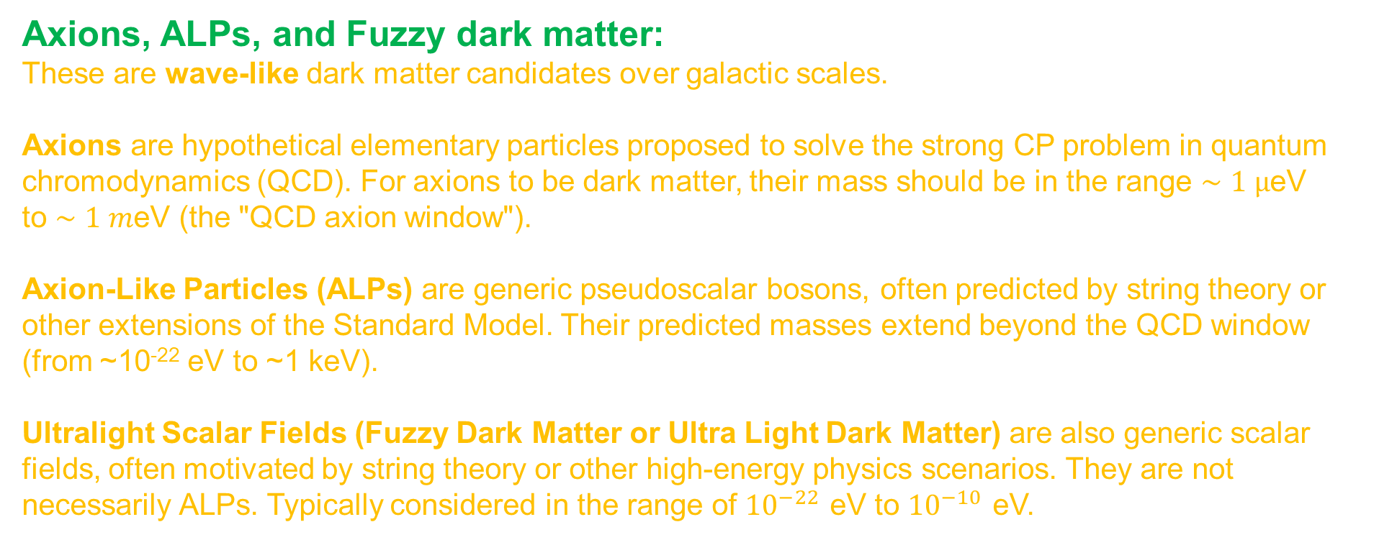
PILLAR 3: Axions (wave-like DM)
Axions, ALPs, and Fuzzy dark matter:
These are wave-like dark matter candidates over galactic scales.
Axions are hypothetical elementary particles proposed to solve the strong CP problem in quantum chromodynamics (QCD). For axions to be dark matter, their mass should be in the range $∼1 µ$eV to $∼1 m$eV (the "QCD axion window").
Axion-Like Particles (ALPs) are generic pseudoscalar bosons, often predicted by string theory or other extensions of the Standard Model. Their predicted masses extend beyond the QCD window (from ~10⁻²² eV to ~1 keV).
Ultralight Scalar Fields (Fuzzy Dark Matter or Ultra Light Dark Matter) are also generic scalar fields, often motivated by string theory or other high-energy physics scenarios. They are not necessarily ALPs. Typically considered in the range of ${10}^{−22}$ eV to ${10}^{−10}$ eV.

Slide 13
PILLAR 3: Axions
Sensitivity Constraints: Theoretical specificity provides a constrained target
Vast parameter space
Mass Uncertainty (Frequency Scanning): Search requires both tuneability and rapid scanning capabilities.
Minute signal: fundamentally limited by the quantum noise of the detection systems.

Slide 14
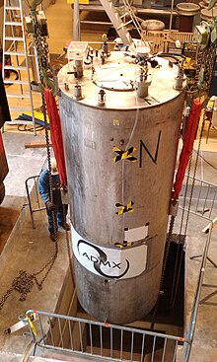
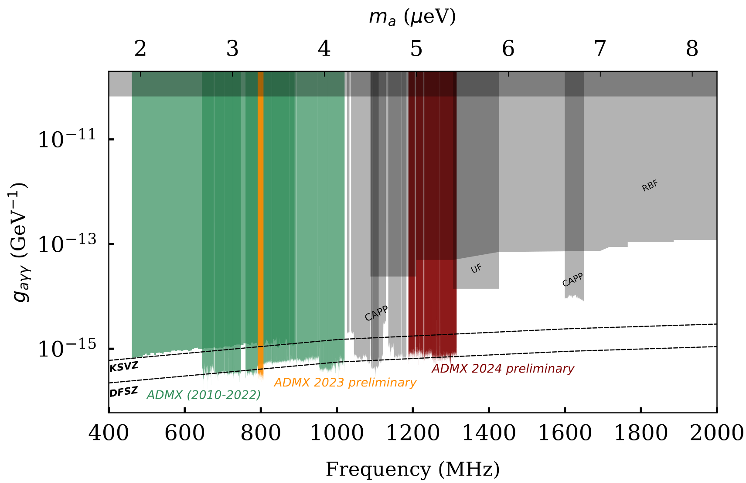
PILLAR 3: Technologies
ADMX-G2
Fermilab management; Located at U. Washington
DOE + international.
ADMX was the first haloscope-based experiment with plausible direct detection potential.
World leading search of QCD axions reaching predicted QCD sensitivity limit.
Employs a superconducting magnet applied to cavities tuned to the dark matter frequency.
Started taking data in 2017 and planned ops through 2029.

Slide 15
Axion Masses Explored in QuantISED 2.0 (eV) – Funded Proposals in 2025 for Detector Dev. R&D
Sensing
Pathfinder
10⁻¹²
10⁻¹¹
10⁻¹⁰
10⁻⁹
10⁻⁸
10⁻⁷
10⁻⁶
10⁻⁵
10⁻⁴
10⁻³
10⁻²
10⁻¹
10⁰
Proposed full DM mass sensitivity range in eV

Slide 16
PILLAR 3 Plan
Complete ADMX-G2 operations as planned (until FY29)
Accelerate quantum-enhanced axion detection technologies aiming for broad band, high sensitivity searches.
HEP is exploring potential ways to coordinate National Lab expertise in QIS for axion searches.
Notes:
*QIS SC-Sponsored Reports | U.S. DOE Office of Science(SC)

Slide 17
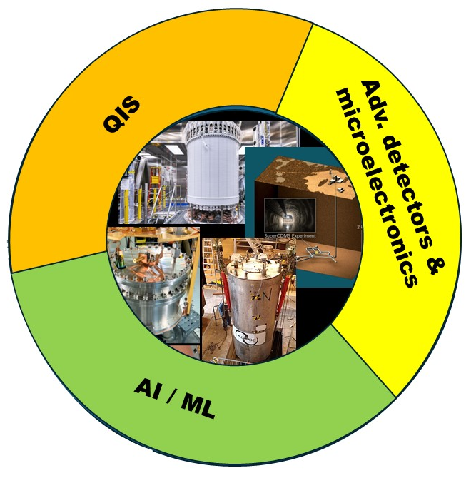
Cross-Cutting Enablers: Fueling Innovation & Efficiency
Quantum Information Science (QIS) Integration: Enhancing detector readout, developing novel sensing modalities, and improving data analysis.
Advanced Detectors: Breakthroughs in ultra-low background materials, high-Q cavities, and novel detectors and amplifiers.
AI/ML & High-Performance Computing (HPC): Optimizing detector design and performance, background rejection, signal identification, and real-time data processing.
Optimized Infrastructure Utilization: Maximizing return on existing National Lab testbeds.

Slide 18
PHASE I
PHASE II
FY26 | FY27 | FY28 | FY29 | FY30 | FY31 | FY32 | FY33 | FY34 | FY35
LZ experiment
LZ 2028+ (?)
Next generation experiment (?)
PILLAR 1
SuperCDMS operations
TESSERACT construction
Operations
LDMX (?)
PILLAR 2
QIS Sensing & Pathfinders
ADMX-G2
QIS broad field axion sensing strategy
G3 broad band axion search experiments (?)
PILLAR 3

Slide 19
Future of Dark Matter Search at HEP
HEP has made major investments in WIMP, LDM, and axion searches.
We are following the P5 top recommendations in completing the G2 experiments.
We have a robust and balanced strategy to search through an extremely large parameter space.
Advances and DOE technology priorities in detectors + QIS + AI/ML are particularly suited to axion and wave-like searches. We plan to take advantage of this opportunity.
We are exploring mechanisms to coordinate QIS expertise at the national labs towards new broad band axion searches.
HEP budgets are highly constrained for the rest of this decade, which force us to prioritize prudent investments that maximize return in discovery potential and technology development.

Slide 20


Slide 21

Leading the Next Era of Dark Matter Discovery
The search for dark matter is one of the most compelling scientific quests of our time. This DOE Strategic Plan provides a robust, forward-looking, and fiscally responsible roadmap to ensure U.S. leadership in this critical global endeavor.
We are poised to:
Unveil the Unseen: Make transformative discoveries that redefine our understanding of the universe.
Drive Innovation: Accelerate breakthroughs in quantum, AI/ML, and detector technologies.
Strengthen the Nation: Develop a world-class workforce and foster a competitive U.S. high-tech industry.
This plan represents a balanced, optimized, and impactful investment in fundamental science with profound returns for the U.S. economy and its technological future.
Call to Action to ensure the U.S. remains at the forefront of this critical global scientific enterprise.

Slide 22
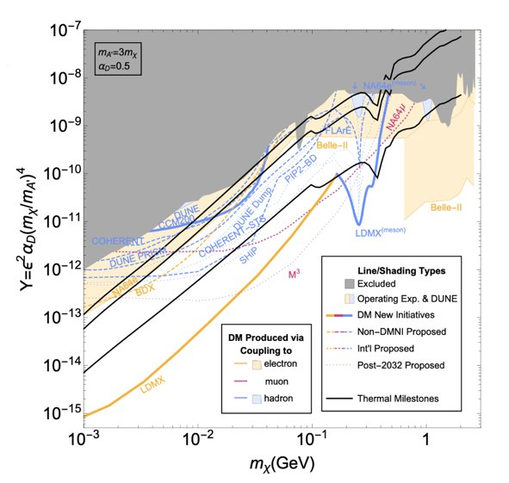
PILLAR 2: LDM
    LDMX
    Lead lab SLAC
    Definitive search for signatures of dark photon mediators based on missing momentum.
Accelerator-based (indirect detection) missing momentum detection ​​
Technology: High intensity e- beam, Si trackers, E&M, hadronic calorimeters, scintillator veto counters.​
Schedule: 2.75-year fabrication. ​
Proposing to begin construction in FY27
Cost: $24M total project cost

