Slide 1
Dark Energy and Cosmology Science Updates DPF Community Meeting December 18, 2025
Bryan J. Field U.S. Department of Energy Office of High-Energy Physics
Cosmic Frontier Team
bryan.field@science.doe.gov
kathy.turner@science.doe.gov
manuel.bautista@science.doe.gov

Slide 2
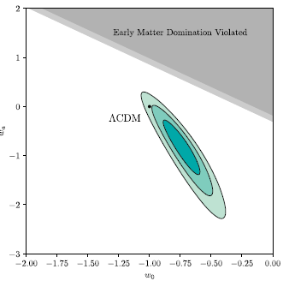
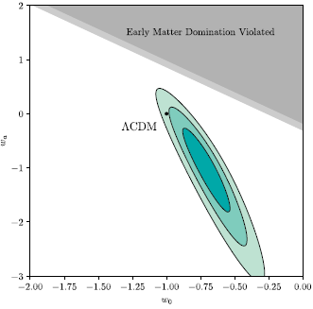
Cosmology Science Updates
NSF-DOE Vera C. Rubin Observatory
Dark Energy Science Collaboration (DESC)
Dark Energy Spectroscopic Instrument (DESI)
SPT-3G
LuSEE-Night (science to come!)
Alpha Magnetic Spectrometer (AMS)
258,241,896,141 cosmic ray events (12/17/2025 5:02PM)
Also, LBNL led Supernova Cosmology Project collected and standardized 2,087 supernovae across several experiments into the ‘Union3’ dataset. Their analysis supports the new DESI dark energy results.
https://supernova.lbl.gov/
Flat Universe
Combined SNe, BAO, and CMB
Curvature was
also part of fit
10.3847/1538-4357/adc0a5
Notes:
The 1998 Nobel Prize was awarded from the study of 50 Type Ia supernovae.

Slide 3

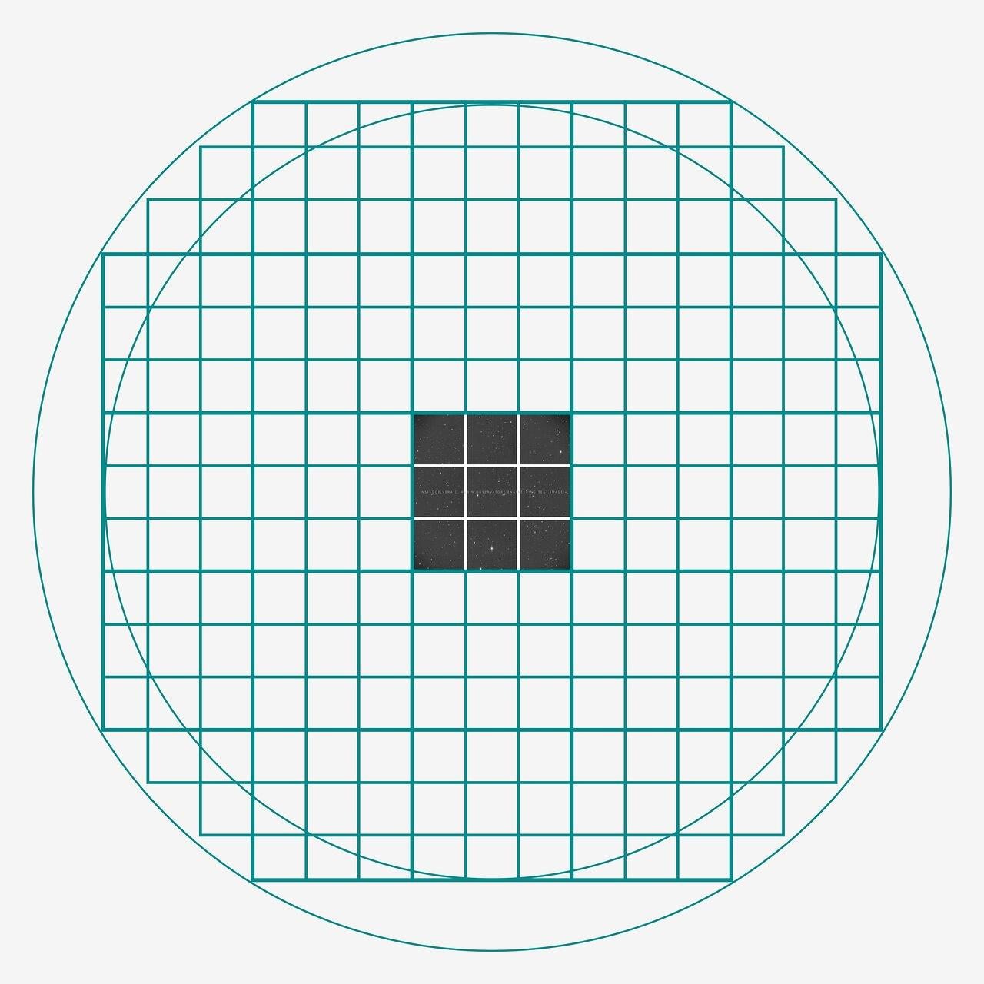
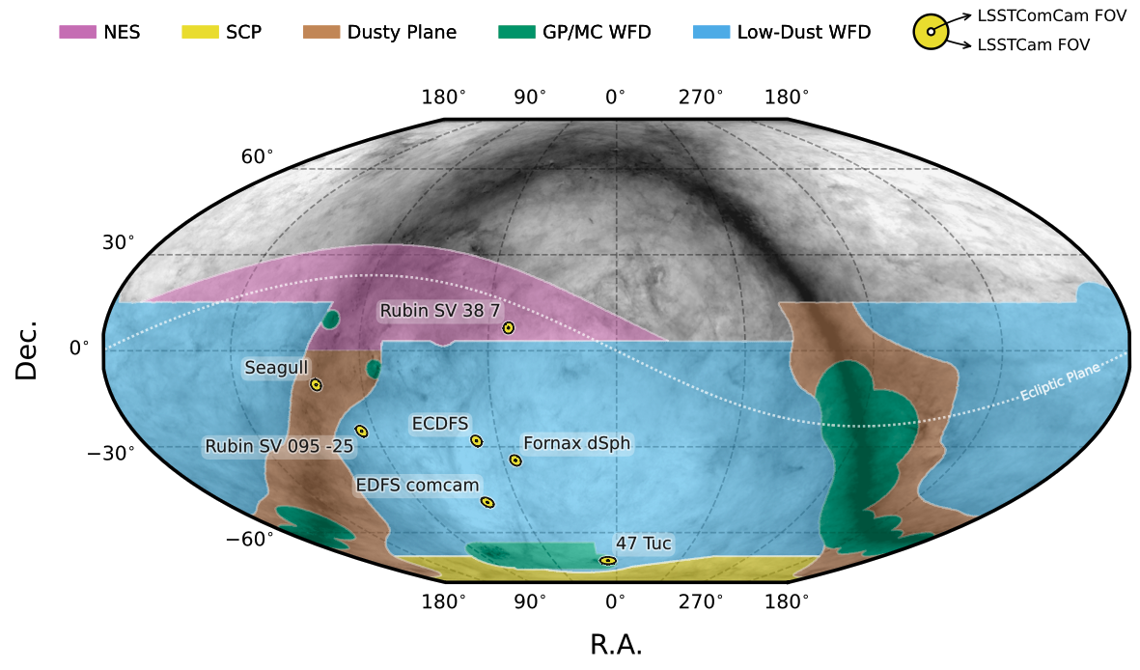
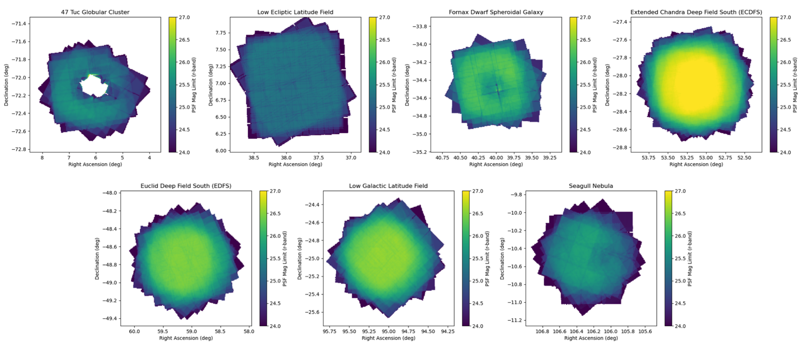
NSF-DOE Vera C. Rubin/LSST Begins
Data Preview 1 (DP1) - available now
Data obtained with the LSST Commissioning Camera (LSSTComCam), a single “raft” of 9 CCDs, over 7 weeks between Oct 10 and Dec 11 2024.
Seven fields across the southern sky support a range of science goals, and observed with different cadences, filter combinations, and coadded depths.
Available now via the Rubin Science Platform (RSP).
DP1 is a small but complete preview. It includes most types of science-ready data products as future releases. Equal to about 100 images with LSSTCam.
Documentation: dp1.lsst.io
Paper: rtn-095.lsst.io

Slide 4
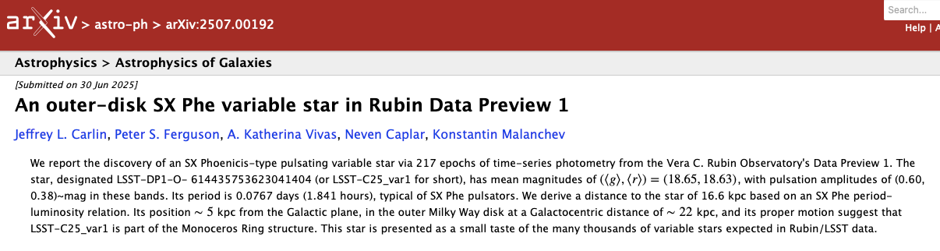
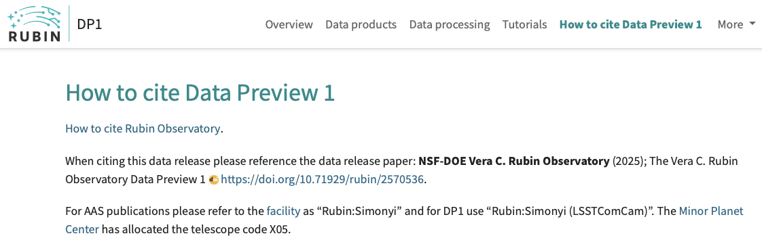
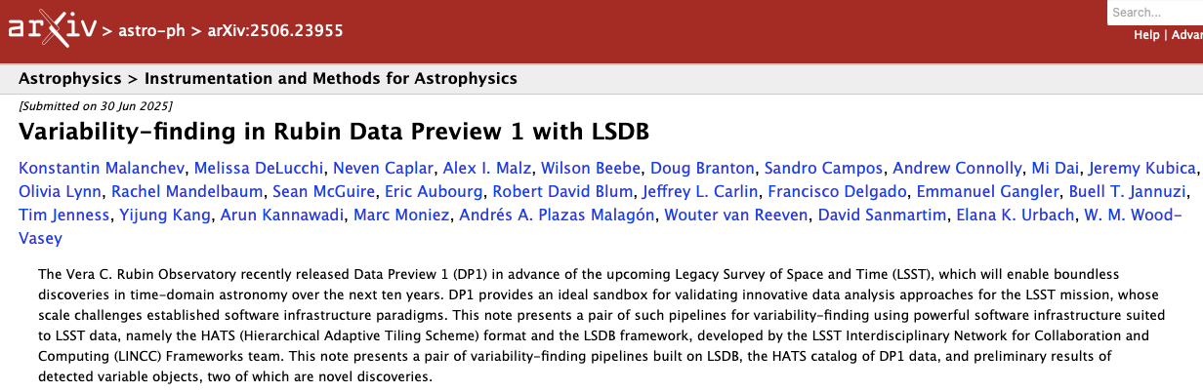
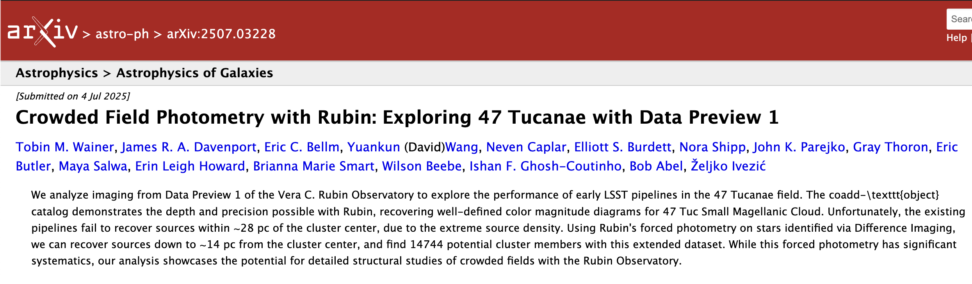
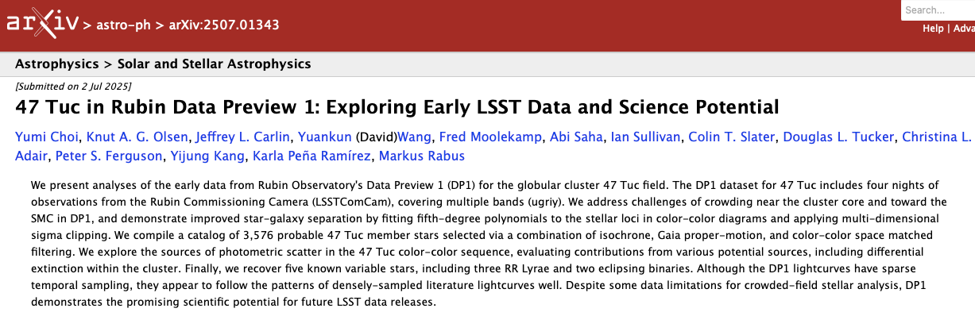

DP1: first Rubin science papers are appearing on arXiv!
See ls.st/rtn-095
8 so far!
Rubin Comet Catchers: the
first Citizen Science project!
~5,000 volunteers, with
~4 million classifications!

Slide 5
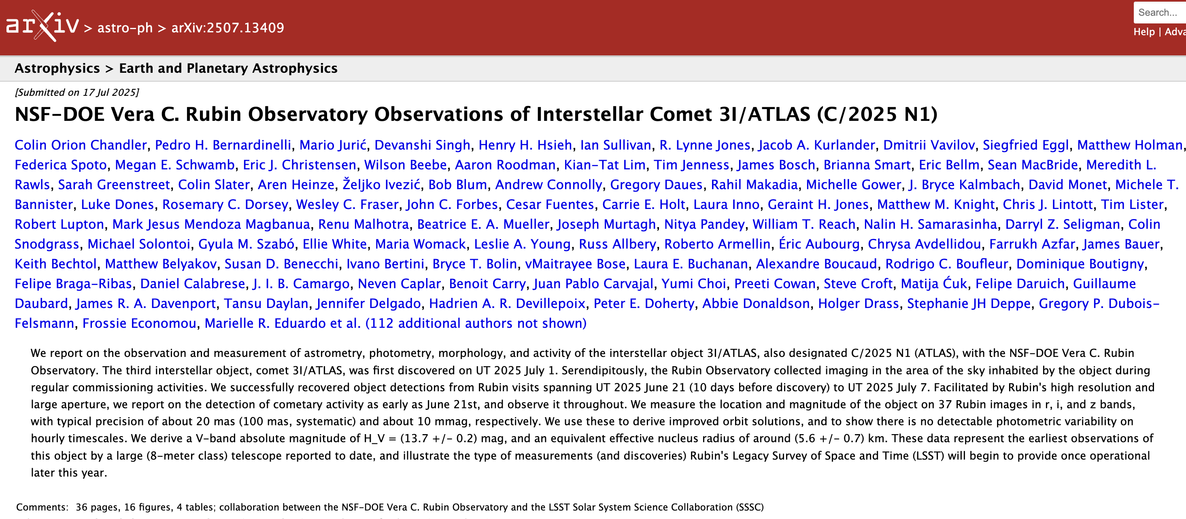
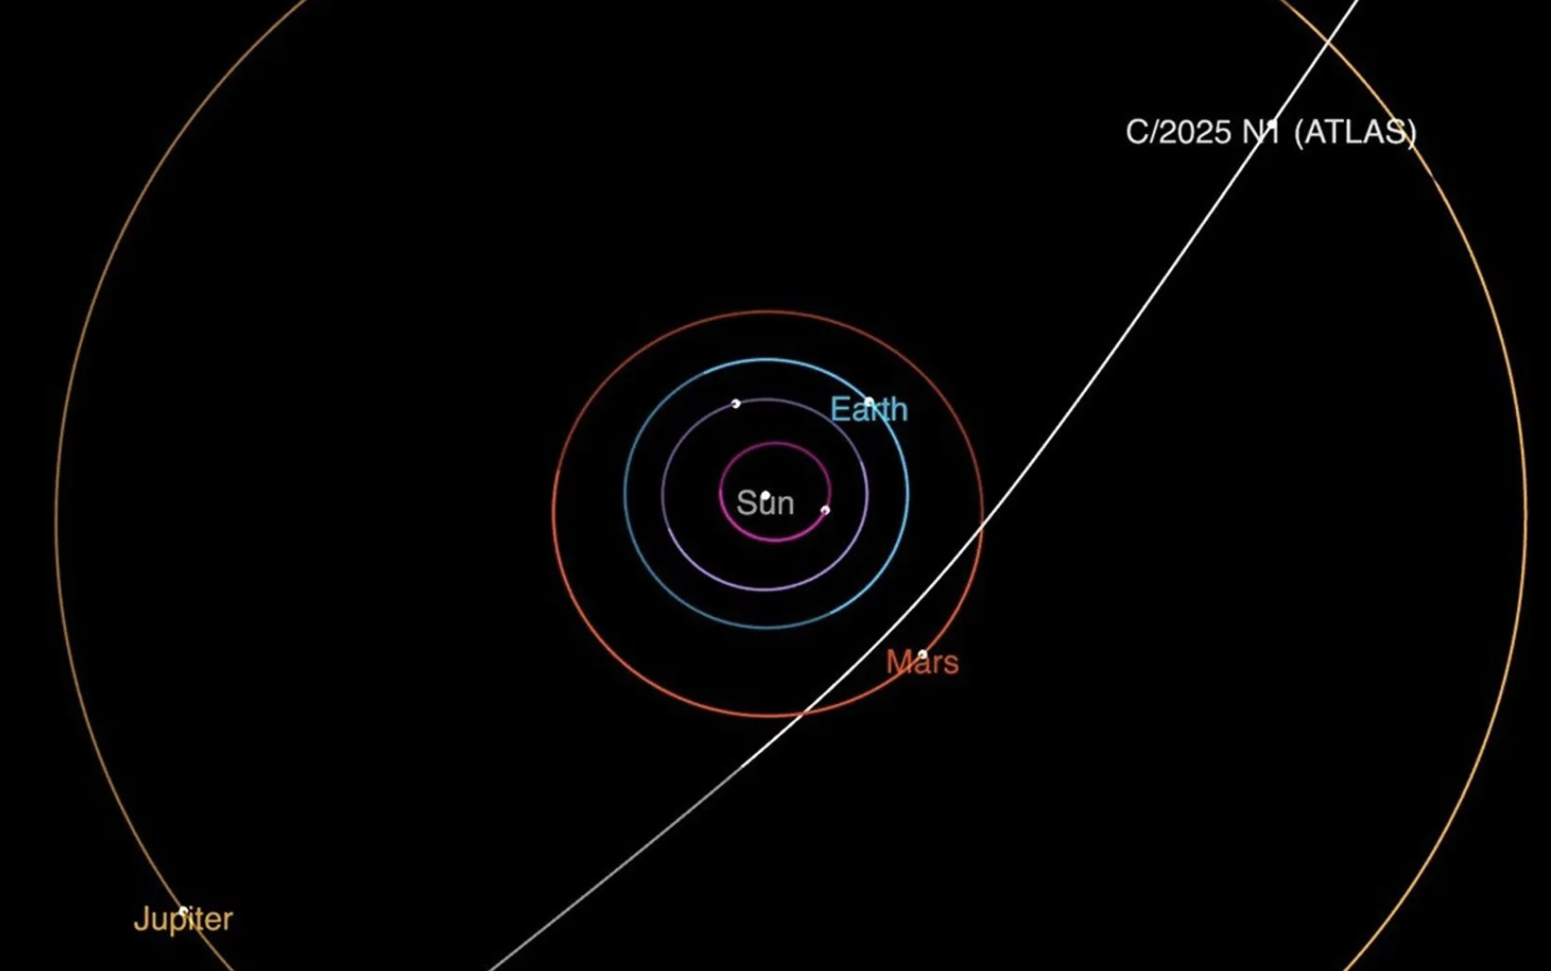
RFL data with LSSTCam: 3I/ATLAS paper on arXiv
Notes:
1 – ‘Oumuamua (19 Oct 2017)
2 – Borisov (29 August 2019)
3 – 3I/ATLAS (1 July 2025)

Slide 6
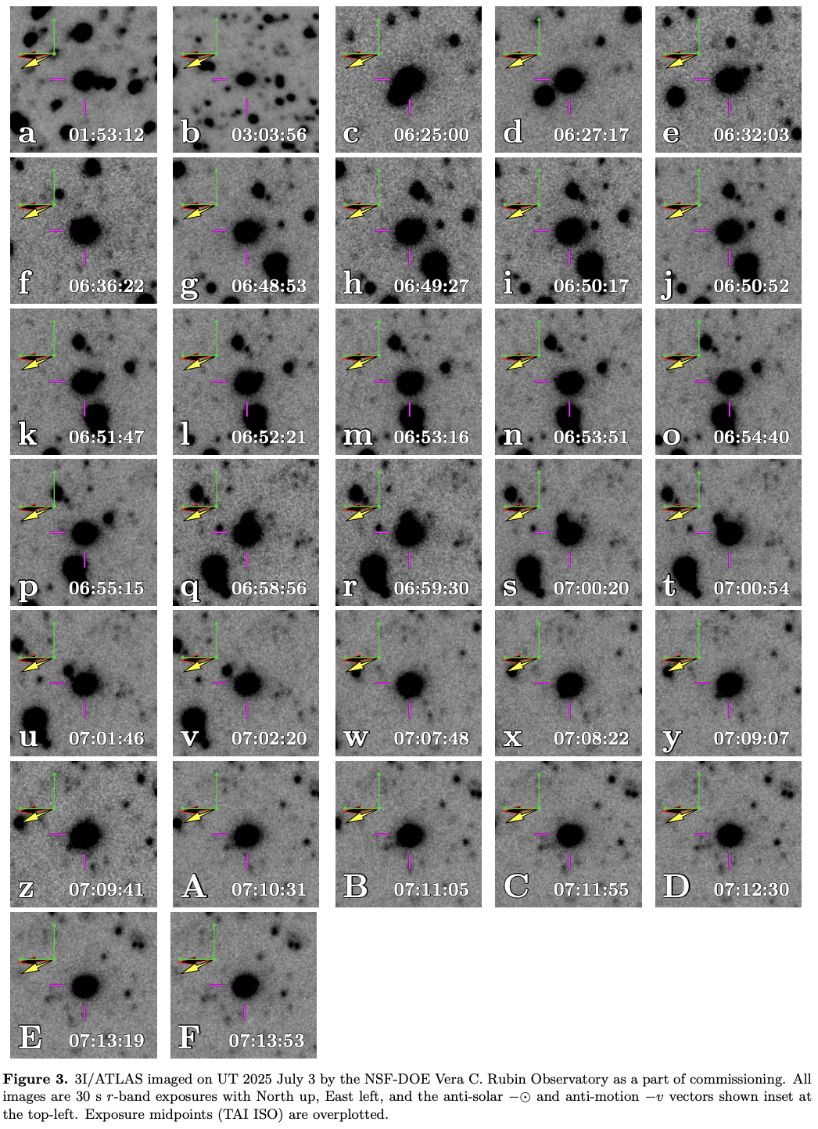
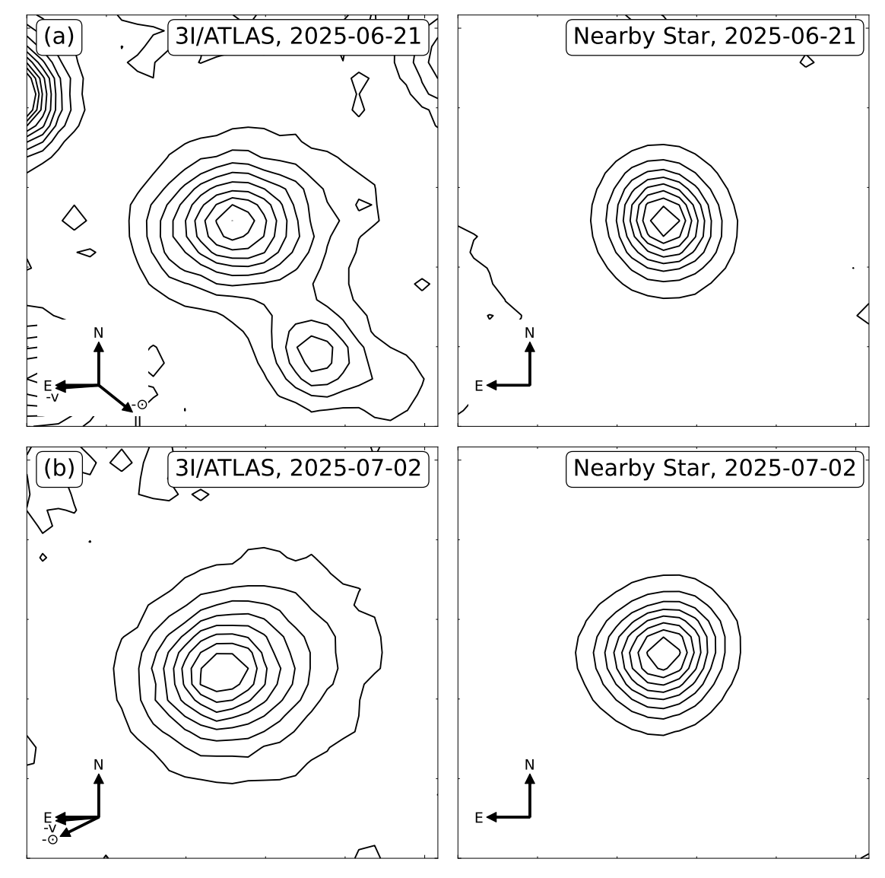
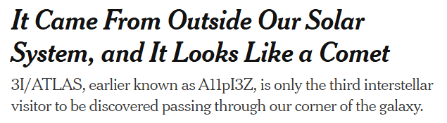
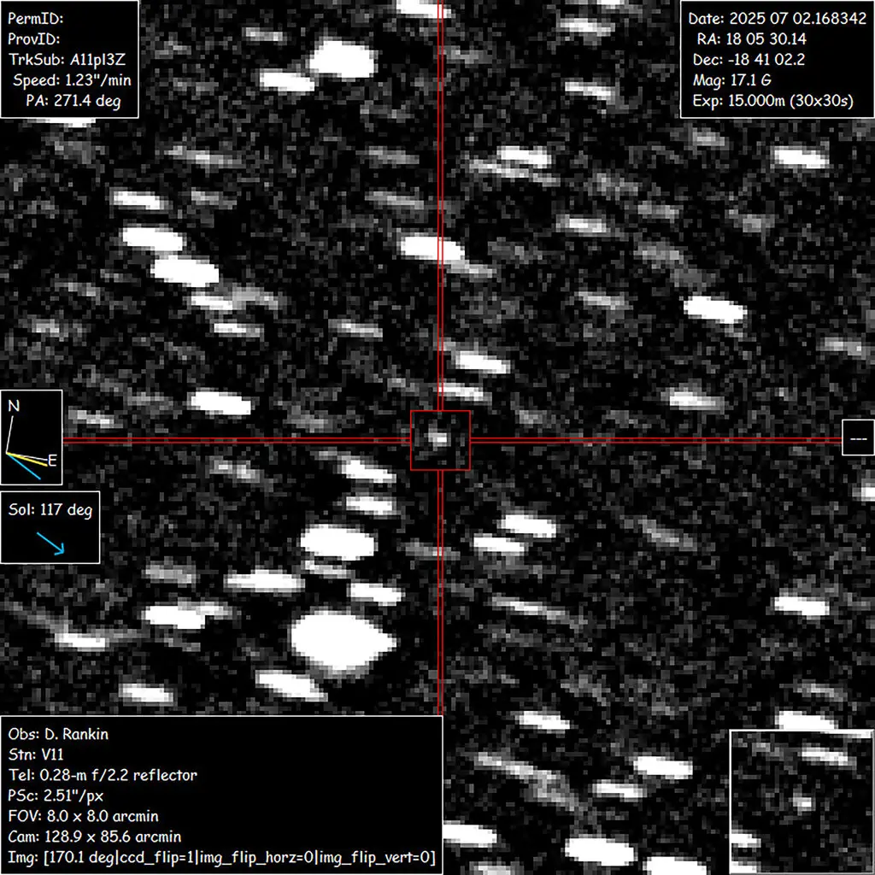
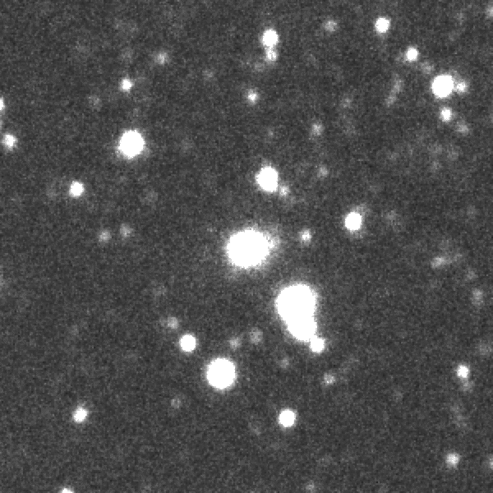
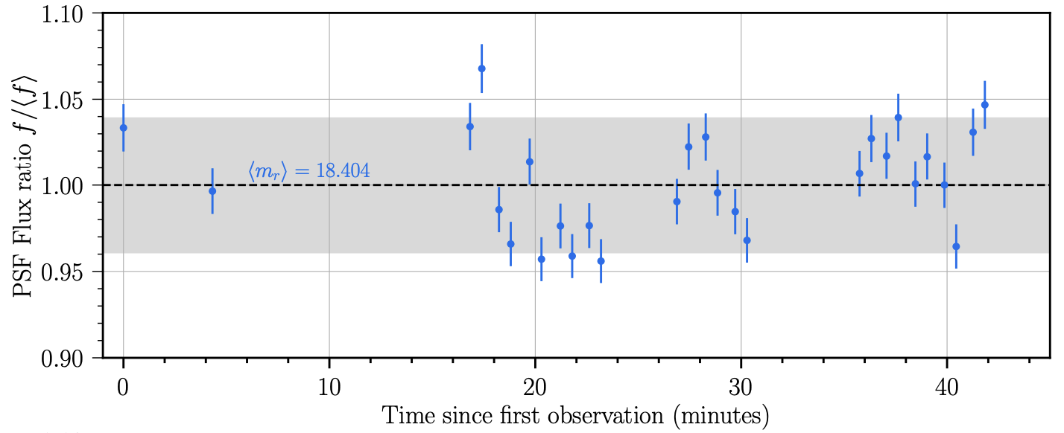
“Rubin Observatory looks everywhere and sees everything!”
NYTimes, July 2, 2025
Asteroid Terrestrial-impact Last Alert System (ATLAS) station at Río Hurtado, Chile

Slide 7

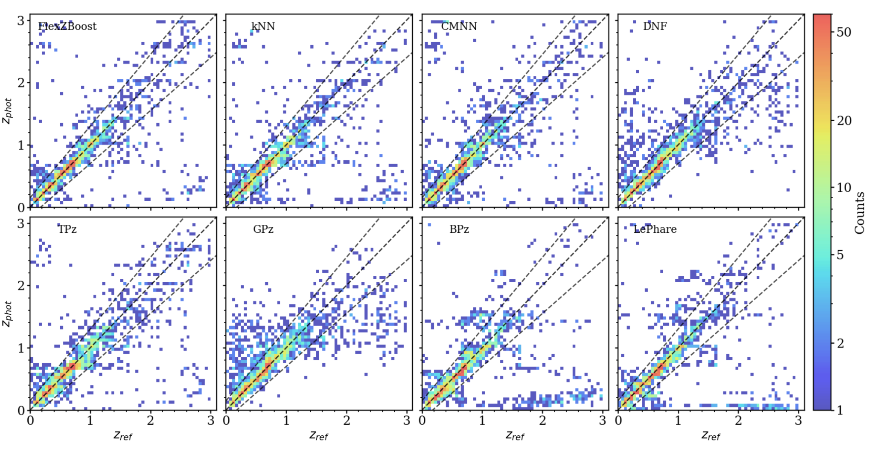
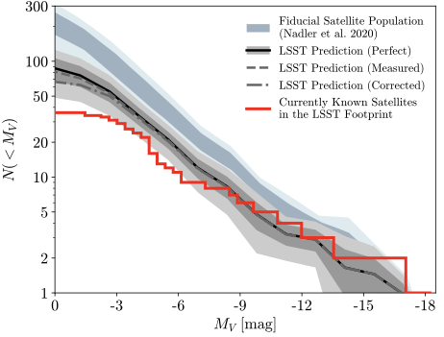
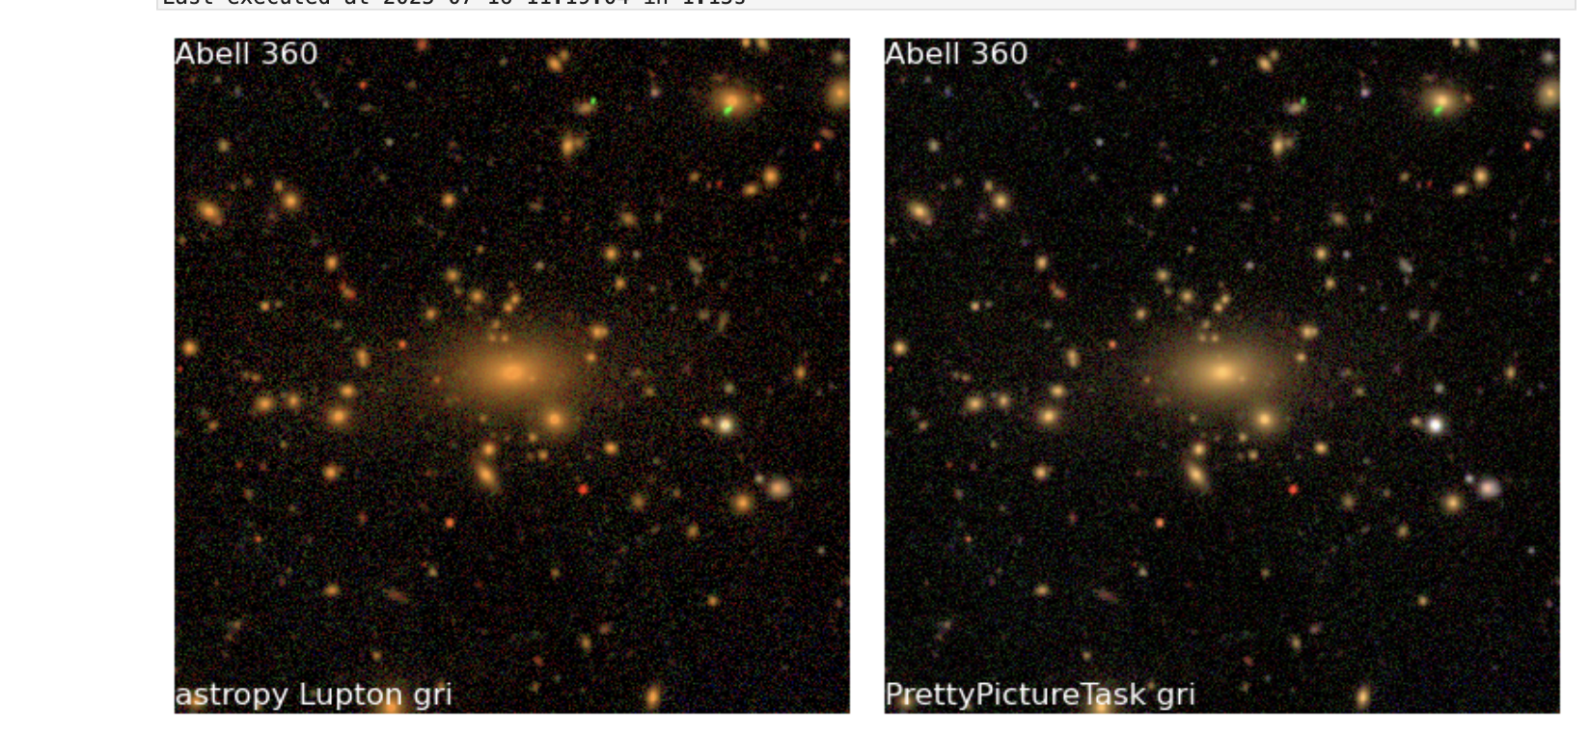
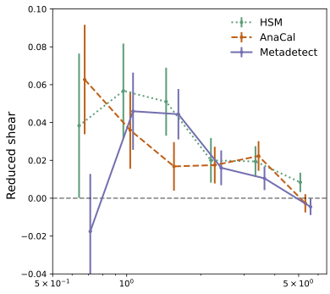
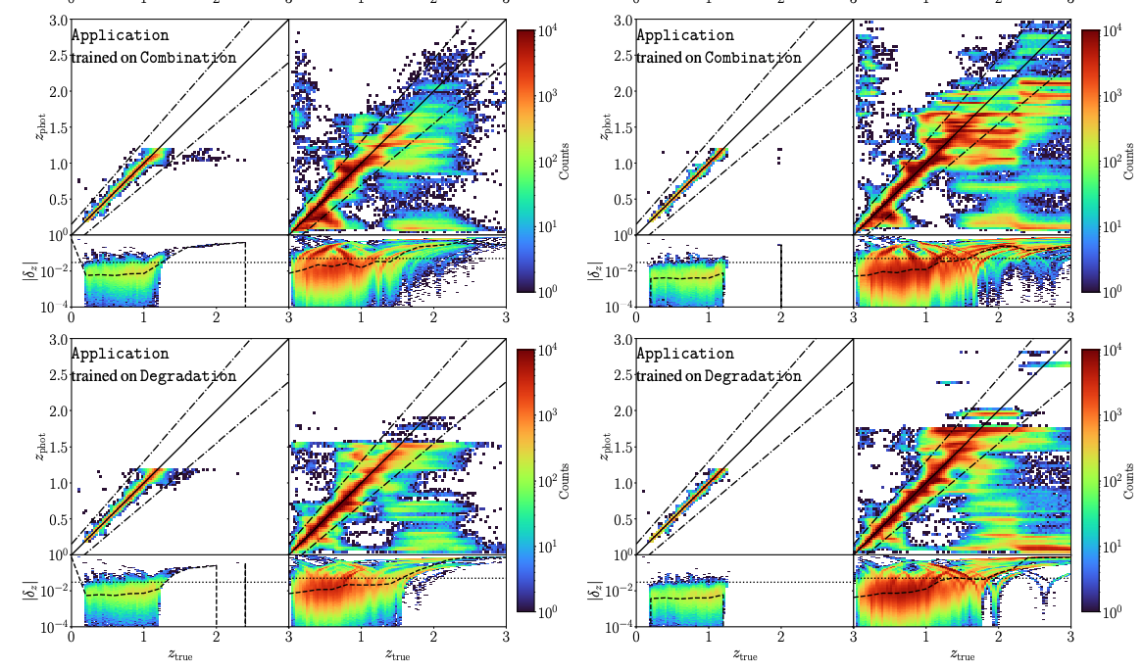
Dark Energy Science Collaboration (DESC) Early Rubin Science
DESC is exercising its pipelines on Data Preview 1 (DP1) and leveraging AI/ML for cosmology to prepare for LSST Observations
Photometric Redshifts for DP1
DESC Photo-z software RAIL applied to the Rubin DP1 Extended Chandra Deep Field South. Eight algorithms, including 6 ML methods. Produced training galaxy catalogs, cross-matched with Euclid. (arXiv: 2510.07370)
Satellite selection out to 250 kpc for dark matter demonstrated with simulations
Evaluated sensitivity to faint Milky Way satellite galaxies and outer-halo star clusters using simulated resolved stellar populations. With perfect star/galaxy separation, estimated >50% efficiency. (Tsiane et al., 2504.16203)
DP1 First weak-lensing measurement
Galaxy cluster Abell 360. DESC members led commissioning work on testing the data quality and measured the cluster mass with 3 shear algorithms (in prep).
Augmenting samples for redshift calibration
Implemented machine learning “self-organizing map” technique to augment samples for photometric redshift calibration yields significant improvements. Tested in CosmoDC2 and OpenUniverse. (Zhang et al., 2508.20903)
Other AI/ML advances in 2025
Hierarchical Inference for photometric classification of supernovae (Shah+)
Cataloging astronomical images via Neural Posterior Estimation (Patel+)
Identifying unrecognized blends with AI/ML (Liang, Adari, von der Linden +)
R (Mpc)

Slide 8
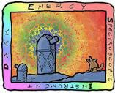
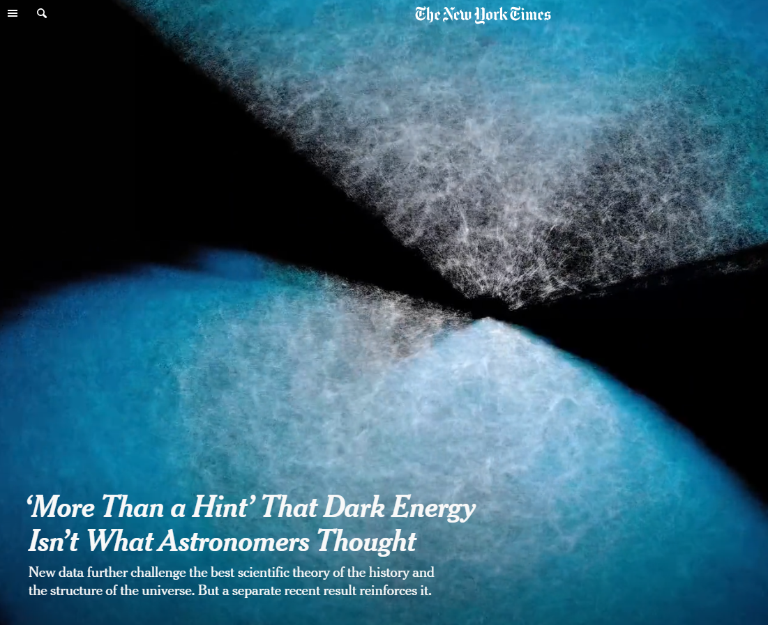
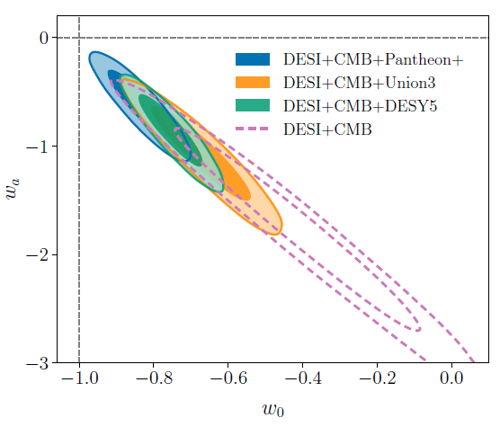
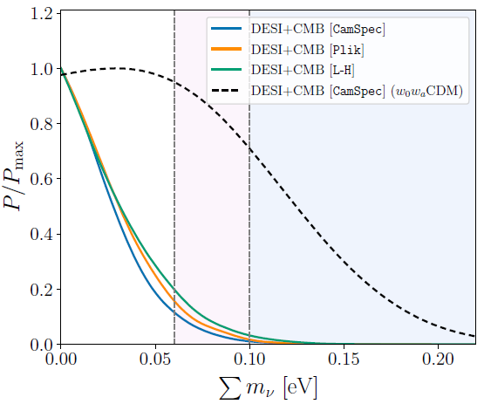
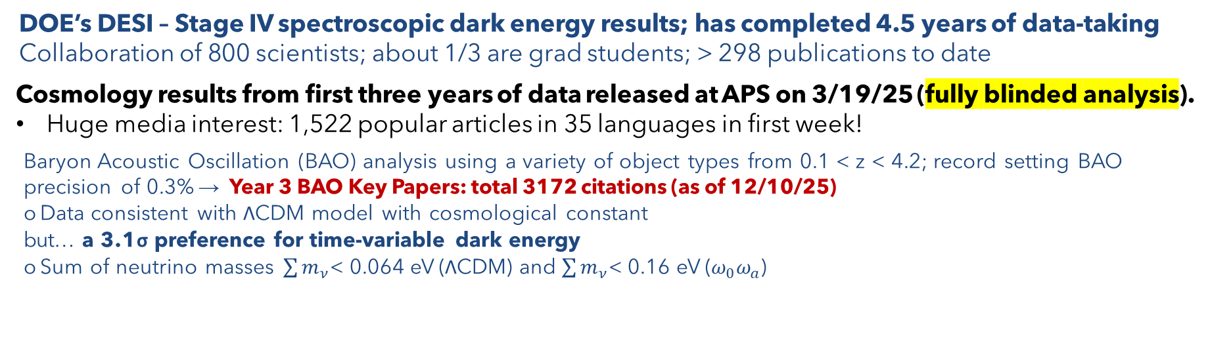
Cosmic Acceleration: Dark Energy Spectroscopic Instrument (DESI)
DOE’s DESI – Stage IV spectroscopic dark energy results; has completed 4.5 years of data-taking
Collaboration of 800 scientists; about 1/3 are grad students; > 298 publications to date
Cosmology results from first three years of data released at APS on 3/19/25 (fully blinded analysis).
Huge media interest: 1,522 popular articles in 35 languages in first week!
Baryon Acoustic Oscillation (BAO) analysis using a variety of object types from 0.1 < z < 4.2; record setting BAO precision of 0.3% → Year 3 BAO Key Papers: total 3172 citations (as of 12/10/25)
Data consistent with ΛCDM model with cosmological constant
but… a 3.1σ preference for time-variable dark energy
Sum of neutrino masses $\sum{m_{ν}}$< 0.064 eV (ΛCDM) and $\sum{m_{ν}}$< 0.16 eV ($ω_{0}ω_{a}$)
ΛCDM
March 19, 2025
Time-varying
dark energy
Actual 3D galaxy positions from DESI 3 year data
DESI continues to be the world’s most competitive instrument for wide-field spectroscopic surveys.

Slide 9
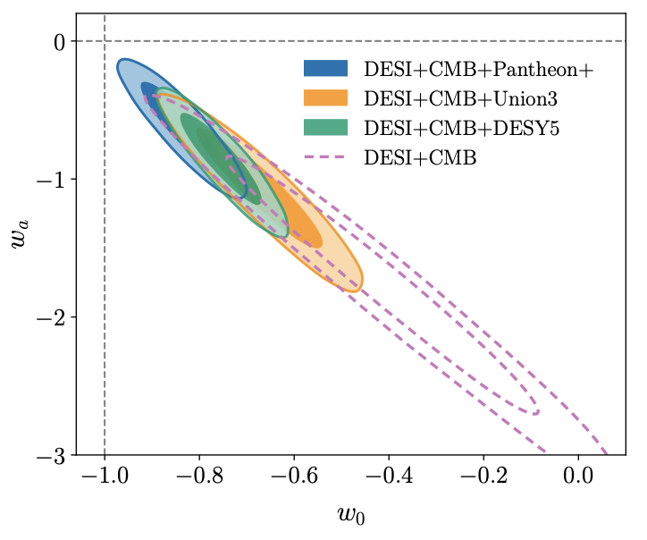
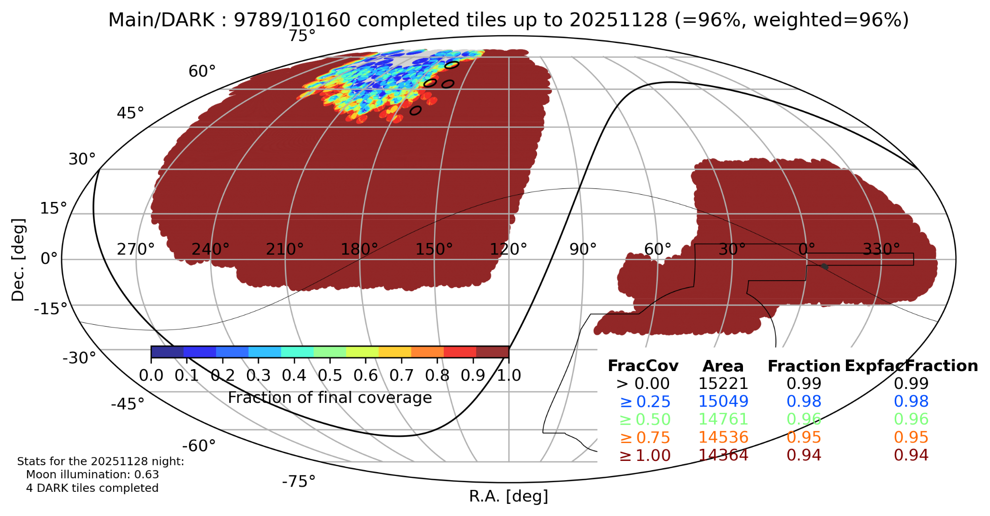
Cosmic Acceleration: Dark Energy Spectroscopic Instrument (DESI)
DOE’s DESI – Stage IV spectroscopic dark energy results; has completed 4.5 years of data-taking
Collaboration of 800 scientists; about 1/3 are grad students; > 298 publications to date
Extensive set of published topics: BAO, Neutrino masses, strong lensing…
DESI Data Release 1, in March 2025, delivered the largest-ever public catalog of extragalactic redshifts — over 14 million galaxies and quasars — providing a foundational 3D map of the Universe.
DESI DR2 Results II: Measurements of Baryon Acoustic Oscillations and Cosmological Constraints, in March 2025, combined galaxy and quasar BAO data from three years of observations. While broadly consistent with the standard ΛCDM model, they show a mild tension with cosmic microwave background results and hint that dark energy might evolve over time rather than remain strictly constant.
DESI’s 5-year survey which will be the 3rd public data release, is 96% complete. Small region near north polar-cap is remaining. Planned operations will continue through 2028.
ΛCDM

Slide 10
Cosmic Acceleration: Dark Energy Spectroscopic Instrument (DESI)
DESI Data Release 1 (DR1) is now available! DR1 contains spectra for more than 18 million unique targets from Main Survey observations taken between May 2021 and June 2022.
14M galaxies, 4M stellar
Release date Mar 2025. https://data.desi.lbl.gov/doc/releases/dr1/
DESI Data Release 2 (DR2) Cosmology Results are now published, including updated results based upon Lyman-alpha and galaxy BAO measurements.
DESI Data Release 2 (DR2) Expanded Cosmology Results will be published this summer, currently being further analyzed.
Full-shape analyses and other topics
The Full-Shape analysis relies on measuring the galaxy power spectrum multipoles, which capture information from galaxy clustering and redshift-space distortions (RSD).
DESI Data Release 3 (DR3) will be available late 2026/early 2027. Main survey observations from May 2021 until April 2024.
33M extragalactic, 12M stellar
Public release: https://data.desi.lbl.gov/doc/
Future public data releases will coincide with: 5-year data with 14,000 sq.deg. of footprint taken through May 2026; and 7.5-year data with 17,000 sq.deg. of footprint taken through Dec. 2028.
The last data release will contain substantially more footprint overlapping CMB & Rubin

Slide 11
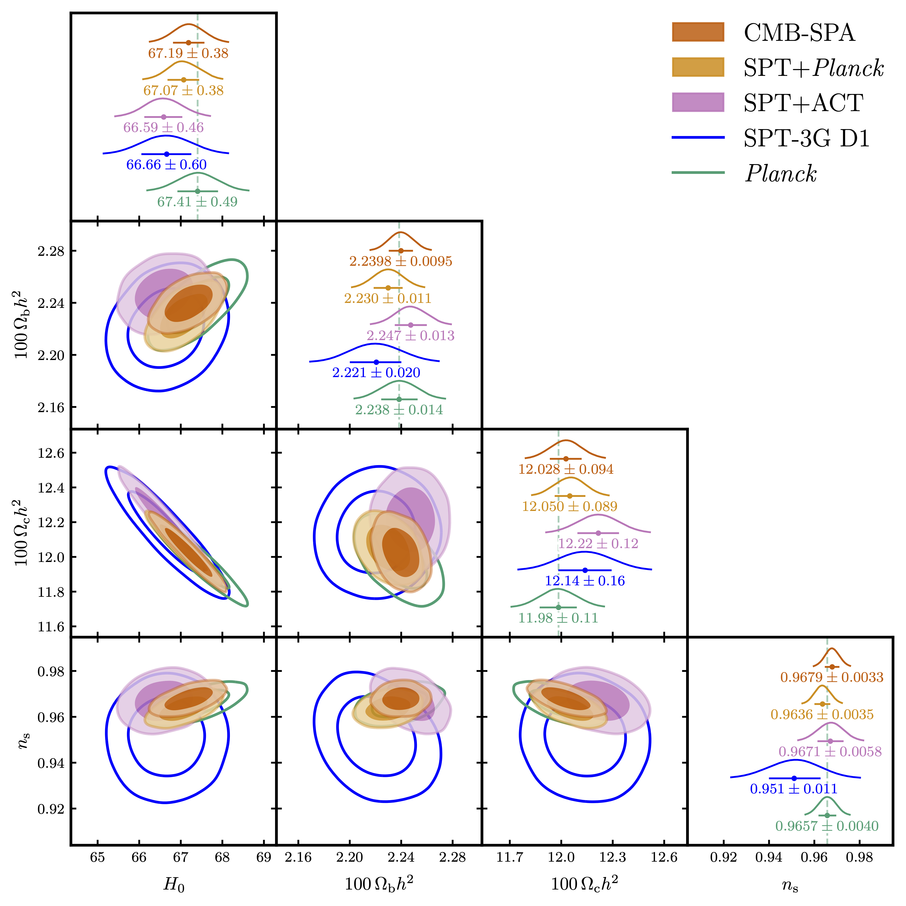
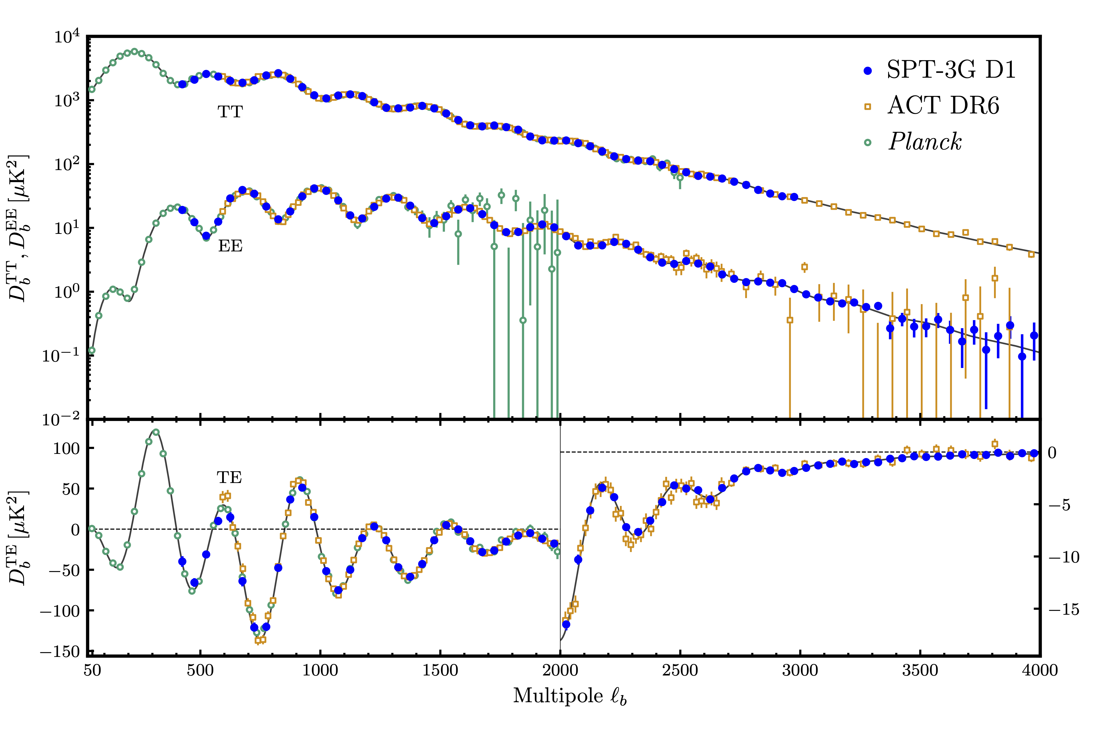
SPT-3G D1 Cosmology Results
SPT-3G measurements of the EE & TE spectrum are most constraining to date at ℓ=1800-4000, ℓ=2200-4000, respectively
Power spectra are well-fit by ΛCDM model
H₀ = 66.66 ± 0.60 km s⁻¹ Mpc⁻¹ from SPT-3G alone (6.2σ away from SH0ES local distance probe)
Constraining power from ground-based CMB experiments (SPT, ACT) in combination surpass the Planck satellite!
arXiv: 2506.20707
CMB-SPA = SPT, Planck, ACT
Notes:
D1 is the 2019/2020 Main Survey (1500 sq deg ) Data. So two years. (and yes, it is major data set 1)
EDF-S is Euclid Deep Field - South. And yes, that is referring the SPT-3G observations of that patch. We made public our maps and source catalogues from that area. The Euclid data in that area was publicly released separately.

Slide 12

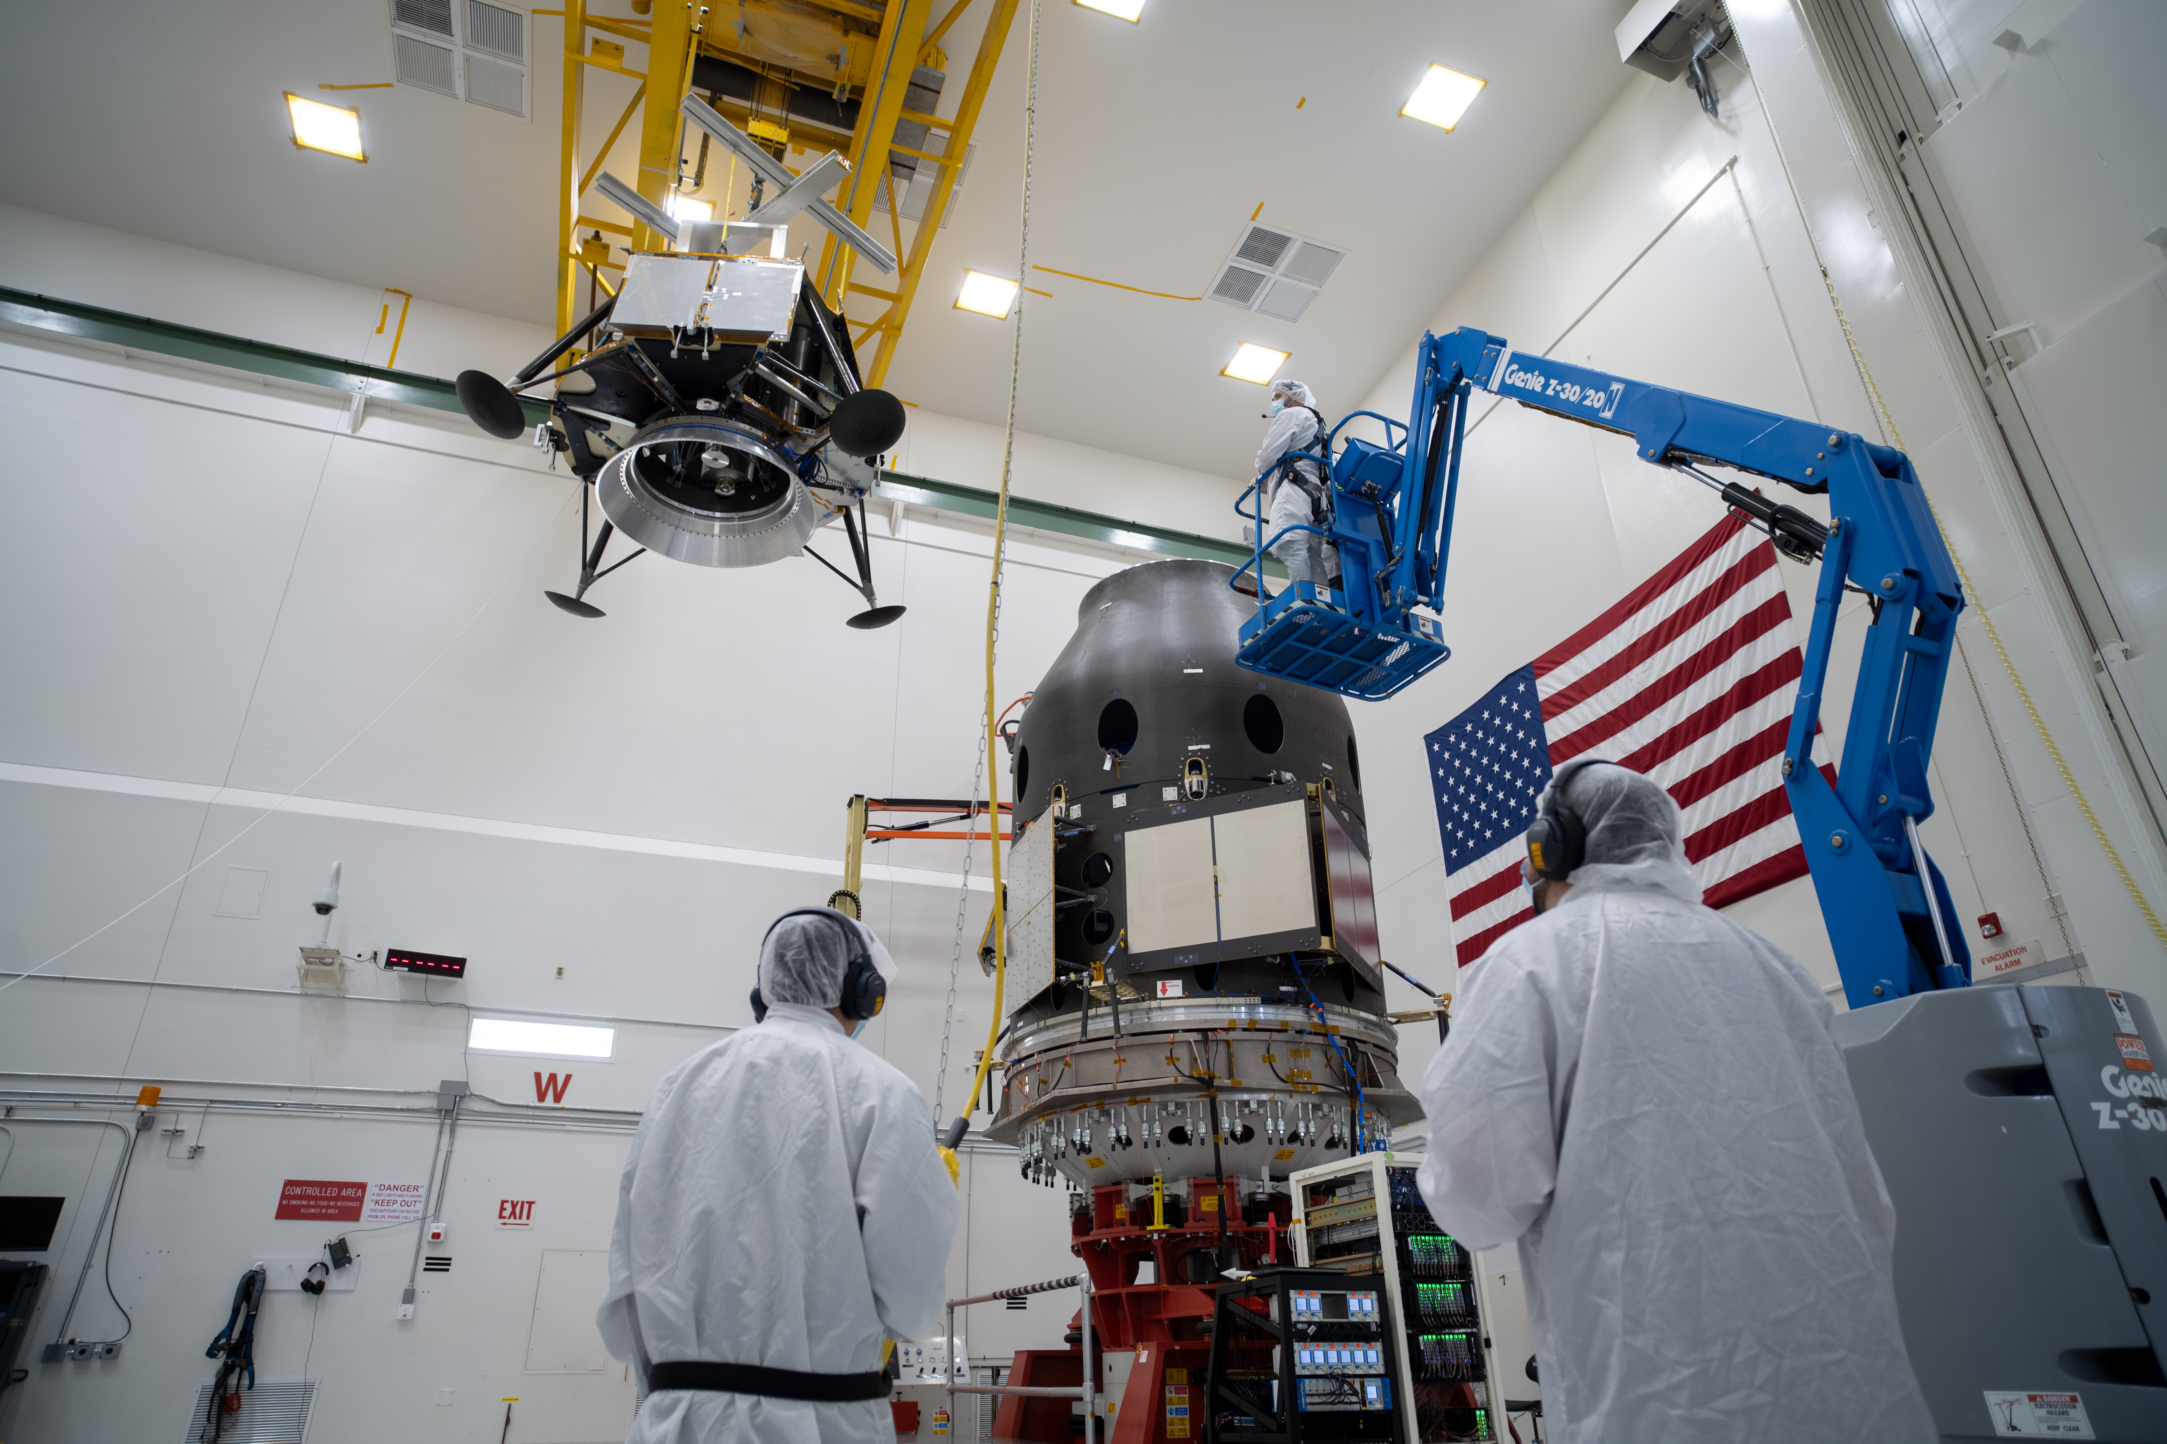
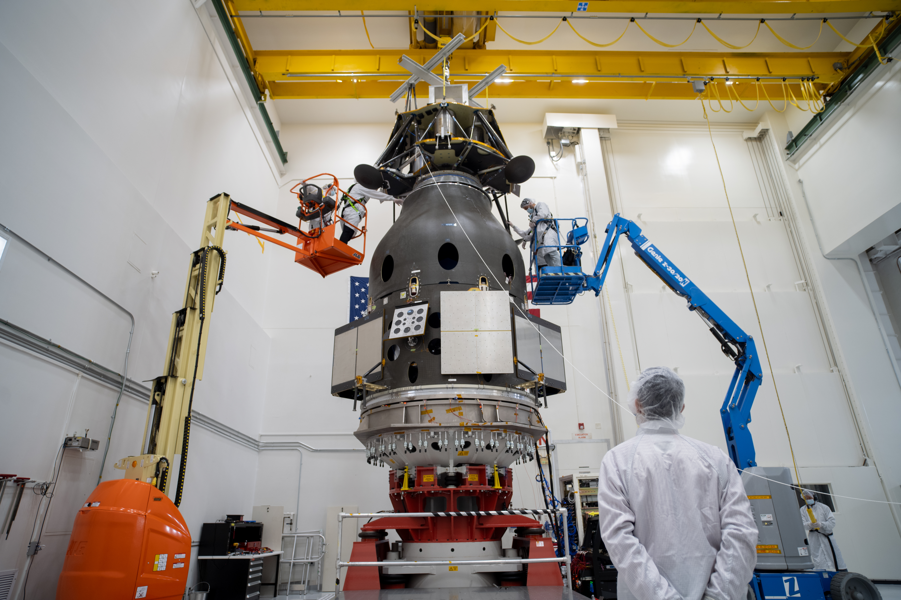
LuSEE-Night
A Pathfinder Radio Telescope on the Far Side of the Moon
Firefly’s Blue Ghost Mission 2
NASA Commercial Lunar Payload Services (CLPS)
Model of the Blue Ghost lunar lander
Firefly’s Elytra Dark orbital vehicle
Notes:
https://www.jpl.nasa.gov/images/pia26598-blue-ghost-mission-2-gets-stacked-at-jpl/
The whole vehicle is 22 feet tall (6.9 meters)

Slide 13
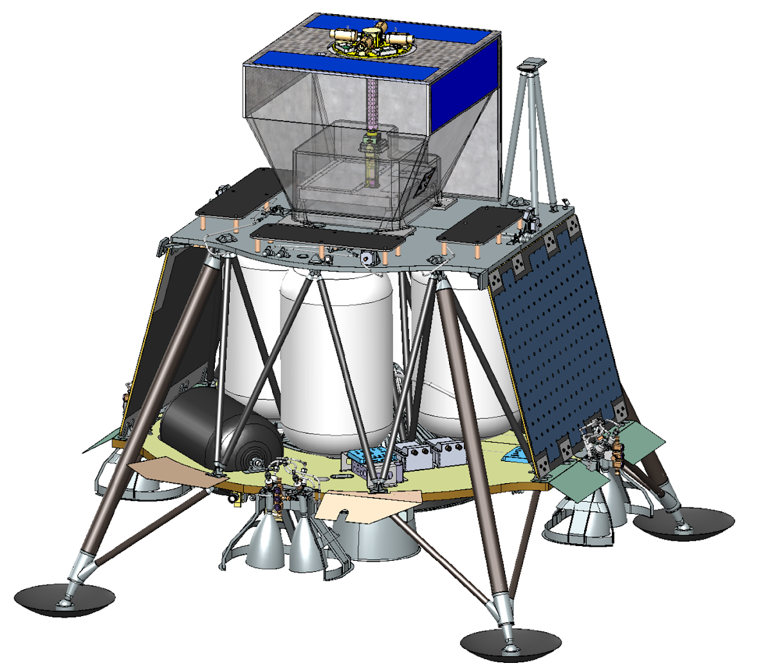
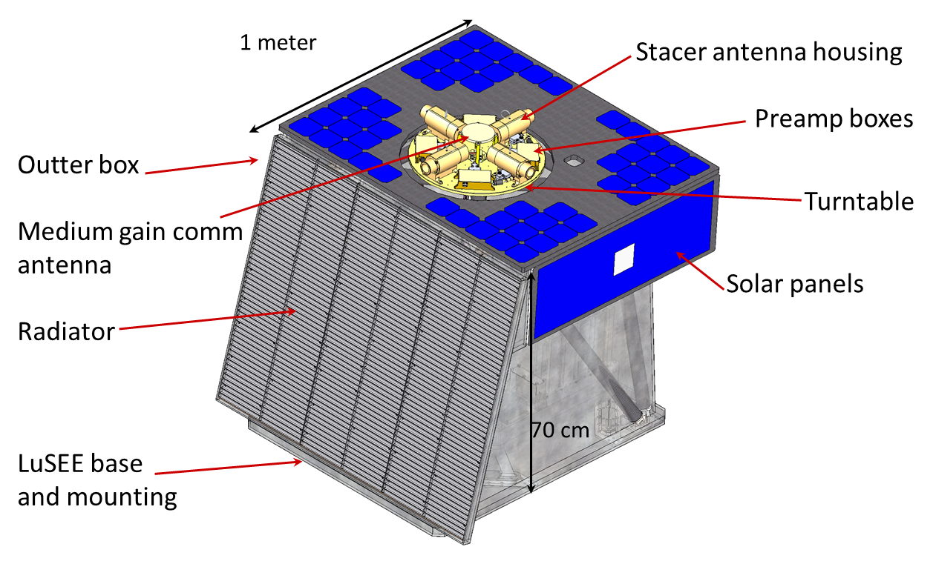
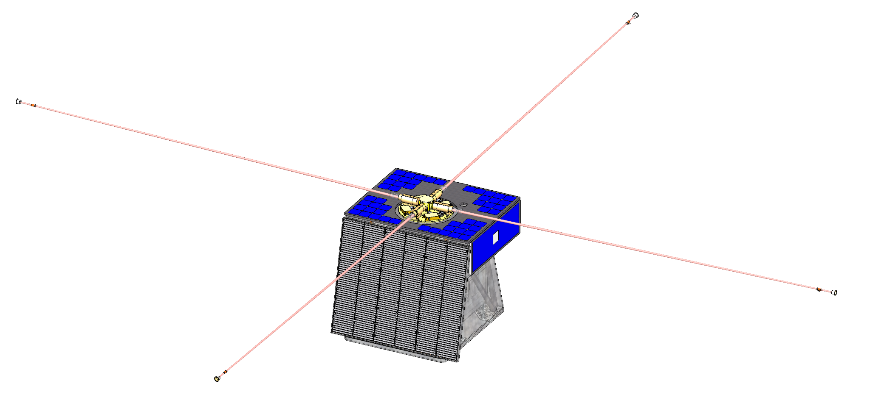
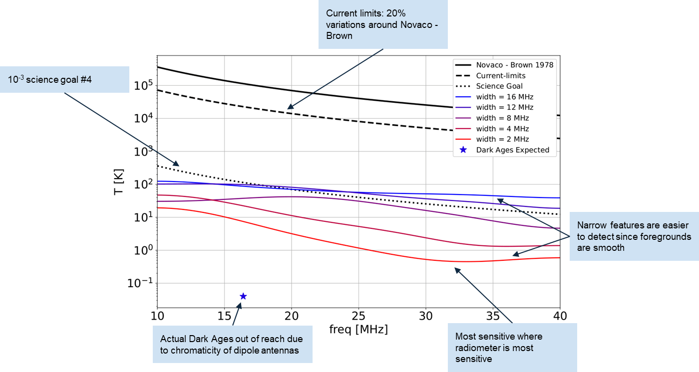
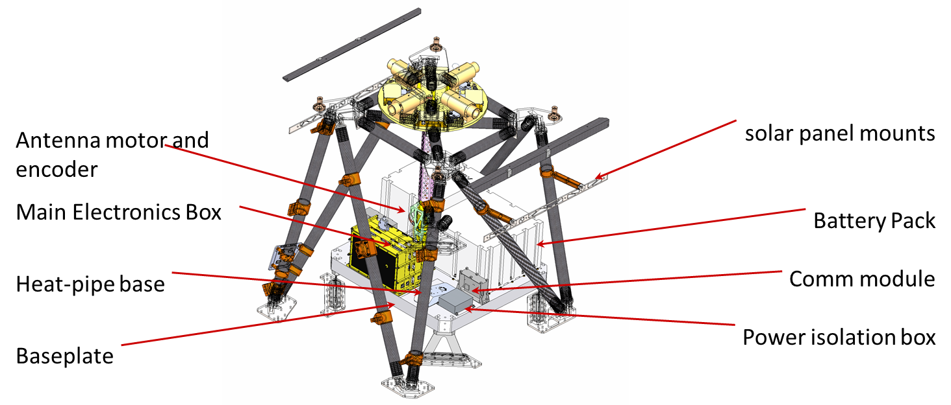
LuSEE-Night
LuSEE-Night
LuSEE-Night payload
Blue Ghost 2
Deployed antennas
Notes:
The whole vehicle is 22 feet tall (6.9 meters)

Slide 14
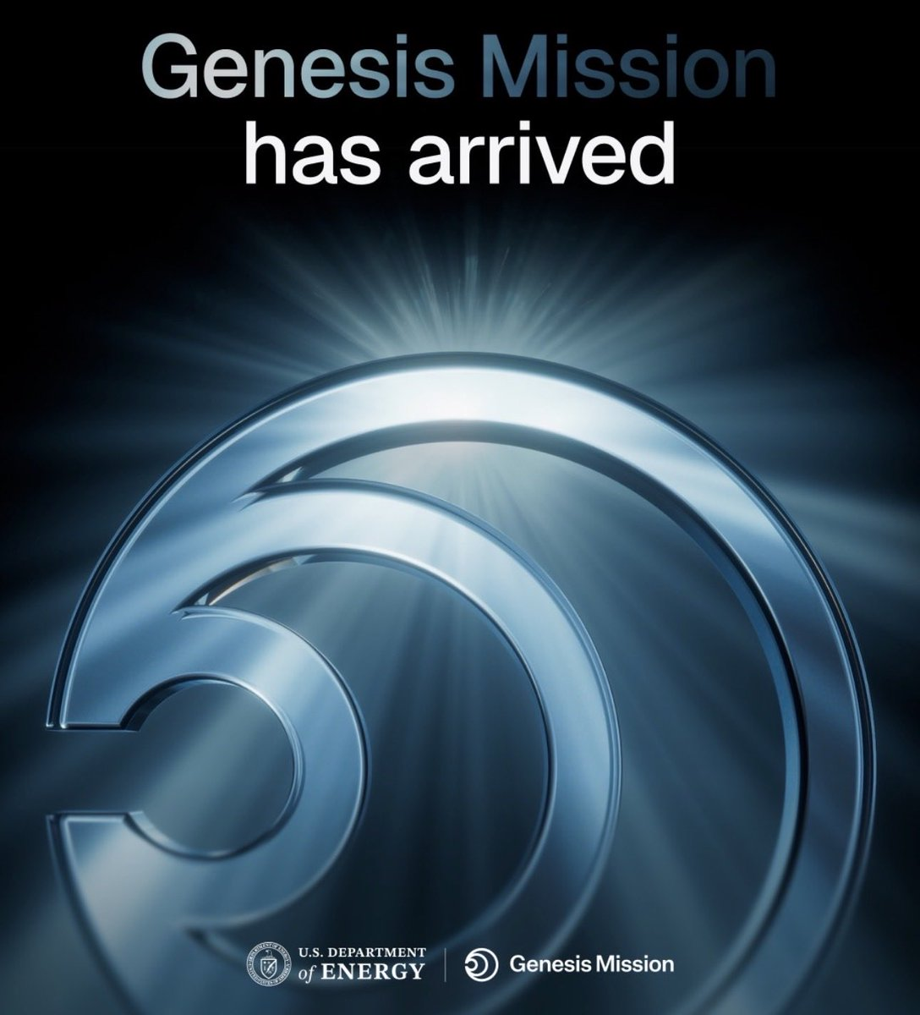
Genesis Mission
Please see Jeremy Love’s talk after the next break!

Slide 15


