Slide 1
FCC Developments
Srini Rajagopalan, Tor Raubenheimer
December 19, 2025

Slide 2
Outline
International Developments
FCC Feasibility Study
European Strategy Group
FCC feasibility challenges: competition and cost
Developments in the US
HFCC organization
Funding and R&D programs
Next steps

Slide 3
FCC Feasibility Study Status
The FCC Feasibility Study was released March 2025
Reviewed over the summer by the Cost Review Panel, chaired by Norbert Holtkamp, and Scientific Advisory Committee, chaired by Andy Parker
Presented to CERN SPC and Finance Committees in September
Reported to CERN Council in November
“The CERN Council reaffirmed its strong wish to maintain CERN as a leader in particle physics and views the continuation of the FCC study as a step towards this goal”
FCC program has moved to pre-TDR phase
FCC-ee approval expected to be considered on the 2028 timescale.

Slide 4
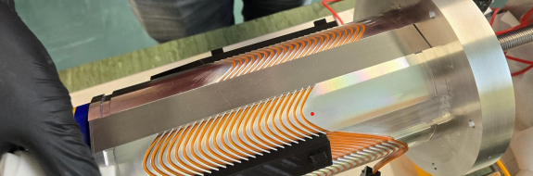
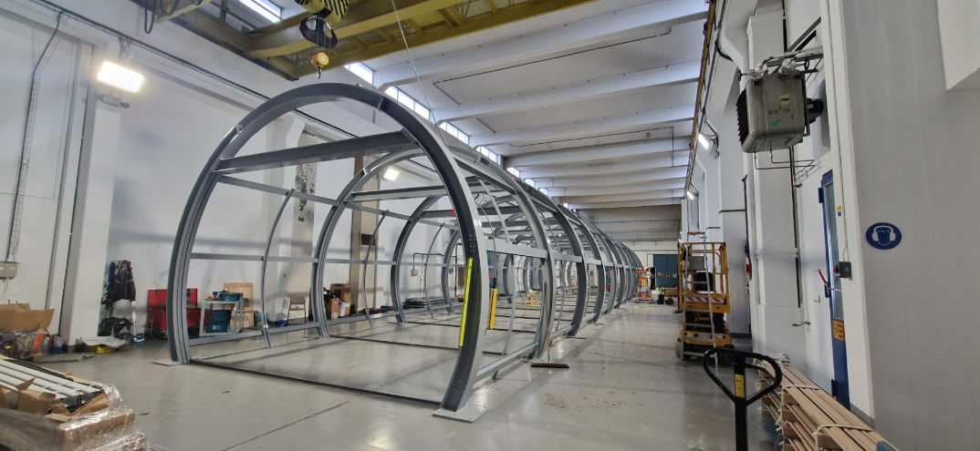
FCC-ee Technical Design progress
The FCC-ee design continues to be refined
Slightly longer L* (2.2 → 2.4 meters)
R&D on HTS for SSS and IR
Lattice down-select review in January 2026
Looking at polarized pilot bunches from the injector
CERN FCC-ee team is working toward pre-TDR phase
Prototypes of key technology and costly systems: e+, SRF, RF Power, Arc Cell, …
Working on implementation aspects: site and environmental studies, boring samples, civil design, infrastructure, ….
Notes:
Positrons and injector systems, IR mockup, project management, implementation,

Slide 5
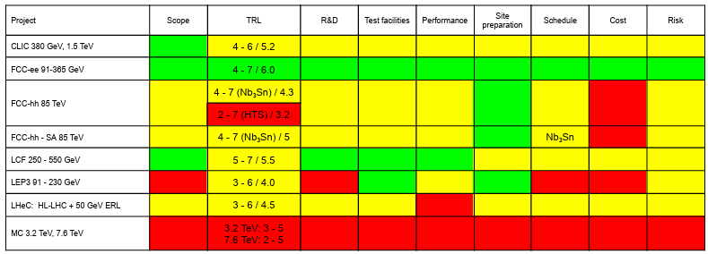
European Strategy Group (to be covered by Mike Tuts)
The European Study Group released their recommendations to the 225th session of CERN Council: https://cds.cern.ch/record/2950671
ESG Working Group 2a released its evaluation of large accelerator projects in October: https://cds.cern.ch/record/2947728/files/ESG_WG2a_Final.pdf
The PPG released the Briefing Book in Sept. https://cds.cern.ch/record/2944678 /files/Physics%20Briefing %20Book.pdf
Still some ongoing work but the next big step is CERN Council adoption

Slide 6
European Strategy Group Recommendations https://cds.cern.ch/record/2950671/files/CERN-ESU-2025-002.pdf
The next CERN flagship project:
3.A. The electron–positron Future Circular Collider (FCC-ee) is recommended as the preferred option for the next flagship collider at CERN.
3.B. A descoped FCC-ee is the preferred alternative option for the next flagship collider at CERN.
“Several other alternative options, … were also assessed. … At this stage, without knowing the reasons for which the FCC-ee would not be feasible, the other alternative options are not ranked”

Slide 7
Recommendation 3B ̶ What is a Descoped FCC-ee?
Descoping scenarios include removing the top-quark run, constructing two rather than four interaction regions and experiments, and decreasing the radiofrequency (RF) system power [and luminosity by (I believe) ~40%].
These measures would reduce the construction cost by approximately 15%.
Should additional resources become available, these descoping scenarios would be reversible.

Slide 8
Feasibility of FCC-ee: uniqueness of facility
The Chinese Academy of Sciences, which filters Chinese projects, has decided to give the green light to the Super Tau-Charm Facility (STCF) in the 2026 5-year plan
The STCF will demonstrate technologies useful for FCC-ee
There are plans to resubmit CEPC by 2030 for the next 5-year plan unless FCC-ee is approved first
Assuming approval, FCC-ee will be the world’s only Higgs Factory

Slide 9


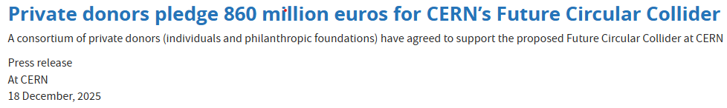
Feasibility of FCC: cost and funding
A detailed cost estimate for FCC-ee has been reviewed
Funding models have been developed and presented to the CERN Finance Committee
Potential support from the European Union announced in July for 2028-2034
Private funding commitment of ~1B$ announced Dec. 18, 2025

Slide 10
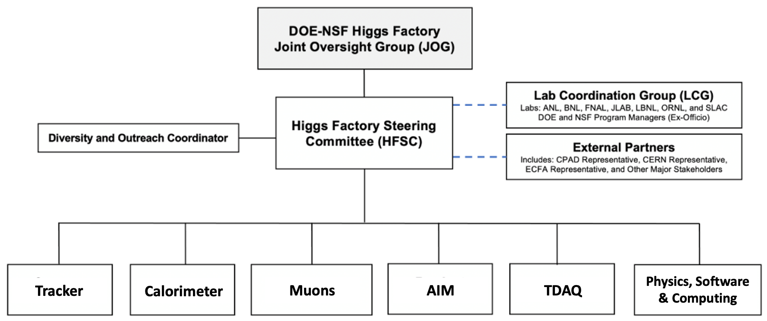
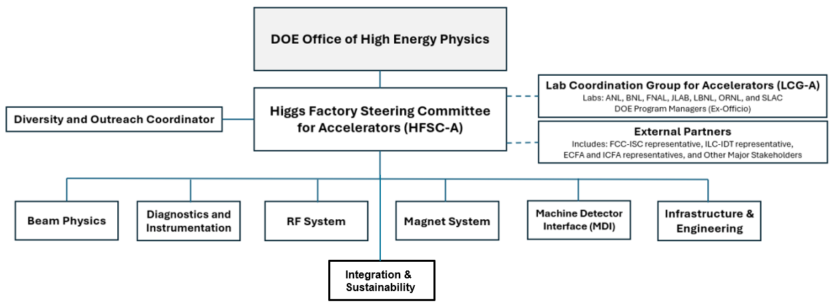
2024 U.S. Higgs Factory Consortium Committee (HFCC)
Physics, Experiment & Detector (PED)
Created by DOE and NSF in 2024 to provide strategic direction and leadership for the U.S. community to engage, shape, and thereby advance the development of the PED and Accelerator program for a potential future Higgs factory; and to ensure cooperation with our partners in the international program.
Led by Higgs Factory Steering Group
(HFSC-PED & HFSC-ACC)
Accelerator (ACC)

Slide 11
2024 HFCC Charge
HFCC should coordinate efforts in the following areas:
Physics and technical feasibility studies, including any associated design and R&D efforts, to advance detector concepts and accelerator designs for a future e+/e- Higgs factory;
Prioritization and stewardship of the national R&D efforts;
Development of the pre-project R&D scope that will be required to initiate a project;
Conceptualization of the software & computing for the experiments and accelerator;
Develop various funding models that will be required to support the R&D efforts;
Ensure collaborations by the U.S. with our partners are cost-effectively carried out to advance the future Higgs factory initiatives.

Slide 12
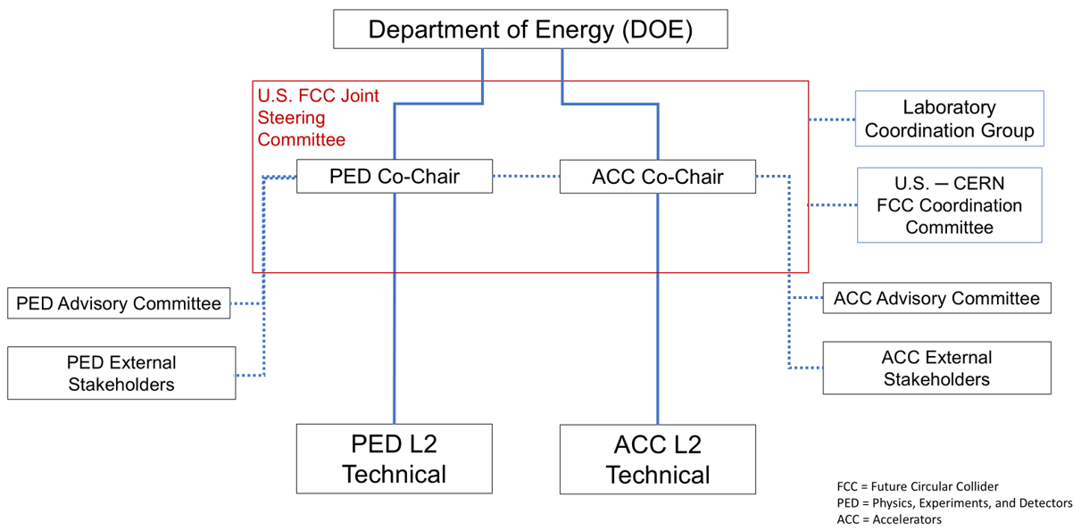
2025 US Higgs Factory Circular Collider organization
Re-focus of HFCC in September 2025
Charge and goals remain essentially the same but are focused on FCC-ee

Slide 13
HF Accelerator Steering Committee (HFSC-A)
HFSC-ACC (2024)
Tor Raubenheimer (chair)
Steve Gourlay (deputy)
Matthias Liepe
Jean-Luc Vay
HFSC-ACC (2025)
Tor Raubenheimer (chair)
Steve Gourlay (deputy)
Matthias Liepe
Jean-Luc Vay
Vladimir Shiltsev (Community Engagement)
US CERN FCC Coordination Committee: Benedikt, Janot, Rajagopalan, Raubenheimer, Tsesmelis, Zimmermann
It will be important to engage industry as program grows.

Slide 14
HF PED Steering Committee (HFSC-PED)
HFSC-PED (2024)
Srini Rajagopalan (chair)
Ritchie Patterson (deputy)
Marcel Demarteau
Sarah Eno
HFSC-PED (2025)
Srini Rajagopalan (chair)
Organization is being updated and will be announced soon!
PED Advisory Committee: Anadi Canepa, John Hobbs, Andy Lankford, Joe Lykken, Jason Nielsen, Maria Spiropulu

Slide 15
Guidelines for HFCC R&D Contributions
Identify potential areas where US can make leading and significant contributions grounded on our historical achievements and our expertise & capabilities
Think about interplay between PED/ACC and where R&D projects can benefit both programs
Collect input from community and encourage proposal submissions
Work with FCC management to ensure our input is relevant and desired
There are some collaborations with CERN that have already been established and we will become responsible for tracking and advising on these
Civil design work with Fermilab
800 MHz cryomodule design with Fermilab
Interaction region magnets with Brookhaven
Detector R&D collaborations established with DRD’s

Slide 16
FY26 HFCC Proposals and Review
HFCC-PED:
Discussed many proposals
L2 provided a prioritized list within the limited funding guidance they were provided, and yet the request was x2 more than the available funds
HFCC-ACC: received 43 2-page proposals with funding request >12 M$
Proposals reviewed over summer by L2 coordinators
Relevance to a Future Higgs Factory
Benefit to the US program (including MC and EIC)
Interest from the Higgs Factory projects
L2’s interacted with proponents to gather additional information and inquired with FCC contacts for clarification and interest in cases

Slide 17
US Program for FCC-ee
The US will contribute to both the PED and Accelerator
US aspires to significant contributions to the detectors, perhaps leading one or more detector collaborations
There are some places where the US has clear leadership and can contribute to the accelerator: bulk Nb SRF, IR magnets, HPC+ modeling, Nb3Sn
The US has relevant experience with e+/e- and will build the EIC having many synergies with FCC-ee
Other topics on the accelerator that nobody really leads: Iron manet/vacuum technologies, diagnostics, controls, RF power sources, power distribution, …
Working on the IR and MDI would be a natural synergy between ACC & PED efforts
SRF, HPC+ modeling, and synergies with MC & EIC will augment US capabilities

Slide 18
Selected FY26 HFCC-ACC R&D Program
FY26 funding is $500k and told to expect $500k / yr in FY27/FY28
Leverage other funding sources, e.g. GARD, LDRD, US-Japan, ….
Selected program is well aligned with FCC-ee and US strengths
SRF technology, Beam-Physics, MDI
Topic | Lead Investigator | Lead Lab | Request | Funding
800 MHz SRF CM | Kellen McGee | FNAL, et al | $1305k | 250k
FCC-ee Beam-Physics and SuperKEKB | Ji Qiang / Chad Mitchell | LBNL, et al | $1100k | 100k
Luminosity measurement systematics | Spencer Gessner | SLAC, et al | $750k | 50k
MDI CM Engineering | John Seeman | SLAC, et al | $250k | 50k

Slide 19
Selected FY26 HFCC-PED R&D Program
Group | Description | Institute/Person
AIM | Lead developer of AI detector optimization pipelines | W. Chung (Princeton)
TDAQ | Development of Digitization framework | T. Oli (ANL)
Muons | Muon Drift Tubes | Michigan (Curtis/Guo)
 | Micro-Rwell | FIT/JLAB
Calo | DR Crystal and Fiber Calo | Fermilab/Princeton
 | LAr design of turbine structures | Arizona
S&C | Docs and Training support | Princeton
 | Core SW in Key4HEP | LBNL
 | MC Production | W. Chung (Princeton)
Tracker | Strawtube | Michigan
 | MAPS | FNAL, SLAC, Universities
 | Tracker Simulation | MIT
 | Low Mass Mechanics | Purdue

Slide 20
HFCC Plans for FY26
FCC Physics Workshop, Munich, January 2026
Meet with OHEP to clarify program in late winter/early spring
Tentative plans to hold in-person L2 meeting on spring timescale
FCC Week, Helsinki, June 2026
Update proposals for FY27 in June; review them over summer.
Hold US HFCC meeting at SLAC/LBNL in early September (Sept 9-11 or Sept 8-10)
Present results of FY26 HFSC R&D efforts and discuss future HFCC program
Engage with OHEP in early fall 2026 to discuss FY28 and beyond
What R&D will be possible? How to augment US capabilities?
Discuss timescale and contributions to targeted panel on HF contributions

Slide 21
Ways to Engage with the HFCC
Mailing lists for ped or (acc) groups:
us-hfcc-ped(acc)@cern.ch: US Higgs Factory PED (Accelerator) Group
anyone can subscribe (needs a CERN account)
Instructions: https://drive.google.com/file/d/1fPGaABgq3h-zM2Te-6DVnr3-TkPQBc32/view?usp=drive_link
us-hfcc-ped(acc)-L2@cern.ch: US Higgs Factory PED (Accelerator) Level 2 coordinators
us-hfsc-ped(acc)@cern.ch: US Higgs Factory steering committees
Web pages: ushfcc.org/ or https://higgsfactory.slac.stanford.edu/
Joint monthly meetings at: https://indico.global/event/14675/

Slide 22
Summary
The European Strategy Group has reported to CERN Council
FCC-ee is the prefered option
A de-scoped FCC-ee is the 1st backup option
U.S. HFCC program has begun
Using unique strengths in the U.S. to engage with FCC-ee which is starting a pre-TDR phase and building prototypes
Re-organization of HFSC committees initiated in September to focus on FCC
Minimal changes to HFSC-ACC and HFSC-ACC/PED L2’s
Updated HFCC-PED organization is imminent
R&D efforts for FY26 were launched and future plans are being developed

Slide 24
Laboratory Coordination Group (LCG) (Unchanged)
LCG-ACC
ANL: Philippe Piot
BNL: Wolfram Fischer
FNAL: Sam Posen
JLAB: Andrei Seryi
LANL: Steve Russell
LBNL: Cameron Geddes
ORNL: Fulvia Pilat
SLAC: Mei Bai
LCG-PED
ANL: Rik Yoshida
BNL: Dmitri Denisov
FNAL: Kevin Burkett
LBNL: Natalie Roe
ORNL: Fulvia Pilat
SLAC: Dan Akerib

Slide 25

European Union Budget (2028 – 2034)
In July 2025, the EU announced budget goals which included Horizon Europe and support for “Moonshots” which, with a strong scientific component, boost EU-wide value creation and strategic autonomy.
Investing in CERN and FCC was listed first amongst possible Moonshots with support of up to 20% of the project cost.

Slide 26
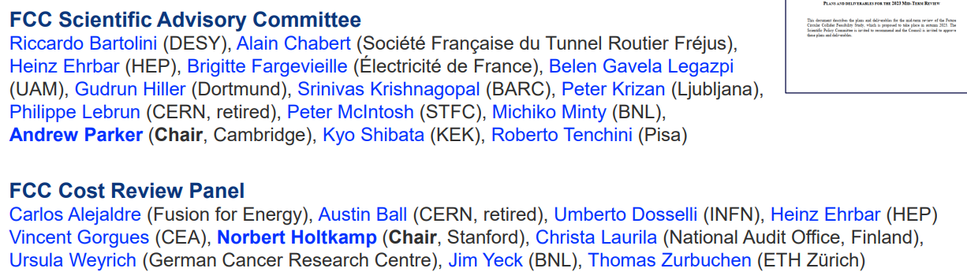
FCC Review Panels
The Feasibility Study was reviewed by the SAC and CRP

