Slide 1
Report on ESG Recommendations European Strategy for Particle Physics 2026 Update
Mike Tuts
Columbia University
DPF Community Meeting
December 19, 2025

Slide 2
Background & Context
Remit: “The aim of the Strategy update should be to develop a visionary and concrete plan that greatly advances human knowledge in fundamental physics through the realisation of the next flagship project at CERN. This plan should attract and value international collaboration and should allow Europe to continue to play a leading role in the field”
The European Strategy for Particle Physics (ESPP) is the equivalent of our US P5 process as input to the long-term future of the field starting in 2006
2006: LHC, discussion of LHC luminosity upgrade, accelerator technology R&D, coordination with ILC
2013 update: High luminosity LHC, need for post-LHC program
2020 update: FCC feasibility study
2026 update: Recommendations for the next flagship project at CERN (preferred collider option and possible prioritized alternatives and areas of priority for exploration complementary to colliders) – the Venice meeting was the equivalent of our Snowmass process to provide community input
Mandated by the CERN Council, the European Strategy Group (ESG) develops recommendations submitted to the Council for an update of the European Strategy with:
Input of the particle physics community
Status of implementation of the 2020 Strategy update
Recent accomplishments (e.g. LHC results, HL-LHC progress, FCC Feasibility Study,…)
International landscape of the field

Slide 3
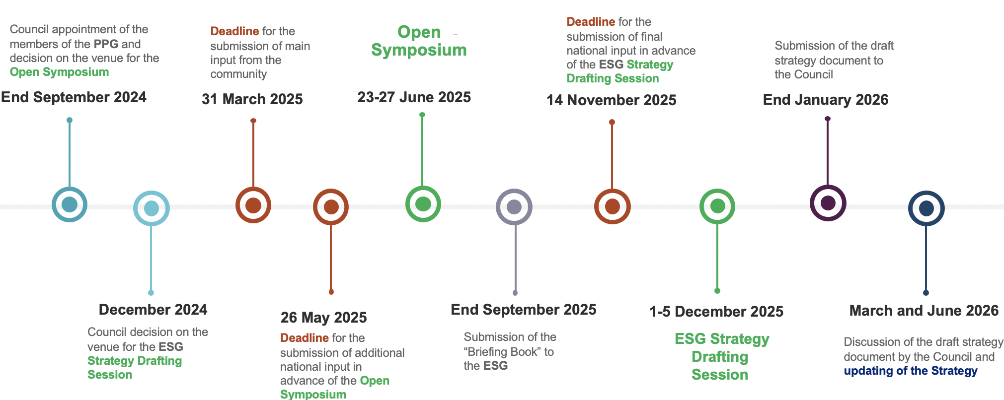
Timeline for 2026 Strategy Update
We are here
Assessment of large-scale accelerator projects at CERN - Report of ESG WG2a - CERN Document Server
Physics briefing book - CERN Document Server
The European Strategy for Particle Physics: 2026 Update - Recommendations by the European Strategy Group - CERN Document Server
March 2026: Council deliberations
28-30 May: Update ESPP docs
2027/2028: Council project approval

Slide 4
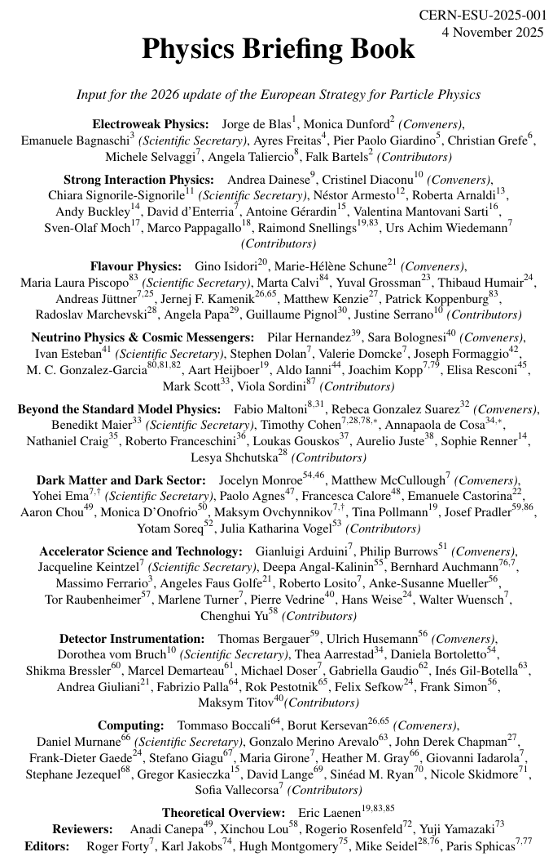
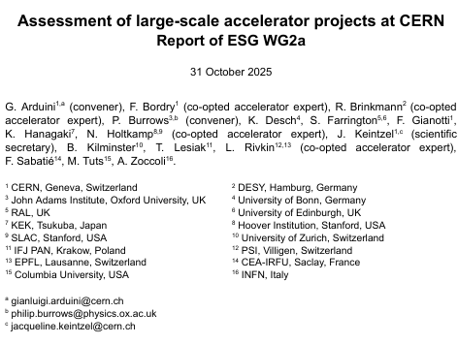
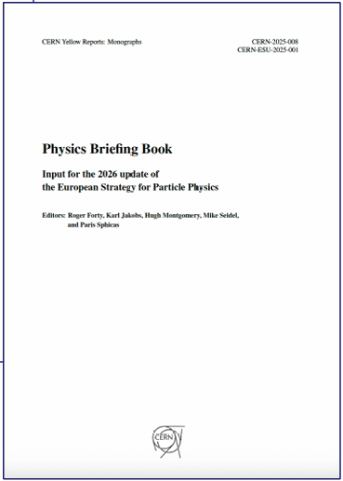

Documents (ESG Input and Output)
Physics Briefing Book (315pp, September 30, 2025) also on arxiv
Input to ESG Working Group 2b for assessment of overall physics potential
Recent Highlights at ECFA, Nov 2025 Mtg: Higgs,EW,Flavor,Top,QCD,BSM; ν, DM, Cosmic; Instr & Comp
Assessment of Large-Scale Accelerator Projects at CERN(41pp, October 31, 2025) – Working Group 2a
Technical feasibility, required R&D, risks, timeline, costs and human resources (including estimates for the associated detectors), environmental impact
Final input by National HEP communities (November 14, 2025)
Overwhelming support for FCC-ee
Recommendation Document (16pp, December 5, 2025) – Discussed here
Summary of high-level Recommendations – 36 “recommendations” result of the ESG Drafting process
Presented to the CERN Scientific Policy Committee (SPC) and the CERN Council the following week
Released by CERN Council as the recommendations of the ESG on December 12, 2025
Deliberation Document (end of January 2026)
More detailed explanations to justify the recommendations
All Working Group Reports (end of January 2026)
Will be released as accompanying documents

Slide 5
General Considerations
In following slides italics are quoted from document recommendation
2A The full exploitation of the physics potential of the LHC and the HL-LHC and the completion of the high-luminosity upgrade remain the highest priorities of European particle physics. Every effort must be made to complete the HL-LHC upgrade within the current schedule.
2B The unique ecosystem of particle physics research centres and universities in Europe should be further strengthened in order to address the objectives set out in this Strategy.
2C The implementation of the Strategy should be pursued in strong collaboration with global partners and neighbouring fields.
2D The relationship between the particle physics community and the European Commission should be further strengthened, exploring funding opportunities for the realisation of infrastructure projects and R&D programmes in cooperation with other fields of science and industry.

Slide 6
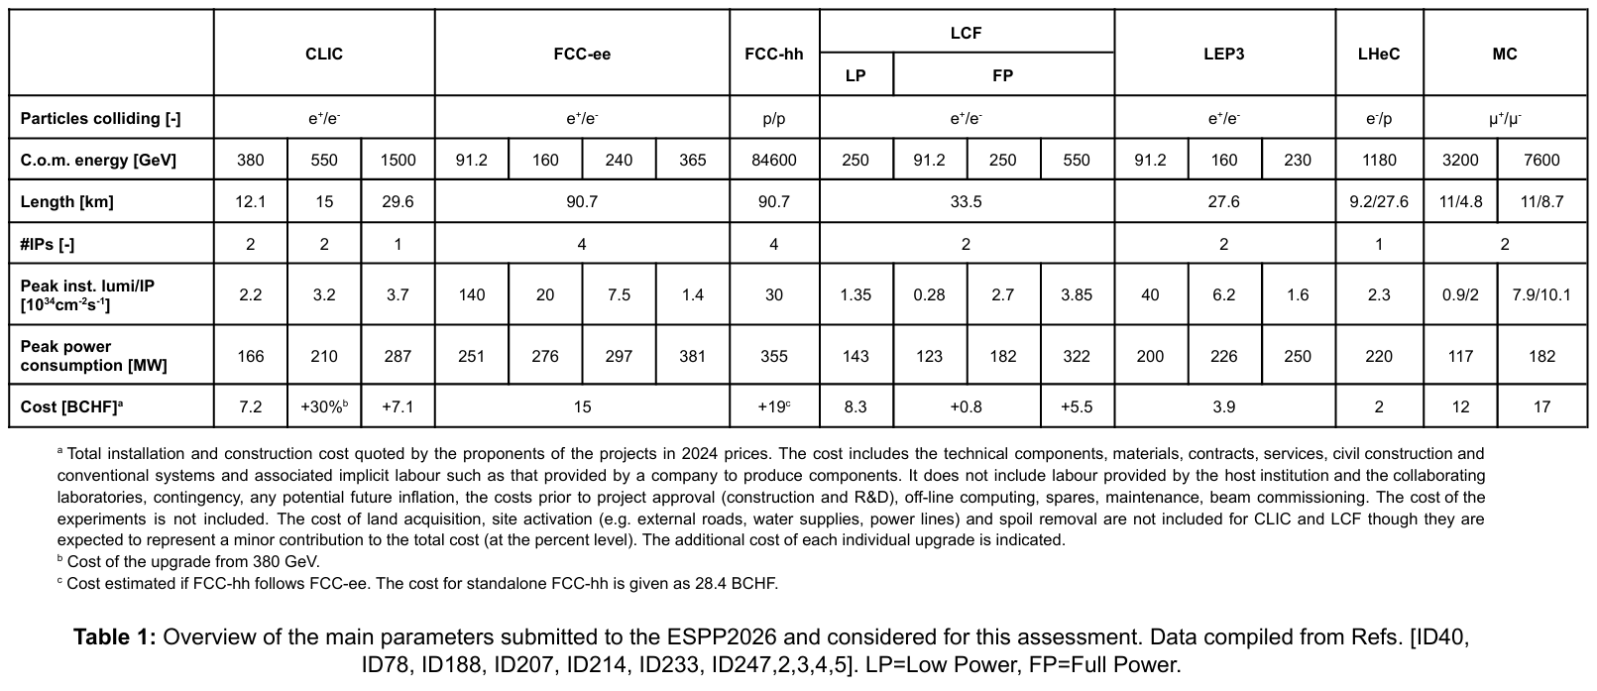
Large-scale Accelerators Projects Assessed by WG2a based on Submissions

Slide 7
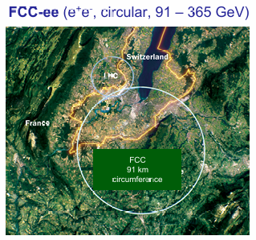
Next CERN Flagship Collider Project
3A The electron–positron Future Circular Collider (FCC-ee) is recommended as the preferred option for the next flagship collider at CERN.
Key elements:
Physics based on briefing book & WG 2a evaluation
“outstanding discovery potential through the Higgs, electroweak, flavour and top-quark sectors, as well as advances in quantum chromodynamics (QCD)”
Accelerator technical feasibility & WG 2b evaluation (next slide)
“technical feasibility is demonstrated by the comprehensive FCC Feasibility Study, its scope and cost are well defined, plausible funding scenarios have been developed and its schedule enables first beams within five to seven years after the end of HL-LHC operations”
Path to highest energy
“The FCC-ee would also pave the way towards a hadron collider reusing the tunnel and much of the infrastructure, providing direct discovery reach well beyond the 10 TeV parton energy scale, in line with the community’s ambition for exploration at the highest achievable energy”
FCC-ee 15.3 BCHF
2028 – approval
2033 – construction start
2041 – end HL-LHC ops
2046 – Start FCC-ee operation
ramp-up
2063 – FCC-ee decommissioning

Slide 8
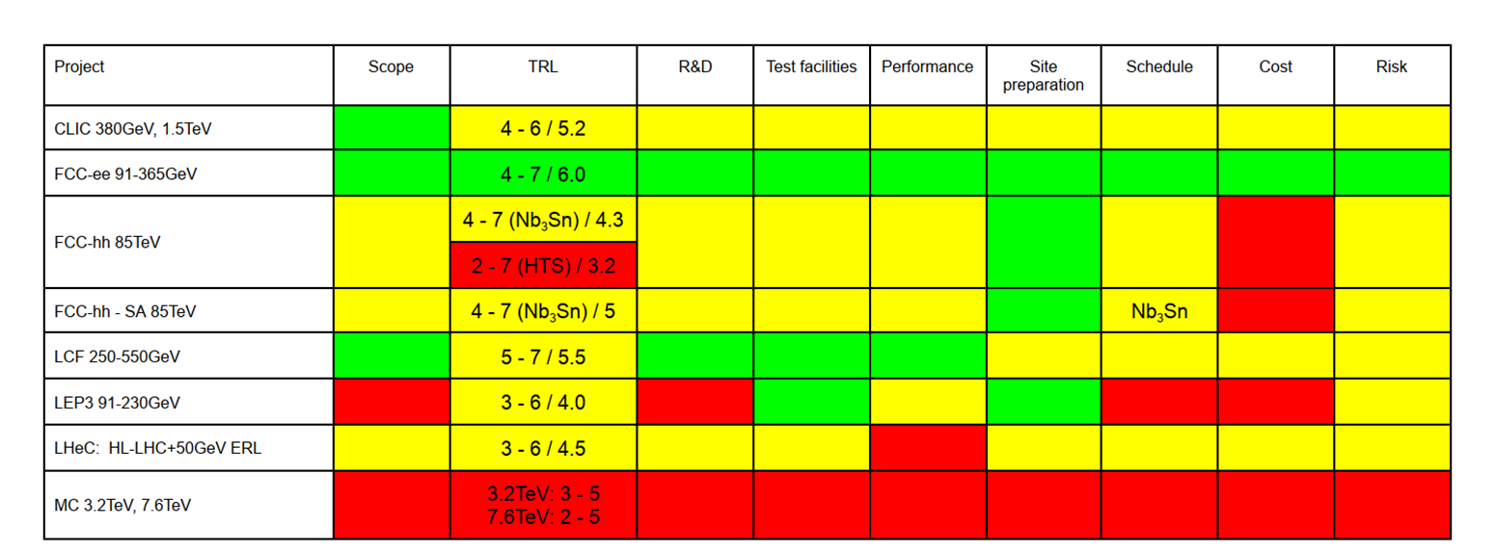
Preferred Alternative Option
Table 16 key findings from WG2a assessment of submitted proposals
3B A descoped FCC-ee is the preferred alternative option for the next flagship collider at CERN.
Impacts breadth of program but still very strong physics program with viable path to high energies
Descoping (~15% reduction in cost) includes:
Remove the top-quark run
Construct 2 vs 4 interaction regions & experiments
Decreasing RF system power
Should additional resources become available, these descoping options would be reversible
Scope = Scope level-of-definition
TRL = Technical Readiness Level score
R&D = R&D plan level-of-definition & funding status
Test facilities = need of test facilities or demonstrators and level-of-definition of their scope
Performance = performance uncertainty
Site preparation = site preparation status
Schedule = schedule uncertainty
Cost = cost uncertainty
Risk = risk level-of-definition

Slide 9
Other Alternative Options (not ranked) - I
Several alternative options were assessed and deemed to “offer substantially reduced precision physics programmes and would not be competitive with a collider like the FCC-ee”, and “at this stage, without knowing the reasons for which the FCC-ee would not be feasible, the other alternative options are not ranked”
CLIC and LCF (linear colliders operating at two energies and up to 550 GeV)
“Competitive programs in Higgs and top-quark physics”
“Compared to circular colliders, they have significantly lower luminosities at lower energies, leading to limited precision in electroweak physics and non-competitive flavour physics programmes”
“Both colliders require a tunnel of up to a third of the length of that of the FCC-ee to reach their ultimate energies of 1.5 TeV and 550 GeV, respectively”
“The path towards 10 TeV collisions would require plasma wakefield acceleration, which is not yet proven to be a viable technology”
“CLIC would initially operate at 380 GeV. The construction cost of the 550 GeV collider is estimated to be about 60% of that of the FCC-ee, whereas the full cost of the 1.5 TeV collider would be at the same level as that of the FCC-ee”
“LCF would initially operate at 250 GeV and could be extended up to 550 GeV. The construction cost of the 550 GeV collider would be at the same level as that of the FCC-ee” – the LCF technology is mature

Slide 10
Other Alternative Options (not ranked) - II
LEP3 and LHeC are colliders that would reuse the LHC tunnel, offering an intermediate physics programme at significantly lower construction costs than the other options. Neither, on its own, would be a flagship collider. To provide a long-term physics programme, they would need to be complemented by an energy-frontier machine, such as a hadron collider
“LEP3, an electron–positron collider operating at energies up to 230 GeV, would offer improvements in Higgs physics with respect to the HL-LHC, strong electroweak and flavour physics programmes, but no top-quark run”
“LHeC, an electron–proton collider that would combine an energy recovery linear electron accelerator with the LHC, would offer a strong QCD programme and significantly extended knowledge of proton structure. Although it would also offer some improvements in Higgs physics with respect to the HL LHC, its overall precision physics programme is limited”

Slide 11
Other Research Directions in Particle Physics
4A European contributions to both accelerator-based and non-accelerator neutrino and dark matter experiments are essential and should be supported.
4B CERN should continue to provide support to the global long-baseline neutrino programme via the Neutrino Platform. The collaboration between CERN and non-accelerator-based experiments on technologies of mutual benefit should be continued.
4C The ecosystem of European particle physics laboratories should continue to support a broad, diverse spectrum of key precision experiments in particle physics.

Slide 12
Theory
5A Europe should maintain a strong and diverse particle theory landscape, from formal to phenomenological aspects, while further strengthening and leveraging connections to neighbouring fields.
The coming decades will be marked by the HL-LHC programme and the beginning of a new flagship facility at CERN. The success of these endeavours crucially depends on achieving theoretical predictions at an unprecedented level of precision. This relies on close interaction in collider phenomenology between theory and experiment. Collaborative efforts in perturbative quantum field theory and lattice QCD calculations, along with the development of theoretical tools for experimental analyses, will be essential. [Note: the J. Love slide 7 Genesis mission on Lattice QCD partner]
5B Collaborative efforts to improve the precision of theoretical predictions should be recognised and supported. Europe is world-leading in these areas and should strive to remain so by attracting, fostering and retaining early-career global talent. CERN should continue to be an integral part of all these efforts.

Slide 13
Technologies - General
The science and technologies underpinning the areas of accelerators, detectors and computing, and related infrastructures, provide the foundation to address the key questions of particle physics. They are deeply embedded in the international particle physics community and are essential for the success of current and future projects.
6A To ensure that Europe remains at the forefront of technologies for particle physics, R&D in collaboration with international partners and industry must continue to be supported with high priority, thereby enhancing sustainability and societal impact.

Slide 14
Technologies - Accelerator Science & Technology
6B In order to realise the visionary plan presented, the highest priority must be the development and industrialisation of key technologies: advanced superconducting and normal-conducting RF structures, efficient RF power sources and accelerator-quality magnets in the 14–20 T range, including those based on high-temperature superconductors.
6C Demonstration of high-current multi-turn energy recovery in linacs constitutes an important step towards power-efficient lepton accelerators for a broad range of applications and should be pursued.
6D The longer-term development of advanced technologies, such as high-gradient wakefield acceleration and those underpinning bright muon beams, should be supported at an appropriate level. Synergies with the US initiative on muon collider R&D should be exploited.

Slide 15
Technologies – Detector Development
Detector R&D is essential for realising future experimental research programmes. This effort is strengthened by the Detector R&D (DRD) collaborations, which have recently been established in accordance with the ECFA Detector R&D Roadmap as a result of the 2020 Strategy update. The roadmap outlined ten General Strategic Recommendations, including sustainable support of R&D facilities, such as test beam and irradiation centres, promoting distributed R&D activities and open science, maintaining engineering support and investing in blue-sky R&D
6E For the DRD collaborations to address the requirements of future flagship projects, they must receive adequate funding. New R&D topics and initiatives should be integrated in the DRD scheme. The General Strategic Recommendations in the roadmap must be fully addressed by dedicated initiatives coordinated across the DRD collaborations.
As noted in S. Rajagopalan presentation at ECFA Nov 2025 “U.S. actively engaged in DRDs, though U.S.–DRD agreements yet to be formalized (ongoing discussions) “
6F A coherent, strategic approach and sufficient resources to support close cooperation with industry are required to address the rising costs and growing complexity in engineering, particularly in microelectronics.
6G To enhance efficiency and align developments with global technology trends in other fields, standardised, off-the-shelf solutions should be prioritised over custom designs, where applicable.

Slide 16
Technologies - Computing
6H Adequate and sustained support for and coordination of software and computing must be provided to achieve the goals of future particle physics projects, starting with the HL-LHC. Planning of future projects should include software and computing from the outset, addressing energy efficiency and sustainability.
6I In order to address theoretical and experimental needs, such as those in lattice QCD, data intensive workflows through WLCG and long-term data preservation and reinterpretation, the particle physics community should further engage with and help shape the evolution of EuroHPC, AI factories and other global initiatives.
6J The European particle physics community must further intensify its activities in AI and sustain them with adequate resources. A roadmap, coordinated among CERN and national laboratories, institutes and universities, should be developed to prioritise AI activities, taking into account synergies with international partners and other communities.

Slide 17
Technologies – Knowledge & Technology Transfers
6K The particle physics community should reinforce KTT as a pillar of basic research that enables its impact on society. Concepts and implementations for bidirectional KTT should be an integral part of all particle physics projects, including R&D collaborations.

Slide 18
Project implementation, cooperation with large particle physics laboratories in Europe
7A The next flagship collider at CERN should be developed under CERN’s leadership, with coordinated in-kind contributions from the PPLs. Collaboration between CERN and PPLs should be strengthened for strategic technology developments.
7B The Large Particle Physics Laboratory Directors Group (LDG) should explore the possibility for a new initiative to enable and strengthen the implementation and promotion of scientific diversity in particle physics with a shared European vision.
7C The LDG must continue the coordination of the Accelerator R&D Roadmap by integrating strategic priorities, enhancing collaboration across PPLs and CERN and optimising usage of laboratory resources. In addition, R&D efforts to enhance the sustainability and energy efficiency of accelerators from design to operation and decommissioning should be supported.

Slide 19
Synergies with neighbouring fields
Strengthened collaboration across particle physics, nuclear physics, astrophysics and cosmology, supported by shared technology development and theoretical interpretation, will be key to unlocking the full potential of these endeavours. European laboratories have been at the cutting edge of the corresponding research. Europe should continue to provide strong support for these activities, with CERN playing a central role
8A The European particle physics community, in coordination with APPEC and NuPECC, should maintain its scientific diversity via strong collaboration with nuclear and astroparticle laboratories and research infrastructures in Europe and beyond, including the Einstein Telescope in Europe and the Electron–Ion Collider in the US.
8B CERN should continue its involvement in experimental nuclear physics and astroparticle physics at the current level. Consideration of additional experimental activities outside of CERN’s accelerator based particle physics programmes should be subject to adequate resources being available for CERN’s primary mission.

Slide 20
Sustainability and environmental impact
9A For new proposed projects, a detailed life cycle assessment should be carried out at each stage, from concept to design and implementation, in order to quantify and minimise environmental impact.
9B The particle physics community should continue and intensify its efforts to develop and adopt sustainable solutions.
9C An effective balance between in-person and online meetings should be considered in order to mitigate the environmental impact of carbon-intensive travel.

Slide 21
Public engagement, education, communication, social and career aspects
10A Education, communication and engagement in particle physics should target a broad range of stakeholders, with a dedicated effort to reach diverse and underrepresented audiences.
10B The many education, communication and outreach initiatives in the various European national communities, EPPCN, IPPOG and the Teacher and Student Forum should be further encouraged, integrated and supported by European institutions and CERN.
10C Dedicated European training programmes in accelerator science, computing and detector instrumentation, including sustainability aspects as well as first-hand exposure to the latest technologies, should be further developed at the master and doctoral levels. The existing international schools in these areas should be strengthened to offer an expanded, coherent training programme.

Slide 22
Public engagement, education, communication, social and career aspects
10D The community should actively promote the creation of long-term positions for engineers and technicians, as well as physicists with technological expertise in accelerators, detectors and computing. Two-way transfer of knowledge via mobility between industry and academia should also be encouraged.
10E The particle physics community should continue its unwavering commitment to place the principles of equity, diversity and inclusion (EDI) at the heart of all its activities.
10F Current efforts for mentoring, easing mobility across institutions and promoting well-being of early career researchers should be reinforced. In addition to scientific achievements, career evaluation should also consider technological, outreach and knowledge transfer activities.

Slide 23
Concluding Remarks
The European Strategy Group (ESG) has provided its recommendations to the CERN Council for the FCC-ee as the next flagship project for CERN
Overwhelming European support (as well as strongly supported by US)
More materials in support of these recommendations will be forthcoming (and made public) by the end of January 2026
For example: the report of Working Group 2b will provide the physics assessment for the various accelerator options
The CERN Council plans to update European Strategy for Particle Physics (ESPP26) based on the ESG inputs and recommendations by May 2026 (with initial deliberations in March 2026)

