Slide 1

National Lab Accelerator Study Group for a Muon Collider
Study Group Membership composed of representatives of DOE National Labs with Accelerator Facilities
Argonne: Philippe Piot, ppiot@anl.gov
Berkeley: Jean-Luc Vay JLVay@lbl.gov
Brookhaven: Steve Peggs, peggs@bnl.gov
Fermi: Steve Gourlay (Chair), sgourlay@fnal.gov
JLab: Robert Rimmer, rarimmer@jlab.org
Los Alamos: Steve Russel, srussell@lanl.gov
Oak Ridge: Fulvia Pilat, pilatfc@ornl.gov
SLAC: Emilio Nanni, nanni@slac.stanford.edu
Scientific Secretary: Diktys Stratakis, USMCC, diktys@fnal.gov
S. Gourlay
December 18, 2025

Slide 2
Charge to the National Lab Accelerator Study Group for a Muon Collider
Charge to the National Lab Accelerator Study Group for a Muon Collider
The purpose of this study group is to:
Identify the key accelerator challenges that must be addressed to enable the realization of a 10 TeV Muon Collider;
Evaluate the R&D steps, including demonstrations, simulation and software tools, and facility capabilities required to address these challenges;
Provide a technically-informed, bounded estimate of the time required to complete each major R&D category, recognizing that these estimates will inform — but not constitute — a full collider development plan; and
Assess the capabilities and roles of U.S. national laboratories in contributing to these critical areas.

Slide 3
Charge to the National Lab Accelerator Study Group for a Muon Collider
The study should build on existing U.S. and International Muon Collider Collaboration (IMCC) R&D planning documents, critically evaluating them to identify areas of alignment, overlap, and gaps that require further attention. This includes technical gaps, infrastructure needs, and coordination challenges.
The group is not tasked with developing a full collider concept or roadmap, but rather with clarifying and prioritizing the foundational technical work needed over the next decade. The resulting estimates and findings should serve as inputs for a coordinated, evolving timeline for muon collider R&D.
Strong emphasis should be placed on coordination across U.S. national labs, as well as alignment with international efforts, to ensure that the U.S. program is both complementary and high impact in the global context.
The study group is expected to deliver a written report by July 1, 2026.

Slide 4
Approach
Kickoff and Scoping
Initial phase will focus on establishing the study group's structure and building a foundation of knowledge from existing work.
Milestones:
  Kickoff Meeting (September 2025)
  Document Reviews: Review all relevant R&D planning documents from the U.S. and the International Muon Collider Collaboration (IMCC) to identify existing plans, technical approaches, and areas of focus.
  Joint Weekly Informational Meetings: Include USMCC, relevant members of IMCC and subject matter experts. Additional meetings as needed to focus on technical issues.
  Initial Challenge Identification: Based on the document reviews and information gathered so far, produce a preliminary list of key accelerator challenges and potential technical gaps for a 10 TeV Muon Collider.
Where we are now

Slide 5
Approach
Technical Analysis and Assessment
The core of the study begins. Form sub-groups to perform detailed analysis and a comprehensive assessment of R&D needs and national laboratory capabilities.
Milestones:
  Challenge & R&D Evaluation: Complete a comprehensive evaluation of R&D steps, including required demonstrations, simulation and software tools, and facility capabilities.
  US Lab Capability Assessment: Assess the unique capabilities and roles of U.S. national laboratories and identify how they can best contribute to addressing the challenges.
  Gap Analysis: Synthesize findings to pinpoint specific technical, infrastructure, and coordination gaps that need to be addressed in future R&D.

Slide 6
Approach
Consolidation and Reporting
Focuses on integrating all findings and start drafting the final report.
Milestones:
  Time & Resource Estimates: Provide a technically informed, bounded estimate of the time required to complete each major R&D category.
  Draft Report Development: Start writing the full report, consolidating all findings on challenges, R&D needs, lab capabilities, and timelines.
  Interim Draft Report: Complete a preliminary draft of the report and circulate to key stakeholders for initial review and feedback. This version should include all major sections, including the identified challenges, R&D plans, and time estimates, allowing for early input from leadership and collaborating labs.

Slide 7
Approach
Report Finalization and Delivery
The final period is dedicated to incorporating feedback, finalizing the report, and preparing for its submission.
Milestones:
  Final Edits: Integrate feedback from the interim report review and makes final revisions to the document.
  Final Report Submission: Deliver the official written report by the mandated deadline.
  Presentations of Findings: Prepare and present findings to relevant scientific committees and program managers to support a coordinated R&D timeline for muon collider development.

Slide 8
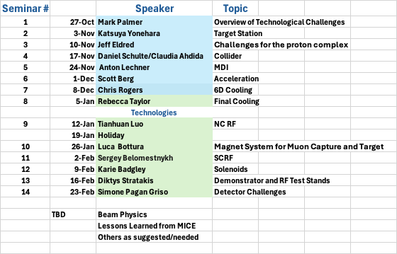
Community Seminar Series
Presentation Schedule
Monday’s at 11:00 Central time
Jointly organized with USMCC
Talks will be recorded unless otherwise requested
AI Summary
Posted on Indico

Slide 9
Access to information
Seminar Series
https://indico.muoncollider.us/event/7/
Seminar Number
Subscribe to the USMCC mailing list: https://listserv.fnal.gov/scripts/wa.exe?SUBED1=usmcc-info&A=1
to receive announcements and news.
Or subscribe to the Slack Channel:
https://join.slack.com/t/usmcc-slack/shared_invite/zt-3iulj4mlc-3d834bCdVXcCv21jSuSLUA
If you wish to join the US Muon Collider collaboration, contact Sergo Jindariani directly: sergo@fnal.gov

Slide 10
Topics for discussion
The Muon collider is unique technologically and sociologically
  We need to create a new paradigm
Determine basis for R&D plan –
  Stable, long-term
  Maintain community interest at an appropriate level

Slide 11
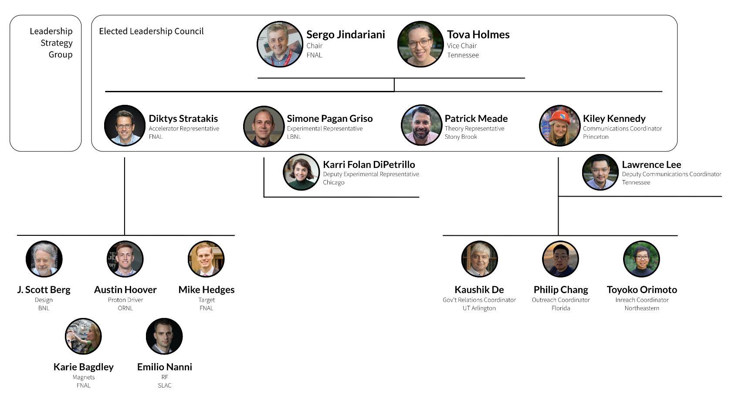
News from USMCC
New appointments within the UMCC Organization – working on engaging broader community
USMCC is actively working on the 2026 Summer Student Accelerator R&D Program*
2026 Annual USMCC Meeting will take place at Stanford/SLAC together with the IMCC demo workshop: Dec 13-18th, 2026
  *with gracious support from DOE
https://www.muoncollider.us/

Slide 12
Background material
Additions welcomed!
International Muon Collider Collaboration (IMCC): https://muoncollider.web.cern.ch/
U.S. Muon Collider Collaboration: https://www.muoncollider.us/
Muon colliders to expand frontiers of particle physics: by K. R. Long, D. Lucchesi, M. A. Palmer, N.Pastrone, D. Schulte, and V. Shiltsev (2021) https://arxiv.org/abs/2007.15684
Towards a Muon Collider: by C. Accettura et al. (2023). https://arxiv.org/abs/2303.08533
Muon Collider Forum Report: https://arxiv.org/abs/2209.01318
Muon Collider Snowmass White Papers: https://indico.cern.ch/event/1130036/
Interim report for the International Muon Collider Collaboration (IMCC): https://arxiv.org/abs/2407.12450

