Slide 1
Magnet development for future colliders20m
S
Magnet development for future colliders20m
S
Magnet development for future colliders
Soren Prestemon
US Magnet Development Program
Lawrence Berkeley National Laboratory
On behalf of the US MDP Collaboration

Slide 2
Outline
Magnet needs of future colliders
Example of enabling magnet technology – HiLumi
HEP Strategy for large-scale technology development
The US Magnet Development Program – recently revised roadmap
Recent major accomplishments
Synergies and collaborations
Summary

Slide 3
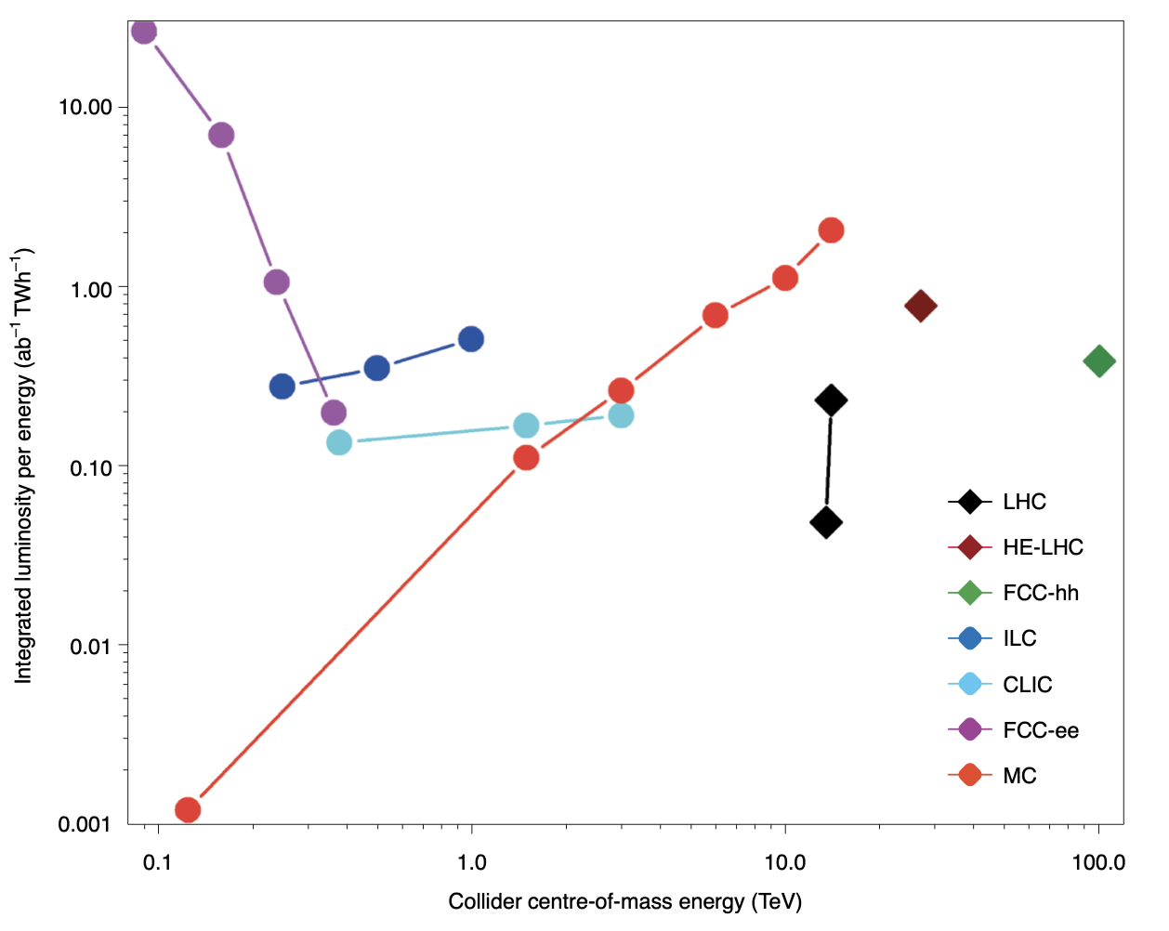
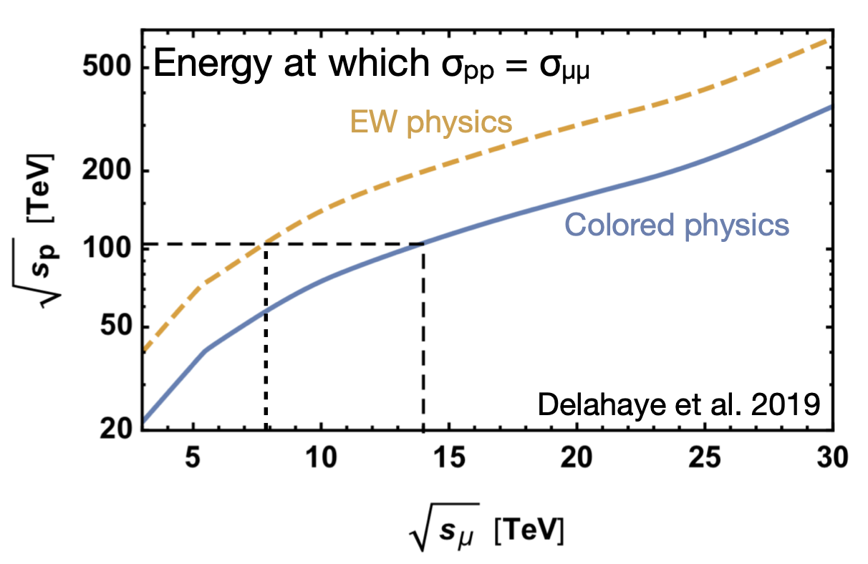
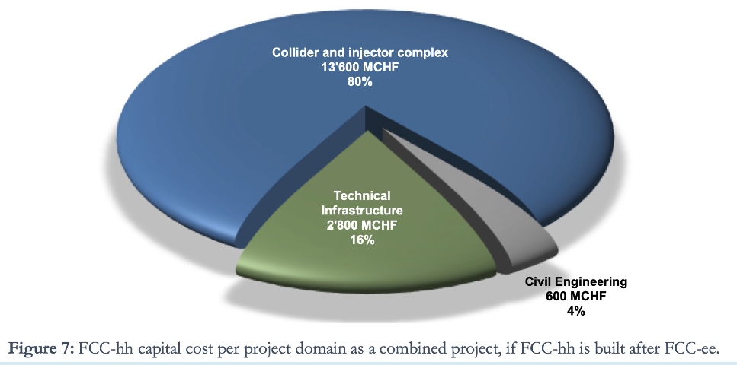
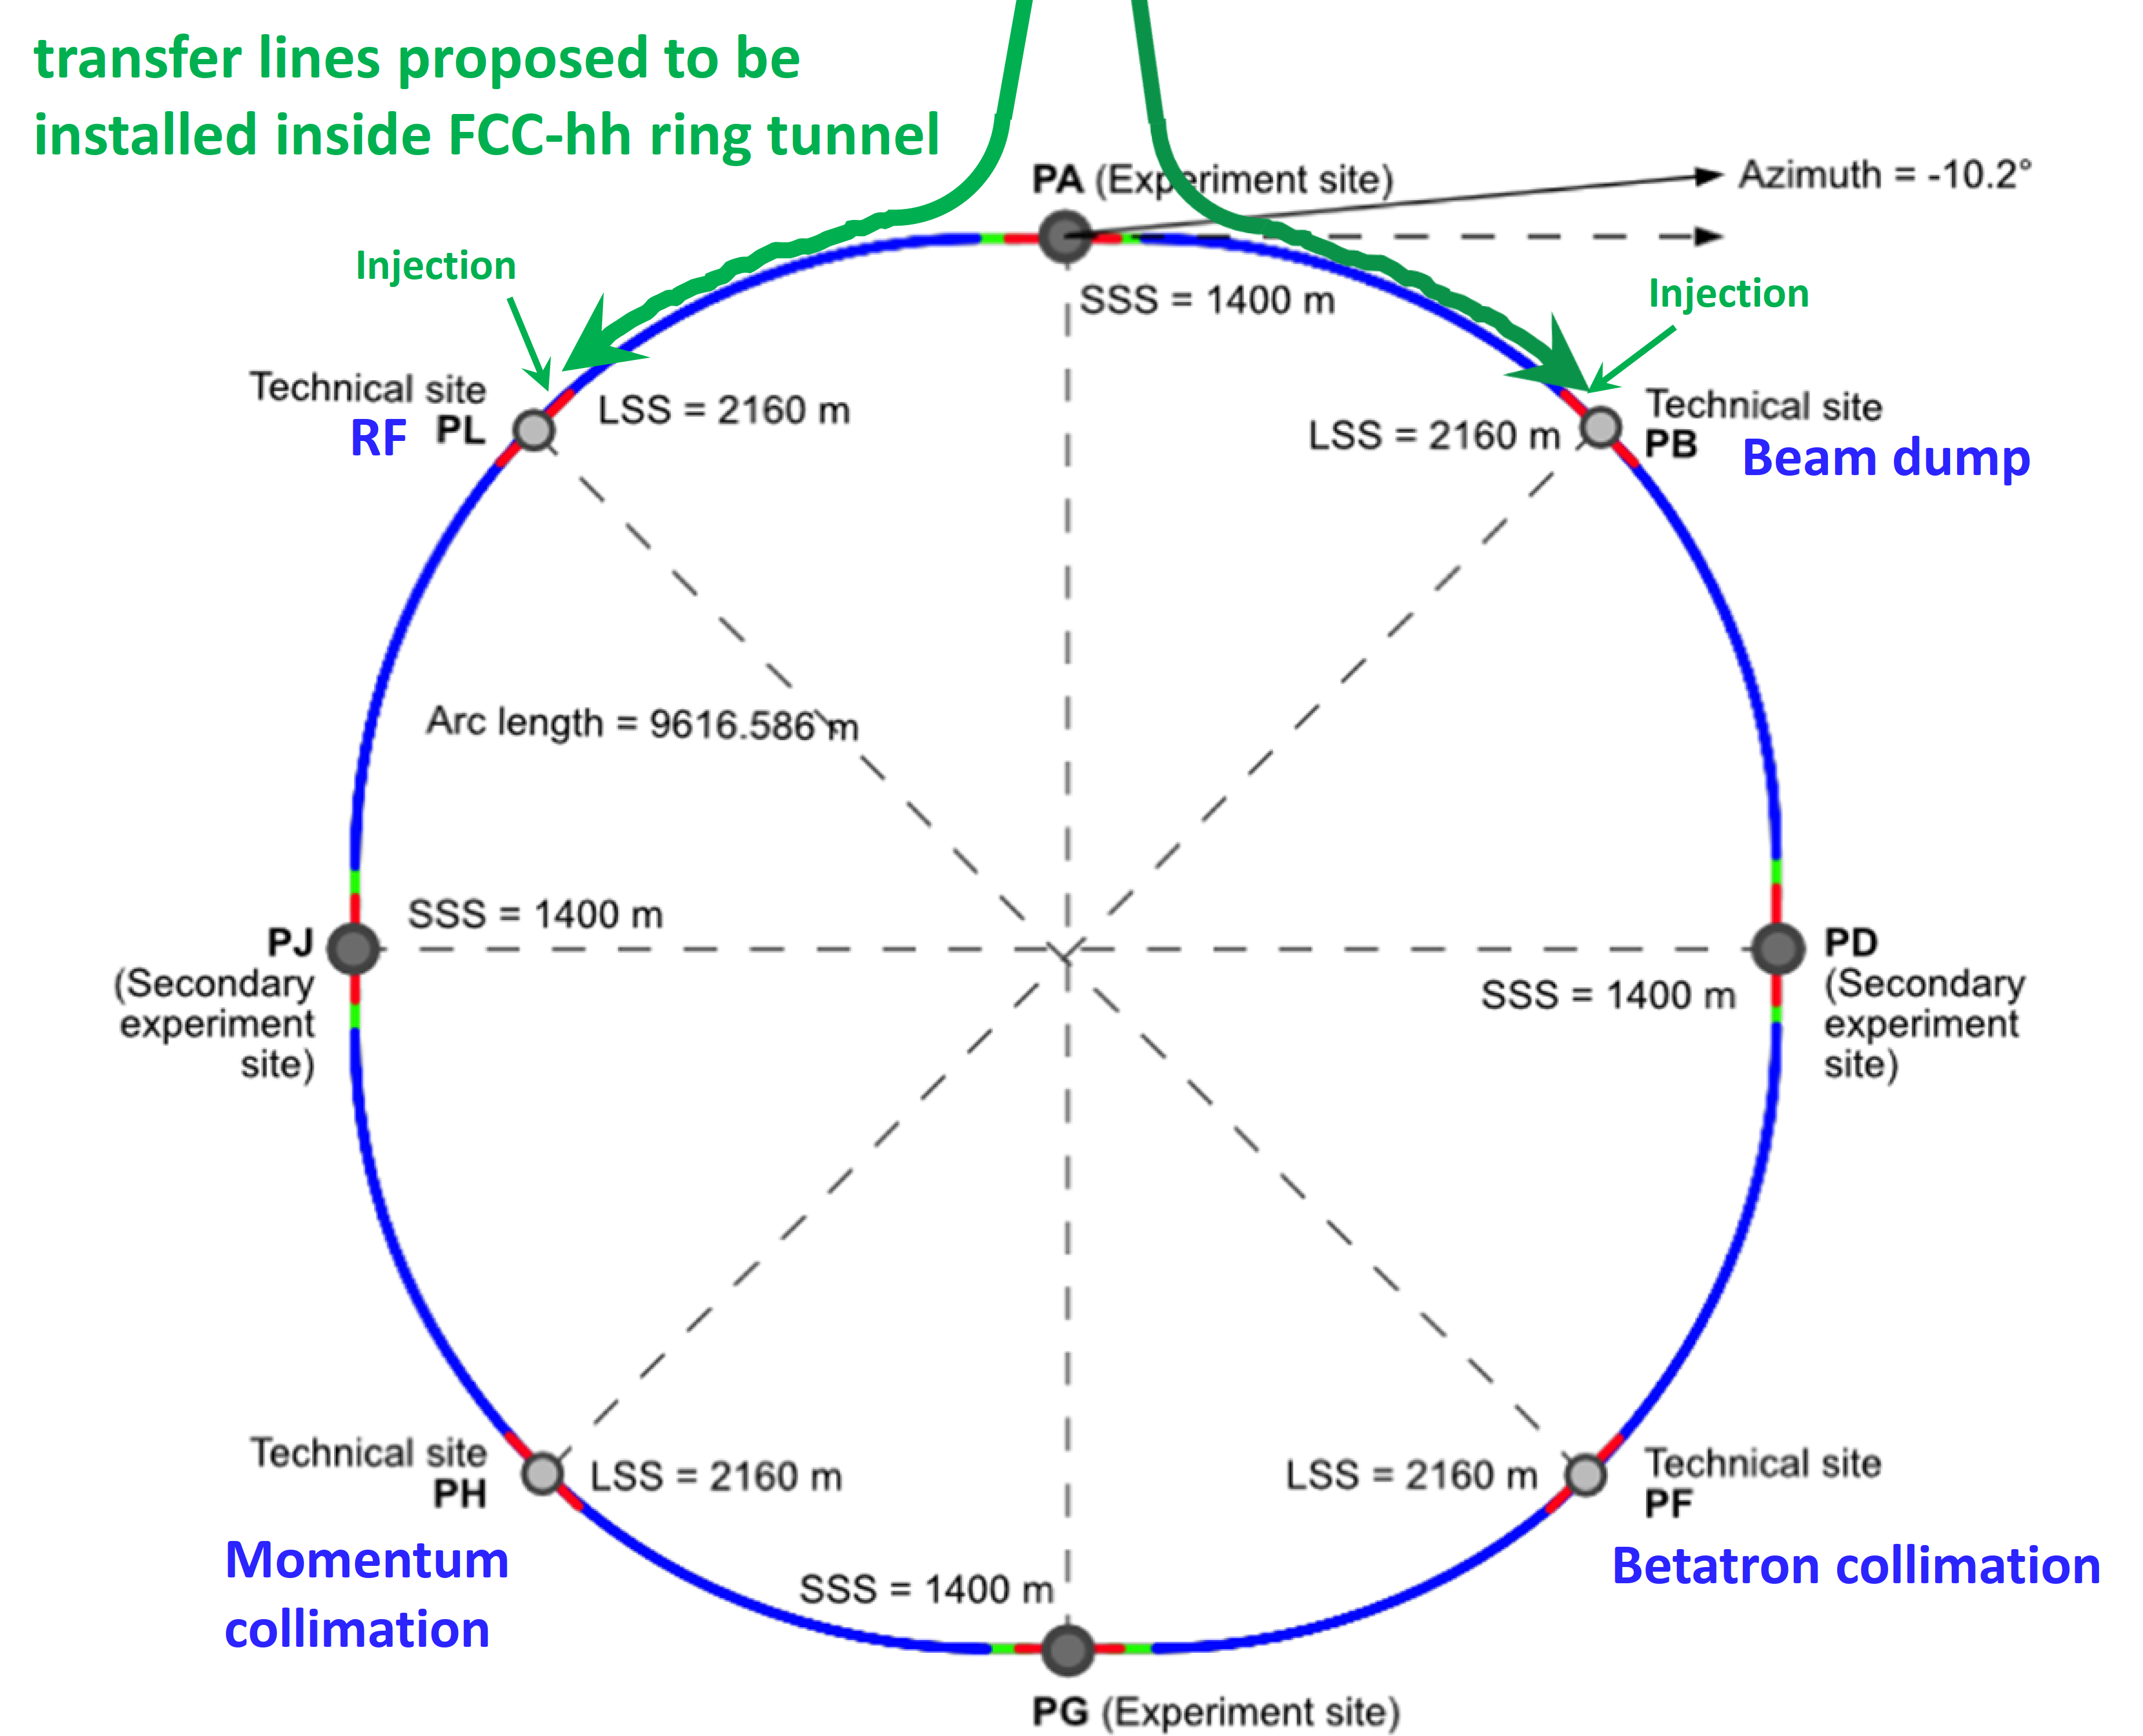
Hadron and muon colliders are primary energy frontier options
Magnets are 70% of Collider & Injector, ~50% project
https://doi.org/10.1038/s41567-020-01130-x
https://arxiv.org/pdf/2203.07256
Muon collider
FCC-hh collider

Slide 4
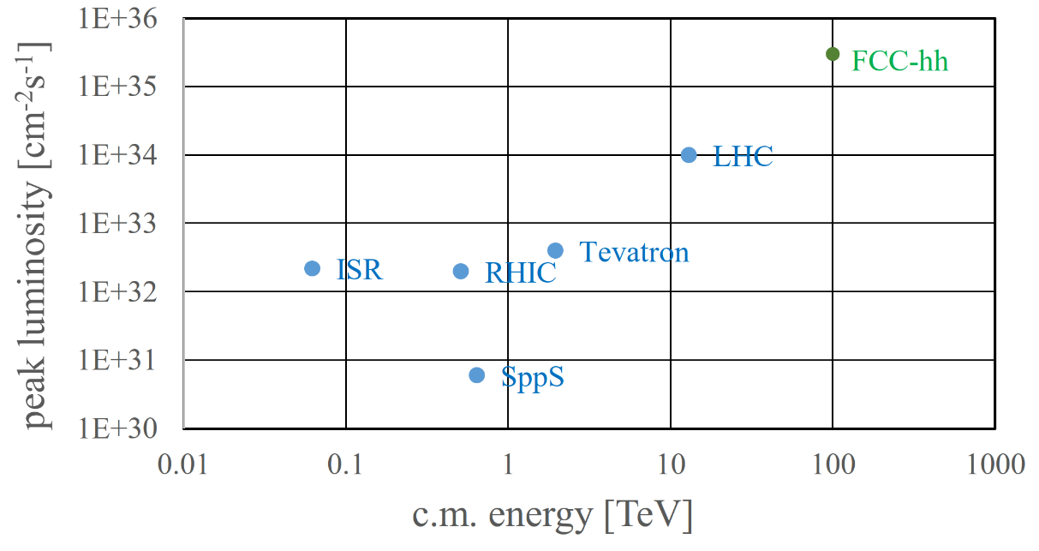
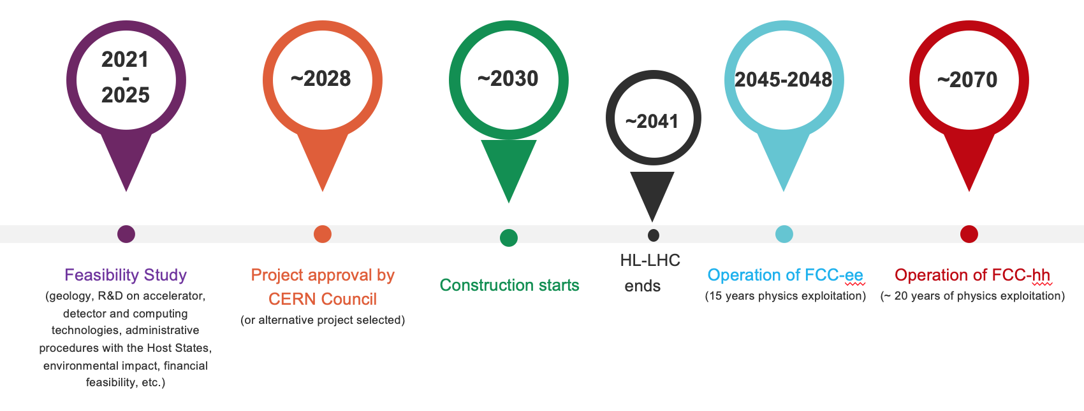
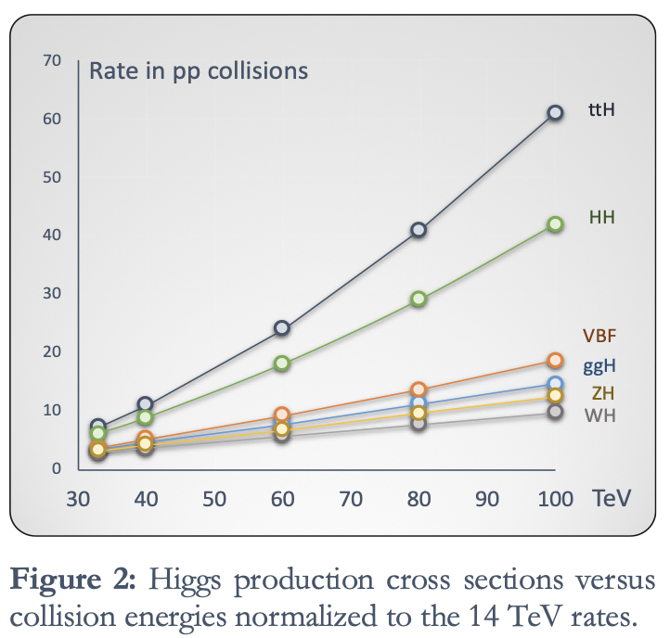
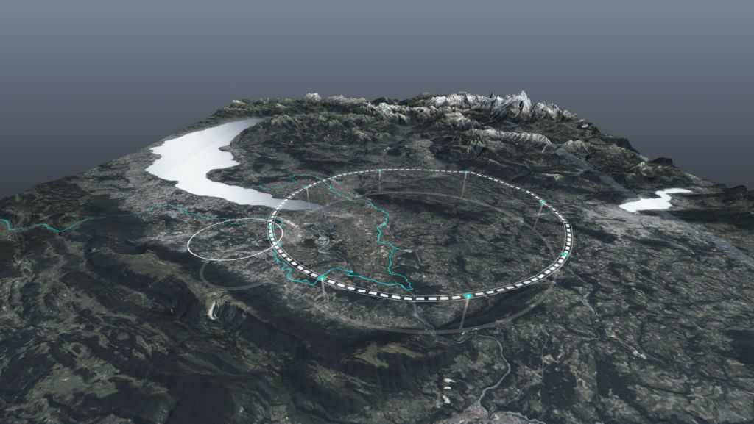
Possible future hadron collider – FCC-hh at CERN
~100 TeV CM collision energy (~10 TeV pCM)
20 ab⁻¹ per experiment over 25 years
Order of magnitude increase luminosity vs LHC
Luminosity per IP: ~30 E34/cm²/s
Site Power ~560 MW
Uses FCC-ee tunnel
With very high field magnets
Develop: 14-20 T
“Low temperature” superconductors: NbTi, Nb₃Sn
“High temperature” superconductors: REBCO (e.g. YBa₂Cu₃O_{7−x}), Bi2212 (e.g. Bi₂Sr₂Ca_{n−1}Cu_{n}O_{2n+4+x})
Material Credit: F. Zimmerman, V. Shiltsev, P5 town hall at SLAC

Slide 5
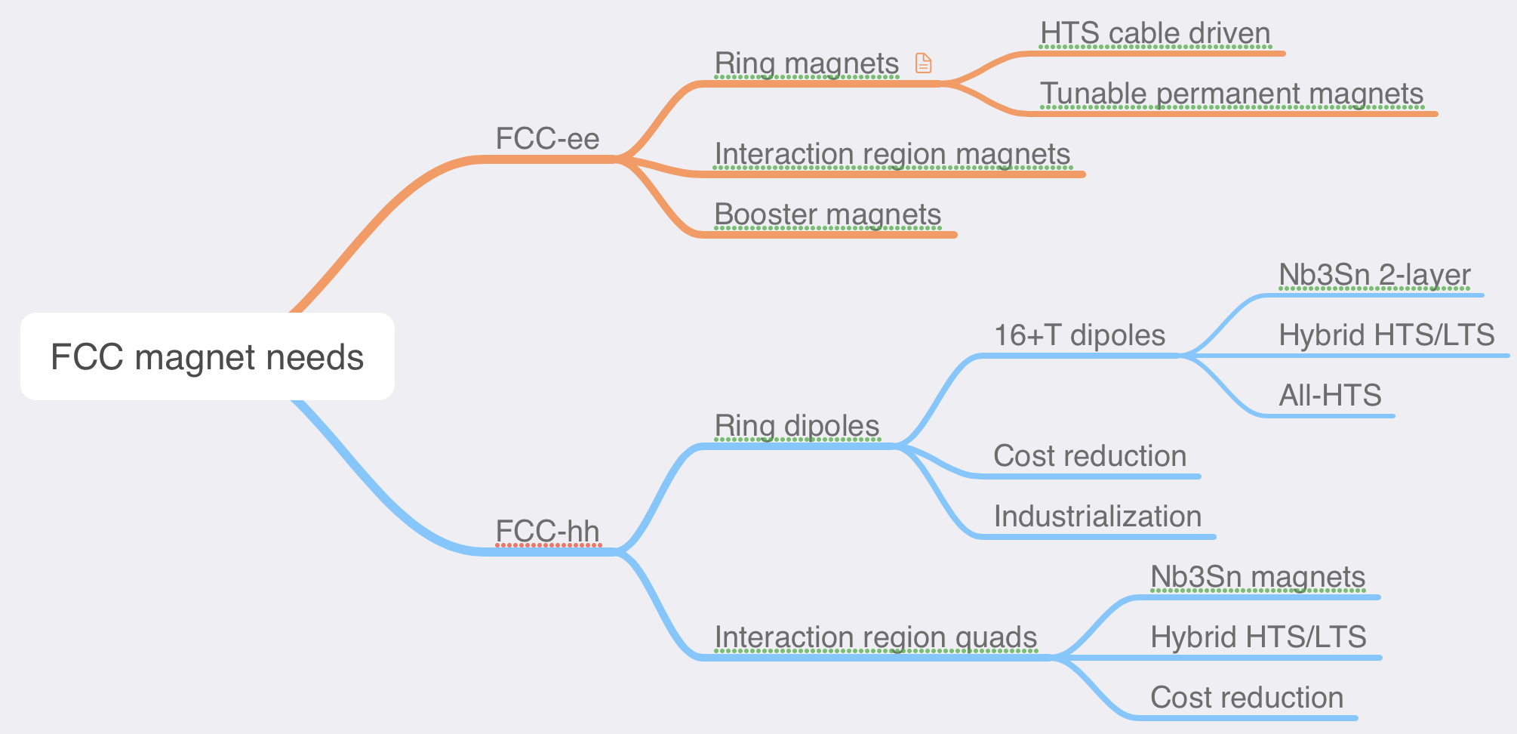
An overview of magnet needs for FCC-ee and FCC-hh
xx T

Slide 6
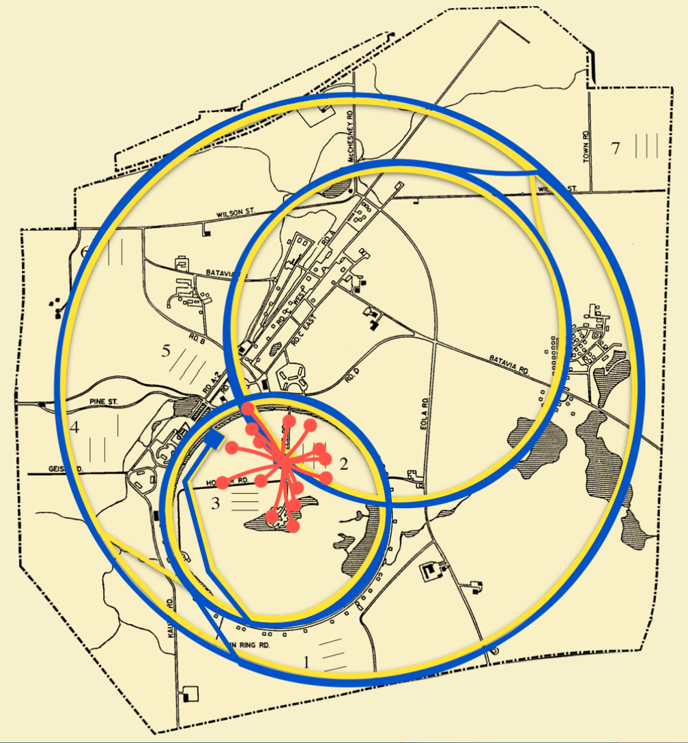
A muon collider will require critical advances in magnet technology – ripe for synergies with other applications
Radiation is a major consideration:
Study tradeoff in aperture/bore+shielding vs magnet radiation hardness
Further advance understanding of radiation hardness of superconductors and magnet materials
Rapid acceleration is critical:
Study fixed-field booster options where applicable
Further investigate high dB/dt magnet concepts
Evaluate acceleration (particularly low-energy) schemes in an integrated approach
Large thermal loads suggest higher-temperature operation
Explore all-HTS option
Explore facility and operational cost models
Leverage strong synergies with fusion and High-Field magnets (e.g. condensed matter):
Fastest development path for very challenging target and cooling magnets

Slide 7

DOE-OHEP has an excellent record of developing advanced technology – Strategic investment in critical general R&D
Long term investments in general accelerator R&D set the stage for dedicated readiness programs, which in turn enable successful delivery of advanced technology for colliders
The programs strive to coordinate efforts to more rapidly advance technology development
General R&D - programmatic
(ex: US MDP)
Directed R&D
(Technology readiness)
(ex: LARP)
Directed R&D
(Technology readiness)
Project
Project
(ex: HL-LHC AUP)
The US DOE approach balances long-range R&D and project preparation

Slide 8
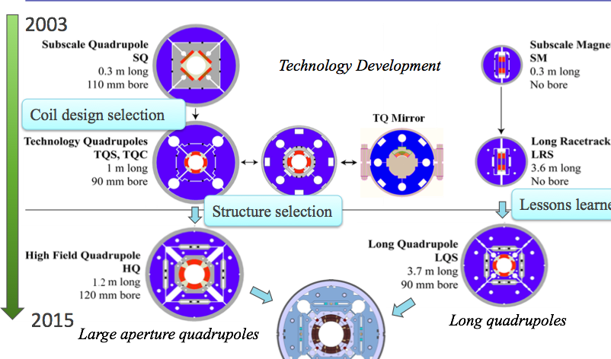
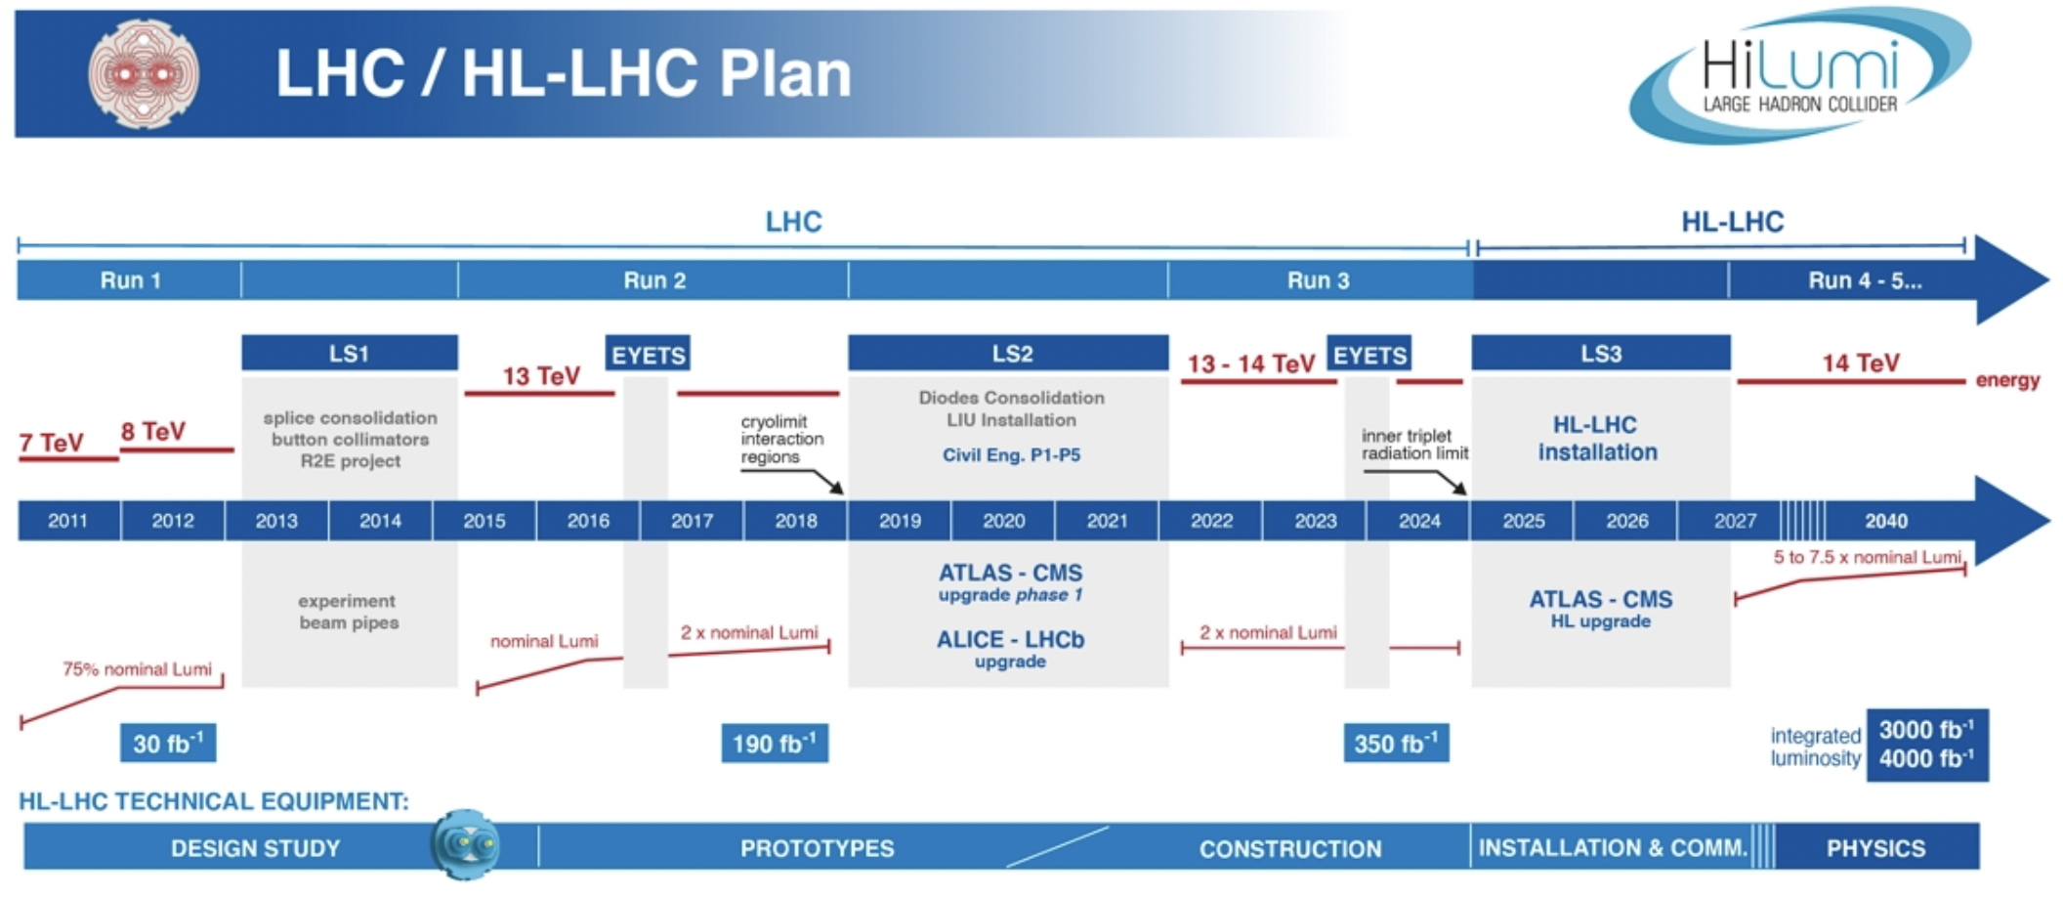
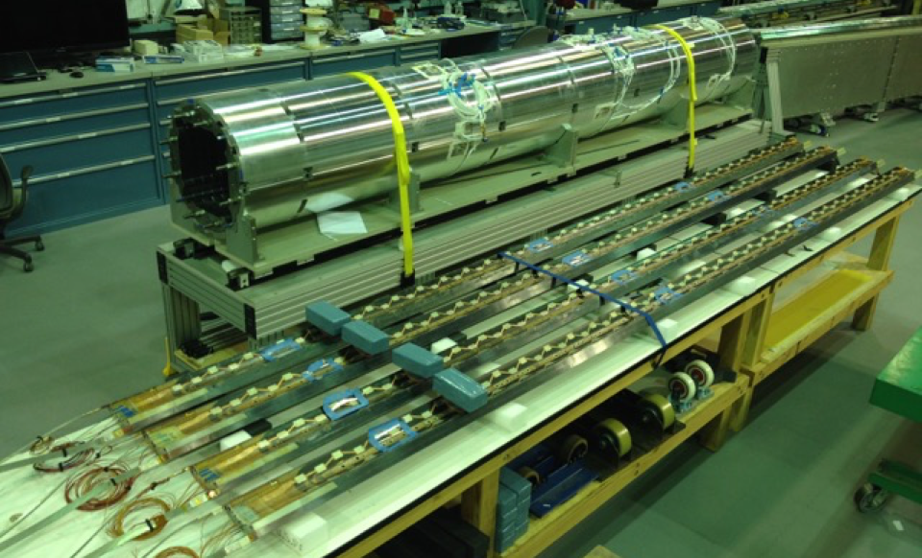
Nb3Sn accelerator magnet technology is - for the 1st time - being installed in a collider
S. Prestemon, Workshop on Advanced Superconducting Materials and Magnets, KEK January 22 2019
S. Prestemon, Workshop on Advanced Superconducting Materials and Magnets, KEK January 22 2019
HiLumi magnet production is arguably “boutique production”
First implementation of Nb₃Sn superconductor in a collider
What are the risks and benefits of full-scale industrial production of Nb₃Sn magnets?
What elements of the design are “robust”, and what elements generate risk/performance limitations?
There is significant value-engineering that can be performed

Slide 9
HEP GARD investment in magnets: US MDP Reviewed and revised to align with P5 recommendations
Central focus: develop and test high field magnets for HEP
Improve integration for hybrid magnets
Investigate HEP-motivated solenoid designs
Support magnets with critical materials, expertise & dev. of new enabling technologies
Strengthen linkage between technologies and magnets
Forward looking – what is enabled by our advances, and what is achievable for colliders
Align with, and support, collider design efforts
Further build collaborations, leverage synergies with fusion and with the NHMFL

Slide 10
Central themes of MDP magnet R&D
Use fast turn-around platforms (subscale magnets, mirror magnets, etc)
Develop and apply advanced diagnostics, modeling
Explore “Quench Current-boosting”, high-Cp concepts, etc.
Understanding the disturbance spectrum and its control
Study training, operating margin, and means to mitigate/reduce
Develop stress-management concepts to enable high-field accelerator magnets with strain-sensitive materials (Nb3Sn, HTS)
Develop and demonstrate REBCO and Bi2212 magnet technologies
Explore the viability of hybrid HTS/LTS magnets for efficient high-field accelerator magnets
Work with industry to advance superconductors tailored to HEP needs
Focus on developing conductor / cable / coil / magnet processes, identifying key issues
Leverage elements above to design optimized high-field configurations
Longstanding nexus between Labs, Universities, and industry in the US
Example: Annual Low Temperature Superconductor Workshop > 40+ years!

Slide 11
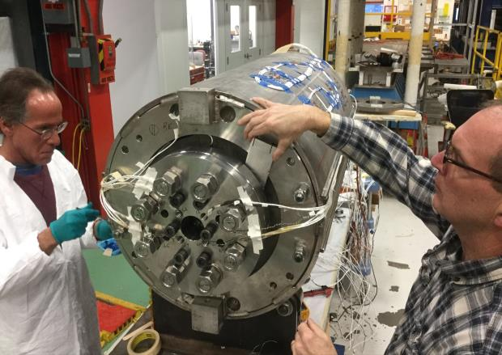
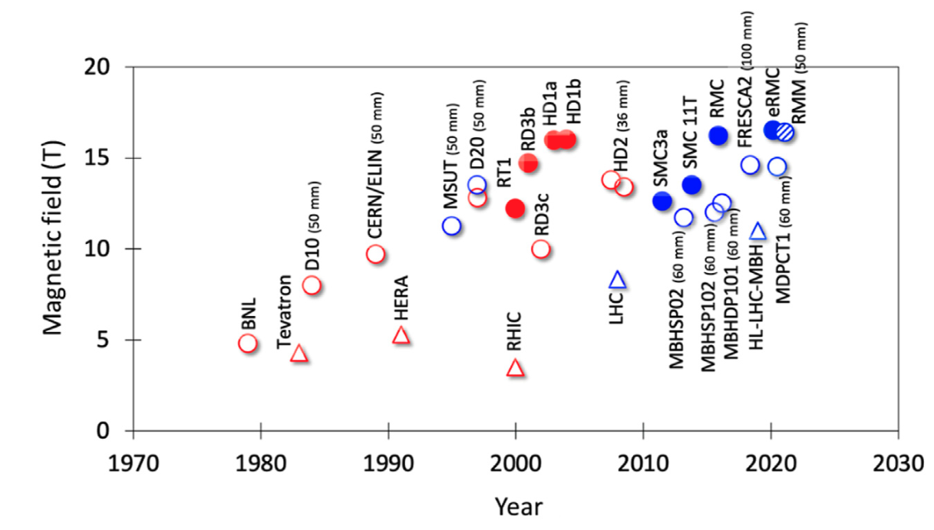
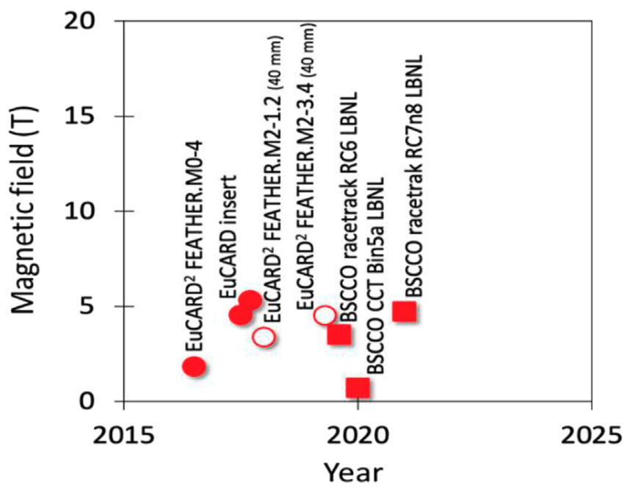
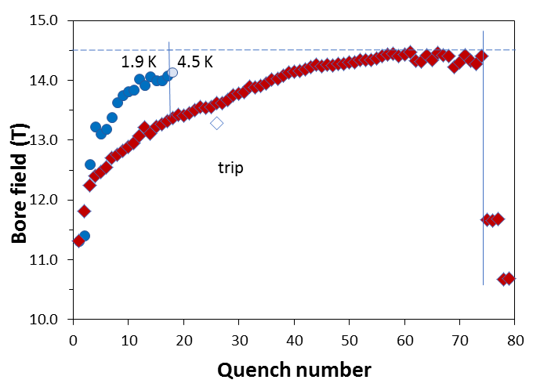
A key early MDP result was the 14.5T “MDPCT1” dipole
FNAL 14.5T “MDPCT1”
A. Zlobin et al, doi: 10.1109/TASC.2020.2967686
Bottura, Prestemon, Rossi, & Zlobin, Front. Phys., 12 October 2022
MDP Perspective:
[I]: Highest priority issue: degradation mechanisms; design mitigation
[II]: Second priority: Initial quench current and memory after thermal cycle
[III]: Third priority: Training rate
II
III
I

Slide 12
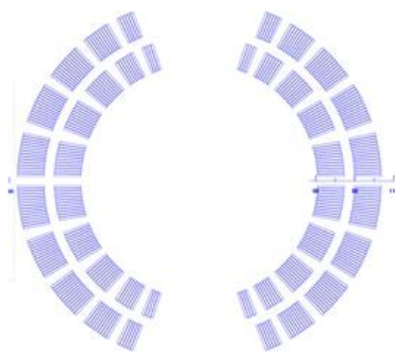
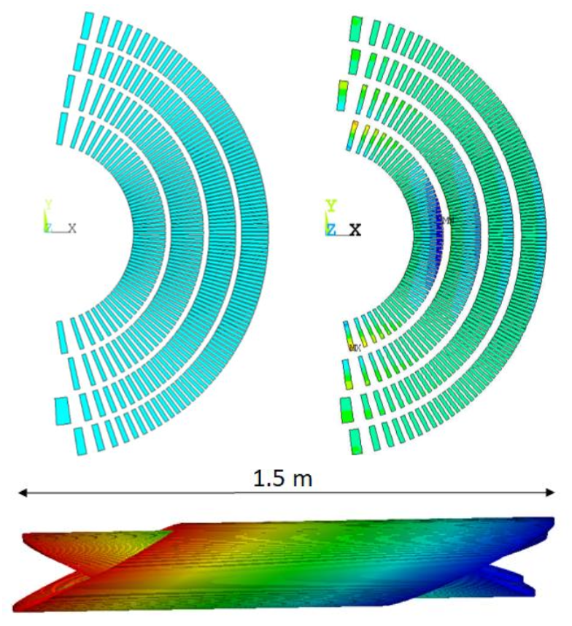
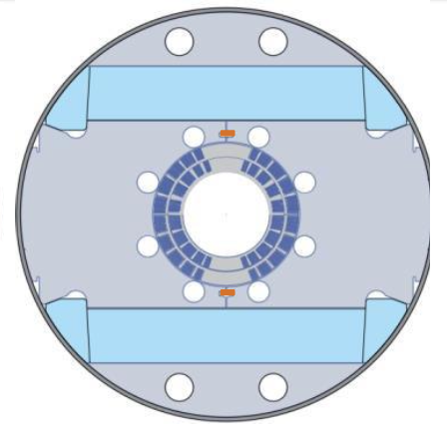
To address the issue of degradation, we incorporate stress-management with goal of >12T with a large bore
Canted Cosine theta (CCT):
4 layers
Bore field of ~12 T / 13 T for standalone operation
Bore diameter: 120 mm
Stress-managed Cosine Theta (SMCT):
2 layers
Bore field of ~12 T
Bore diameter: 120mm
SMCT
CCT
30+ % current margin at target fields of 12 T, 4.2 K and 13 T, 1.9 K
These are two variants on stress-management
CCT is a “limiting case” of maximal SM
SMCT is a more efficient design

Slide 13
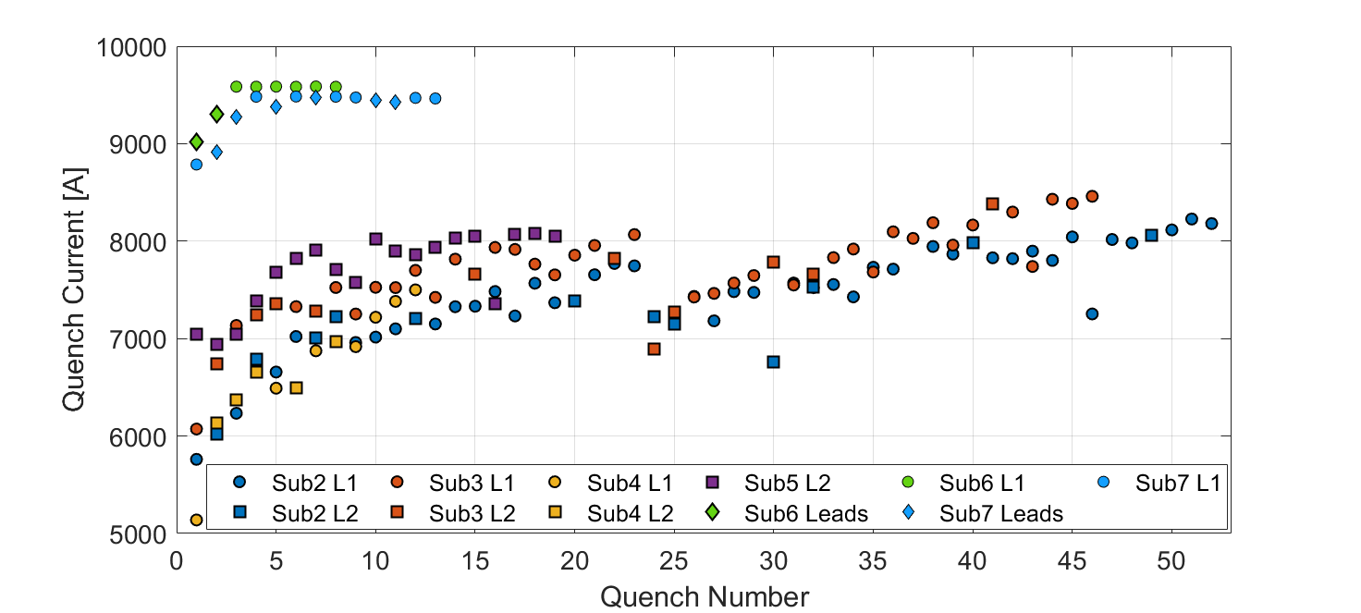
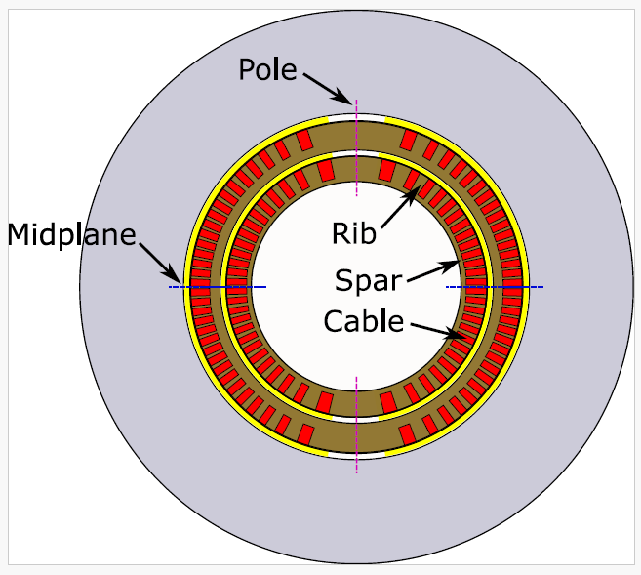
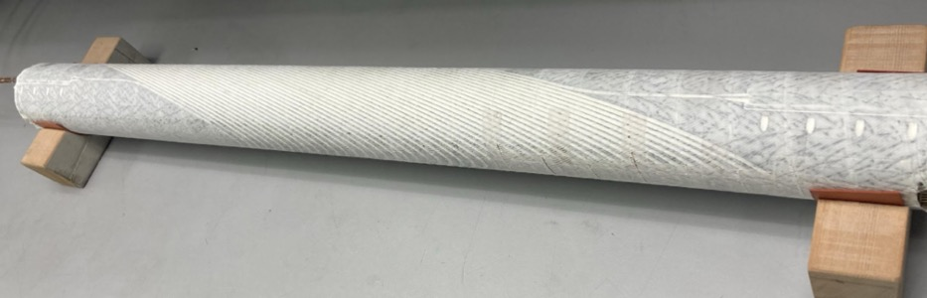
Subscale magnets are used to evaluate impregnation materials – the return of Paraffin Wax!
Subscale CCT’s built with Paraffin wax (sub-6), then filled-wax (sub-7)
Subscale with Telene is being fabricated
Daly et al 2022 ,SUST 35 055014
D. Arbelaez, IEEE TAS, Vol. 32, No. 6, Sep. 2022, 4003207.
D Arbelaez et al., SUST, 37 065015, 2024
E. Barzi et al 2024 SUST. 37 045008
Very promising – is it a lasting breakthrough?

Slide 14
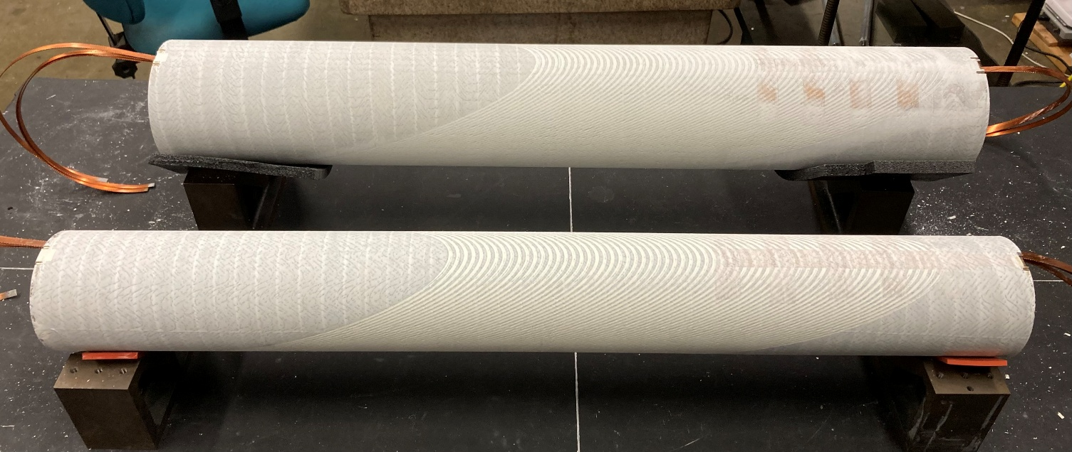
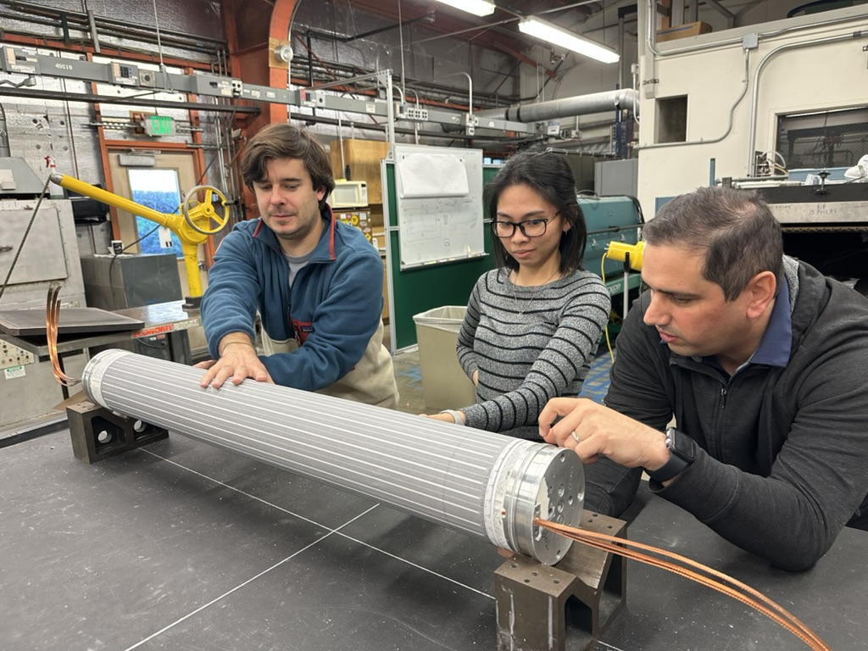
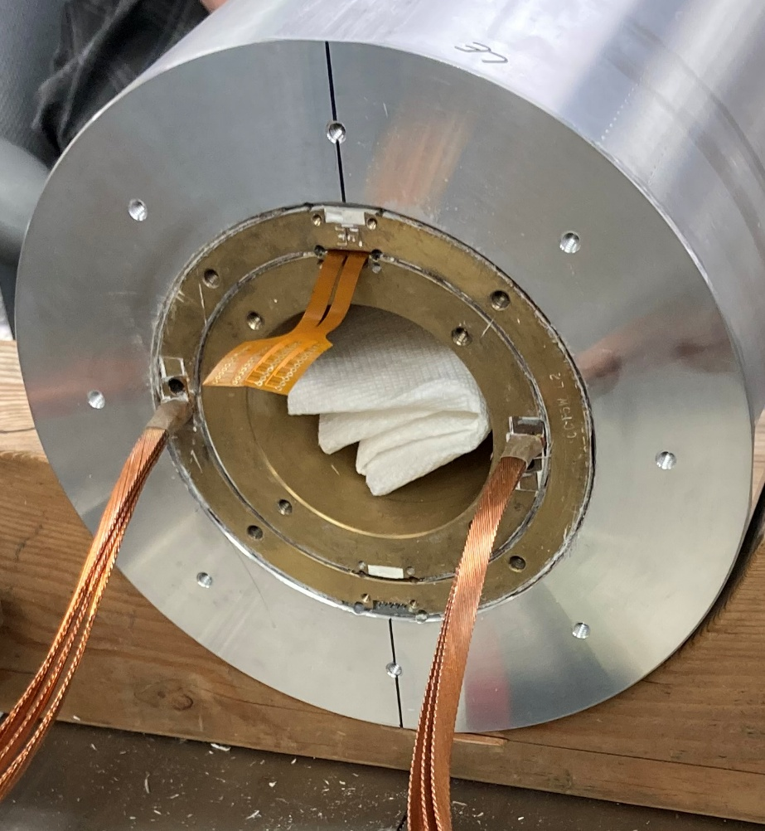
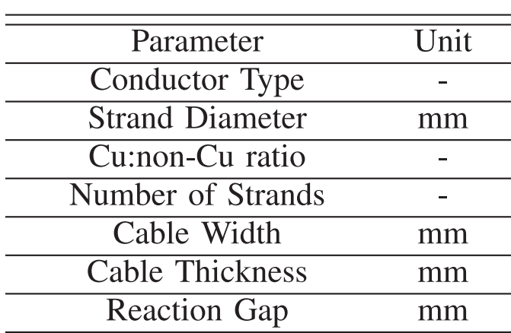
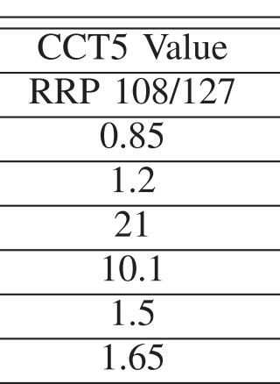
Filled Wax Impregnation Beyond Subscale Models (CCT5W)
CCT5w cable parameters
✔️
✔️
✔️

Slide 15
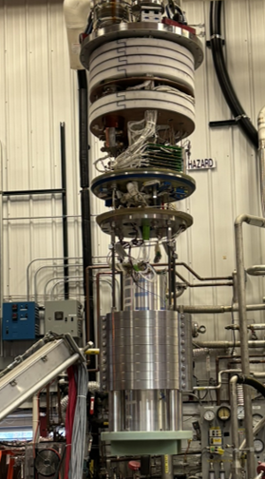
Training Results: Comparison between CCT5 and CCT5-W
Dramatic reduction in training, good memory Impacts collider magnet cost
No degradation observed Ready to scale to the 14-16T level
Quench Current
11.1T
Normalized Quench Current
9.9T

Slide 16
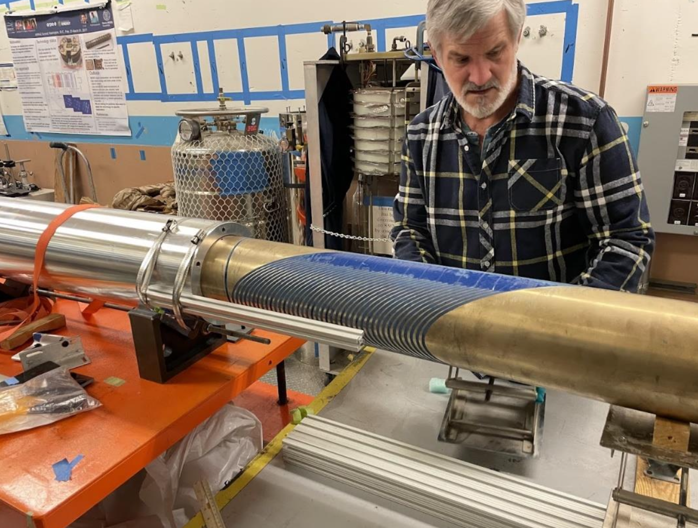
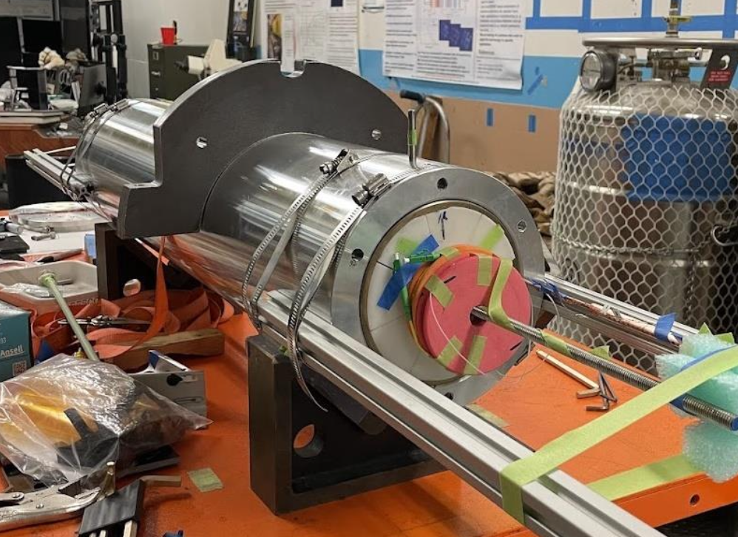
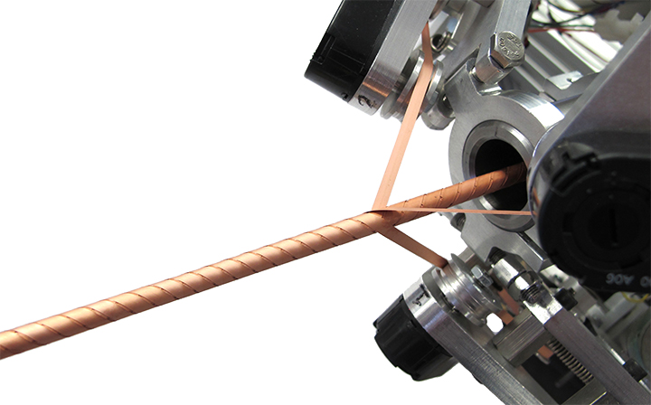
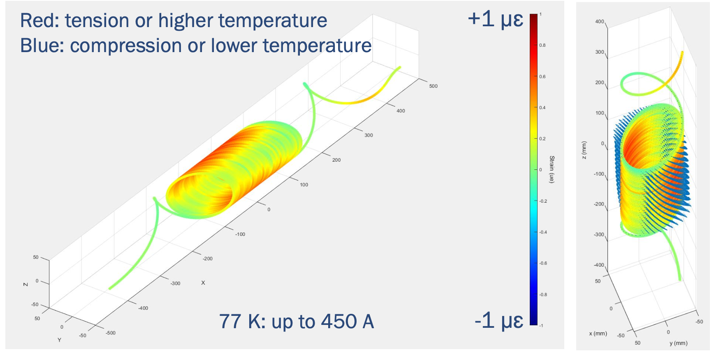
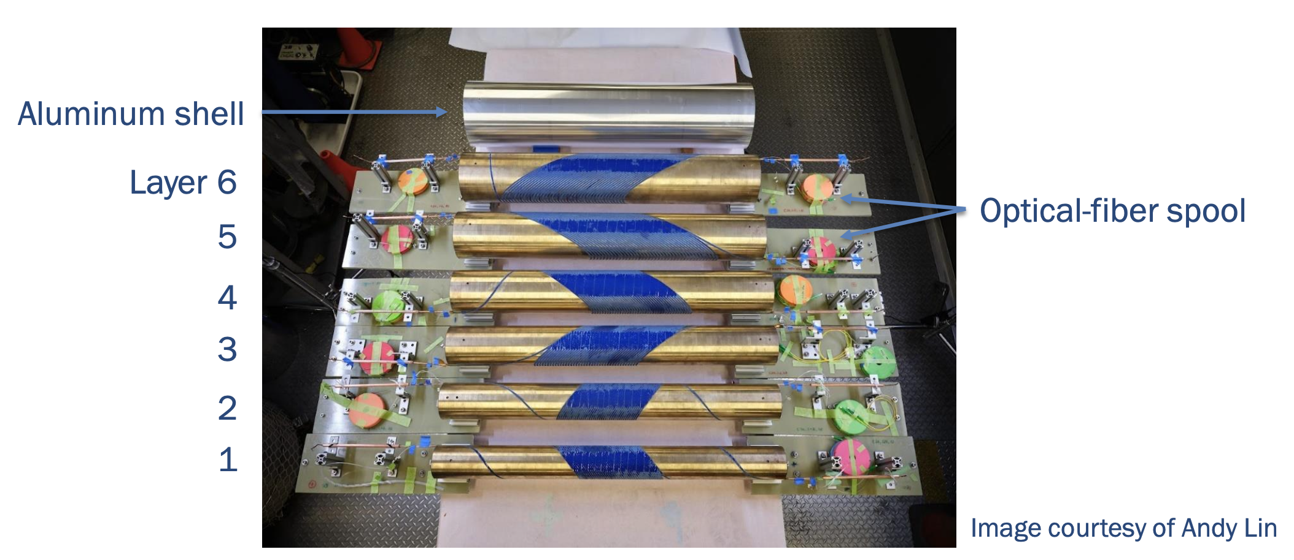
Major new result with REBCO High Temperature Superconductor - C3 is a 6-layer CCT magnet using CORC conductor
145 m of CORC® wires in six pieces, maximum piece length 35 m
Specified the minimum tape Ic for HM tapes

Slide 17
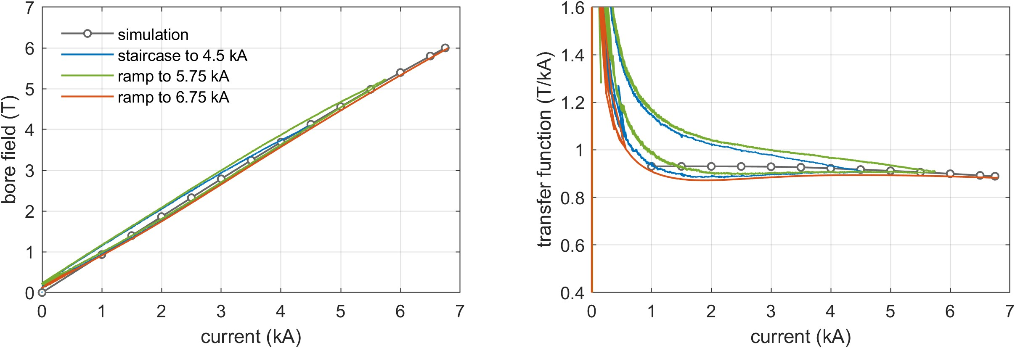
The dipole field reached 5.99 T at 6.75 kA, in a 60mm bore
5.99 T
4.2 K
4.2 K
Calculation by L. Brouwer and Y. Yan
Peak I x B force on the conductor ~ 42 kN/m
Iron contribution ~ 1.1 T, 19% of the total field

Slide 18
The MDP Roadmap is aligned with DOE-OHEP Strategy
The magnet research supports hadron and muon colliders, also axion-searches
A major focus of MDP is on the science of magnets, i.e. modeling, diagnostics & instrumentation, and materials
The new roadmap enforces strong interfacing with collider designs
Next major milestones are getting HTS (REBCO and Bi2212) magnets into high field via “hybrid magnet” testing

Slide 19
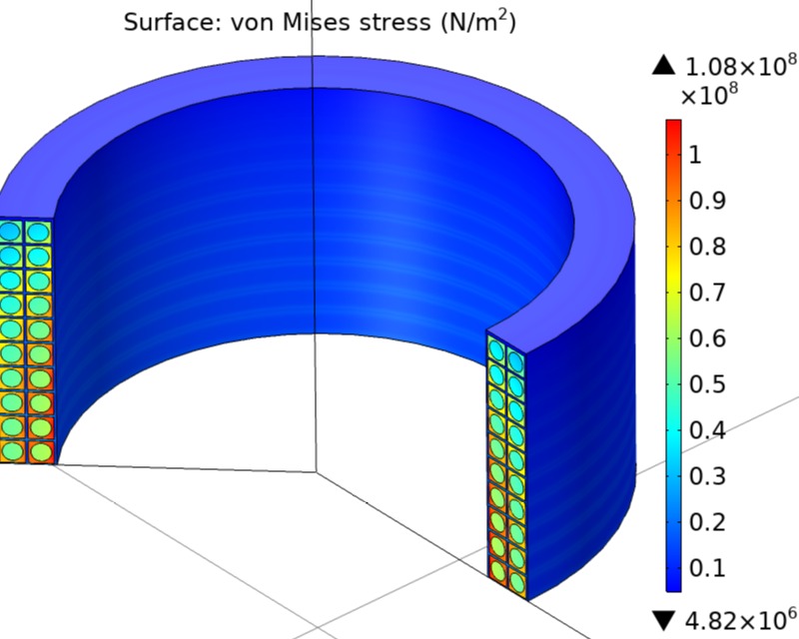
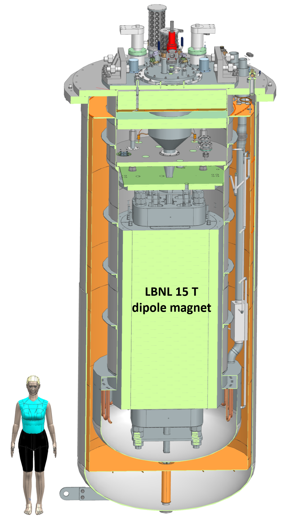
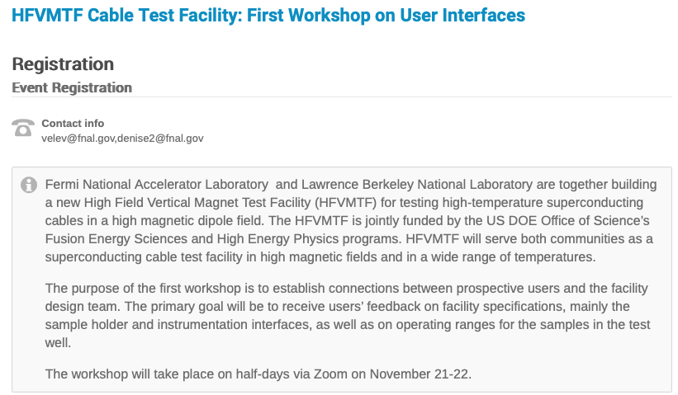
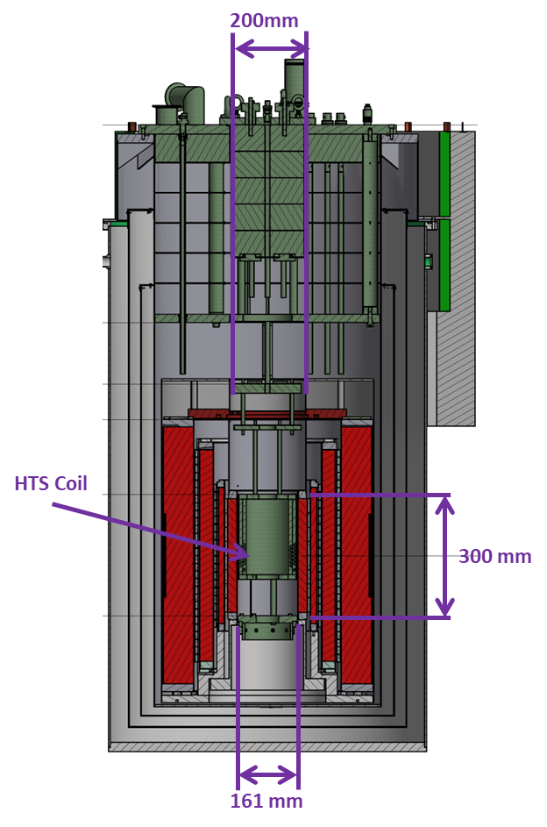
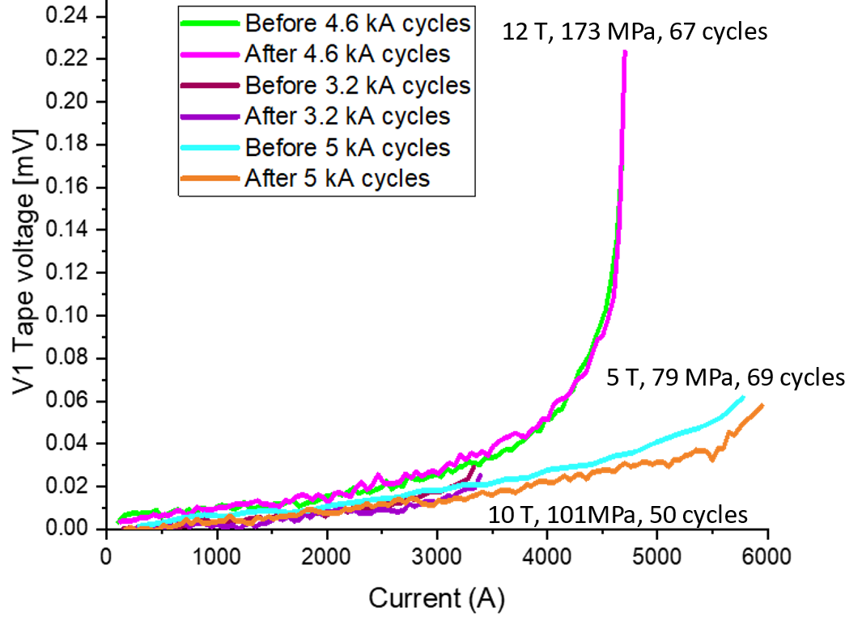
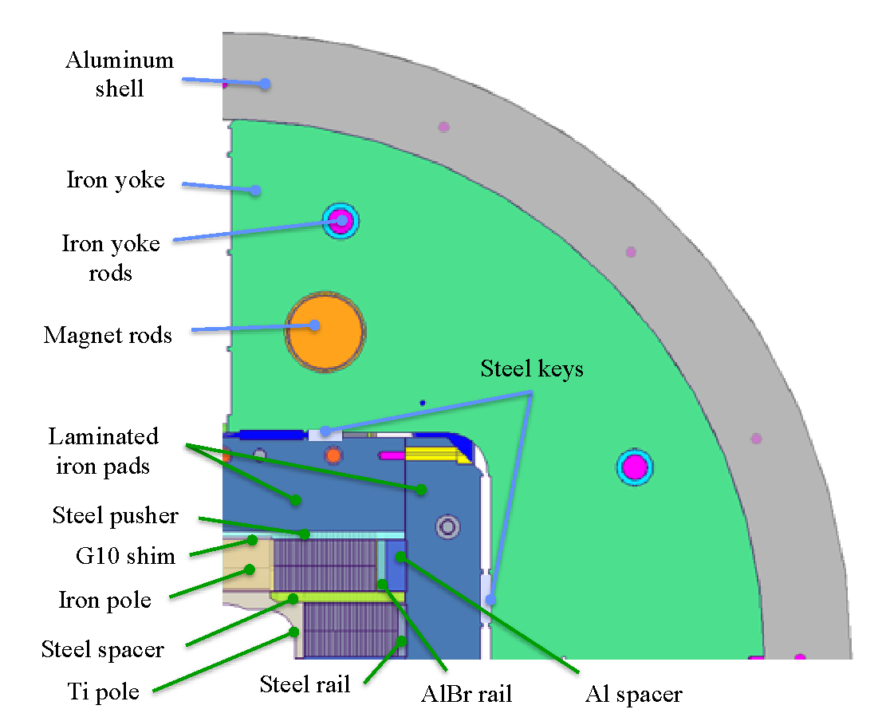
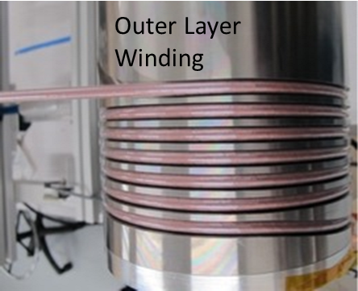
Strong synergies with Fusion REBCO research are leveraged
No sign of degradation seen in high field & low-cycle fatigue testing - IC>80% sum of tapes
Demonstrate feasibility of direct dry wound (non-VPI) coil design
DOE Offices of HEP & FES jointly funding a large-bore cable test facility
Will provide 15T dipole field over 750mm good-field, 1.9-50K on-sample
Cryostat will enable testing of high-field hybrid magnets
Being located at FNAL
A two layer Cable Model Coil to test for cyclic degradation

Slide 20











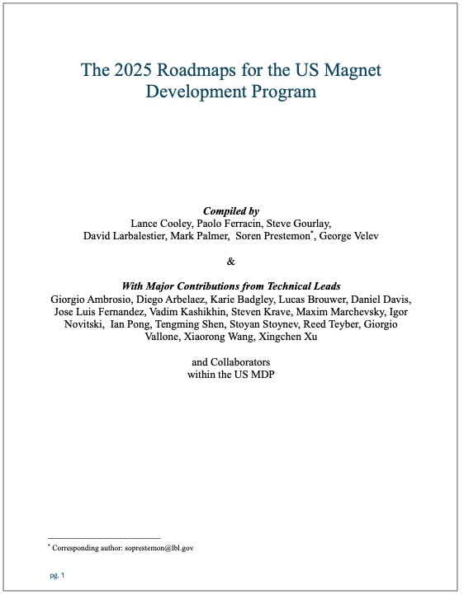





















Magnet and Conductor Plans & Roadmaps are well-advanced globally
US MDP – well established
European HFM – established, rapid development
Japan efforts at KEK - coordinated with CERN and MDP
China efforts led by IHEP – progressing well
This is not a comprehensive list of collaborators… our community is broad and diverse!
中国科学院电工研究所
Institute of Electrical Engineering, CAS
中国科学院高能物理研究所
Institute of High Energy Physics, CAS
Updated US MDP Roadmaps have been published https://arxiv.org/abs/2508.19220

Slide 21
Summary
Future colliders depend critically on magnet technology
HEP invests in magnet technology through the US Magnet Development Program
US-MDP has an updated roadmap aligned with P5 and HEP strategic vision
Recent progress has potential impact on collider performance and cost
US-MDP is increasingly focusing on advancing HTS accelerator magnet technology
Strong collaborations exist on the international front
and strong synergies are leveraged with fusion

Slide 22
Thank you!
We are at a critical period, where innovation and progress in magnet technology is essential to enable the next generation of colliders – the opportunity and challenge is shared with Fusion and other applications!

Slide 23
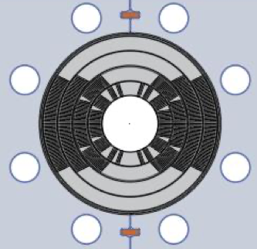
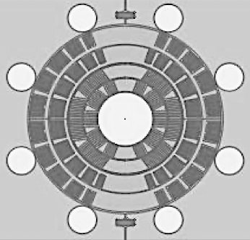
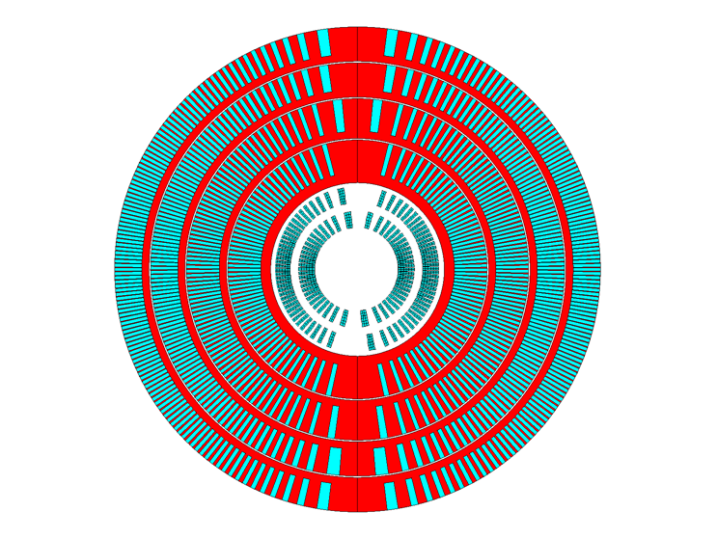
Managing mechanical stresses is key to higher fields – exploring stress-managed structures
“Traditional” Cos-theta
- Midplane stress due to azimuthal force accumulation
“Stress-managed” Cos-theta
- Groups of turns, azimuthal forces intercepted by support
MDP stress-managed hybrid magnets are under development
Critical for strain sensitive Nb₃Sn & HTS conductors
Characterized by significant interfaces
Nb₃Sn outsert
These “stress-managed” structures may enable combined function high-field accelerator magnets, which are subject to complex force distributions
HTS insert
Serves as good candidate for muon collider ring dipole

Slide 24
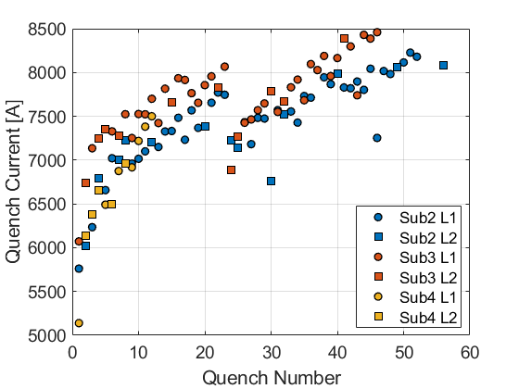
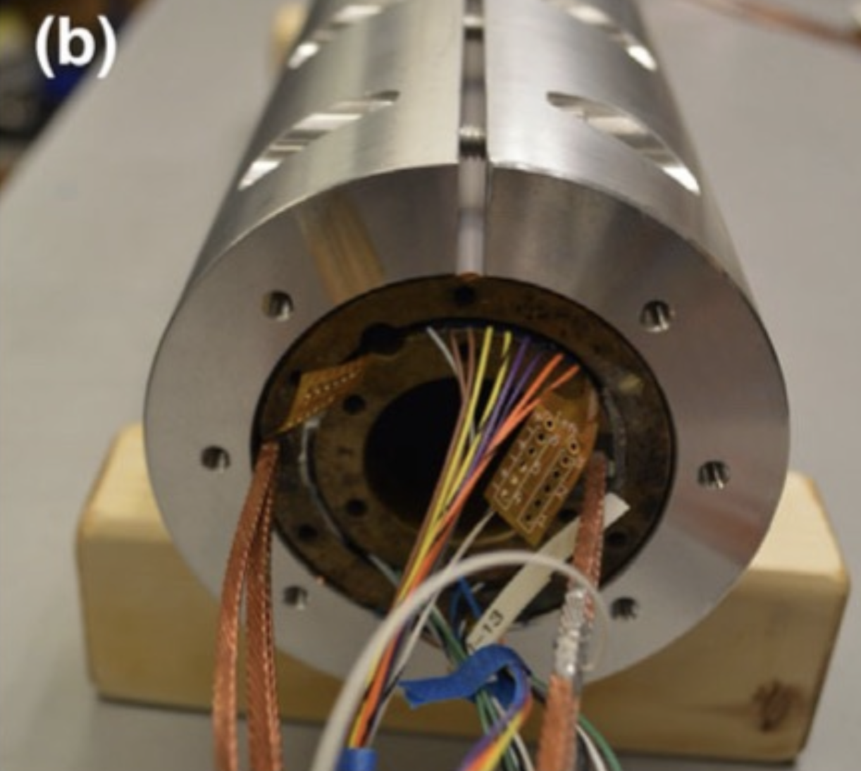
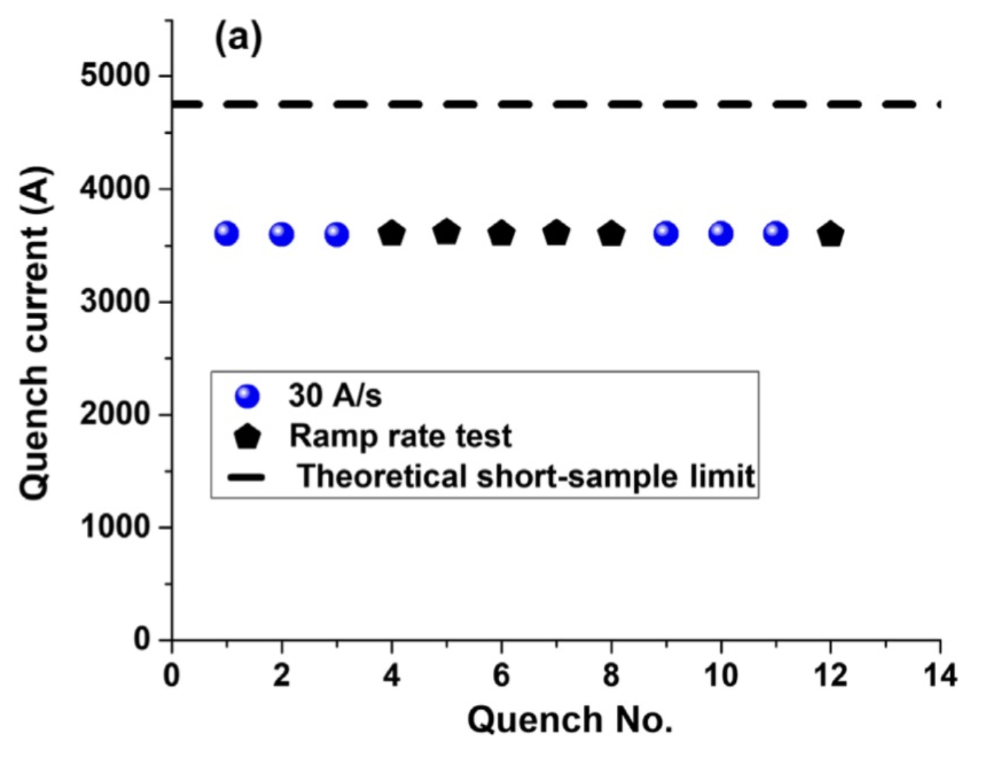
New paradigms: quench-free HTS magnet designs?
Traditional superconducting magnet design ensures magnet can survive quenches
Motivation:
spontaneous quenches => lack of reliable precursor, not controllable
Training => potential for improved performance after quenching
Can we contemplate a new paradigm for HTS?
Higher MQE => not (?) susceptible to spontaneous quenches => no “random” behavior
So far no indication that HTS magnets exhibit training => no performance enhancement
Design to eliminate run-away quenching !?
“Typical” Nb₃Sn CCT magnet training
T. Shen et al., PHYS. REV. ACCEL. BEAMS 25, 122401 (2022)
“Rapid” training to ~75% short-sample, then rate changes
“Fair” memory after thermal cycle
Sub 2/3 thermal cycle

Slide 25
New paradigms: Liquid hydrogen cooled collider?
Hydrogen has critical advantages:
Plentiful => not supply limited
Carnot + liquefaction efficiency => dramatic improvement in ”wall-plug efficiency”
Strong investments from other societal uses => cost, storage/shipping evolving rapidly
But there are concerns/issues:
Safety => highly combustible in presence of oxygen
Materials compatibility => some restrictions due to embrittlement/corrosion
Limits superconductor option => only REBCO maintains significant transport current at 20K
Sustainability will be a driving consideration in any future international physics experiment - our community needs to make a strong, dedicated effort to explore liquid hydrogen for future colliders

