Slide 1
RHIC Modeling & Operation Experience
G. Robert-Demolaize, A. Drees, K. Hock, B. Lepore, S. Peggs

Slide 2
OUTLINE
The RHIC model: structure, workflow and the interfacing between AP – Controls – Ops crews.
Lessons learned from 25 years of operations
Looking ahead: online/offline modeling for the HSR

Slide 3
1- The RHIC model 2 – Lessons Learned 3 – Looking ahead
A little bit of semantics to begin with:
the online model combines the information contained in multiple databases (DBs) with real time magnet settings of each collider ring to deliver the closest digital representation of the machine as possible;
the offline model uses the same pool of DB information but is a snapshot in time of a given set of machine settings.
Main difference: the online model has a constant, direct line of communication with the machine via the Controls System and various Operations Applications.
3 main databases: magbase, RHICgddb, rhic99
magbase: contains every magnetic measurement made during construction/commissioning of RHIC;
RHICgddb: features engineering information about the RHIC lattices: cold masses, windings, lengths, locations, sequence, survey, etc…
rhic99: a repository of magnet settings for specific linear optics – deprecated and not used since early 2010s

Slide 4
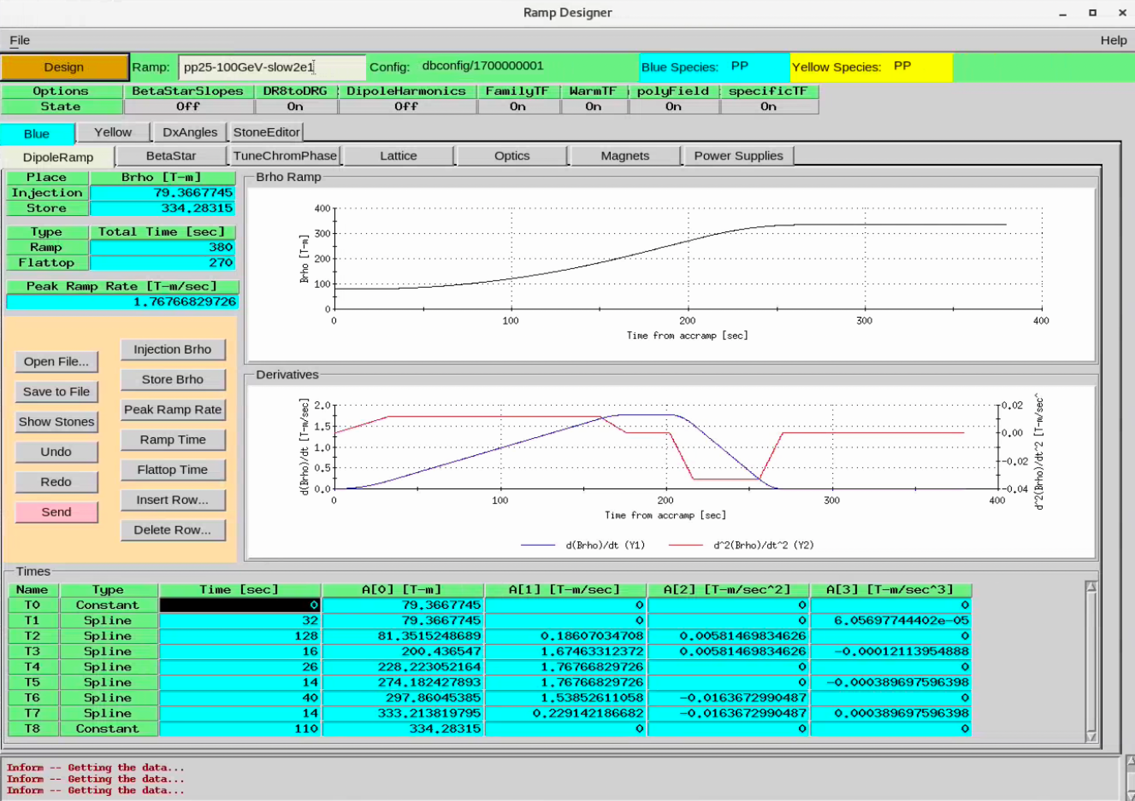
1- The RHIC model 2 – Lessons Learned 3 – Looking ahead
What the online model allows:
RampDesigner
GUI to fine-tune ramp dynamics based on PS limits
shows interpolated settings between “stepstones”
accelerator physicist (AP) tool

Slide 5
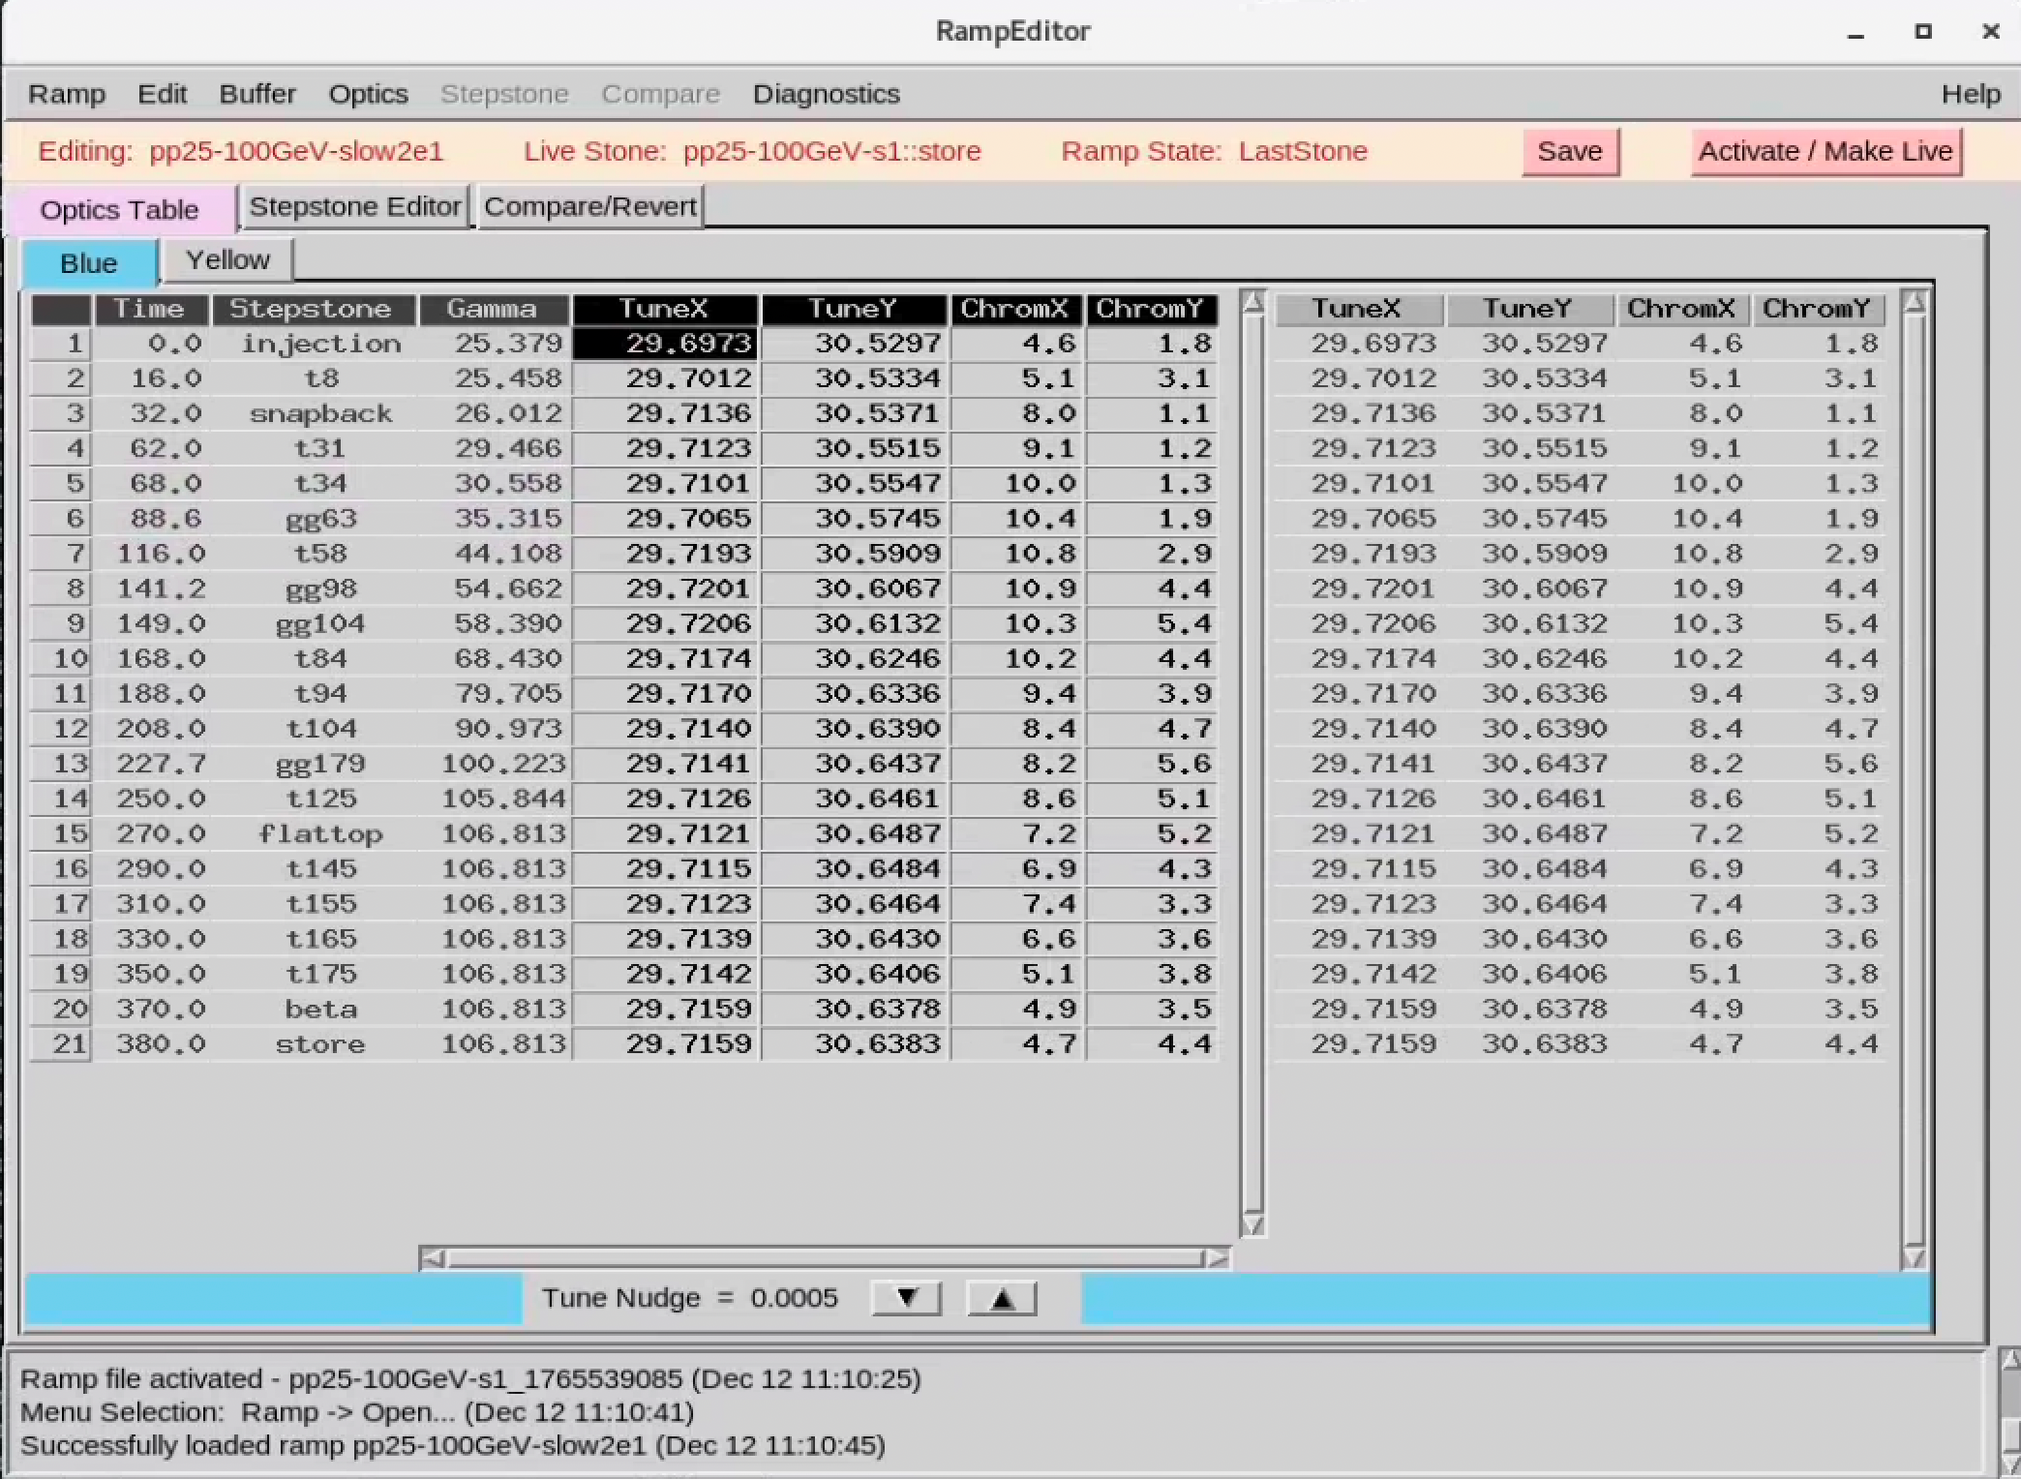
1- The RHIC model 2 – Lessons Learned 3 – Looking ahead
What the online model allows:
RampEditor
GUI for tunes/chromaticities control

Slide 6
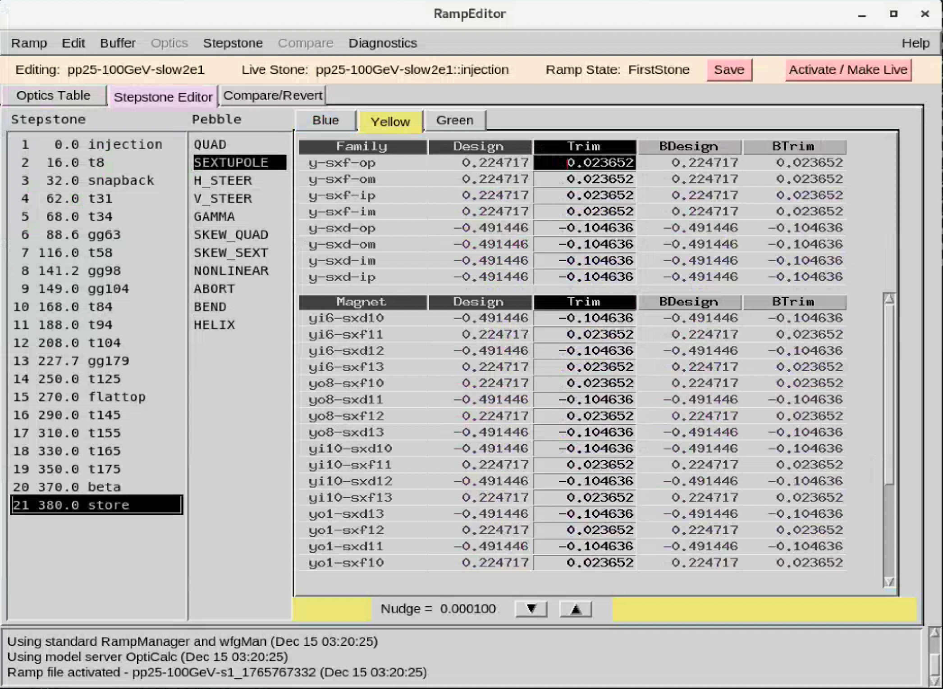
1- The RHIC model 2 – Lessons Learned 3 – Looking ahead
What the online model allows:
RampEditor
GUI for tunes/chromaticities control
can manipulate magnet strengths via individual PS and/or full families.
Operations tool

Slide 7
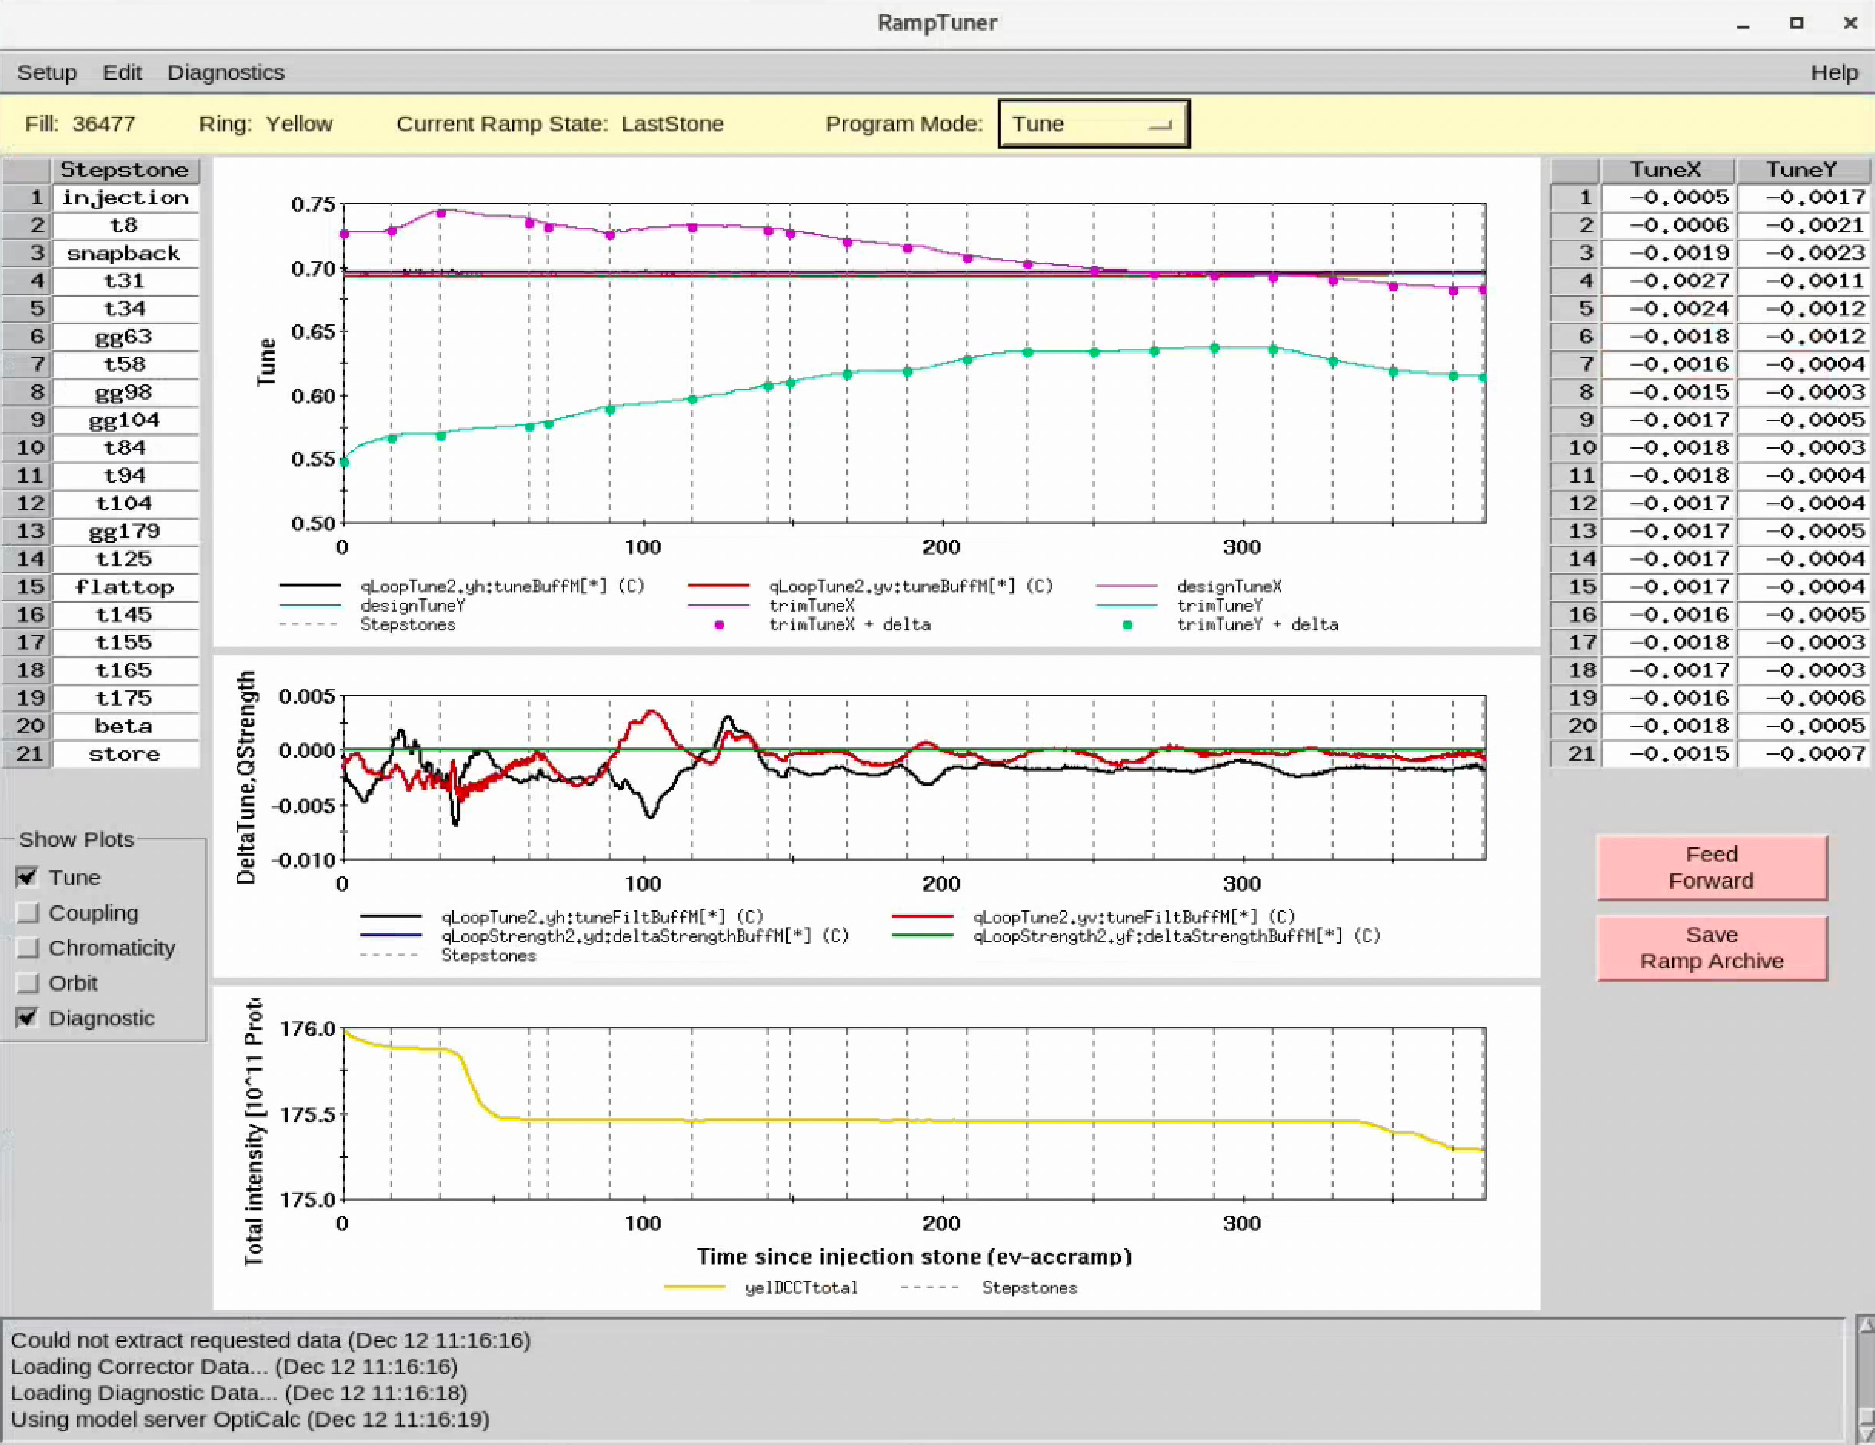
1- The RHIC model 2 – Lessons Learned 3 – Looking ahead
What the online model allows:
RampTuner
GUI to handle tune/coupling/orbit feedback system behavior
enables feed-forwarding of corrections
Machine Specialist tool

Slide 8
1- The RHIC model 2 – Lessons Learned 3 – Looking ahead
Machine Specialist tool
What the online model allows:
The offline model is generally used for anything that does not require real time settings – e.g. lattice/orbit design (fixed rigidity), tracking studies, post-processing of APEX data.
Ramp design uses the online model to take Controls limits into account: PS rates, number of splines, “smooth” path between critical points in time of the energy ramp.
Ops tool
ramp design
ramp/lattice tuning
feedback/feed-forward
(tune, coupling, orbit)

Slide 9
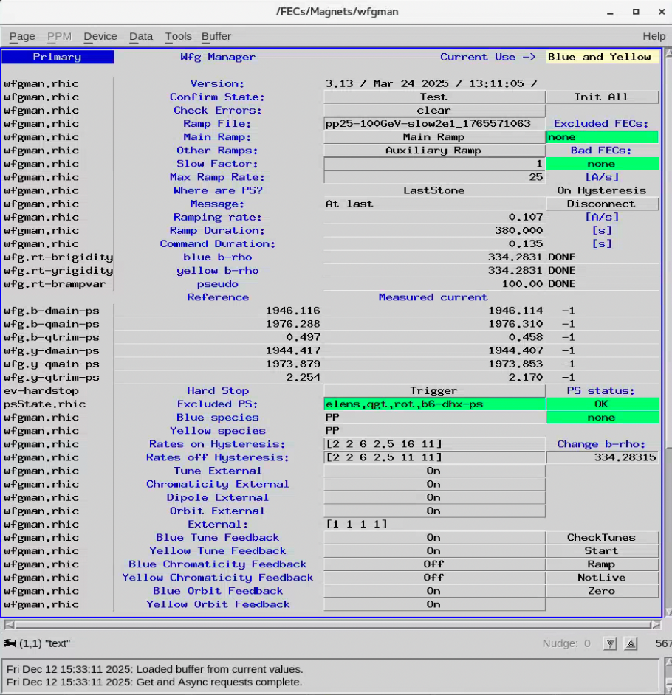
1- The RHIC model 2 – Lessons Learned 3 – Looking ahead
wfgman – waveform generator, the key Controls cog that communicates with the online model:
manages all aspects of RHIC ramps
ensures synchronicity of mechanics on the ramp
=> uses external 720 Hz clock to synchronize and make corrections
link between RampManager and PS FECs
interprets error messages from hardware for Ops

Slide 10
1- The RHIC model 2 – Lessons Learned 3 – Looking ahead
From RHIC early days:
APs were a strong resource that MUST be used during commissioning;
at that stage, every AP was assigned to:
commissioning shifts
a key system e.g. injection setup, orbit correction, background control…
develop dedicated controls application
gradual evolution to “routine” operations: collider was handed to Ops and Machine Specialists (MPs).
Maintaining open lines of communication between groups is paramount: nothing should be done in a vacuum i.e. APs should coordinate with Controls and MPs to ensure the Applications for the Accelerator Complex:
are functional
are thoughtfully designed
have a long shelf life
have documentation available

Slide 11
1- The RHIC model 2 – Lessons Learned 3 – Looking ahead
Starting in 2015, the offline model was expanded to:
use the measured transfer functions of all RHIC quadrupoles;
the proper quadrupole wiring scheme inside of each straight section;
sextupole harmonics (b2) of all RHIC dipoles to take into account feed-down effects and better chromaticity values at lower energies
What was gained:
markedly improved linear optics (less beta-beat and dispersion-beat);
better modeling led to a lessened workload for the feedback system…
…as well as easier ramp development at the start of each physics run, significantly decreasing commissioning time.
The pool of RHIC documentation about the online model and Applications for Ops was initially well maintained and even consolidated into web pages. As feedback systems became more reliable and physics running became more routine, things deteriorated quickly – up to and including some items turning out obsolete without being labeled as such.

Slide 12
1- The RHIC model 2 – Lessons Learned 3 – Looking ahead
Many different simulation/tracking codes exist in the offline modeling world:
Zgoubi
Elegant
Many different simulation/tracking codes exist in the offline modeling world:
Simtrack
Sparks
Many different simulation/tracking codes exist in the offline modeling world:
MAD-X/Xsuite
BMAD
These codes are used to evaluate HSR lattices to help make engineering decisions e.g. tolerances on PS ripples, warm dipole harmonics, transition crossing with different jump schemes, etc…
=> need access to lattice + DB information in a “version control” environment!
Much has changed in terms of hardware, FEC management and networking resources – all 3 parties AP/Controls/Ops need to get on with the times: some of our tools have been deprecated since late 90s…
About documentation for modeling tools and apps for Ops: there should be a central repository, and manuals should follow a templated form – as it was done in the early days of RHIC.

Slide 13
1- The RHIC model 2 – Lessons Learned 3 – Looking ahead
It is paramount that a DB structure featuring magbase and RHICgddb be maintained.
=> losing/wasting away knowledge is not an option.
Lattice evaluations in support of magnet design studies (e.g. DW0) are being performed by appending information to sandbox clones of magbase and RHICgddb (HSRgddb?).
Much has changed in terms of software/hardware, FEC management and networking resources – all 3 parties AP/Controls/Ops need to get on with the times: some of our tools (cdev, Sybase) have been deprecated since late 90s…
Coordination with Controls and Ops is going to be more important than ever:
APs: “this is what the accelerator must be able to do”
Controls: “this is what you have access to”
Ops: “this is the procedure to do it”

